Slide 1
中国极化电子离子对撞机EicC
梁羽铁（代表EicC讨论组）
中科院近代物理研究所
10/30/2020
强子物理在线论坛

Slide 2
Outline
Introduction
EicC: What physics? Why important? When? Where?
Selected physics topics in EicC
Spin, Mass, 3D-imaging, Exotic states, etc.
Connections to BESIII and STCF
Project status and future plan

Slide 3
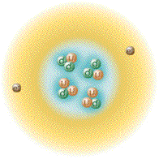
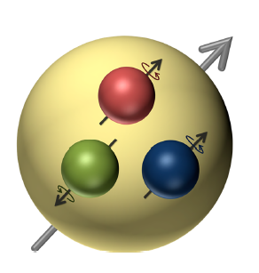
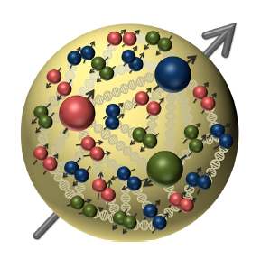
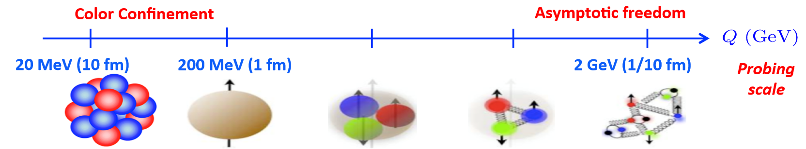
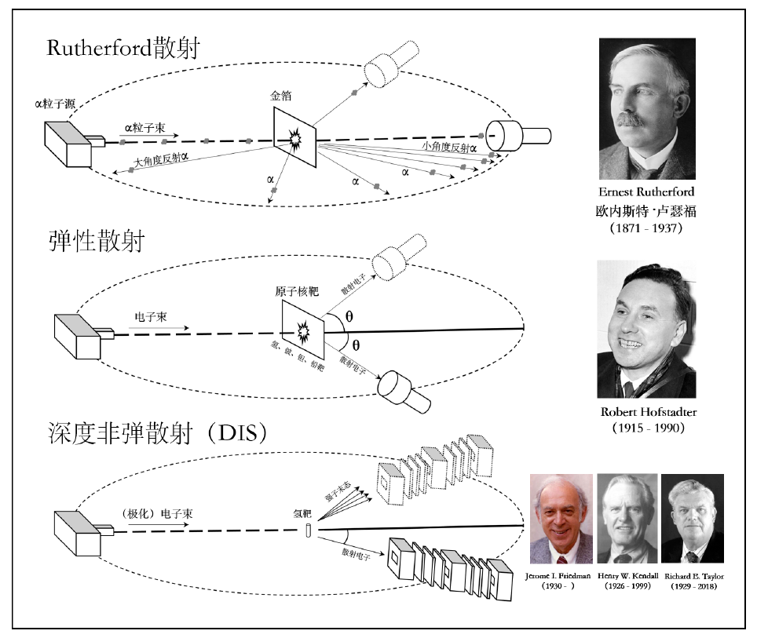
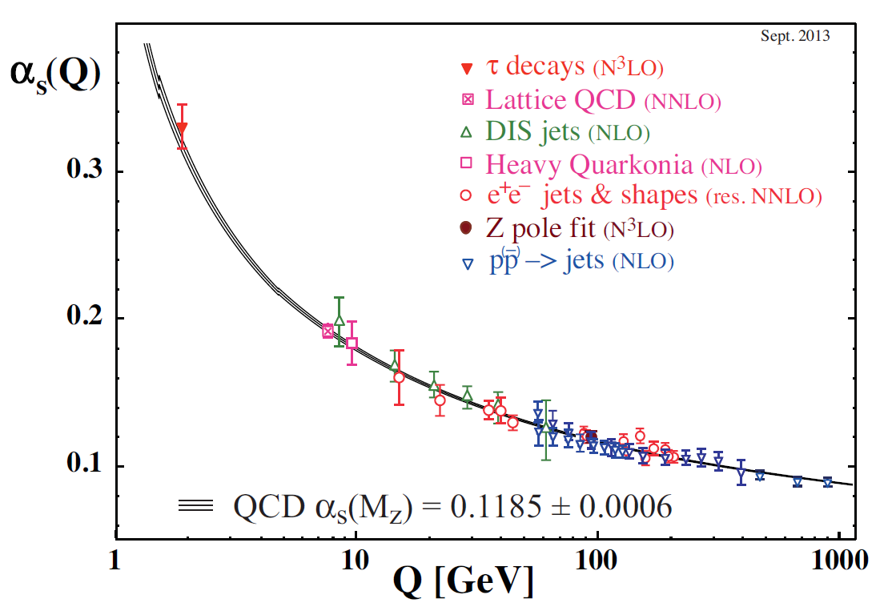
Atomic structure to Hadron structure
QCD, theory of the strong interaction.
non-pQCD
pQCD

Slide 4
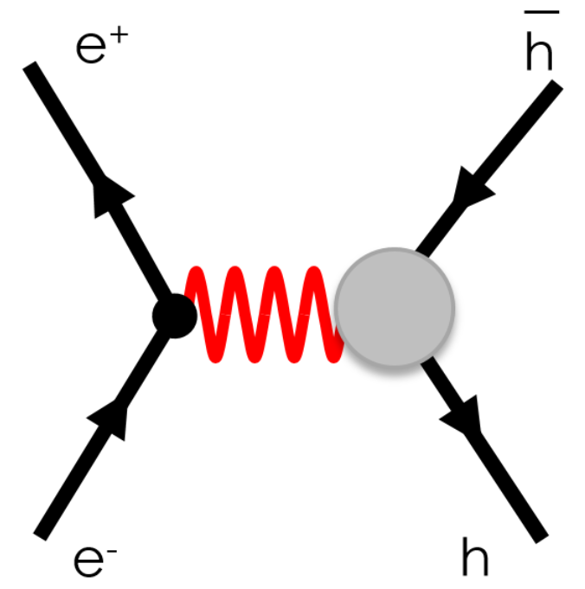
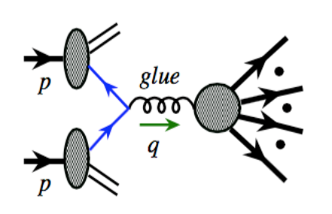
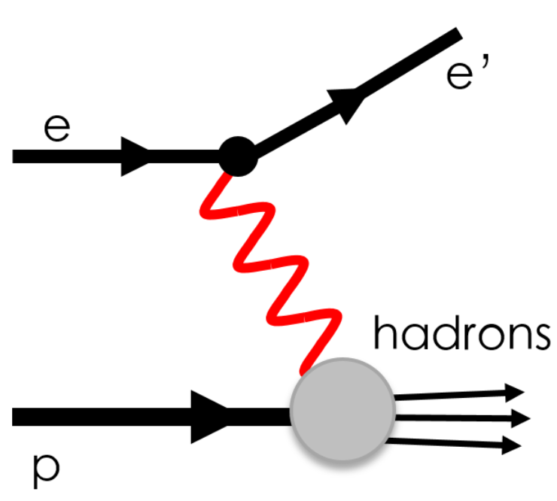
Facilities on hadron structure study
e⁺e⁻ collisions
hadron-hadron collisions
lepton-hadron collisions
BELLE, BESIII etc.
RHIC, LHC etc.
JLab, HERA etc.
No hadron to start with
Emergence of hadrons
Partonic structure
Emergence of hadrons
Heavy ion target or beam(s)
Imaging partonic structure
Emergence of hadrons
Heavy ion target or beam(s)

Slide 5
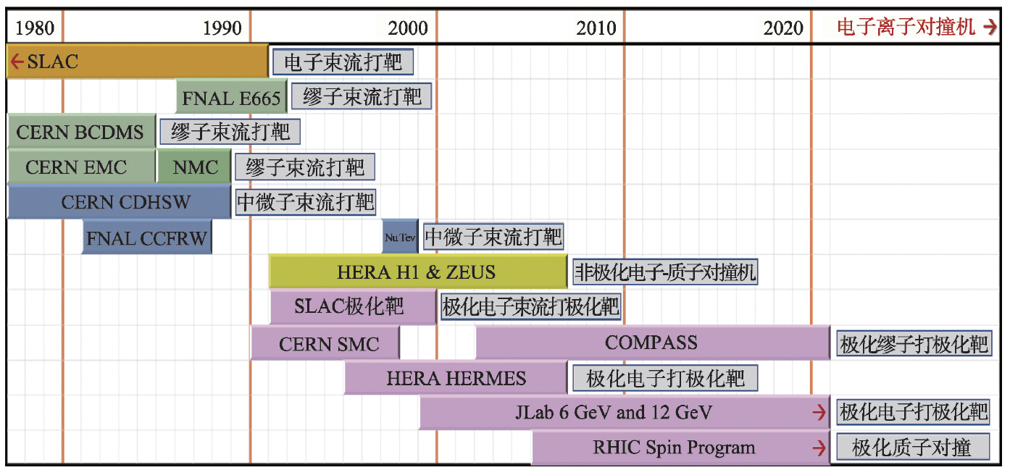
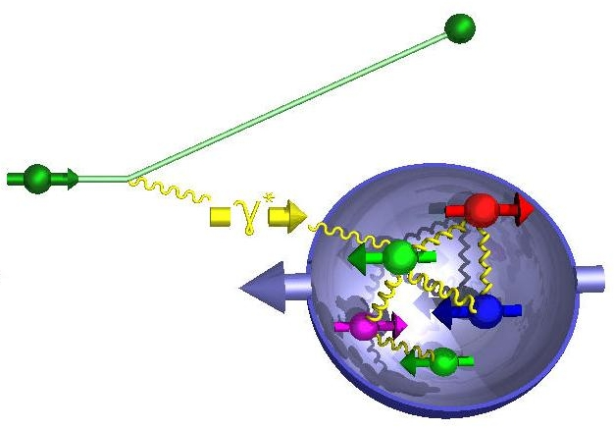
Why do we need lepton-hadron facilities
New generation of “Rutherford” experiment:
e’
π,K
e
Inclusive events: e + p/A → e’ + X detect only the scattered lepton
Semi-Inclusive events: e + p/A → e’ + h + X detect extra hadrons
Exclusive events: e + p/A → e’ + p’/A’ + h detect everything (scattered or fragments)

Slide 6
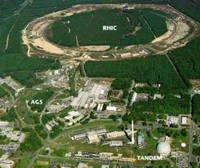

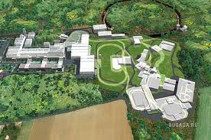
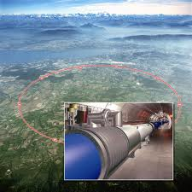
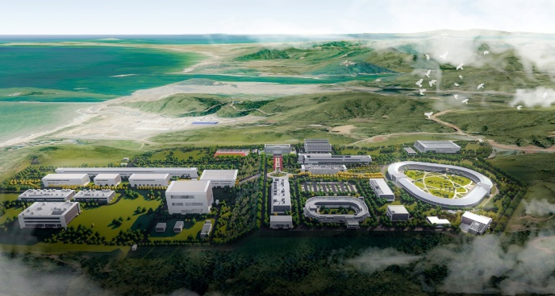
EIC Facilities Landscape
RHIC ➔ eRHIC
FAIR ➔ ENC
LHC ➔ LHeC
HIAF ➔ EicC
  能量 ~ 10倍， 流强 ~ 1000倍
  放射性束流强 1000 ~ 10000倍
  能量沉积率 1000 ~ 10000倍

Slide 7
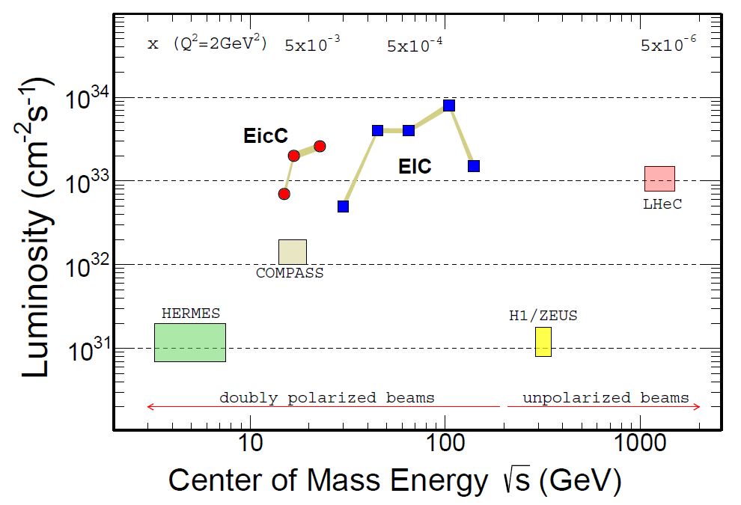
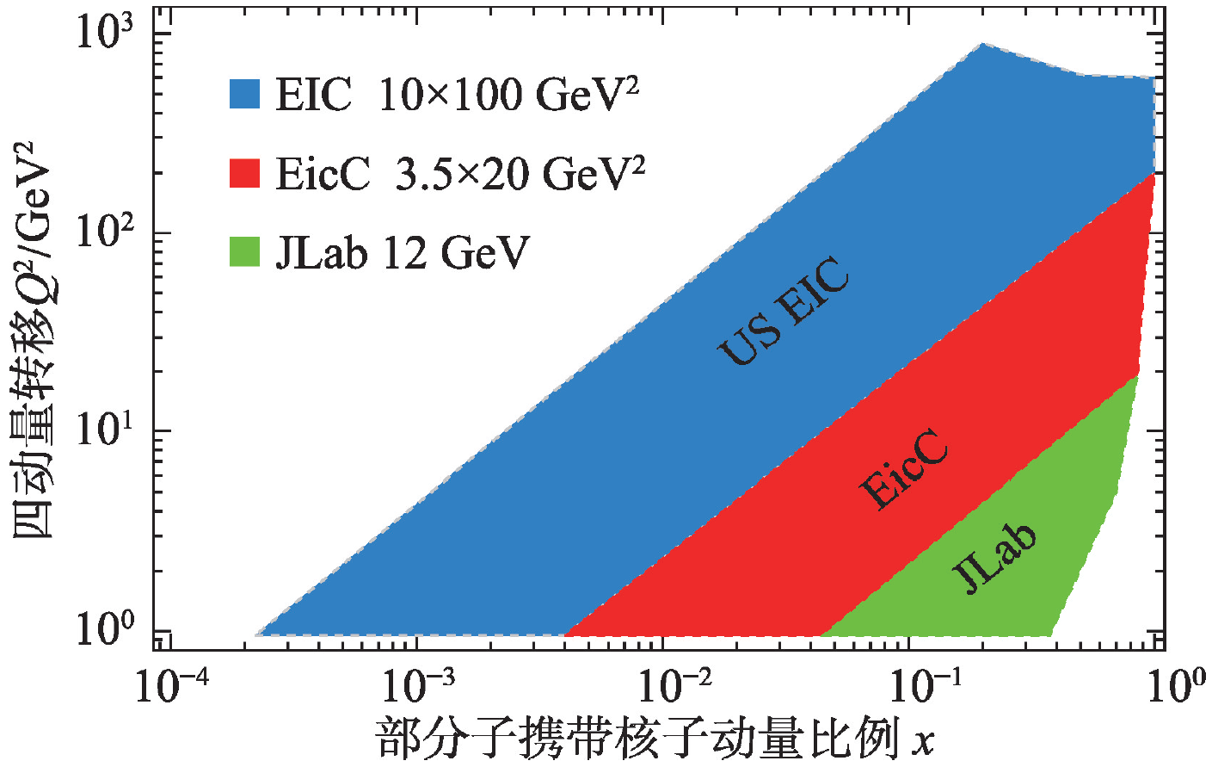
Machine Kinematics
EicC, √s : 15 ~ 20 GeV
Focus on nuclear physics
B-quark hadron production
Facilities | Main goals
JLab 12 GeV | Valence quark
EicC | Valence and Sea
US and Europe EIC | gluon

Slide 8
EIC-US and EicC
EIC-US | EicC
Gluon helicity at small-x | Sea quark helicity and orbital angular momentum in moderate x
Nuclear partonic structure at small-x | Nuclear partonic structure at moderate-x
Large cross section of exotic hadron production | Middle rapidity of exotic hadron production
Proton mass, near threshold upsilon production | Near threshold upsilon production
EIC-US timeline: approved, Yellow Report(now), TDR(near future), Construction, Operation (2030)…

Slide 9



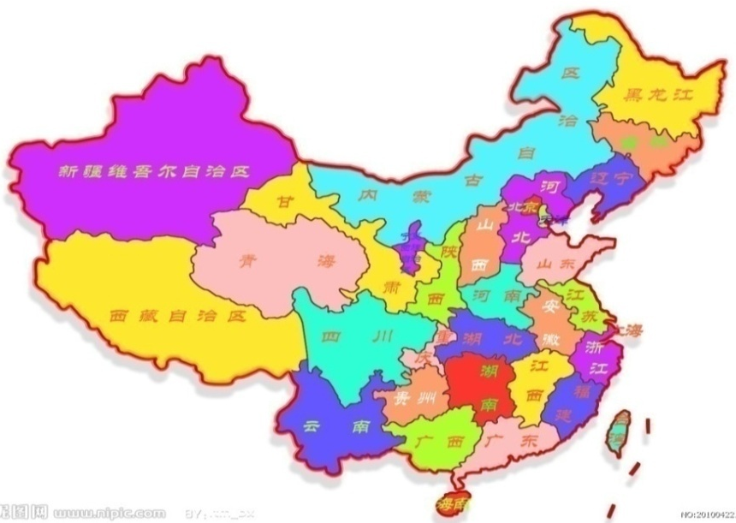
Location
Location of HIAF and EicC
HIAF
HIAF

Slide 10
High Intensity heavy-ion Accelerator Facility (HIAF)
Booster Ring:
Circumference: 569 m
Rigidity: 34 Tm
Aaccumulation
Cooling & acceleration
High intensity ion beams for atomic physics, nuclear physics, applied research in biology and material science etc.
HFRS
SRing
Phase I
iLinac
Superconducting Ion Linac:
Length: 180 m
Energy: 17 MeV/u (U³⁴⁺)
  CW and pulse modes
BRing
Two-plane painting injection scheme
Fast ramping rate operation

Slide 11
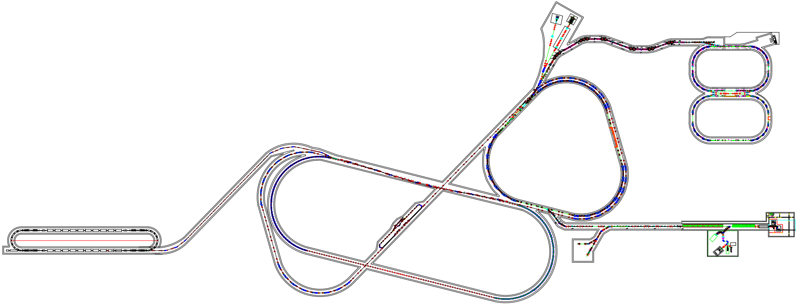

EicC accelerator complex overview
pRing: figure 8
2 interaction regions
20GeV p + 3.5 GeV e，$\sqrt{S}$=16.7GeV
High Lumi.： 2-4 x10³³ cm⁻²s⁻¹
SRing
MRing
BRing
低能冷却
Siberia snake
IP-1
离子束电子冷却
IP-2
Ion Source
SRF Linac-ring
3.5-5.0 GeV
Top-up
eRing
pRing
20 GeV，C: 1347 m
Polarized proton
3.5 -5.0 GeV，C: 822 m
Polarized electron

Slide 12
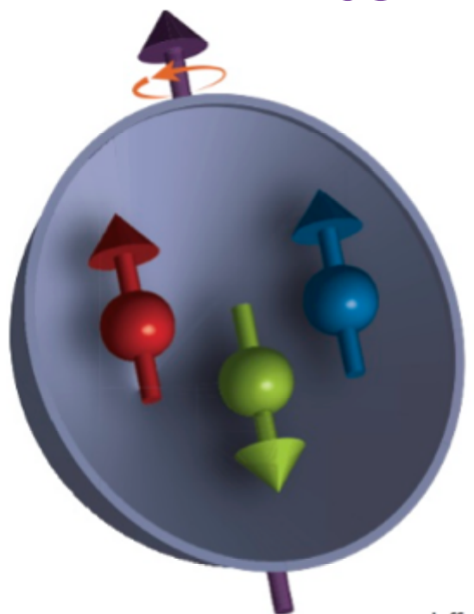
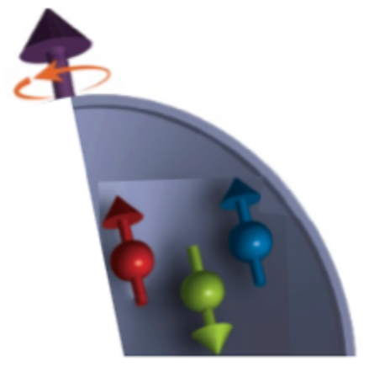
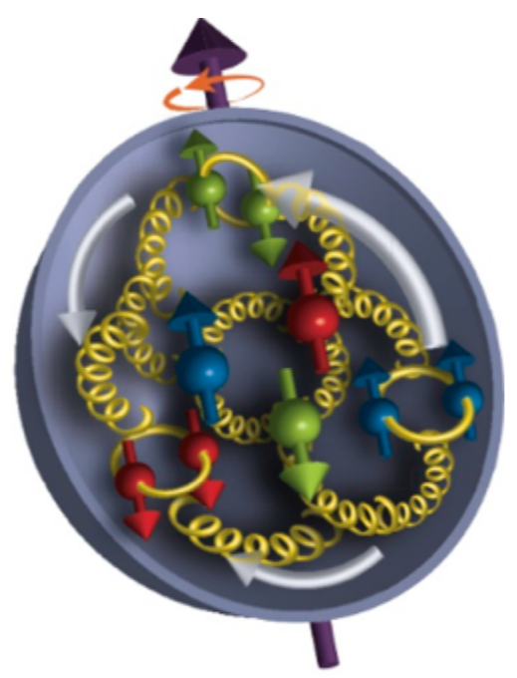
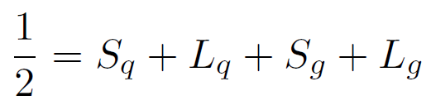
Spin of the Proton
Only ~30% of the proton spin from the quark spin, based on experiments.
1980s
now
S_{q} ~ 30% S_{p} ^{[1]} L_{q} < 70% S_{p} ^{[2,3]}
[1] EMC, J. Ashman et al., Phys. Lett. B206, 364 (1988).
[2] Lattice: P. Hagler, Phys. Rept. 490, 49 (2010)
[3] Lattice: Yi-Bo Yang, R. Sufian, et. A., PRL118, 042001(2017)
[4] EPJA52, 268 (2016), arXiv: 1212.1701
[5] D. Florian, PRL 113, 012001 (2014)
[6] STAR NPA932, 500(2014),1404.5134
[7] PHENIX PRD90, 012007(2014), 1402.6296
[8] COMPASS PLB690, 466(2010), 1001.4654
[9] X. Ji, J. Zhang, and Y. Zhao, PRL111 112002 (2013)

Slide 13
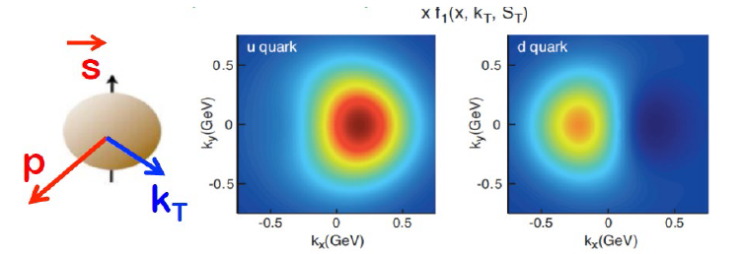
Questions driving the spin physics
How do quarks/gluons and their dynamics make up the proton spin?
How is proton’s spin correlated with the motion of the quarks/gluons?
How does proton’s spin influence the spatial distribution of partons?
polarized e/ion beams
Precise measurements:
1D (helicity)
3D (TMDs, GPDs)
flavor separation
valence/sea region
EicC
1/2 = S_{q} + L_{q} + S_{g} + L_{g}
TMDs
Deformation of parton’s spatial distribution when hadron is polarized?
GPDs
[1] EMC, J. Ashman et al., Phys. Lett. B206, 364 (1988). [2] Lattice: P. Hagler, Phys. Rept. 490, 49 (2010) [3] Lattice: Yi-Bo Yang, R. Sufian, et. A., PRL118, 042001(2017)

Slide 14
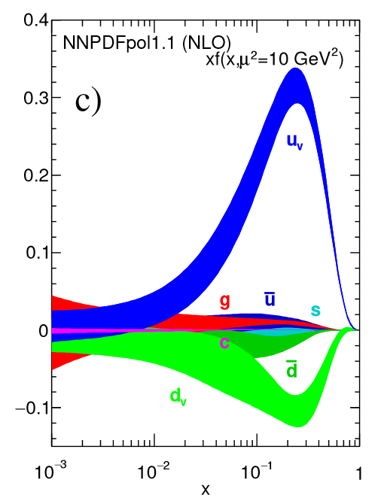
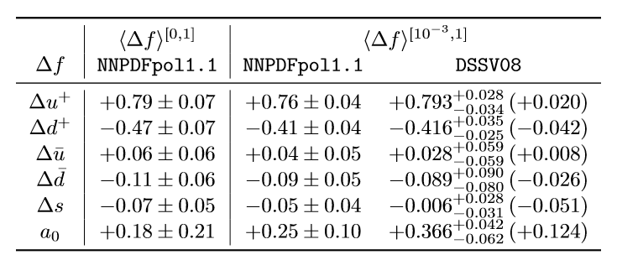
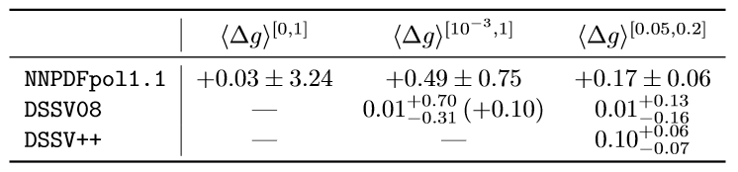
World data of helicity study
ΔΣ
polarized e/ion beams
Precise measurements:
1D (helicity)
3D (TMDs, GPDs)
flavor separation
valence/sea region
EicC
ΔG
arXiv: 1801.04842 (2018)

Slide 15
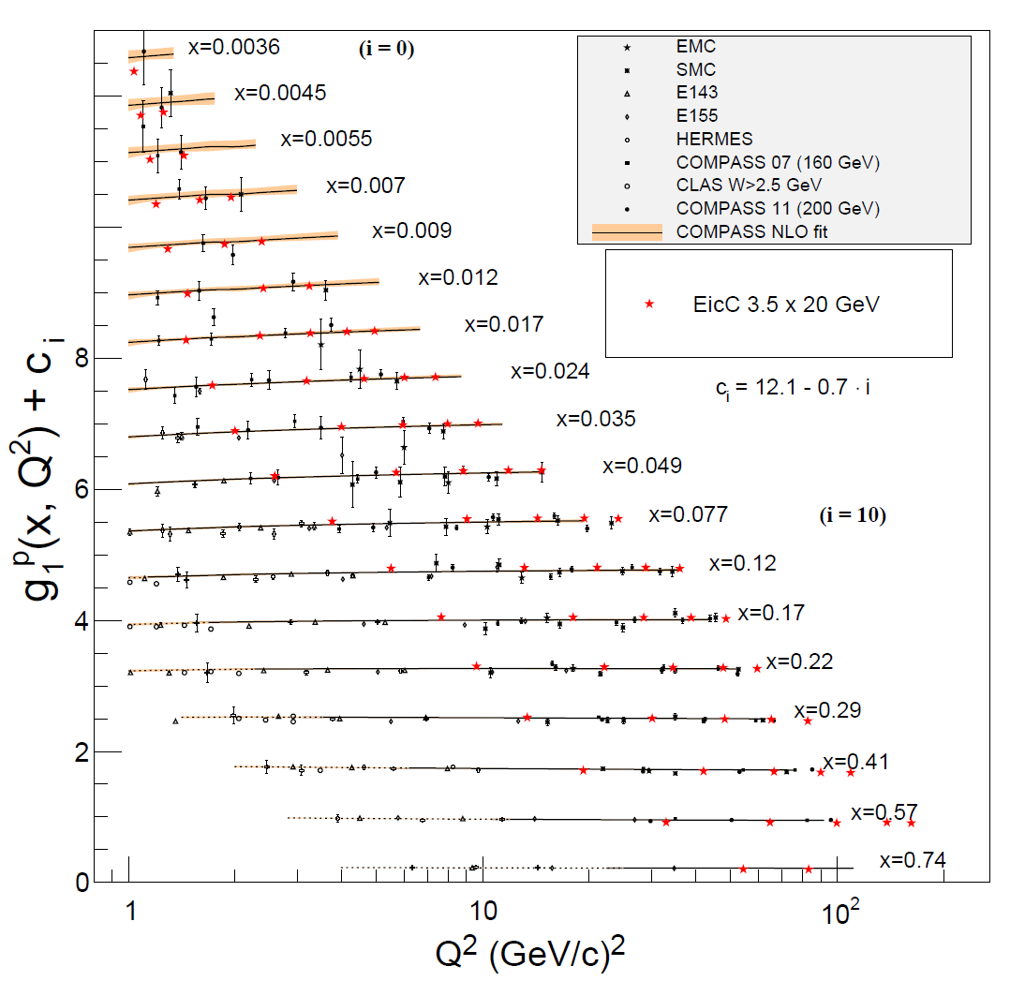
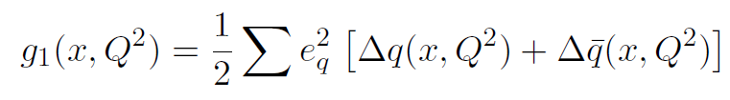
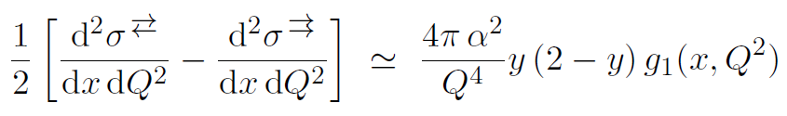
The Longitudinal Spin of the Nucleon
EicC projection with 50 fb⁻¹ lumi.
Improving in the low x region
High luminosity and large acceptance.

Slide 16
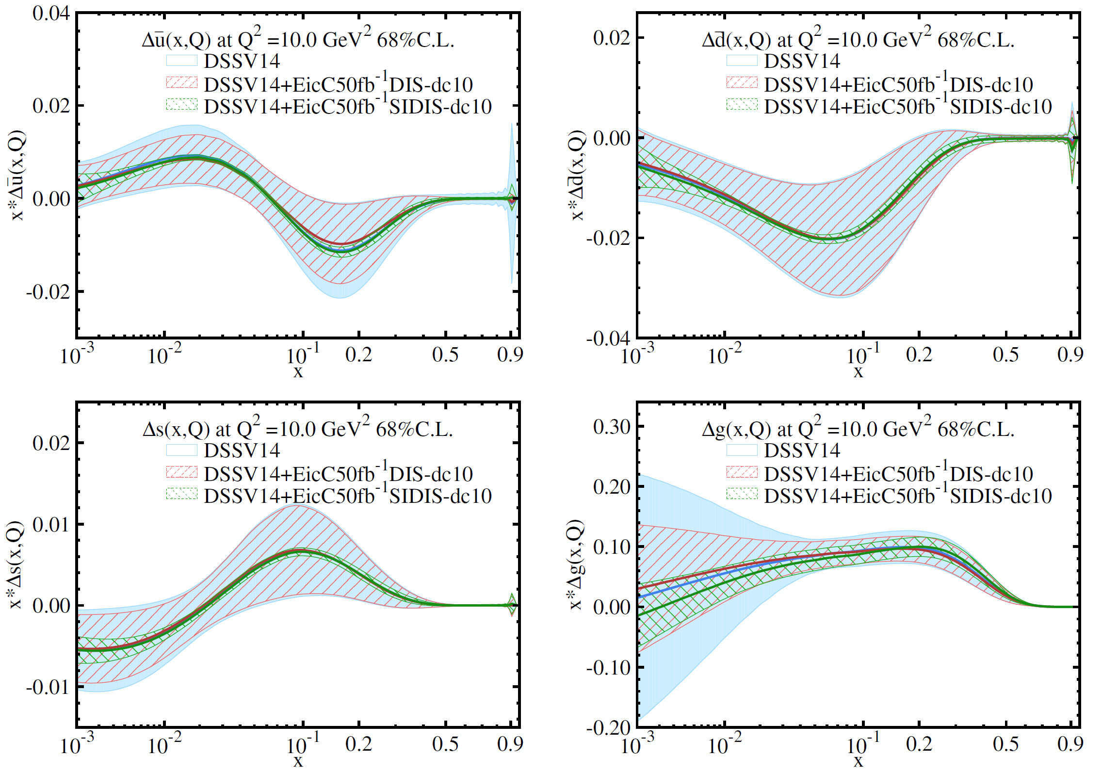
Projections on helicity distributions
EicC SIDIS data:
Pion(+/-), Kaon(+/-)
ep: 3.5 GeV X 20 GeV
eHe-3: 3.5 GeV X 40 GeV
Pol.: e(80%), p(70%),
He-3(70%)
Lumi: ep 50 fb⁻¹
eHe-3 50 fb⁻¹
EicC, precise measurements of sea quarks
Fragmentation function used: DSS

Slide 17
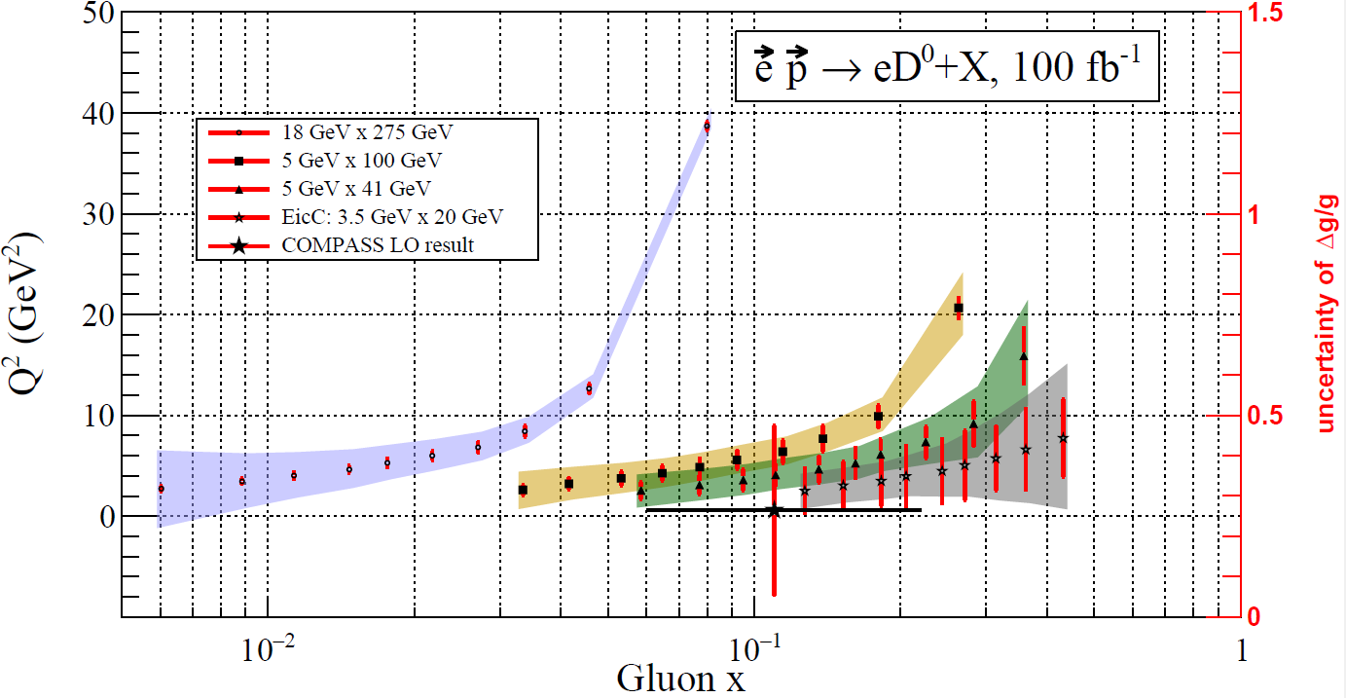
Projections on helicity distributions
EicC can also contribute to gluon polarization study in high x region.

Slide 18
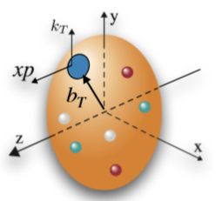
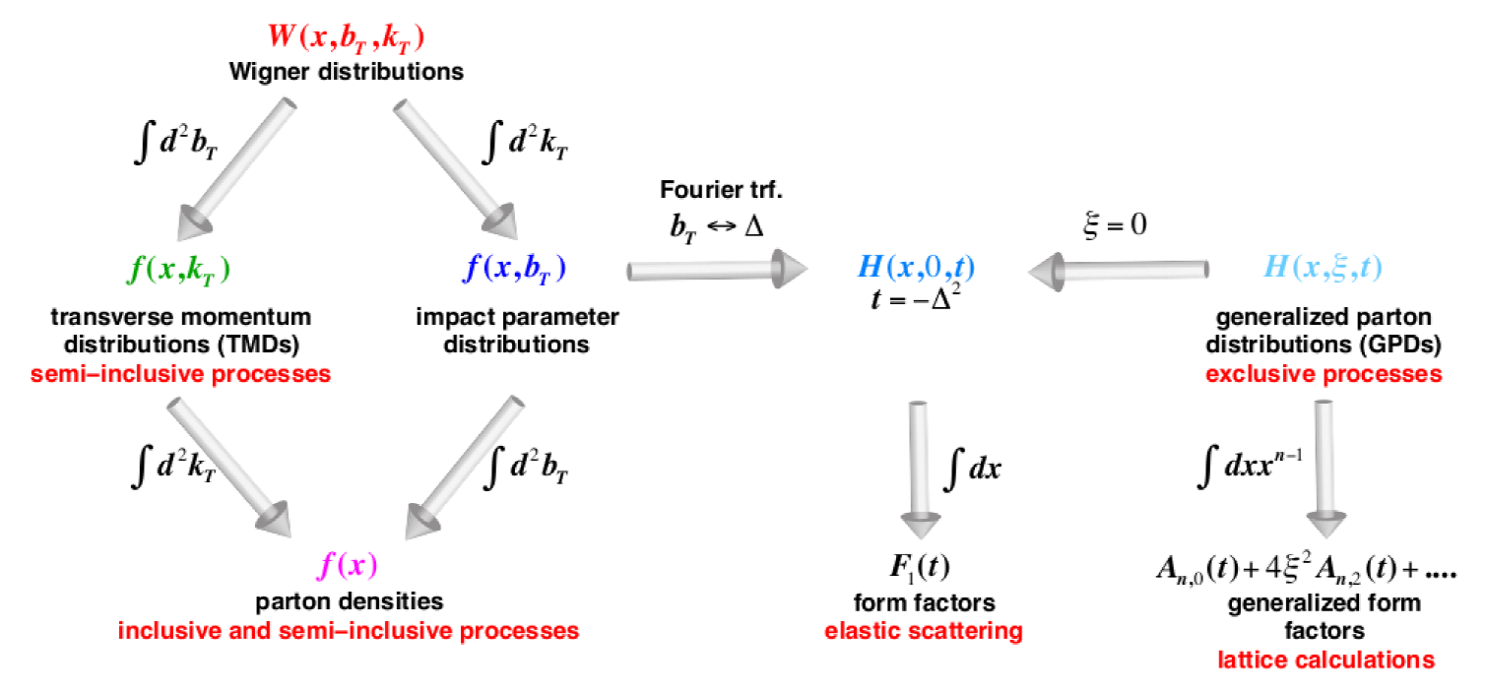
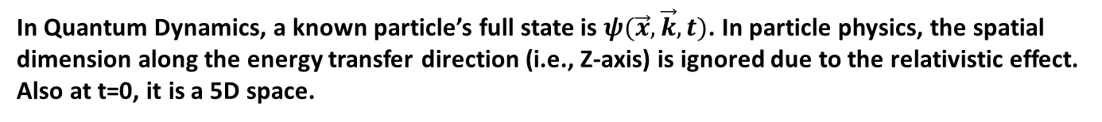
3D Structure of Nucleons – TMDs & GPDs
In Quantum Dynamics, a known particle’s full state is $ψ(\vec{x}, \vec{k}, t)$. In particle physics, the spatial dimension along the energy transfer direction (i.e., Z-axis) is ignored due to the relativistic effect. Also at t=0, it is a 5D space.
TMD =
1D Longitudinally Momentum
+ 2D Transverse Momentum
GPD =
1D Longitudinally Momentum
+ 2D Transverse Position

Slide 19
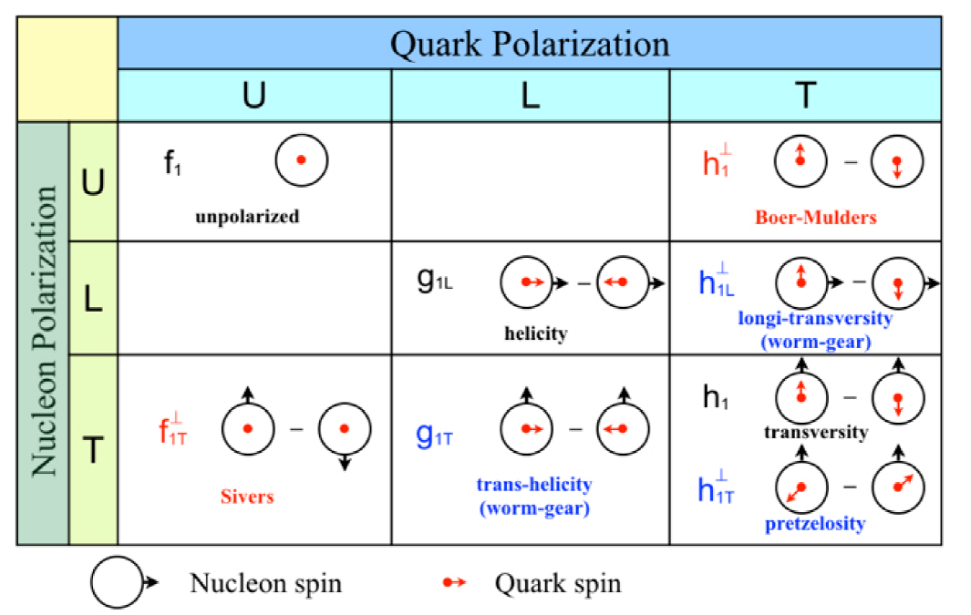
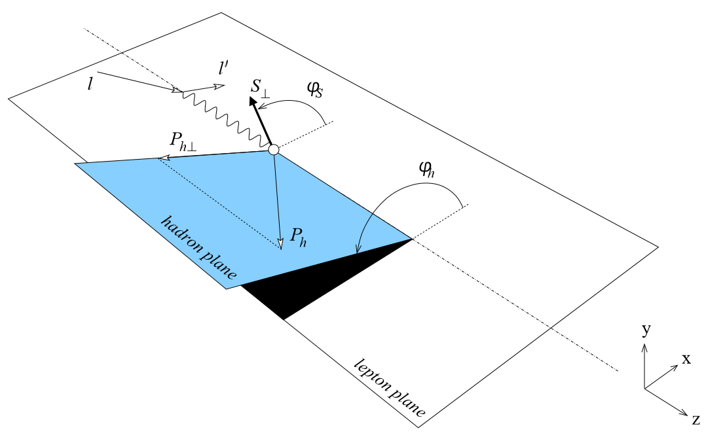
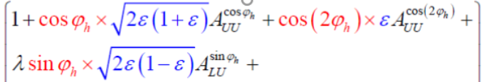
Transverse Momentum Dependent Functions (TMDs)
Unpolarized Density Function:
Helicity Function:
Transversity Function:
Final state
hadron
parton
parton + γ
parton + γ + FF
+ … }
Asymmetries → TMDs

Slide 20
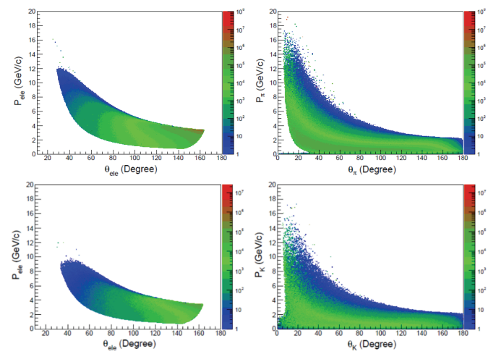
SIDIS Observables
Plot Courtesy of Zhi Yang
e’
π,K
e
SIDIS: Detect scattered electrons and produced single-hadron in the final state.
Measuring different hadrons, as flavor-tagger to probe the internal quark structure of nucleons.
provide hadron identification to access the parton flavor

Slide 21
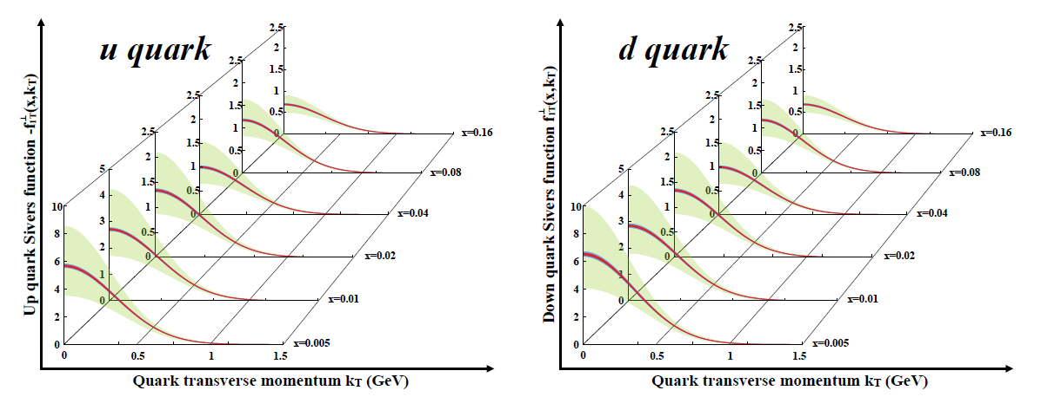
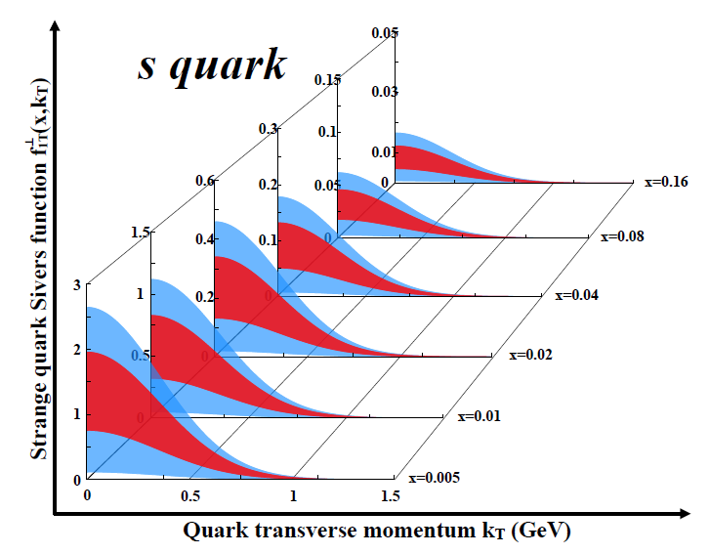
EicC projections on Sivers
u/d Sivers EicC vs world data
LO analysis
EicC SIDS data:
Pion(+/-), Kaon(+/-)
ep: 3.5 GeV X 20 GeV
eHe-3: 3.5 GeV X 40 GeV
Pol.: e(80%), p(70%), He-3(70%)
Lumi: ep 50 fb⁻¹, eHe-3 50 fb⁻¹
Green: Current accuracy
Red: stat. error only
Blue: sys. Error included
EicC, precise measurements.

Slide 22
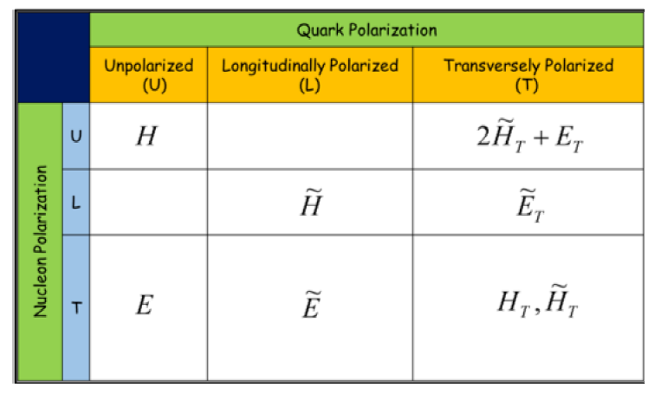
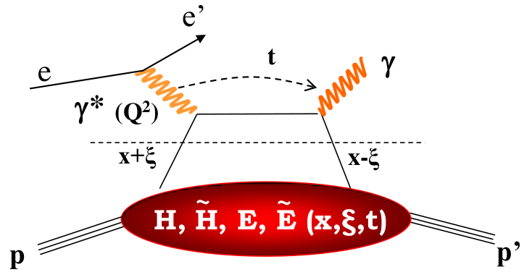

Generalized Parton Distributions (GPDs)
Eight GPDs for quarks or gluons
GPDs encode information about the spatial distribution of partons inside a hadron, correlated with their distribution in longitudinal momentum.
GPD is related to quark angular momentum.
Exclusive reactions, such as DVCS, can get access to GPDs.
Ji’s sum rule ^{[1]}
[1] X.-D. Ji, Phys. Rev. Lett. 78 (1997) 610.

Slide 23
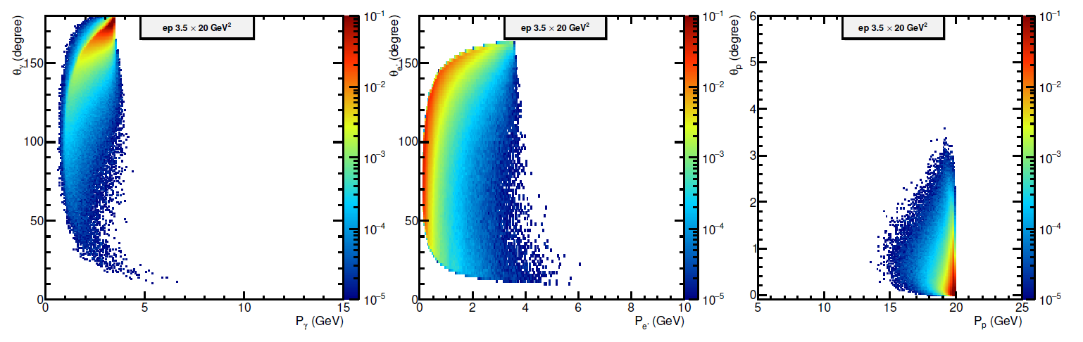
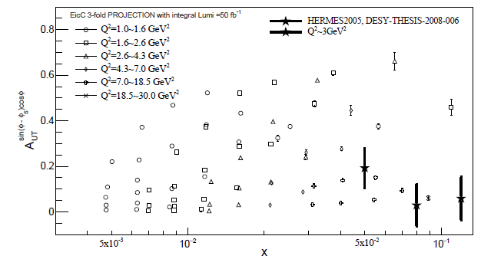
GPD -- EicC Projections
Need far-forward detection of scattered proton.
Plot Courtesy of Qiang Fu and Xu Cao.
Integrated Lumi. 50 fb⁻¹
EicC can measure GPD related
asymmetries:
In high precision
In multi-dimensional bins
on p and n for flavor separations
EicC， Statistic error only

Slide 24
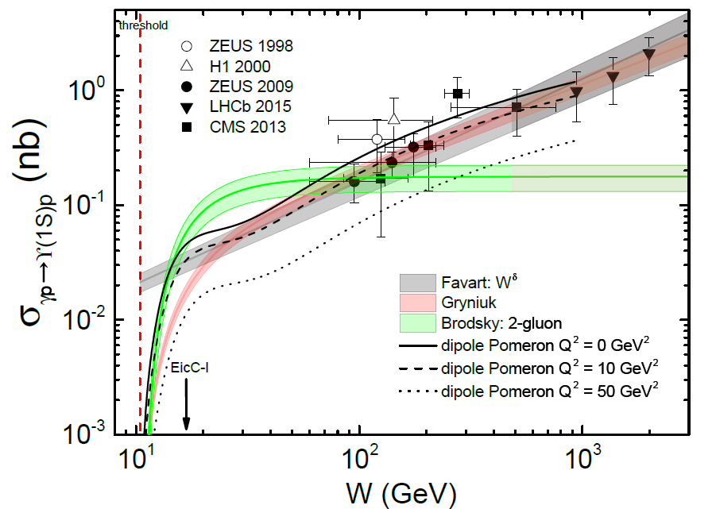
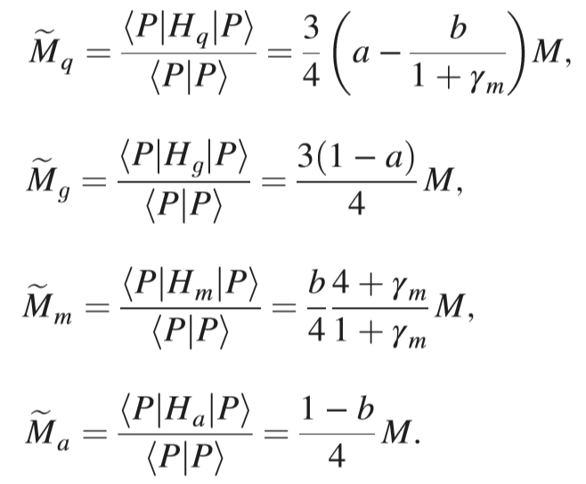
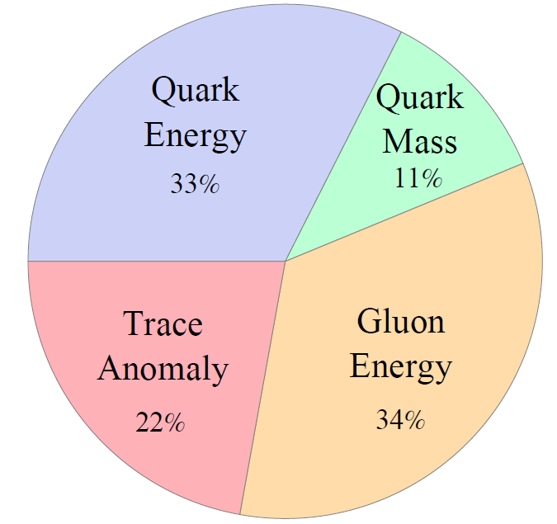
Proton Mass
Proton mass decomposition^{[1]}:
a: related to PDFs, well constrained
b: related to quarkonium-proton scattering amplitude Mψp near-threshold
[1] X. Ji, PRL 74, 1071 (1995) & PRD 52, 271 (1995)

Slide 25
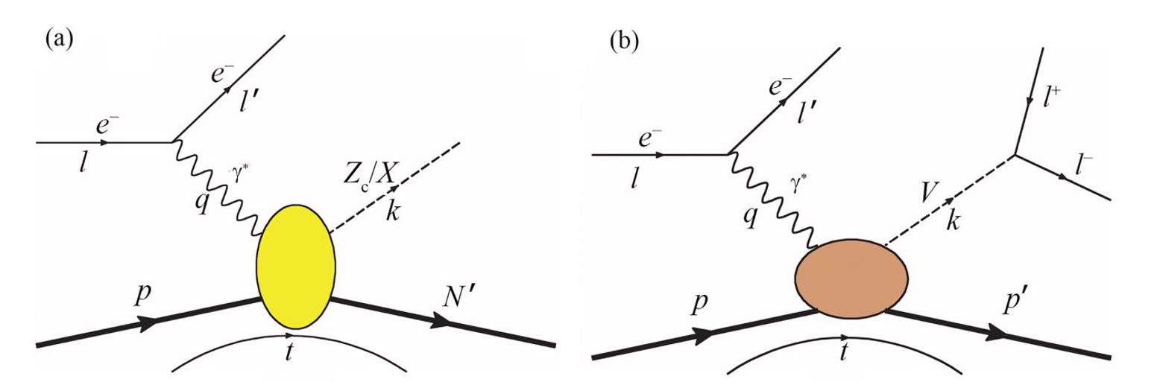



Exotic States
Potential advantages at EicC
Larger cross-section compared to e+e- collision
Smaller background compared to pp and ppbar collision
Polarized beam → pin down the quantum numbers
Gamma-P invariant mass, i.e. W, is a window in ep collision
No triangle singularity for kinematics

Slide 26



Other interesting topics
Hadronization
Pion/Kaon structure
And more…

Slide 27

EicC detector conceptual design
Very first design; detector options are open.
欢迎各位老师、同学参与！

Slide 28




Tracking detectors
Options for central tracking:
TPC, drift chambers, straw tubes,
CGEM etc.
Momentum resolution below few %
is required
TPC +
GEM readout
3.5GeV on 20 GeV at EicC
Straw Tubes
@ PANDA
All-silicon
The interaction rate and multiplicity are moderate.
TPC/STT or others can manage!
欢迎各位老师、同学参与！
28

Slide 29



Vertex detector
Important for heavy flavor physics
Technology options:
MAPS (used in ALICE, STAR, PANDA)
DEPFET (used in BELLE-II)
Vertex resolution of ~ 20 μm or better
PANDA
Inner: Pixel (MAPS)
Outer: Si-Strips
Belle II
Inner: Pixel (DEPFET)
Outer: Si-Strips
• EicC gets support from
Plac(Pixel Lab at CCNU)
Slimp (Silicon Lab at IMP)
• Design a MAPS-based chip for EicC
• 15~20 μm resolution possible!
ALICE ITS upgrade
ALPIDE chip, MAPS-based (CCNU)
Pixel: 30X30 μm²
欢迎各位老师、同学参与！
29

Slide 30


Cherenkov detectors
• -5<η<1 : (Barrel and electron endcap)
π/K/p separation < 5 GeV/c
Options: DIRC, compact Cherenkov detector
(BaBar, Belle II, GlueX, Panda)
p/K: 10 GeV/c,
pi/K: 6 GeV/c,
e/pi: 1.8 GeV/c
or others
• 1<η<3~4 : π/K/p separation < 10~15 GeV/c
aerogel RICH (n = 1.02 ?)
DIRC
Aerogel RICH
欢迎各位老师、同学参与！
30

Slide 31


Time-of-Flight
Provide hadron identification at low momentum.
• MRPC (ALICE, STAR, BESIII, etc.)
Time resolution: several tens ps
• Plastic scintillation counter,
Scintillator tiles, etc.
MRPC, time resolution ~20 ps reached.
MRPC
Scintillator tile @ PANDA
欢迎各位老师、同学参与！
31

Slide 32




EMCal
Electron going direction: δE/E(1GeV) = 2-3%
Others: δE/E(1GeV) = 5-10%
Pb+Sc Shashlik
Crystal: CsI / PWO
欢迎各位老师、同学参与！
32
Notes:
32

Slide 33




Geometry and Event Display
ep→ e⁻ p J/psi → e⁻ p e⁻ e⁺
e⁺
e⁻
e⁻
p
33
Notes:
33

Slide 34





Connection of ep and e⁺e⁻ collisions
D₁: unpolarized FF
H₁: Collins FF
  describes the fragmentation of a transverse polarized quark into a spin-less hadron h.
  leads to an azimuthal modulation of hadrons around the quark momentum.

Slide 35
Connection of structure and spectroscopy
Two branches in hadron physics: Spectroscopy, Structure
Future facilities: STCF (Super Tau Charm Facility), EicC
STCF has similar Q² coverage with the SIDIS in EicC.
STCF and EicC both need e⁻ beam of almost same energy.
STCF
BEPCII
EicC
e⁺e⁻
COMPASS
Potentials: STCF + EicC ?
A combination of spectroscopy and structure.
A QCD hadron physics center.
BaBar
Hermes
BELLE
SIDIS
JLab
10GeV²
50GeV²
100GeV²
Q²

Slide 36

高亮度电子离子研究装置: 加速器
质子或离子
电子
正电子
EicC
EicC 探测器-1
ERL电子冷却
EicC 探测器-2
STCF
HFRS
SRing
EicC 离子环
STCF 探测器
EicC 电子环
正电子阻尼环
BRing
HIAF
STCF 电子环
STCF 正电子环
正负电子加速器
iLinac
SECR
电子注入器

Slide 37




EicC 科普推广
宣传视频：包括物理、加速器、探测器三大场景介绍。
EicC Logo：最底层的绿色字母E代表电子（Electron）；向上的蓝色箭头代表极化的离子（ion）；绿色字母c代表对撞机（collider)；最上层的红色大写字母C代表中国(China)。三基色“红绿蓝”代表强相互作用中基本量子数。

Slide 38



EicC+STCF虚拟展示平台
EicC虚拟展示平台测试版，适用于Windows、Mac，存放于中科大indico服务器，网址如下：
http://cicpi.ustc.edu.cn/indico/conferenceDisplay.py?confId=2858
或者扫码打开链接
EicC虚拟展示平台
虚拟平台截图预览
EicC科普视频

Slide 39






Project Status
1st@Lanzhou
2nd@Lanzhou
3rd@Kunshan
4th@Beijing
6th@Guangzhou
7th@Lanzhou
7 pre-Collaboration meetings up to now.

Slide 40


Project Status
白皮书—中文版
2020年2月发表
38个单位，
80余名专家

Slide 41



Project Status
白皮书—英文版
将于2020年底发表
43个单位，近100名专家

Slide 42
Future plan
经费申请尝试：自然科学基金重大项目申请，中国科学院经费支持，近物所内培育支持。
2021-2025：物理模拟，探测器R&D。欢迎各位专家、老师、同学参与！
2026: EicC项目争取进入“十五五”预研计划
2031：项目建设

Slide 43
Summary
EicC面向重要的基础物理问题 — 可见物质深层次结构
国家“十二五”HIAF将于2025年建成，为EicC项目提供良好的基础
中国强子物理基础雄厚，可以提供理论和实验支撑
与STCF同能区，物理互补、硬件技术相通；STCF + EicC更完备的强子物理研究
与国际上同类装置互相补充；也有部分竞争 — 紧迫性，目前是最好时间窗口
欢迎各位老师、同学参与！

Slide 44
Thank You

