Slide 1

Recent Progress in LaMET

Slide 2
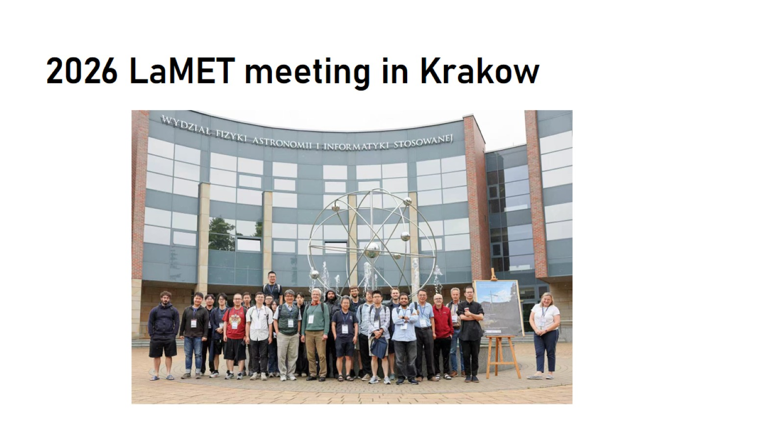
2026 LaMET meeting in Krakow

Slide 3
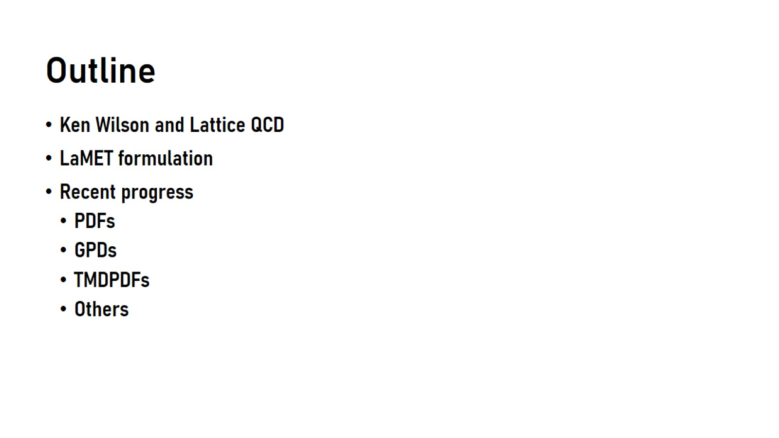
Outline

Slide 4
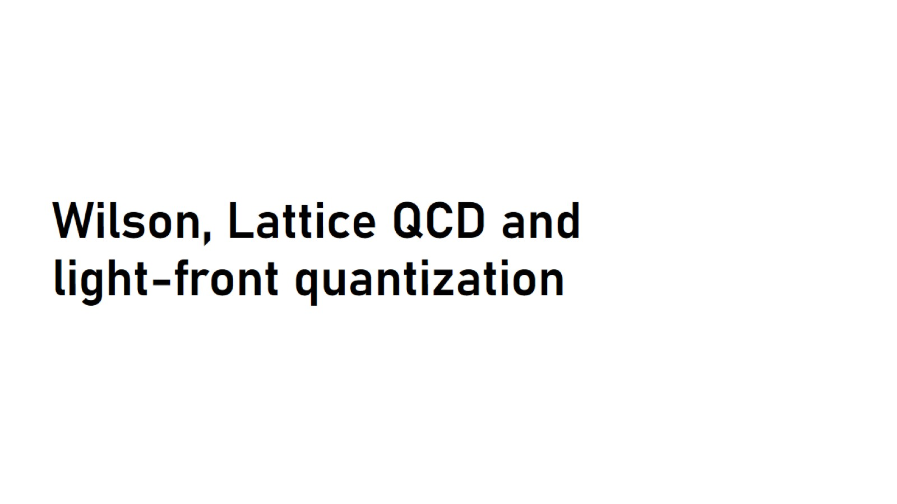
Wilson, Lattice QCD and light-front quantization

Slide 5
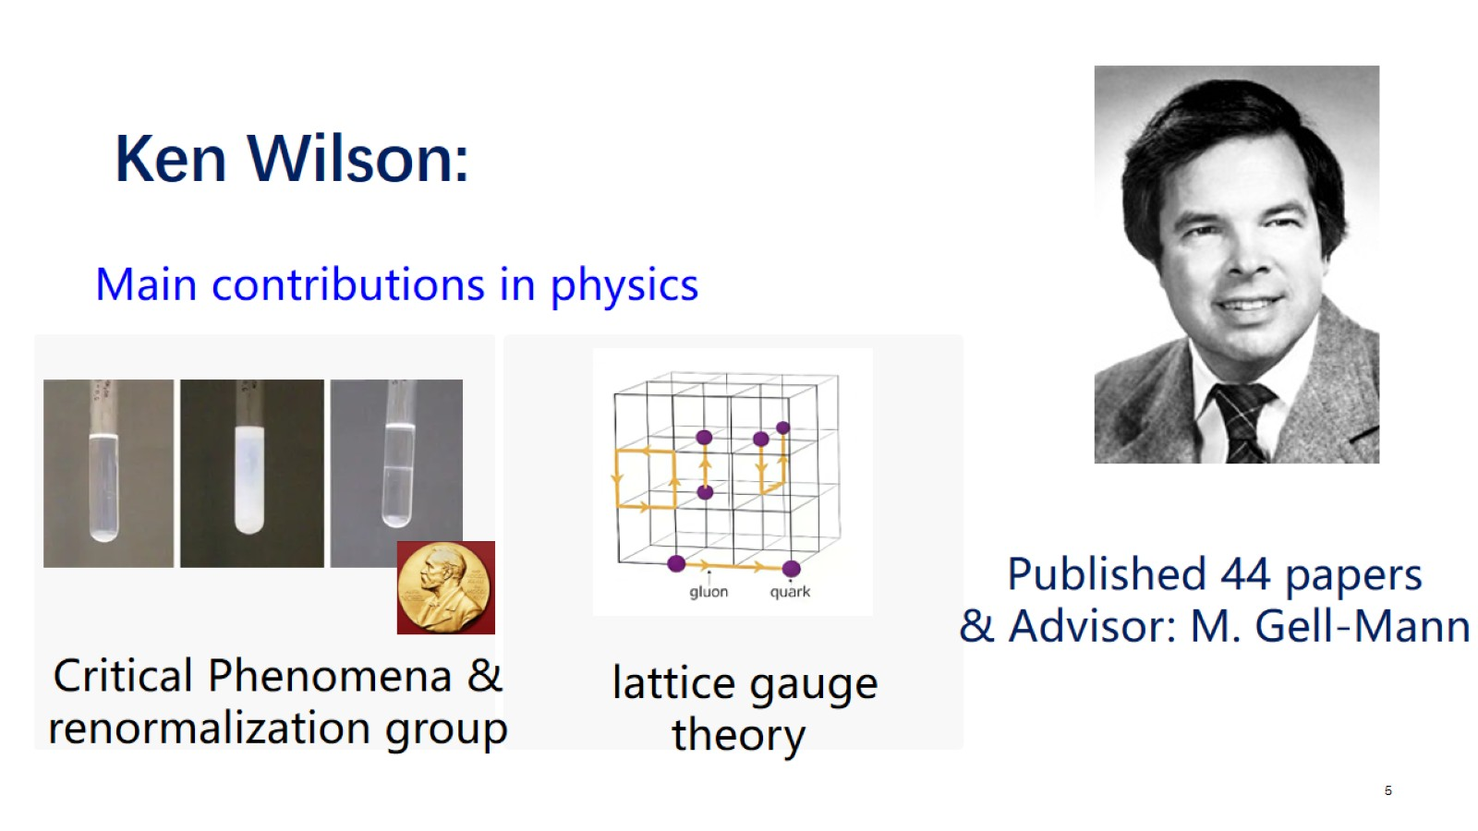
Ken Wilson:

Slide 6
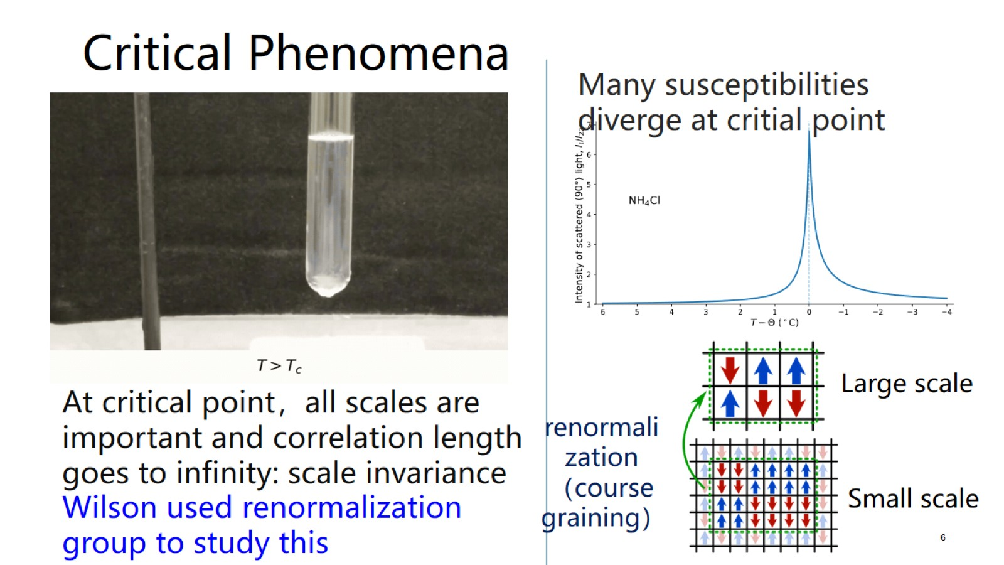

Slide 7
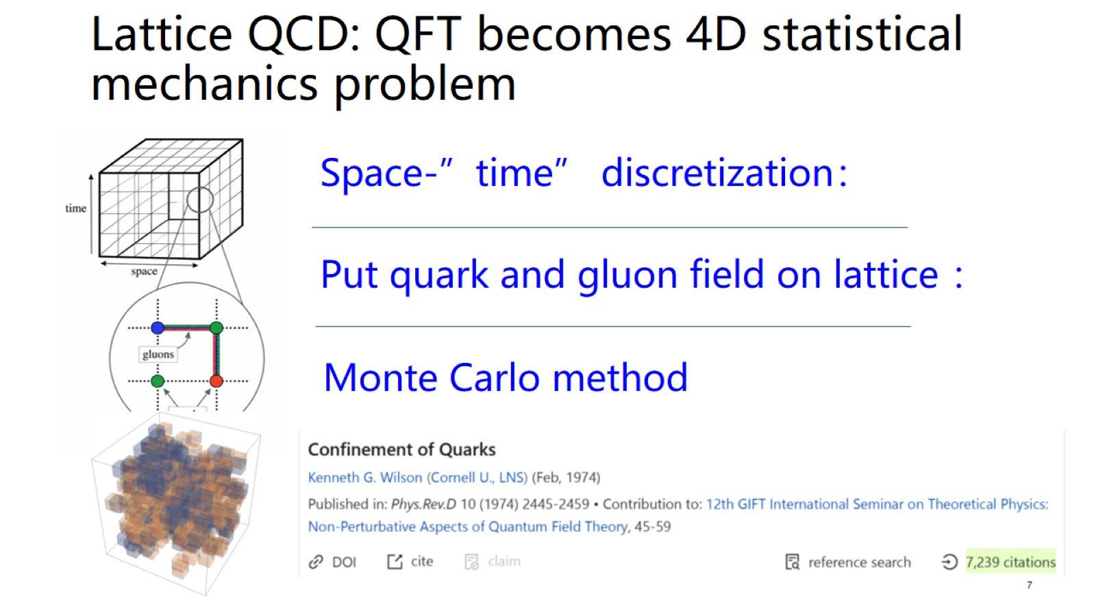

Slide 8
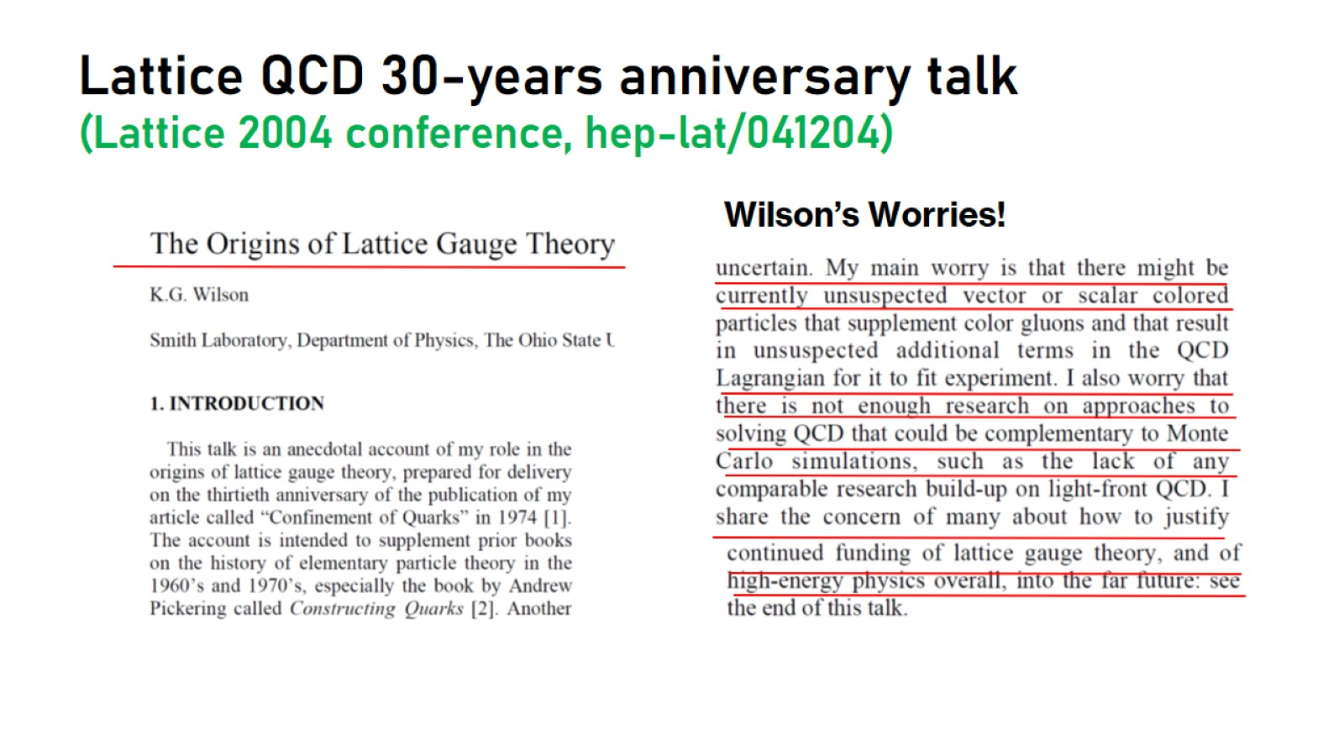
Lattice QCD 30-years anniversary talk
(Lattice 2004 conference, hep-lat/041204)

Slide 9
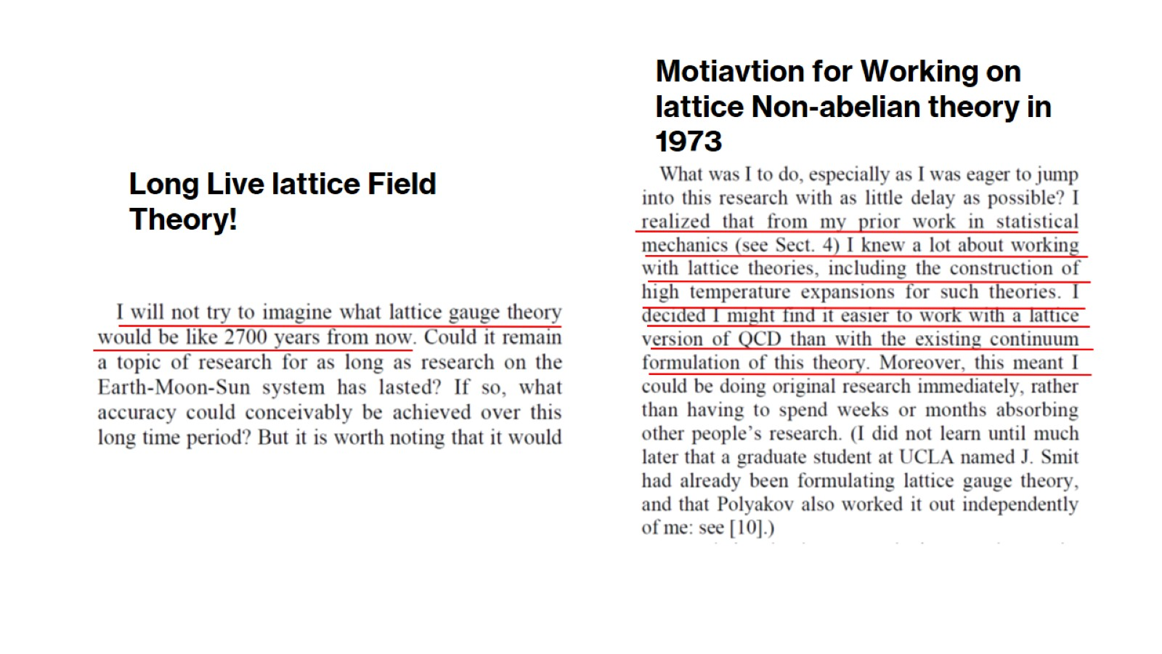

Slide 10
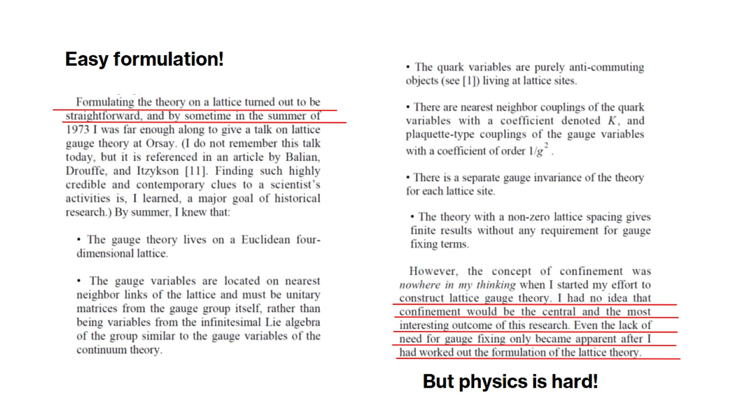

Slide 11
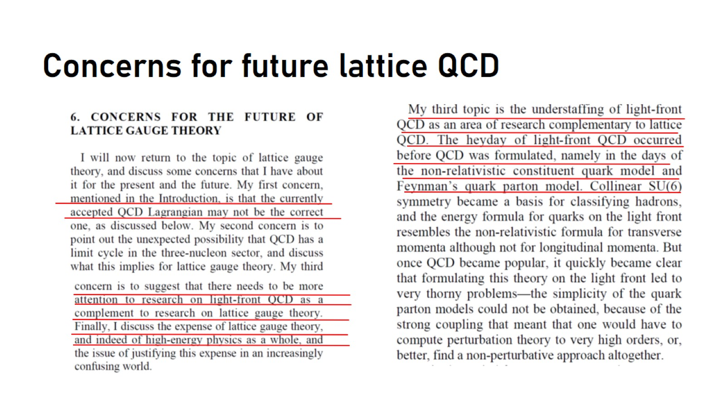
Concerns for future lattice QCD

Slide 12
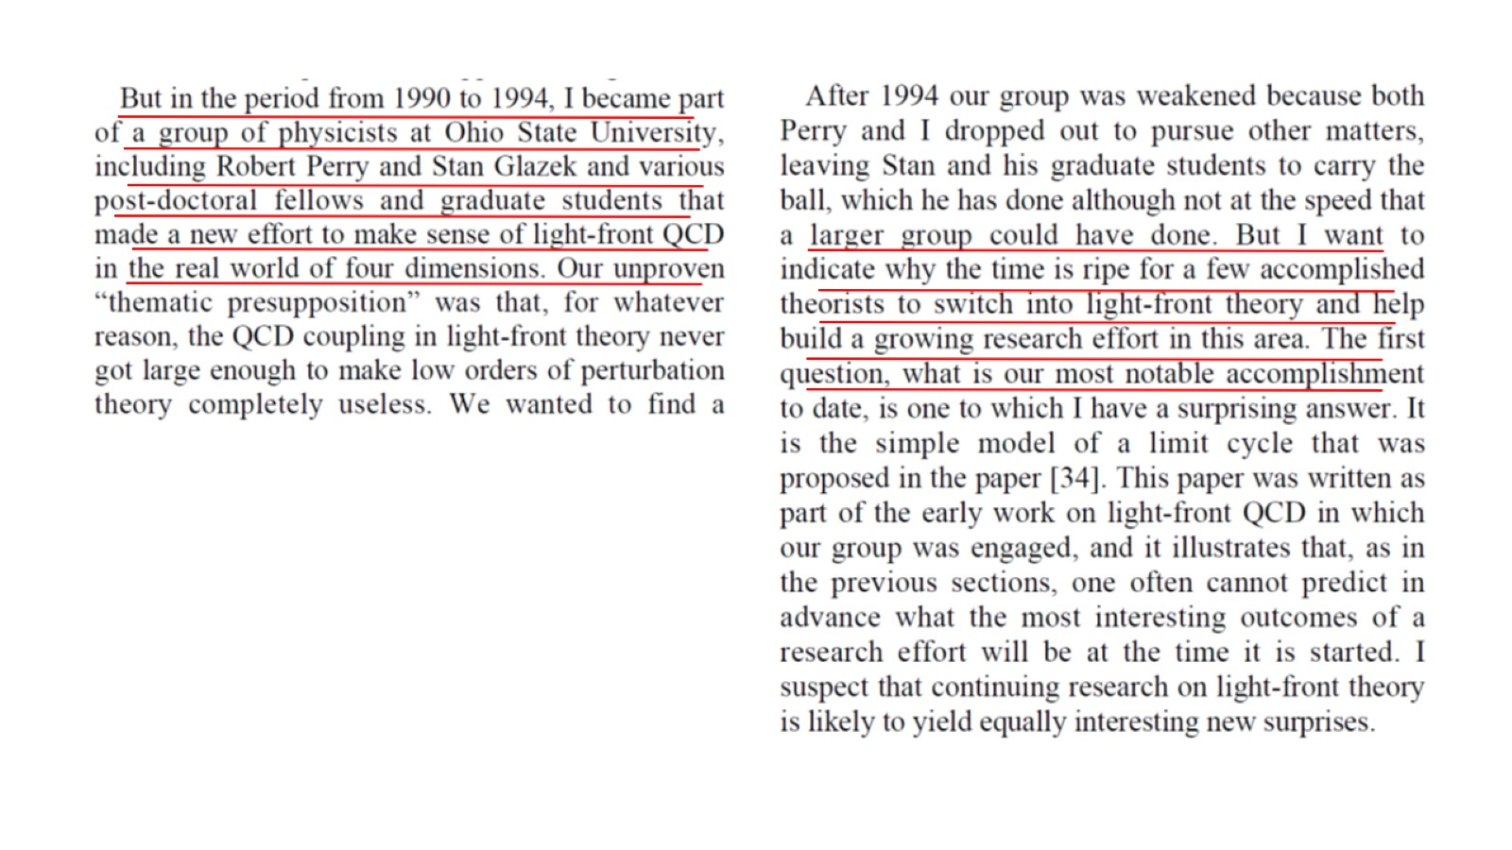

Slide 13
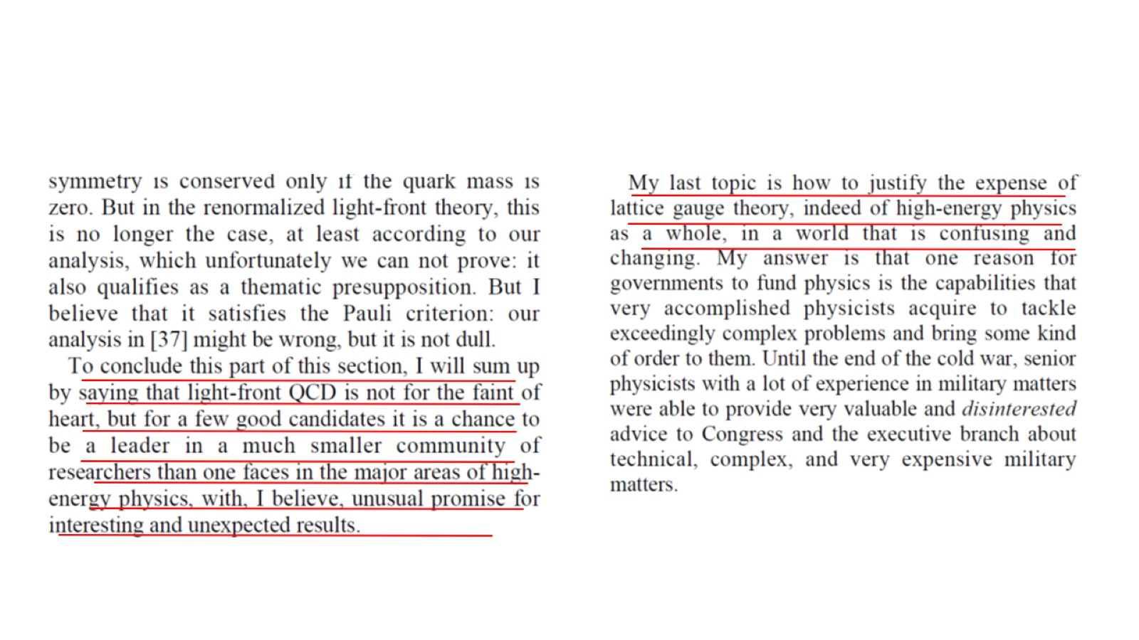

Slide 14
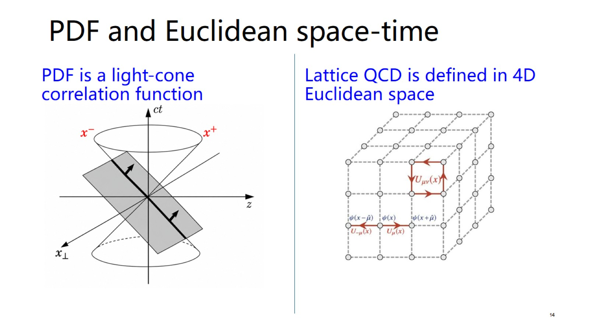

Slide 15
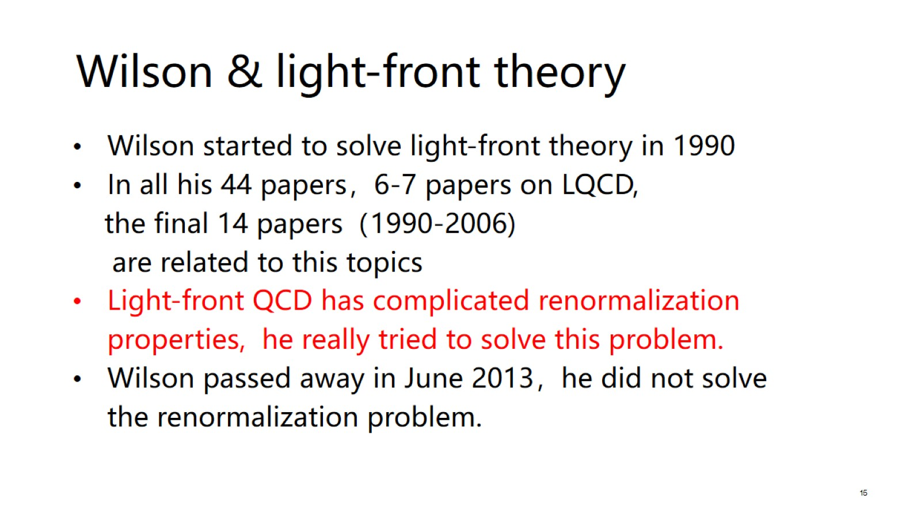

Slide 16
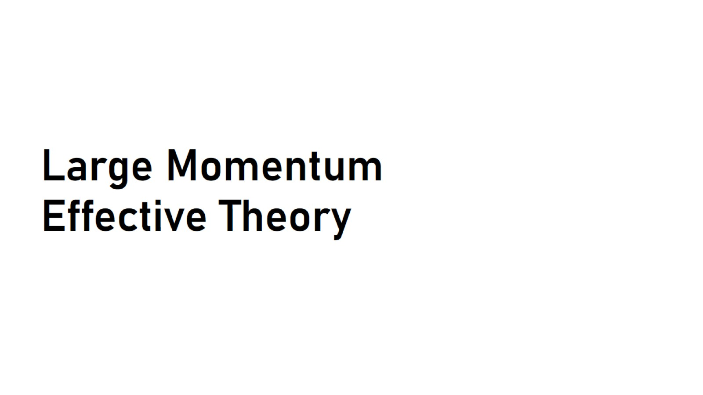
Large Momentum Effective Theory

Slide 17
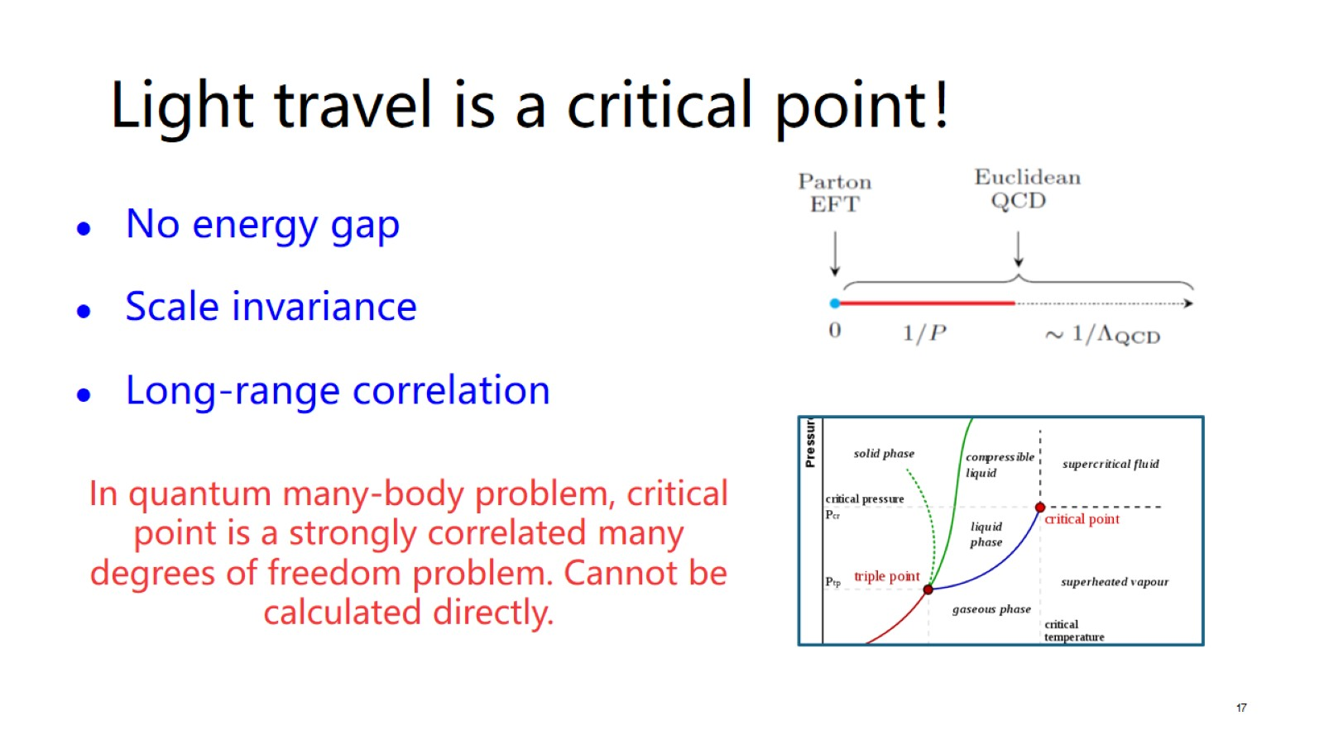

Slide 18
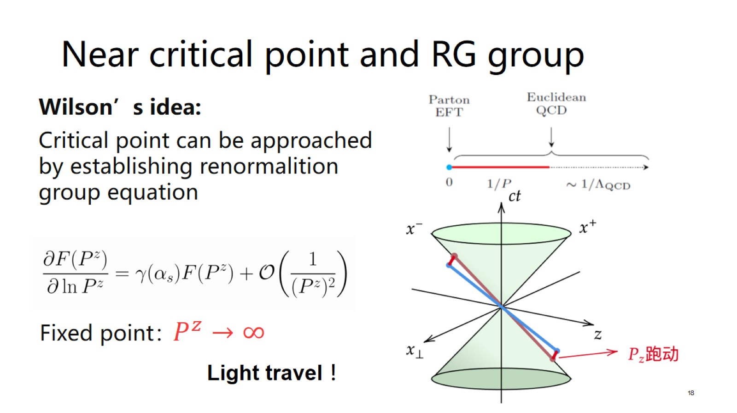

Slide 19
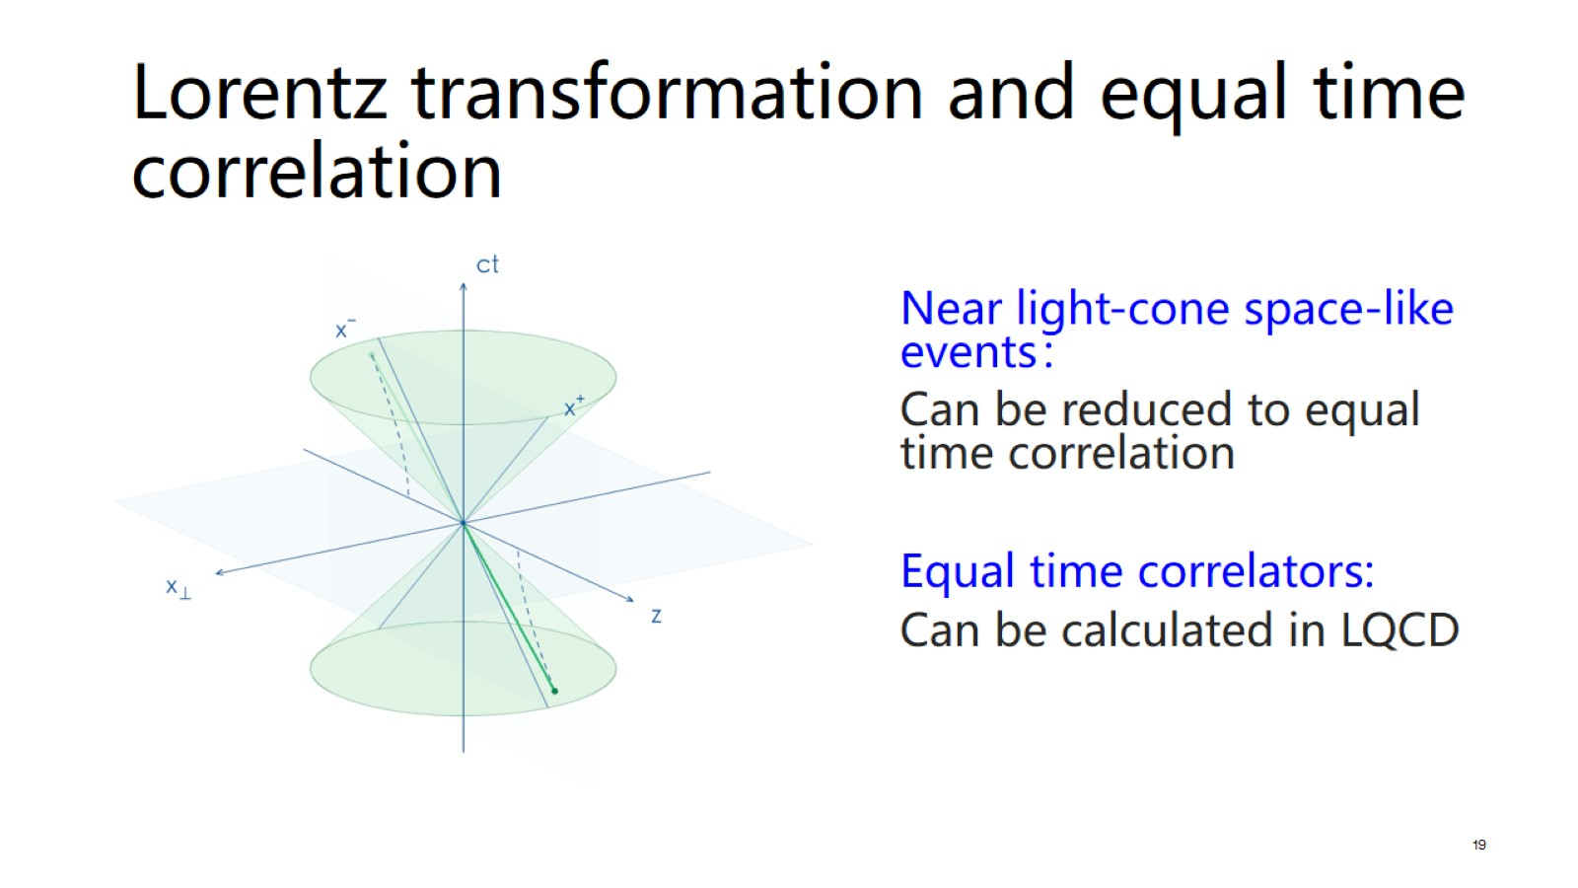

Slide 20
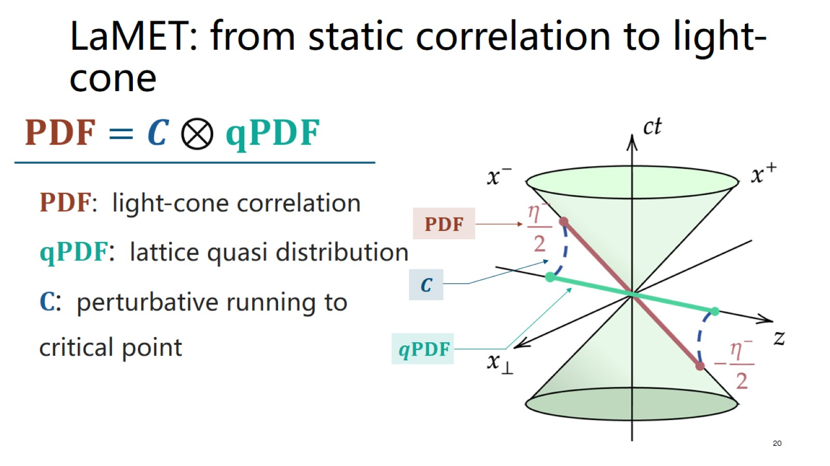

Slide 21

Recent progress: PDFs

Slide 22
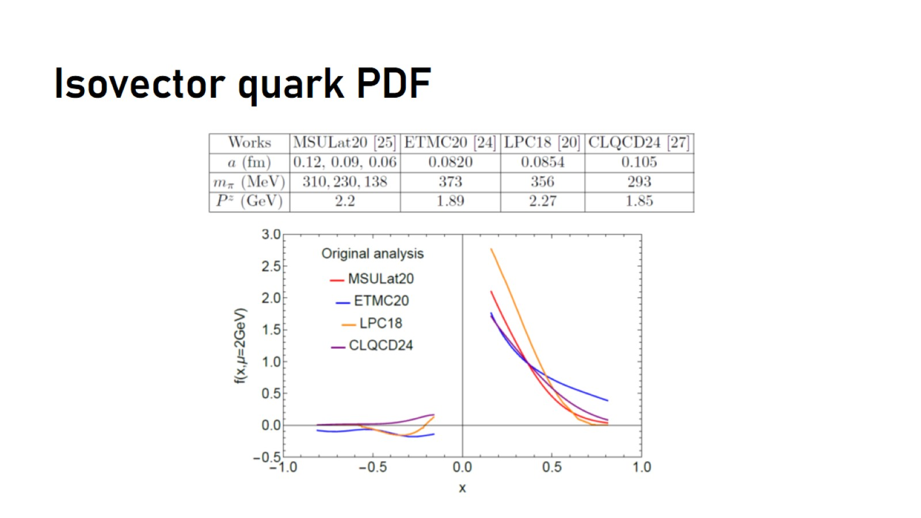
Isovector quark PDF

Slide 23
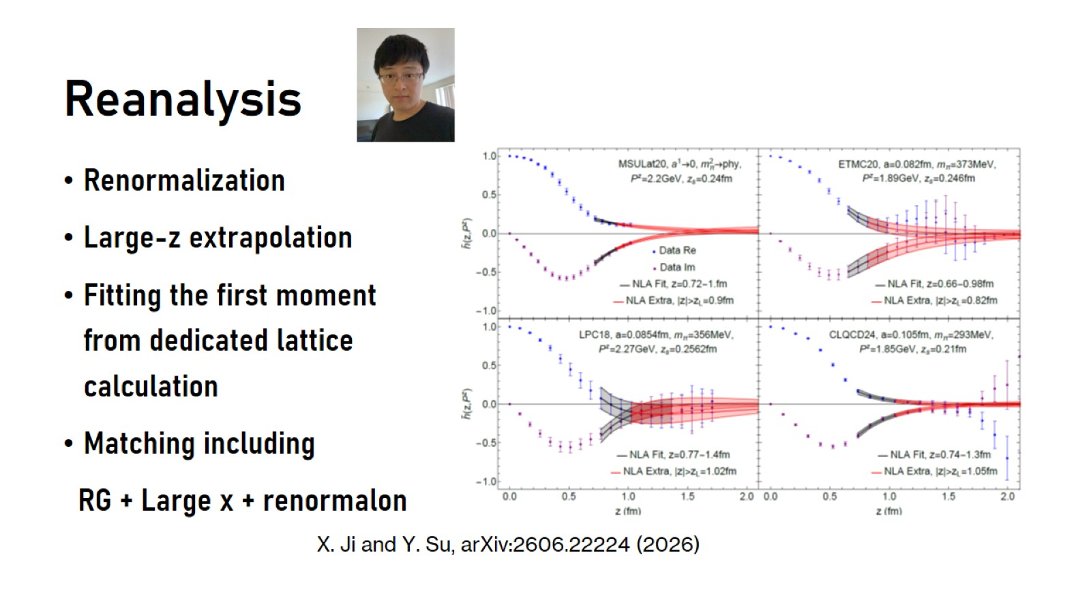
Reanalysis

Slide 24
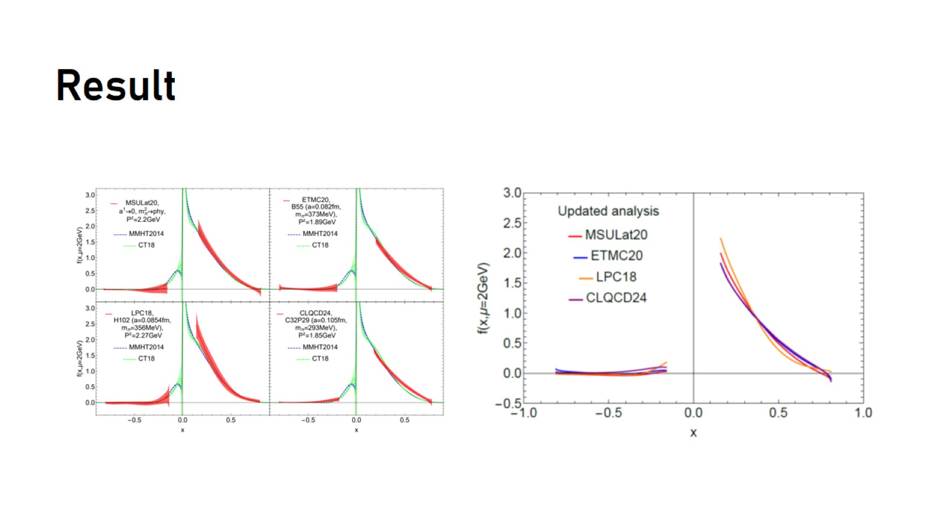
Result

Slide 25
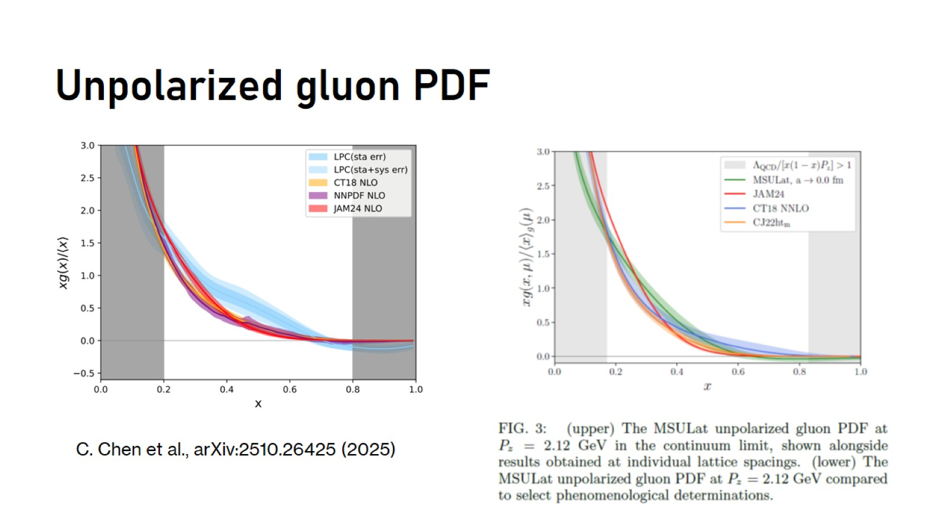
Unpolarized gluon PDF

Slide 26
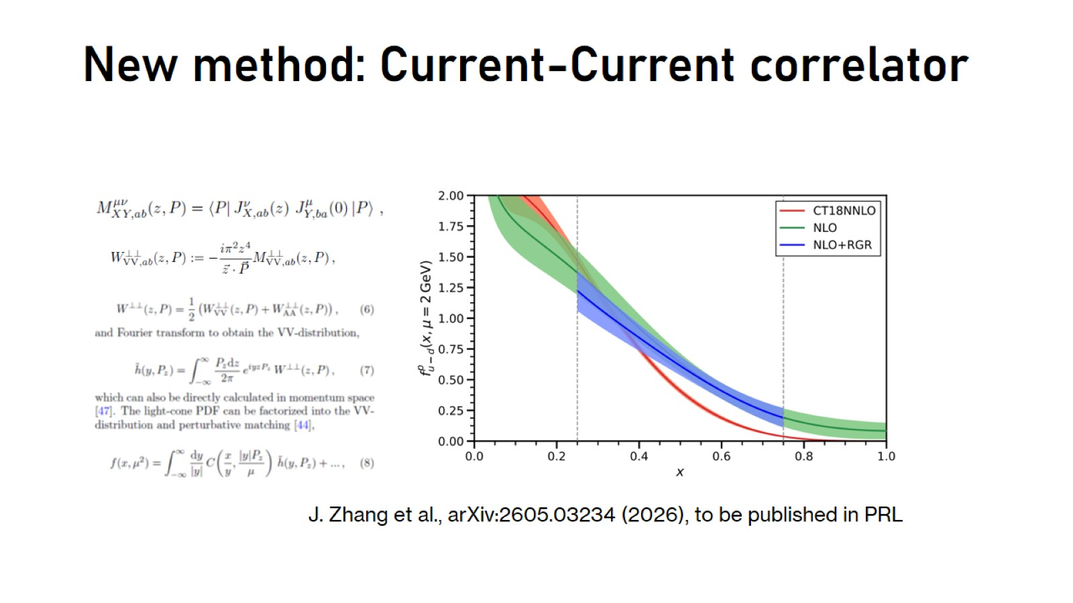
New method: Current-Current correlator

Slide 27
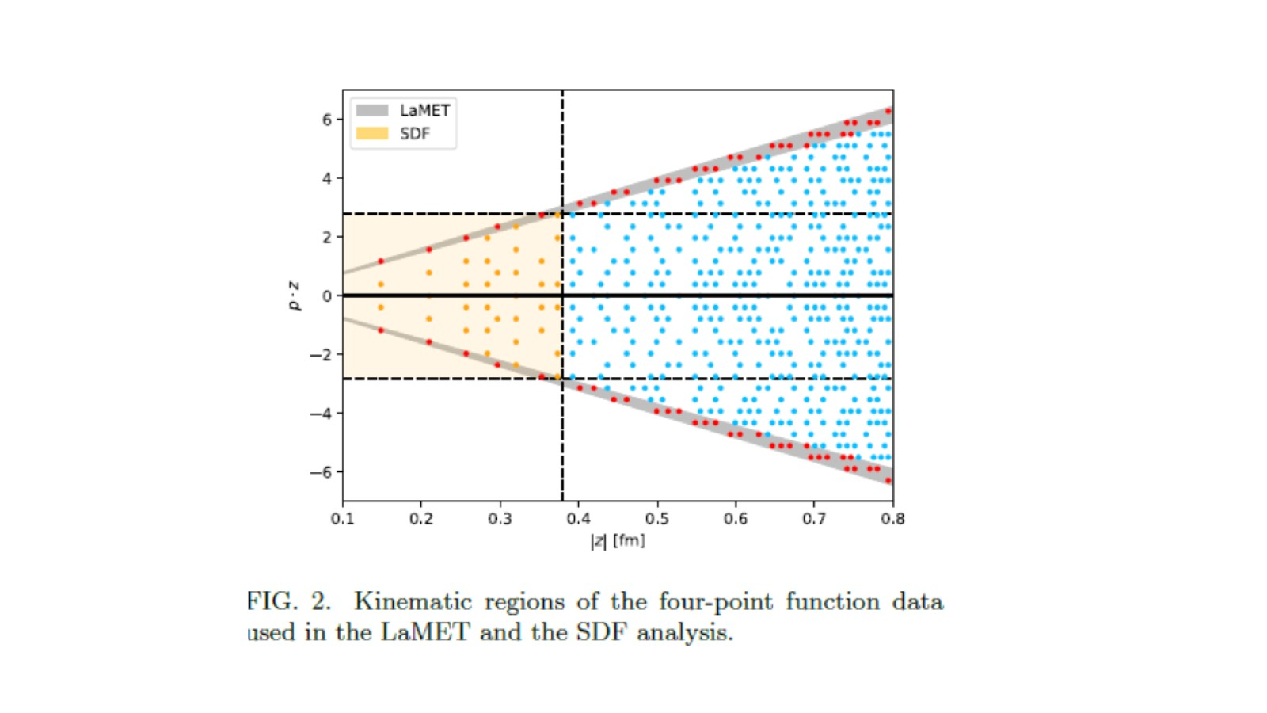

Slide 28
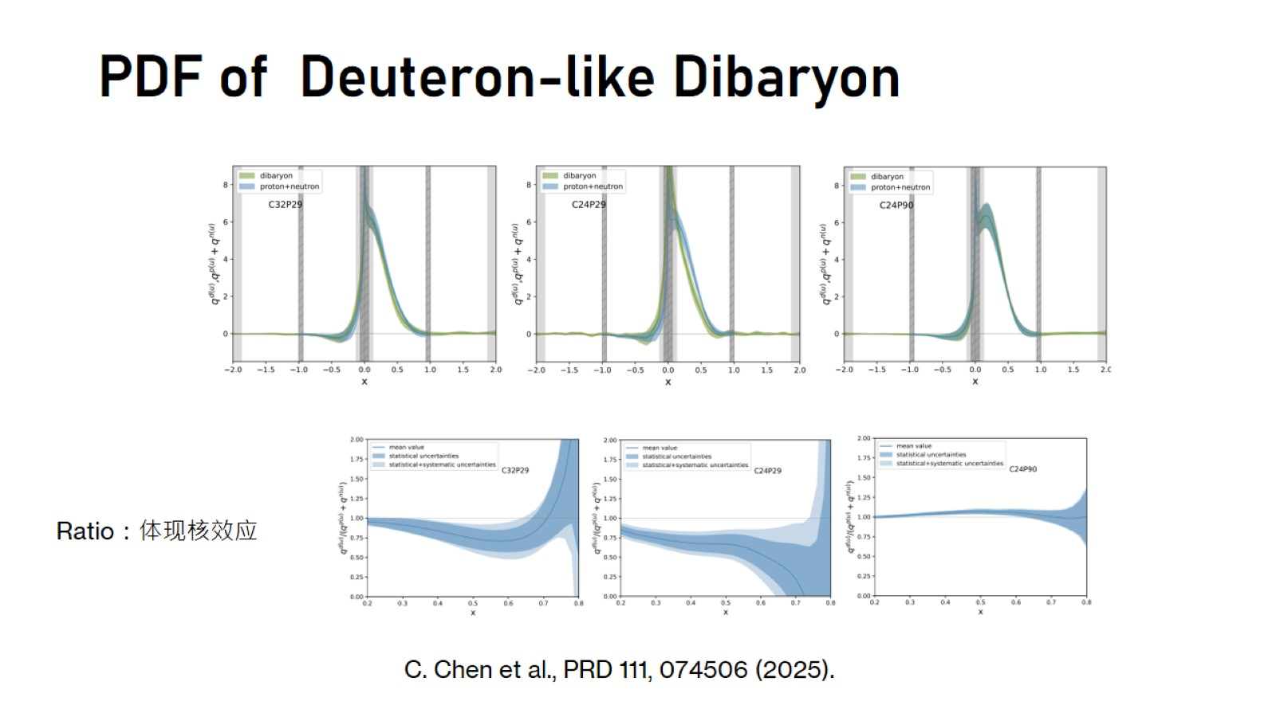
PDF of Deuteron-like Dibaryon

Slide 29
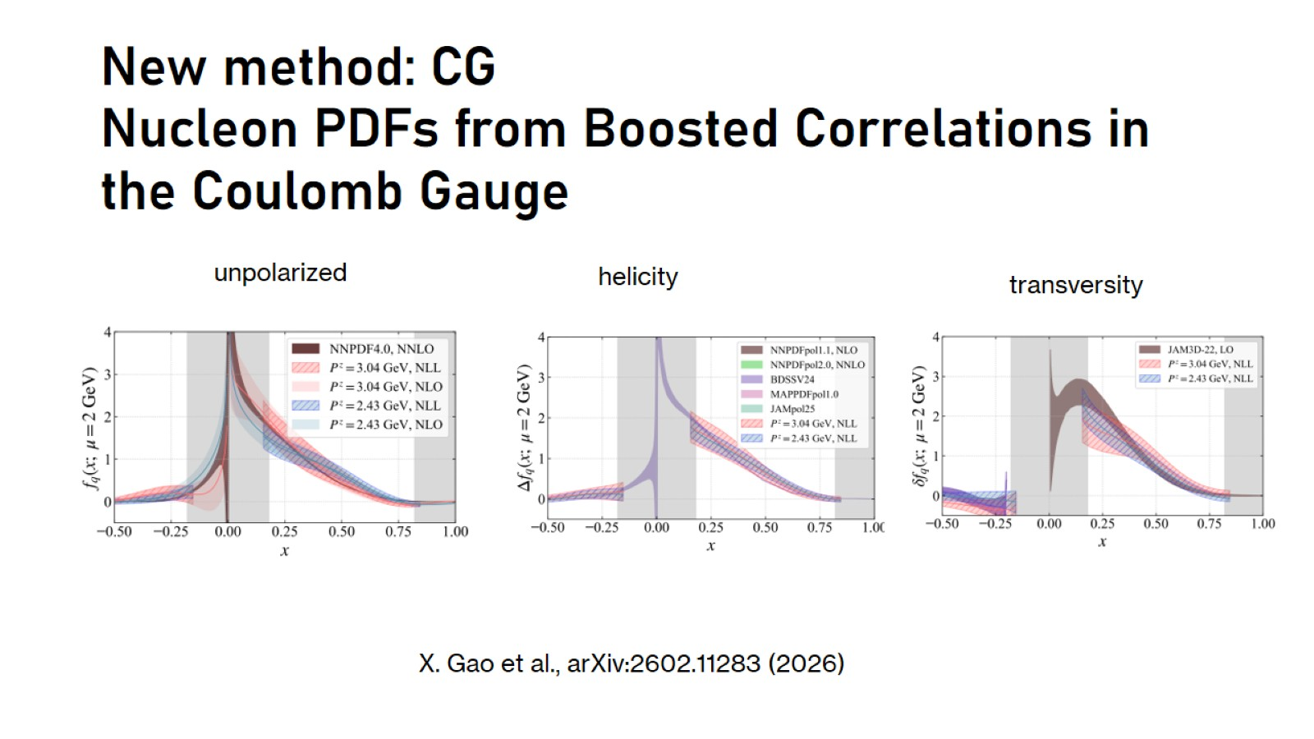
New method: CG
Nucleon PDFs from Boosted Correlations in the Coulomb Gauge

Slide 30
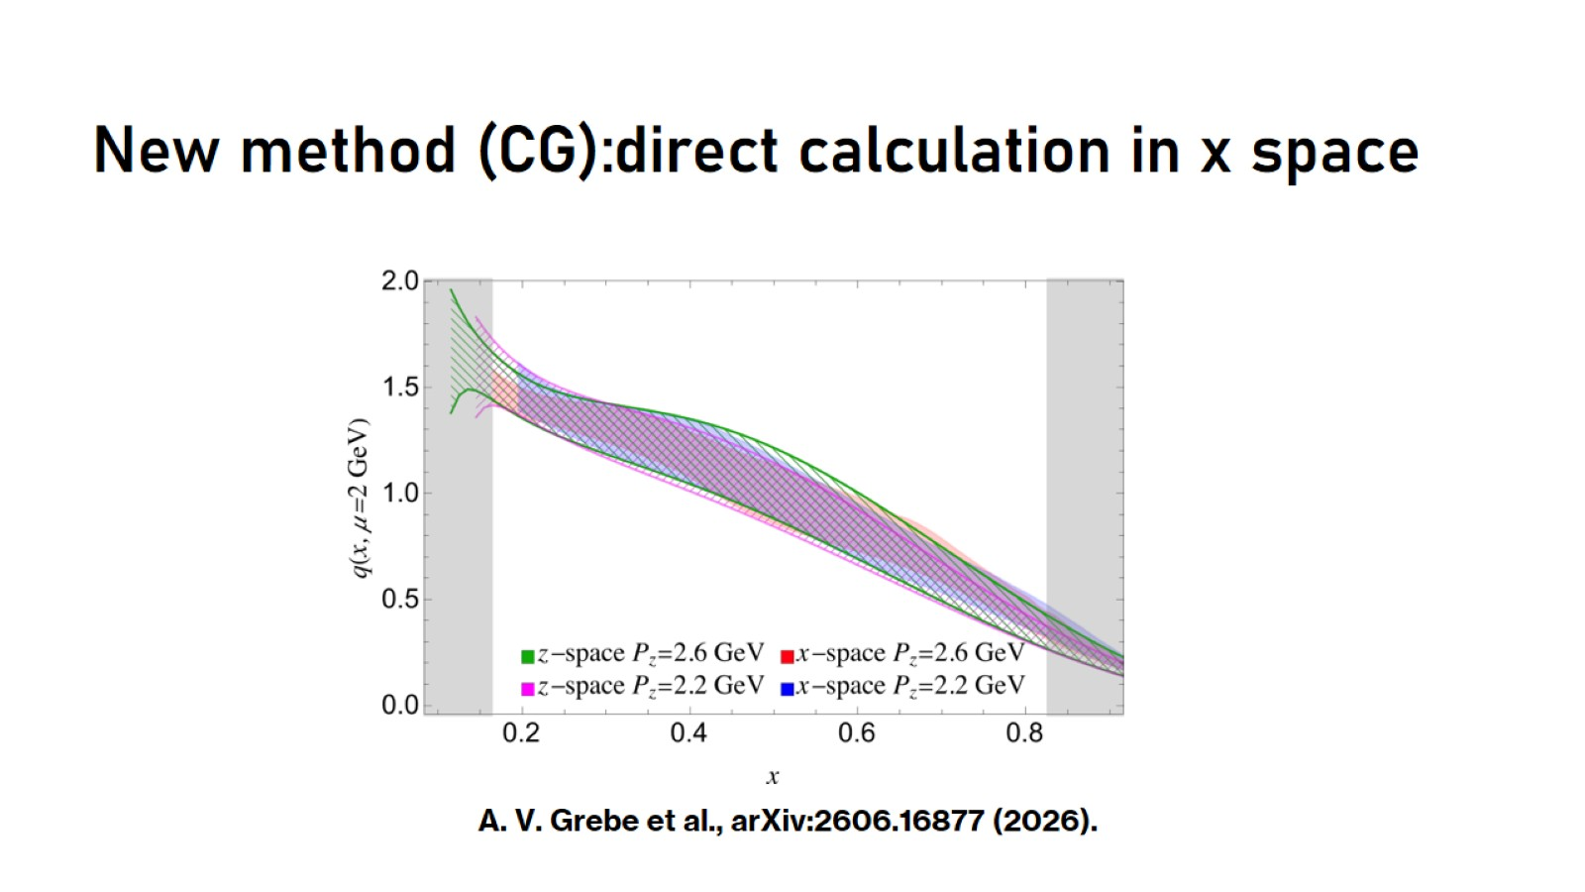
New method (CG):direct calculation in x space

Slide 31
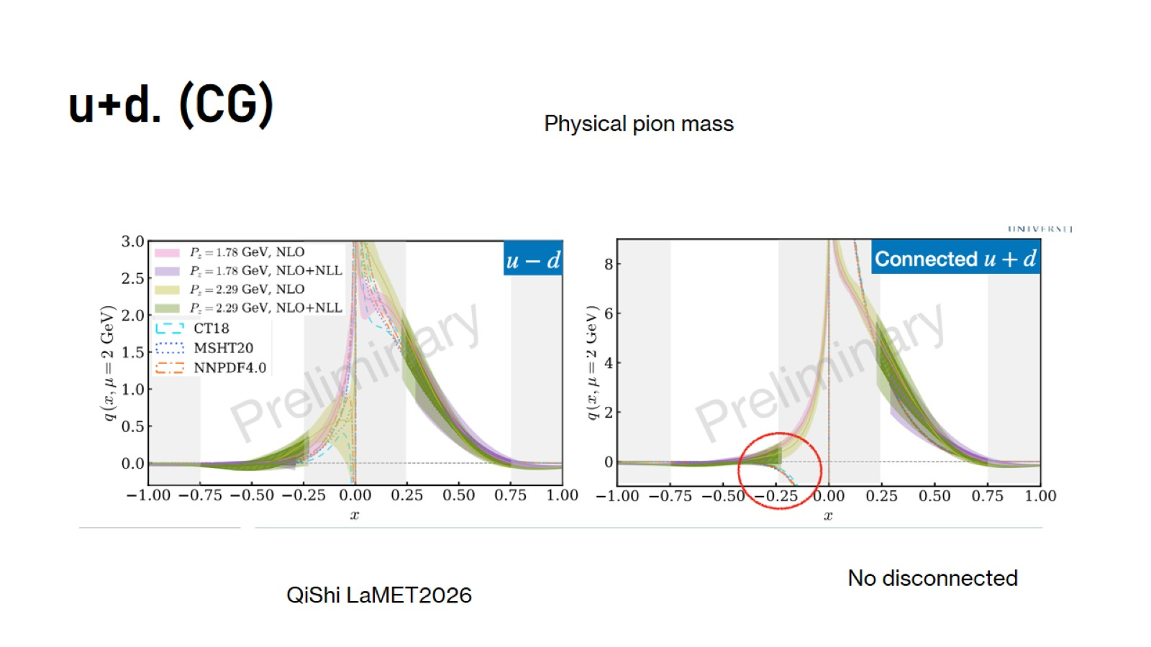
u+d. (CG)

Slide 32
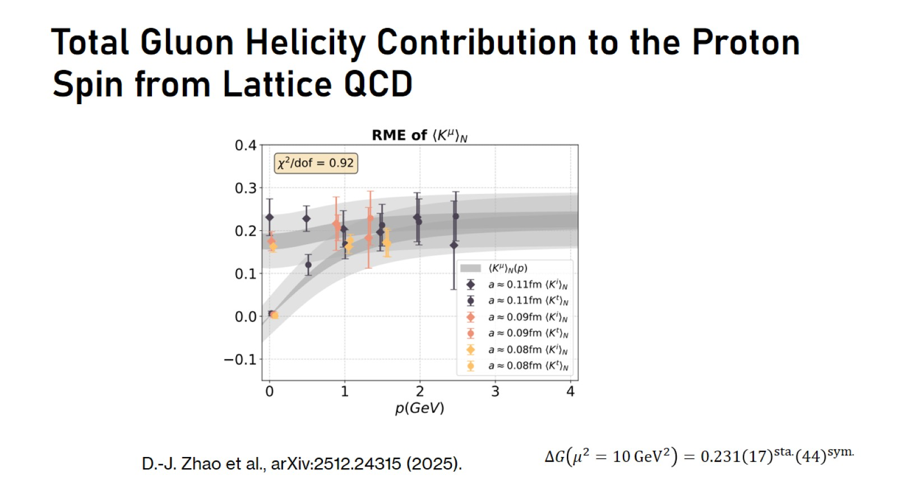
Total Gluon Helicity Contribution to the Proton Spin from Lattice QCD

Slide 33
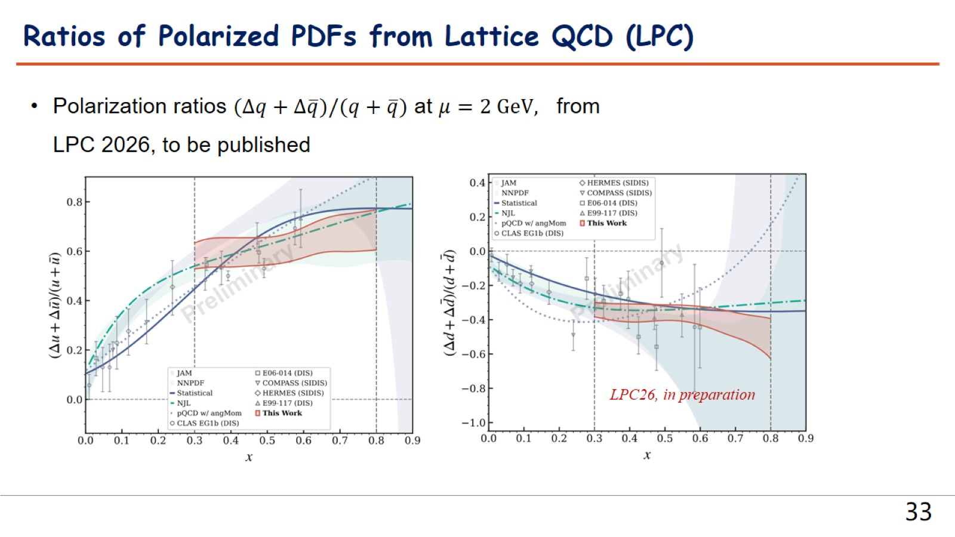

Slide 34
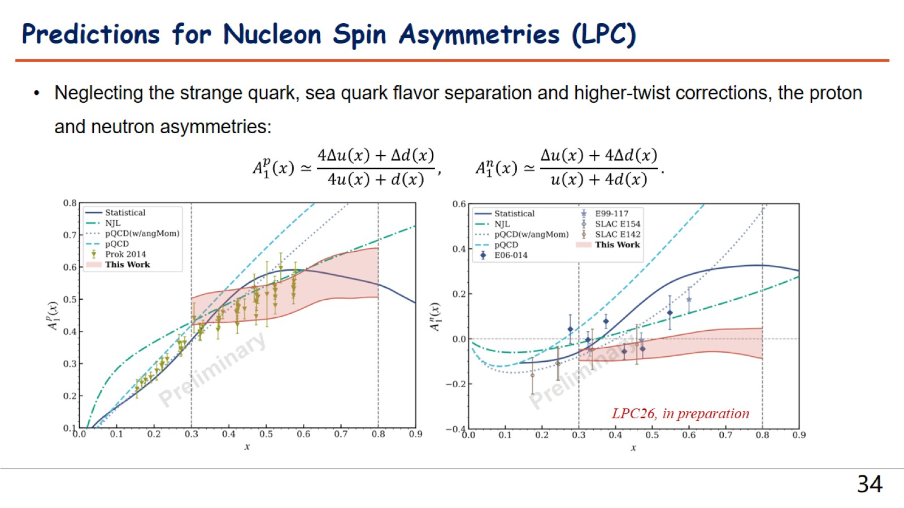

Slide 35

Recent progress: GPDs

Slide 36
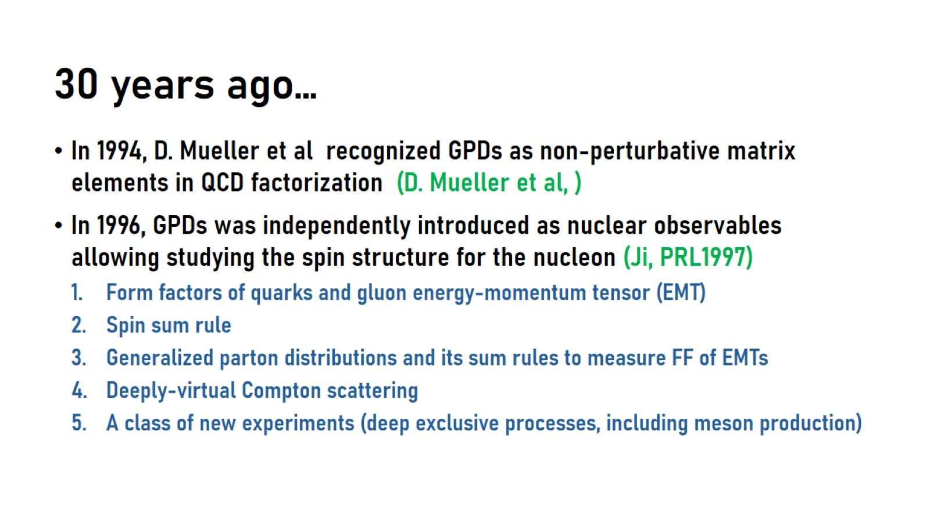
30 years ago…

Slide 37
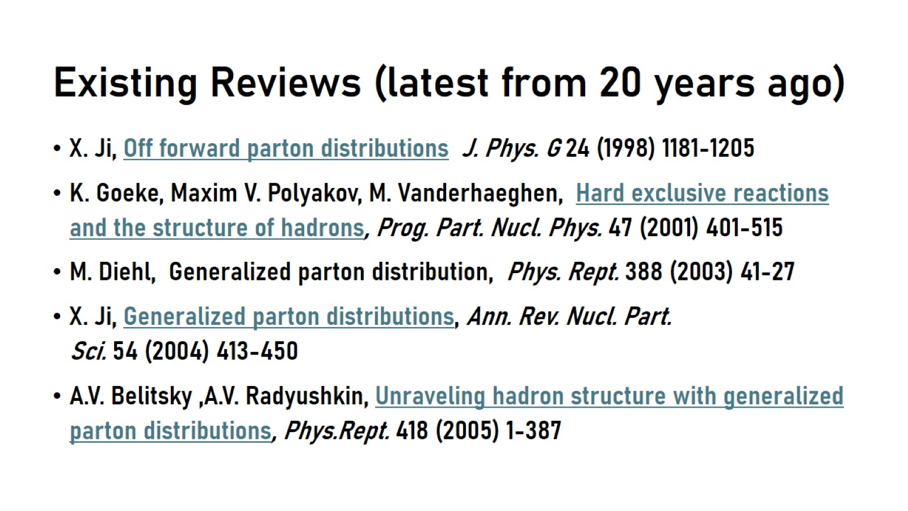
Existing Reviews (latest from 20 years ago)

Slide 38
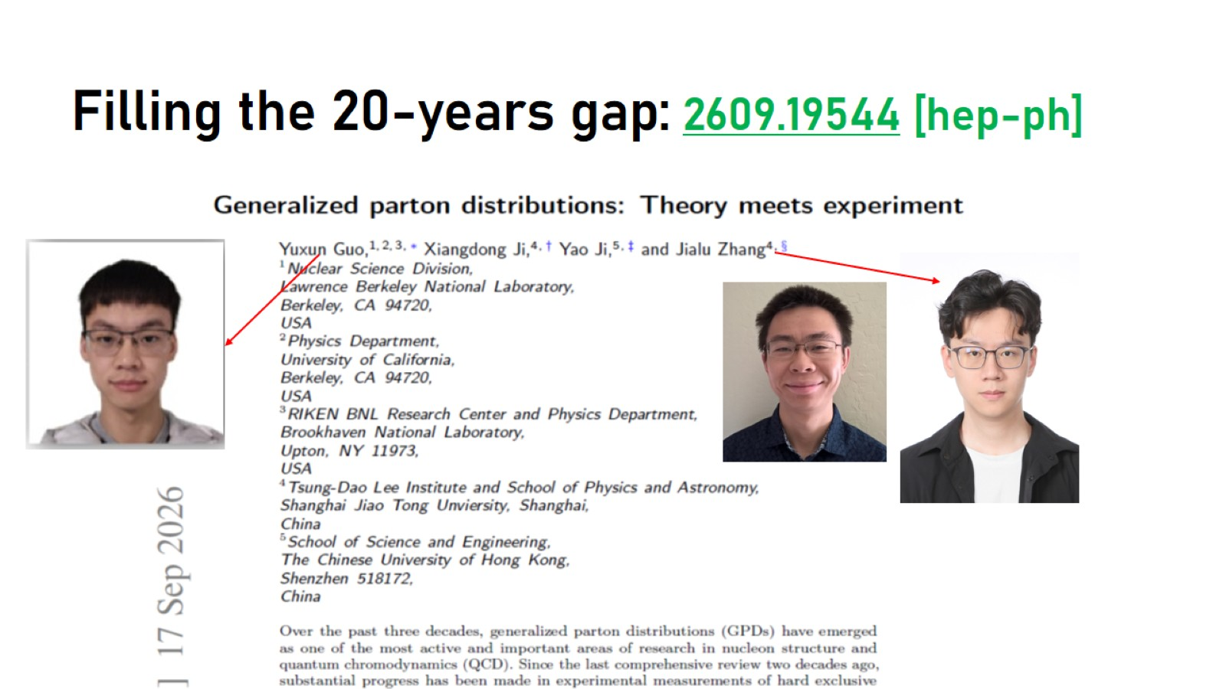
Filling the 20-years gap: 2609.19544 [hep-ph]

Slide 39
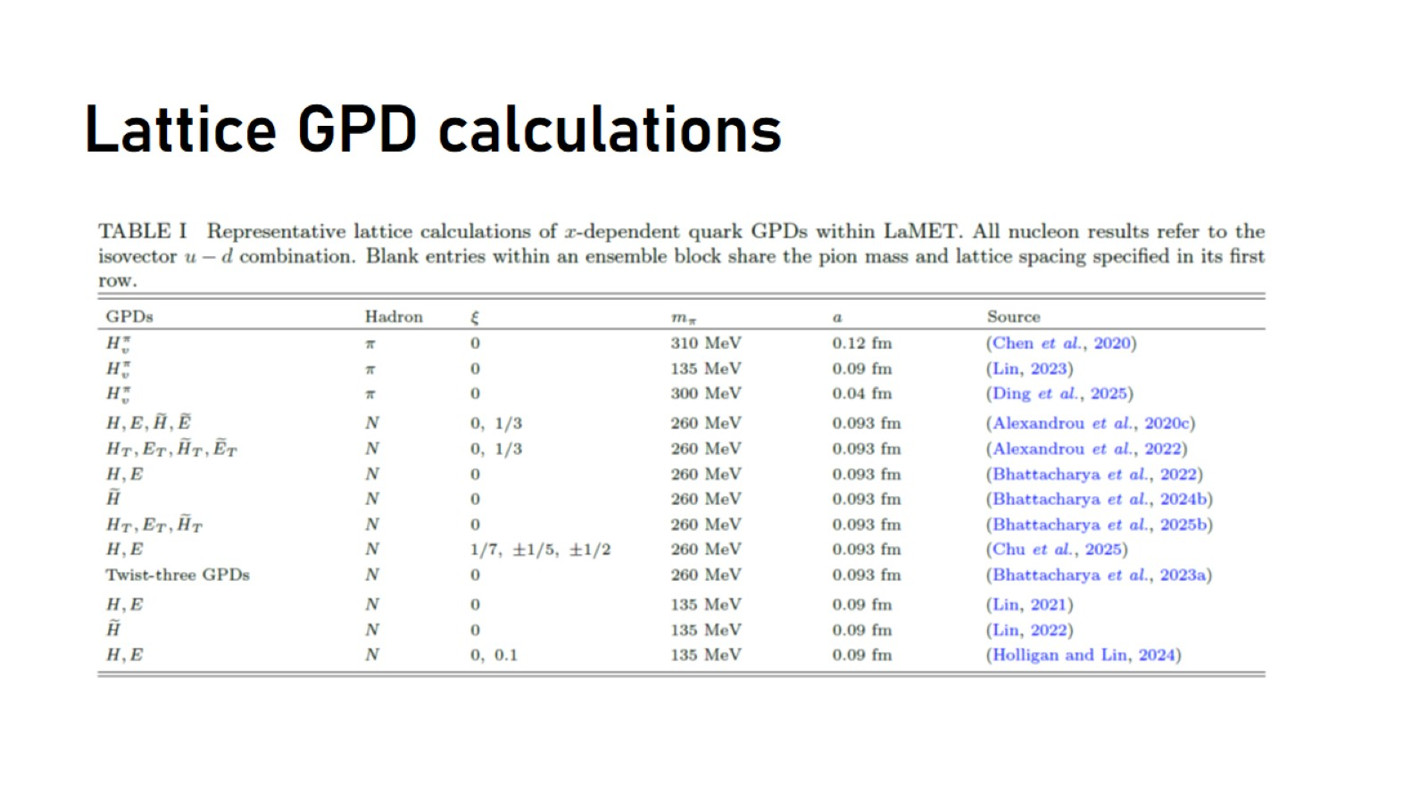
Lattice GPD calculations

Slide 40
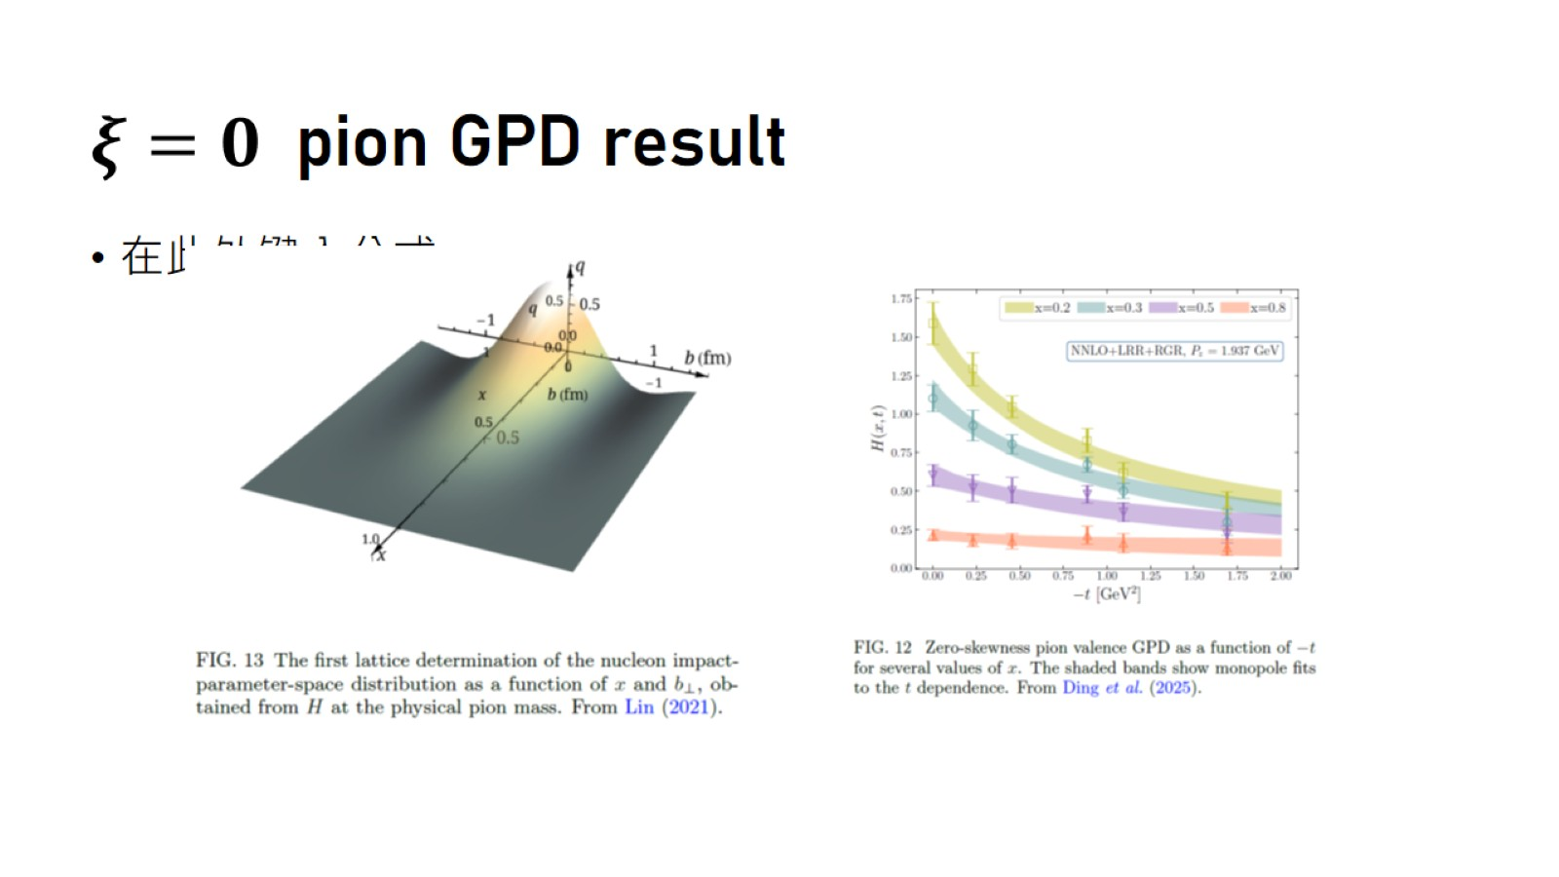
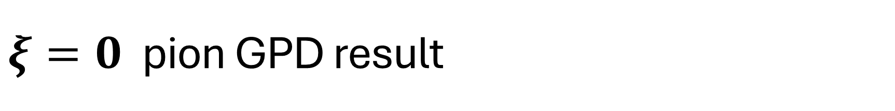
$ξ=0$ pion GPD result

Slide 41
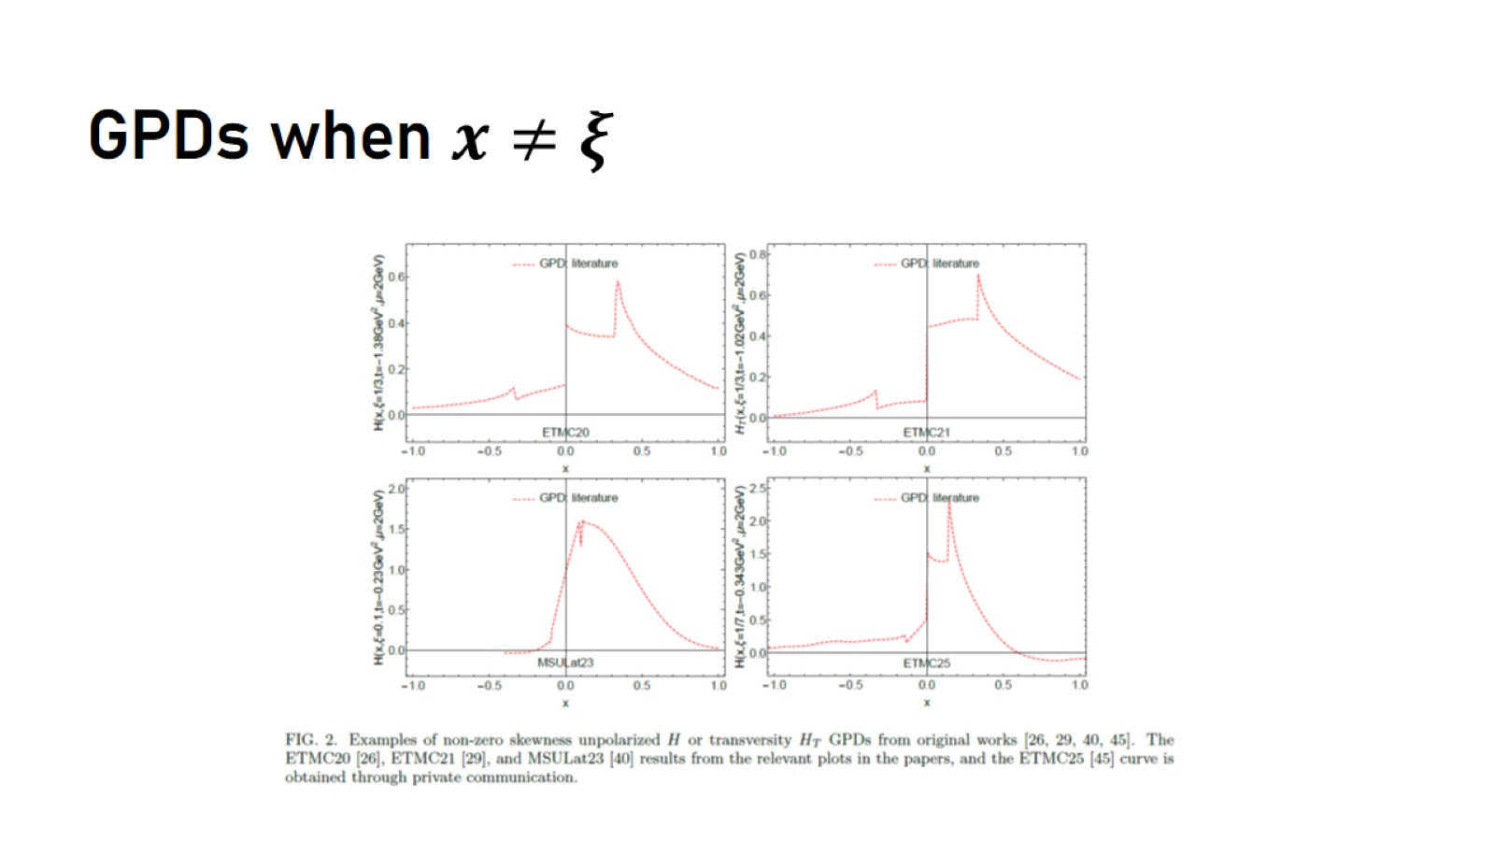

GPDs when $x≠ξ$

Slide 42
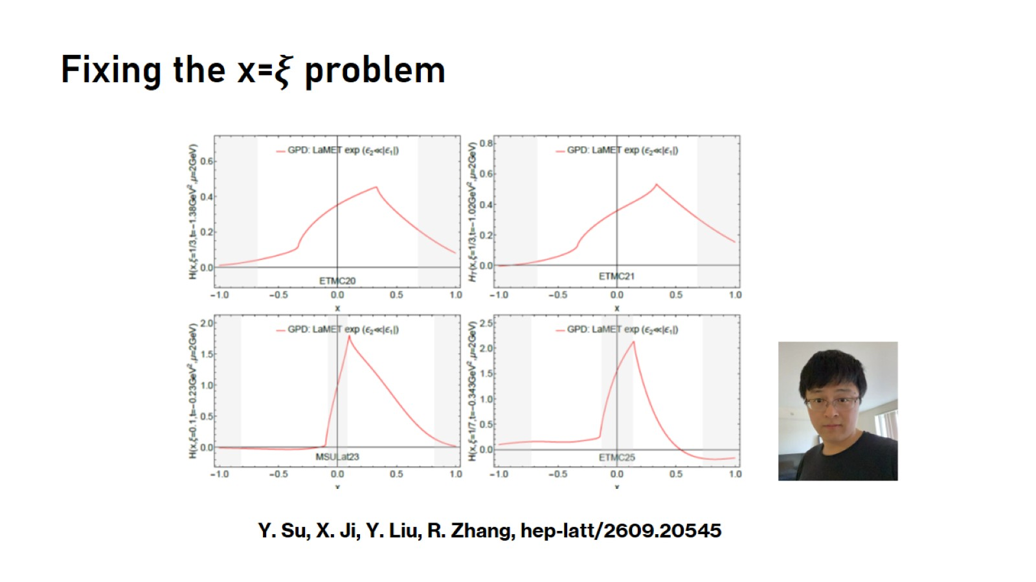

Fixing the x=$ξ$ problem

Slide 43

Recent progress:TMDPDFs

Slide 44
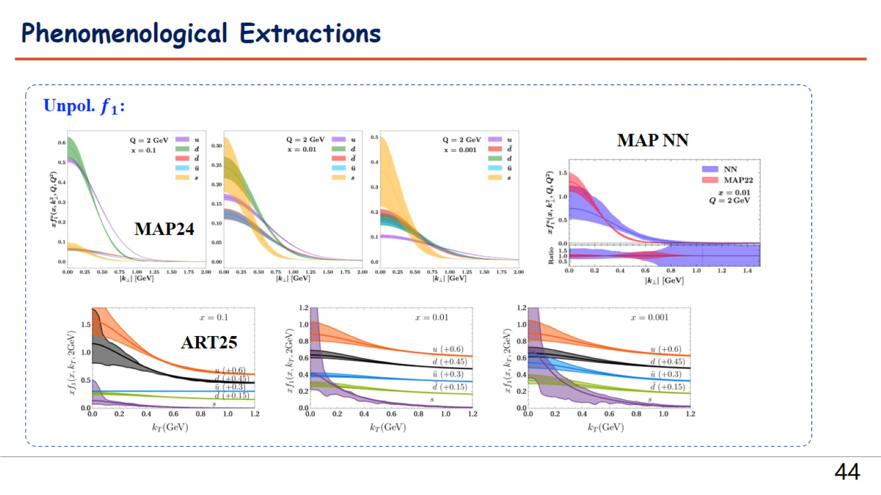

Slide 45
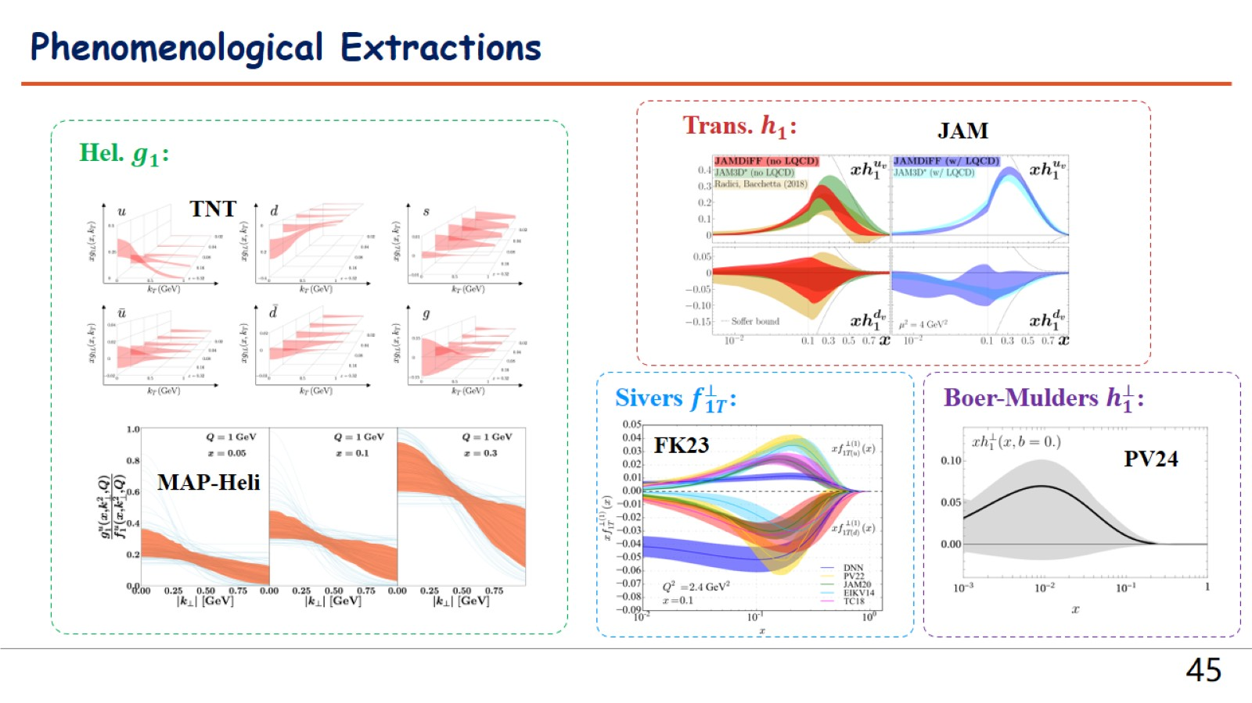

Slide 46
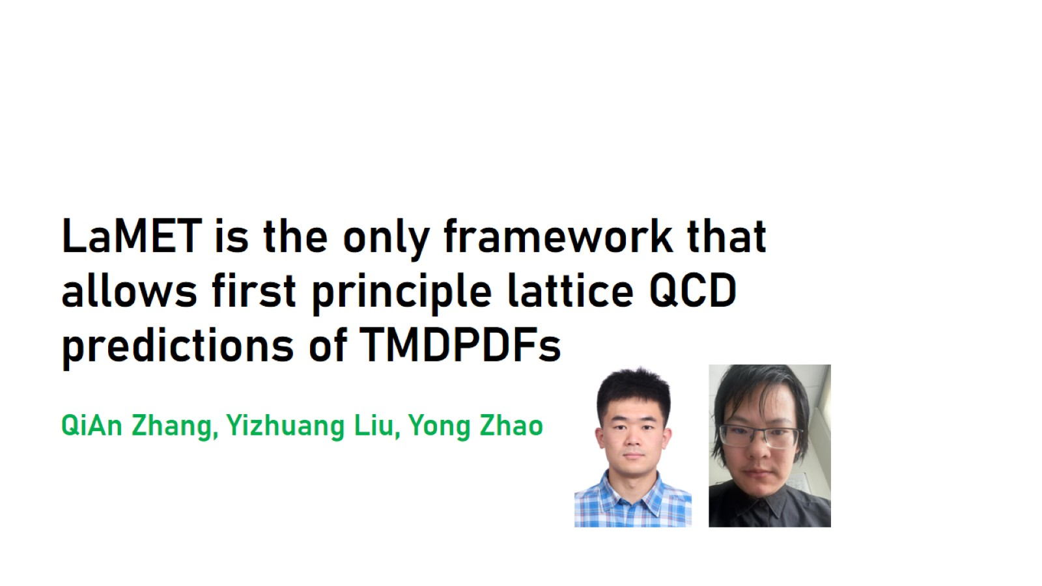
LaMET is the only framework that allows first principle lattice QCD predictions of TMDPDFs
QiAn Zhang, Yizhuang Liu, Yong Zhao

Slide 47
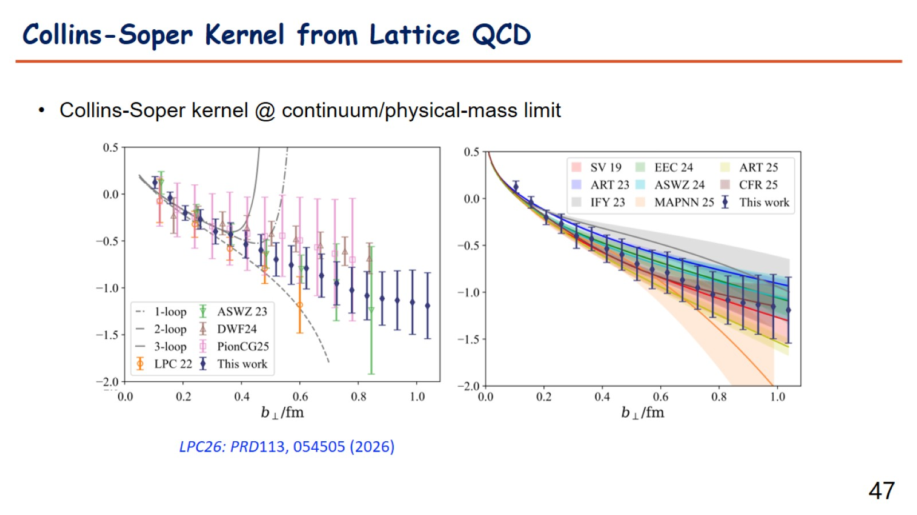

Slide 48
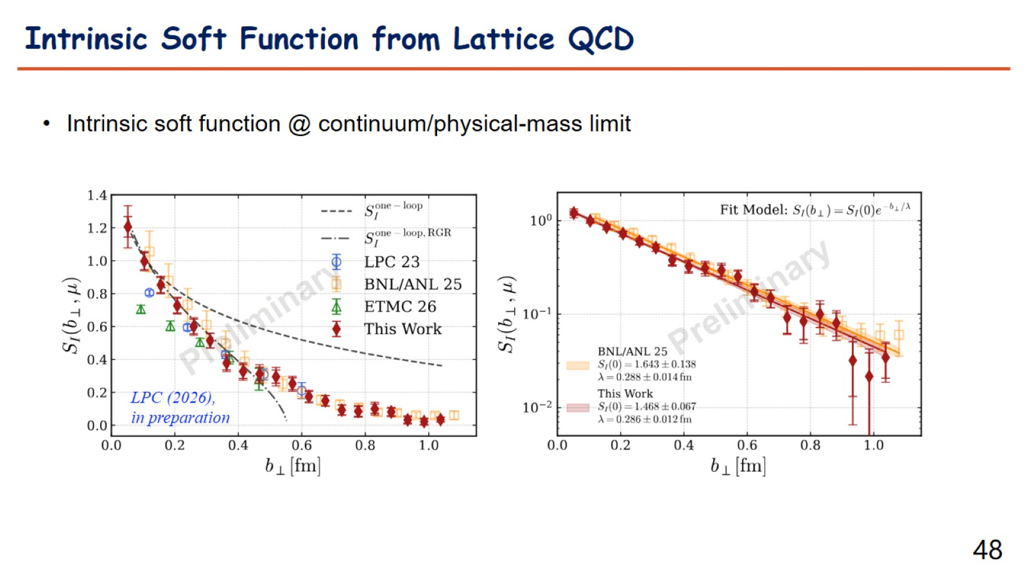

Slide 49
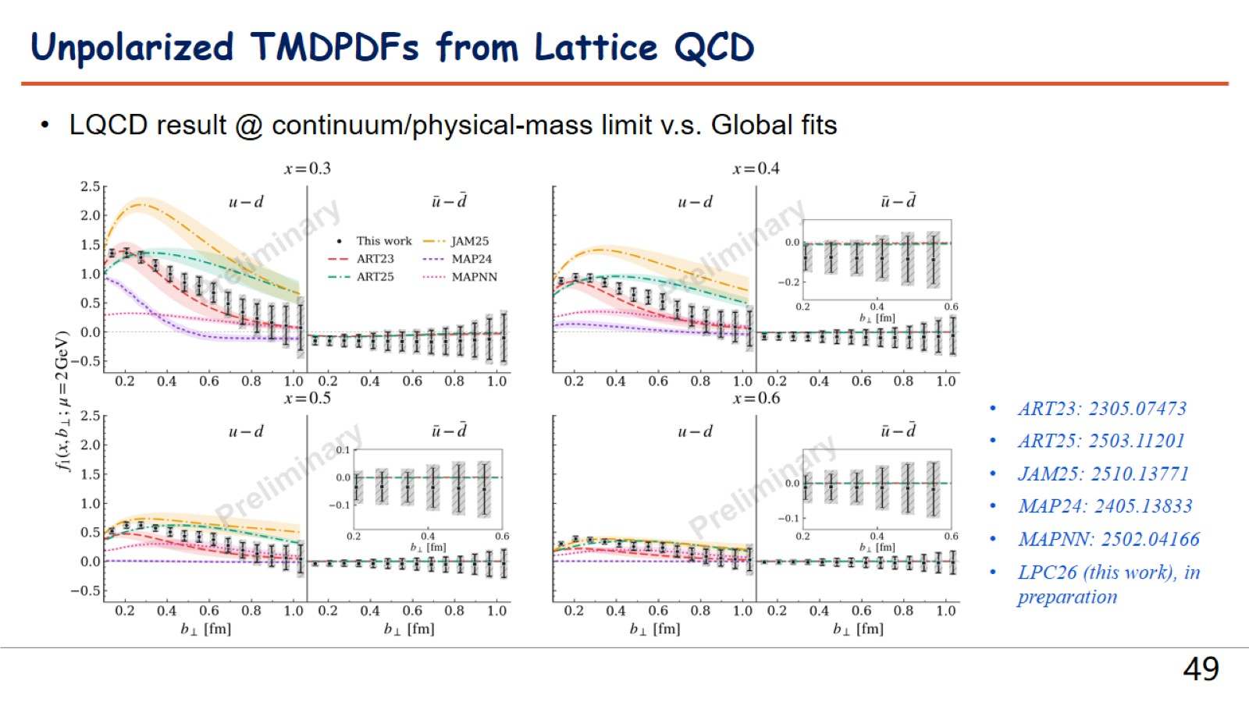

Slide 50
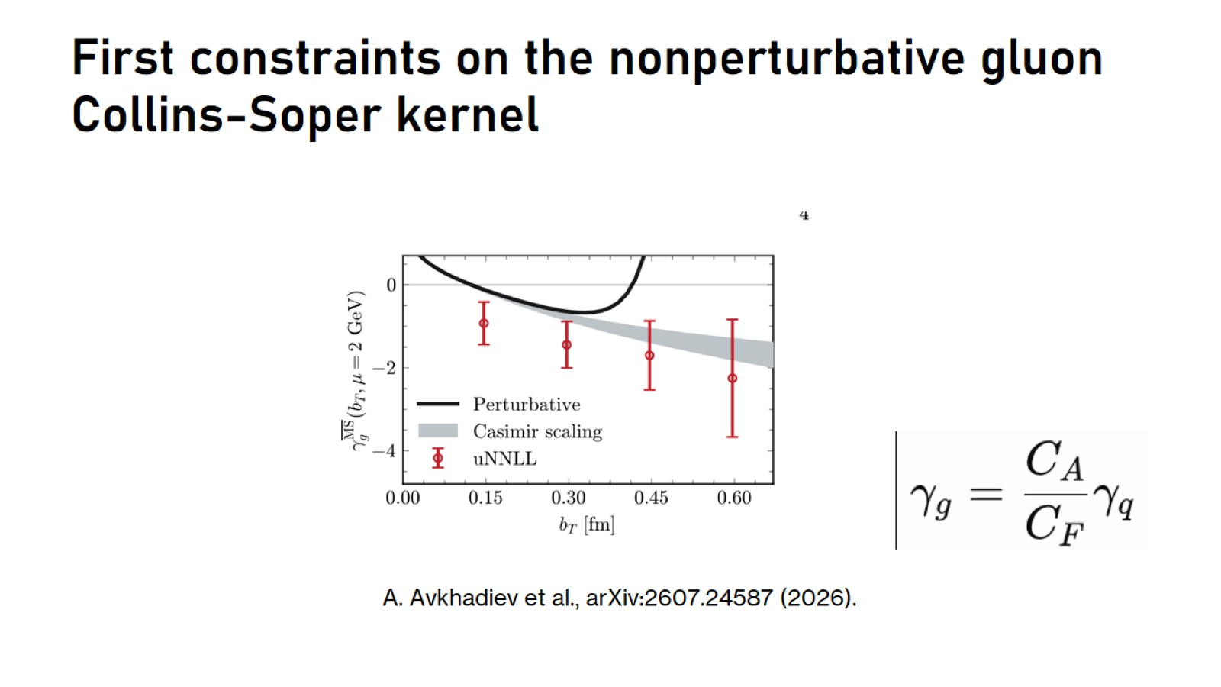
First constraints on the nonperturbative gluon Collins-Soper kernel

Slide 51
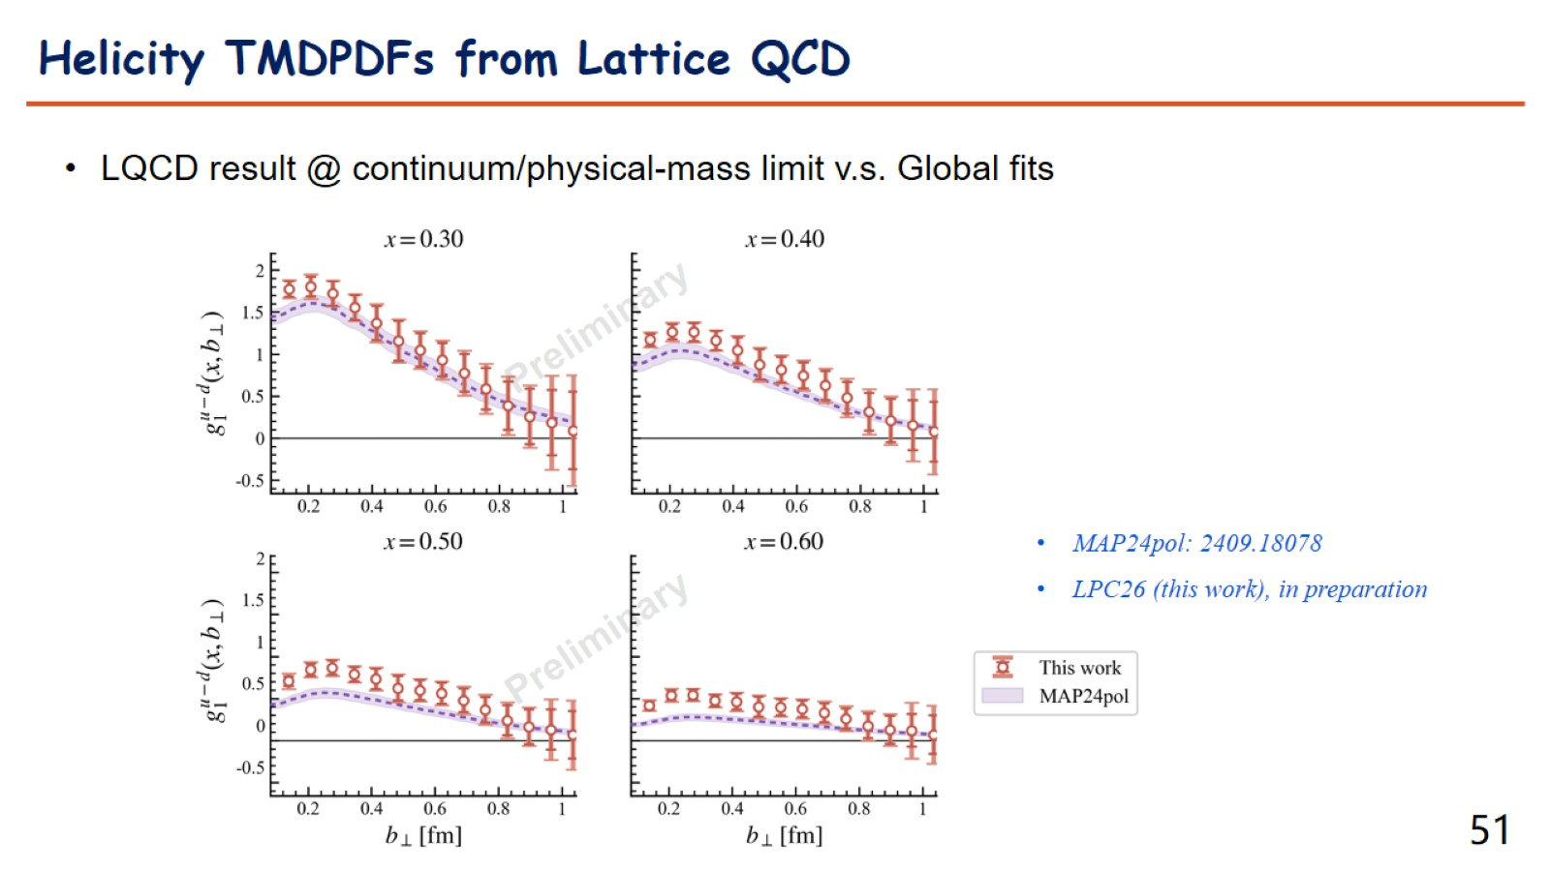

Slide 52
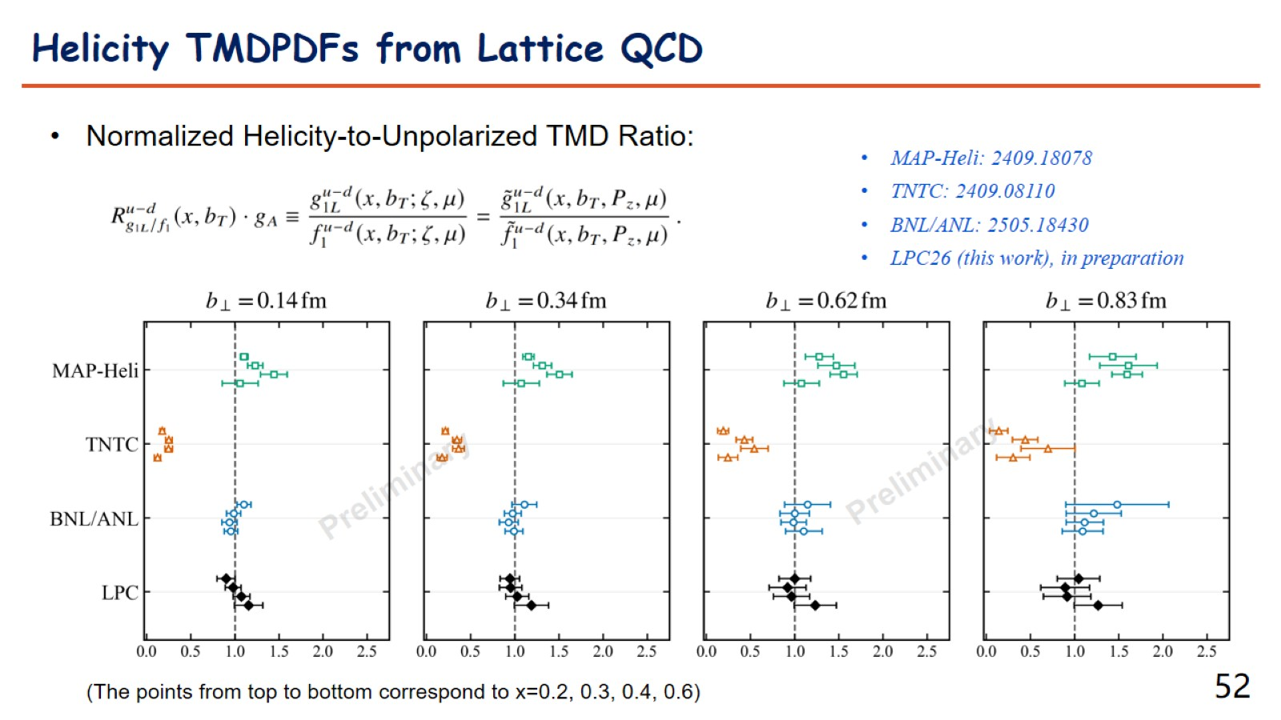

Slide 53
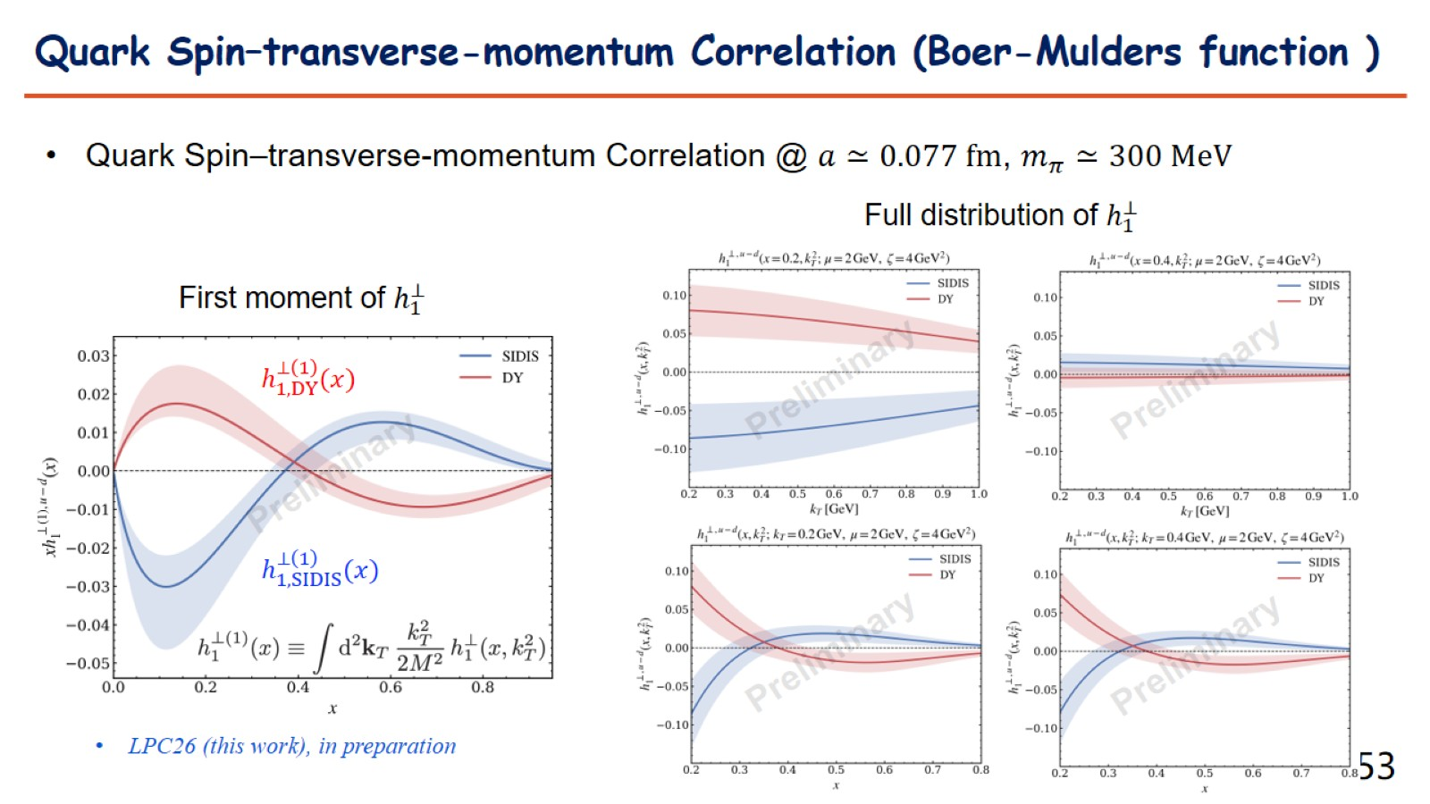

Slide 54

unpolarized, helicity, and transversity

Slide 55

Lattice QCD Benchmark of Proton Helicity and Flavor-Dependent Unpolarized TMPDF at Physical Quark Masses

Slide 56

Recent progress: others

Slide 57

Complete Access to Leading-Twist Λ-Baryon LCDAs from Lattice QCD

Slide 58


HQET $B$-meson LCDAs

Slide 59

Final comments

Slide 60


