Slide 1
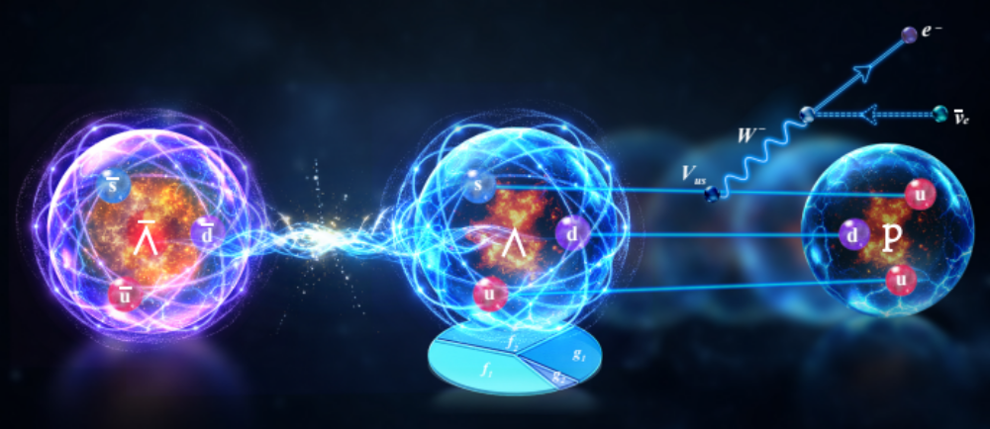
BESIII上超子β衰变的实验研究
罗 涛，复旦大学
(on behalf of BESIII Collaboration)
第六届中国格点量子色动力学研讨会（CLQCD2026）
香港中文大学（深圳）2026.10.08 ~ 10.11
BESIII Collaboration, Nature 657, 92-97 (2026), arXiv:2509.09266
BESIII Collaboration, PRL 137, 091801 (2026), arXiv:2512.15273
BESIII Collaboration, PRL 127. 121802 (2021), arXiv:2107.06704.
Notes:
感谢老师的热情邀请！

Slide 2
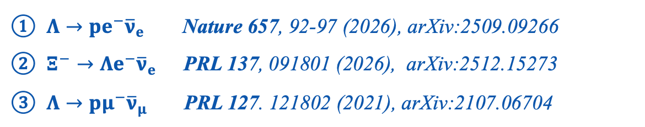
Outline
01
Introduction
02
Highlights of Hyperon β decay from BESIII
$Λ→pe^{−}{\overline{ν}}_{e}$ Nature 657, 92-97 (2026), arXiv:2509.09266
$Ξ^{−}→Λe^{−}{\overline{ν}}_{e}$ PRL 137, 091801 (2026), arXiv:2512.15273
$Λ→pμ^{−}{\overline{ν}}_{μ}$ PRL 127. 121802 (2021), arXiv:2107.06704
03
Summary
Notes:
部分

Slide 3
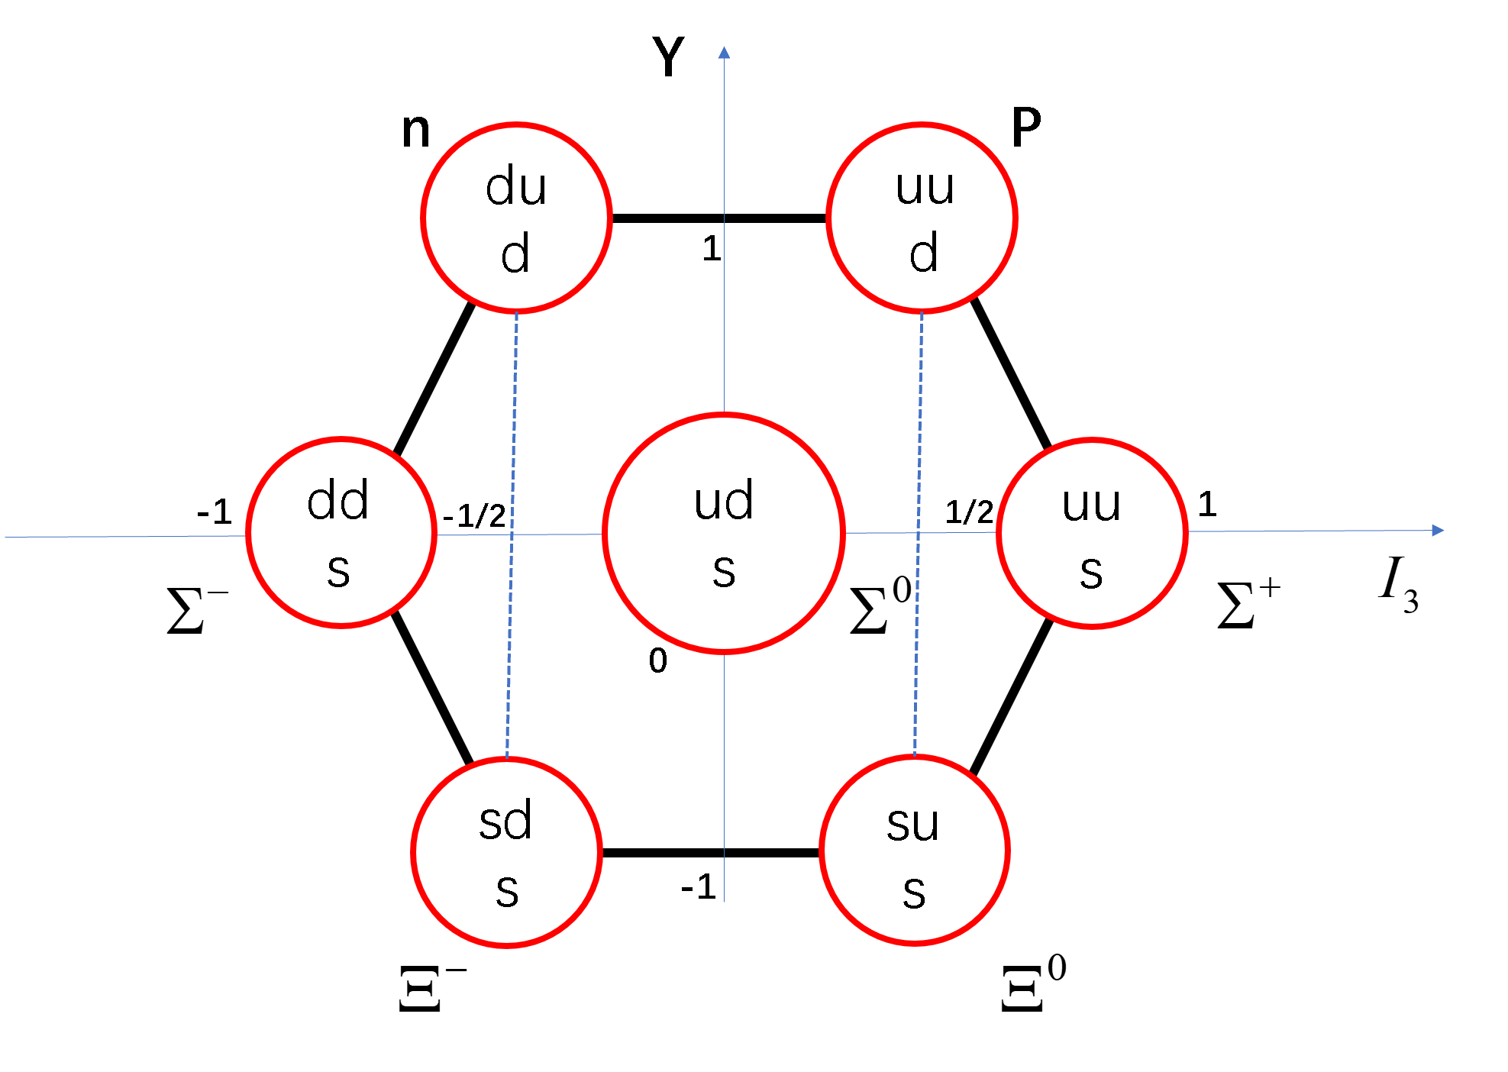
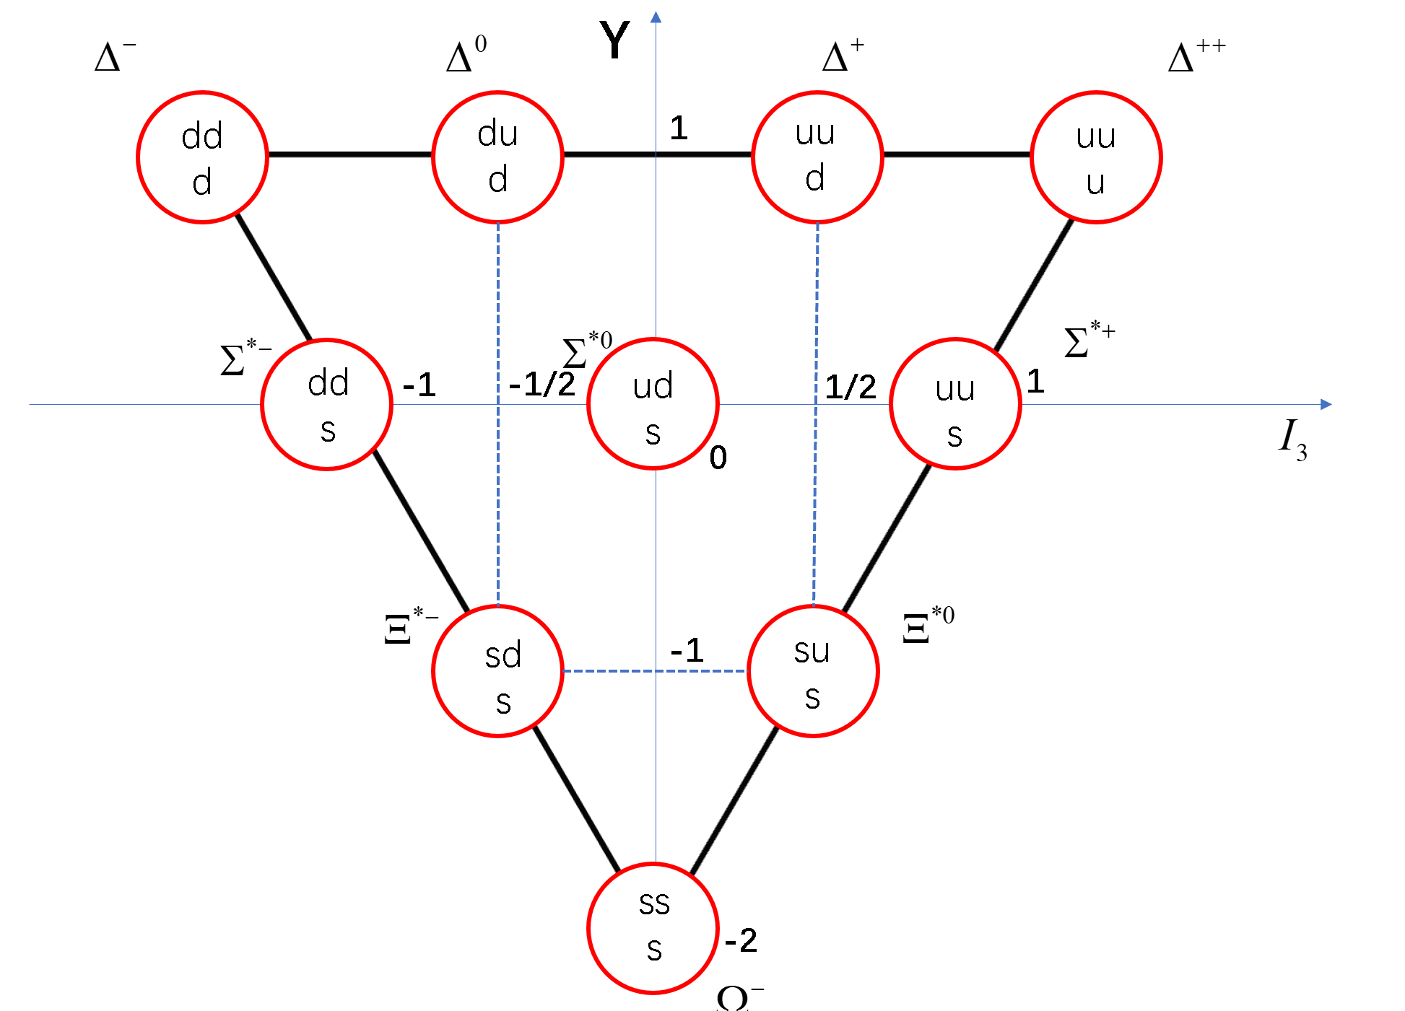
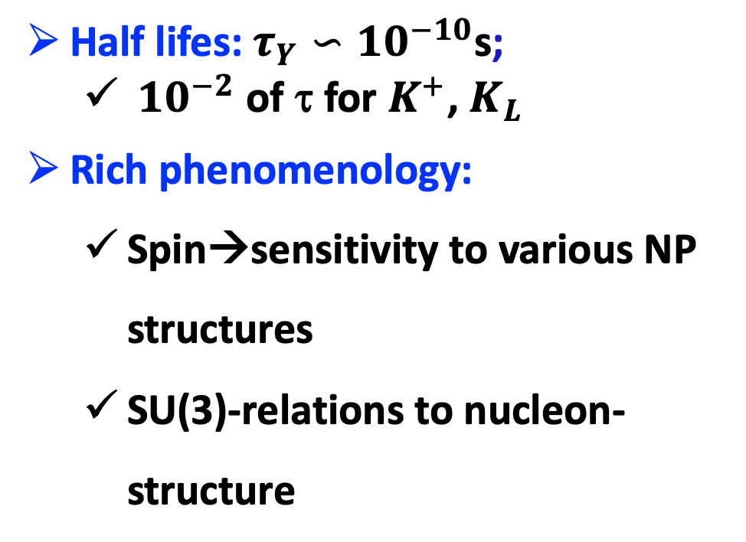
The hyperons
Hyperons are the strange siblings of the proton and neutron
Half lifes: $τ_{Y}∽{10}^{−10}$s;
  ${10}^{−2}$ of τ for $K^{+}$, $K_{L}$
Rich phenomenology:
  Spin→sensitivity to various NP structures
  SU(3)-relations to nucleon-structure
Notes:
超子是含有奇异夸克的重子。
超子的寿命在10^-10量级，可以飞出对撞机的对撞点，但是一般飞不出探测器。为我们研究超子提供了重要的条件 (K+的寿命：)
由于超子有自旋，所以相比之下，对新物理结构更加敏感。
超子通过SU(3)和核子相关联。超子的研究有利于我们了解核子的结构。

Slide 4

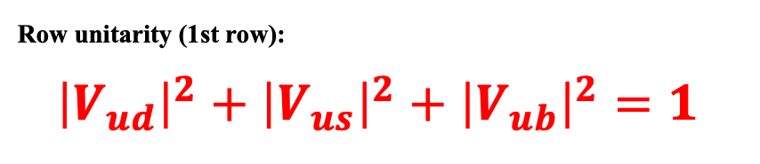

Cornerstone of the Standard Model: The CKM Matrix
$$d$$
$$s$$
$$b$$
Six quark flavors mix through the weak interaction.
Mixing probabilities form the 3×3 CKM matrix.
Unitarity: each row obeys $\sum{{\left|V_{ij}\right|}^{2}}$ = exactly 1.
Key element: $|V_{us}|$, the strange → up quark transition.
Precision tests of $|V_{us}|$are sensitive probes of new physics.
$$u$$
$$V_{ud}$$
$$V_{us}$$
$$V_{ub}$$
$$c$$
$$V_{cd}$$
$$V_{cs}$$
$$V_{cb}$$
$$t$$
$$V_{tb}$$
$$V_{td}$$
$$V_{ts}$$
Row unitarity (1st row):
${\left|V_{ud}\right|}^{2}+{\left|V_{us}\right|}^{2}+{\left|V_{ub}\right|}^{2}=1$
4
Notes:
CKM矩阵是标准模型的重要组成部分

Slide 5




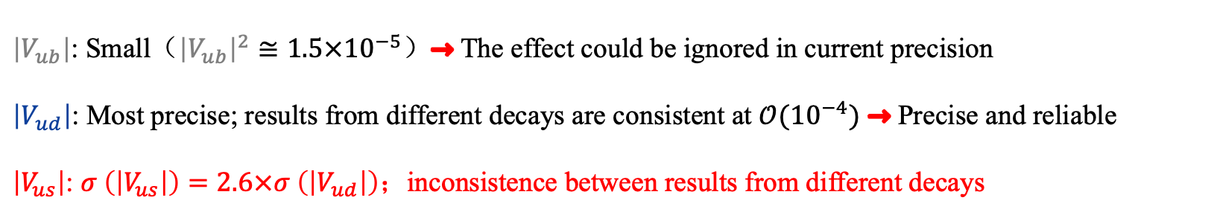








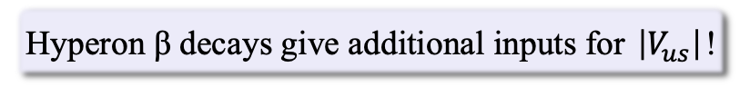
CKM Unitarity Test Anomaly：Why Is ${|V}_{us}|$ So Important?
Prelude: The Cabibbo-angle anomaly
In the SM：First-row unitarity relation
$2.3σ$ tension
PDG 2026：Independent measurements
${\left|V_{ud}\right|}^{2}+{\left|V_{us}\right|}^{2}+{\left|V_{ub}\right|}^{2}=1$
A hint of new physics?
${\left|V_{ud}\right|}^{2}+{\left|V_{us}\right|}^{2}+{\left|V_{ub}\right|}^{2}=0.9984±0.0007$
$\left|V_{ub}\right|$: Small（${\left|V_{ub}\right|}^{2}≅1.5×{10}^{−5}$）$→$ The effect could be ignored in current precision
$\left|V_{ud}\right|$: Most precise; results from different decays are consistent at $𝒪({10}^{−4})$ $→$ Precise and reliable
$\left|V_{us}\right|$: $σ \left(\left|V_{us}\right|\right)=2.6×σ \left(\left|V_{ud}\right|\right)$；inconsistence between results from different decays
PRL 92, 251803 (2004)
Most precise
Second most precise
Largest uncertainty
Kaon：2.2$σ$ tension from CKM unitarity
Tau：3.6$σ$ deviation from CKM unitarity
Hyperon：consistent with CKM unitarity
$$\left|V_{us}\right|=0.22431±0.00085$$
$$\left|V_{us}\right|=0.2208±0.0014$$
$$\left|V_{us}\right|=0.2250±0.0027$$
PDG 2026
HFLAV 2023
2.1$σ$ tension
Dominated by the $Λ→pe^{−}{\overline{ν}}_{e}$
Hyperon β decays give additional inputs for $\left|V_{us}\right|$!
Notes:
long-standing puzzle

Slide 6
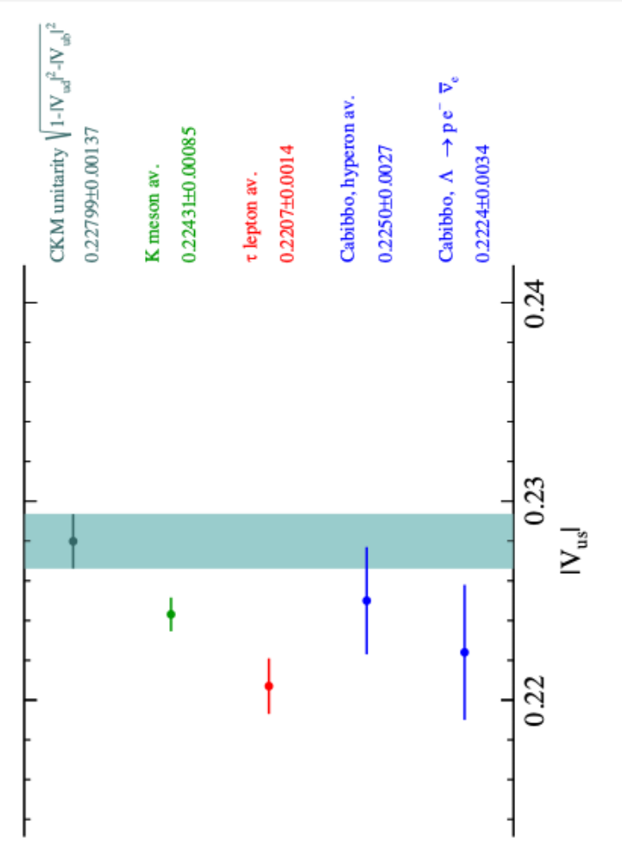


CKM Unitarity Test Anomaly：Why Is ${|V}_{us}|$ So Important?
Prelude: The Cabibbo-angle anomaly
In the SM：First-row unitarity relation
$2.3σ$ tension
PDG 2026：Independent measurements
${\left|V_{ud}\right|}^{2}+{\left|V_{us}\right|}^{2}+{\left|V_{ub}\right|}^{2}=1$
A hint of new physics?
${\left|V_{ud}\right|}^{2}+{\left|V_{us}\right|}^{2}+{\left|V_{ub}\right|}^{2}=0.9984±0.0007$
2.$2σ$ tension
$\left|V_{ub}\right|$: Small（${\left|V_{ub}\right|}^{2}≅1.5×{10}^{−5}$）$→$ The effect could be ignored in current precision
$\left|V_{ud}\right|$: Most precise; results from different decays are consistent at $𝒪({10}^{−4})$ $→$ Precise and reliable
$\left|V_{us}\right|$: $σ \left(\left|V_{us}\right|\right)=2.6×σ \left(\left|V_{ud}\right|\right)$；inconsistence between results from different decays
3.6$σ$ tension
PRL 92, 251803 (2004)
Most precise
Second most precise
Largest uncertainty
Kaon：2.2$σ$ tension from CKM unitarity
Tau：3.6$σ$ deviation from CKM unitarity
Hyperon：consistent with CKM unitarity
$$\left|V_{us}\right|=0.22431±0.00085$$
$$\left|V_{us}\right|=0.2208±0.0014$$
$$\left|V_{us}\right|=0.2250±0.0027$$
PDG 2026
HFLAV 2023
2.1$σ$ tension
Dominated by the $Λ→pe^{−}{\overline{ν}}_{e}$
Hyperon β decays give additional inputs for $\left|V_{us}\right|$!
Notes:
long-standing puzzle

Slide 7
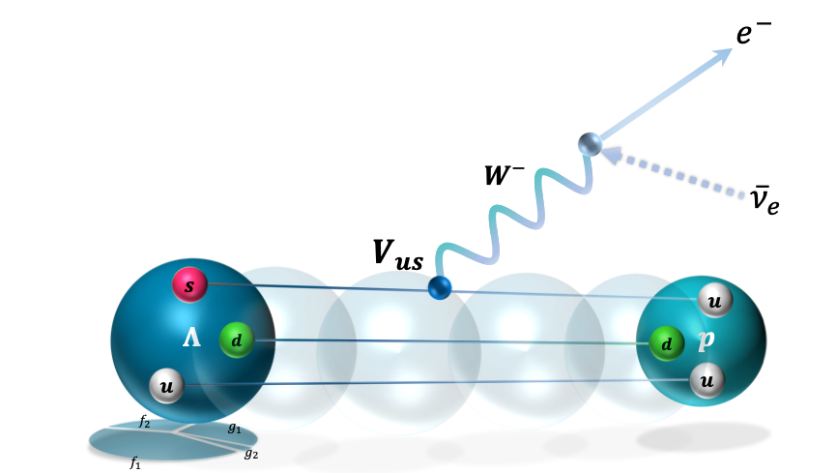
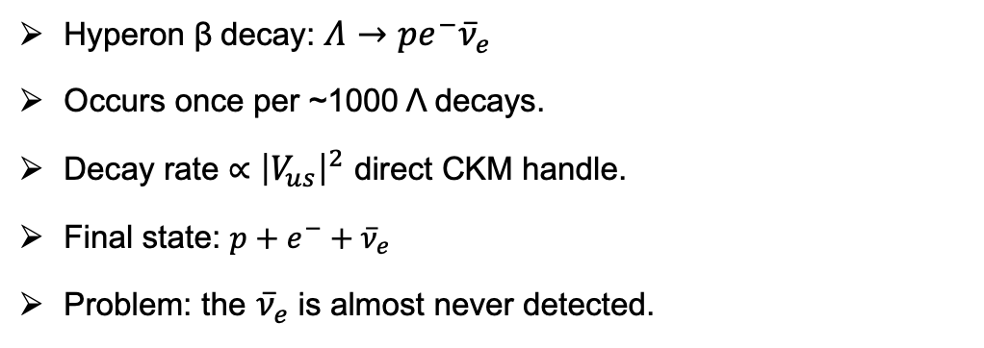
Λ Hyperon β Decay
Quark content
Λ (S = −1)
u
d
s
Λ = u + d + s, strangeness −1
Hyperon β decay: $Λ→pe^{−}{\overline{ν}}_{e}$
Occurs once per ~1000 Λ decays.
Decay rate ∝ ${\left|V_{us}\right|}^{2}$ direct CKM handle.
Final state: $p+e^{−}+{\overline{ν}}_{e}$
Problem: the ${\overline{ν}}_{e}$is almost never detected.
Branching fraction
≈ 10⁻³
once per ~1000 Λ decays
7

Slide 8

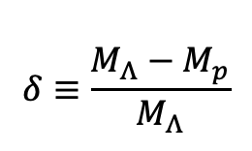
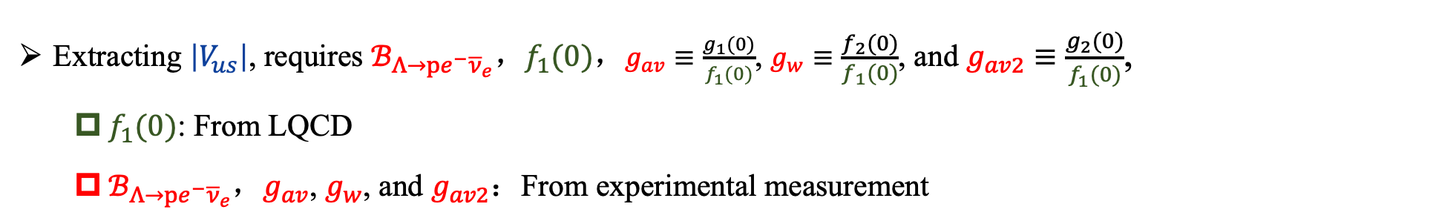
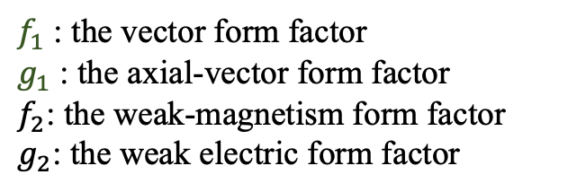
Λ Hyperon β Decay: Extraction of V_{us}
Decay width of $Λ→pe^{−}{\overline{ν}}_{e}$ in the SM
$$Γ_{SM}=\frac{ℬ_{Λ→pe^{−}{\overline{ν}}_{e}}}{τ_{Λ}} =\frac{G_{F}^{2}{\left|V_{us}\right|}^{2}f_{1}{\left(0\right)}^{2}Δ^{5}}{60π^{3}}[(1−\frac{3}{2}δ+\frac{6}{7}δ^{2})+\frac{4}{7}δ^{2}g_{w}^{2}$$
PRD 70, 114036 (2004)
$$Δ≡M_{Λ}−M_{p}$$
$$δ≡\frac{M_{Λ}−M_{p}}{M_{Λ}}$$
$$+\left(3−\frac{9}{2}δ+\frac{12}{7}δ^{2}\right)g_{av}^{2}+\frac{12}{7}δ^{2}g_{av2}^{2}+\frac{6}{7}δ^{2}g_{w}+(−4δ+6δ^{2})g_{av}g_{av2}]$$
Extracting $\left|V_{us}\right|$, requires $ℬ_{Λ→pe^{−}{\overline{ν}}_{e}}$，$f_{1}(0)$，$g_{av}≡\frac{g_{1}(0)}{f_{1}(0)}$, $g_{w}≡\frac{f_{2}(0)}{f_{1}(0)}$, and $g_{av2}≡\frac{g_{2}(0)}{f_{1}(0)}$,
  $f_{1}(0)$: From LQCD
  $ℬ_{Λ→pe^{−}{\overline{ν}}_{e}}$，$g_{av}$, $g_{w}$, and $g_{av2}$：From experimental measurement
PRL 114, 161802 (2015)
$f_{1}$ : the vector form factor
$g_{1}$ : the axial-vector form factor
$f_{2}$: the weak-magnetism form factor
$g_{2}$: the weak electric form factor
Notes:
The Ademollo-Gatto theorem suggests an analytic approach to the available data that first examines the vector form factor f_1 because it is not subject to first-order SU(3) symmetry-breaking effects.
𝑓_3 为标量（scalar）形状因子、𝑔_3 为赝标量（pseudo-scalar）形状因子
矢量形状因子是和SU(3)对称性破坏无关的量， 可以被LQCD计算！
dDelta是微分截面随着角分布的变化形式。可以通过角分布分析直接抽取形状因子！
sigma_Lambda^sl(), a_{Lambda}^{sl}, I_{Lambda}^{sl}是g_av^{\Lambda}和g_w^{\Lambda}的函数

Slide 9
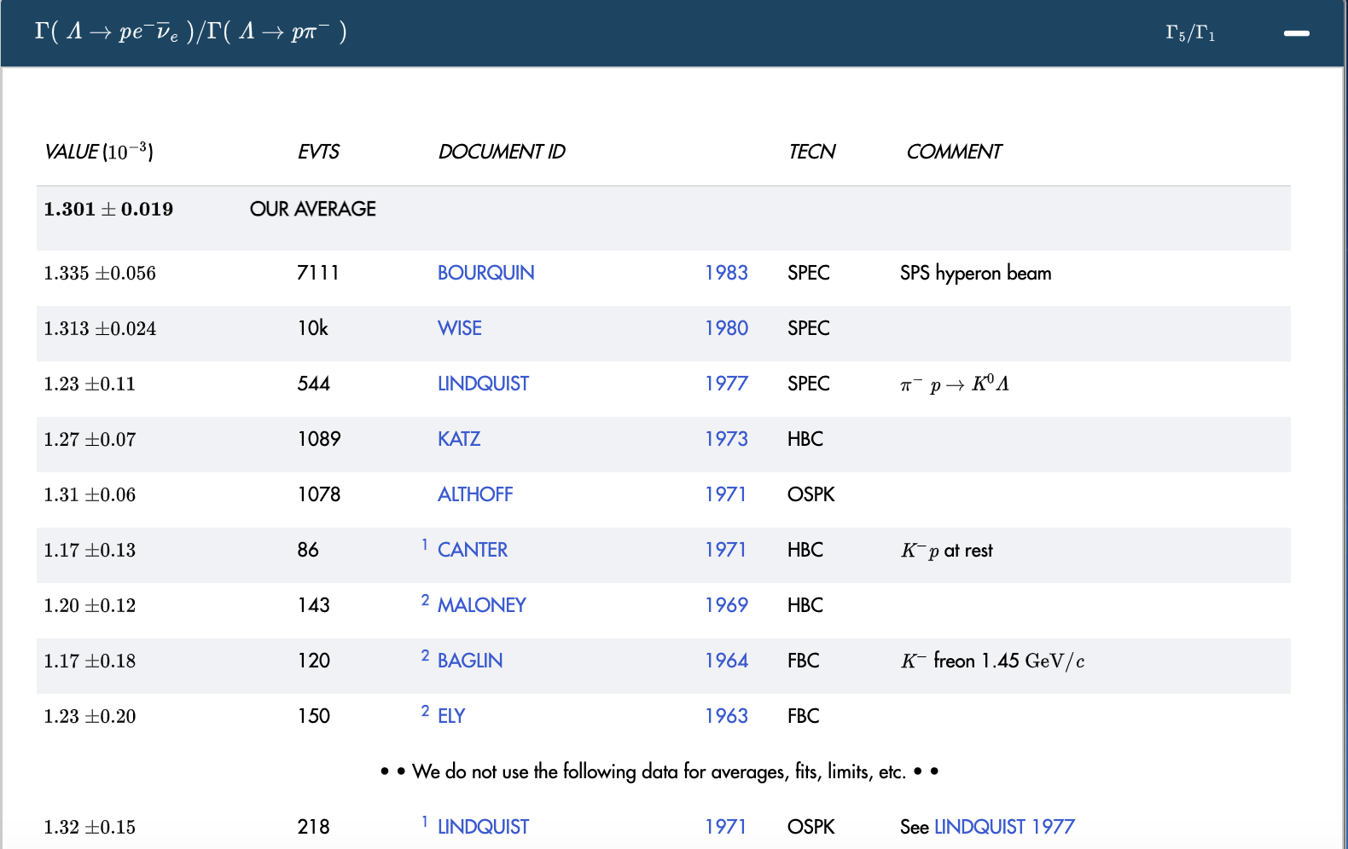

Λ Hyperon β Decay: Current status of $𝓑_{Λ→pe^{−}{\overline{ν}}_{e}}$
PDG 2026
PDG 2024
Only relative BF
Old results (>40 years)
Only fixed target experiment

Slide 10
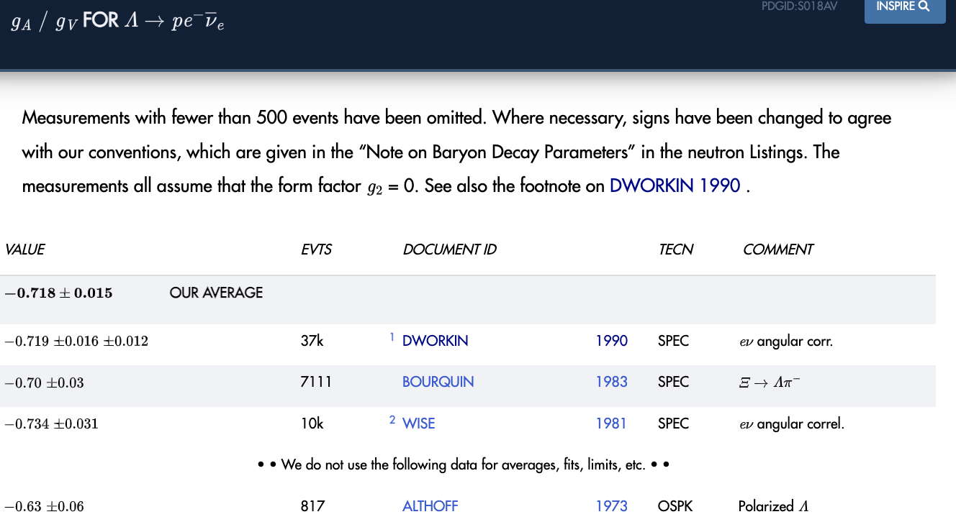

Λ Hyperon β Decay: Current status of $g_{av}$
PDG 2024
PDG 2026
All assume $g_{2}\left(i.e. g_{av2}\right)=0$
Old results (>30 years)
Only fixed target experiment

Slide 11
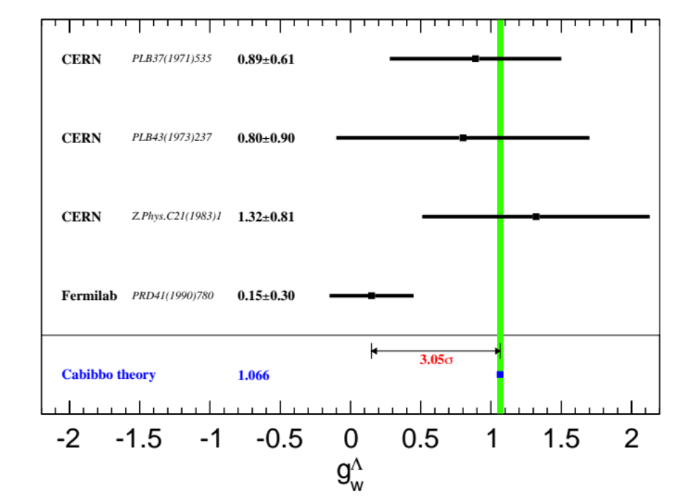
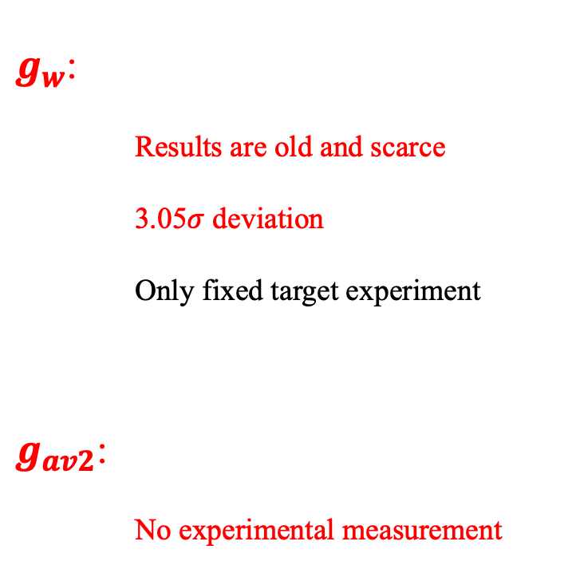
Λ Hyperon β Decay: Current status of $g_{w}$, and $g_{av2}$
$g_{w}$:
    Results are old and scarce
    3.05$σ$ deviation
    Only fixed target experiment
$g_{av2}$:
    No experimental measurement

Slide 12
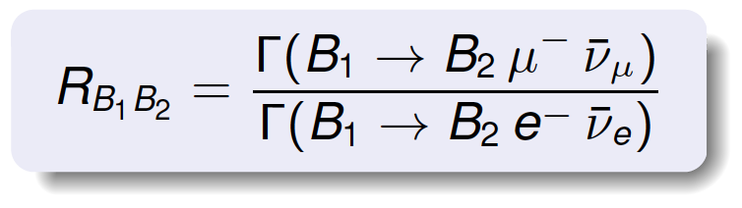
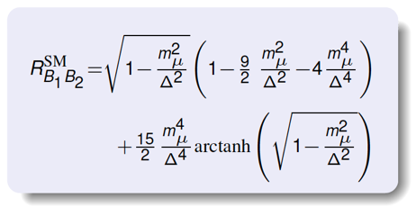

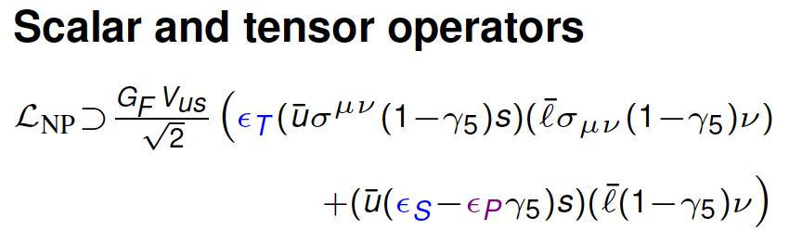
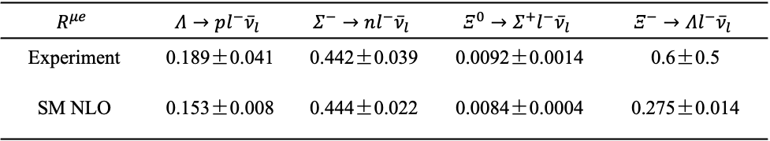
Λ Hyperon β Decay: The lepton-universality Test
$$R^{μe}$$ | $$Λ→pl^{−}{\overline{ν}}_{l}$$ | $$Σ^{−}→nl^{−}{\overline{ν}}_{l}$$ | $$Ξ^{0}→Σ^{+}l^{−}{\overline{ν}}_{l}$$ | $$Ξ^{−}→Λl^{−}{\overline{ν}}_{l}$$
Experiment | 0.189±0.041 | 0.442±0.039 | 0.0092±0.0014 | 0.6±0.5
SM NLO | 0.153±0.008 | 0.444±0.022 | 0.0084±0.0004 | 0.275±0.014
PRL 114, 161802(2015)
Notes:
我们知道，轻子普适性是标准模型的一个假设，同样的，我们也可以通过比较超子的电子道和muon子道的半轻衰变分支比来检验轻子普适性！
在标准模型中，这两个分支比的比值只和这两个过程的相空间大小有关，而和形状因子无关。这篇15年的PRL文章分别计算了次领头阶下不同过程的R的理论值。并和实验结果进行了比较。
Delta = M_B1 – M_B2
注：LHC上看到了一个可能是新物理贡献的事例，但是和预期本底事例一致，因此只给了一个新物理贡献的上限。(PRL 114, 161802(2015))(LHC bounds obtained from CMS data at 8 TeV (7 TeV) are represented by the black solid (dashed) ellipse.)

Slide 13
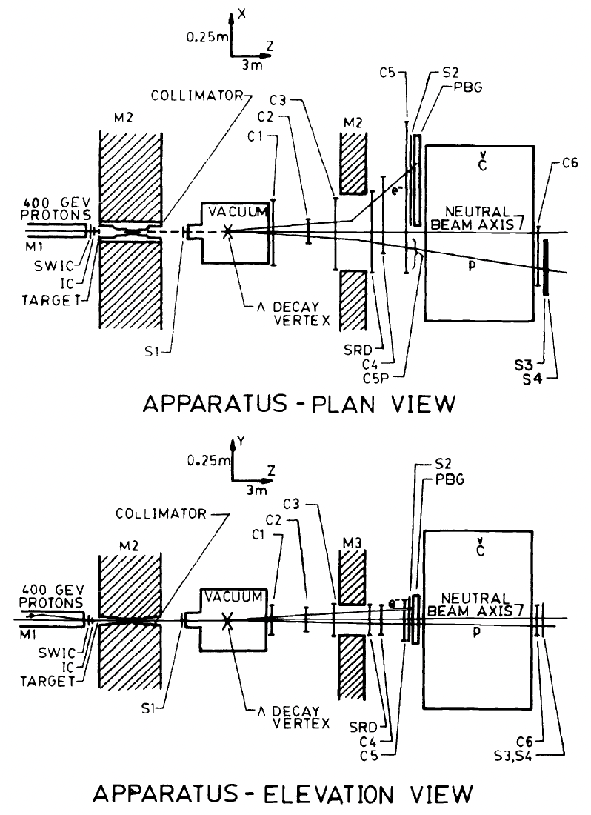

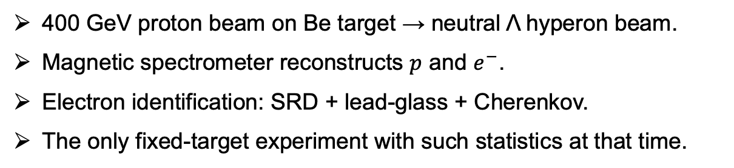
Fermilab 1990: Experiment & Data Sample
Neutral hyperon beam apparatus (plan view, schematic)
400 GeV p
decay region
(Λ beam)
Be target
Magnet
SRD
Pb
glass
Cherenkov
$$Λ→pe^{−}{\overline{ν}}_{e}$$
MWPC
MWPC
MWPC
400 GeV proton beam on Be target → neutral Λ hyperon beam.
Magnetic spectrometer reconstructs $p$ and $e^{−}$.
Electron identification: SRD + lead-glass + Cherenkov.
The only fixed-target experiment with such statistics at that time.
J. Dworkin et al., Phys. Rev. D 41, 780 (1990)
37,286 Λ hyperon β decays
13

Slide 14
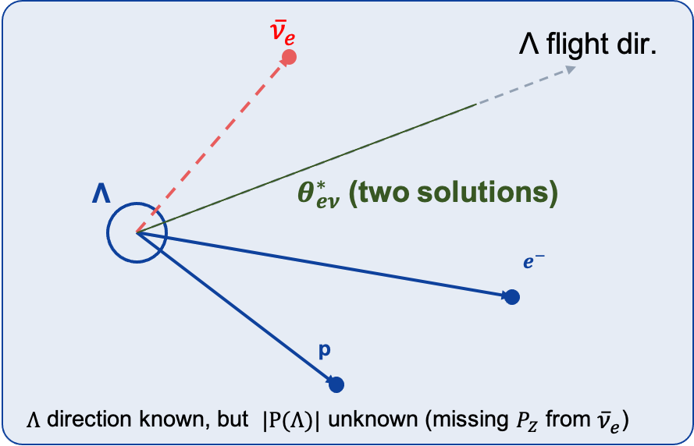
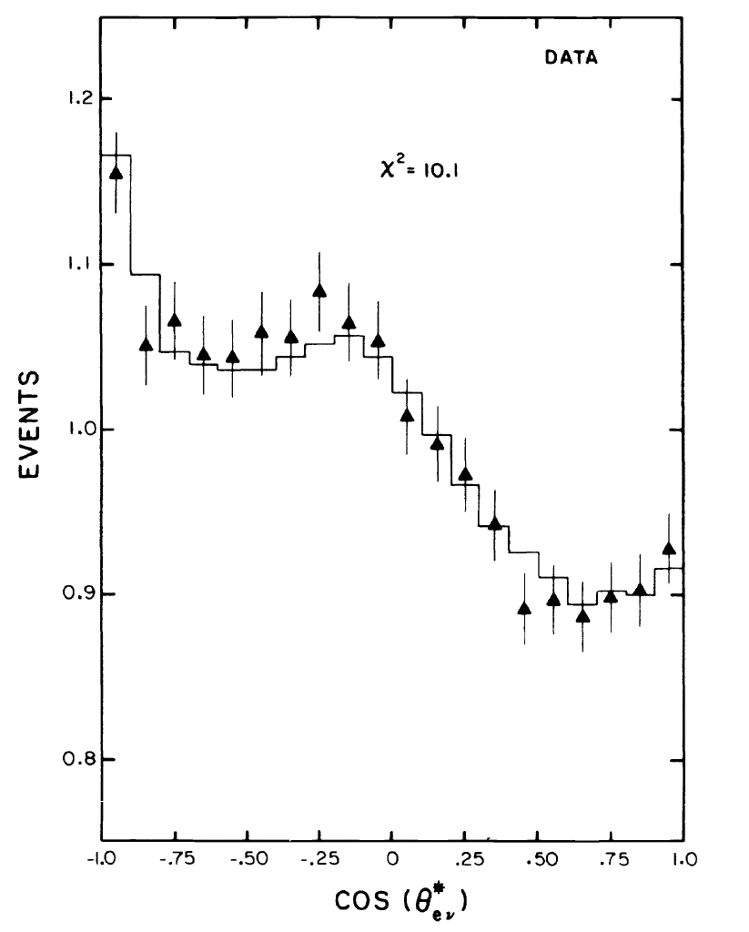
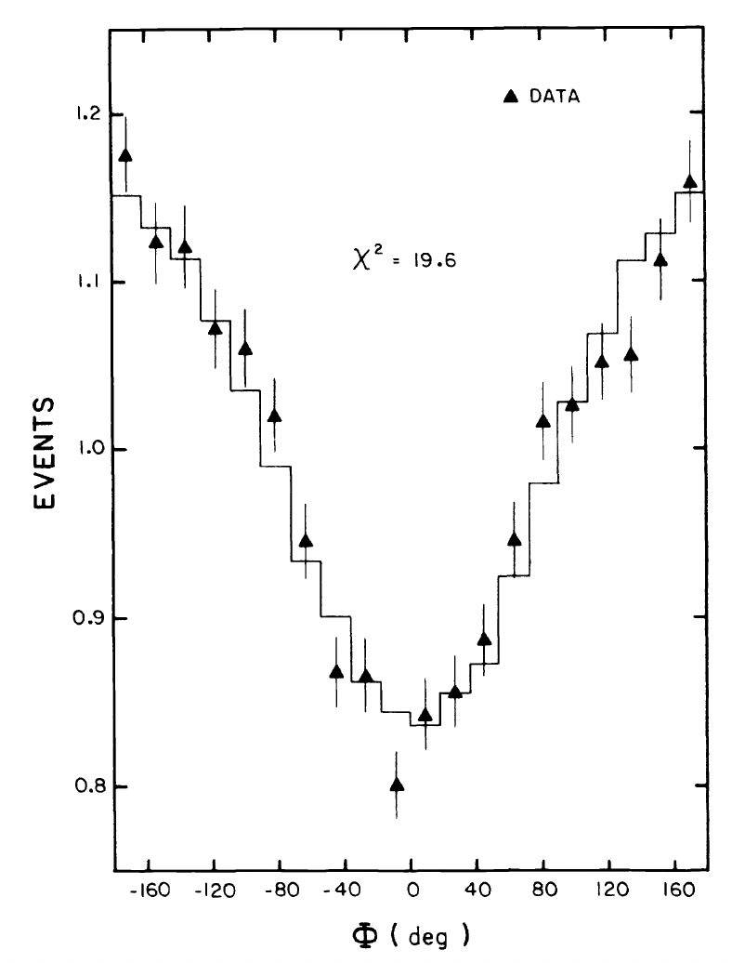
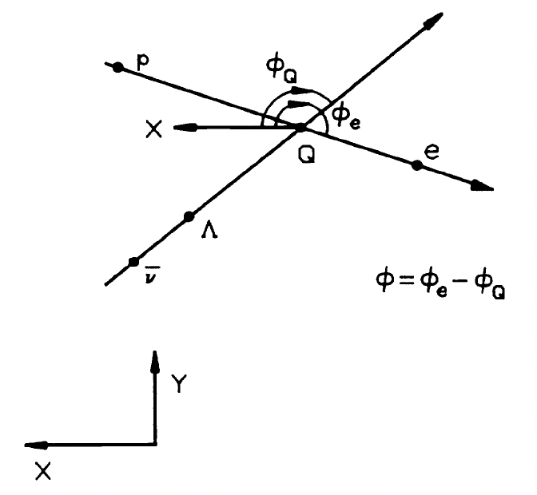
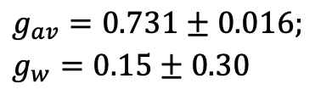
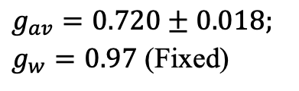

Fermilab 1990: Two method & limitations
1D Fit
1D Fit
Standard ${cosθ}_{eν}^{∗}$ analysis
New Φ analysis
$$g_{av}=0.720±0.018;$$
$g_{w}=0.97$ (Fixed)
$$g_{av}=0.731±0.016;$$
$$g_{w}=0.15±0.30$$
14

Slide 15
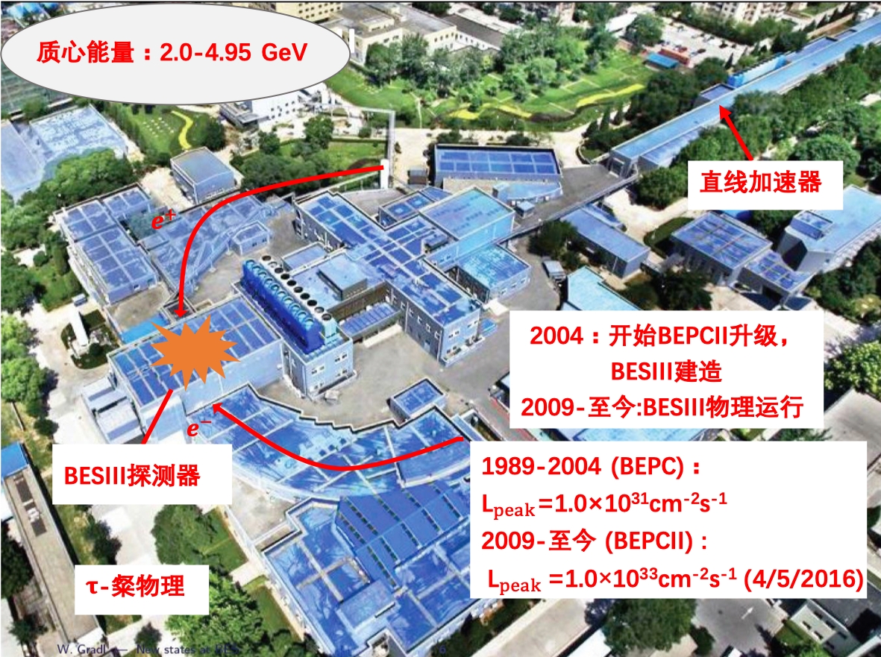
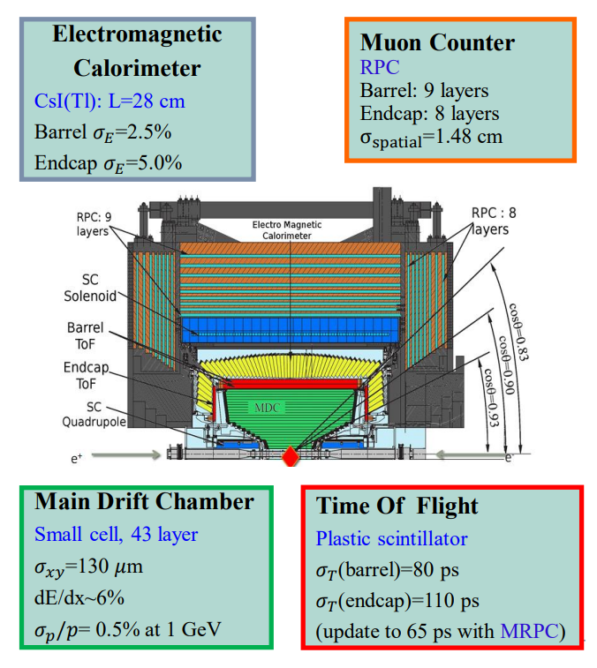
BEPCII and BESIII
Reached E_{cm}=4.95 GeV in Jan. 2021
1989-2004 (BEPC):
L_{peak}=1.0x10³¹/cm²s
2009-now (BEPCII):
L_{peak}=1.1x10³³/cm²s (2022、2023)

Slide 16
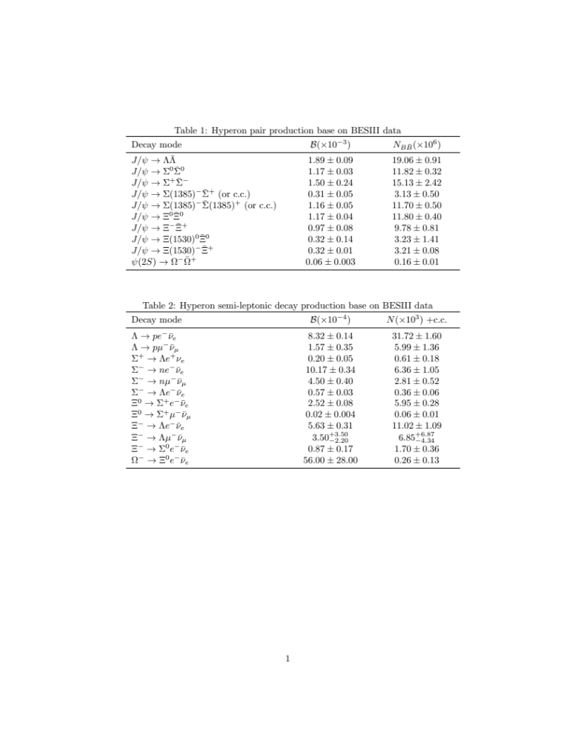



Why Hyperon Physics at BESIII?
Hyperon pair production
10 billion $J/ψ$, 3 billion $ψ(2S)$
Large datasets of hyperon pair
Double tag method
Large BFs in $J/ψ$, $ψ(2S)$ decays
Advantage of double tag method:
  Absolute BF
  Low background
  Cancel systematic uncertainties
Quantum correlated polarized-hyperon factories (BESIII&STCF)
4-momentum conservation
Full event information!
Higher single-event sensitivity!
Known initial 4-momentum
Information of the neutrino
16

Slide 17
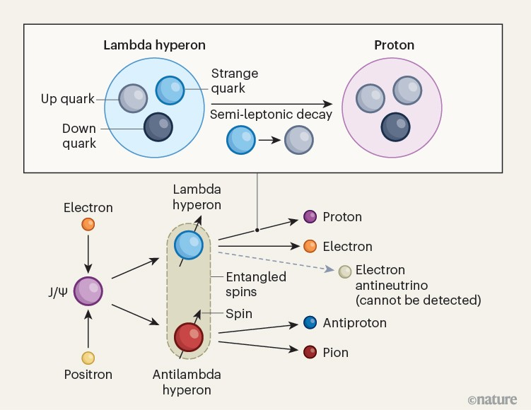
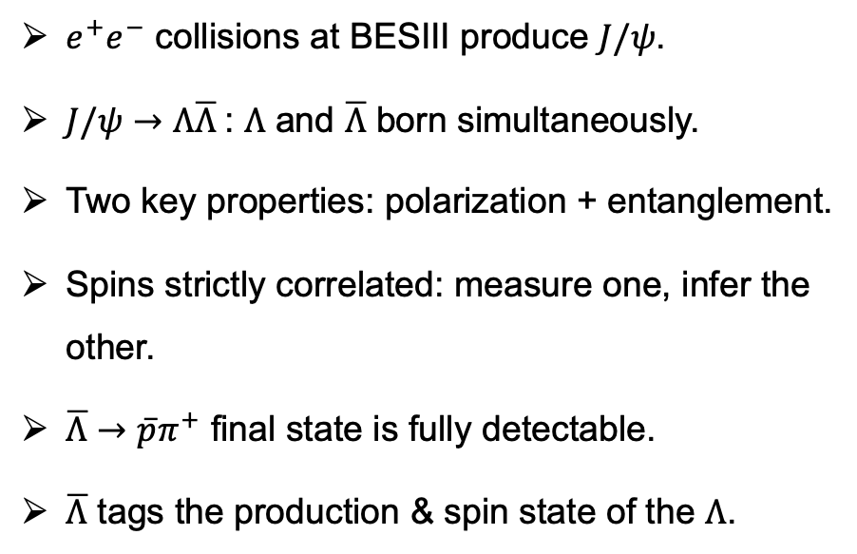
Quantum Entanglement as a Measurement Tool
$e^{+}e^{−}$ collisions at BESIII produce $J/ψ$.
$J/ψ→Λ\overline{Λ}$: $Λ$ and $\overline{Λ}$ born simultaneously.
Two key properties: polarization + entanglement.
Spins strictly correlated: measure one, infer the other.
$\overline{Λ}→\overline{p}π^{+}$ final state is fully detectable.
$\overline{Λ}$ tags the production & spin state of the $Λ$.
Nature 657, 42-44 (2026)
17

Slide 18
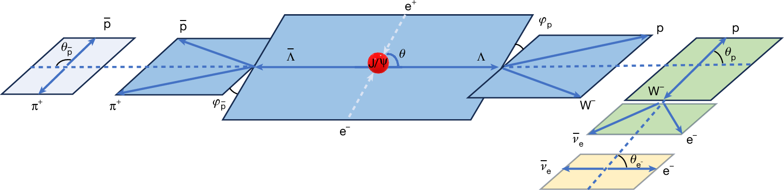
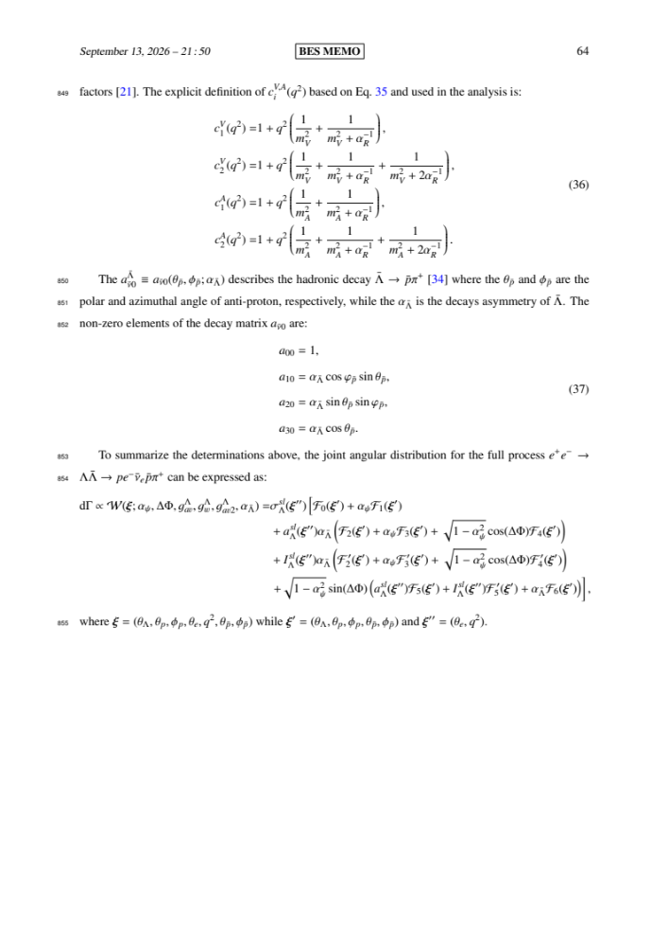

Quantum Entanglement as a Measurement Tool
Unpolarized part
Varvara et al, Phys. Rev. D 108, 016011 (2023)
Entangled part
Polarized part
$g_{av}^{Λ}$, $g_{w}^{Λ}$, and $g_{av2}^{Λ}$ are included in $a_{Λ}^{sl}$ and $I_{Λ}^{sl}$.
All the form factors are include in both of the entangled part and polarized part.
Entanglement and polarization information can be used to constrain form factors. In other words,
incorporating entanglement and polarization information can improve the single-event sensitivity of form factor measurements.
18
Notes:
The Ademollo-Gatto theorem suggests an analytic approach to the available data that first examines the vector form factor f_1 because it is not subject to first-order SU(3) symmetry-breaking effects.
矢量形状因子是和SU(3)对称性破坏无关的量， 可以被LQCD计算！
dDelta是微分衰变宽度随着角分布的变化形式。可以通过角分布分析直接抽取形状因子！
α_Jpsi 和ΔΦ分别是Jpsi产生的非对称参数和Lambda Lambda-bar的产生相对相位；α_lambda-bar is decays asymmetry of Λ-bar

Slide 19
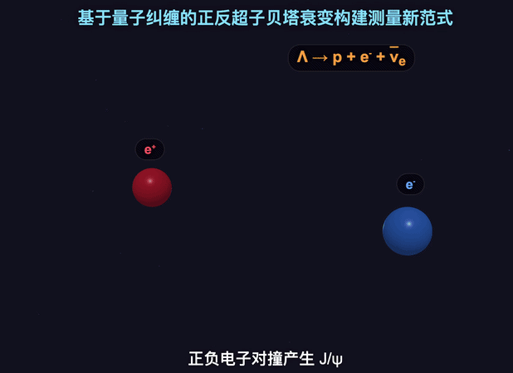

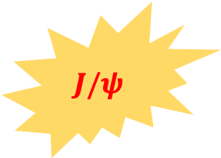








Exploring baryon semileptonic decays through polarization and entanglement
$$\overline{p}$$
$$\overline{Λ}$$
Tag
$$π^{+}$$
$$J/ψ$$
$$e^{+}$$
$$e^{−}$$
Signal
$$Λ$$
$$p$$
$$l^{−}$$
$${\overline{ν}}_{l}$$

Slide 20
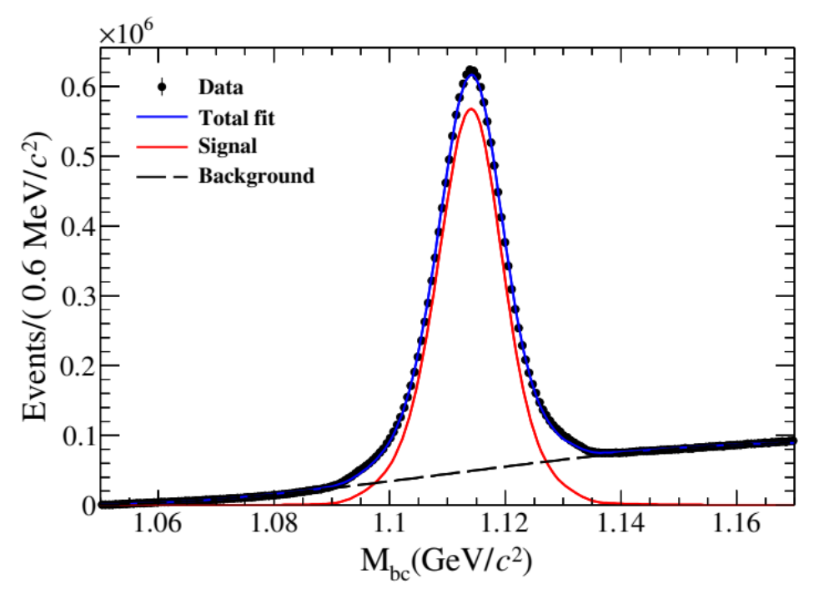
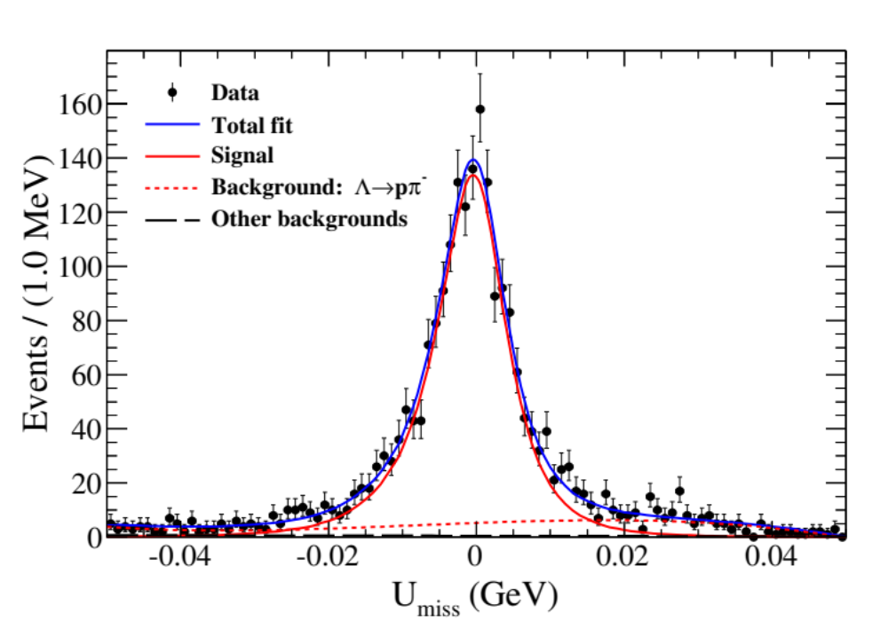
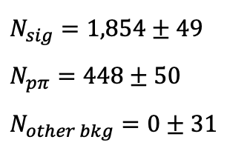

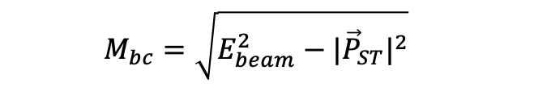

First absolute BF measurement of $Λ→pe^{−}{\overline{ν}}_{e}$
$$N_{sig}=1,854±49$$
$$N_{pπ}=448±50$$
$$N_{other bkg}=0±31$$
$$M_{bc}=\sqrt{E_{beam}^{2}−{|{\vec{P}}_{ST}|}^{2}}$$
$$U_{miss}≡E_{miss}−c|{\vec{P}}_{miss}|$$
$$N_{tag}=14,327,900±4,824$$
First absolute BF measurement
BESIII: Nature 657, 92 – 97 (2026)
$$ℬ\left(Λ→pe^{−}{\overline{ν}}_{e}\right)=(8.16±0.22±0.15)×{10}^{−4}$$

Slide 21
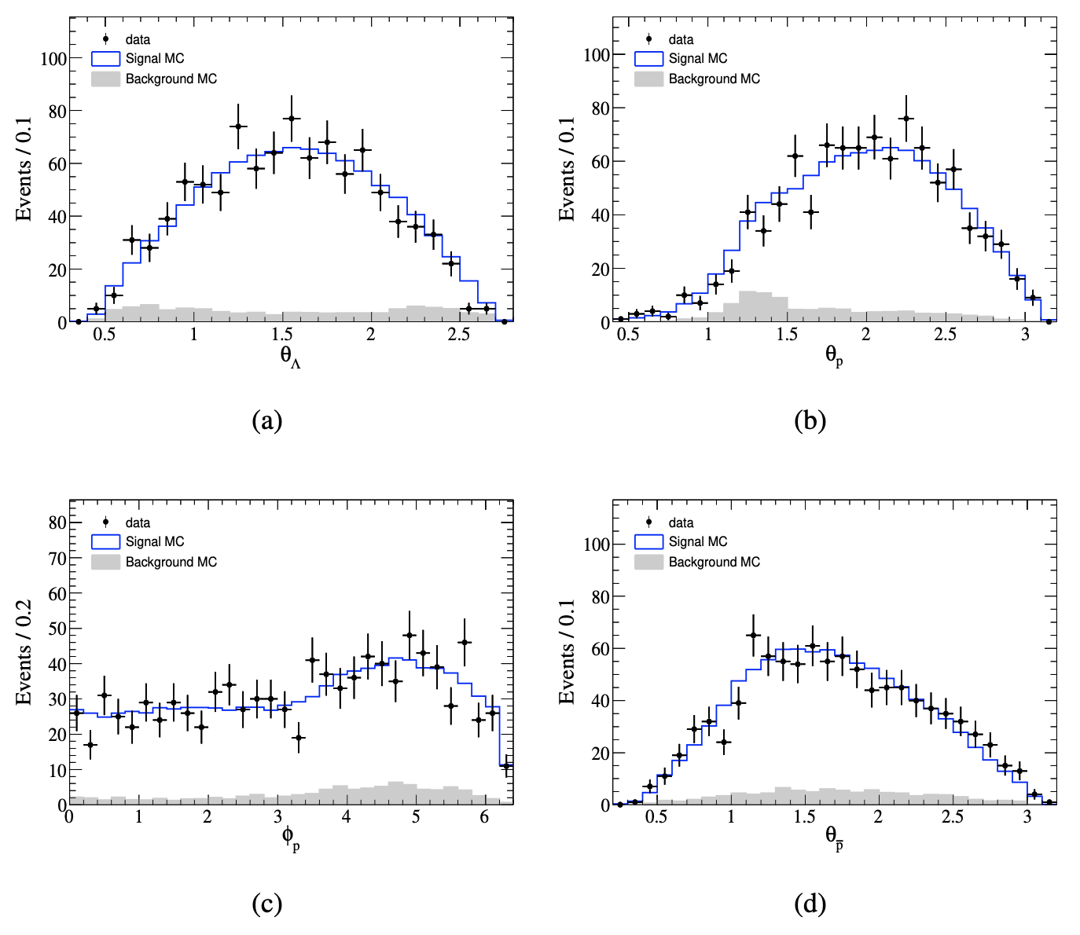
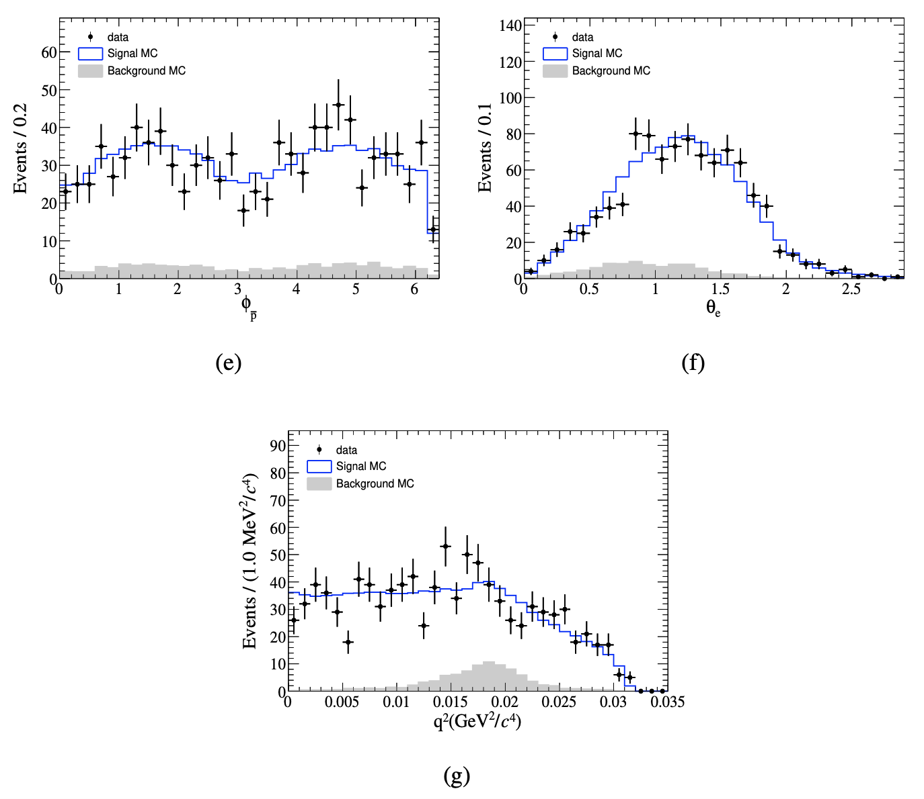







Determination of form factors from 7-D fit
$θ_{Λ}$ distribution
$θ_{p}$ distribution
$φ_{\overline{p}}$ distribution
$θ_{e}$ distribution
$φ_{p}$ distribution
$θ_{\overline{p}}$ distribution
$q^{2}$ distribution
Notes:
The Ademollo-Gatto theorem suggests an analytic approach to the available data that first examines the vector form factor f_1 because it is not subject to first-order SU(3) symmetry-breaking effects.
矢量形状因子是和SU(3)对称性破坏无关的量， 可以被LQCD计算！
dDelta是微分截面随着角分布的变化形式。可以通过角分布分析直接抽取形状因子！
sigma_Lambda^sl(), a_{Lambda}^{sl}, I_{Lambda}^{sl}是g_av^{\Lambda}和g_w^{\Lambda}的函数

Slide 22
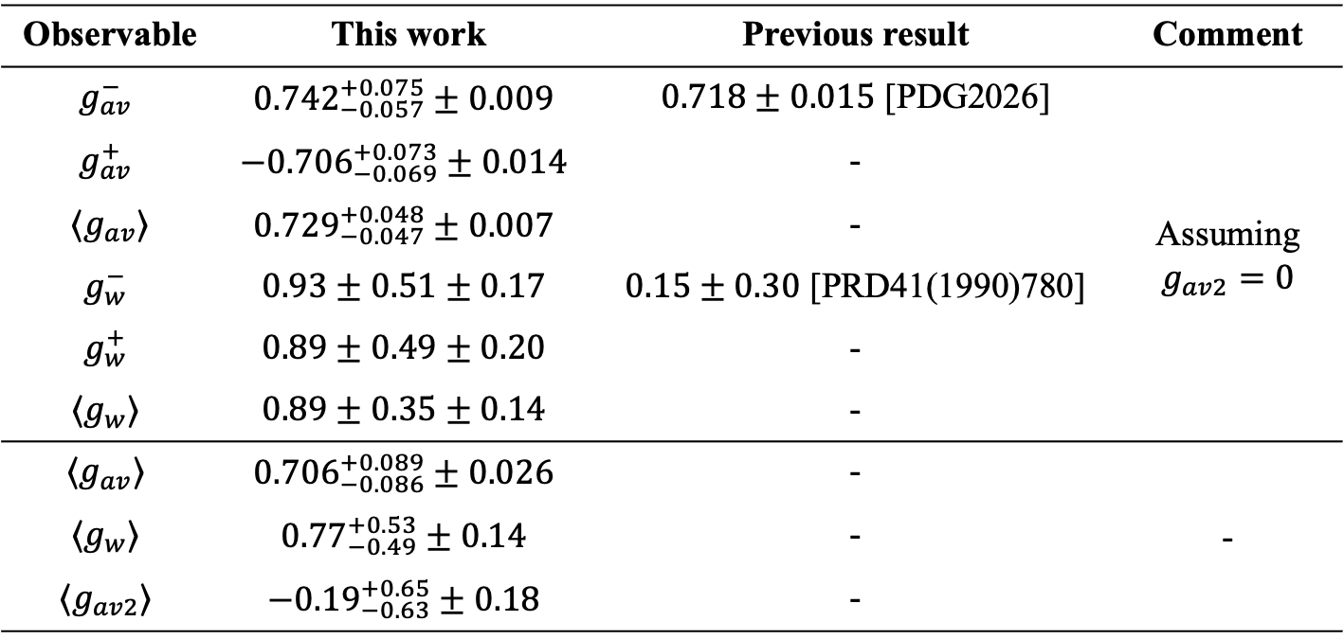
Determination of form factors of $Λ→pe^{−}{\overline{ν}}_{e}$
For the first time, the weak-electricity coupling parameter in Λ β decay and the form factors describing the internal structure of the anti-Λ were measured (see table below).
Observable | This work | Previous result | Comment
$$g_{av}^{−}$$ | $${0.742}_{−0.057}^{+0.075}±0.009$$ | $0.718±0.015$ [PDG2026] | Assuming $$g_{av2}=0$$
$$g_{av}^{+}$$ | $${−0.706}_{−0.069}^{+0.073}±0.014$$ | -
$⟨g_{av}⟩$ | $${0.729}_{−0.047}^{+0.048}±0.007$$ | -
$$g_{w}^{−}$$ | $$0.93±0.51±0.17$$ | $0.15±0.30$ [PRD41(1990)780]
$$g_{w}^{+}$$ | $$0.89±0.49±0.20$$ | -
$$⟨g_{w}⟩$$ | $$0.89±0.35±0.14$$ | -
$$⟨g_{av}⟩$$ | $${0.706}_{−0.086}^{+0.089}±0.026$$ | - | -
$$⟨g_{w}⟩$$ | $${0.77}_{−0.49}^{+0.53}±0.14$$ | -
$$⟨g_{av2}⟩$$ | $${−0.19}_{−0.63}^{+0.65}±0.18$$ | -
BESIII: Nature 657, 92 – 97 (2026)

Slide 23



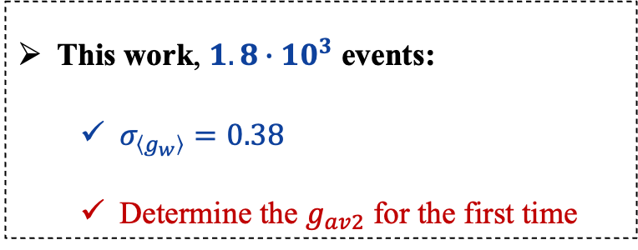
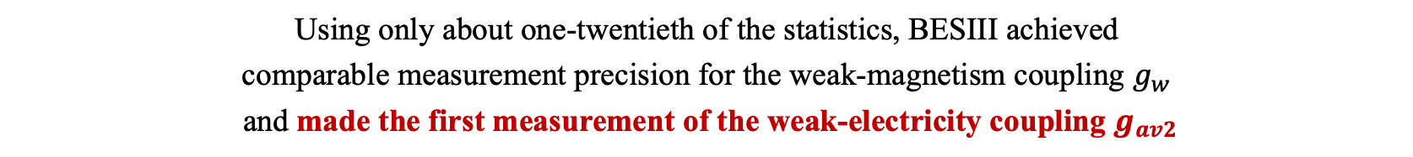
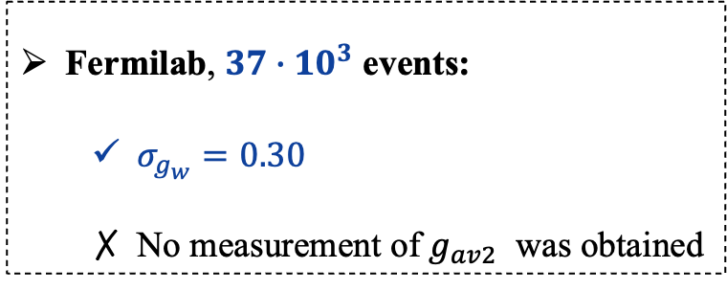
Determination of form factors of $Λ→pe^{−}{\overline{ν}}_{e}$
Nature 657, 92–97 (2026)
Phys. Rev. D 41, 780 (1990)
This work, $1.8∙{10}^{3}$ events:
  $σ_{\left\langle g_{w}\right\rangle }=0.38$
  Determine the $g_{av2}$ for the first time
Fermilab, $37∙{10}^{3}$ events:
  $σ_{g_{w}}=0.30$
  No measurement of $g_{av2}$ was obtained
First exploitation of polarization and quantum entanglement in baryon β decays
First usage of joint angular-distribution fit hyperon β dacyas
Using only about one-twentieth of the statistics, BESIII achieved
comparable measurement precision for the weak-magnetism coupling $g_{w}$
and made the first measurement of the weak-electricity coupling $g_{av2}$
The innovative methodology significantly enhances the single-event sensitivity

Slide 24
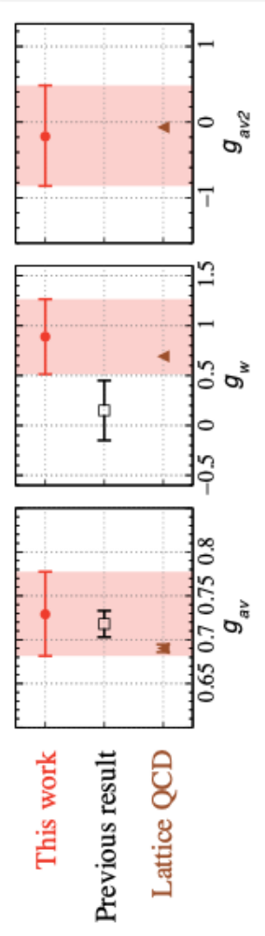

Comparison of measured form factors with LQCD
Observable | This work <$g_{i}$>, $i=\left\{av, w, av2\right\}$ | Previous result | LQCD (PRL 135, 231901 (2025))
$g_{av}$ | $${0.729}_{−0.047}^{+0.048}±0.007$$ | $0.718±0.015$ [PDG2026] | $$\text{0.6902}±0.0044$$
$$g_{w}$$ | $$0.89±0.35±0.14$$ | $0.15±0.30$ [PRD41(1990)780] | $$0.693±0.017$$
$$g_{av2}$$ | $${−0.19}_{−0.63}^{+0.65}±0.18$$ | - | $$\text{−0.069}±0.016$$

Slide 25





Extraction of $|V_{us}|$ from $Λ→pe^{−}{\overline{ν}}_{e}$
Assume SU(3) is conserved, $f_{1}=\sqrt{3/2}$ [PRL92(2004)251803]
Using LQCD FF prediction [PRL135(2025)231901]
$${\left|V_{us}\right|}_{SU\left(3\right)}=0.2194±0.0094$$
$${\left|V_{us}\right|}_{LQCD}=0.2339±0.0041$$
2.$2σ$ tension
3.6$σ$ tension
LQCD based value consistent with unitarity at 1.4σ.
≈ 2σ above the Cabibbo world-average extraction.
BESIII: Nature 657, 92 – 97 (2026)
Quantum-entangled hyperons open a new route to testing the Standard Model CKM unitarity.

Slide 26

Impact of LQCD Calculations on $|V_{us}|$Measurement Precision
Impact of LQCD Calculations on $|V_{us}|$Measurement Precision
LQCD calculation：PRL 135, 231901 (2025)
BESIII measurement, Nature 657, 92 – 97 (2026)
Before LQCD Publication
After LQCD Publication
$${\left|V_{us}\right|}_{SU\left(3\right)}=0.2190±0.0094$$
Total uncertainty $↓$ ~56%
$${\left|V_{us}\right|}_{LQCD}=0.2339±0.0041$$
Form factor uncertainty $↓$ ~87%
Reduced Uncertainty：
LQCD form factor: ±0.0011
Dominant Uncertainty ：
BESIII form factor: ±0.0087
LQCD improves the precision of $|V_{us}|$ by more than twofold, reducing the total uncertainty from 0.0094 to 0.0041
Theoretical inputs are so important!

Slide 27

Model-Independent Constraint
$$\left|V_{us}\right|∙\sqrt{f_{1}^{2}+3g_{1}^{2}}=0.4496±0.0061±0.0041±0.0009±0.0011$$
BESIII BF_{stat}
±0.0061
BESIII BF_{syst}
±0.0041
$$τ_{Λ}$$
±0.0009
RC
±0.0011
Theory-input-free product.
Stringent test of the theoretical description of baryon β decays.
First such determination in any baryon β decay.
Benchmark for lattice QCD & symmetry-based form factors.
Assume $g_{av2}$ = 0 and neglecting the $δ^{2}$term contribution

Slide 28



Nature News & Views
Original Article Basic Info
Original Text Excerpt
Nature 657, 42-44 (2026)
Matt Kenzie
Professor from University of Cambridge
Subgroup convener of the HFLAV
Core member of the PDG
" … opens up a credible path … giving physicists a long-sought independent check on one of the load-bearing walls of the standard model. "
Notes:
这开辟了一条可信途径：基于超子测量Vus，且精度能与黄金过程K介子衰变相媲美——从而为物理学家提供了一种长期以来梦寐以求的独立检验手段，用以检验标准模型的一根承重墙。

Slide 29








Methodology
$$\overline{p}$$
$$π^{+}$$
Tag
First experiment use of entanglement + polarization to extract $|V_{us}|$.
“Spooky action at a distance” → measurement tool.
Single-event sensitivity greatly enhanced.
Methodological blueprint for future colliders (e.g., STCF).
Entanglement: from quantum information to particle physics information.
$$\overline{Λ}$$
Measure one → infer the other
$${\overline{ν}}_{e}$$
$$Λ$$
$$e^{−}$$
$$p$$
Notes:
利用幽灵般的相互作用-量子纠缠作为工具，提高单事例灵敏度

Slide 30






Systematic Research Program
Method extends to $Ξ$, $Ω$ semileptonic decays.
A new, systematic research program on baryon semileptonic decays
Aim: precision comparable to kaon decays.
Stringent, independent tests of the Standard Model.
Target decay channels
$$Λ→pe^{−}{\overline{ν}}_{e}$$
BESIII Collaboration,
Nature 657, 92-97 (2026)
$$Ξ^{−}→Λe^{−}{\overline{ν}}_{e}$$
BESIII Collaboration,
PRL 137, 091801 (2026)
$$Ω^{−}→Ξ^{0}e^{−}{\overline{ν}}_{e}$$
Next
$$Ξ^{0}→Σ^{+}e^{−}{\overline{ν}}_{e}$$
Next
Roadmap
BESIII Nature (2026) → first $Λ$ result
STCF era (2030s) → statistics ×10–100
Full baryon program → CKM precision frontier
Charm baryon semileptonic
decays and so on
Future

Slide 31

Study of the Hyperon β Decay $Ξ^{−}→Λe^{−}{\overline{ν}}_{e}$
Before our measurement, the experimental information comes only from fixed-target experiments which were performed about 40 years ago.
All these previous branching fraction results are relative.

Slide 32
















Study of the Hyperon β Decay $Ξ^{−}→Λe^{−}{\overline{ν}}_{e}$
$$\overline{p}$$
BESIII: PRL 137, 091801 (2026)
$$M_{rec}≡\sqrt{{\left(E_{CM}−E_{\overline{Λ}π^{+}}\right)}^{2}−{|{\vec{P}}_{\overline{Λ}π^{+}}|}^{2}}$$
$$\overline{Λ}$$
$$π^{+}$$
$${\overline{Ξ}}^{+}$$
Tag
$$π^{+}$$
$$J/ψ$$
$$e^{+}$$
$$e^{−}$$
Single tag ${\overline{Ξ}}^{+}$
Single tag $Ξ^{−}$
Signal
$$p$$
$$Ξ^{−}$$
$$Λ$$
$$e^{−}$$
$${\overline{ν}}_{e}$$
$$N_{ST}=2, 069, 500±1,800(stat)$$
$$N_{ST}=2, 157, 600±1,900(stat)$$
$$π^{−}$$

Slide 33


First absolute BF measurement of $Ξ^{−}→Λe^{−}{\overline{ν}}_{e}$
BESIII: PRL 137, 091801 (2026)

Slide 34


Determination of form factors of $Ξ^{−}→Λe^{−}{\overline{ν}}_{e}$
Exploitation of polarization and quantum entanglement.
Usage of joint angular-distribution fit method.
BESIII: PRL 137, 091801 (2026)

Slide 35


Summary of the Results for $Ξ^{−}→Λe^{−}{\overline{ν}}_{e}$
The axial-vector to vector coupling:
$$g_{av}=0.18±{0.07}_{stat.}±{0.01}_{syst.}$$
A comparable precision achieved with 1/20 data size
Taking $f_{1}=\sqrt{3/2}$ , the axial charge of the Ξ⁻:
$$g_{A}^{H}=g_{av}×f_{1} =0.22±{0.08}_{stat.}±{0.02}_{syst.}$$
Updated for the first time in over 40 years
The absolute BF is lower than the PDG value by 3.9σ
$g_{av}$is consistent with the previous result and in good agreement with prediction of chiral perturbation theory
BESIII: PRL 137, 091801 (2026)

Slide 36


First absolute BF measurement of $Λ→pμ^{−}{\overline{ν}}_{μ}$
Before our measurement, the experimental information comes only from fixed-target experiments^{[1-4]} which were performed about 50 years ago.
All these previous branching fraction results are relative with huge uncertainty.
The best previous result was obtained based on only 14 events that are selected from about 0.6M bubble chamber pictures.
[1] Phys. Lett. 11, 357 (1964)
[2] Stern, Phys. Rev. 135, B1483 (1964)
[3] Phys. Rev. Lett. 27, 59 (1971)
[4] Zeitschrift fu¨r Physik A Hadrons and nuclei 252,362 (1972)

Slide 37




Double Tag method
$$N_{tag}=2N_{Λ\overline{Λ}}ℬ_{tag}ε_{tag}$$
Advantage:
  Absolute BF
  Low background
  Cancel the systematic uncertainties in tag side
$$\overline{p}$$
$$N_{sig}=2N_{Λ\overline{Λ}}ℬ_{tag}ℬ_{sig}ε_{tag,sig}$$
$$\overline{Λ}$$
$$ℬ_{sig}=\frac{N_{sig}/ε_{tag,sig}}{N_{tag}/ε_{tag}}$$
Tag
$$π^{+}$$
$N_{Λ\overline{Λ}}$: the number of $Λ\overline{Λ}$ pairs
$ℬ_{tag}$: branching fraction of $\overline{Λ}→\overline{p}π^{+}$
$ℬ_{sig}$: branching fraction of $Λ→pl^{−}{\overline{ν}}_{l}$
$N_{tag}$: ST yield
$N_{sig}$: DT yield
$ε_{tag}$: ST efficiency
$ε_{tag,sig}$: DT efficiency
$$J/ψ$$
$$e^{+}$$
$$e^{−}$$
Signal
$$Λ$$
$$p$$
$$l^{−}$$
$${\overline{ν}}_{l}$$
Obtained in the analysis
The charge-conjugated channel is also implied.

Slide 38







Number of observed $\overline{Λ}$ in single tag analysis
$$M_{BC}^{tag}=\sqrt{E_{beam}^{2}−{|{\vec{P}}_{\overline{Λ}}|}^{2}}$$
Use the minimun $\left|∆E\right|$ to select the best ST $\overline{Λ}$ candidates, where
The total ST $\overline{Λ}$ yield:
$N_{ST}=14, 609, 800±7, 117(stat)$
$$ΔE≡E_{\overline{Λ}}−E_{beam}$$
Signal:
MC-simulated shape $⊗$ a double-Gaussian
Background:
3rd order Chebyshev function
Reconstructed via $\overline{Λ}→\overline{p}π^{+}$

Slide 39







Number of observed $Λ→pμ^{−}{\overline{ν}}_{μ}$signals in double tag analysis from 10 billion $J/ψ$
BESIII: PRL 127. 121802 (2021)
$$U_{miss}≡E_{miss}−c|{\vec{P}}_{miss}|$$
$$E_{miss}=E_{beam}−E_{p}−E_{μ^{−}}$$
$${\vec{P}}_{miss}=|{\vec{P}}_{Λ}−{\vec{P}}_{p}−{\vec{P}}_{μ^{−}}|$$
$${\vec{P}}_{Λ}=−\frac{{\vec{P}}_{\overline{Λ}}}{|{\vec{P}}_{\overline{Λ}}|}\sqrt{E_{beam}^{2}−m_{Λ}^{2}}$$
Signal: MC-simulated shape $⊗$ a Gaussian
Background 1: MC-simulated shape
from $J/ψ→Λ\overline{Λ}$, $Λ→pπ^{−}$, $\overline{Λ}→\overline{p}π^{+}$
Background 2 (dashed): MC-simulated shape
from $J/ψ→Λ\overline{Λ}$, $Λ→pe^{−}{\overline{ν}}_{e}$, $\overline{Λ}→\overline{p}π^{+}$ +c.c.
Other background (dashed): 1st order polynomial
The total DT yield:
$N_{DT}=64.12±9.13(stat)$

Slide 40

Systematic uncertainties
BESIII: Phys. Rev. Lett. 127. 121802 (2021)
BESIII Preliminary

Slide 41




$$Λ→pμ^{−}{\overline{ν}}_{μ}$$
Phys. Rev. Lett. 127. 121802 (2021)
First absolute BF measurement of $Λ→pμ^{−}{\overline{ν}}_{μ}$
BESIII: PRL 127. 121802 (2021)
Theory | Prediction of $$ℬ\left(Λ→pμ^{−}{\overline{ν}}_{μ}\right)×{10}^{−4}$$
SU(3) symmetry without symmetry breaking | $$1.40±0.02$$
The factorization of the contribution of valence quarks and chiral effects | $1.50$^{[1]}
$$ℬ\left(Λ→pμ^{−}{\overline{ν}}_{μ}\right)=[1.48±0.21\left(stat\right)±0.08(syst)]×{10}^{−4}$$
$$ℬ\left(Λ→pμ^{−}{\overline{ν}}_{μ}\right)×{10}^{−4}$$
The first absolute BF measurement.
The most precise result to date.
[1] Phys. Rev. D 78, 094005 (2008)
Open a new area of studying hyperon β decays in electron-positron collisions!

Slide 42






$$Λ→pμ^{−}{\overline{ν}}_{μ}$$
Phys. Rev. Lett. 127. 121802 (2021)
The lepton-universality Test in $Λ→pl^{−}{\overline{ν}}_{l}$
Prediction from SM
PRL 114, 161802(2015)
BESIII: PRL 127. 121802 (2021)
$$𝒜_{CP}≡\frac{ℬ_{Λ→pμ^{−}{\overline{ν}}_{μ}}−ℬ_{\overline{Λ}→\overline{p}μ^{+}ν_{μ}}}{ℬ_{Λ→pμ^{−}{\overline{ν}}_{μ}}+ℬ_{\overline{Λ}→\overline{p}μ^{+}ν_{μ}}}$$
$$R_{SM}^{μe}=\frac{ℬ(Λ→pμ^{−}{\overline{ν}}_{μ})}{ℬ(Λ→pe^{−}{\overline{ν}}_{e})}=0.153±0.008$$
Consistent
with LFU
$$𝒜_{CP}=0.02±0.14\left(stat\right)±0.02(syst)$$
Experimental measurement
From this work
Consistent
with CP symmetry
$$R^{μe}=\frac{ℬ(Λ→pμ^{−}{\overline{ν}}_{μ})}{ℬ(Λ→pe^{−}{\overline{ν}}_{e})}=\frac{(1.48±0.23)×{10}^{−4}}{(8.32±0.14)×{10}^{−4}}=0.178±0.028$$
The $R^{μe}$ result agrees with the SM supporting NO LFUV.
No evidence of CP violation.
From PDG 2021

Slide 43



Summary
1
2
3
First absolute branching fraction
$$ℬ\left(Λ→pe^{−}{\overline{ν}}_{e}\right)=(8.16±0.22±0.15)×{10}^{−4}$$
First $g_{av2}$ and $\overline{Λ}$ form factors
Joint 7D fit, all three form-factor couplings at once
First entanglement-based $|V_{us}|$
Extracted at a collider experiment, model-independent product too
Compared to the traditional method: High precision with far fewer event!
Incomplete and isolated information –VS – Full and even extra information
Pioneering the study of baryon β decays through polarization and quantum entanglement,
opening a new route to testing the Standard Model!
Thank you!
Notes:
首次通过极化和量子纠缠研究重子β衰变，开辟了一条检验标准模型的“新航线”

Slide 44
Backup

