Slide 1

宇宙学一级相变和引力波
郭宗宽
第四届新物理数值计算与模拟前沿讲习班
河南师范大学
2026.7.7

Slide 2
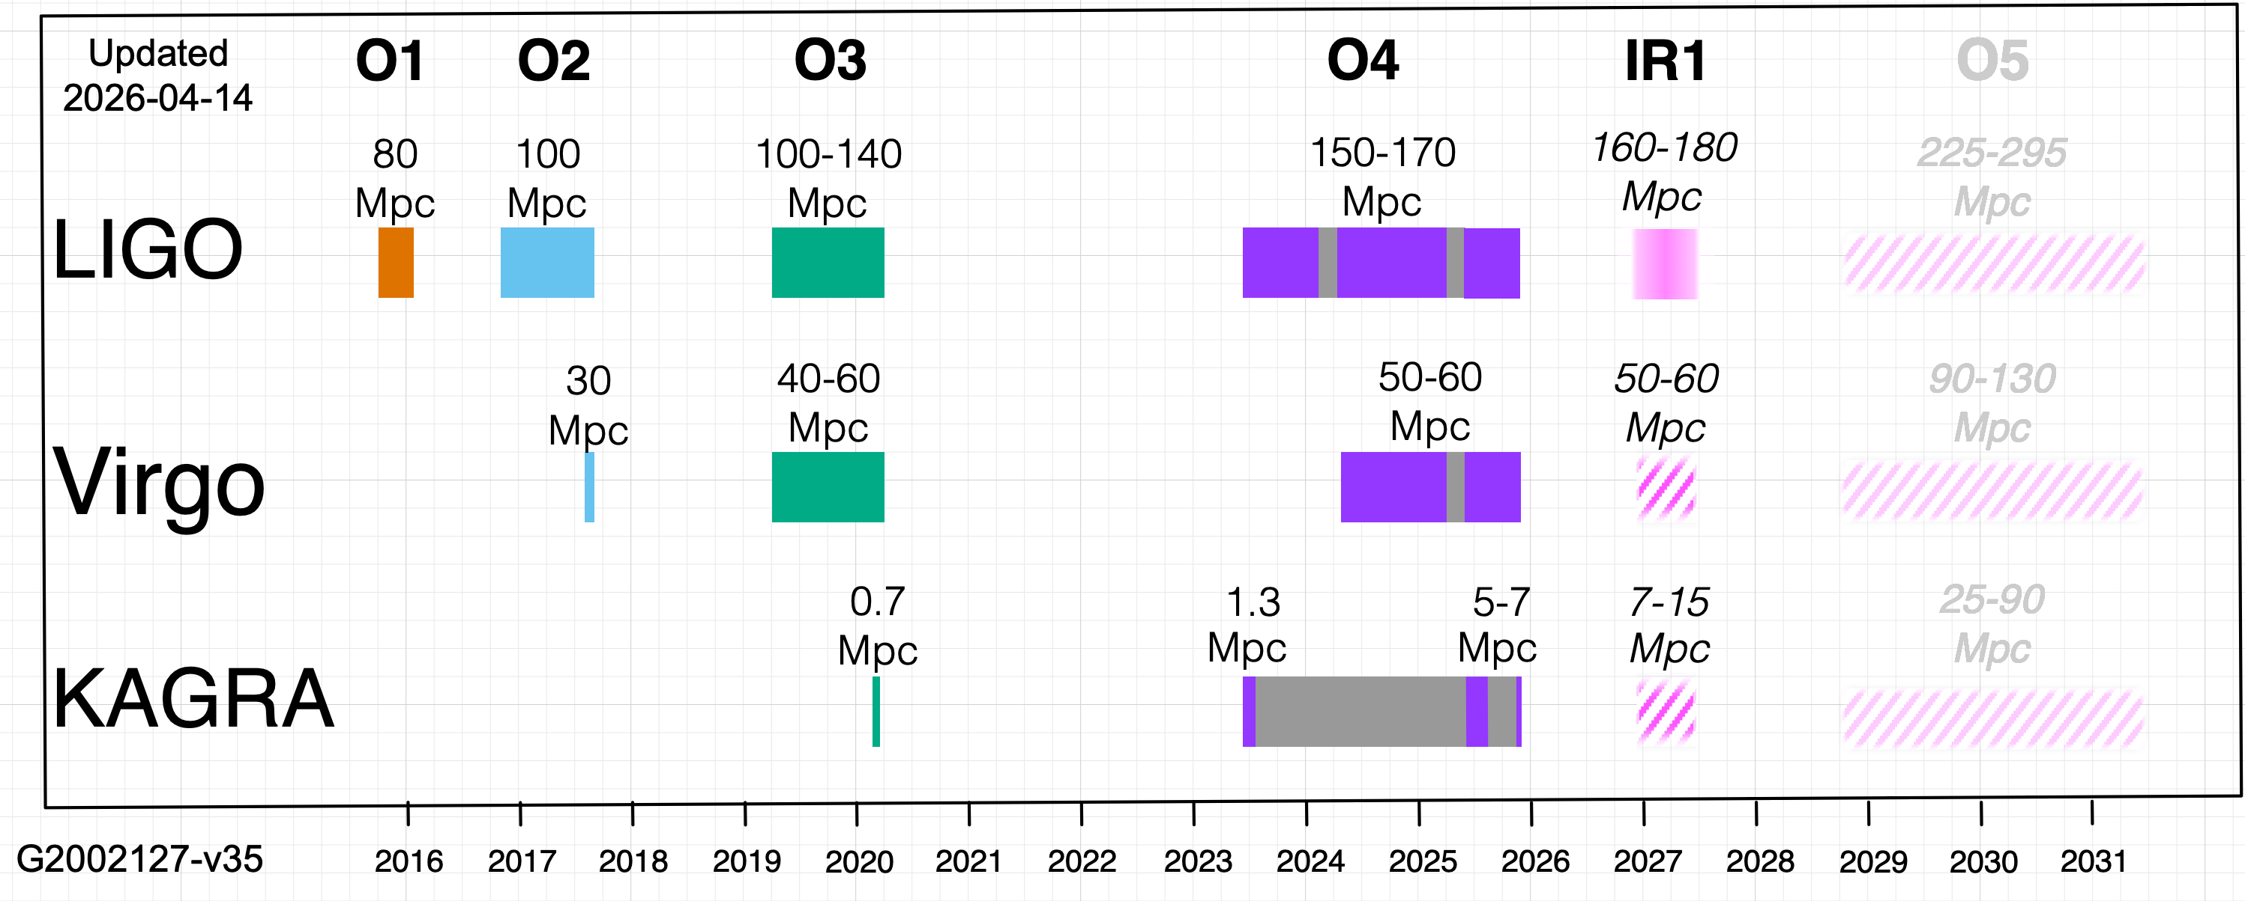
arXiv:2605.27223, GWTC-5.0: An Introduction to Version 5.0 of the Gravitational-Wave Transient Catalog
arXiv:2605.27224, GWTC-5.0: Methods for Identifying and Characterizing Gravitational-wave Transients
arXiv:2605.27225, GWTC-5.0: Observations from the Second Part of the Fourth LIGO-Virgo-KAGRA Observing Run and Updates to the Gravitational-Wave Transient Catalog
arXiv:2605.27226, GWTC-5.0: Population Properties of Merging Compact Binaries
arXiv:2605.27227, GWTC-5.0: Constraints on the Cosmic Expansion Rate and Modified Gravitational-wave Propagation

Slide 3
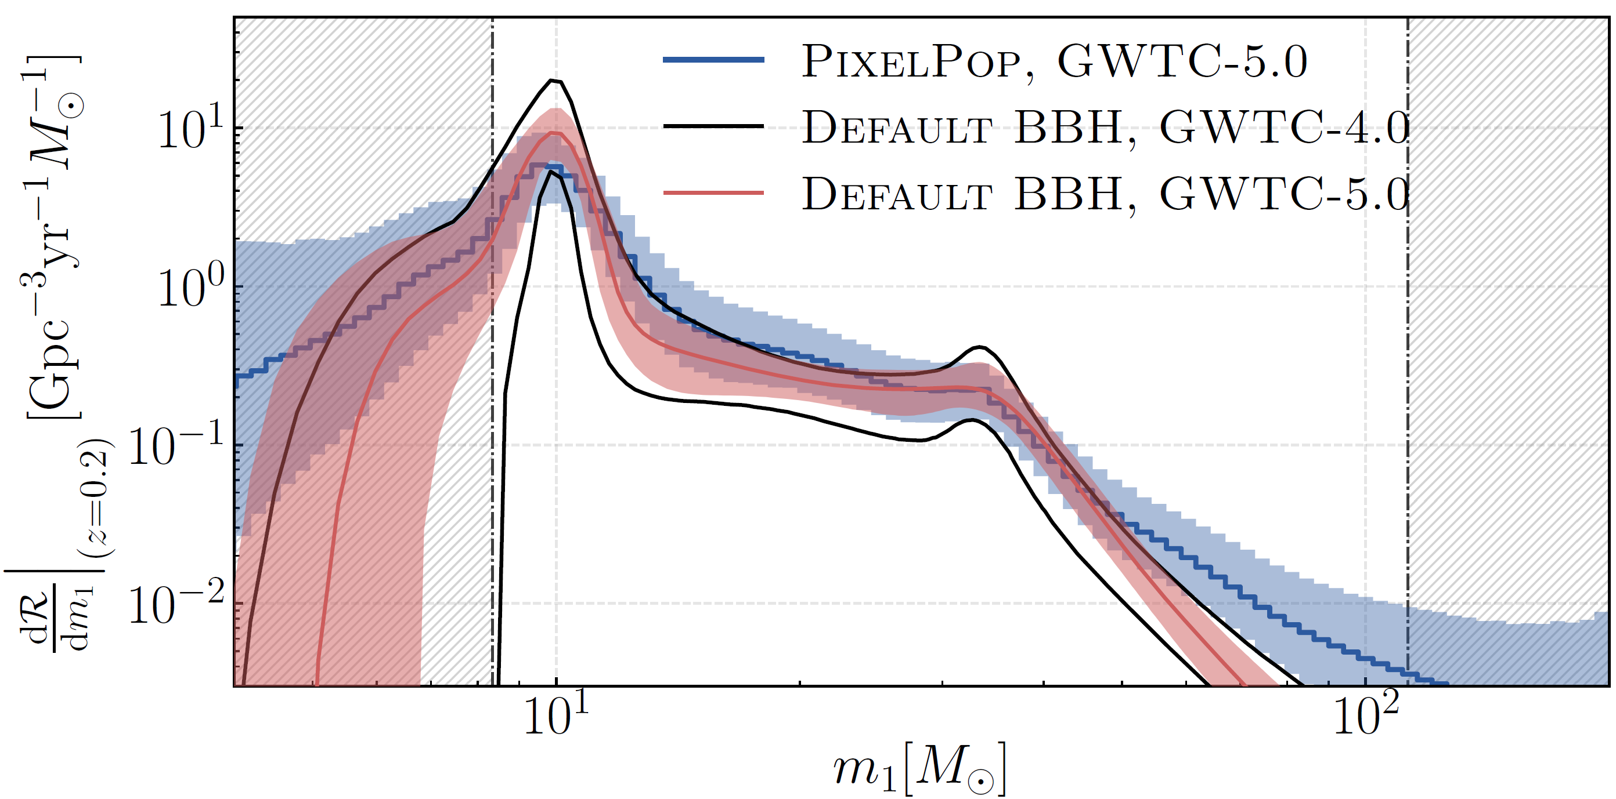
双驼峰
青梅竹马
一见钟情
35
LIGO-Virgo-KAGRA, arXiv:2605.27226 [GWTC-5.0]

Slide 4
LIGO-Virgo-KAGRA, arXiv:2605.27227 [GWTC-5.0]

Slide 5
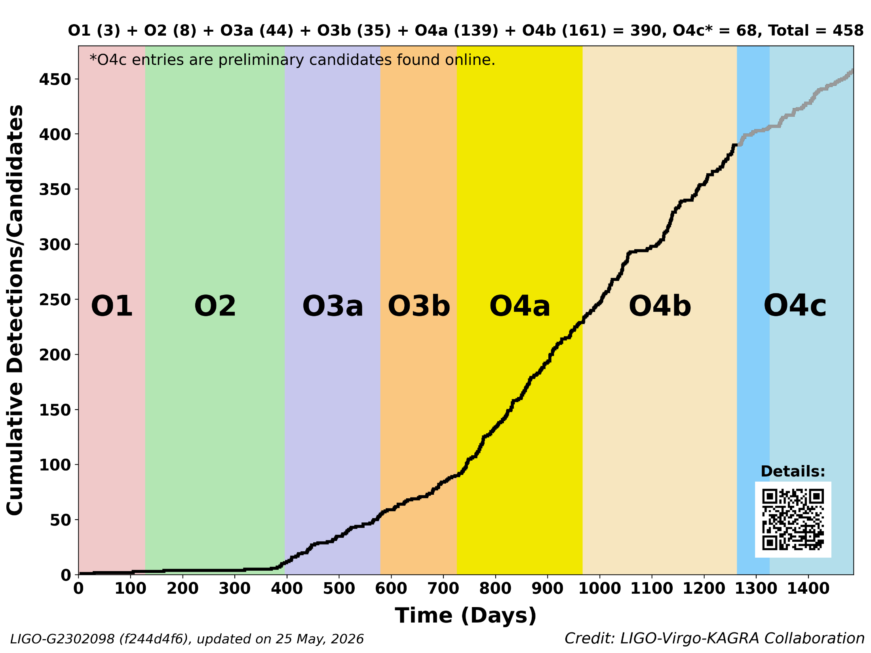
GW231123
黑洞形成演化
GW150914
人类首次
GW250114
黑洞物理
GW170817
多信使天文学

Slide 6


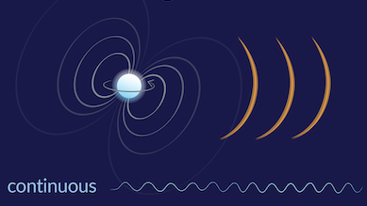

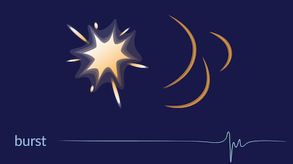
天体物理源
双星并合、连续、爆发、 …
宇宙学源
暴胀、预加热、相变、畴壁、宇宙弦、 …
Properties: Gaussian, isotropic, stationary, unpolarized

Slide 7
2 观测实验对随机引力波背景的限制
对随机引力波背景的观测限制
来自 LIGO-Virgo-KAGRA 的限制
来自宇宙微波背景辐射 B 模极化的限制
来自脉冲星计时阵列的限制
未来空间引力波观测项目对 SGWB 的探测

Slide 8
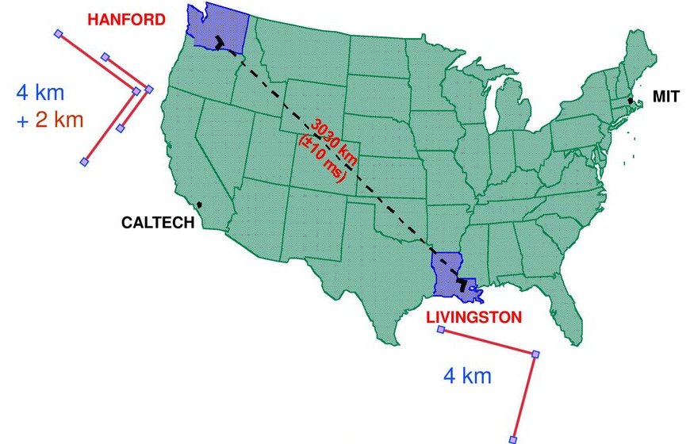


The way to detect the SGWB is to take the correlation between two detectors.
$$s\left(t\right)=h\left(t\right)+n(t)$$
$$\left\langle s_{1}\left(t\right) s_{2}\left(t\right)\right\rangle =\left\langle \left(h\left(t\right)+n_{1}\left(t\right)\right) \left(h\left(t\right)+n_{2}\left(t\right)\right)\right\rangle$$
$$=\left\langle h\left(t\right)h(t)\right\rangle +\left\langle h\left(t\right)n_{2}(t)\right\rangle +\left\langle h\left(t\right)n_{1}(t)\right\rangle +\left\langle n_{1}\left(t\right)n_{2}(t)\right\rangle$$
$$=\left\langle h\left(t\right)h(t)\right\rangle$$

Slide 9
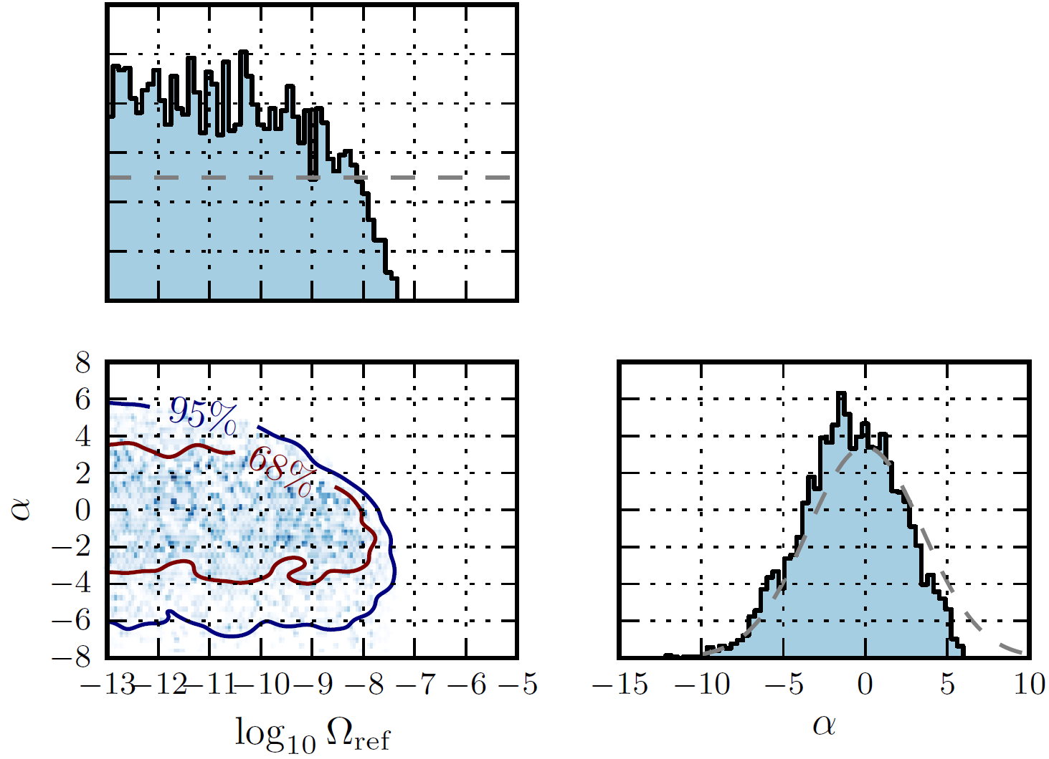
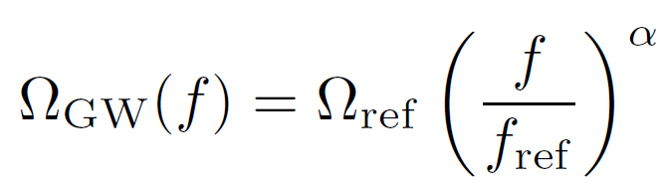

来自 LIGO-Virgo-KAGRA 的限制
$$Ω_{\text{ref}}≤6.6×{10}^{−9} (95\% \text{CL})$$
@LVK O3
LIGO-Virgo-KAGRA, arXiv:2101.12130 [O3]

Slide 10
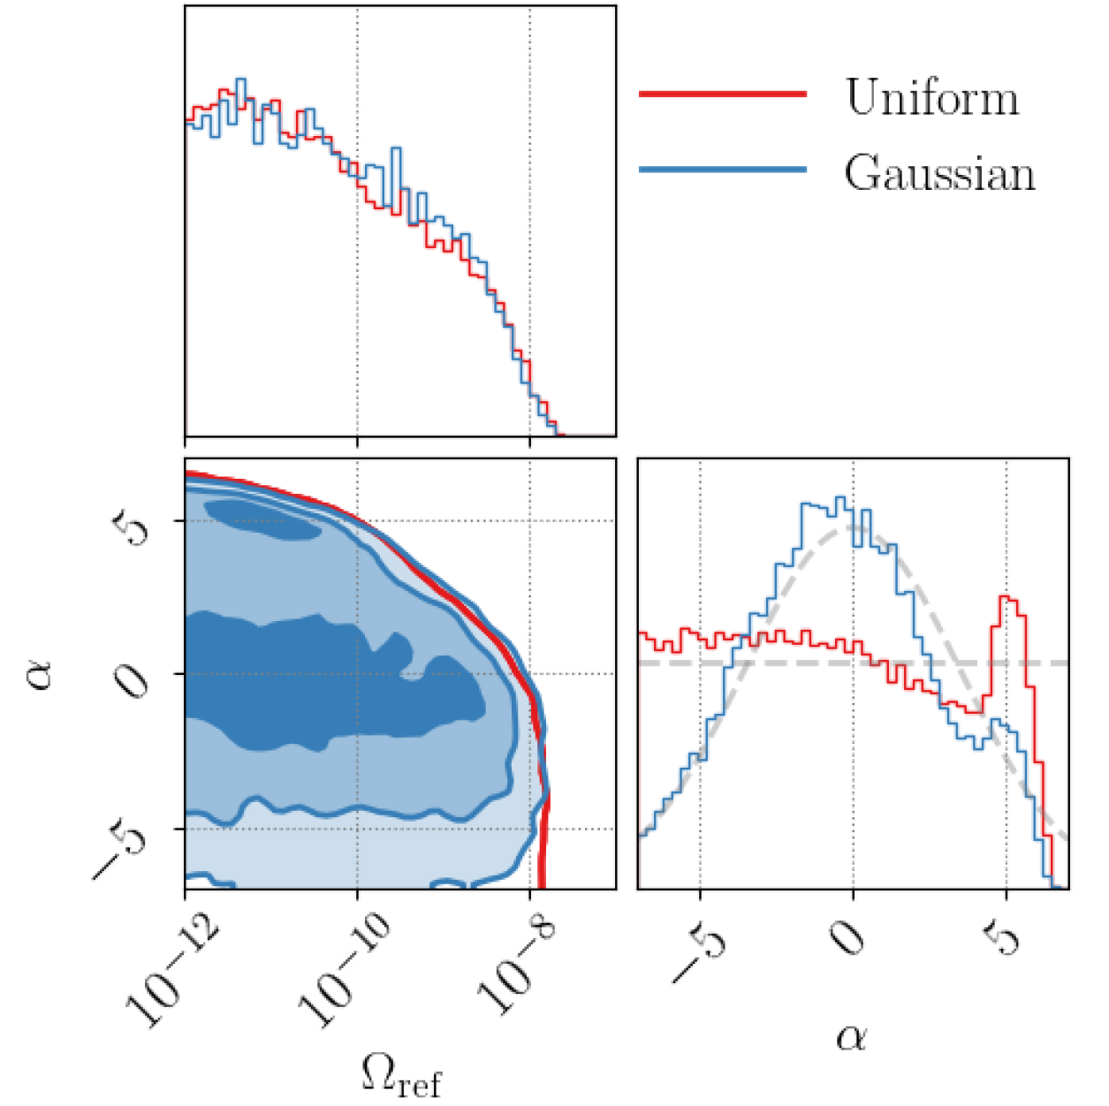
LIGO-Virgo-KAGRA, arXiv:2508.20721 [O4a]

Slide 11
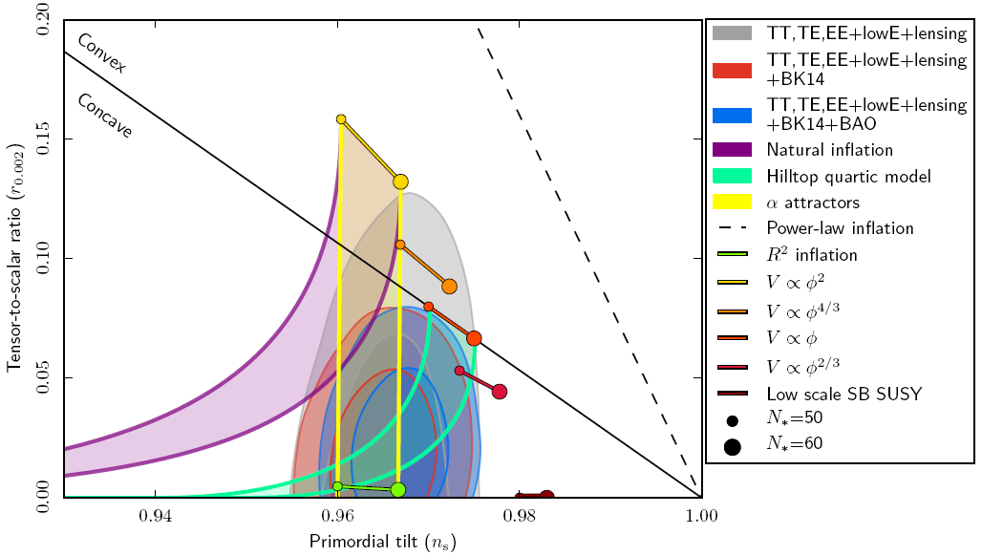
来自宇宙微波背景辐射 B 模极化的限制
@Planck 2018
Planck, arXiv:1807.06211

Slide 12
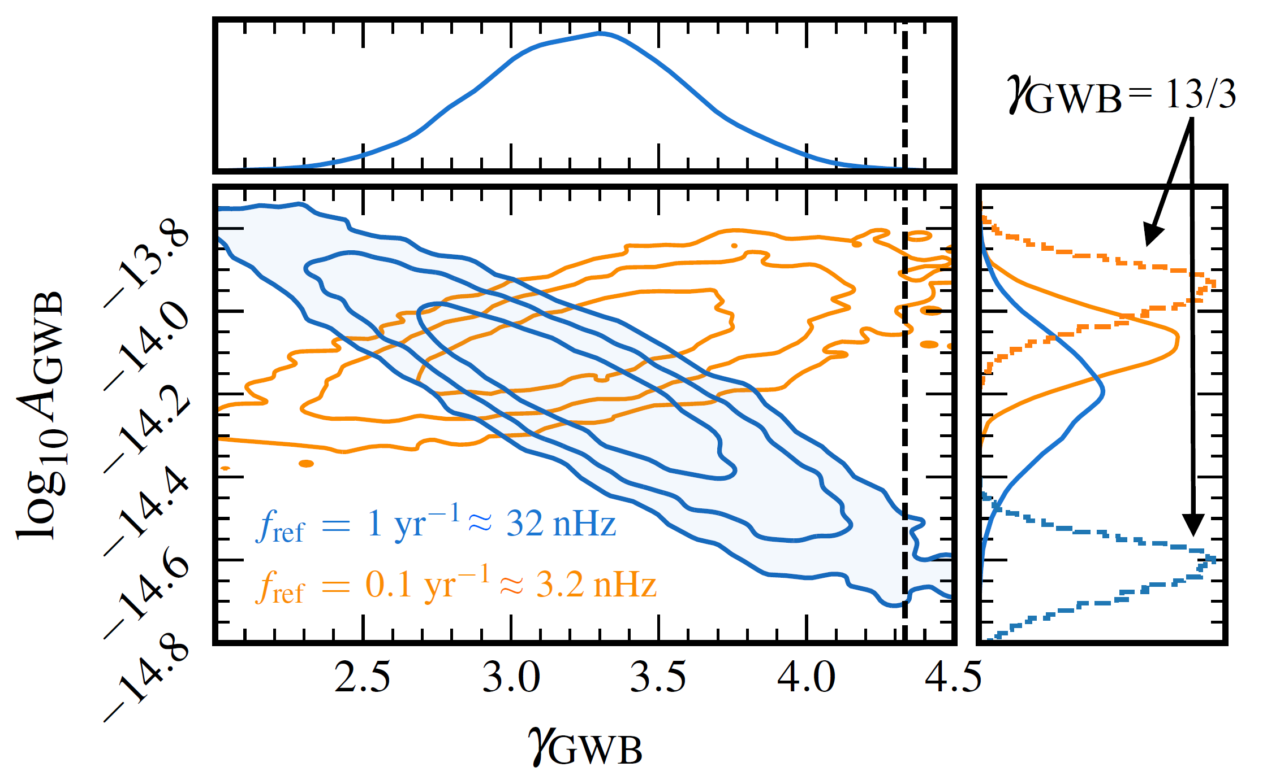
来自脉冲星计时阵列的限制
NANOGrav 15-year data; PPTA third data release; EPTA second data release; CPTA first data release.
NANOGrav, arXiv:2306.16213

Slide 13
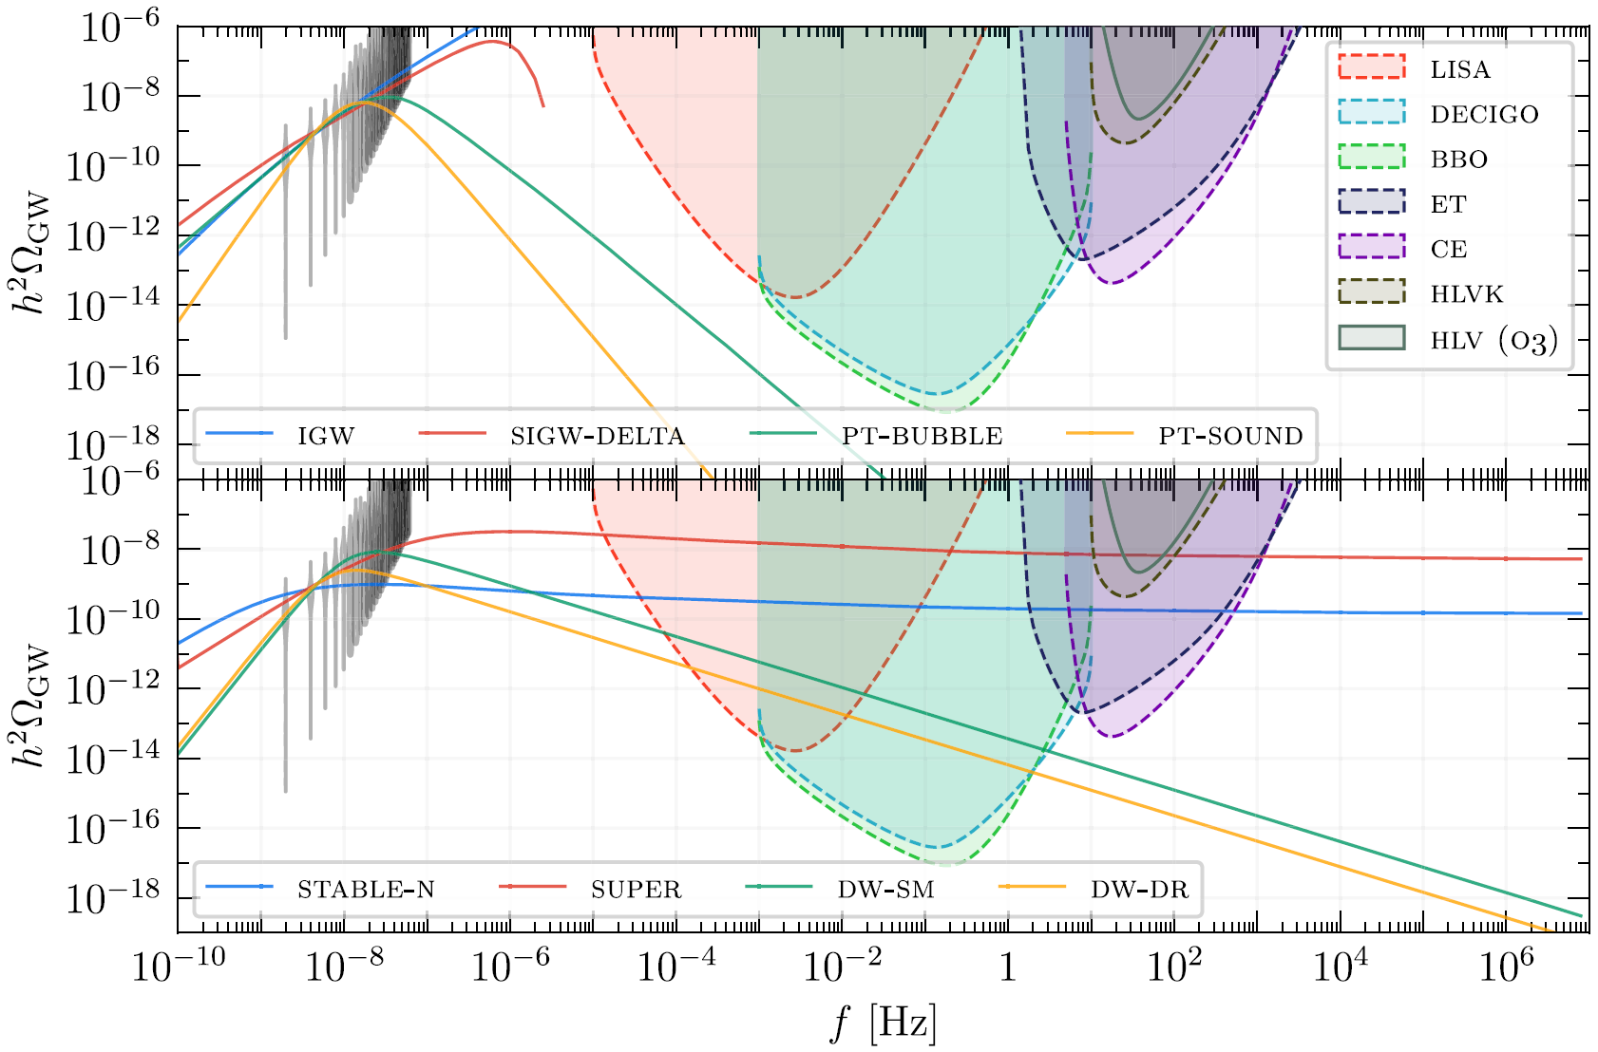
NANOGrav, arXiv:2306.16219

Slide 14
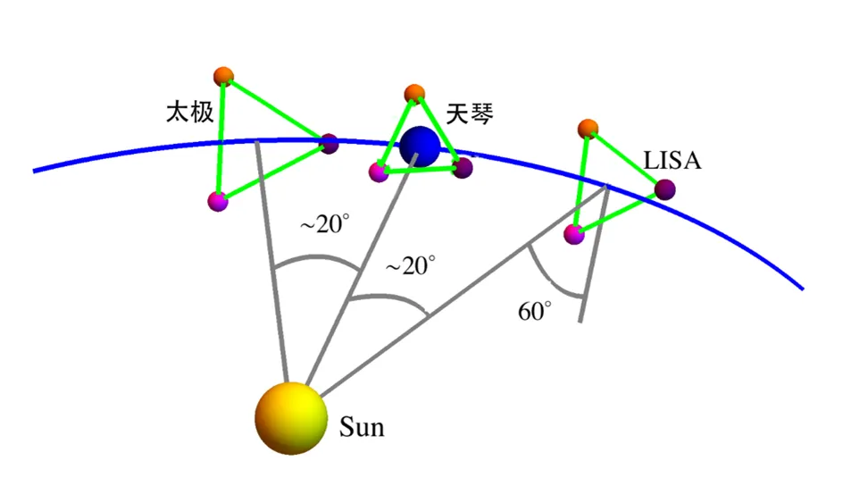
未来空间引力波观测项目对 SGWB 的探测
2016年06月，中国科学院战略性先导科技专项(B)：多波段引力波宇宙研究
2017年01月，国家自然科学基金重大项目：引力波相关物理问题研究
2018年07月，中国科学院战略性先导科技专项(A)：空间引力波探测太极计划
2019年08月，太极一号发射
2019年12月，天琴一号发射
2020年12月，国家重点研发计划“引力波探测”重点专项
太极二号、天琴二号
from Gang Wang

Slide 15
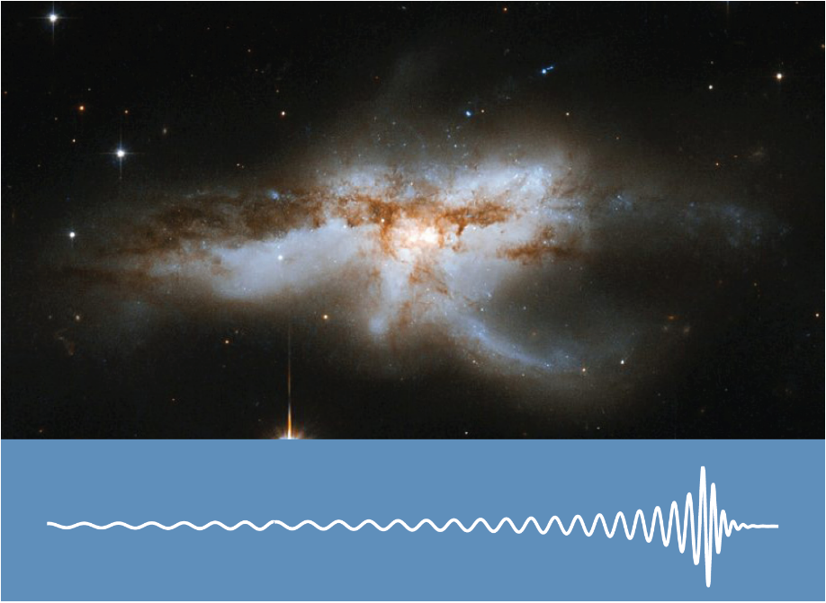
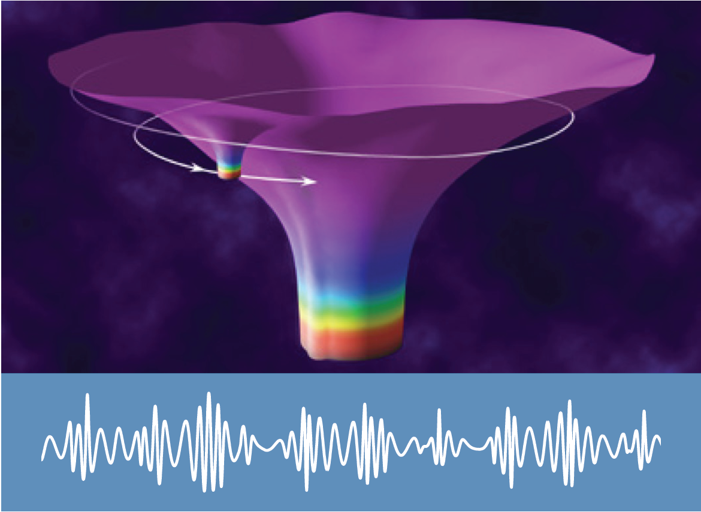
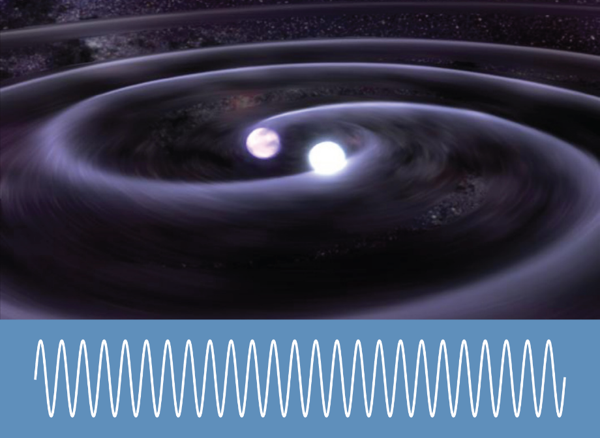
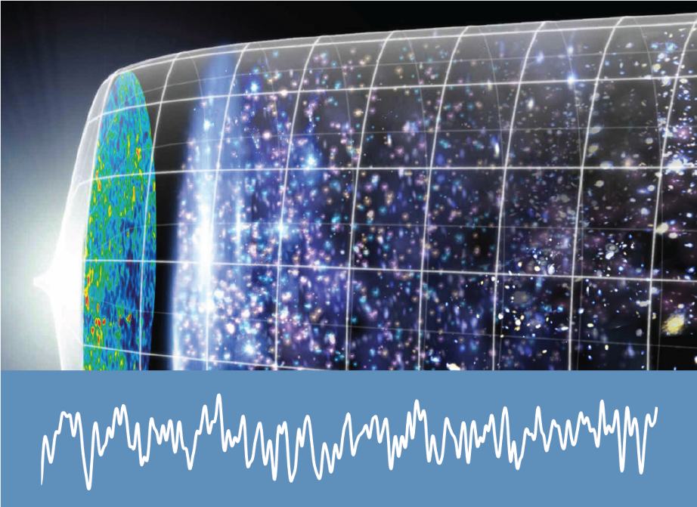
超大质量双黑洞并合
极端质量比双星旋进
银河系内致密双星旋进
随机引力波背景

Slide 16
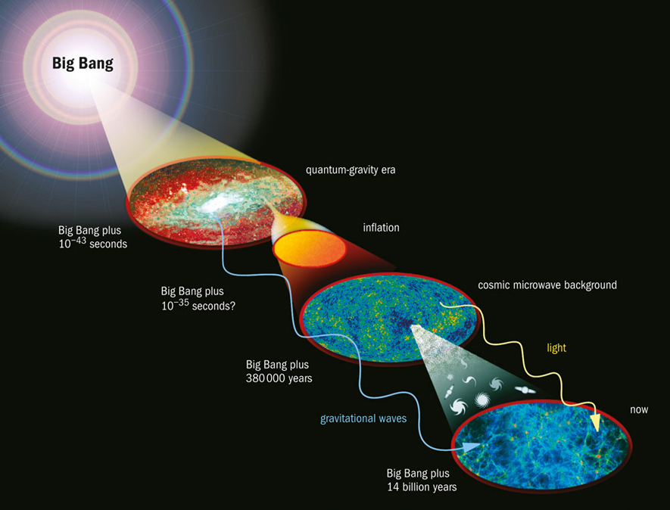

Slide 17
早期宇宙中引力波产生机制
暴胀期间原初引力波的放大机制
曲率扰动诱导的引力波
物质到辐射转变时曲率扰动诱导的引力波
重加热 / 预加热期间产生的引力波
拓扑缺陷 (宇宙弦、畴壁) 产生的引力波
宇宙学一级相变产生的引力波
场扰动的共振放；粒子产生；修改引力理论
R.G. Cai, Z. Cao, ZKG, et. al., “The Gravitational-Wave Physics”, Natl. Sci. Rev. 4 (2017) 687 [arXiv:1703.00187]. 【被引用 189 次】
L. Bian, R.G. Cai, ZKG, et. al., “The Gravitational-Wave Physics II: Progress”, Sci. China Phys. Mech. Astron. 64 (2021) 120401 [arXiv:2106.10235]. 【被引用 106 次】
L. Bian, R.G. Cai, ..., ZKG, et. al., “Gravitational wave cosmology”, Sci. China Phys. Mech. Astron. 69 (2026) 210401 [arXiv:2505.19747]. 【被引用 28 次】

Slide 18
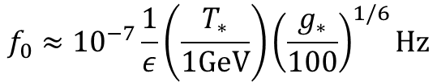

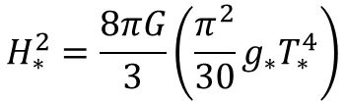


Assuming that GWs with frequency $f_{∗}$ are produced at time $t_{∗}$.
$$f_{0}=f_{∗}a_{∗}/a_{0}$$
Assuming that the Universe evolves adiabatically.
$$g_{∗}T_{∗}^{3}a_{∗}^{3}=g_{0}T_{0}^{3}a_{0}^{3}$$
The characteristic wavelength at time $t_{∗}$ is $εH_{∗}^{−1}$ with $ε≤1$.
$$λ_{∗}=εH_{∗}^{−1}$$
If GWs are produced during the radiation-dominated era,
$$H_{∗}^{2}=\frac{8πG}{3}\left(\frac{π^{2}}{30}g_{∗}T_{∗}^{4}\right)$$
the typical frequency of GWs is
$$f_{0}≈{10}^{−7}\frac{1}{ε}\left(\frac{T_{∗}}{1\text{GeV}}\right){\left(\frac{g_{∗}}{100}\right)}^{1/6}\text{Hz}$$

Slide 19
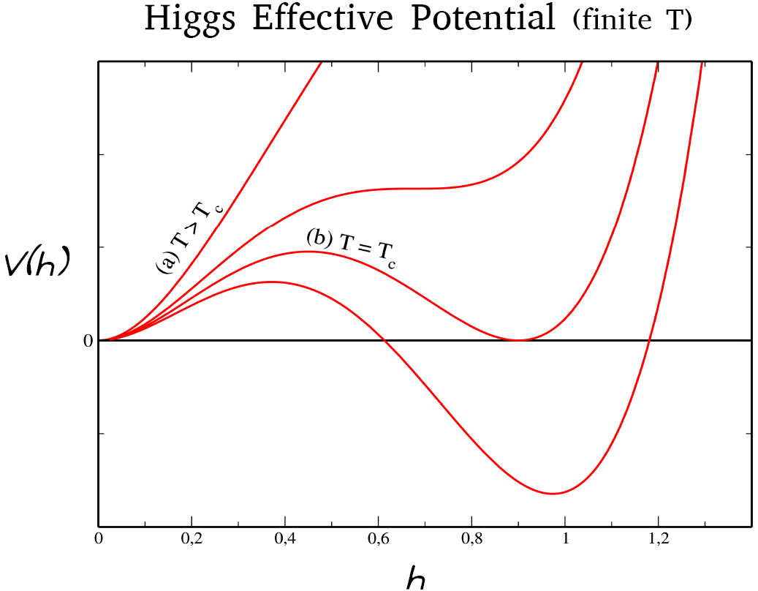
vacuum
false vacuum
A. Kosowsky, M.S. Turner and R. Watkins, Phys. Rev. D45 (1992) 4514.
A. Kosowsky, M.S. Turner and R. Watkins, Phys. Rev. Lett. 69 (1992) 2026.
A. Kosowsky and M. S. Turner, Phys. Rev. D47 (1993) 4372.
Y. Di, et. al., Phys. Rev. Lett. 126 (2021) 251102.

Slide 20
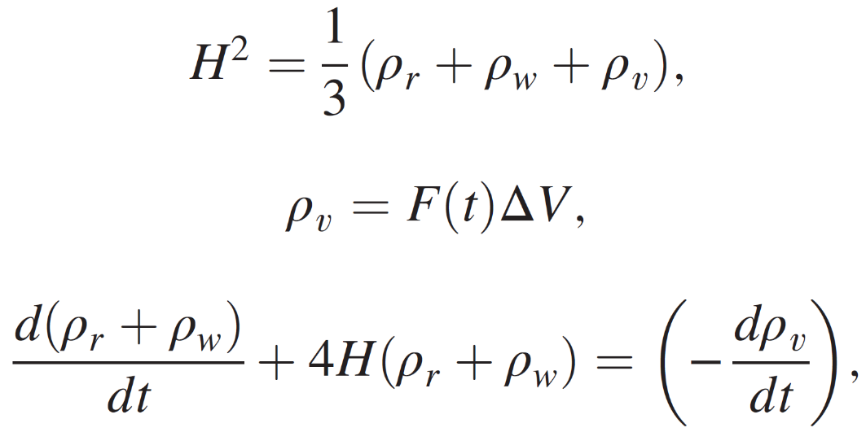
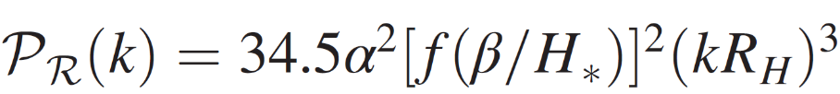
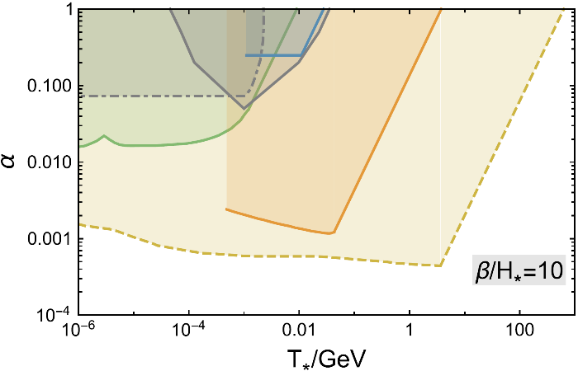
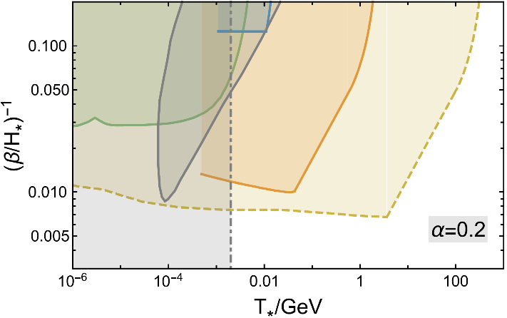
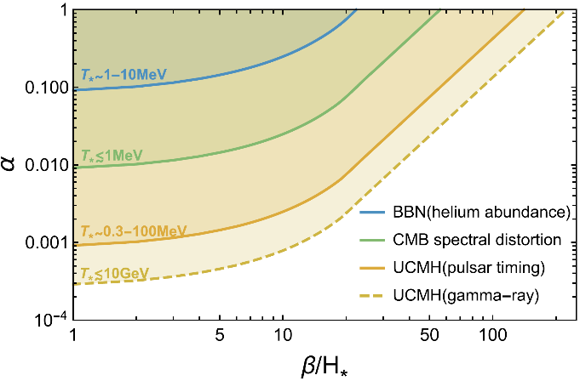




$$ρ_{v}$$
$$ρ_{r},ρ_{w}$$
$$ρ_{r},ρ_{w}$$
$$ρ_{r},ρ_{w}$$
J. Liu, L. Bian, R.G. Cai, ZKG, S.J. Wang, Phys. Rev. Lett. 130 (2023) 051001 [arXiv:2208.14086].

Slide 21
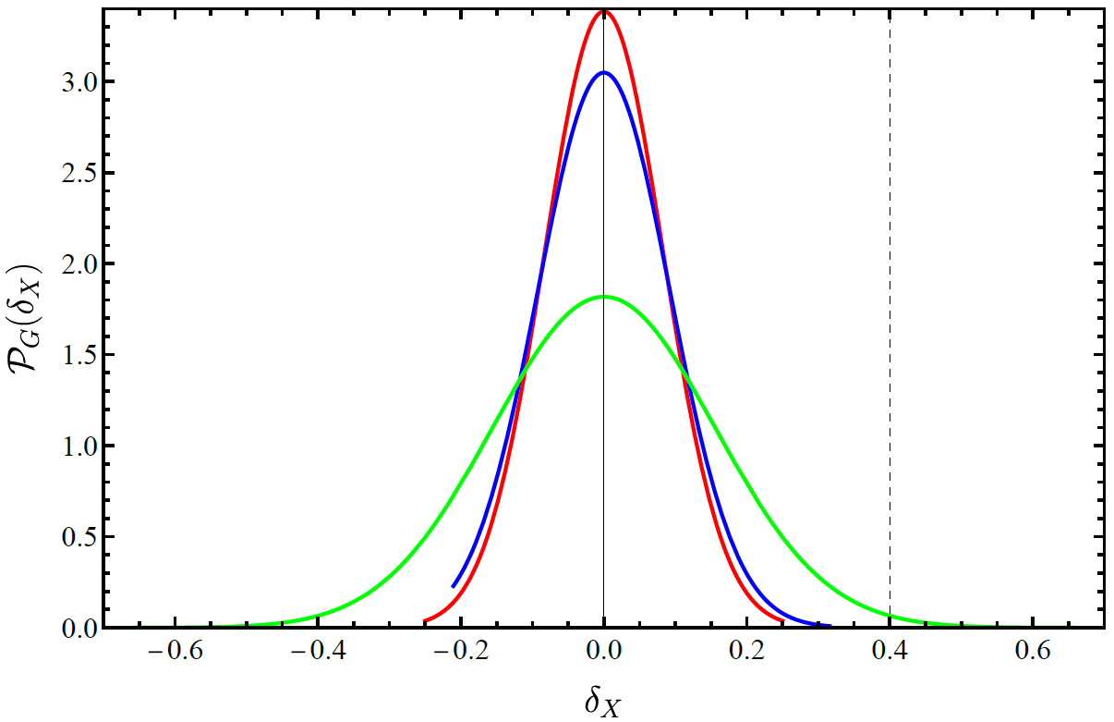
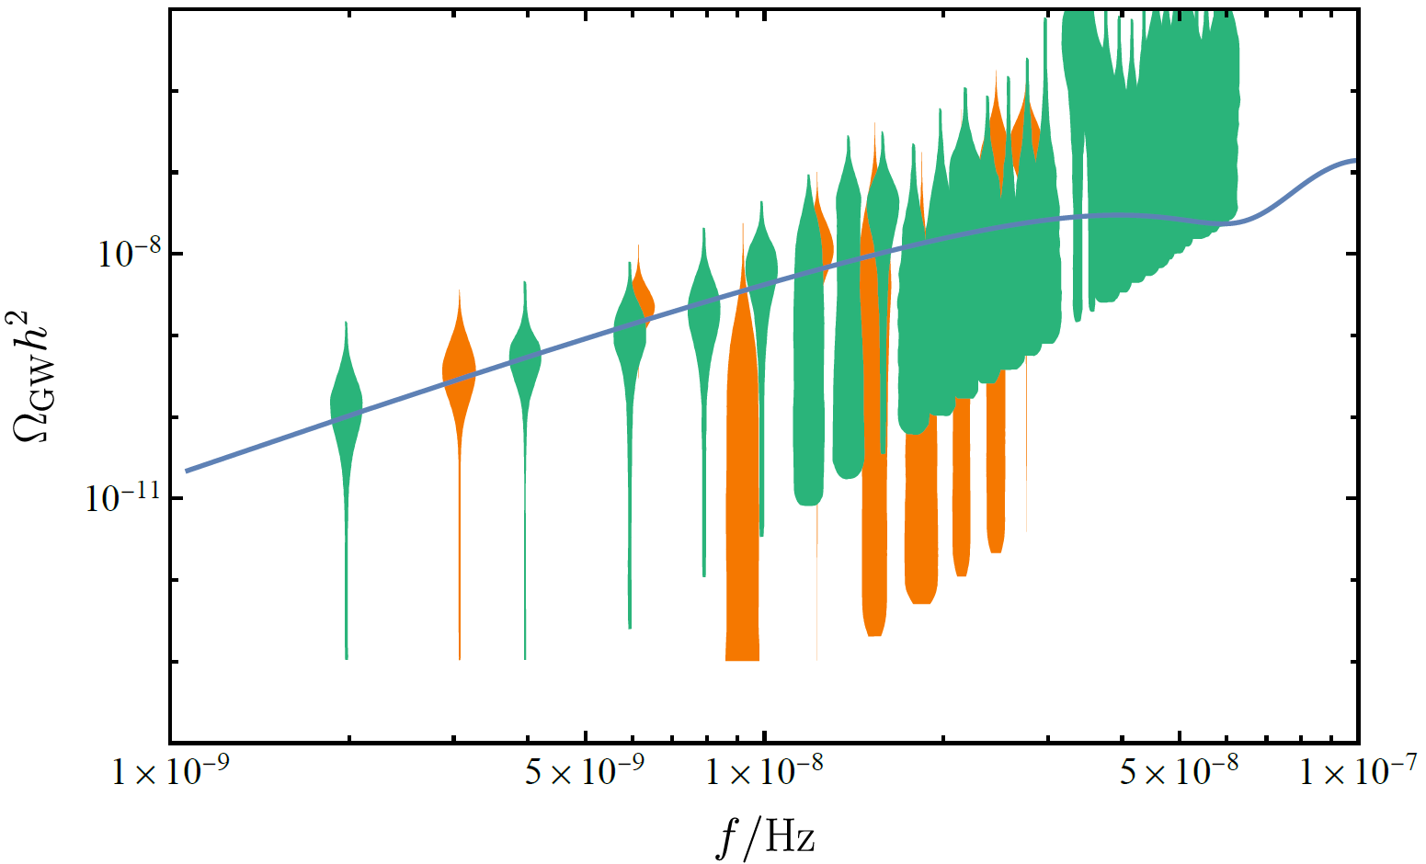
Z.M. Zeng, ZKG, Phys. Rev. D110 (2024) L041301 (Letter) [arXiv:2402.09310].

Slide 22
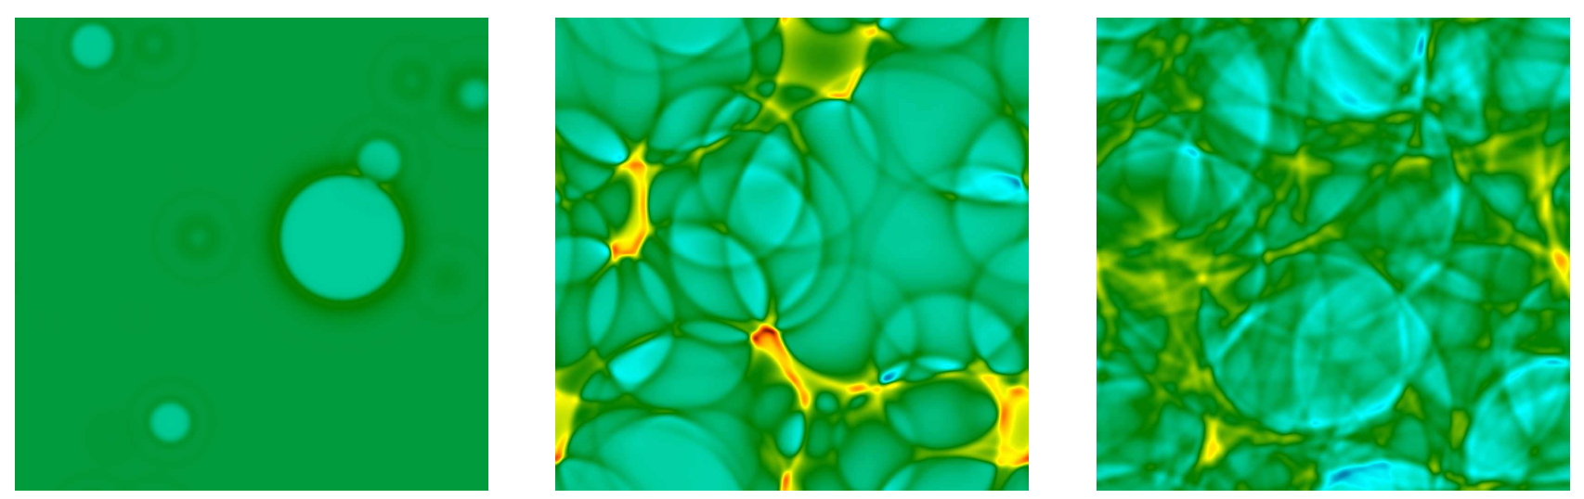
cosmic-fluid-order-parameter-field model (hep-ph/9512202)
$$T_{;μ}^{μν}\left(\text{field}\right)=η(φ,v_{w})U^{μ}∂_{μ}φ∂^{ν}φ T_{;μ}^{μν}\left(\text{f}\text{lui}\text{d}\right)=−η\left(φ,v_{w}\right)U^{μ}∂_{μ}φ∂^{ν}φ$$
M. Hindmarsh, et al, Phys. Rev. Lett. 112 (2014) 041301 [arXiv:1304.2433].

Slide 23
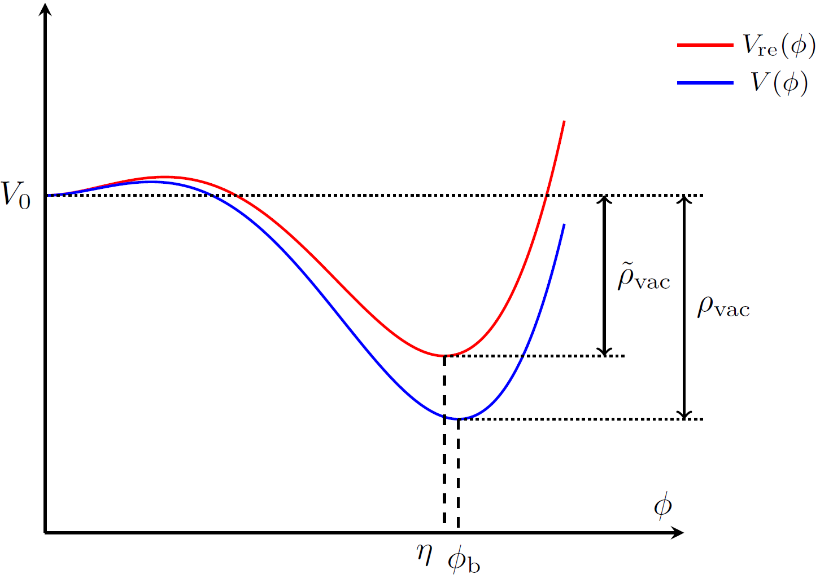
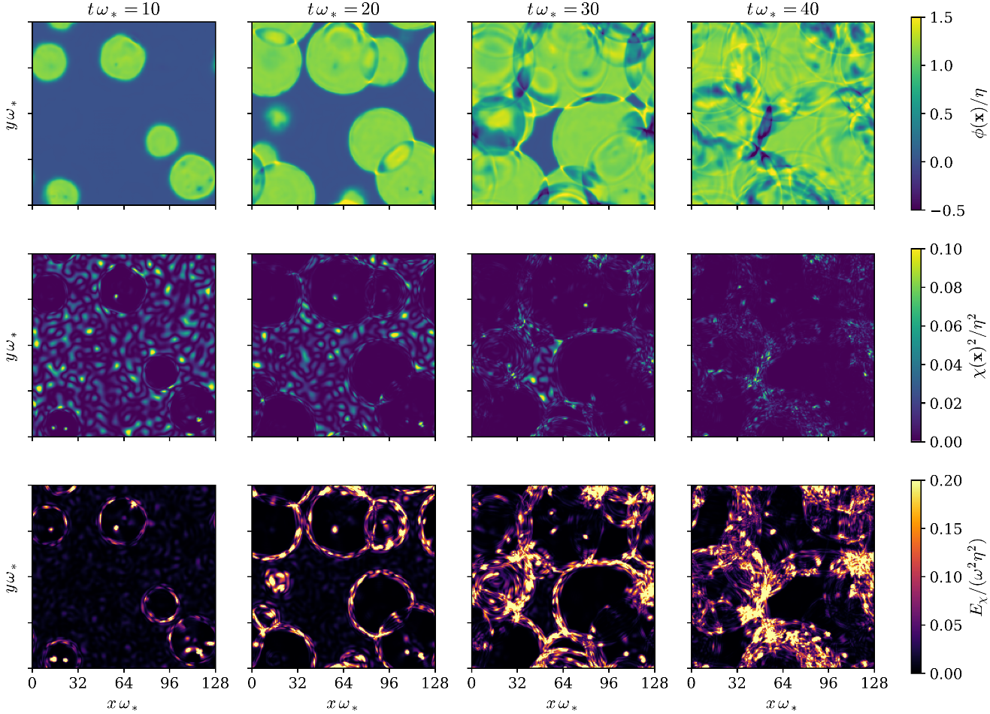

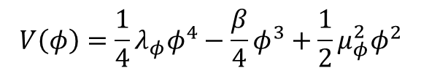

$$V\left(φ,χ\right)=V(φ)+V_{φχ}(φ,χ)$$
$$V\left(φ\right)=\frac{1}{4}λ_{φ}φ^{4}−\frac{β}{4}φ^{3}+\frac{1}{2}μ_{φ}^{2}φ^{2}$$
$$V_{φχ}(φ,χ)=λ_{φχ}φ^{2}χ^{2}$$
fluctuations suppressed
in the bubbles
energy shell
Y.J. Li, J. Liu, ZKG, Phys. Rev. D113 (2026) 023550 [arXiv:2508.14665].

Slide 24
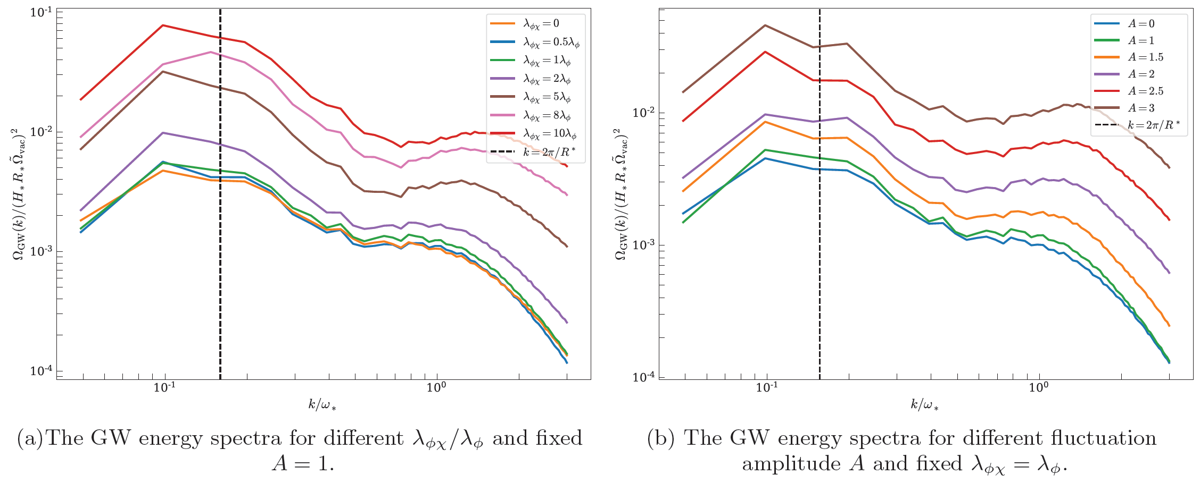
Y.J. Li, J. Liu, ZKG, Phys. Rev. D113 (2026) 023550 [arXiv:2508.14665].

Slide 25
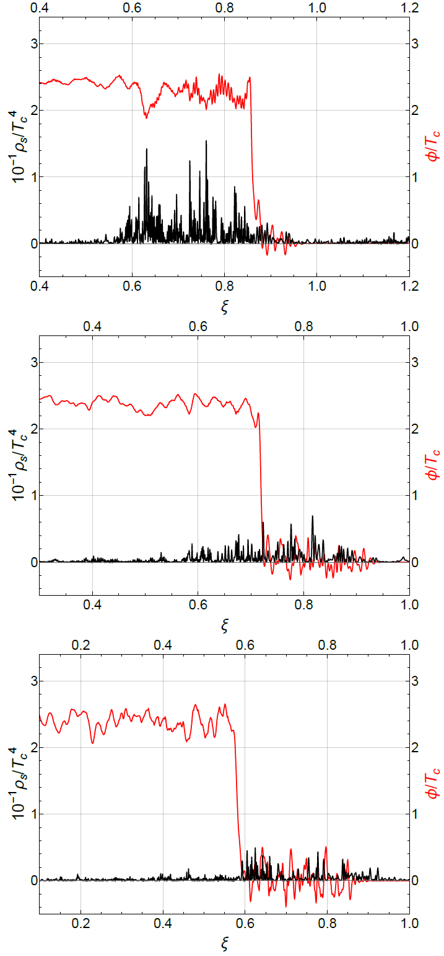
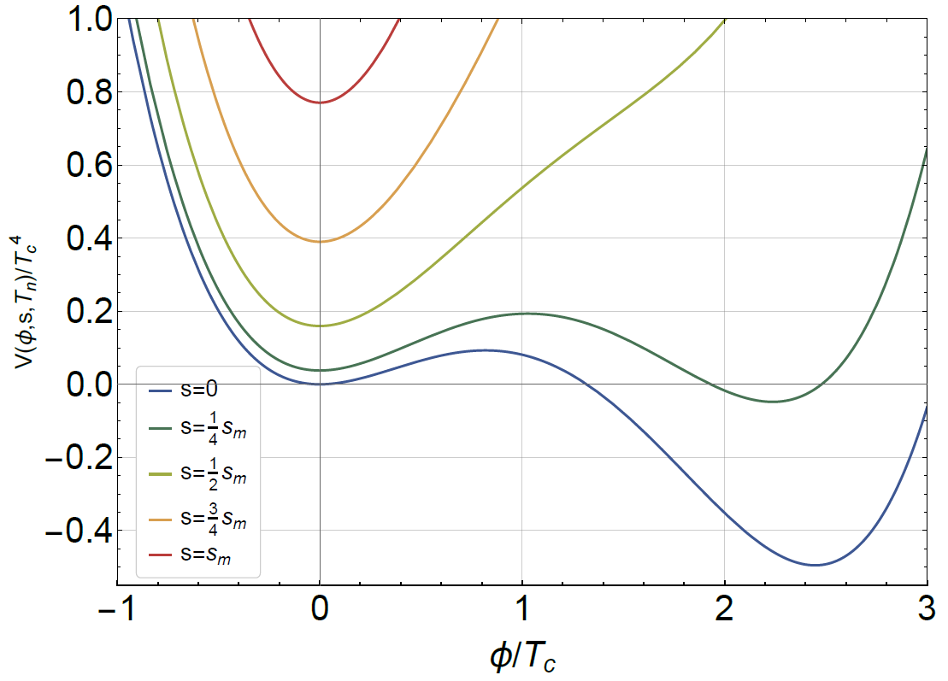
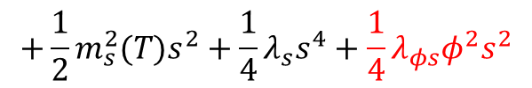
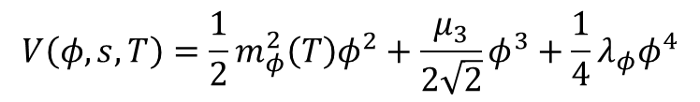



arXiv:2602.04586
detonation
$$λ_{φs}=0.65$$
arXiv:2602.04586
$$V\left(φ,s,T\right)=\frac{1}{2}m_{φ}^{2}\left(T\right)φ^{2}+\frac{μ_{3}}{2\sqrt{2}}φ^{3}+\frac{1}{4}λ_{φ}φ^{4}$$
$$+\frac{1}{2}m_{s}^{2}(T)s^{2}+\frac{1}{4}λ_{s}s^{4}+\frac{1}{4}λ_{φs}φ^{2}s^{2}$$
hybrid
$$λ_{φs}=1.1$$
deflagration
$$λ_{φs}=1.8$$
D. Wei, ZKG, arXiv:2602.04586

Slide 26
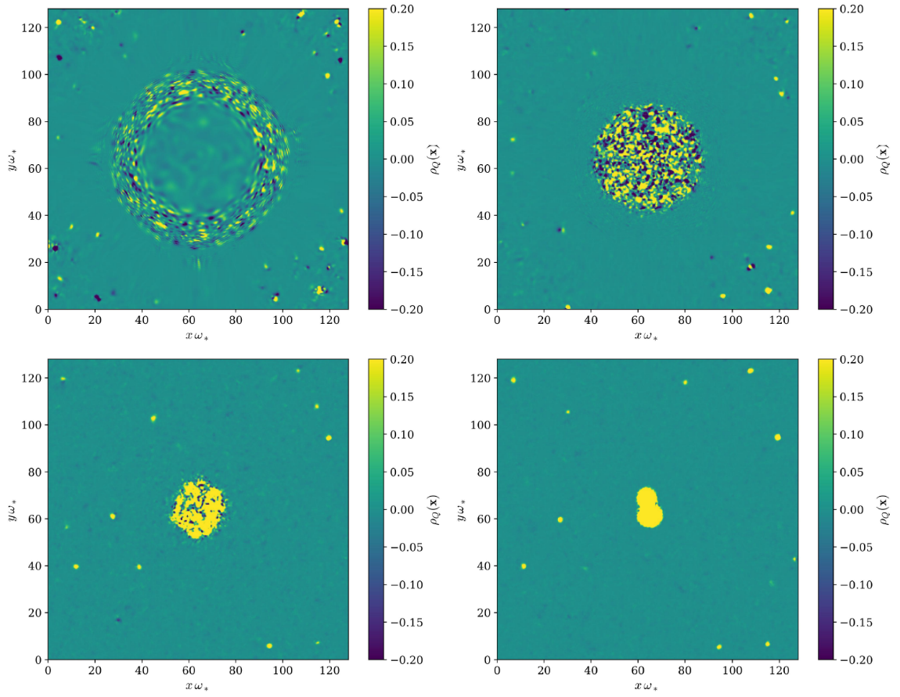
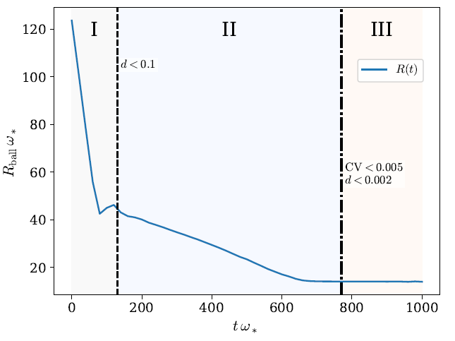

The Friedberg-Lee-Sirlin model [Phys. Rev. D 13 (1976) 2739]
$$V\left(φ,χ\right)=V(φ)+g^{2}φ^{2}χ^{∗}χ$$
cooling phase
thermal ball
Q-ball
Y.J. Li, J. Liu, ZKG, arXiv:2601.19150.

Slide 27
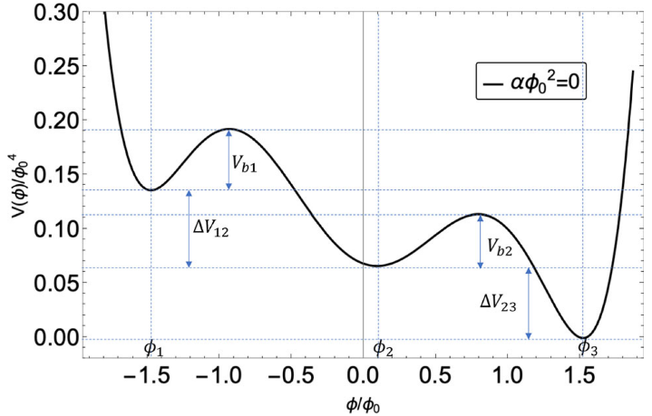
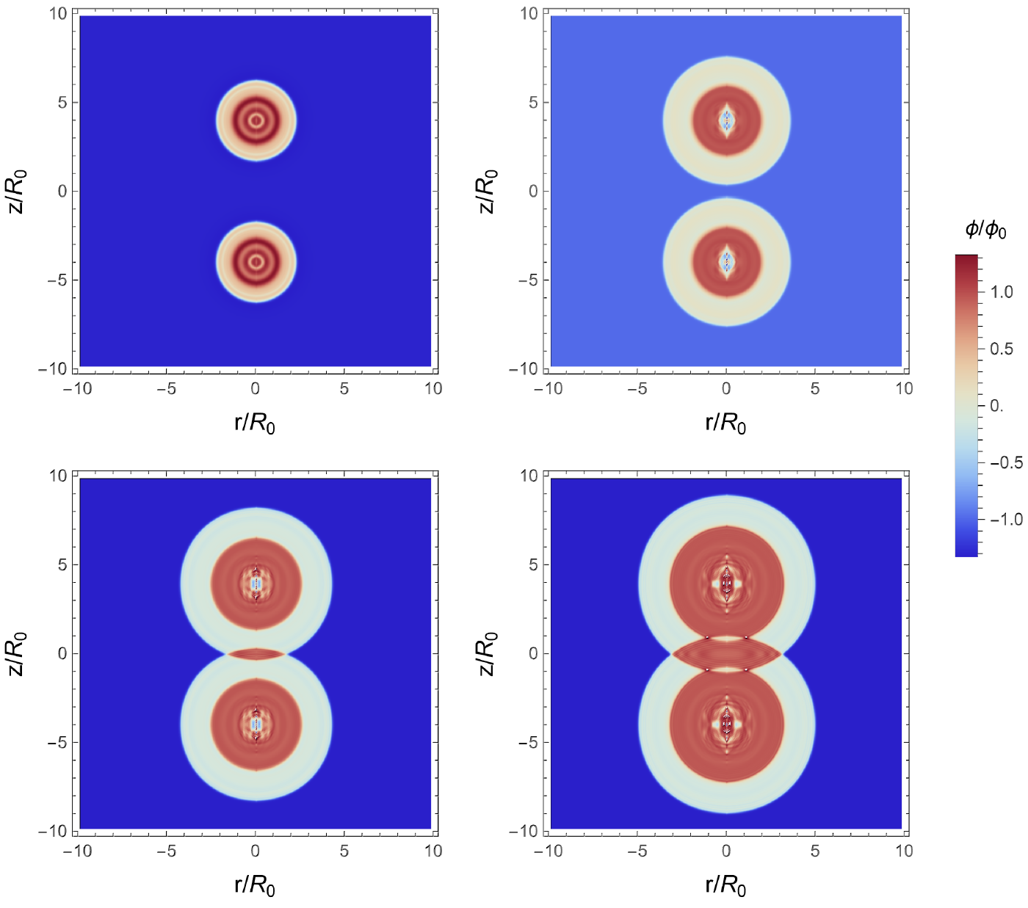
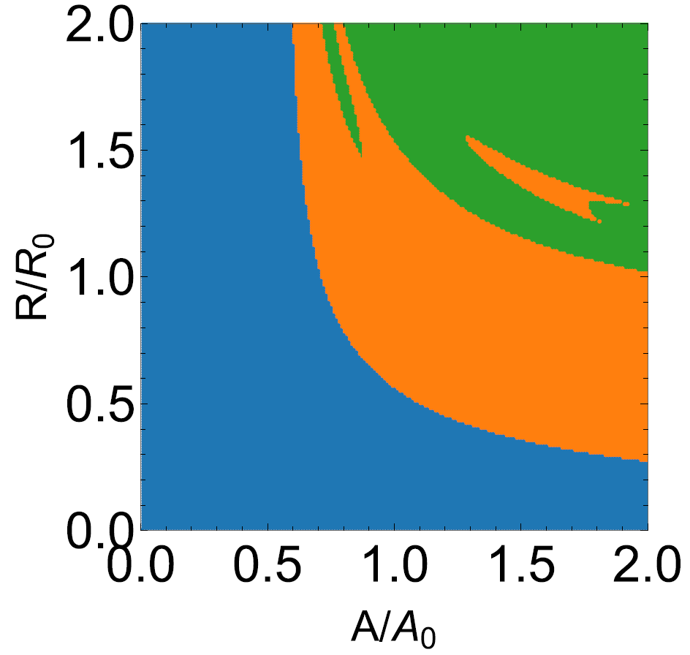
flyover transitions
double-layered bubbles
D. Wei, ZKG, Q. Fan, Eur. Phys. J. C86 (2026) 258 [arXiv:2509.00758].

Slide 28
谢谢！

