Slide 1





Local Cosmography from Causal-Set Pixies
Can small patterns of causal order recover cosmic expansion?
He Liu
School of Economics and Management, Tsinghua University
Department of Physics and Astronomy, University of Mississippi
ICFP 2026 · 24 October 2026
Notes:
Slide 1. Local Cosmography from Causal-Set Pixies
Timing: 10 seconds
This is joint work with Luca Bombelli. We ask whether small patterns of causal order can reveal how the universe expands.
Sources:
local_cosmography_cqg.tex, title and abstract, 23 October 2026

Slide 2
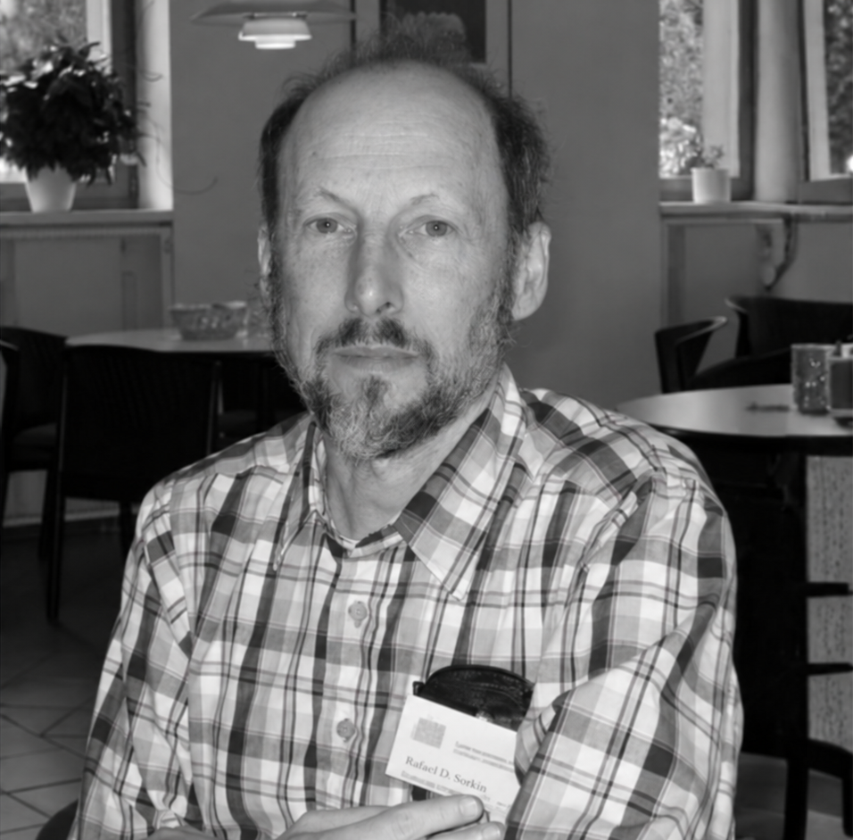
In loving memory of
Rafael D. Sorkin
1945–2026
founding architect of causal set theory
Photograph: Perimeter Institute, memorial article (15 September 2026).
Notes:
Slide 2. In loving memory of Rafael D. Sorkin
Timing: 20 seconds
I'd like to dedicate this talk to Rafael Sorkin. Many of the ideas behind this work grew from the questions he helped establish. Before turning to the calculation, I want to remember his contribution to the way we think about spacetime.
Sources:
https://perimeterinstitute.ca/news/perimeter-remembers-eminent-physicist-rafael-sorkin-1945-2026
Portrait: Perimeter Institute, official memorial notice, 15 September 2026. Black-and-white treatment for this presentation. https://perimeterinstitute.ca/news/perimeter-remembers-eminent-physicist-rafael-sorkin-1945-2026

Slide 3
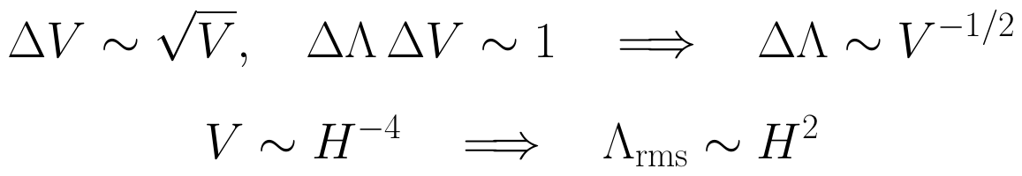
Motivation: Sorkin’s estimate of Λ
Could spacetime discreteness set the cosmological-constant scale?
Poisson number–volume fluctuations, with Λ–V conjugacy:
Λ: cosmological constant. V: causal-past four-volume. H: expansion rate.
Δ: typical fluctuation. rms: root mean square. 8πG = ℏ = c = 1.
Heuristic fluctuation scale about zero mean.
motivation: can richer causal patterns reveal local cosmic expansion?
3
Notes:
Slide 3. Motivation: Sorkin’s estimate of Λ
Timing: 60 seconds
My starting point is Sorkin's estimate of the cosmological constant, Lambda. Why pair it with four-volume? In Einstein's action, the cosmological term is minus Lambda times four-volume over eight pi G. Its quantum phase is a Fourier kernel. A fixed-volume amplitude and a fixed-Lambda amplitude are therefore Fourier-paired. Unimodular gravity provides a canonical version of this statement.
Sorkin combines this pairing with Poisson number-volume fluctuations. In Planck units, a volume uncertainty of order the square root of V suggests Lambda fluctuations of order one over the square root of V. Taking the causal-past volume to be of order H to the minus fourth gives a fluctuation scale of order H squared. The quantum-state assumptions and zero mean make this a heuristic estimate.
This motivated our question: what can richer causal patterns tell us about cosmic expansion?
Preparation notes (not spoken):
The cosmological term in the gravitational action is minus ΛV/κ, where κ = 8πG and Λ is the geometric cosmological constant in Einstein's equation. Consequently the fixed-Λ path integral is a formal Fourier transform of the fixed-volume amplitude, with Fourier variable Λ/κ. A canonical global volume coordinate exists in Henneaux-Teitelboim unimodular gravity. The three-page preparation note, ‘Why Λ and four-volume are conjugate’, derives both statements and separates them from the extra assumptions used in Sorkin's fluctuation estimate. In ordinary GR with a fixed cosmological coupling, Λ is an external parameter; this action term alone does not make it a fluctuating observable. The later fixed-cardinality experiments reconstruct geometry and do not simulate fluctuating-Λ dynamics.
Sources:
https://arxiv.org/abs/0710.1675
https://arxiv.org/abs/astro-ph/0209274
https://doi.org/10.1016/0370-2693(89)91251-3
https://arxiv.org/abs/2203.15714
https://arxiv.org/abs/2304.03819

Slide 4
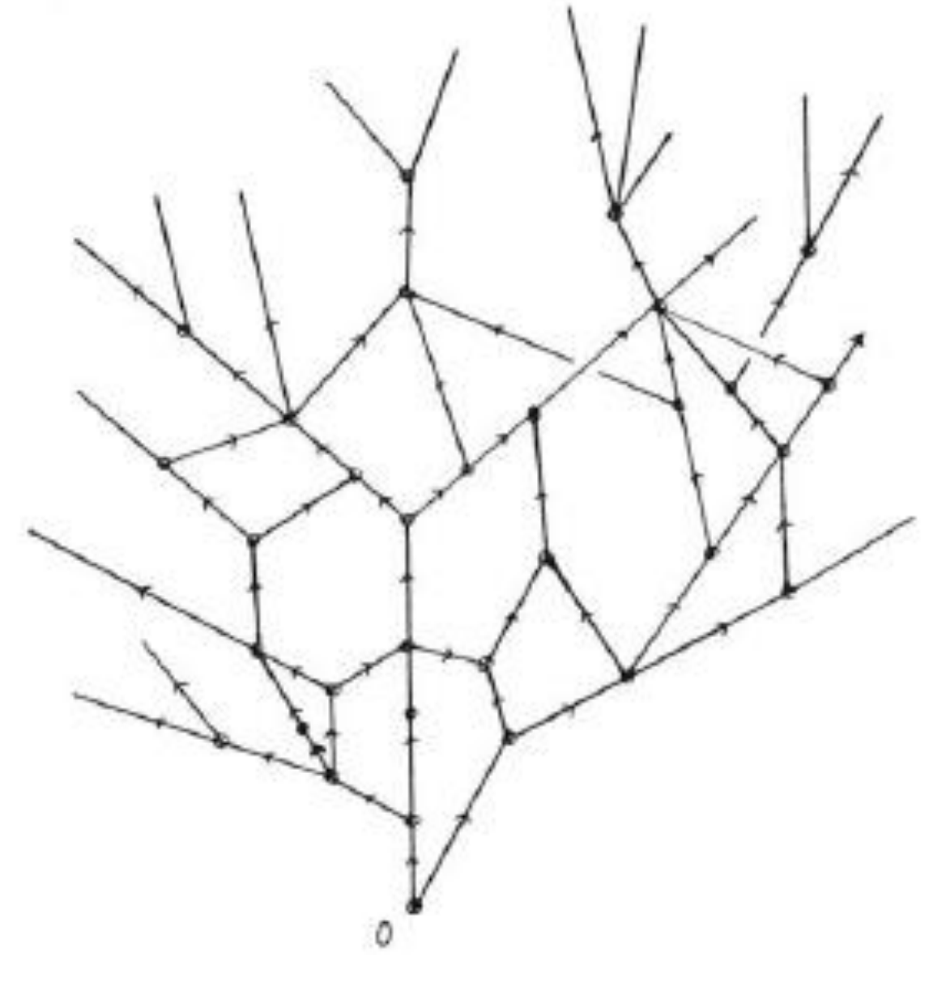
Causal set theory: an early discrete picture
1970s: causal structure determines conformal geometry under suitable causality assumptions.
1979: ’t Hooft explores discrete causal structure.
1987: Bombelli, Lee, Meyer and Sorkin formulate order plus number.
Later: growth dynamics (2000), discrete curvature and gravitational action (2010).
G. ’t Hooft, “Quantum Gravity: A Fundamental Problem and Some Radical Ideas”,
Recent Developments in Gravitation (1979), pp. 323–345.
Speculative question: could a non-manifoldlike early phase precede smooth spacetime?
4
Notes:
Slide 4. Causal set theory: an early discrete picture
Timing: 35 seconds
Here is 't Hooft's early sketch of discrete causal structure, published in 1979. It invites the question of whether a discrete phase might precede a smooth spacetime.
The mathematical background links causal structure to conformal geometry, under suitable causality assumptions. Bombelli, Lee, Meyer and Sorkin formulated the modern causal-set proposal in 1987. Classical growth dynamics followed in 1999 and 2000, and discrete curvature and a gravitational action in 2010.
Preparation notes (not spoken):
Original drawing: G. 't Hooft, Quantum Gravity: A Fundamental Problem and Some Radical Ideas, in Recent Developments in Gravitation (1979), pp. 323-345, https://doi.org/10.1007/978-1-4613-2955-8_8. A nonmanifoldlike early phase is presented as a speculative question, not an interpretation established by the drawing alone. Order determines conformal geometry under suitable continuum hypotheses; number and a volume calibration supply scale information.
Sources:
https://doi.org/10.1063/1.523436
https://doi.org/10.1103/PhysRevLett.59.521
https://doi.org/10.1103/PhysRevD.61.024002
https://doi.org/10.1103/PhysRevLett.104.181301
Original drawing: G. 't Hooft, Quantum Gravity: A Fundamental Problem and Some Radical Ideas, in Recent Developments in Gravitation (1979), pp. 323-345. https://doi.org/10.1007/978-1-4613-2955-8_8

Slide 5
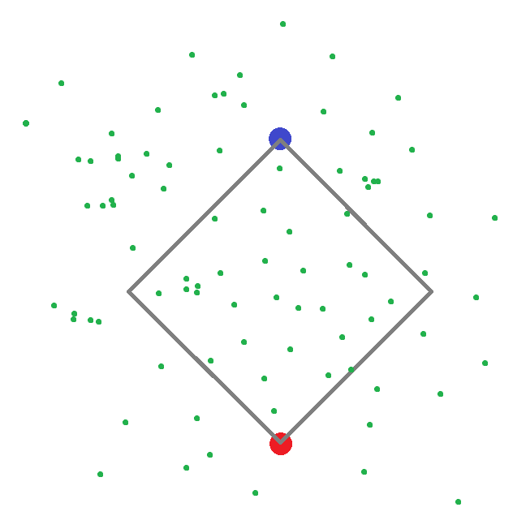
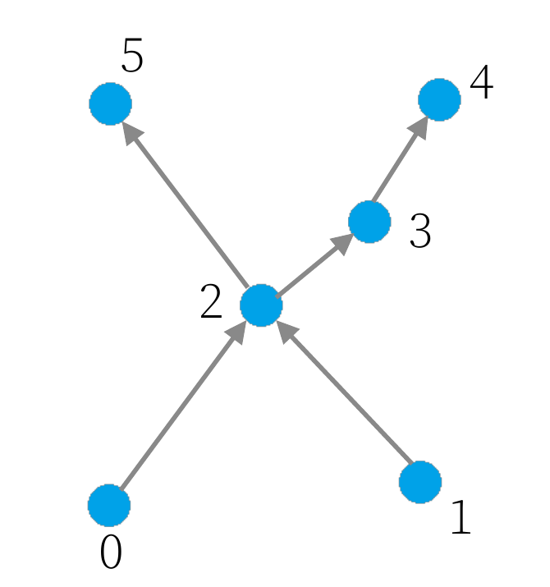
Causal sets: order plus number
Events are elements. A causal relation records which events can influence which.
The order is transitive and has no causal cycles. Unrelated pairs are incomparable.
Local finiteness: finitely many events lie between each comparable pair.
At a specified density, counting events estimates spacetime volume.
Sprinkled spacetime
Order diagram
Future upward. Edges show links. 0 ≺ 2 ≺ 3 also gives 0 ≺ 3.
Random sprinklings into a known spacetime let us test how much geometry the order recovers.
5
Notes:
Slide 5. Causal sets: order plus number
Timing: 55 seconds
Here are two illustrations from my APS talk. The left panel shows a sprinkling of events and a marked causal diamond. On the right is an abstract six-event order diagram, with the future upward. The examples illustrate the same construction; they are not the same finite set.
The order tells us which events can influence which. In this diagram, zero precedes two and two precedes three, so zero also precedes three, even though no edge directly connects them. Zero and one are incomparable. Local finiteness means that only finitely many elements lie between each comparable pair.
Counting supplies volume when we specify an average sprinkling density. The Poisson sampling law respects Lorentz symmetry in Minkowski spacetime. Generate examples in a known geometry, retain the order and counts, and ask which small patterns recover that geometry.
Sources:
https://doi.org/10.1063/1.523436
https://doi.org/10.1103/PhysRevLett.59.521
https://doi.org/10.1007/s41114-019-0023-1
He Liu, APS April Meeting 2024 presentation (APS24.pdf), pages 3 and 5.
Both illustrations reproduced from the presenter's APS24 slides, pp. 3 and 5. The sprinkling and abstract Hasse diagram illustrate separate finite sets.

Slide 6
Current programme I: geometry and dynamics
Direction | Recent papers and contributors | Questions
Embeddings | Johnston: Minkowski embeddings (2022), Simpler embeddings (2025); Madsen: uniqueness (2026) | Recover coordinates from order? When is the continuum unique?
Geometry and structure | Boguñá, Krioukov; Braun; Müller; Hu, D. Meyer, E. Meyer | Distances, curvature and continuum reconstruction?
Actions and emergence | P. and S. Carlip, Surya; Dowker, R. Liu, Lloyd-Jones; de Brito, Eichhorn, Pfeiffer | Which histories dominate the gravitational path integral?
Growth and histories | Bento, Dowker, Zalel; Srivastava, Surya; Gutzeit, Shaban, Yeats | Covariant observables and quantum causal dynamics?
Geometry – what an order describes. Dynamics – which orders occur.
6
Notes:
Slide 6. Current programme I: geometry and dynamics
Timing: 30 seconds
There are several routes into this problem. One reconstructs distances or coordinates and asks when the continuum geometry is unique. Embedding algorithms have a history, including Henson's work and the Liu-Reid construction, followed by recent constructions such as Johnston's.
Other work develops curvature operators and gravitational actions, or studies growth and quantum histories. These are connected questions: which orders occur, and what geometry do they describe? Our contribution is an observable that helps read that geometry.
Preparation notes (not spoken):
The overview samples research questions rather than listing an official roadmap. Henson (2006) and Liu-Reid (2018) are historical background, outside the recent-literature window. Johnston's 2021 preprint/2022 publication and 2025 paper are within it. Embedding constructions, probabilistic reconstruction theorems, and suppression of unwanted orders address different questions and have different hypotheses; none alone completes a generic four-dimensional dynamical continuum limit.
Sources:
https://arxiv.org/abs/2111.09331
https://arxiv.org/abs/2401.17376
https://arxiv.org/abs/2507.01907
https://arxiv.org/abs/2503.01719
https://arxiv.org/abs/2607.05840
https://arxiv.org/abs/2601.03280
https://arxiv.org/abs/2311.18238
https://arxiv.org/abs/2501.00139
https://arxiv.org/abs/2301.13525
https://arxiv.org/abs/2212.01149
https://arxiv.org/abs/2302.10582
https://arxiv.org/abs/2603.25503
https://arxiv.org/abs/2605.00622
https://arxiv.org/abs/gr-qc/0601069
https://doi.org/10.1088/1361-6382/aac082
https://arxiv.org/abs/2502.09701
https://doi.org/10.1103/PhysRevD.111.106020

Slide 7
Current programme II: fields and tests
Direction | Recent contributors: examples | Questions
Fields and scattering | Albertini et al.; Jubb; Hawkins et al.; Shuman; Kastrati, Hinrichsen | Local operators, interactions and scattering?
Entropy and horizons | Yazdi, Jones; Mathur, Surya, Nomaan X; Dou; Homšak, Veroni | Vacuum selection, area laws and horizon molecules?
Cosmology and tests | Das, Nasiri, Yazdi; Albertini, Panella; de Brito et al.; Carone, Donald | Dark-energy fluctuations, diffusion, nonlocal matter?
Computation | Glaser; Moradi et al.; Ferguson et al.; Adamson, Wallden | Sampling, fluctuations and scalable algorithms?
Here, small order patterns measure the local cosmic expansion.
7
Notes:
Slide 7. Current programme II: fields and tests
Timing: 25 seconds
For matter, the programme extends from free propagation to interactions and scattering. It also asks how to choose a vacuum, define entanglement, and count horizon degrees of freedom.
Cosmology provides tests through fluctuating Lambda and diffusion models. Classical simulations and quantum algorithms address the computational challenge. These efforts ask which features of discreteness could become measurable. I'll focus on one geometric ingredient: what small causal patterns reveal about local expansion.
Sources:
https://arxiv.org/abs/2306.12484
https://arxiv.org/abs/2402.08555
https://arxiv.org/abs/2607.04980
https://arxiv.org/abs/2207.05667
https://arxiv.org/abs/2212.10592
https://arxiv.org/abs/2602.16782
https://arxiv.org/abs/2404.11670
https://arxiv.org/abs/2304.03819
https://arxiv.org/abs/2307.13743
https://arxiv.org/abs/2407.03395
https://arxiv.org/abs/2409.02188
https://arxiv.org/abs/2305.07595
https://arxiv.org/abs/2310.04319
https://arxiv.org/abs/2306.09904
https://arxiv.org/abs/2506.19538
https://arxiv.org/abs/2505.22217

Slide 8

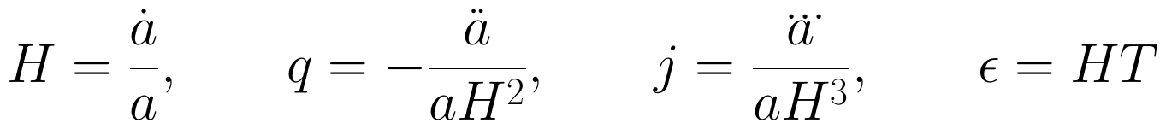
The cosmographic target
Our target is the local expansion history, encoded by derivatives of the scale factor.
Four-dimensional, spatially flat FLRW (Friedmann–Lemaître–Robertson–Walker).
A comoving diamond of full proper duration T, centred on the measurement event.
a: scale factor. Derivatives are w.r.t. the comoving proper time.
H: expansion rate. q: deceleration. j: normalized third derivative (“jerk”).
ε = HT is dimensionless. All quantities refer to the midpoint, with H ≠ 0.
The interval is short compared with curvature and variation scales.
8
Notes:
Slide 8. The cosmographic target
Timing: 70 seconds
Our continuum class is four-dimensional, spatially flat Friedmann-Lemaitre-Robertson-Walker spacetime, or FLRW. Its scale factor a tells us how distances between comoving observers change. A dot means a derivative with respect to their proper time.
H is the first proper-time derivative of a, divided by a. The deceleration parameter q is minus the second derivative, divided by a H squared. The jerk j is the third derivative, divided by a H cubed. One, two and three dots denote these derivatives. These normalized quantities describe the local expansion history. Negative q means acceleration for an expanding universe.
Around a comoving observer, take a causal diamond of full proper duration T, centred on the event of interest. Epsilon means H times T. We recover quantities at that midpoint using a short-interval expansion. The response comes directly from the geometry, without imposing a Friedmann equation or choosing a matter model.
Preparation notes (not spoken):
At the proper-time midpoint t=0, H=dot(a)/a, q=-ddot(a)/(a H^2), j=dddot(a)/(a H^3), epsilon=H T. T is the full duration, with endpoints at t=-T/2 and +T/2. A comoving observer has fixed FLRW spatial coordinates. Dimensionless q and j require H nonzero; the reconstruction uses the expanding branch H>0. Short interval means short compared with curvature and derivative-variation scales, not merely a small numerical T in arbitrary units. Throughout the talk, dots denote derivatives with respect to comoving proper time. Any prime denotes a derivative with respect to conformal time. Triple-dot and quadruple-dot notation denote the third and fourth derivatives, respectively.
Sources:
local_cosmography_cqg.tex, section 2, equations cosmography and curvature

Slide 9
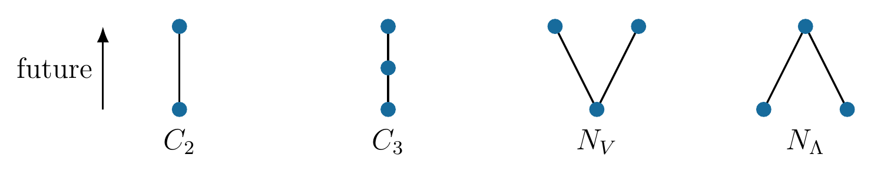
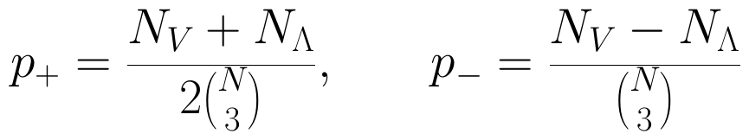
Chains and the two pixie orientations
Small order patterns → evolving geometry.
The two pixie arms are incomparable. Count all strict transitive relations.
N: interior events per diamond. M: independent diamonds per ensemble.
p₊: normalized orientation average. p₋: normalized orientation difference.
9
Notes:
Slide 9. Chains and the two pixie orientations
Timing: 75 seconds
Let N be the number of interior events in a diamond; the marked endpoints are left out. C2 counts ordered pairs and C3 counts three-event chains. NV counts upward pixies, and N-Lambda counts downward pixies. Here the subscript Lambda names the shape, rather than the cosmological constant.
The upward pixie has one common past and two incomparable future events. Reversing it gives the downward pixie. If the arms are comparable, the triple is a chain, so subtract those cases. The diagram lines need not be nearest-neighbour links in the full set.
Divide the pixie counts by the number of possible triples. P-plus is half their normalized sum, and p-minus is their normalized difference. We average over M independent diamonds. The finite-N mean fractions are exact pattern probabilities; large N enters the covariance approximation, rather than these counting identities.
Preparation notes (not spoken):
N_V and N_Lambda denote the two induced three-element fork counts. p2=C2/binom(N,2), p3=C3/binom(N,3), p+=(N_V+N_Lambda)/(2 binom(N,3)), p-=(N_V-N_Lambda)/binom(N,3). binom(N,k) counts unordered k-element selections. M is the number of independently generated diamonds per duration and trial. A strict relation includes transitive pairs; it is not restricted to full-causal-set links. The average uses the extra factor 1/2 shown above.
Sources:
local_cosmography_cqg.tex, section 2, equations counts1, counts2, fractions

Slide 10
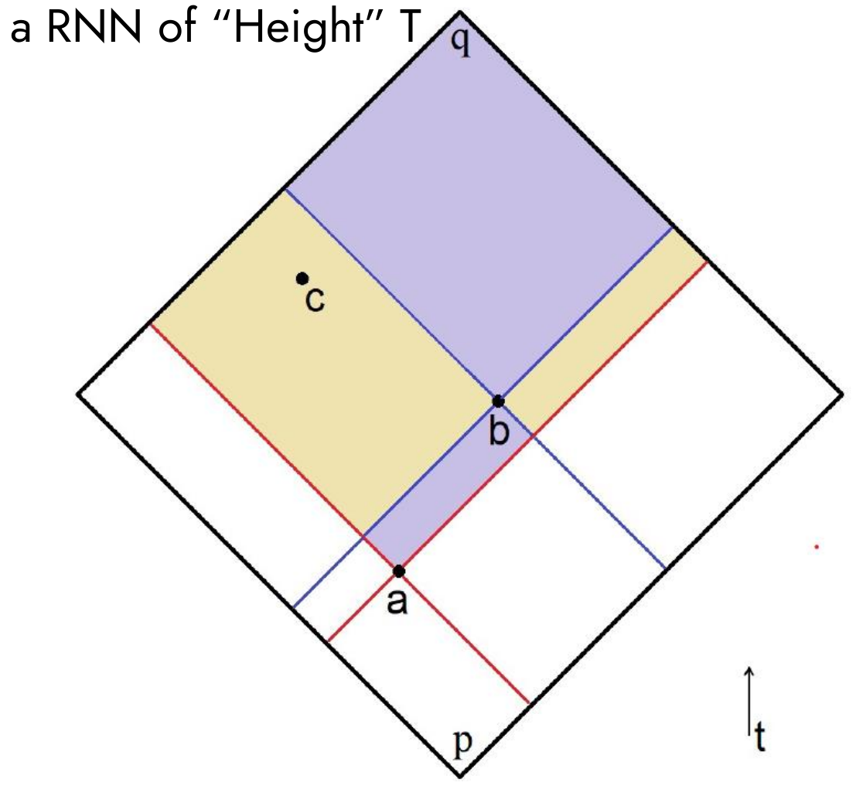
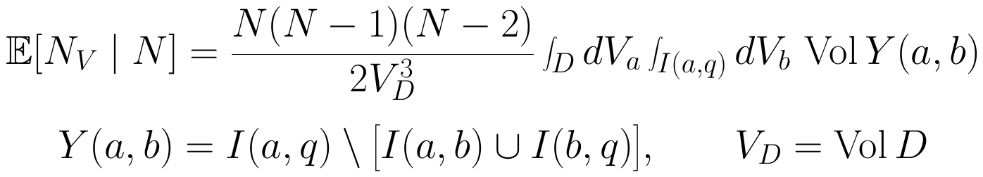
Expected count of a three-element pixie
We sample N events from physical volume in a Riemann normal neighborhood (RNN).
Choose a in D = I(p,q), then b in its future subinterval I(a,q).
Place c in the yellow region, spacelike to b. Exclude the purple regions.
Integrate physical volume over all three allowed positions.
Divide by two for arm exchange. Use the fixed-N sampling factor below.
Diagram: He Liu, APS April Meeting 2024, p. 7. Current formula uses fixed N and excludes marked endpoints.
10
Notes:
Slide 10. Expected count of a three-element pixie
Timing: 45 seconds
Here is the coloured-region calculation from my APS talk. We sample N events uniformly in physical volume inside the small diamond. Choose the common past point a, then choose b above it. The yellow region contains allowed positions of c: above a and spacelike to b. Exclude the purple regions, where b and c are comparable.
Integrate over these allowed positions and normalize by the volume cubed. The falling factorial counts assignments of three distinct events. Divide by two because exchanging b and c gives the same pixie. The chosen metric determines the volume elements and causal regions.
Preparation notes (not spoken):
The three-element V is a 2-pixie in the terminology of APS24. Fix N interior events distributed independently with probability dV/V_D in D = I(p,q), a small interval inside a Riemann normal neighbourhood. Exclude the marked endpoints. For a fixed common past a and a future arm b, restrict c to Y(a,b), the yellow region in the original APS diagram. The two purple subintervals I(a,b) and I(b,q) contain the positions comparable to b. The exact falling-factorial prefactor counts distinct assignments of a,b,c; 1/2 removes the exchange of the arms. The expectation is conditional on N. The Poisson calculation instead uses ρ³/2. Do not replace that factor by N³/(2V_D³) at finite N.
Sources:
He Liu, Molecules of Discrete Spacetime, APS April Meeting 2024 slides, pp. 6–8 (APS24.pdf).
local_cosmography_cqg.tex, exact interval integrals, eqs. labelled integrals2–integrals4.
Original coloured-region diagram reproduced from He Liu’s APS24 slides, p. 7. Current equations use the exact fixed-cardinality convention of the manuscript.

Slide 11
Calculating curvature corrections
We evaluate the motif integrals for the chosen geometry.
Expand the physical measure and interval volumes in Riemann normal coordinates (RNC).
Use conformal coordinates to keep the complete flat-FLRW causal domain.
Integrate weighted moments to obtain exact rational coefficients, including boundary and normalization terms.
Convert the endpoints to centre the interval in proper time.
η: conformal time, with dt = a dη.
11
Notes:
Slide 11. Calculating curvature corrections
Timing: 25 seconds
The same integrals give the curvature corrections. We expand the physical measure and the interval volumes in Riemann normal coordinates. For flat FLRW, conformal coordinates preserve the complete causal domain. Integrate the weighted moments to obtain exact rational coefficients, including the boundary and normalization. Finally, convert the endpoints to centre the interval in proper time.
Preparation notes (not spoken):
Riemann normal coordinates, abbreviated RNC, organize the local curvature expansion. The Riemann normal neighbourhood, RNN, is the region in which this expansion is controlled. Expand both the volume density and the causal integration boundaries, then normalize by the physical interval volume. In the spatially flat FLRW calculation, conformal time obeys dt = a dη. The conformal factor leaves the light cones unchanged and weights four-volume by the fourth power of the scale factor. Exact integration over the conformal domain includes the full boundary. Convert the endpoints because the proper-time and conformal-time midpoints generally differ. Independent integration checks the rational coefficients.
Sources:
local_cosmography_cqg.tex, section 3, conformal moments and proper-time endpoints

Slide 12
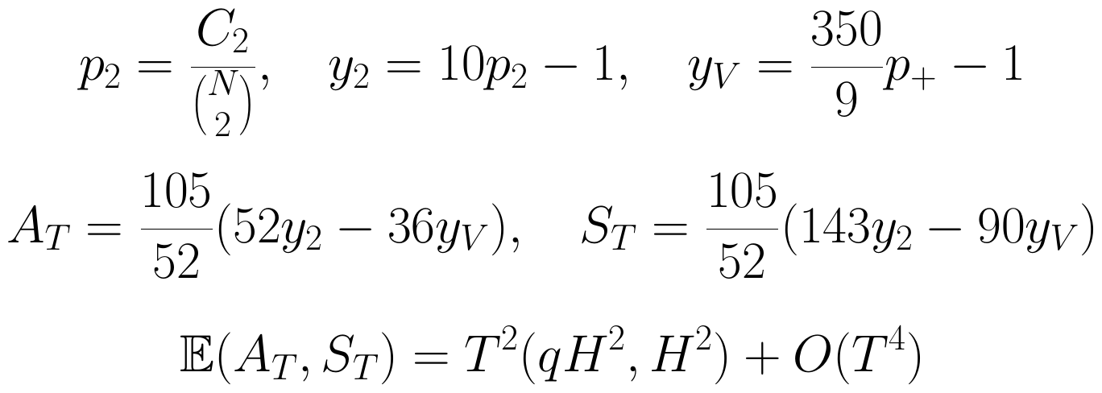
From symmetric counts to H and q
Symmetric counts isolate H² and qH². Subtract the flat-space means before combining them:
𝔼: average over sprinklings. O(T⁴): corrections beginning at fourth order.
Fit the T² amplitudes A = qH² and S = H² across durations. Then q = A/S.
12
Notes:
Slide 12. From symmetric counts to H and q
Timing: 65 seconds
First remove the flat-spacetime baselines. Let p2 be the relation fraction. We rescale it to y2, and the averaged pixie fraction to yV, so both vanish on average in a flat diamond. Rescale the three-chain fraction in the same way to obtain y3.
Then form two fixed linear combinations, A-sub-T and S-sub-T. The coefficients cancel one of the two quadratic geometric responses in each combination. Their leading means are q H squared T squared and H squared T squared. The explicit definitions are included here in the manuscript.
The expectation symbol means an average over sprinklings. O of T to the fourth denotes the next geometric corrections. Fit the leading T-squared amplitudes A and S across several durations. Their ratio gives q; S gives H squared. Using several durations lets us separate the local response from finite-duration corrections.
Preparation notes (not spoken):
Definitions at first use: p2=C2/binom(N,2), y2=10 p2-1, yV=(350/9) p+-1. The exact linear combinations are A_T=(105/52)(52 y2-36 yV) and S_T=(105/52)(143 y2-90 yV). Their ensemble means obey E[A_T]=q H^2 T^2+O(T^4), E[S_T]=H^2 T^2+O(T^4). E denotes a sprinkling ensemble expectation. O(T^n) denotes a remainder bounded by a constant times |T|^n near T=0 for fixed smooth local geometry; the coefficients carry the required dimensions. Ratios of finite-duration or noisy quantities have geometric and statistical effects that must be controlled. The later fit calls the leading T^2 amplitudes A=q H^2 and S=H^2; they are different from the finite-duration statistics A_T,S_T. On the expanding branch H=+sqrt(S).
Sources:
local_cosmography_cqg.tex, equations fractions, deviations, A and S

Slide 13
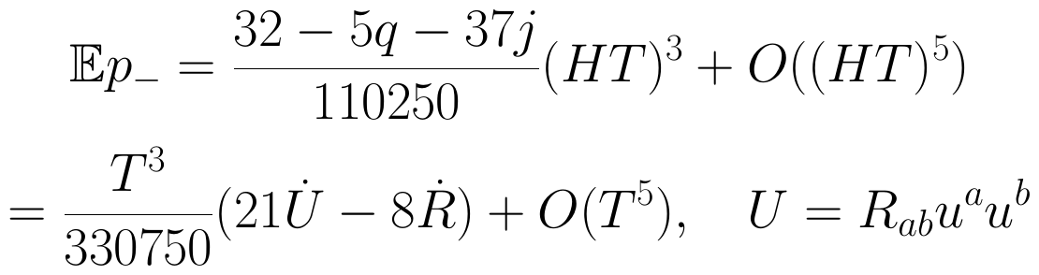
Orientation probes curvature evolution
Subtracting the orientations cancels even terms and exposes how curvature changes.
U is the Ricci curvature along the observer. Dots are proper-time derivatives.
With H and q from symmetric counts, the cubic coefficient determines j.
Exact de Sitter gives zero. The odd signal measures local geometric evolution.
13
Notes:
Slide 13. Orientation probes curvature evolution
Timing: 65 seconds
The difference between orientations gives another piece of information. Its lower-order terms cancel, leaving a cubic response. Its coefficient is a known linear combination of the deceleration and jerk. Once the even statistics determine H and q, this cubic coefficient determines j.
We can express this geometrically. R is scalar curvature. Let u be the observer's unit four-velocity, and U the Ricci tensor contracted twice with u: the timelike Ricci curvature seen by that observer. A dot again means change along proper time. The odd response measures a combination of dot U and dot R.
In exact de Sitter, the difference vanishes. An evolving geometry can produce it without fundamental time-reversal violation. Its next correction is fifth order. Smaller diamonds suppress that correction, but the cubic signal also weakens, so measuring jerk becomes harder. Combined with the symmetric amplitudes, this gives us a way to infer jerk while also estimating H and q.
Preparation notes (not spoken):
U=R_ab u^a u^b, with metric signature -+++. E[p-]=(32-5q-37j)(HT)^3/110250+O((HT)^5)=T^3(21 dot U-8 dot R)/330750+O(T^5). The uncertainty in jerk scales as |HT|^(-3)/sqrt(MN) in the leading fixed-H,q forecast. Exact de Sitter has zero orientation difference at every duration. A log-polynomial 'de Sitter jet' only matches specified local derivatives and need not share this exact finite-duration property.
Sources:
local_cosmography_cqg.tex, equations evenseries, odd, oddcurvature

Slide 14
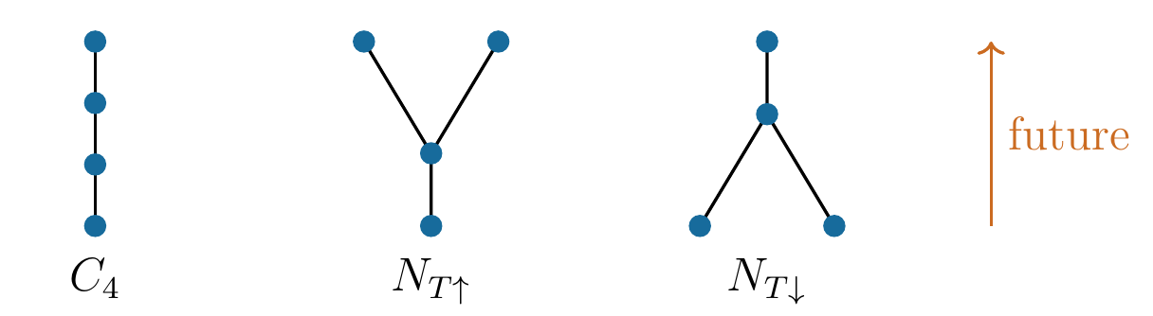
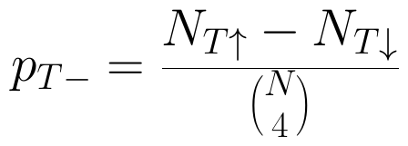
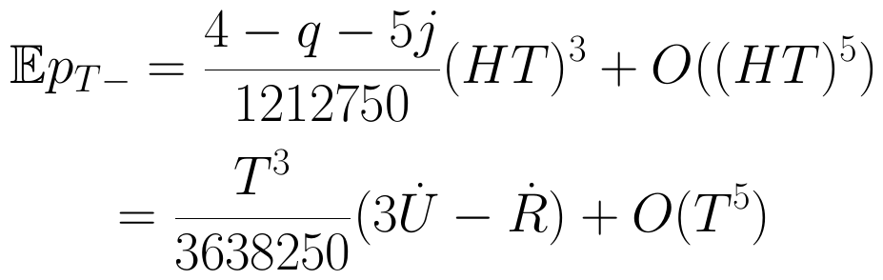
Four-chains and fork-tail motifs
Four-event patterns supply a second response to curvature evolution.
In FLRW, the new response probes an independent combination of curvature derivatives.
Its precision gain depends on correlations with the original motif counts.
14
Notes:
Slide 14. Four-chains and fork-tail motifs
Timing: 60 seconds
We next add a four-event chain, whose count is C4, and a fork with one event below the branch. Call the upward and downward fork-tail counts N-T-up and N-T-down. Their normalized difference, p-T-minus, divides the count difference by the number of possible quadruples.
This odd response is cubic too. It has a different linear dependence on q and j from the original pixie difference. In curvature language, it measures three dot U minus dot R, with the normalization given in the equations.
That is algebraically independent of the three-element combination in FLRW. The symmetric four-element channels also have different quadratic and quartic coefficients. Whether these extra responses improve an estimate substantially depends on how their noise fluctuates with the original counts.
Preparation notes (not spoken):
p4=C4/binom(N,4); p_T-=(N_Tup-N_Tdown)/binom(N,4). E[p_T-]=(4-q-5j)(HT)^3/1212750+O((HT)^5)=T^3(3 dot U-dot R)/3638250+O(T^5). The invariant denominator is 3,638,250. The future direction is upward in the diagrams. These are induced fork-tail motifs with incomparable arms and transitive tail relations. Algebraic independence of curvature-derivative combinations does not imply a well-conditioned noisy inversion.
Sources:
local_cosmography_cqg.tex, section 4, equations count4, countT, oddT

Slide 15
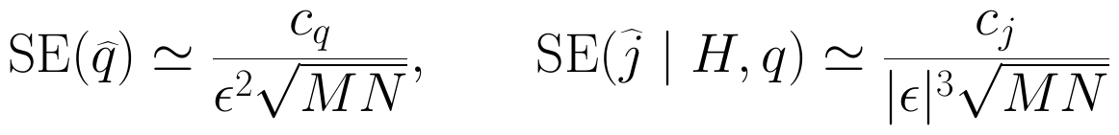
More patterns: how much precision?
We compare the information carried by extra motifs at equal sampling effort.
Observable set | q SE coefficient | j SE coefficient
Relations + three-chains | 32.0275 | —
+ original pixies | 22.2248 | 298.2916
+ four-element motifs | 21.5946 | 293.2876
Correlated counts give modest extra SE reductions: 2.84% for q and 1.68% for conditional jerk.
Leading forecasts at equal M, N, T: q = ½ with H inferred; jerk holds H and q fixed.
15
Notes:
Slide 15. More patterns: how much precision?
Timing: 55 seconds
For this comparison, keep N, M and the duration the same. A hat denotes an estimate; SE means its standard error. The coefficients in the uncertainty formulas summarize the leading sampling noise.
Adding the original averaged pixies reduces the forecast standard error of q by about thirty-one percent relative to relations and three-chains. The four-element motifs add another 2.84 percent. The extra odd channel improves the conditional jerk forecast by 1.68 percent.
The conditions differ: the q forecast estimates H as well, at q equal to one half; the jerk forecast holds H and q fixed. Covariance describes how the statistics fluctuate together. Keeping it matters because motifs share events. These are local forecasts, rather than measured coverage of the extended estimator.
Preparation notes (not spoken):
At q=1/2, c_q=32.0275 for relations+three-chains, 22.2248 with original pixies, and 21.5946 with four-element even motifs. SE(qhat) approximately c_q/[epsilon^2 sqrt(MN)]. The known-H,q jerk coefficients are 298.2916 and 293.2876, multiplying 1/[|epsilon|^3 sqrt(MN)]. N,M,T are matched; runtime or computational cost is not held fixed by this comparison. The 2.84% and 1.68% reductions are relative to the original pixie estimators, not to chain-only jerk inference.
Sources:
local_cosmography_cqg.tex, table four_information and leading covariance forecast

Slide 16
Experiment setup: one reconstruction trial
We test recovery on known geometries.
Choose six flat-FLRW backgrounds with H(0) = a(0) = 1. Vary q, j and higher derivatives.
Sample exactly N independent events from each diamond’s physical four-volume: a Poisson sprinkling conditioned on N.
Generate M diamonds at each HT = 0.20, 0.35, 0.50, 0.65, 0.80. Use independent ensembles at different durations.
Count relations, three-chains and both pixie orientations on the same events. Fit all durations with their full covariance.
Repeat fresh trials. Check parameter recovery, 95% interval coverage and χ² goodness of fit.
Repeated-trial baseline: N = 512, M = 65,536 per duration. Full design in the appendix.
16
Notes:
Slide 16. Experiment setup: one reconstruction trial
Timing: 85 seconds
Let me put the numerical experiment together. We choose six smooth, positive scale factors, with midpoint H and a set to one. Matter, radiation and de Sitter label their local derivatives; they are not the exact global solutions. Other backgrounds change jerk, snap, or a higher derivative. Snap is the fourth derivative of a, normalized by a H to the fourth. The independent jerk shift tests whether the counts distinguish the third derivative when local expansion and acceleration agree.
Each diamond contains exactly N independent events distributed uniformly in physical four-volume. This is a Poisson sprinkling conditioned on N. Generate M independent diamonds at each of five durations, 0.20, 0.35, 0.50, 0.65 and 0.80 in Hubble units. Those five ensembles make one trial.
Fit the original four statistics jointly and form nominal ninety-five-percent intervals, using their measured covariance. This is generalized least squares. A residual is a simulated mean minus its fitted mean; the covariance weights these differences together. The primary fit keeps even powers through fourth and odd powers through fifth; the other keeps sixth and seventh.
Repeat with fresh events. Coverage counts intervals containing the input value. The fit test asks whether the truncated expansion describes the simulated means within their sampling uncertainty; a p-value below five percent rejects it. Counts, durations and covariance determine the estimates. The input values enter afterward to check the answers.
Preparation notes (not spoken):
Exact duration grid: HT in {0.20,0.35,0.50,0.65,0.80}; H(0)=1 in the six backgrounds, so the numerical T values equal HT. N is events per diamond; M is diamonds per duration per trial. Distinct durations and different trials use independent point ensembles; the primary and secondary fits reuse the same data in a trial and are not independent experiments. A cell means one background/duration/sample-size combination. The original statistic vector is (y2,y3,yV,p-), where y3=350 p3-1. All four entries come from the same diamond and can be correlated. Sample covariance between diamonds divided by M estimates the covariance of the mean. Fit labels 4/5 and 6/7 identify highest even/odd powers, not counts of observations. There are 20 mean observations per trial (4 statistics at 5 durations), giving 13 or 9 residual degrees of freedom. Confidence sets are nominal 95%; the lack-of-fit rejection threshold is p<0.05. Exact models and full campaign sizes are in Appendices A6-A7 (slides 26-27).
Sources:
local_cosmography_cqg.tex, sections 2 and 6; exact background table; multiscale GLS protocol
output/gpu_expansion_20261017/plan.json
output/cqg_jerk_coverage_plan.json
higher_order_gpu_sampling.py
higher_order_jerk_inference.py

Slide 17
Independent tests of the new motifs
These checks test the counting formulas and their mean geometric response.
Enumerate finite orders to check the identities. Match CPU/GPU counts on identical coordinates.
Integrate independently: even remainders scale as T⁴, then T⁶; odd remainders as T⁵.
Check the means: six backgrounds + Minkowski; T = 0.5, N = 256, M = 131,072 per cell. Total: 917,504 diamonds.
Mean-response check | χ² / degrees of freedom | p value
New three statistics | 16.477 / 21 | 0.742
All seven statistics | 54.134 / 49 | 0.285
χ²: covariance-weighted discrepancy. p: its null-model upper-tail probability.
Both mean checks are consistent with the predictions. Extended-estimator coverage is the next test.
17
Notes:
Slide 17. Independent tests of the new motifs
Timing: 70 seconds
The new four-element observables have a separate check. We first enumerate small orders to verify the counting identities and compare CPU and GPU counts on identical coordinates. Independent integration then checks how the omitted geometric terms scale with duration.
For the sampling test, use the six backgrounds plus Minkowski, at duration 0.5, with 256 events and 131,072 independent diamonds per cell. That is 917,504 diamonds. Retain all seven statistics and their covariance.
Chi-square measures the covariance-weighted discrepancy from exact mean predictions. Degrees of freedom count the independent comparison components; a p-value is the upper-tail probability under that mean model. The three new statistics give 16.477 for 21 degrees of freedom; all seven give 54.134 for 49. The corresponding p-values are 0.742 and 0.285. Neither check shows an unusually large discrepancy from the exact mean prediction. These are mean-response checks. Repeated multiscale interval coverage for the extended estimator remains the next test.
Preparation notes (not spoken):
The new observables are y4, yT and p_T-, in addition to (y2,y3,yV,p-). Each of the seven background cells has T=0.5, N=256, M=131072; Minkowski is only a flat-baseline mean check and does not have H=1 or defined cosmographic ratios. New-three omnibus: chi-square=16.477, dof=21, p=0.742. All-seven omnibus: chi-square=54.134, dof=49, p=0.285. The covariance is estimated, so these Gaussian/chi-square diagnostic probabilities are asymptotic approximations. For the independent deterministic integration checks, the powers of the discrepancy from the stated truncated prediction are T^4 after quadratic even prediction, T^6 after including quartic even terms, and T^5 after cubic odd prediction. A p-value is not the probability the model is true. The seven-cell design tests means at one duration, not coverage of seven-statistic multiscale inference.
Sources:
local_cosmography_cqg.tex, section labelled sec:four_validation

Slide 18
More sampling exposes geometric truncation
Original four-statistic follow-up: 1.573 billion diamonds, 2,240 trials, N up to 2,048.
Earlier matched H, q backgrounds with j = 1 and 2 give 0.983 ± 0.113 and 2.033 ± 0.113 (one SE).
Radiation jet: 64 fresh trials, N = 512, M = 1,048,576 per duration
Highest powers: even / odd | Fit rejections | Mean jerk SE
T⁴ / T⁵ | 54 / 64 | 0.1214
T⁶ / T⁷ | 8 / 64 | 0.3667
Residual = simulated mean − fitted mean. χ² weights residuals by their full covariance.
It tests whether the truncated expansion fits the simulated means within their sampling uncertainty.
Reject if p < 0.05. Coverage = intervals containing the input: 60/64 for j with both fits. Higher order term increases uncertainty.
18
Notes:
Slide 18. More sampling exposes geometric truncation
Timing: 90 seconds
We also tested the original four-statistic reconstruction much more extensively. The follow-up contains 2,240 trials and 1.573 billion diamonds, with causal sets up to 2,048 events. Standard trials use 65,536 diamonds per duration; the high-precision trials use just over a million.
In the earlier large ensemble, two input backgrounds share H and q but have jerks one and two. The recovered values are about 0.983 and 2.033, each with a standard error near 0.113. The fit estimates H and q as well.
The fit diagnostic tests whether the truncated expansion fits the simulated means within their sampling uncertainty. Its chi-square combines the residuals using their full covariance. Higher sampling precision can expose the omitted geometric terms. In the high-precision radiation-jet test, the primary fit rejects in 54 of 64 trials. Adding higher powers reduces this to eight, while increasing the mean jerk standard error from 0.1214 to 0.3667.
That improvement has a cost, and some coverage and diagnostic exceptions remain. The reported results include all of them. At matched M times N, the larger sets give approximately the expected leading precision. The size comparison uses the matter and snap-shift backgrounds. It tests the scaling in those examples. This campaign tests original four-statistic inference; the separate seven-statistic experiment tests the additional mean responses.
Preparation notes (not spoken):
The follow-up has 1,572,864,000 diamonds, 2,240 independent trials and 4,480 fits. Every trial is fitted with both methods. In its high-precision radiation subgroup, jerk coverage is 60/64 at both fit orders even though lack-of-fit rejection changes from 54/64 to 8/64; these are different diagnostics. All six high-precision pointwise Wilson intervals for jerk coverage contain 95%. Primary q coverage for de Sitter/radiation jets is 57/64 and 56/64, with Wilson intervals below nominal 95%. The high-precision de Sitter exact-mean subgroup discrepancy remains at p=0.00875, and secondary exceptions are retained. No fit-p-value filtering or trial replacement was used. The 1.573-billion total excludes the earlier initial ensemble and 128-trial calibration. Matched MN=33,554,432 tests N=512,1024,2048 on matter and snap-shift jets; it does not establish universal finite-size scaling in arbitrary causal sets.
The truncation remainder is the deterministic contribution of omitted higher powers in the geometric expansion. A measured residual is a simulated mean minus the fitted mean at the same duration; it contains sampling fluctuations and any response left unrepresented by the fitted expansion. The lack-of-fit statistic is the covariance-weighted sum of squared residuals, r^T C^(-1) r, with C the covariance of the simulated means. It tests whether the truncated expansion fits those means within their sampling uncertainty. The reference chi-square law uses the residual degrees of freedom and is an asymptotic approximation here because C is estimated. A small p-value indicates a discrepancy with the fitted mean model under these assumptions; it does not identify its cause by itself. The reduction in rejection after adding higher powers supports a truncation explanation in this controlled comparison. Confidence-interval coverage is a separate repeated-trial check of whether an interval contains the input parameter.
Sources:
local_cosmography_cqg.tex, tables jerk and gpu_high_precision, section sec:gpu_followup

Slide 19
From independent ensembles to one causal set
The next step is a measurement within one discrete spacetime.
Current inputs: marked comoving diamonds and calibrated relative durations.
The counts use order alone. Identifying the observer and the clock needs further structure.
A common clock rescaling cancels from q and j. Absolute H needs a physical time scale.
Next test: infer the interval clock and propagate correlations between overlapping intervals.
Then test spatial curvature, anisotropy and the full seven-statistic estimator.
19
Notes:
Slide 19. From independent ensembles to one causal set
Timing: 65 seconds
Our next task is to make this measurement inside a single causal set. The counts already use only the marked order, but the present tests supply the observer, the family of diamonds, and their relative durations. That information gives the counts their cosmographic interpretation.
A common change of clock units drops out of q and jerk. Estimate relative durations intrinsically and propagate their uncertainty into the inference. Absolute H also needs a time calibration.
There is another statistical change: overlapping diamonds share events. Propagate those correlations into the joint fit. Run coverage tests for the extended estimator as well. These tools allow measurements within a common discrete spacetime and tests of a broader class of geometries.
Preparation notes (not spoken):
Relabelling invariance of marked-order counts is distinct from a complete relational construction of observer, interval selection and clock. A common positive rescaling of all duration units preserves q and j; uncertainty in relative durations does not cancel. A single Poisson realization at common intensity has fluctuating interval cardinalities and overlap covariance, unlike the present independent conditional fixed-N ensembles. General spatial curvature, anisotropy and independent Weyl responses require additional geometric calculations.
Sources:
local_cosmography_cqg.tex, discussion and conclusion

Slide 20
How far are we from a prediction?
Recovering geometry is just one step. Predicting its realized value requires a cosmological dynamics.
Achieved: a calibrated map from motif statistics to local H, q and j in prescribed flat-FLRW ensembles.
Next milestone: recover them within one causal set, with an intrinsic clock and validated uncertainty.
A physical prediction needs a dynamics and state or initial conditions that select a distribution of causal sets.
Apply the observables to that distribution, then connect to measured redshifts, distances and other data.
Sorkin’s Λ estimate motivates this work. A predicted value or history of Λ remains a dynamical question.
These observables can test a candidate cosmological dynamics.
20
Notes:
Slide 20. How far are we from a prediction?
Timing: 75 seconds
We have built a geometric estimator and tested its inference on prescribed FLRW backgrounds. Small order patterns recover local curvature, and their orientation difference probes its evolution. Four-element motifs add another response, with a modest precision gain once correlations are included. The simulations also show where statistical intervals or geometric truncation need further work.
Predicting cosmic expansion requires a dynamical model that assigns weights to causal-set histories, together with its initial or boundary-state assumptions. Then this estimator could measure the distribution of H, q and jerk that the model produces, and its implications for Lambda. Different matter models can share the same local expansion, so relating these quantities to dark components also needs additional physical assumptions. A numerical cosmological-constant prediction remains a dynamical target.
Connecting that distribution to observations needs another bridge: how signals, redshift, distances and lensing emerge and relate to our local quantities. That gives a concrete use for the present work. Once a model supplies histories, these observables can help test what geometry it predicts. Thank you.
Preparation notes (not spoken):
Achieved: explicit local kinematic response and covariance in prescribed four-dimensional spatially flat FLRW; inference studies with pointwise coverage measurements and retained failures of nominal calibration; separate verification of four-element motif means. Required next: intrinsic clock, interval selection and overlap covariance, extended-estimator calibration, a specified causal-set dynamics/measure and state, and a continuum/observational map. H,q,j alone do not determine matter content or Lambda without further field equations/assumptions. A quantum measure generally cannot be treated as an ordinary positive probability distribution without an appropriate account of events and probabilities. The talk does not claim that the microscopic dynamics selecting the observed cosmology has been solved.
Sources:
local_cosmography_cqg.tex, discussion and conclusion; inference and scope statements

Slide 21
Thanks.

Slide 22
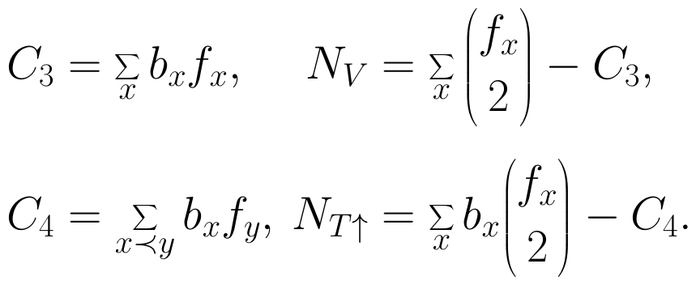
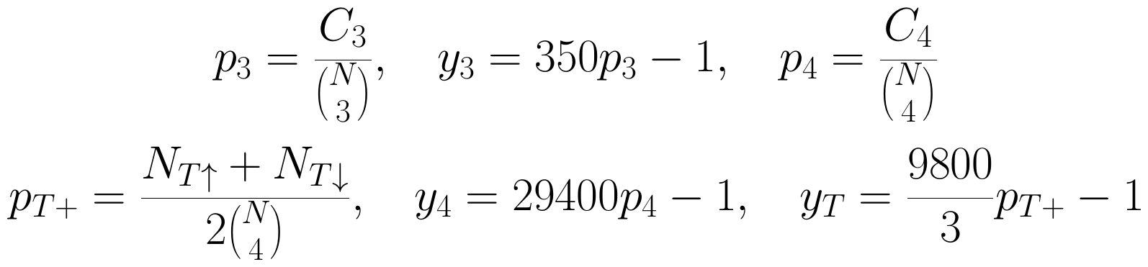
Appendix: counts and normalized combinations
bₓ, fₓ: predecessors and successors inside the parent diamond.
The fractions above normalize four-chains and the fork-tail average.
The subscript T on a motif labels its tail; T alone is interval duration.
Subtract chains to impose incomparability.
A1
Notes:
Slide 21. Appendix: counts and normalized combinations
Timing: 0 seconds
Let b_x and f_x count the strict past and future of an event x within the diamond. A three-chain has one middle element, so summing b_x times f_x counts it once. Choosing two future events of x counts both upward pixies and chains. Subtract the chain count to enforce incomparable arms.
For four elements, sum b_x times f_y over strict relations x preceding y to count four-chains. The upward fork-tail count is the sum of b_x times the number of pairs in the future of x, minus the four-chain count. Reverse past and future for its partner. These formulas use transitive relations, not only links.
Preparation notes (not spoken):
C2=sum_x f_x; C3=sum_x b_x f_x; N_V=sum_x binom(f_x,2)-C3; N_Lambda=sum_x binom(b_x,2)-C3. C4=sum_(x<y) b_x f_y; N_Tup=sum_x b_x binom(f_x,2)-C4; N_Tdown=sum_x f_x binom(b_x,2)-C4. p2=C2/binom(N,2); p3=C3/binom(N,3); y2=10p2-1; y3=350p3-1; yV=(350/9)p+-1. A_T=(105/52)(52y2-36yV); S_T=(105/52)(143y2-90yV). N counts interior events and excludes marked endpoints. Distinct selected events and induced-order incomparability are enforced by the identities.
Sources:
local_cosmography_cqg.tex, 23 October 2026
https://arxiv.org/abs/1212.0631

Slide 23
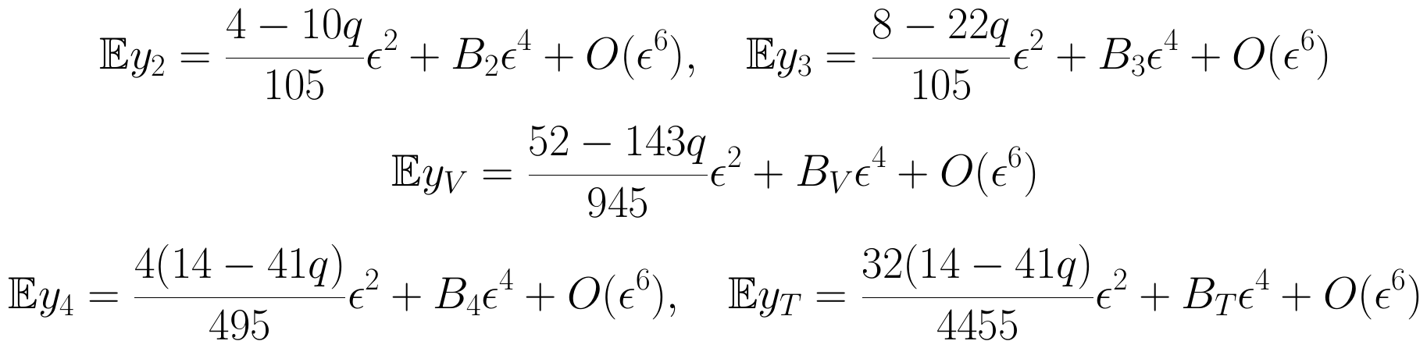
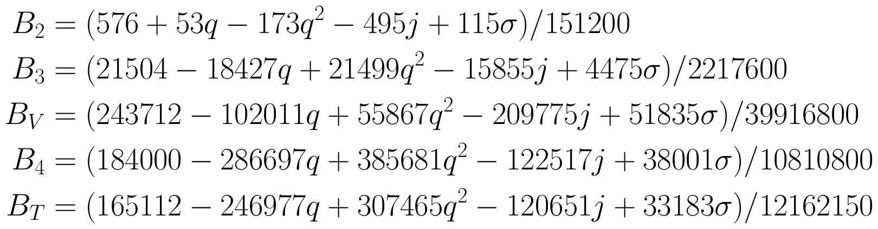
Appendix: quadratic and quartic responses
The coefficients below describe the first curvature response and its leading finite-duration correction.
A2
Notes:
Slide 22. Appendix: quadratic and quartic responses
Timing: 0 seconds
These corrections come from the finite physical duration in a classical continuum comparison. The even responses have quadratic and quartic terms, with sixth-order remainders; the odd responses are cubic, with fifth-order remainders.
For four-event motifs, p4 is the four-chain fraction, and p-T-plus is the average of the two fork-tail fractions. We subtract their flat baselines to define y4 and yT. Each B coefficient multiplies the fourth power of epsilon in the corresponding normalized even response. Snap, sigma, is the fourth derivative of the scale factor divided by a H to the fourth.
The formulas contain an independent snap response. A precise snap measurement also needs a successful inference and coverage study. A quantum correction would require additional state and dynamics.
Preparation notes (not spoken):
p4=C4/binom(N,4); p_T+=(N_Tup+N_Tdown)/(2 binom(N,4)); p_T-=(N_Tup-N_Tdown)/binom(N,4). y4=29400p4-1; yT=(9800/3)p_T+-1. Flat means are 1/29400 and 3/9800. For i=2,3,V,4,T, E[y_i]=c_i(q)epsilon^2+B_i(q,j,sigma)epsilon^4+O(epsilon^6). sigma=quadruple-dot a/(aH^4). The symbols B2,B3,BV,B4,BT denote quartic coefficients, not independent measured backgrounds. They include causal-boundary, endpoint and probability-normalization contributions.
Sources:
local_cosmography_cqg.tex, 23 October 2026
https://arxiv.org/abs/1212.0631

Slide 24
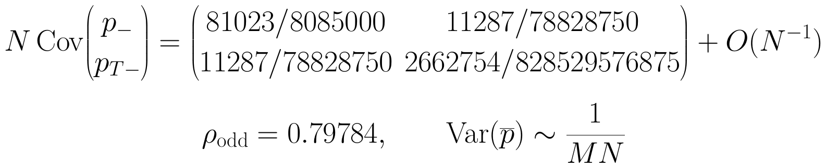
Appendix: shared elements correlate counts
Different motif counts share events. Retain the full covariance.
Variance is generically O(1/N) per diamond, despite O(N³) possible triples.
The second odd response improves conditional jerk SE by only 1.68%.
A3
Notes:
Slide 23. Appendix: shared elements correlate counts
Timing: 0 seconds
Covariance records how two estimates fluctuate together; the correlation coefficient rho divides it by their standard deviations. Here rho-odd is the correlation between the two orientation differences. Its leading value is 0.79784.
A bar means averaging over M independent diamonds. Their mean variance scales as one over M times N at leading order. Shared events prevent the enormous number of triples from acting like that many independent observations.
With H and q known, the combined jerk coefficient changes from 298.2916 to 293.2876, a 1.68 percent standard-error reduction. The response vectors are nearly aligned as well as correlated. Algebraic independence alone therefore says little about practical precision.
Preparation notes (not spoken):
Cov denotes covariance; Var denotes variance; pbar is an ensemble sample mean; rho_odd=Cov(p-,p_T-)/sqrt[Var(p-)Var(p_T-)]. For independent equivalent diamonds, Cov(pbar)=Cov(p)/M, and the generic leading covariance within a fixed-N diamond is Sigma/N. The displayed rational odd covariance is the leading flat-diamond limit. Finite-duration inference uses measured complete covariance, including even-odd terms, rather than setting them to their flat limiting values.
Sources:
local_cosmography_cqg.tex, 23 October 2026
https://arxiv.org/abs/1212.0631

Slide 25
Appendix: high-precision coverage and rejection
Background | Even/odd | j covers | q covers | Rejects | Mean j SE
Matter jet | 4 / 5 | 61 | 59 | 4 | 0.1099
Matter jet | 6 / 7 | 58 | 59 | 3 | 0.3478
de Sitter jet | 4 / 5 | 61 | 57 | 4 | 0.1148
de Sitter jet | 6 / 7 | 61 | 61 | 5 | 0.3594
Radiation jet | 4 / 5 | 60 | 56 | 54 | 0.1214
Radiation jet | 6 / 7 | 60 | 59 | 8 | 0.3667
Every denominator is 64. Coverage: nominal 95% intervals containing the input.
Fit rejection: residual-based χ² p < 0.05. All jerk Wilson intervals include 95%.
Primary q undercovers in de Sitter and radiation. Retain all trials.
A4
Notes:
Slide 24. Appendix: high-precision coverage and rejection
Timing: 0 seconds
Coverage asks whether each nominal 95 percent interval contains the known input parameter. Repeating independent trials estimates that frequency. Wilson intervals describe uncertainty in this estimated frequency; they are pointwise checks rather than simultaneous guarantees across all rows.
All six high-precision jerk Wilson intervals contain 95 percent. Primary q coverage undercovers in the de Sitter and radiation jets, at 57 and 56 out of 64. For radiation, rejection changes from 54 to eight out of 64, while jerk coverage stays at 60 out of 64. A fit-rejection test and parameter coverage answer different questions.
The exact-mean subgroup discrepancy and remaining secondary exceptions stay in the analysis. All fits resolved a positive expansion amplitude and returned jerk intervals; none were removed according to the outcome.
Preparation notes (not spoken):
Each high-precision subgroup has 64 independent trials; intervals are nominal 95%; fit rejection is p<0.05. Matter jet: primary (Cj,Cq,R,meanSEj)=(61,59,4,0.1099), secondary=(58,59,3,0.3478). De Sitter jet: primary=(61,57,4,0.1148), secondary=(61,61,5,0.3594). Radiation jet: primary=(60,56,54,0.1214), secondary=(60,59,8,0.3667). Every availability count is 64. De Sitter/radiation primary q Wilson intervals are [79.10,94.60]% and [77.23,93.53]%. High-precision de Sitter mean diagnostic: chi-square=38.044 for 20 degrees of freedom, p=0.00875. No universal calibration conclusion follows from Wilson intervals containing the nominal value.
Sources:
local_cosmography_cqg.tex, 23 October 2026
https://arxiv.org/abs/1212.0631

Slide 26
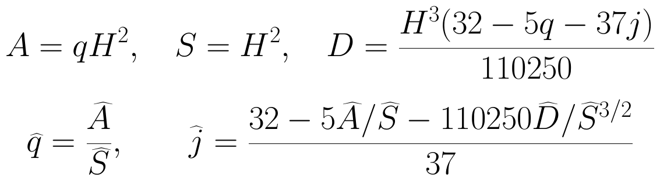
Appendix: fitting the parameters and clock
A, S: fitted even T² amplitudes. D: odd T³ amplitude.
Fit all four statistics with generalized least squares and their full covariance.
Keep even T² + T⁴ and odd T³ + T⁵ in the primary fit. Add T⁶ and T⁷ in the secondary fit.
Propagate denominator uncertainty in S with Fieller confidence sets for q.
Resolve positive S before taking its square root for H and transforming to j.
Use relative durations to identify q, j. Calibrate an absolute time scale to infer H.
The χ² test checks fit residuals against sampling uncertainty. Coverage checks the inferred intervals.
A5
Notes:
Slide 25. Appendix: fitting the parameters and clock
Timing: 0 seconds
The counts are invariant under relabelling of the marked causal set. Their cosmographic interpretation also supplies an observer, interval family and relative durations. The fit separates leading amplitudes from free higher-order terms. A is q H squared, S is H squared, and D is the coefficient of the cubic odd response. We estimate these jointly, keeping their covariance. H uses the positive square root of S; q is A divided by S; jerk follows from A, S and D.
A residual is a simulated mean minus its fitted mean. Generalized least squares weights these residuals with their full measured covariance. Their chi-square tests whether the truncated expansion fits the means within sampling uncertainty; the truncation remainder itself consists of omitted geometric terms. Fieller's method constructs the ratio confidence set for q while allowing an uncertain denominator. Such a set can be unbounded or disconnected; the analysis retains those cases. The jerk transformation requires a positive lower confidence bound for S.
An intrinsic clock and covariance between overlapping intervals remain necessary. Spatial curvature changes the leading ratio to q over one minus Omega-K, where Omega-K is the usual spatial-curvature density parameter.
Preparation notes (not spoken):
A=qH^2, S=H^2, D=H^3(32-5q-37j)/110250. The fits use E[y(T)]=T^2 R_response(A,S)+T^4 b4+[T^6 b6] and E[p-(T)]=D T^3+d5 T^5+[d7 T^7]. R_response denotes the known numerical response matrix, not the Ricci scalar R. qhat=Ahat/Shat; jhat=[32-5Ahat/Shat-110250 Dhat/Shat^(3/2)]/37. Fieller inverts (Ahat-q Shat)^2 <= c^2(C_AA-2q C_AS+q^2 C_SS), c=1.959964. S is resolved if Shat-c SE(Shat)>0. Covariance is plug-in, obtained by Cholesky whitening and scaled QR; no reduced-chi-square inflation is used. Delta-method jerk variance propagates all A,S,D cross-covariances. Omega_K=-K/(a^2 H^2), giving q/(1-Omega_K) in the stated leading flat-inversion curvature diagnostic.
The truncation remainder is the deterministic contribution of omitted higher powers in the geometric expansion. A measured residual is a simulated mean minus the fitted mean at the same duration; it contains sampling fluctuations and any response left unrepresented by the fitted expansion. The lack-of-fit statistic is the covariance-weighted sum of squared residuals, r^T C^(-1) r, with C the covariance of the simulated means. It tests whether the truncated expansion fits those means within their sampling uncertainty. The reference chi-square law uses the residual degrees of freedom and is an asymptotic approximation here because C is estimated. A small p-value indicates a discrepancy with the fitted mean model under these assumptions; it does not identify its cause by itself. The reduction in rejection after adding higher powers supports a truncation explanation in this controlled comparison. Confidence-interval coverage is a separate repeated-trial check of whether an interval contains the input parameter.
Sources:
local_cosmography_cqg.tex, 23 October 2026
https://arxiv.org/abs/1212.0631

Slide 27
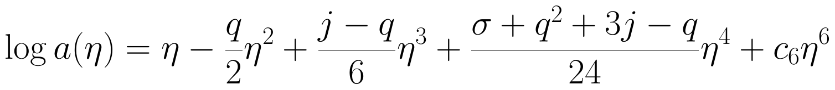
Appendix: exact backgrounds and local jets
η: conformal time. σ: snap. c₆: independent sixth-order coefficient. H(0) = a(0) = 1.
Background | q | j | σ | c₆
Matter jet | 1/2 | 1 | −7/2 | 0
Jerk shift | 1/2 | 2 | −7/2 | 0
Snap shift | 1/2 | 1 | 1/2 | 0
Sixth-order shift | 1/2 | 1 | −7/2 | 1/2
de Sitter jet | −1 | 1 | 1 | 0
Radiation jet | 1 | 3 | −15 | 0
The labels match local derivatives. These are prescribed positive log-polynomial scale factors.
A6
Notes:
Slide 26. Appendix: exact backgrounds and local jets
Timing: 0 seconds
The six backgrounds are specified exactly by a polynomial for log a in conformal time eta, then exponentiated. They are positive smooth scale factors, with a and H equal to one at the midpoint. The polynomial coefficients reproduce the specified local q, jerk and snap. An independent sixth-order coefficient changes higher derivatives while preserving those four midpoint quantities.
The table distinguishes a matter-like local jet, an independent jerk shift, an independent snap shift, a sixth-order shift, and the de Sitter and radiation jets. The labels identify matching local derivatives, rather than exact global solutions of a chosen matter model. Minkowski is an additional flat-baseline cell in the new-motif mean check only.
Preparation notes (not spoken):
Exact model: log a(eta)=eta-(q/2)eta^2+[(j-q)/6]eta^3+[(sigma+q^2+3j-q)/24]eta^4+c6 eta^6. Parameter rows (q,j,sigma,c6): matter=(1/2,1,-7/2,0); jerk shift=(1/2,2,-7/2,0); snap shift=(1/2,1,1/2,0); sixth-order shift=(1/2,1,-7/2,1/2); de Sitter=(-1,1,1,0); radiation=(1,3,-15,0). a(0)=H(0)=1. The midpoint is proper time t=0, with dt=a d eta and endpoints solved for t=+/-T/2. c6 is a coefficient of log a in these H=1 units. Minkowski has a=1 and H=0, so q,j are undefined there; it tests flat motif baselines only.
Sources:
local_cosmography_cqg.tex, exact testbackground and backgrounds table
higher_order_backgrounds.py, log_coefficients, conformal_endpoints and backgrounds

Slide 28
Appendix: sampling and repeated-trial design
Original four-statistic campaign | Backgrounds | N | M / duration | Trials / model
Expanded calibration | All six | 512 | 65,536 | 256
High precision | Matter, dS, radiation | 512 | 1,048,576 | 64
Larger sets | Matter, snap shift | 1,024 | 32,768 | 128
Larger sets | Matter, snap shift | 2,048 | 16,384 | 128
Generate five independent duration ensembles per trial. Apply both fit orders to that same trial.
Propose events in the conformal diamond. Accept with physical-volume weight a(η)⁴. Fix N and exclude endpoints.
Estimate covariance of the mean as sample covariance / M. Use separate streams and fixed sample sizes. Retain every outcome.
Total follow-up: 2,240 trials, 4,480 fits, 1,572,864,000 diamonds. Independent SVD replay agrees.
A7
Notes:
Slide 27. Appendix: sampling and repeated-trial design
Timing: 0 seconds
Draw proposal points uniformly in a conformal Minkowski diamond. Rejection sampling with the physical-volume weight a to the fourth gives independent accepted events; an interval bound supplies the envelope. We partition accepted events into fixed-N groups. These form conditional Poisson ensembles.
One trial combines fresh ensembles at five calibrated durations. Within each duration, all four statistics use the same events. Sample covariance between diamonds divided by M gives the covariance of their mean. Different durations are independent, but both fit orders share the same trial data.
The larger follow-up uses four bounded GPU workers and fixed campaign sizes. The new seven-statistic check is a separate, single-duration experiment. The records retain sources, plans, seeds, aggregate means and covariances, and trial outcomes. Input values enter only in the checks after fitting. Every trial enters the report, regardless of its fit rejection or interval outcome.
Preparation notes (not spoken):
Durations: T={0.20,0.35,0.50,0.65,0.80} in H(0)=1 units. Initial large ensemble: six backgrounds, N=512, M=1048576 per duration, 31,457,280 diamonds. Earlier repeated calibration: six backgrounds, 128 trials each, N=512, M=65536, 251,658,240 diamonds. Expanded follow-up: (i) all six backgrounds, 256 trials each at N=512,M=65536; (ii) matter/de Sitter/radiation jets, 64 trials each at N=512,M=1048576; (iii) matter/snap-shift jets, 128 trials each at N=1024,M=32768; (iv) same two, 128 trials each at N=2048,M=16384. Follow-up total: 2240 trials, 11200 duration cells, 4480 fits, 1,572,864,000 diamonds. It uses four RTX 4090 D GPUs, 5400 seconds per-worker resource limit and one CPU thread per worker. It completed without a resource stop. Larger-N comparisons match MN=33,554,432. New-motif means: six backgrounds+Minkowski, T=0.5,N=256,M=131072 each, total 917,504 diamonds; retain full 7x7 covariance. FP64 geometry, int64 counts; CPU/GPU comparisons on identical coordinates. Raw per-diamond counts are discarded after deterministic aggregation; regeneration needs the recorded environment. Inference uses Cholesky whitening/scaled QR; an independent SVD replay reproduced all 4480 follow-up coverage decisions. Nominal 95% intervals; 5% fit-rejection threshold; Wilson intervals are pointwise Monte Carlo uncertainty.
Sources:
local_cosmography_cqg.tex, numerical studies and GPU follow-up
output/gpu_expansion_20261017/plan.json
output/four_motif_gpu/plan.json
output/cqg_jerk_coverage_plan.json
higher_order_gpu_sampling.py
four_motif_gpu.py
cqg_gpu_expansion.py
higher_order_jerk_inference.py

Slide 29
Appendix: selected references and resources
Sorkin (2007); Ahmed et al. (2004), Everpresent Λ.
Bombelli, Lee, Meyer & Sorkin (1987), Phys. Rev. Lett. 59, 521.
Rideout & Sorkin (2000), Phys. Rev. D 61, 024002.
Benincasa & Dowker (2010), Phys. Rev. Lett. 104, 181301.
Roy, Sinha & Surya (2013), Phys. Rev. D 87, 044046.
Surya (2019), Living Reviews in Relativity 22, 5.
Liu & Bombelli, current draft and reproducibility archive, 23 October 2026.
Full links and source details are in the speaker notes and speaking manuscript.
A8
Notes:
Slide 28. Appendix: selected references and resources
Timing: 0 seconds
Chain-based curvature reconstruction is established, including Roy, Sinha and Surya and subsequent numerical work. Here we add normalized induced-pixie responses, the orientation-odd curvature derivative, higher-order terms and the four-element extension, with covariance-aware inference.
The research archive contains fixed plans, aggregate statistics, trial records, coefficient audits and analysis code. Recovery from generated geometries tests the estimator. Applied to histories from a specified dynamics, the same observable can ask which local expansion that model produces.
Sources:
local_cosmography_cqg.tex, 23 October 2026
https://arxiv.org/abs/1212.0631

Slide 30
Appendix: embedding papers
Henson (2006), Constructing an interval of Minkowski space from a causal set. CQG 23, L29–L35.
Liu & Reid (2018), A new approach for embedding causal sets into Minkowski space. CQG 35, 124002.
Johnston (2022), Embedding Causal Sets into Minkowski Spacetime. CQG 39, 095006 [2111.09331].
Johnston (2025), Simpler embeddings of causal sets into Minkowski spacetime. PRD 111, 106020 [2502.09701].
Madsen (2026), On the Uniqueness of Embeddings of Causal Sets [2607.05840]. Conditional uniqueness, rather than a coordinate algorithm.
A9
Notes:
Slide 29. Appendix: embedding papers
Timing: 0 seconds
Embedding is a complementary reconstruction task: assign continuum coordinates that approximately reproduce a causal order. Henson gave an early algorithm tested in two dimensions. My 2018 paper with David Reid developed another approach. Johnston's later constructions use volume-derived geometric data and matrix methods, with tests in two, three and four dimensions. Madsen studies uniqueness under well-conditioned embedding assumptions, rather than proposing another coordinate algorithm.
Our present task estimates a few local geometric quantities from pattern statistics, rather than reconstructing every event's coordinates. Embedding and clock reconstruction may help make those measurements intrinsic.
Full author credits and source links:
Joe Henson. Constructing an interval of Minkowski space from a causal set. Class. Quantum Grav. 23, L29-L35 (2006). https://arxiv.org/abs/gr-qc/0601069 ; https://doi.org/10.1088/0264-9381/23/4/L02
He Liu; David D. Reid. A new approach for embedding causal sets into Minkowski space. Class. Quantum Grav. 35, 124002 (2018). https://doi.org/10.1088/1361-6382/aac082
Steven Johnston. Embedding Causal Sets into Minkowski Spacetime. arXiv:2111.09331 (2021); Class. Quantum Grav. 39, 095006 (2022). https://arxiv.org/abs/2111.09331 ; https://doi.org/10.1088/1361-6382/ac5922
Steven Johnston. Simpler embeddings of causal sets into Minkowski spacetime. Phys. Rev. D 111, 106020 (2025). https://arxiv.org/abs/2502.09701 ; https://doi.org/10.1103/PhysRevD.111.106020
Nathan Madsen. On the Uniqueness of Embeddings of Causal Sets. Preprint, 7 July 2026. https://arxiv.org/abs/2607.05840
Preparation notes (not spoken):
Historical references, outside the five-year current-programme window: Joe Henson, Constructing an interval of Minkowski space from a causal set, Class. Quantum Grav. 23, L29-L35 (2006), DOI 10.1088/0264-9381/23/4/L02, arXiv:gr-qc/0601069. He Liu and David D. Reid, A new approach for embedding causal sets into Minkowski space, Class. Quantum Grav. 35, 124002 (2018), DOI 10.1088/1361-6382/aac082. Recent references: Steven Johnston, Embedding Causal Sets into Minkowski Spacetime, arXiv:2111.09331 (2021), Class. Quantum Grav. 39, 095006 (2022). Steven Johnston, Simpler embeddings of causal sets into Minkowski spacetime, arXiv:2502.09701, Phys. Rev. D 111, 106020 (2025), DOI 10.1103/PhysRevD.111.106020. Johnston 2025 infers spatial distances and decomposes a distance matrix; Henson and Liu-Reid are not retroactively grouped as 2021-2026 publications.
Full reference credits:
Joe Henson. Constructing an interval of Minkowski space from a causal set. Class. Quantum Grav. 23, L29-L35 (2006). https://arxiv.org/abs/gr-qc/0601069 ; https://doi.org/10.1088/0264-9381/23/4/L02
He Liu; David D. Reid. A new approach for embedding causal sets into Minkowski space. Class. Quantum Grav. 35, 124002 (2018). https://doi.org/10.1088/1361-6382/aac082
Steven Johnston. Embedding Causal Sets into Minkowski Spacetime. arXiv:2111.09331 (2021); Class. Quantum Grav. 39, 095006 (2022). https://arxiv.org/abs/2111.09331 ; https://doi.org/10.1088/1361-6382/ac5922
Steven Johnston. Simpler embeddings of causal sets into Minkowski spacetime. Phys. Rev. D 111, 106020 (2025). https://arxiv.org/abs/2502.09701 ; https://doi.org/10.1103/PhysRevD.111.106020
Nathan Madsen. On the Uniqueness of Embeddings of Causal Sets. Preprint, 7 July 2026. https://arxiv.org/abs/2607.05840
Sources:
https://arxiv.org/abs/gr-qc/0601069
https://doi.org/10.1088/0264-9381/23/4/L02
https://doi.org/10.1088/1361-6382/aac082
https://arxiv.org/abs/2111.09331
https://doi.org/10.1088/1361-6382/ac5922
https://arxiv.org/abs/2502.09701
https://doi.org/10.1103/PhysRevD.111.106020
https://arxiv.org/abs/2607.05840

Slide 31
Recent references: geometry and structure
Boguñá; Krioukov (2024): spatial distances [2401.17376].
Braun (2025): order and number [2507.01907].
Müller (2025): Hauptvermutung [2503.01719].
Hu; D. Meyer; E. Meyer (2025): Minkowski geometry from causal separations [2601.03280].
Eichhorn; Mack; Le; Wagner (2026): graph observables [2605.27514].
Barton; Borza; Röhrig (2026): Ollivier–Ricci curvature [2606.04910].
Full author credits, metadata and additional papers: companion research map and notes.
A10
Notes:
Slide 30. Recent references: geometry and structure
Timing: 0 seconds
These papers approach geometric reconstruction through distances, order and number, uniqueness results and graph observables. The embedding papers are on the preceding appendix slide. Full credits and links are here so you can follow whichever part is closest to your own work.
Full author credits and source links:
Marián Boguñá; Dmitri Krioukov. Measuring spatial distances in causal sets via causal overlaps. https://arxiv.org/abs/2401.17376
Mathias Braun. Spacetime reconstruction by order and number. https://arxiv.org/abs/2507.01907
Olaf Müller. On the Hauptvermutung of Causal Set Theory. https://arxiv.org/abs/2503.01719
Chenyang (Amy) Hu; David A. Meyer; Eleanor J. Q. Meyer. Reconstructing Minkowski geometry from causal separations. J. Math. Phys. 66, 122502 (2025). https://arxiv.org/abs/2601.03280 ; https://doi.org/10.1063/5.0290407
Astrid Eichhorn; Harald Mack; Kim Tuyen Le; Fabian Wagner. Charting causal set configuration space with graph observables. https://arxiv.org/abs/2605.27514
Joe Barton; Samuël Borza; Jona Röhrig. Ollivier-Ricci curvature for causal sets. https://arxiv.org/abs/2606.04910
Full reference credits:
Marián Boguñá; Dmitri Krioukov. Measuring spatial distances in causal sets via causal overlaps. https://arxiv.org/abs/2401.17376
Mathias Braun. Spacetime reconstruction by order and number. https://arxiv.org/abs/2507.01907
Olaf Müller. On the Hauptvermutung of Causal Set Theory. https://arxiv.org/abs/2503.01719
Chenyang (Amy) Hu; David A. Meyer; Eleanor J. Q. Meyer. Reconstructing Minkowski geometry from causal separations. J. Math. Phys. 66, 122502 (2025). https://arxiv.org/abs/2601.03280 ; https://doi.org/10.1063/5.0290407
Astrid Eichhorn; Harald Mack; Kim Tuyen Le; Fabian Wagner. Charting causal set configuration space with graph observables. https://arxiv.org/abs/2605.27514
Joe Barton; Samuël Borza; Jona Röhrig. Ollivier-Ricci curvature for causal sets. https://arxiv.org/abs/2606.04910
Sources:
https://arxiv.org/abs/2401.17376
https://arxiv.org/abs/2507.01907
https://arxiv.org/abs/2503.01719
https://arxiv.org/abs/2601.03280
https://doi.org/10.1063/5.0290407
https://arxiv.org/abs/2605.27514
https://arxiv.org/abs/2606.04910

Slide 32
Recent references: actions and growth
Carlip; Carlip; Surya (2022): path-integral suppression [2209.00327].
Carlip; Carlip; Surya (2023): entropically dominant orders [2311.18238].
Dowker; Liu; Lloyd-Jones (2024): timelike boundaries [2501.00139].
de Brito; Eichhorn; Pfeiffer (2023): higher-curvature operators [2301.13525].
Srivastava; Surya (2026): quantum sequential growth [2603.25503].
Gutzeit; Shaban; Yeats; Zalel (2026): Covtree witnesses [2605.00622].
Yeats; Zalel (2023): Hopf algebra and growth [2310.17547].
Full author credits, metadata and additional papers: companion research map and notes.
A11
Notes:
Slide 31. Recent references: actions and growth
Timing: 0 seconds
These are the papers behind the dynamics rows in the overview. They cover actions and boundary terms, suppression of nonmanifoldlike orders, and covariant or quantum growth. The connection to this talk is that such models can produce histories on which we could measure our observables.
Full author credits and source links:
P. Carlip; S. Carlip; S. Surya. Path integral suppression of badly behaved causal sets. https://arxiv.org/abs/2209.00327
Peter Carlip; Steve Carlip; Sumati Surya. The Einstein-Hilbert Action for Entropically Dominant Causal Sets. https://arxiv.org/abs/2311.18238
Fay Dowker; Roger Liu; Daniel Lloyd-Jones. Timelike boundary and corner terms in the causal set action. https://arxiv.org/abs/2501.00139
Gustavo. P. de Brito; Astrid Eichhorn; Christopher Pfeiffer. Higher-order curvature operators in causal set quantum gravity. https://arxiv.org/abs/2301.13525
Ritesh Srivastava; Sumati Surya. Implementing Bell causality in Quantum Sequential Growth. https://arxiv.org/abs/2603.25503
Jette Gutzeit; Kimia Shaban; Karen Yeats; Stav Zalel. Sizes of witnesses in Covtree. https://arxiv.org/abs/2605.00622
Karen Yeats; Stav Zalel. Hopf algebras from poset growth models. https://arxiv.org/abs/2310.17547
Full reference credits:
P. Carlip; S. Carlip; S. Surya. Path integral suppression of badly behaved causal sets. https://arxiv.org/abs/2209.00327
Peter Carlip; Steve Carlip; Sumati Surya. The Einstein-Hilbert Action for Entropically Dominant Causal Sets. https://arxiv.org/abs/2311.18238
Fay Dowker; Roger Liu; Daniel Lloyd-Jones. Timelike boundary and corner terms in the causal set action. https://arxiv.org/abs/2501.00139
Gustavo. P. de Brito; Astrid Eichhorn; Christopher Pfeiffer. Higher-order curvature operators in causal set quantum gravity. https://arxiv.org/abs/2301.13525
Ritesh Srivastava; Sumati Surya. Implementing Bell causality in Quantum Sequential Growth. https://arxiv.org/abs/2603.25503
Jette Gutzeit; Kimia Shaban; Karen Yeats; Stav Zalel. Sizes of witnesses in Covtree. https://arxiv.org/abs/2605.00622
Karen Yeats; Stav Zalel. Hopf algebras from poset growth models. https://arxiv.org/abs/2310.17547
Sources:
https://arxiv.org/abs/2209.00327
https://arxiv.org/abs/2311.18238
https://arxiv.org/abs/2501.00139
https://arxiv.org/abs/2301.13525
https://arxiv.org/abs/2603.25503
https://arxiv.org/abs/2605.00622
https://arxiv.org/abs/2310.17547

Slide 33
Recent references: quantum fields
Hawkins; Minz; Rejzner (2022): distinguished quantum states [2207.05667].
Jubb (2023): interacting scalar fields [2306.12484].
Albertini; Dowker; Nasiri; Zalel (2024): in-in correlators and scattering [2402.08555].
Zalel (2026): reduction formula [2607.04980].
Shuman (2023): propagator evaluation [2307.08864].
Hinrichsen; Kastrati (2026): propagators in 1+1D [2604.24812].
Kastrati (2026): propagators in 2+1D [2610.26221].
Full author credits, metadata and additional papers: companion research map and notes.
A12
Notes:
Slide 32. Recent references: quantum fields
Timing: 0 seconds
Here are some of the recent field-theory papers, from propagators and state selection to interactions and scattering. Their constructions use different kernels and assumptions, so the individual sources give the right setting for each result.
Full author credits and source links:
Eli Hawkins; Christoph Minz; Kasia Rejzner. Quantization, dequantization, and distinguished states. https://arxiv.org/abs/2207.05667
Ian Jubb. Interacting Scalar Field Theory on Causal Sets. https://arxiv.org/abs/2306.12484
Emma Albertini; Fay Dowker; Arad Nasiri; Stav Zalel. In-in correlators and scattering amplitudes on a causal set. https://arxiv.org/abs/2402.08555
Stav Zalel. The causal set reduction formula. https://arxiv.org/abs/2607.04980
Samuel Shuman. Path Sums for Propagators in Causal Sets. https://arxiv.org/abs/2307.08864
Haye Hinrichsen; Arsim Kastrati. Link-based causal set propagators in $1+1$ dimensions. https://arxiv.org/abs/2604.24812
Arsim Kastrati. Construction of Causal Set Propagators in $2+1$-Dimensional Constant-Curvature Spacetimes from Two-Link Paths. https://arxiv.org/abs/2610.26221
Full reference credits:
Eli Hawkins; Christoph Minz; Kasia Rejzner. Quantization, dequantization, and distinguished states. https://arxiv.org/abs/2207.05667
Ian Jubb. Interacting Scalar Field Theory on Causal Sets. https://arxiv.org/abs/2306.12484
Emma Albertini; Fay Dowker; Arad Nasiri; Stav Zalel. In-in correlators and scattering amplitudes on a causal set. https://arxiv.org/abs/2402.08555
Stav Zalel. The causal set reduction formula. https://arxiv.org/abs/2607.04980
Samuel Shuman. Path Sums for Propagators in Causal Sets. https://arxiv.org/abs/2307.08864
Haye Hinrichsen; Arsim Kastrati. Link-based causal set propagators in $1+1$ dimensions. https://arxiv.org/abs/2604.24812
Arsim Kastrati. Construction of Causal Set Propagators in $2+1$-Dimensional Constant-Curvature Spacetimes from Two-Link Paths. https://arxiv.org/abs/2610.26221
Sources:
https://arxiv.org/abs/2207.05667
https://arxiv.org/abs/2306.12484
https://arxiv.org/abs/2402.08555
https://arxiv.org/abs/2607.04980
https://arxiv.org/abs/2307.08864
https://arxiv.org/abs/2604.24812
https://arxiv.org/abs/2610.26221

Slide 34
Recent references: entropy and cosmology
Keseman; Muneesamy; Yazdi (2021): entanglement entropy [2111.05879].
Mathur; Surya; Nomaan X (2022): covariance and discreteness [2207.01080].
Zhu; Yazdi (2022): Hadamard property [2212.10592].
Jones; Yazdi (2026): spectral spacetime entropy [2602.16782].
Homšak; Veroni (2024): black-hole state counting [2404.11670].
Das; Nasiri; Yazdi (2023): Everpresent Λ I [2304.03819].
Das; Nasiri; Yazdi (2023): Everpresent Λ II [2307.13743].
Albertini; Nasiri; Panella (2024): stochastic dark matter [2409.02188].
Full author credits, metadata and additional papers: companion research map and notes.
A13
Notes:
Slide 33. Recent references: entropy and cosmology
Timing: 0 seconds
I've grouped the entropy and cosmology references here. The entropy papers concern spectral prescriptions and horizon counting. The cosmology papers develop and test fluctuating Lambda or diffusion models. They are several distinct approaches to connecting discreteness with observable physics.
Full author credits and source links:
Théo Keseman; Hans J. Muneesamy; Yasaman K. Yazdi. Insights on Entanglement Entropy in $1+1$ Dimensional Causal Sets. https://arxiv.org/abs/2111.05879
Abhishek Mathur; Sumati Surya; Nomaan X. Spacetime Entanglement Entropy: Covariance and Discreteness. https://arxiv.org/abs/2207.01080
Yifeng Rocky Zhu; Yasaman K. Yazdi. On the (Non)Hadamard Property of the SJ State in a $1+1$D Causal Diamond. https://arxiv.org/abs/2212.10592
Joshua Y. L. Jones; Yasaman K. Yazdi. Spectral Spacetime Entropy for Quasifree Theories. https://arxiv.org/abs/2602.16782
Vid Homšak; Stefano Veroni. Boltzmannian state counting for black hole entropy in Causal Set Theory. https://arxiv.org/abs/2404.11670
Santanu Das; Arad Nasiri; Yasaman K. Yazdi. Aspects of Everpresent $Λ$ (I): A Fluctuating Cosmological Constant from Spacetime Discreteness. https://arxiv.org/abs/2304.03819
Santanu Das; Arad Nasiri; Yasaman K. Yazdi. Aspects of Everpresent $Λ$ (II): Cosmological Tests of Current Models. https://arxiv.org/abs/2307.13743
Emma Albertini; Arad Nasiri; Emanuele Panella. Stochastic dark matter: Covariant Brownian motion from Planckian discreteness. https://arxiv.org/abs/2409.02188
Full reference credits:
Théo Keseman; Hans J. Muneesamy; Yasaman K. Yazdi. Insights on Entanglement Entropy in $1+1$ Dimensional Causal Sets. https://arxiv.org/abs/2111.05879
Abhishek Mathur; Sumati Surya; Nomaan X. Spacetime Entanglement Entropy: Covariance and Discreteness. https://arxiv.org/abs/2207.01080
Yifeng Rocky Zhu; Yasaman K. Yazdi. On the (Non)Hadamard Property of the SJ State in a $1+1$D Causal Diamond. https://arxiv.org/abs/2212.10592
Joshua Y. L. Jones; Yasaman K. Yazdi. Spectral Spacetime Entropy for Quasifree Theories. https://arxiv.org/abs/2602.16782
Vid Homšak; Stefano Veroni. Boltzmannian state counting for black hole entropy in Causal Set Theory. https://arxiv.org/abs/2404.11670
Santanu Das; Arad Nasiri; Yasaman K. Yazdi. Aspects of Everpresent $Λ$ (I): A Fluctuating Cosmological Constant from Spacetime Discreteness. https://arxiv.org/abs/2304.03819
Santanu Das; Arad Nasiri; Yasaman K. Yazdi. Aspects of Everpresent $Λ$ (II): Cosmological Tests of Current Models. https://arxiv.org/abs/2307.13743
Emma Albertini; Arad Nasiri; Emanuele Panella. Stochastic dark matter: Covariant Brownian motion from Planckian discreteness. https://arxiv.org/abs/2409.02188
Sources:
https://arxiv.org/abs/2111.05879
https://arxiv.org/abs/2207.01080
https://arxiv.org/abs/2212.10592
https://arxiv.org/abs/2602.16782
https://arxiv.org/abs/2404.11670
https://arxiv.org/abs/2304.03819
https://arxiv.org/abs/2307.13743
https://arxiv.org/abs/2409.02188

Slide 35
Recent references: computation and extensions
Moradi; Yazdi; Zilhão (2024): interval abundances and fluctuations [2407.03395].
Ferguson; Nasiri; Wallden (2025): MCMC sampling [2506.19538].
Adamson; Wallden (2025): quantum algorithms [2505.22217].
Boguñá; Krioukov (2026): finite-region sampling bias [2610.03247].
Gomes; Cortês; Liddle (2023): energetic causal sets [2309.08694].
Wüthrich (2023): philosophical introduction [2308.05217].
Butterfield (2024): foundations and dynamics [2401.15474].
Full author credits, metadata and additional papers: companion research map and notes.
A14
Notes:
Slide 34. Recent references: computation and extensions
Timing: 0 seconds
These references include practical sampling questions, quantum algorithms and broader foundational work. Energetic causal sets add structure beyond the causal orders used in our calculation, so I include them as a related approach in the wider programme.
Full author credits and source links:
Heidar Moradi; Yasaman K. Yazdi; Miguel Zilhão. Fluctuations and Correlations in Causal Set Theory. https://arxiv.org/abs/2407.03395
Stuart Ferguson; Arad Nasiri; Petros Wallden. Dynamics of discrete spacetimes with Quantum-enhanced Markov Chain Monte Carlo. https://arxiv.org/abs/2506.19538
Sean A. Adamson; Petros Wallden. Benincasa-Dowker-Glaser causal set actions by quantum counting. https://arxiv.org/abs/2505.22217
Marián Boguñá; Dmitri Krioukov. Sampling biases in sprinkled causal sets. https://arxiv.org/abs/2610.03247
Vasco Gil Gomes; Marina Cortês; Andrew R. Liddle. Higher Dimensional Energetic Causal Sets. https://arxiv.org/abs/2309.08694
Christian Wüthrich. The philosophy of causal set theory. https://arxiv.org/abs/2308.05217
Jeremy Butterfield. En Route to Reduction: Lorentzian Manifolds and Causal Sets. https://arxiv.org/abs/2401.15474
Full reference credits:
Heidar Moradi; Yasaman K. Yazdi; Miguel Zilhão. Fluctuations and Correlations in Causal Set Theory. https://arxiv.org/abs/2407.03395
Stuart Ferguson; Arad Nasiri; Petros Wallden. Dynamics of discrete spacetimes with Quantum-enhanced Markov Chain Monte Carlo. https://arxiv.org/abs/2506.19538
Sean A. Adamson; Petros Wallden. Benincasa-Dowker-Glaser causal set actions by quantum counting. https://arxiv.org/abs/2505.22217
Marián Boguñá; Dmitri Krioukov. Sampling biases in sprinkled causal sets. https://arxiv.org/abs/2610.03247
Vasco Gil Gomes; Marina Cortês; Andrew R. Liddle. Higher Dimensional Energetic Causal Sets. https://arxiv.org/abs/2309.08694
Christian Wüthrich. The philosophy of causal set theory. https://arxiv.org/abs/2308.05217
Jeremy Butterfield. En Route to Reduction: Lorentzian Manifolds and Causal Sets. https://arxiv.org/abs/2401.15474
Sources:
https://arxiv.org/abs/2407.03395
https://arxiv.org/abs/2506.19538
https://arxiv.org/abs/2505.22217
https://arxiv.org/abs/2610.03247
https://arxiv.org/abs/2309.08694
https://arxiv.org/abs/2308.05217
https://arxiv.org/abs/2401.15474

