Slide 1
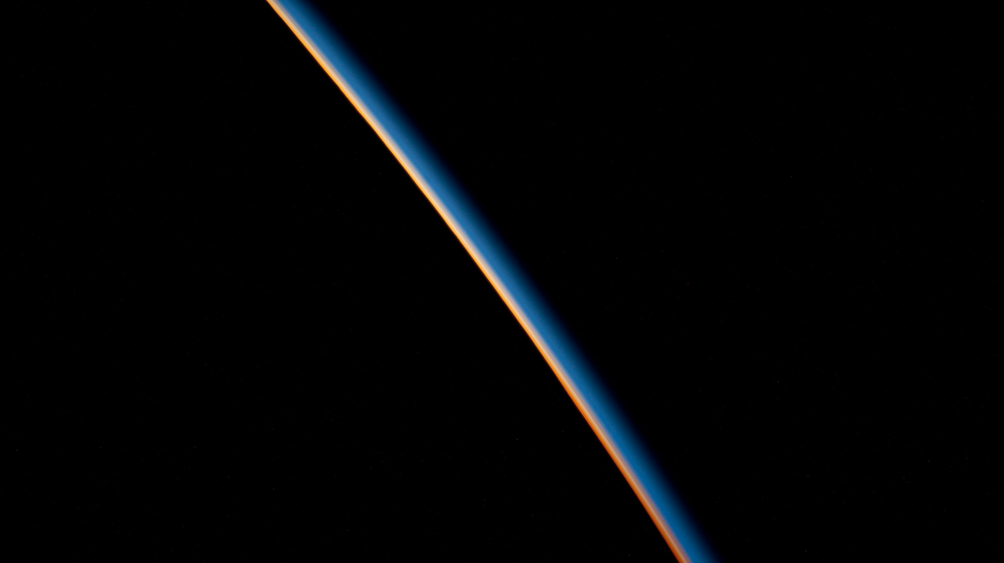


High Frequency Gravitational Wave Production during Reheating
Wenbin Zhao(赵文斌), ICTP-AP, UCAS
Based on recent works with Chenhuan Wang and Yong Xu
2504.02604.12687

Slide 2
Content
One Introduction
Two approaches:
  Bogoliubov treatment
  Boltzmann treatment
Three conclusions

Slide 3
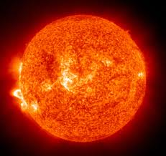
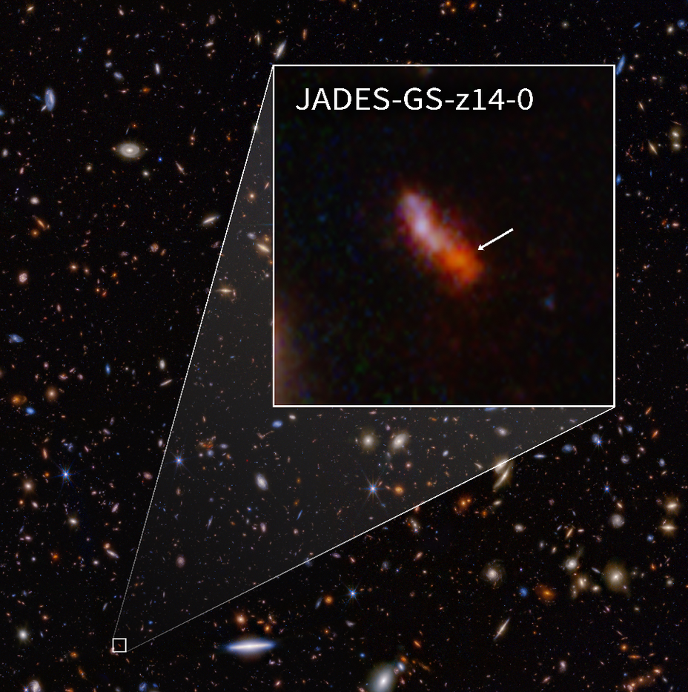
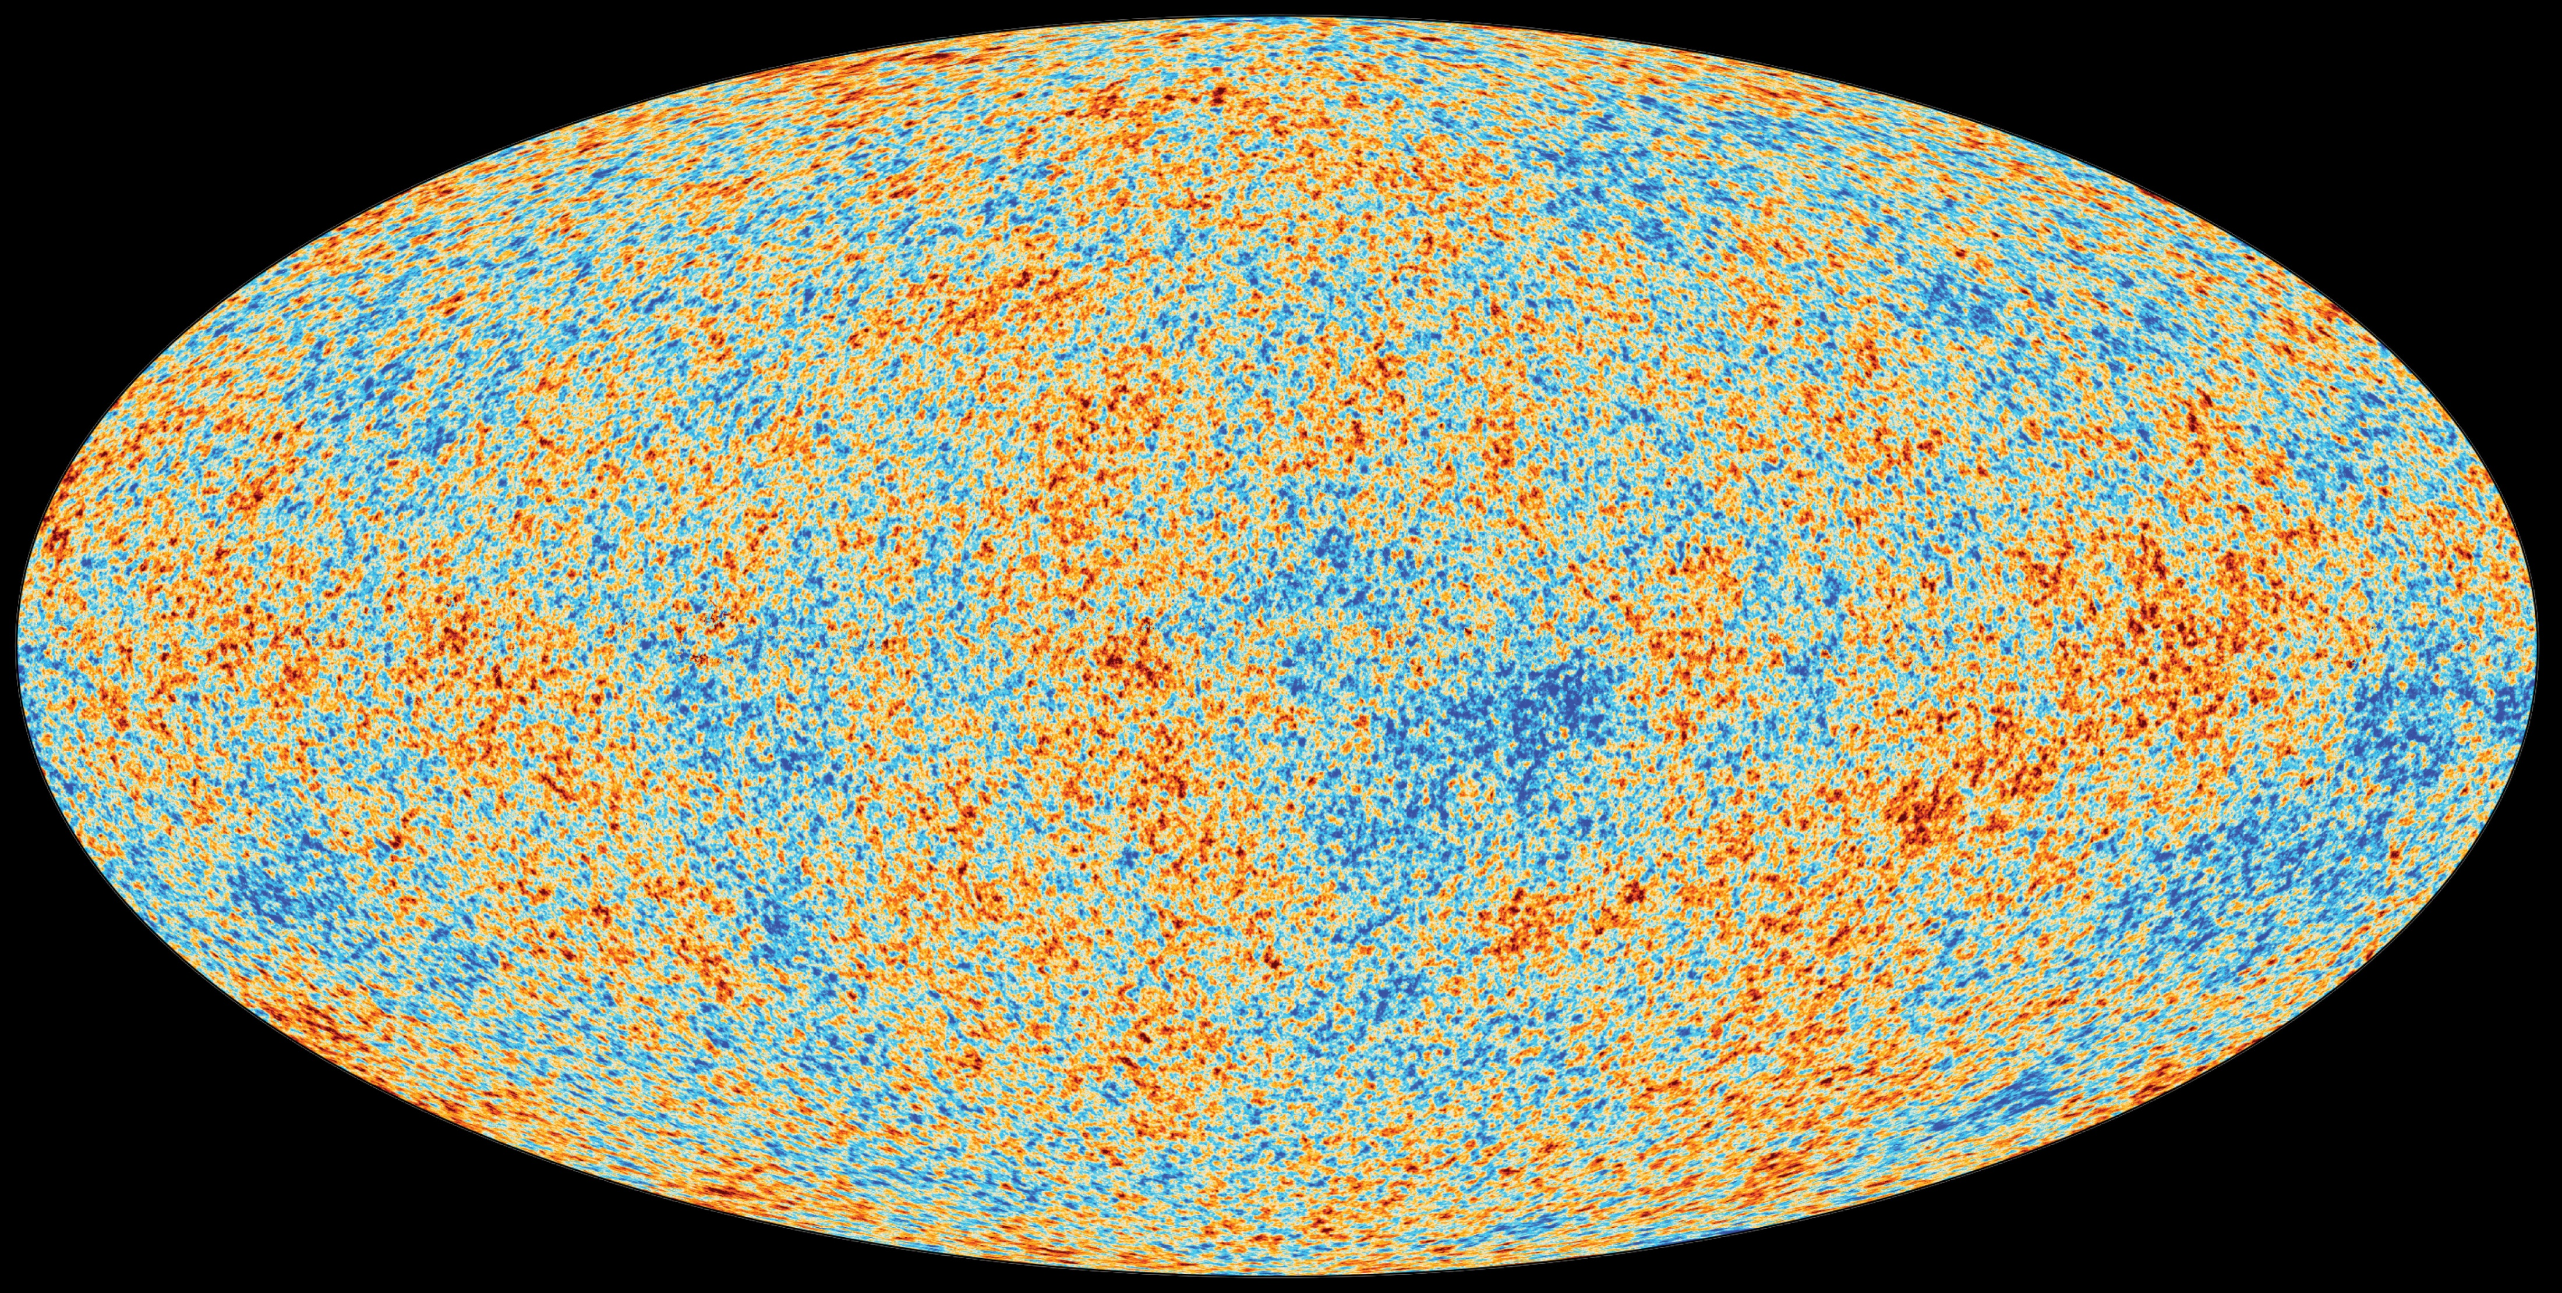
New physics from Cosmology
Cosmology/Astrophysics has become a strong probe of new physics:
Sun
JADES-GS-z14-0
Cosmic microwave background
Notes:
Sun: Neutrino Oscillation

Slide 4
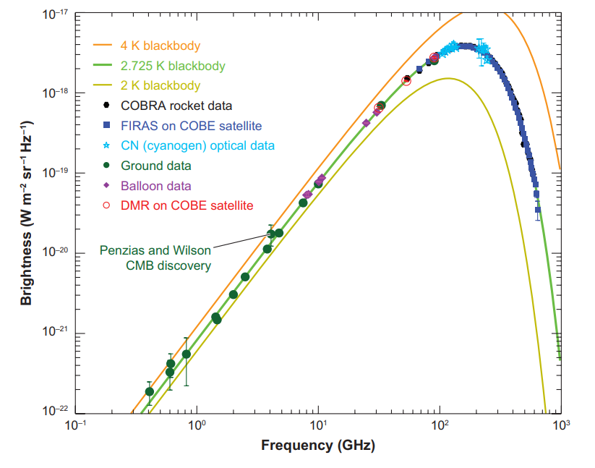
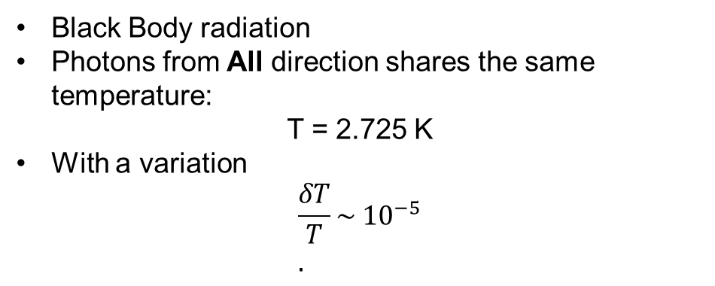
Cosmic Microwave Background
Black Body radiation
Photons from All direction shares the same temperature:
T = 2.725 K
With a variation
$$\frac{δT}{T}\sim {10}^{−5} \\ .$$
We would like to understand:
Why the early universe is isotropic and homogeneous?
Where the small fluctuations comes from?

Slide 5
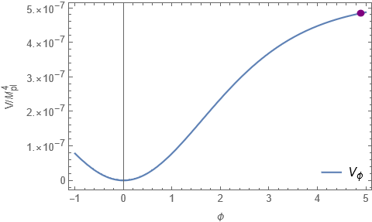
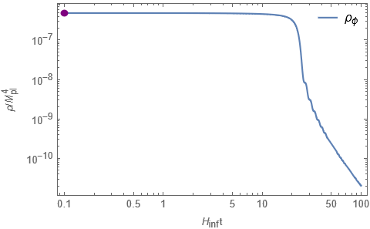
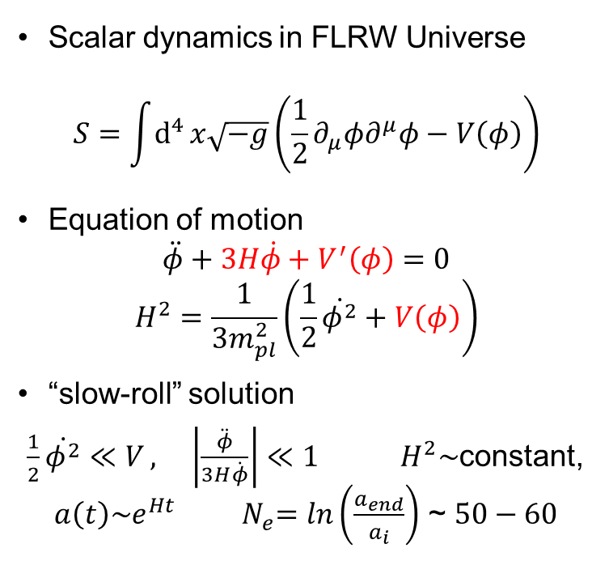
Inflation as a Solution
Scalar dynamics in FLRW Universe
$$S=\int{d^{4}}x\sqrt{−g}\left(\frac{1}{2}∂_{μ}φ∂^{μ}φ−V\left(φ\right)\right)$$
Equation of motion
$$\ddot{φ}+3H\dot{φ}+V^{′}\left(φ\right)=0$$
$$H^{2}=\frac{1}{3m_{pl}^{2}}\left(\frac{1}{2}\dot{φ^{2}}+V\left(φ\right)\right)$$
“slow-roll” solution
$\frac{1}{2}\dot{φ^{2}}≪V , \left|\frac{\ddot{φ}}{3H\dot{φ}}\right|≪1$ $H^{2}\sim$constant, $a\left(t\right)\sim e^{Ht}$ ${ N}_{e}=\ln\left(\frac{a_{end}}{a_{i}}\right)$ ~ $50−60$
CMB
Notes:
homogeneous and isotropic universe

Slide 6
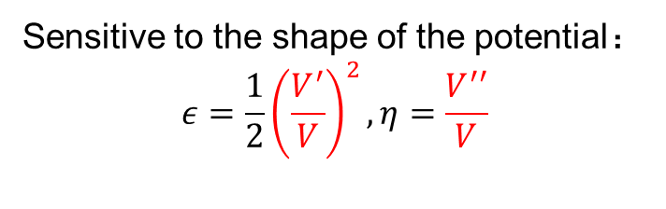
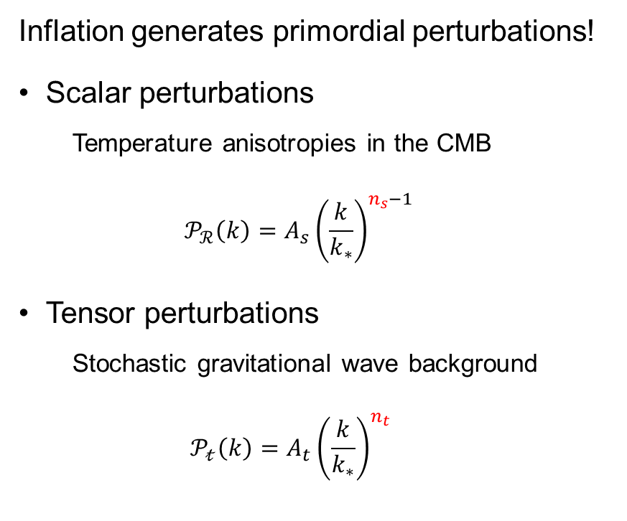


How to test Inflation?
Inflation generates primordial perturbations!
Scalar perturbations
  Temperature anisotropies in the CMB
  $${ 𝒫}_{ℛ}\left(k\right)=A_{s}{\left(\frac{k}{k_{∗}}\right)}^{n_{s}−1}$$
Tensor perturbations
  Stochastic gravitational wave background
  $$𝒫_{𝓉}\left(k\right)=A_{t}{\left(\frac{k}{k_{∗}}\right)}^{n_{t}}$$
$$φ_{c}$$
$$δφ$$
Sensitive to the shape of the potential：
$$ε=\frac{1}{2}{\left(\frac{V^{′}}{V}\right)}^{2},η=\frac{V^{′′}}{V}$$

Slide 7
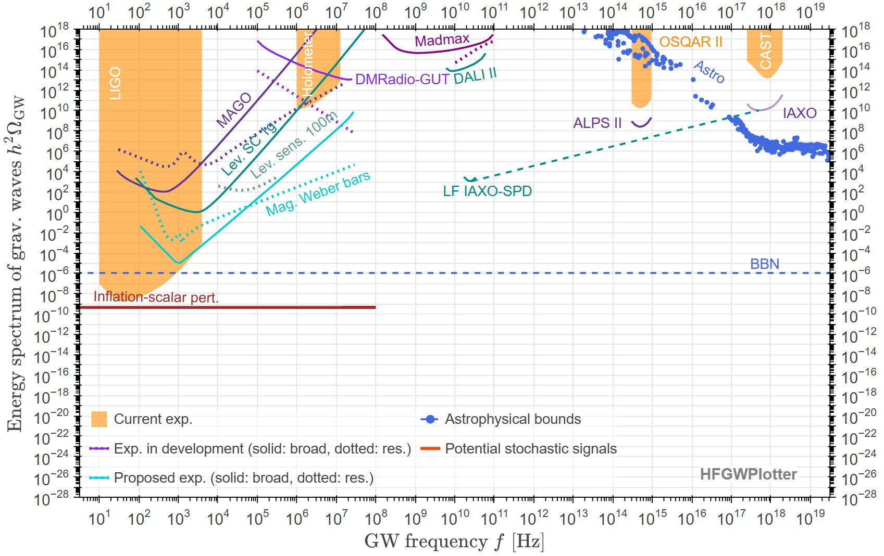
Stochastic gravitational wave background

Slide 8
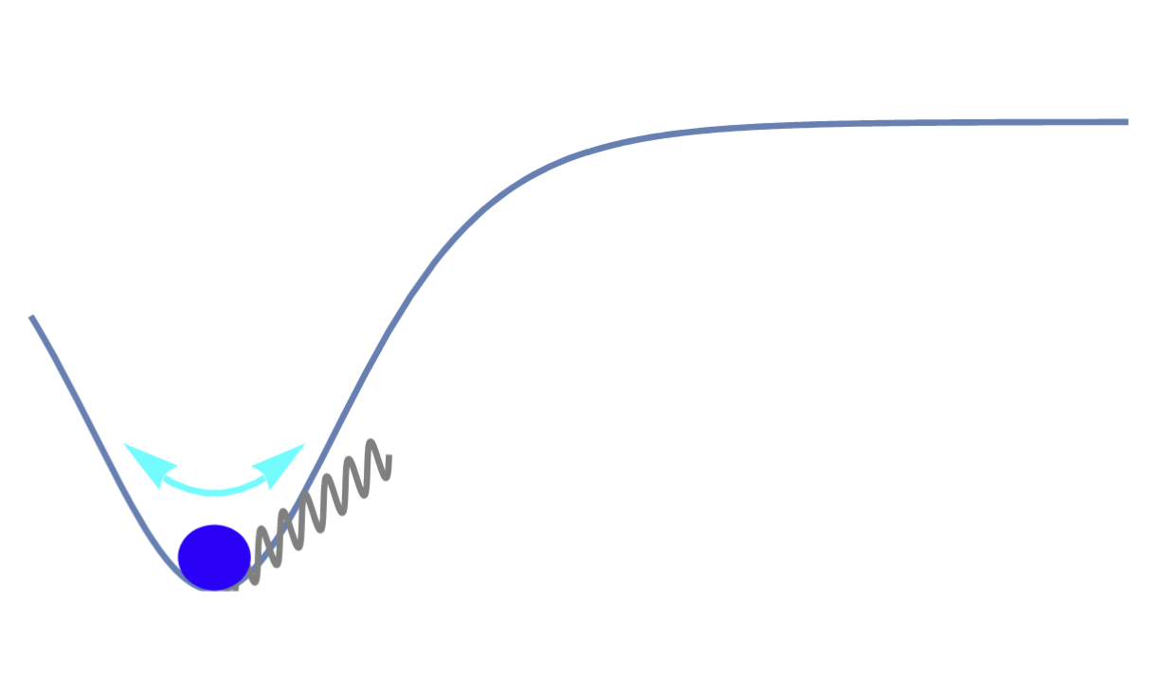
Stochastic gravitational wave background

Slide 9
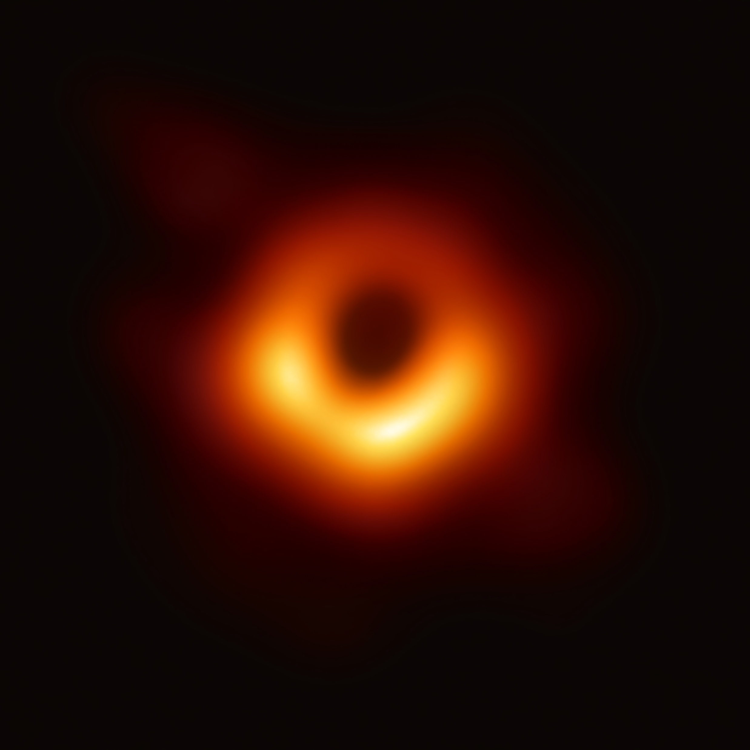
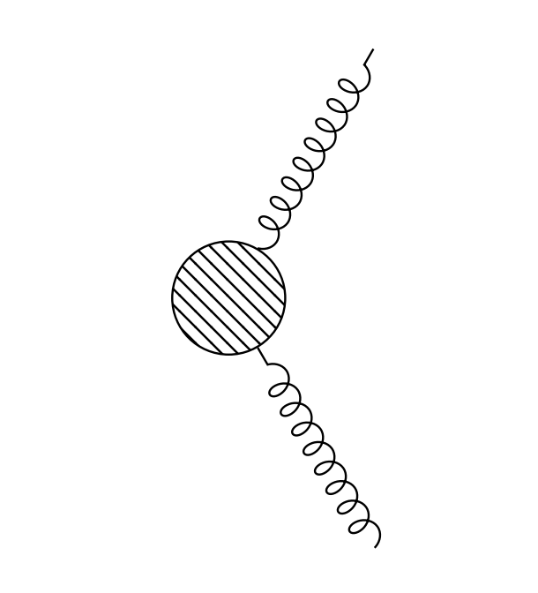
Particle production in an external field
Schwinger effect
Hawking Radiation
GPP
Notes:
Schwinger effect：1951 Hawking Radiation：1974

Slide 10
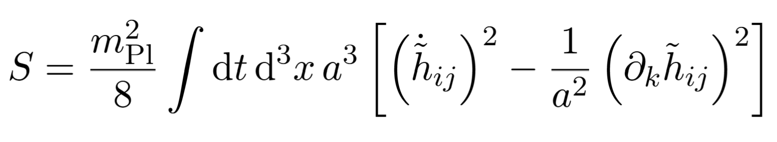
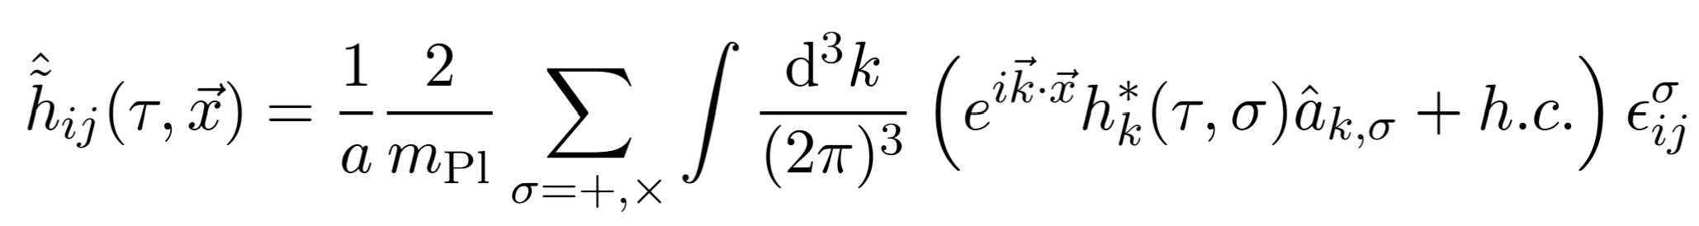

Gravitational Particle Production
Linearized Action
Canonical Quantization
Mode function
$$h_{k}^{′′}\left(τ\right)+ω_{k}^{2}\left(τ\right)h_{k}\left(τ\right)=0, ω_{k}^{2}\left(τ\right)≡k^{2}−\frac{a^{2}\left(τ\right)R\left(τ\right)}{6}=k^{2}−\frac{a^{′′}\left(τ\right)}{a\left(τ\right)} .$$
Mukhanov-Sasaki equation

Slide 11
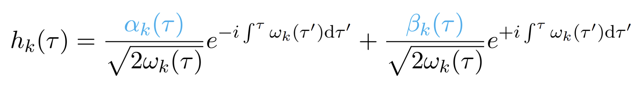
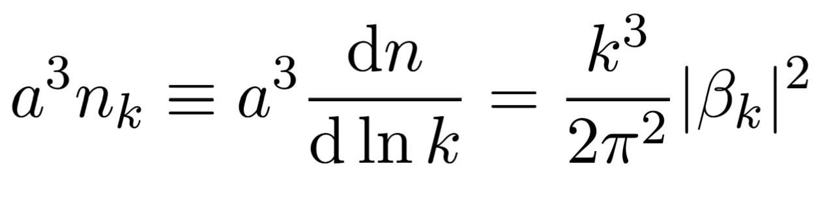
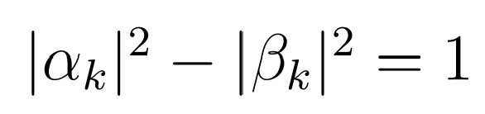
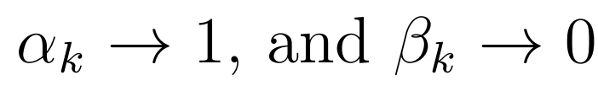

Solving the Mode function
$$h_{k}^{′′}\left(τ\right)+ω_{k}^{2}\left(τ\right)h_{k}\left(τ\right)=0, ω_{k}^{2}\left(τ\right)≡k^{2}−\frac{a^{2}\left(τ\right)R\left(τ\right)}{6}=k^{2}−\frac{a^{′′}\left(τ\right)}{a\left(τ\right)}$$
$Formal solution$
Under this decomposition, we have:
  Number density:
  Constraints:
Bogoliubov coefficients
Initial condition:
Bunch–Davies vacuum

Slide 12
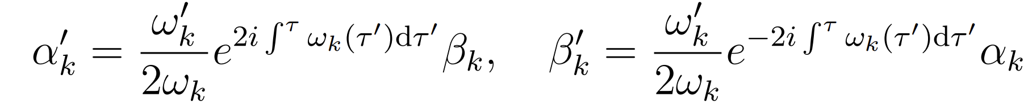
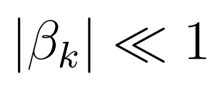
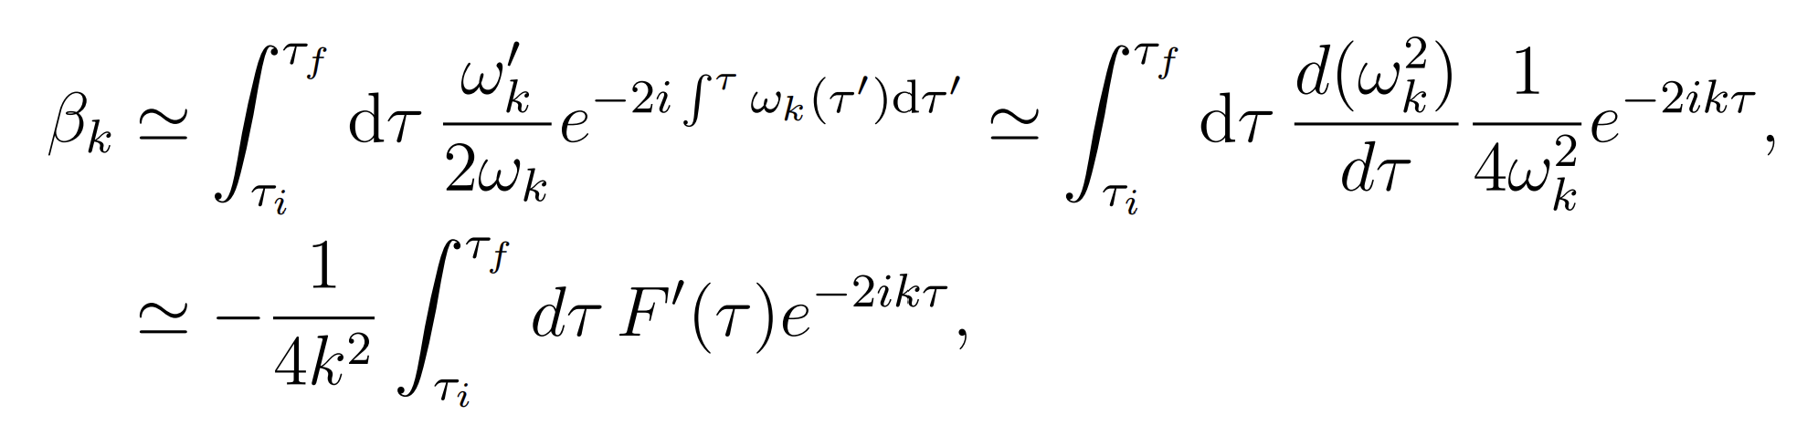
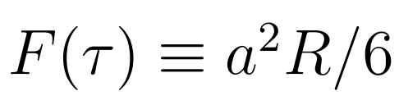
Solving the Mode function
Since gravity is a weak source,

Slide 13
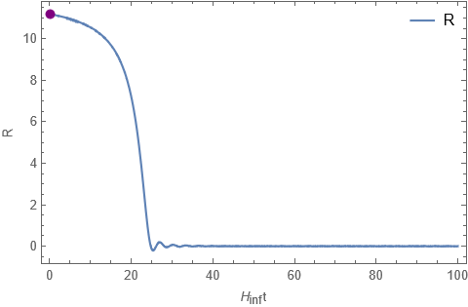
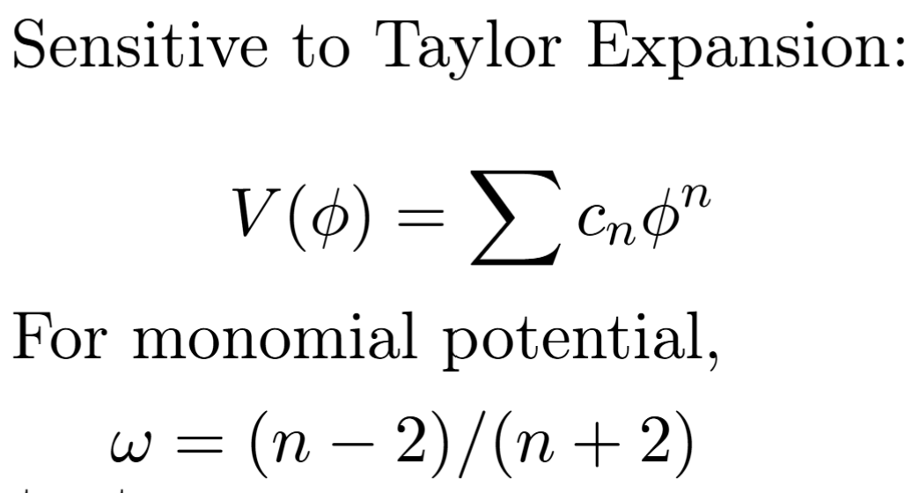

Behavior of Ricci Scalar
During inflation
$$R=12H^{2}$$
During Oscillation
  $n=2 φ\sim cos\left(mt\right)$
  $n=4 φ\sim sn\left(Φt,i\right)$
Transition between Inflation to Reheating
Oscillation induced by inflaton field
Jacobi elliptic functions

Slide 14
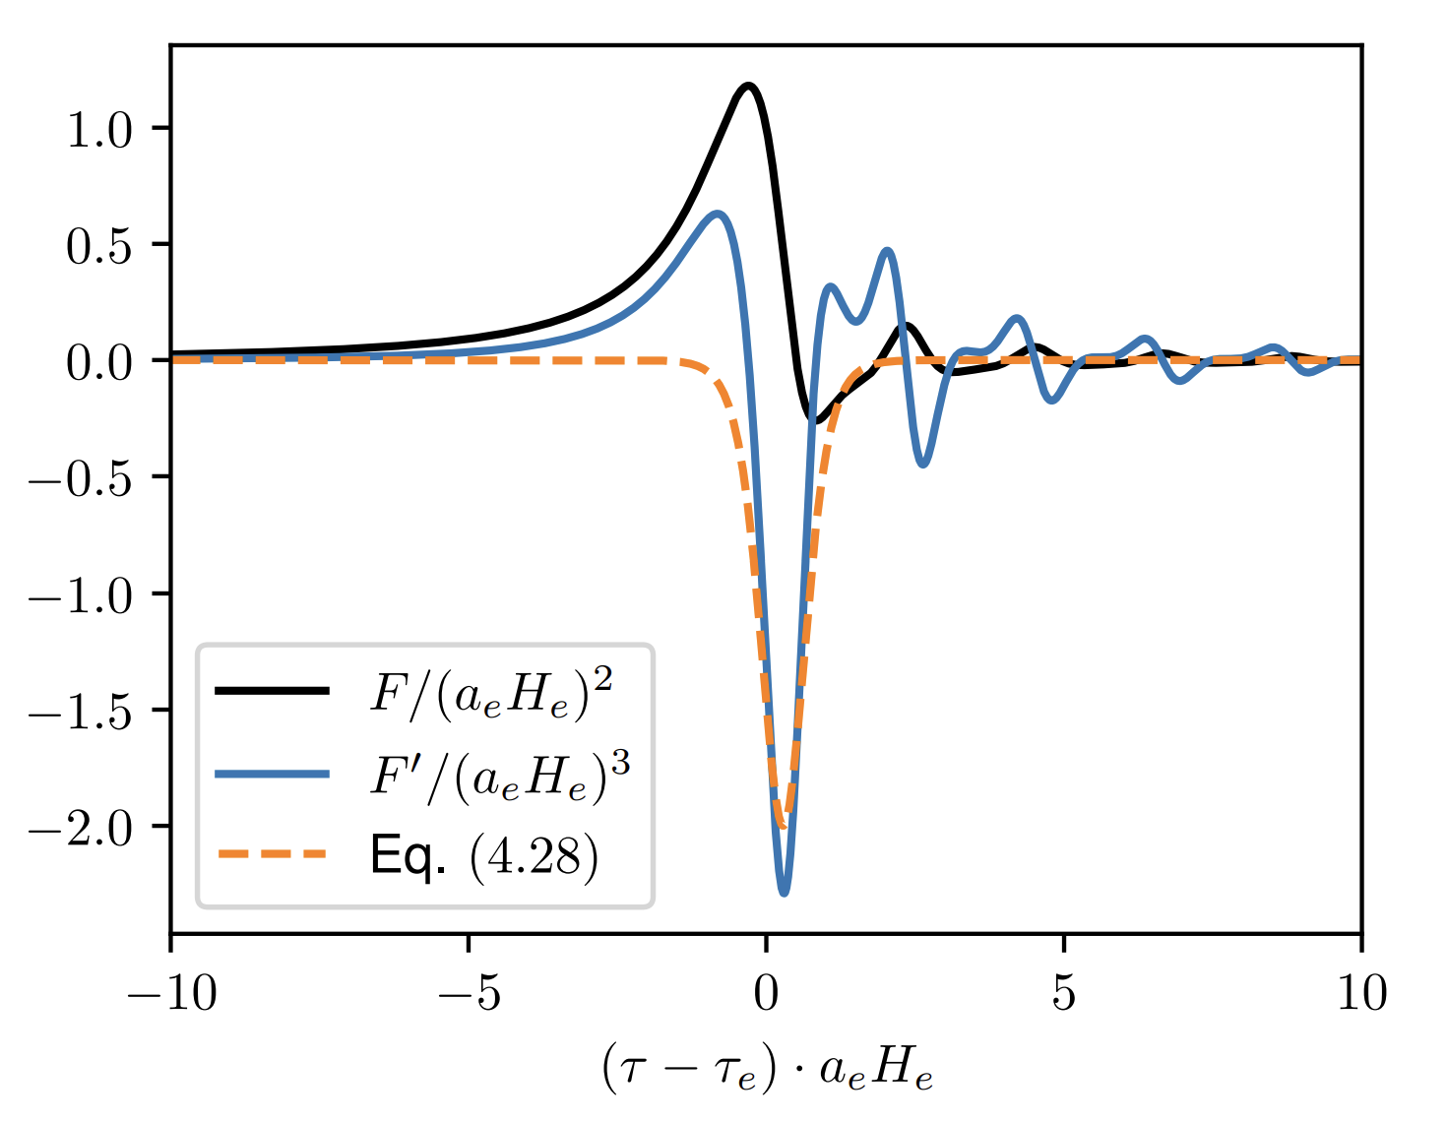
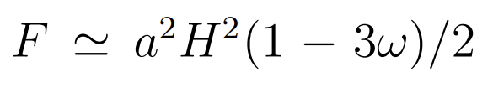


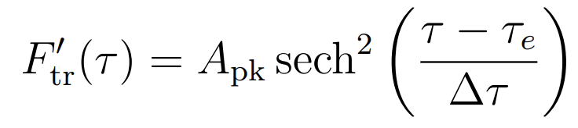
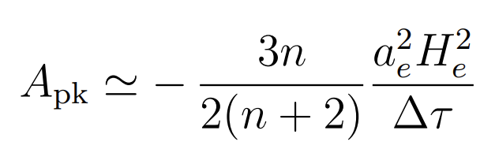
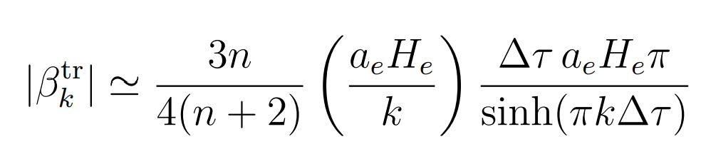

Transitional Contribution
During Oscillation
During Inflation
At UV, $e^{−πk∆τ}$

Slide 15
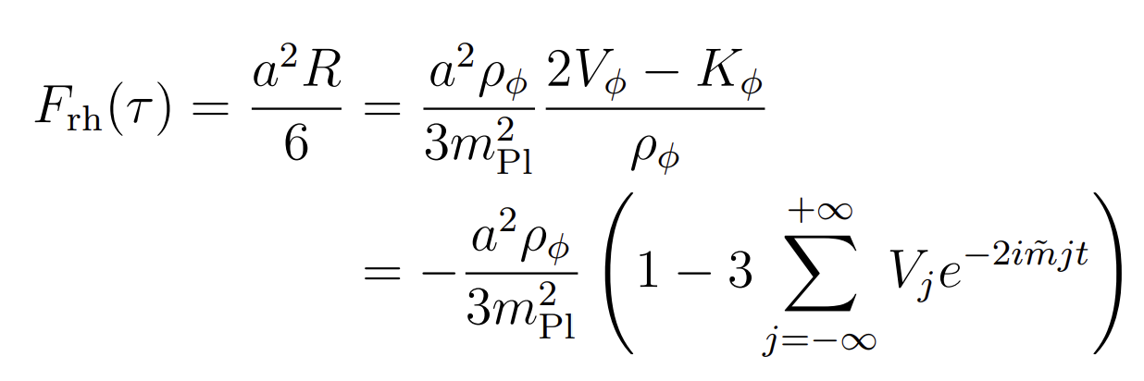
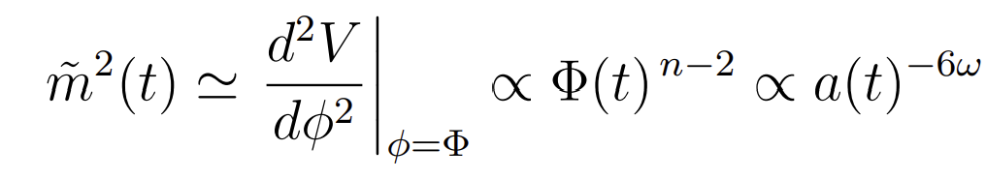
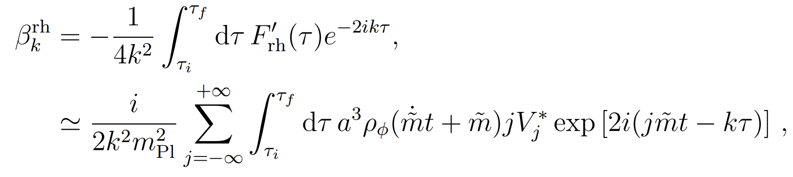
Oscillation Contribution
Fourier Transform of Potential and Kinetic Energy
Put it into the integral

Slide 16
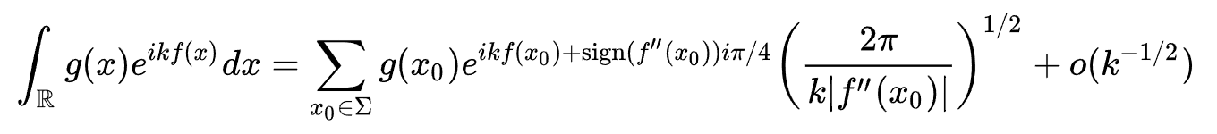
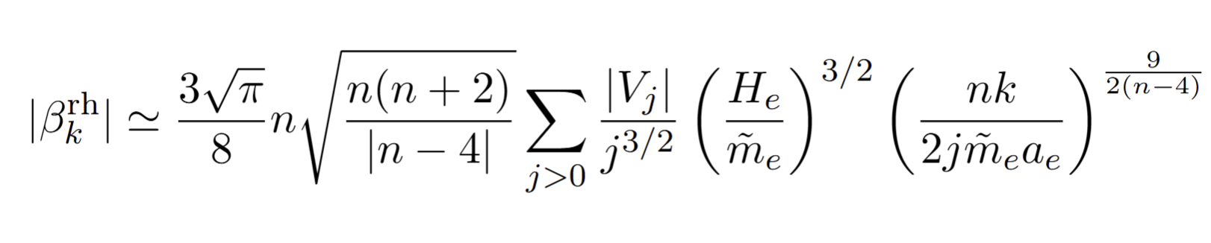


Oscillation Contribution
$$f^{′}\left(x_{0}\right)=0$$
Stationary Phase Approximation
Results from stationary phase approximation
Hidden exponential drop $e^{−π}$

Slide 17
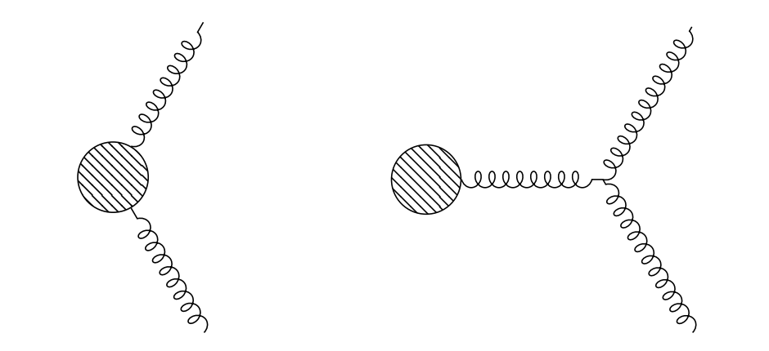
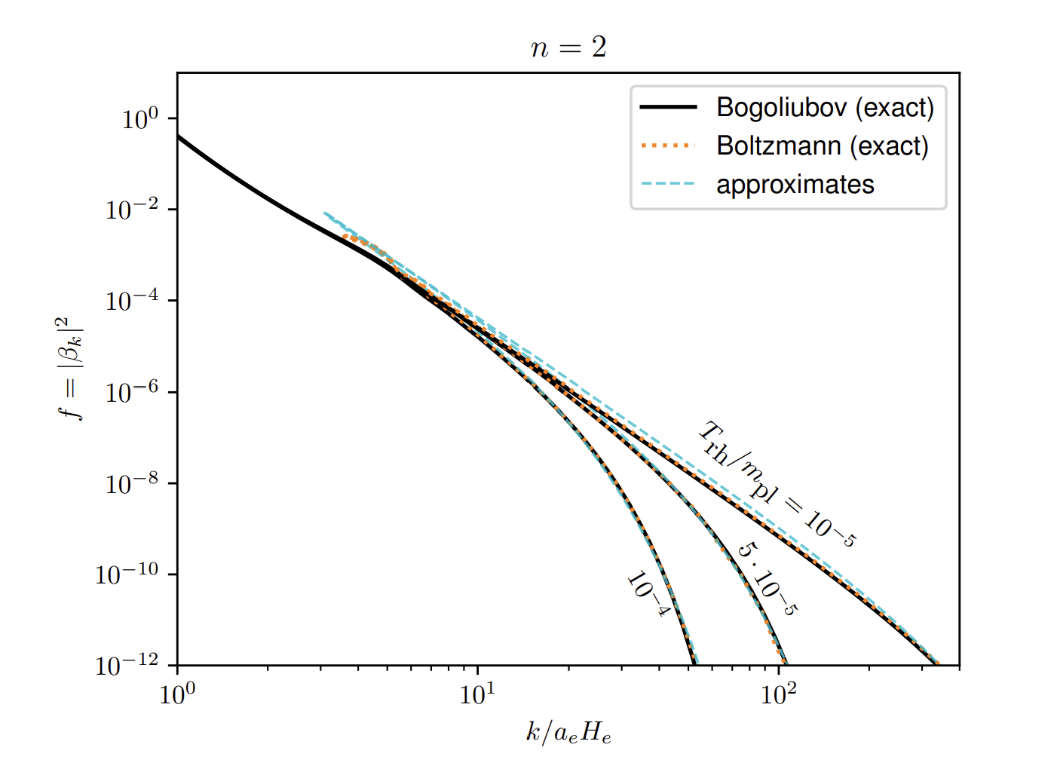
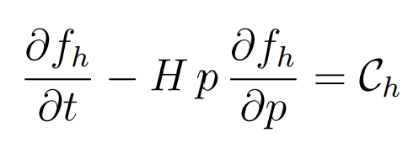
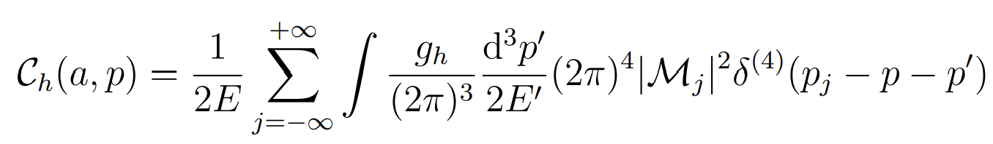
Boltzmann Treatment

Slide 18
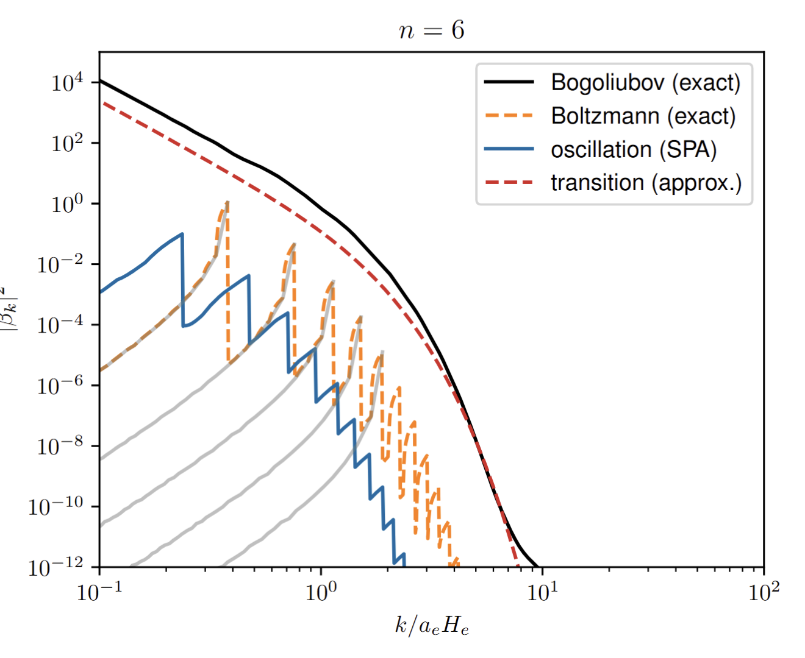

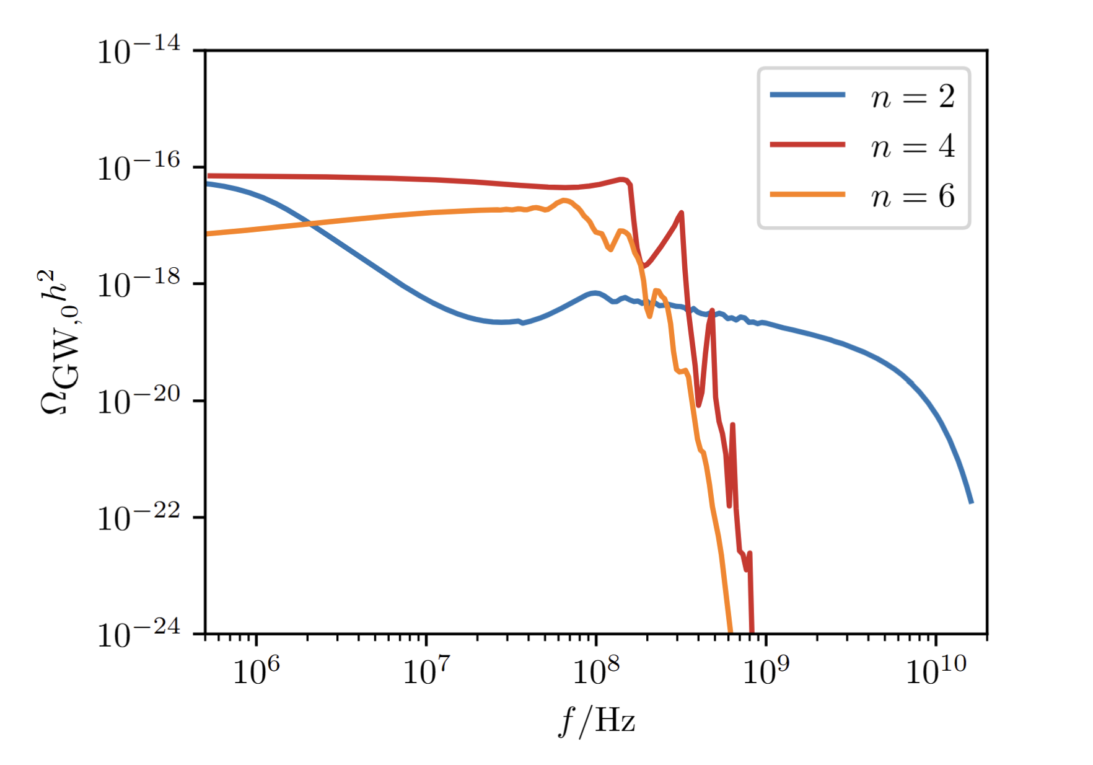


Results
$$ρ_{φ}$$
$$V_{j}$$
Transitional contribution dominates.

Slide 19
Summary
In the early universe, inflaton dynamics can produce gravitional waves solely from gravity effects.
They are irreducible background for any new physics.
Boltzmann treatment sometimes can fail due to rapid change of space-time background.
Thanks for your attention and organizers!

