Slide 1


Cosmic Expansion Amplifies
Gravitational Waves from First-Order
Phase Transitions
田驰 (Chi Tian)
安徽大学
2026第十五届新物理研讨会
2026.8, 威海
Collaborator: Xiao Wang, Csaba Balazs
Based on work arxiv:2606.31571

Slide 2
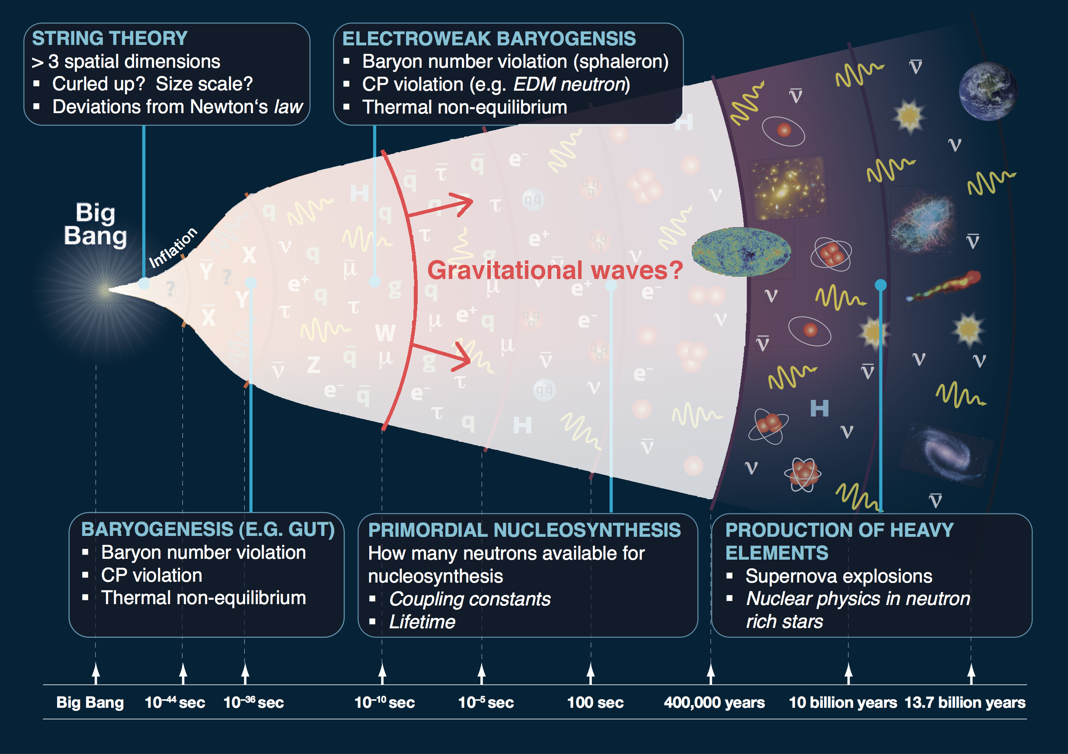
Credit: 1205.2451

Slide 3
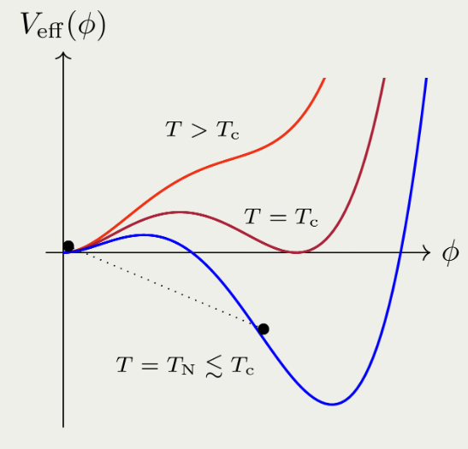
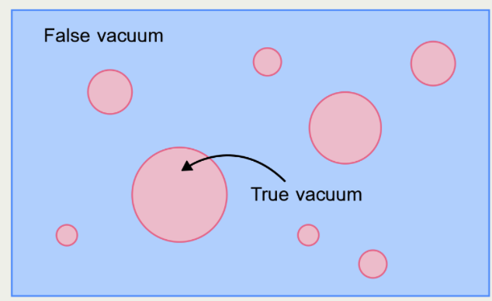
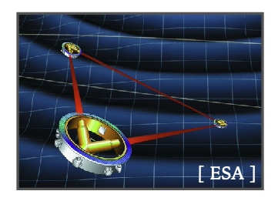
Credit: 1205.2451
Credit: 1205.2451
Cosmological FOPTs as SGWB sources
Bubble nucleation
Dynamics of
bubbles

Slide 4
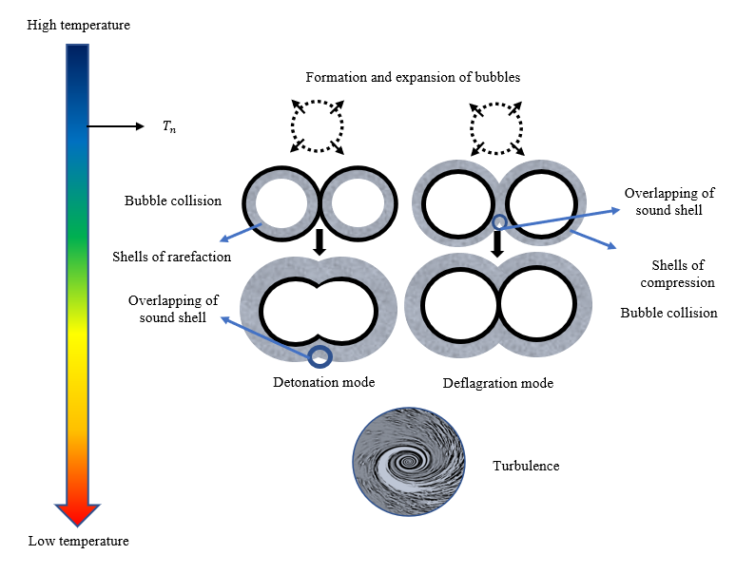
Credit: 1205.2451
Various GW generation mechanisms
Typical GWs sources of during FOPTs:
Bubble collisions
Sound wave
Turbulence
Other sources of GWs during phase transition:
  Particles produced by bubble collisions
  (Inomata et al. arXiv: 2412.17912)
  Particle splitting/losing momentum process across the bubble wall
  (Wenyuan Ai. arXiv:2508.02794, Qiu et al, arXiv:2508.04314)
  Feebly Interacting Particles
  (Jinno et al. arXiv: 2211.06405)
  …
Wang, et. al. PRD 2022

Slide 5
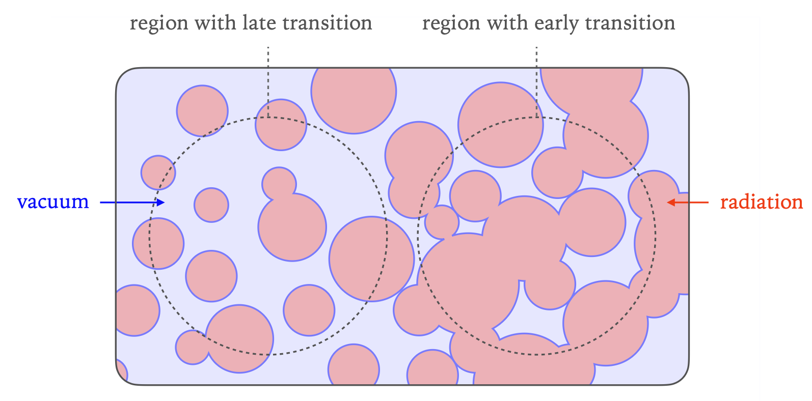
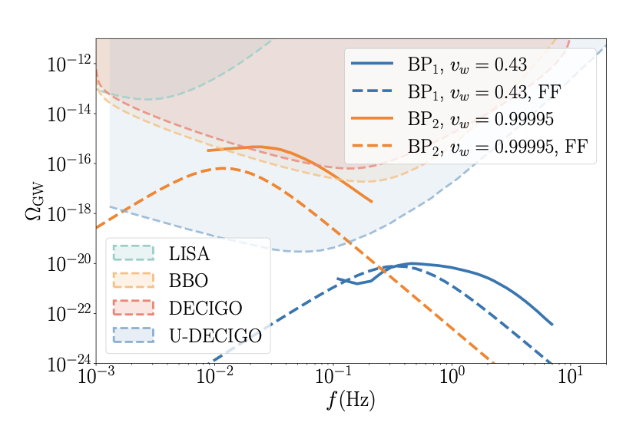
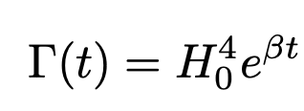

Credit: 1205.2451
Credit: 1205.2451
Cosmological FOPTs as SGWB origins
, when $β$ is small
Bubble separation imprints GW spectrum

Slide 6
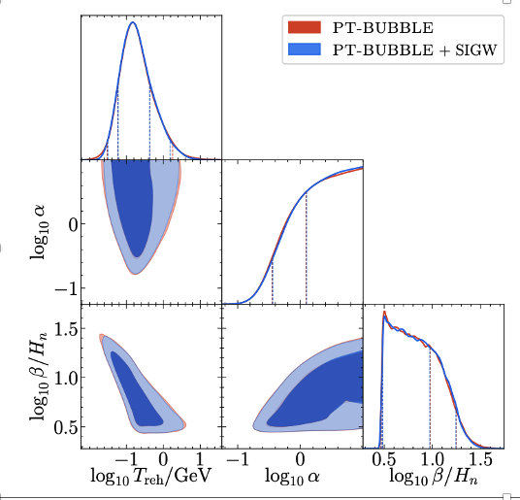
Credit: 1205.2451
Credit: 1205.2451
Cosmological FOPTs as SGWB origins
, when $β$ is small
PTA prefers slow transitions!

Slide 7
Credit: 1205.2451
Credit: 1205.2451
Cosmological FOPTs as SGWB origins
, when $β$ is small
Interested in curvature perturbations from slow FOPT?
Pay attention to 2601.14412.

Slide 8
Credit: 1205.2451
Credit: 1205.2451
Something is different when considering CE
Reducing mean separation of bubbles;
Growing strength of the FOPTs;
Different sound wave dynamics!

Slide 9
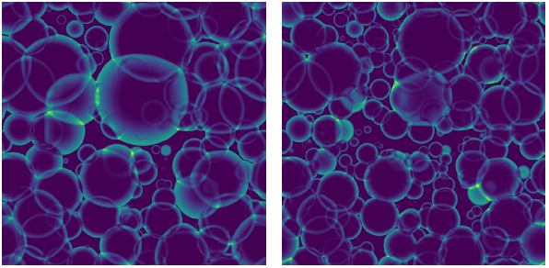
Credit: 1205.2451
Credit: 1205.2451
Something is different when considering CE
Reducing mean separation of bubbles;
Growing strength of the FOPTs;
Different sound wave dynamics!
Simulating Poissonian process
Increasing physical volume
Reducing mean-bubble separation
Guo, et. al. JCAP 2021

Slide 10
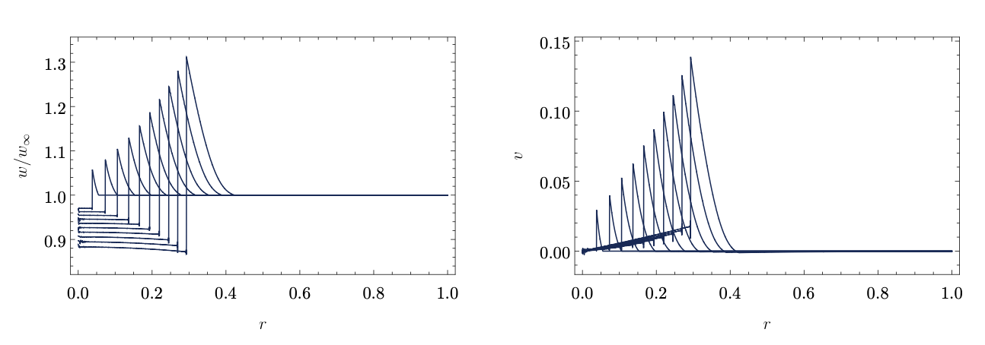


Credit: 1205.2451
Credit: 1205.2451
Something is different when considering CE
Reducing mean separation of bubbles;
Growing strength of the FOPTs;
Different sound wave dynamics!
Initial strength:
$$α_{0}=ε/ρ_{rad}(t=0)$$
Time dependent strength:
$$α\left(t\right)∝{ a}^{4}(t)$$
Jinno, et. al. JCAP 2022

Slide 11

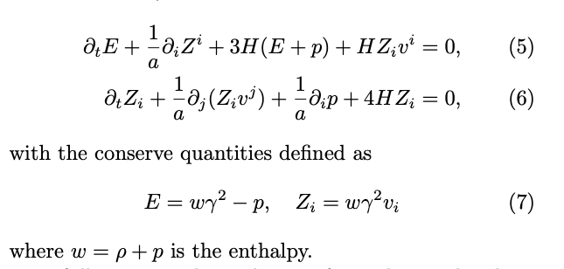
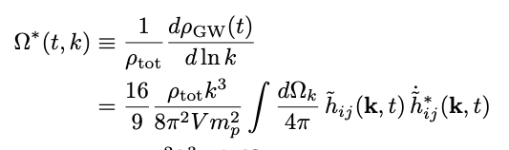
Credit: 1205.2451
Credit: 1205.2451
Something is different when considering CE
Reducing mean separation of bubbles;
Growing strength of the FOPTs;
Different sound wave dynamics!
Evolving EOM for GWs
Use Higgsless conserved hydro-dynamical equation

Slide 12
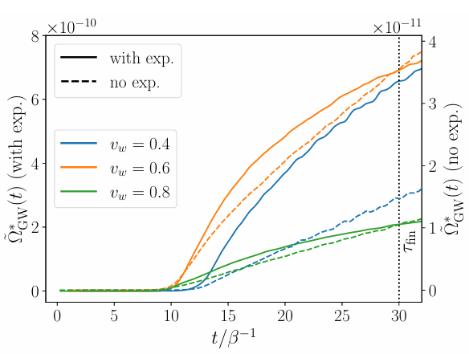
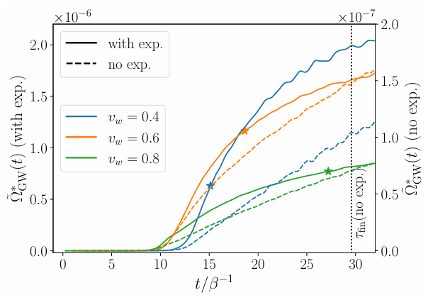


Credit: 1205.2451
Credit: 1205.2451
Something is different when considering CE
Weak $α_{0}=0.005$
Reducing mean separation of bubbles;
Growing strength of the FOPTs;
Different sound wave dynamics!
Use Higgsless conserved hydro-dynamical equation
Intermediate $α_{0}=0.05$

Slide 13

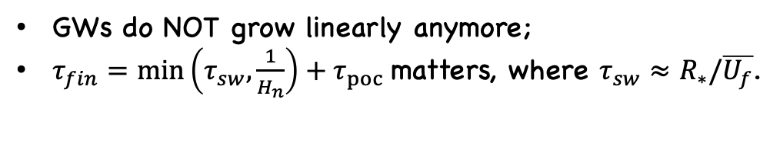
Credit: 1205.2451
Credit: 1205.2451
Something is different when considering CE
Weak $α_{0}=0.005$
Weak $α_{0}=0.005$
Reducing mean separation of bubbles;
Growing strength of the FOPTs;
Different sound wave dynamics!
Intermediate $α_{0}=0.05$
GWs do NOT grow linearly anymore;
$τ_{fin}=\min\left(τ_{sw},\frac{1}{H_{n}}\right)+τ_{poc}$matters, where $τ_{sw}≈R_{∗}/\overline{U_{f}}$.

Slide 14
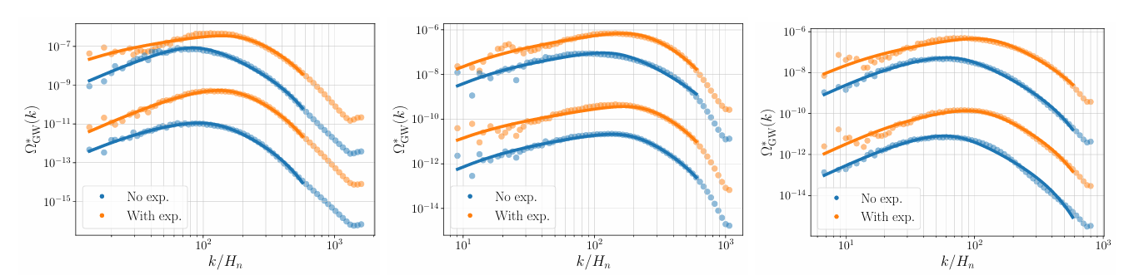
Credit: 1205.2451
Credit: 1205.2451
Something is different when considering CE
Reducing mean separation of bubbles;
Growing strength of the FOPTs;
Different sound wave dynamics!

Slide 15
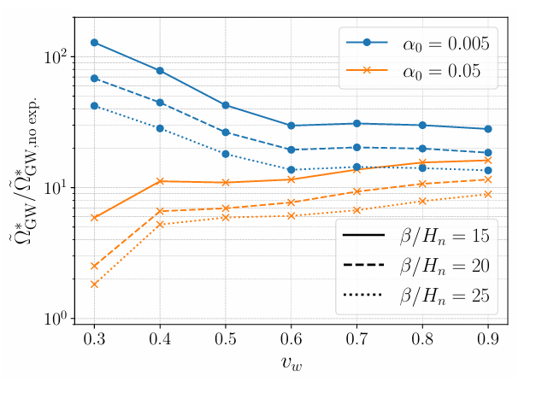
Credit: 1205.2451
Credit: 1205.2451
Something is different when considering CE
Reducing mean separation of bubbles;
Growing strength of the FOPTs;
Different sound wave dynamics!

Slide 16
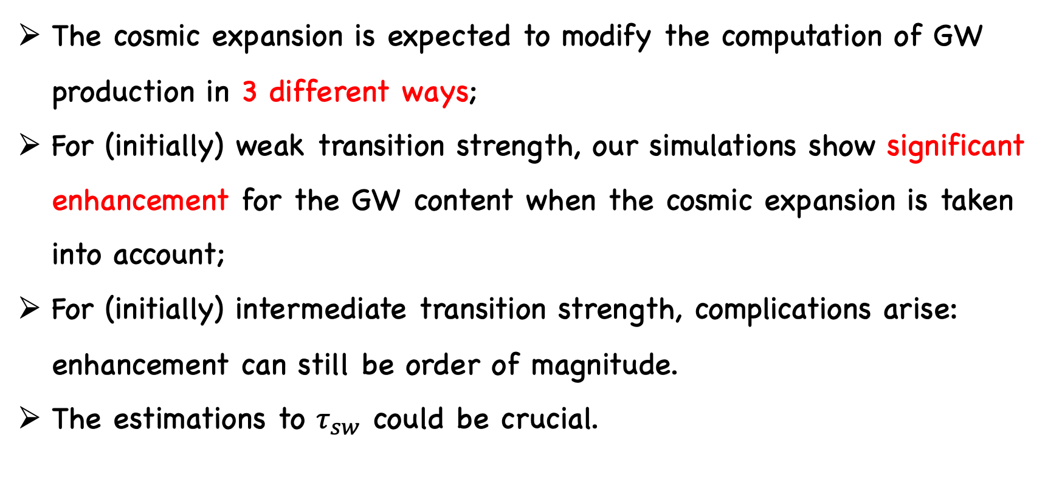
Summary
The cosmic expansion is expected to modify the computation of GW production in 3 different ways;
For (initially) weak transition strength, our simulations show significant enhancement for the GW content when the cosmic expansion is taken into account;
For (initially) intermediate transition strength, complications arise: enhancement can still be order of magnitude.
The estimations to $τ_{sw}$ could be crucial.

Slide 17
Thank You

