Slide 1



Revelation from Cosmic Acceleration
——Model building, data fitting and cosmological applications of dark energy
第十五届“新物理研讨会”
Taotao Qiu
Huazhong University of Science and Technology
2026.08.25
Based on Reviews:
Y. Cai, X. Ren, TQ, M. Li, X. Zhang, Natl. Sci. Rev. 2026
TQ, Y. Cai, Y. Liu, S. Li, J. Evslin, X. Zhang, CPC 2026
and references therein.

Slide 2
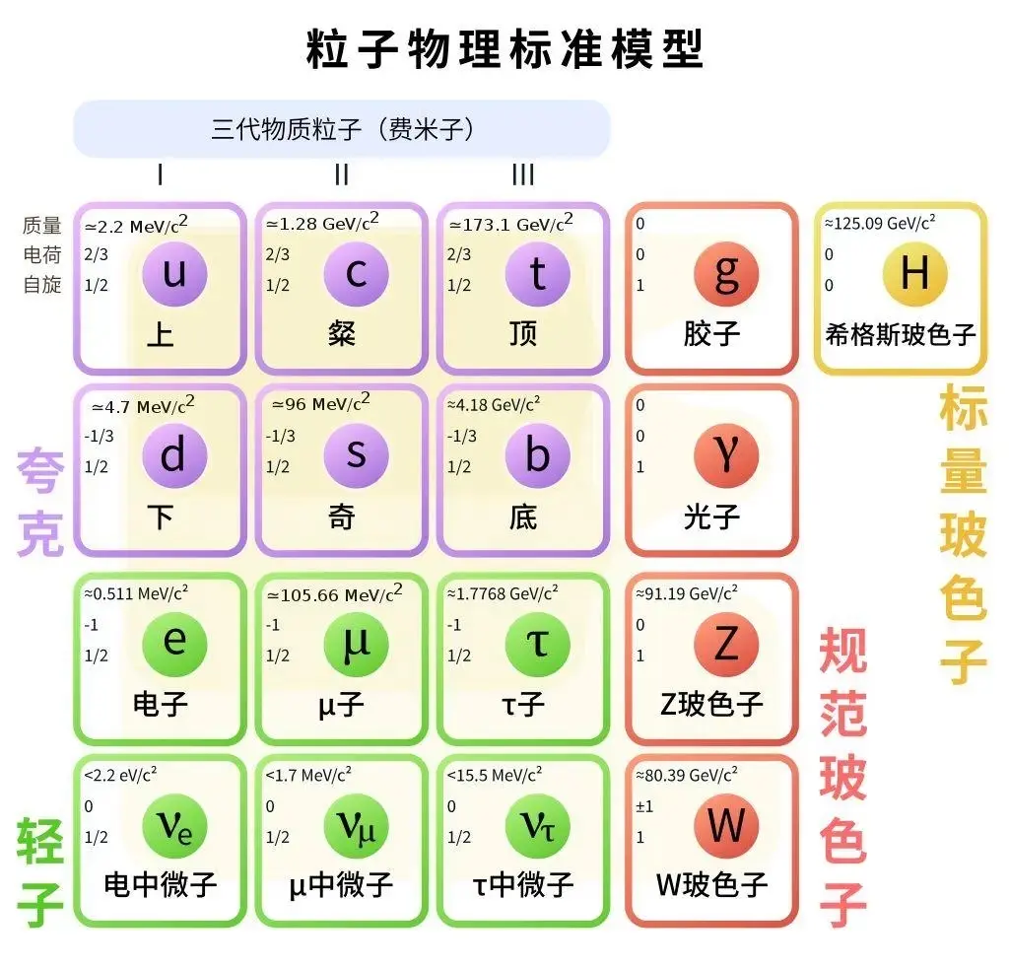
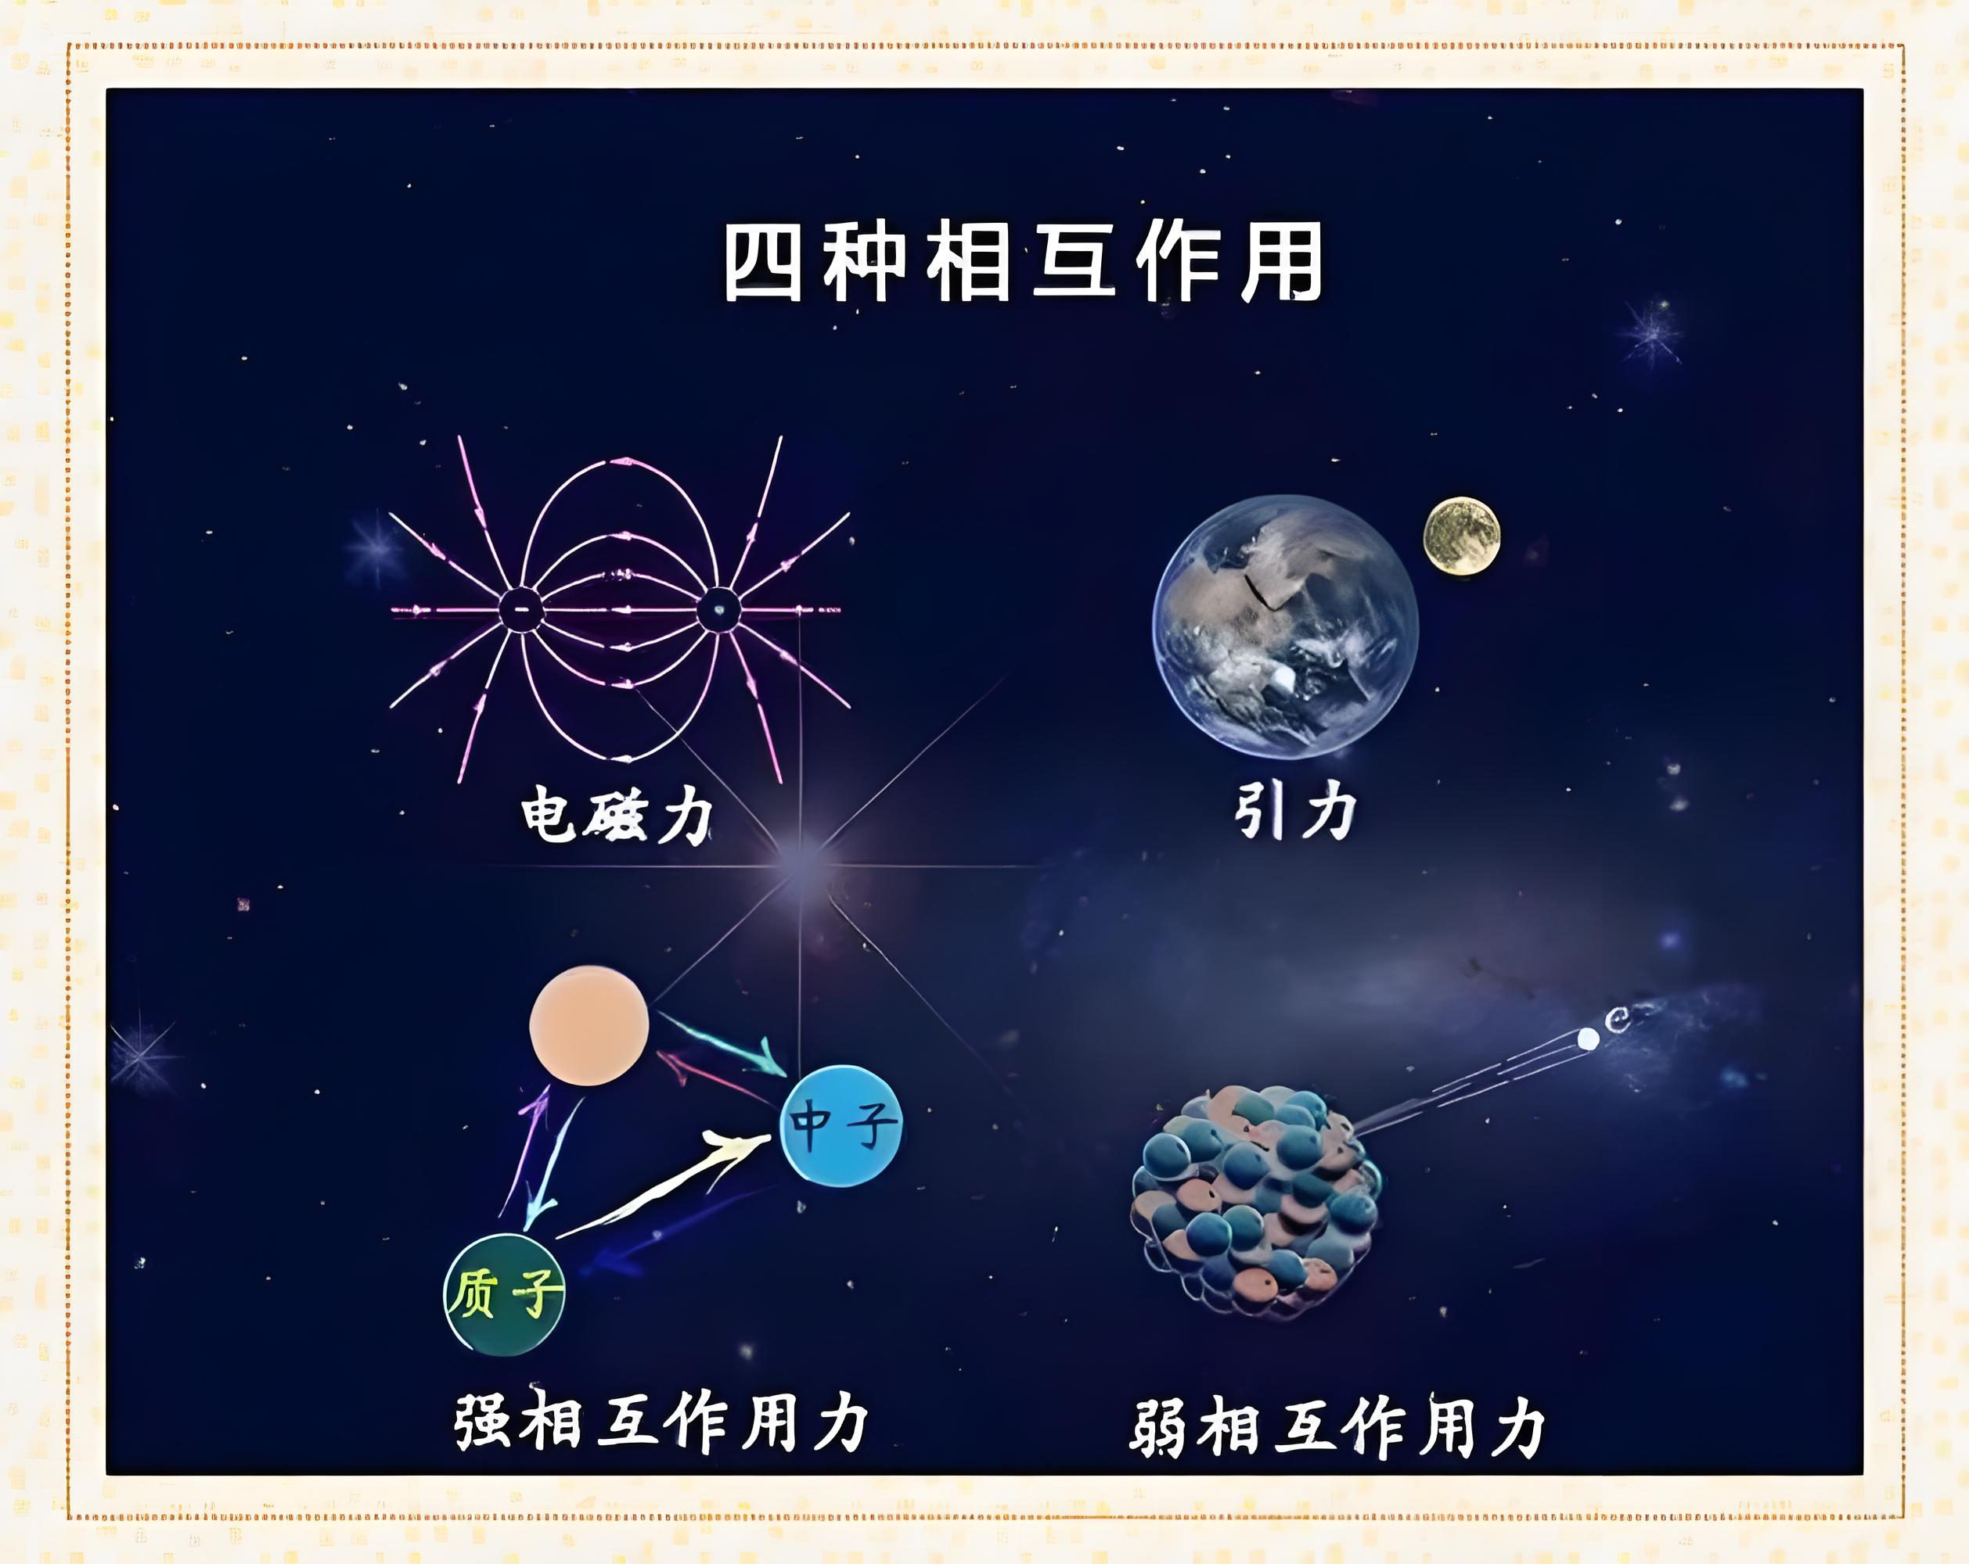
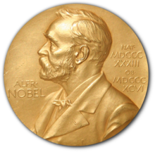
From Particles to Universe
In 1970s, the “standard model” of the particle physics has been established, which is known as the cornerstone of our reality.
(S. L. Glashow, 1961; S. Weinberg, 1967; A. Salam, 1968; H. Fritzsch, M. Gell-Mann, H. Leutwyler, 1973; D. Politzer, 1973; D. Gross and F. Wilczek, 1973.)
1979
2004

Slide 3
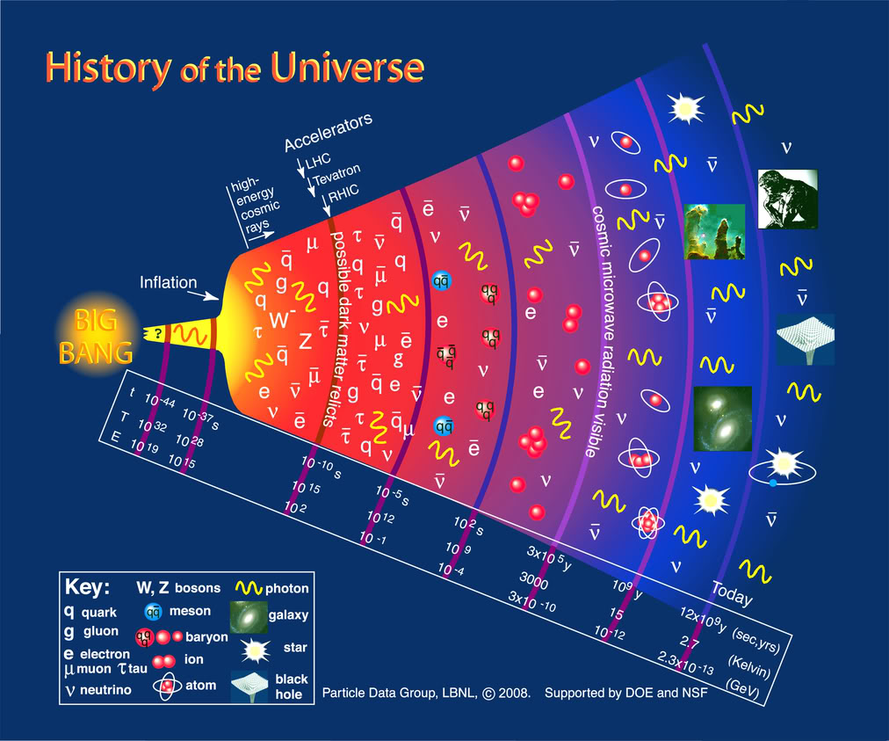
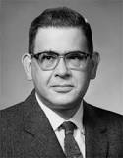
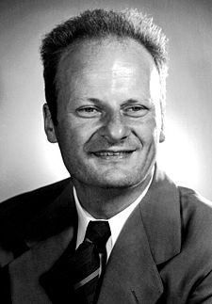
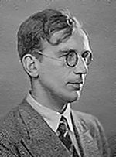
From Particles to Universe
In 1948, Alpher, Bethe and Gamow established a theory of the evolution of the universe (the Hot Big Bang Theory). In this theory, the universe comes from an extremely hot and dense stage, and is continuously expanding and cooling till current era.
R. Alpher (α)
H. Bethe (β)
G. Gamow (γ)

Slide 4
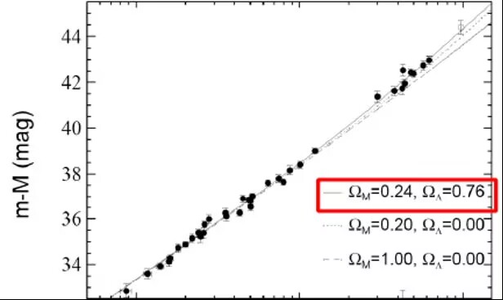
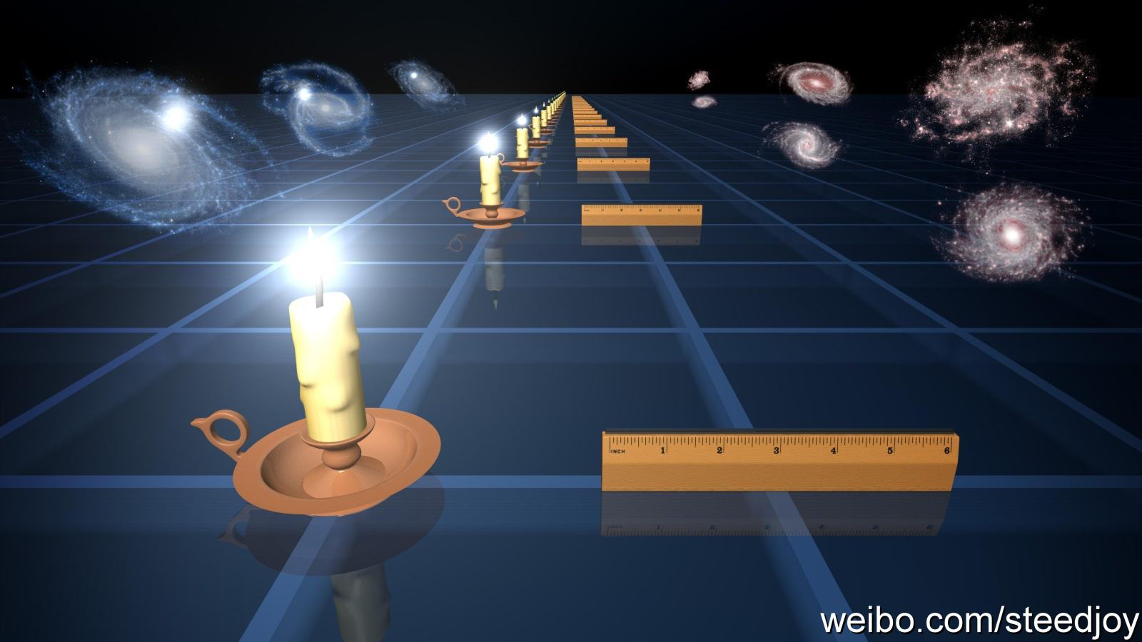
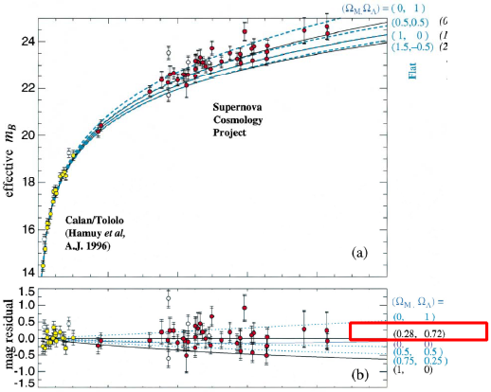
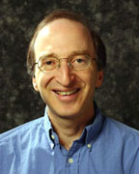

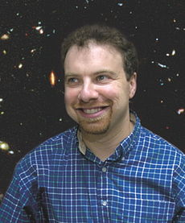
Things changed from 1998……
Accelerating expansion has been found!
  1. Supernovae Type Ia
High z Search Team
(A. Riess, et al., 1998,
B. Schmidt et al.,1998)
Supernovae Cosmology Project
(S. Perlmutter et al., 1998)
S. Perlmutter
B. Schmidt
A. Riess
2011

Slide 5
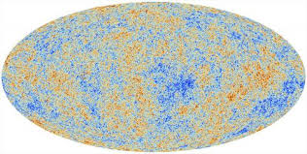
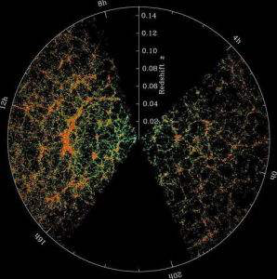
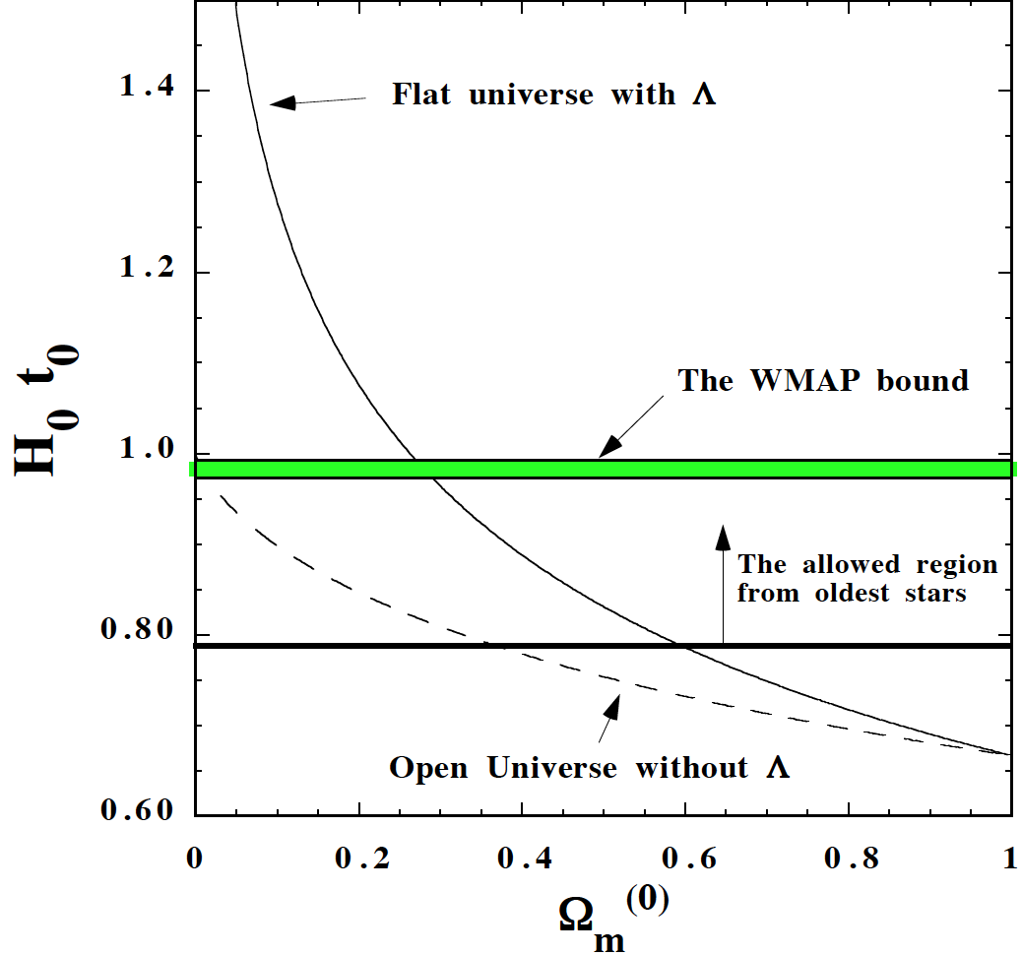
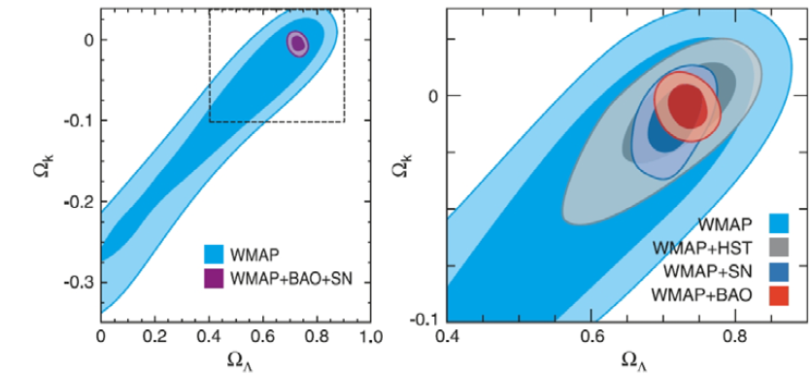
Things changed from 1998……
Accelerating expansion has been found!
  2. CMB and LSS
3. Age of the universe
Cosmic Microwave Background
Large Scale Structure
Komatsu et al., WMAP Collaboration, 2008
E. Copeland, M. Sami & S. Tsujikawa, 2006

Slide 6
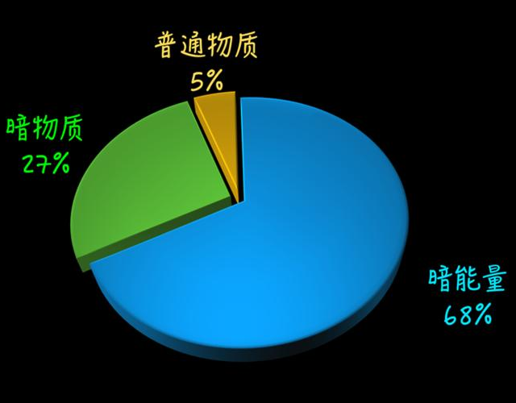
More “Concordance” Cosmological Model
The universe not only consists of matter, but also some “Dark” energy that drives the acceleration!
Basic features of dark energy:
possesses repulsive force;
not clustering;
consist of nearly 70% of the total amount of the universe.

Slide 7









Dark Energy Models
Introduction: Basic equations
Einstein Equation:
stress-energy tensor
In Friedmann-Lametre-Robertson-Walker metric:
where for flat universe: $k=0$
Einstein equations are reduced into Friedmann equations:
$$H≡\dot{a}/a$$
Hubble parameter
acceleration equation
acceleration:
Equation of state parameter

Slide 8



Dark Energy Models
The first dark energy model: Cosmological Constant (CC) (Einstein, 1915)
Just by adding a constant term to the Einstein Equation:
The constant used to be regarded by Einstein himself as a biggest mistake in his life!
The simplest model that can drive acceleration and serve as dark energy!
BUT……

Slide 9




Dark Energy Models
Problem I: Fine-tuning problem
People realized that vacuum has energy! (P. A. M. Dirac, 1929)
Vacuum energy density can be calculated from quantum field theory as:
＋
－
On the other hand, the CC energy density required to drive cosmic acceleration is:
Different by 120 orders of magnitude, so a constant with the same size is required to contribute, only with difference by 120 orders smaller!
c.f.
1,234,567,……,……,654,321-1,234,567,……,……,654,320=1
120 orders of magnitude
120 orders of magnitude

Slide 10



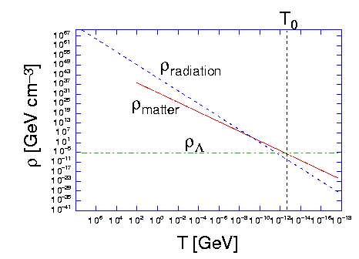



Dark Energy Models
Problem II: Coincidence problem
One can calculate the evolution of each species in the universe from the continuity equation:
For regular matter:
For cosmological constant:
However, the relative energy density of matter and dark energy are of the same order
which causes big unnatrualness!

Slide 11
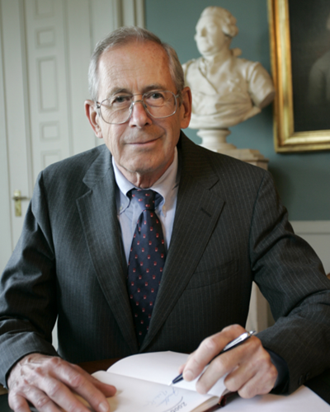






Dark Energy Models
DE might be dynamical!
Dynamical DE models I: Quintessence (P. J. E. Peebles & B. Ratra 1988, C. Wetterich 1994)
Action:
Energy density and pressure:
Equation of state:
P. J. E. Peebles
B. Ratra
$$V(φ)$$
DE can be real matter/field with kinetic energy and potential
DE can be evolving, rather than static
The EoS will definitely larger than 1
What other applications?
$$φ$$

Slide 12
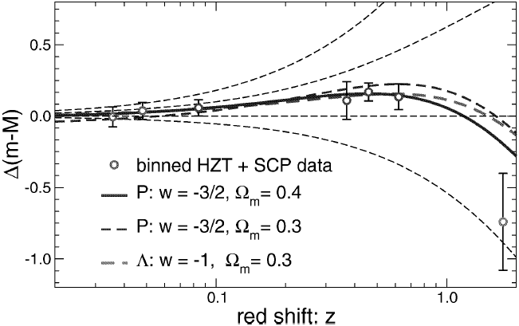





Dark Energy Models
DE might be dynamical!
Dynamical DE models II: Phantom (R. Caldwell, 1999, R. Caldwell, M. Kamionkowski, N. Weinberg, 2003)
Motivation: Quintessence can only realize $w>−1$, but the region of $w<−1$also accords with the observational data!
Action:
Energy density and pressure:
$$V(φ)$$
Equation of state:
$$φ$$
Ghost problem: when there is a minus sign in front of the kinetic term, NEC will be violated and the model will experience ghost instability!(to be explained later)

Slide 13

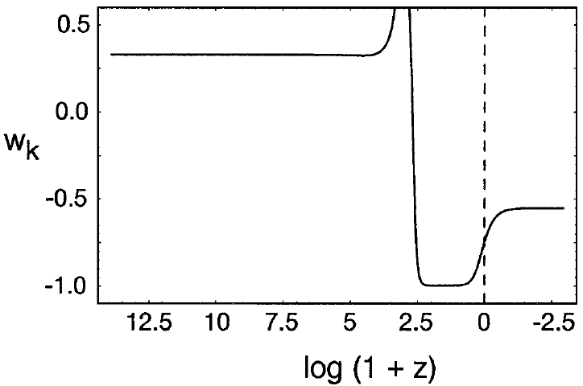



Dark Energy Models
DE might be dynamical!
Dynamical DE models III: K-essence (Chiba, Okabe, Yamaguchi 2000, Armendariz-Picon, Mukhanov, Steinhardt 2000 & 2001.)
Action:
Energy density and pressure:
Equation of state:
An example of K-essense model, which possesses the “tracking” behavior.
which can be either >-1 or <-1, but cannot cross -1 (to be explained later.)

Slide 14

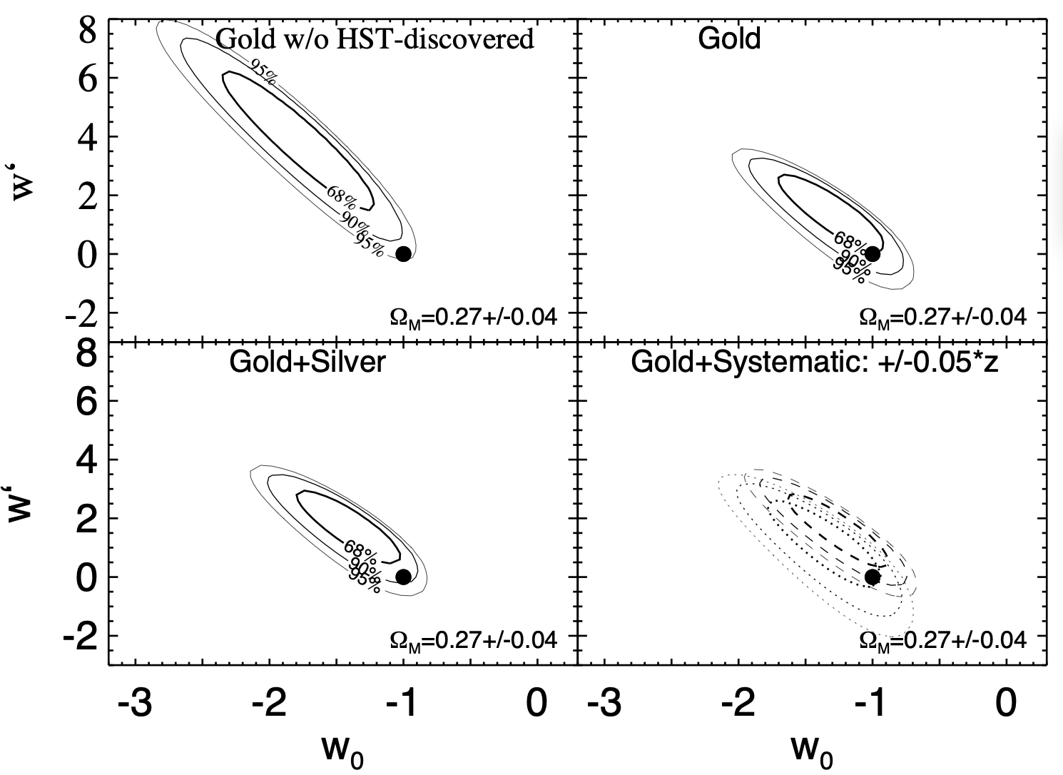
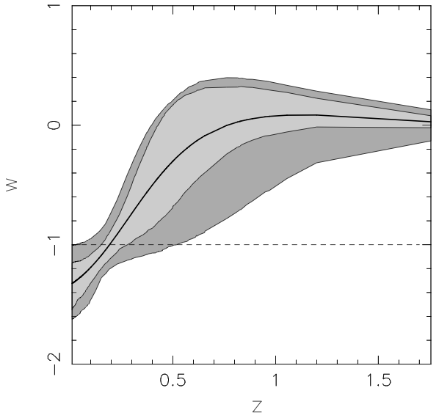
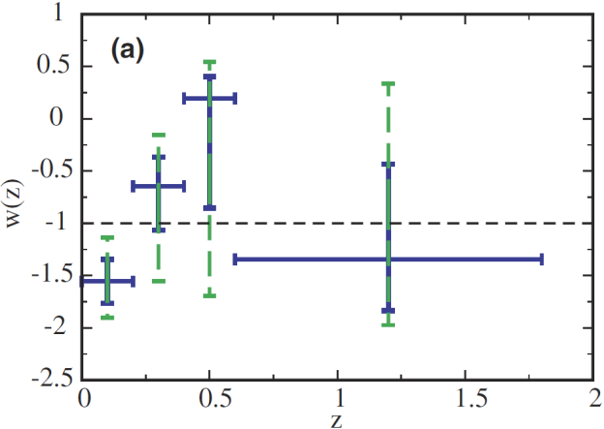
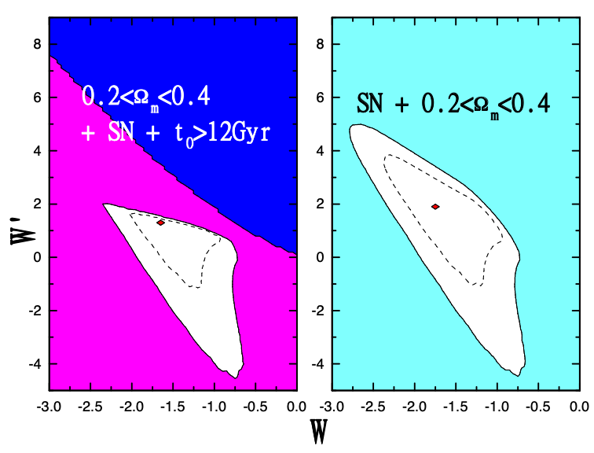
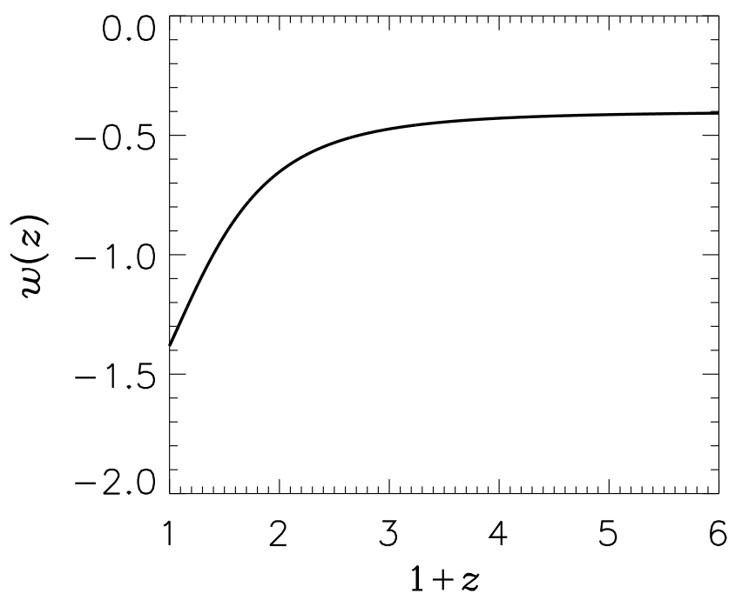
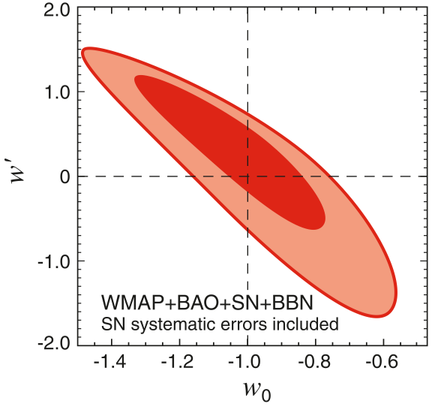

New Hints from Observations
Data I: ”Gold” data from Sne Ia in 2004
$w$ crossing $−1$ is favored!
A. Riess et al., 2004
U. Alam et al., 2004
D. Huterer et al., 2005
Data II: Cosmic Age, CMB and LSS
B. Feng et al., 2004
S. Hannestad et al., 2004
E.Komatsu et al., 2009

Slide 15

No-Go Theorem
No-Go Theorem
w crossing -1 can never be reached for matter which is
in 4D classical Einstein Gravity,
described by single simple component:
----perfect fluid
---- single scalar field with lagrangian as
(3) coupled minimally to Gravity or other matter.
(A. Vikman 2004, W. Hu 2004, R. Caldwell & M. Doran 2005, Zhao, Xia, Li, Feng & Zhang 2005, M. Kunz & D. Saphone 2006, Xia, Cai, TQ, Zhao & Zhang 2007)
To realize crossing, one of these conditions should be violated!
Beyond 4D or Modify Einstein Gravity;
Invoke more degree(s) of freedom;
Introduce non-minimal coupling.
Maybe also more……

Slide 16
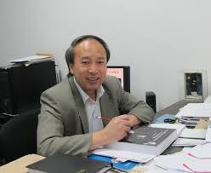



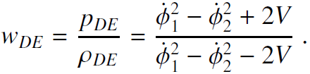






Quintom dark energy models
Double field (Quintom) model (B. Feng, X. Wang, X. m. Zhang 2004)
Action:
Teminology: Quintessence + Phantom
X. m. Zhang
Energy density, pressure, and equation of state:
For non-interacting double field Quintom model:
The equation of state $w$ can be expressed as:
with
and the condition:

Slide 17

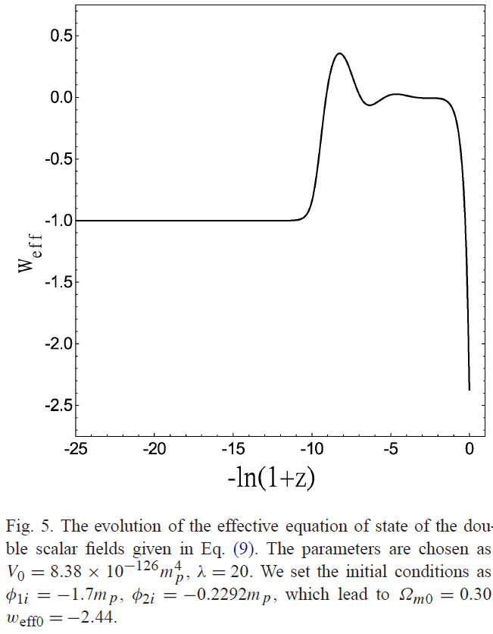















Quintom dark energy models
Double field (Quintom) model (B. Feng, X. Wang, X. m. Zhang 2004)
Sample:
decreasing with $a(t)$
increasing with $a(t)$
High $z$:
matter dominant
Intermediate $z$:
$φ_{1}$ dominant
Low $z$:
$φ_{2}$ dominant

Slide 18








Quintom dark energy models
Single field (Quintom) model (M. Li, B. Feng, X. m. Zhang 2005)
Action:
where the higher derivative operators could be derived from fundamental theories such as QFT or string theory! (e.g. J. Z. Simon, 1990)
The equation of motion is of fourth order:
The model can be equivalent to Double field model by defining
The Lagrangian transforms into:
Energy density and pressure:

Slide 19
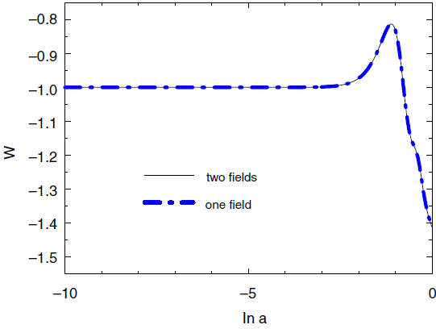
Quintom dark energy models
Single field (Quintom) model (M. Li, B. Feng, X. m. Zhang 2005)
For proper form of $V(φ)$ such as $V(φ)=m^{2}φ^{2}/2$, $ψ$ and $χ$ can even be normalized to give rise to non-interacting double-field Quintom!

Slide 20






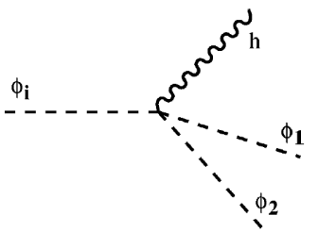



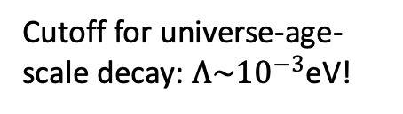
Ghost Problem and its solution
Revisiting the phantom dark energy model
Lagrangian:
Ghost mode!
Hamiltonian (density) & particle number (density)
Recipe 1:
unbounded energy!
Phantom to graviton process:
Cutoff for universe-age-scale decay: $Λ\sim {10}^{−3}$eV!
Recipe 2:
Non-unitarity!
(S. Carroll, M. Hoffman, M. Trodden 2003, J. Cline, S. Jeon, G. Moore, 2003)

Slide 21
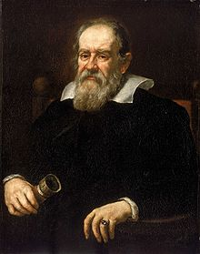
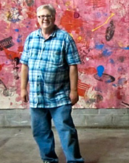

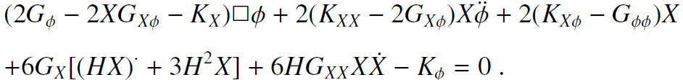

Ghost Problem and its solution
Solution: Galileon/Horndeski theories (2008/1974)
Lagrangian:
The Lagrangian is delicately designed such that
Higher derivative in lagrangian but 2nd order in equation of motion
Multi-degrees of freedom but only one is dynamical
violating NEC free of ghosts.
Eg. Equation of Motion for $L_{2}+L_{3}$:
Ghost Free!

Slide 22




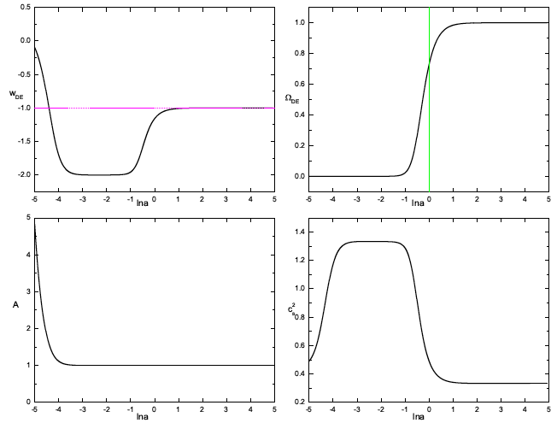
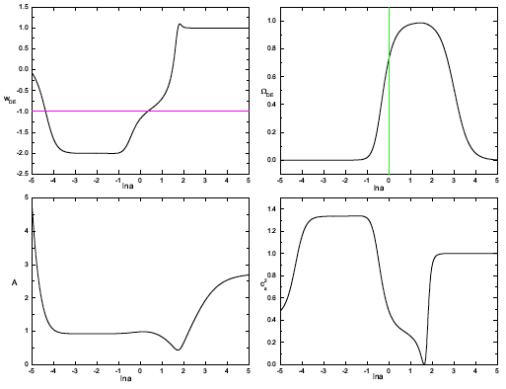
Ghost Problem and its solution
A concrete model of Galileon dark energy (Li, TQ, Cai & Zhang 2011)
Lagrangian:
Energy density and pressure:
Equation of state:

Slide 23



Modified Gravity Theories of dark energy
Modified Gravity theories
Revisiting the Einstein Equation:
Modified Gravity
Dark Energy
GR
Modified Gravity
Why modify Gravity?
Theoretical dilemma: Singularity problem, gravity quantization……
Theoretical development: form low-energy effective theory to high-energy full theory
Observational dilemma: galactic rotational curve, cosmic accelerations, various tensions/anomalies……
Observational development: non-Gaussianities, galactic survey, BAO, gravitational waves…

Slide 24
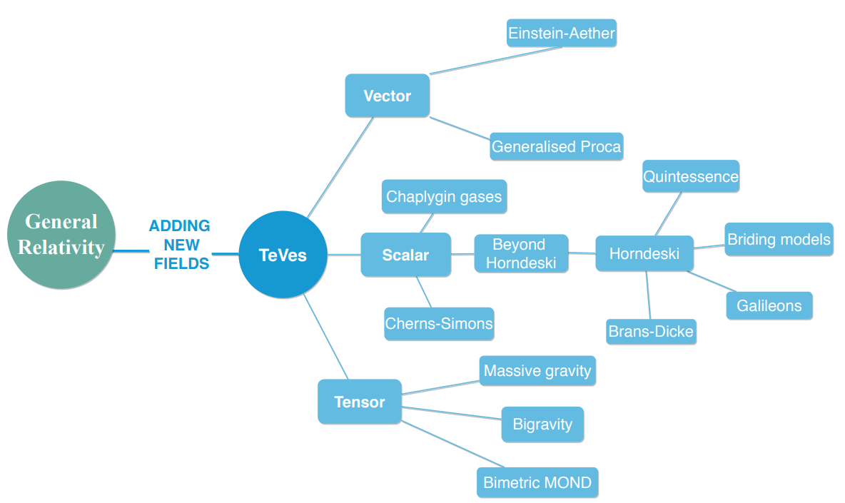
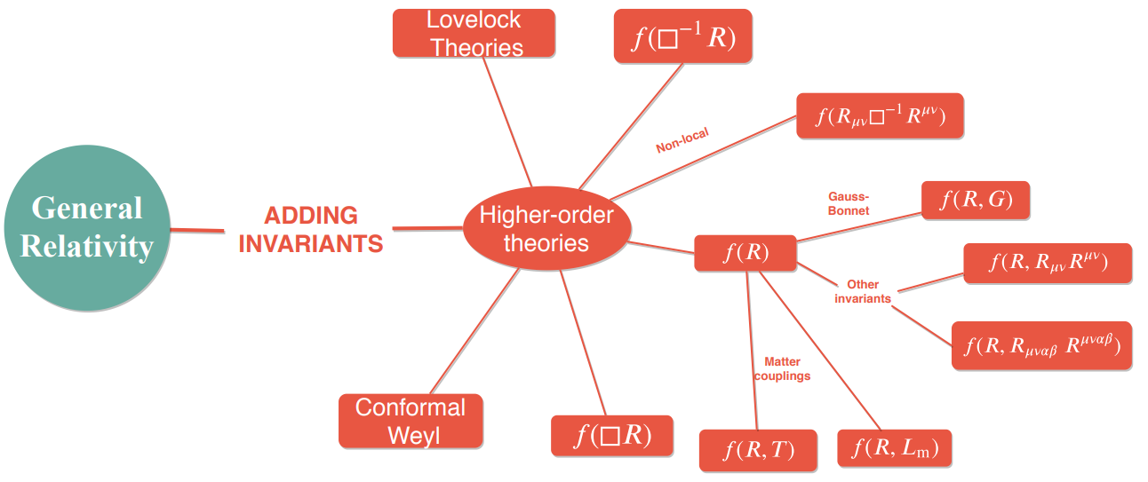
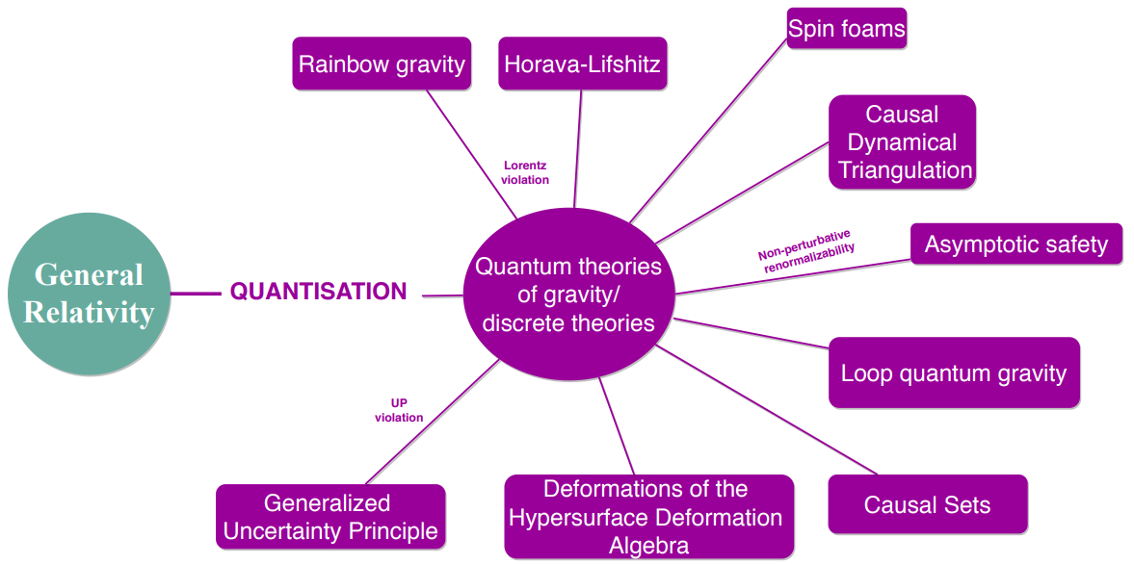
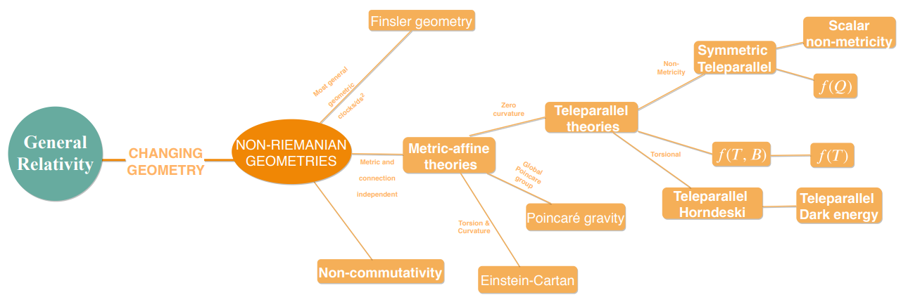
Modified Gravity Theories of dark energy
How many modified gravity theories are there in our market?
(Emmanuel N. Saridakis et al., 2023)

Slide 25







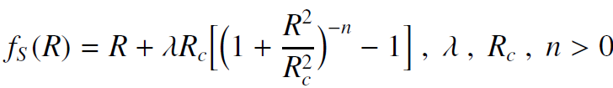
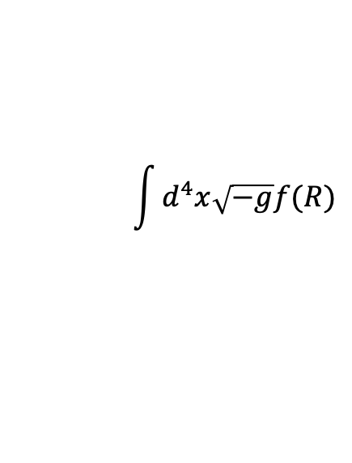
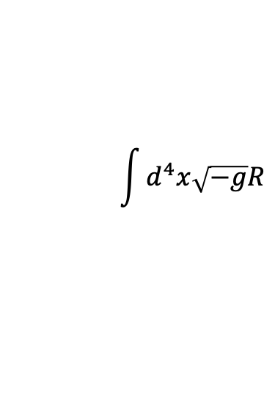
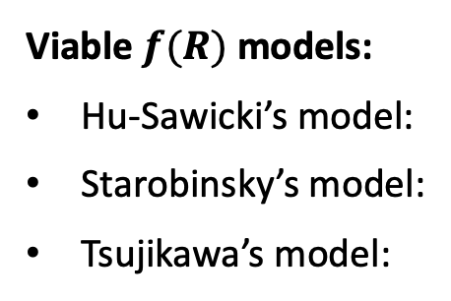
Modified Gravity Theories of dark energy
The simplest example: $f(R)$ modified gravity
$$\int{d^{4}x\sqrt{−g}R}$$
$$\int{d^{4}x\sqrt{−g}f(R)}$$
However, several constraints must be satisfied in order not to spoil local GR!
constraints:
Ghost-free;
Tachyonic instability;
Consistency with the local gravity test;
Stability of an accelerating phase;
… ...
where
(A. Dolgov & M. Kawasaki 2003)
at
at
(Amendola, Gannouji, Polarski & Tsujikawa 2006)
Viable $f(R)$ models:
Hu-Sawicki’s model:
Starobinsky’s model:
Tsujikawa’s model:
(W. Hu & I. Sawicki 2007)
(A. Starobinsky 2007)
(S. Tsujikawa 2007)

Slide 26


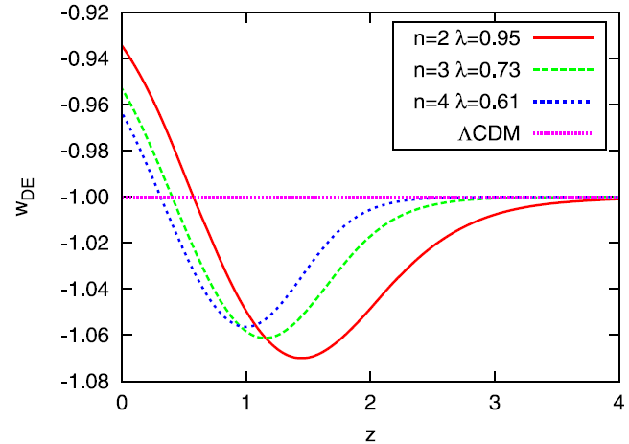


Modified Gravity Theories of dark energy
The simplest example: $f(R)$ modified gravity
Action:
Friedmann equations:
from which we can get:
A specific model with $w$ crossing $−1$:
(Motohashi, Starobinsky & Yokoyama 2010)

Slide 27
Other dark energy models
Incomplete list:
Chaplygin Gas (Kamenshchik, Moschella, Pasquier 2001)
Vector field Dark Energy (Armendariz-Picon 2004)
Holographic/Agegraphic/Ricci Dark Energy (Li 2004, Cai, 2007, Gao, Wu, Chen, Shen 2007);
Interacting Dark Energy (Zhang, Li, Piao, Zhang, 2006);
Spinor field Dark Energy (Cai & Wang 2008)
Horava-Lifshitz Dark Energy (E. Saridakis 2009);
Ghost Dark Energy (Urban & Zhitnitsky 2009, N. Ohta 2010);
Entropic Dark Energy (Gao 2010, Easson, Frampton, Smoot 2010, Cai, Liu, Li 2010);
Metric-affine Dark Energy (Bengochea & Ferraro 2008, Linder 2010, Geng, Lee, Saridakis and Wu 2011);
Massive Gravity Dark Energy (S. Mukohyama 2011);
… … … … … …
See review c.f. Y. Cai, X. Ren, TQ, M. Li, X. Zhang, Natl. Sci. Rev. 2026

Slide 28
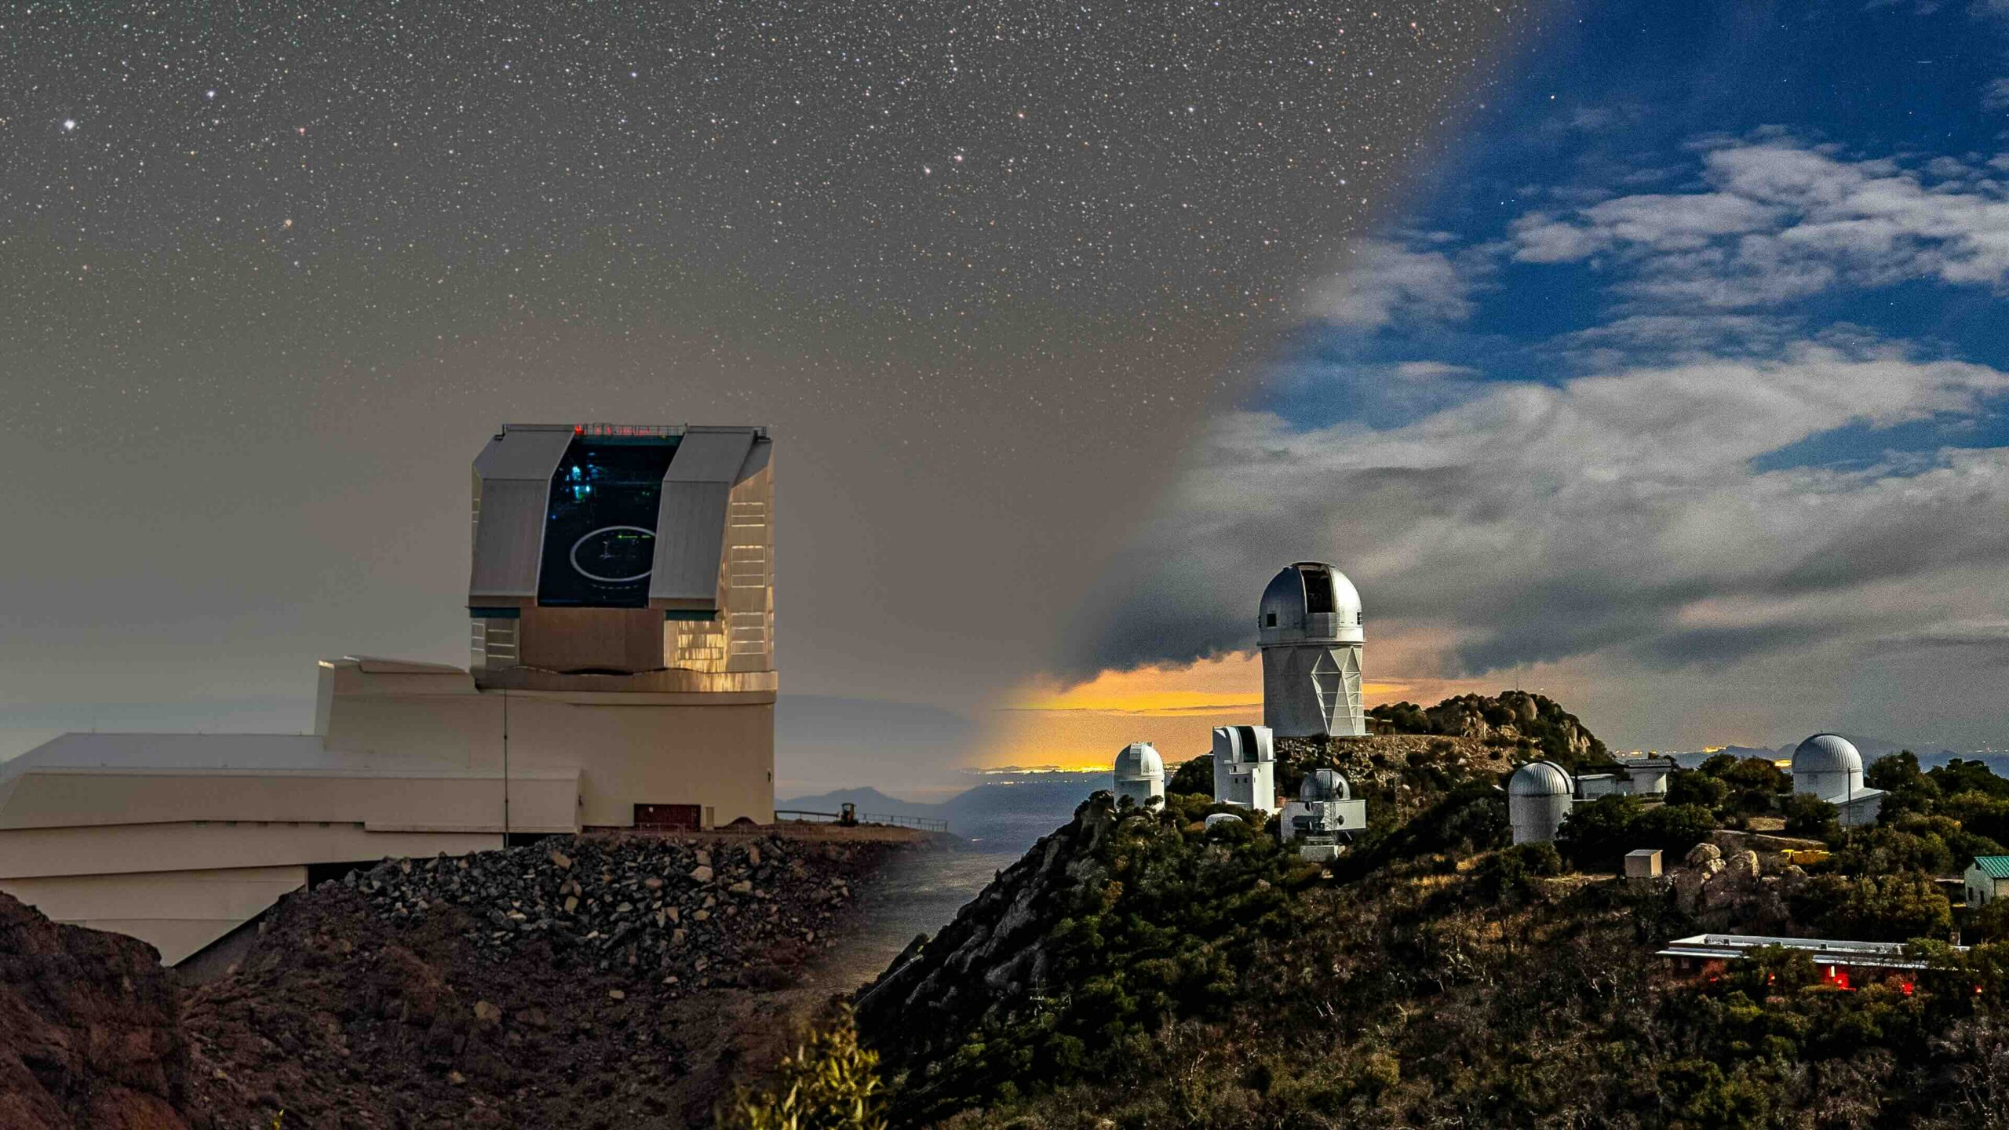
New observational data on dark energy
Observation from DESI
Supported by the Department of Energy Office of Science with more than 70 institutes all over the world.
conducted on the Mayall 4-meter telescope at Kitt Peak National Observatory with 5,000 fibers to receive light from faraway galaxies.
observed more than 47 million galaxies and quasars along with over 20 million stars.
perform dark energy measurement using baryon acoustic oscillations and other techniques that rely on spectroscopic measurements.

Slide 29
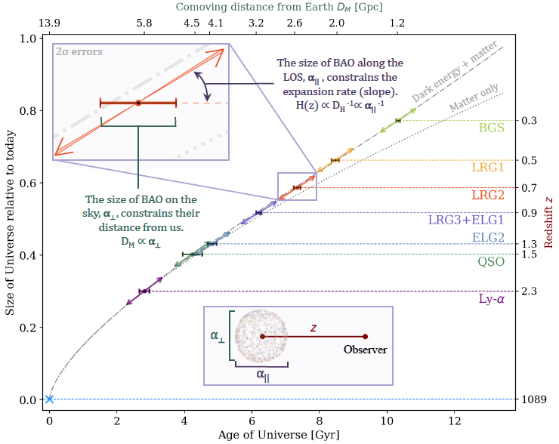
New observational data on dark energy
Observation from DESI
(DESI Collaboration, M. A. Karim et al., 2005)

Slide 30
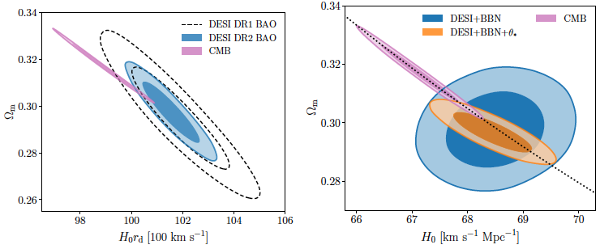





New observational data on dark energy
Observation from DESI
$ΛCDM$:
$w_{0}w_{a}CDM$:
$$2.8σ$$
(DESI Collaboration, M. A. Karim et al., 2005)

Slide 31

New observational data on dark energy
New released data: DESI DR1 & DR2
Methodology: CPL parametrization:
(A. G. Adame, J. Aguilar, S. Ahlen et al., JCAP 2025 [DESI DR1];
M. Abdul, J. Aguilar, S. Ahlen et al., PRD 2025 [DESI DR2];
Y. Cai, X. Ren, TQ, M. Li, X. Zhang, Natl. Sci. Rev. 2026.)

Slide 32

New observational data on dark energy
New released data: DESI DR1 & DR2
Methodology: Gaussian Process
(K. Lodha, et al. [DESI Collaborations], Phys. Rev. D. 2025.)

Slide 33




New observational data on dark energy
New released data: DESI DR1 & DR2
Methodology: Principal Component Analysis
(G. Zhao, R. Crittenden, L. Pogosian, X. Zhang, Phys. Rev. Lett., 2012 (2.5$σ$),
G. Zhao et al., [BOSS Collaboration] Nature Astron., 2017 (3.5$σ$)
G. Gu et al., [DESI Collaboration] Nature Astron., 2025 (4.3$σ$).)

Slide 34


New observational data on dark energy
New released data: DESI DR1 & DR2
Disfavoring $ΛCDM$: $4.2σ$；Favoring Quintom-B: $4.05σ$
(TQ, Y. Cai, Y. Liu, S. Li, J. Evslin, X. Zhang, CPC 2026) (Editors’ Suggestion)

Slide 35









New observational data on dark energy
Higher derivative Quintom model compared with DESI DR2
The Lagrangian:
Constraints on parameters
energy density & pressure:
equation of state:
Under ansatz solution:
(prime: derivative w.r.t. $a$)
Left top: DESI+CMB Right top: DESI+CMB+Pantheon+
Left bottom: DESI+CMB+Union3 Right bottom: DESI+CMB+DESY5
one gets the EoS as:
$$w=w_{0} (c_{1}, c_{2})+w_{a}(c_{1}, c_{2})(1−a)$$
(TQ, Y. Cai, Y. Liu, et al., CPC 2026)

Slide 36







New observational data on dark energy
Higher derivative Quintom model compared with DESI DR2
The perturbative Lagrangian:
with
All positive (indicating stability)!!!
Left top: DESI+CMB Right top: DESI+CMB+Pantheon+ Left bottom: DESI+CMB+Union3 Right bottom: DESI+CMB+DESY5
(TQ, Y. Cai, Y. Liu, et al., CPC 2026)

Slide 37
Quintom-like model in the early universe
The Hot Big Bang Theory
(Alpher, Bethe, Gamow, 1948)
The age of galaxies
The redshift of the galactic spectrum
The He abundance
The prediction of CMB temperature
Flatness problem
Horizon problem
Unwanted relics problem
Singularity problem

Slide 38

Quintom-like model in the early universe
The Inflationary Scenario
(Alan Guth et al., 1980s)
The age of galaxies
The redshift of the galactic spectrum
The He abundance
The prediction of CMB temperature
Flatness problem
Horizon problem
Unwanted relics problem
Singularity problem

Slide 39




Quintom-like model in the early universe
The Singularity Theorem
The universe will meet a singularity when
described by General Relativity
satisfies Null Energy Condition (NEC)
where at finite time point
for any null vector :
S. Hawking
R. Penrose
(Hawking et al., 1973; Borde et al., 1994)
Big Bang Singularity
Black Hole Singularity

Slide 40
Quintom-like model in the early universe
4D-based Non-singular scenarios
today
expansion
expansion
big bang
bounce
genesis
contraction
static
Bounce Scenario
Emergent Scenario
infinite past

Slide 41






Quintom-like model in the early universe
Cosmic Bounce Scenario
Non-zero at the minimum
Contraction:
$$H<0$$
Expansion:
$$H>0$$
Bouncing Point:
$$ρ+p<0$$
$$w<−1$$
$$\dot{H}>0$$
The Null Energy Condition violated!
(Y. F. Cai, TQ, et al., JHEP 2004; TQ et al., CPC 2026)

Slide 42

Quintom-like model in the early universe
Cosmic Bounce Scenario
After bounce, the universe reenters into radiation dominant era, matter dominant era, etc., which requires the EoS larger than $−1$ again!
Therefore, in the whole period, the EoS of the universe requires to go across $−1$, presenting a quintom-like behavior!

Slide 43






Quintom-like model in the early universe
A Concrete Example: Galileon Bounce
Action
G-term
where
$$k\left(φ\right)=1−\frac{2k_{0}}{(1+2κ_{1}φ^{2})^{2}},$$
$$t\left(φ\right)=\frac{t_{0}}{(1+2κ_{2}φ^{2})^{2}},$$
$$G\left(φ,X\right)=\frac{γX}{(1+2κ_{2}φ^{2})^{2}}.$$
Behavior:
around bounce: G-term is important (violating NEC while killing the ghost);
away from the bounce: canonical field form (simplest).
(TQ, Y. –T. Wang, JHEP 2015)

Slide 44









Quintom-like model in the early universe
A Concrete Example: Galileon Bounce
Background:
$w>1$ (contraction)
$$w≃−1$$
(inflation)
$$H(t)$$
$$w(t)$$
oscillating $w$ (reheating)
Perturbation:
Action:
Ghost Free!
(TQ, Y. –T. Wang, JHEP 2015)

Slide 45





Quintom-like model in the early universe
A Concrete Example: Galileon Bounce
Power spectrum
Bounce inflation:
Normal inflation:
$$P_{ζ}=\frac{H_{e}^{2}}{8π^{2}M_{p}^{2}ε_{e}}{\left(\frac{k}{k_{∗}}\right)}^{3−2ν_{e}}{\left|C_{1}−C_{2}\right|}^{2}$$
with five parameters ($H_{c},H_{e},ε_{c},ε_{e},{∆η}_{B}$)
$$P_{ζ}=A_{s}{\left(\frac{k}{k_{∗}}\right)}^{n_{s}−1}$$
with only two ($A_{s}, n_{s}$)
(Li, Zhang, TQ, CSB 2025)
oscillation
Spectral tilt
suppression

Slide 46

Connecting to observations
Fitting with the CMB TT spectrum: small $l$ suppression
pure power law inflation
our model
(TQ, Y. –T. Wang, JHEP 2015)

Slide 47








Connecting to observations
Cosmological tensions I: The $H_{0}$ tension
Early time: CMB
>5$σ$
$θ_{s}=\frac{r_{s}}{D_{M}}=\frac{\int_{z_{rec}}^{∞}{\frac{c_{s}\left(z\right)}{H\left(z\right)}dz}}{\int_{0}^{z_{rec}}{\frac{1}{H\left(z\right)}dz}}$
$\int{\frac{1}{H(z)}dz}$=
$$\int{\frac{dz}{H_{0}\sqrt{Ω_{Λ0}+Ω_{m0}{(1+z)}^{3}+Ω_{r0}{(1+z)}^{4}}}}$$
$\text{Λ}\text{CDM}$!
Late time: SNe Ia
$$d_{L}={10}^{−5+(m−M)/5}Mpc$$
$$H_{0}≈z/d_{L}$$
for low $z$ ($z<1$)

Slide 48



Connecting to observations
Cosmological tensions II: The $S_{8}$ tension
Early time: CMB
$$σ_{8}^{2}=\frac{1}{2π^{2}} \int_{0}^{∞}{dk k^{2}P_{m}\left(k,z=0\right)W^{2}\left(kR\right)},R=8h^{−1}Mpc$$
$$W\left(kR\right)=\frac{3}{{\left(kR\right)}^{3}}\left[\sin\left(kR\right)−kR\cos\left(kR\right)\right]$$
$$S_{8}≡σ_{8}\sqrt{Ω_{m}/0.3}$$
Late time: Large Scale Structure
Some new debates:
KiDS: $S_{8}={0.815}_{−0.021}^{+0.016}$
DESI: $S_{8}^{DESI×KiDS}=0.771±0.017$
(Wright et al., A. & A. 2025; Semenaite et al., 2025).

Slide 49




Connecting to observations
Solutions to the Tensions
Exponential inflation
(Tram et al., 2017),
Quintessintal inflation
(Areste Salo et al., 2021),
Harrison-Zeldovich spectrum
(Di valentino et al., 2018),
Primordial black holes
(Nesseris et al., 2020),
Primordial magnetic fields
(Jedamzik et al., 2020),
Ultra-light dark photon
(Flambaum et al., 2019),
…… ……
Bounce inflation model
(Li, Zhang, TQ, Sci. Bull. 2025)
Anharmonic oscillating potential
(Poulin et al., 2019),
Ultra-light axions
(Hill et al., 2020),
Power-law potential
(Chudaykin et al., 2020),
Rock’n’roll model
(Agrawal et al., 2019),
New early dark energy
(Niedermann et al., 2020),
Anti-de Sitter phase
(Ye et al., 2020),
Acoustic dark energy
(Yin et al., 2020),
Modified gravity
(Nunes 2018),
…… ……
Metastable dark energy
(Yang et al., 2020),
Phantom crossing
(Di Valentino et al., 2020),
Running vacuum
(Sola et al., 2017),
Bulk viscous models
(Yang et al., 2019),
Holographic dark energy
(Dai et al., 2020),
Emergent dark energy
(Yang et al., 2021),
Sterile neutrinos
(Cameiro et al., 2019),
Interacting Dark Sector,
(Di Valentino et al., 2020),
…… ……
$$z→∞$$
$$z_{eq}≈3400$$
$$z_{rec}≈1100$$
$$z_{0}=0$$
Primordial approach
Early-time approach
Late-time approach
redshift
Di Valentino et al., CQG 2021

Slide 50




Connecting to observations
The primodial approach
Parameters:
$$\{ω_{b}, ω_{c},θ_{s},τ_{reio},ε_{c},ℋ_{c},ε_{e},ℋ_{e},{∆η}_{B},A_{L}\}$$
Datasets:
Planck 2018, SPT-3G Y1
Results:
$H_{0}$ tension can be reduced to $3σ$!
$S_{8}$can be consistent within $1σ$!
(Li, Zhang, TQ, CSB 2025)

Slide 51



Connecting to observations
Fitting with Bounce Inflation+$w_{0}w_{a}$CDM
Parameters:
$$\{ω_{b}, ω_{c},θ_{s},τ_{reio},ε_{c},ℋ_{c},ε_{e},ℋ_{e},{∆η}_{B},w_{0},w_{a}\}$$
Datasets:
Planck 2018, SPT-3G Y1, ACT DR4, DESI DR2
Results:
Bounce Inflation v.s. Power Law
PSA constrains weakly on CPL form!
(Zhang, Li, TQ, 2026)

Slide 52




Connecting to observations
Fitting with Bounce Inflation+$w_{0}w_{a}$CDM
Adding $A_{L}$ and $Ω_{k}$:
Results:
Bounce Inflation v.s. Power Law
$H_{0}$ gets worsen, but BI still better than PL!
$A_{L}$ and $Ω_{k}$ remain consistent!
(Zhang, Li, TQ, 2026)

Slide 53




Connecting to observations
Fitting with Bounce Inflation+$w_{0}w_{a}$CDM
Adding SNe data:
Results:
Bounce Inflation v.s. Power Law
BI:2$σ$
PL:1$σ$
$H_{0}$can be raised to about 68!
More favoring dynamical dark energy!
(Zhang, Li, TQ, 2026)

Slide 54





《科学通报》——聚合中文科学与科普的高端、综合类期刊
1950年创刊，旬刊，每月出版3期
Impact Factor 1.2
CiteScore
2.5
栏目：评述、论文、快讯、观点、 亮点述评、悦读科学、科学访谈、科技前沿
收录： ESCI、EI、Scopus、中国科学引文数据库
中国科技期刊卓越行动计划领军期刊
《中国科学院文献情报中心期刊分区表》1区TOP期刊
报道范围
物理学与天文学
化学与能源科学
地球与环境科学
生命科学
医学科学
材料科学与工程
曾报道过许多重要成果，如《结晶牛胰岛素的全合成》《水稻的雄性不孕性》和有关哥德巴赫猜想的研究等。其中1977年发表的《一种新型的倍半萜内酯——青蒿素》一文，是2015年诺贝尔生理学或医学奖获得者屠呦呦等人重要发现的首次记录。
http://csb.scichina.com
科学家交流的平台 │ 国际科学研究的展台 │ 向世界展示的窗口 │ 中文期刊的旗舰

Slide 55



A World-leading Multidisciplinary Academic Journal
编委会充分发挥学术引领作用，指导编辑部工作
历史沿革
全球135种综合类SCI期刊第6位 （Q1区，前5%）
JCR综合类期刊Q1区，影响因子21.1
中国科学院文献情报中心期刊分区表Q1区TOP期刊
中国科技期刊卓越行动计划领军期刊
Article, Short Communication, Review, Perspective, News & Views, Research Highlight, etc.
Indexed by SCI, Scopus, Medline, EI, etc.
每月出版2期，年出版量~650篇
影响因子
21.1
CiteScore
20.3
●物理学与天文学 ●化学与能源科学 ●生命科学
●医学科学 ●材料科学与工程 ●地球与环境科学
主管：中国科学院│主办：中国科学院 & 国家自然科学基金委员会│出版：《中国科学》杂志社 & Elsevier

Slide 56




Summary
Observational:
Acceleration (1998)
Non-exponential acceleration (2026)
Theoretical:
$$ΛCDM$$
Dynamical dark energy
Quintom B ($>4σ$)
Next step:
Is $ΛCDM$ really dead? If yes, what is next?
Double field model?
Single field model?
Modified gravity/nonminimal coupling model?
Interacting dark energy model?
……
Other applications:
the early universe (nonsingular bounce)
Cosmic tensions
……
THANKS!
STAY TUNED!

