Slide 1


Physics-Informed Neural-Network Modeling of Axion–Photon Conversion in Structured Electromagnetic Fields
N. S. Akintsov School of Artificial Intelligence and Computer Science, Nantong University, Nantong, China ORCID: 0000-0002-1040-1292. E-mail: akintsov777@ntu.edu.cn
第五届国际轴子物理与实验会议（Axion 2026）
The 5th International Conference on Axion Physics and Experiment (Axion 2026)
August 12, 2026
Qingdao, China

Slide 2
Presentation Structure
What is the physical problem? — Relativistic electron dynamics and axion–photon conversion in structured Gaussian laser fields, described via coupled parameters, the gyrovector triad, and the axion-Maxwell Lagrangian (KSVZ, DFSZ, ALP).
How is it modeled? — An extended Physics-Informed Neural Network jointly solving the field equations (E, B, a) and the relativistic particle trajectory, with a loss function combining PDE, boundary, initial, and Lorentz-force residuals.
What do the results show? — Optimized pulse shaping increases conversion yield over a Gaussian pulse, and autodiff-based inverse inference recovers the axion mass with accuracy comparable to least-squares fitting, even under 10% noise.

Slide 3

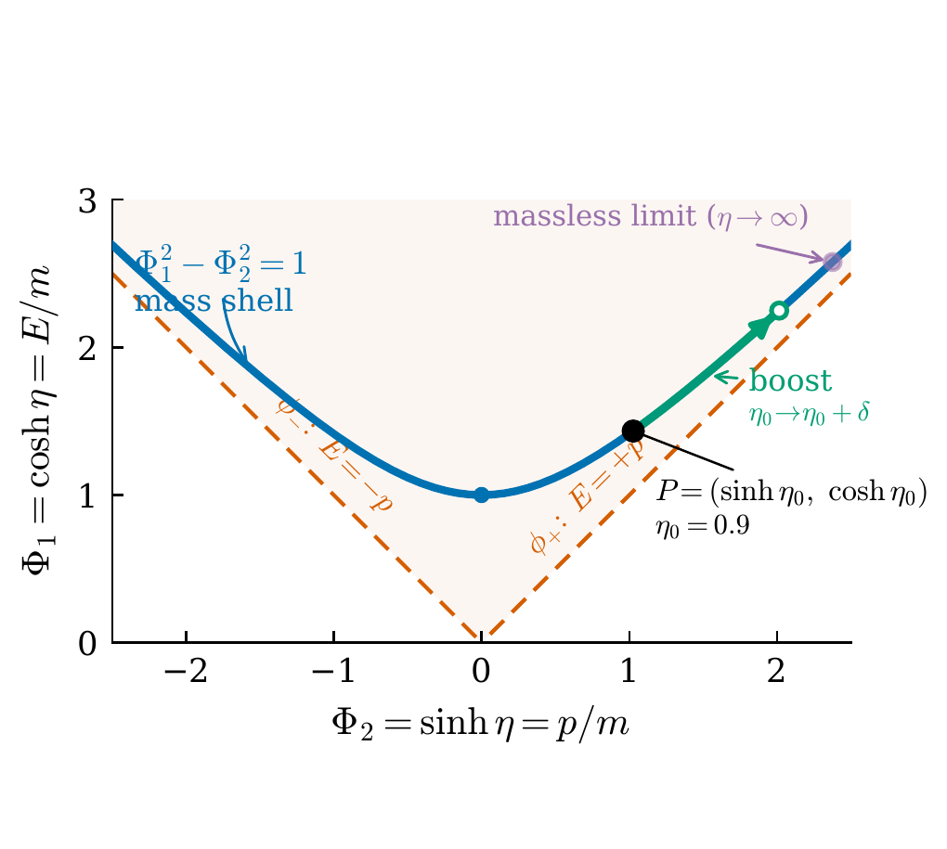
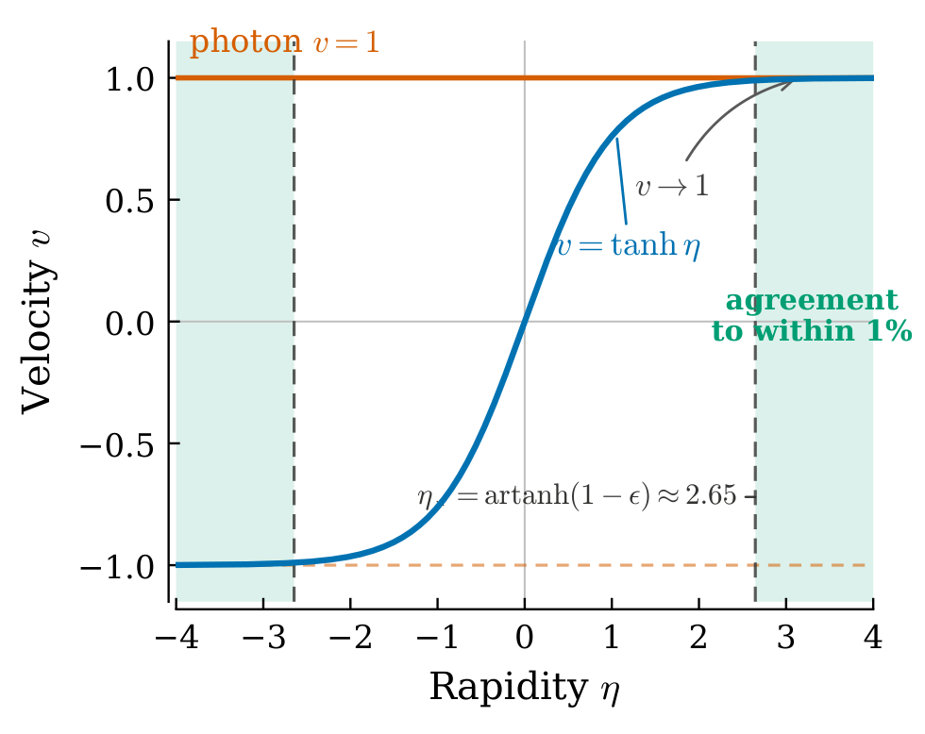
Mass-Shell Hyperbola and the Relativistic Velocity–Rapidity Relation
Mass-Shell Hyperbola Velocity vs. Rapidity

Slide 4

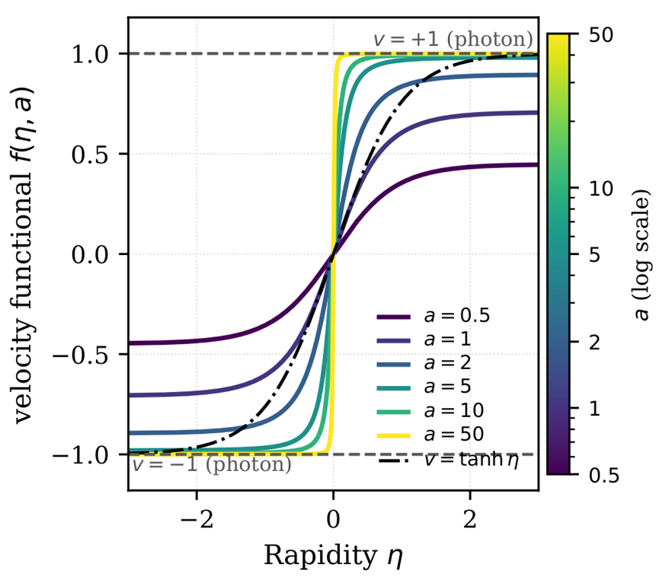
Relativistic Intensity Parameter for Electron Dynamics
Rapidity parameter η as a measure of the relativistic field strength:
a is the dimensionless amplitude (relativistic field-strength parameter); e is the electron charge; me​ is the electron mass; c is the speed of light; E0​ is the amplitude vector of the electric field of the incident electromagnetic wave;𝐼 is the intensity of the incident linearly polarized electromagnetic wave (in W/cm²);
Akintsov et al., Symmetry 2023, 15, 1691.

Slide 5
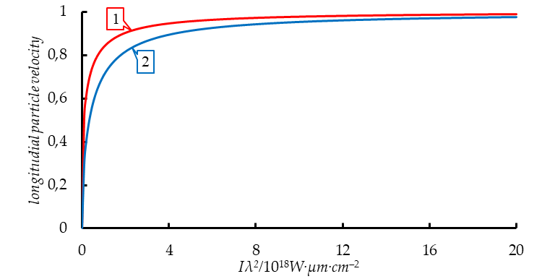
Coupled parameters
is proper time and is proper coordinate.
where is an invariant.
Akintsov et al., Symmetry 2023, 15, 1691.
Velocities (labeled 1) and (labeled 2) depend on dimensionless field amplitude .

Slide 6
Kottler–Møller and Rindler Coordinates
As is known, inertial coordinates , and Riedler coordinates , have the following relationship:
, ,
where a is the proper acceleration, is the proper time of the accelerating object. For space-like coordinates we have the following relations
, ,
where is the normal gyrovector, is the rapidity.

Slide 7

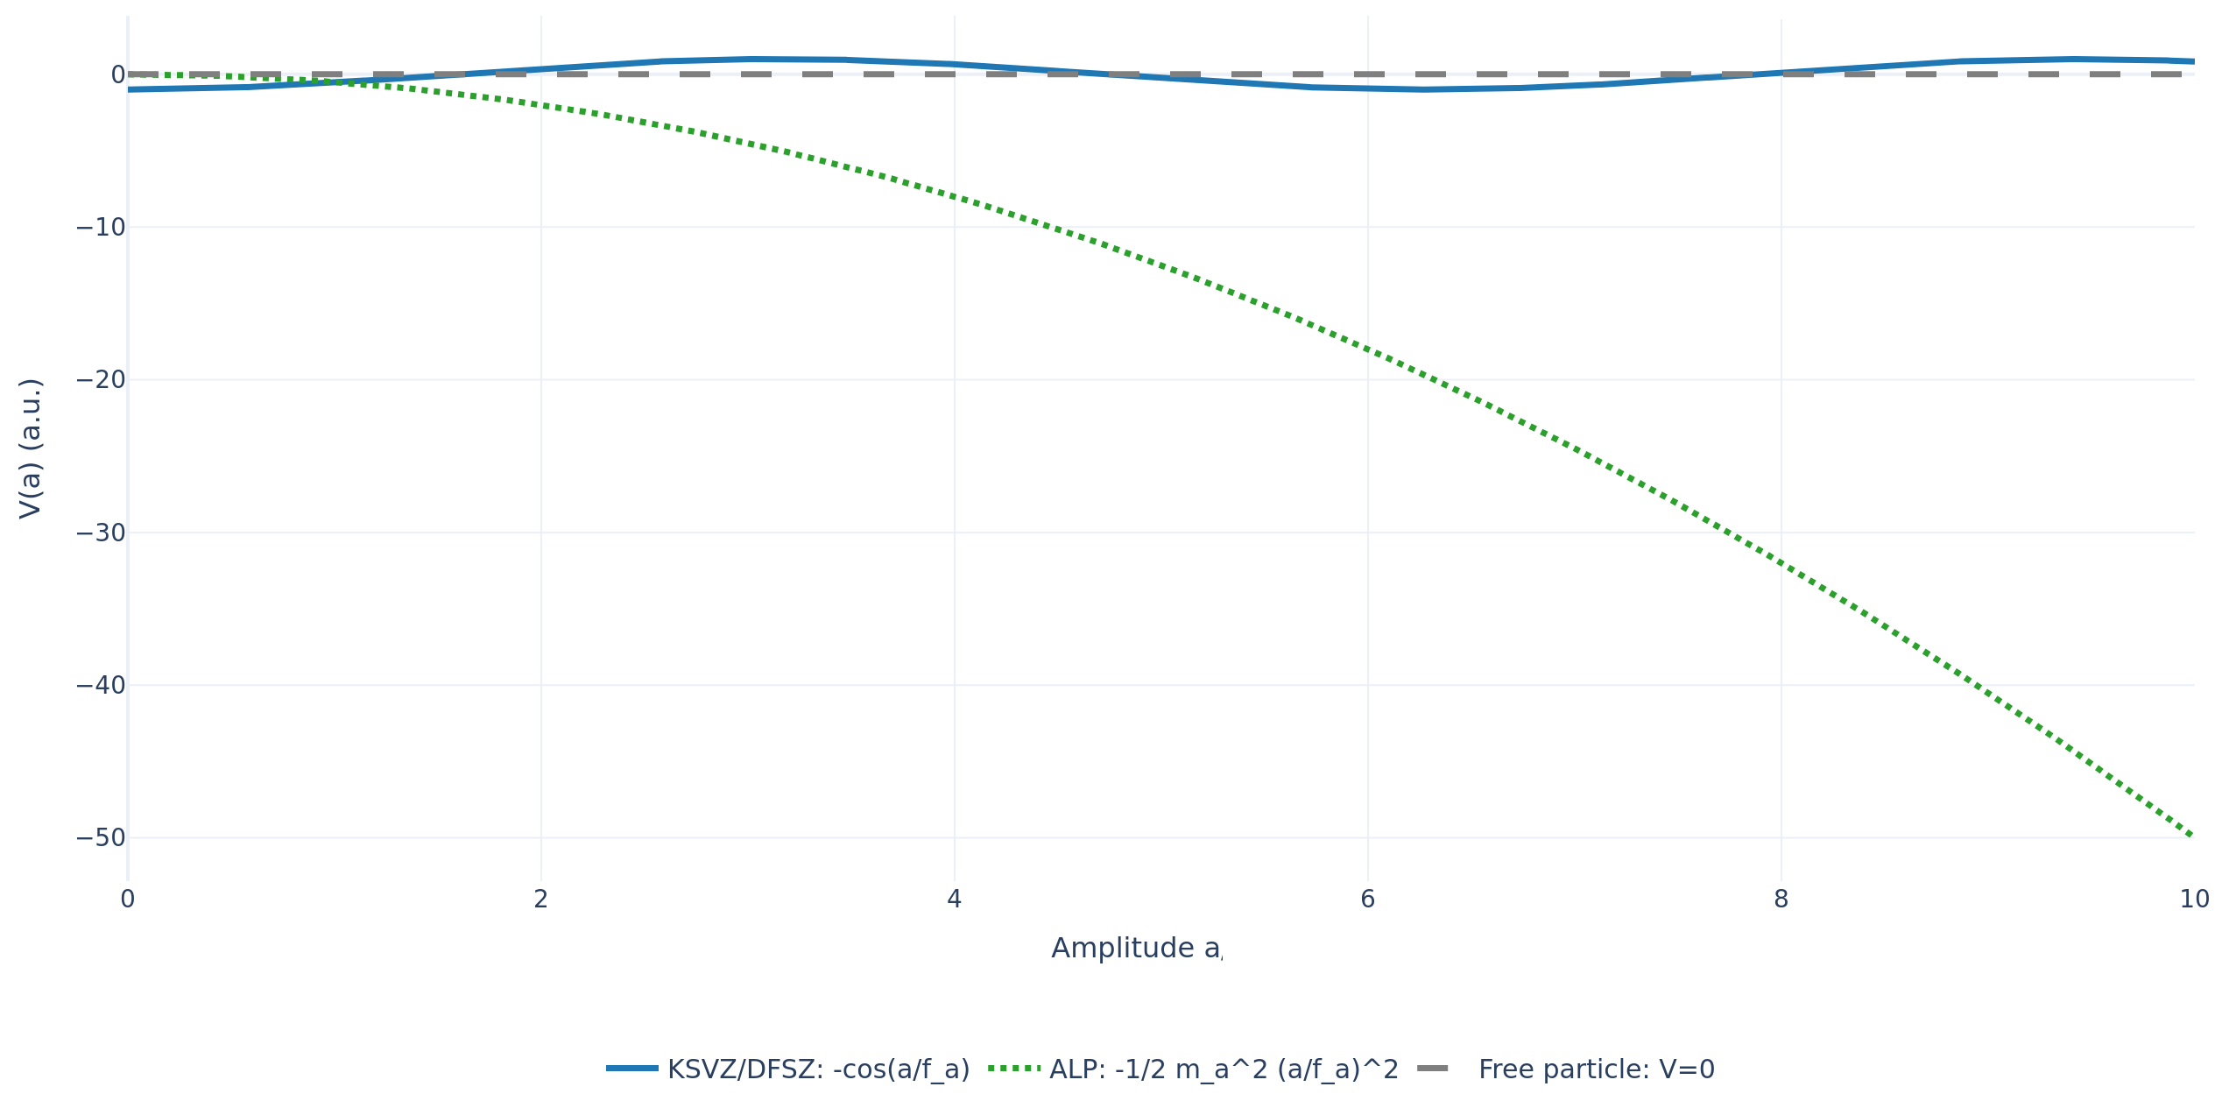
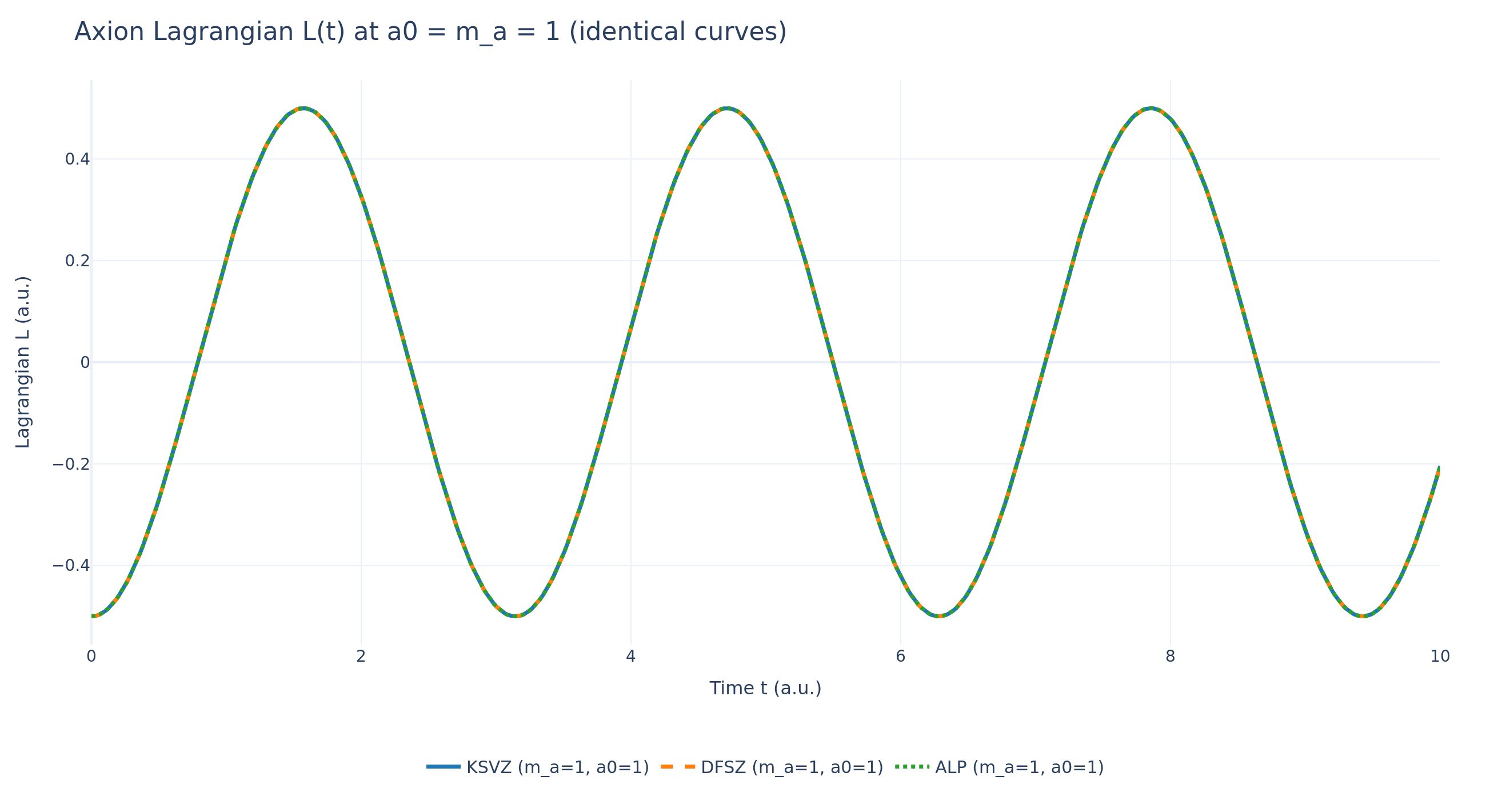
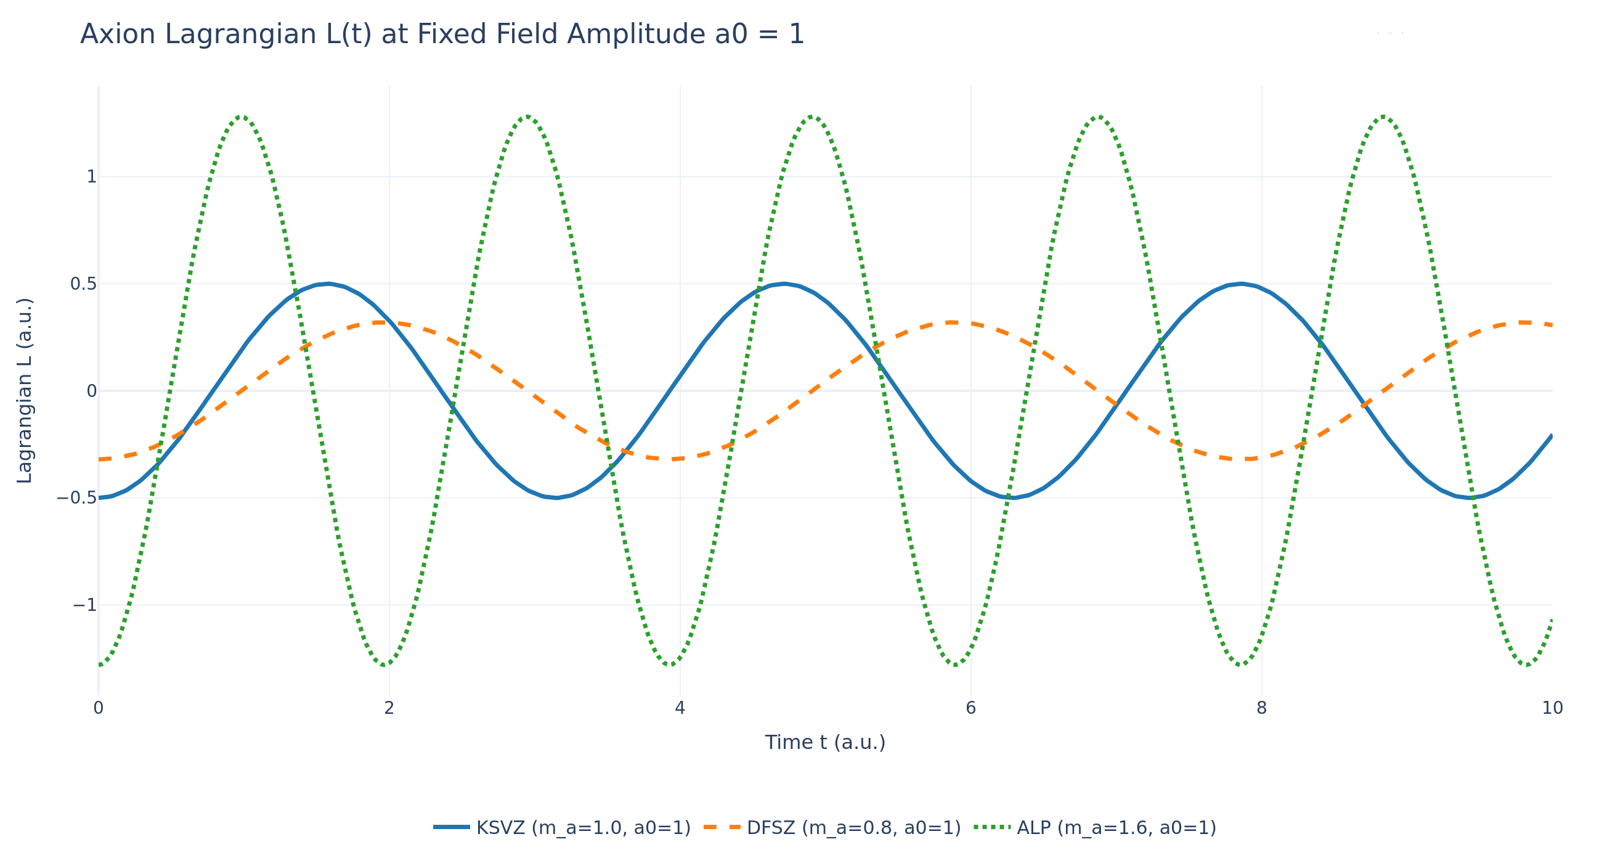
Axion Model Lagrangians: KSVZ, DFSZ, ALP
(KSVZ)
(DFSZ)
(ALP)
M. A. Shifman, A. I. Vainshtein, V. I. Zakharov, Nucl. Phys. B 166, 493 (1980)
M. Dine, W. Fischler, M. Srednicki, Phys. Lett. B 104, 199 (1981)
H. Georgi, D. B. Kaplan, L. Randall, Phys. Lett. B 169, 73 (1986)

Slide 8
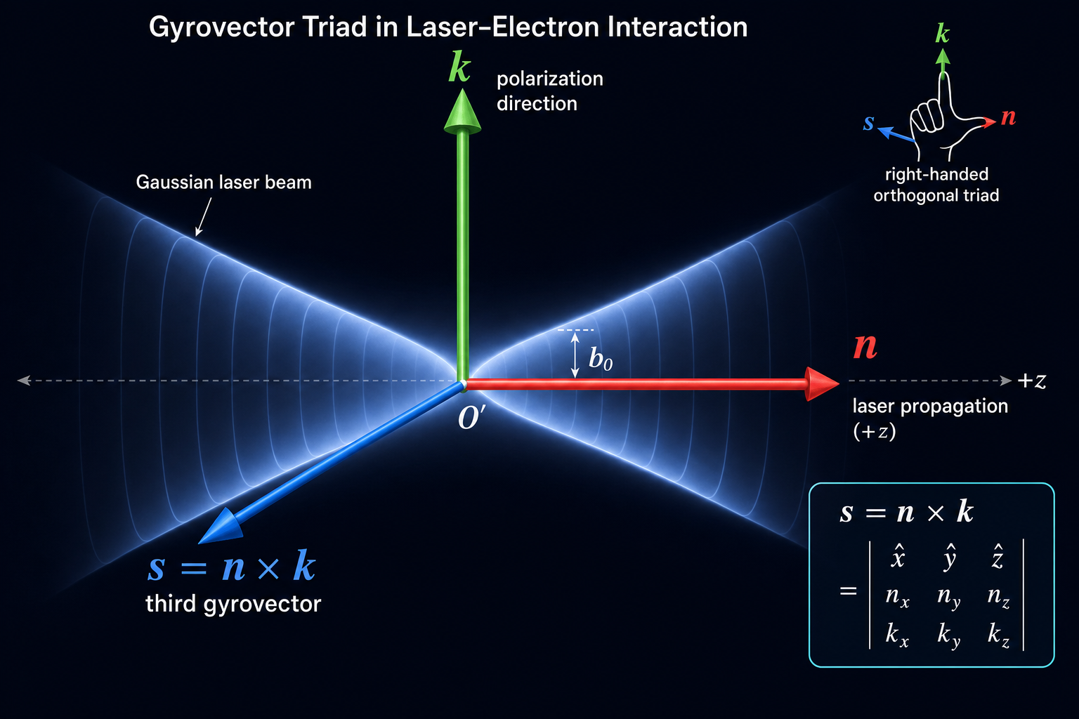
The Gyrovector Triad: Local Field Frame at the Laser Focal Point
Akintsov et al., Symmetry, 2024, 16(3), 357.
Akintsov et al., Phys. Plasmas 32, 082105 (2025).
Three mutually orthogonal gyrovectors — n (laser propagation), k (polarization), and s = n × k — define a right-handed local coordinate frame at the focal point O′ of the Gaussian beam. This frame replaces the standard Cartesian basis and rotates with the field, enabling a compact, covariant description of relativistic electron dynamics directly in the laser field geometry. All equations of motion in the coupled-parameter framework are expressed in this basis.
Akintsov et al., Mod. Phys. Lett. A, 2026.

Slide 9
Gaussian Laser Pulse Model in 3+1 Dimensions

Slide 10
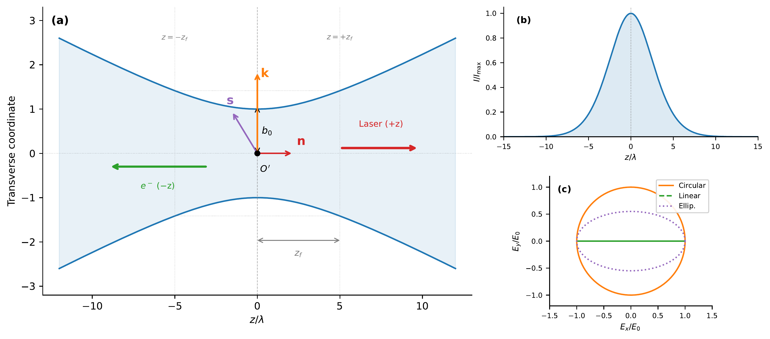
Gaussian Laser Beam Geometry and Polarization States
A focused Gaussian laser beam propagates along the +z axis and collides head-on with a counter-propagating electron (−z direction). The beam is characterized by its waist radius, Rayleigh length, and focal point, with the gyrovector triad defining the local field frame. The on-axis intensity follows a Gaussian envelope modulated by beam diffraction. Three polarization states — circular, linear, and elliptical — are illustrated in the transverse plane.

Slide 11
Effective Lagrangian of Axion-Photon Interaction

Slide 12
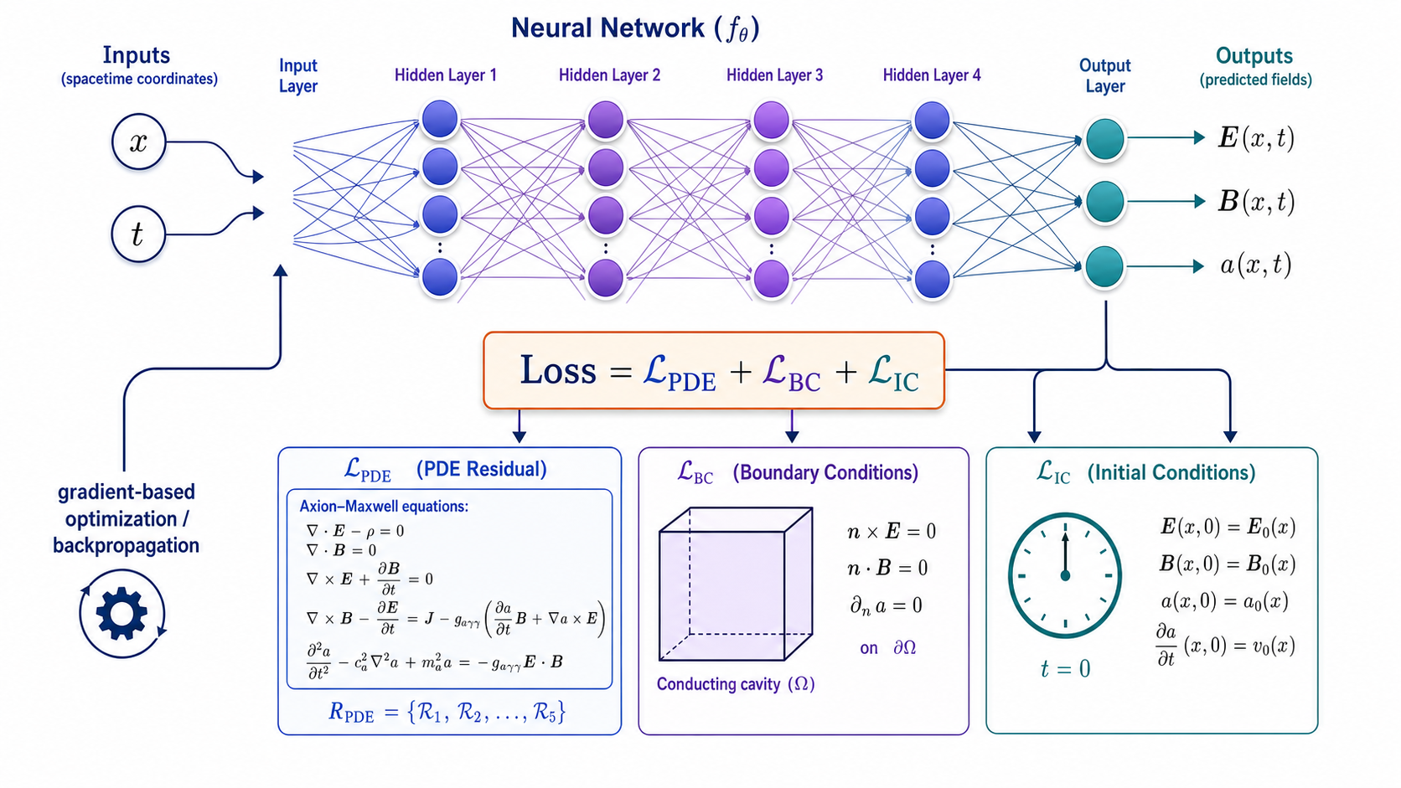
Physics-Informed Neural Network Architecture for Axion–Maxwell Equations
ccc

Slide 13
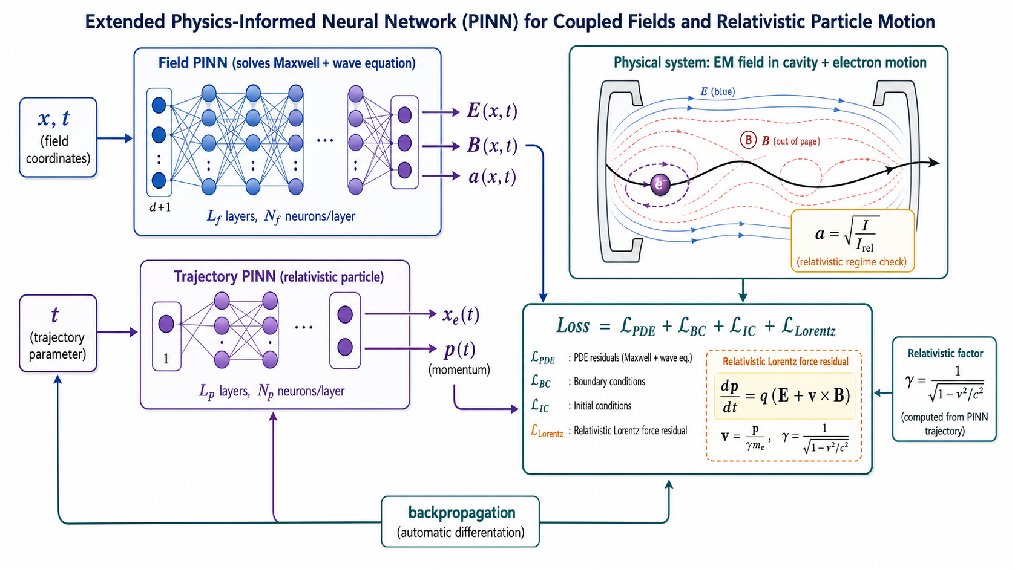

Slide 14
Simulation results

Slide 15
Key Takeaways
Coupled parameters (rapidity η, the invariant t^2-q^2) provide a compact, relativistically invariant description of particle motion in a strong laser field, consistent with the author's earlier results (Symmetry 2023, 2024; Phys. Plasmas 2025; Mod. Phys. Lett. A 2026).
The gyrovector triad (n, k, s) replaces the Cartesian basis and allows the equations of motion to be written covariantly directly in the laser-field geometry.
The Gaussian pulse model in the paraxial approximation accounts for the Gouy phase, wavefront curvature, and diffraction — necessary for a realistic description of axion–photon interaction under laboratory conditions.
The extended PINN architecture jointly solves the axion–Maxwell equations and the relativistic electron dynamics through a shared loss function that includes the Lorentz-force residual.
Gradient-based optimization of the laser pulse shape increases the effective conversion yield compared with a Gaussian pulse of equal energy, especially for larger σ/λL​ ratios.
Inverse inference of the axion mass ma​ from noisy spectra shows that the autodiff-based method achieves bias and variance comparable to the classical least-squares method (Levenberg–Marquardt), even at noise levels up to 10%.

