Slide 1

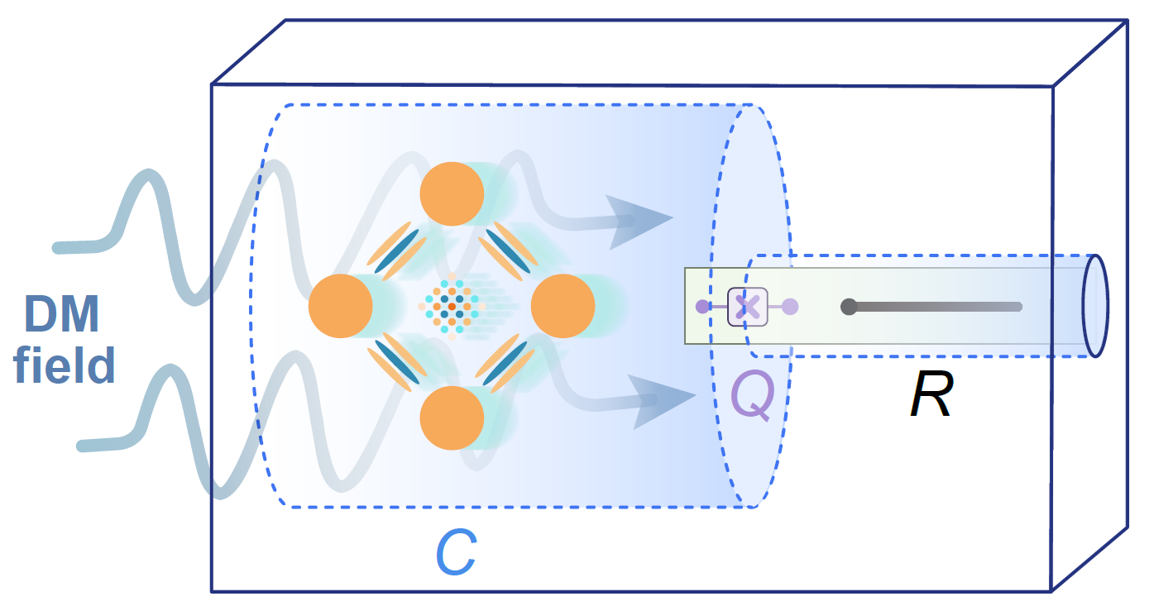
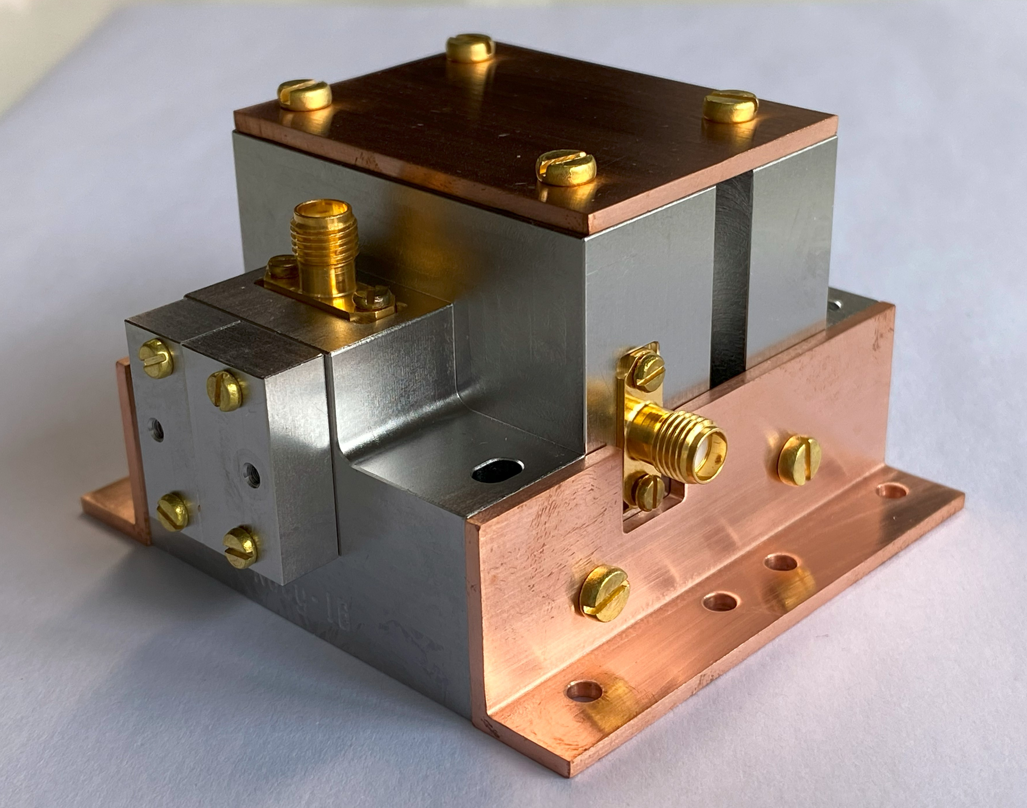
Quantum-enhanced dark matter searches using cat states
Pan Zheng
Shenzhen International Quantum Academy
zhengpan@iqasz.cn
International Conference on
Axion Physics and Experiment
Axion - 2026
PRL 136, 171002 (2026)
2026.08.11

Slide 2
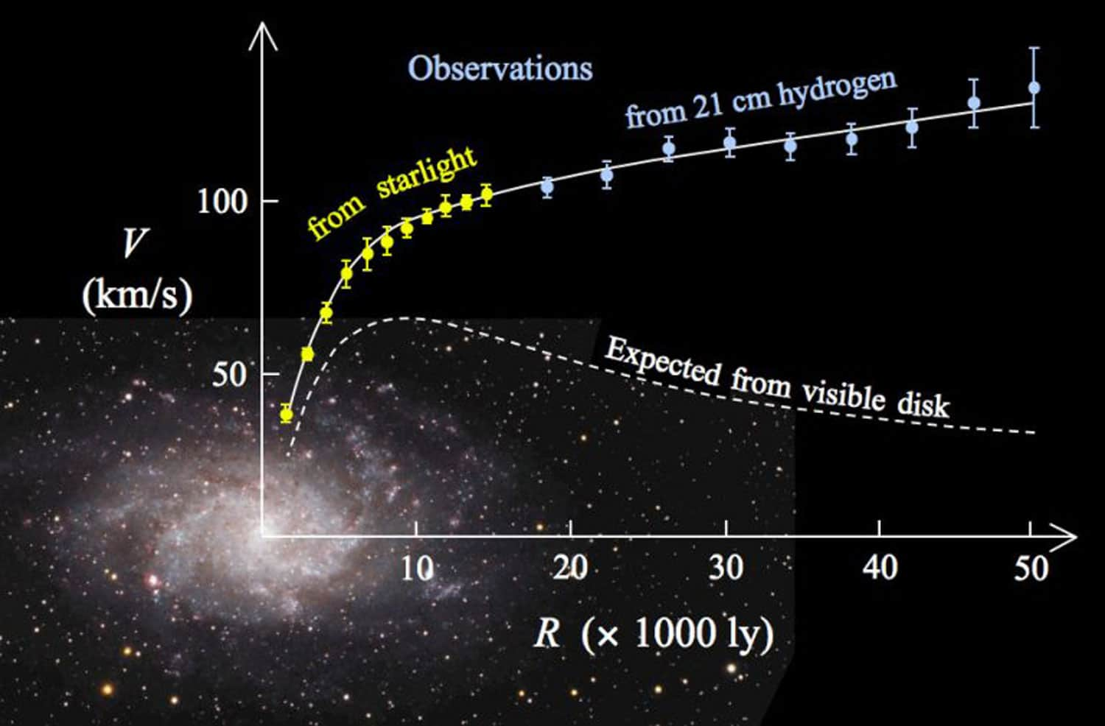
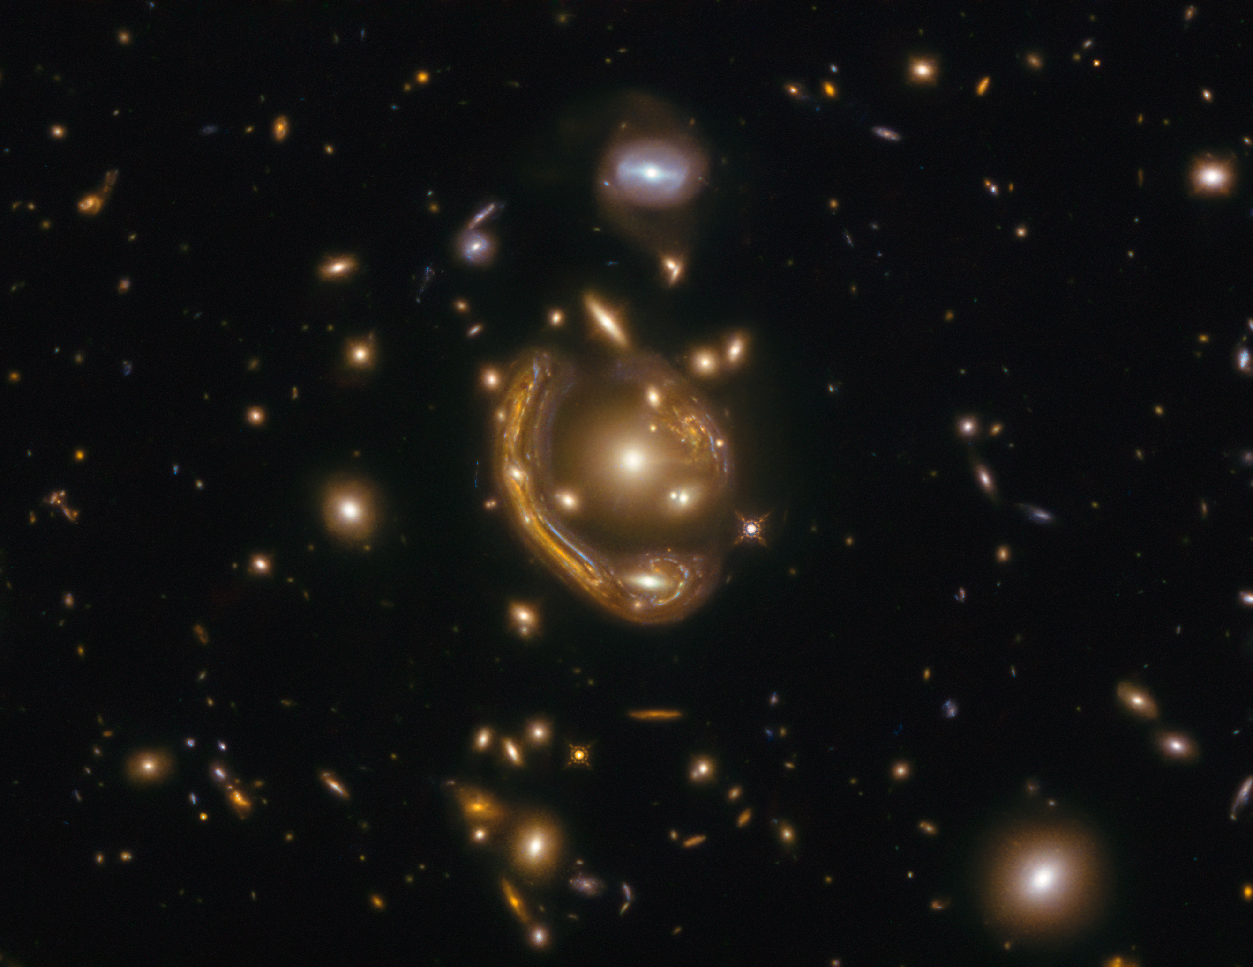
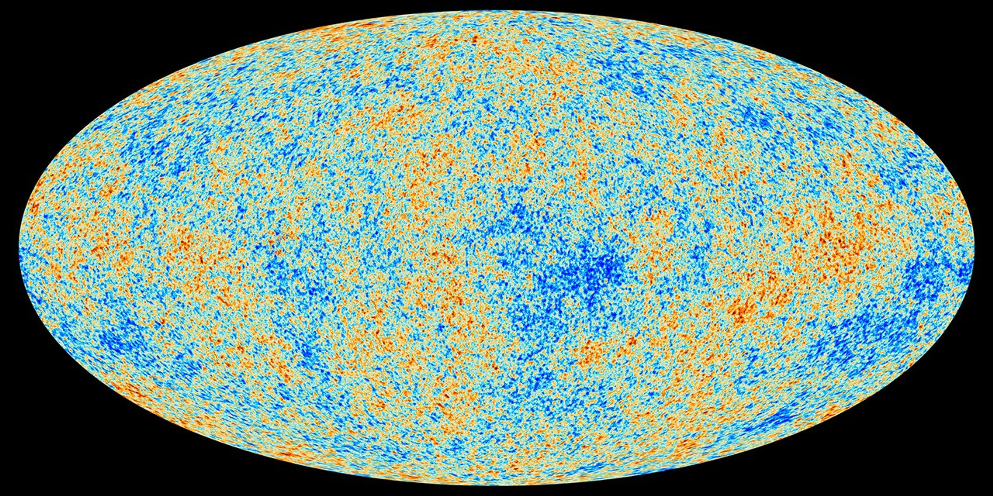
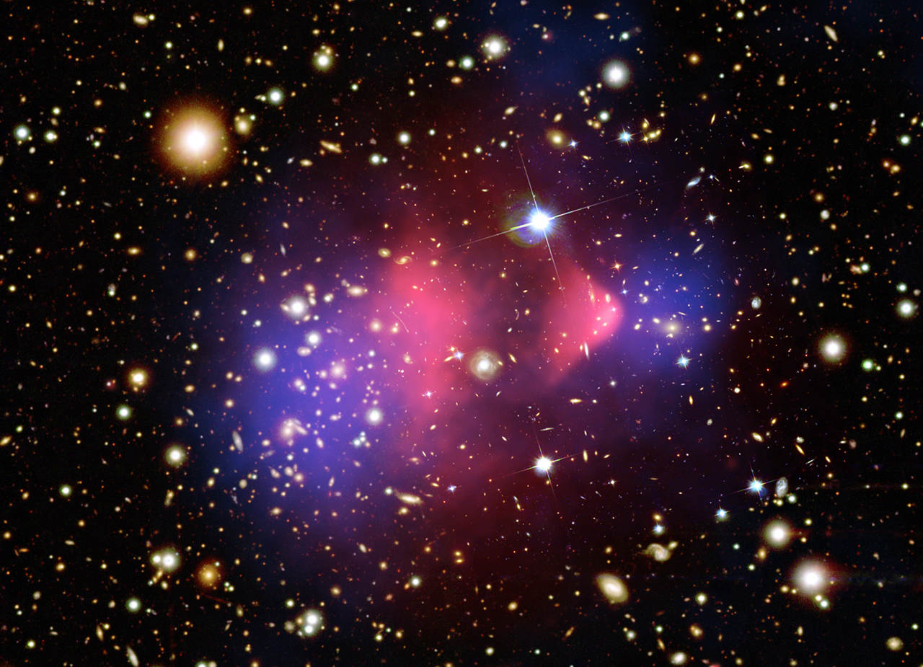
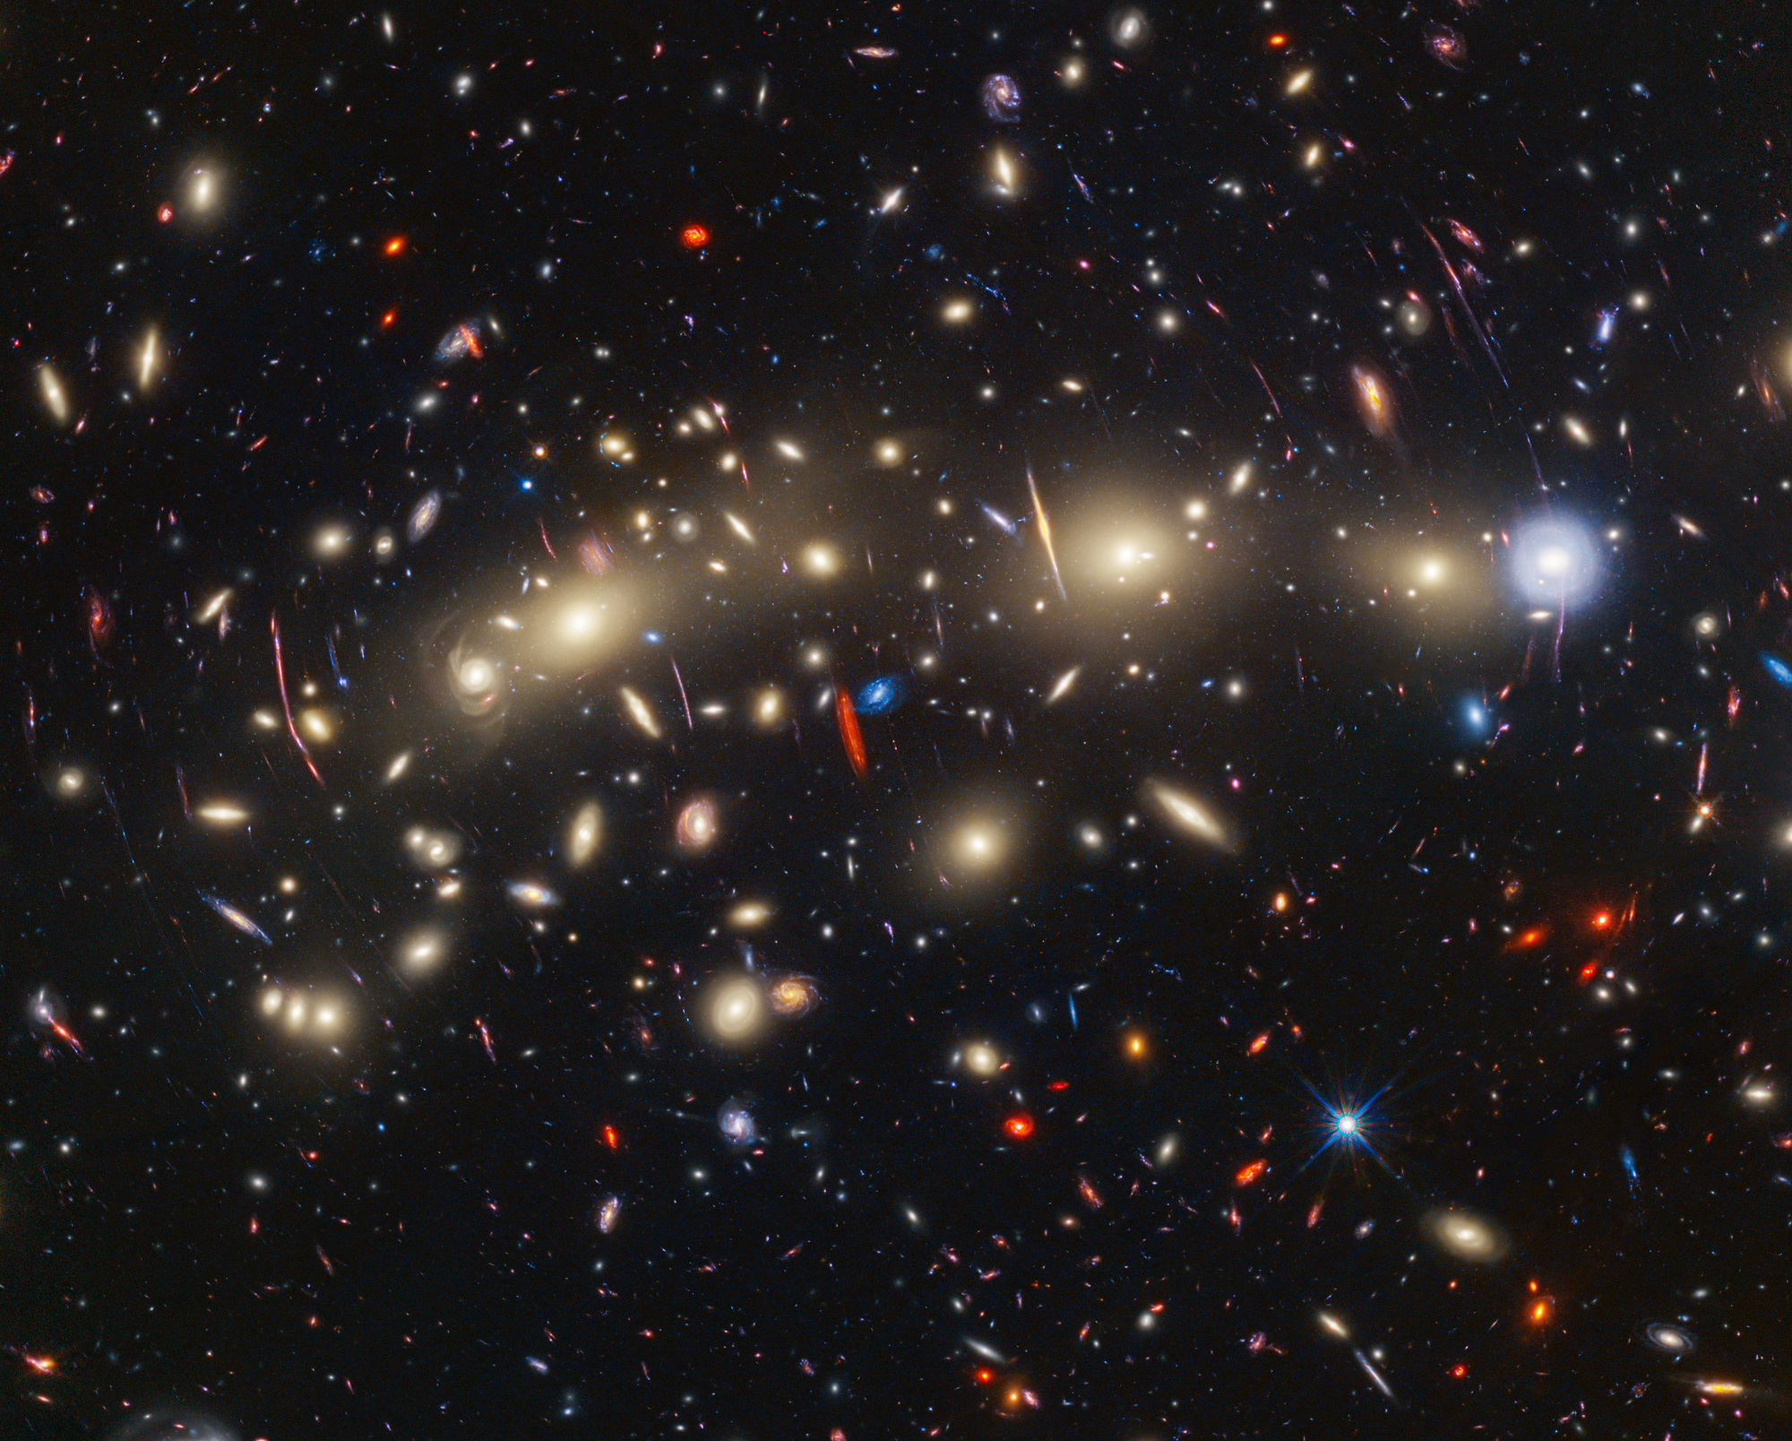
Motivation for dark matter search
Cosmic microwave background
Galaxy rotation curve
Gravitational lensing
Bullet cluster
Structure formation
Images from nasa.gov

Slide 3




Some candidates of dark matter
$$M_{⨀}$$
${10}^{−22}$eV
${10}^{−2}$eV
keV
MeV
GeV
TeV
${\sim 10}^{57}$GeV
Energy
Sterile neutrinos
MACHOs
Ultralight dark matter
(axions, axion-like particles, dark photons)
WIMPs
(Weakly interacting massive particles)
Dark photons
Strong theoretical motivation,
Compatible with superconducting quantum circuits
PRD 98, 030001 (2018)
PRD 110, 030001 (2024)

Slide 4
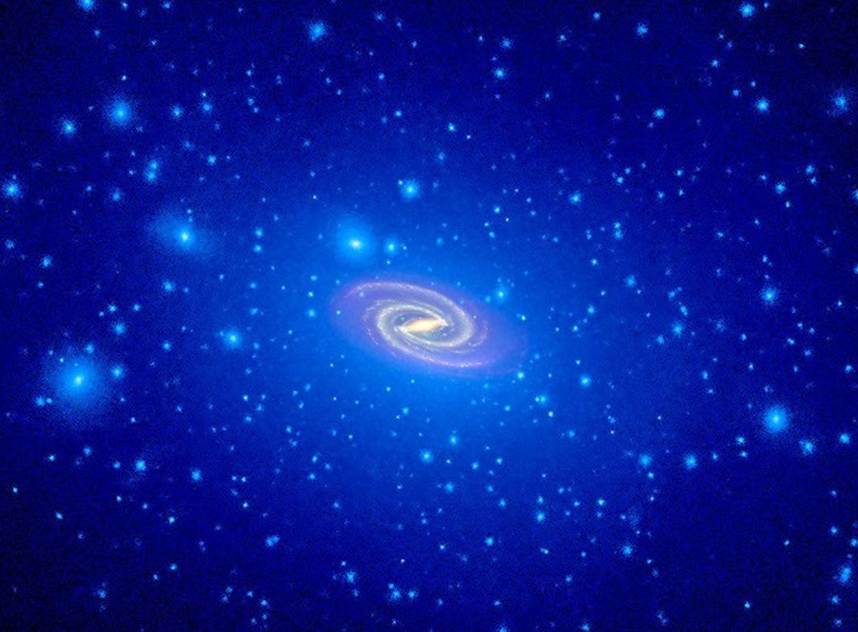












Haloscopes for ultra-light dark matter search
Dark Photon ${A′}^{μ}$
Normal Photon $A^{μ}$
$$ε$$
$$ℒ⊃εm_{A′}^{2}{A′}^{μ}A_{μ}$$
$ε$: kinetic mixing angle
$m_{A′}$: mass of dark photon
$$m_{A′}$$
$$ω_{c}$$
$$ρ_{DM}=0.4 \text{GeV/cm}\text{3}$$
$$m_{A′}c^{2}=ℏω_{c}$$
$$\hat{D}\left(β\right)\text{ @ }ω_{c}$$
$${\left|β\right|}^{2}∝ε^{2}$$

Slide 5
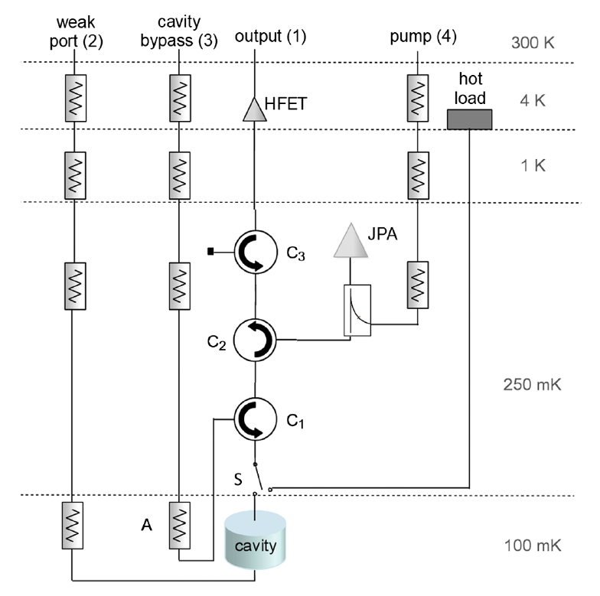
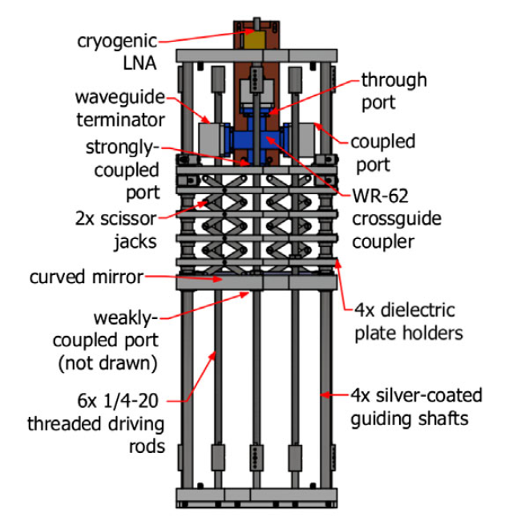
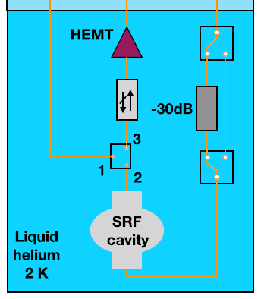
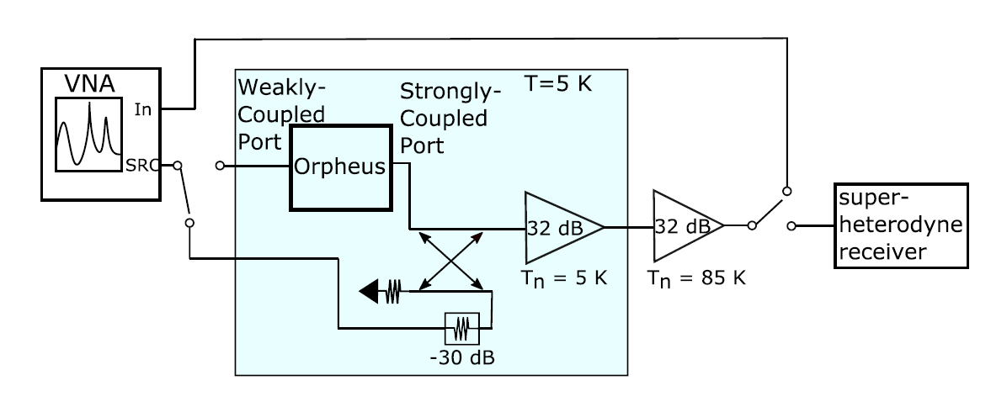
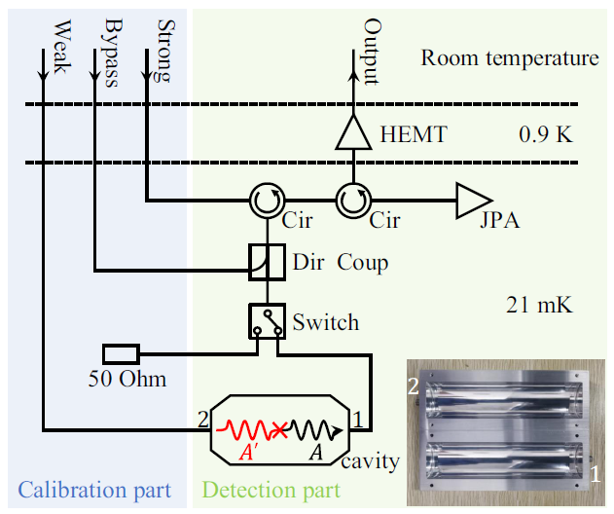
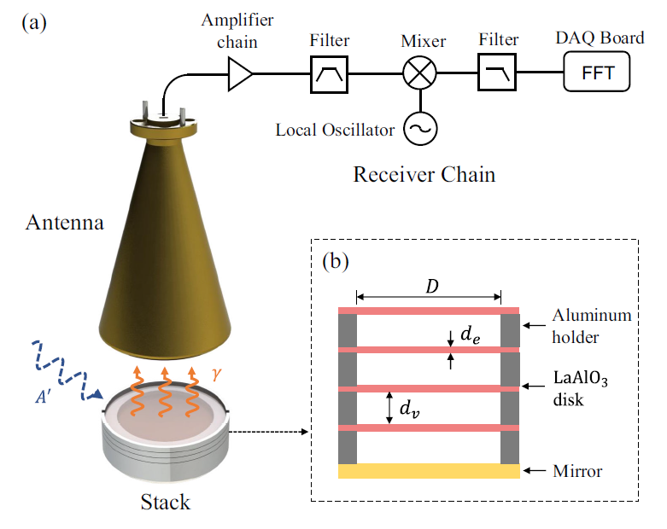
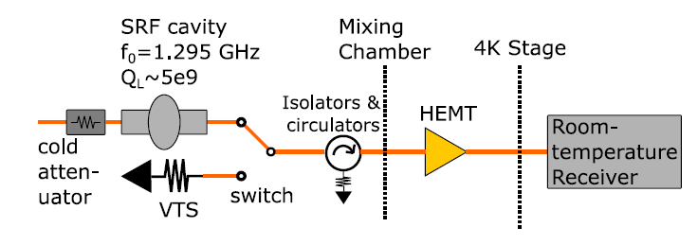
Haloscopes for ultra-light dark matter search
Axion haloscope at 100 mK
Dielectrically loaded
multimode cavity at 5K
Tunable SRF cavity at 2K
PRL 124, 101303 (2020)
PRD 104,092016 (2021)
PRL 133, 021005 (2024)
PRL 129, 201301 (2022)
High Q SRF cavity at 33 mK
JPA for near-QL noise
mm-wave dielectric stack
PRD 110, 043022 (2024)
PRD 109, 095037 (2024)
PRL 136, 071001 (2026)

Slide 6
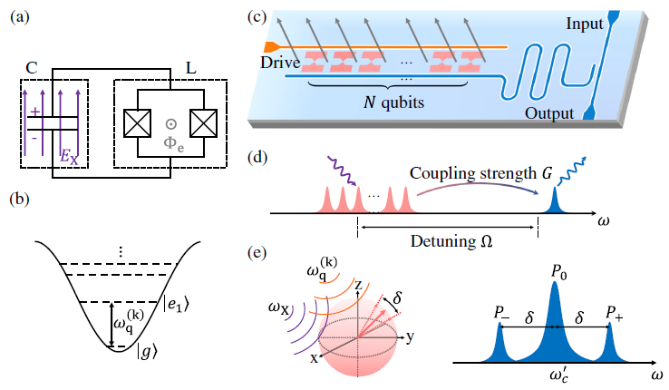
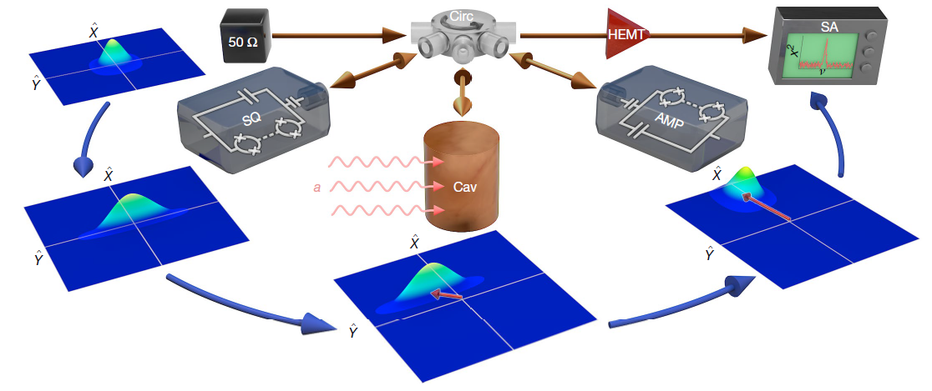
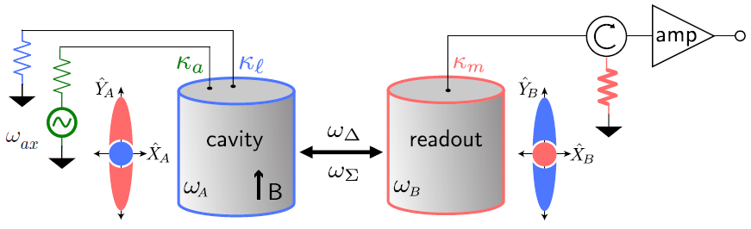
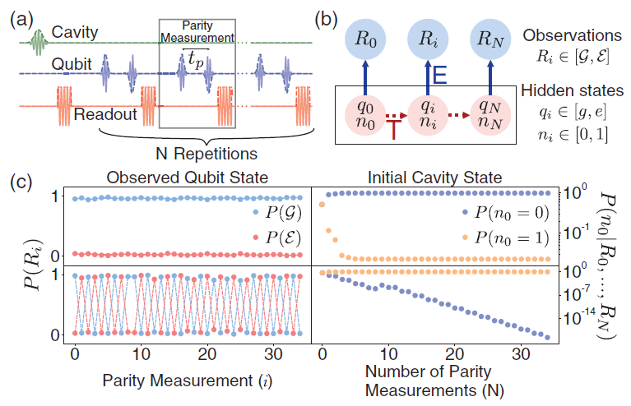
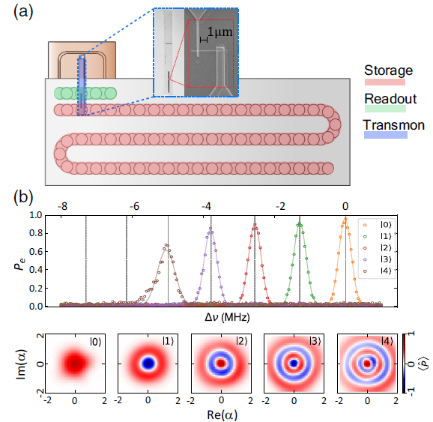
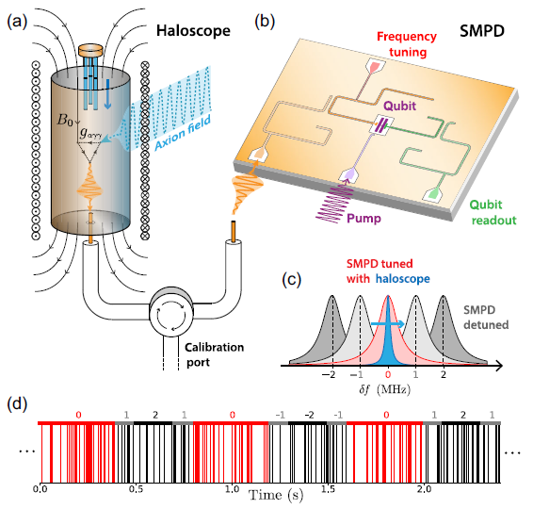
Quantum enhancement for dark matter search
Vacuum squeezing
Mode entanglement & state swapping
Qubit array & freq tuning
Nature 590, 238 (2021)
PRX Quantum 4, 020302 (2023)
PRL 135, 181004 (2025)
QND measurement and freq tuning
Fock state stimulated emission
Itinerant SMPD & freq tuning
PRL 126, 141302 (2021)
PRL 135, 201002 (2025)
PRL 132, 140801 (2024)
PRX 15, 021031 (2025)

Slide 7
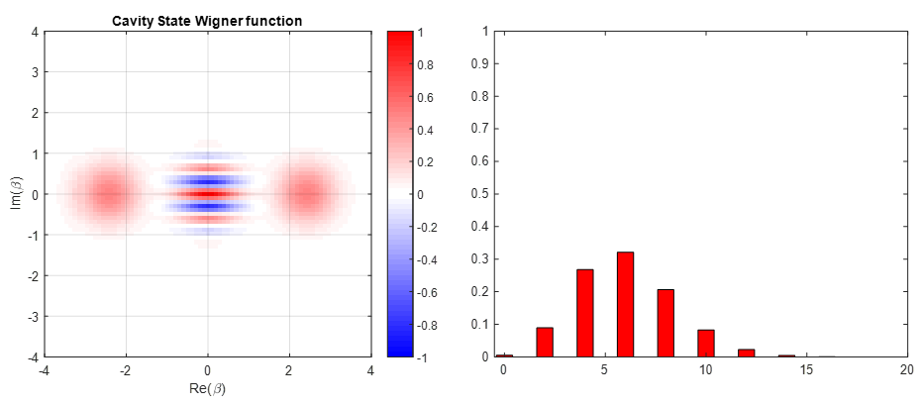
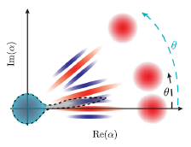
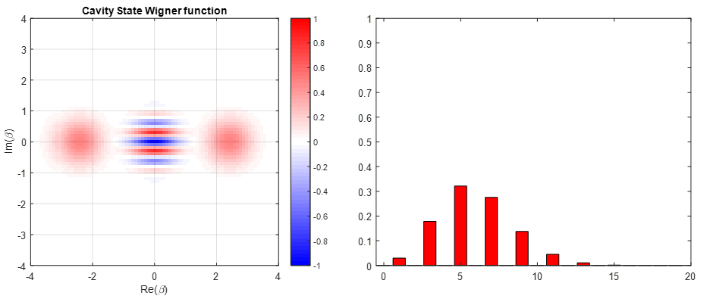
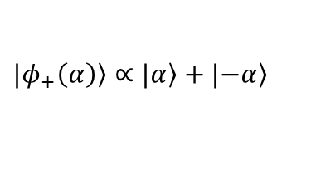
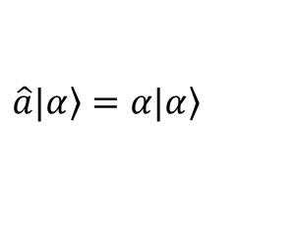
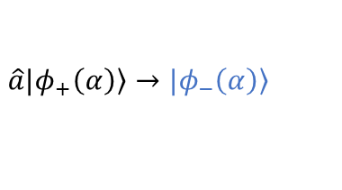

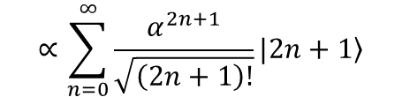
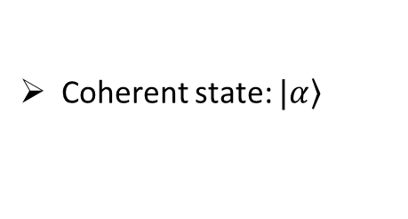
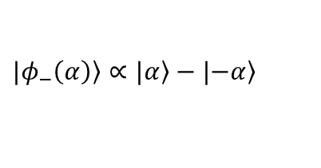
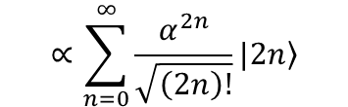
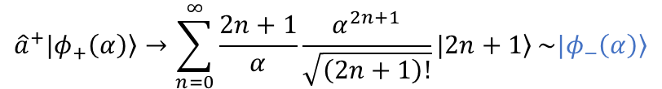
Cat states for quantum enhancement
Photon number distribution
$$α=\sqrt{6}$$
even
parity
$$∝\sum_{n=0}^{∞}{\frac{α^{2n}}{\sqrt{\left(2n\right)!}}|\left.2n\right\rangle }$$
$$|\left.φ_{+}\left(α\right)\right\rangle ∝|\left.α\right\rangle +|\left.−α\right\rangle$$
PRX Quantum 6, 010304 (2025)
Photon number distribution
Coherent state: $|\left.α\right\rangle$
$$\hat{a}|\left.α\right\rangle =α|\left.α\right\rangle$$
odd
parity
Photon loss:
$$\hat{a}|\left.φ_{+}\left(α\right)\right\rangle →|\left.φ_{−}\left(α\right)\right\rangle$$
Photon addition:
$$∝\sum_{n=0}^{∞}{\frac{α^{2n+1}}{\sqrt{\left(2n+1\right)!}}|\left.2n+1\right\rangle }$$
$${\hat{a}}^{+}|\left.φ_{+}\left(α\right)\right\rangle →\sum_{n=0}^{∞}{\frac{2n+1}{α}\frac{α^{2n+1}}{\sqrt{\left(2n+1\right)!}}|\left.2n+1\right\rangle }\sim |\left.φ_{−}\left(α\right)\right\rangle$$
$$|\left.φ_{−}\left(α\right)\right\rangle ∝|\left.α\right\rangle −|\left.−α\right\rangle$$

Slide 8
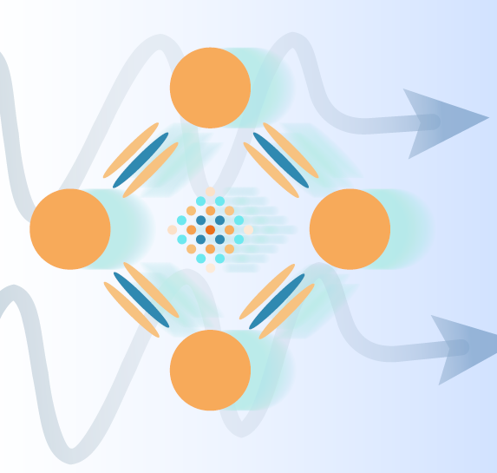
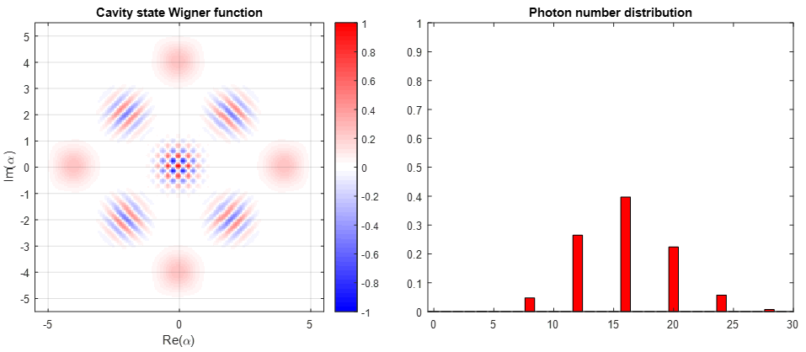
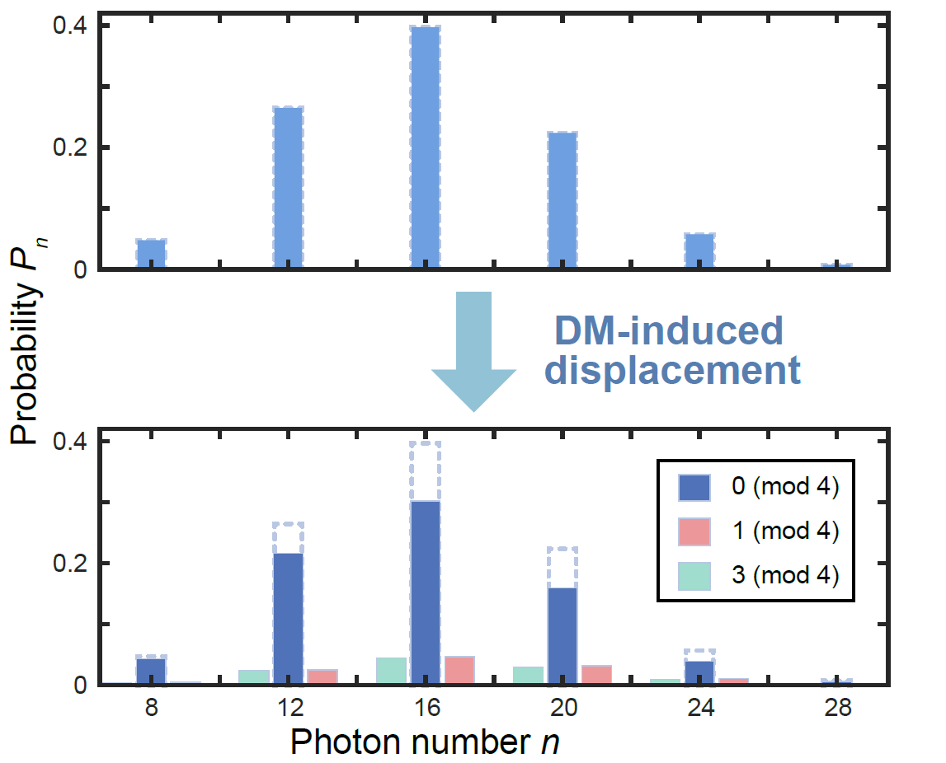
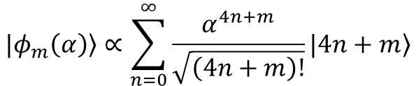


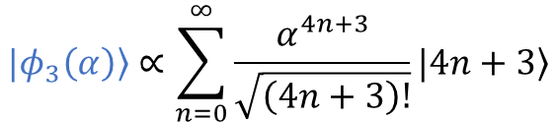

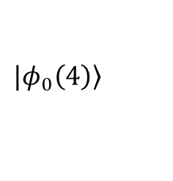
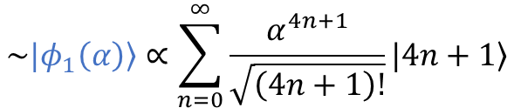

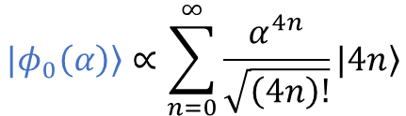




The probe state: four-component cat states
Four-component cat states
$$|\left.φ_{m}\left(α\right)\right\rangle ∝\sum_{n=0}^{∞}{\frac{α^{4n+m}}{\sqrt{\left(4n+m\right)!}}|\left.4n+m\right\rangle }$$
$$m_{A′}$$
$$α=4$$
$$ω_{c}$$
$$m_{A′}c^{2}=ℏω_{c}$$
$$\hat{D}\left(β\right)\text{ @ }ω_{c}$$
$${\left|\left\langle φ_{1}\left(α\right) | \hat{D}\left(β\right) | φ_{0}\left(α\right)\right\rangle \right|}^{2}≈{\left|\left\langle φ_{1}\left(α\right) | βa^{+} | φ_{0}\left(α\right)\right\rangle \right|}^{2}={\left|β\right|}^{2}{\left|α\right|}^{2}$$
$${\left|\left\langle 1 | \hat{D}\left(β\right) | 0\right\rangle \right|}^{2}≈{\left|\left\langle 1 | βa^{+} | 0\right\rangle \right|}^{2}={\left|β\right|}^{2}∝ε^{2}$$
0 (mod 4)
$$|\left.φ_{0}\left(α\right)\right\rangle ∝|\left.α\right\rangle +|\left.iα\right\rangle +|−\left.α\right\rangle +|\left.−iα\right\rangle$$
$$|\left.φ_{0}\left(4\right)\right\rangle$$
Dark matter
$$\sim |\left.φ_{1}\left(α\right)\right\rangle ∝\sum_{n=0}^{∞}{\frac{α^{4n+1}}{\sqrt{\left(4n+1\right)!}}|\left.4n+1\right\rangle }$$
$$|\left.φ_{0}\left(α\right)\right\rangle ∝\sum_{n=0}^{∞}{\frac{α^{4n}}{\sqrt{\left(4n\right)!}}|\left.4n\right\rangle }$$
$$|\left.φ_{3}\left(α\right)\right\rangle ∝\sum_{n=0}^{∞}{\frac{α^{4n+3}}{\sqrt{\left(4n+3\right)!}}|\left.4n+3\right\rangle }$$
$$\hat{α}$$

Slide 9
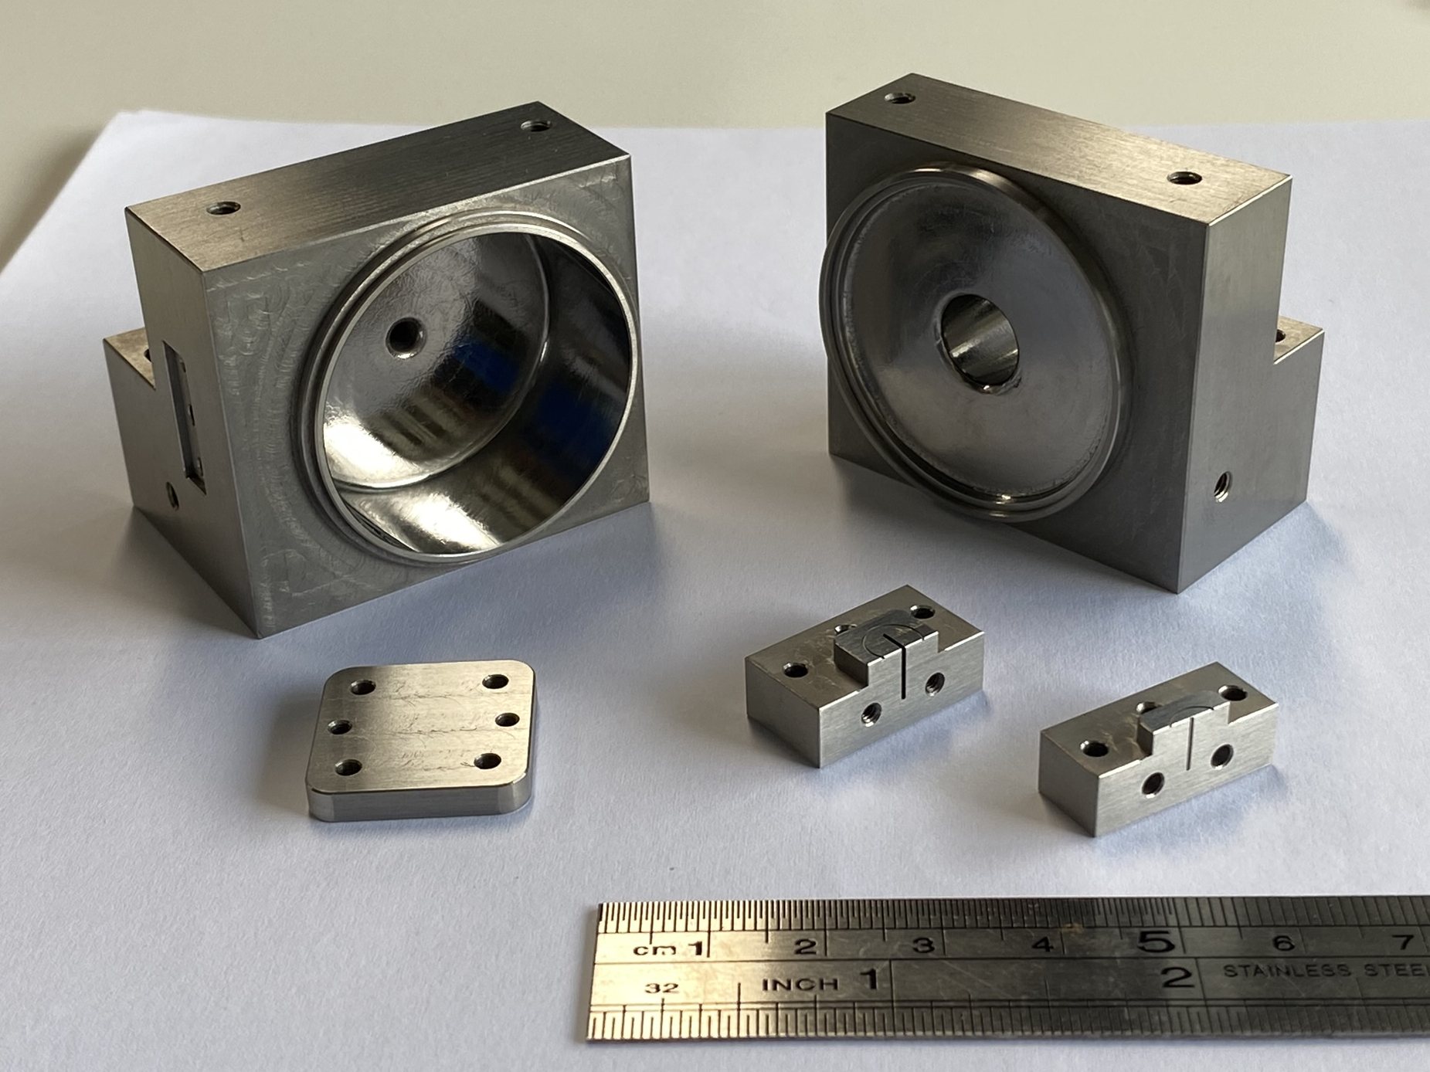
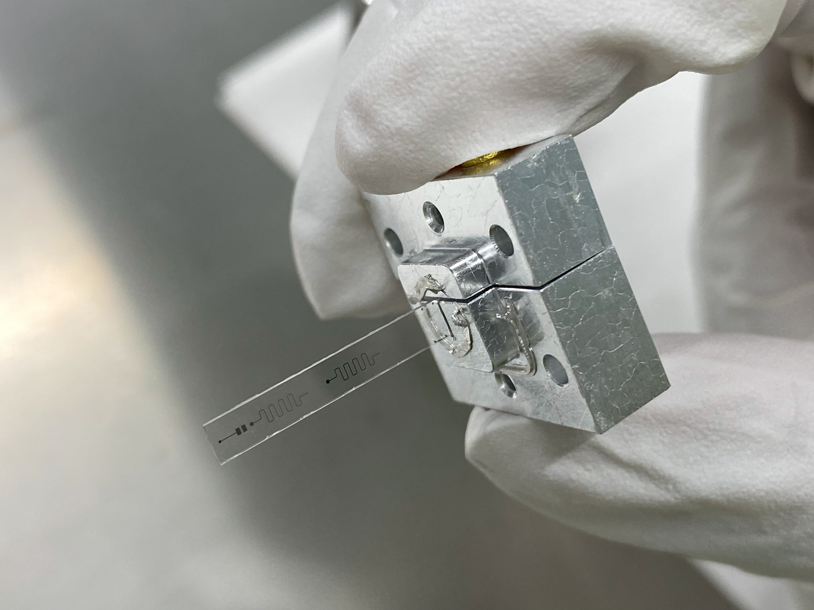
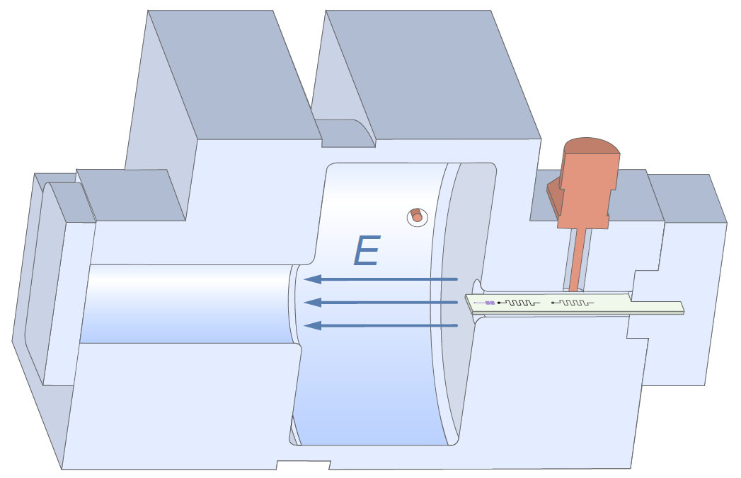
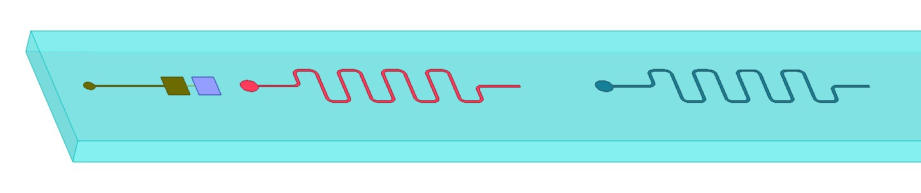
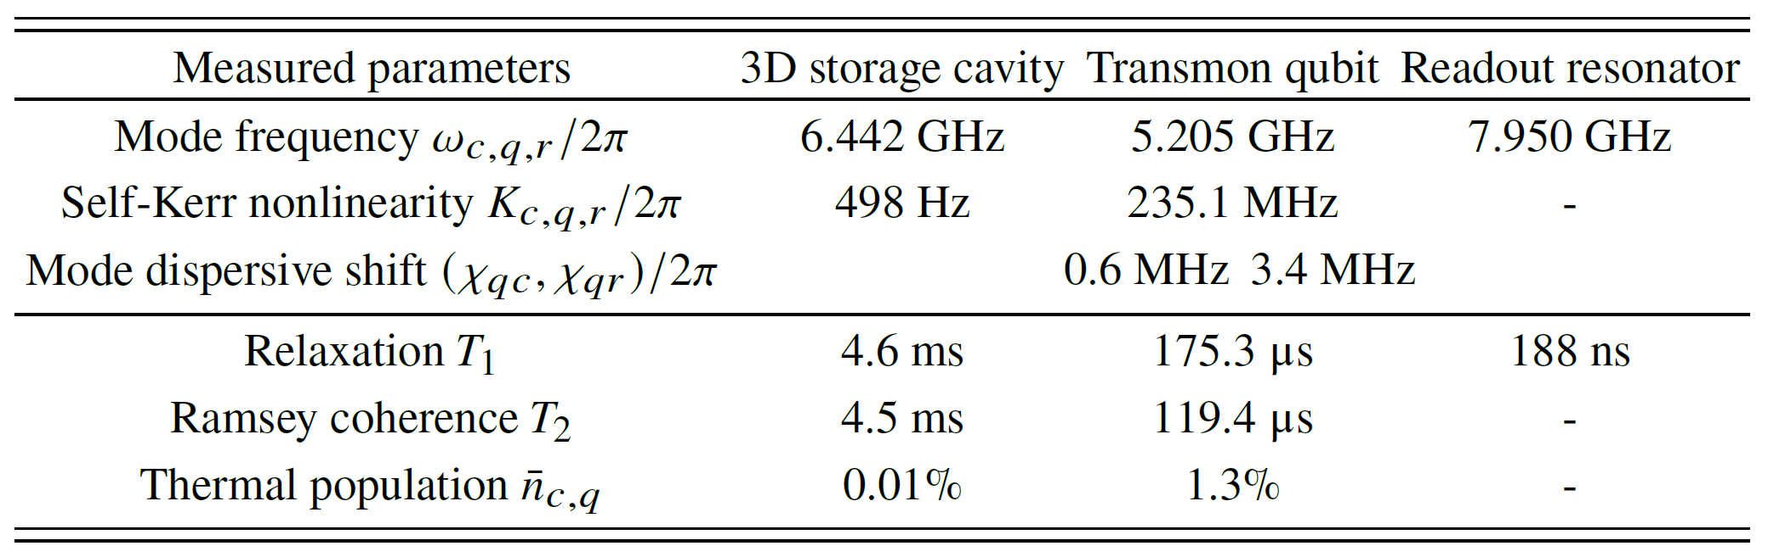
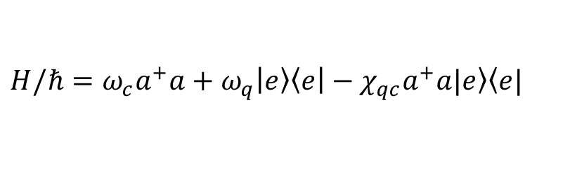
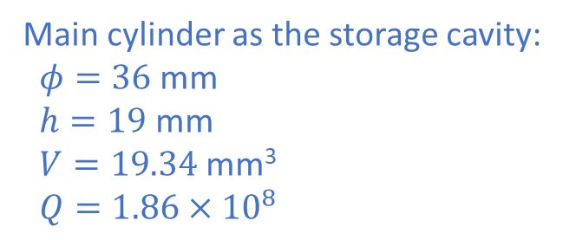
Hardware and Hamiltonian
$$H/ℏ=ω_{c}a^{+}a+ω_{q}\left|\left.e\right\rangle \left\langle e\right.\right|−χ_{qc}a^{+}a|\left.e\right\rangle \left\langle e\right.|$$
Main cylinder as the storage cavity:
$φ=36$ mm
$h=19$ mm
$V=19.34$ mm³
$Q=1.86×{10}^{8}$

Slide 10
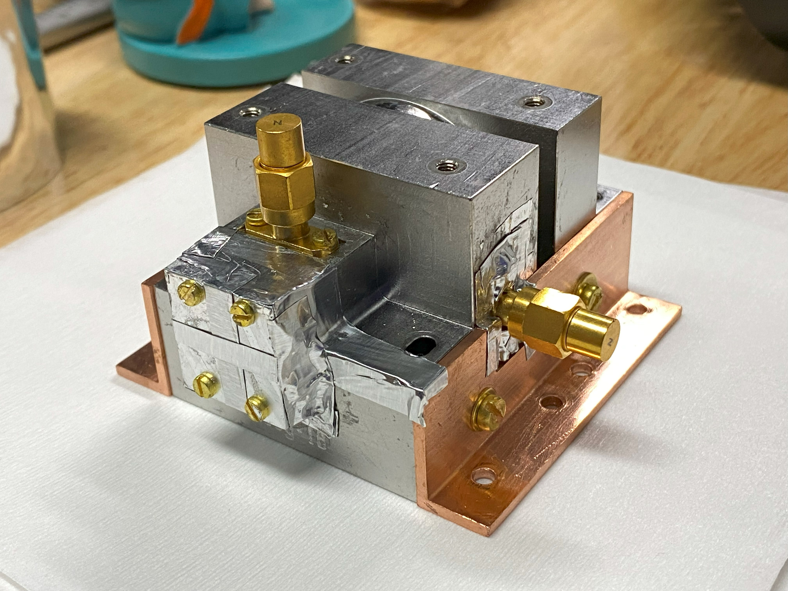
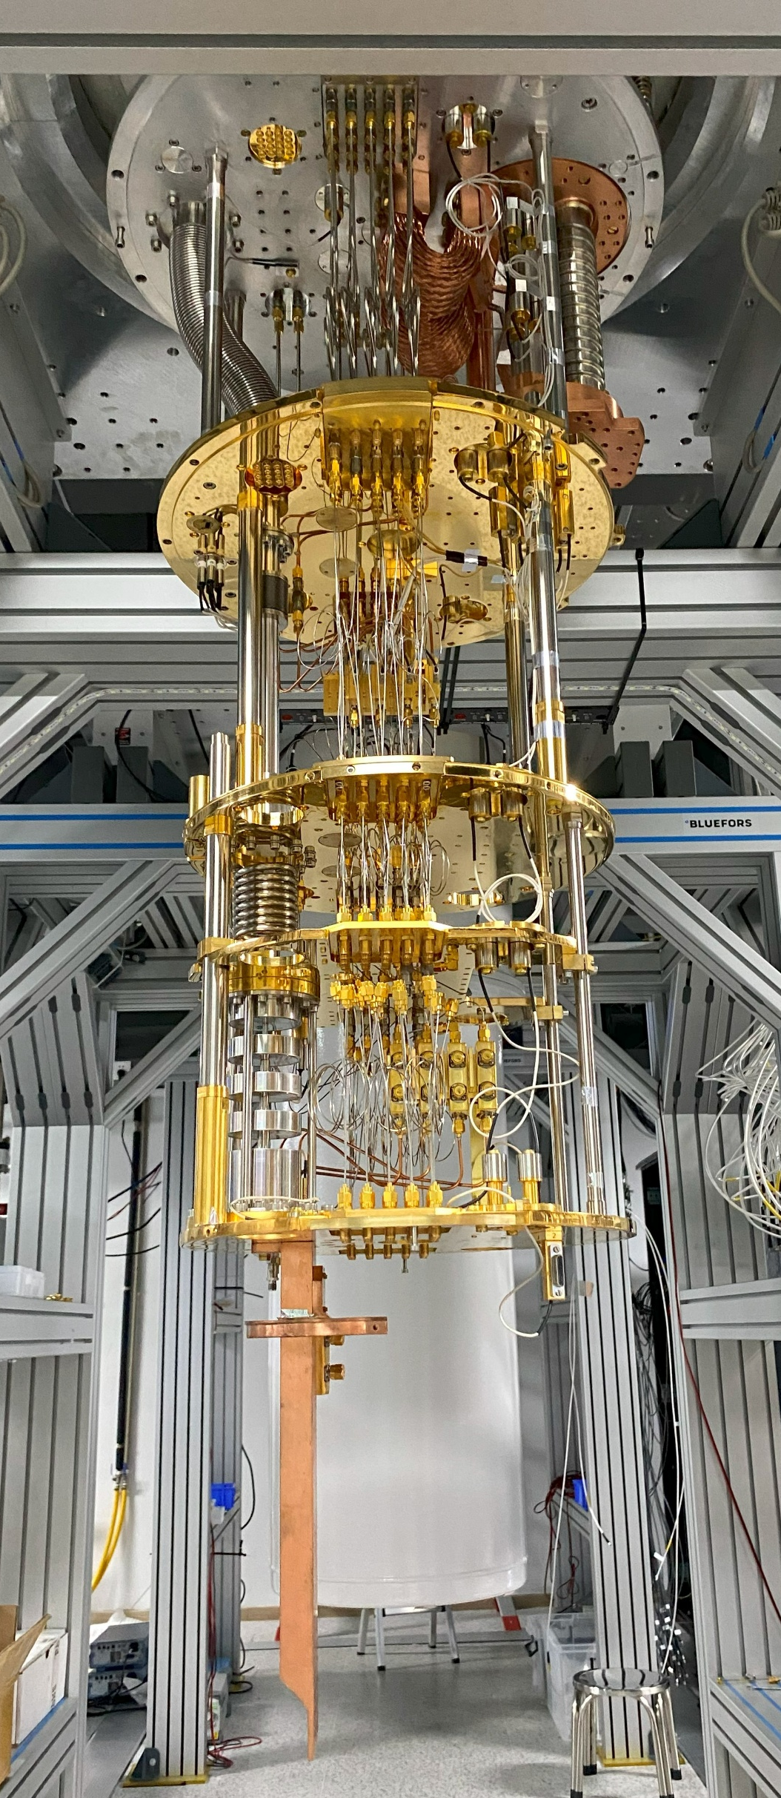


Refrigerator and Circuits

Slide 11










Probe state preparation
①
②
③
$$H/ℏ=ω_{c}a^{+}a+ω_{q}\left|\left.e\right\rangle \left\langle e\right.\right|−χ_{qc}a^{+}a|\left.e\right\rangle \left\langle e\right.|$$
$$C_{θ}=I⊗\left|\left.g\right\rangle \left\langle g\right.\right|+e^{iθa^{+}a}\left|\left.e\right\rangle \left\langle e\right.\right|$$
① $|\left.α\right\rangle$
② $|\left.φ_{+}\left(α\right)\right\rangle$ or $|\left.φ_{−}\left(α\right)\right\rangle$
③ $|\left.φ_{0}\left(α\right)\right\rangle$ or $|\left.φ_{2}\left(α\right)\right\rangle$ following $|\left.φ_{+}\left(α\right)\right\rangle$
③ $|\left.φ_{1}\left(α\right)\right\rangle$ or $|\left.φ_{3}\left(α\right)\right\rangle$ following $|\left.φ_{−}\left(α\right)\right\rangle$
$$|\left.φ_{0}\left(α\right)\right\rangle ∝\sum_{n=0}^{∞}{\frac{α^{4n}}{\sqrt{\left(4n\right)!}}|\left.4n\right\rangle }$$

Slide 12














Calibration of the detector and hidden Markov model
Joint cavity-qubit hidden states: $S_{i}$, $i∈\left[0,M\right]$
$$S_{i}∈\left\{|\left.φ_{0}g\right\rangle ,|\left.φ_{0}e\right\rangle ,|\left.φ_{1}g\right\rangle ,|\left.φ_{1}e\right\rangle ,|\left.φ_{2}g\right\rangle ,|\left.φ_{2}e\right\rangle ,|\left.φ_{3}g\right\rangle ,|\left.φ_{3}e\right\rangle \right\}$$
Readout signal: $R_{i},i∈\left[0,M\right]$
$$R_{i}∈\left\{𝒢, ℰ\right\}$$
$$R_{i}=EP_{i}$$
$E$: emission matrix
Probability for all hidden states before i-th measurement:
$$P_{i}={\left(|\left.φ_{0}g\right\rangle ,|\left.φ_{0}e\right\rangle ,|\left.φ_{1}g\right\rangle ,|\left.φ_{1}e\right\rangle ,|\left.φ_{2}g\right\rangle ,|\left.φ_{2}e\right\rangle ,|\left.φ_{3}g\right\rangle ,|\left.φ_{3}e\right\rangle \right)}^{T}$$
$$P_{i+1}=TP_{i}$$
$T$: transition matrix

Slide 13









Calibration of the detector
$$n_{meas}=η_{α}{\left|α\right|}^{2}n_{inj}+δ_{α}$$
Likelihood ratio:
$$n_{inj}={\left|β\right|}^{2}$$
$$λ=\frac{P_{0}\left(φ_{1}\right)}{P_{0}\left(φ_{0}\right)+P_{0}\left(φ_{2}\right)+P_{0}\left(φ_{3}\right)}$$
$η_{α}$: detection efficiency
Measured average photon number:
$δ_{α}$: false positive probability
$$n_{meas}=\frac{N\left(λ>λ_{thresh}\right)}{N_{trials}}$$

Slide 14







Search attempts for dark photons
$$n_{meas}=a_{0}η_{α}{\left|α\right|}^{2}g\left(τ\right)+b_{α}τ+c_{α}$$
$$g\left(t\right)≃\left\{\begin{aligned}t^{2}, 0<t<τ_{DM} \\ &τ_{DM}t, t>τ_{DM}\end{aligned}\right.$$
$$n_{meas}=a_{0}η_{α}{\left|α\right|}^{2}τ^{2}+b_{α}τ+c_{α}$$
For $t<τ_{DM}≈152$ µs

Slide 15





Constraint for kinetic mixing angle
$$ε<ε_{0}+1.28σ_{ε_{0}}=7.3×{10}^{−16}$$
for 90% confidence level
$$ε_{0}=\sqrt{\frac{a_{0}}{ρ_{DM}m_{DM}V_{eff}}}=5.6×{10}^{−16}$$
$$σ_{ε_{0}}≈\frac{ε_{0}}{2a_{0}}σ_{a_{0}}=1.4×{10}^{−16}$$

Slide 16










Frequency scan search for dark photons
$$H_{d}=\frac{Ω}{2}a^{+}\left|\left.g\right\rangle \left\langle f\right.\right|e^{iΔt}+\text{h.c.}$$
$$H_{d}^{eff}=\frac{Ω^{2}}{4Δ}a^{+}a$$
for $Δ≫Ω$
$$Δ=ω_{d}−(ω_{ge}+ω_{ef}−ω_{c})$$

Slide 17



Summary and outlooks
Developed dark photon detectors near 6.44 GHz (26.6 µeV) based on superconducting cavities;
Demonstrated an 8.1-fold enhancement in the measured photon number using four-component cat states;
Constrained the dark photon kinetic mixing angle to less than $7.3×{10}^{−16}$;
Demonstrated a frequency scan search for dark photons within a 100 kHz bandwidth, yielding a sensitivity at the ${10}^{−16}$ level;
Studying frequency-tunable superconducting cavities for scan search;
Will develop detector array for correlated measurements.

Slide 18

Acknowledgements
Director of SZIQA: Dapeng Yu*;
Yuan Xu Group @ SZIQA
  Yuan Xu*, Xiaowei Deng, Ling Hu, Zhongchu Ni;
  Yanyan Cai, Shengcheng Wen, Jiasheng Mai;
Center for Quantum Devices and Chips @ SZIQA
  Song Liu*, Libo Zhang;
Jing Shu Group @ Peking U.
  Jing Shu*, Bin Xu;
  Yanjie Zeng;
Peking U.: Lin Lin.
Yuan Xu Group @ SZIQA
*Corresponding authors of PRL 136, 171002 (2026)

Slide 19
Thanks!
Questions?

Slide 20


Slide 21


with vacuum states

Slide 22



