Slide 1


Constraints on Axion-Like Particles
with the Silicon Detector at a Nuclear Reactor
Reporter: Yuanlin Gong (龚远林) Nanjing Normal University
Work with: Jun Guo, Ning Liu, Liangliang Su, Wen-Na Yang
arXiv: 2601.07448, accepted by Sci.China Phys.Mech.Astron.
2026.8.11 @Qiangdao
Notes:
开场：介绍题目、核心关键词：反应堆提供相对论性 ALP，Skipper-CCD 通过等离子体激发探测 eV 能量沉积。

Slide 2

01
Introduction
目录
02
Method and Results
CONTENTS
03
Conclusion
Notes:
I have divied the presentation into three parts: Firstly, I will simply introduce dark matter，Secondly, I will introduce the direct detection of dark matter；finally, we will give a conclusion.

Slide 3
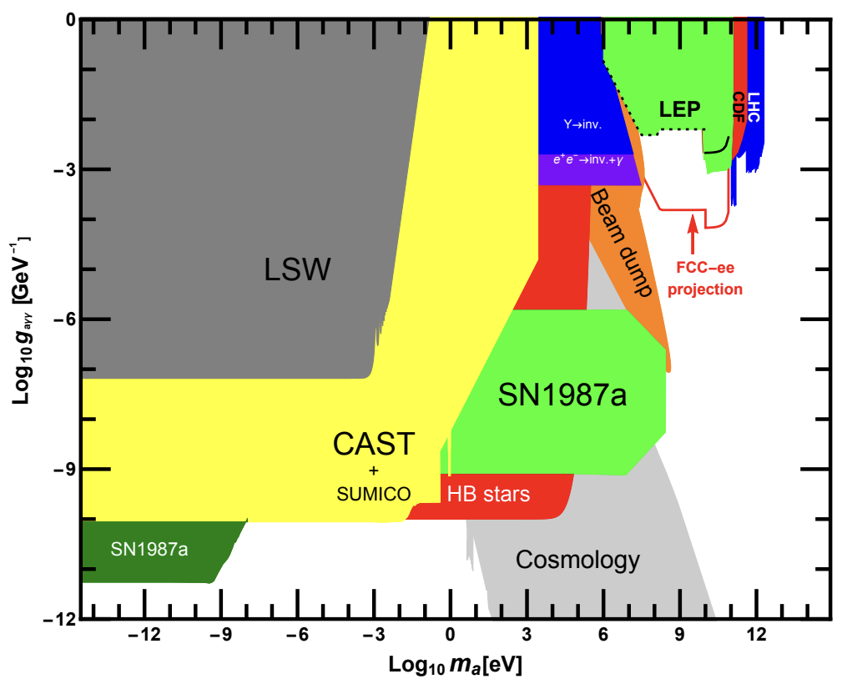
Axion-Like Particles (ALPs)
ALPs are light pseudoscalars predicted in many extensions of the Standard Model, such as string theory
P. Svrcek and E. Witten, hep-th/0605206
A. Arvanitaki et al, 0905.4720
Dominated by Cosmology and Astrophysical bounds
Affects the He-burning lifetime of HB stars
Energy-loss of SN 1987A via Primakoff process and photon coalescence
Abundance of light elements during BBN
bounds can be generally eluded by many mechanisms
J. Jaeckel et al, arXiv:hep-ph/0610203
keV-MeV Gap
R. N. Mohapatra and S. Nasri, arXiv:hep-ph/0610068
Allan Sung, Gang Guo, and Meng-Ru Wu, 2102.04601
Fig. from: J. Jaeckel and M. Spannowsky, 1509.00476
Notes:
Unlike the QCD Axion, ALP mass ($m_{a}$) and couplings (e.g.,$g_{aγγ}$) are independent parameters

Slide 4
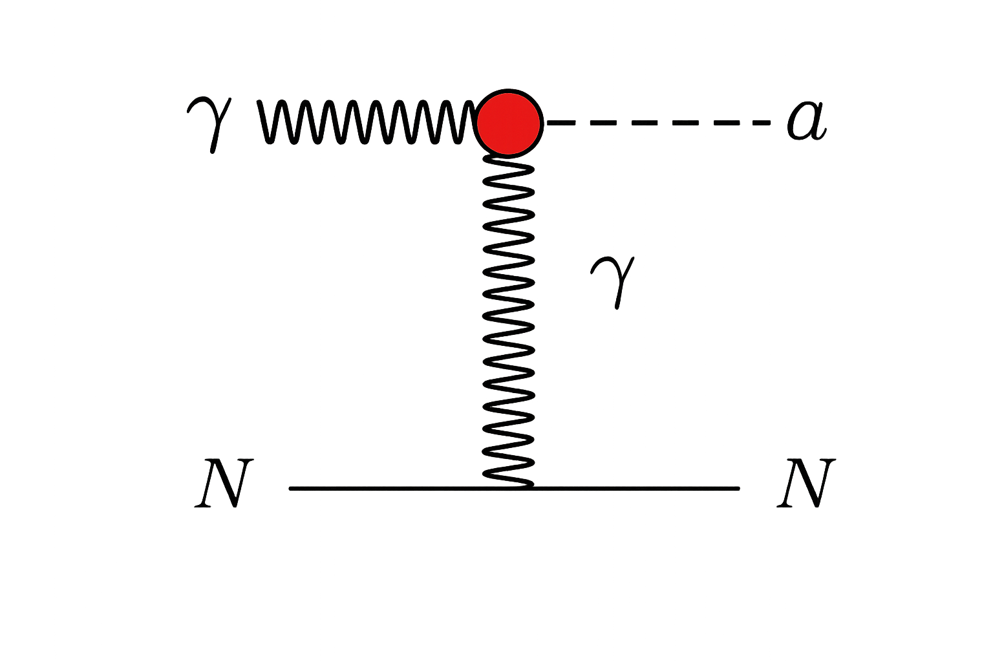
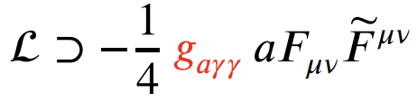
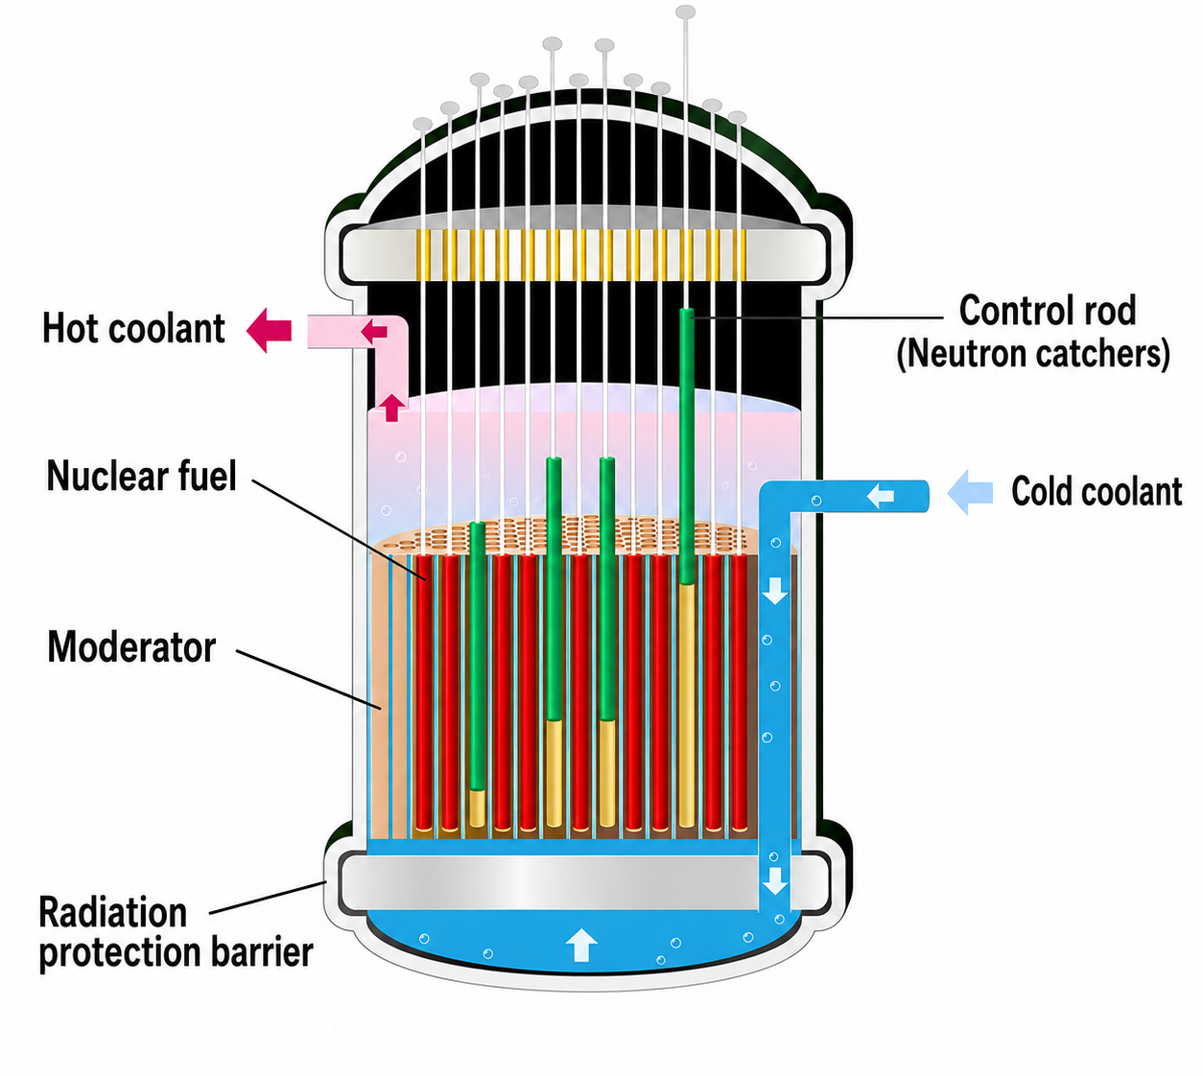
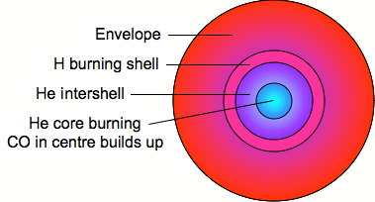
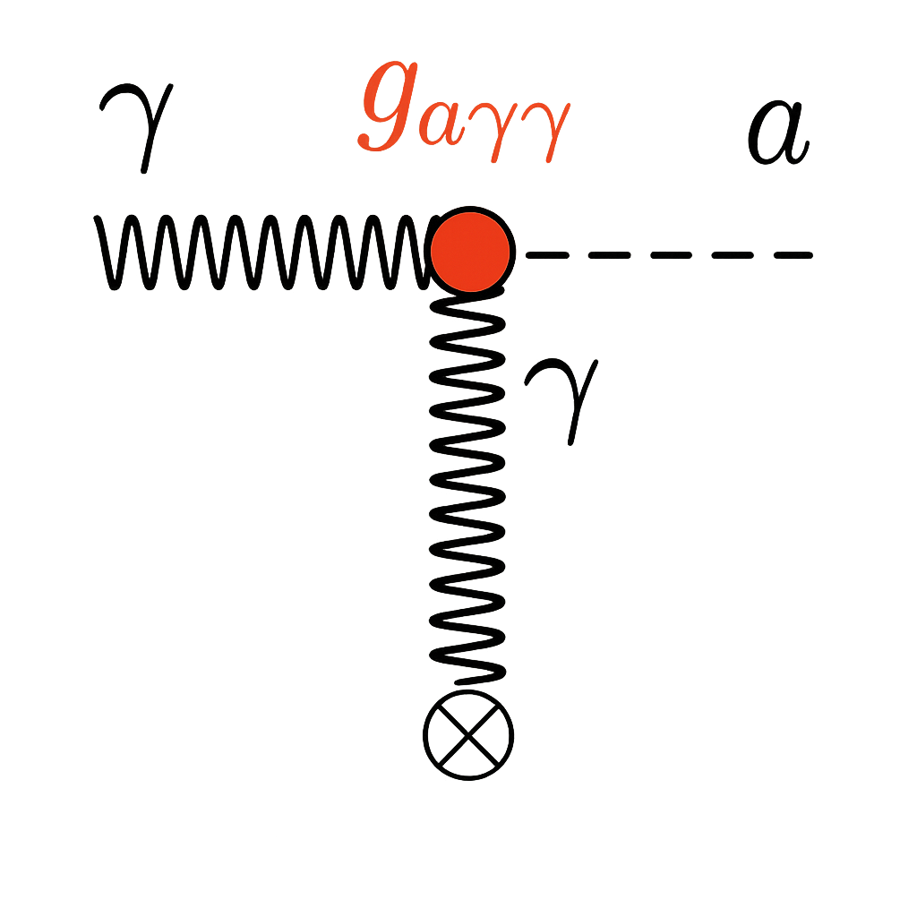
From Stellar Primakoff to Reactor ALPs
Primakoff process
Dominant astrophysical constraint
Leading experiment constraint ?
Laboratory realization
Dicus et. al, PRD 18 (1978)
G. G. Raffelt and D. S. P. Dearborn, PRD (1987)
Copyright: (c) Designua | Dreamstime.com
HB stars (stellar plasma)
Nuclear Reactor
Notes:
Affects the He-burning lifetime of Horizontal branch HB stars

Slide 5
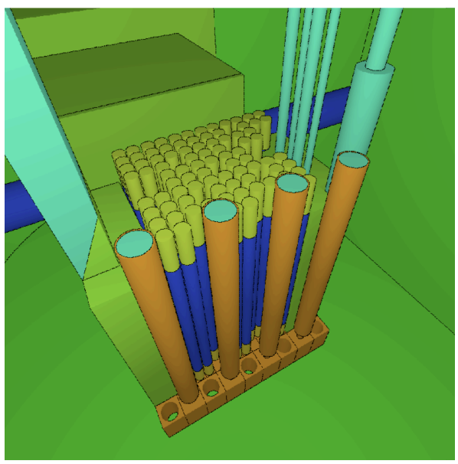
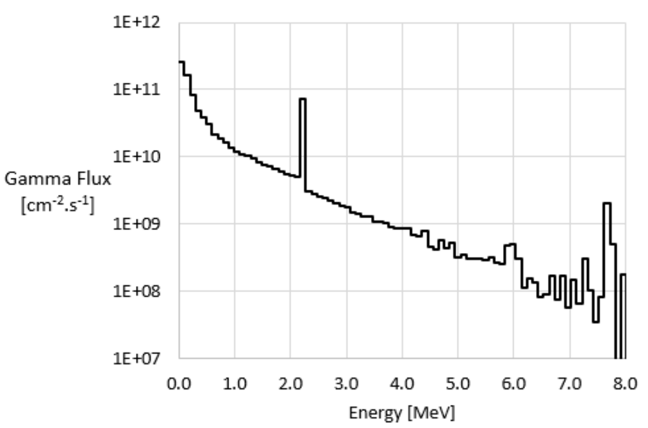


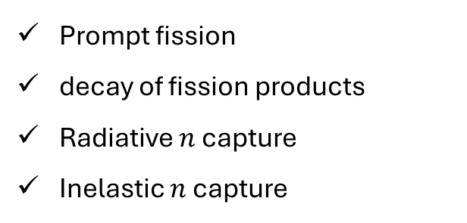
Why Nuclear Reactors?
G. Agnolet,…B. Dutta et al, 1609.02066
Photons production channels
Prompt fission
decay of fission products
Radiative $n$ capture
Inelastic $n$ capture
graphite reflectors
fuel and control rods
TRIGA reactor core modeled in MCNP framework
$$γ+{}_{ }^{235}U → {}_{ }^{235}U+a$$
neutron capture on Hydrogen in the surrounding water
A substantial amount $𝒪\text{(keV}\text{)}$ relativistic ALP
statistical fluctuations
$E_{a}= \sqrt{m_{a}^{2}+p_{a}^{2}} ≈E_{γ} \sim MeV$
Background Control
Reactor-on/off data reduce backgrounds
The reactor photon flux from MCNP
Notes:
The small circles in the picture represent the various fuel and control rods while the green rectangles are graphite reflectors.
The fuel rods are about 3.58 cm in diameter and 38.1 cm in length。

Slide 6
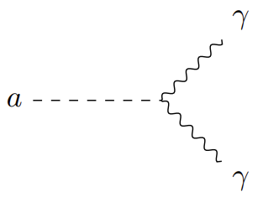
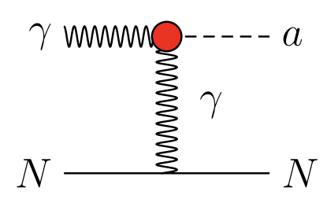
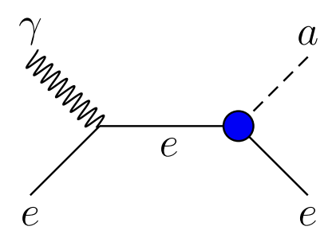
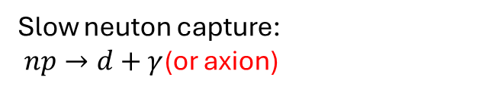


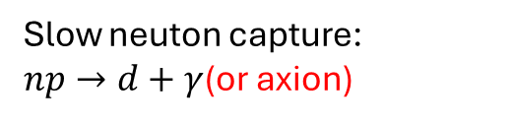

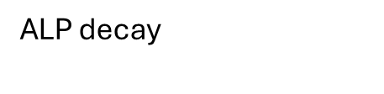
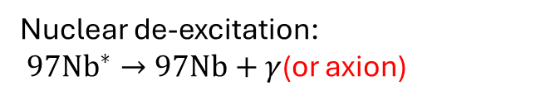


Reactor Based Searches
$$a$$
Reactor
Detector
Production
Detection
Proposals
A New Light Boson? Steven Weinberg, PRL 1978 (intended for PQWW model)
Do Axions Exist? T.W. Donnelly et al, PRD 1978 (intended for PQWW model)
Early searches
Bugey Nuclear power plant (France)
A Searches for Axions at Power Reactor, J.F. Cavaignac et.al, PLB 121, 1983
Slow neuton capture:
$np→d+γ$(or axion)
$$g_{aNN}$$
$$g_{aγγ}$$
ALP decay
$$a→γ+γ$$
Nuclear de-excitation:
${97Nb}^{∗}→97Nb+γ$(or axion)
Kuosheng nuclear power plant (Taiwan)
H. M. Chang et. al, PRD 75, 2007 [TEXONO Collaboration]
Inverse Primakoff+Compton
Slow neuton capture:
$np→d+γ$(or axion)
$$g_{aNN}$$
$$g_{aγγ}, g_{aee}$$

Slide 7
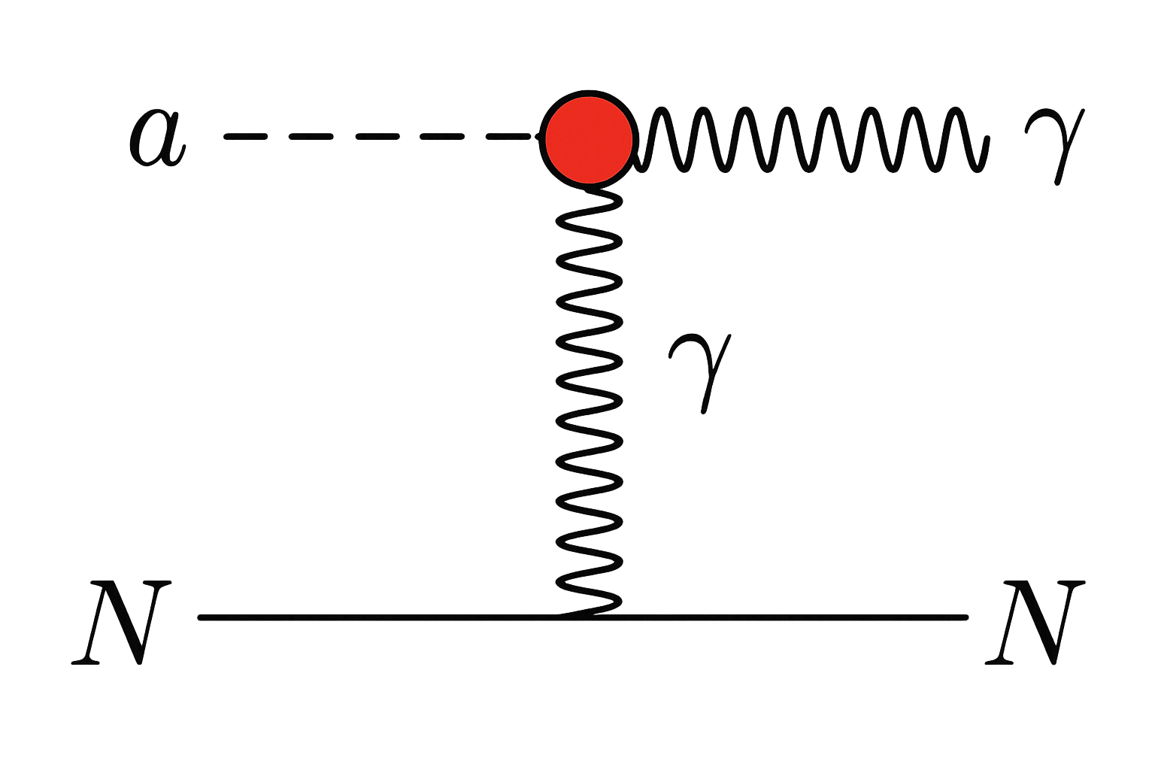
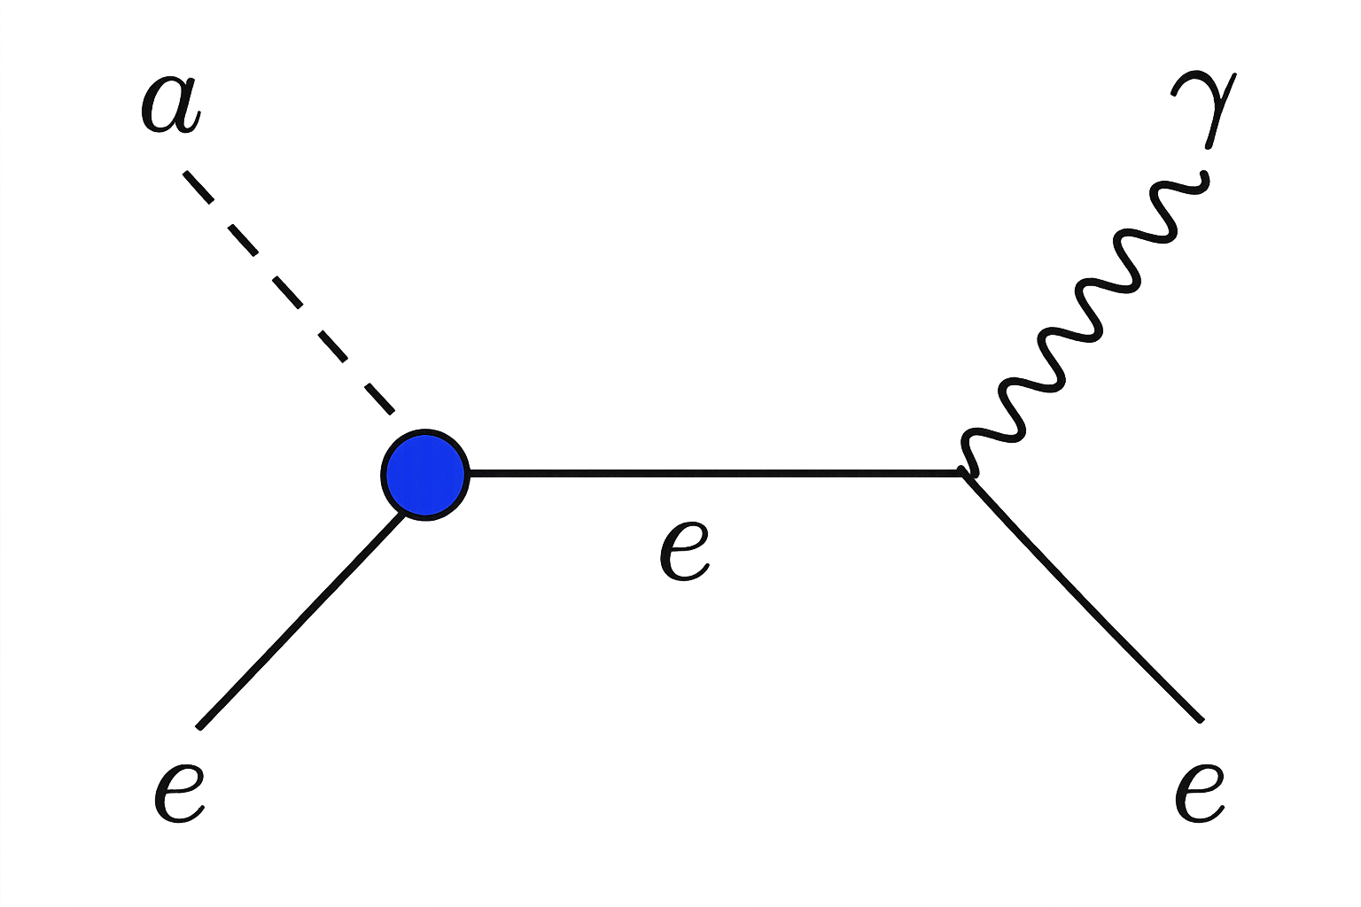
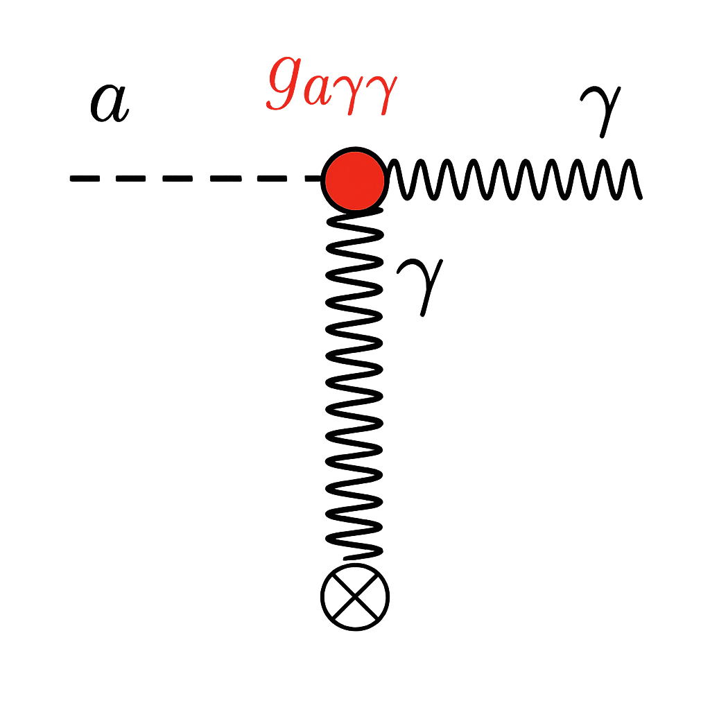



Reactor Based Searches
$$a$$
Reactor
Detector
Production
Detection
Recent Proposals
$$g_{aγγ}$$
Inverse pro.
$$g_{aee}$$
J. Dent, Bhaskar Dutta, et. al, PRL 124 (2020) (intended for ALP)
Primakoff process
Compton process
Reactor + Haloscopes
Recent searches
Fernando Arias-Arag ́on et al, PRL, 132(2024) (intended for ALP)
S. Sahoo et al, arXiv:2407.14704 [CsI(TI) Detector]
Byung Ju Park et al, PRL, 134(2025) [NEON Collaboration]

Slide 8
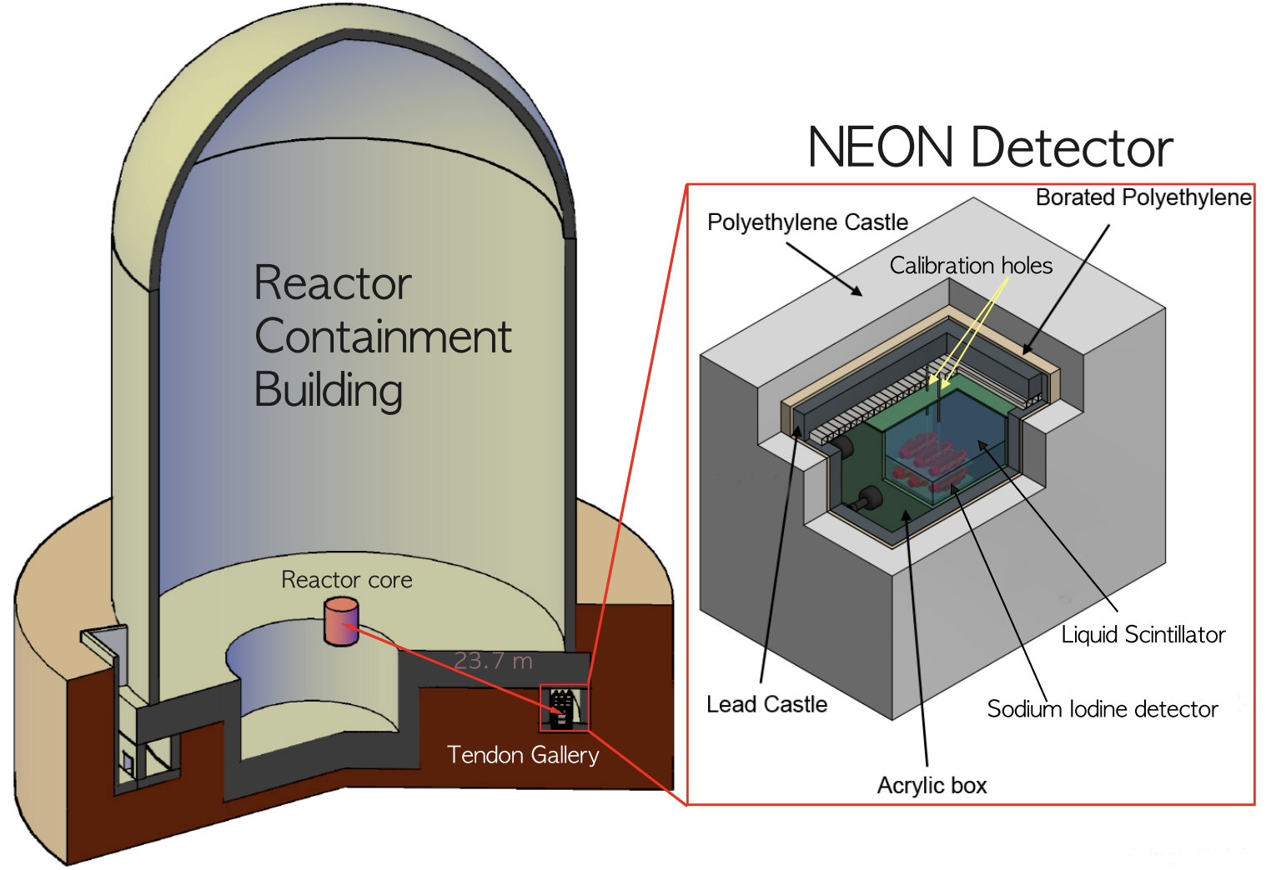
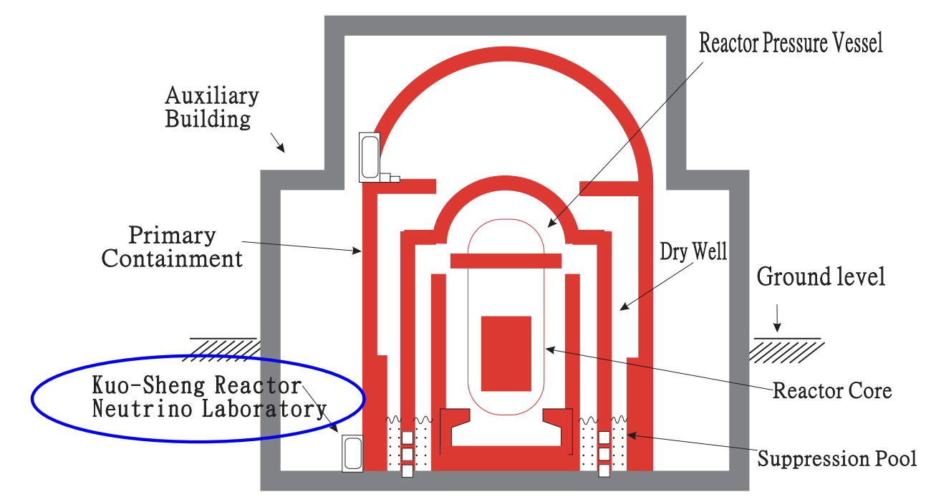
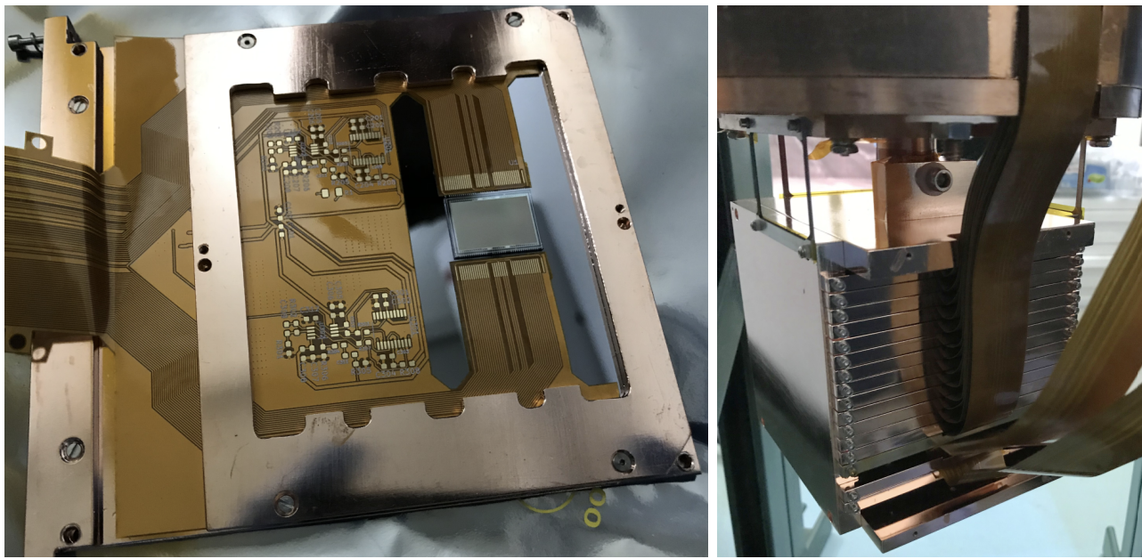
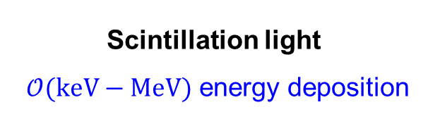
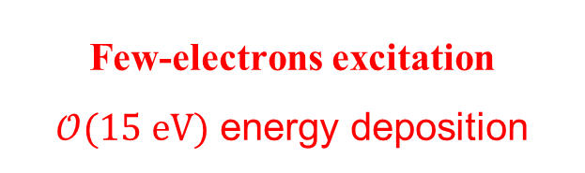
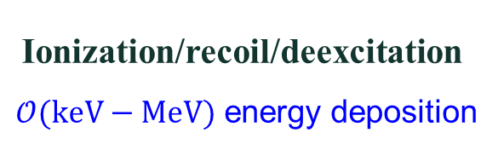
keV–MeV to eV-Scale Detection
Scintillation detectors
Germanium detectors
Silicon Skipper-CCDs
NEON (NaI) Experiment
TEXONO, RECODE
CONNIE, vIOLETA
Byung Ju Park et al, PRL, 134(2025)
H. M. Chang et. al, PRD 75, 2007
CONNIE and Atucha-II Collaboration, 2405.16316
W. Dai, YLG, GH. Gu, LL. Su, L. Wang, L. Wu, YC. Wu, LT. Yang, 2509.01538
Scintillation light
$𝒪(keV−MeV)$ energy deposition
Ionization/recoil/deexcitation
$𝒪(keV−MeV)$ energy deposition
Few-electrons excitation
$𝒪(15 eV)$ energy deposition
Can we detect reactor-produced keV ALPs through an eV-scale energy deposition?
Notes:
这里回应实验分类：NEON 属于 NaI(Tl) 闪烁, Scin t illation; Sod ium I o dide crystal；RECODE 放入 Ge 电离探测器；本文重点是 silicon CCD。

Slide 9
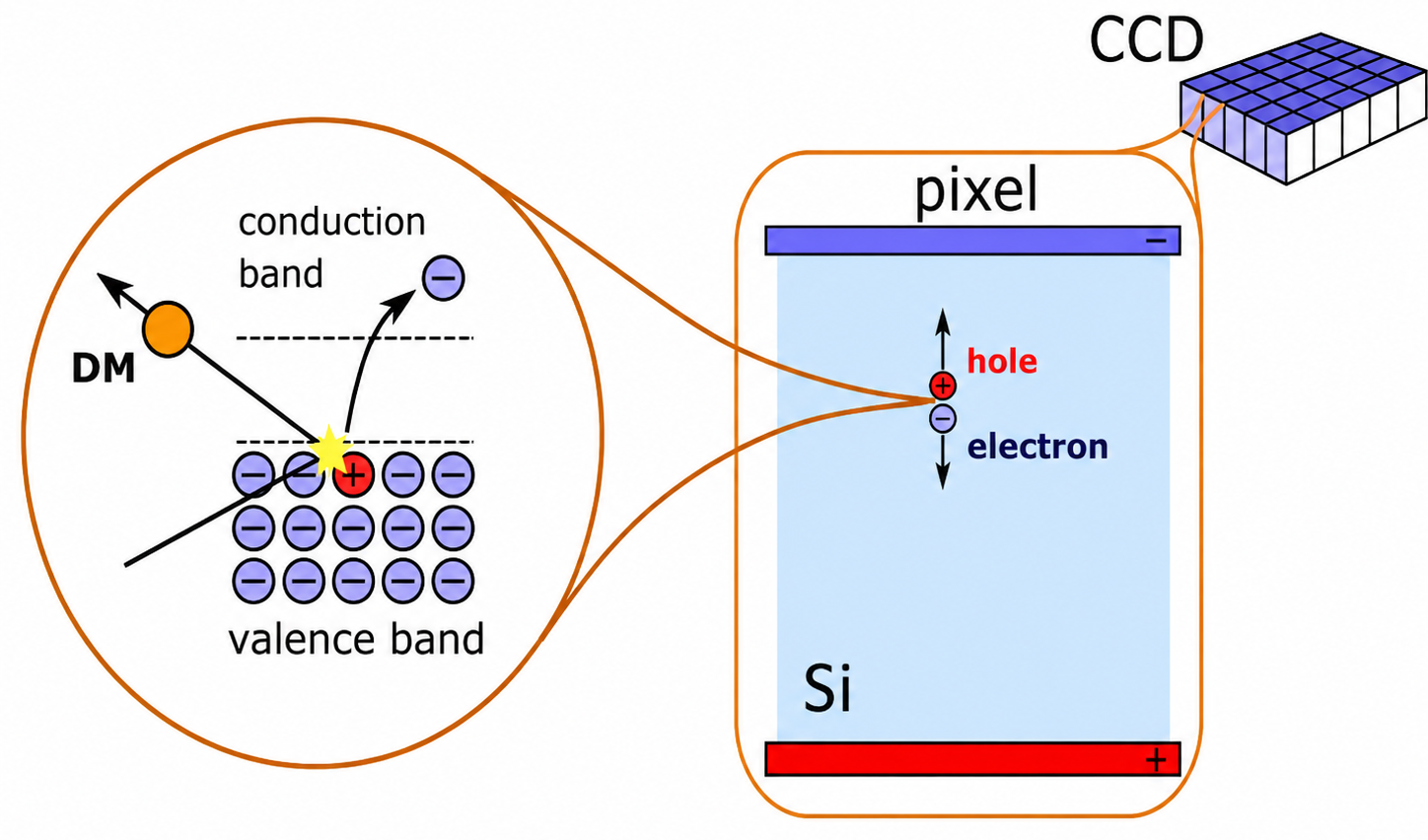
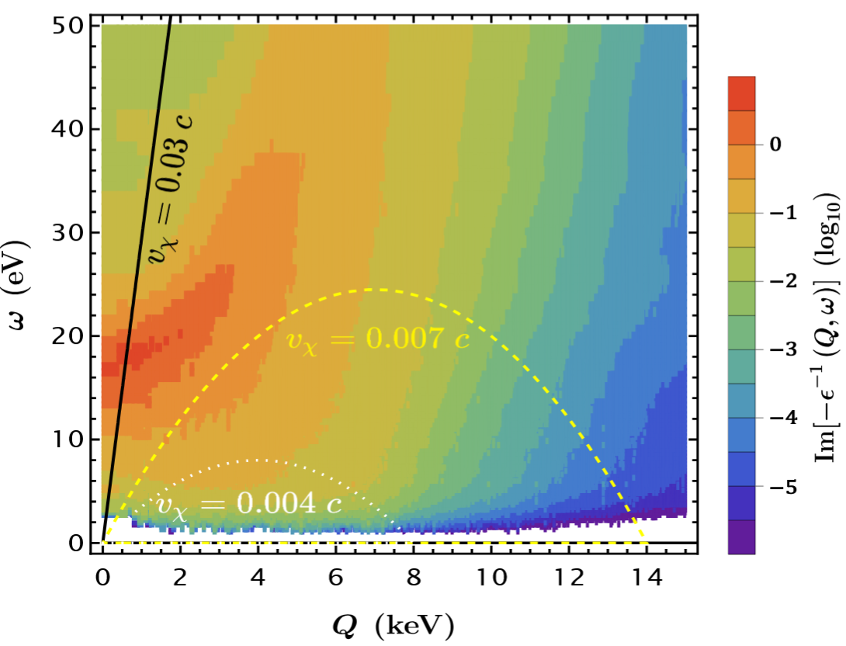
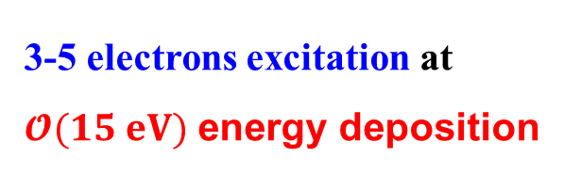
Plasmon resonance at Semiconductor
Accessed by relativistic particles
Fig from A. M. Botti
Plasmon resonance:
Energy loss function
3-5 electrons excitation at
$𝓞(15 eV)$ energy deposition
Fig from: Z.-L. Liang, L.L. Su, L. Wu, B. Zhu, PRL 2025
Silicon Skipper-CCDs

Slide 10
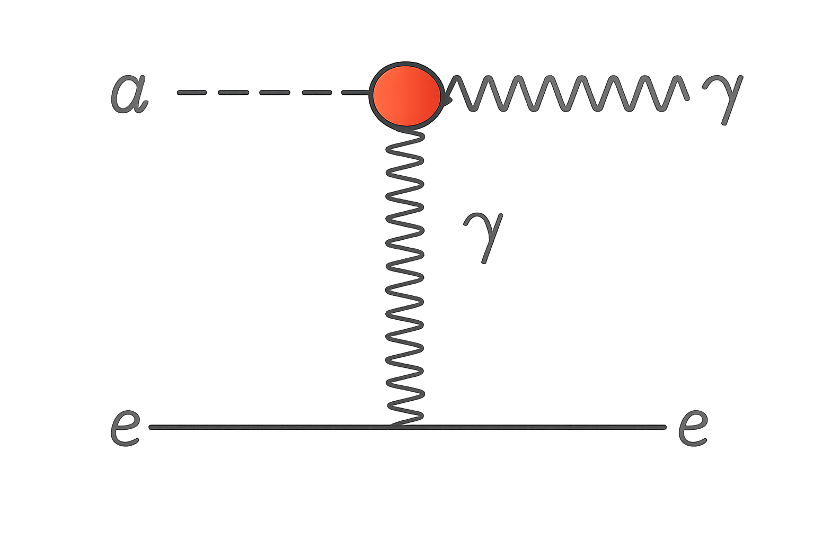
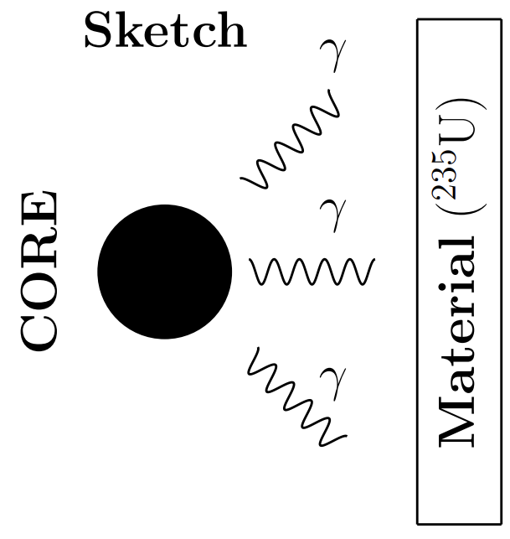




Plasmon Excitation as a probe of ALP
$$a$$
$$γ$$
$$a$$
Fig from A. M. Botti
Reactor Production of relativistic ALPs
Detection with plasmon excitation at $𝓞$(15 eV)
YL. G, J. Guo, N. Liu, L.L. Su, W.-N. Yang, arXiv: 2601.07448
Notes:
The sub-GeV DM with the coupling to the electrons can be detected in semi-conductor targets, such as SENSEI。 In addition to single-electron excitations, Relativistic light dark matter scattering in semi-conductor targets can generate collective plasmon excitations. We can describe this behavior with the energy loss function。

Slide 11
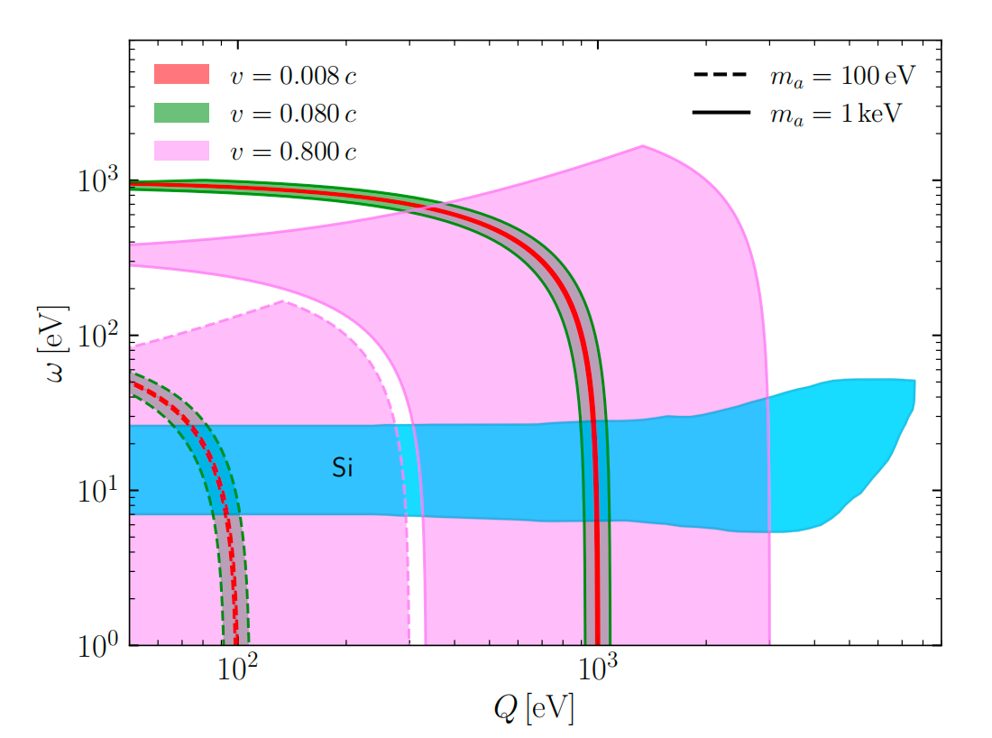


Relativistic ALPs Induce Plasmon Excitations
(By Absorption of ALPs)
Material response
@ Energy deposition: $ω$ ~ 15 eV
Plasmon band
@ Momentum transfers: Q$≤$ 5 keV
Relativistic ALPs with masses below 100 keV can efficiently excite Plasmon
Plasmonic energy-loss region in silicon and ALP kinematic reach
Notes:
强调材料响应：不是自由电子散射，而是用能量损失函数描述多体介质效应。图中蓝色区域就是 silicon plasmon region。absorption

Slide 12
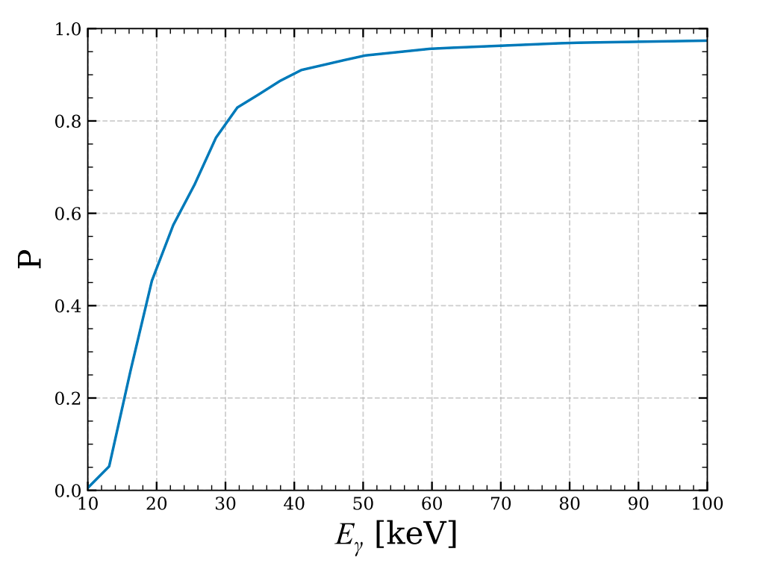


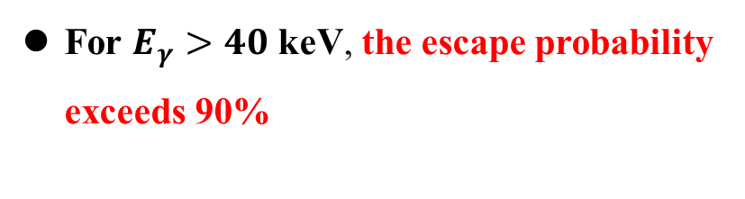
Fate of Energetic Final-State Photon
Inverse Primakoff-like absorption will emit a high-energy photon (~ MeV)
90%
Thin CCD
(~ 675 $μm$)
For $E_{γ}>40$ keV, the escape probability exceeds 90%
Photon escape probability P
through a 675 $μm$ silicon CCD
The observable is the eV-scale energy deposition from plasmon
Notes:
讲清楚为什么传统 Ge/NaI 中用高能光子信号，而这里硅 CCD 的高能光子会逃逸，因此低能 plasmon 反而成为关键。

Slide 13
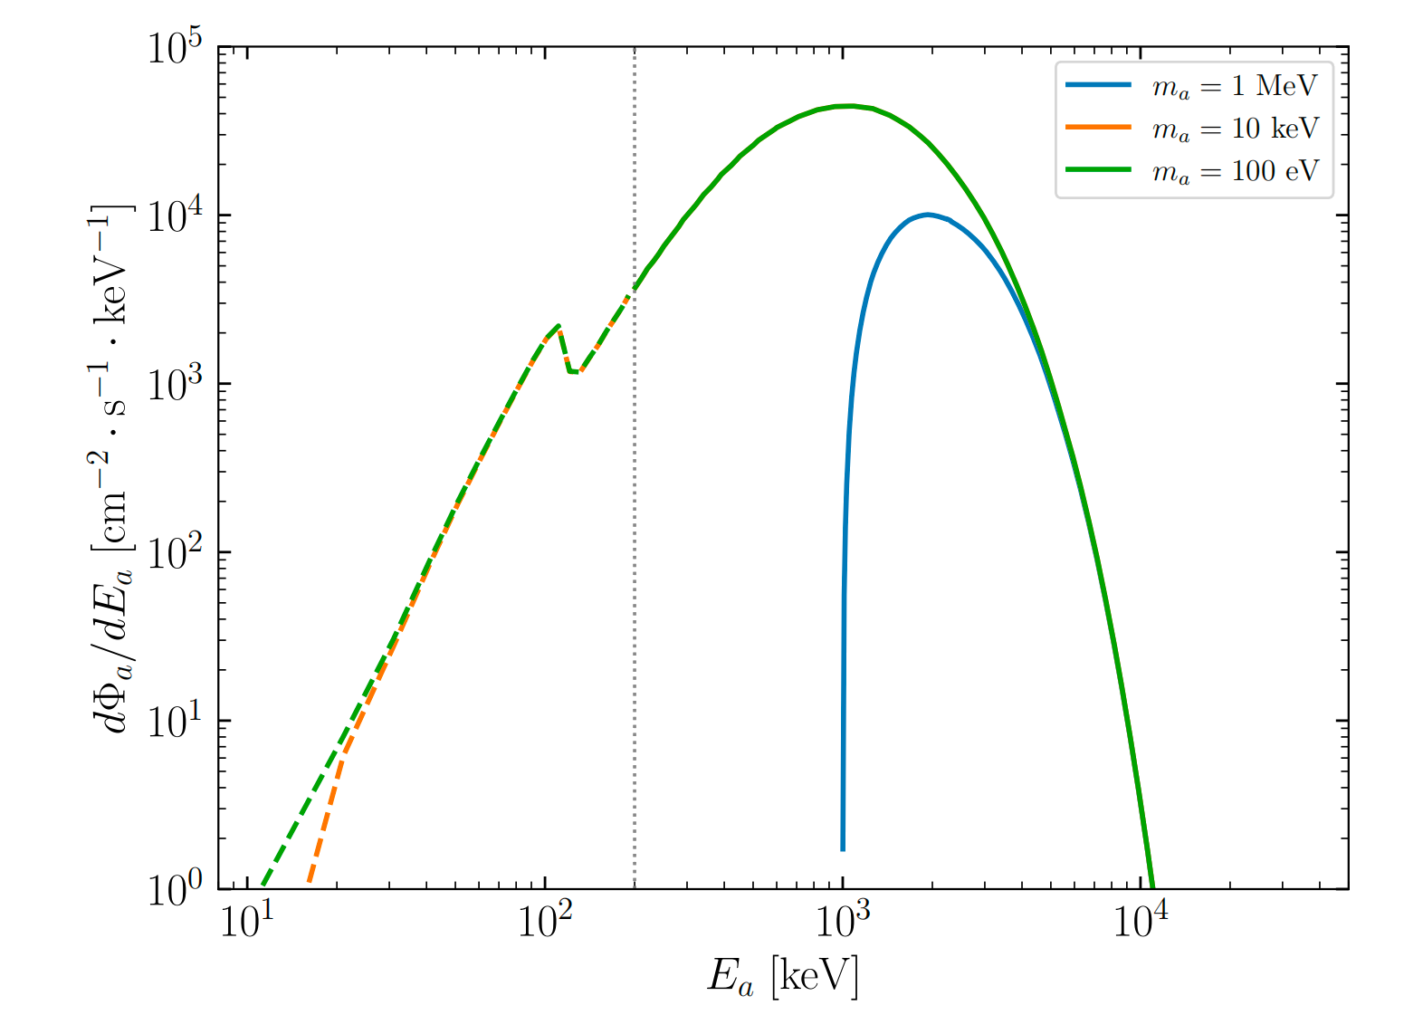
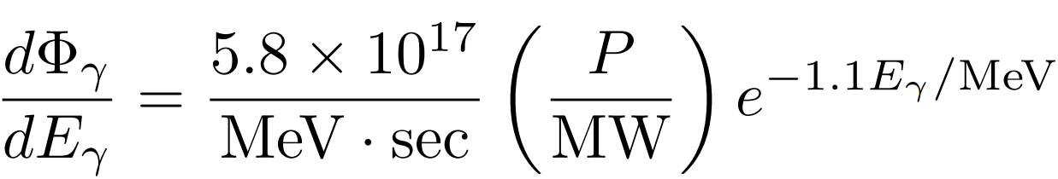
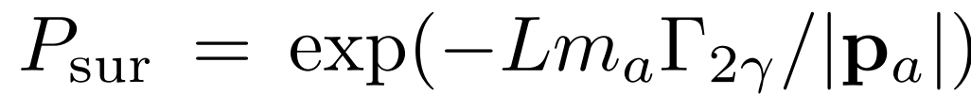


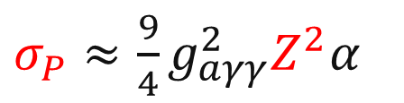


ALP flux (at detector)
200 keV threshold
The photon flux for energies above 200 keV
Where $σ_{Tot}=σ_{SM}+σ_{P}$
$σ_{SM}$ SM cross section for $γ$
Primakoff cross section:
Coherent conversion with $Z^{2}$ enhancement
$σ_{P}≈\frac{9}{4}g_{aγγ}^{2}Z^{2}α$
ALP flux at $L=30$m away from a P = 3.95 ${GW}_{th}$ reactor for different ALP masses
The survival probability
Notes:
先给出相互作用和通量卷积公式，再解释图：质量为 100 eV 和 10 keV 时通量形状接近；1 MeV 质量下低能部分被截断。重点：反应堆提供相对论性 ALP。Feasibility

Slide 14
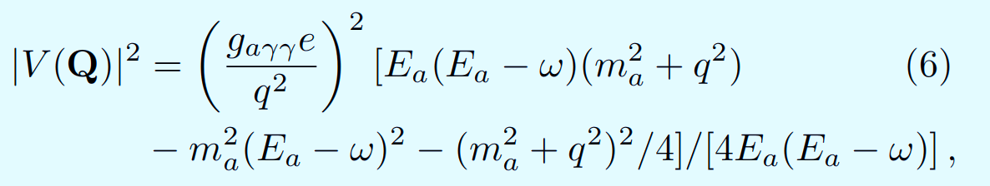

Detection Rate
ALP–photon interaction potential
Fig from A. M. Botti
energy loss function
@ Momentum transfers: Q$≤$ 5 keV
Fig from: Z.-L. Liang, L.L. Su, L. Wu, B. Zhu, PRL 2025,
@ Energy deposition: $ω$ ~ 15 eV
Notes:
这一页不需要逐项推导，重点讲公式结构：通量、相互作用势、介质响应三部分相乘，最后给出 dR/dω。DarkELF (GPAW) model

Slide 15
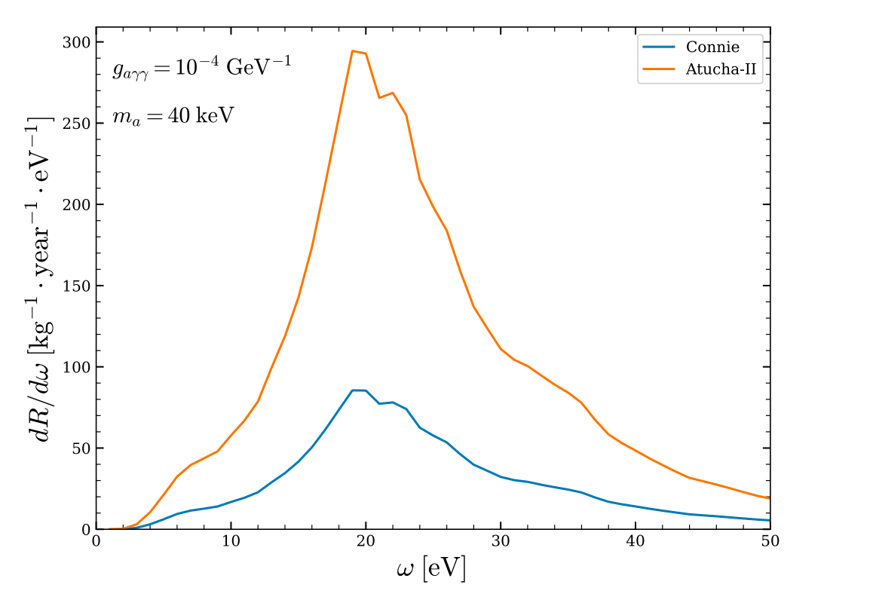
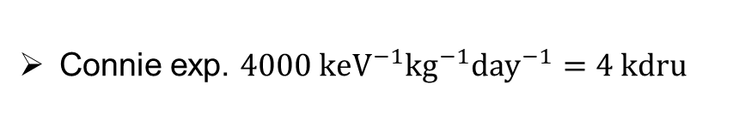
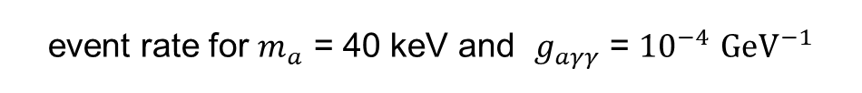
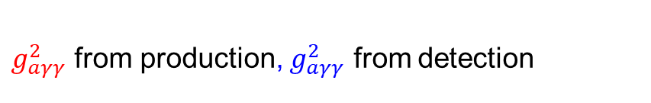

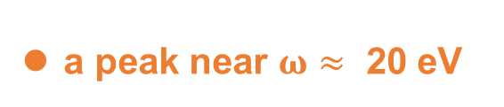

Differential event rate
$$∝g_{aγγ}^{2}⋅g_{aγγ}^{2}$$
$g_{aγγ}^{2}$ from production, $g_{aγγ}^{2}$ from detection
a peak near $ω≈$ 20 eV
Background rate
Connie exp. $4000 keV^{−1}kg^{−1}day^{−1}=4 kdru$
event rate for $m_{a}$ = 40 keV and $g_{aγγ}$ = ${10}^{−4}$ ${GeV}^{−1}$
Atucha-II exp. $30 kdru$
YLG, J. Guo, N. Liu, L.L. Su, W.-N. Yang, arXiv: 2601.07448
Notes:
讲图 3：低能区域的峰来自 plasmon resonance；Atucha-II 曲线更高，但最终约束还取决于背景、曝光和可用能窗。the mass density of the target

Slide 16
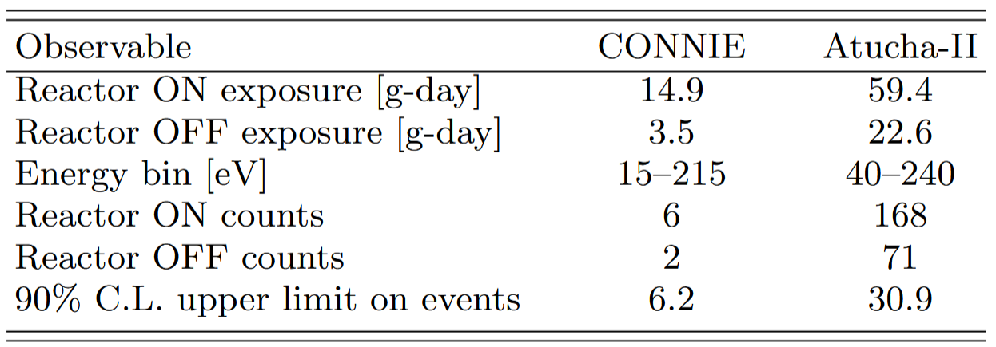
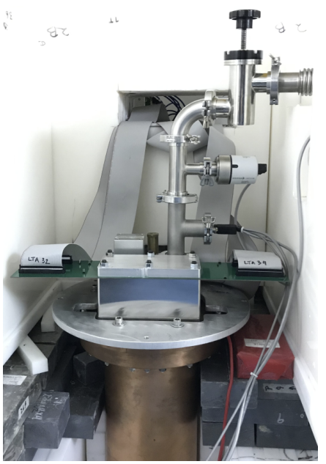
Connie & Atucha-II Experiments
Experimental observables of each experiment
CONNIE and Atucha-II Collaboration, 2405.16316
CONNIE Collaboration, 2403.15976
vacuum interface board on top of the copper vacuum vessel
packaged Skipper-CCD
copper cold box

Slide 17
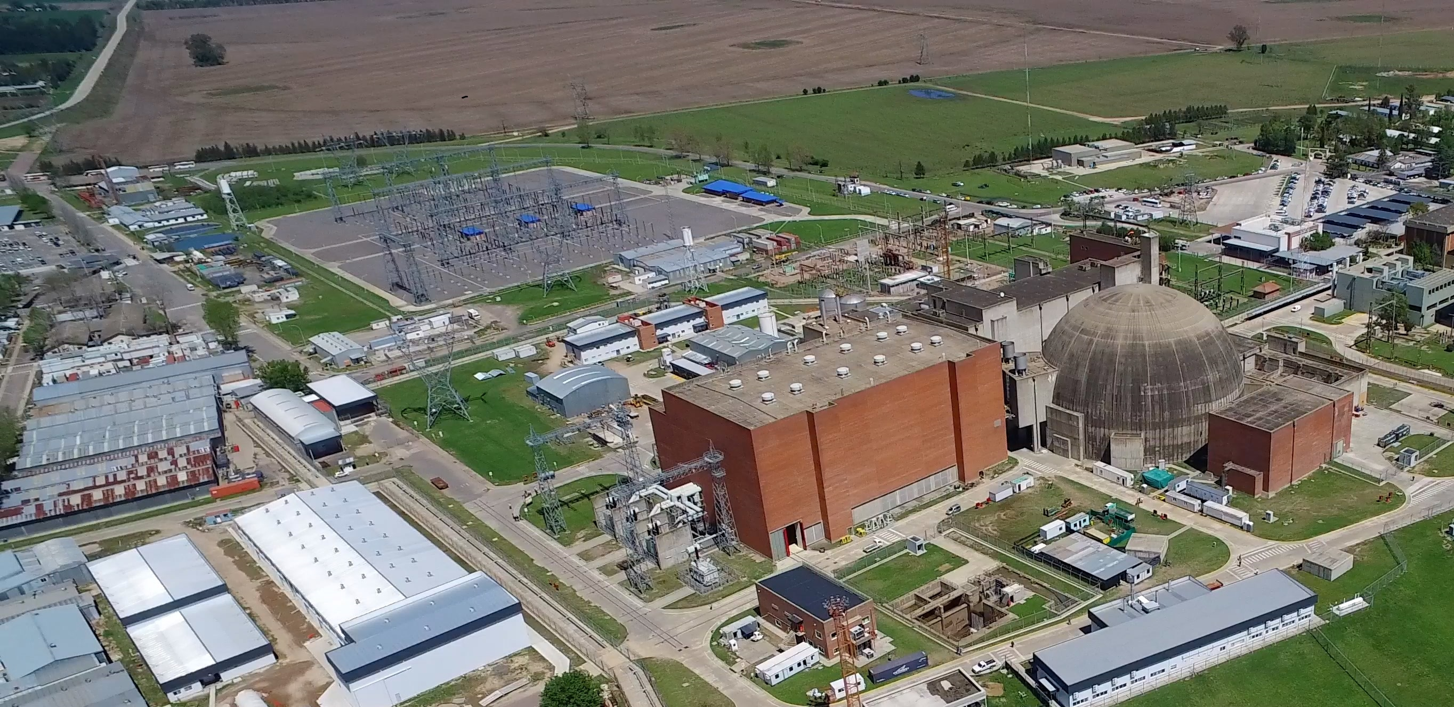
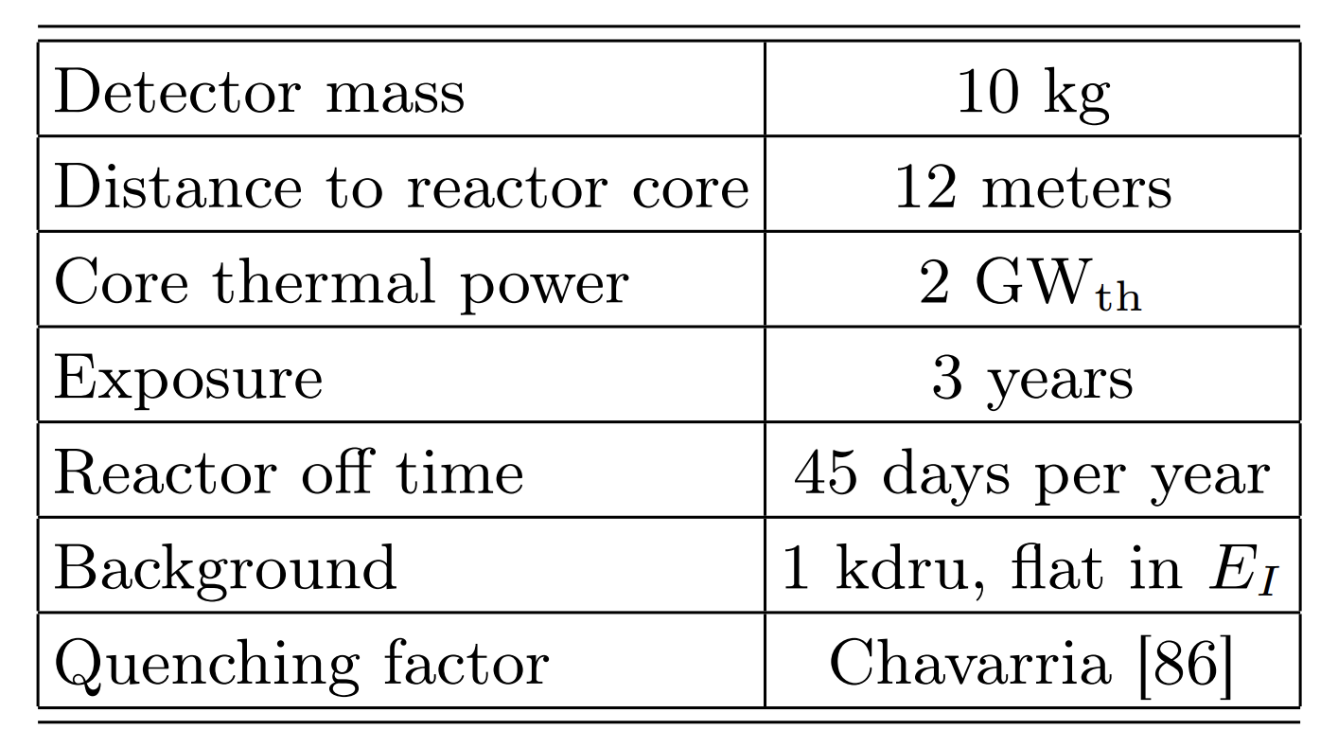

vIOLETA Experiments
Fuel: Natural Uranium
1 $dru$ = $1/keV/kg/day$
Main characteristics of the Benchmark experimental setup
https://www.na-sa.com.ar/en/centrales-nucleares/atucha-2
May also locate at Atucha-II nuclear power plant (Argentina)
G. Fernandez-Moroni et al, 2009.10741, JHEP
G. Fernandez-Moroni et al, 2108.07310, JHEP

Slide 18
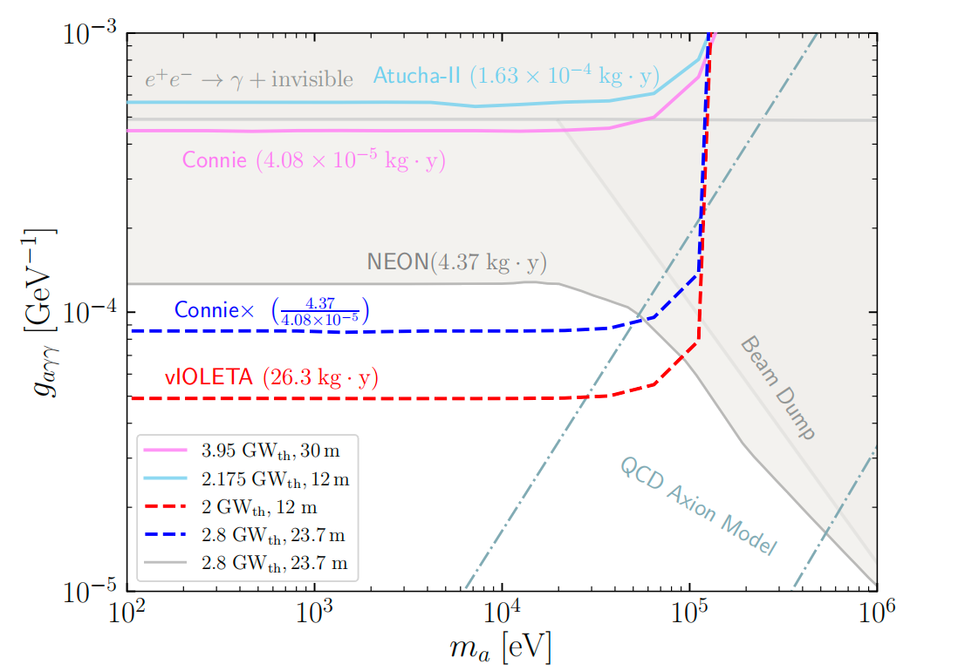
Sensitivity Results
weaker than the NEON constraint, owing to their smaller exposures
At comparable flux and exposure, a Connie-like setup improves over NEON by about 1.5
With an exposure of 30 kg·yr, vIOLETA experiment improves over NEON by about 3
YL. G, J. Guo, N. Liu, L.L. Su, W.-N. Yang, arXiv: 2601.07448
Notes:
这一页是结果页，讲清楚每条线代表什么。强调当前实验由于暴露量小还弱于 NEON，但未来大曝光 CCD 可以超过 NEON。

Slide 19
Conclusion
01
New detection channel
Reactor-produced relativistic ALPs
excite plasmon resonance at eV-scale in silicon Skipper-CCDs,
while the accompanying MeV-scale photon typically escapes
Current constraints
02
from CONNIE and Atucha-II with Low-threshold data
03
Promising and Leading sensitivity from vIOLETA ！
Notes:
Reactor-produced relativistic ALPs excite plasmons in silicon Skipper-CCDs through inverse Primakoff-like absorption. The accompanying MeV-scale photon typically escapes, leaving an eV-scale signal in the detector.

Slide 20
Thank you!
Notes:
结束。

Slide 21
Backup

Slide 22
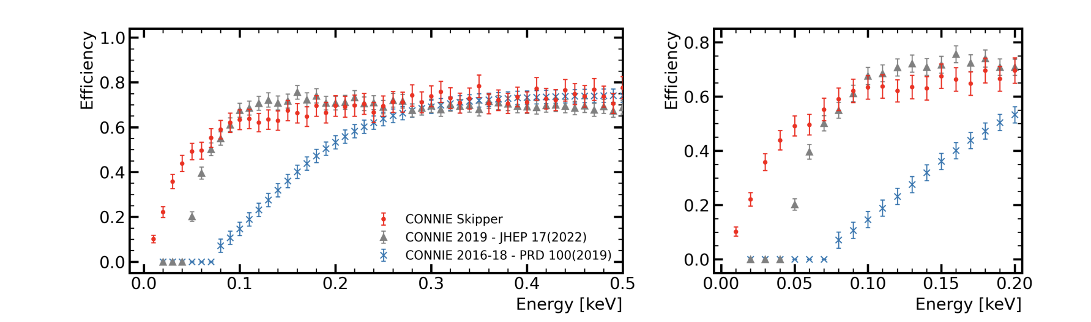
Connie & Atucha-II Experiments
CONNIE Skipper-CCDs detection efficiency (red), accounting for the event extraction acceptance and the selection cuts. The CONNIE standard CCD efficiencies from 2016-18 [44] (blue) and 2019 [47] (grey) are shown for reference. (Left) Efficiency up to energies of 0.5 keV and (right) a zoom into the low-energy region
Alexis A. Aguilar-Arevalo et al, CONNIE Collaboration, 2403.15976

Slide 23
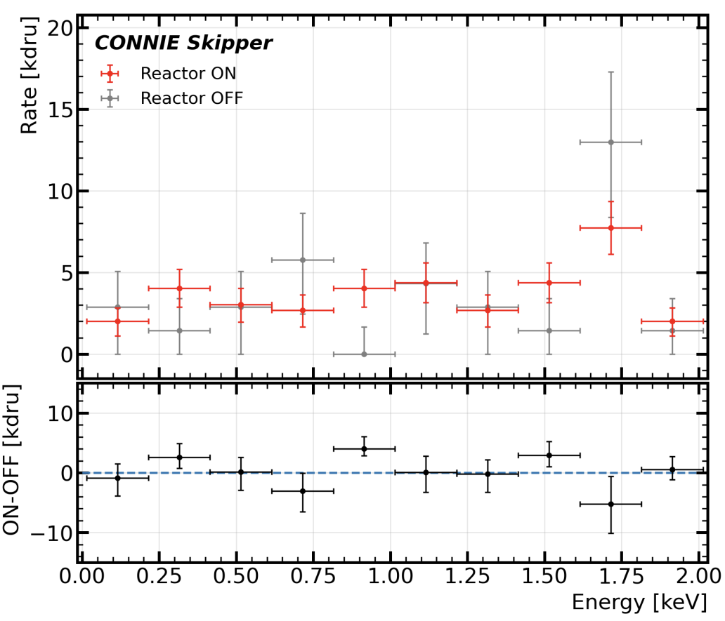

Connie & Atucha-II Experiments
(Top) CONNIE Skipper-CCD reactor-on and reactoroff spectra and (bottom) their difference.

Slide 24



Uncertainties
D. Aristizabal Sierra et al, Axionlike particles searches in reactor experiments, JHEP, 2020

Slide 25


Oscura Experiment
Aguilar-Arevalo et al, arXiv:2202.10518
Design of the Oscura Multi Chip Module (MCM) with 16 sensors mounted on a 150 mm silicon wafer
Sketch of a pressure vessel holding the full detector load and an inner lead and copper shields. The dimension lines refer to the “stacks” of supermodules, which in this sketch cover 120×36.5 cm. An external shield of ∼60 cm of HDPE (or equivalent absorption power of water) and an additional ∼10 cm of lead is not shown
Oscura Super Module (SM) with 16 MCMs supported and shielded with electroformed copper

Slide 26

Discussion
From: A. M. Botti for SENSEI@IDM

Slide 27

Plasmon Excitation as a New Detection Channel
By Ellery - Own work, CC BY-SA 3.0
Kuosheng Nuclear Power Plant
Notes:
The sub-GeV DM with the coupling to the electrons can be detected in semi-conductor targets, such as SENSEI。 In addition to single-electron excitations, Relativistic light dark matter scattering in semi-conductor targets can generate collective plasmon excitations. We can describe this behavior with the energy loss function。

