Slide 1





Gravitational Waves
and
Black Hole Environment
Chen Yuan (袁晨)
yuanchen@shu.edu.cn
Collaborators: Richard Brito, Vitor Cardoso, Riccardo Della Monica, Francisco Duque, Yin-Da Guo, Qing-Guo Huang, Yang Jiang, Rodrigo Vicente, Qi-Xuan Xu, and Ziri Younsi

Slide 2
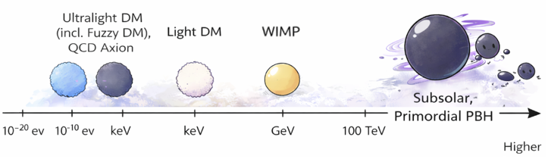
Dark Matter

Slide 3
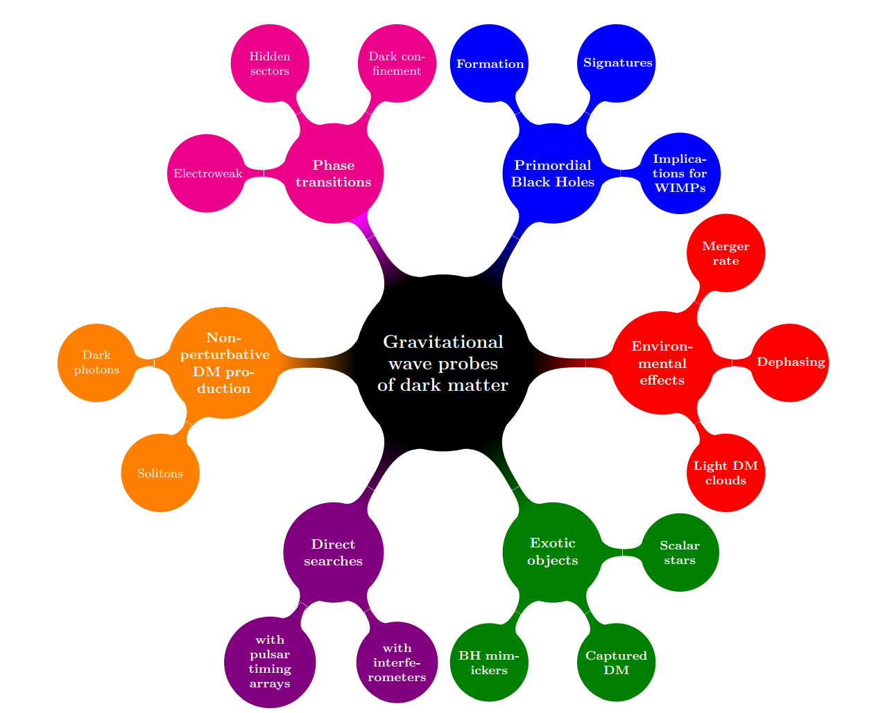
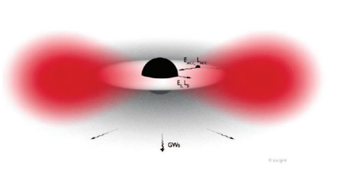
BH environment
G. Bertone et al. (2020)

Slide 4
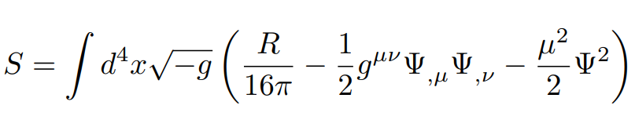
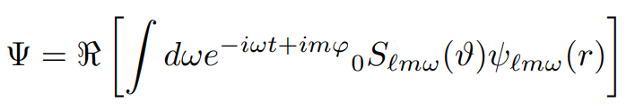



Ultralight DM
Massive bosonic fields in Kerr space time
General solution
Boundary conditions: horizon acts as a dissipative membrane
Eigenfrequencies
The bosonic field is extracting energy from the BH when
Brito et al. (2017)

Slide 5
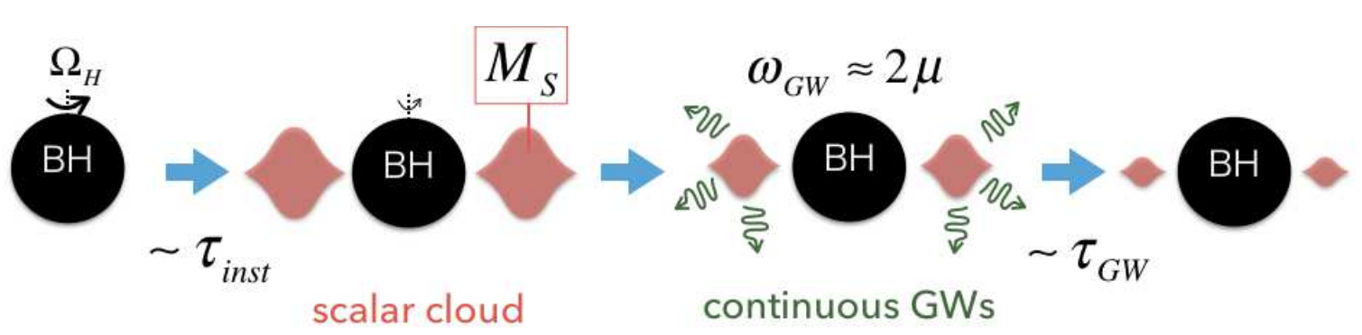
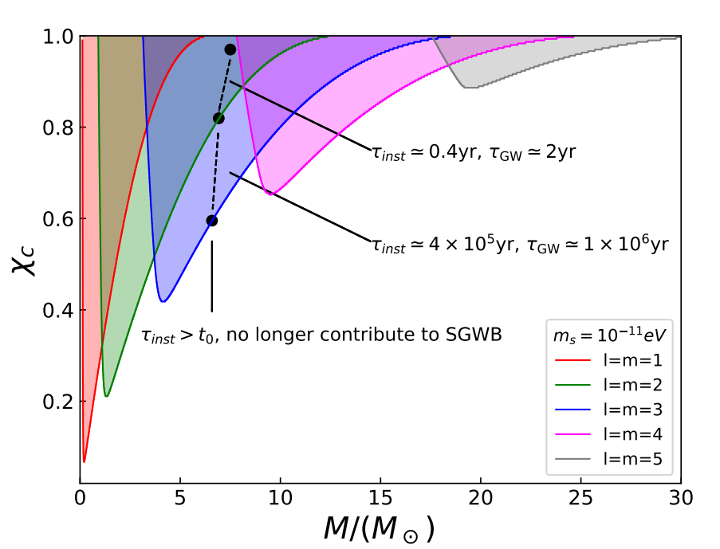
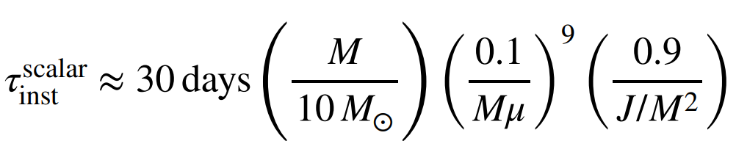
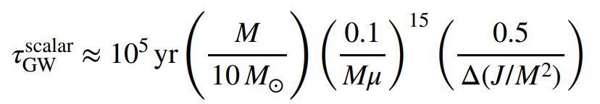
Ultralight DM
Tsukada et al. (2019)
Yuan et al. (2021)

Slide 6
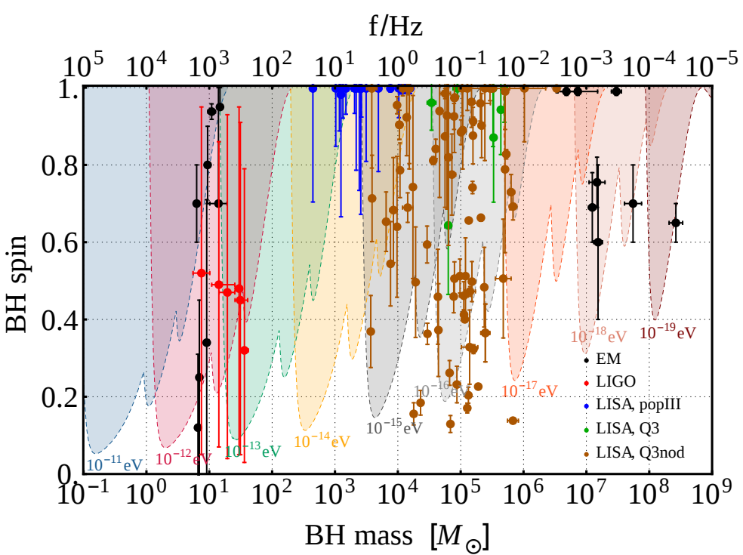
Ultralight DM
“Gaps” in the mass-spin plot can be used to constrain ultralight bosons
Brito et al. (2017)

Slide 7
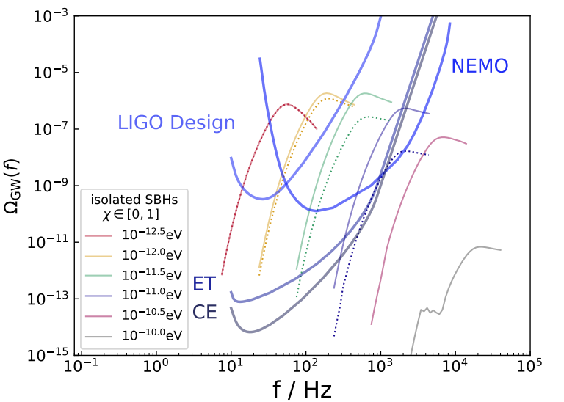
Ultralight DM
The contribution of higher l, m modes
GW emission dominated by higher modes
Yuan et al. (2021)

Slide 8
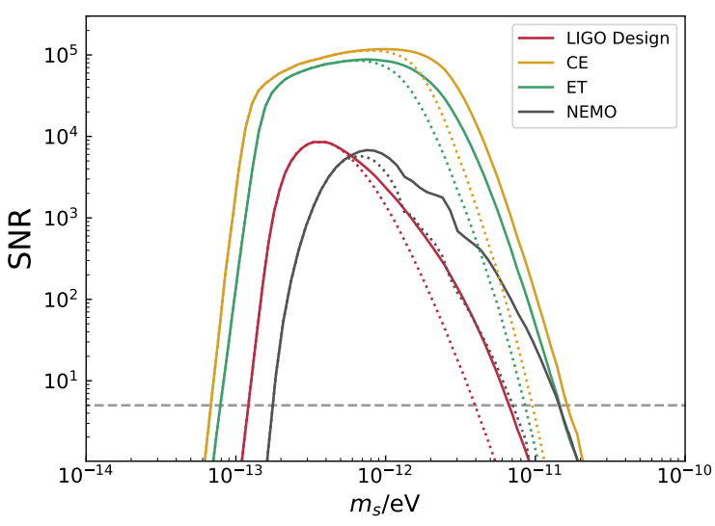
Ultralight DM
  Search for ultralight dark matter using next-generation ground-based GW detectors
Yuan et al. (2021)

Slide 9
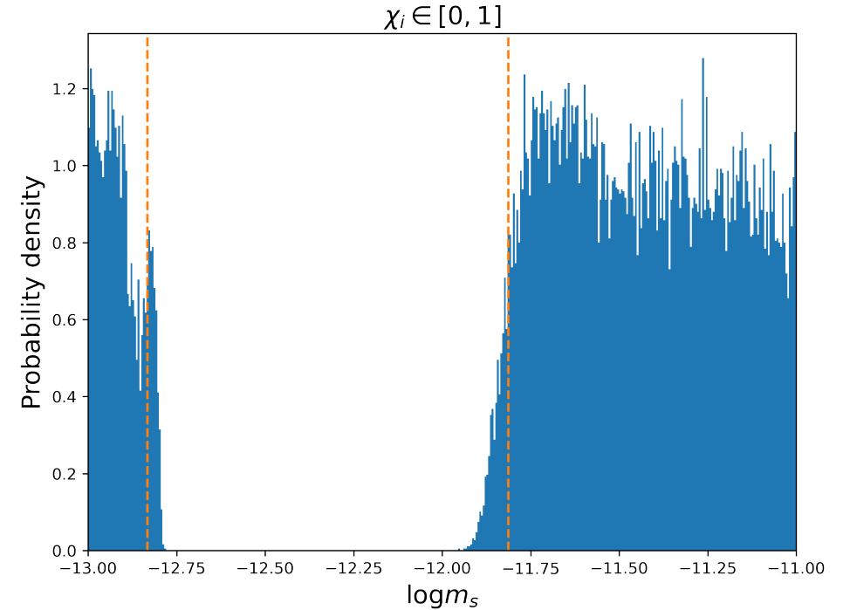
Ultralight DM
  Search for ultralight dark matter using LIGO O1-O3 dataset
Yuan et al. (2021a)

Slide 10
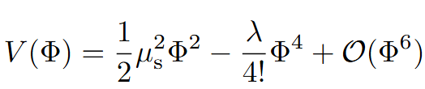
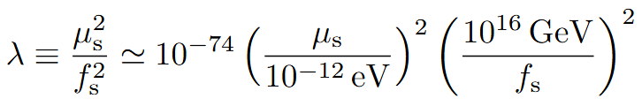
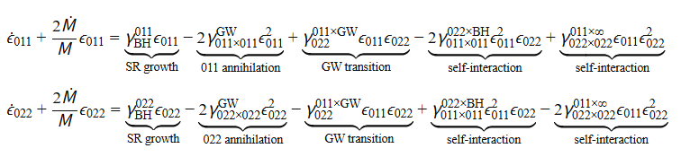
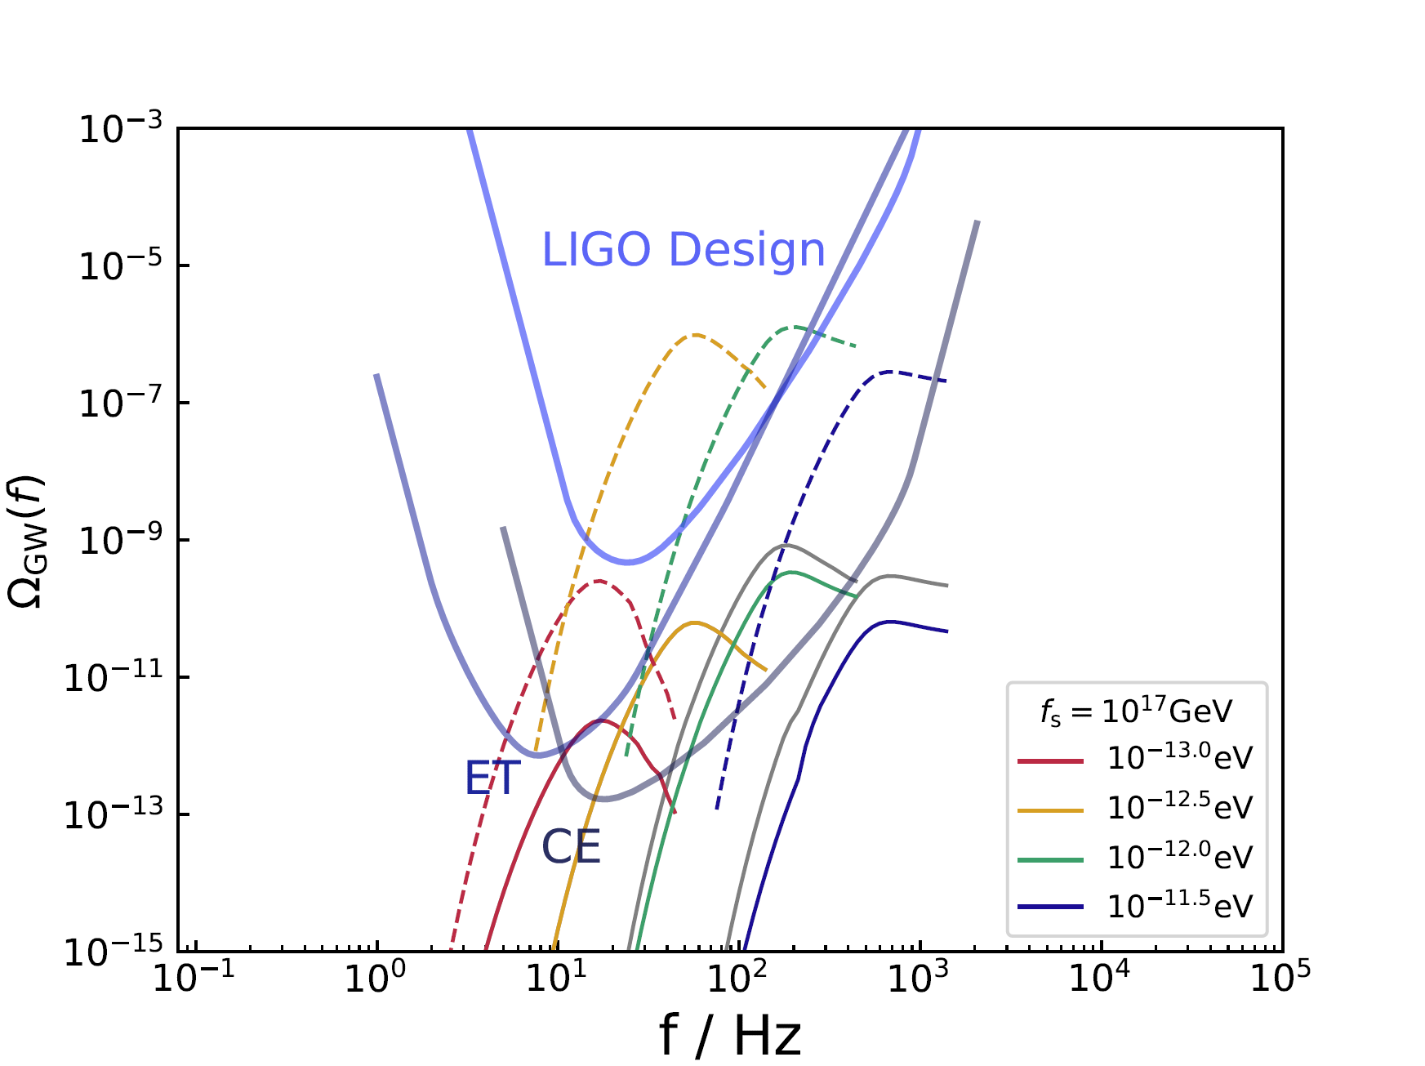
Ultralight DM
With self-interaction
Guo et al. arXiv 26XX.XXXX

Slide 11
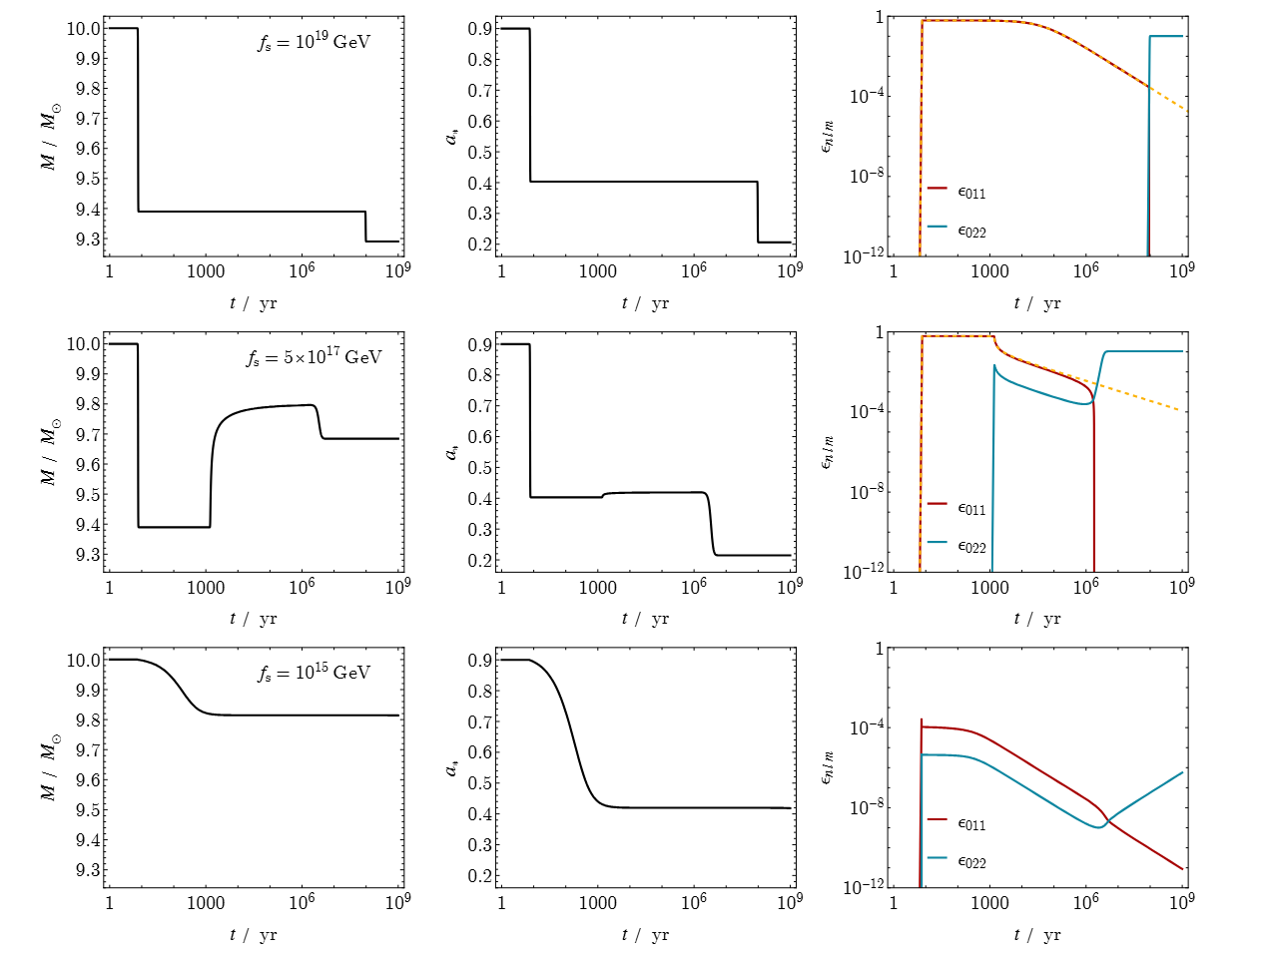
Ultralight DM
Main Process
BH → 011
  Early stage
  Superradiance
  Cloud growth
011 × 011 → GW
  Dominant GW annihilation
  Cloud dissipation
011 × 011 → 022 × BH
  BH re-absorption
  011 cloud dissipation & 022 cloud growth
  Self-interaction
022 × 022 → 011 × ∞
  Cloud dissipation
  Scalar emission to infinity
  Self-interaction
022 → 011 × GW
022 × 022 → GW
  Subdominant GW emission
  022 cloud dissipation
BH ↔ 022
  Secondary superradiance
Guo et al. arXiv 26XX.XXXX

Slide 12
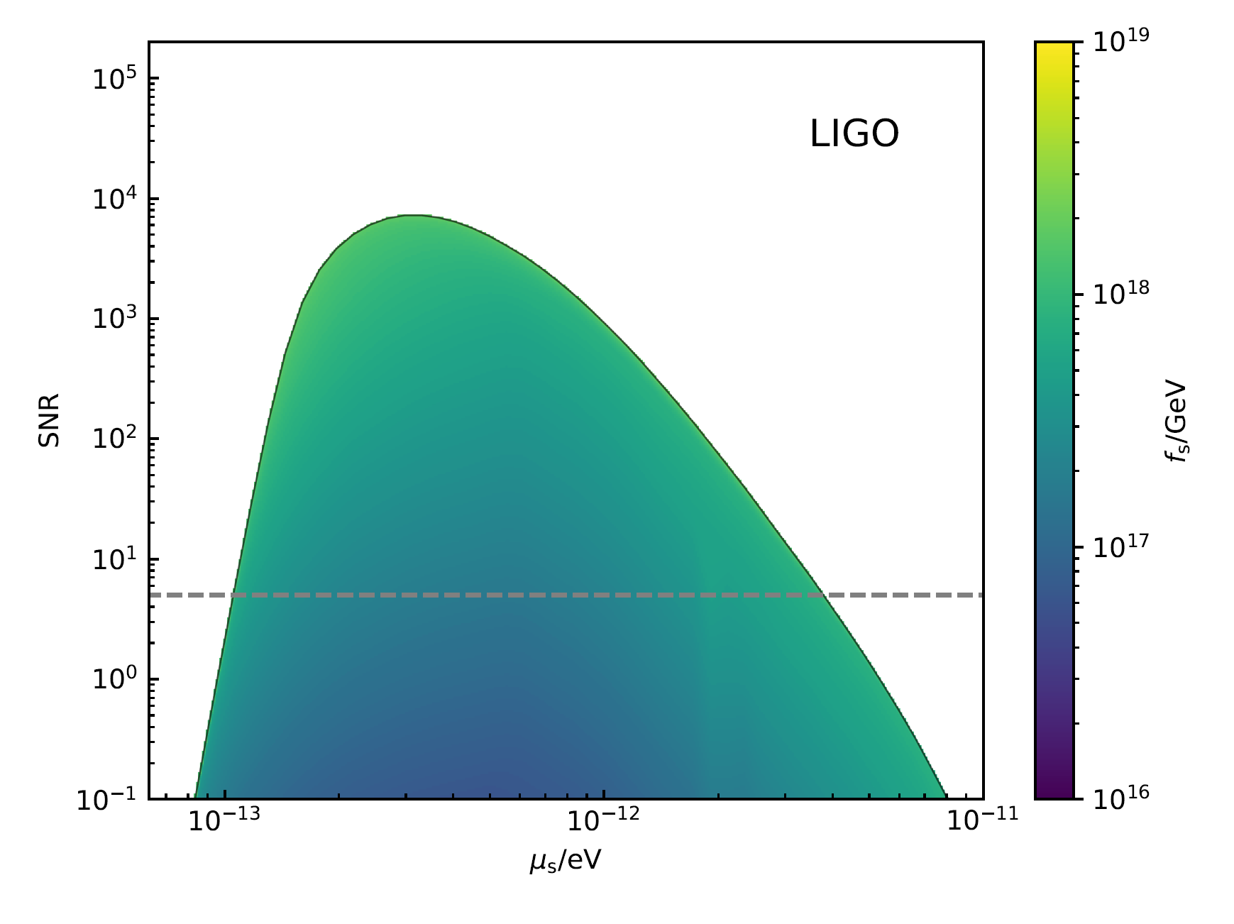
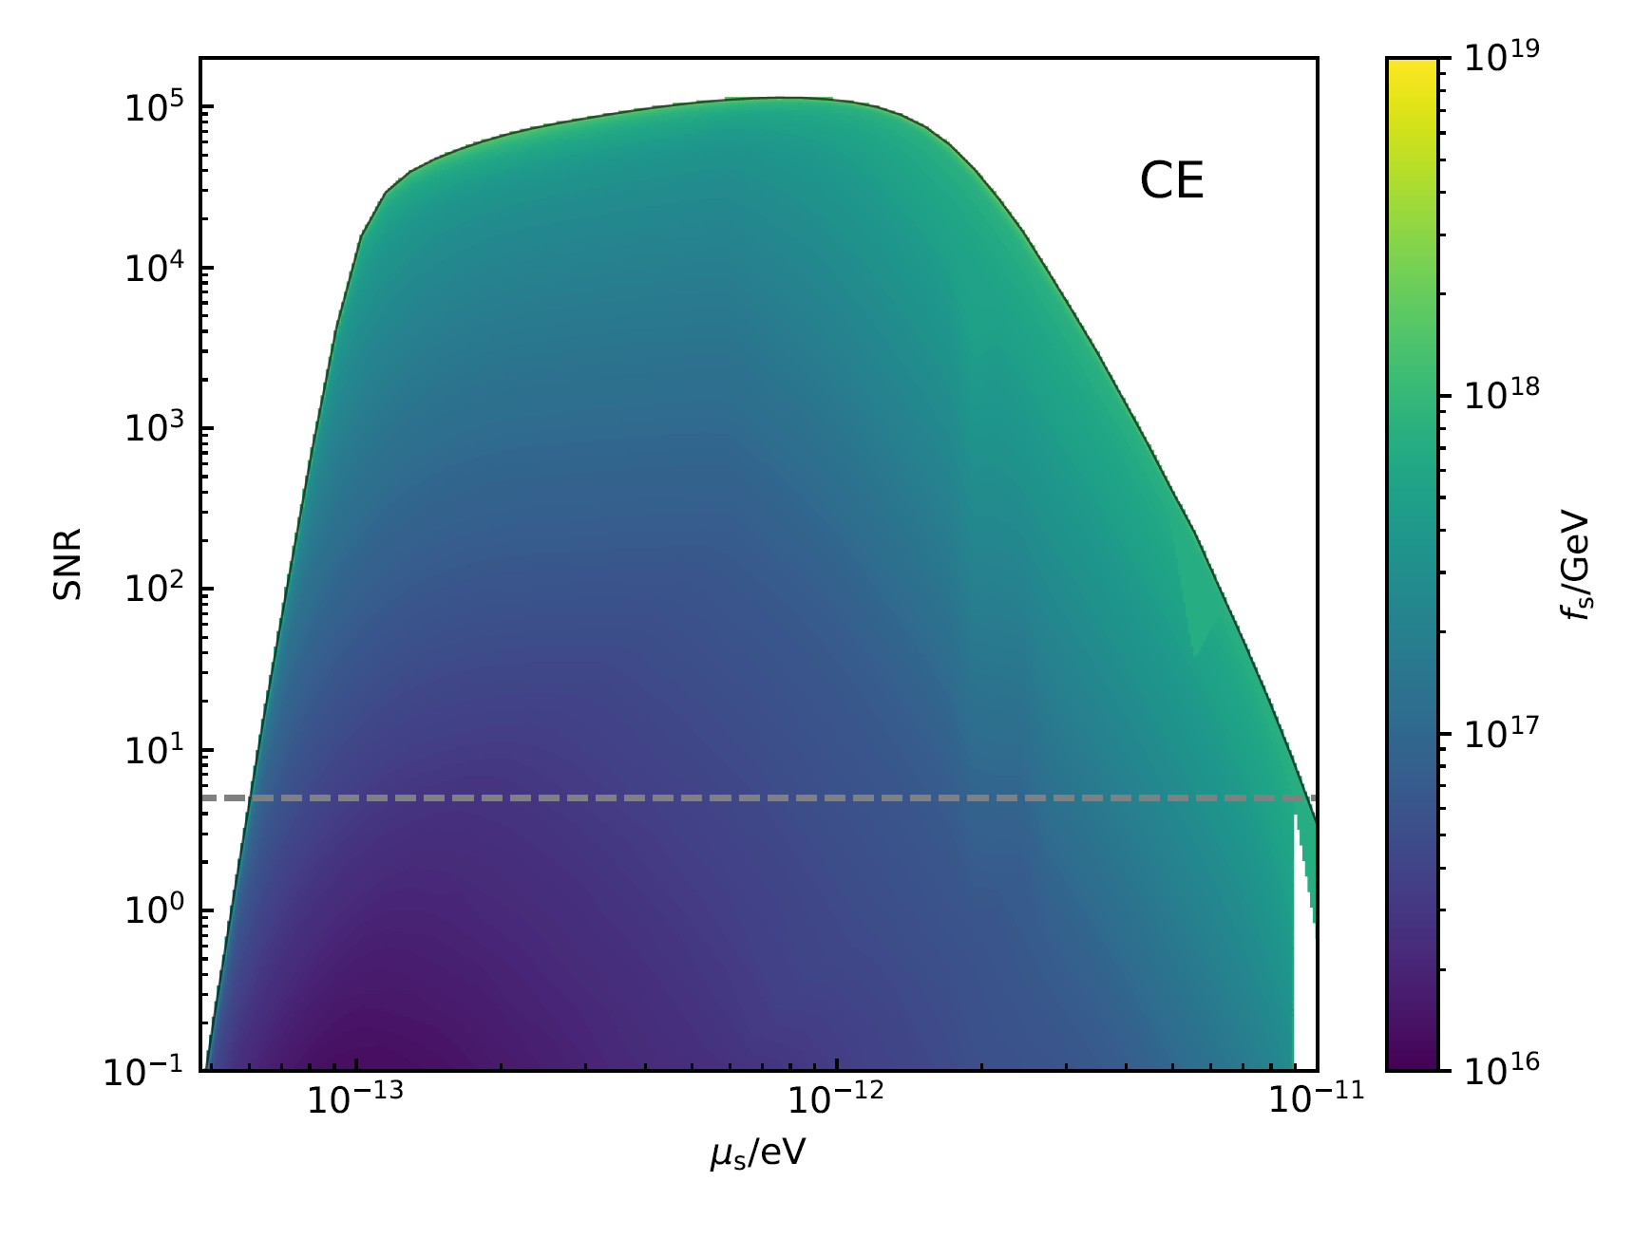
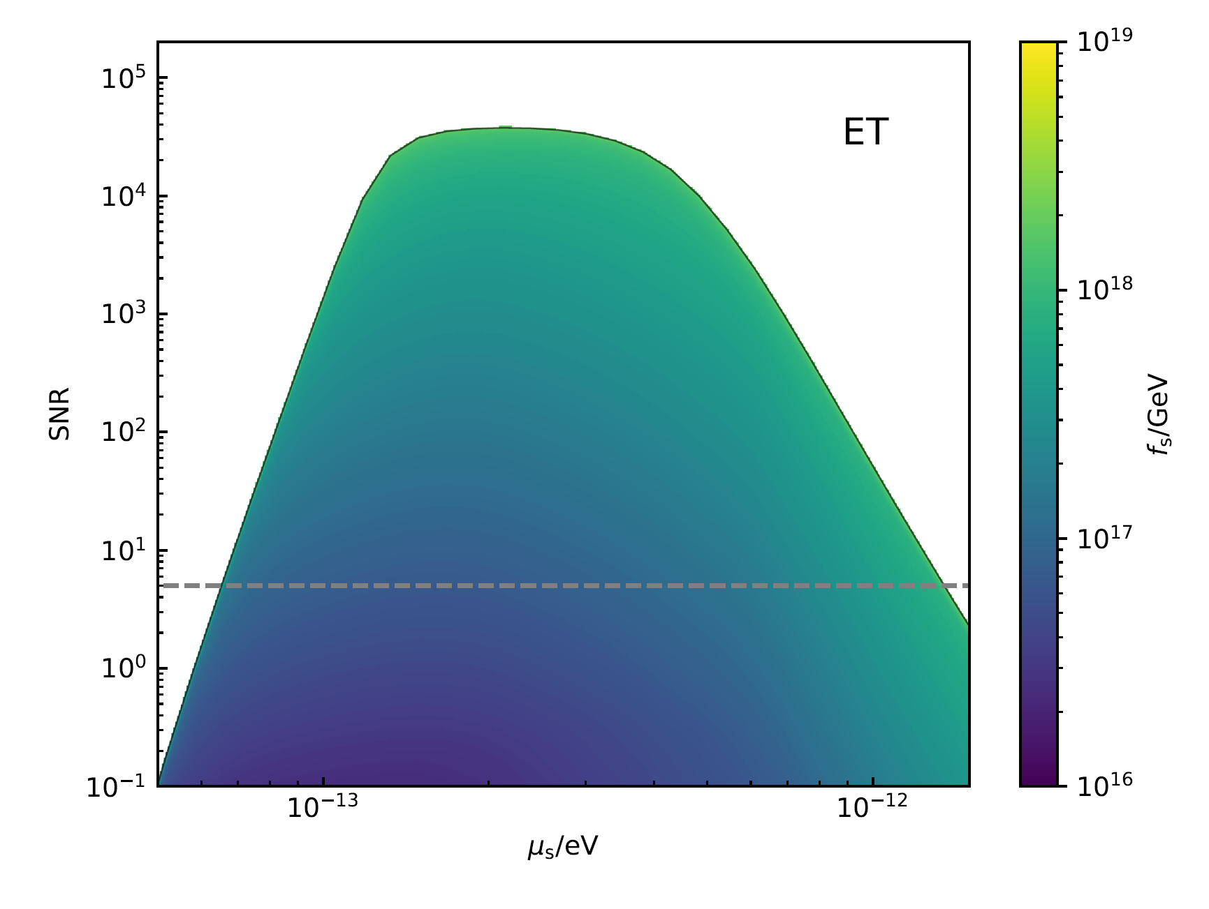
Ultralight DM
With self-interaction
Guo et al. arXiv 26XX.XXXX

Slide 13
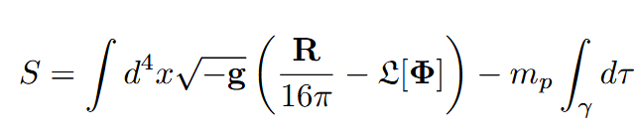


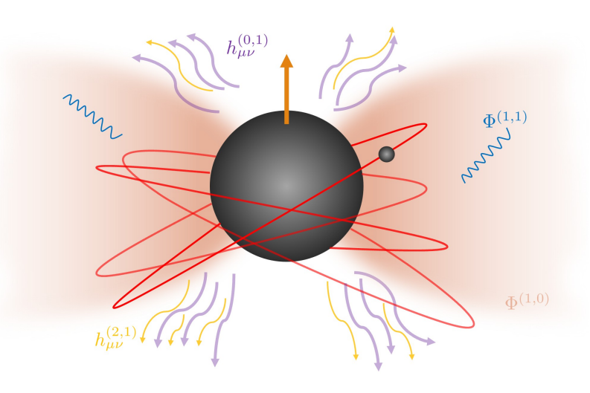







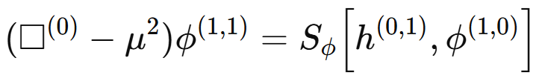

Ultralight DM
Relativistic effects of EMRI within scalar cloud
Perturbed metric
(from test particle)
GW flux
horizon/infinity
Scalar flux
horizon/infinity
Vacuum
Test particle
Scalar cloud
Dipolar cloud
(n,l,m)=(0,1,1)
SMBH a=0
Eccentric orbit
Point particle
Li et al. (2025)
GW flux, metric reconstruction
Mixed order
Scalar flux

Slide 14
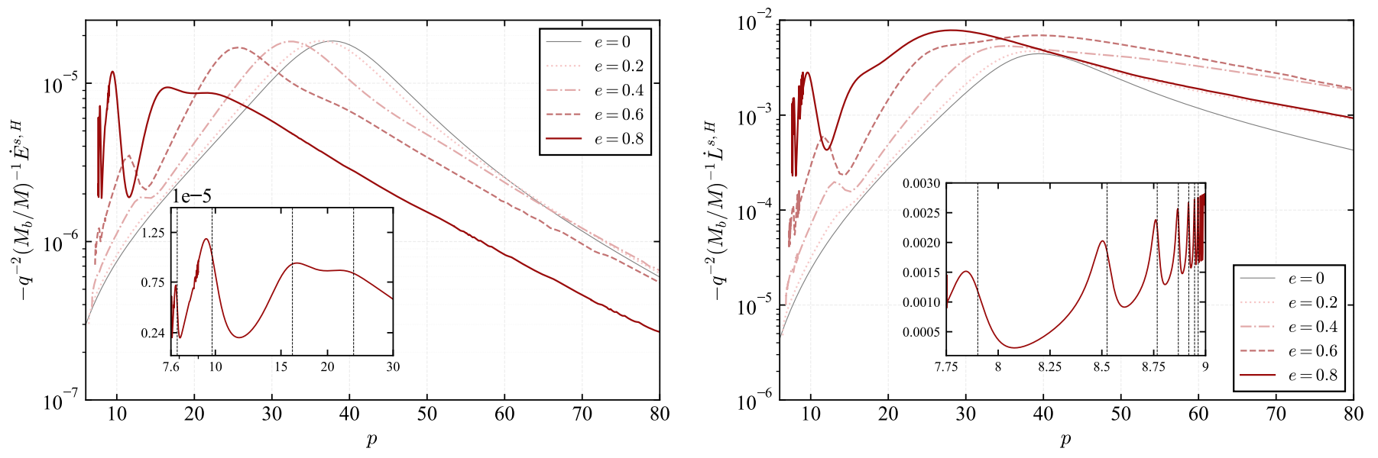


Ultralight DM
Orbit frequency:
Resonance condition:
Xu et al. arXiv:2606.21439, 2605.03576

Slide 15
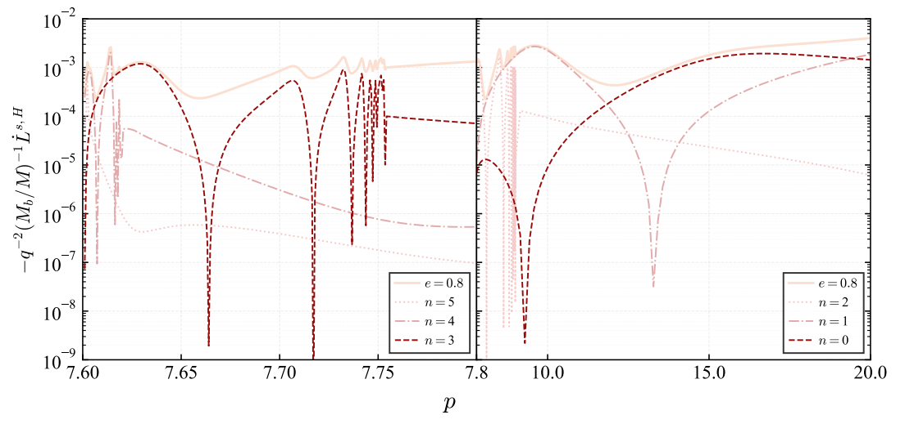
Ultralight DM
Orbit frequency:
Resonance condition:
Xu et al. arXiv:2606.21439, 2605.03576

Slide 16
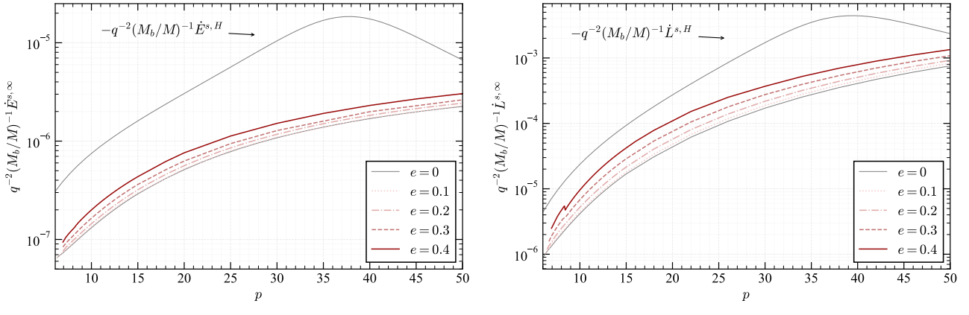
Ultralight DM
Orbit frequency:
Resonance condition:
Xu et al. arXiv:2606.21439, 2605.03576

Slide 17
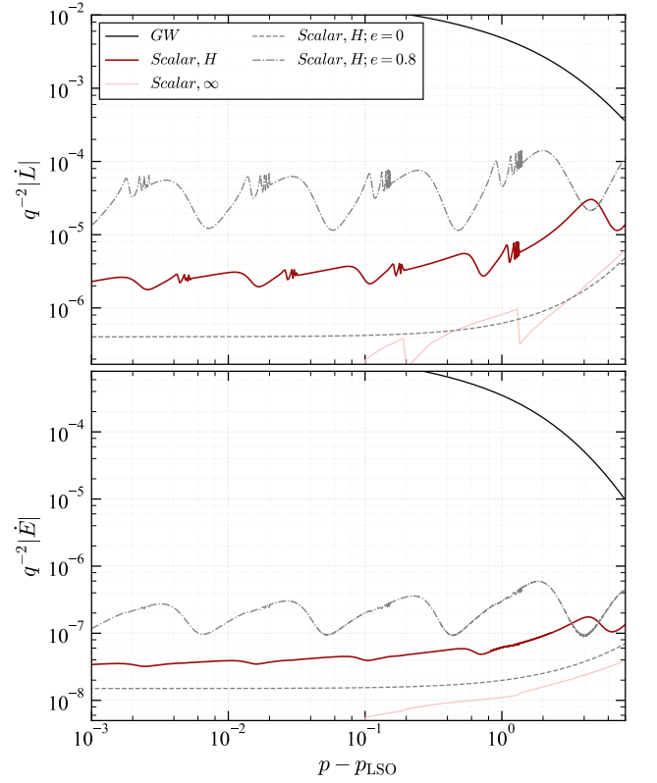
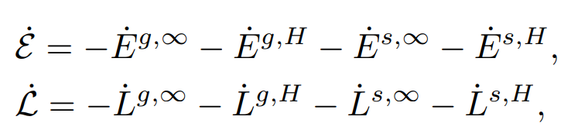
Ultralight DM
Xu et al. arXiv:2606.21439, 2605.03576

Slide 18
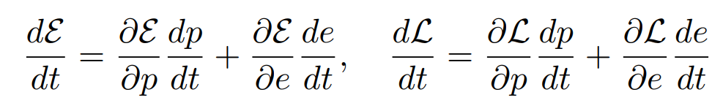
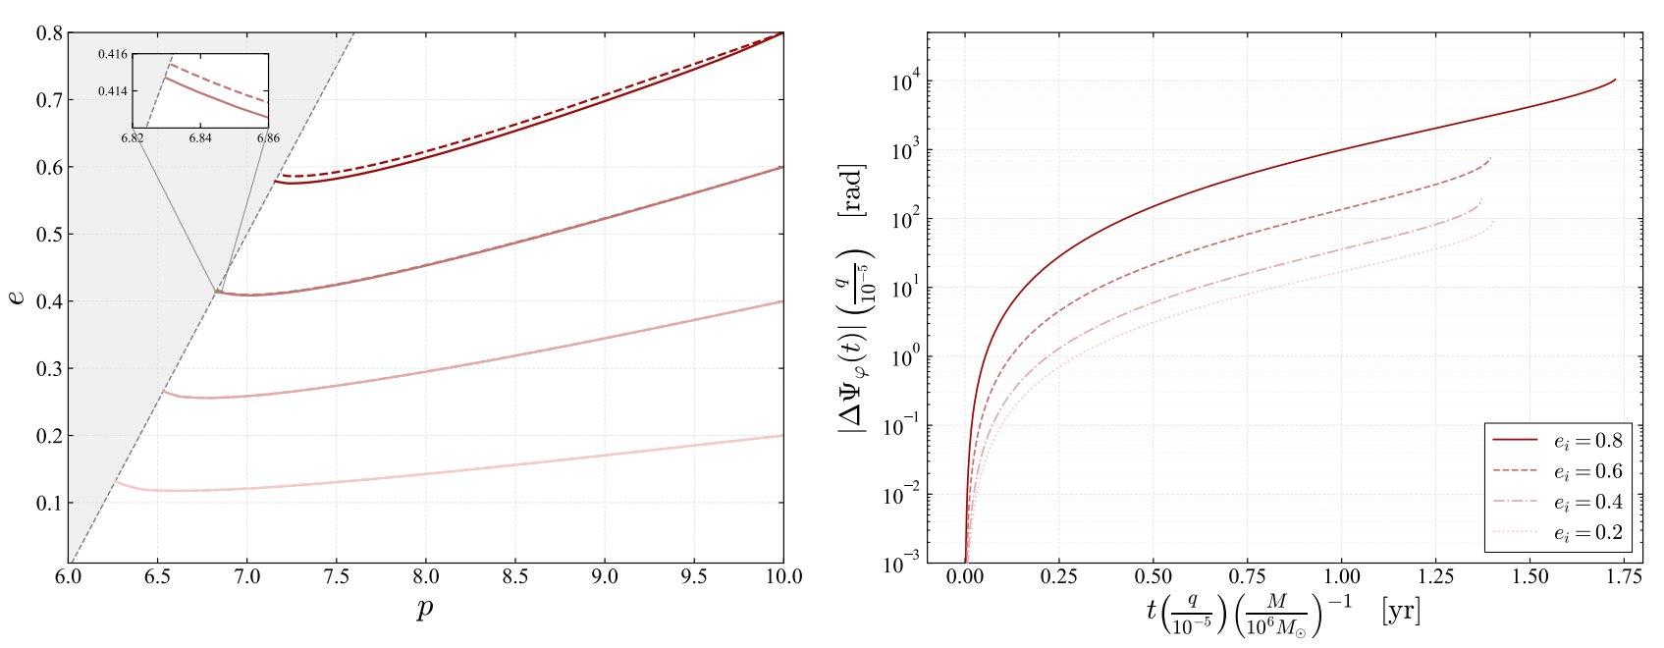
Ultralight DM
Evolution of the system
Xu et al. arXiv:2606.21439, 2605.03576

Slide 19
Summary
Ultralight bosons around spinning BHs can trigger superradiant instabilities, form gravitational atoms, and generate observable GW signatures.
Self-interactions can modify the evolution of boson clouds, opening new channels of mode coupling, scalar emission, and GW phenomenology.
Ultralight dark matter environments around BHs may also leave measurable imprints on compact-object dynamics, such as resonant effects and waveform dephasing in EMRIs.

