Slide 1
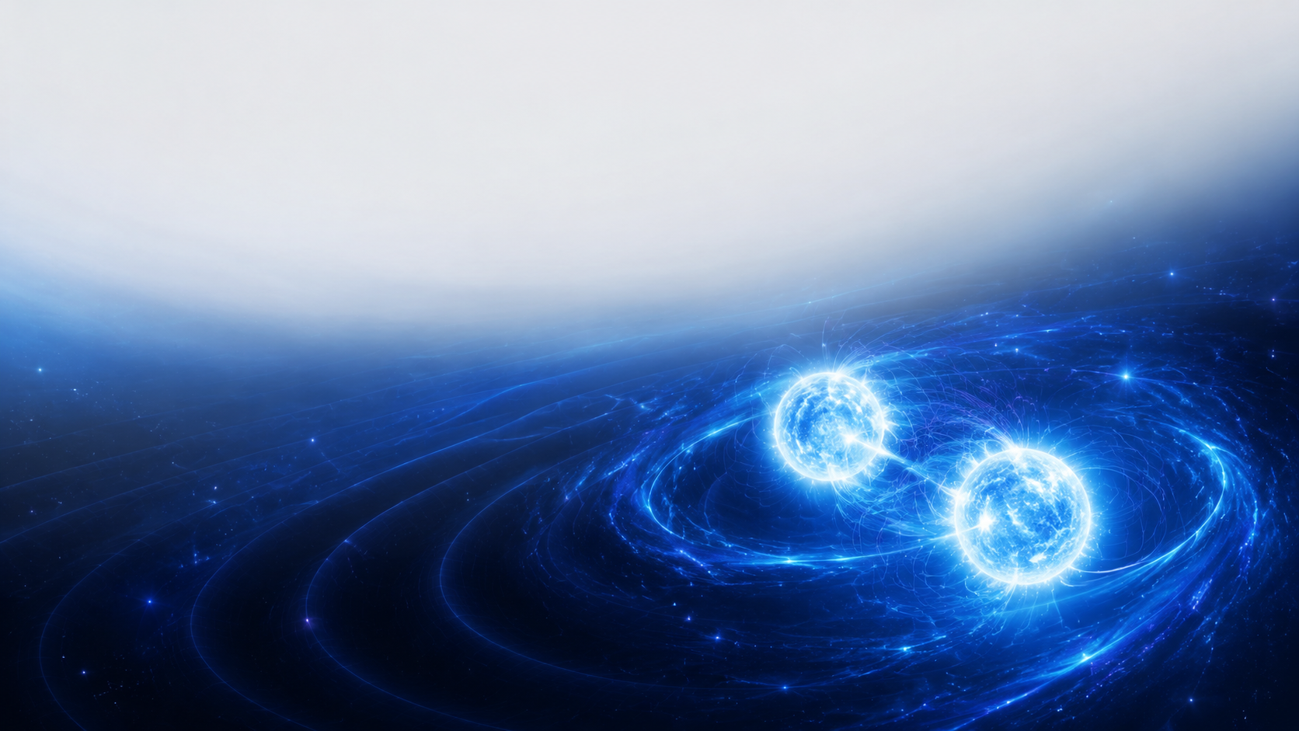


Constraining axion quadratic couplings with the Hulse–Taylor binary
Ziwen Yin(尹孜文)
Tsung-Dao Lee institute & SJTU
with David Marsh, Shyam Balaji, Malcolm Fairbairn in King’s College London
Based on: 2607.25631
Axion 2026, QingDao
August 11, 2026

Slide 2
Contents
Axion-fermion quadratic couplings and its consequences
Test exotic long-range force & radiation with Hulse-Taylor binary neutron stars
Results & Conclusion

Slide 3

01
Axion-fermion quadratic couplings

Slide 4
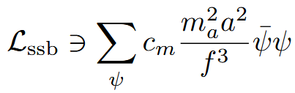


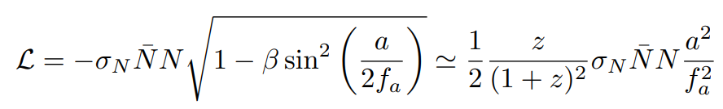
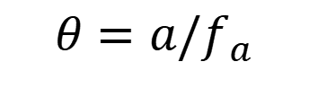
Brief introduction of axion-fermion quadratic couplings
Kim, et al, Phys. Rev. D, 2024
Banerjee, A, et al JHEP, 2026
Martin Bauer, et al Phys. Rev. Lett. 2024
EFT side： quadratic term from shift symmetry breaking
UV side: which can be introduced naturally in QCD & light QCD aixons below the QCD scale
Pion mass term
$$θ=a/f_{a}$$
Nucleon mass depends on Pion
Axion-Nucleon quadratic coupling

Slide 5
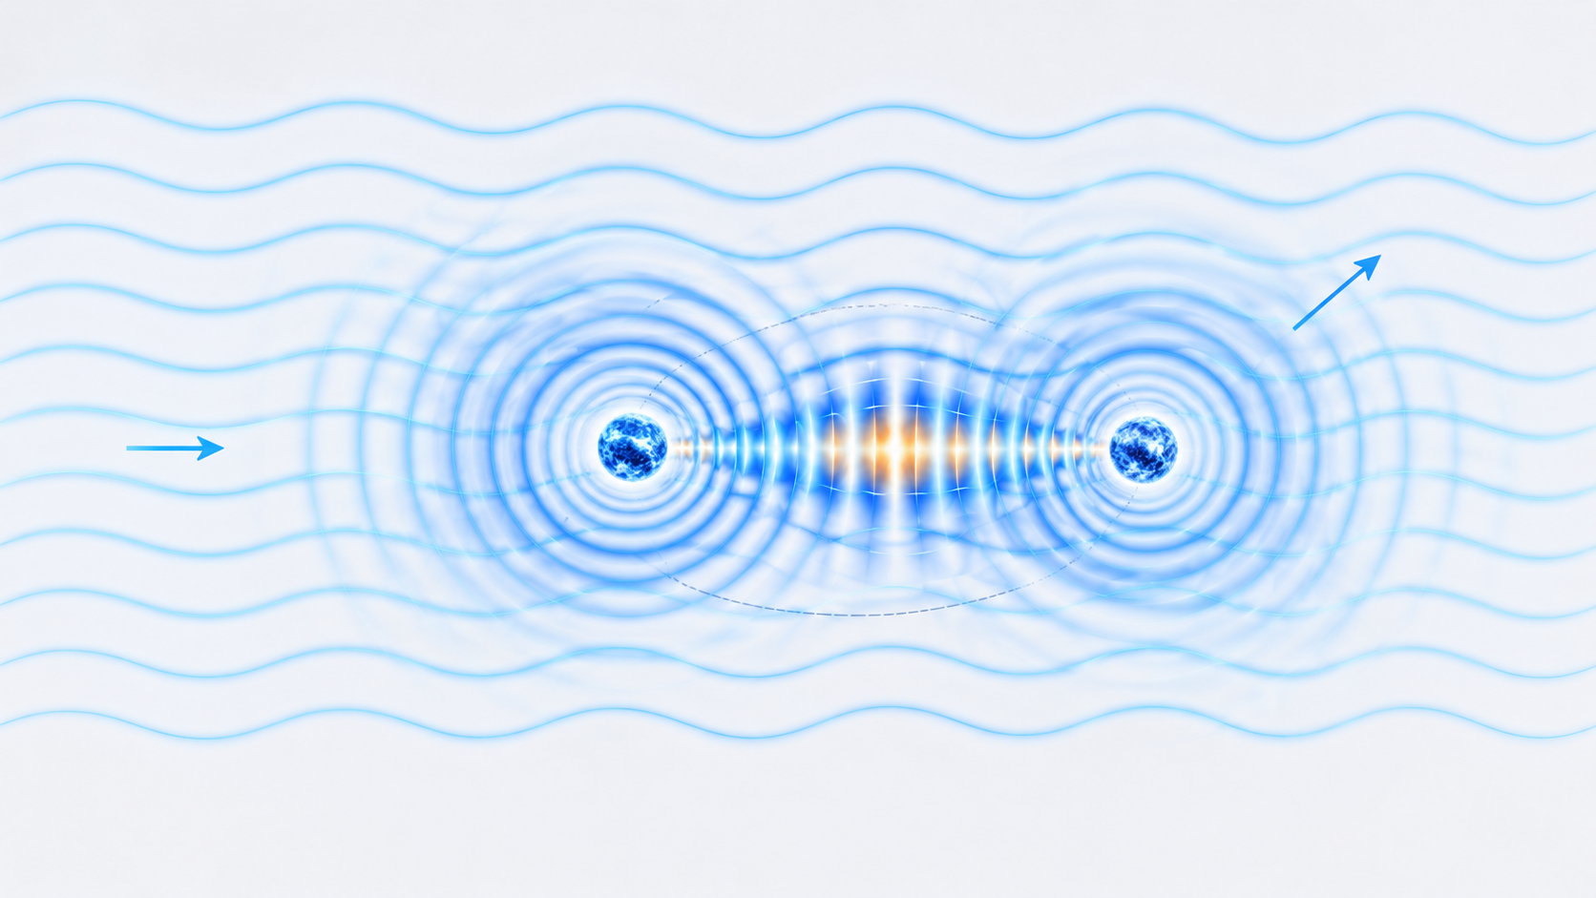
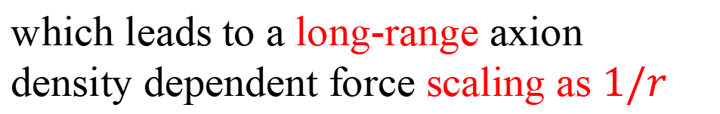



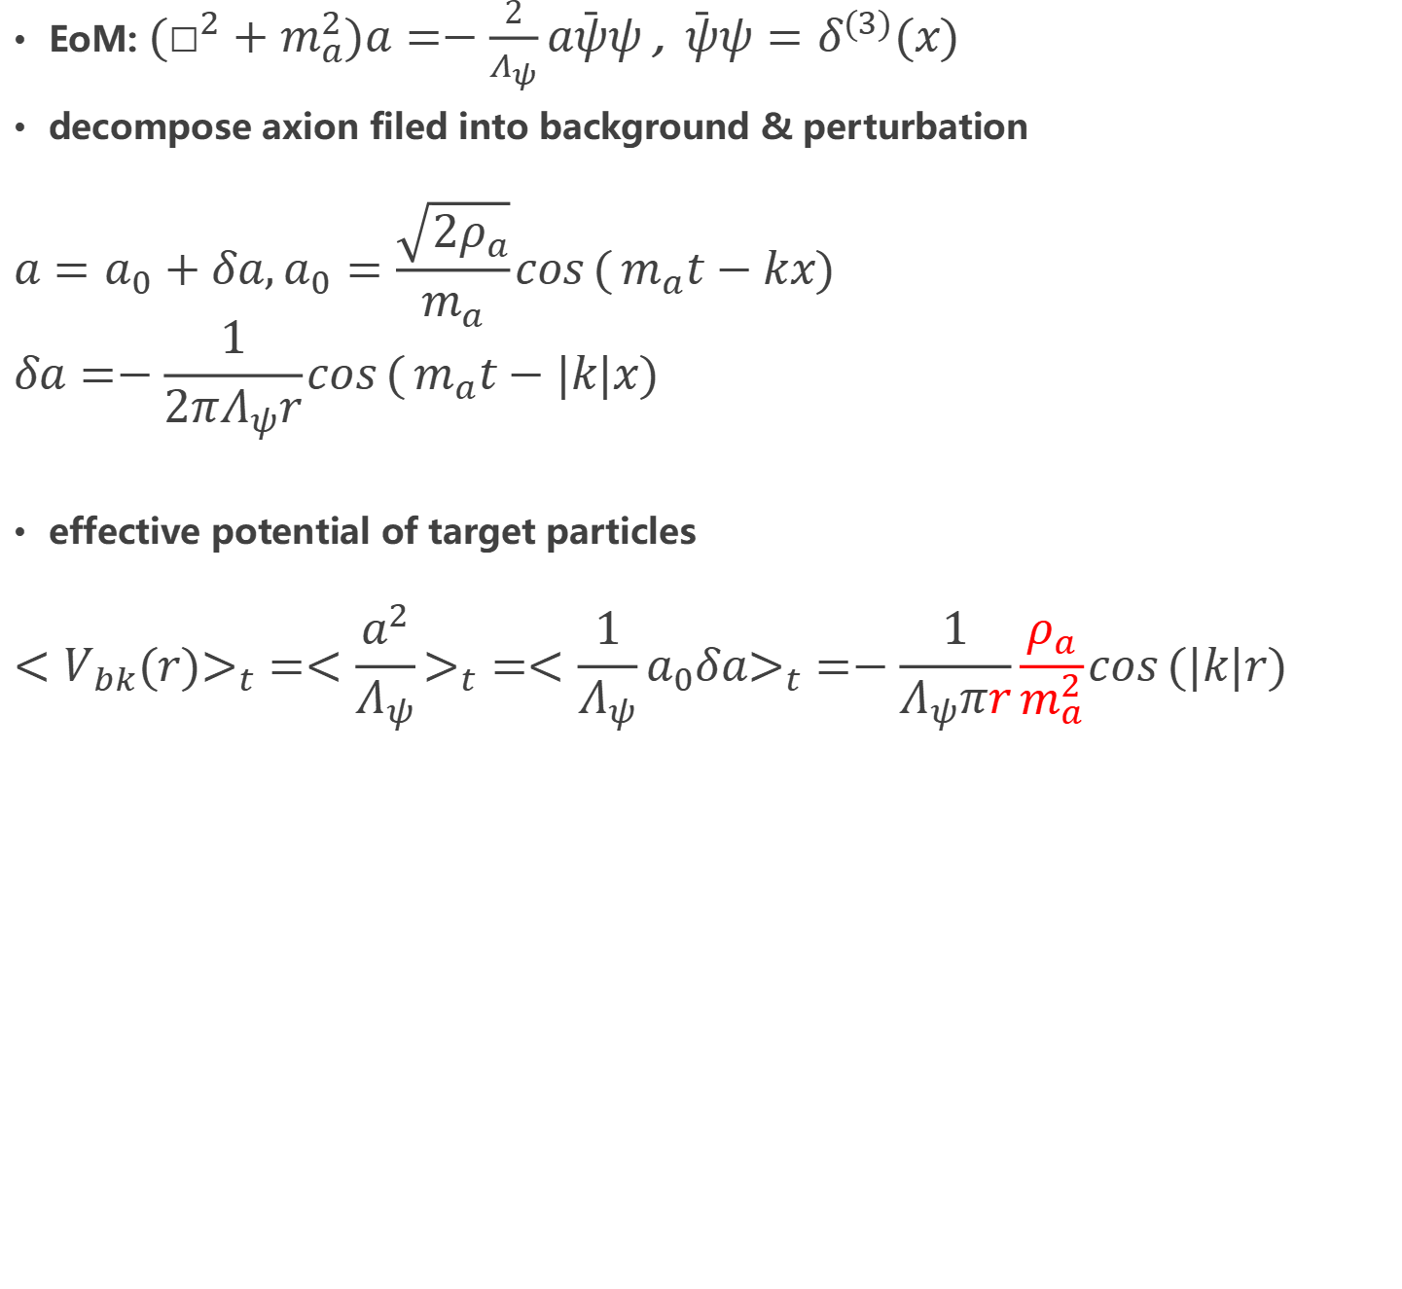
Consequences of axion-fermion quadratic couplings
Axion dark matter background enhanced spin-independent long-range force(an intuitive simplified classical description)
Tilburg, Phys. Rev. D, 2024
Bingrong Yu,et al, JHEP, 2026
Cheng Yu, et al, Phys. Rev. D, 2026
$$δa$$
$$a_{0}$$
EoM: $(□^{2}+m_{a}^{2})a=−\frac{2}{Λ_{ψ}}a\bar{ψ}ψ$ , $\bar{ψ}ψ=δ^{(3)}(x)$
decompose axion filed into background & perturbation
$$a=a_{0}+δa,a_{0}=\frac{\sqrt{2ρ_{a}}}{m_{a}}\cos{(}m_{a}t−kx)$$
$$δa=−\frac{1}{2πΛ_{ψ}r}\cos{(}m_{a}t−|k|x)$$
effective potential of target particles
$$<V_{bk}(r)>_{t}=<\frac{a^{2}}{Λ_{ψ}}>_{t}=<\frac{1}{Λ_{ψ}}a_{0}δa>_{t}=−\frac{1}{Λ_{ψ}πr}\frac{ρ_{a}}{m_{a}^{2}}\cos{(|k|r)}$$
$$r$$
which leads to a long-range axion density dependent force scaling as $1/r$

Slide 6
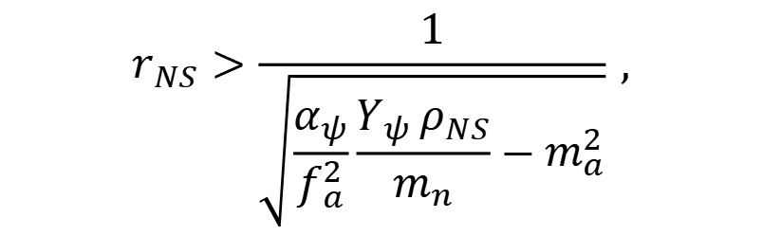
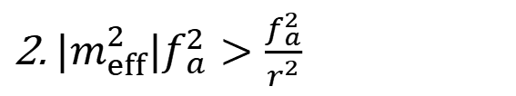
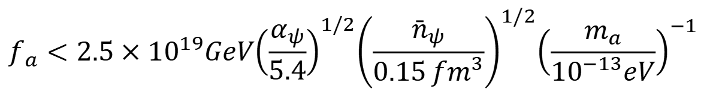

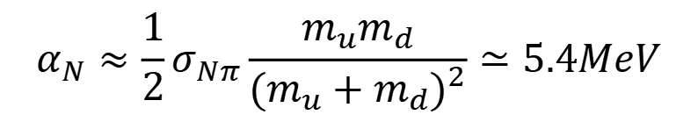
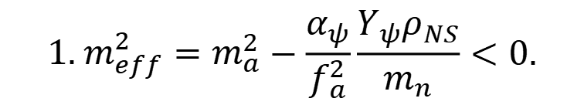

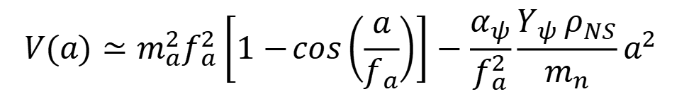
Consequences of axion-fermion quadratic couplings
Tachyonic phase transition for Light QCD axion in compact objects (dark matter background independent) leads to a long-range force
$$m_{a}=εm_{QCD},ε≪1$$
$$V(a)≃m_{a}^{2}f_{a}^{2}\left[1−\cos\left(\frac{a}{f_{a}}\right)\right]−\frac{α_{ψ}}{f_{a}^{2}}\frac{Y_{ψ} ρ_{NS}}{m_{n}}a^{2}$$
$$α_{N}≈\frac{1}{2}σ_{Nπ}\frac{m_{u}m_{d}}{(m_{u}+m_{d})^{2}}≃5.4MeV$$
Tachyonic conditions:
$$Y_{ψ}=\frac{n_{ψ}}{n_{N}}$$
Potential flipping
$${1. m}_{eff}^{2}=m_{a}^{2}−\frac{α_{ψ}}{f_{a}^{2}}\frac{Y_{ψ}ρ_{NS}}{m_{n}}<0.$$
$$f_{a}<2.5×10^{19}GeV{\left(\frac{α_{ψ}}{5.4}\right)}^{1/2}{\left(\frac{{\bar{n}}_{ψ}}{0.15 {fm}^{3}}\right)}^{1/2}{\left(\frac{m_{a}}{10^{−13}eV}\right)}^{−1}$$
Potential energy > Gradient energy
2.$|m_{eff}^{2}|f_{a}^{2}>\frac{f_{a}^{2}}{r^{2}}$
$$r_{NS}>\frac{1}{\sqrt{\frac{α_{ψ}}{f_{a}^{2}}\frac{Y_{ψ} ρ_{NS}}{m_{n}}−m_{a}^{2}}} ,$$
Huang, Hook, JHEP, 2018

Slide 7
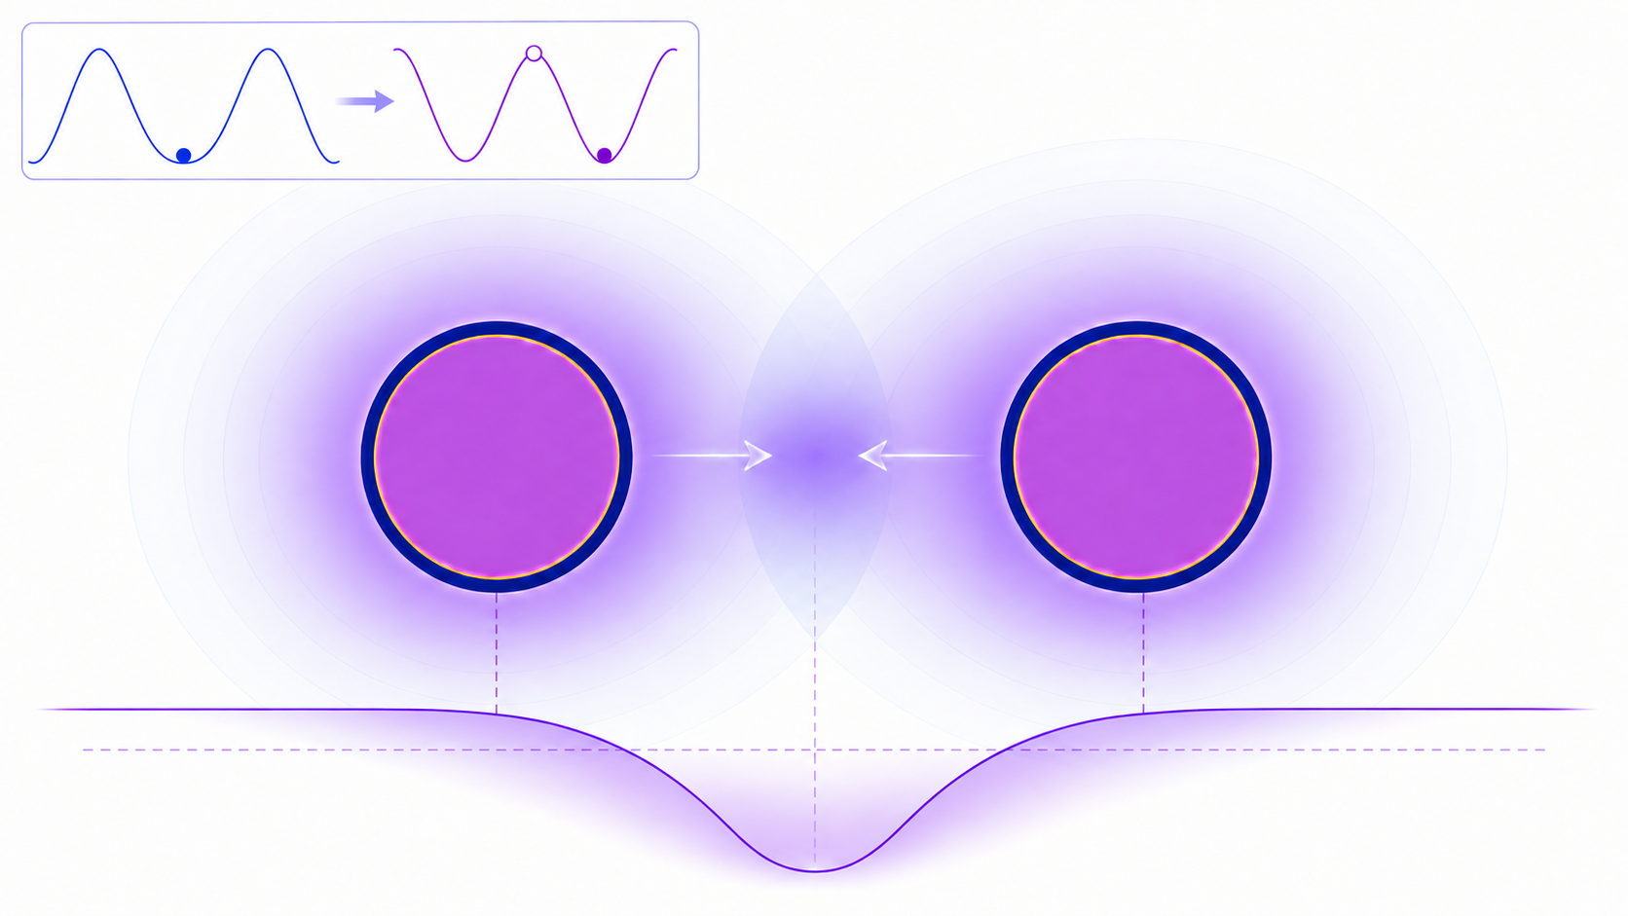





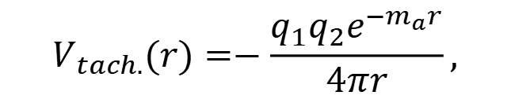



Consequences of axion-fermion quadratic couplings
After tachyonic phase transition, axion profile forms
$$a(r<r_{NS})=±πf_{a}$$
$$a=0$$
$$a=πf_{a}$$
$$a(r)=\frac{q_{eff}e^{−m_{a}r}}{r} .$$
$$q_{eff}=±πf_{a}r_{NS}$$
Which leads to an effective potential between neutron stars
$$V_{tach.}(r)=−\frac{q_{1}q_{2}e^{−m_{a}r}}{4πr},$$
$$q_{1,2}=±4π(πf_{a}r_{NS})$$
$$q_{1}q_{2}>0$$
attractive
$$q_{1}q_{2}<0$$
repulsive

Slide 8
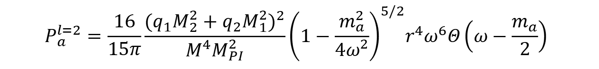
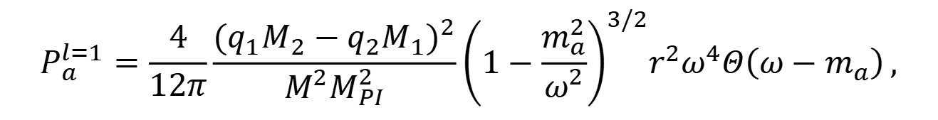

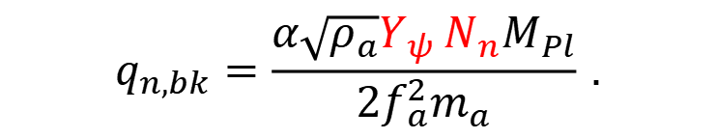

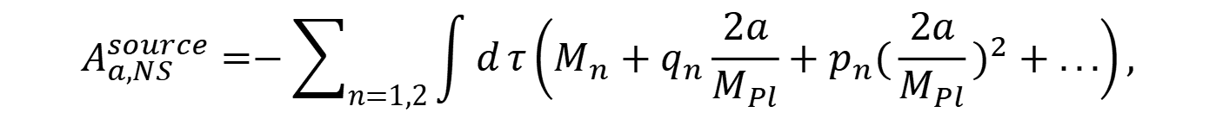

Consequences of axion-fermion quadratic couplings
Axion radiation in neutron star binary system
Action of neutron star with axion
$$A_{a}^{source}=\int{d}t Ja(t,x)$$
$$A_{a,NS}^{source}=−\sum_{n=1,2}{\int{d}}τ\left(M_{n}+q_{n}\frac{2a}{M_{Pl}}+p_{n}(\frac{2a}{M_{Pl}})^{2}+...\right),$$
Source term and effective charges for axion radiation
$$J=\frac{q_{n}}{M_{Pl}}$$
$$q_{n,bk}=\frac{α\sqrt{ρ_{a}}Y_{ψ} N_{n}M_{Pl}}{2f_{a}^{2}m_{a}} .$$
where
$$q_{n,tachy.}=±2πf_{a}r_{NS}M_{Pl}$$
$$P_{a}^{l=1}=\frac{4}{12π}\frac{(q_{1}M_{2}−q_{2}M_{1})^{2}}{M^{2}M_{PI}^{2}}{\left(1−\frac{m_{a}^{2}}{ω^{2}}\right)}^{3/2}r^{2}ω^{4}Θ\left(ω−m_{a}\right) ,$$
dipole
$$P_{a}^{l=2}=\frac{16}{15π}\frac{(q_{1}M_{2}^{2}+q_{2}M_{1}^{2})^{2}}{M^{4}M_{PI}^{2}}{\left(1−\frac{m_{a}^{2}}{4ω^{2}}\right)}^{5/2}r^{4}ω^{6}Θ\left(ω−\frac{m_{a}}{2}\right)$$
Huang, et al, Phys. Rev. D, 2019
quadrupole

Slide 9
02
Statistical analysis of the Hulse–Taylor system

Slide 10
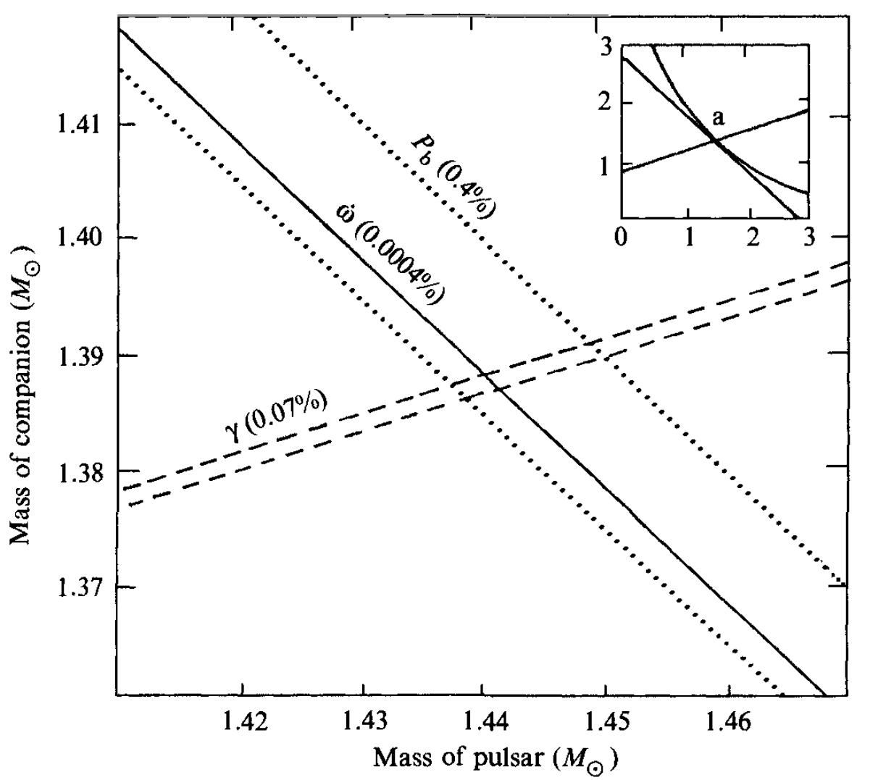


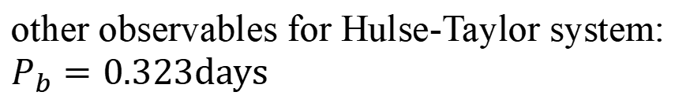
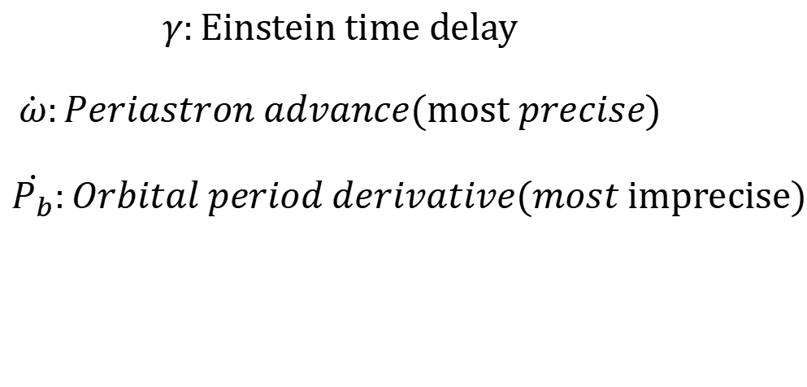
Statistical analysis of the Hulse–Taylor system
How to determinant each neutron stars mass and test GR in binary NS system？
very precise measurements of Three GR effects
$$γ:Einstein time delay$$
$$\dot{ω}:Periastron advance(most precise)$$
$$\dot{P_{b}}:Orbital period derivative(most imprecise)$$
other observables for Hulse-Taylor system: $P_{b}=0.323days$
$$a≈1.95×10^{6}km$$
$$e≃0.617$$
M. Will, Theory and experiments in gravitational physics

Slide 11
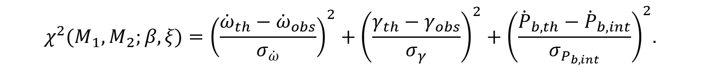
Statistical analysis of the Hulse–Taylor system
parametric exotic force and radiation
$$V(r)=−\frac{G(1+β)M_{1}M_{2}}{r}, E_{rad}=(1+ξ)E_{GW}^{GR},$$
$χ^{2} statistic$
$$χ^{2}(M_{1},M_{2};β,ξ)={\left(\frac{{\dot{ω}}_{th}−{\dot{ω}}_{obs}}{σ_{\dot{ω}}}\right)}^{2}+{\left(\frac{γ_{th}−γ_{obs}}{σ_{γ}}\right)}^{2}+{\left(\frac{{\dot{P}}_{b,th}−{\dot{P}}_{b,int}}{σ_{P_{b,int}}}\right)}^{2}.$$
profile likelihood
$$χ_{prof}^{2}(β,ξ)=\min_{M_{1},M_{2}}{χ^{2}}(M_{1},M_{2};β,ξ),$$
$$Δχ^{2}(β,ξ)=χ_{prof}^{2}(β,ξ)−χ_{min}^{2}<5.99(95\% C.L.)$$

Slide 12
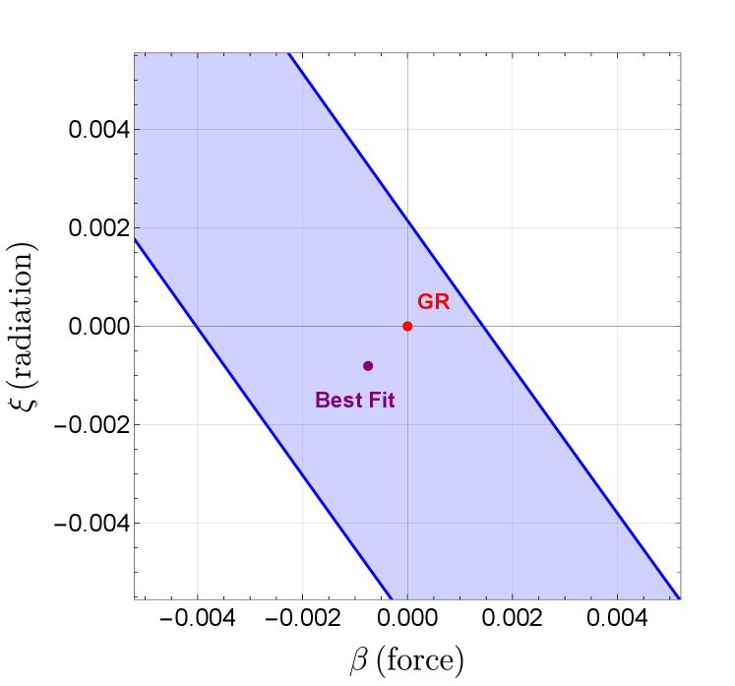


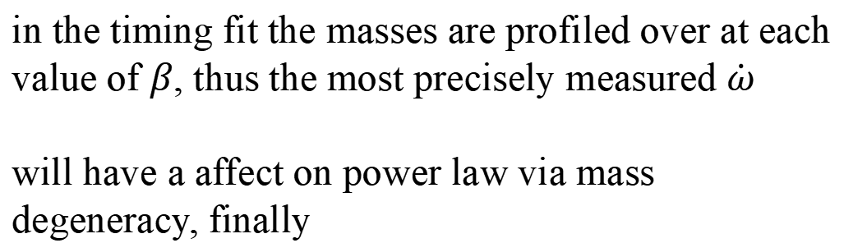


Statistical analysis of the Hulse–Taylor system
$$0.993976<\frac{{\dot{P}}_{b mod}}{{\dot{P}}_{b GR}}=(1+ξ)(1+β)^{3/2}<1.002126$$
General criteria:
understand the scaling law
The fixed-mass scaling of the orbital-period derivative:
$$P_{b}∝μM^{2/3}(1+ξ)(1+β)^{2/3}$$
in the timing fit the masses are profiled over at each value of $β$, thus the most precisely measured $\dot{ω}$
will have a affect on power law via mass degeneracy, finally
$${\dot{ω}}_{th}∝M^{2/3}(1+β)^{−1/3},$$
$$μM^{2/3}∝M^{5/3}∝(1+β)^{5/6}.$$
$$P_{b,th}∝(1+ξ)(1+β)^{2/3}(1+β)^{5/6}=(1+ξ)(1+β)^{3/2}.$$

Slide 13
03
Results & Conclusion

Slide 14
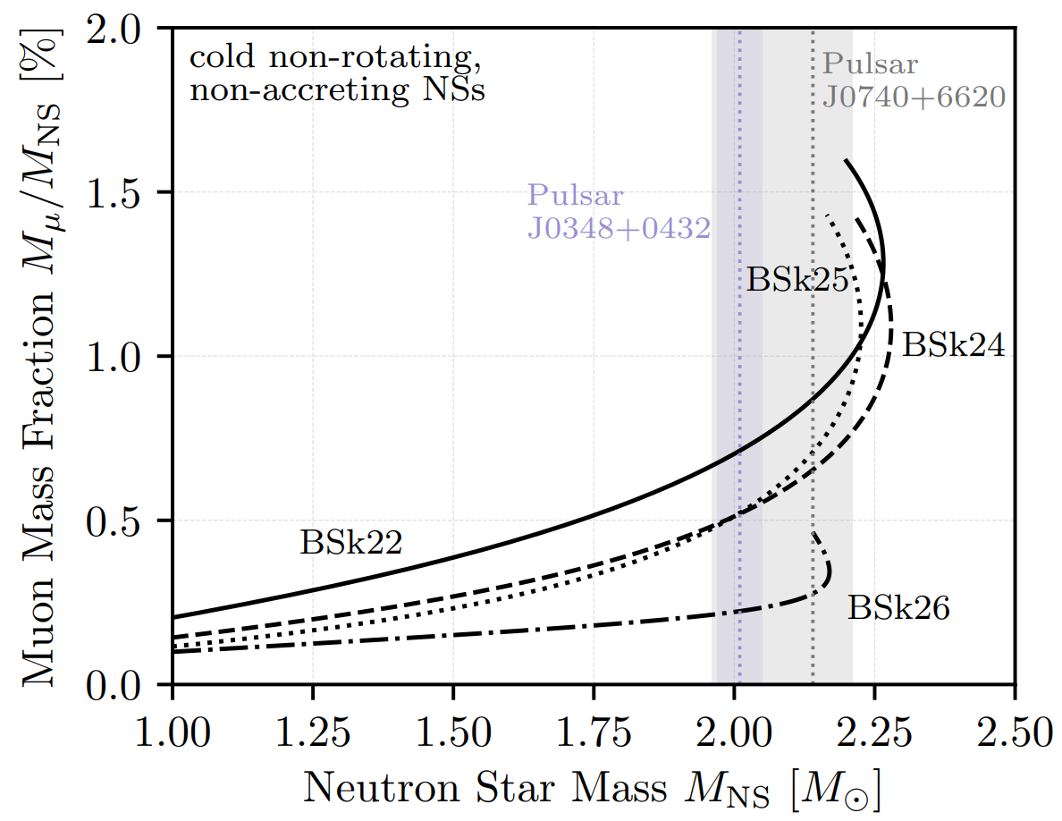



Constraints on axion couplings with neutron star constituents
Through beta equilibrium in neutron star, muon can stably populate with electrons inside neutron stars with number fraction about 1-3%, for neutron is near 100%
$$n→p+e^{−}/μ^{−}+\bar{ν_{e}}/\bar{ν_{μ}}$$
$$e^{−}→μ^{−}+ν_{e}+\bar{ν_{μ}}$$
$$Y_{e}∼Y_{μ}∼𝒪(10^{−2})$$
Dror, et al, Phys. Rev. D, 2020

Slide 15
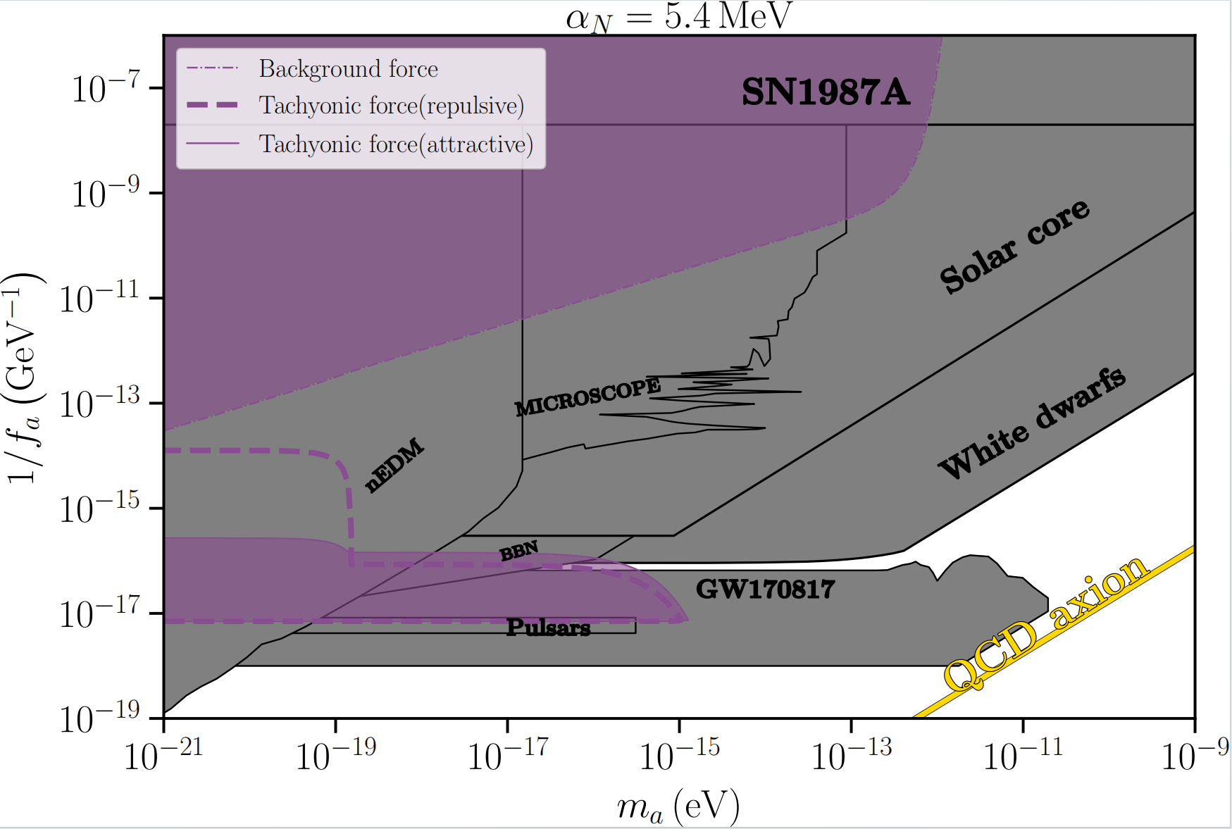
Inferred axion-gluon couplings from neutron
much robust and stronger Pulsar bound

Slide 16
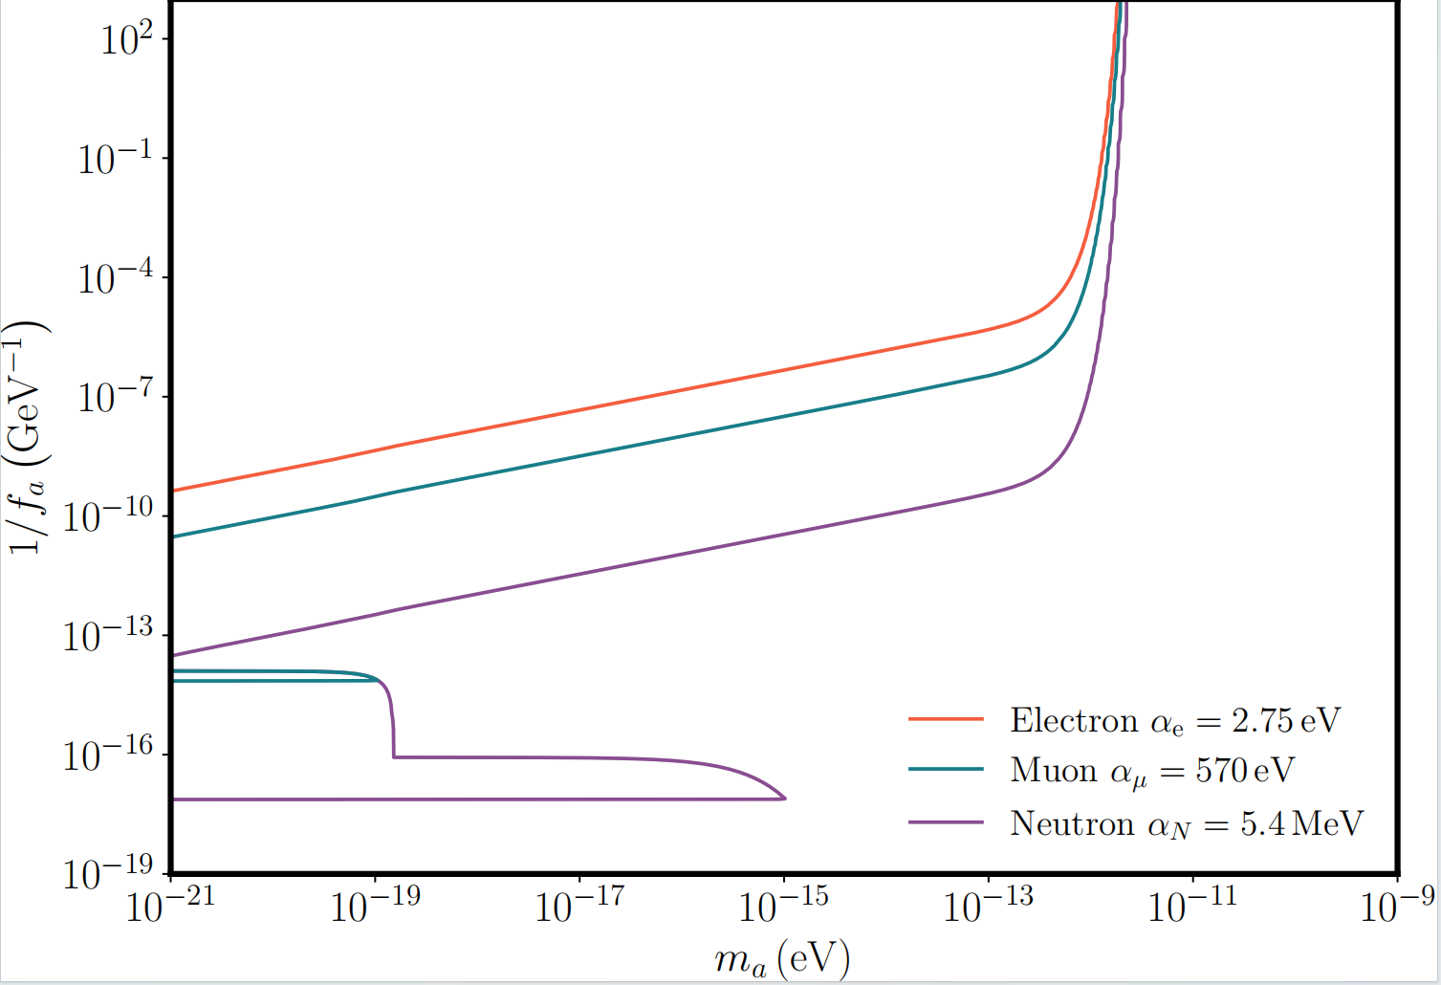

Inferred axion-gluon couplings from neutron, muon and electron
Benchmark values from two loop mass correction terms for light QCD axion
$$α_{μ}≈(α_{EM}/π)^{2}m_{μ}≈570eV$$
$$α_{e}≈(α_{EM}/π)^{2}m_{e}≈2.75eV$$

Slide 17
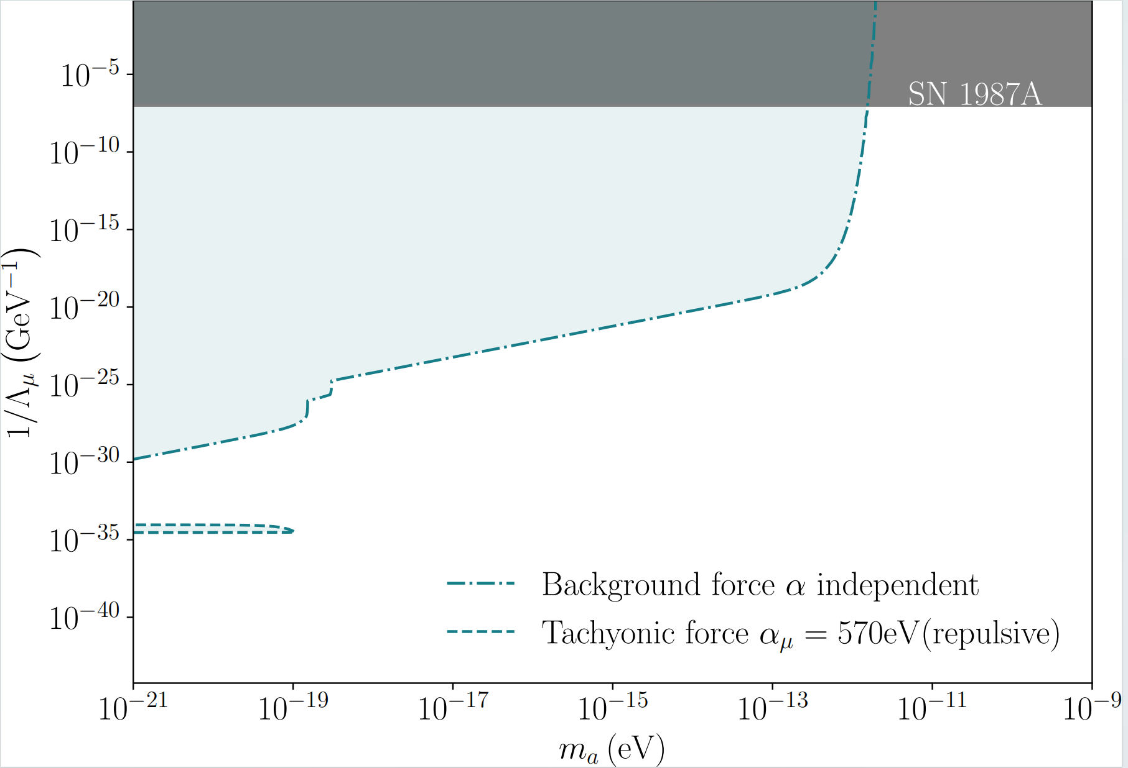
Axion-muon quadratic coupling

Slide 18
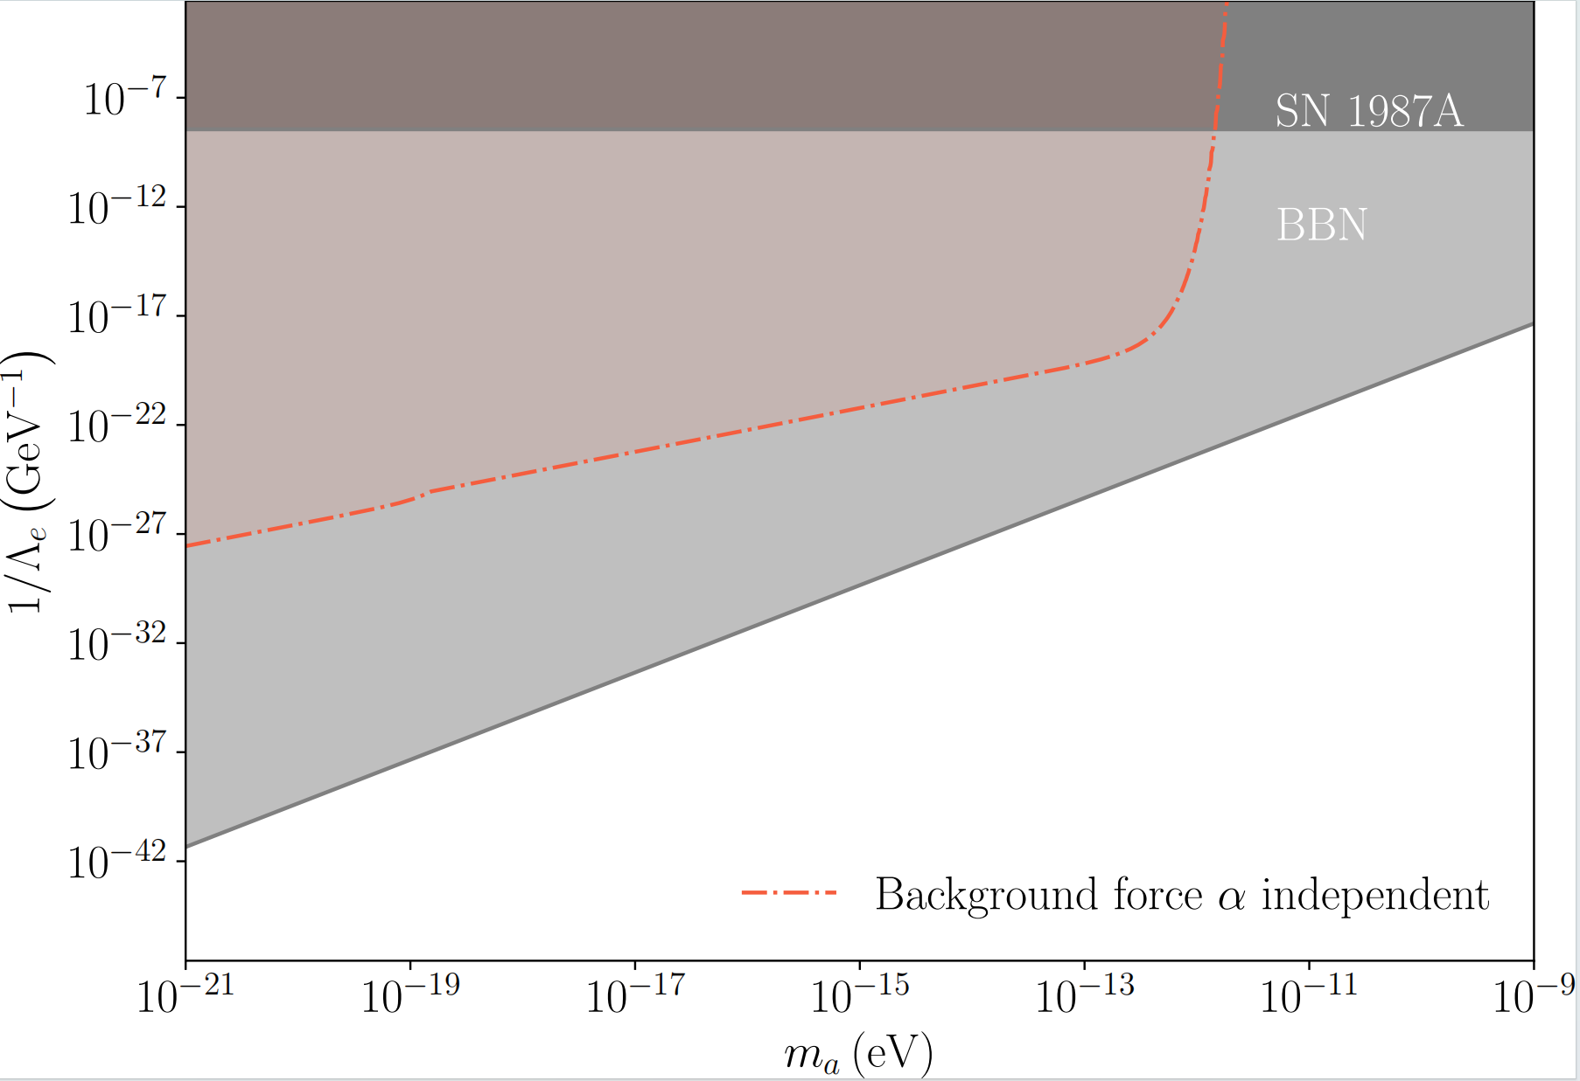
Axion-electron quadratic coupling

Slide 19
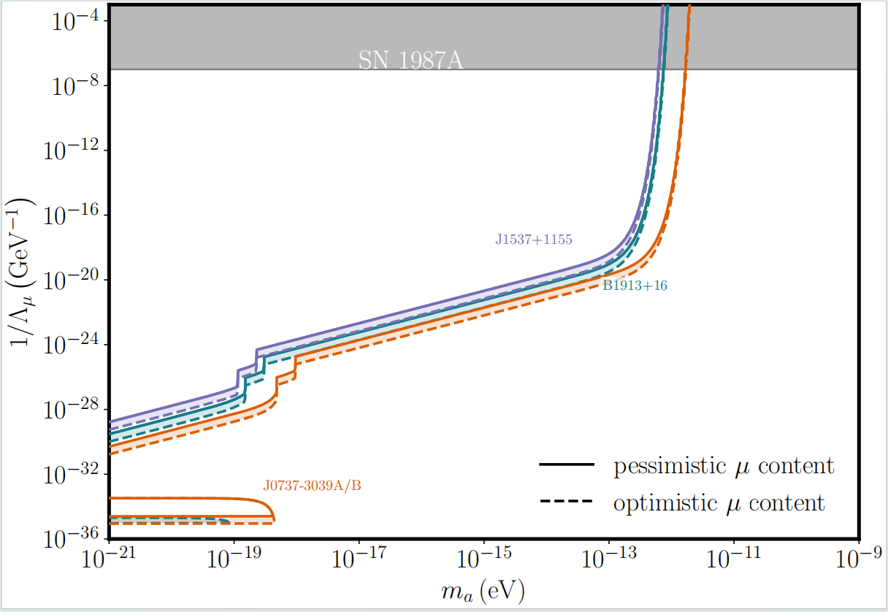
Constraints on axion-muon quadratic coupling with different binaries

Slide 20
Conclusion
1. We have developed a robust neutron star binary probes of exotic forces and radiations, which can extended to any relevant new physics scenarios
2. We have the novel constraints on axion-muon quadratic couplings with neutron star binary systems
3. We shows the new robust and stronger pulsar constraints on axion-gluon coupling

