Slide 1
Hyperfine Electronic Bridge in the ²²⁹Th Nucleus
Wu Wang (王武)
Institute of Theoretical Physics, Chinese Academy of Sciences
2026.01.20

Slide 2
Contents
1. Introduction to the ²²⁹Th isomer
2. Hyperfine electronic bridge in ²²⁹Th
3. The variation of fine-structure constant in hyperfine electronic bridge
4. Summary and outlook

Slide 3
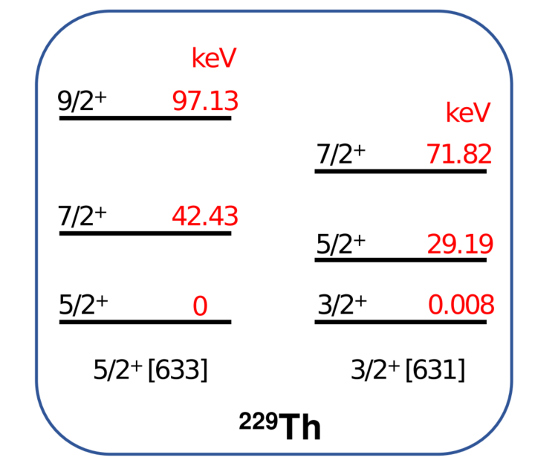
1. Introduction to the ²²⁹Th isomer
Thorium (Th): atomic number 90
²²⁹Th: a radiative isotope with a half-life
of about 7900 yr
^{229m}Th: a unique isomeric state with
an energy of about 8 eV
Typical nuclear excitation energies：keV and MeV
Partial nuclear levels of ²²⁹Th
W. Wang, H. Zhang, X. Wang, J. Phys. B 54, 244001 (2021)

Slide 4

1. Introduction to the ²²⁹Th isomer
Atomic clock: a frequency reference based on a specific transition between atomic levels
Fractional frequency uncertainty: ${10}^{−19}$
Limitation: external electromagnetic perturbations
A potential solution: ²²⁹Th nuclear clock
E. Peik, C. E. Tamm, Europhys. Lett. 61, 181 (2003)
High robustness against external electromagnetic perturbations
Narrow relative linewidth $ΔE/E \sim 1.6×{10}^{−20}$
Accessible with a vacuum-ultraviolet (VUV) laser: 8 eV ~150 nm
A candidate for next-generation frequency standard
V. V. Flambaum, Phys. Rev. Lett. 97, 092502 (2006)
Precision measurements, search for variations of fundamental constants

Slide 5
1. Introduction to the ²²⁹Th isomer
Weak radiative transition: lifetime ~ 2500 s
J. Tiedau et al., Phys. Rev. Lett. 132, 182501 (2024)
It is difficult to excite the ²²⁹Th isomer
Various methods are proposed

Slide 6

1. Introduction to the ²²⁹Th isomer
2. Indirect x-ray pumping:
1. Direct optical excitation：
Isomeric state
150 nm
photon
Ground state
After many years of effort, it was finally successful.
C. Zhang et al., Nature (London) 633, 63 (2024)
J. Tiedau et al., Phys. Rev. Lett. 132, 182501 (2024)
T. Hiraki et al., Nat. Commun. 15, 5536 (2024)
R. Elwell et al., Phys. Rev. Lett. 133, 013201 (2024)
T. Masuda et al., Nature (London) 573, 238 (2019)

Slide 7
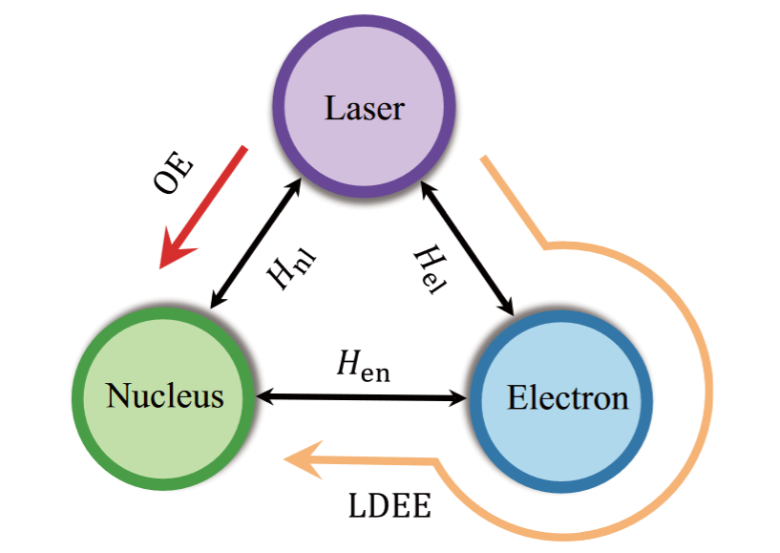
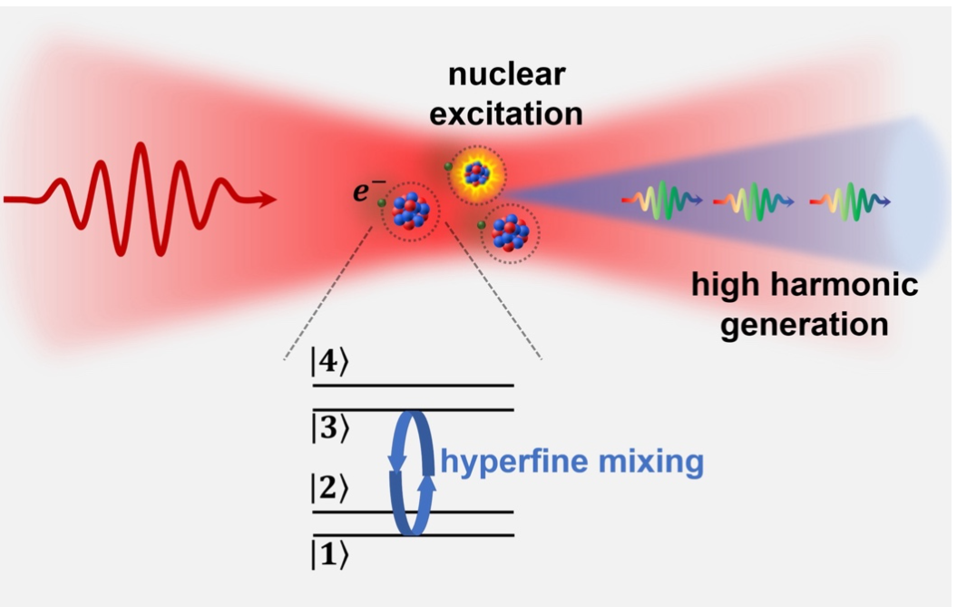


1. Introduction to the ²²⁹Th isomer
3. Strong laser field excitation:
Isomeric state
Ground state
Semi-classical method: recollision electron
Quantum theory: laser-nucleus-electron interaction
Nuclear hyperfine mixing
${Th}^{0+,1+,2+,3+,4+}\sim {10}^{−11}$ per pulse
${Th}^{89+}\sim 0.1−0.9$ per pulse
W. Wang, J. Zhou, B. Liu, and X. Wang, Phys. Rev. Lett. 127, 052501 (2021)
W. Wang and X. Wang, Phys. Rev. Res. 5, 043232 (2023)
H. Zhang, T. Li, and X. Wang, Phys. Rev. Lett. 133, 152503 (2024); Phys. Rev. C 111, 044614 (2025)

Slide 8
1. Introduction to the ²²⁹Th isomer
4. Electronic bridge
5. Other methods

Slide 9
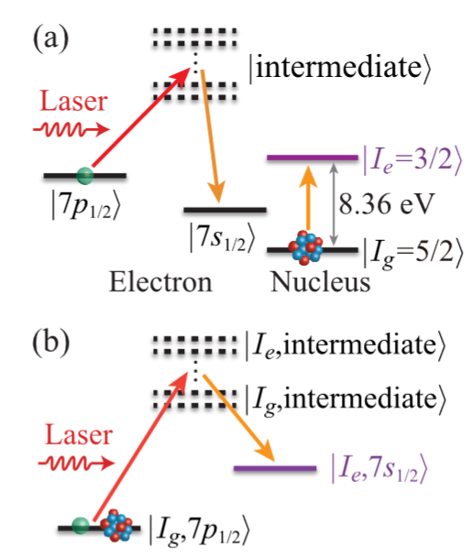
2. Electronic bridge
Electronic Bridge (EB):
Nuclear transition is induced by laser-driven electronic transitions
Photon energy +Eletronic transition energy$=$Nuclear energy
I. S. Batkin, Sov. J. Nucl. Phys. 29, 464 (1979)
E. V. Tkalya, JETP Lett. 55, 216 (1992)
EB can enhance the effective coupling between laser and ^{229m}Th
Two-photon EB: two lasers, wavelength ~ 300 nm
Schematic diagram of EB in ²²⁹Th³⁺
S. G. Porsev et al., Phys. Rev. Lett. 105, 182501 (2010)
W. Wang, F. Zou, S. Fritzsche, and Y. Li, Phys. Rev. Lett. 133, 223001 (2024)

Slide 10
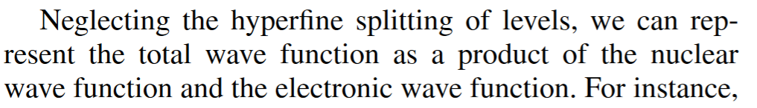
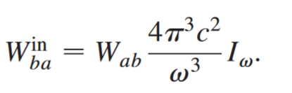
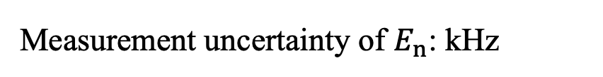
2. Electronic bridge
Limitations of existing research:
2. Excitation rate based on the Fermi’s golden rule
1. Neglecting the hyperfine structure
Perturbation behavior, incoherent excitation
S. G. Porsev and V. V. Flambaum, Phys. Rev. A 81, 032504 (2010)
3. For two-photon EB, the decay of excited
electronic level is neglected
Hyperfine splitting in ²²⁹Th³⁺: GHz
Measurement uncertainty of $E_{n}$: kHz
As a result, the actual efficiency of EB method remains unknown
J. Tiedau et al., Phys. Rev. Lett. 132, 182501 (2024)
C. Zhang et al., Nature (London) 633, 63 (2024)

Slide 11
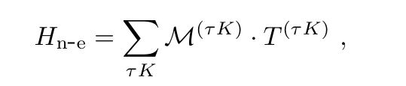
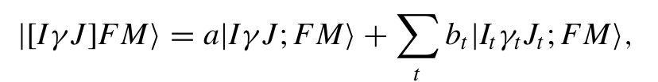

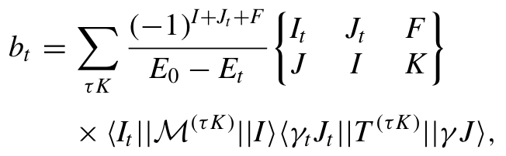
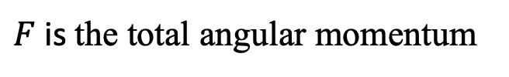
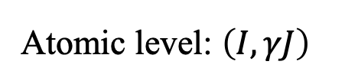
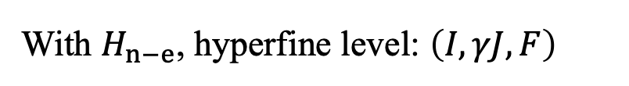

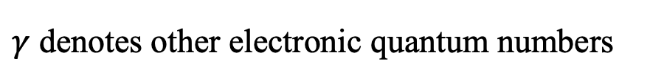
2. Dressed hyperfine state
Atomic level: $\left(I,γJ\right)$
$I$ is the nuclear spin$,$ $J$ is the electronic angular momentum
$γ$ denotes other electronic quantum numbers
Hyperfine interaction:
With $H_{n−e}$, hyperfine level: $\left(I,γJ, F\right)$
$F$ is the total angular momentum
Dressed hyperfine state:
$$\left(I,γJ, F\right)$$
Eigenstate of the coupled electron–nucleus system
Hyperfine-coupled basis:
Mixing of different nuclear states, i.e., nuclear hyperfine mixing
Mixing coefficient:
W. Wang, F. Zou, S. Fritzsche, and Y. Li, Phys. Rev. Lett. 133, 223001 (2024)

Slide 12
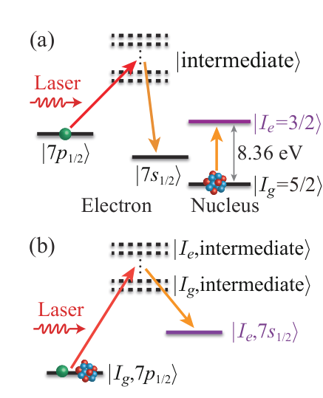
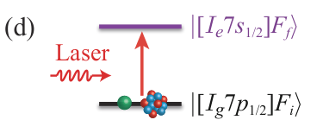


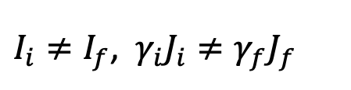
2. Hyperfine electronic bridge
Hyperfine EB (HEB) transition:
$$\left|\left[I_{i}γ_{i}J_{i}\right]F_{i}M_{i}\right\rangle →\left|\left[I_{f}γ_{f}J_{f}\right]F_{f}M_{f}\right\rangle$$
or $\left(I_{i},γ_{i}J_{i}, F_{i}\right)→$ $\left(I_{f},γ_{f}J_{f}, F_{f}\right)$
$I_{i}≠I_{f}$, $γ_{i}J_{i}≠γ_{f}J_{f}$
The advantages of HEB:
Hyperfine structure is considered
The intermediate state of traditional EB was eliminated
Two-level transition
Easy to combine with the quantum-optical methods
W. Wang, F. Zou, S. Fritzsche, and Y. Li, Phys. Rev. Lett. 133, 223001 (2024)
W. Wang, S. Fritzsche, and Y. Li, Phys. Rev. A 112, 022811 (2025)

Slide 13
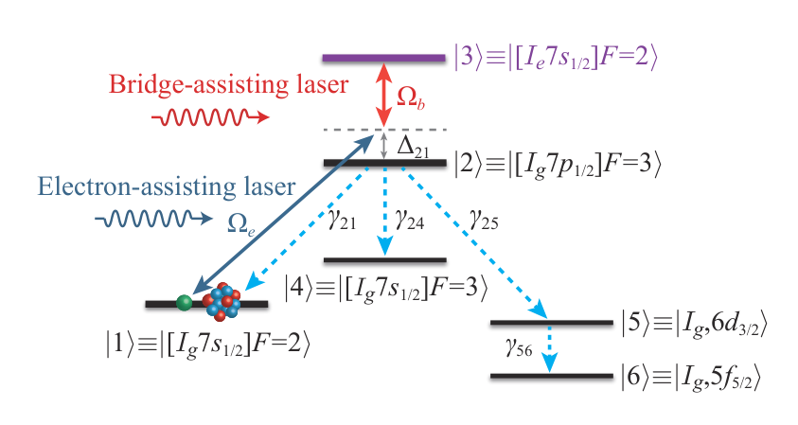



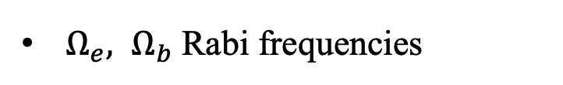
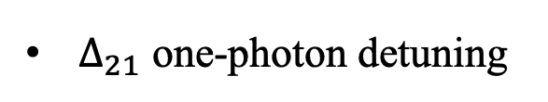
2. Quantum-optical model based on HEB
With the HEB transition, a quantum-optical model is readily constructed
²²⁹Th³⁺ $: \left(I_{g},7p_{1/2}, F=3\right)→$ $\left(I_{e},7s_{1/2}, F=2\right)$
$\left|\left[I_{g}7p_{1/2}\right]F_{2}\right\rangle ≡|2⟩$ is unstable (1.1 ns) with three decay channels
Quantum master equation:
$Δ_{21}$ one-photon detuning
$Ω_{e}, Ω_{b}$ Rabi frequencies
A schematic diagram of a six-level HEB scheme in ²²⁹Th³⁺
W. Wang, F. Zou, S. Fritzsche, and Y. Li, Phys. Rev. Lett. 133, 223001 (2024)

Slide 14
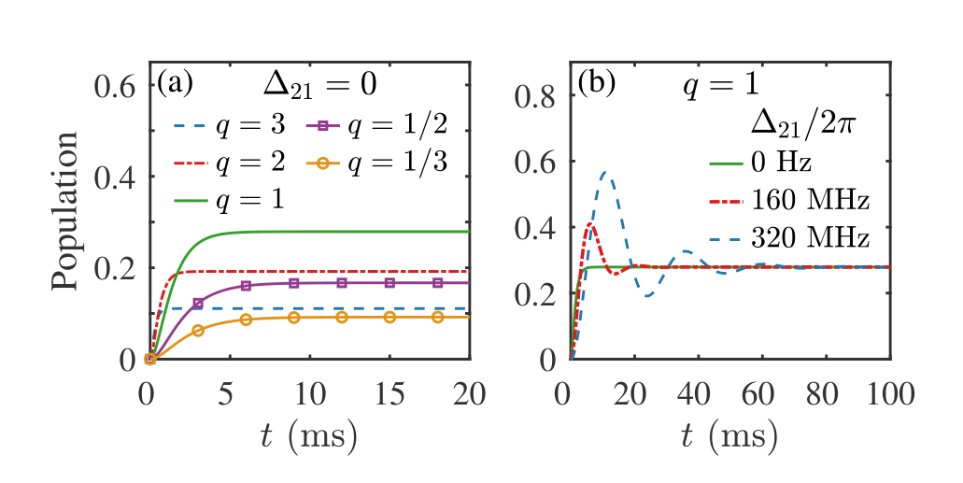

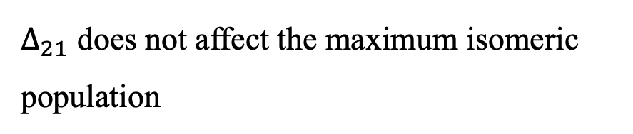
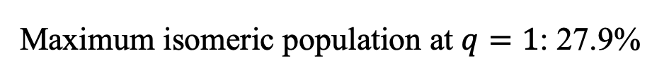
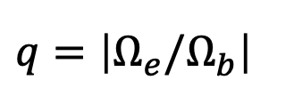
2. Isomeric population transfer of ²²⁹Th
Time-independent scheme:
envelop functions of Rabi frequencies $f_{b}\left(t\right)=f_{e}\left(t\right)=1$
$q=\left|Ω_{e}/Ω_{b}\right|$
Maximum isomeric population at $q=1$: 27.9%
$Δ_{21}$ does not affect the maximum isomeric population
Bridge-assisting laser intensity: $3×{10}^{5}$ W/cm²
(a, b) Isomeric population as a function of time
W. Wang, F. Zou, S. Fritzsche, and Y. Li, Phys. Rev. Lett. 133, 223001 (2024)

Slide 15
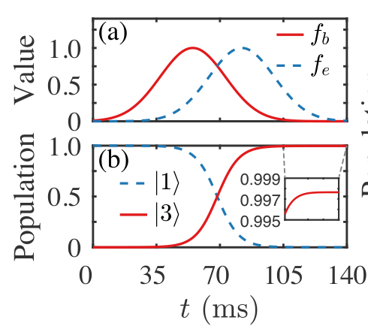




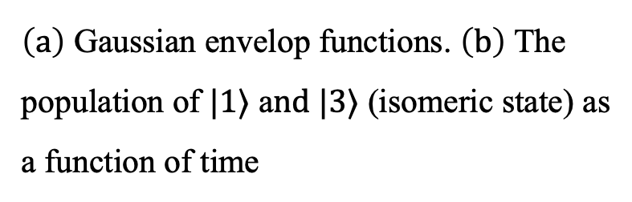
2. Isomeric population transfer of ²²⁹Th
Time-independent scheme:
stimulated Raman adiabatic passage (﻿STIRAP)
Envelop functions:
$$\left|Ω_{b}\left(t_{b}\right)\right|=\left|Ω_{e}\left(t_{e}\right)\right|$$
adiabatic condition $:{ Ω}_{b}^{2}\left(t_{b}\right)T^{2}≫1$
$\left(a\right)$ Gaussian envelop functions. $\left(b\right)$ The population of $|1⟩$ a$nd |3⟩$ (isomeric state) as a function of time
Bridge-assisting laser peak intensity: $2×{10}^{7}$ W/cm²
At final time 140 ms: isomeric population of 99.7%
W. Wang, F. Zou, S. Fritzsche, and Y. Li, Phys. Rev. Lett. 133, 223001 (2024)

Slide 16

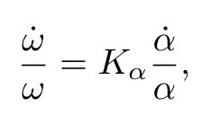
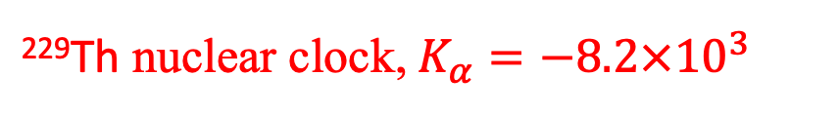
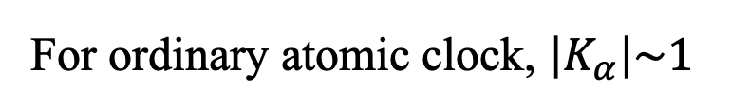
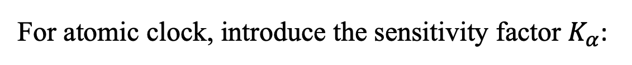
3. The variation of fine-structure constant in HEB
Fine-structure constant:
Some theories beyond the Standard Model predict the possibility that the variation of $α$
Experiments: cosmological observations, atomic clock measurements
For atomic clock, introduce the sensitivity factor $K_{α}$:
For ordinary atomic clock, $\left|K_{α}\right|\sim 1$
²²⁹Th nuclear clock, $K_{α}=−8.2×{10}^{3}$
P. Fadeev, J. C. Berengut, and V. V. Flambaum, Phys. Rev. A 102, 052833 (2020)

Slide 17
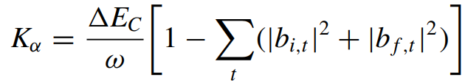

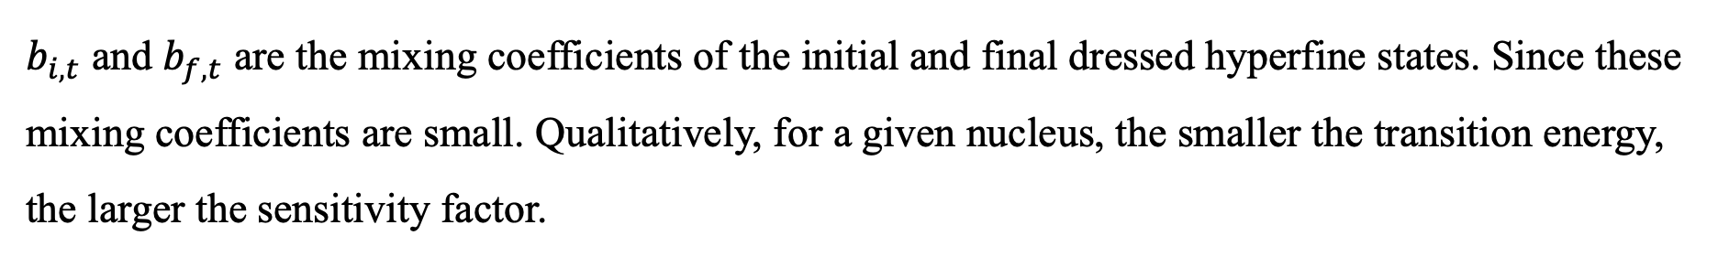
3. The variation of fine-structure constant in HEB
In previous studies, electronic and nuclear transitions are treated as independent processes.
If correlation arises, how does this influence the clock performance?
HEB transition provides a natural framework to answer this question
: the Coulomb energy difference between nuclear isomeric and ground states
$b_{i,t}$ and $b_{f,t}$ are the mixing coefficients of the initial and final dressed hyperfine states. Since these mixing coefficients are small. Qualitatively, for a given nucleus, the smaller the transition energy, the larger the sensitivity factor.
W. Wang, S. Fritzsche, and Y. Li, Phys. Rev. A 112, 022811 (2025)

Slide 18
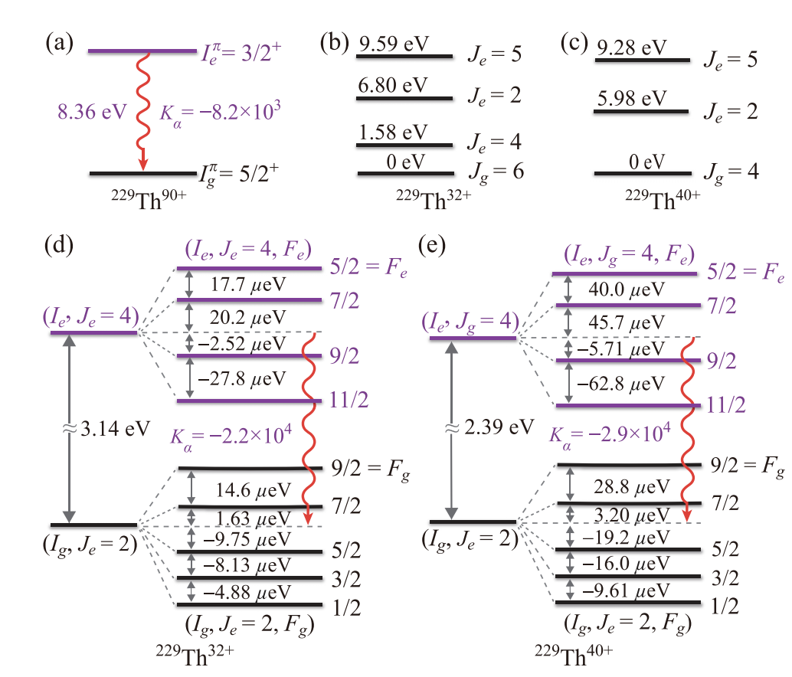
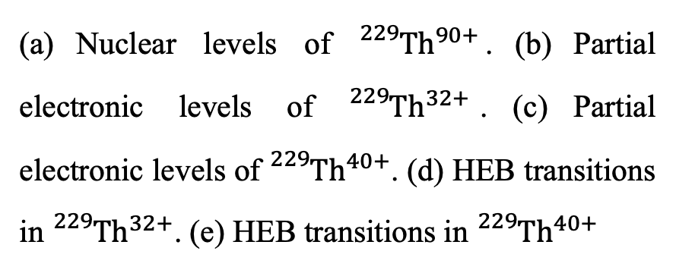


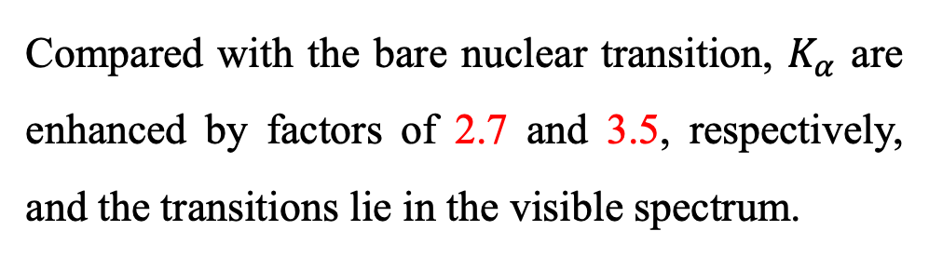
3. The variation of fine-structure constant in HEB
(a) Nuclear levels of ${}_{}^{229}{{Th}^{90+}}$. (b) Partial electronic levels of ${}_{}^{229}{{Th}^{32+}}$. (c) Partial electronic levels of ${}_{}^{229}{{Th}^{40+}}$. (d) HEB transitions in ${}_{}^{229}{{Th}^{32+}}$. (e) HEB transitions in ${}_{}^{229}{{Th}^{40+}}$
3.14-eV HEB transitions in ${}_{}^{229}{{Th}^{32+}}$
2.39-eV HEB transitions in ${}_{}^{229}{{Th}^{40+}}$
Compared with the bare nuclear transition, $K_{α}$ are enhanced by factors of 2.7 and 3.5, respectively, and the transitions lie in the visible spectrum.
W. Wang, S. Fritzsche, and Y. Li, Phys. Rev. A 112, 022811 (2025)

Slide 19
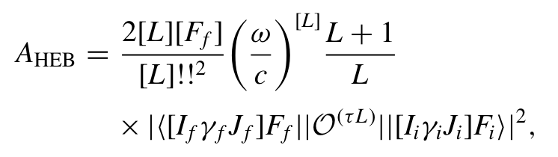
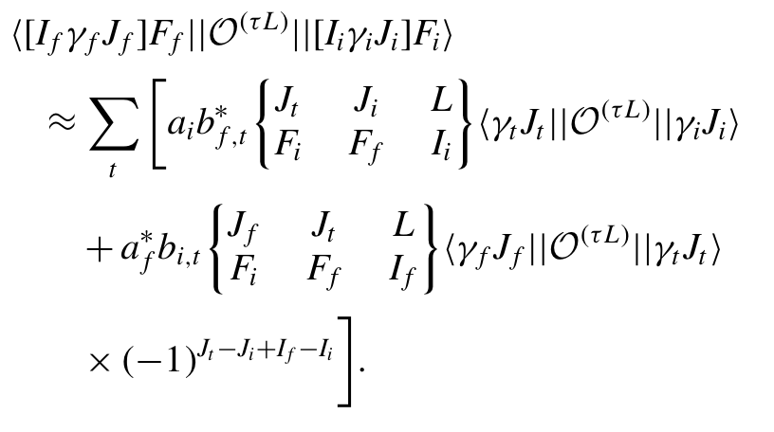
3. The variation of fine-structure constant in HEB
HEB transition rate formula
A general formula for multipole transitions
W. Wang, S. Fritzsche, and Y. Li, Phys. Rev. A 112, 022811 (2025)

Slide 20
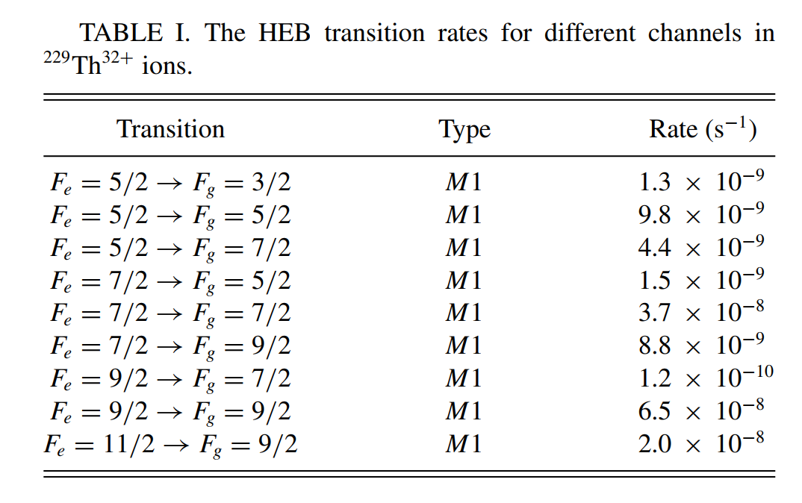
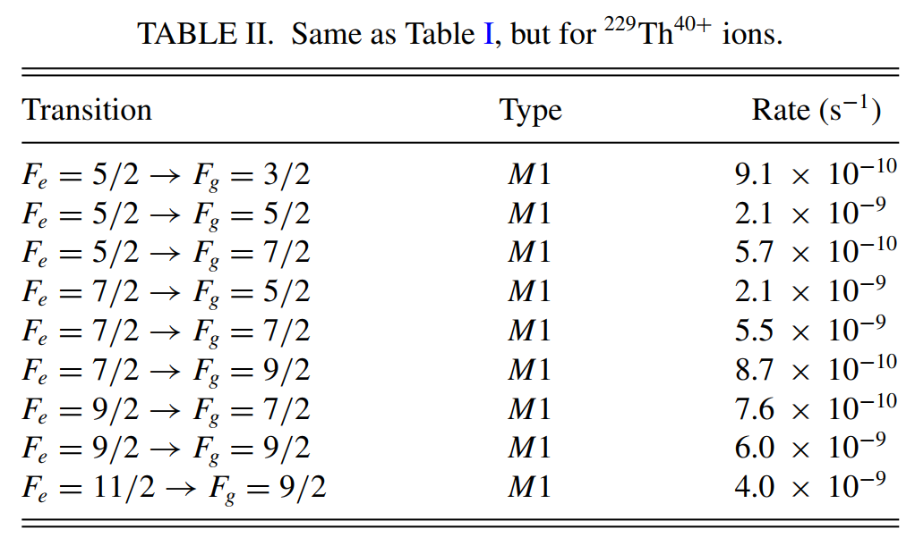

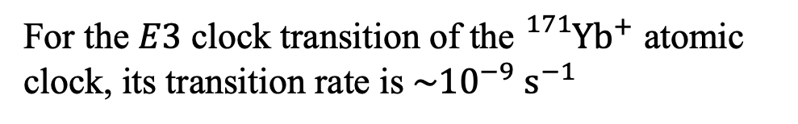
3. The variation of fine-structure constant in HEB
Results:
HEB transition rates ${\sim 10}^{−9} s^{−1}$
For the $E3$ clock transition of the ${}_{}^{171}{{Yb}^{+}}$ atomic clock, its transition rate is$\sim {10}^{−9} s^{−1}$
These HEB transitions can be controlled by the precision spectroscopy
W. Wang, S. Fritzsche, and Y. Li, Phys. Rev. A 112, 022811 (2025)

Slide 21
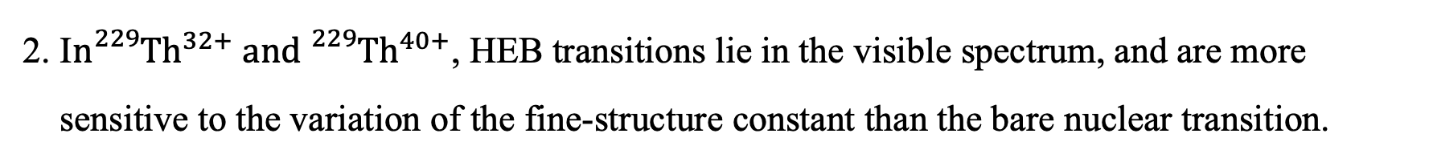
4. Summary and outlook
Summary:
1. The HEB transition is proposed and investigated. A quantum-optical model is constructed.
By employing quantum control techniques, efficient isomeric population transfer is predicted.
2. I$n{}_{}^{229}{{Th}^{32+}} and {}_{}^{229}{{Th}^{40+}}$, HEB transitions lie in the visible spectrum, and are more
sensitive to the variation of the fine-structure constant than the bare nuclear transition.
Outlook:
1. By employing different quantum control techniques, the isomeric population transfer can
be further optimized.
2. Since ²³⁵U has a nuclear excitation energy of about 76.7 eV, investigating HEB transitions in
²³⁵U is of interest.

Slide 22
Thank you for your attention!

