Slide 1
H
D
Polarized HD target
for SPring-8 LEPS experiment
Hadron photoproduction experiment in Japan
Norihito Muramatsu (IMP, CAS)
PBT2026 Mar 30 – Apr 2, 2026

Slide 2
History of the HD target
A solid hydrogen-deuteride target with proton or/and deuteron polarization.
Merit: HD molecule does not contain heavy nuclei such as C & N.
1970s-1980s 1995-2000 ~2000 2005-2020
Syracuse BNL (for LEGS) Orsay (for Graal) RCNP (for LEPS)
A. Honig et al. A.M. Sandorfi et al. J.-P. Didelez et al. H. Kohri et al.
Unfortunately, this project was not completed.
I joined only at the beginning of this project.
Many materials come from Prof. Hideki Kohri (RCNP, Osaka Univ.).
Outline of this talk
Introduction (Polarization mechanism, Physics motivation)
Target production system (Various cryostats & Magnets)
Experimental results (Distillation, NMR, Proton polarization test)
1 / 14

Slide 3
Introduction (Polarization mechanism, Physics motivation)
Target production system (Various cryostats & Magnets)
Experimental results (Distillation, NMR, Proton polarization test)

Slide 4
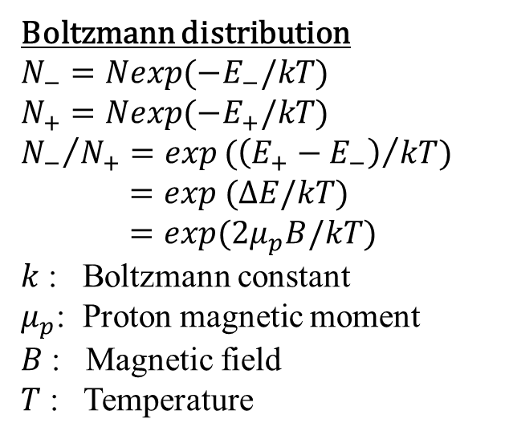
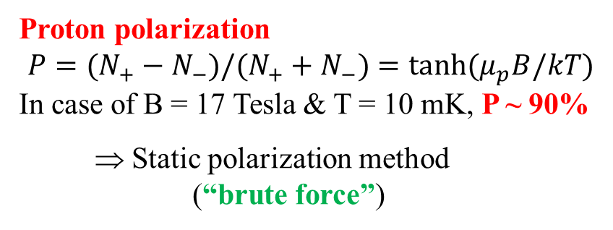
What is the polarized HD target?
Boltzmann distribution
$$N_{−}=Nexp(−E_{−}/kT)$$
$$N_{+}=Nexp(−E_{+}/kT)$$
$${N_{−}}/{N_{+}}={exp(\left(E_{+}−E_{−}\right)}/{kT)}$$
$=exp (∆E/kT)$
$=exp(2μ_{p}B/kT)$
$k$ : Boltzmann constant
$μ_{p}$: Proton magnetic moment
$B$ : Magnetic field
$T$ : Temperature
Proton polarization
$$P=(N_{+}−N_{−})/(N_{+}+N_{−})=\tanh{(μ_{p}B/kT)}$$
In case of B = 17 Tesla & T = 10 mK, P ~ 90%
⇒ Static polarization method
(“brute force”)
H polarization
D polarization
E
Polarization (%) at 17 T
Ｂ
E₋
E₊
Temperature (mK)
N
2 / 14

Slide 5
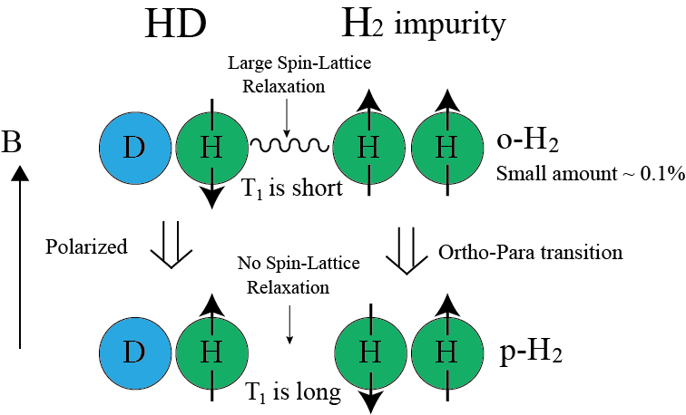
What is the polarized HD target?
😓 It is not practical to keep 17 T & 10 mK during the experiment…
0.01%
2-3 months
ageing
Polarization is frozen for a long time (~1 year)
even with a lower B-field & a higher temperature.
(For D₂, the roles of ortho and para are reversed due to Bose statistics.)
3 / 14

Slide 6
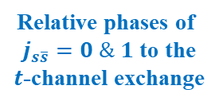


Physics motivations
Strangeness content in the proton
Beam-target asymmetry in φ photoproduction. [PRC 58 (1998) 2429]
Double polarization observables in baryon resonance spectroscopy
Pseudoscalar meson photoproduction is described by only four complex
amplitudes. Measurement of the polarization observables in addition to
the cross section are helpful to completely solve those amplitudes.
Relative phases of
$j_{s\overline{s}}=0 \& 1$ to the
$t$-channel exchange
0.25%
1%
$t$-channel Pomeron exchange
$s\overline{s}$-knockout
4 / 14

Slide 7
Introduction (Polarization mechanism, Physics motivation)
Target production system (Various cryostats & Magnets)
Experimental results (Distillation, NMR, Proton polarization test)

Slide 8
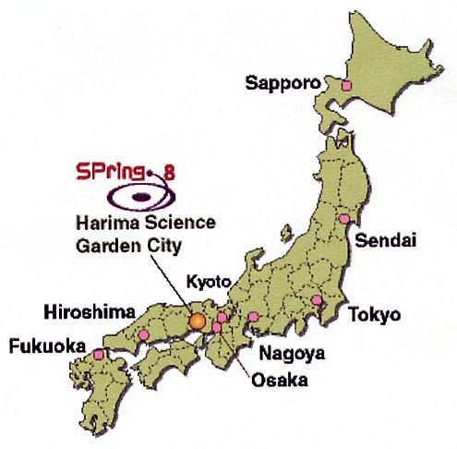
Original concept of the target operation
Finally, the project has finished
at this stage because of the world
helium crisis, etc.
DRS: Dilution Refrigerator System
TC : Transfer Cryostat (1 & 2)
SC : Storage Cryostat
IBC : In-Beam Cryostat
125 km
5 / 14

Slide 9
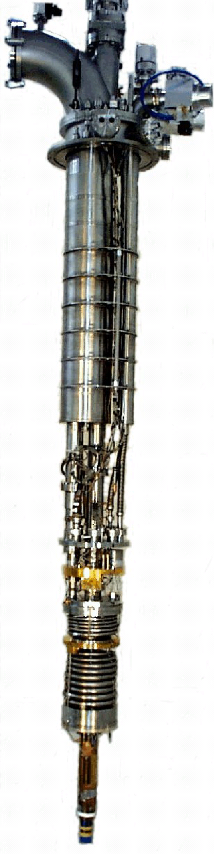
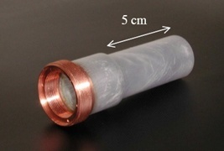
Dilution refrigerator
Leiden Cryogenics DRS-2500
Cooling power : 2500μW at 120 mK
Lowest temperature : 6 mK
³He/⁴He mixing chamber to cool down the cold finger.
HD target cell
Kle-F container
(p-free for NMR)
Narrow Al wires
(20% in weight)
2.5 cm
Inner thread is used when taking out the cell by a TC.
6 / 14

Slide 10

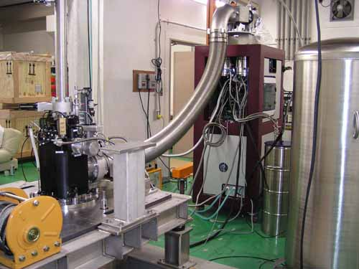
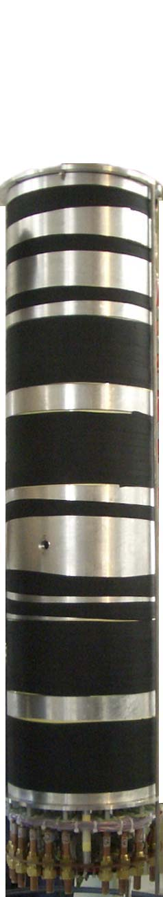
Superconducting magnet
Magnetic Field : 17 Tesla
Homogeneity of Magnetic Field : 5×10⁻⁴ for 15 cm
DRS
Y axis
Magnetic Field (Tesla)
The cell can be taken
out from the top part.
HD
target
Magnet
The HD production system is
embedded under ground.
Y Position (mm)
7 / 14

Slide 11
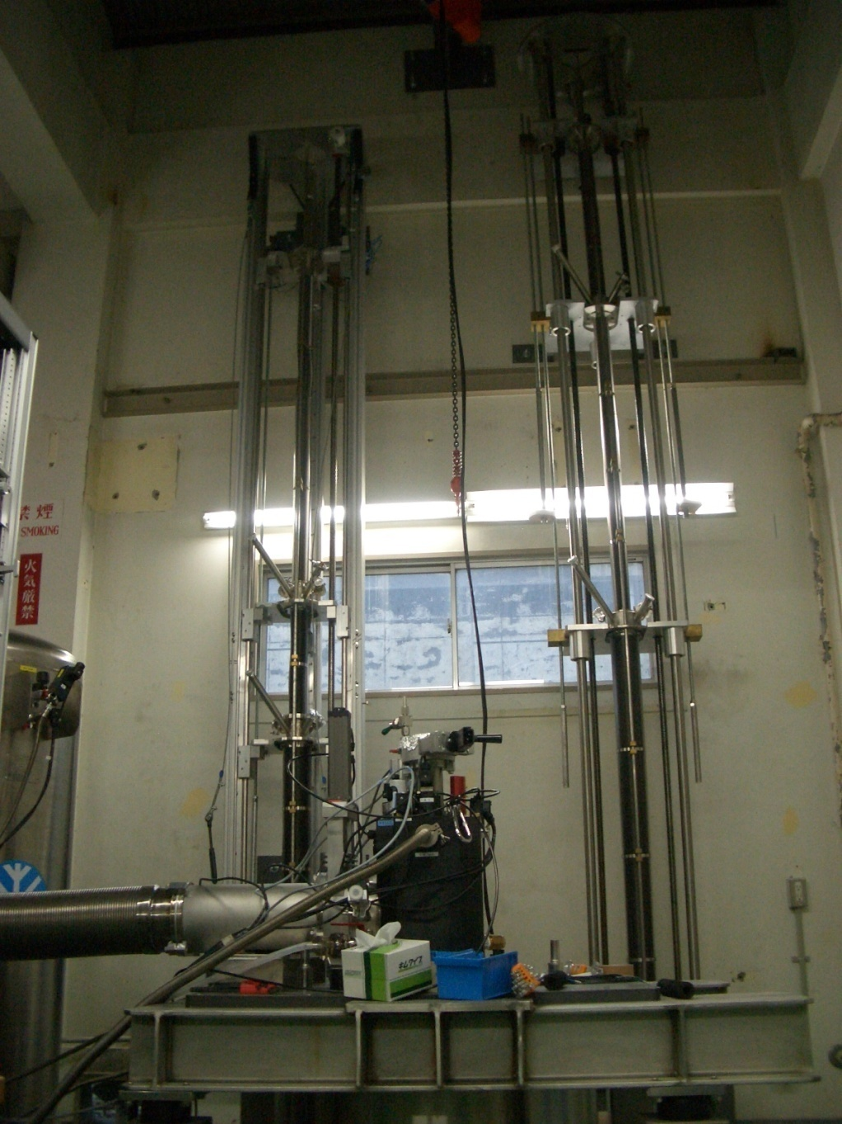
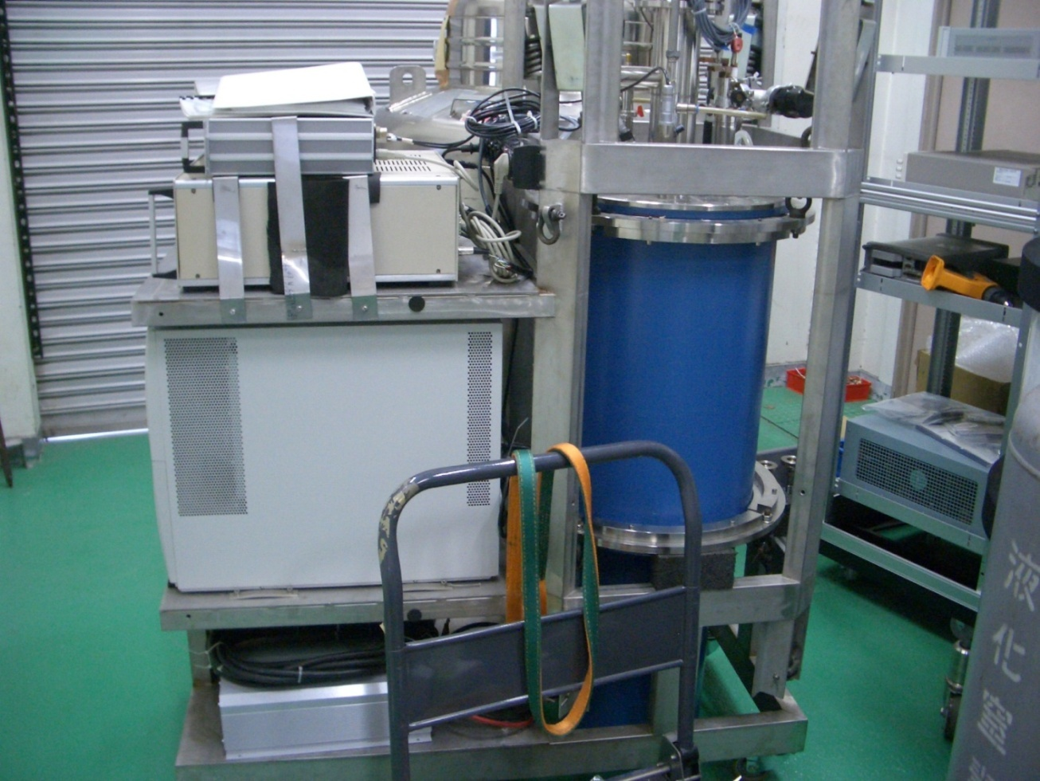
Transfer cryostats & Storage cryostat
Both are ⁴He cryostats & provided from the Orsay group.
TC for IBC
TC for DRS
SC
Magnetic Field : 2.5 Tesla
Temperature : T~1.5 K
Homogeneity : 10 ⁻⁴
for target region
Magnetic Field : ~0.2 Tesla
Temperature : T ~ 4.2 K
8 / 14

Slide 12
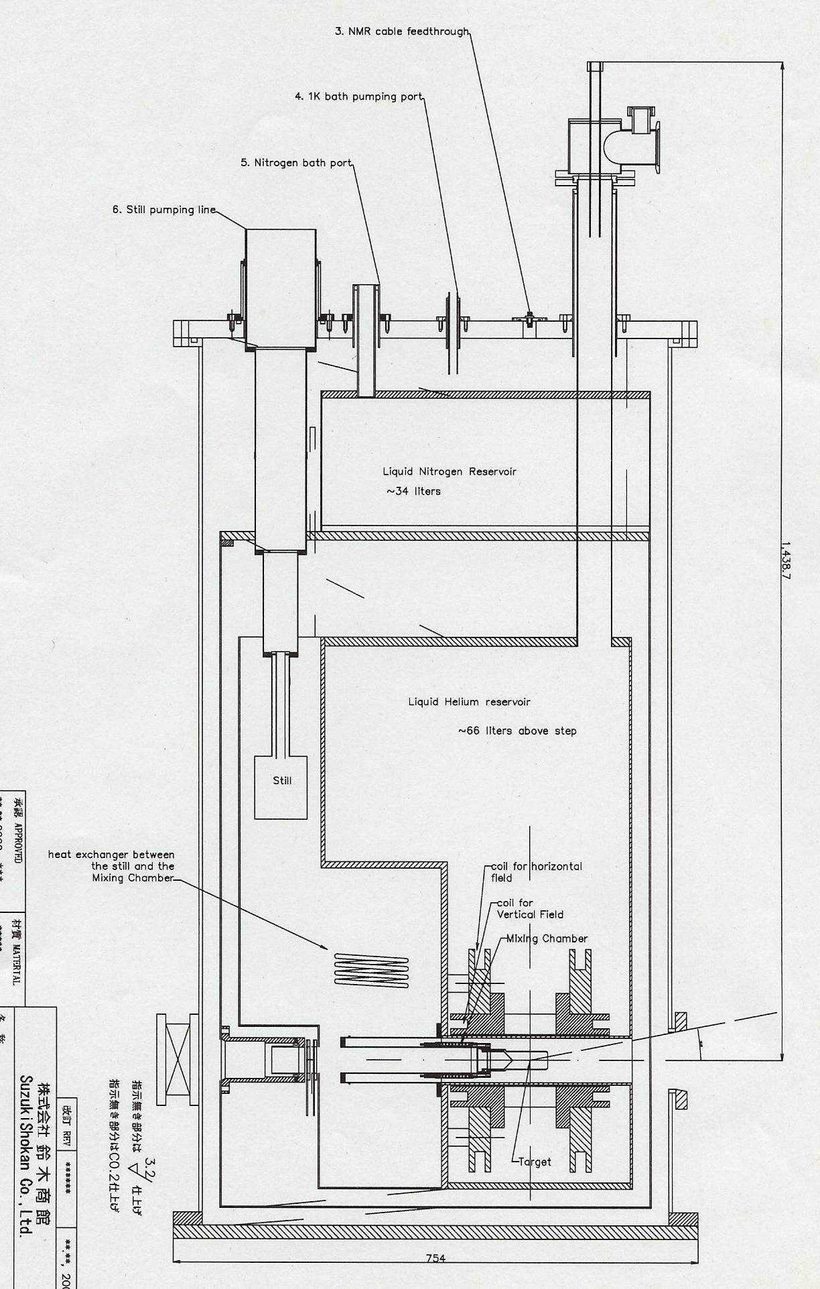
In-beam cryostat
T=300 mK
B=1 T
Target polarization can be changed to the longitudinal or transverse directions by coils.
Many polarization observables can be obtained by combining with the circular or linear polarization of γ-ray beam.
Cell insertion
by TC
9 / 14

Slide 13
Introduction (Polarization mechanism, Physics motivation)
Target production system (Various cryostats & Magnets)
Experimental results (Distillation, NMR, Proton polarization test)

Slide 14
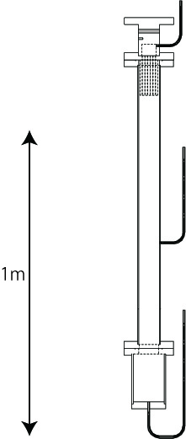
HD gas distillation
Refrigerator
HD solid
HD liquid
T~18 K
T~20 K
T~21 K
H₂ solid
H₂ liquid
H₂ gas
HD gas
Filled by Heli-packs
0
T. Ohta et al. NIM A 640 (2011) 241
Gas chromatograph
(T~110 K)
Quadrupole
Mass
Spectrometer
Heater
10 / 14

Slide 15
HD gas distillation
T. Ohta et al. NIM A 664 (2012) 347
Commercial-base HD gas purity before distillation is about 95%.
⇒ The new distillation system has enough ability to purify an HD gas.
(The amount of o-H₂ is also adjustable.)
p-H₂
H₂ concentration (p-H₂ + o-H₂) during gas distillation
HD purity
~99.99%
o-H₂
Partial Pressure (mbar)
HD
D₂
Elapsed Time in Gas Chromatograph (min)
Mass/Charge (u/e)
11 / 14

Slide 16
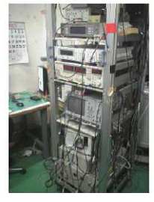
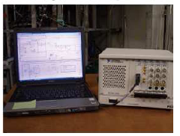
NMR measurement
The polarization should be measured at any place during the target transportation
from RCNP to SPring-8. Need a system which is easy to move.
⇒ Portable NMR measurement system by PCI eXtensions for Instrumentation
(PXI) with a LabVIEW control.
Conventional NMR system (~80 kg)
Portable NMR system (~7 kg)
T. Ohta et al. NIM A 633 (2011) 46
12 / 14

Slide 17
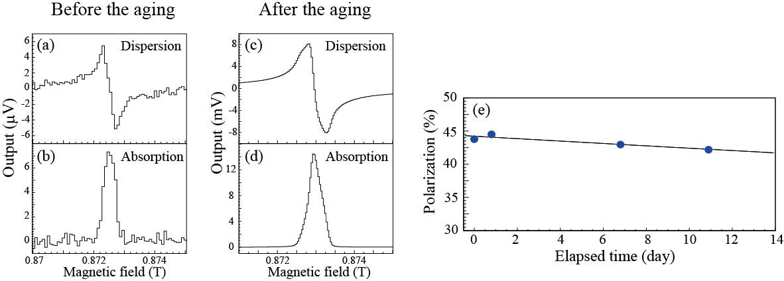
Proton polarization test
T. Ohta et al., Review of Scientific Instruments 91, 095104 (2020)
3-month ageing was performed with DRS under B=17 T & T=30 mK.
Relaxation of the H polarization
T₁ = 8 ± 2 months
Thermal Equilibrium ~2000 times larger
at 4.2 K and 0.87 T P_{H} = 44 ± 1 %
13 / 14

Slide 18
Summary
HD polarized target (90% for H and 60% for D) is producible by “brute force” under a high magnetic field (17 T) & a vary low temperature (10 mK). It is useful to reduce heavy element contamination.
After an HD distillation down to the H₂ contamination of 0.01% and a 3-month ageing process, it has been confirmed that the relaxation time can be the order of a year.
So far, only the proton polarization has been done. But the deuteron polarization should also be available with adiabatic fast passage and can be frozen by the contamination of o-D₂. The polarization of H or/and D is controllable.
14 / 14

Slide 19
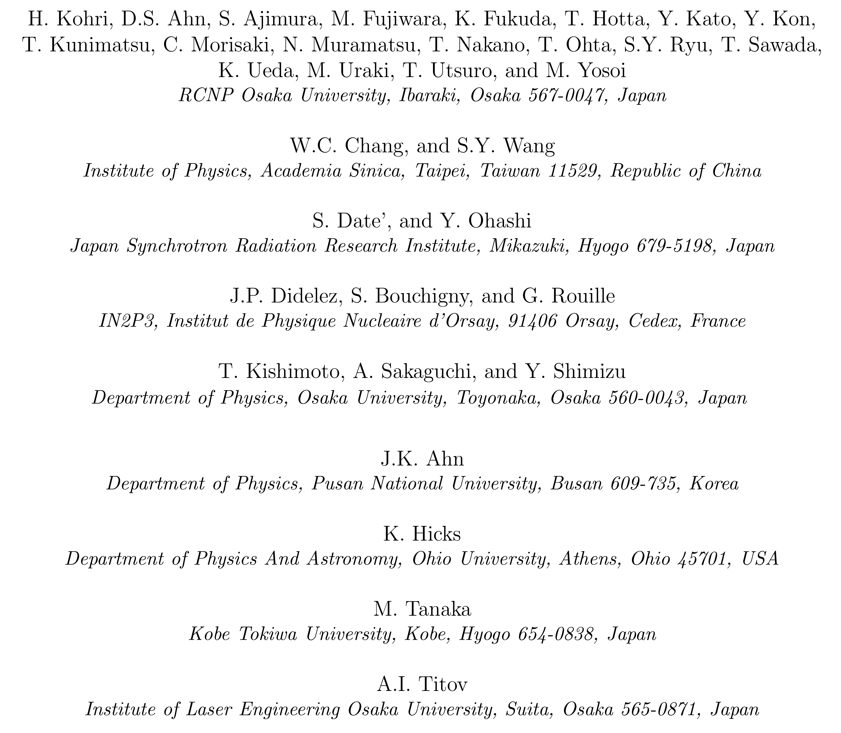
Collaboration list in 2005

