Slide 1
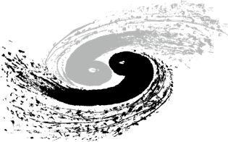
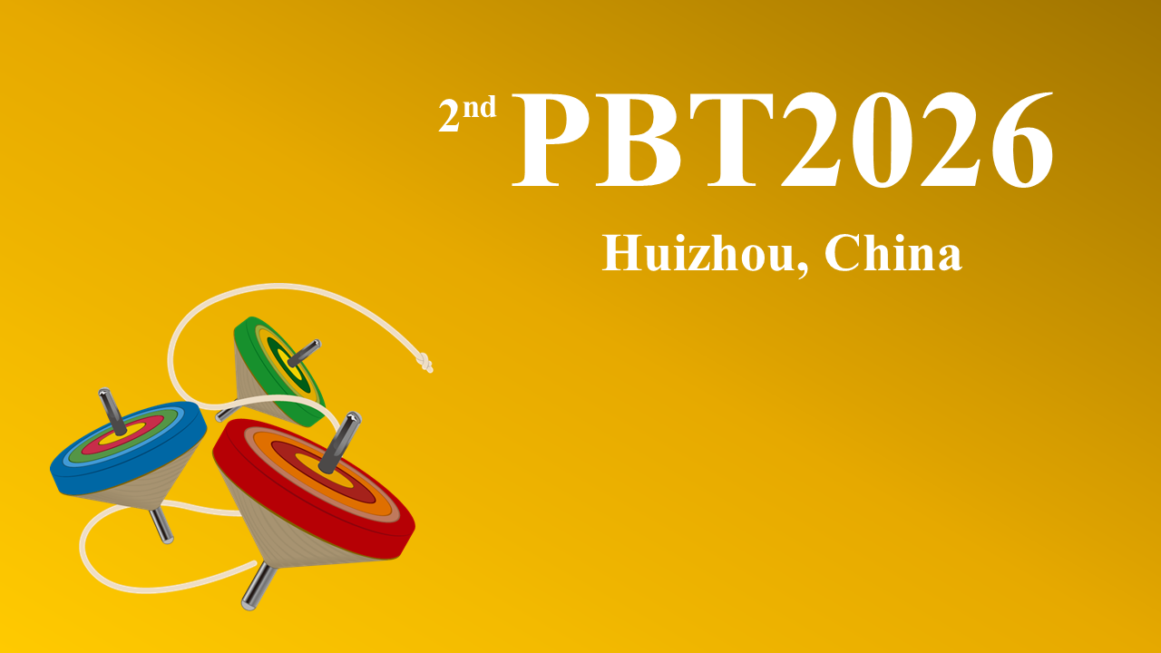
Polarized beam studies for CEPC and BEPCII
Zhe Duan
Institute of High Energy Physics, CAS
March 30 – April 3, 2026, 2nd workshop on polarized beam and target, Huizhou, email: duanz@ihep.ac.cn

Slide 2
Outline
Polarization studies for CEPC
R&D for polarized beams at BEPCII
Summary

Slide 3
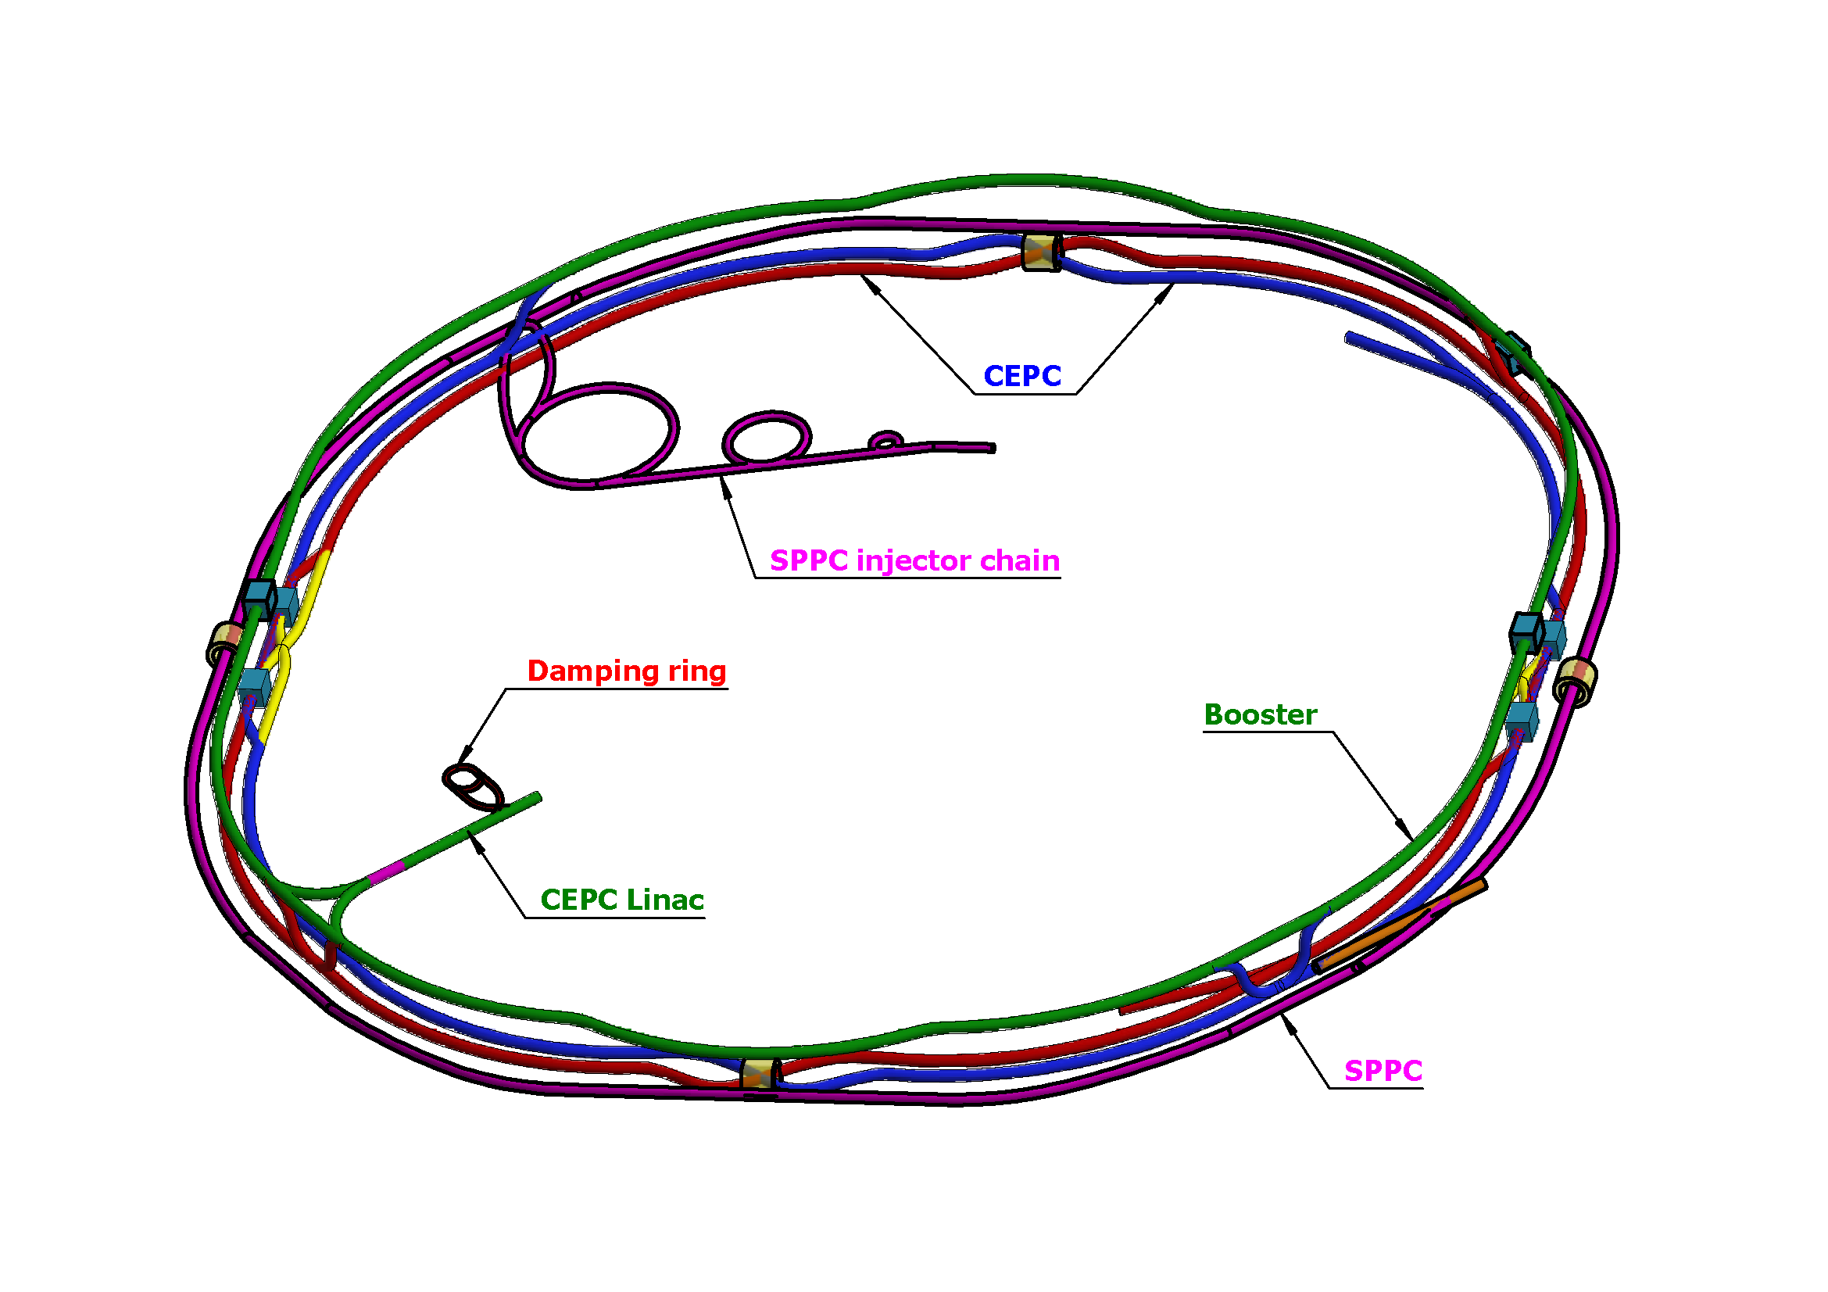
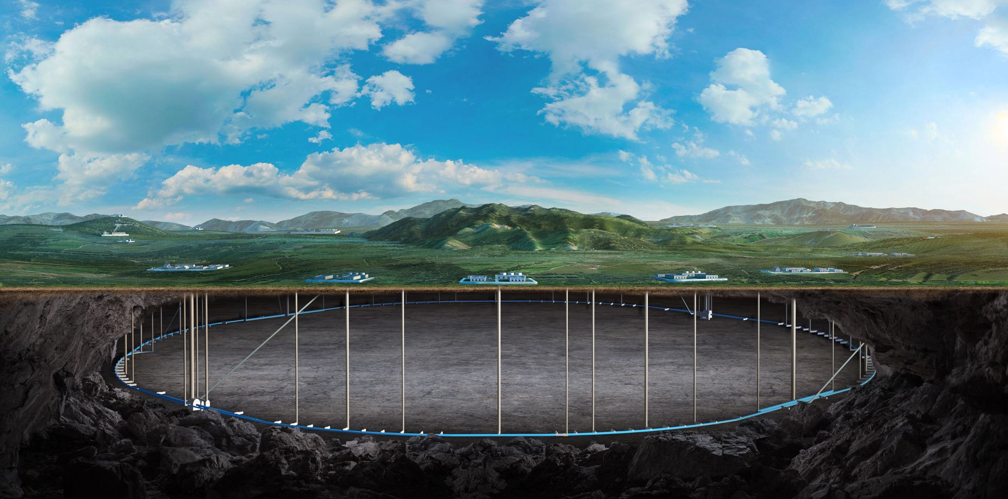
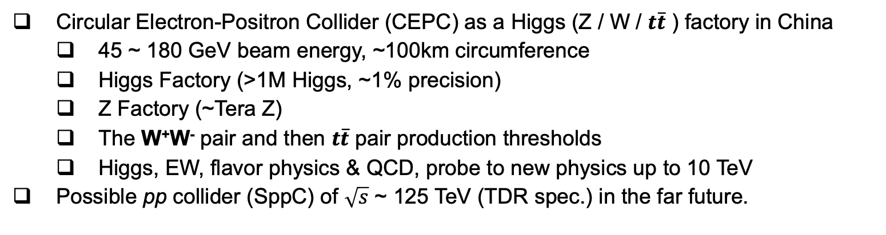
Circular Electron Positron Collider (CEPC)
Circular Electron-Positron Collider (CEPC) as a Higgs (Z / W / $t\overline{t}$ ) factory in China
  45 ~ 180 GeV beam energy, ~100km circumference
  Higgs Factory (>1M Higgs, ~1% precision)
  Z Factory (~Tera Z)
  The W⁺W⁻ pair and then $t\overline{t}$ pair production thresholds
  Higgs, EW, flavor physics & QCD, probe to new physics up to 10 TeV
Possible pp collider (SppC) of $\sqrt{s}$ ~ 125 TeV (TDR spec.) in the far future.

Slide 4
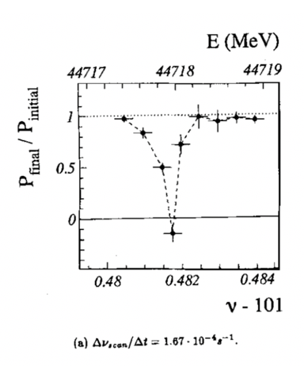
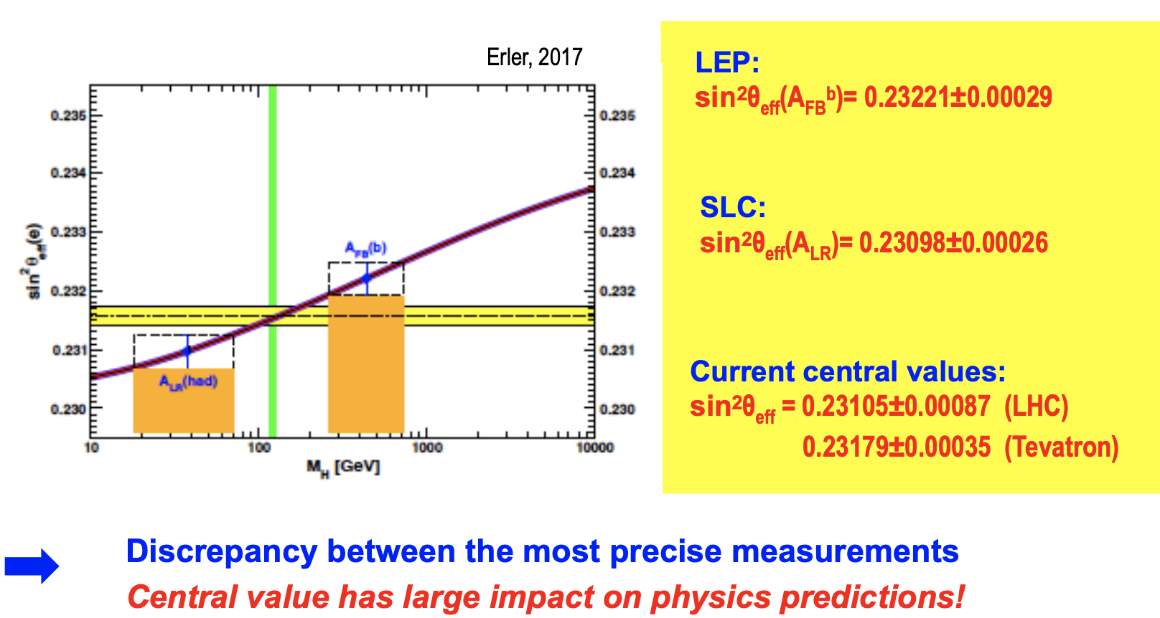
Physics motivation of polarized beams @ CEPC
Precision beam energy calibration @ Z, W (~100keV)
  resonant depolarization with vertically polarized beams (> 10% pol)
Precision measurement of weak mixing angle @ Z
  Longitudinally polarized colliding beams for measuring A_{LR}
  could resolve the tension between A_{FB} & A_{LR}, by measuring both in the same experiement
CPV with polarized beams in e+e- → HZ. H → ττ etc
ECFA meeting on e+e- to ZH angular measurements
Polarized beam applications @ ILC,
arXiv:2105.09691, 2111.06687, 2202.07385
L. Arnaudon, et al., Z. Phys. C 66, 45-62 (1995).
G. Moortgat-Pick’s talk on CEPC Workshop EU @ Marseille, 2024 April

Slide 5
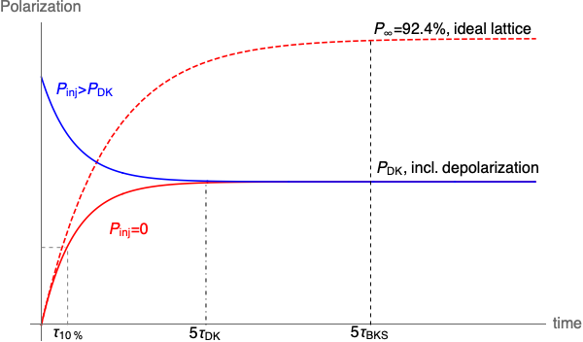
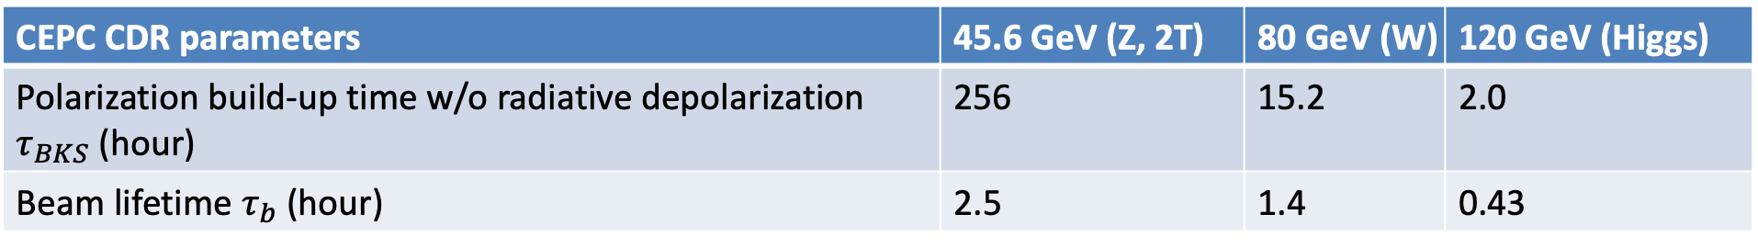
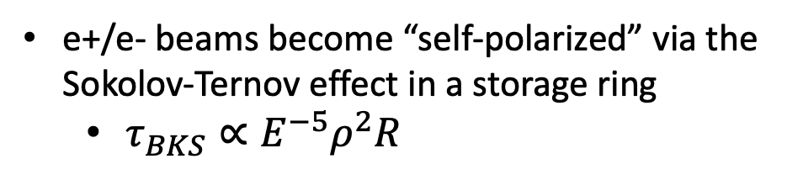
Self-polarization in the CEPC
e+/e- beams become “self-polarized” via the Sokolov-Ternov effect in a storage ring
  $τ_{BKS}∝E^{−5}ρ^{2}R$
Beam polarization build-up rate much slower than the beam decay rate @ Z-pole
  Boosted with asymmetric wigglers in the Collider (FCC-ee original scheme)
  Hard to achieve a high-level polarization
  In conflict with a high luminosity
CEPC CDR parameters | 45.6 GeV (Z, 2T) | 80 GeV (W) | 120 GeV (Higgs)
Polarization build-up time w/o radiative depolarization $τ_{BKS}$ (hour) | 256 | 15.2 | 2.0
Beam lifetime $τ_{b}$ (hour) | 2.5 | 1.4 | 0.43

Slide 6
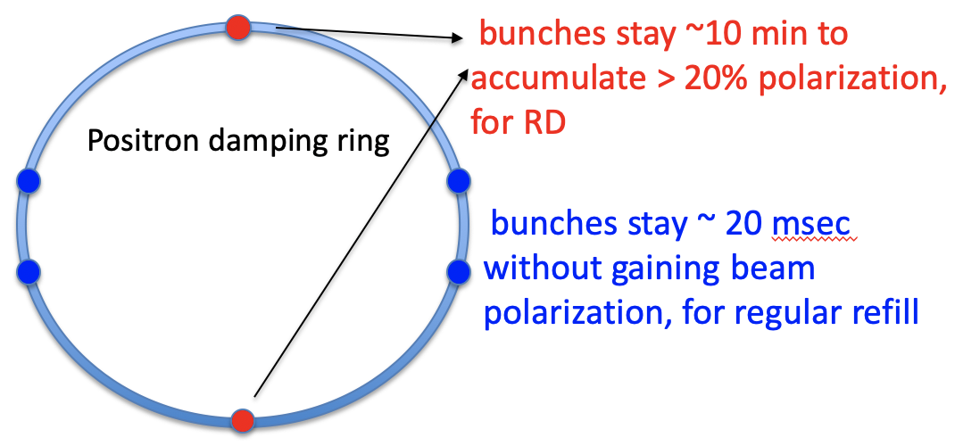
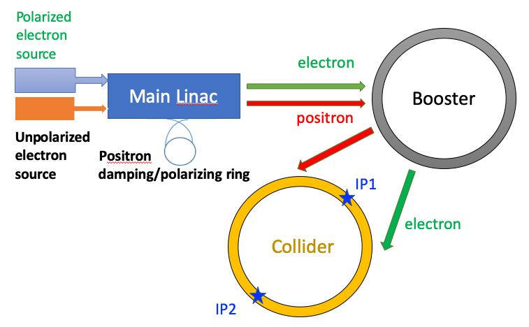
Injecting polarized beams for resonant depolarization
Polarized source
  Polarized electron gun w/ superlattice GaAs cathode (>80% polarization)
  Positron damping/polarizing ring(>20% polarization)
Use self-polarization at the e+ damping ring
  polarization build-up time ~ 14.5 min
  extracted beam polarization @ 10min ~ 44%
DR V4.0 | unpolarized e+ | polarized e+
Energy (Gev) | 1.983
Circumference (m) | 144.2
Dipole strength B₀ (T) | 1.92
U₀ (kev/turn) | 397.9
Damping time x/y/z (ms) | 4.8/4.8/2.4
Storage time | 20 ms | 10 min
δ₀ (%) | 0.0917
ε₀ (mm.mrad) | 132
injection σ_{z} (mm) | 6
Extract σ_{z} (mm) | 6.7 | 6.6
ε_{inj} (mm.mrad) | 2500
ε_{ext x/y} (mm.mrad) | 133/13 | 132/13

Slide 7
Injecting polarized beams for resonant depolarization
Polarized source
  Polarized electron gun w/ superlattice GaAs cathode (>80% polarization)
  Positron damping/polarizing ring(>20% polarization)
Linac & Transport lines
  no interleaved H & V bendings
  polarization loss is negligible
Booster
  free from intrinsic spin resonances
  polarization can be well maintained for Z & W
T. Chen, Z. Duan, D. H. Ji, D. Wang, Phys. Rev. Accel. Beams, 26, 051003 (2023).
The key is to understand the spin resonance structure

Slide 8
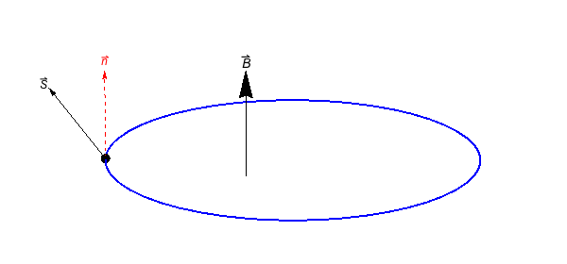
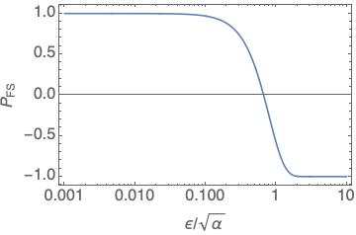
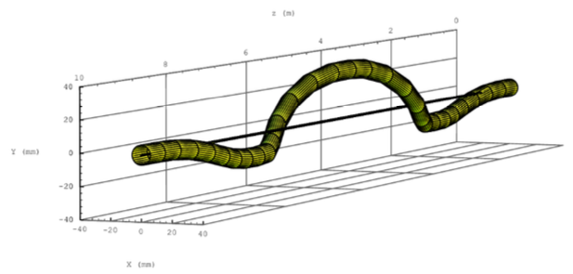
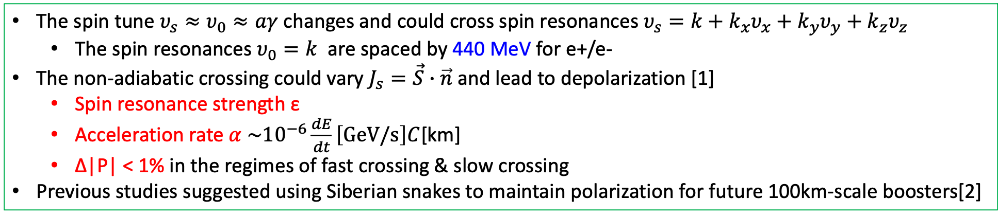
Polarization Maintenance in the Booster
Concern
  Depolarization due to crossings of hundreds of spin resonances, during Booster acceleration
The spin tune $υ_{s}≈υ_{0}≈aγ$ changes and could cross spin resonances $υ_{s}=k+k_{x}υ_{x}+k_{y}υ_{y}+k_{z}υ_{z}$
  The spin resonances $υ_{0}=k$ are spaced by 440 MeV for e+/e-
The non-adiabatic crossing could vary $J_{s}=\vec{S}∙\vec{n}$ and lead to depolarization [1]
  Spin resonance strength ε
  Acceleration rate $α \sim {10}^{−6}\frac{dE}{dt}\left[GeV/s\right]C$[km]
  Δ|P| < 1% in the regimes of fast crossing & slow crossing
Previous studies suggested using Siberian snakes to maintain polarization for future 100km-scale boosters[2]
Fast crossing
Slow crossing
Spin precession
Orbit motion in a helical snake @ RHIC
[1] Froissart and Stora, NIM 7, 297 (1960)
[2] I. Koop et al., Phys. Part. Nucl. Lett. 13. 7 (2016);
S. Nikitin, IJMPA 34, 1940004(2019); IJMPA 35, 2041001 (2020).

Slide 9


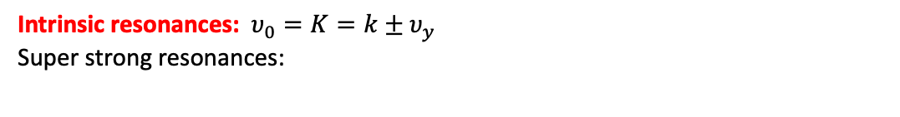

Spin resonance structure: Intrinsic resonance strength
due to P superperiods
$$\left|ε\right|≈\left|ζ_{P}\right| |ε_{arc}+ε_{ss}+ε_{DOM}|$$
due to M identical FODOs in each arc
$$ε_{arc}{=|ε}_{FODO}| {|ζ}_{M}|$$
$ε_{ss}$ = 0 for integer vertical phase advance & identical cells
CEPC booster as an example
Intrinsic resonances: $υ_{0}=K=k±υ_{y}$
Super strong resonances:
Summation from all FODO cells, essentially interference pattern
  Enhancement under certain resonance conditions
  Cancellation away from these resonances
[1] S. Y. Lee, Spin dynamics and snakes in synchrotrons (World Scientific, 1997).
[2] T. Chen, Z. Duan, D. H. Ji, D. Wang, Phys. Rev. Accel. Beams, 26, 051003 (2023).

Slide 10
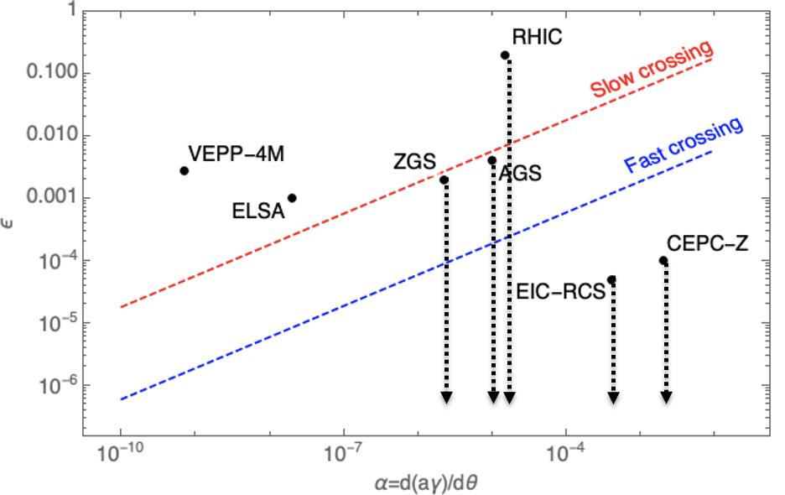
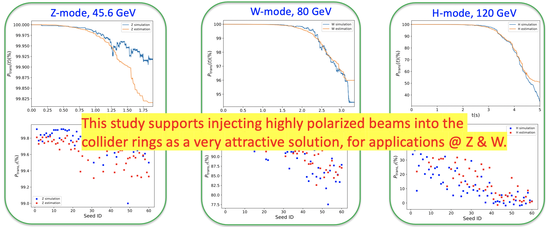
Polarization Maintenance in the Booster
Finding
  Highly periodic lattice -> structural cancellation -> weak spin resonances
  Spin resonance crossings lead to negligible depolarization to Z
Resonance strength vs ramping rate:
CEPC-Z in the regime of negligible depolarization
Polarization transmission to Z, W and Higgs energies in Booster:
Z: over 99%, W: 77.5%~ 98%, Higgs: no better than 40%
T. Chen, et al., Booster free from spin resonance for future 100-km-scale circular e+e- colliders, Phys. Rev. Accel. Beams, 26, 051003 (2023).

Slide 11
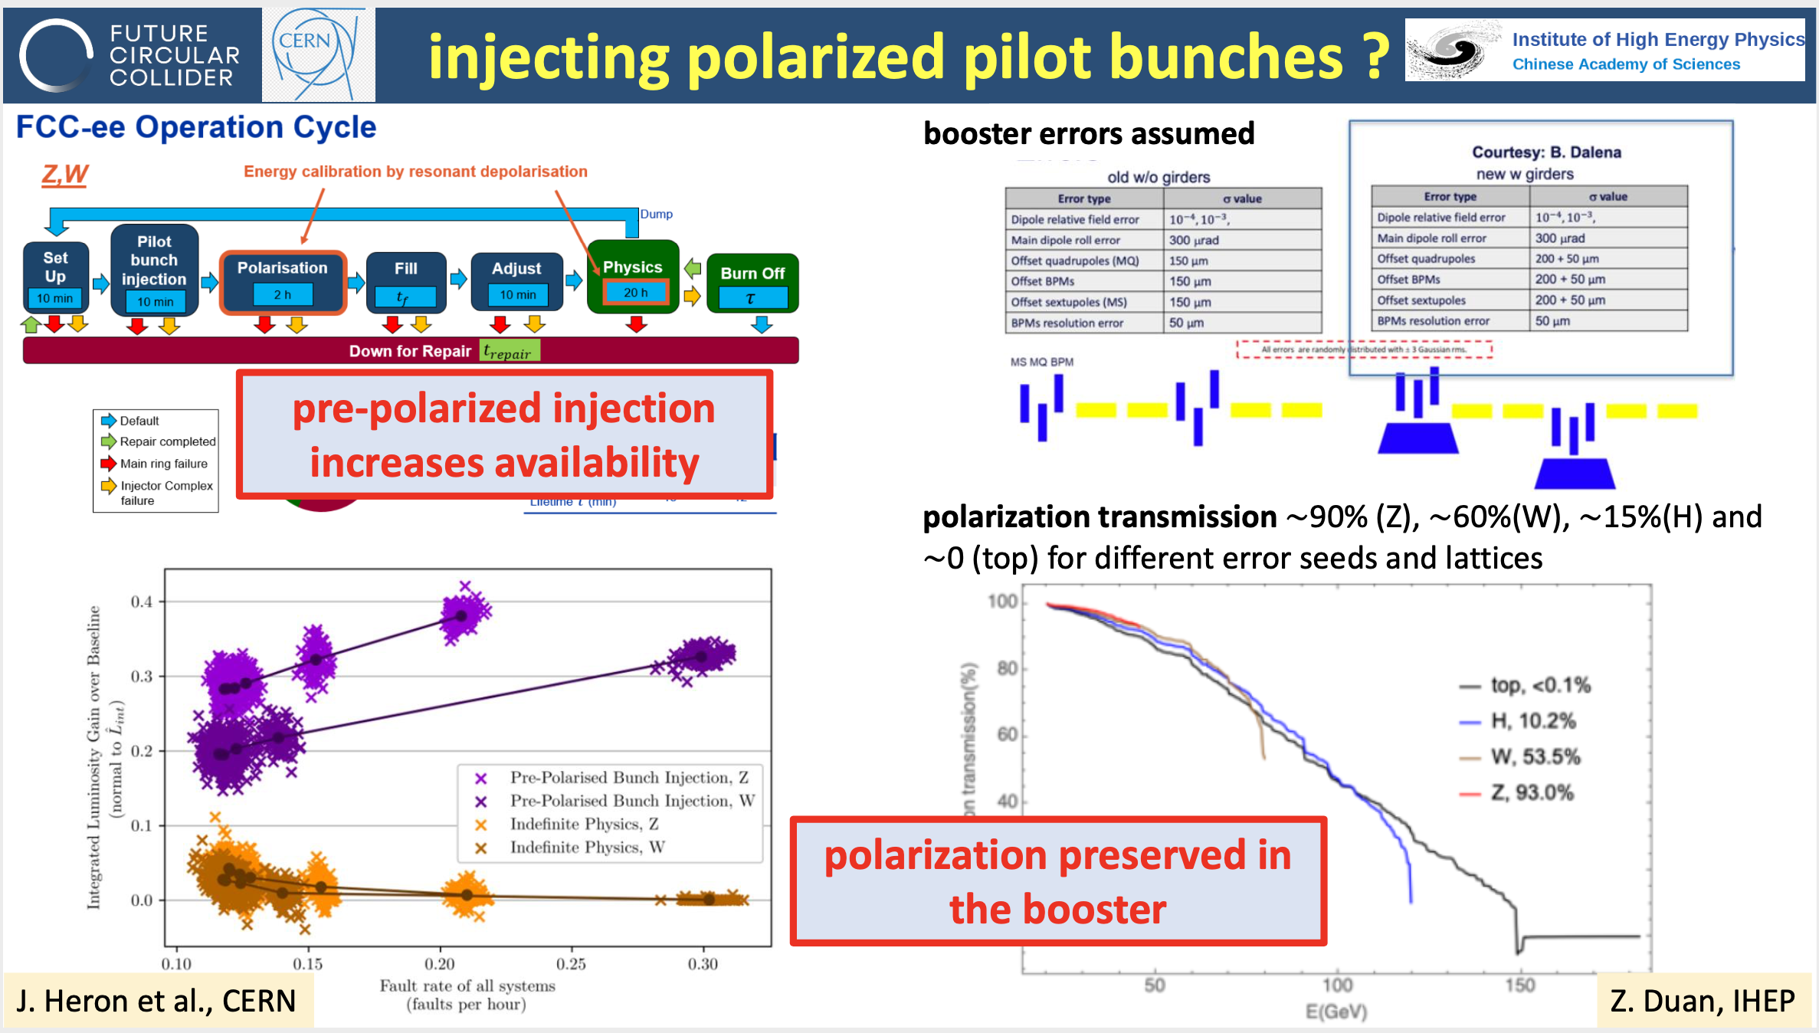
Endorsed by FCC-ee studies
F. Zimmermann, FCC Accelerator Status, FCC Week 2024

Slide 12
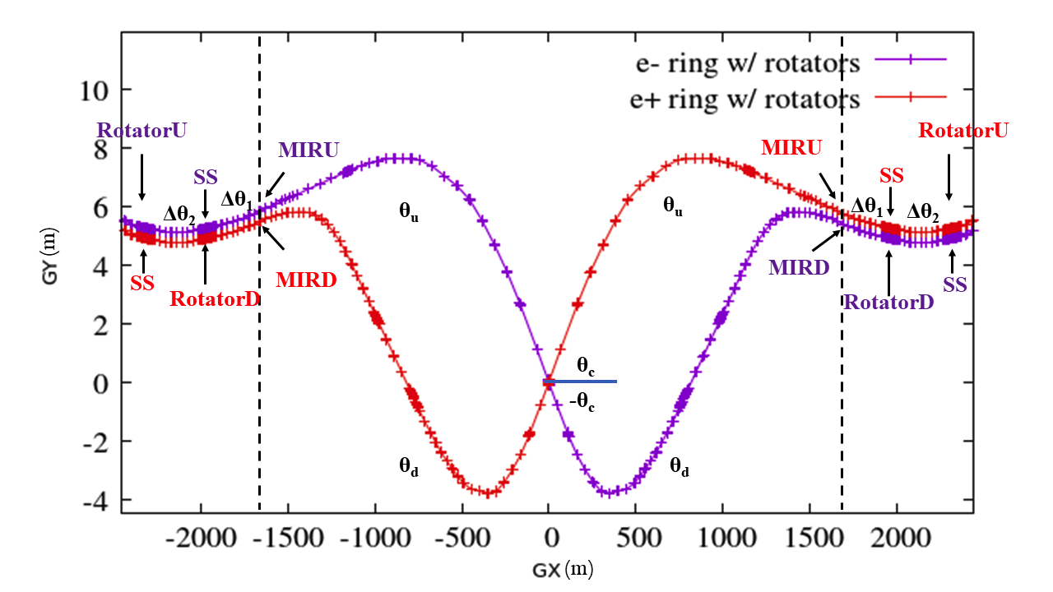
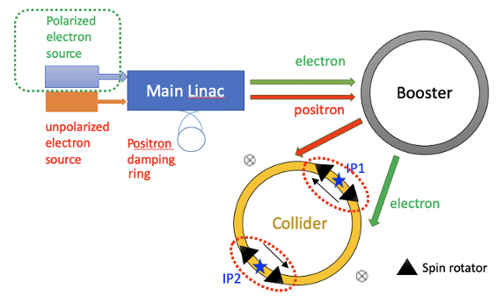
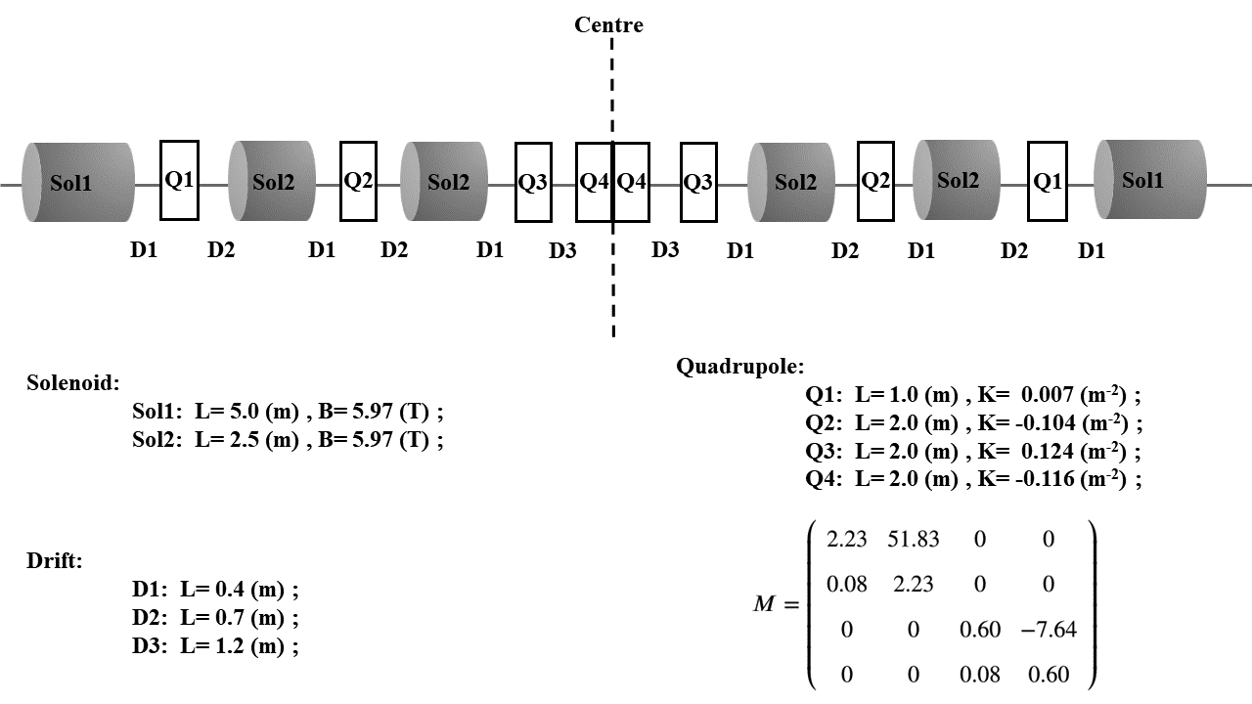
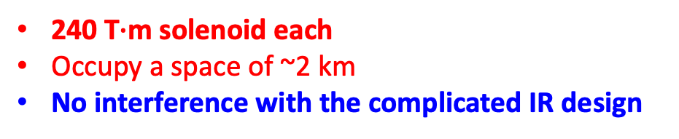
A high-level longitudinal polarization @ Z-pole
2 pair of spin rotators inserted to attain longitudinal polarization at IPs of Collider
240 T$∙$m solenoid each
Occupy a space of ~2 km
No interference with the complicated IR design
Implementation of the spin rotators adjacent to the IR
W. Xia et al., Investigation of spin rotators in CEPC at the Z-pole,
Radiat. Det. Tech. Meth. 6:490 (2022).

Slide 13
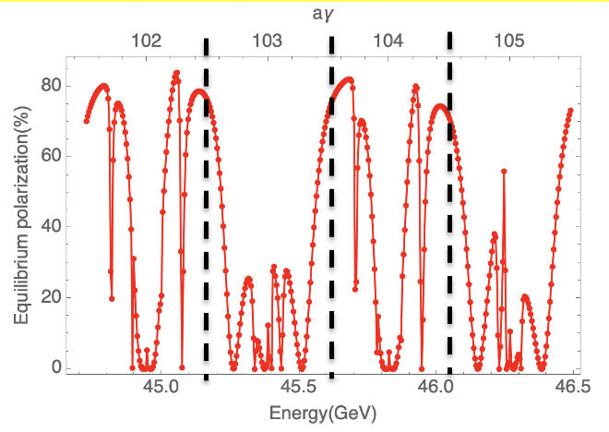
A high-level longitudinal polarization @ Z-pole
50%-70% longitudinal polarization for e- bunches is a reasonable goal
Unpolarized e+ is assumed
Over 70% injected e- beam polarization
Simulated equilibrium longitudinal polarization > 70%, leaving a large margin for effects not yet covered.
Implementation of the spin rotators adjacent to the IR
Simulated equilibrium polarization for an imperfect lattice w/ rotators after closed orbit correction
W. Xia et al., Investigation of spin rotators in CEPC at the Z-pole,
Radiat. Det. Tech. Meth. 6:490 (2022).

Slide 14
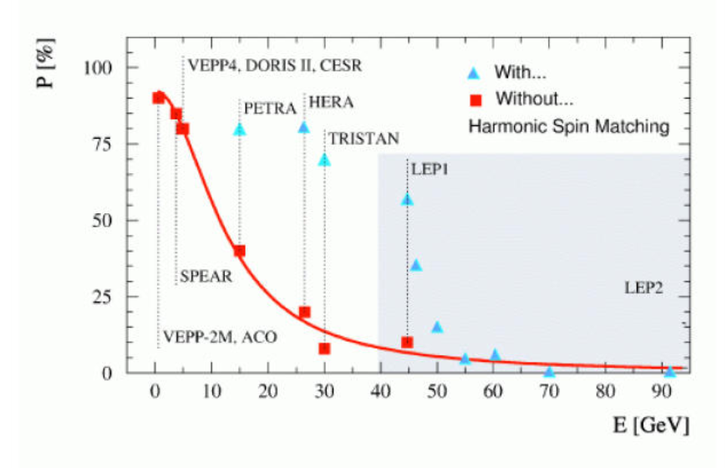
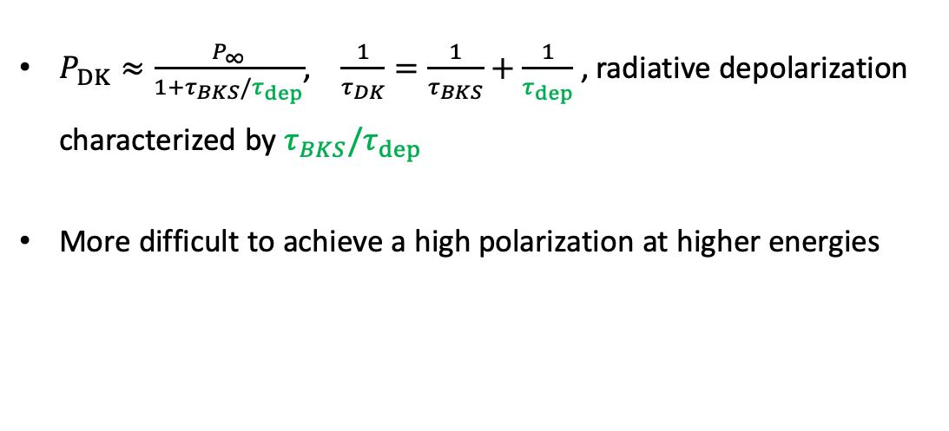
Radiative depolarization in electron storage rings
$P_{DK}≈\frac{P_{∞}}{1+τ_{BKS}/τ_{dep}}$, $\frac{1}{τ_{DK}}=\frac{1}{τ_{BKS}}+\frac{1}{τ_{dep}}$ , radiative depolarization characterized by $τ_{BKS}/τ_{dep}$
More difficult to achieve a high polarization at higher energies
Electron polarization measurements in different machines [1]
[1] R. Assmann, et al., AIP Conference Proceeding, 570, 169 (2001).

Slide 15
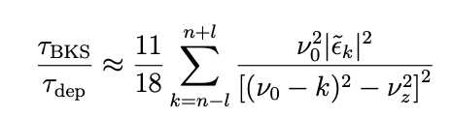
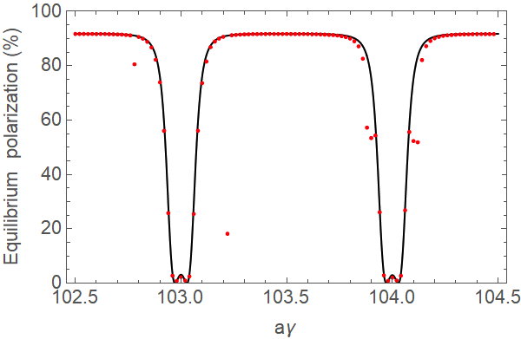
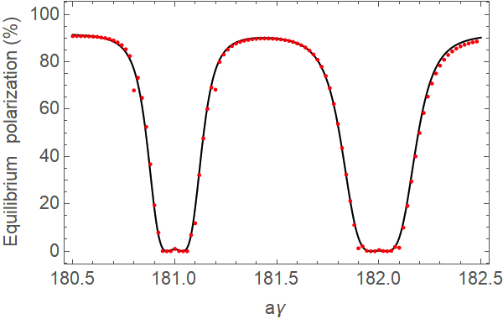
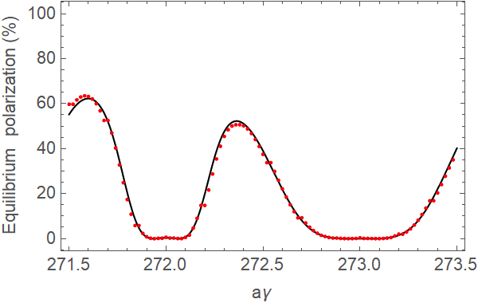
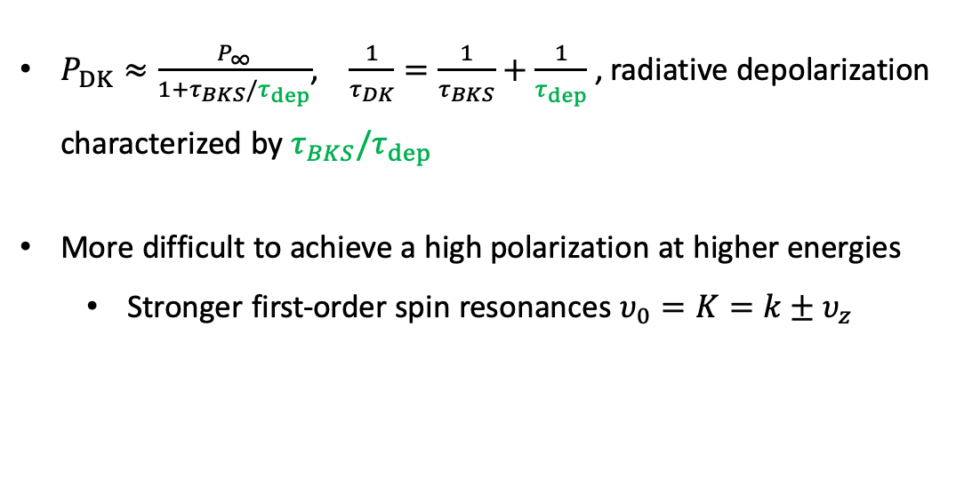
Radiative depolarization in electron storage rings
$P_{DK}≈\frac{P_{∞}}{1+τ_{BKS}/τ_{dep}}$, $\frac{1}{τ_{DK}}=\frac{1}{τ_{BKS}}+\frac{1}{τ_{dep}}$ , radiative depolarization characterized by $τ_{BKS}/τ_{dep}$
More difficult to achieve a high polarization at higher energies
  Stronger first-order spin resonances $υ_{0}=K=k±υ_{z}$
Electron polarization measurements in different machines [1]
[1] R. Assmann, et al., AIP Conference Proceeding, 570, 169 (2001).
Agree well with SLIM simulations, can be alleviated w/ harmonic spin matching
Z
W
Higgs

Slide 16
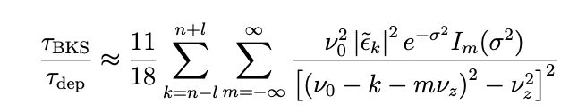


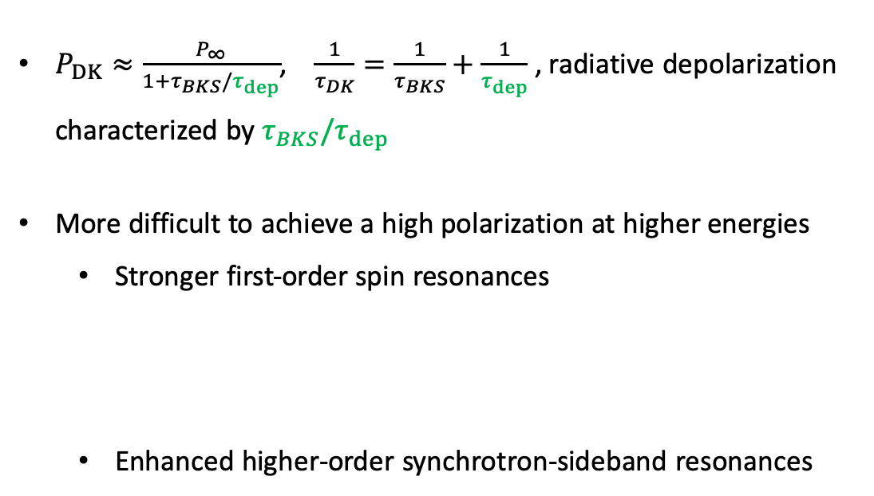


Radiative depolarization in electron storage rings
$P_{DK}≈\frac{P_{∞}}{1+τ_{BKS}/τ_{dep}}$, $\frac{1}{τ_{DK}}=\frac{1}{τ_{BKS}}+\frac{1}{τ_{dep}}$ , radiative depolarization characterized by $τ_{BKS}/τ_{dep}$
More difficult to achieve a high polarization at higher energies
  Stronger first-order spin resonances
  Enhanced higher-order synchrotron-sideband resonances
Electron polarization measurements in different machines [1]
[1] R. Assmann, et al., AIP Conference Proceeding, 570, 169 (2001).
Size of safe region in ν₀ shrinks
What about even higher energies?
$$\text{ν}\text{0}σ_{δ}$$
$$\text{ν}\text{0}σ_{δ}$$
$$\text{ν}\text{z}$$
$$\text{ν}\text{z}$$

Slide 17
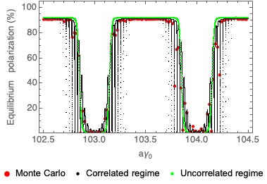
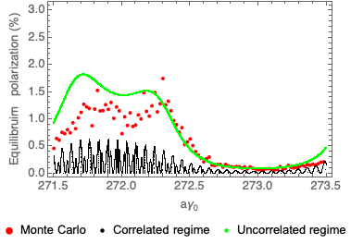
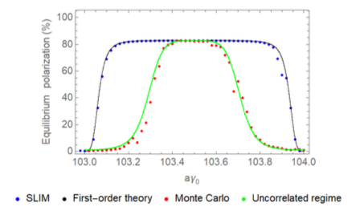
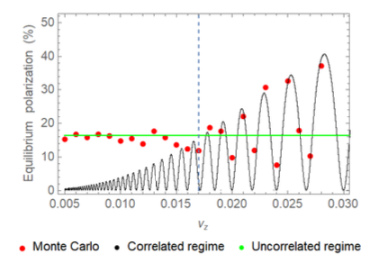

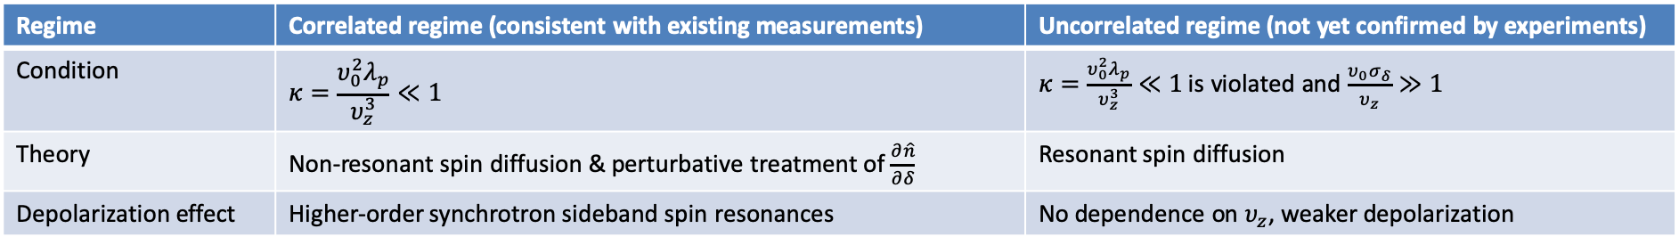
Radiative depolarization in ultra-high-energy storage rings
Two distinct spin diffusion mechanisms were proposed in [1] in 1970s, regarding the regimes of spin resonance crossing, in the combined effects of synchrotron oscillation and synchrotron radiation
Regime | Correlated regime (consistent with existing measurements) | Uncorrelated regime (not yet confirmed by experiments)
Condition | $$κ=\frac{υ_{0}^{2}λ_{p}}{υ_{z}^{3}}≪1$$ | $κ=\frac{υ_{0}^{2}λ_{p}}{υ_{z}^{3}}≪1$ is violated and $\frac{υ_{0}σ_{δ}}{υ_{z}}≫1$
Theory | Non-resonant spin diffusion & perturbative treatment of $\frac{∂\hat{n}}{∂δ}$ | Resonant spin diffusion
Depolarization effect | Higher-order synchrotron sideband spin resonances | No dependence on $υ_{z}$, weaker depolarization
Monte-Carlo simulations were compared with these theories in the energy range of CEPC [2]
  showing a gradual evolution from the correlated regime to the uncorrelated regime in parameter scan
This study suggests existing theories are incomplete, requiring further development
Case A: dependence on beam energy
Case B: influence of harmonic RF cavity
Z
Higgs
optimal lengthening condition
Scan harmonic RF voltage
$$κ=\frac{{\text{ν}}_{0}^{2}λ_{p}}{{\text{ν}}_{z}^{3}}→∞$$
[1] Derbenev, Kondrantenko and Skrinsky, Part. Accel. 9, 247 (1979)
[2] W. H. Xia, Z. Duan, D. P. Barber, Y. W. Wang, B. Wang, J. Gao, Phys. Rev. Accel. Beams. 2023

Slide 18
Outline
Polarization studies at CEPC
R&D for polarized beams at BEPCII
Summary

Slide 19
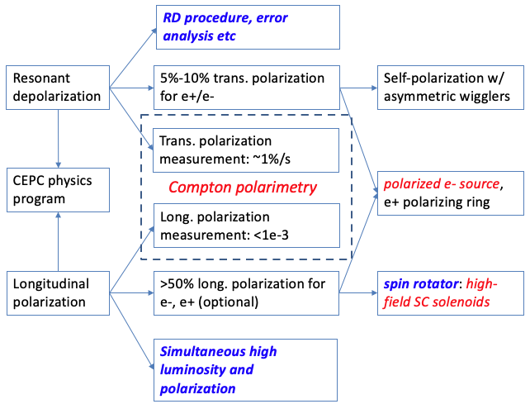
Beam polarization R&D for future colliders
CEPC requirements, R&D items and required experiment demonstration
Shared interests from other future collider projects,
R&D and demonstration at existing facilities is beneficial

Slide 20
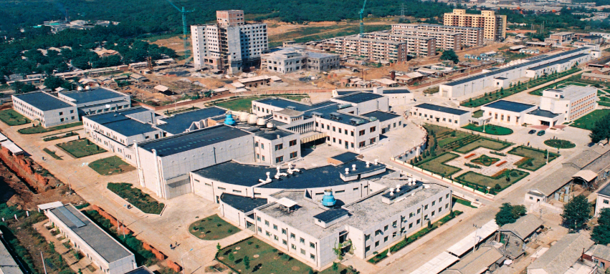
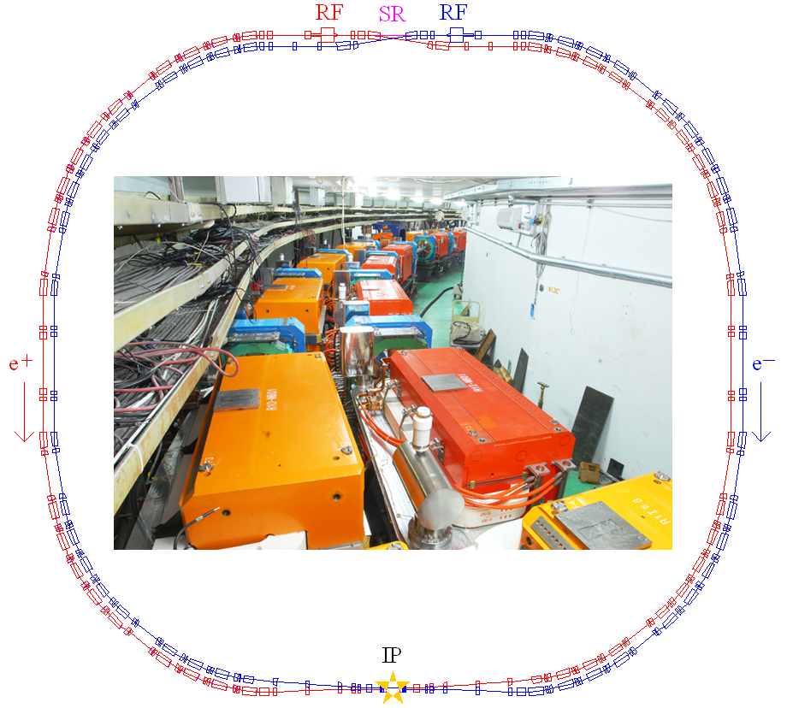
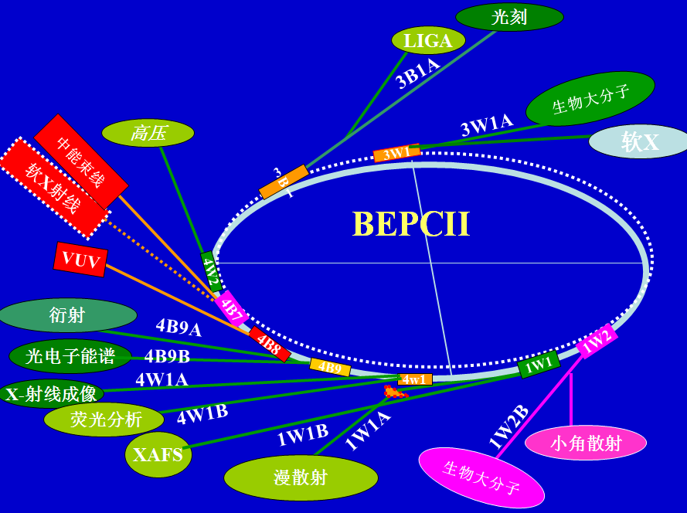
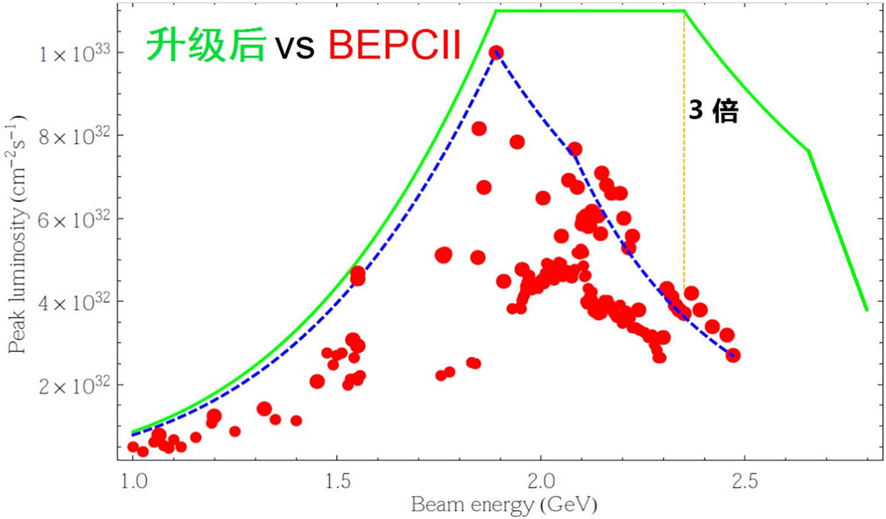
Beijing Electron Positron Collider (BEPC)
BEPCII: Single-ring -> double-ring collider (1.0 ~ 2.5 GeV )
User operation since 2009, luminosity goal (*100) reached in 2016, now in routine operation
first large science facility in China (1988-2005)
BSRF: synchrotron light source operation (since 1990)
BEPCII-U (from mid-2024)
Increase the energy reach (~2.8GeV) & luminosity at higher energies

Slide 21
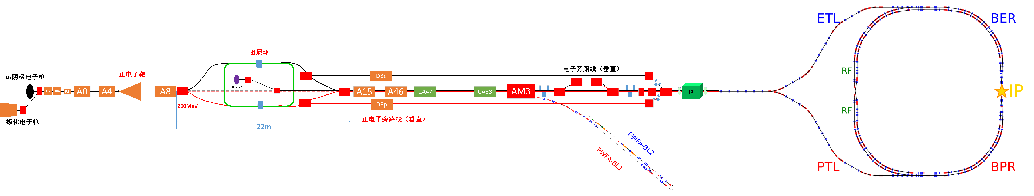
Accelerator R&D at BEPCII
A platform for PWFA established, beam commissioning in April, 2026
Crab-waist scheme & new damping ring under study for another luminosity upgrade
R&D for polarized electron beam in progress

Slide 22
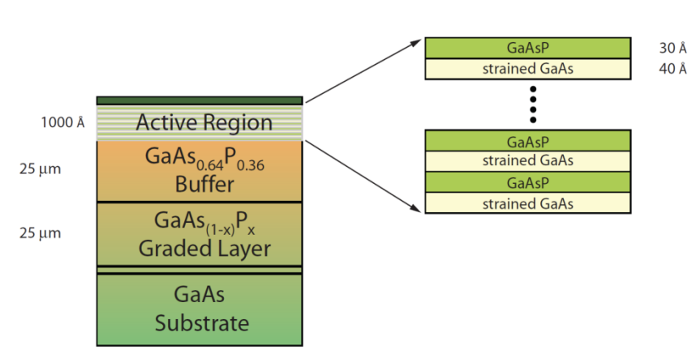
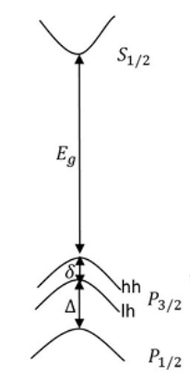
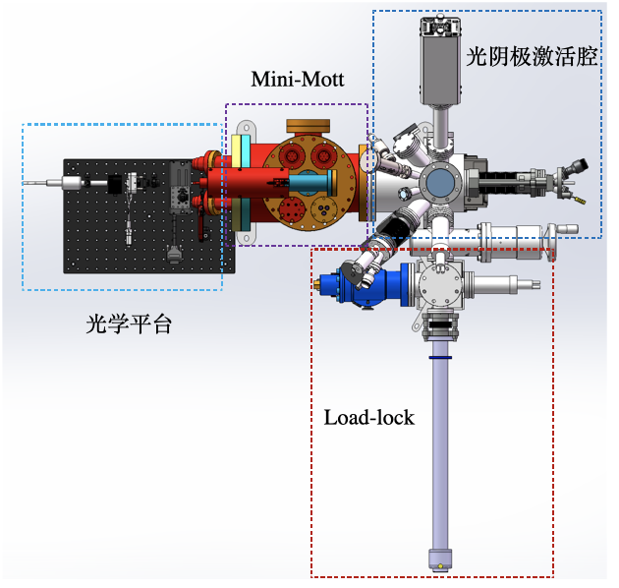
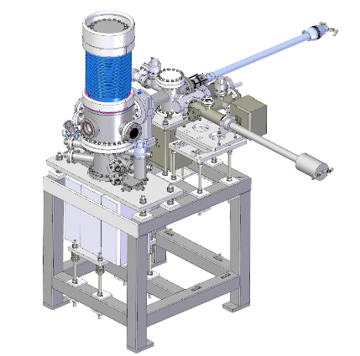
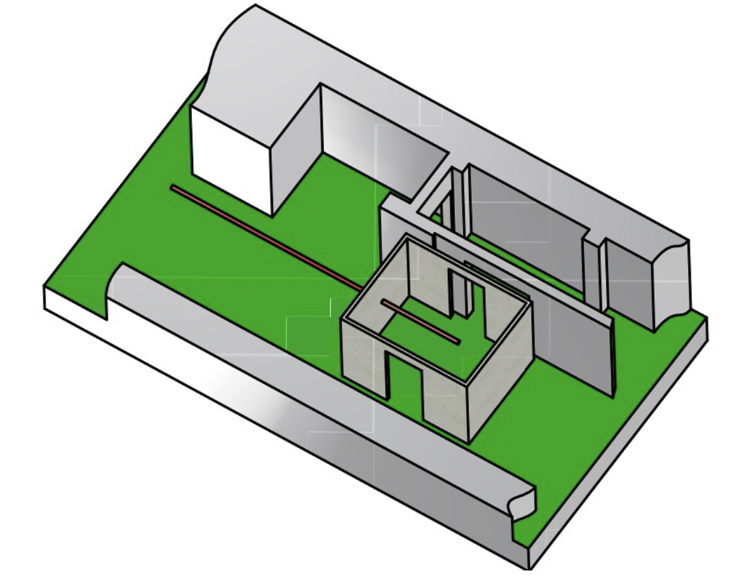

R&D on polarized electron source
Domestic R&D on superlattice GaAs cathode
  cathode production: polarization > 85%, QE > 0.8%
  build a platform for cathode performance test (pol & QE)
  First cathode sample is under test
A polarized electron source for BEPCII is under design
Space for polarized electron source
Platform for cathode test:
ESP & QE
Existing unpolarized source @ BEPCII

Slide 23

Compton polarimeter @ BEPCII
Simulations show a sizable polarization in routine operation conditions of BEPCII
A Compton polarimeter at BEPCII would help set up an interesting experimental platform for spin dynamics research
Vertical polarization 1 hour after injection
Aspects | R&D item
Compton polarimeter | laser polarization measurement/control, silicon pixel detector
Resonant depolarization | Operation scenarios, error analysis, colliding bunches & pilot bunches
Depolarization mechanism | Rich data of parameter dependence, beam-beam depolarization
Polarization tuning/optimization | spin matching, machine learning techniques

Slide 24





Introduction to Compton polarimeter
Muchnoi, FCC-ee polarimeter, arXiv:1803.09595
linear
polarization
circular polarization (helicity adjustable)
$$\frac{d^{2}σ}{dxdφ}=σ_{unp}(1+f(S_{1}^{L},S_{2}^{L})− S_{3}^{L}[P_{z}^{e}A_{z}+P_{t}^{e}A_{t}\cos{φ}])$$
Left-right (Counting rate) asymmetry
Up-down (Spatial distribution) asymmetry
${{(S}_{1}^{L})}^{2}+{{(S}_{2}^{L})}^{2}$+ ${{(S}_{3}^{L})}^{2}$=1

Slide 25



Compton polarimeter @ BEPCII
prototype of CEPC vertex detector
Location | beamline and experimental hall of 4W2 wiggler
Laser | 532nm, 4.5 kHz, 2 mJ, 1 ns, flippable circular polarization
Observable | Vertical asymmetry of backscattered γ (up to 180 MeV)
Detector | lead preshower + silicon pixel detector
Signal | backscattered γ ~ 20kHz/mA/W
Background | bremsstruhlung γ ~ 1kHz/mA
Assume 50% vertical polarization
MC simulation
Measured polarization (%)
~1% stats uncertainty in ~ 20 sec
Thickness of lead (mm)
25
25

Slide 26




Progress and status
Measurement of beam polarization effect under way
2026.4
Causality between laser & signal
Correlation between signal intensity and laser power
plastic scintiliator + PMT
Status report accepted by RDTM

Slide 27



Recent experiments with TaichuPix3
Commissioning of TaichuPix-3
Laser-to-Taichu as trigger
Laser-signal causality observed
Offline analysis of asymmetries
TaichuPix3

Slide 28

Recent experiments with TaichuPix3
Benchmark of the measurement against the Sokolov-Ternov effect is under way

Slide 29


Motivation for longitudinal polarization at BEPCII
BESIII spin physics has flourishes, focusing on polarization of final products of e+e- collisions
  Nature,606,64-69,2022; PRL 116,042001, 2016; PRL 130, 231901, 2023; arXiv:2502.16084
e- longitudinal polarization will enhance the spin physics potential at BESIII
  Search for CP violation in production & decay of Hyperon-Antihyperon pairs (arXiv:2502.20274)
  Spin dependent fragmentation function etc.
Refer to Haibo Li’s talk on “Spin physics at BESIII”

Slide 30


Motivation for longitudinal polarization at BEPCII
e- longitudinal polarization at BEPCII: a demonstrator for future colliders
  simultaneous achievement of high luminosity and high longitudinal polarization
  swap-out injection applied to e+e- collider, already demonstrated at APS-U & HEPS
  Long-term operation of polarized electron source
  Precision Compton polarimetry
swap-out injection
Courtesy of C. Steier

Slide 31


Longitudinal polarization scheme @ BEPCII
Longitudinal polarized e- versus unpolarized e+
Inserting a Siberian snake to attain longitudinal polarization at IP
  Superconducting solenoid, BL[T$∙$m]=10.467E[GeV], ~20T$∙$m @ 1.89GeV
  Depolarization time ~ E⁻⁷, 24 min @ 1.55 GeV (for spin matched snake)
A single full snake
IP

Slide 32


Longitudinal polarization scheme @ BEPCII
Longitudinal polarized e- versus unpolarized e+
Inserting a Siberian snake to attain longitudinal polarization at IP
  Superconducting solenoid, BL[T$∙$m]=10.467E[GeV], ~20T$∙$m @ 1.89GeV
  Depolarization time ~ E⁻⁷, 24 min @ 1.55 GeV (for spin matched snake)
top-up injection: frequently refill depleted depolarized bunches with fresh polarized bunches
  Polarized electron source can deliver injected beam polarization > 80%
  A shorter beam lifetime -> higher time-averaged beam polarization
A single full snake
IP

Slide 33


Longitudinal polarization scheme @ BEPCII
Longitudinal polarized e- versus unpolarized e+
Inserting a Siberian snake to attain longitudinal polarization at IP
  Superconducting solenoid, BL[T$∙$m]=10.467E[GeV], ~20T$∙$m @ 1.89GeV
  Depolarization time ~ E⁻⁷, 24 min @ 1.55 GeV (for spin matched snake)
Swap-out injection: frequently dump depolarized bunches and replace with fresh polarized bunches
  Polarized electron source can deliver injected beam polarization > 80%
  e.g. replace 1/12 of all 120 bunches every 20 seconds, corresponding to a beam lifetime of ~ 4min
1.55GeV, ~70%
$$P_{avg}=\frac{P_{inj}}{1+τ_{b}/τ_{p}}$$
A single full snake
1.89GeV, ~50%
IP

Slide 34

Layout of BEPCII

Slide 35
Modified layout for longitudinal polarization
Key issue 3: injection
injection
Key issue1： polarized e- source
Key issue 5: polarimetry
spin rotator
Compton polarimeter
Siberian
snake
150kV polarized DC gun
wien filter
Mott polarimeter
Key issue 2: spin manipulation
extraction to beam dump
Detailed design study is under way.
Key issue 4: extraction

Slide 36
Summary
Potential of polarized beam at CEPC is reviewed
R&D of key technologies in progress
Longitudinal polarization option is being studied for BEPCII
These activities will prepare for polarization applications at future colliders
Thank you for your attention!

Slide 38


What does that mean for the injector?
Top-up injection is prohibited by injection beam loss & dark current in BESIII detector
  A polarized electron source features a much smaller beam emittance, alleviating the injection beam loss
Increase in the duty factor of the linac, the burden is much relaxed than SuperKEKB linac
The required average beam current of the polarized e- source is moderate
Iida, IPAC’23, Beam injection issues at SuperKEKB
Comparison between parameters of polarized electron sources

Slide 39



Uncorrelated regime of spin resonance crossing
Prediction of the theory of resonant spin diffusion [1]
  Assume the adjacent two integer resonances have the same strength
  Influence of first-order betatron spin resonances are not included
120
180
120
180
Is it possible to have a few percent polarization at Higgs or even ttbar energies?
Improvement in Booster transmission
Mitigation of spin resonances in the Collider
[1] Derbenev, Kondrantenko and Skrinsky, Part. Accel. 9, 247 (1979)

Slide 40









Spin-orbit coupling resonances in circular accelerators
In a planar ring without solenoids, ${\hat{n}}_{0}$ could deviate from vertical near integer (imperfection) resonances $ν_{0}=K$, characterized by
Misalignments: quad ΔY & dipole roll
  Random: zero mean
  Systematic: “smoothed” vertical positioning, uneven settling, etc
Orbital correctors
$\hat{n}$deviates from ${\hat{n}}_{0}$ near spin resonances
First-order parent spin resonances:
For intrinsic resonances $ν_{0}=K=k±ν_{y}$

