Slide 1
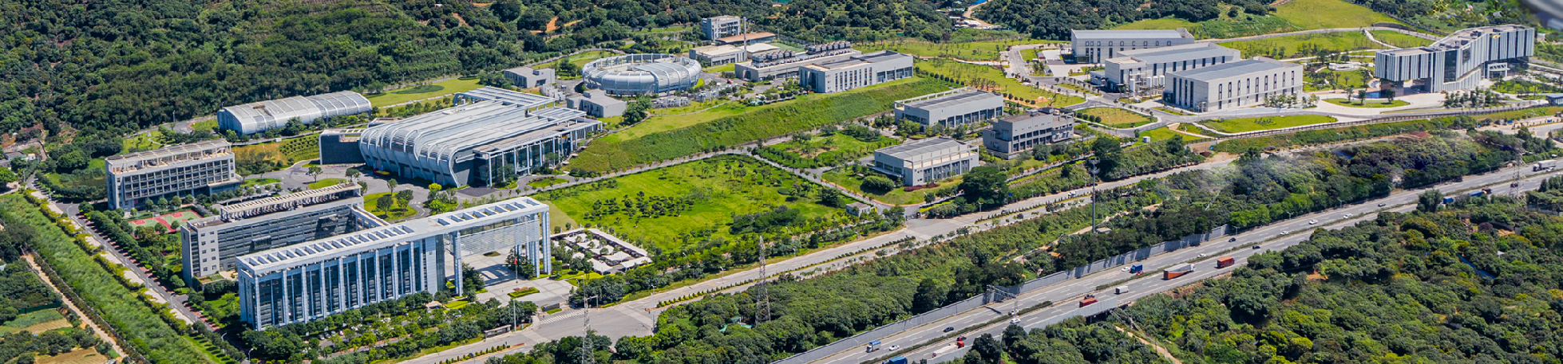



Report of Dongguan Branch
Status of China Spallation Neutron Source
Xin Tong (Tony)
Institute of High Energy Physics

Slide 2
Report Outline
1
Neutron Technology
2
Spallation Overview
Outline
3
Phase I operation
4
Phase II construction

Slide 3
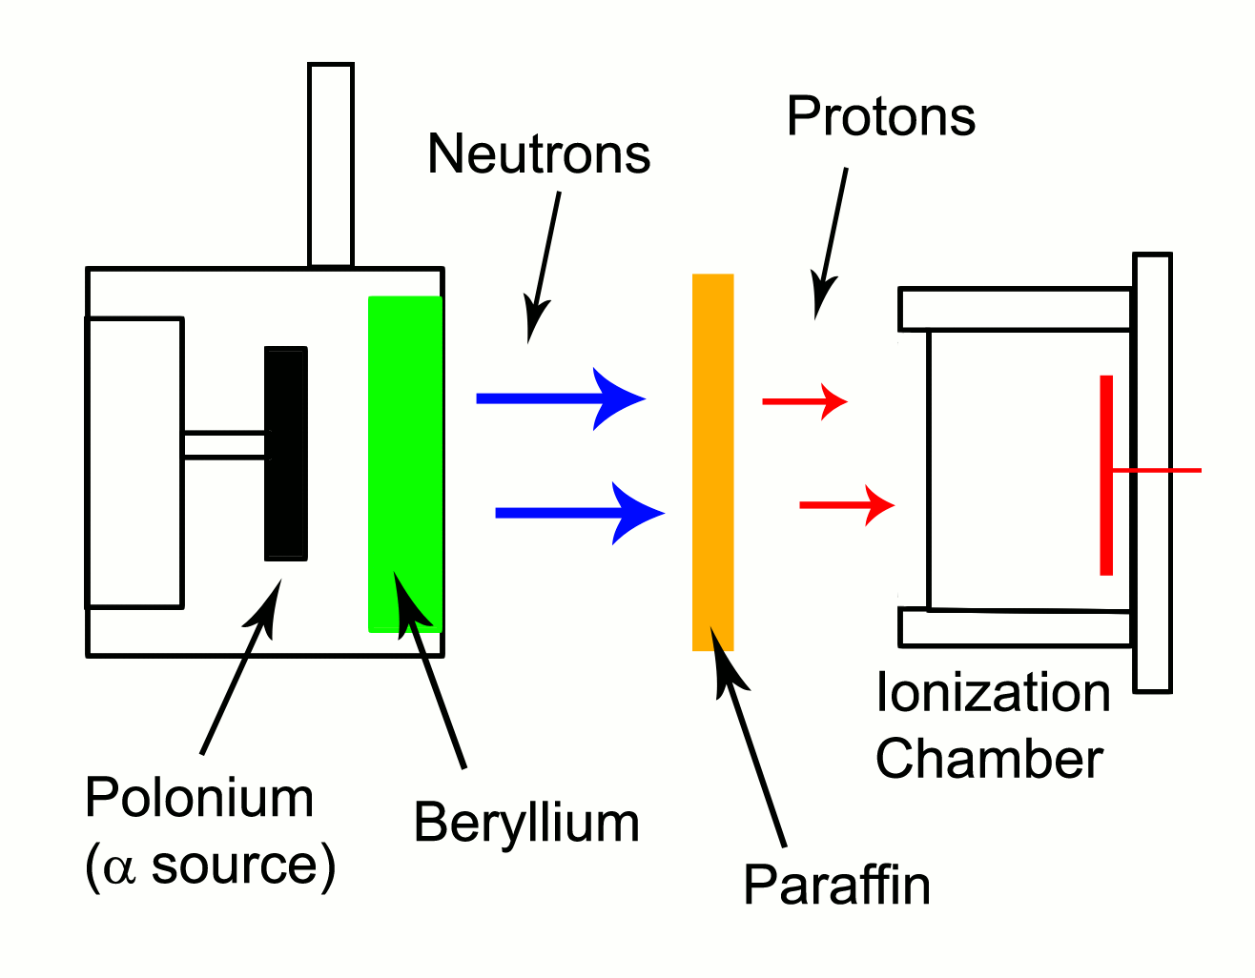
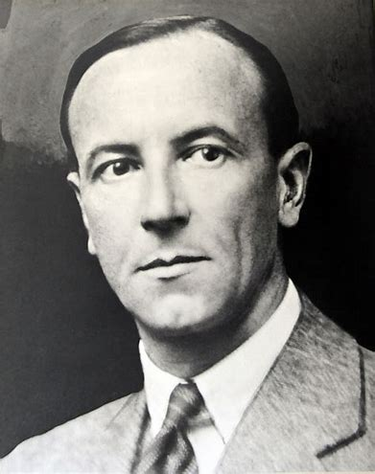
Discovery of neutrons
James Chadwick
1932 discovery，1935 Nobel Prize

Slide 4
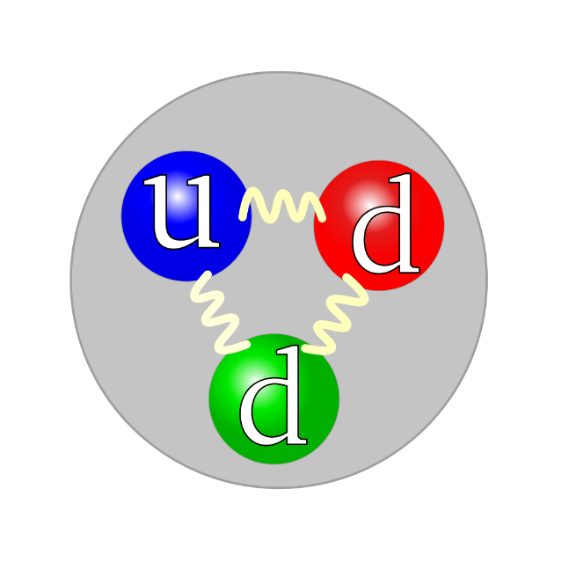
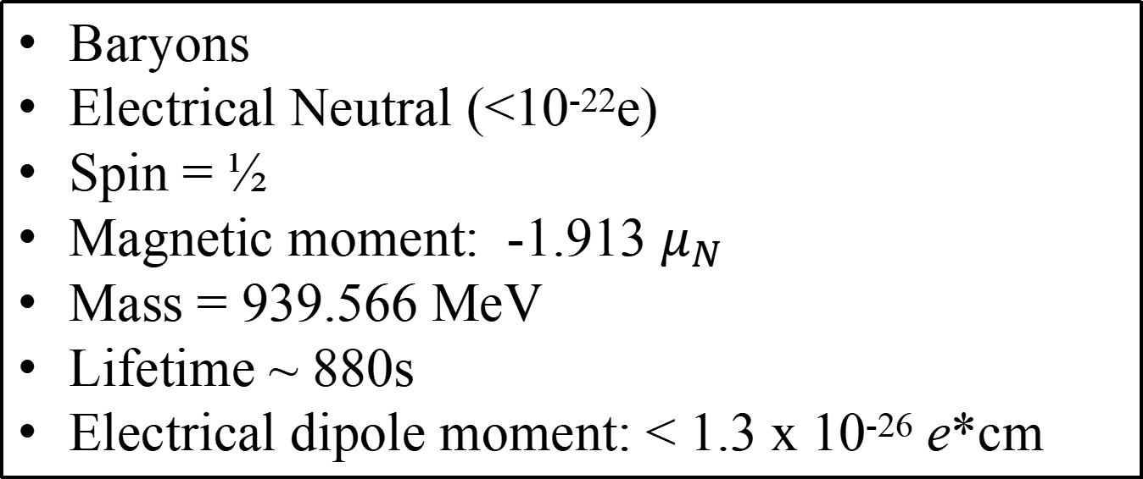
Properties of free neutrons
Baryons
Electrical Neutral (<10⁻²²e)
Spin = ½
Magnetic moment: -1.913 $μ_{N}$
Mass = 939.566 MeV
Lifetime ~ 880s
Electrical dipole moment: < 1.3 x 10⁻²⁶ e*cm
Difficult to handle, can’t accelerate/guide/focus
Destruction to detect
Low flux
Respond to all four forces, and possibly “fifth” force
Simpler compare to nucleus
Polarization is a unique feature

Slide 5
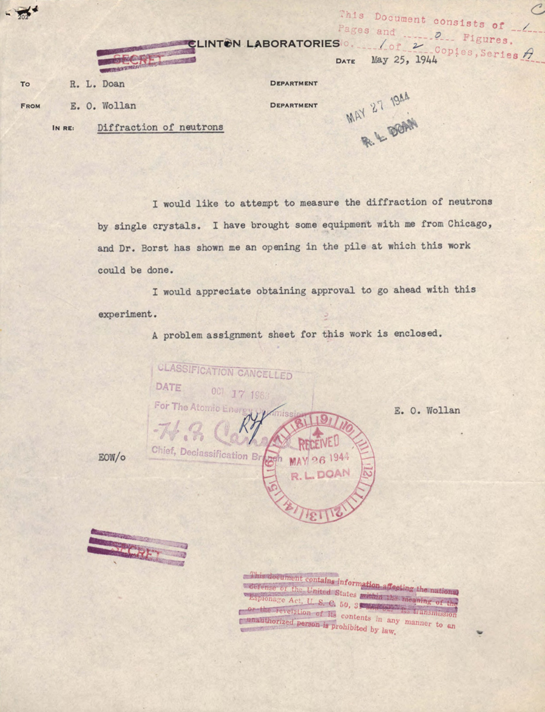
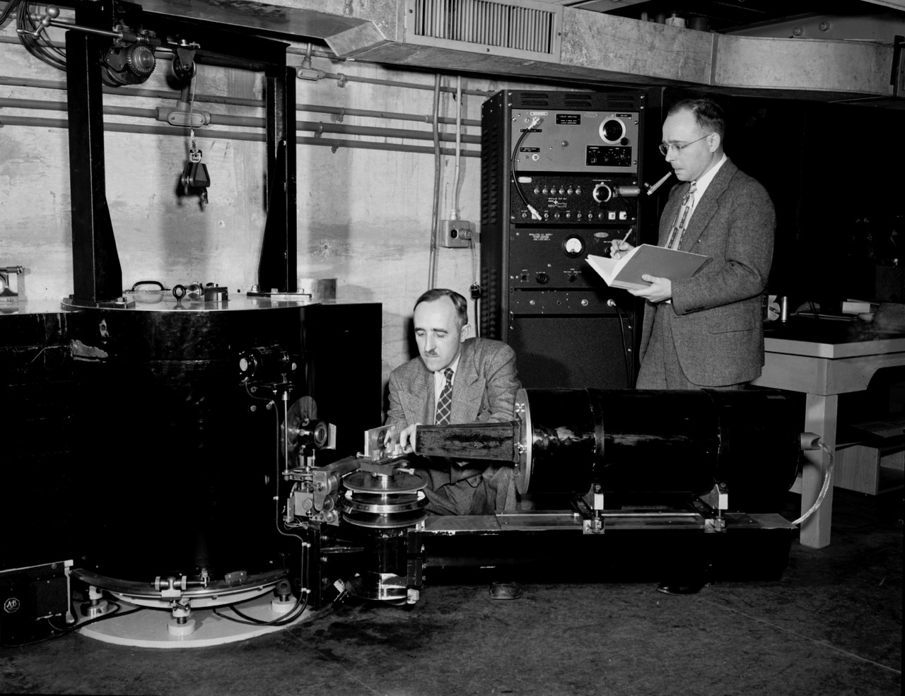
the birth of neutron scattering （E. Wollan)

Slide 6
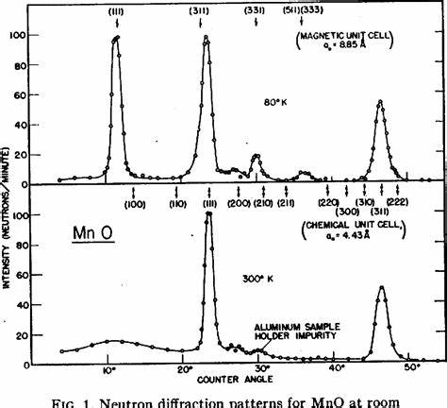
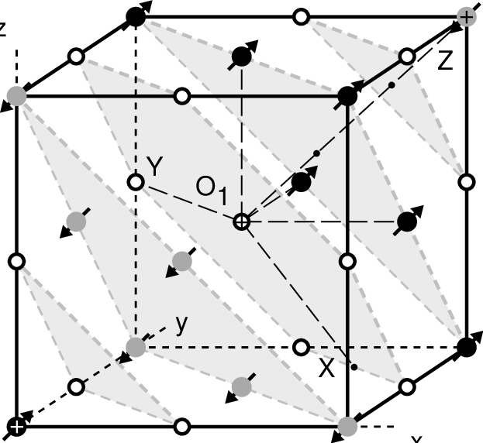
Antiferomagnetism in MnO

Slide 7
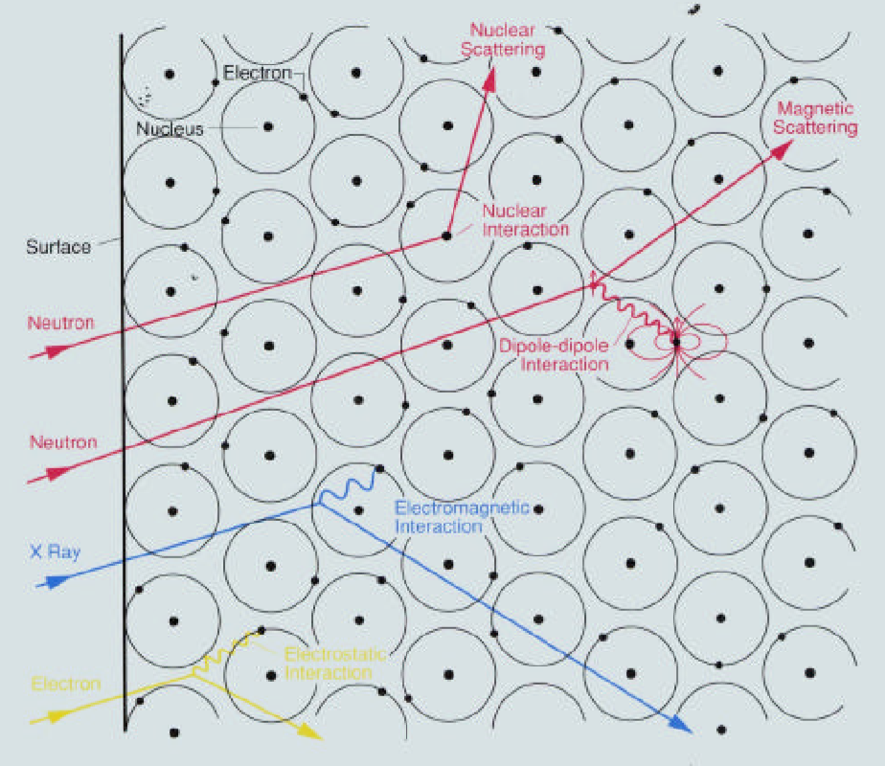


Neutrons, X-rays, Electrons vs. Matter
Wavelength ~ Å
Energy ~ meV

Slide 8
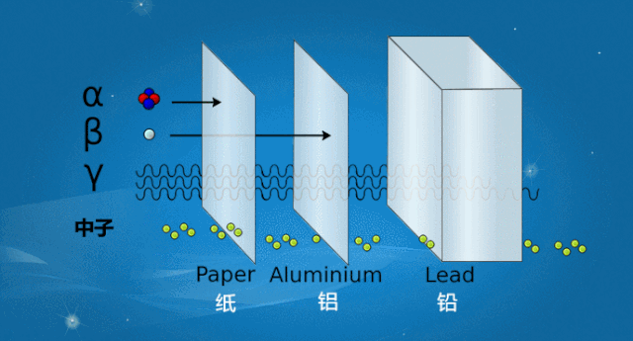
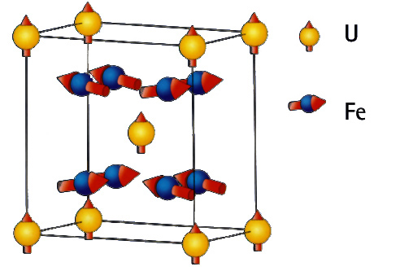


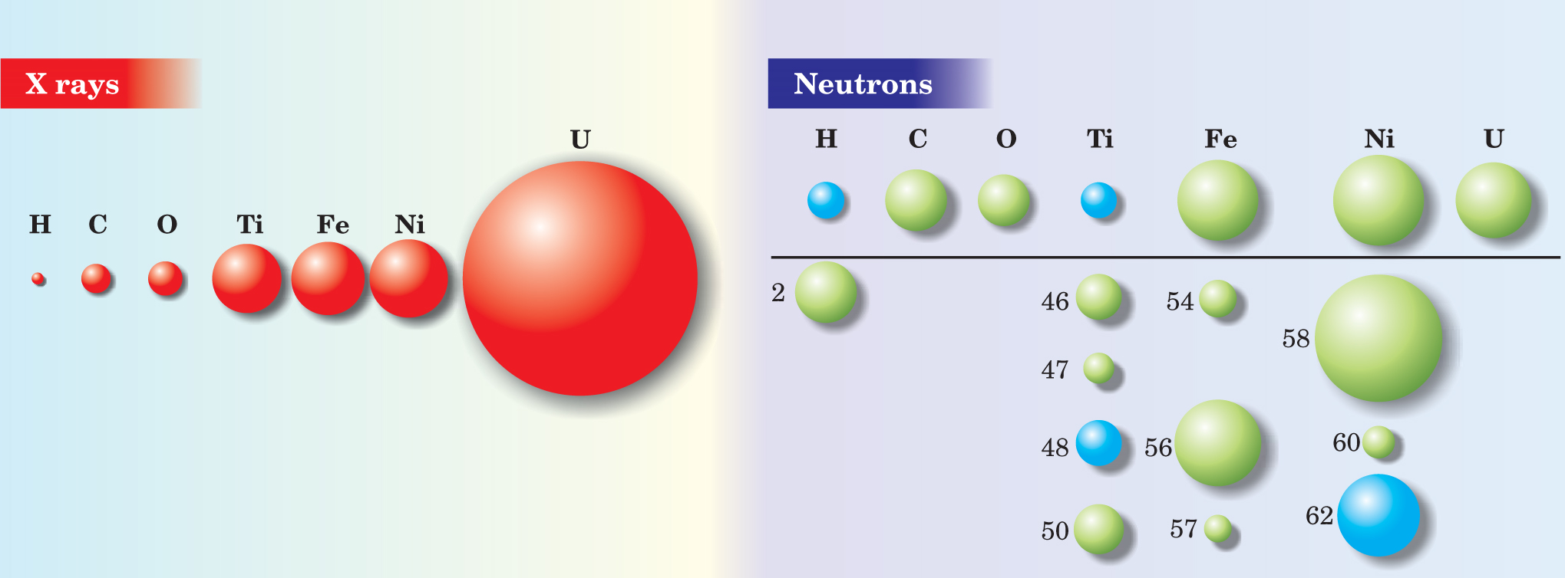
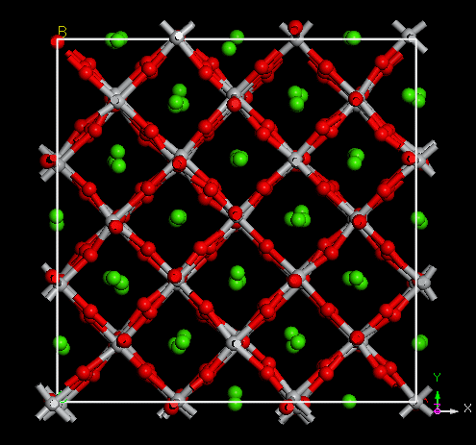
Features of neutron scattering
magnetic moment
dynamics
penetrating
light element

Slide 9


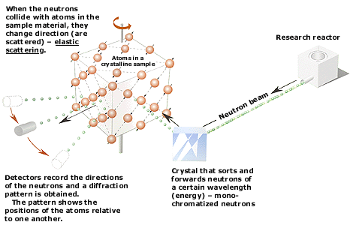
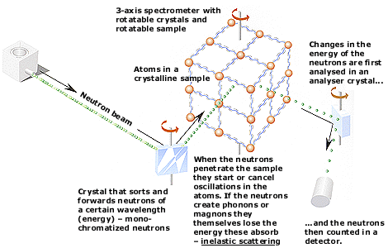
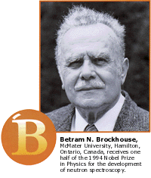

‘94 Nobel Prize in physics
http://www.nobelprize.org/nobel_prizes/physics/laureates/1994/illpres/neutrons.html

Slide 10
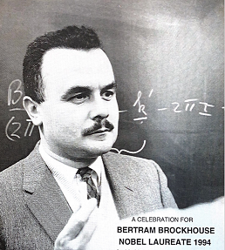
Neutron, a multidisciplinary tool
If neutrons were not
discovered by Chadwick, as an important and unique probe, it should be invented.

Slide 11
Report Outline
1
Neutron Technology
2
Spallation Overview
Outline
3
Phase I operation
4
Phase II construction

Slide 12
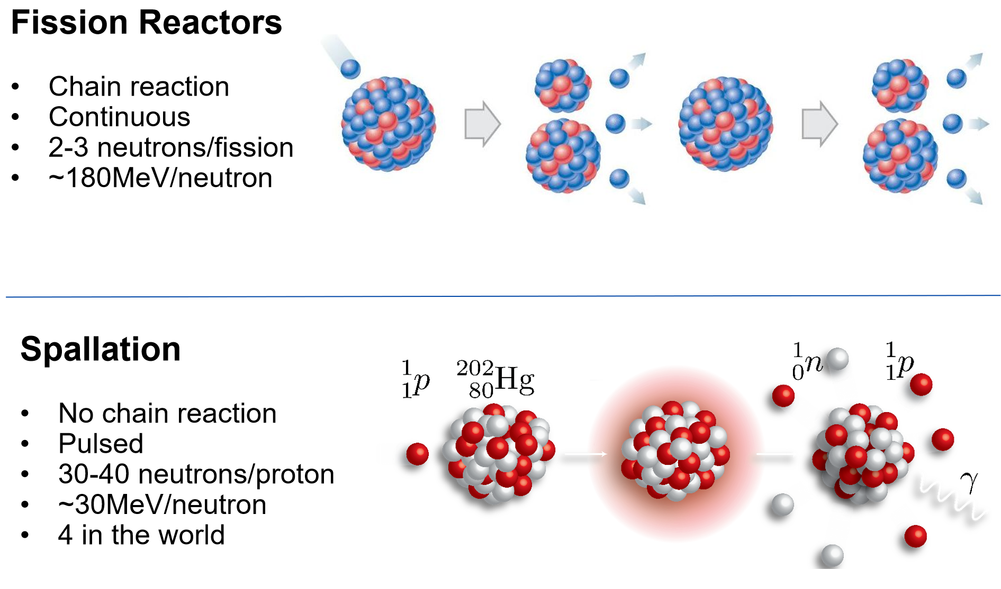
Neutron Production

Slide 13
Introduction to Spallation Neutron Source
Stable and Efficient operation
Beam time and beam delivery efficiency have reached the highest levels among comparable international facilities.
Responsible Authority：
CAS
Legal Entity：
IHEP
Phase I
Phase II
estimated investment
1.86632 billion yuan
2.8941 billion yuan
construction period
6.5 years
5.8 years
September 2008
February 2011
May 2011
August 2018
February 2020
Phase I
Approval of the Project Proposal
Approval of Feasibility Study
Approval of Preliminary Design and Budget Estimate
Successfully passed national acceptance
Met the design specifications
Phase II
December 2022
June 2023
January 2024
March 2024
June 2025
Approval of Feasibility Study
Approval of Preliminary Design
Approval of Budget Estimate
Launch Meeting for Phase II Construction
STC Meeting
Three building structures have been capped
Equipment development has proceeded smoothly

Slide 14
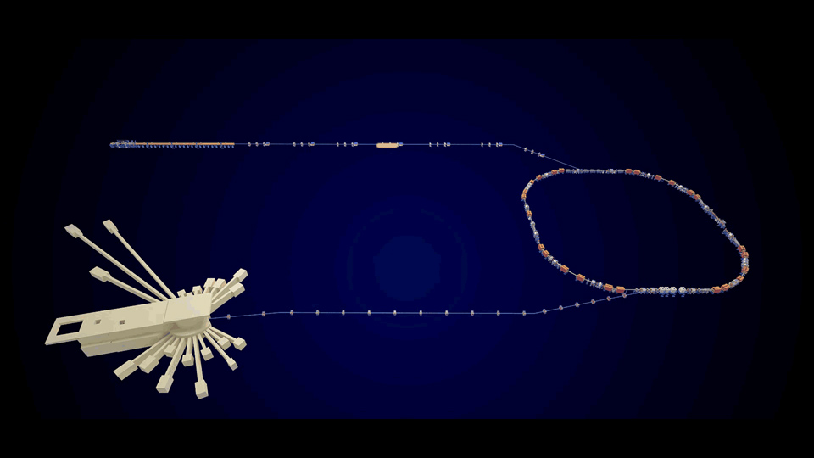
Schematics
Phase I Construction：One 80 MeV linear accelerator and one 1.6 GeV rapid-cycling synchrotron;
One target station and three neutron instruments. The design beam power reaches 100 kW.
rapid-cycling synchrotron
(1.6 GeV)
linear accelerator (80 MeV)
Target Station Experimental Hall
(Three instruments)

Slide 15

General Introduction to the Spallation Neutron Source
  The first domestic facility (Phase I) was completed in 2018, filling the gap in China’s pulsed neutron source and related application fields, narrowing the gap with the world’s cutting-edge level by approximately 30 years, and sustaining long-term satisfaction of domestic demand.
It is one of the four major pulsed spallation neutron sources in the world, possessing strong international competitiveness, with its neutron flux density exceeding that of the UK spallation neutron source.
It is a world-class multidisciplinary research and application platform for neutron scattering, complementing the advantages of China’s synchrotron radiation sources. Since commissioning, it has set world-leading records in beam time and delivery efficiency among comparable international facilities; the scientific output of its spectrometers has surpassed that of equivalent spectrometers at similar international facilities during the same operational phase.

Slide 16
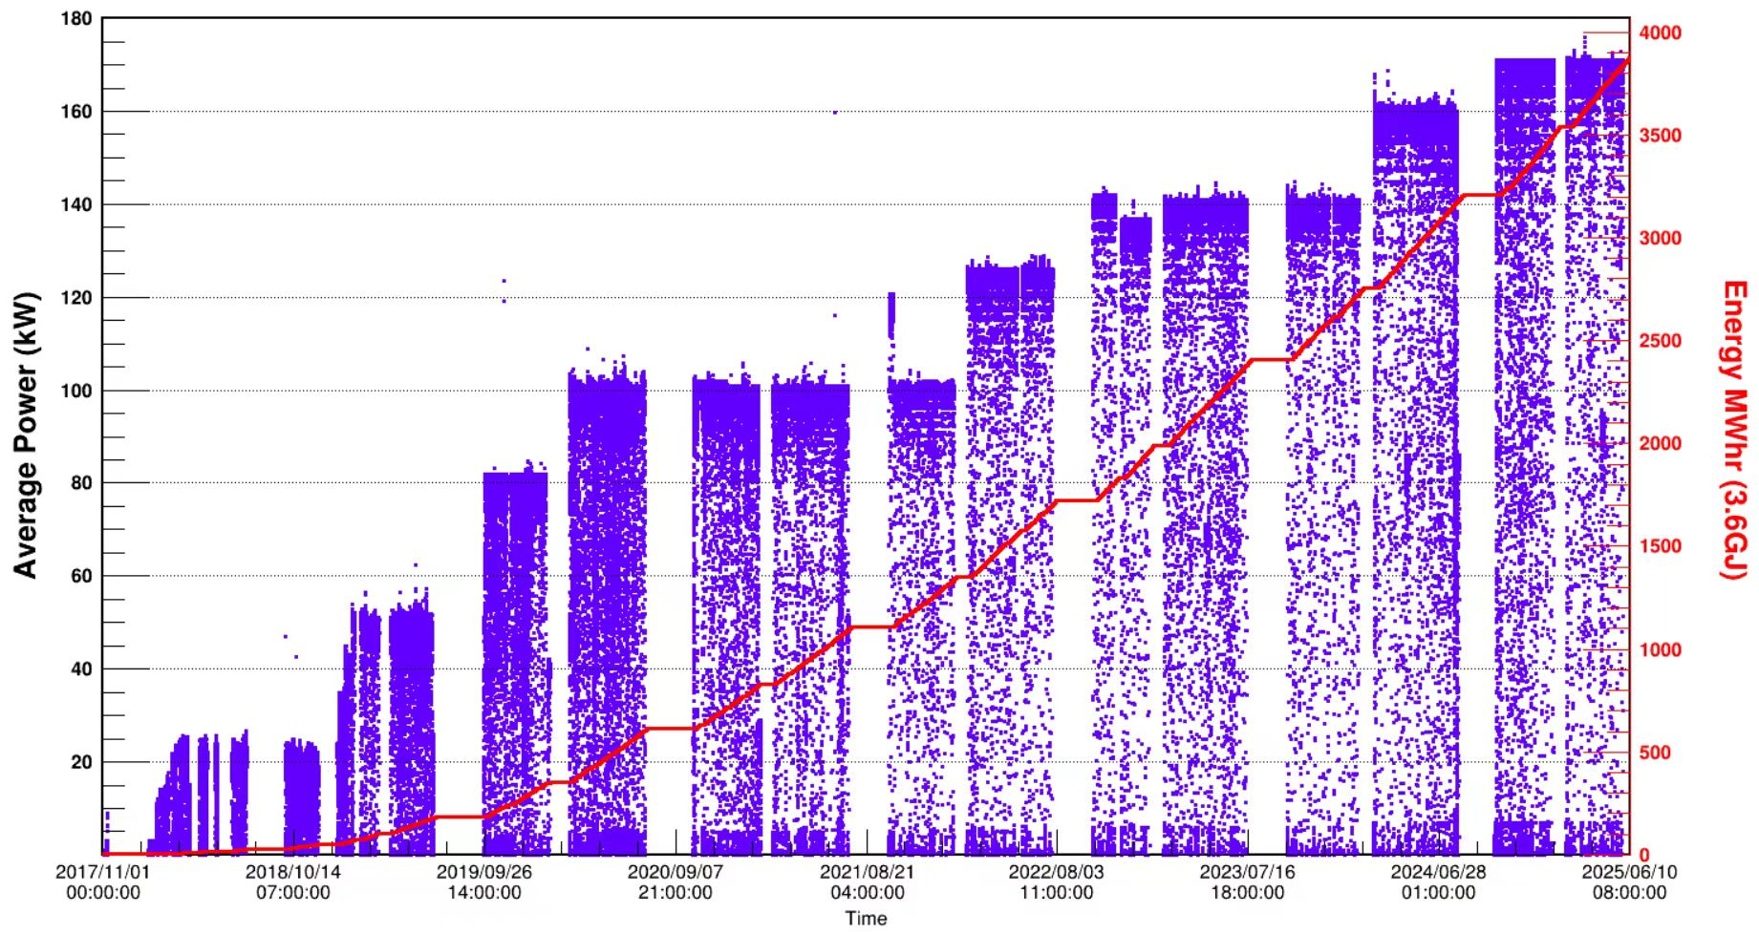
Power upgrade
160kW
170kW
140kW
125kW
100kW
80kW
2018.08 It has passed national acceptance inspection, and the three Phase I instruments have been officially opened to users from various disciplines both domestically and internationally.
2022.09 The beam power has been increased to 140 kW, achieving high-availability operation.
2024.01 NDRC has approved the preliminary design budget estimate for the Phase II project.
2024.03 The beam power has been increased to 160 kW.
2024.10 The beam power has been increased to 170 kW, continuously enhancing the research capabilities of the facility.
2025.07 Eight collaborative instruments have been constructed, among which three are in formal operation and five are under commissioning.

Slide 17
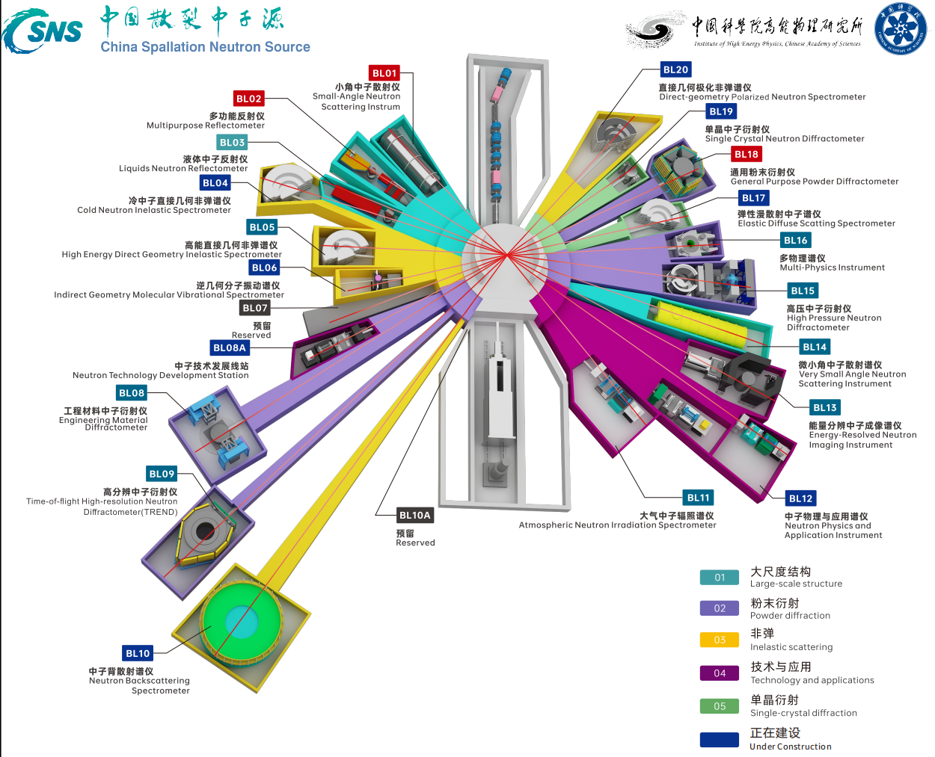
Instrument layout
01 Small-Angle Neutron Scattering Instrum
02 Multifunctional Reflectometer
03 Liquid Neutron Reflectometer
04 Cold Neutron Inelastic Spectrometer
05 High-Energy Direct-Geometry Inelastic Spectrometer
06 Indirect Geometry Molecular Vibrational Spectrometer
07 Reserved
08A Engineering Materials Neutron Diffractometer
08B Neutron Technology Development Beamline Station
09 Time-of-flight High-Resolution Neutron Powder Diffractometer
10 Neutron Backscattering Spectrometer
11 Atmospheric Neutron Irradiation Spectrometer
12 Neutron Physics and Application Spectrometer
13 Energy-Resolved Neutron Imaging instrument
14 Very small Angle Neutron Scattering instrument
15 High-Pressure Neutron Diffractometer
16 Multi-Physics instrument
17 Elastic Diffuse Scatting Spectrometer
18 General Purpose Powder Diffractometer
19 Single-Crystal Neutron Diffractometer
20 Direct-geometry Polarized Inelastic Spectrometer
Eight collaborative instruments have been constructed, among which three are in formal operation and five are under commissioning.

Slide 18
Notable open achievements have been made, with contributions growing year by year
This year, 497 experimental projects from 140 institutions have been completed, with an approval rate of approximately 42.8% for general proposals. Cumulatively, a total of 2285 experimental projects from 268 institutions have been completed.
Approximately 2100 new registered users were added, with a cumulative total of over 9200 registered users.
A total of 204 papers have been published from user projects, including 2 nature/science publicaiton, with 76.7% in Q1 journals.
9200 users
497 projects
4422 hours
204 papers
Registered Users
Institutions with Completed Projects

Slide 19
Report Outline
1
Neutron Technology
Outline
2
Spallation Overview
3
Phase I operation
4
Phase II construction

Slide 20
Open Access - Overall Achievements of 2024
Major National Needs
Key Frontier Scientific Problems
R&D of Industrial Technology
Scientific Achievements
Metal Matrix Composites for Remote Sensing Satellites
Welding Technology for Deep-Sea Titanium Alloys
Silicon Carbide Composite Components for Submarine Noise Reduction
Deformation of Radar Alloy Structural Components
Aircraft Carrier LJS Process
Weapon Mount Process
Chang'e-7 Calibration
Detector Calibration
Collaborators
IMR , CAS, CALT, USTB, CNPE Northwest, AECC ACSRI, CISRI, PMO, CAS...
Scientific Achievements
Fine Structure of Ultra-large Zeolites
Stability of Sodium-Ion Batteries
Superplastic ceramics
Giant magnetic exchange
Thermal Transport of Interpenetrating Magnets
Collaborators
JLU, IOP , CAS , USTB , USTB, HKU, HIT…
Scientific Achievements
Chip Single-Event Effect Detection
EV Battery R&D
Shale Oil Storage Evaluation
Polymer Solar Cell R&D
Boron Neutron Capture Tumor-Targeted Drugs
Collaborators
HW, BYD, Guodian, CRRC, CNPC, AVIC, Zhongke Chaorui、PANGO, GSMC, SMiT, XJ Electric...

Slide 21
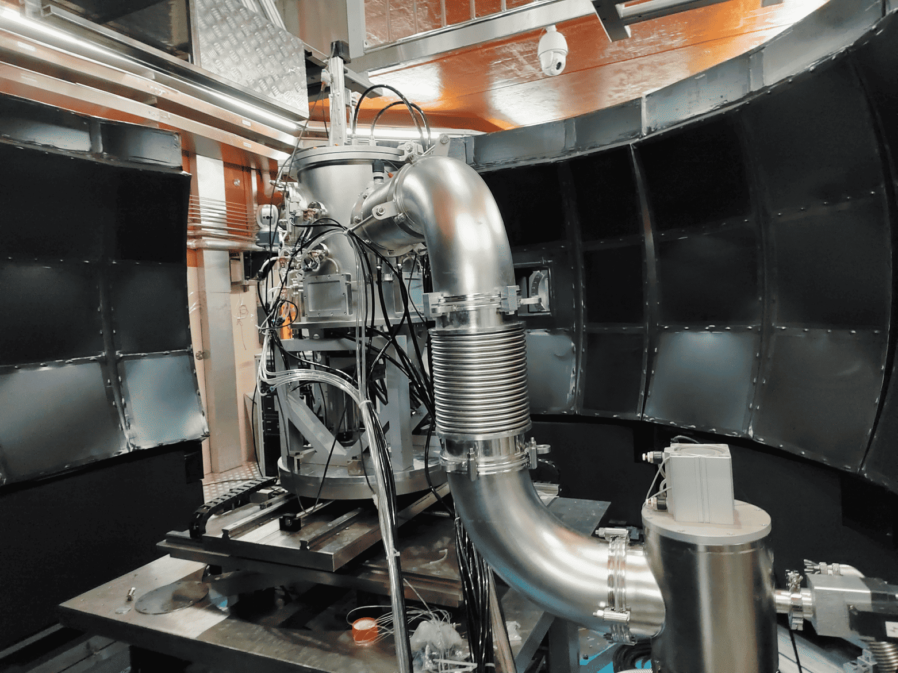
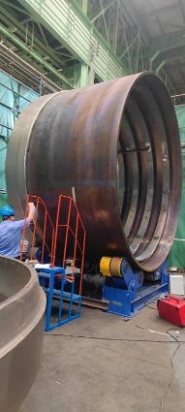
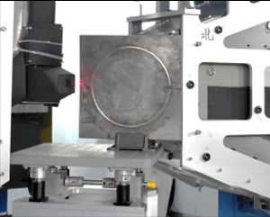
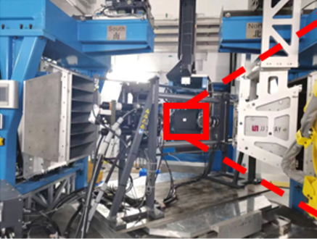
Critical National Needs: Engines, High-Speed Rail Wheels, Key Equipment Materials and More
Organization & Implementation
Pilot Project Initiation
国家重大需求
经济主战场
Service mount cycles of CALT equipment hangers doubled
Optimized three processes for CSMRI special alloy structural parts; dimensional stability basically resolved
Obtained full in-service data for high-speed rail wheels with CISRI
Fracture found in aircraft Ti-alloy frames (IMR)
Preliminary damage measured for 10,000m drill bits
First welding reliability assessment for cross-border oil pipelines
Microstructure & Stress Evolution of Rigging
Characterization of Gas Turbine Blades
R&D & Demo of Advanced Nuclear Materials

Slide 22
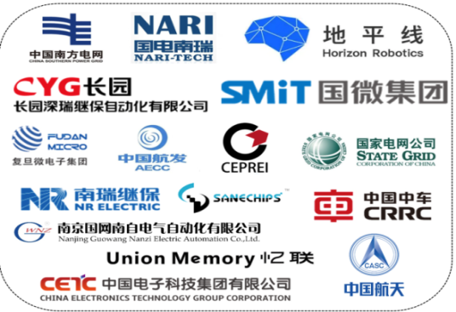
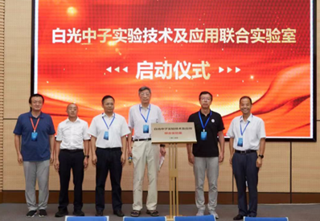
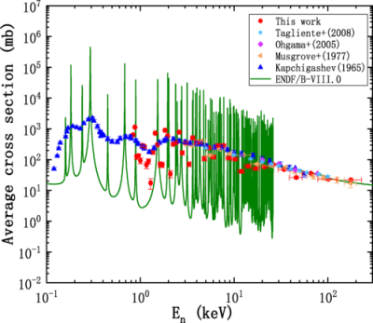
Neutron-Induced Single-Event Effects of Chips and Key Nuclear Data Measurement
Research on Neutron-Induced Single-Event Effects
Cooperation with AECC Aero Engine Control System Research Institute, China Aero Technology Research Institute, and other institutions
Completed Chang'e 7 calibration, fault location for the XXX vehicle, and radiation hardening of electronic devices for the XXX vehicle
Key Nuclear Data Measurement
Collaborated with CAEP, SWINP, and other institutions to accomplish a number of key nuclear data measurements and calibration experiments for national defense security
Jointly established the Joint Laboratory for White Neutron Experimental Technology and Applications with three institutions including CAEP and SWINP
Key R&D Program: Th‑U Cycle Nuclear Data Measurement
国家重大需求
经济主战场

Slide 23
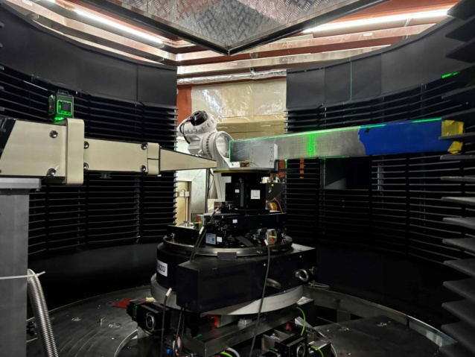
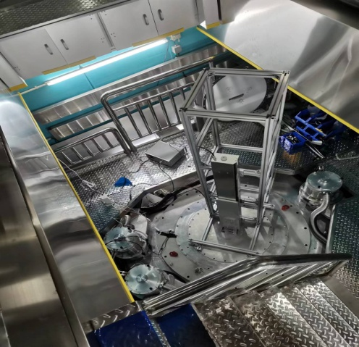
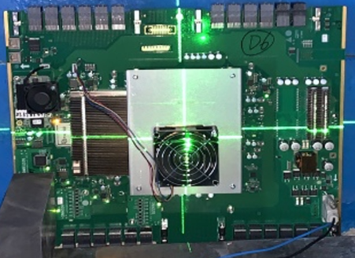
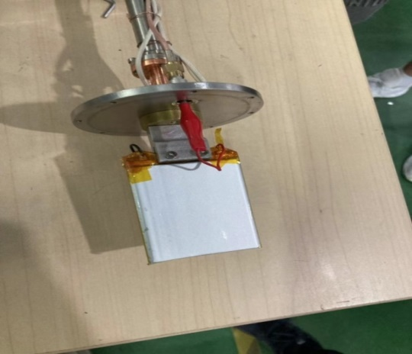
Industrial Technology R&D
Failure Detection of Lithium-Ion Battery Energy
In-situ cycle measurement for BYD, CATL, solving uneven battery charging/discharging
Na-ion batteries for SolarEdge: enhanced cycle life
Detection of Irradiation Effects in Integrated Circuits
Irradiation tests and research on over 1,000 chips, ICs and power devices.
Provided R&D support for Huawei, Guowei, XJ Electric, Fudan Microelectronics, Saibao, Shenrui, Horizon Robotics, etc.
国家重大需求
经济主战场
Notes:
图1：宁德时代电池失效检测
图2：比亚迪电池性能研究
图3：电路板
图4：电池原位充放电装置
集成电路的辐照效应检测可补充：支持新能源汽车、智能驾驶、消费终端、电力电子、通信产品研发

Slide 24
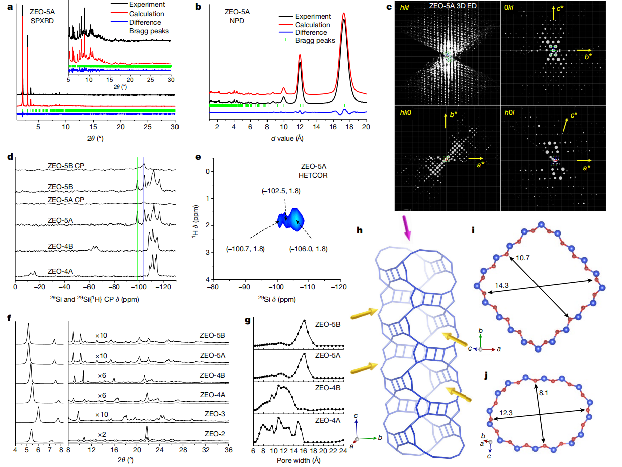
Frontier: Extra-Large Molecular Sieves
Academician Yu Jihong's group at Jilin University characterized the fine 3D structure of an extra-large pore zeolite using neutron diffraction, 3D ED, synchrotron XRD, AC-STEM and solid-state NMR. The team confirmed the extra-large triple 4-ring structure, exceeding traditional crystallization limits and revising conventional understanding of hydrothermal synthesis.
Nature, 2024, 628, 99–103

Slide 25
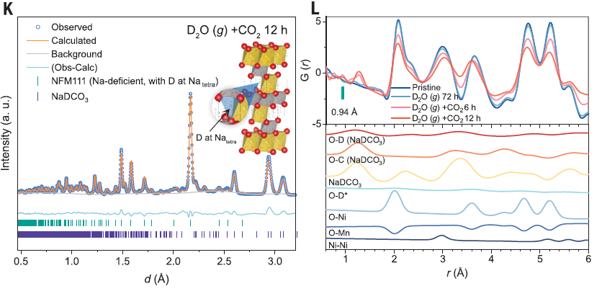
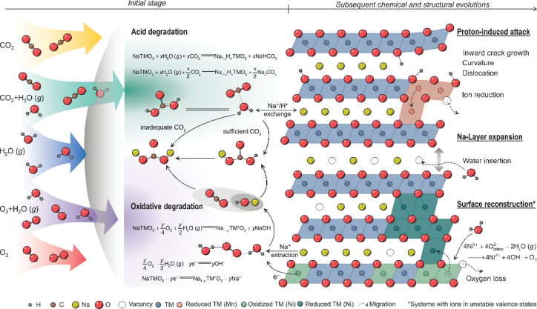
Frontier: Sodium-Ion Batteries
Hu Yongsheng's team at the Institute of Physics, Chinese Academy of Sciences, used neutron scattering to reveal the degradation mechanism of the stability of sodium layered oxide cathodes under the action of water and carbon dioxide in air, providing a rational basis for designing air-stable NLOs. Solving the issue of air instability is crucial for unlocking the potential of sodium-ion batteries and reshaping the development of the energy storage sector.
Science 385, 744–752 (2024)

Slide 26
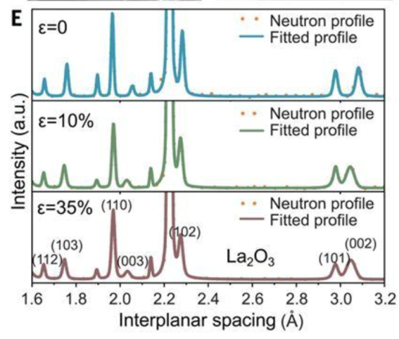
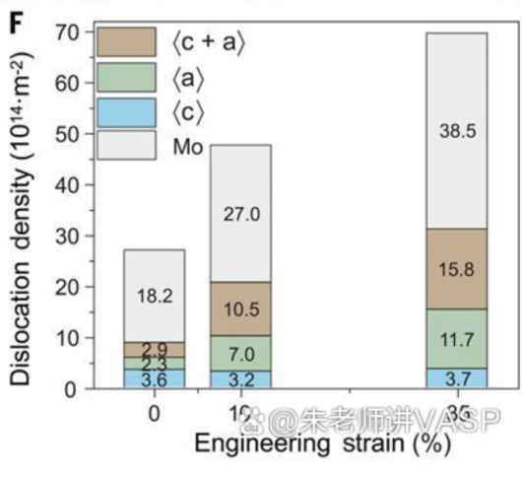
Frontier: Plastic Ceramics
A joint team led by Chen Kexin from University of Science and Technology Beijing, Wang Jinshu from Beijing University of Technology, and Huang Mingxin from the University of Hong Kong has achieved large tensile plasticity in ceramics at room temperature for the first time. Using neutron diffraction data, the team quantitatively determined the dislocation density of ceramics and pioneered a strategy of "borrowing dislocations" from metals, enabling ceramics to exhibit tensile plasticity similar to metals.
Science 385, (2024) 422–427

Slide 27
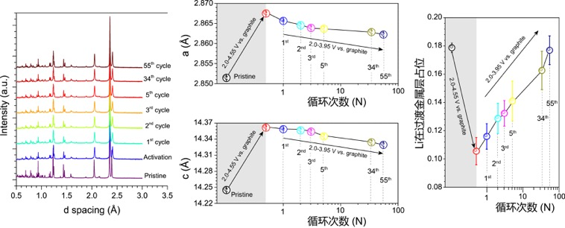
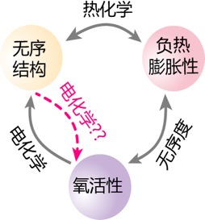

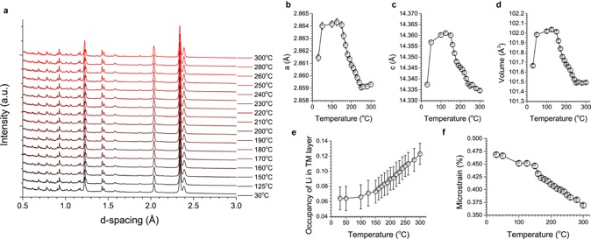
Frontier:Heat-shrinkable lithium battery materials
Tuning material thermal expansion by electrochemical annealing:From positive (PTE), zero (ZTE) to negative (NTE)
Neutron diffraction experiments@TREND
High-resolution neutron diffraction enables precise determination of Li-ion occupancy during electrochemical annealing, clarifying the Li intercalation–deintercalation mechanism
Neutron diffraction experiments@GPPD
NTE behavior & Li re-intercalation into transition metal layers: structure-activity relationship
Microscopic mechanism：
Structural disorder & negative thermal expansion
Structural disorder & electrochemical annealing
Nature, 2025, DOI: 10.1038/s41586-025-08765-x

Slide 28
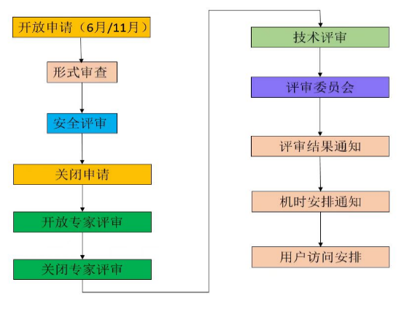
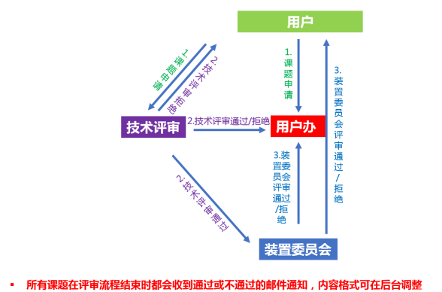
Open Sharing - Operation Management
https://user.csns.ihep.ac.cn/
The operation management system is improved through regular meetings to ensure stable operation and effective plan implementation
CSNS operation info account and electronic log system established for real-time status monitoring
Improved user management and standardized review processes, establishing a full system for users, projects, key tasks and safety
Dedicated to providing excellent user services
General proposals: open twice yearly, 1-month application (centralized call, online review)
Rapid proposals: open during operation only; (emergencies needspecial approval)

Slide 29
Report Outline
1
Neutron Technology
Outline
2
Spallation Overview
3
Phase I operation
4
Phase II construction

Slide 30
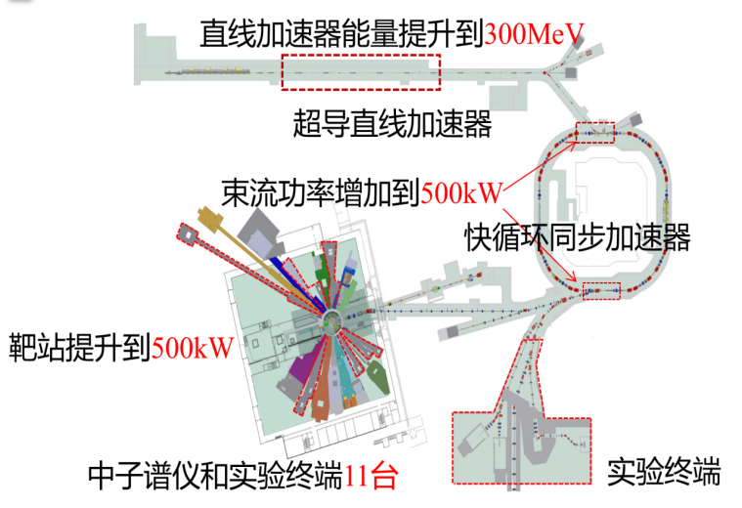
Phase I & Phase II Comparison
Overall Technical Specifications
 | Phase I | Phase II
Proton beam power (kW) | 100 | 500 (Acceptance criteria: 300)
Pulse repetition frequency (Hz) | 25 | 25
Beam energy (GeV) | 1.6 | 1.6
Ring injection energy（MeV) | 80 | 300 (Acceptance criteria: 250)
Neutron efficiency (n/proton/sr) | 0.1 | 0.1
Number of spectrometers & stations | 3 | 11
Phase I has reserved space and prepared for Phase II upgrade.

Slide 31
Innovation and Advantages of Phase II
Cost-effective upgrade: 5× beam power, world's highest-power fixed solid target with high neutron efficiency.
linear
accelerator
First use of superconducting cavities as the injector for a fast-cycling synchrotron worldwide.
First successful development of high-power magnetic alloy cavities in China; world's highest circulating beam current.
Rapid Cycling
Synchrotron
target
station
Compact TMR design: single-pulse neutron flux at world-class spallation source level.

Slide 32
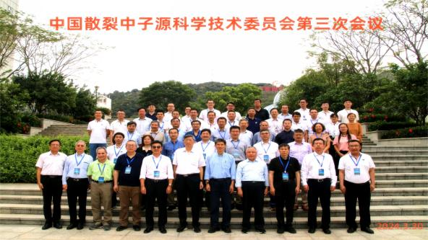
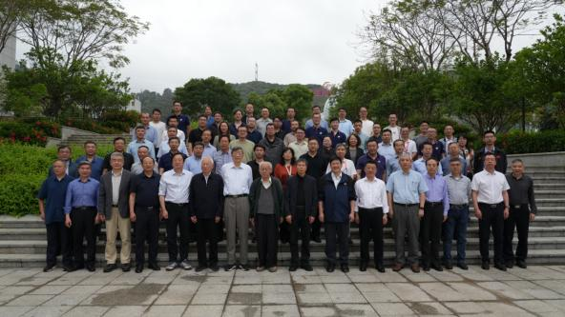
Current Progress
2022.12
2024.1
2024.6
2024.9
2024.11
Approval of Feasibility Study
Approval of Budget Estimate
Construction Personnel Position Review
Construction Permit
IAC Meeting
2023.6
2024.3
2024.7
2024.10
2025.4
Preliminary Design Approval
Phase II Kick-off Meeting
STC Meeting
Civil Construction Bidding
Approval of Temporary Land Use
STC Meeting
中国散裂中子源科学技术委员会第四次会议

Slide 33
Current Progress
Accelerator System
Spectrometer System
Key equipment such as superconducting cavities is under fabrication, and 648 MHz klystron power sources are under test.
Full engineering design for 9 spectrometers and the high-energy proton beam terminal; some equipment procurement and fabrication started.
Utility System
Target Station System
Optimized engineering design; fabrication of moderators, reflectors; engineering design for muon source terminal.
Construction drawing design for 5 single buildings completed; civil construction fully underway, with some general equipment under fabrication.

Slide 34
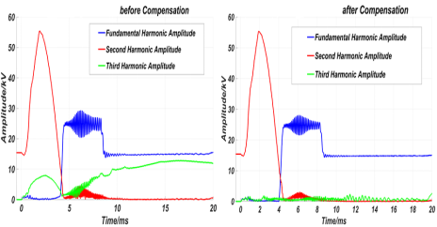
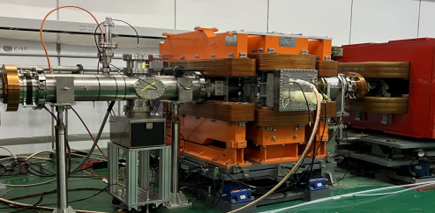
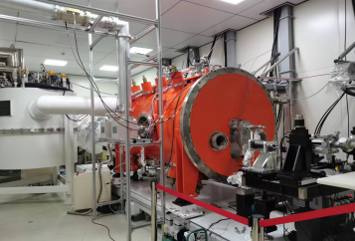
Progress on the Accelerator System
Magnetic Alloy Loaded Cavity：Accelerating gradient 50 kV/m; magnetic rings max high-power operation 10,000 h
  Beam diagnostics：IPM first realizes RCS turn-by-turn beam profile online measurement; LW prototype completed (1.7 mm beam spot); fluorescent wire beam halo detector dynamic range 10⁸
  Prototype Dual Spoke Cavity Module：Completed module integration and horizontal testing.
  Improved dual-spoke and 6-cell elliptical superconducting cavities：Successfully developed and completed vertical testing
  1000W@2K Refrigerator：A cold compressor plus ambient-temperature pump system is adopted to achieve 2 K. The cooling scheme using cold compressors has passed expert review (jointly designed, fully domestic production)
CCG (2024)
Detector
(2020)
ion pump
(2024)
C-magnet
(2020)

Slide 35
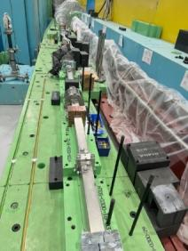




Progress on Spectrometers and Experimental End Stations (Two batches：7+4)
Neutron Technology Development Beamline：Neutron guide, beamline and scattering chamber shielding installed.
Inverse Geometry Molecular Vibration Spectrometer: Physical design and key equipment review finished.
Neutron Backscattering Spectrometer: Physical design done; guides under fabrication.
Elastic Diffuse Scattering Spectrometer: Physical design done; choppers under fabrication.
Neutron Physics and Application Spectrometer: Physical design finished, engineering design ongoing.
Liquid Neutron Reflectometer: Physical design and optimization in progress.
Cold Neutron Direct Geometry Inelastic Spectrometer: Physical design and optimization in progress.
Direct Geometry Polarized Inelastic Spectrometer: Preparing for physical design review.
Single Crystal Neutron Diffractometer: Preparing for physical design review.
High-Energy Proton Beam End Station: Physical design done, engineering design ongoing.
Muon Source End Station: Physical design review passed, engineering design ongoing.

Slide 36



Target Station Progress
Target station neutron physics and thermal optimization design
    TMR neutron performance optimization
    Provide input for engineering design of other target station subsystems
  Target optimization design
  500kW target design and seal structure optimization
  Key materials for low residual heat target plates successfully developed
Moderator and reflector
Design completed and reviewed
Main equipment bidding completed
Remote maintenance
Post-irradiation testing capability established
Low temperature
Key equipment designed and procured
Target plate structure
Welded specimen of heavy-thickness special-shaped 6061-T6 aluminum vessel
Decoupling layer spray thickness optimization test specimen

Slide 37







Civil work progress
Radioactive Solid Waste Temporary Storage Hall
Structure topping completed
Masonry works commenced
Linear Equipment Building Phase II
Work below ±0.00 has been fully completed
Backscattering Spectrometer Experimental Station
Structure topping completed
High Energy Proton Experimental Hall
Excavation fully completed
Foundation inspection fully completed
Pipeline embedding works have commenced
Temporary works
Erected and put into use
Experimental Support Equipment Building
Structure topping completed

Slide 38




Major achievements in technology
3‑meter linear position‑sensitive ³He detector
Neutron guide
m=2 small substrate coating meets international standards
Key performance matches US imports
High-speed neutron pulse chopper
R&D of Key Polarized Neutron Technologies
First supersonic carbon fiber turntable prototype developed
First wide-angle ³He glass vessel developed

Slide 39
Construction period of Spallation Neutron Source Phase II
Construction: Jan 2024 – Oct 2029 (5 years 9 months). Design targets met 2 years after acceptance. During construction, open operation will be largely unaffected by reasonable scheduling of tunnel installation and commissioning.
2024.09
Construction commenced
2025.11 The backscattering spectrometer beamline has been completed
2026.07 Experimental support building completed
2026.10 Linear equipment building, cryogenic hall and high-energy proton hall completed
2029.10
Project completed
2024 | 2025 | 2026 | 2027 | 2028 | 2029
2024.01
Approval of Preliminary Design
2025.08 Commissioning of the accelerator injection region
2025.12
200 kW beam commissioning of the accelerator
2027.07~2028.04 Shutdown installation: superconducting linac & target station
2029.01
Integrated commissioning
2029.07
Beam power: 300 kW
2026.10 Experimental terminal installation
2028.12 Spectrometer project completed
2028.12 Experimental terminal construction completed
2024.07 Spectrometer installation

Slide 40
Conclusion
Neutron technology is a vital tool for studying the microscopic structure and dynamics of matter.
CSNS has successfully fulfilled its annual open operation tasks. The facility runs stably, reliably and efficiently, with beam time and efficiency among the best of similar international facilities. Guided by the "Four Orientations", CSNS has made important achievements in aerospace, magnetism, quantum, energy, alloys, polymers and information materials, supporting major national needs while meeting growing user demands.
Construction of CSNS-II has started and progressed smoothly as planned, with key advances in civil engineering, accelerator, spectrometers and target station. Localization R&D is on track.

Slide 41






SEOP ³He-NSF (Junpei Zhang’s talk)
Three major steps for SEOP based neutron spin filter applications
Sci. China Phys. Mech. Astron., 65, 241011 (2022).
China. Phys. Lett., 42, 022901 (2025).
1. In-house ³He cell
fabrication and filling
2. Off-situ and in-situ
SEOP ³He spin filter
3. Beamline commission and scientific application

Slide 42








³He-NSF Commissioning (Junpei Zhang’s talk)
Neutron Beam
Calibration of Neutron Spin Control Devices
Inelastic Spectrometer
Supports
In-situ
³He-NSF
Detector
Sample
Neutron Beam
Back-n
NOPTREX
CARR
Sample
Neutron Beam
Neutron Beam
In-situ
³He NSF
SM
Neutron Beam
Neutron Beam
MR
P-SANS
Sample
In-situ ³He NSF
Detector
³He Supports
In-situ NSF

Slide 43


CP/T symmetry violation measurement at CSNS back-n beamline
NOPTREX：A Neutron Optics Time-Reversal Violation Experiment
(Tianhao Wang’s talk)
T-violation leads to possible Baryon asymmetry explanation
Since T violation involving neutrons and protons has not yet been observed, a nonzero observation of T violation in any nuclear system would be of fundamental importance*.
Series measurement of P-odd/T-odd and P-Odd term
J. Engel, M. J. Ramsey-Musolf, U. van Kolck, “Electric Dipole Moments of Nucleons, Nuclei, and Atoms: The Standard Model and Beyond”, Prog. Part. Nucl. Phys. 71, 21 (2013).
M. Pospelov and A. Ritz, “Electric dipole moments as probes of new physics”, Ann. Phys. 318, 119 (2005).
NOPTREX Collaboration
Polarize Neutron at resonance energy (734meV)
Transfer calibrated and polarized neutron to gamma detector
Switch between spin states every 2s to remove systematic error
University of Kentucky
Indiana University
LANSCE FP12
J-PARC
China Spallation Neutron Source
China Institute of Atomic Energy

Slide 44




Generating polarized neutron CSNS back-n beamline
Successfully acquired spin-asymmetry signal at Back-n beamline
First step of NOPTREX measurement of P-Odd/T-even term Spin Asymmetry（4.67%±1.19%）
Fully calibrated neutron flip and long distance transfer
(Tianhao Wang’s talk)

Slide 45




Thanks for your attention

