Slide 1
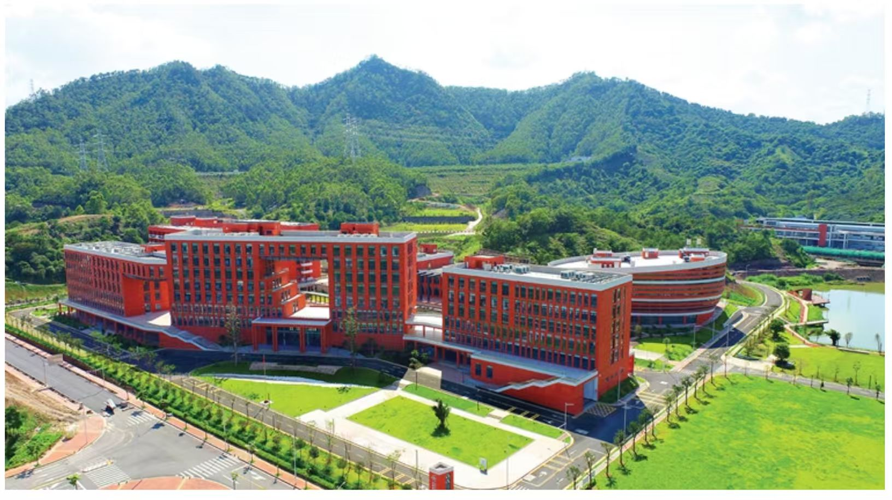
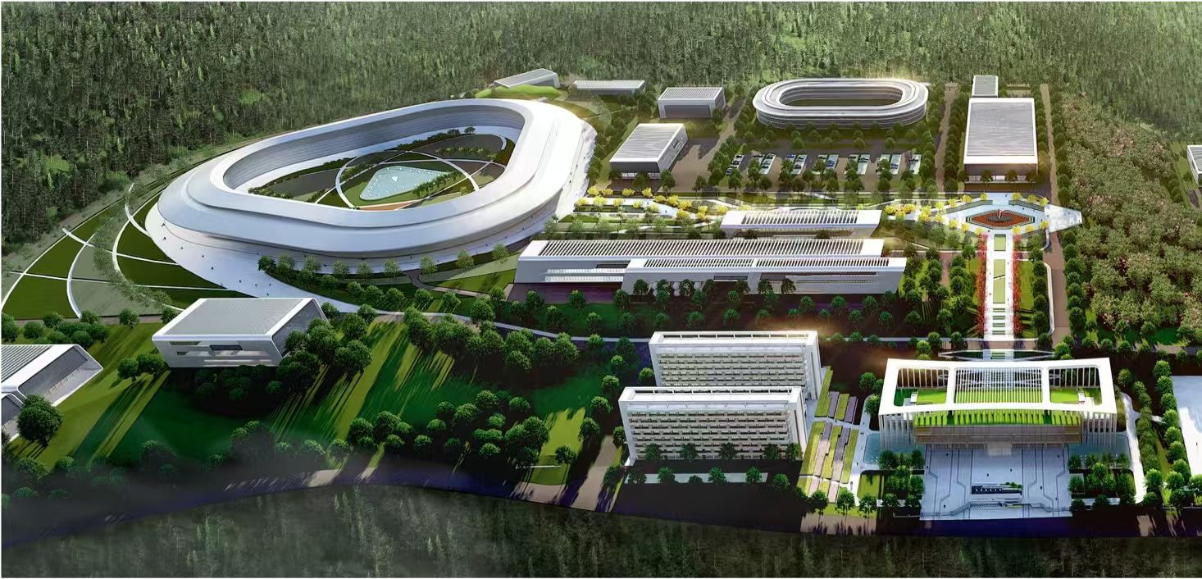
Light hadron physics possibilities at HHaS
Norihito Muramatsu (IMP, CAS)
HHaS Collaboration Meeting
Nov. 30, 2025

Slide 2
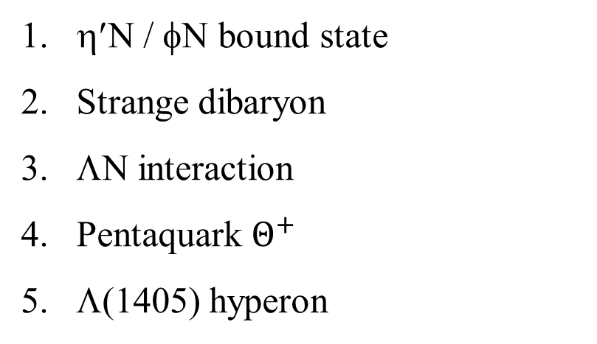
Very high luminosity of GeV-scale pp collisions will be available at HIAF, so it is suitable to search for exotic hadron states and conduct the precise measurement of hadron-hadron interactions.
Today’s Menu
η′N / φN bound state
Strange dibaryon
ΛN interaction
Pentaquark $Θ^{+}$
Λ(1405) hyperon
Presented at previous meetings,
so just briefly summarized.
simulation studies
Today’s main topics.
1 / 22

Slide 3
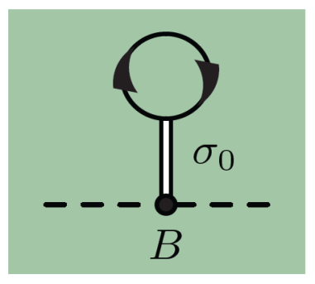
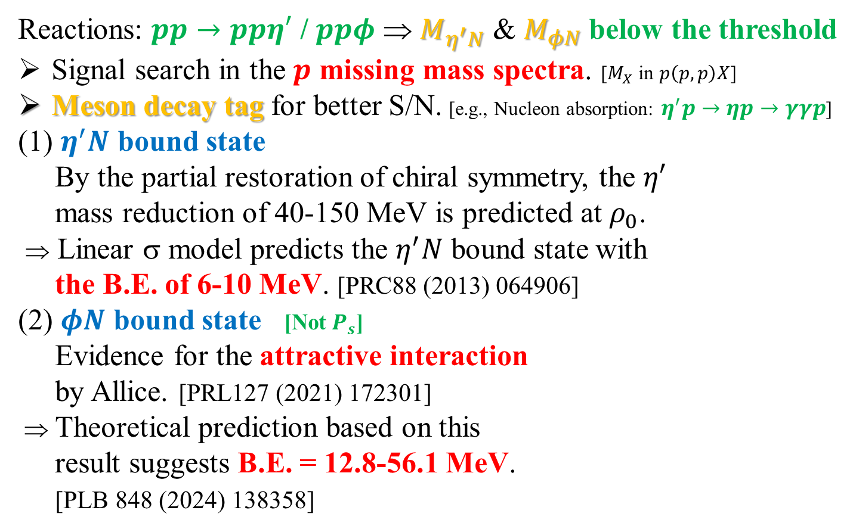

$η^{′}N$ / $φN$ bound state
Reactions: $pp→ppη′$ / $ppφ$ ⇒ $M_{η^{′}N}$ & $M_{φN}$ below the threshold
Signal search in the $p$ missing mass spectra. [$M_{X}$ in $p\left(p,p\right)X$]
Meson decay tag for better S/N. [e.g., Nucleon absorption: $η^{′}p→ηp→γγp$]
(1) $η^{′}N$ bound state
By the partial restoration of chiral symmetry, the $η′$
mass reduction of 40-150 MeV is predicted at $ρ_{0}$.
⇒ Linear σ model predicts the $η^{′}N$ bound state with
the B.E. of 6-10 MeV. [PRC88 (2013) 064906]
(2) $φN$ bound state [Not $P_{s}$]
Evidence for the attractive interaction
by Allice. [PRL127 (2021) 172301]
⇒ Theoretical prediction based on this
result suggests B.E. = 12.8-56.1 MeV.
[PLB 848 (2024) 138358]
N
N
η’
η’
2 / 22

Slide 4



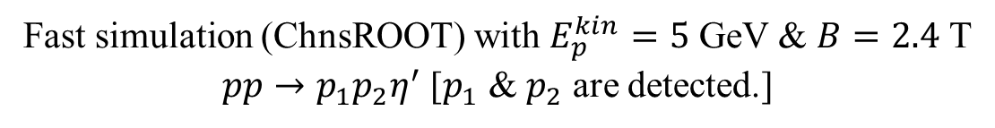


$η^{′}N$ / $φN$ bound state
Fast simulation (ChnsROOT) with $E_{p}^{kin}=5$ GeV & $B=2.4$ T
$pp→p_{1}p_{2}η^{′}$ [$p_{1}$ & $p_{2}$ are detected.]
Searching this bound state.
Relative momentum of the $p_{2}η^{′}$ system
$p_{1}$ missing mass resolution (reconstructed − true)
Selected.
P_{rel} MeV/c
M(reconstructed)−M(true) MeV/c²
$p_{2}η^{′}$ rest frame
P_{rel} < 0.25 GeV & P₁ < 2 GeV/c
σ = 12.6 MeV
Moderate for bound-state search
$$p_{2}$$
$$η^{′}$$
relative momentum
3 / 22

Slide 5
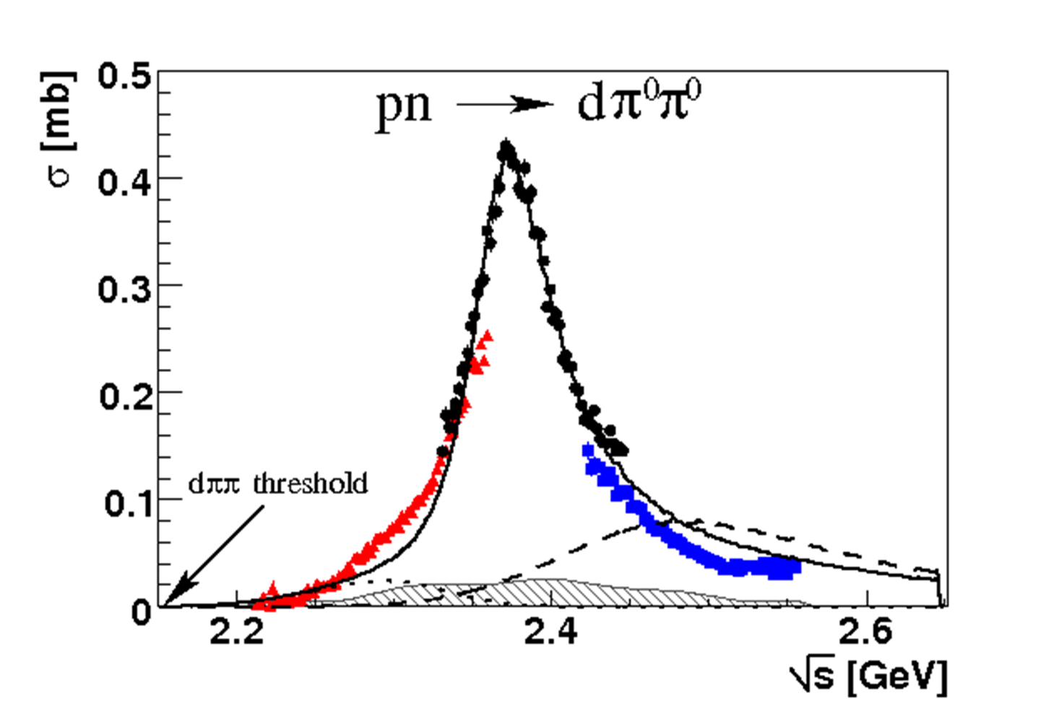
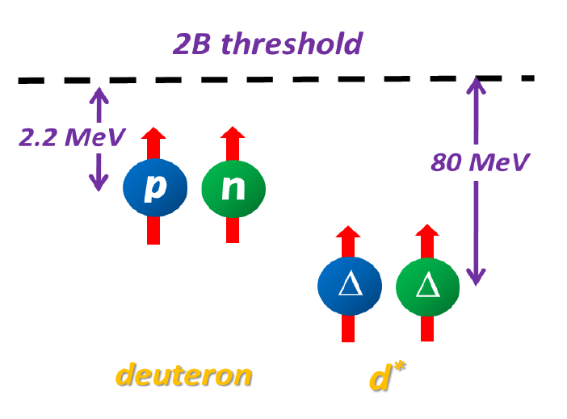
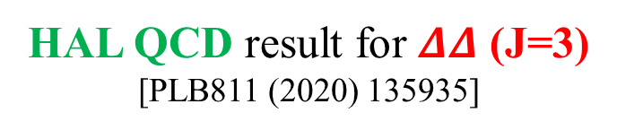
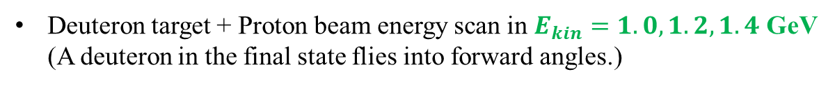
Strange dibaryons
$pn→d^{∗}(2380)→dπ^{0}π^{0}$ @ COSY-WASA [PRL 106 (2011) 242302]
Deep B.E. & Narrow Γ
Compact 6-quark state ?
(“inevitable” dibaryon
w/o repulsive force)
PLB90(1980)41, PRC39(1989)1889,
PRC89(2014)034001, …
Γ∼70 MeV
IJ^{P} = 01⁺ 03⁺
Deuteron target + Proton beam energy scan in $E_{kin}=1.0, 1.2, 1.4$ GeV
(A deuteron in the final state flies into forward angles.)
HAL QCD result for $ΔΔ$ (J=3)
[PLB811 (2020) 135935]
4 / 22

Slide 6
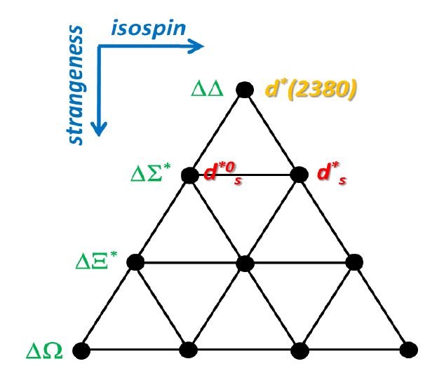
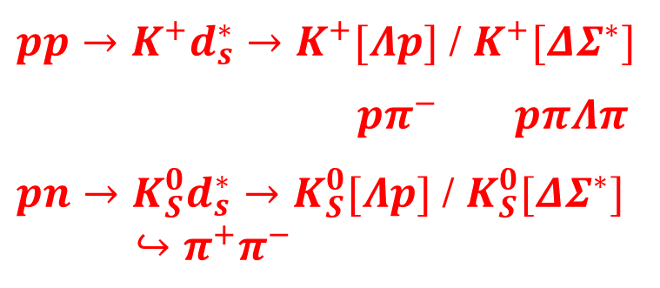
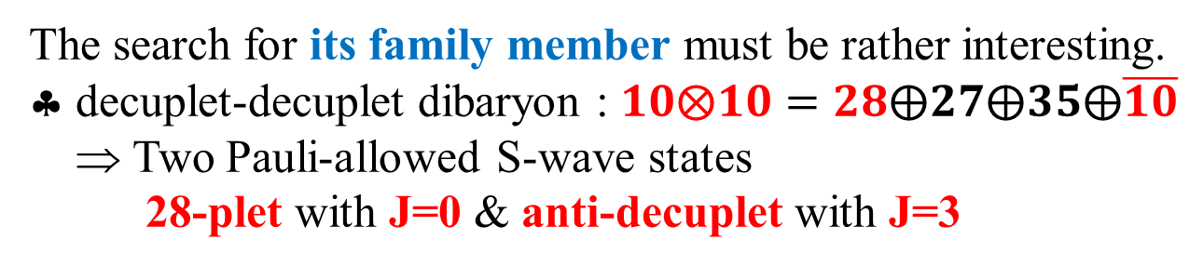
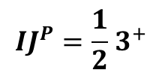
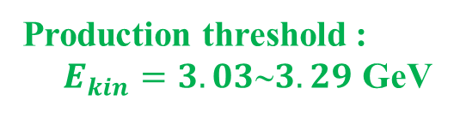

Strange dibaryons
The search for its family member must be rather interesting.
♣ decuplet-decuplet dibaryon : $10⨂10=28⨁27⨁35⨁\overline{10}$
⇒ Two Pauli-allowed S-wave states
28-plet with J=0 & anti-decuplet with J=3
Production threshold :
$E_{kin}=3.033.29$ GeV
$$IJ^{P}={0 3}^{+}$$
$$IJ^{P}={\frac{1}{2} 3}^{+}$$
$pp→K^{+}d_{s}^{∗}→K^{+}[Λp]$ / $K^{+}[ΔΣ^{∗}]$
$pπ^{−}$ $pπΛπ$
$pn→{K_{S}^{0}d}_{s}^{∗}→K_{S}^{0}[Λp]$ / $K_{S}^{0}[ΔΣ^{∗}]$
$↪π^{+}π^{−}$
This PID would be
important for S/N.
Now realistic simulation studies are under way
to evaluate mass resolutions and acceptance.
5 / 22

Slide 7
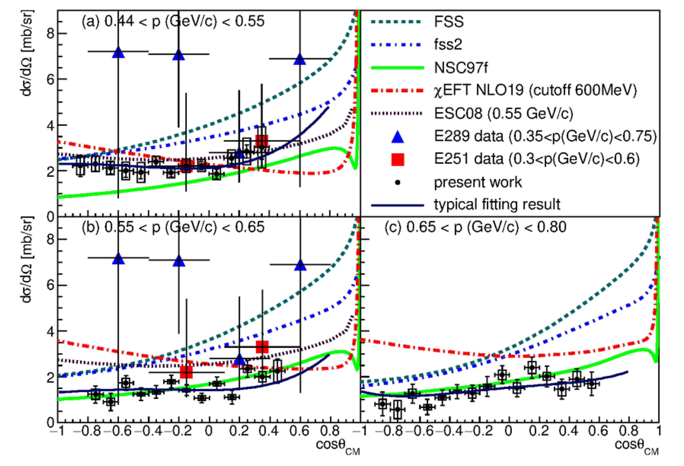
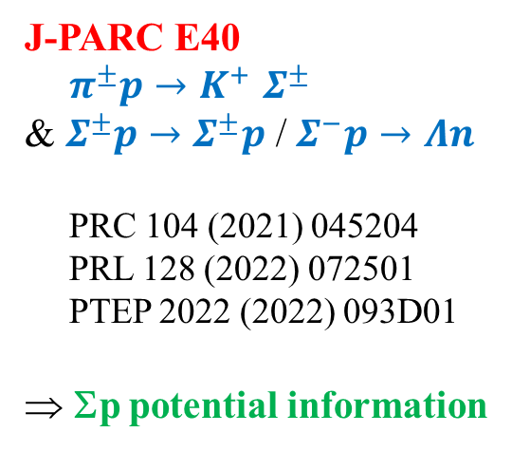
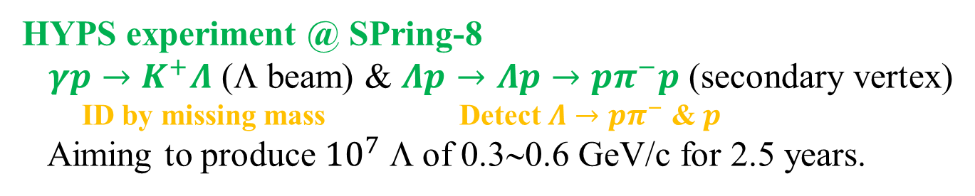

ΛN interaction
Differential cross sections for $Σ^{+}p→Σ^{+}p$
J-PARC E40
$π^{±}p{→K}^{+}Σ^{±}$
& $Σ^{±}p→Σ^{±}p$ / $Σ^{−}p→Λn$
PRC 104 (2021) 045204
PRL 128 (2022) 072501
PTEP 2022 (2022) 093D01
⇒ Σp potential information
HYPS experiment @ SPring-8
$γp→K^{+}Λ$ (Λ beam) & $Λp→Λp→pπ^{−}p$ (secondary vertex)
ID by missing mass Detect $Λ→pπ^{−}$ & $p$
Aiming to produce ${10}^{7}$ Λ of 0.3∼0.6 GeV/c for 2.5 years.
6 / 22

Slide 8
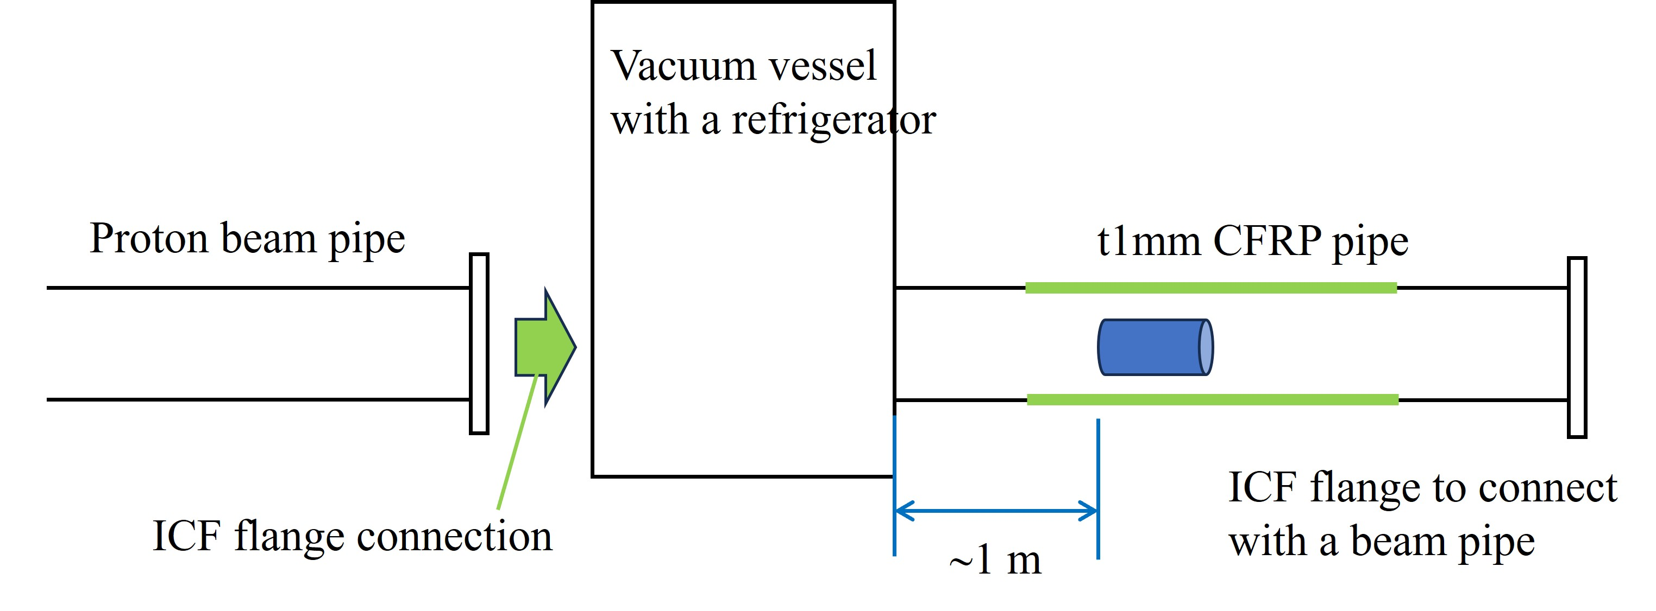
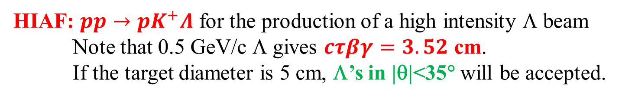
ΛN interaction
HIAF: $pp→pK^{+}Λ$ for the production of a high intensity Λ beam
Note that 0.5 GeV/c Λ gives $cτβγ=3.52$ cm.
If the target diameter is 5 cm, Λ’s in |θ|<35° will be accepted.
p
π⁻
LH₂ target
Forward
high-P proton
Λ
Λ
Proton beam
E_{kin} = 4 GeV
K⁺
Scattered
proton
Thin CFRP pipe
LH₂ target system with
low multiple scattering
is under consideration.
7 / 22

Slide 9





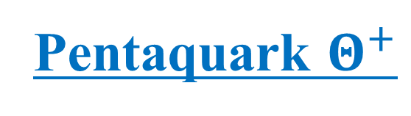
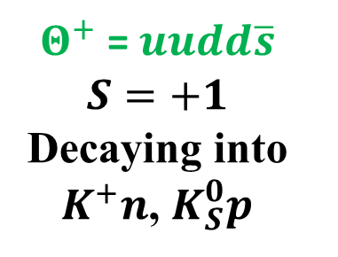



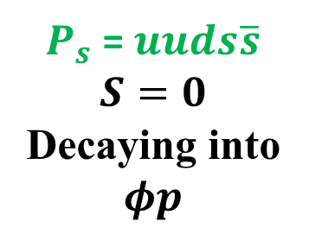



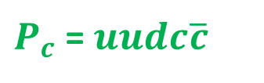
Pentaquark $Θ^{+}$
Many people think $Θ^{+}$ is dead, so difficult to mention it officially.
But I am an author of the first result that still survives and have not given up a chance to get a further evidence…
$Θ^{+}$ = $uudd\overline{s}$
$$S=+1$$
Decaying into
$K^{+}n$, $K_{S}^{0}p$
$P_{c}$ = $uudc\overline{c}$
$$u$$
$$d$$
$$d$$
LHCb, PRL 122 (2019) 222001
$$\overline{s}$$
$$u$$
$$u$$
$P_{s}$ = $uuds\overline{s}$
$$S=0$$
Decaying into
$$φp$$
$$d$$
$$s$$
$$\overline{s}$$
$$u$$
8 / 22

Slide 10
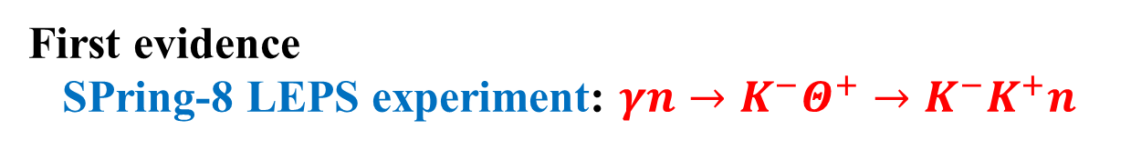
Pentaquark $Θ^{+}$
First evidence
SPring-8 LEPS experiment: $γn→K^{−}Θ^{+}→K^{−}K^{+}n$
PRL 91 (2003) 012002
SVTX
DC1
TOF
C target
AC(n=1.03)
4.6σ
Photons
Target
Dipole Magnet
0.7 Tesla
Start Counter
DC2
DC3
9 / 22

Slide 11
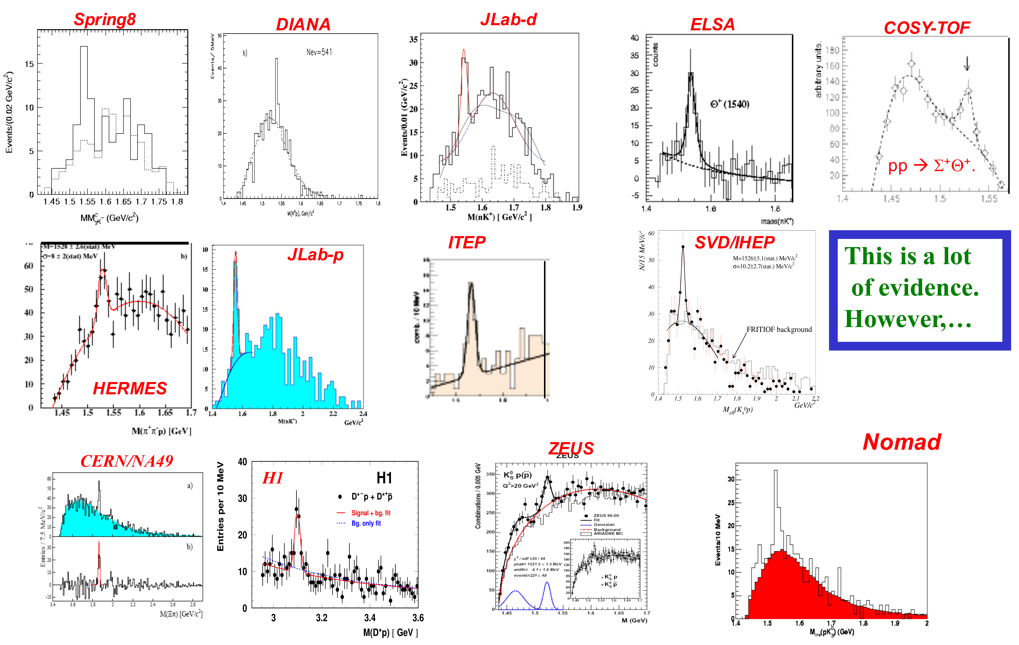
Pentaquark $Θ^{+}$
Appeared in
PDG(2006)
searched mass width statistical
mode [MeV/c²] [MeV/c²] significance
LEPS(C) γC → K⁺K⁻X 1540±10 < 25 4.6σ
DIANA K⁺Xe → K_{S}⁰pX 1539±2 < 9 4.4σ
CLAS(d) γd → K⁺K⁻p(n) 1542±5 < 21 5.2σ
SAPHIR γp → K⁺K⁰(n) 1540±6 < 25 4.8σ
ITEP νA → K_{S}⁰pX 1533±5 < 20 6.7σ
CLAS(p) γp→ π⁺K⁻K⁺(n) 1555±10 < 26 7.8σ
HERMES e⁺d → K_{S}⁰pX 1528±3 13±9 ~5σ
ZEUS e⁺p → e’K_{S}⁰pX 1522±3 8±4 ~5σ
COSY pp → K_{S}⁰pΣ⁺ 1530±5 < 18 4-6σ
SVD(2004) pA→K_{S}⁰pX 1526±4 < 24 5.6σ
SVD(2005) pA→K_{S}⁰pX 1523±4 < 14 8.0σ
ITEP
10 / 22

Slide 12
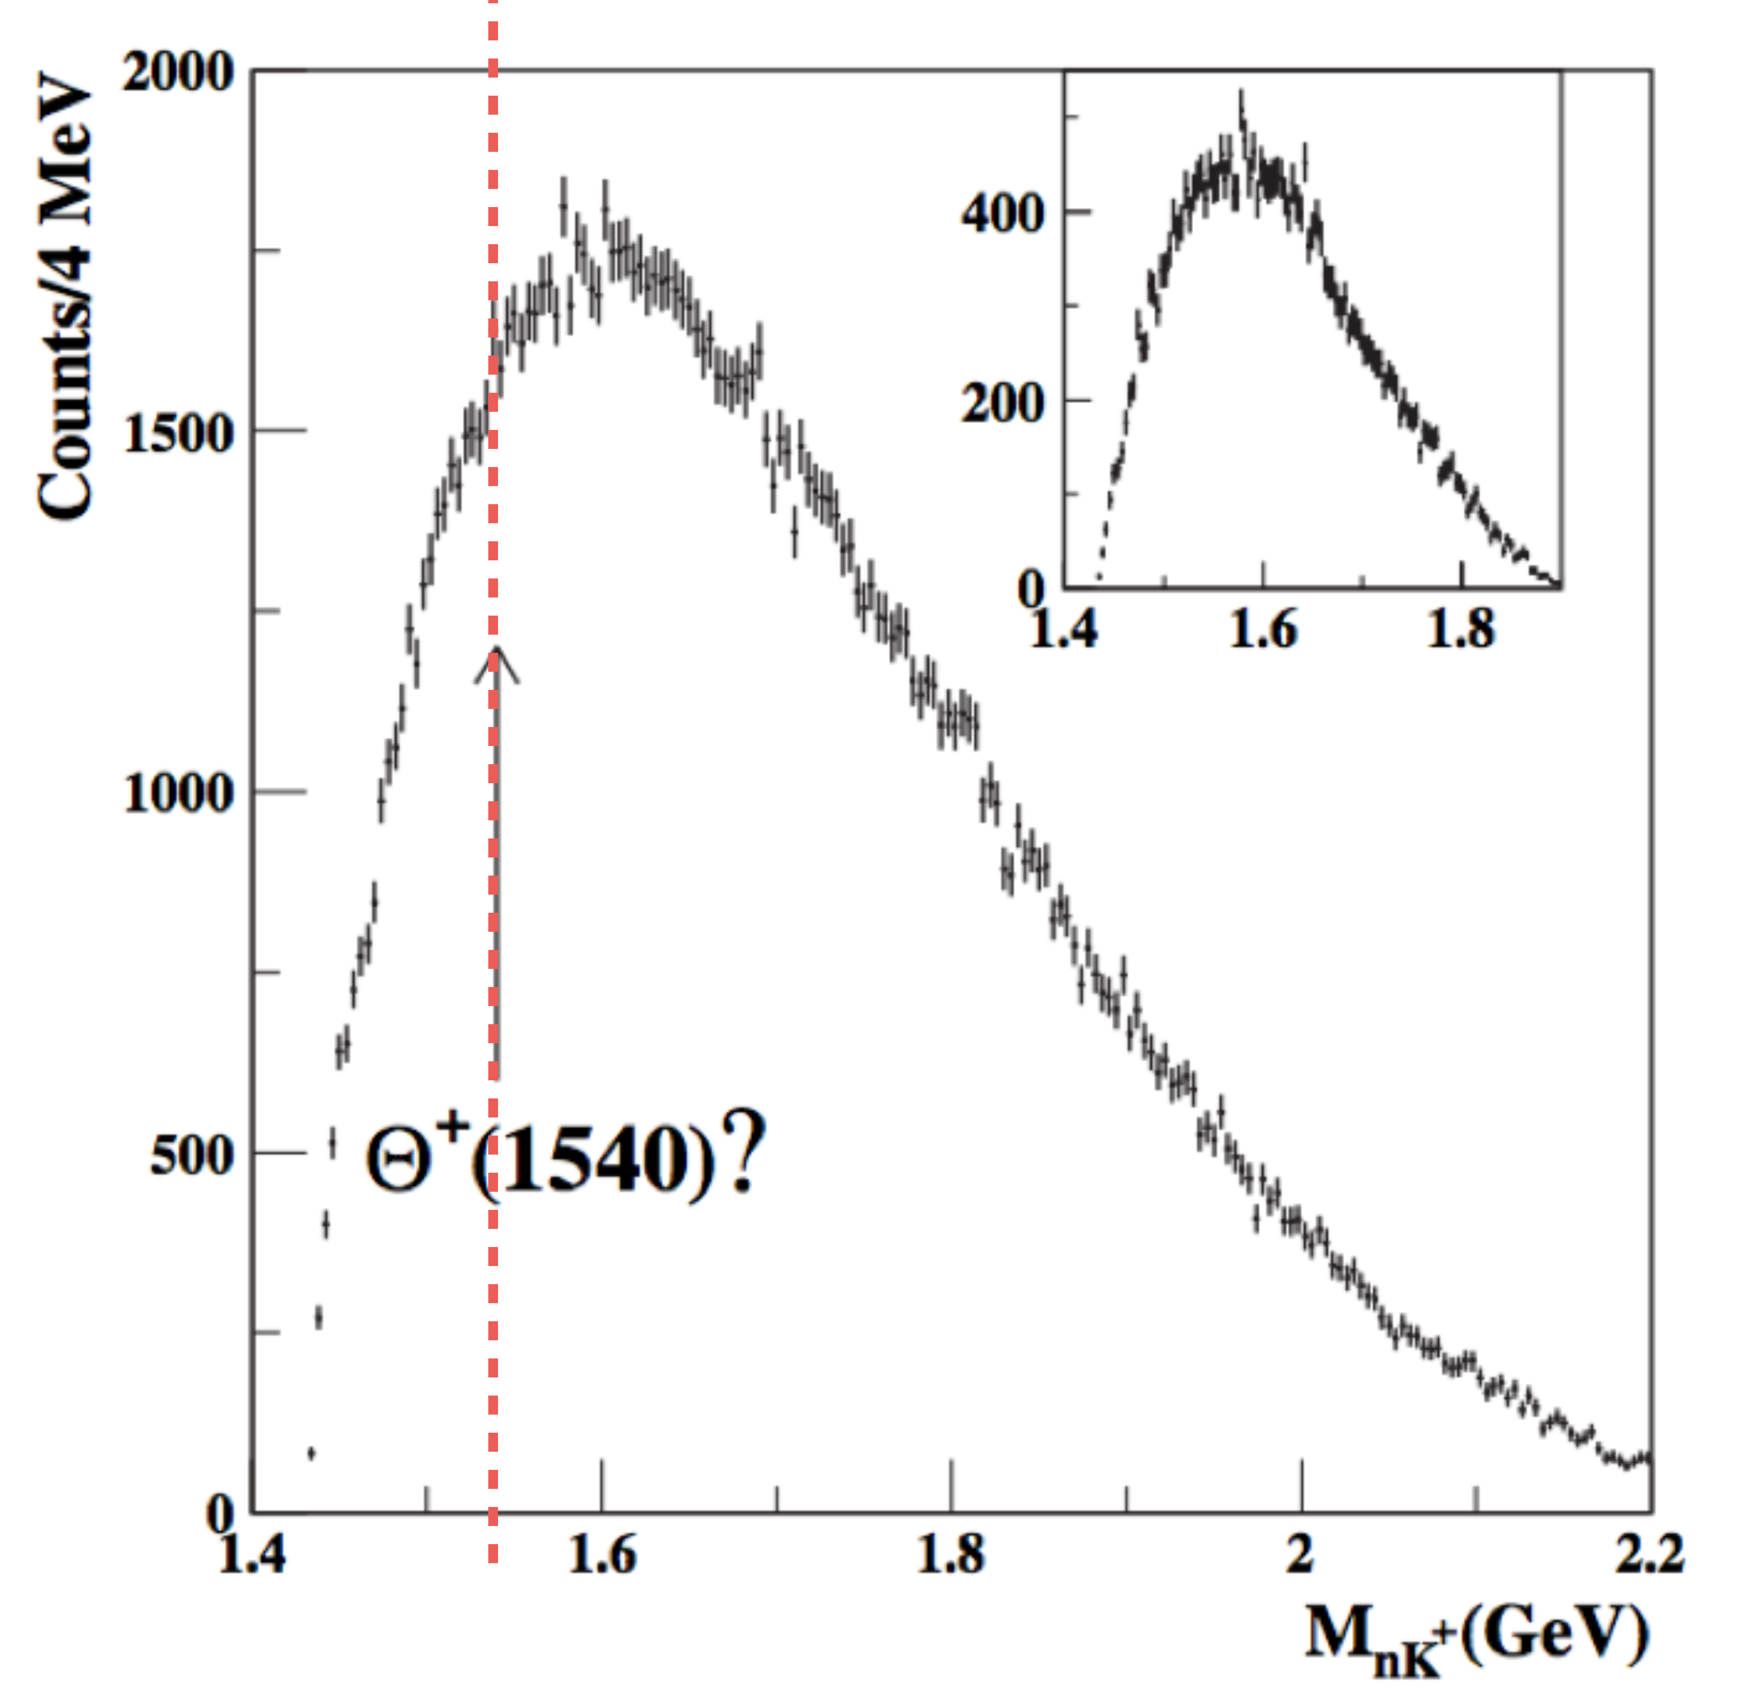
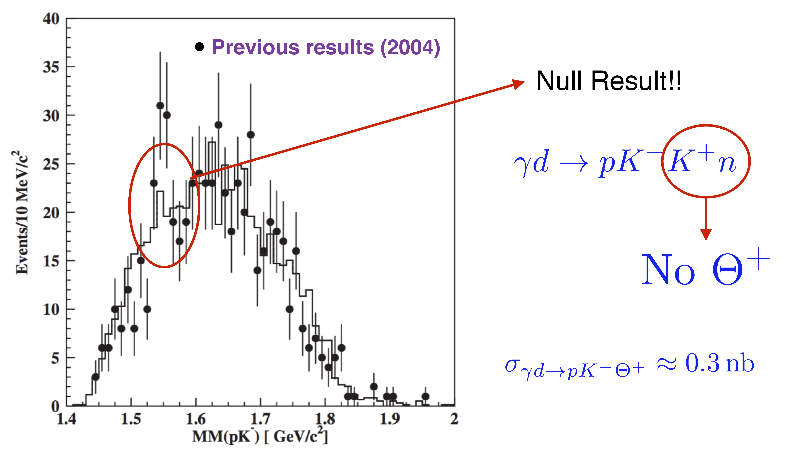

Pentaquark $Θ^{+}$
JLab prohibited further research on $Θ^{+}$.
CLAS, PRL 96
(2006) 212001
CLAS, PRL 96
(2006) 042001
5.2σ peak disappeared.
New result
is scaled by
1/5.92.
11 / 22

Slide 13
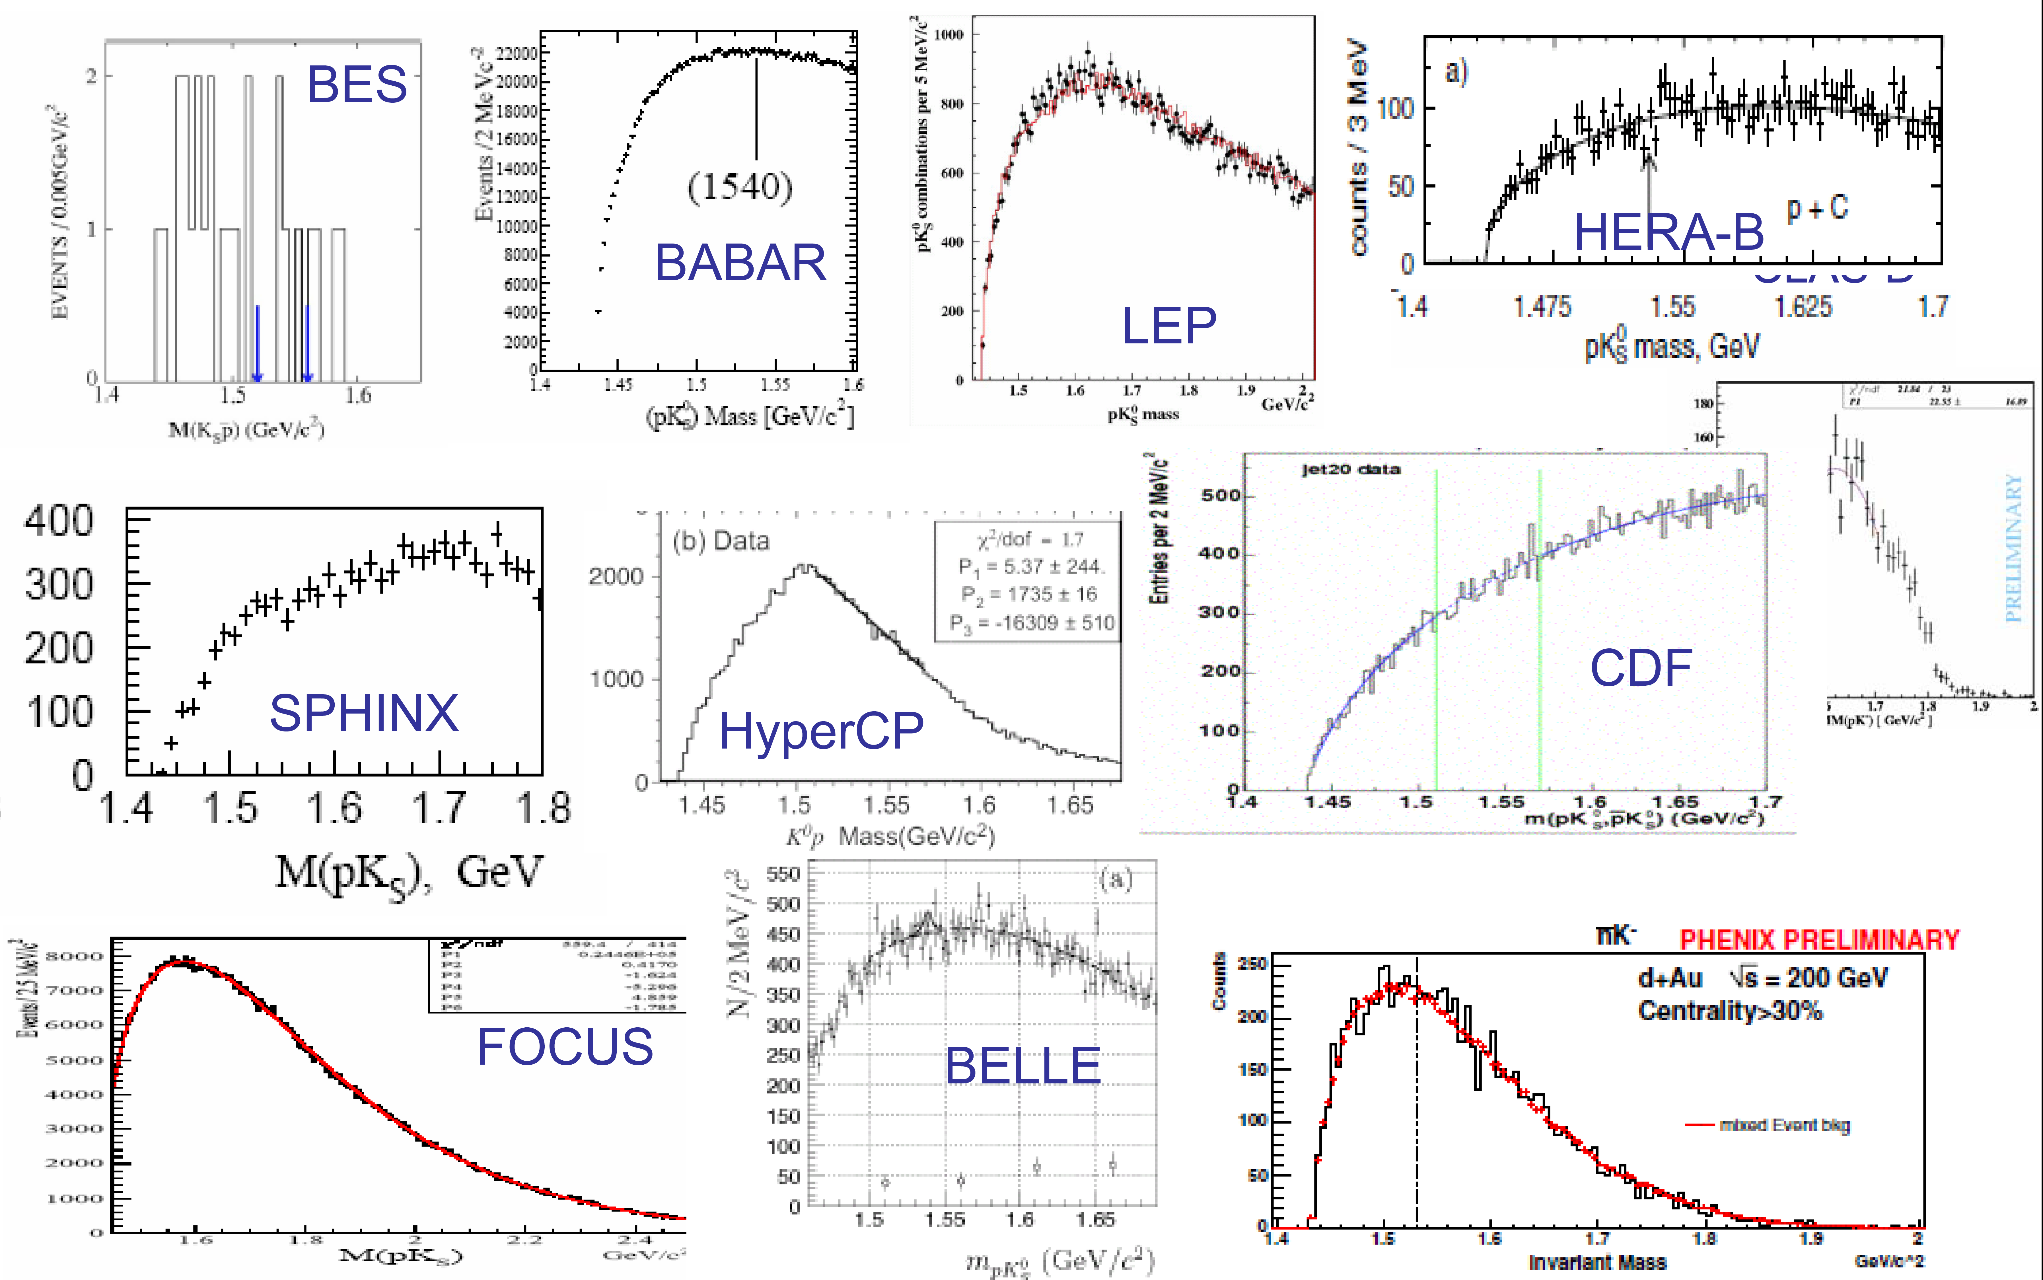
Pentaquark $Θ^{+}$
Many negative results. ⇒ Disappeared in PDG(2008)…
12 / 22

Slide 14
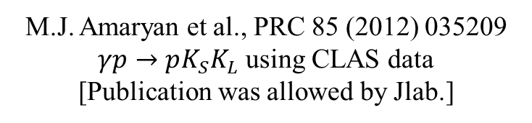
Pentaquark $Θ^{+}$
LEPS, PRC 79 (2009) 025210
LD₂
tgt.
5.1σ
DIANA, PRC 89
(2014) 045204
M.J. Amaryan et al., PRC 85 (2012) 035209
$γp→pK_{S}K_{L}$ using CLAS data
[Publication was allowed by Jlab.]
13 / 22

Slide 15
Pentaquark $Θ^{+}$
COSY-TOF: $pp→Σ^{+}K_{S}^{0}p$ @ $E_{p}^{kin}=2.16$ & $2.26$ GeV
PLB 595 (2004) 127
PLB 649 (2007) 252
214 nb⁻¹
1/8
14 / 22

Slide 16





Pentaquark $Θ^{+}$
$$pp→Σ^{+}K_{S}^{0}p→\left[{pπ}^{0}\right]\left[π^{+}π^{−}\right]p→[pγγ]\left[π^{+}π^{−}\right]p$$
$$pp→Σ^{+}K_{S}^{0}p→\left[{nπ}^{+}\right]\left[π^{+}π^{−}\right]p$$
$$pp→{\overline{K}}^{∗0}pK_{S}^{0}p→\left[{K^{−}π}^{+}\right]p\left[π^{+}π^{−}\right]p$$
$$pp→{\overline{K}}^{∗0}pK^{+}n→\left[{K^{−}π}^{+}\right]pK^{+}n$$
$$pn→K^{−}pK_{S}^{0}p→K^{−}p\left[π^{+}π^{−}\right]p$$
LD₂ target
$Θ^{+}$ decay ($S=+1$)
Need to tag $S=−1$
Missing mass
LH₂ : Assume t = 20 cm ⇒ 8.53×10⁻¹⁰ nb⁻¹
Proton beam : Assume 10⁶ /s conservatively.
Reach 214 nb⁻¹ (COSY-TOF) in 2.9 days.
15 / 22

Slide 17


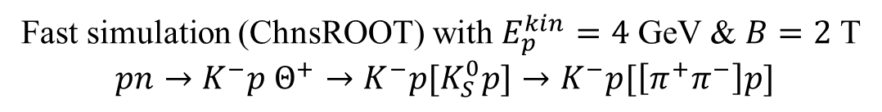



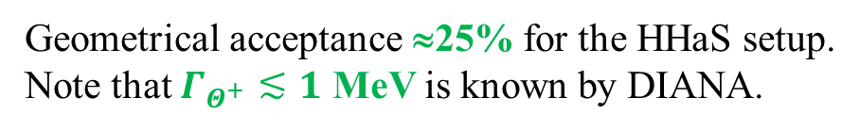


Pentaquark $Θ^{+}$
Fast simulation (ChnsROOT) with $E_{p}^{kin}=4$ GeV & $B=2$ T
$$pn→K^{−}p Θ^{+}→K^{−}p[K_{S}^{0}p]→K^{−}p[\left[π^{+}π^{−}\right]p]$$
$$K_{S}^{0}→π^{+}π^{−}$$
$${Θ^{+}→K}_{S}^{0}p$$
$σ_{M}=4.4$ MeV
$σ_{M}=3.4$ MeV
$K_{S}^{0}$ mass = PDG value
M(reconstructed $K_{S}^{0}$) MeV/c²
M(reconstructed $Θ^{+}$) MeV/c²
Geometrical acceptance ≈25% for the HHaS setup.
Note that $Γ_{Θ^{+}}≲1$ MeV is known by DIANA.
16 / 22

Slide 18

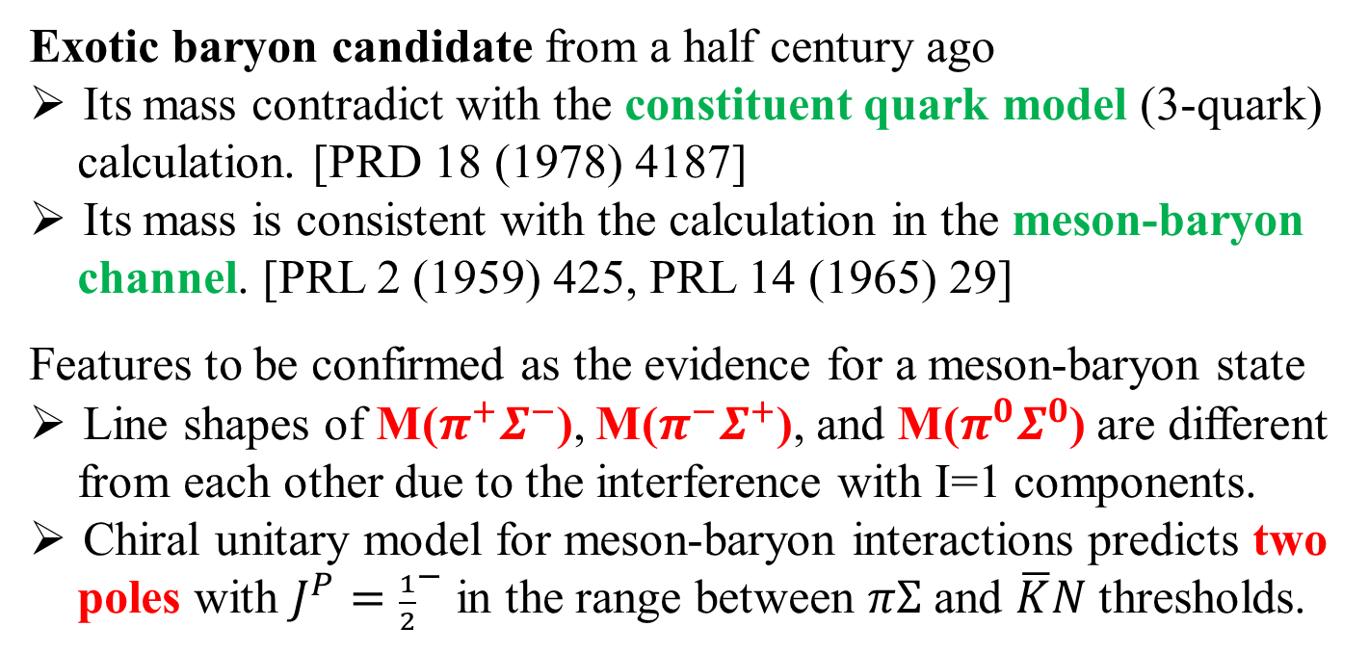





$Λ$(1405) hyperon
Exotic baryon candidate from a half century ago
Its mass contradict with the constituent quark model (3-quark)
calculation. [PRD 18 (1978) 4187]
Its mass is consistent with the calculation in the meson-baryon
channel. [PRL 2 (1959) 425, PRL 14 (1965) 29]
Features to be confirmed as the evidence for a meson-baryon state
Line shapes of M($π^{+}Σ^{−}$), M($π^{−}Σ^{+}$), and M($π^{0}Σ^{0}$) are different
from each other due to the interference with I=1 components.
Chiral unitary model for meson-baryon interactions predicts two
poles with $J^{P}={\frac{1}{2}}^{−}$ in the range between $πΣ$ and $\overline{K}N$ thresholds.
$$πΣ$$
PDG
“$Λ$(1380)”
PDG
“$Λ$(1405)”
$$\overline{K}N$$
$Λ$(1405)
∼1330
1380
1420
∼1435
17 / 22

Slide 19

$Λ$(1405) hyperon
CLAS, PRC 87 (2013) 035206
$Λ$(1405)
Most precise mass spectra come from CLAS (γp reactions).
Unknown I=1 components at 1394 and 1413 MeV/c².
18 / 22

Slide 20
$Λ$(1405) hyperon
COSY-Jülich, PLB 660 (2008) 167
HADES, PRC 87 (2013) 025201
Statistics for
pp data are
not good yet.
156±23 signal events
19 / 22

Slide 21
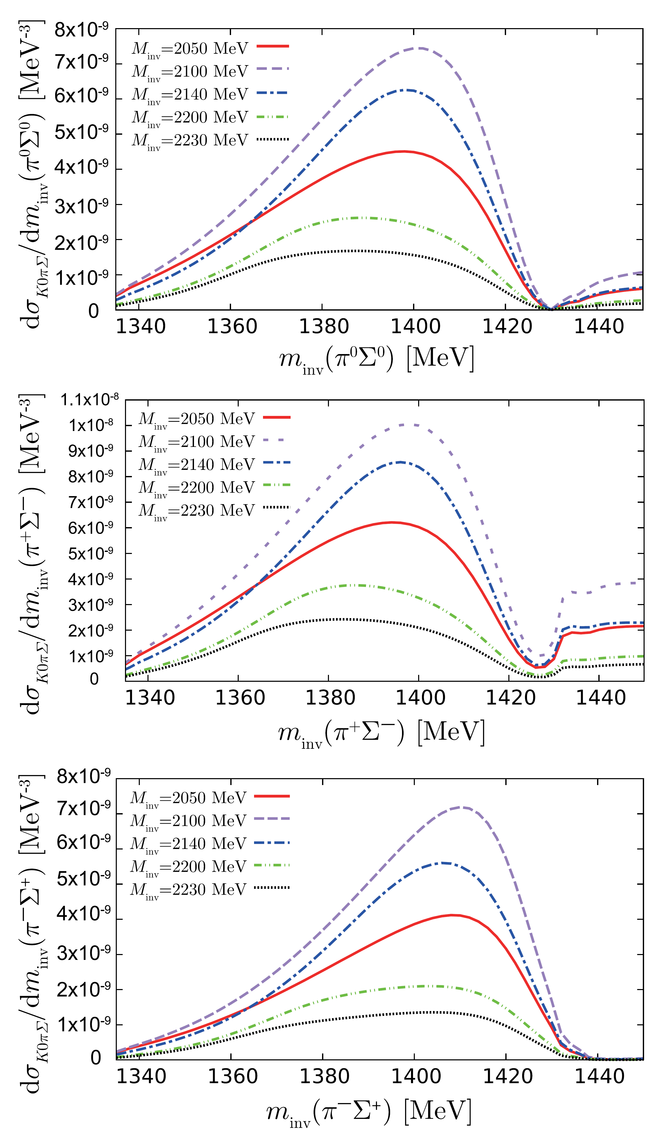



$Λ$(1405) hyperon
PRC 97 (2018) 035203
Theoretical calculation for pp reactions.
Λ(1405) mass peaks become lower by
the triangle diagram coupling to πΣ.
$$π^{0}Σ^{0}$$
$$π^{+}Σ^{−}$$
Other calculations are also available.
PRC 88 (2013) 055201
EPJA 34 (2007) 405
Experimental constraint is necessary.
$$π^{−}Σ^{+}$$
20 / 22

Slide 22








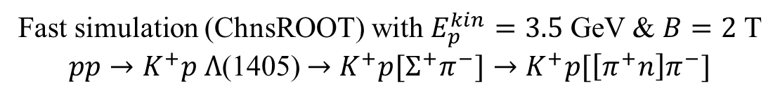


$Λ$(1405) hyperon
Fast simulation (ChnsROOT) with $E_{p}^{kin}=3.5$ GeV & $B=2$ T
$pp→K^{+}p Λ$(1405) $→K^{+}p[Σ^{+}π^{−}]→K^{+}p[\left[π^{+}n\right]π^{−}]$
$n$ (missing mass)
$Λ$(1405)$→Σ^{+}π^{−}$
$σ_{M}=11.3$ MeV
$σ_{M}=5.3$ MeV
M$p$($p$,$K^{+}pπ^{+}π^{−}$) MeV/c²
$$Σ^{+}→π^{+}n$$
M(reconstructed $Λ(1405)$) MeV/c²
Good enough resolution to measure mass spectrum difference.
Geometrical acceptance ≈ 46%
Total cross section : 9.2 μb
10⁶ protons/s + 20 cm-long LH₂ target
⇒ 7.8 Λ(1405)/s
$σ_{M}=4.3$ MeV
$n$ mass = PDG value
M(reconstructed $Σ^{+}$) MeV/c²
21 / 22

Slide 23
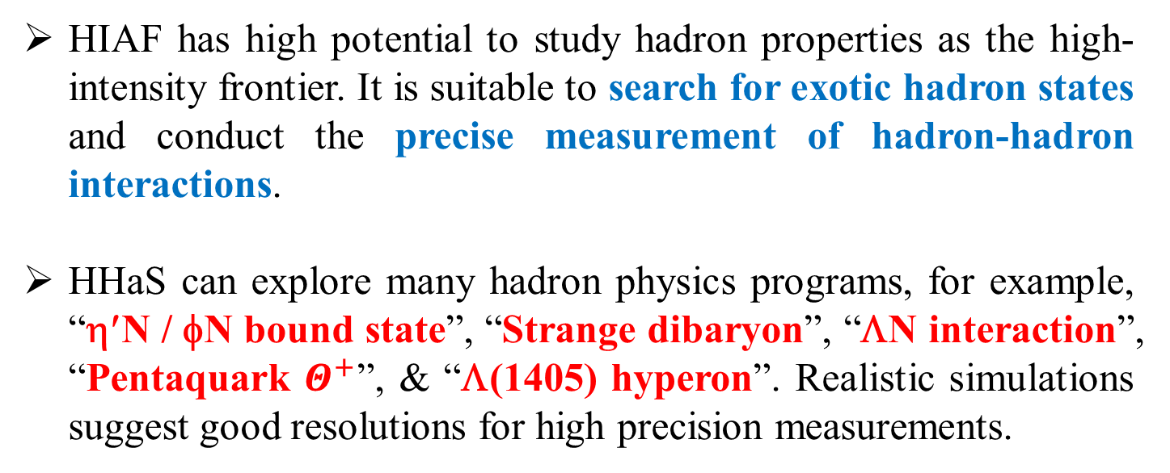
Summary
HIAF has high potential to study hadron properties as the high-intensity frontier. It is suitable to search for exotic hadron states and conduct the precise measurement of hadron-hadron interactions.
HHaS can explore many hadron physics programs, for example, “η′N / φN bound state”, “Strange dibaryon”, “ΛN interaction”, “Pentaquark $Θ^{+}$”, & “Λ(1405) hyperon”. Realistic simulations suggest good resolutions for high precision measurements.
Thank you for your attention.
22 / 22

