Slide 1

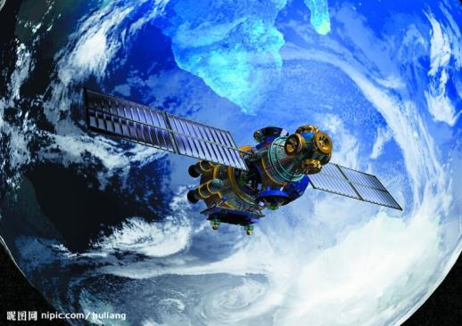
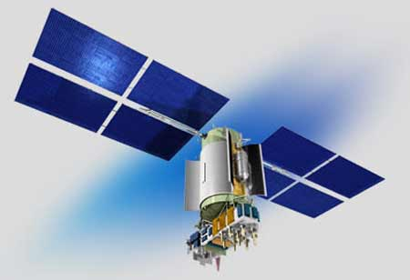


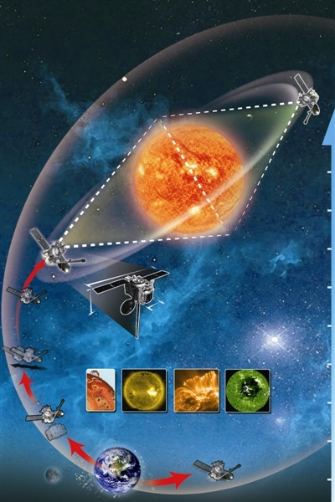

第十届海峡两岸量子物理与宇宙学研讨会
广义标准模型
——粒子物理与宇宙学的统一
吴岳良 (YLWU)
中国科学院理论物理研究所 (ITP-CAS)
国际理论物理中心-亚太地区 (ICTP-AP, UNESCO )
中国科学院大学 引力波宇宙太极实验室
2026年1月18-23日 @ 暨南大学 （广州）

Slide 2
CONTENTS
Fundamental Challenges in QFT(QM) & GR
GQFT: Spin Dynamics for the Unification of QFT(QM) and GR
GSM: A Unified Framework for Particle Physics & Cosmology
HUFT : Hyper-spin Dynamics for Unification Theory
Taiji Program: Space-based GWD in China

Slide 3
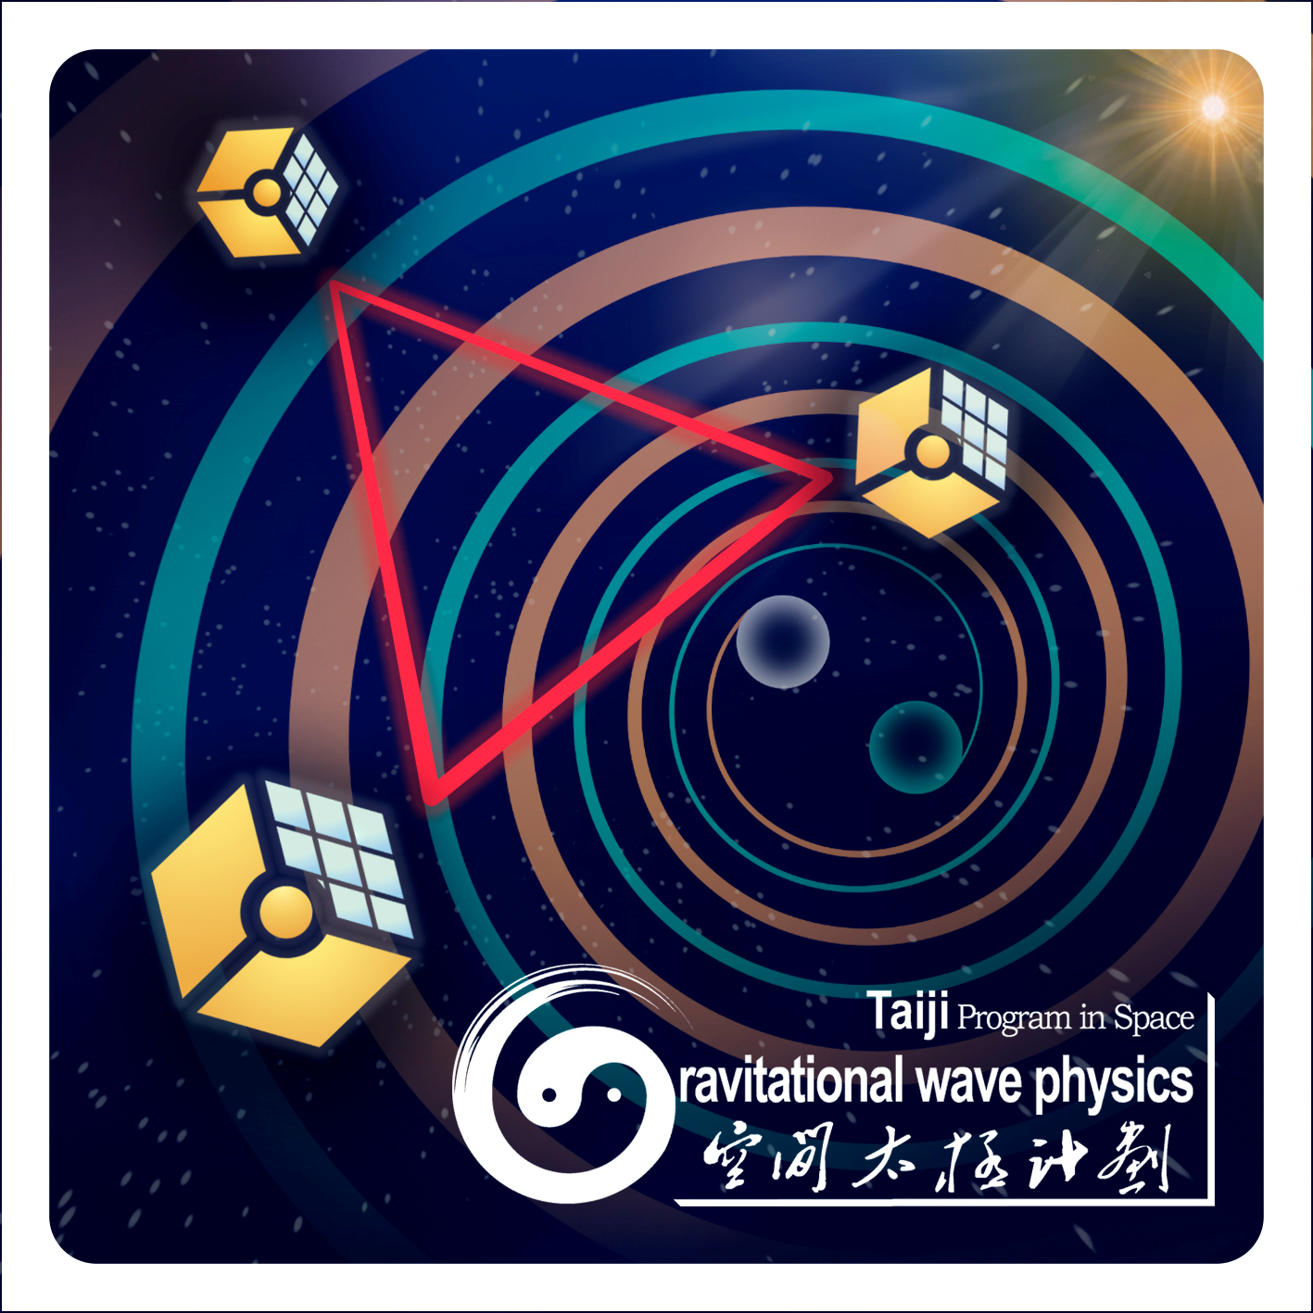
Fundamental Challenges in QFT(QM) & GR

Slide 4
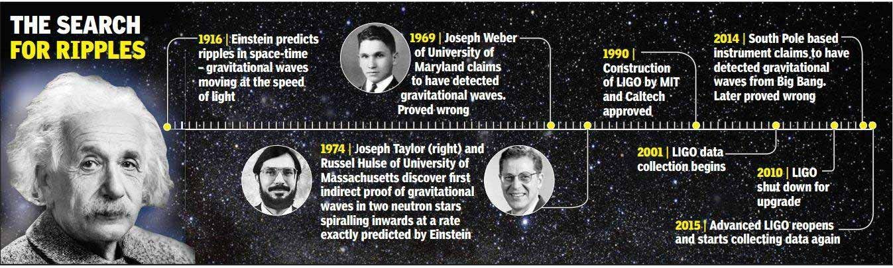
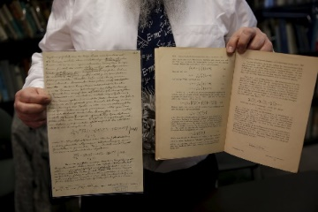
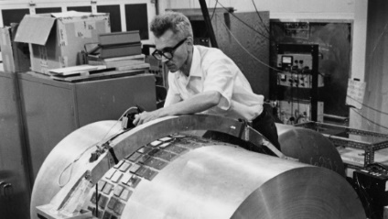
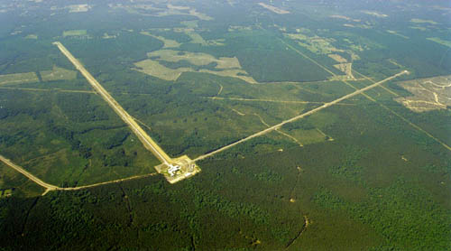
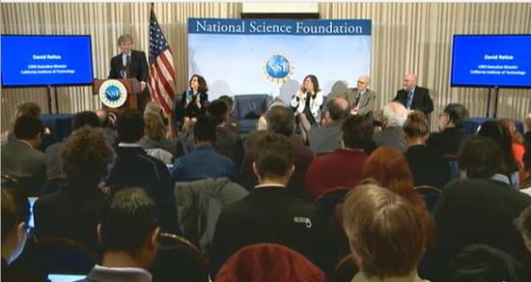
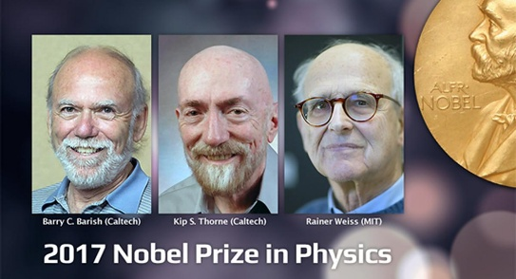
Discovery of Gravitational Waves
Feb. 11, 2016, LIGO announced the first direct observation of GW
Provide a more fundamental test on Einstein GR and
Bring us to study deeply on the nature of spacetime & gravity

Slide 5
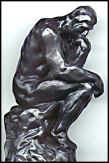
Fundamental Challenges in QFT(QM) & GR
The quest for a successful combination of the quantum field theory (QFT) (quantum mechanics(QM) ) & general theory of relativity (GR), and the unification of all basic forces has become the most challenging frontier of sciences in the 21st century.
Three basic forces of electroweak & strong interactions in SM are governed by the gauge symmetries U(1) x SU(2) x SU(3) and described by the dynamics of gauge fields within the framework of QFT .
SM cannot explain the dark side of the universe: dark matter & dark energy

Slide 6
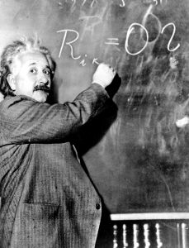
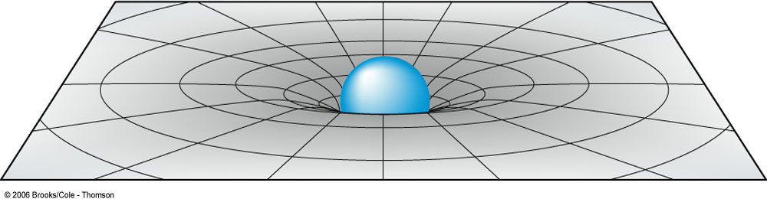

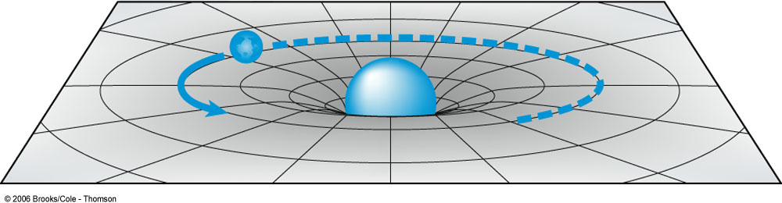
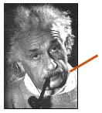
The Successes & Limitations of GR & QM/QFT
Einstein’s theories of SR and GR transformed our comprehension of spacetime, overturning the Newtonian framework of absolute space and time. Instead, they revealed spacetime as a dynamic, curved fabric influenced by mass and energy.
Einstein: SR in Minkowski spcetime→GR in Riemannian spacetime for Gravity
Geometry Matter
Einstein’s GR did not challenge the Newton's hypothesis that all massive objects are assumed to be indivisible, point-like particles

Slide 7
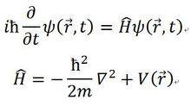

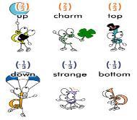
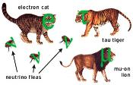
The Successes & Limitations of GR & QM/QFT
The QM/QFT fundamentally departs from Newton‘s concept of point-like particles, and introduces the notion: the basic constituents of matter are described by the wave functions/quantum fields.
1925~1928: NQM→RQM=QM+SR: Schrodinger Equation→Dirac equation
Spacetime Dimension Intrinsic Quantum Number of Matter Field
Conserv. of total Angular Mom.
ψ_{i} (i=1,2,3,4), SO(1,3)
RQM→QFT (QED)→SM: leptons & quarks as quantum fields have an intrinsic structure characterized by quantum numbers, which reflect basic properties: helicity& boost-spin, charge-spin, isospin, color-spin
The QM/QFT did not distinguish the intrinsic spin symmetry SP(1,3) of spinor quantum fields with the external Lorentz symmetry SO(1,3) of coordinate system, they are assumed to be an associated symmetry.

Slide 8
GQFT: Spin Dynamics for the Unification of QFT(QM) and GR

Slide 9
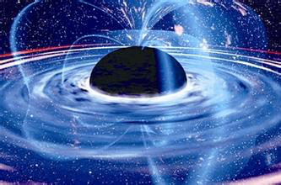
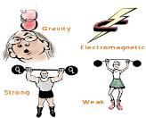
GQFT: a Unified Framework of QM/QFT and GR
How the presence of intrinsic structure and relevant symmetry in quantum fields and their gravitational interactions are going to challenge the foundation of Einstein's equivalence principle in GR.
Basic considerations
Gauge theory of gravity is constructed within the framework of QFT in a flat Minkowski space-time
Treat the gravitational force on the same footing as the three basic forces (electroweak & strong) in SM based on QFT
Basic issue:
what is the fundamental symmetry indicated from quantum numbers of leptons & quarks for governing the gravity ?
引力
电磁力
强作用力
弱作用力
Notes:
One frame is the globally flat coordinate Minkowski spacetime, which acts as an inertial reference frame for characterizing the motions of basic fields.
Another spacetime frame is called locally flat non-coordinate gravigauge spacetime, which functions as an intrinsic interaction frame for characterizing the dynamics of basic fields.

Slide 10
GQFT: a Unified Framework of QM/QFT and GR
Essential Notions:
The laws of nature are governed by the intrinsic properties of the basic constituents of matter, characterized by quantum fields, rather than geometry.
The laws of nature are independent of the choice of local field configurations
Distinguish the internal symmetry of quantum field and the external symmetry of coordinate system
Beyond GR: spacetime geometry should no longer play a fundamental role
Beyond QM/QFT: all internal symmetries including spin symmetry SP(1,3) of fundamental quantum fields should be localized as gauge symmetries, and the corresponding gauge fields describe fundamental interactions of nature.

Slide 11
GQFT: a Unified Framework of QM/QFT and GR
Basic Postulates:
Fundamental constituents of matter are assumed to be quantum fields:
Dirac-type or Weyl-type spinor fermions
Kinematics of all quantum fields obeys the principles of special relativity
Dynamics of all quantum fields is characterized by the basic interactions
governed by gauge symmetries of quantum fields
New Concepts
Distinguish the spin symmetry SP(1,3) in Hilbert space of spinor field & the Lorentz symmetry SO(1,3) in Minkowski spacetime of coordinates
The intrinsic Spin quantum number requires the spin gauge symmetry SP(1,3) that causes spin gauge interactions associated with gravitational interactions
The SP(1,3) spin gauge symmetry brings on the notion of bi-frame spacetime,
which is essential for establishing the gravitational quantum field theory (GQFT)
within the framework of QFT in flat Minkowski spacetime.

Slide 12
Gravitational Quantum Field Theory (GQFT)
A unified Framework of QM and GR
Concept of bi-frame Spacetime in GQFT
One frame is a globally flat Minkowski spacetime of coordinates, which acts as an inertial reference frame for characterizing the motions of fundamental fields, which is regarded as a base spacetime M₄
The other is a spin-associated gravigauge spacetime, which functions as an intrinsic frame characterizing the dynamics of fundamental fields, such a spacetime forms noncommutative geometry, regarded as a fiber G₄
The bi-frame spacetime brings a Fiber Bundle structure
E ~ M₄ x G₄
In GQFT, the fundamental gravitational field is no longer the metric field g_{μν} , but a bicovariant vector field χ_{μ}ª , defined in flat Minkowski spacetime and valued in spin-associated gravigauge spacetime, characterizing the bi-frame spacetime.
g_{μν}
χ_{μ}ª
Metric field
Gauge-type Goldstone boson

Slide 13
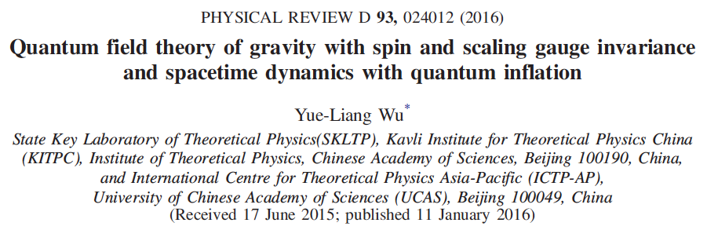
物理评论 D93, 024012 （2016）
自旋和标度规范不变的引力量子场论
& 量子暴胀宇宙时空动力学
吴岳良

Slide 14
引力量子场论框架下的引力动力学、自旋动力学和电动力学
吴岳良
国际理论物理中心-亚太地区，中国科学院大学
中国科学院理论物理研究所
中国科学院大学 引力波宇宙太极实验室
国科大杭州高等研究院 基础物理与数学科学学院
中国科学 SCPMA 66 260411(2023)

Slide 15
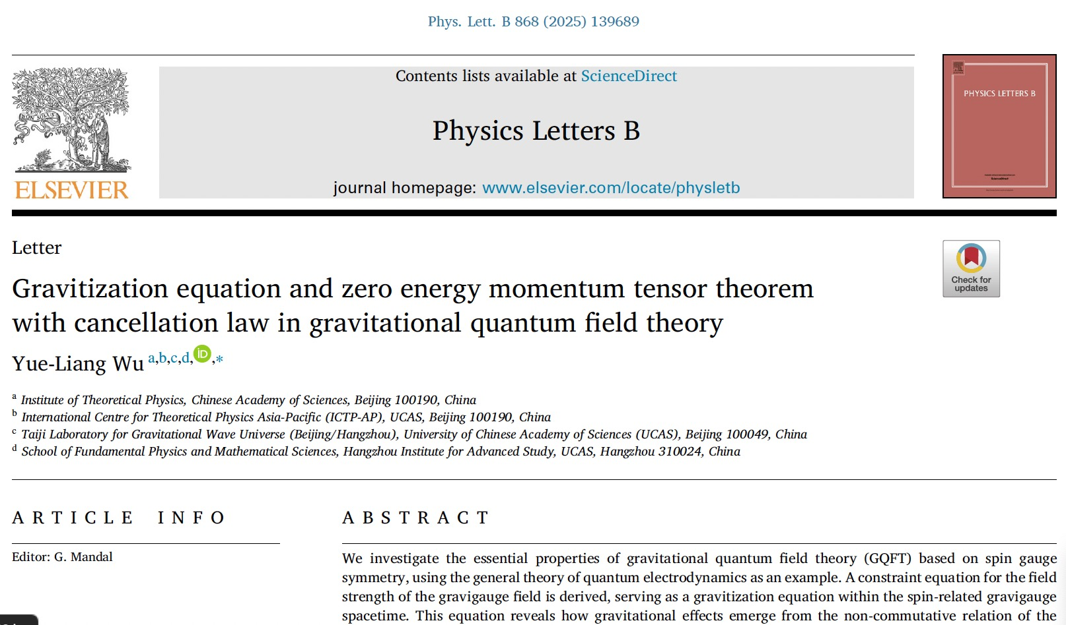
arXiv: 2411.15166
引力量子场论中的引力化方程与相消定律对应的零能动量张量定理
吴岳良

Slide 16
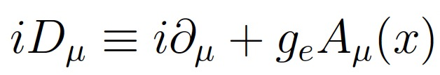
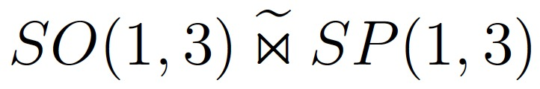
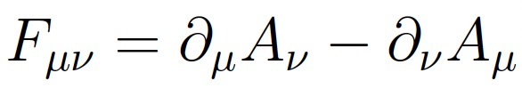
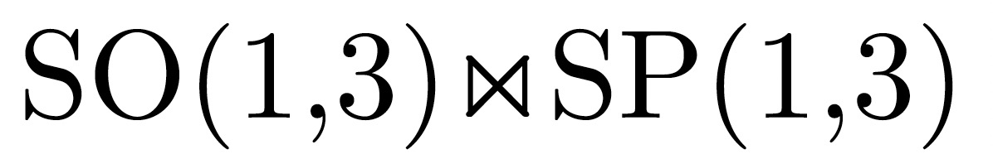
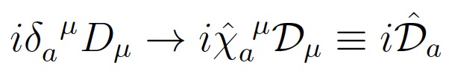
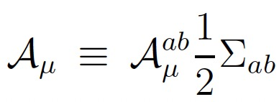
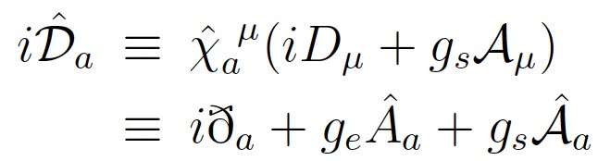
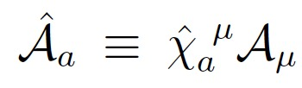
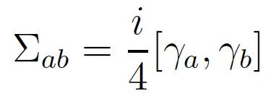
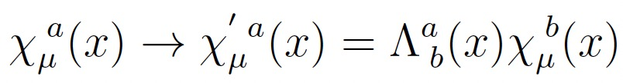

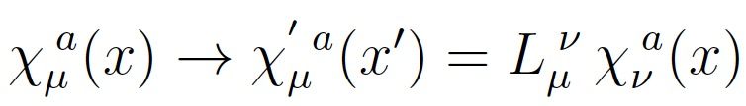


General Theory of QED within the Framework of GQFT
Action
of QED
Ordinary Lorentz symmetry is an associated global symmetry
In GQFT, it becomes a joint symmetry of global Lorentz sym. and spin gauge sym.
Covariant Derivative of spin gauge symmetry in gravigauge spacetime
The joint symmetry transformations under the global Lorentz sym. and spin gauge sym.

Slide 17
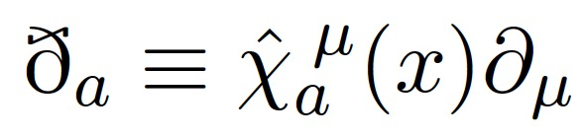
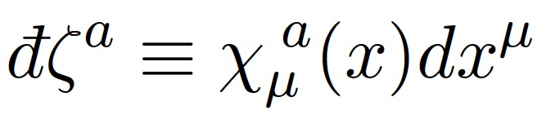
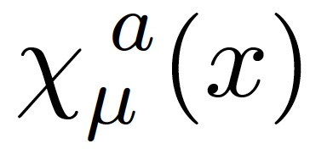
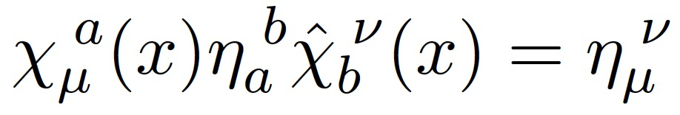
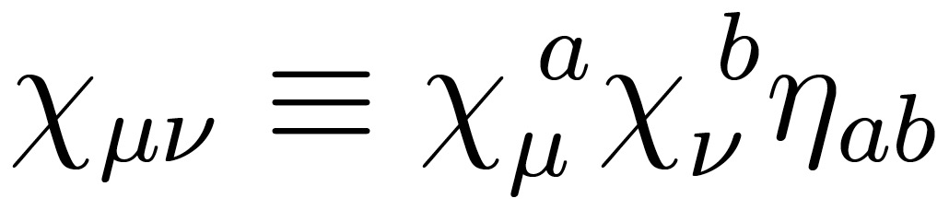
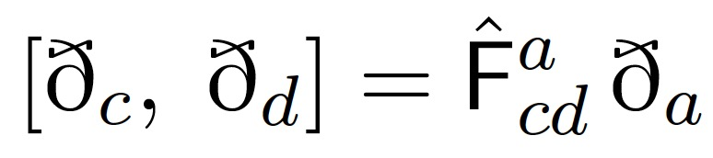
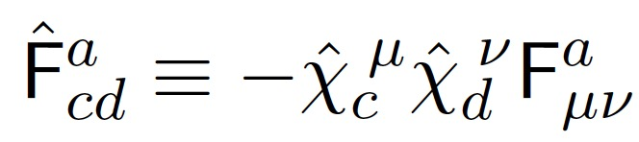
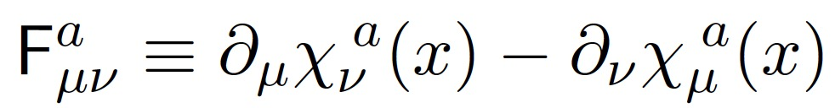
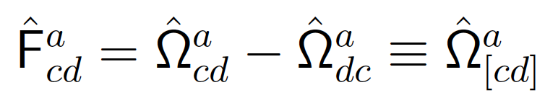
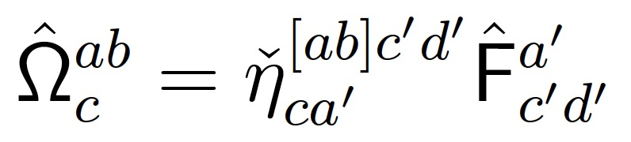
Emergence of Spin-associated Gravigauge Spacetime
Gravigauge displacement & derivative → gravigauge basis
Dual gravigauge fields
Composite gravimetric fields
→ g_{μν}
Gravigauge spacetime governed by non-commutative geometry
Gravigauge field strength
or Group structure factor

Slide 18
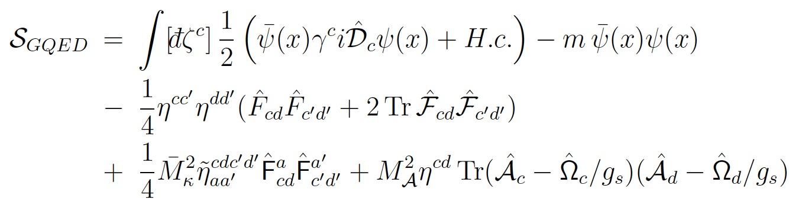
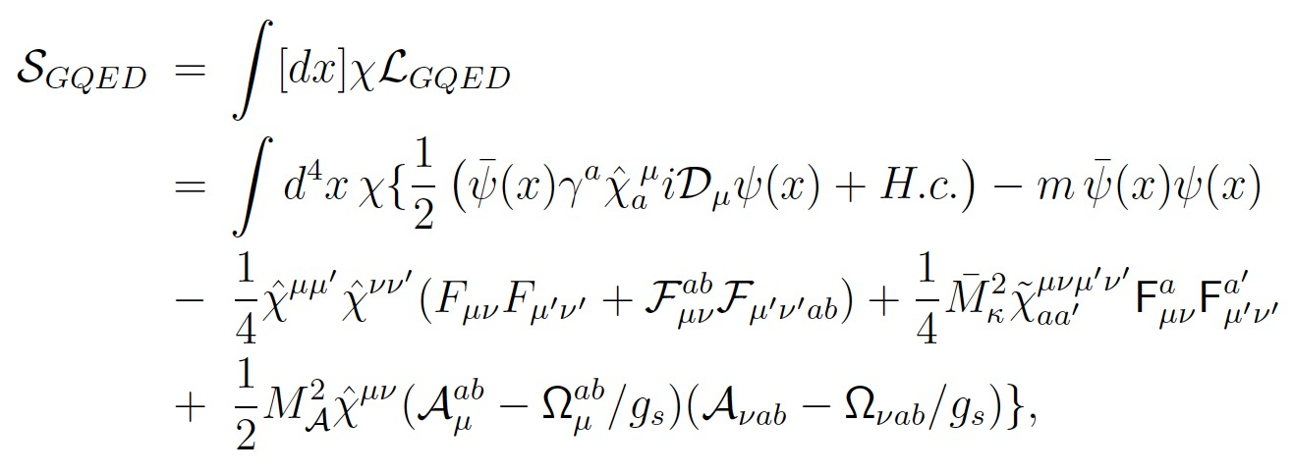
General Theory of QED (GQED) within Framework of GQFT
Gauge invariant action of GQED in gravigauge spacetime
Coordinate independence indicates Hidden Group Symmetry GL(1,3,R) , which lays the foundation of Einstein’s GR
Gauge invariant action of GQED in GQFT based on bi-frame spacetime

Slide 19
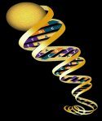
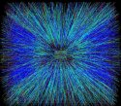
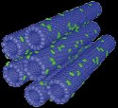
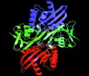
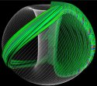

General Dirac Equation
General Maxwell Equation
General Einstein Equation

Slide 20
Gravitational Relativistic Quantum Theory & Generalized Dirac Equation
Dirac Equation
General Dirac Equation in gravigauge spacetime
General Dirac Equation
Gravitational Relativistic Quantum Mechanics

Slide 21
Electrodynamics in GQFT & Generalized Maxwell Equation
Gravigeometry-medium Electrodynamics with Generalized Maxwell Equations hold for arbitrary motional body and in any reference frame
Gravigeometry-medium Electromagnetic Fields

Slide 22





Gravidynamics in GQFT & Gauge-type Gravitational Equations
Gauge-type Gravitational Equation for the gravigauge field with the conserved bi-covariant vector current
General Geometric-type Gravitational Equation
Symmetric Generalized Einstein Equation
Antisymmetric Gravitational Equation beyond Einstein

Slide 23

引力量子场论的线性动力学和经典检验
高远坤、黄达、马永亮、汤勇、周宇峰、吴岳良
PRD109,064072 (2024)
arXiv:2403.17619

Slide 24









Gravitational Waves in GQFT
from Free Equations of Gravigauge Field
5 massless propagating GW DoFs in GQFT: two tensor modes , two vector and one scalar modes, rather than 2 polarizations in GR
Broken down of Einstein equivalence principle in GQFT !

Slide 25

Gravitational Wave Generation and Detection
in Gravitational Quantum Field Theory （GQFT）
引力量子场论中引力波的产生与探测
高远坤、黄达、吴岳良
arXiv:2506.21225

Slide 26









Gravitational Wave Generation in GQFT
One Scalar-Transverse GW production
Two Vector-Transverse GW production
Wigner function
for spin density
Two Tensor-Transverse GW production
quadruple tensor

Slide 27


Taiji & LISA GWDs: seeking to probe lower frequency gravitational wave signals, and planning to be launched in 2030s
Signals between any two of the three satellites can be used to detect GWs
2016年《NATURE》报道太极计划相关情况
太极计划
Hu, W. R. & Wu, Y. L. The Taiji Program in Space for gravitational wave physics and the nature of gravity. Natl Sci. Rev. 4, 685–686 (2017).
Luo, Z. R., Guo, Z. K., Jin, G., Wu, Y. L. & Hu, W. R. A brief analysis to Taiji: science and technology. Results Phys. 16, 102918 (2020).
Luo, Z. R., Jin, G.,Wu, Y. L. & Hu,W. R. The Taiji program: a concise overview. Progr. Theor. Exp. Phys. https://doi.org/10.1093/ptep/ptaa083 (2020).
太极计划三颗卫星
各相距300万公里
 | Position noise 测距指标 | Accelerate noise 加速度残差 | Orbit 轨道 | Armlength ( 10000km） 臂长（万公里) | Frequency 频段 | Launch 发射时间
TaiJi 太极 | 8pm/Hz^{1/2} | 3×10⁻¹⁵ms⁻²/Hz^{1/2} | Sun 太阳 | 300（2012） 3 million km | 0.1mHz-1Hz | 2030~2033
LISA | 12pm/Hz^{1/2} | 3×10⁻¹⁵ms⁻²/Hz^{1/2} | Sun Helio-center | 500（1995） 100（2011） 250（2017） | 0.1mHz-1Hz | 2030~2034

Slide 28



该文章分析揭示了贝叶斯因子约为2.5，将四极（张量横向，TT）相关性与标量横向（ST）相关性进行了比较，并表明ST相关性为NANOGrav数据中观察到的随机引力波信号提供了具有可比性的解释
This analysis reveals a Bayes factor of approximately 2.5, comparing the quadrupolar (tensor transverse, TT) correlations to the scalar transverse (ST) correlations, and suggesting that the ST correlations provide a comparable explanation for the observed stochastic signal in the NANOGrav data.

Slide 29


Figure 1. A plot of transverse overlap reduction function（ORF）（ related to the spatial geometry of the two pulsars in relation to the Earth）as a function of angular separation. The blue curve describes the Hellings and Downs curve, which is produced by the TT polarization mode, while the orange curve describes the shape of the correlations induced by the ST polarization mode of gravity.
该文章探索了NANOGrav 15年的数据集，以寻找具有四极Hellings-Downs（HD）和标量横向（ST）相关性的引力波背景的证据
通过使用最佳统计数据，他们发现，当分别适用时，HD的中值信噪比为5.0，ST相关性的值信噪比为4.6，当同时适用时，高清的中值信噪声比为3.5，ST相关性为3.0。
This paper explored the NANOGrav 15 yr data set for evidence of a gravitational-wave background with quadrupolar Hellings and Downs (HD) and scalar-transverse (ST) correlations.
By using the optimal statistic, they found that the median signal-to-noise ratios of 5.0 for HD and 4.6 for ST correlations when fit for separately, and median signal-to-noise ratios of 3.5 for HD and 3.0 for ST correlations when fit for simultaneously.

Slide 30




引力量子场论中的相消定律与零能动量张量定理
arXiv: 2411.15166

Slide 31


Summary & Conclusions
Essential Notions Beyond QM/QFT & GR:
The laws of nature are governed by the intrinsic properties of the basic constituents of matter, characterized by quantum fields, rather than geometry.
The laws of nature are independent of the choice of local field configurations
Distinguish the internal inhomogeneous spin symmetry WS(1,3) of quantum field and the external Poincare symmetry PO(1,3) of coordinate system
GQFT provides a novel approach for consistently combining the GR and QFT/QM
GQFT brings a single and unified theoretical framework for describing the four basic forces
引力
电磁力
强作用力
弱作用力
GQFT leads to deep understanding of the universe, from the smallest quanta to the largest cosmos.

Slide 32
GSM: A unified Framework for Particle Physics & Cosmology

Slide 33

标准模型的广义理论及其对暗宇宙的揭示
吴岳良
中国科学院理论物理研究所
国际理论物理中心(亚太地区)
中国科学院大学 引力波宇宙太极实验室
国科大杭州高等研究院 基础物理与数学科学学院
Sci. Bull. 70 (2025) 1740 (科学通报)

Slide 34

广义标准模型的理论基础
——粒子物理与宇宙学的统一框架

Slide 35








The General Theory of the Standard Model
——A Framework of Unifying Particle Physics and Cosmology
Based on Intrinsic Properties of Leptons & Quarks as basic constituents of matter in SM
Associated global Lorentz Symmetry
Gauge Symmetries in SM
Leptons & Quarks are Weyl Fermions in SM
Action of SM in left-right chiral duality representation
Chiral Duality：

Slide 36




General Theory of the Standard Model
——A Framework of Unifying Particle Physics and Cosmology
Enlarged associated global symmetry in the action of SM var left-right chiral duality representation
Poincare group symmetry
Conformal inhomogeneous spin symmetry
Associated global Lorentz & Scaling Sym.
Spin sym. SP(1,3)：
Generators & Algebra
Chirality boost-spin sym.
W^{1，3} Generators & Algebra
Chiral conformal-spin sym.
SP_{c}(1,1) Generators & Algebra

Slide 37





General Theory of the Standard Model
——A Framework of Unifying Particle Physics and Cosmology
Action of SM in left-right chiral duality representation with enlarged gauge symmetries
After gauge fixings: SP_{c}(1,1) , W^{1,3} , SG(1)

Slide 38













General Theory of the Standard Model (GSM)
——A Framework of Unifying Particle Physics and Cosmology
U(1)xSU(2)xSU(3)→ SM gauge fields
Gravigauge field assoc. SP(1,3) → massless graviton
WS_{c}(1,3) → novel gauge fields
SP(1,3) →spin gauge field → spin gauge force
W^{1,3} →chirality boost-spin gauge field → Massive dark graviton → dark matter candidate
SP_{c}(1,1)→ chiral conformal-spin gauge field (force)
SG(1)→scaling gauge field (force)
SU(2)→ Higgs field →God particle→ symmetry breaking
SP_{c}(1,1), SG(1)→sc aling fields → primordial potential energy & dark energy→ inflation & accelerated exp.
GSM provides a unified framework for particle interactions and universe evolution

Slide 39









The General Standard Model (GSM)
——A Unified Framework for Particle Physics and Cosmology
Scaling gauge field as heavy dark matter 标度规范场作为重暗物质候选者
Dark graviton as dark matter 暗引力子作为暗物质候选者
Dark graviton interacts with all leptons and quarks via spin gauge field 暗引力子与所有夸克-轻子的有效普适相互作用（通过自旋规范场）
Dark graviton gets effective self-interactions via spin gauge bosons
暗引力子之间的有效自相互作用（通过自旋规范场）
Dark graviton gets effective self-interactions via chiral conformal-spin gauge bosons
暗引力子之间的有效自相互作用（通过手征共形自旋规范场)

Slide 40







The General Standard Model (GSM)
——A Unified Framework for Particle Physics and Cosmology
Scalar Fields Provide Primordial Energy and Dark Energy of the Universe
标度标量场作为宇宙原初能量和动力学暗能量
Scalar potential as the primordial energy driving early inflation of universe. 标量势作为原初能量驱动早期宇宙暴胀
Scalar potential as dynamic dark energy leads to the accelerating expansion of the universe
标量势作为暗能量驱动当今宇宙加速膨胀

Slide 41












Scalar potential as the primordial energy driving early inflation of universe. 标量势作为原初能量驱动早期宇宙暴胀
The slow-roll conditions for the inflation of universe 标量势驱动早期宇宙暴胀需满足的慢滚条件

Slide 42







The VEVs of two scalar bosons 两个标量场的标量势自发破缺的真空结构
The minimum of scalar potential with a small cosmological constant as dark energy, scalar boson as cosmino with a tiny mass 导致暴胀结束，并产生动力学暗能量——微小质量的宇宙微子

Slide 43
HUFT : Hyper-spin Dynamics for Unification Theory
& Qubit-spinor Field as Nature’s Foundation

Slide 44

超统一场论与引力的规范-几何对偶
吴岳良

Slide 45





Inspiration From Quantum Mechanics of Dirac Equation
SO(1,3)
Dirac equation reveals a correlation between the quantum numbers and the geometry of spacetime at a profound level
The 4-dimensional spacetime of coordinates with movement and rotation corresponds to the 4-component entity of Dirac spinor that reflects the helicity spin and boost spin.
The dimensions of spacetime are coherently related to the degrees of freedom of Dirac spinor due to SO(1,3) symmetry
The Dirac equation as a unity of quantum mechanics and special relativity has led to a successful development of relativistic quantum mechanics (QM) and quantum field theory (QFT)

Slide 46
Unification of all Elementary Particles
into a Single Hyperspinor Field
Treat all spin-like charges of elementary particles on the same footing as a hyperspin charge: boost-spin, helicity-spin, chirality-spin, isospin, color-spin, family-spin.
Express the degrees of freedom of all elementary particles （leptons & quarks in SM) into a single column vector in a spinor representation of a high-dimensional hyper-spacetime
Establish a coherent relation between the hyperspinor structure of elementary particles and the dimension of hyper-spacetime, it is just the other way around inspired from relativistic QM of Dirac equation where 4D Minkowski spacetime brings on 4-component entity spinor field,
Lead to a globally flat Minkowski hyper-spacetime with the dimension D_{h} =19 from unifying all discovered leptons and quarks (64x3 =192) into a single hyper-spinor field

Slide 47

Bimaximal Global and Local Joint Symmetry in HUFT
The 19D Minkowski hyper-spacetime is proposed to have a global Lorentz-type symmetry SO(1,18)
The hyper-unified spinor field belongs to a self-conjugated hyperspinor field in an irreducible spinor representation of a hyperspin symmetry group SP(1,18) $≅$SO(1,18)
It is the key point to distinguish hyperspin symmetry SP(1,18) that operates on Hilbert space of hyper-spinor field with Lorentz-type symmetry SO(1,18) that acts on Minkowski spacetime of coordinates.
It is essential to take the hyperspin symmetry SP(1,18) in Hilbert space of hyper-spinor field to be a local gauge symmetry for characterizing fundamental interactions
Bimaximal global and local Joint Symmetry in Hyperunified Field Theory HUFT

Slide 48


超统一场论的基础
The Book
Dedicated

Slide 49
Entangled Qubit-Spinor Field as Nature’s Foundation
More Fundamental Questions:
what is made to be the fundamental building block of nature? (why spinors)
What brings about the fundamental symmetry of nature? (why hyper-spin)
What makes time difference from space? (why only one temporal dimension)
Two Guiding Principles
Maximum Coherence Motion Principle: A real column vector field 𝚿(x), encoding a locally entangled state of qubits, is treated as the fundamental matter field. Its Hermitian action governs free dynamics determined entirely by the first-order derivative of 𝚿(x) with respect to X𝛍. The motion exhibits maximal coherence, realized through a purely bilinear form of 𝚿(x), with each component obeying an independent quadratic free motion.
Gauge and Scaling Invariance Principle : The laws of nature should be independent of the choice of local field configurations and local scaling transformations.

Slide 50
Local coherent state of qubits as hyperqubit-spinor field
Categorization of hyperqubit-spinor fields and hyper-spacetimes with the periodic Q_{c}-spin charges and the hyper-spacetime dimension from categoric qubit number
Intrinsic Q_{c}-spin charge shows a periodic feature as the mod 4 qubit number
All qubit-spinor fields and spacetime dimensions can be classified into four categories with respective to four Q_{c}-spin charges C_{Q} =0,1,2,3.

Slide 51
Local coherent state of qubits as hyperqubit-spinor field
Classifications of qubit number and spacetime dimension with four categories of Q_{c}-spin charge
Categoric spacetime dimension
Spacetime dimension D_{h} from categoric qubit number Q_{N}

Slide 52
The Action of the Hyperunified Field Theory
The whole action with gauge-gravity-geometry correspondences
Fundamental building block of nature is found to be an entangled decaqubit-spinor field which unifies all leptons & quarks in SM into a single hyperqubit-spinor field.
Global & Local Joint Symmetry in 19D Hyper-spacetime
Inhomogeneous Lorentz-type symmetry
Inhomogeneous hyperspin gauge symmetry

Slide 53
Foundations of the hyperunified field theory
——fundamental building block and symmetry
Yue-Liang Wu (IJMPA Vol.36, No.28, 2143001 (2021), arXiv2104.05404)
what is made to be the fundamental building block of nature?
What brings about the fundamental symmetry of nature?
Which symmetry governs the gravitational interaction?
Summary and Conclusion: Based on the maximum coherence motion principle enables us to explain long-standing issues, such as:
What is the basic structure of spacetime?
How many dimensions does spacetime have?
What makes time difference from space?
Why is there only one temporal dimension?
Why do we live in a universe with only 4D spacetime?
Why are there leptons and quarks more than one family?
Why are the existed leptons and quarks the chiral fermions with maximum parity violation?

Slide 54
Foundation of the hyperunified field theory
—— fundamental interaction and evolving universe
Yue-Liang Wu (IJMPA Vol.36, No.28, 2143001 (2021), arXiv2104.05404)
Summary & Conclusion:
Based on the Gauge and scaling invariance principle, to answer the following fundamental issues:
what is acted as the fundamental interaction of nature?
how does the fundamental symmetry govern basic forces?
what is the nature of gravity?
what is the basic structure of spacetime?
how does early universe get inflationary expansion?
what is a dark matter candidate?
what is the nature of dark energy?
what is the nature of Higgs boson?
how can we understand three families of chiral type leptons and quarks discovered by current experiments?

Slide 55
中国空间引力波探测“太极计划”

Slide 56

重要性及其科学意义
空间引力波探测的研究对象囊括了由近到远、由小到大的极为丰富的引力波源；
探测的范围可以覆盖几乎整个宇宙空间；
具有更丰富的宇宙学和天文学意义，对应更重要的科学价值；
与其它探测途径互补，覆盖引力波全频段。
空间引力波探测
地面引力波探测
脉冲星定时引力波探测

Slide 57
太极Taiji-LISA
2016年《NATURE》报道太极计划相关情况
太极计划可追溯到2008年，在中国科学院支持下，由胡文瑞院士组织我国科学家进行论证。
2012年由吴岳良院士代表中国引力波探测工作组在欧空局eLISA首次联盟会议上报告了该计划
太极计划
太极计划三颗卫星
各相距300万公里
 | 测距指标要求 | 加速度残差要求 | 轨道 | 臂长（公里) | 频段 | 发射时间
太极 | 8pm/Hz^{1/2} | 3×10⁻¹⁵ms⁻²/Hz^{1/2} | 太阳 Sun | 300万（2012） | 0.1mHz-1Hz | 2033
LISA | 12pm/Hz^{1/2} | 3×10⁻¹⁵ms⁻²/Hz^{1/2} | 太阳 Sun | 500万（1995） 100万（2011） 250万（2017） | 0.1mHz-1Hz | 2034

Slide 58



发射入轨
2019年8月31号
07:41发射
08:08:49星箭分离
30秒后转对日定向
“太极一号”
卫星升起的地方
引力波探测出发地

Slide 59


“太极一号”——中国空间引力波探测迈出第一步！
太极一号”实验成果发表在nature子刊“Comm. Phys.”
干涉仪精度突破100pm/Hz^{1/2}
部分频段可达25pm/Hz^{1/2} ；
（比一个原子大小还小）
引力参考传感器噪声水平达到10⁻¹⁰ms⁻²/Hz^{1/2}；（相当于一只蚂蚁推动“太极一号”卫星产生的加速度）
引力参考传感器传感精度与量程比：2×10⁻⁶/Hz^{1/2}
微推进系统达到0.15μN/Hz^{1/2}噪声水平；（约为一粒芝麻重量的万分之一）
无拖曳突破10⁻⁸ms⁻²/Hz^{1/2}残余加速度水平；
平台温控达到±2.6mK。
“太极二号”已完成方案论证和关键技术地面攻关

Slide 60
空间引力波探测“太极计划”发展路线图
第一步
第二步
第三步
2022年
2033年
形成在空间探测引力波的技术能力
探测各种引力波天体源 & 认知引力宇宙
对关键技术进行整体验证&有限科学目标
2018.6
“太极一号”
2018～2022
“太极探路者”
2022～2033
“太极发现者”
2033～
空间引力波探测太极计划三步走

Slide 61

Nature of Gravity
Matter
Spacetime Structure
Space
Time
Matter, Space, Time
are all independent
Newton theory
Matter
Space & time related as a 4D spacetime → a globally flat Minkowski
Einstein
Special Relativity
Space-Time
Matter & spacetime related→dynamics of Riemannian spacetime
Einstein
General Relativity
ST M
Spacetime itself is the matter → hyper-gravigauge spacetime → Bi-frame spacetime
Fiber bundle E ~ V^{D} x G^{D}
Gravitational Quantum field theory (GQFT)
Hyperunified field theory in hyper-spacetime (HST)
(HUFT 超统一场论)
ST M (Gravigauge ST)

Slide 62

THANKS
谢谢
ICTP-AP：

