Slide 1
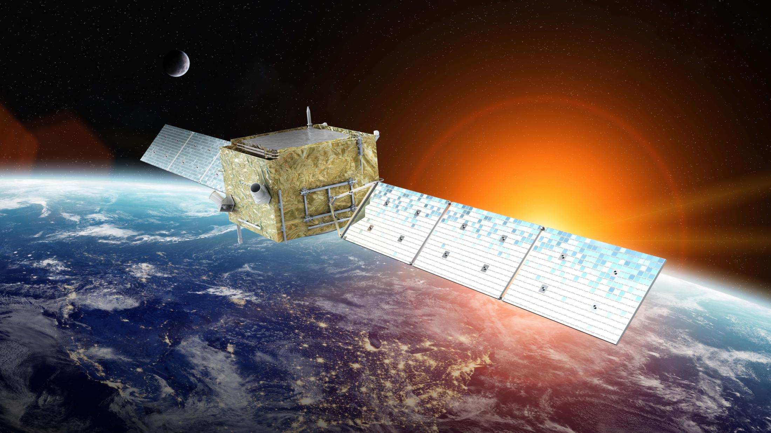
第十届海峡两岸粒子物理和宇宙学研讨会
悟空号暗物质粒子探测卫星
与甚大面积伽马射线空间望远镜
范一中
（中国科学院紫金山天文台）
2026年1月19日
Notes:
各位嘉宾大家好！我是中国科学院的常进，今天我给大家分享的是我们利用悟空号卫星探测暗物质的尝试。
Ladies and gentlemen, I am Chang Jin, from Purple Mountain Observatory, Chinese Academy of Sciences. I am going to talk about our attempts to detect dark matter with the Wukong satellite.

Slide 2
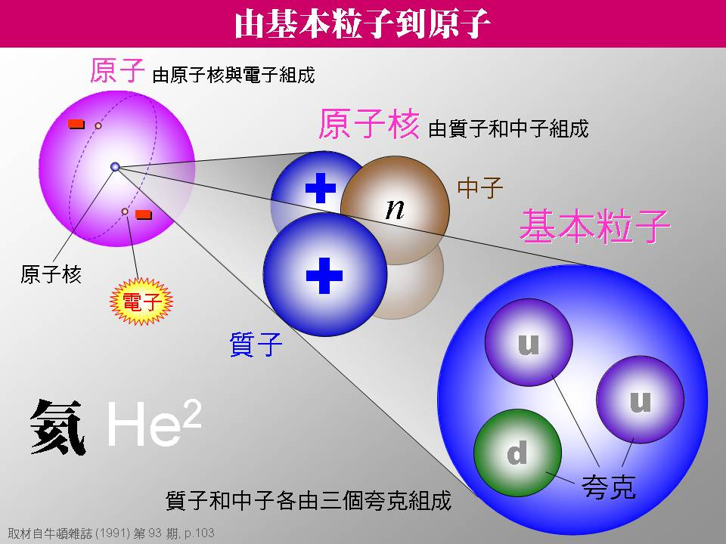

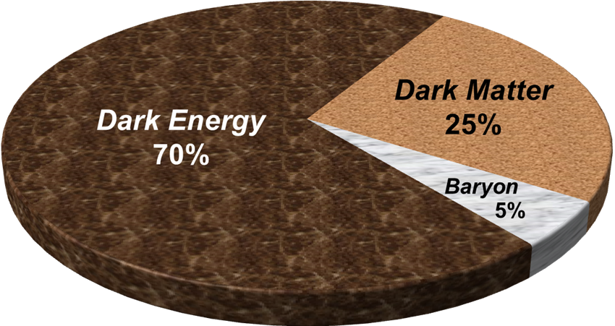
暗物质:人类未知的全新粒子
天文观测发现宇宙中存在大量的暗物质，其总质量是普通物质的~5倍。
标准粒子物理模型预言的61种基本粒子已经被成功探测到，
但其中没有任何一种可以合理地解释暗物质！
Notes:
如今我们已经建立起一个标准的粒子物理模型，夸克构成核子，核子结合形成原子核，原子核和电子结合形成原子，原子作为物质世界的单元构成宏观物体甚至天体。但是根据天文观测所揭示出的暗物质性质不同于标准粒子物理模型里的任何一种，因此暗物质很可能是一种或者多种超出标准模型的新粒子。
We have already built a standard model of particle physics. In this model, quarks form nucleons, nucleons combine to form nuclei, nuclei and electrons make up of atoms, and atoms form macro objects and even celestial objects. But the properties of dark matter is different from any of the known particles in the standard model. Dark matter is most likely to be one or more kinds of new particles beyond the standard model.

Slide 3

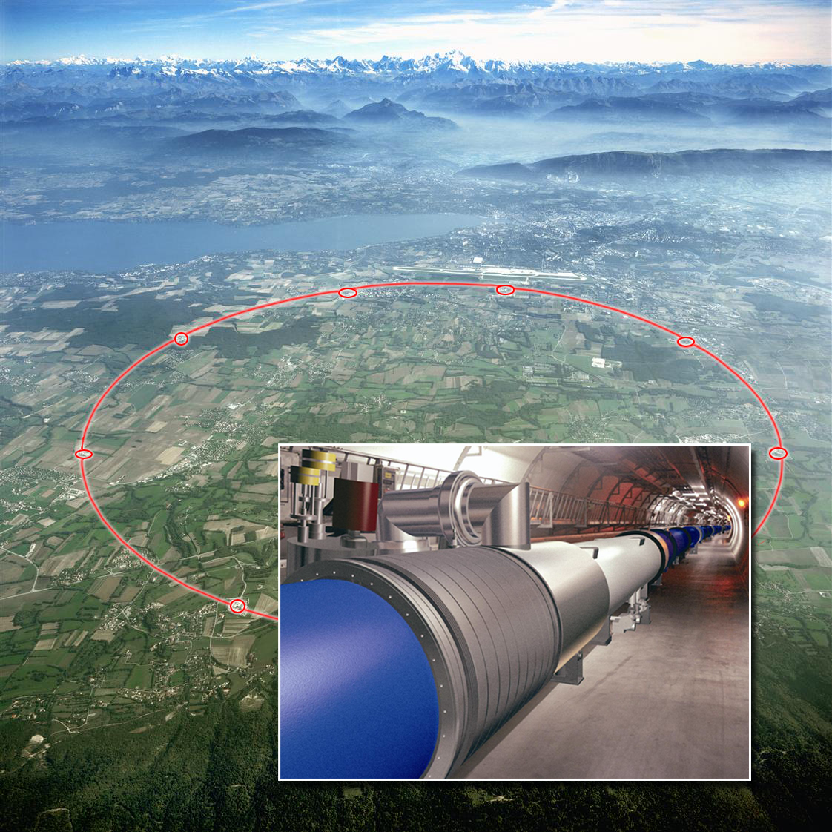
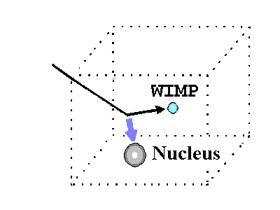
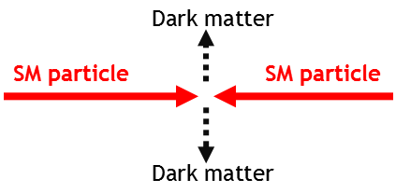
入地探测暗物质(直接探测、加速器探测)

Slide 4
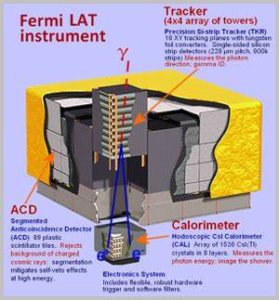
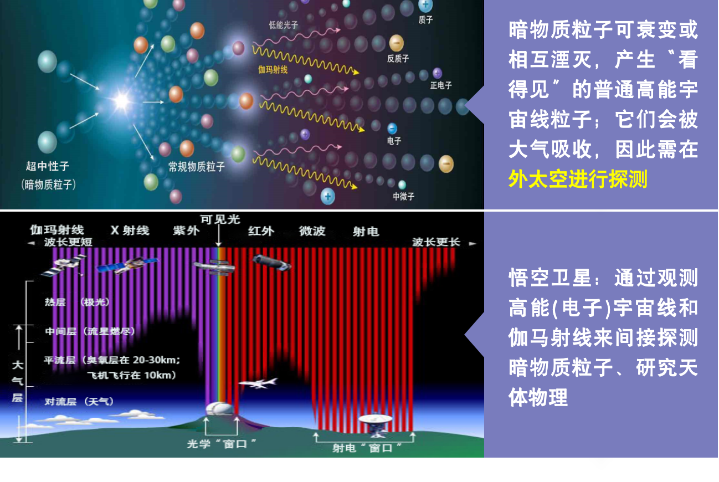
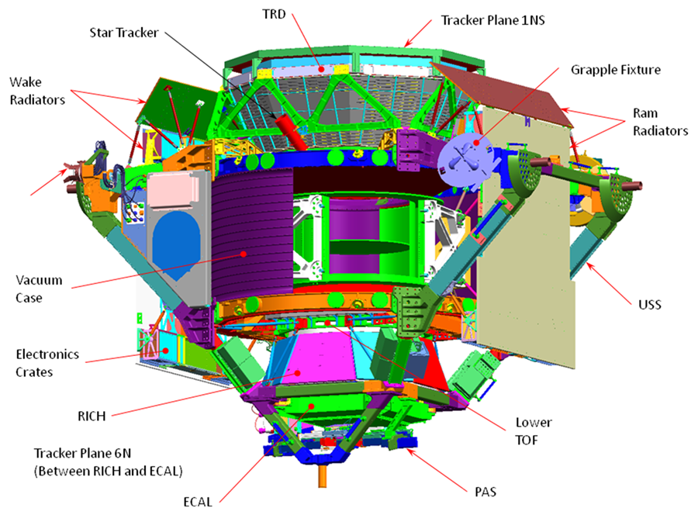
上天探测暗物质(空间间接探测实验)

Slide 5
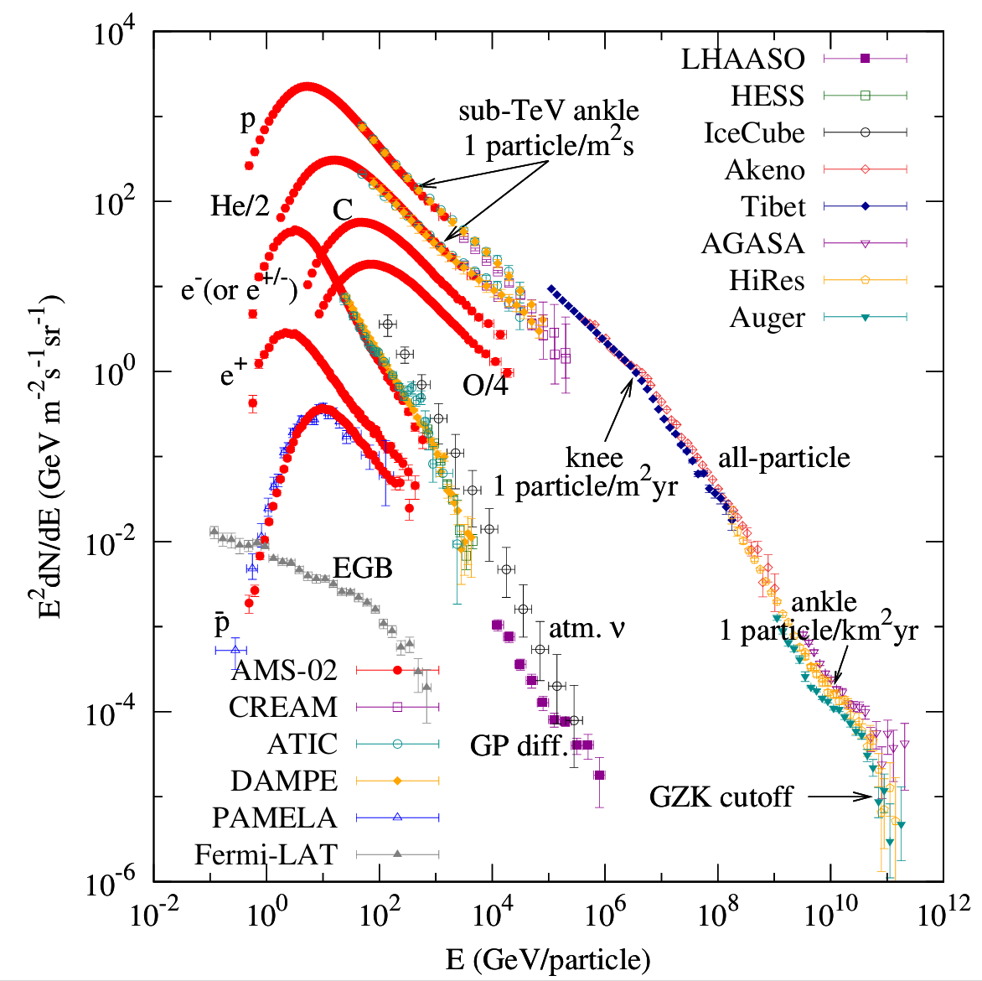
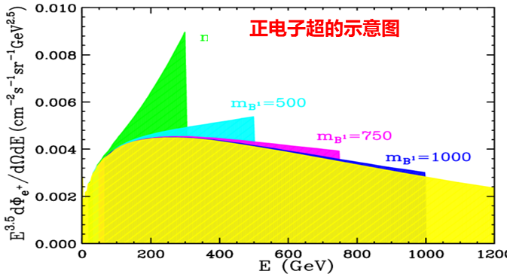
暗物质空间探测实验: 主要目标信号
暗物质湮灭或衰变产生正负电子、正反质子、γ射线等粒子。间接探测暗物质主要搜寻宇宙线和γ射线能谱及空间分布中出现的奇特现象，如特殊的“峰”(“超”)、“掉”、“拐”！
暗物质间接探测的主要目标及当前国际引领性空间设施
目标信号 | γ射线超 | γ射线线谱 | 反质子超 | 正电子超 | 正负电子总能谱
引领性设施 | Fermi-LAT | 悟空号 | AMS-02 | AMS-02 | 悟空号

Slide 6
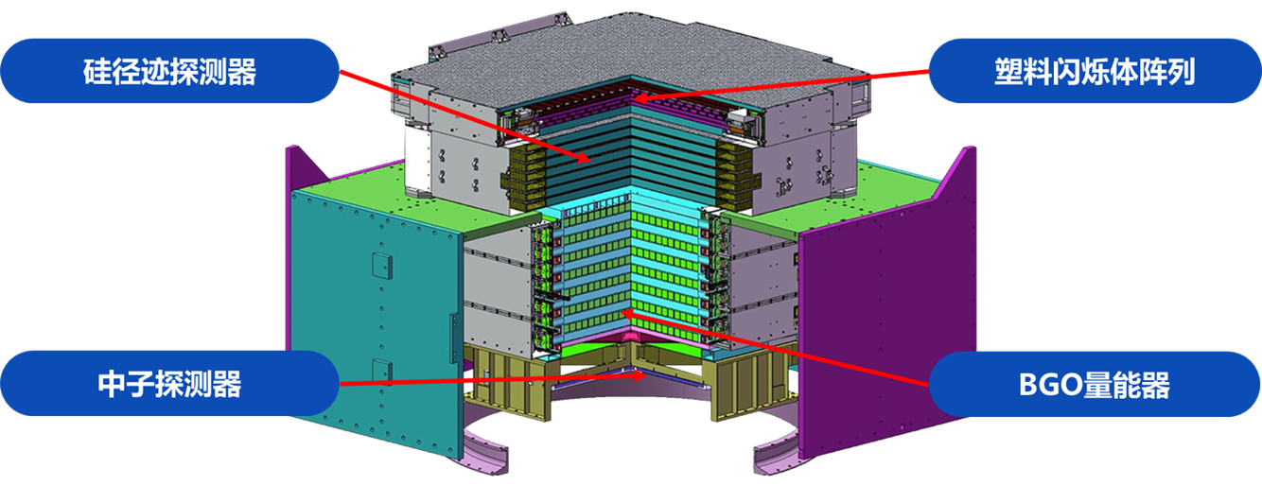
“悟空”号卫星的探测器
Chang (2014 Chin. J. Space Sci. 34, 550) & Chang et al. (2017 Astropart. Phys. 95, 6)

Slide 7
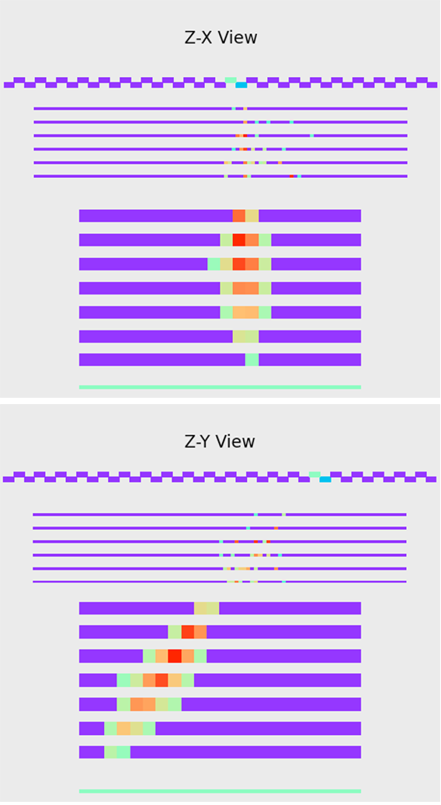
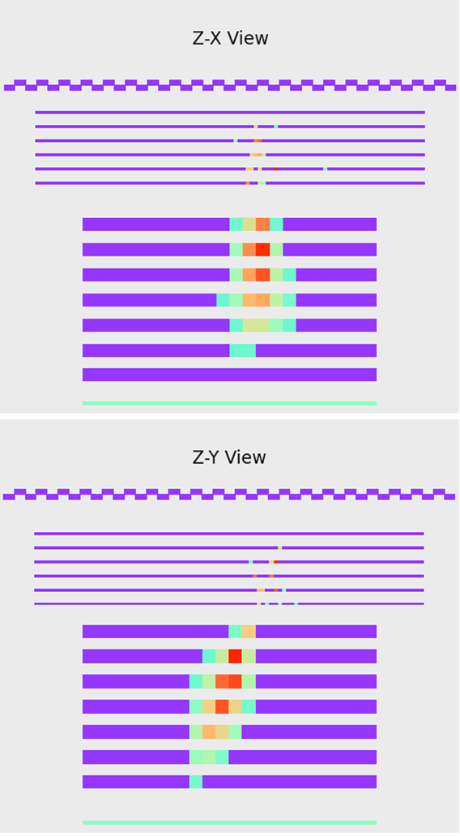
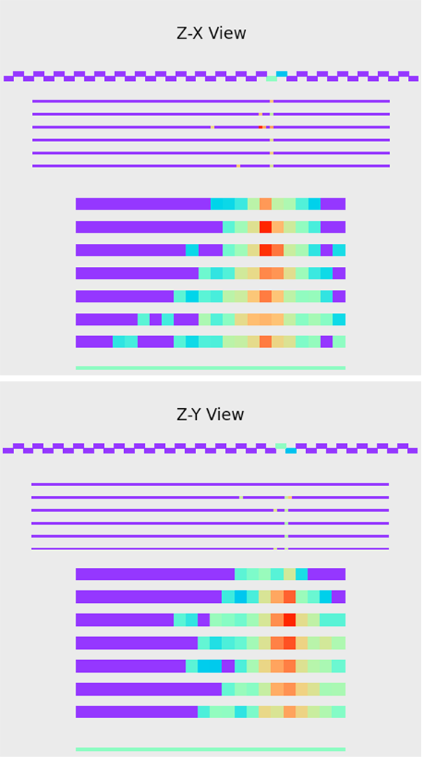
悟空号粒子鉴别的基本原理
electron
gamma
proton

Slide 8
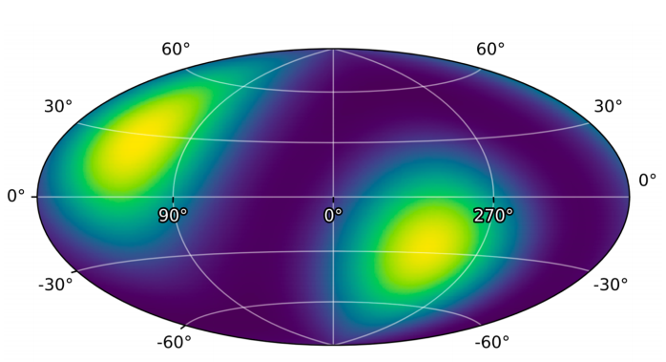
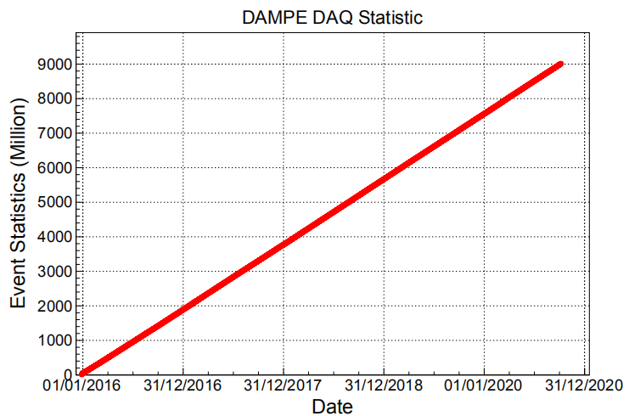
“悟空”号卫星已平稳在轨运行近10年时间
2015.12.17发射 完成全天扫描观测20次 积累180+亿高能事例

Slide 9
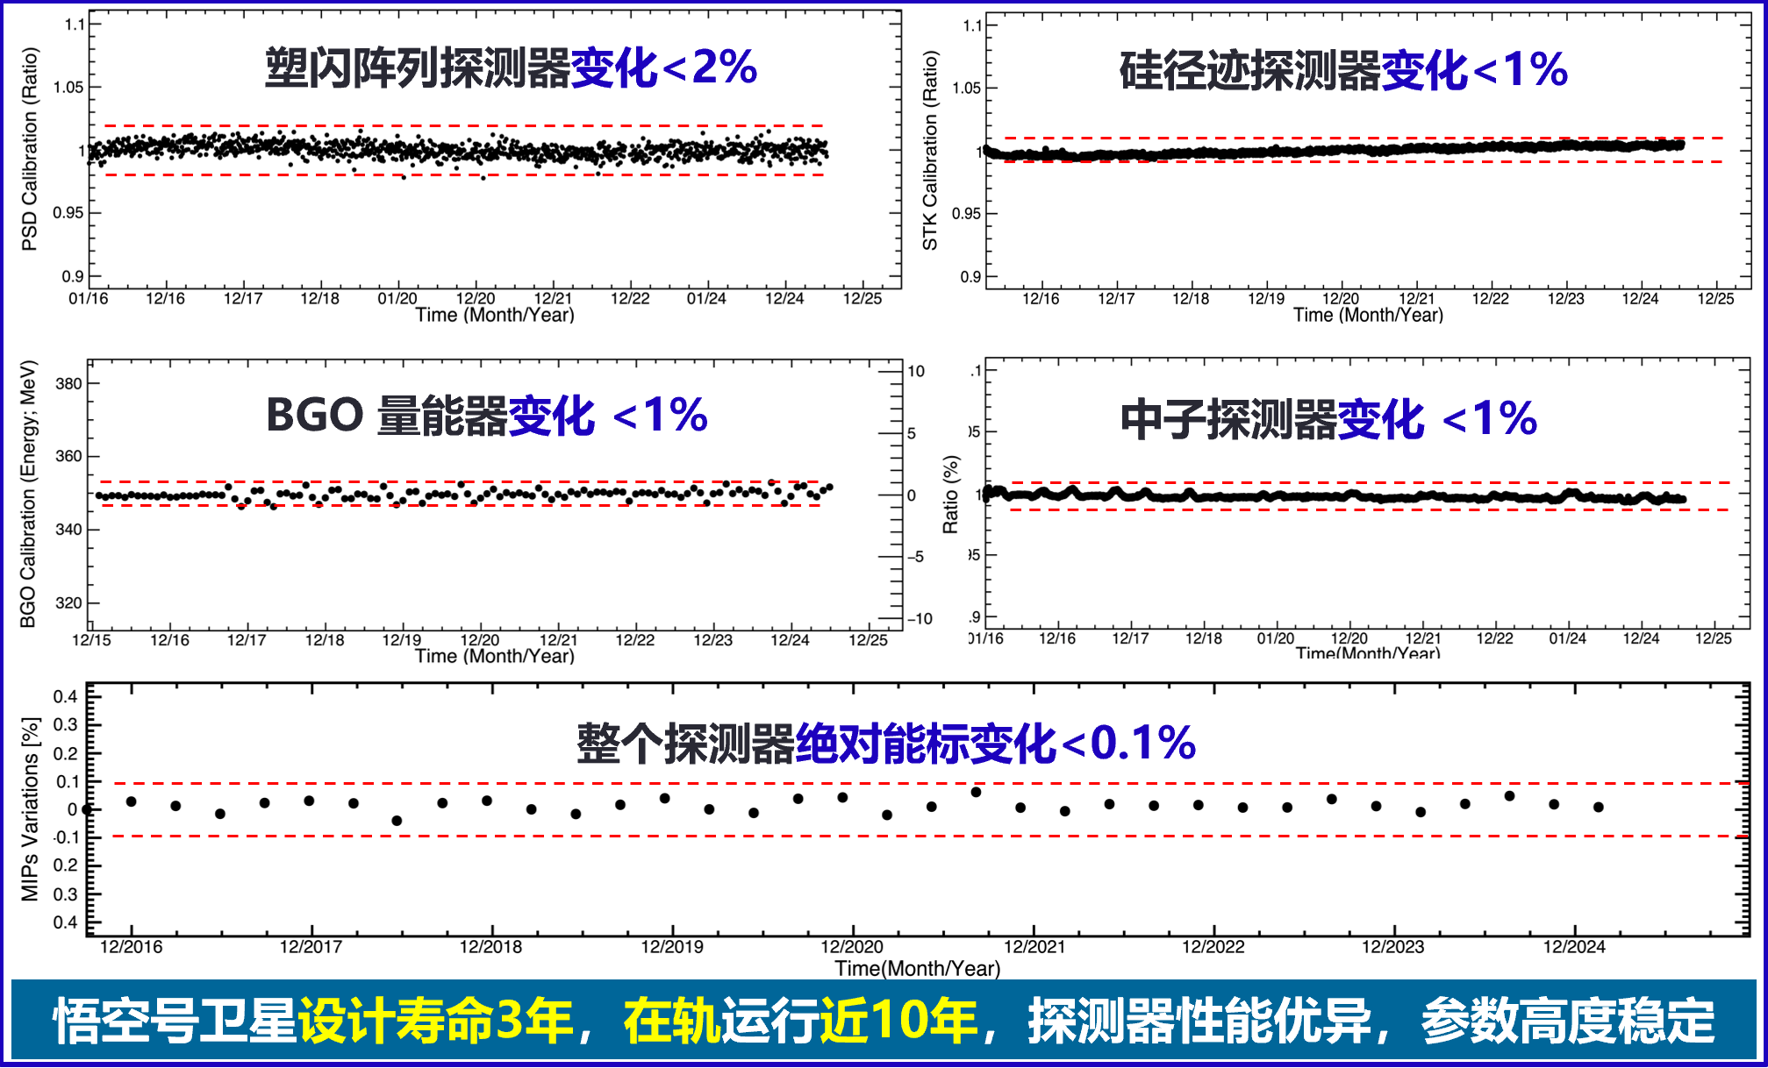
四大子探测器工作状态非常稳定

Slide 10
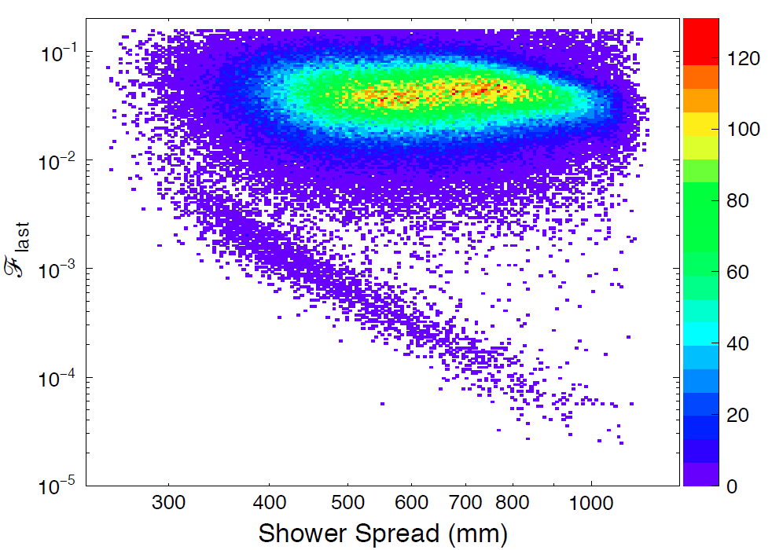
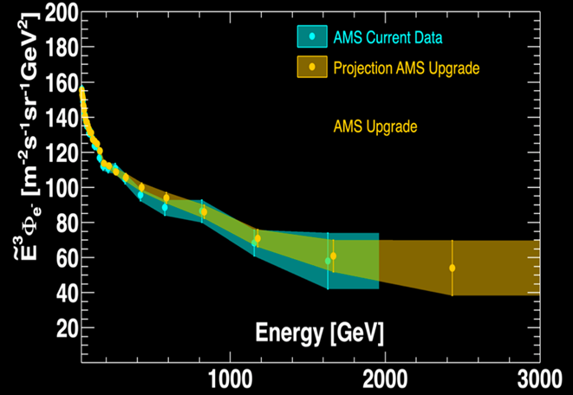
暗物质信号搜寻: 宇宙射线电子能谱测量
0.5-1.0 TeV
Nature, 552, 63 (2017)
Candidate protons
疑似反常？
Candidate electrons
超出

Slide 11
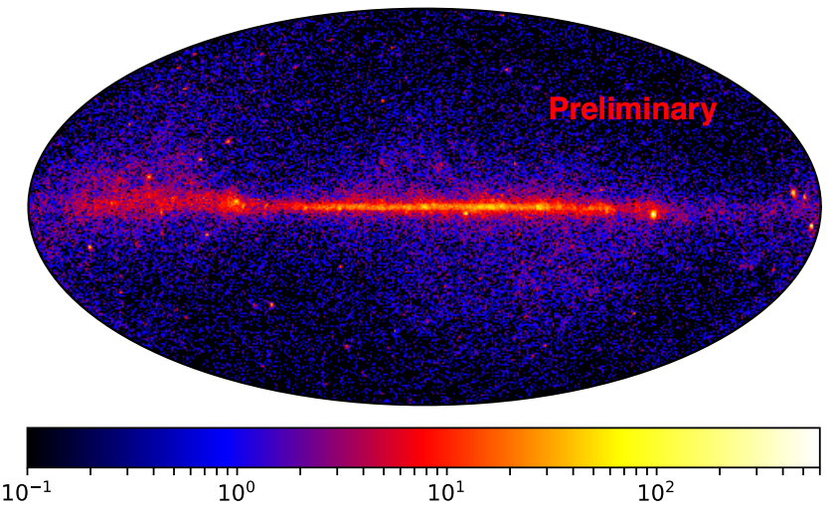
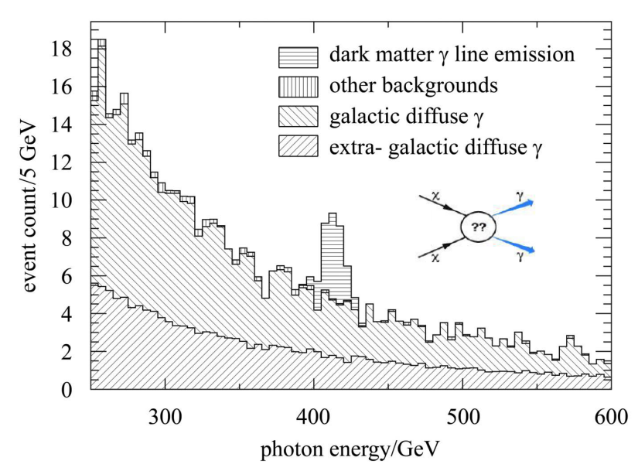
暗物质信号搜寻: 单能伽马线谱结果
χχ→γγ
χχ→γγ
χχ→γγ
χ→γν
“悟空”卫星能量分辨为国际最高水平，尤其适合探测伽马射线线谱(2022 Sci. Bull.)

Slide 12
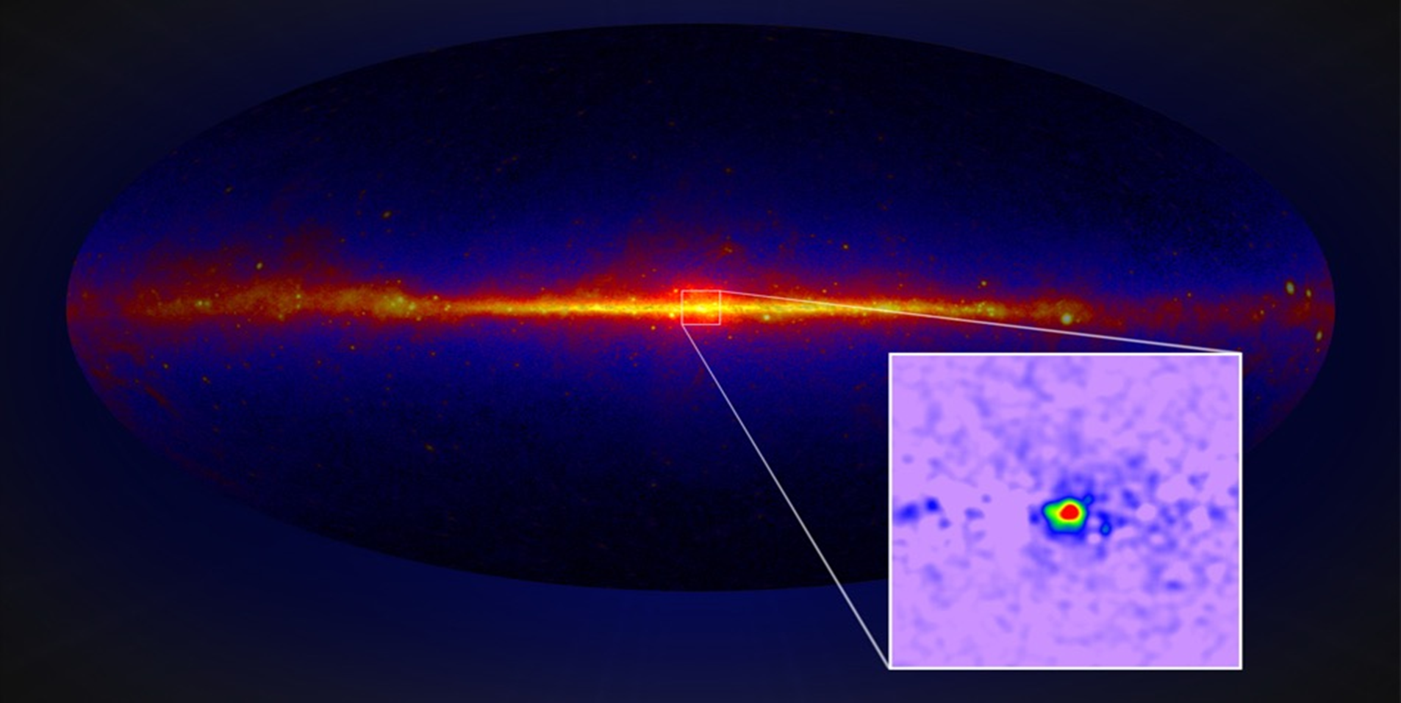
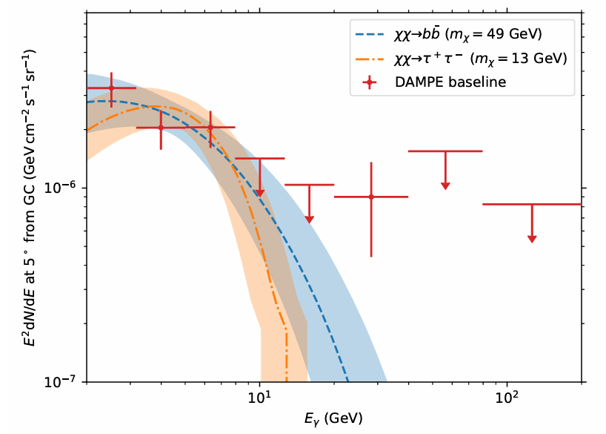
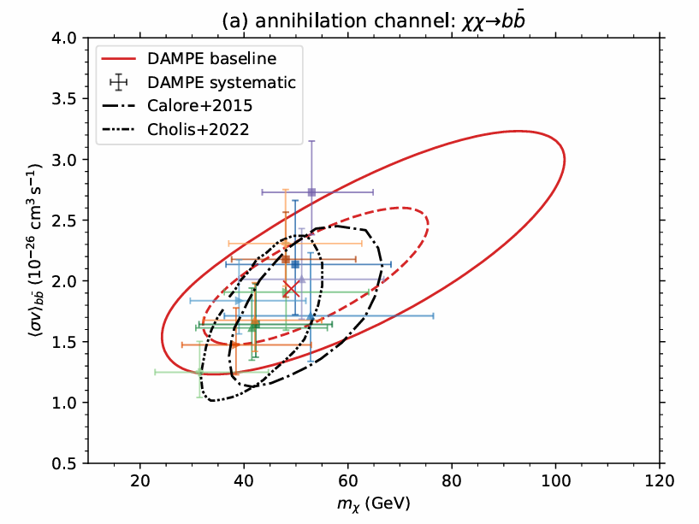
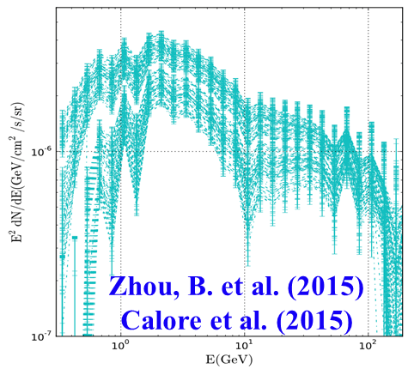
暗物质信号搜寻: 银心GeV伽马射线超
银心GeV超出
DAMPE coll. arXiv:2512.23458
银心GeV超出: 悟空号～8σ 置信度
暗物质湮灭解释下，参数空间与主流的WIMP模型预测相符

Slide 13
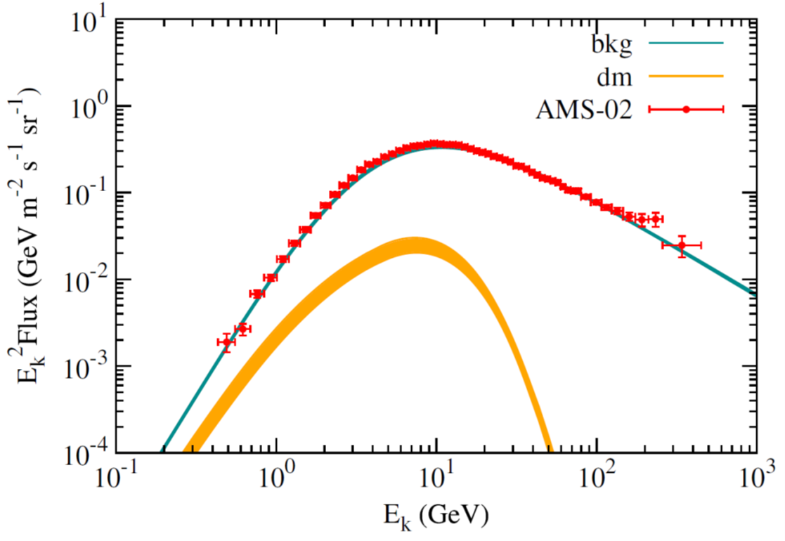
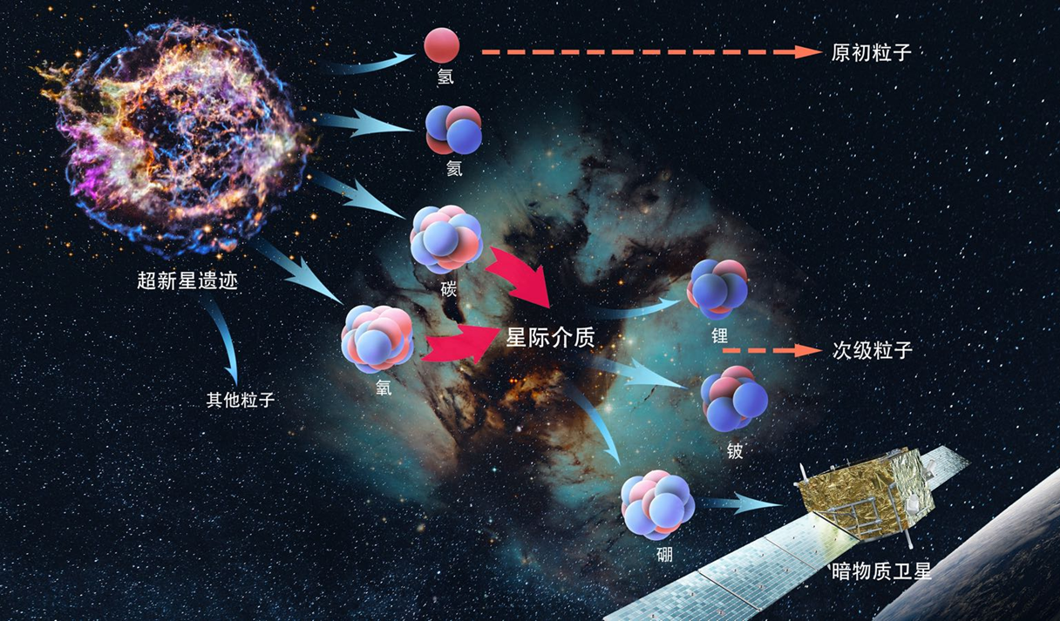
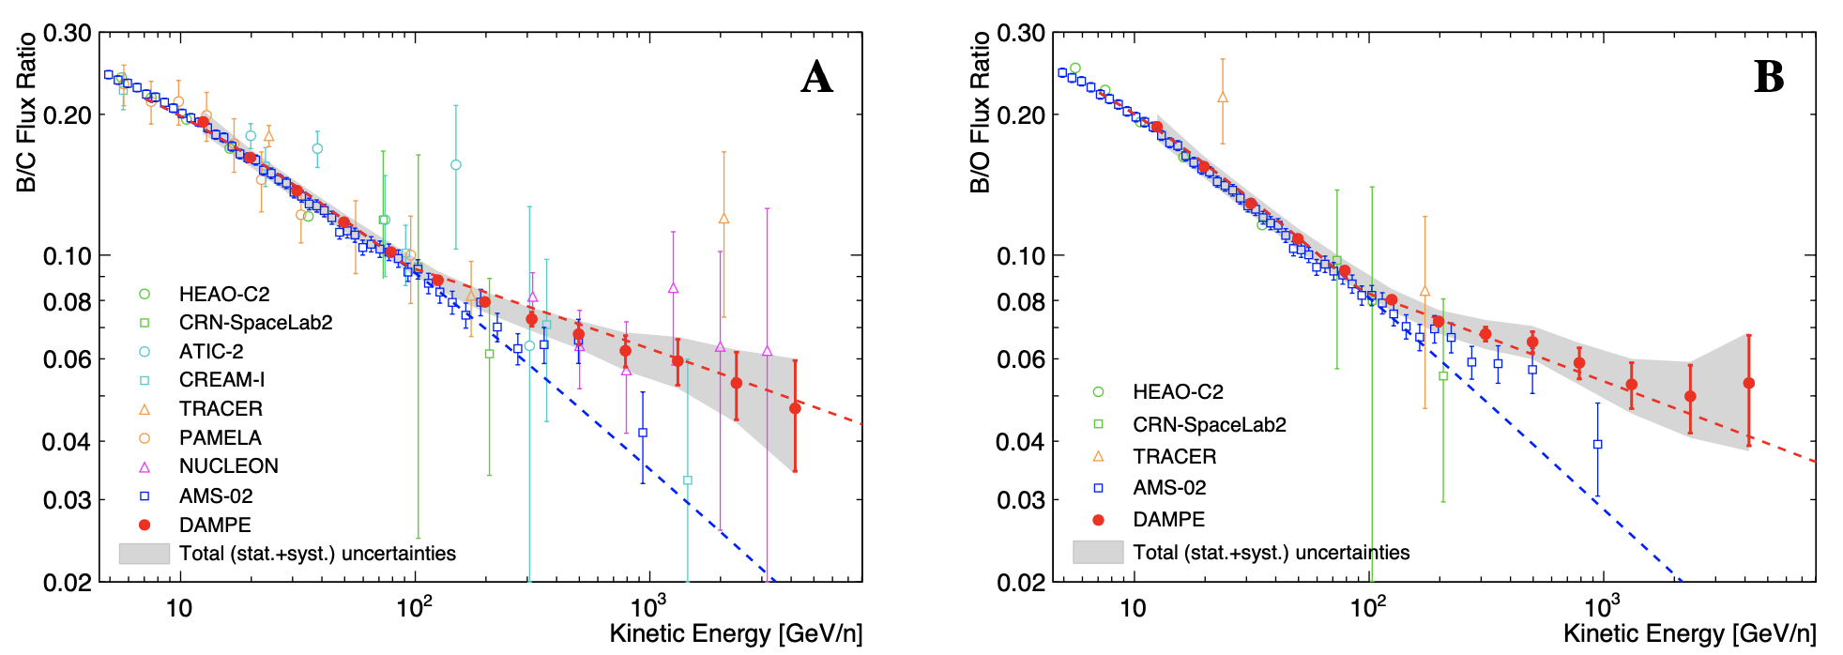
宇宙射线: 传播新效应
反质子超出: 暗物质信号？
(Cui et al. 2017 PRL 118)
悟空新数据
悟空新数据
标准假设
标准假设
B/C(B/O)是研究宇宙射线传播过程的重要物理量，悟空号发现：与标准宇宙线模型(Kolmogorov 1941)预测的单一幂律谱不同，B/C(B/O)是能量的分段函数，意味着扩散系数的改变或者存在着其它物理过程，在基于反物质的暗物质间接探测中该新效应必须予以考虑(DAMPE Coll. 2022 Sci. Bull.)

Slide 14
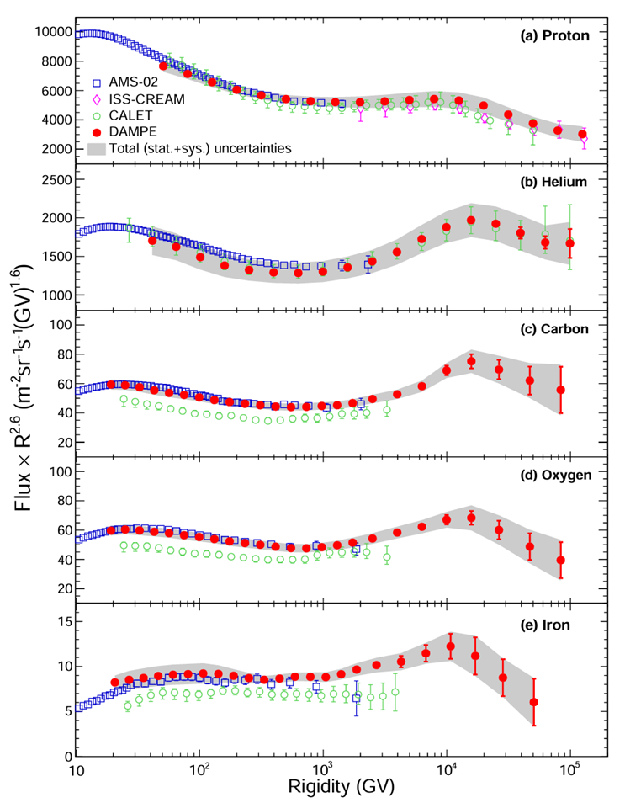
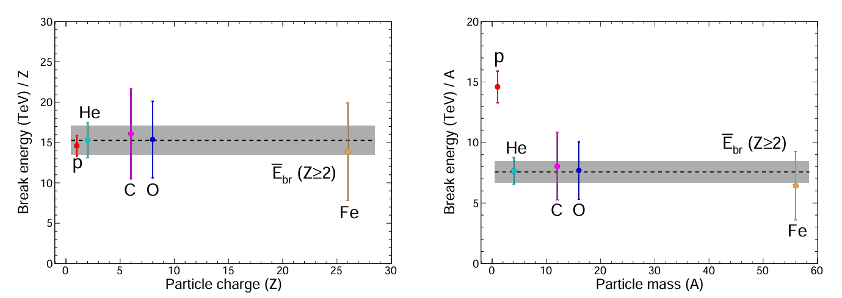
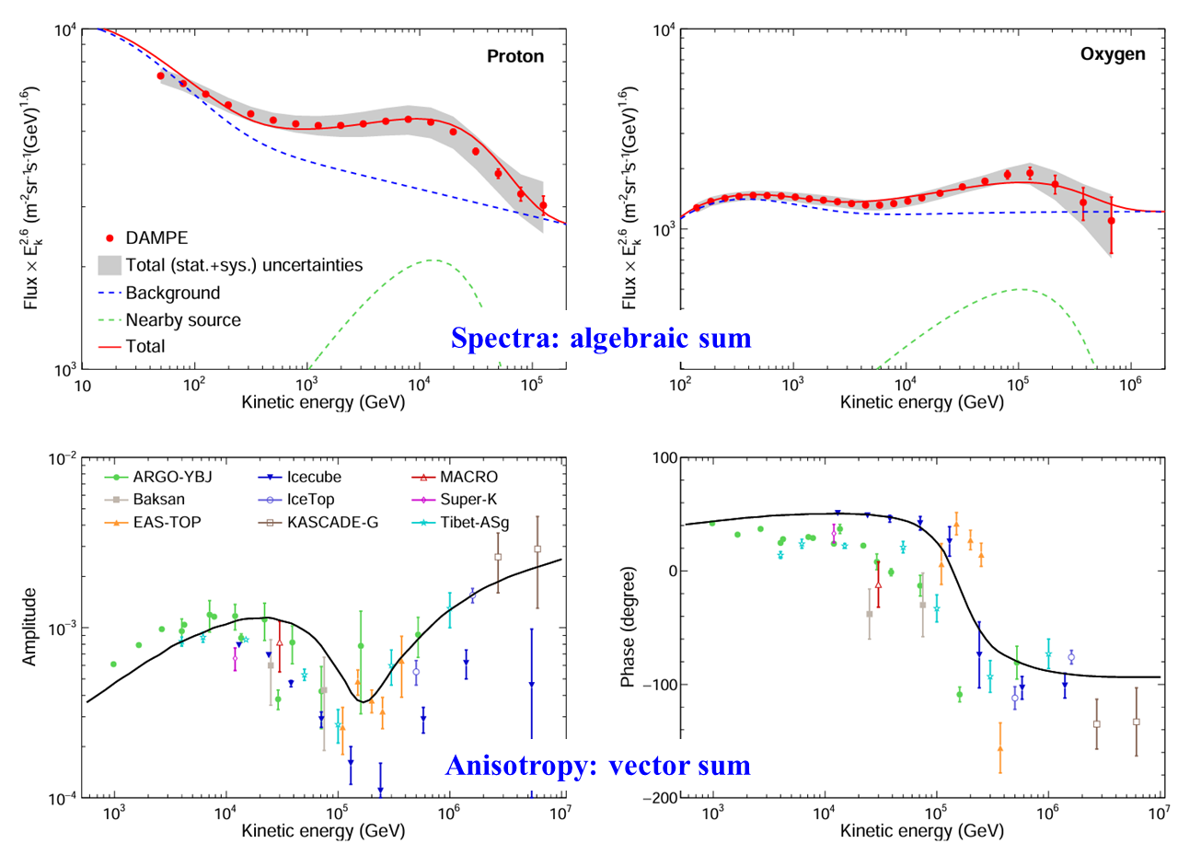
悟空号观测证实宇宙线加速模型关键预言
悟空号得到质子、氦、碳、氧、铁核素宇宙线的精确能谱，发现高能拐折能量与电荷的线性相关性(DAMPE Collaboration 2025 arXiv:2511.05409)

Slide 15
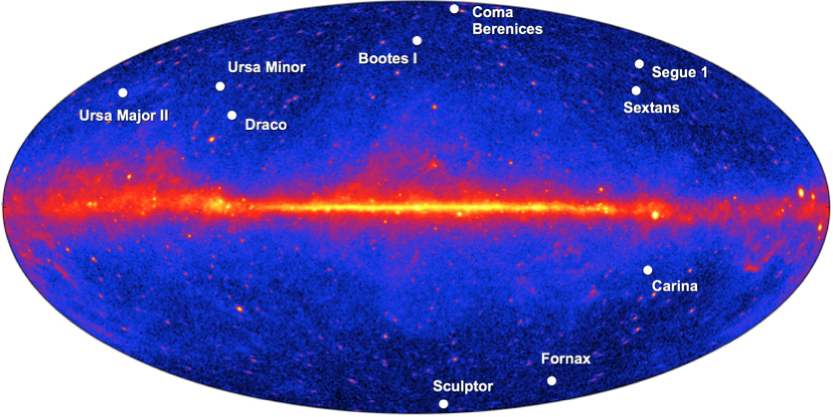
Very Large gamma-ray Space Telescope
为什么聚焦伽马射线？
宇宙射线带电，到达地球时已丢失了方向信息，找暗物质主要是依靠能谱的奇异结构
伽马射线提供能谱+空间分布多维信息可靠甄别暗物质模型
原因: 天文观测可以给出暗物质在太空中的分布

Slide 16
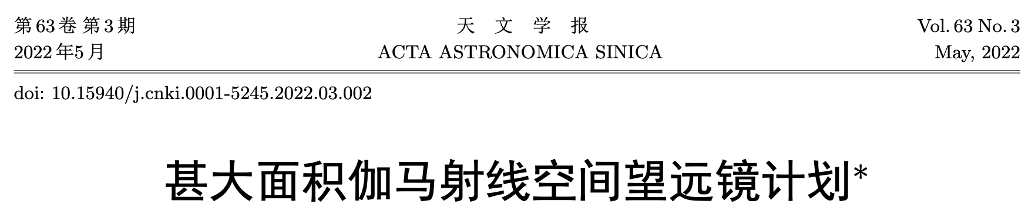
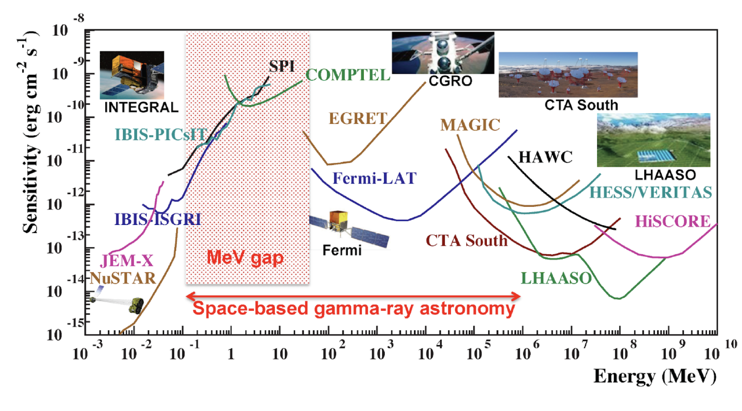
Very Large Area gamma-ray Space Telescope
A very broad energy range: ~1MeV-10TeV
Notes:
Though DAMPE has made some interesting discoveries, it mainly focuses on the cosmic ray measurements. Its gamma-ray observation capability is relatively limited. We need a much better gamma-ray space telescope to advance the knowledge of the dark matter and high energy astronomy. That is why we are proposing a new mission, the Very Large Area gamma-ray space telescope, in short, the VLAST. In addition to its unprecedented large acceptance, VLAST will measure the gamma-rays in an extremely wide energy range, from about 1 MeV to 10 TeV. This means the VLAST can contribute to the so-called MeV gap that is hard to reach by other instruments.

Slide 17
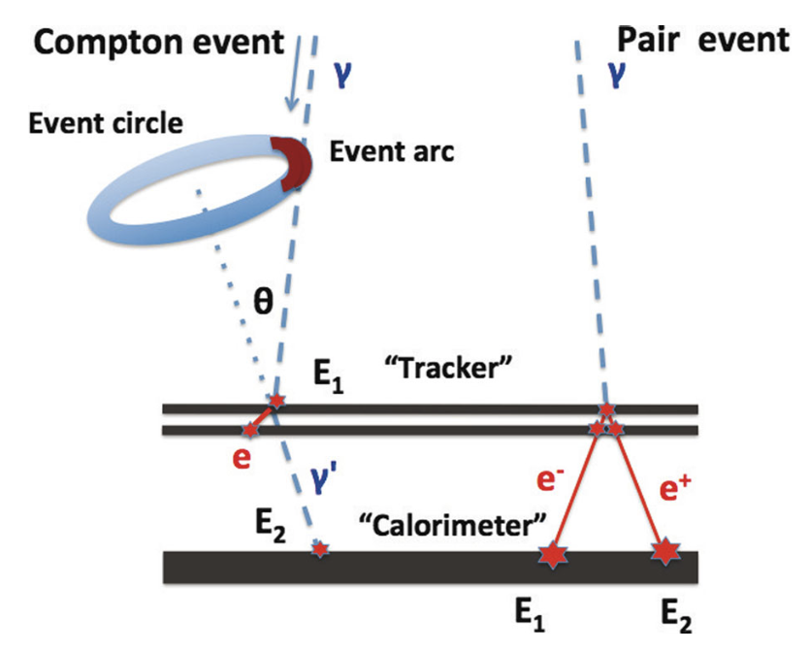
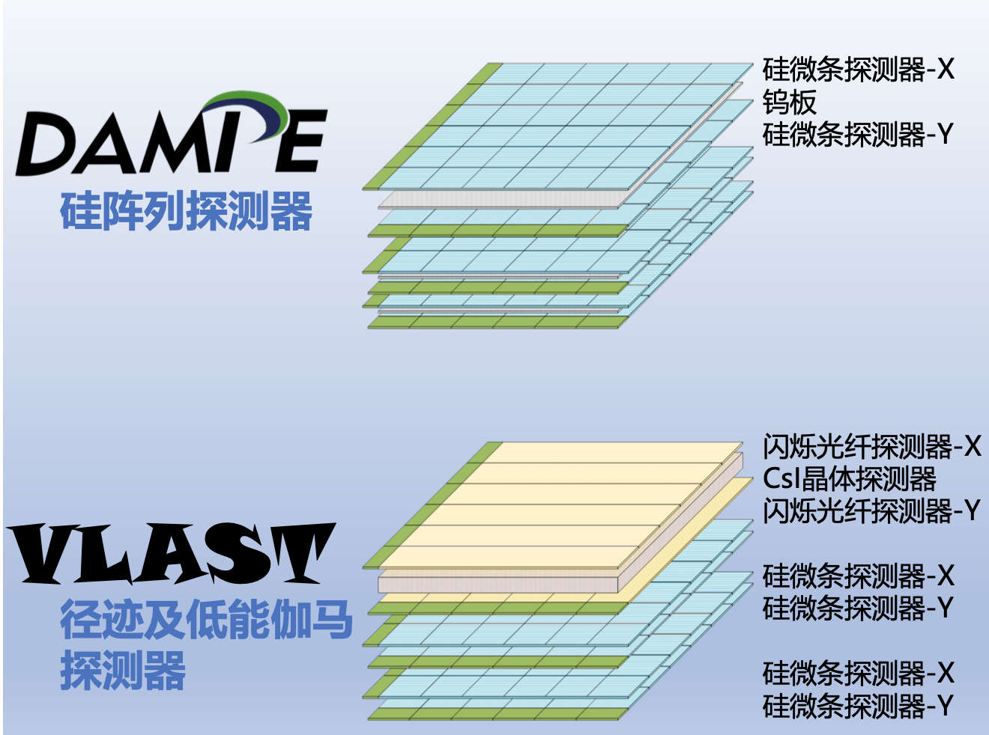
Very Large Area gamma-ray Space Telescope
Key design: replacing the tungsten layer in the silicon track detector by CsI, with which the MeV γ-rays can be measured via the Compton scattering
Notes:
As Fermi-LAT and DAMPE, we measure the high energy gamma-rays in the way of pair production. To measure the MeV gamma-rays, we have to monitor the Compton scattering process. For such a purpose, we replace the tungsten layer in the silicon tracker detector by cesium iodide [ˈsiziəm ˈaɪəˌdaɪd]. This also improves the energy measurements of the sub-GeV gamma-rays.

Slide 18
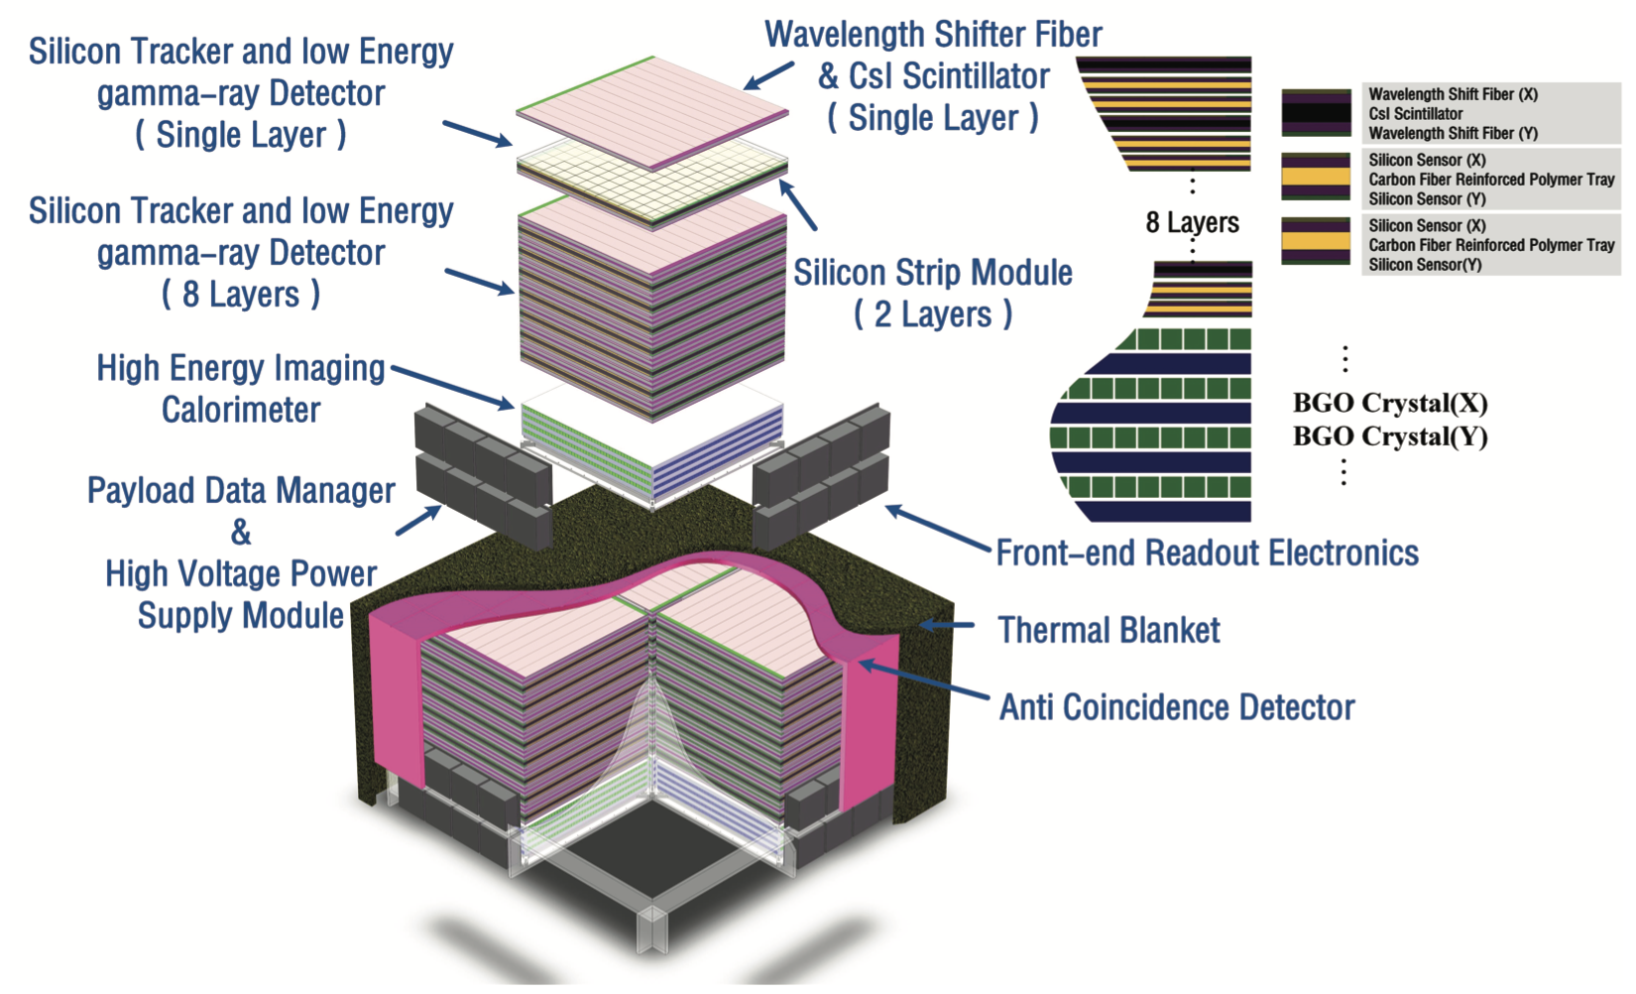
Very Large Area gamma-ray Space Telescope
Each sub-detector contains four units, each >1.2m×1.2m
Notes:
This is a schematic plot of the detectors of VLAST. Each sub-detector has four units, each is a square with a size of at least 1.2m, similar to Fermi-LAT. VLAST is a monster in space. It has a surface area of about 9 m^2, and the total weight is about 18 tons. If launched, it will be a flagship mission.

Slide 19
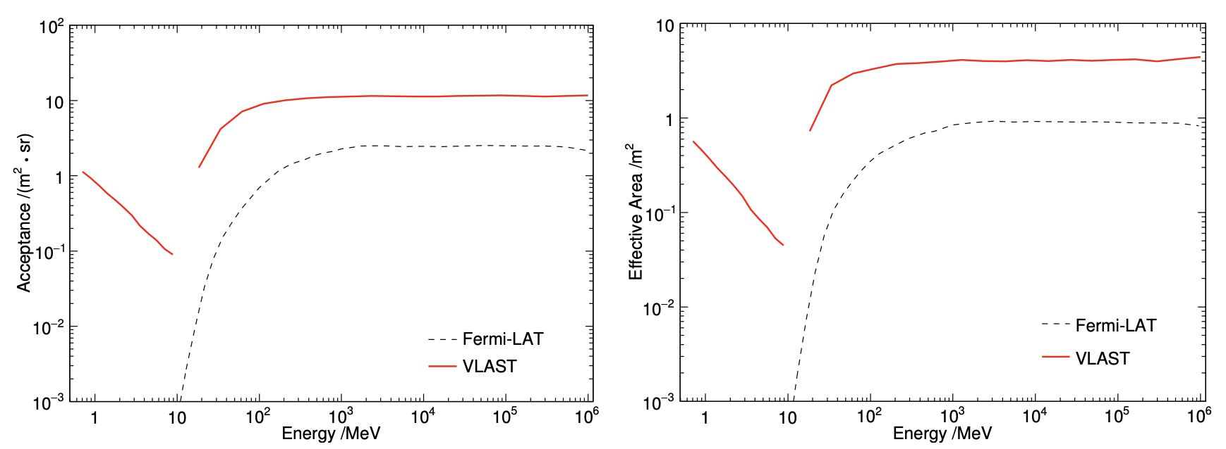
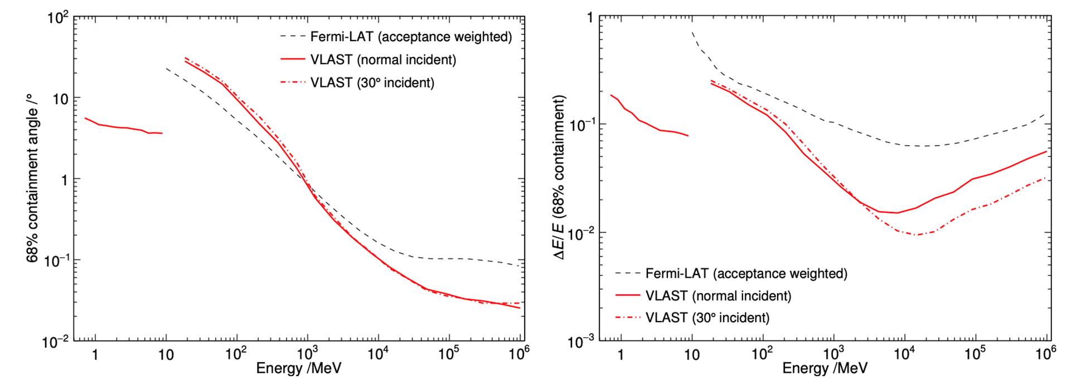
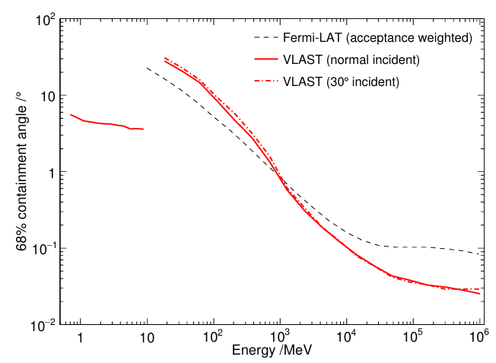
Very Large Area gamma-ray space telescope
In comparison with Fermi-LAT, VLAST has higher acceptance, energy resolution and good angular resolution (Fan, Chang & Guo et al. 2022)
Notes:
We have carried out the simulations on the performance of VLAST. The left panel shows the acceptance. From GeV to TeV, the acceptance is about five times that of Fermi-LAT, while in the sub-GeV band, the enhancement is much higher. The right panel is for the energy resolution. VLAST has a thick calorimeter, so its energy resolution is better than Fermi-LAT. This is in particular the case in the high energy band, VLAST can measure the energy of the gamma-rays much more accurately than Fermi-LAT.

Slide 20
Expected performance of VLAST
Some space-based gamma-ray missions
facility | acceptance (m² sr) | energy range | energy resolution (@10GeV) | angular resolution (@50GeV)
Fermi-LAT | ～2 | 20 MeV-300 GeV | ~6.0% | ~ 0.10 deg
DAMPE | ～0.2 | 5 GeV-10 TeV | ~1.5% | ~ 0.10 deg
AMS-100 (concept) | ~30 | 0.1 GeV-10 TeV |  | ~ 0.03 deg
APT (in proposal) | ~20 | 1 MeV-10 TeV | ～20% | ~ 0.10 deg
HERD | ~2 | 0.5 GeV-10 TeV | ~1.5%
VLAST (in proposal) | ~12 | 1 MeV-10 TeV | ~1.5% | ～0.10 deg
Notes:
Here we compare the expected performance of VLAST with some other experiments. Our mission is distinguished by its very large acceptance, a very wide energy range, and the high energy resolution. Hopefully this mission could be realized in ten years.

Slide 21
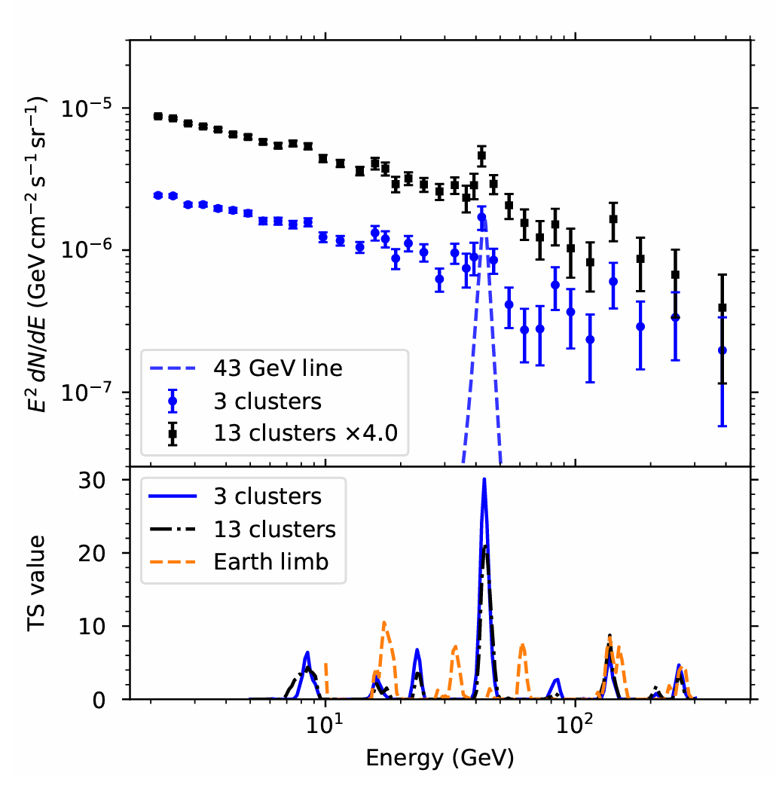
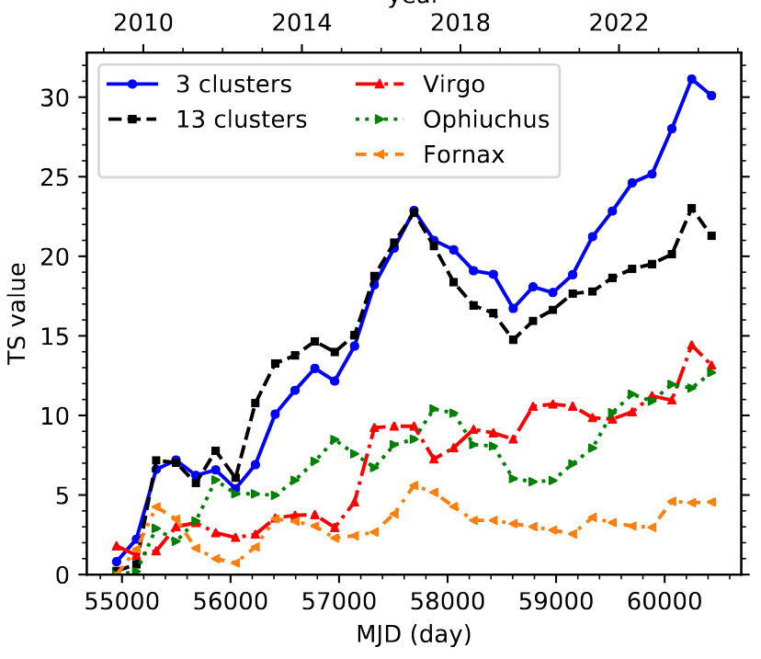
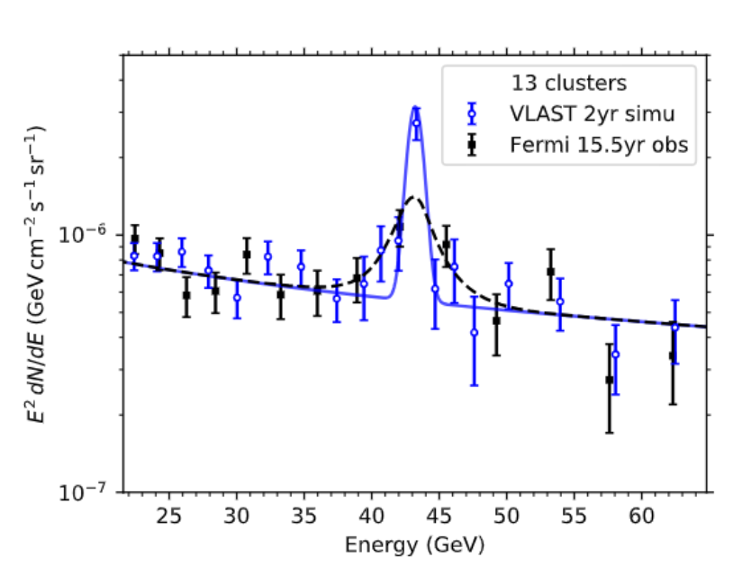
甚大面积伽马射线空间望远镜VLAST
星系团方向存在43GeV线谱迹象，VLAST的2年巡天数据可望判定
(Fan et al. arXiv:2407.11737)

Slide 22
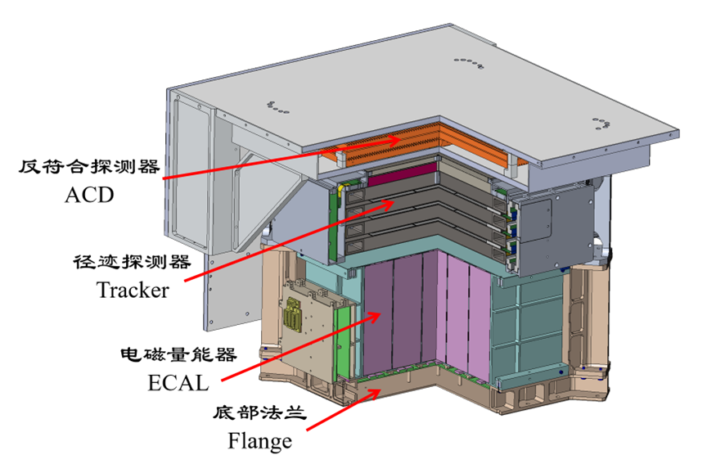
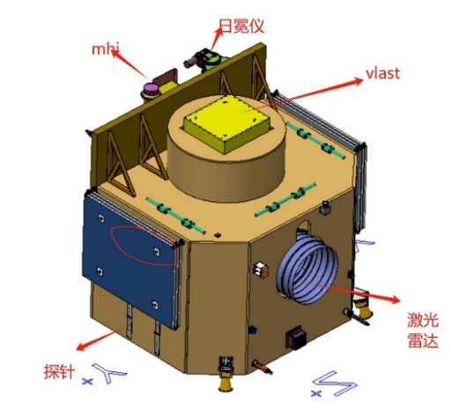
总 结
暗物质的本质是现代科学面临的重大前沿问题，有望带来新一轮物理学的革命
悟空号卫星设计寿命3年，已平稳运行~10年，在宇宙线正负电子、核素和伽马射线的观测中已取得重要成果，对暗物质物理参数给出严格限制
为全面了解暗物质粒子尽快布局下一代暗物质空间探测实验
VLAST探路者载荷（预计2026年发射）

