Slide 1
Charmed Baryons
Tetraquark nature of light scalar mesons
Hai-Yang Cheng (鄭海揚)
Academia Sinica, Taipei
In collaboration with Cheng-Wei Chiang & Fanrong Xu
第十屆海峽兩岸粒子物理和宇宙學研討會
January 20, 2026

Slide 2
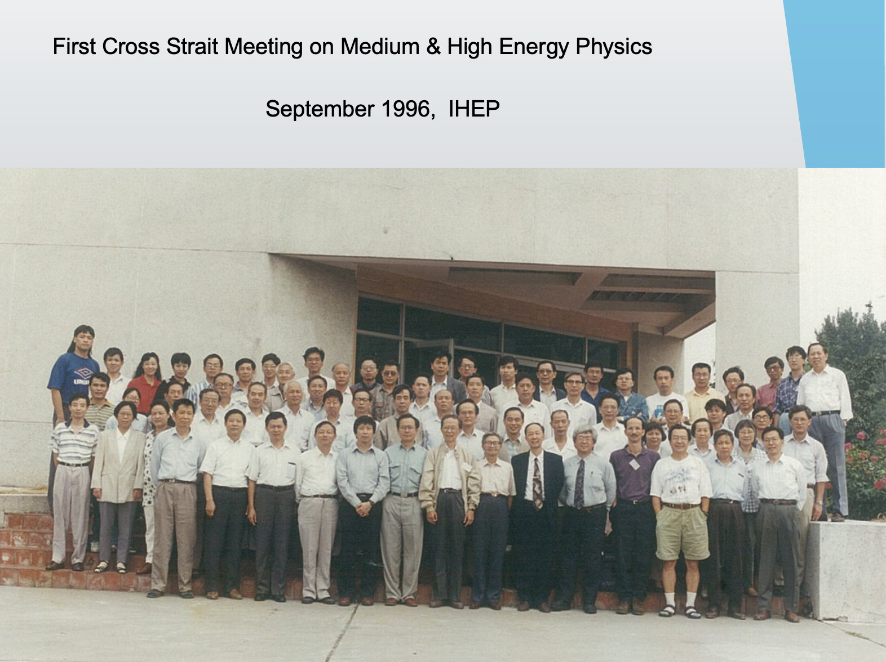

Slide 3
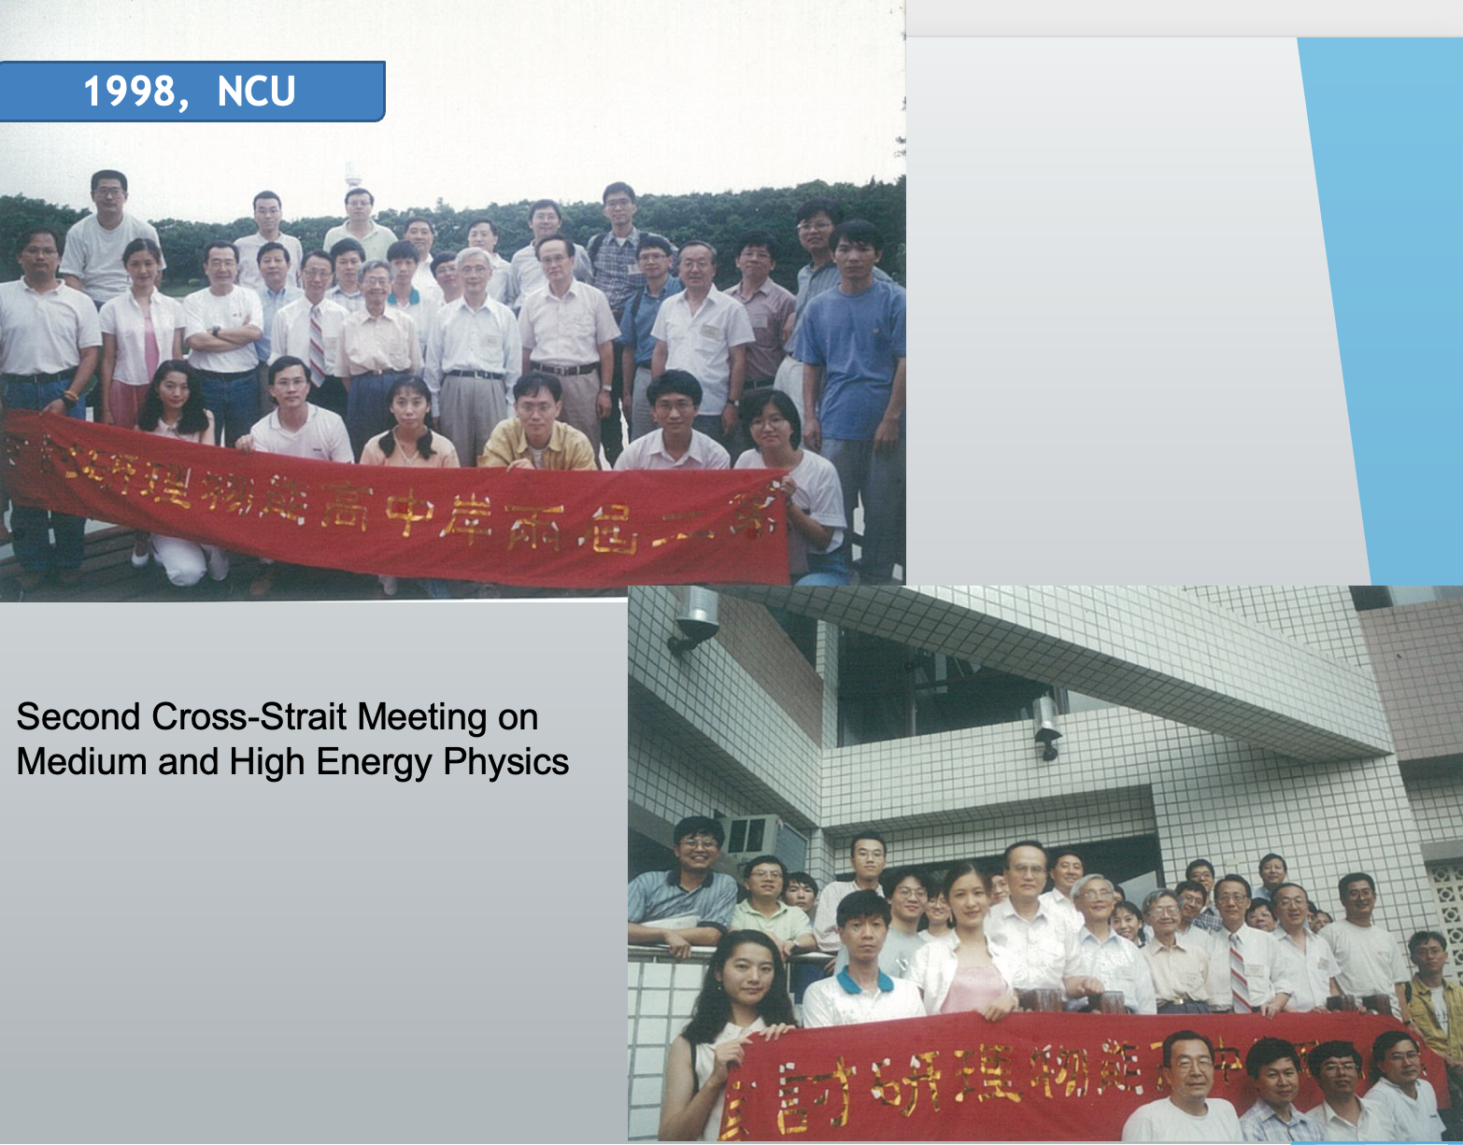

Slide 4
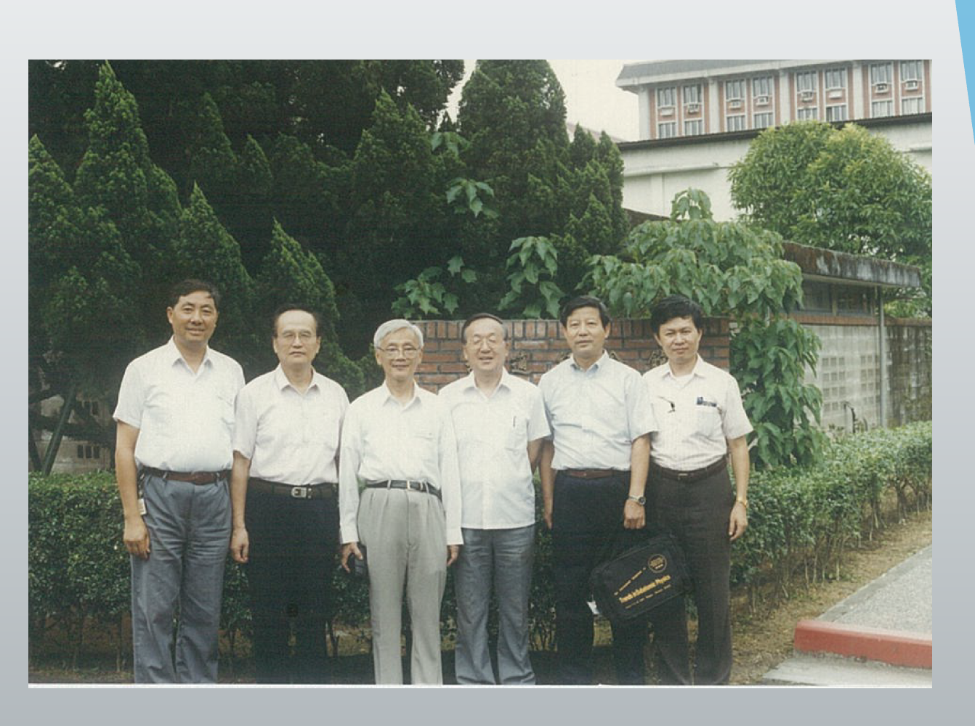

Slide 5
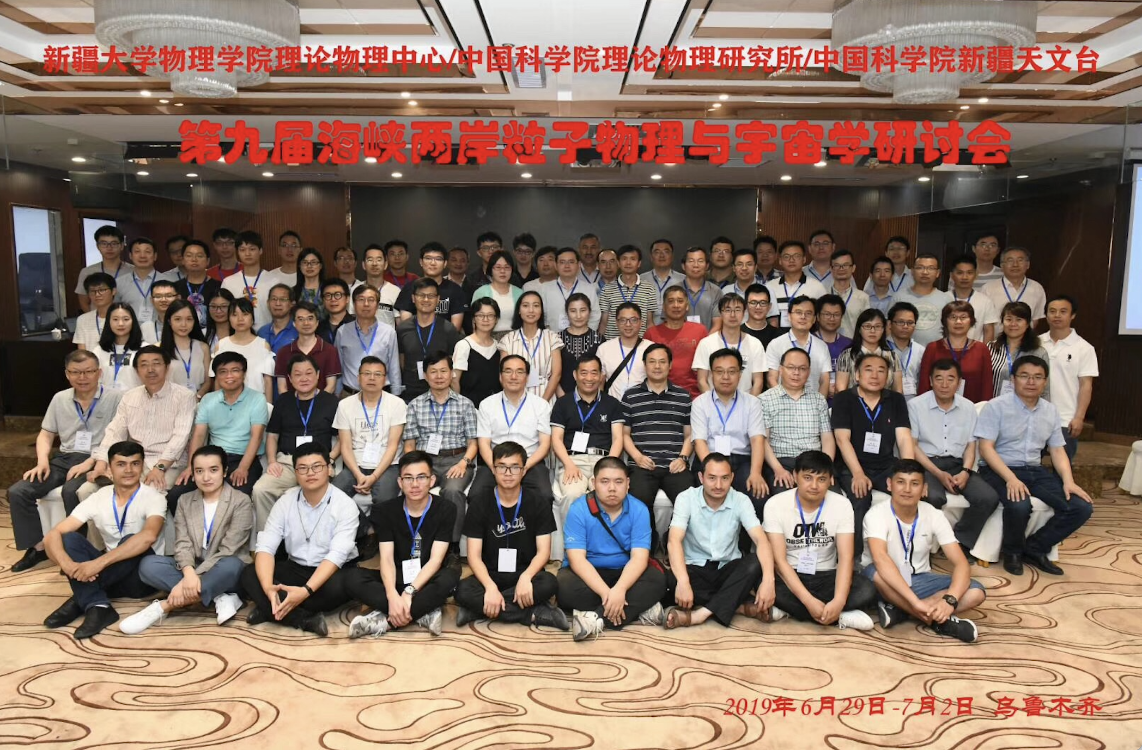

Slide 6
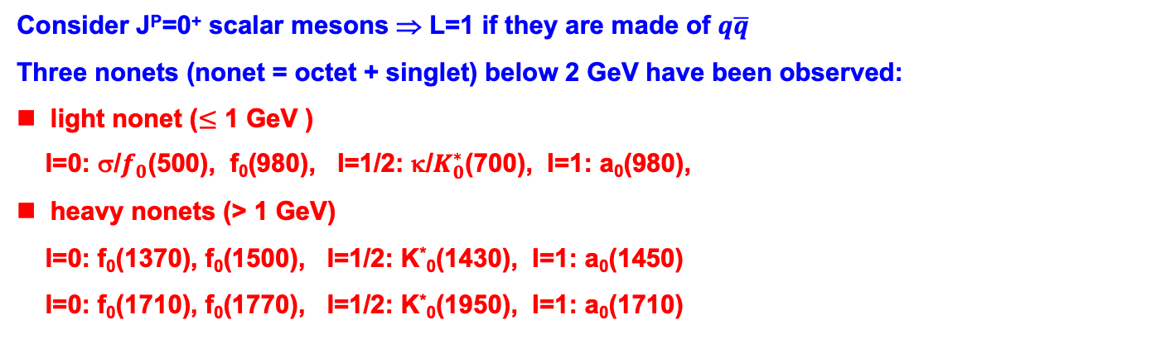
Light Scalars
Consider J^{P}=0⁺ scalar mesons ⇒ L=1 if they are made of $q\overline{q}$
Three nonets (nonet = octet + singlet) below 2 GeV have been observed:
light nonet ($≤$ 1 GeV )
I=0: σ/$f_{0}$(500), f₀(980), I=1/2: κ/$K_{0}^{∗}$(700), I=1: a₀(980),
heavy nonets (> 1 GeV)
I=0: f₀(1370), f₀(1500), I=1/2: K*₀(1430), I=1: a₀(1450)
I=0: f₀(1710), f₀(1770), I=1/2: K*₀(1950), I=1: a₀(1710)
 | f₀(500) | K₀*(700) | f₀(980) | a₀(980)
mass (MeV) | 400-550 | 630-730 | 990±20 | 980±20
width (MeV) | 400-700 | 520-680 | 10-100 | 50-100
Why are f₀ and a₀ degenerate in masses?
Why are σ/f₀(500) and κ/K₀*(800) much broader than f₀ and a₀ ?

Slide 7
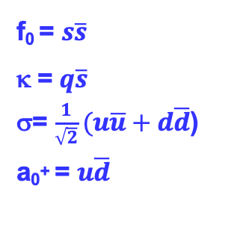
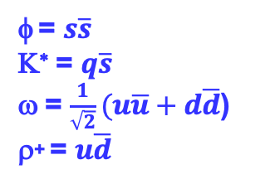
1⁻ ½⁺
φ = $s\overline{s}$
Κ∗ = $q\overline{s}$
ω = $\frac{1}{\sqrt{2}}(u\overline{u}+d\overline{d}$)
ρ⁺ = $u\overline{d}$
φ
Ξ
Κ∗
Σ
Λ
ω
ρ
N
0⁺
f₀ = $s\overline{s}$
κ = $q\overline{s}$
σ= $\frac{1}{\sqrt{2}}(u\overline{u}+d\overline{d}$)
a₀⁺ = $u\overline{d}$
a₀
f₀
f₀
κ
κ
σ
a₀
σ
2-quark model
expt.

Slide 8
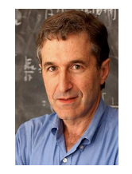
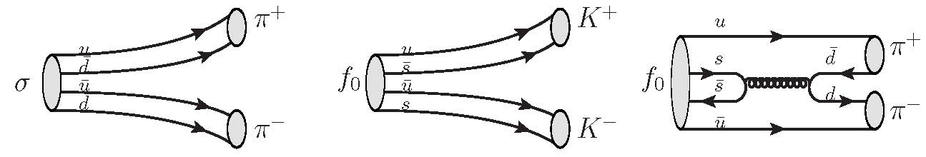
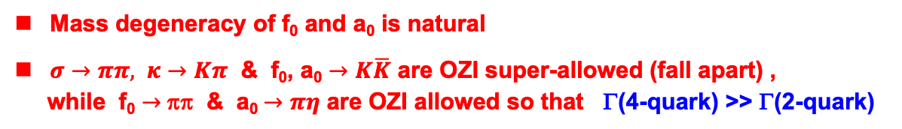
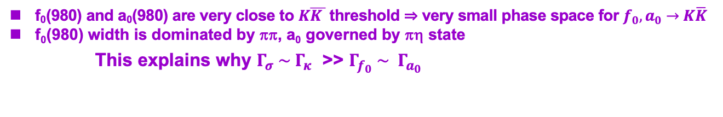
Tetraquark picture
Major difficulties with a₀ and f₀ can be circumvented in the tetraquark model
Mass degeneracy of f₀ and a₀ is natural
$σ→ππ,$ $κ→Kπ$ & f₀, a₀ $→K\overline{K}$ are OZI super-allowed (fall apart) ,
while f₀ $→$ ππ & a₀ $→πη$ are OZI allowed so that Γ(4-quark) >> Γ(2-quark)
Jaffe (’77)
f₀(980) and a₀(980) are very close to $K\overline{K }$ threshold ⇒ very small phase space for $f_{0}, a_{0}→K\overline{K}$
f₀(980) width is dominated by ππ, a₀ governed by πη state
This explains why $Γ_{σ} \sim Γ_{κ}$ >> $Γ_{f_{0}} \sim Γ_{a_{0}}$

Slide 9
Decay constants
μ dependent
For neutral f₀, σ, a₀⁰, f_{S}=0 due to C invariance
finite-energy sum rule, or NLJ model ⇒
Du, Li, MZ Yang (QCD sum rule) ⇒
HYC, KC Yang (sum rule) ⇒
Typical scalar decay constant ${\overline{f}}_{S}$ is above 300 MeV !

Slide 10
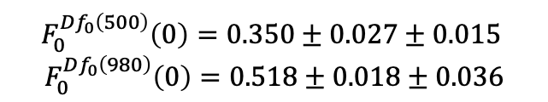
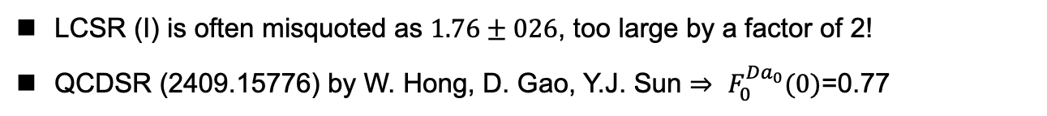
Form factors
 | CCQM | LCSR (I) | LCSR (II) | QCDSR | BESIII
$$F_{0}^{Da_{0}}(0)$$ | $$0.55±0.02$$ | $$0.88±0.13$$ | $${0.85}_{−0.11}^{+0.10}$$ | $${1.058}_{−0.035}^{+0.068}$$ | $$0.559±0.056±0.013$$
$$F_{0}^{Df_{0}\left(500\right)}\left(0\right)=0.350±0.027±0.015$$
$$F_{0}^{Df_{0}\left(980\right)}\left(0\right)=0.518±0.018±0.036$$
Recall that
measured by BESIII (’24)
CCQM (’20): Soni, Gadaria, Patel, Pandya
LCSR (I) (’17): X.D. Cheng, H.B. Li, B. Wei, Y.G. Xu, M.Z. Yang
LCSR (II) (’21): Q. Huang, Y.J. Sun, D. Gao, G.H. Zhao, B. Wang, W. Hong,
QCDSR (’23): Z.H. Wu, H.B. Fu, T. Zhong, D. Huang, D.D. Hu, X.G. Wu
BESIII (’24): arXiv 2411.07730
LCSR (I) is often misquoted as $1.76±026$, too large by a factor of 2!
QCDSR (2409.15776) by W. Hong, D. Gao, Y.J. Sun ⇒ $F_{0}^{Da_{0}}(0)$=0.77

Slide 11
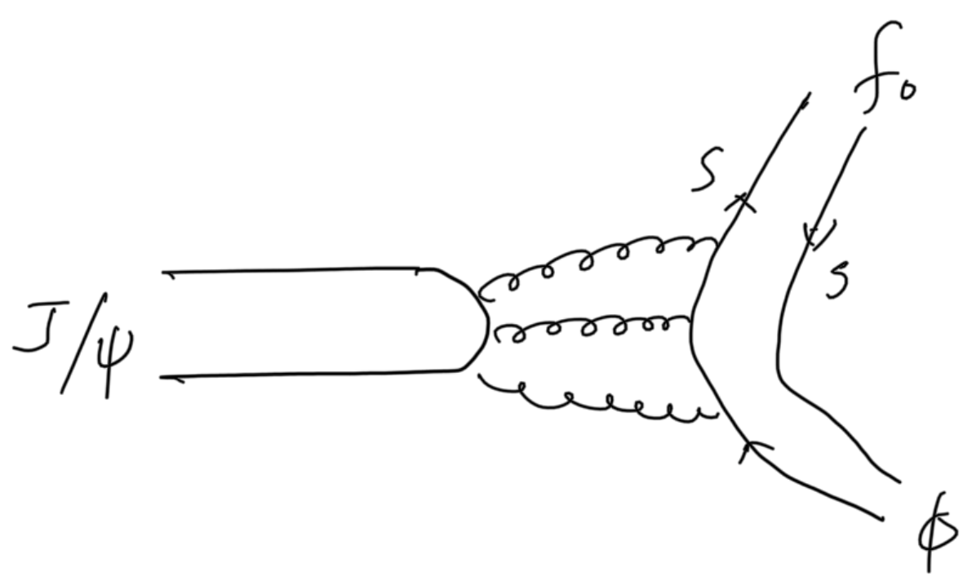
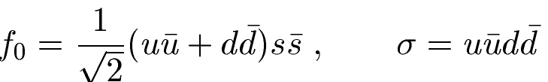
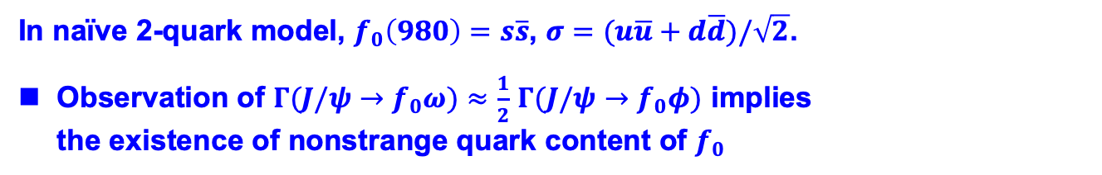

Mixing of $f_{0}(980)$ and $σ/f_{0}(500)$
In naïve 2-quark model, $f_{0}\left(980\right)=s\overline{s}$, $σ=(u\overline{u}+d\overline{d})/\sqrt{2}$.
Observation of $Γ(J/ψ→f_{0}ω)≈\frac{1}{2}$ $Γ(J/ψ→f_{0}φ)$ implies the existence of nonstrange quark content of $f_{0}$
LHCb measurement of $ℬ(B→J ψf_{0})ℬ(f_{0}→π^{+}π^{−})$ ⇒$\left|θ\right|<{30}^{∘}$
with $φ=({174.6}_{−3.2}^{+3.4}) ^{∘}$
Maiani et al. (’04)

Slide 12



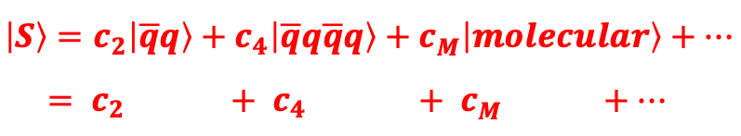
$$\left|S\right\rangle =c_{2}\left|\overline{q}q\right\rangle +c_{4}\left|\overline{q}q\overline{q}q\right\rangle +c_{M}^{ }\left|molecular\right\rangle +⋯$$
$$= c_{2 } {+ c}_{4 } + c_{M}^{ } +⋯$$
Spectroscopy and strong decays of light scalar mesons imply that they are dominated by tetraquark or molecular state
Q: Are the light scalars produced in hadronic weak decays of heavy
hadrons tetraquark states?

Slide 13
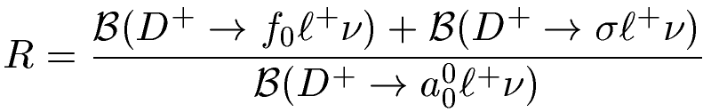
Production of light scalars in semileptonic decays
The 2-quark or 4-quark descriptions of light scalars $f_{0}\left(500\right),{ f}_{0}\left(980\right),{ a}_{0}\left(980\right)$ can be discriminated in semileptonic charm decays
1.0±0.3, 2-quark
3.0±0.9, 4-quark
=
Wang, Lu (’10)
BESIII (’18)
⇒ R > 2.7 in favor of tetraquark nature of light scalars
Further support from the analysis of BESIII data of $D^{+}→π^{+}π^{−}e^{+}ν_{e}$and CLEO data of $D_{s}^{+}→π^{+}π^{−}e^{+}ν_{e}$
Achasov, Kiselev, Shestakov (’20)

Slide 14

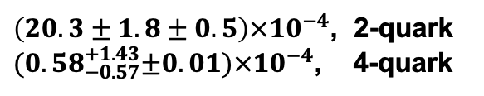
In $q\overline{q}$ model, $s$quark content of $σ$ depends on $f_{0}−σ$ mixing angle, of order ${30}^{∘}.$ In tetraquark model of $σ$, it is quite suppressed.
$$ℬ\left(D_{s}^{+}→f_{0}\left(500\right)e^{+}ν_{e}→π^{+}π^{−}e^{+}ν_{e}\right)=$$
$\left(20.3±1.8±0.5\right)×{10}^{−4}$, 2-quark
${(0.58}_{−0.57}^{+1.43}±0.01)×{10}^{−4}$, 4-quark
Hsiao, Yang, Wei, Ke (’23)
BESIII (’24) ⇒ $ℬ\left(D_{s}^{+}→f_{0}\left(500\right)e^{+}ν_{e}→π^{+}π^{−}e^{+}ν_{e}\right)<3.3×{10}^{−4}$
The $q\overline{q}$ model of $f_{0}(500)$ is most likely ruled out!

Slide 15
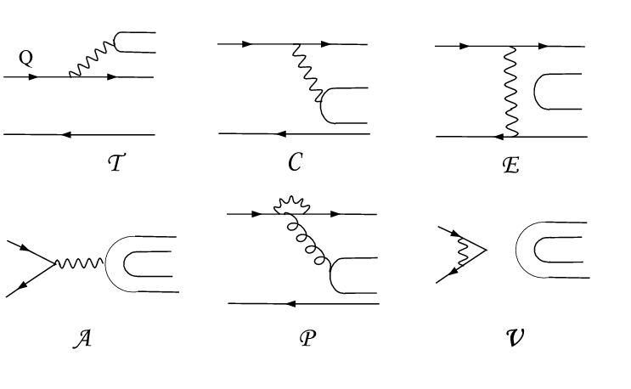
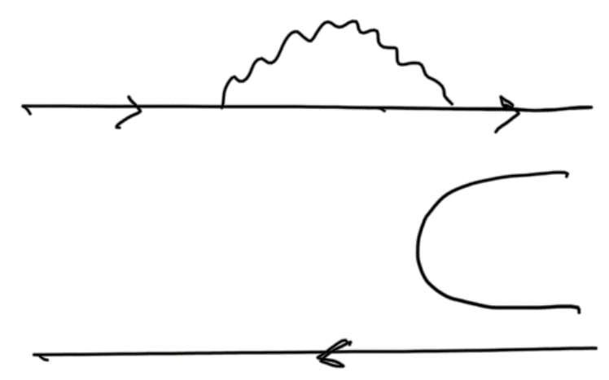
Topological Diagrammatic Approach
All two-body hadronic decays of heavy mesons can be expressed in
terms of six distinct topological diagrams [Chau (’80,’83); Chau, HYC (’86)]
(tree)
(color-suppressed)
(exchange)
(annihilation)
H (horizontal W-loop)
(vertical W-loop)
All quark graphs are topological, classified according to topologies of weak interactions and meant to have all strong interactions encoded and hence they are not Feynman graphs. That is, final-state interactions are included.

Slide 16
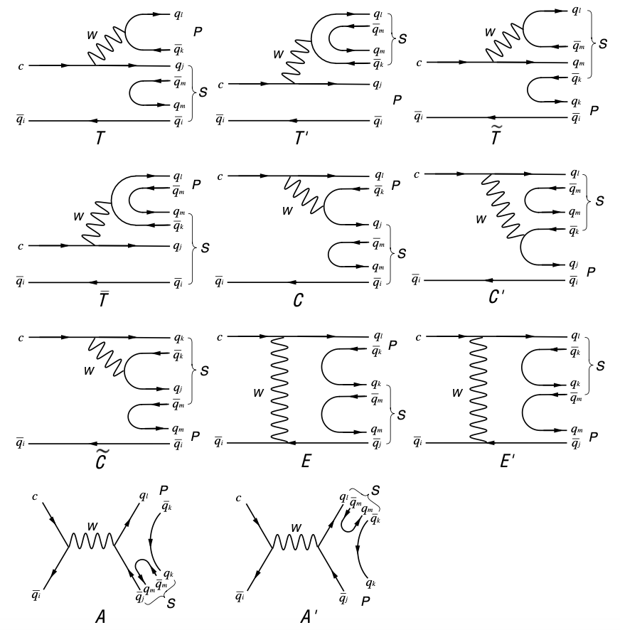
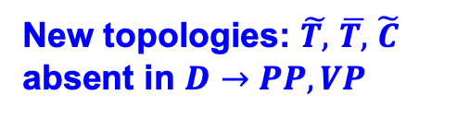


Topological diagrams in $D→SP$ decays
$$T^{′}≪T$$
New topologies: $\tilde{T, }$ $\overline{T,}$ $\tilde{C}$ absent in $D→PP, VP$
$\tilde{C}$ is redundant with $\tilde{T}$

Slide 17
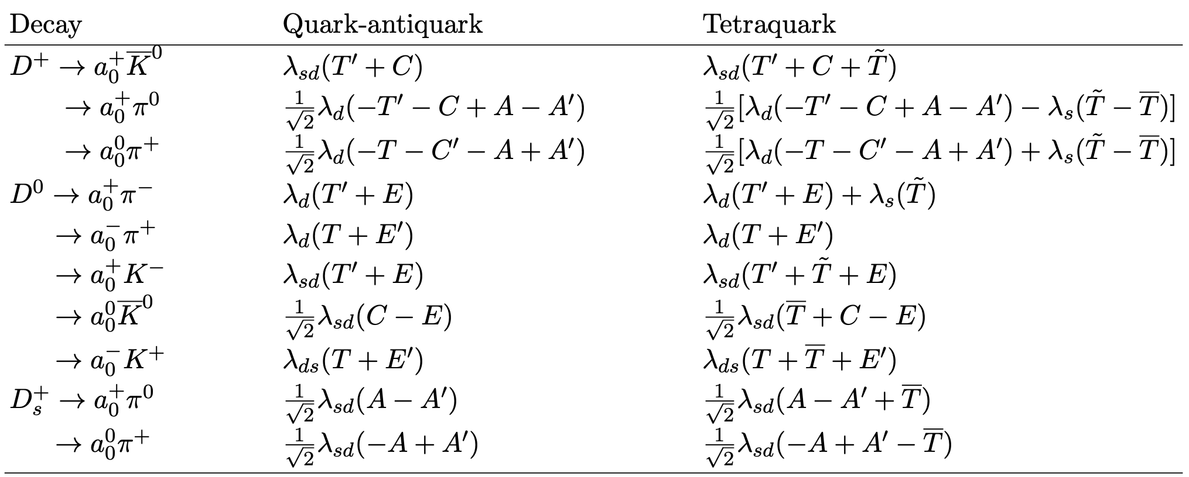
$λ_{sd}=V_{cs}^{∗}V_{ud},{ λ}_{ds}=V_{cd}^{∗}V_{us},{ λ}_{s}=V_{cs}^{∗}V_{us},$ ${ λ}_{d}=V_{cd}^{∗}V_{ud}$

Slide 18
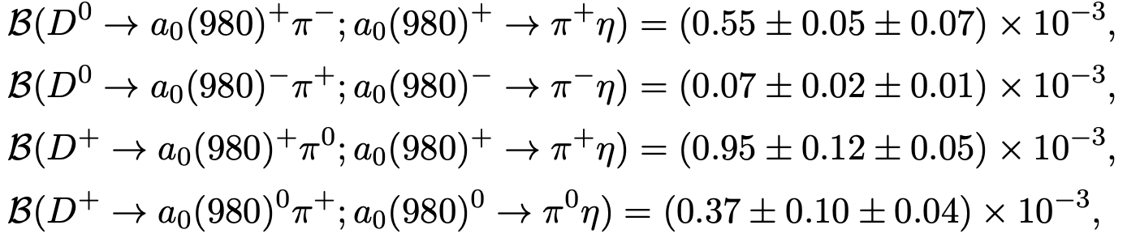
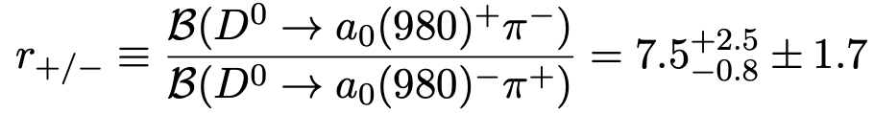
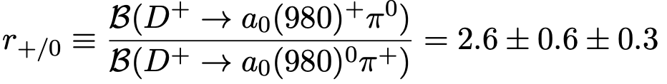
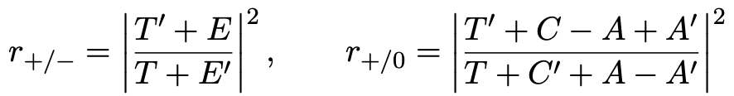
Two-quark or tetraquark nature in hadronic D decays
BESIII (’24)
Since ${T^{′}∝f}_{a_{0}^{+}}\sim 1.3$ MeV, $T∝f_{π},$ these ratios are expected to be smaller than unity: $r_{+/−}=0.29, r_{+/0}=0.08$ in the absence of weak annihilation
The $q\overline{q}$ model of $a_{0}(980)$ fails to explain the ratios${ r}_{+/−}, r_{+/0}$

Slide 19
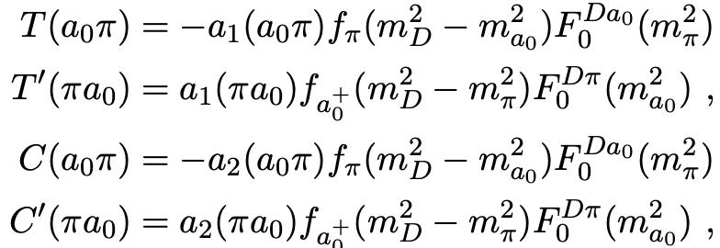
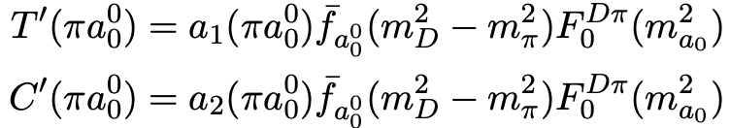
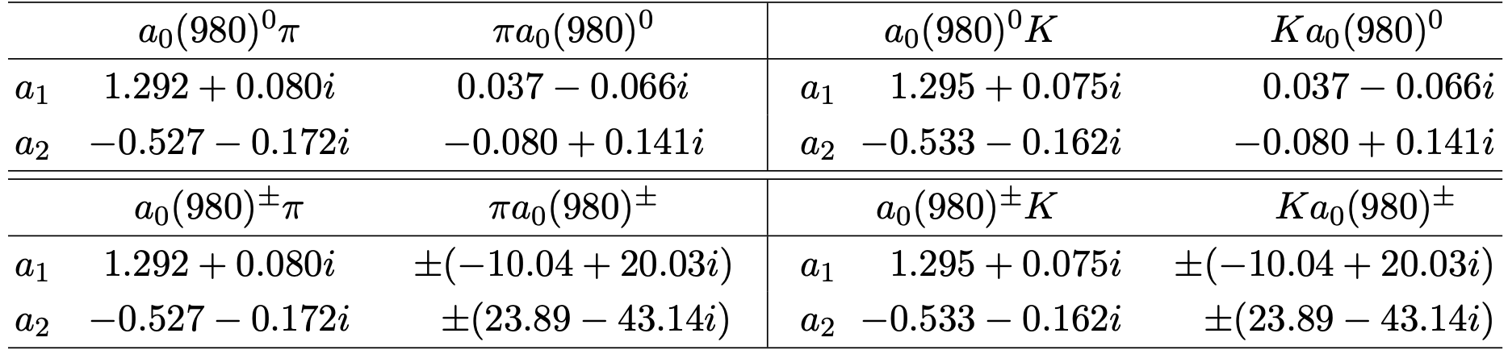
Extraction of $\tilde{T,}$ $\overline{T,}$ $E′$
$\tilde{T}$ can be inferred from $D^{+}→K_{S}^{0}a_{0}^{+}$
evaluated using QCDF
HYC, Chiang, Zhang (’22)
A fit to $D^{+}→K_{S}^{0}a_{0}^{+}$ ⇒ $\tilde{T}$/$T=−{0.52}_{−0.02}^{+0.03},$ ${1.56}_{ }^{ }$

Slide 20




${ E}^{′}$from $D^{0}→a_{0}^{−}π^{+}→π^{+}π^{−}η:$ $A(D^{0}→a_{0}^{−}π^{+}$)$=λ_{d}(T+E^{′})$
$\overline{T}$ from $D^{0}→a_{0}^{0}{\overline{K}}^{0}→ηπ^{0}{\overline{K}}^{0}: A(D^{0}→a_{0}^{0}{\overline{K}}^{0}$)$={\frac{1}{\sqrt{2}}λ}_{sd}(C−E+\overline{T})$
$$\overline{T}/T={1.74}_{−0.27}^{+0.23}$$
The solution $\tilde{T}$/$T={1.56}_{ }^{ }$ is ruled out by $D^{+}→a_{0}^{+}π^{0}$ ⇒ $\tilde{T}$/$T=−{0.52}_{−0.02}^{+0.03}$
$$\overline{T}/T={1.74}_{−0.27,}^{+0.23}$$
$\tilde{T}$/$T=−{0.52}_{−0.02,}^{+0.03}$

Slide 21
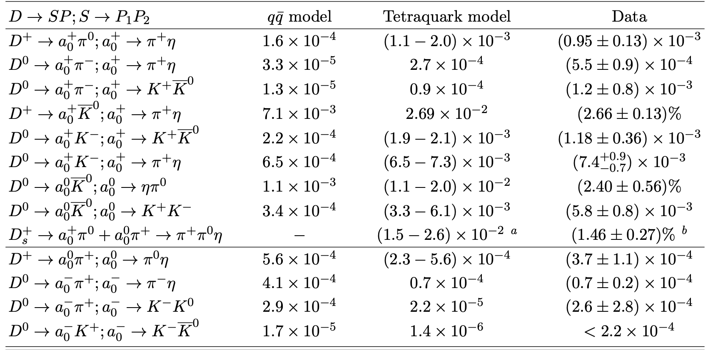

Slide 22
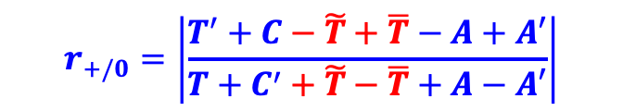
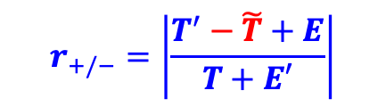



naïve with $\tilde{T},\overline{T}$ expt
$$r_{+/−}=\left|\frac{T^{′}−\tilde{T}+E}{T+E′}\right|$$
0.036 3.8 ${7.5}_{−0.8}^{+2.5}±1.7$
$$r_{+/0}=\left|\frac{T^{′}+C−\tilde{T}+\overline{T}−A+A′}{T+C^{′}+\tilde{T}−\overline{T}+A−A′}\right|$$
0.16 2.0 ~ 8.7 $2.6±0.6±0.3$

Slide 23
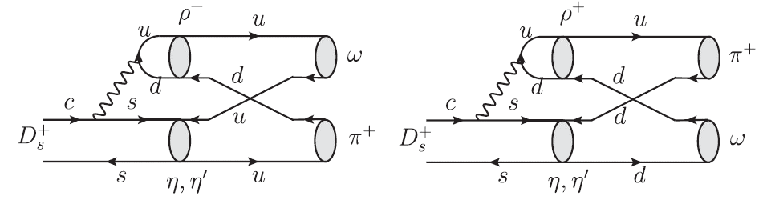
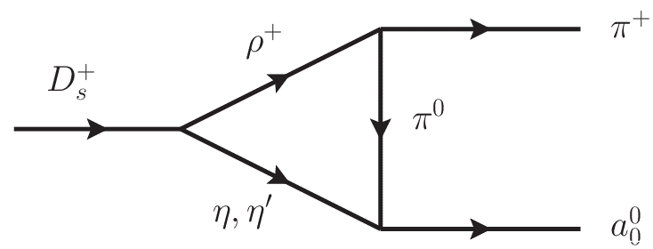
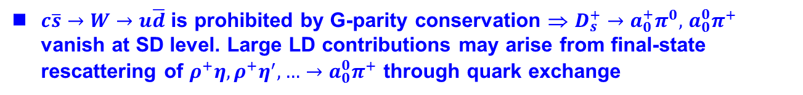


Large W-annihilation in D→ SP?
$D_{s}^{+}→a_{0}^{+}π^{0},$ $a_{0}^{0}π^{+}, ωπ^{+},ρ^{0}π^{+}$ can only proceed through W-annihilation
1%, 1%, 0.2%, 0.02% in BF ⇒ |$A_{SP}$| >> |$A_{VP}$|
Large BF of $D_{s}^{+}→a_{0}^{+}π^{0}+$ $a_{0}^{0}π^{+}$ at a percent level was observed by BESIII (’19)
$c\overline{s}→W→u\overline{d}$ is prohibited by G-parity conservation ⇒ $D_{s}^{+}→a_{0}^{+}π^{0},$ $a_{0}^{0}π^{+}$ vanish at SD level. Large LD contributions may arise from final-state rescattering of $ρ^{+}η,ρ^{+}η^{′},…→a_{0}^{0}π^{+}$ through quark exchange
HYC, Chiang (’22)
$$a_{0}^{0}$$
Hsiao, Yu, Ke (’20) Ling, Liu, Lu, Geng, Xie (’21)
$$a_{0}^{0}$$
${\left|A/T\right|}_{SP}∼0.5,$ $(0.84±0.23$ from BESIII),${ \left|A/T\right|}_{PP}∼0.18,{ \left|A_{V}/T_{P}\right|}_{VP}∼0.07$
Why an anomalously large W-annihilation in $D→SP?$

Slide 24
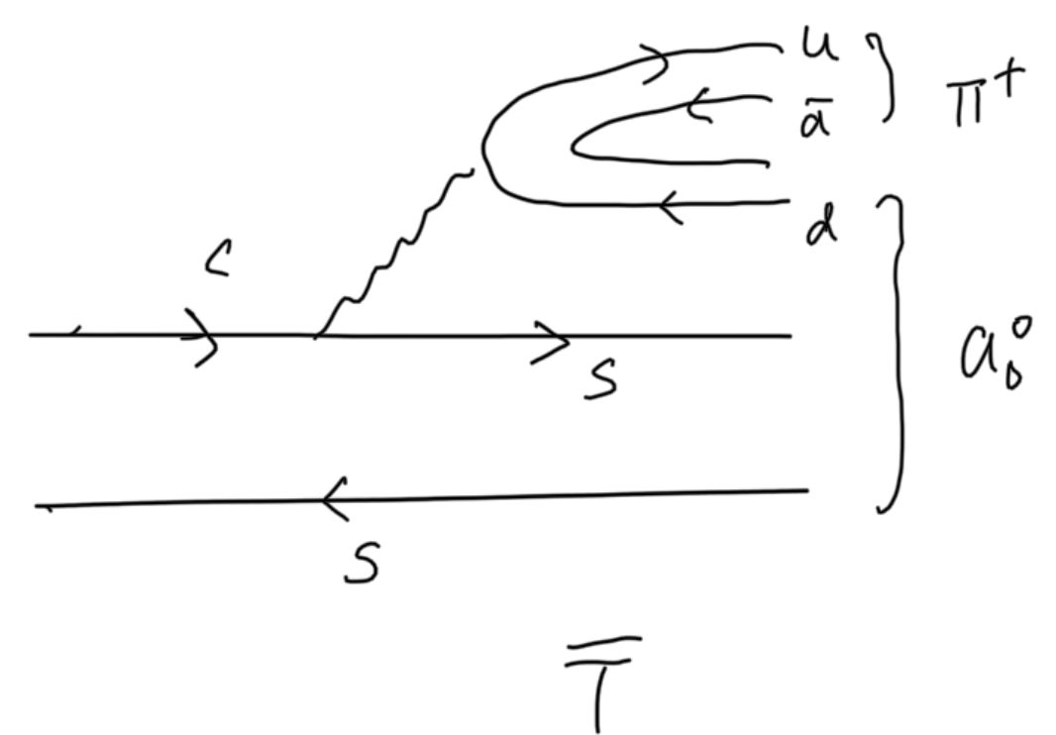
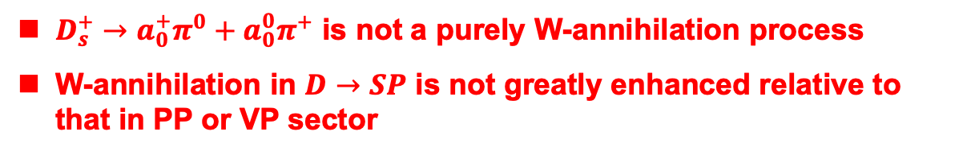
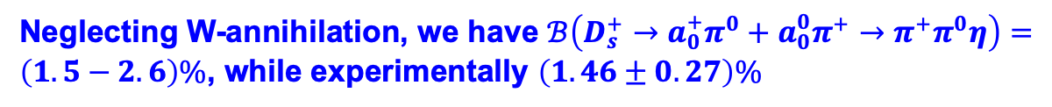
$$A\left(D_{s}^{+}→a_{0}^{+}π^{0}\right)=\frac{1}{\sqrt{2}}λ_{sd}\left(A−A^{′}+\overline{T}\right), A\left(D_{s}^{+}→a_{0}^{0}π^{+}\right)=\frac{1}{\sqrt{2}}λ_{sd}\left(−A+A^{′}−\overline{T}\right)$$
Neglecting W-annihilation, we have $ℬ\left(D_{s}^{+}→a_{0}^{+}π^{0}+a_{0}^{0}π^{+}→π^{+}π^{0}η\right)=\left(1.5−2.6\right)\%$, while experimentally $\left(1.46±0.27\right)\%$
$D_{s}^{+}→a_{0}^{+}π^{0}+a_{0}^{0}π^{+}$ is not a purely W-annihilation process
W-annihilation in $D→SP$ is not greatly enhanced relative to that in PP or VP sector

Slide 25
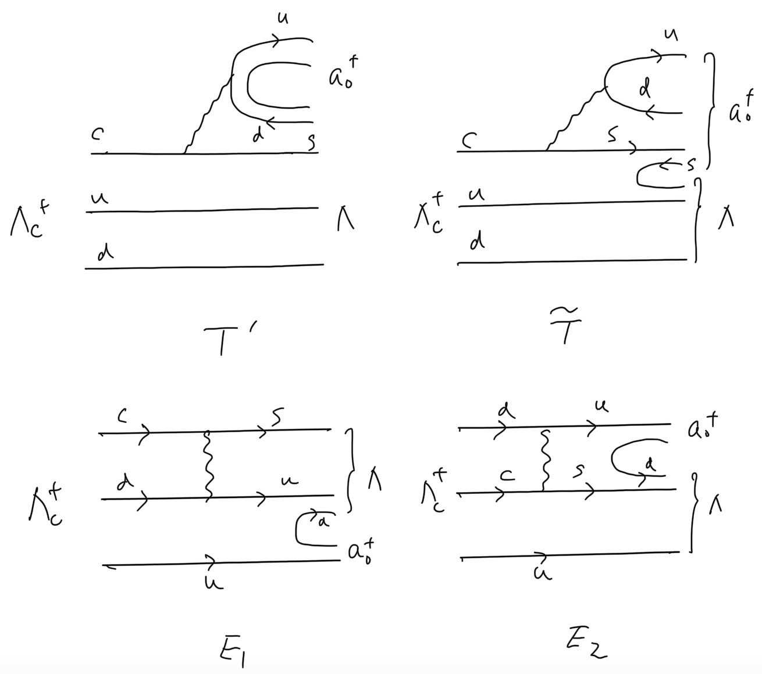
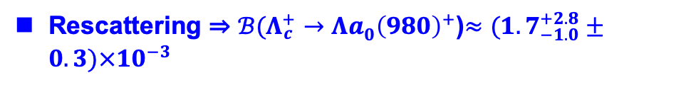


$Λ_{c}^{+}→Λa_{0}^{ }{\left(980\right)}^{+}→Λπ^{+}η$
Nonfactorizable W-exchanges $E_{1,2}$estimated in pole model
$q\overline{q}$ model ⇒ $ℬ(Λ_{c}^{+}→Λa_{0}^{ }{\left(980\right)}^{+}$)$≈1.9×{10}^{−4}$
Sharma, Verma (’09)
Rescattering ⇒ $ℬ(Λ_{c}^{+}→Λa_{0}^{ }{\left(980\right)}^{+}$)$≈({1.7}_{−1.0}^{+2.8}±0.3)×{10}^{−3}$
Yu, Hsiao (’21)
BESIII (’24) ⇒ $ℬ\left(Λ_{c}^{+}→Λa_{0}^{ }{\left(980\right)}^{+}→Λπ^{+}η\right)=\left(1.05±0.16±0.05±0.07\right)\%$
⇒ $ℬ\left(Λ_{c}^{+}→Λa_{0}^{ }{\left(980\right)}^{+}\right)=\left(1.23±0.21\right)\%$
A nonfactorizable $\tilde{T} could$ enhance the rate substantially, recalling that $\tilde{T}$ $≈−0.52T$ in $D→a_{0}\left(980\right)π$decays

Slide 26
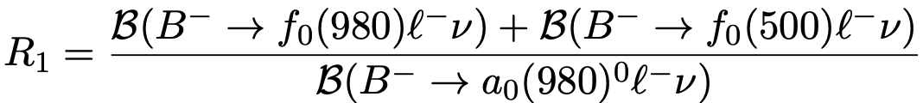
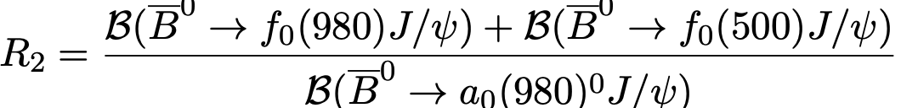
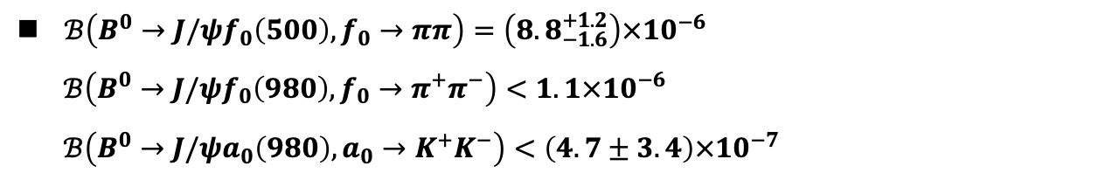
Two-quark or tetraquark nature in B decays
=
1, 2-quark
3, 4-quark
$B^{−}→Sℓ\overline{ν}$ decays have not been observed.
$ℬ\left(B^{0}→J/ψf_{0}\left(500\right), f_{0}→ππ\right)=\left({8.8}_{−1.6}^{+1.2}\right)×{10}^{−6}$
$ℬ\left(B^{0}→J/ψf_{0}\left(980\right), f_{0}→π^{+}π^{−}\right)<1.1×{10}^{−6}$
$ℬ\left(B^{0}→J/ψa_{0}\left(980\right), a_{0}→K^{+}K^{−}\right)<\left(4.7±3.4\right)×{10}^{−7}$
Production of $a_{0}\left(980\right)$ in B decays has never been observed

Slide 27
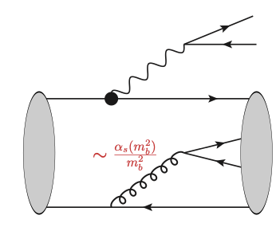
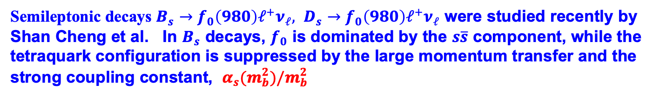
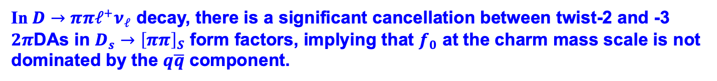
$$\left|S\right\rangle =c_{2}\left|\overline{q}q\right\rangle +c_{4}\left|\overline{q}q\overline{q}q\right\rangle +c_{M}^{ }\left|molecular\right\rangle +⋯$$
Naively, one may wonder if the energetic light scalar produced in B decays
is dominated by the tetraquark configuration as it requires to pick up an energetic quark-antiquark pair to form a fast-moving light tetraquark scalar meson.
Semileptonic decays $B_{s}→f_{0}\left(980\right)ℓ^{+}ν_{ℓ}, D_{s}→f_{0}\left(980\right)ℓ^{+}ν_{ℓ}$ were studied recently by Shan Cheng et al. In $B_{s}$ decays, $f_{0}$ is dominated by the $s\overline{s}$ component, while the tetraquark configuration is suppressed by the large momentum transfer and the strong coupling constant, $α_{s}(m_{b}^{2})/m_{b}^{2}$
Shan Cheng, Ling-yun Dai, Jian-ming Shen, Shu-lei Zhang [2509.15659]
In $D→ππℓ^{+}ν_{ℓ}$ decay, there is a significant cancellation between twist-2 and -3 $2π$DAs in $D_{s}→{\left[ππ\right]}_{S}$ form factors, implying that $f_{0}$ at the charm mass scale is not dominated by the $q\overline{q}$ component.

Slide 28
$$\left|S\right\rangle =c_{2}\left|\overline{q}q\right\rangle +c_{4}\left|\overline{q}q\overline{q}q\right\rangle +c_{M}^{ }\left|molecular\right\rangle +⋯$$
$$= c_{2 } {+ c}_{4 } + c_{M}^{ } +⋯$$
Spectroscopy and strong decays of light scalar mesons imply that they are dominated by tetraquark or molecular state
Q: Are the light scalars produced in hadronic weak decays of heavy
hadrons tetraquark states?
A: Light scalars produced in hadronic D decays are mainly tetraquark
states, but most likely 2-quark ones in B decays

Slide 29
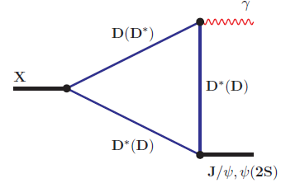
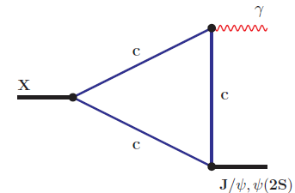

|X(3872)> = c₀|$c\overline{c}$> + c₁|D⁰D^{*0}> + c₂|D⁺D^{*-} > +…
dominated by c₁
a mixture of DD* (S-wave) and χ_{c1} (P-wave) charmonium
Composition of X(3872) depends on the distance: $c\overline{c}$ at SD and DD* molecule at LD
(Brambilla et al. PRL (’25) ⇒ 8% $of c\overline{c}$, 92% of tetraquark )
Radiative decay is dominated by $c\overline{c}$ component in χ_{c1}(2³P₁) state as $c\overline{c}$ pair forms J/ψ or ψ’ more easily than $D\overline{D}$ or $D^{∗}\overline{D^{∗}}$. Also it is natural to expect the rate of 2³P₁→ ψ(2S)γ is larger than 2³P₁→ J/ψ(1S)γ.
Production of X(3872) in $B$ decays & in $pp$ or$p\overline{p}$ collisions is governed by SD and proceeds through $c\overline{c}$ core component
X(3872) decays into J/ψρ & J/ψω are accounted for by the DD* component which decays into those channels more easily than $c\overline{c}$ .

Slide 30



|$D_{s0}^{∗}(2317)$> = c₀|$c\overline{s}$> + c₁|DK> +…
dominated by c₁
Composition of $D_{s0}^{∗}(2317)$ depends on the distance: $c\overline{s}$ at SD and DK molecule at LD
$$\frac{ℬ(D_{s0}^{∗}{\left(2317\right)}^{+}→D_{s}^{∗+}γ)}{ℬ(D_{s0}^{∗}{\left(2317\right)}^{+}→D_{s}^{+}π^{0})}=\left(7.14±0.74\right)\%$$
Belle & Belle II (’25)
Radiative decay is dominated by $c\overline{s}$ component of D*_{s0}(2317) state.
30

Slide 31

Conclusions
The $q\overline{q}$ model of $a_{0}(980)$ fails to explain the measured ratios${ r}_{+/−}, r_{+/0}$
For tetraquark${ a}_{0}(980), t$here exist two additional T-like topologies
$D_{s}^{+}→a_{0}^{+}π^{0}+a_{0}^{0}π^{+}$ is not a purely W-annihilation process. W-annihilation
in $D→SP$ is not greatly enhanced relative to that in PP or VP sector
Nonfactorizable $\tilde{T} could$ enhance the rate of $Λ_{c}^{+}→Λa_{0}^{ }{\left(980\right)}^{+}→Λπ^{+}η$ substantially
Light scalars produced in hadronic D decays are mainly tetraquark states, but most likely 2-quark ones in B decays

Slide 32
Back-up slides

