Slide 1

Analytic Calculation for QCD Corrections to Hard Exclusive Processes
Phys.Rev.Lett. 135,131903(2025)
Phys.Rev.Lett. 132,201901(2024)
Phys.Lett.B. 870,139116(2025)
陈龙斌
In collaboration with：Wen Chen, Feng Feng,Yu Jia, Siwei Hu
2026/1/20

Slide 2
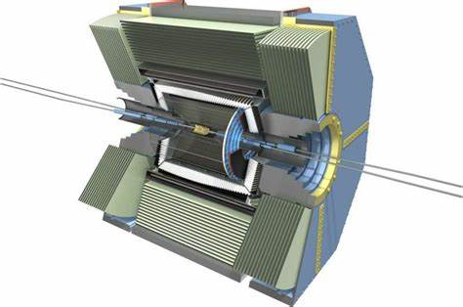

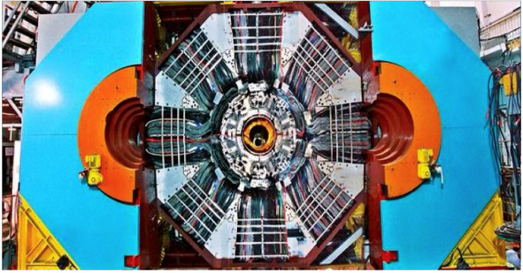
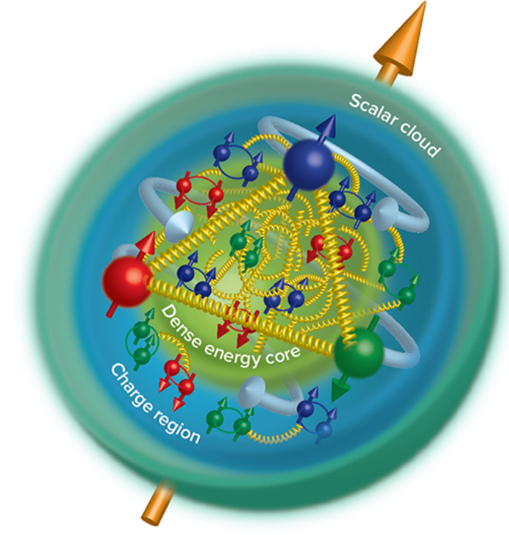
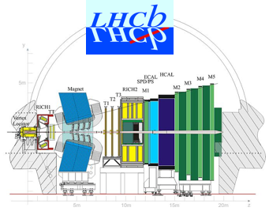
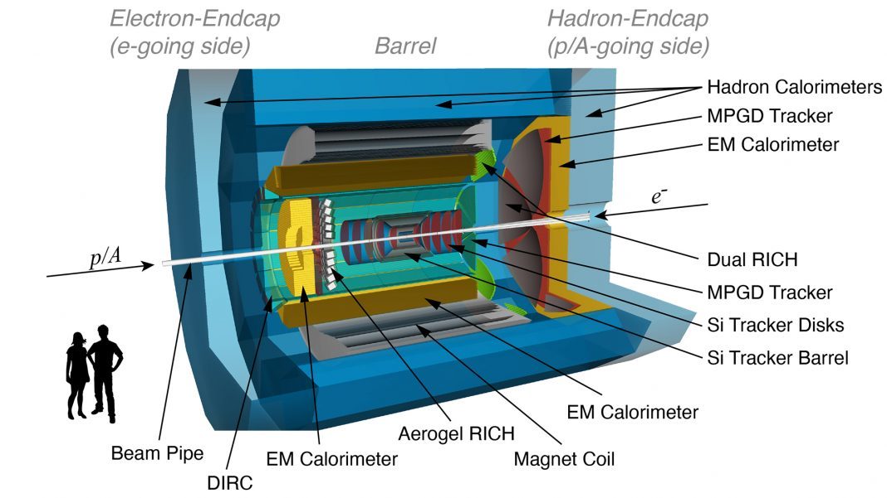
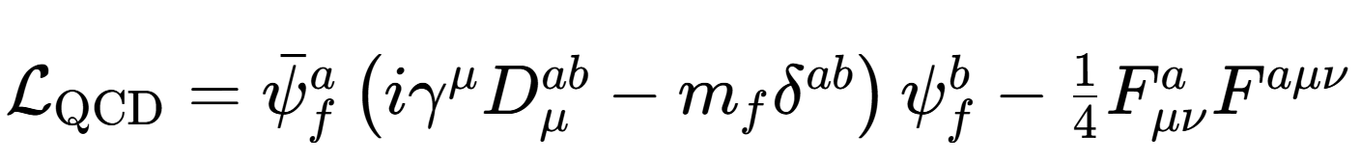

Unveiling the inner structure of hadron
Understanding the internal structure of nucleons from quantum chromodynamics (QCD), the underlying theory of strong interaction, is the fundamental challenge faced by the contemporary hadron and nuclear physics.--Eur. Phys. J. C83, 1125 (2023 )

Slide 3
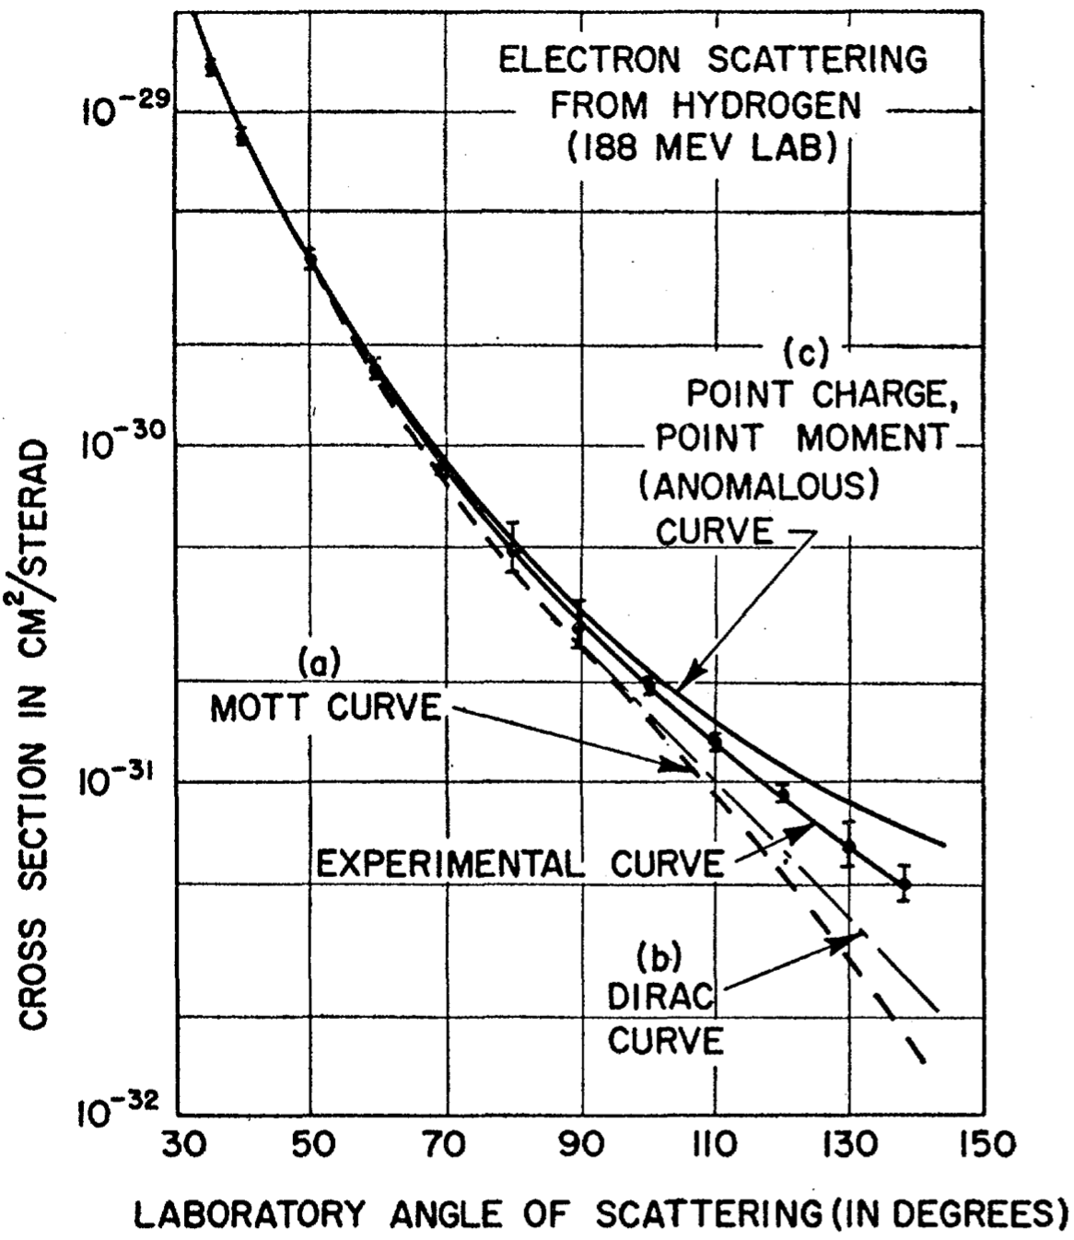
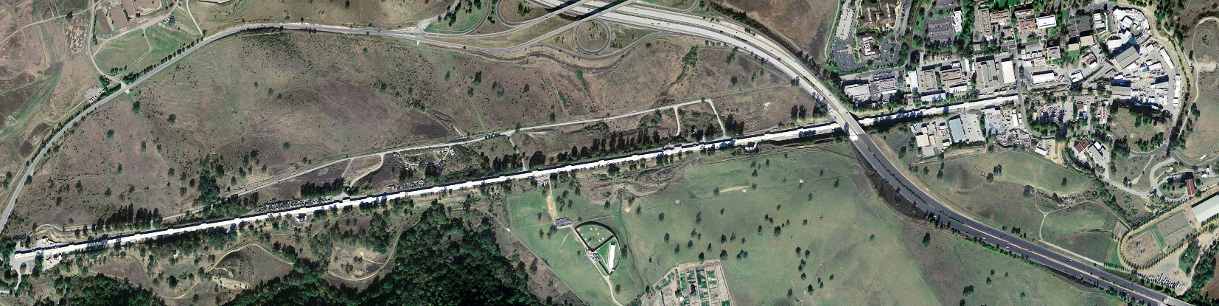
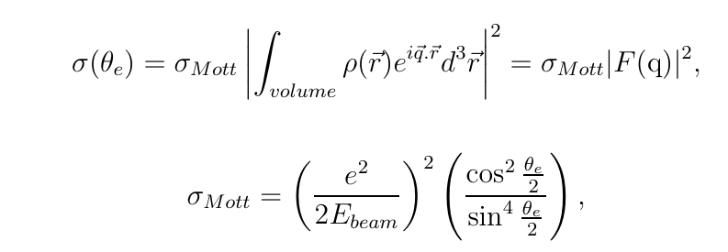


Historic Milestones
From Hu Jifeng’s talk
Electron Scattering (1950s)
Hofstadter R. etc., “electron scattering and nuclear structure”
Rev. Mod. Phys. 28, 214–254 (1956)
Developments of the definition
Sachs formula
$$G_{E}=F_{1}+{τF}_{2}, G_{M}=F_{1}+F_{2}$$
Electric FF
Magnetic FF

Slide 4
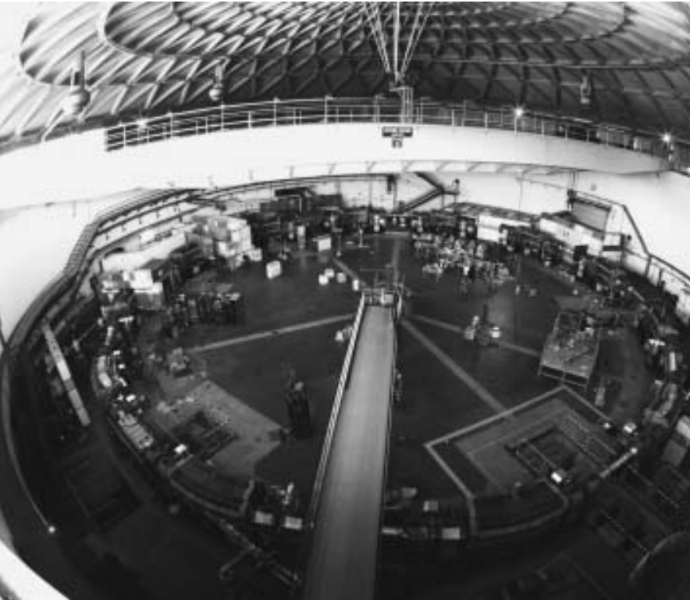
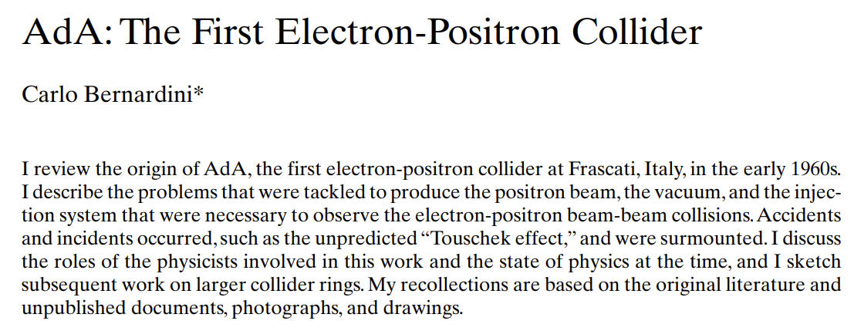

Historic Milestones
From Hu Jifeng’s talk
https://cas.web.cern.ch/sites/default/files/lectures/baden-2004/bernardini.pdf
Electron Scattering (1950s)
$e^{+}e^{−}$ → $p\overline{p}$ (1972)
Hofstadter R. etc., “electron scattering and nuclear structure”
Rev. Mod. Phys. 28, 214–254 (1956)

Slide 5
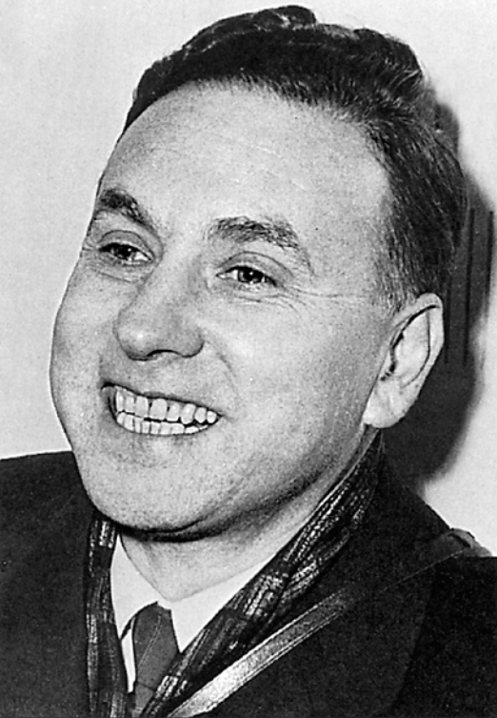
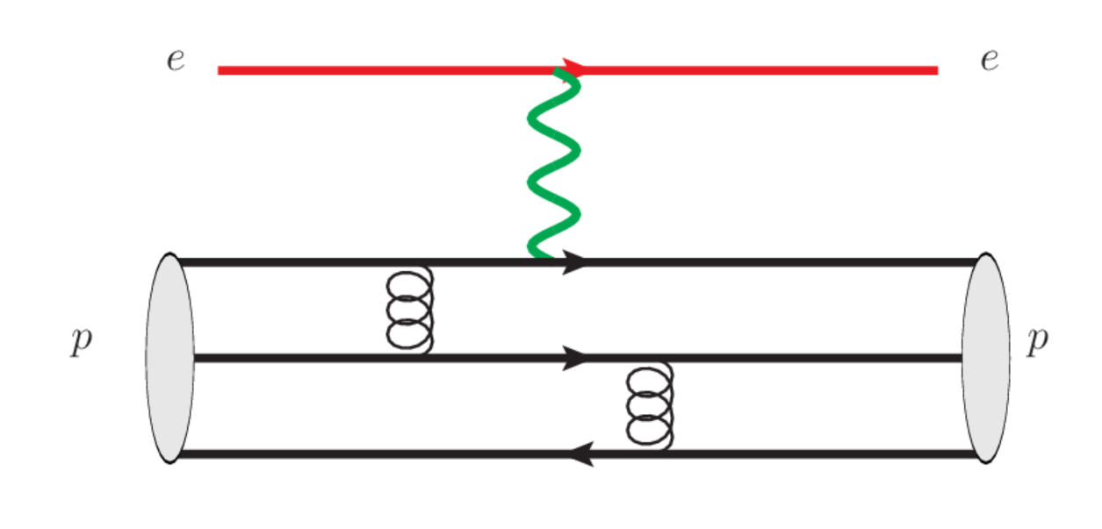
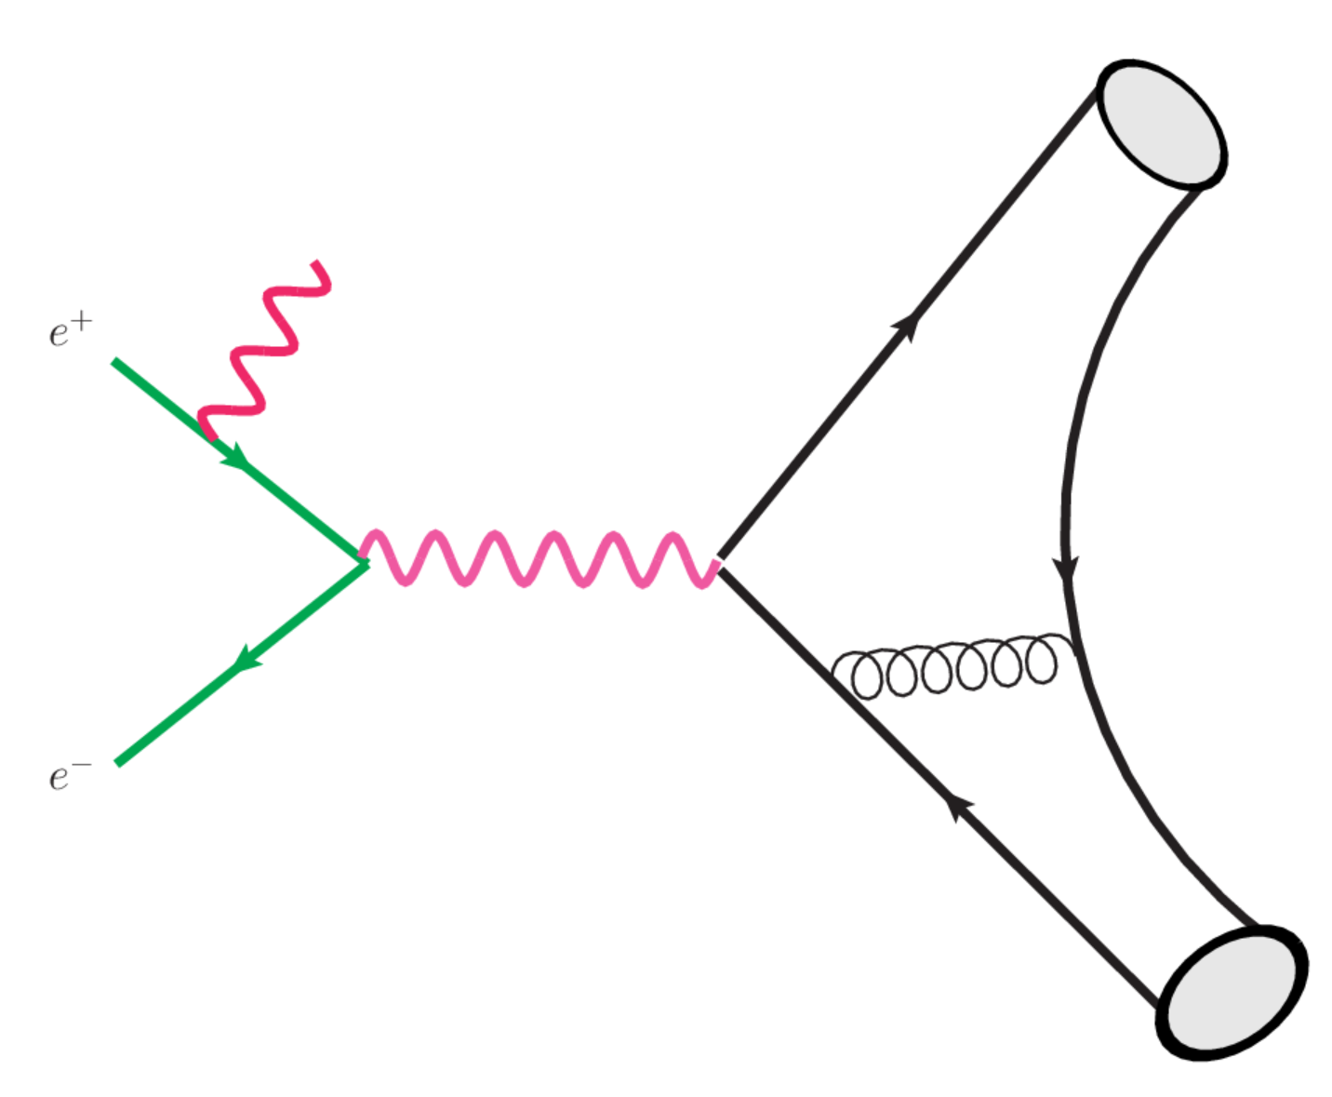

Probing baryon and meson EM Form Factors
1961
Space Like
R. Hofstaders’ pioneering work in mid-50s
SLAC, Q^2 up to 30GeV^2 in early 90
Phys. Rev. D 48 , 29 (1993)
EIC：Q^2 up to 40-50 GeV^2
arXiv:2208.14575
Time Like
BESIII, BarBar, Belle II, STCF
Babar, Q^2 up to 40GeV^2 in 2013
Phys. Rev. D88 , 072009 (2013)

Slide 6
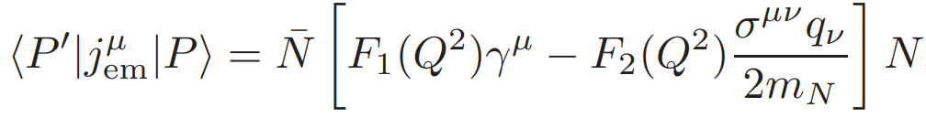
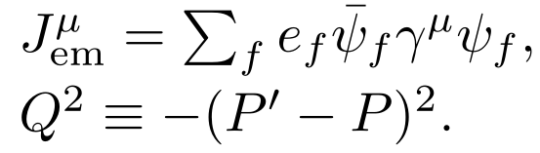
EM FFs: Probing the internal structure of hadrons
EM Form Factors for mesons and baryons:
Dirac FF
Pauli FF
EM FFs describe the distributions of electric charge and magnetization inside the hadron, key roles to probes the internal structure of hadron.

Slide 7
Theoretical side on EMFFs
Vector meson dominance model
PLB43,191 (1973); PRD69,054022 (2004); NCA109, 241 (1996); CPL41, 021302 (2024); ……
Constitute quark model
PRD44, 229 (1991); PRD73, 114021 (2006); PLB671, 153 (2009); ……
Cloudy bag model
PRD24, 216 (1981); PRD28, 2848 (1983); PRC46, 1077 (1992); ……
Dyson-Schwinger equation
CTP58, 79 (2012); PRL111, 101803 (2013); FBS55, 1185(2014); ……
Light-front Hamiltonian
PRD102, 016008 (2020); ……
Chiral perturbation theory
EPJA26, 1 (2005); PRC86, 065206 (2012); ……
Light-cone sum rule
PRD65, 074011 (2002); PRD78, 033009 (2008); PRD111,L071902……
Lattice QCD
PRD84, 074507 (2011); PRD83, 094502 (2011); PRD96, 114509 (2017);
PRD92, 054511 (2015); PRD100, 014509 (2019); PRD101, 014507 (2020); ……
Dispersive analysis
NPA596, 367 (1996); PRC75, 035202 (2007); ……

Slide 8
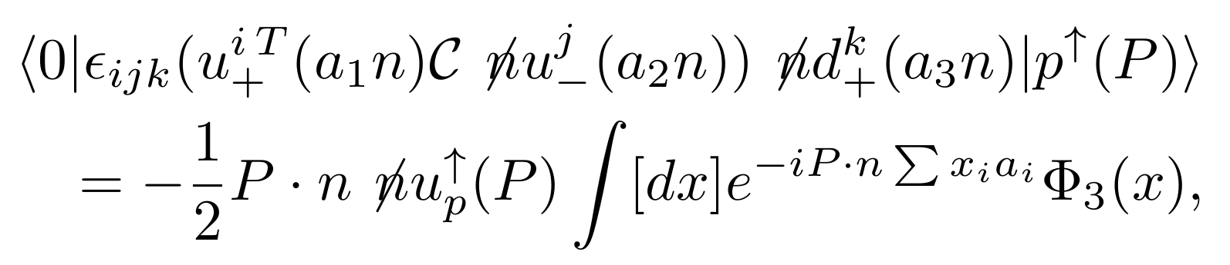
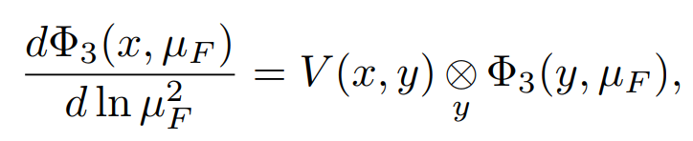

Large $Q^{2}$, Collinear Factorization
(Brodsky, Lepage, Efremov, Radyushkin, Duncan, Mueller)
Meson
Baryon
Operator definition of Tiwst-3 LCDA for baryon
ERBL evolution equations
Phys. Rev. D22 , 2157 (1980)
Phys. Rev. D78 , 033009 (2008)

Slide 9
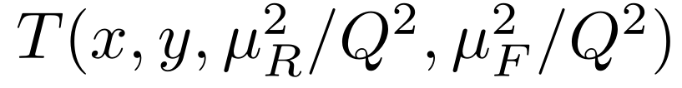
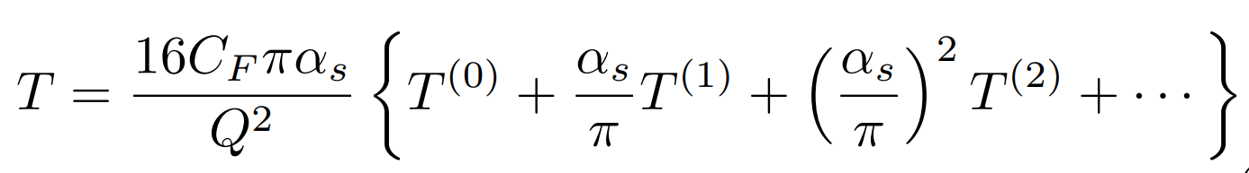
Hard Kernel
Perturbative Expansion
Leading Order EMFFs
G. P. Lepage and S. J. Brodsky, Phys. Rev. Lett. 43, 545 - 549 (1979)
G. P. Lepage and S. J. Brodsky, Phys. Rev. D22, 2157 (1980)
V. L. Chernyak, A. R. Zhitnitsky and V. G. Serbo, JETP Lett. 26, 594 (1977)
V. L. Chernyak and A. R. Zhitnitsky, Phys. Rept. 112, 173 (1984)

Slide 10
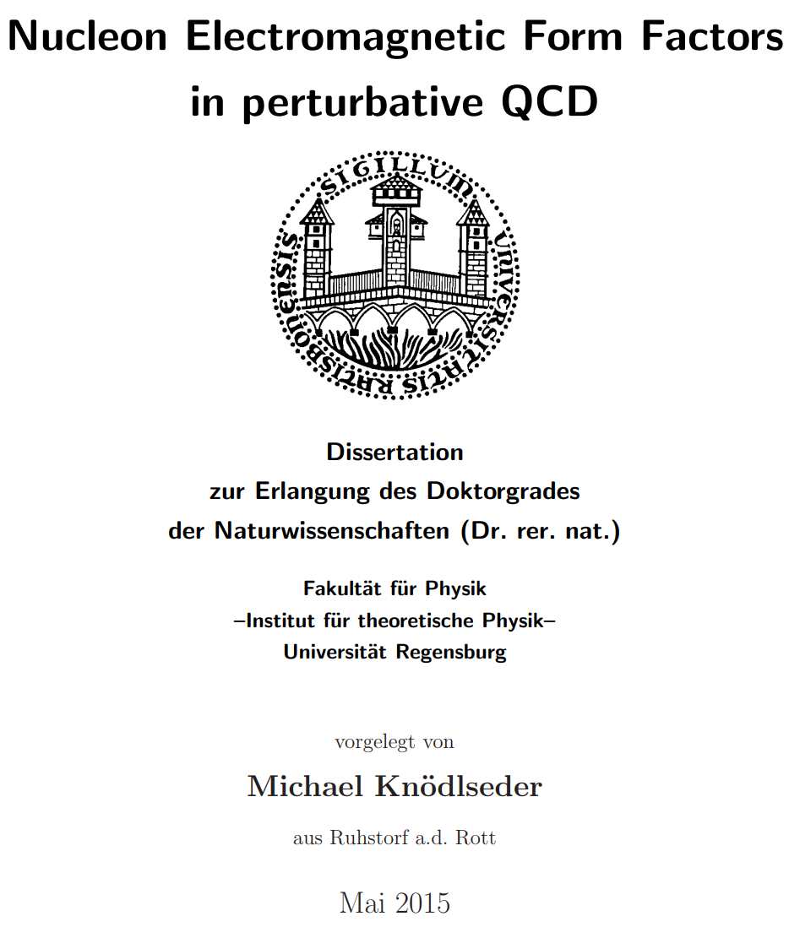
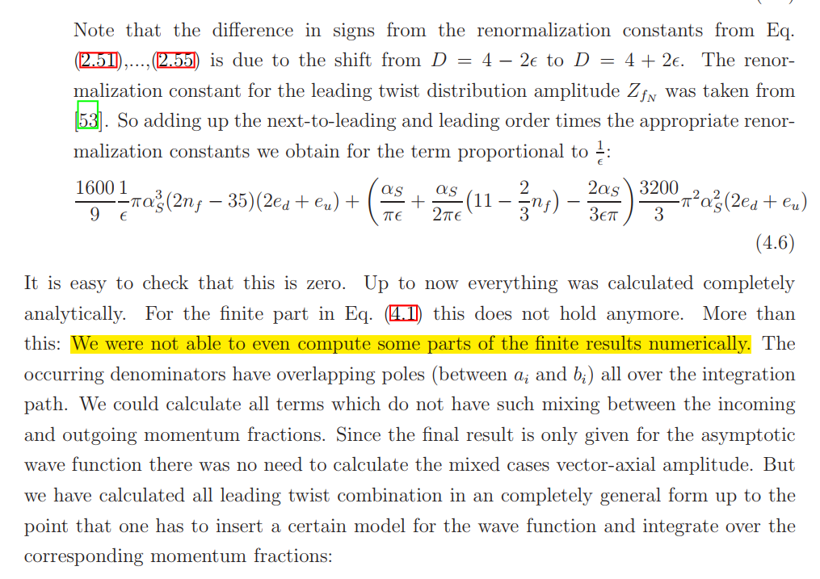
Status of EMFF in pQCD for baryon FFs
Promotionsgesuch eingereicht am: 18.06.2014
Die Arbeit wurde angeleitet von: Prof. Dr. V. Braun

Slide 11
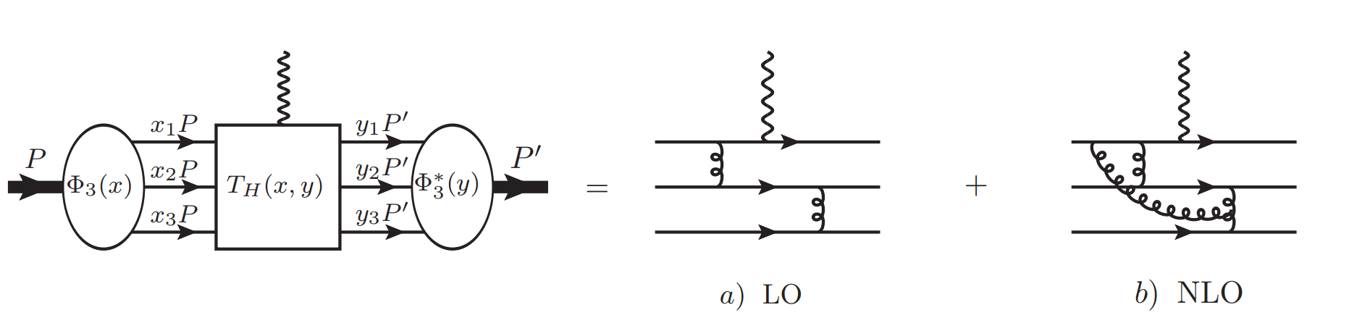
Feynman Diagrams(about 2000)

Slide 12
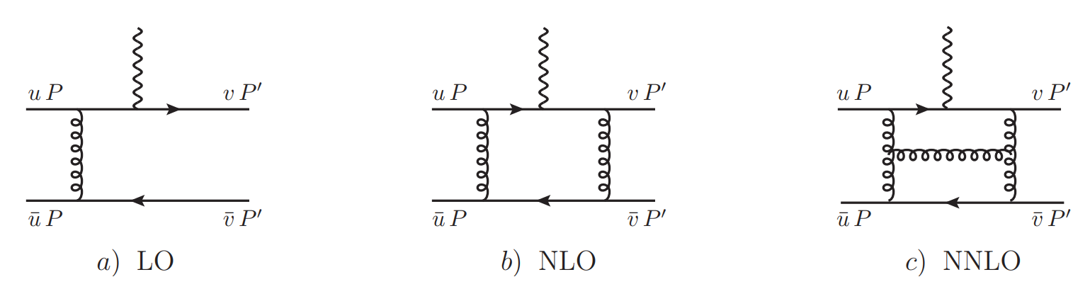
Feynman Diagrams(about 1600)
Partonic Process

Slide 13
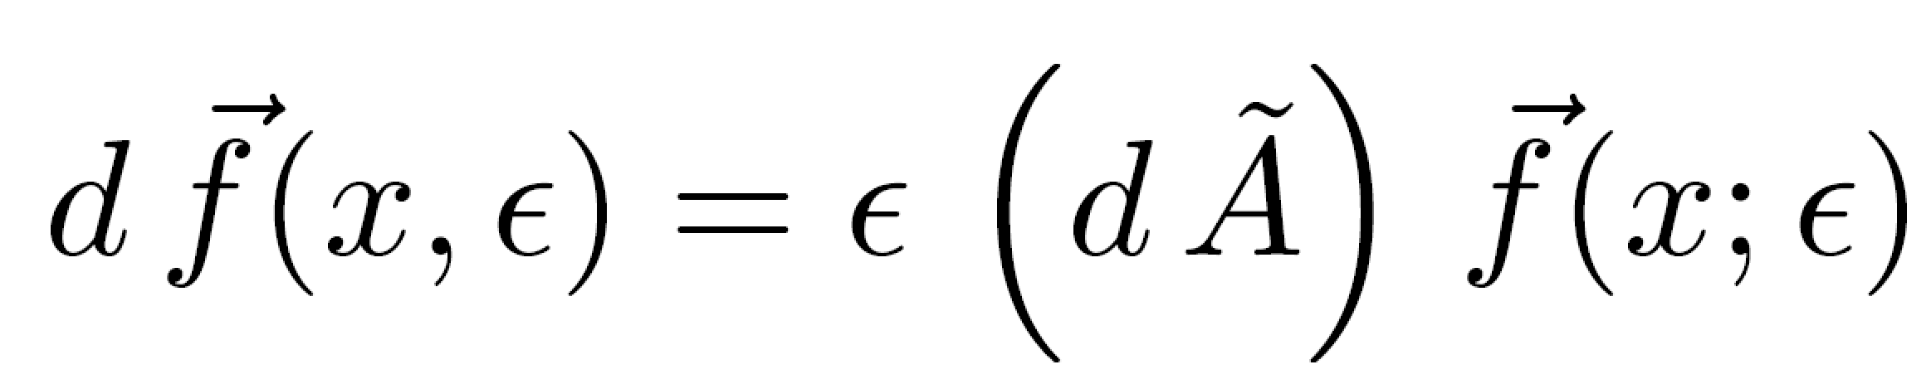
Calculation Methods
Diagrams and amplitudes : HepLibFeng 2021, FeynArts
Partial Fraction: Apart
Integrals Reduction: FIRE (Integration-By-Parts)
Master Integrals Calculation: Differential Equations
Validations of analytic results for MIs: AMFLOW, AmpRed
Two-fold and Four-fold convolutions: Cubature, PolylogTool
Feng 2012
Liu, Ma 2022
Chen 2024

Slide 14
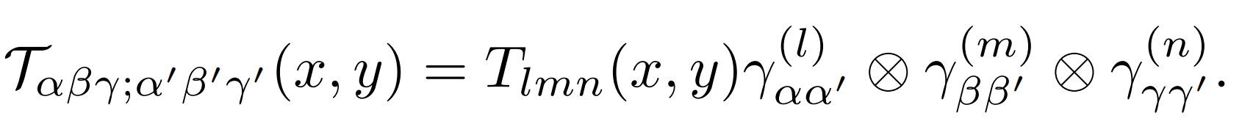
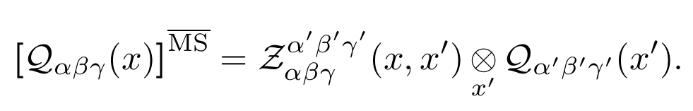
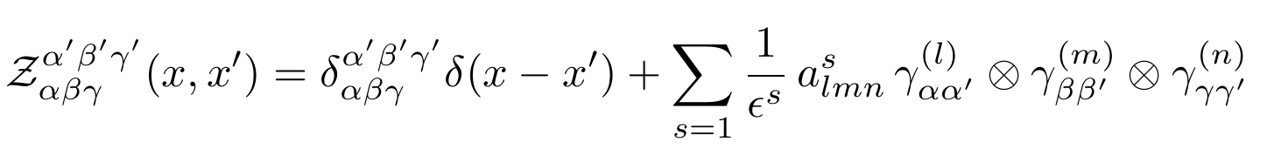
Perturbative matching in KM scheme
S. Krankl and A. Manashov, Phys. Lett. B. 703,519-523 (2011)
Renormalization of DA

Slide 15
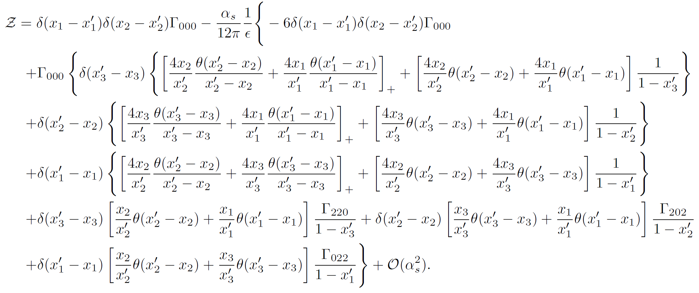
Renormalization Factor

Slide 16
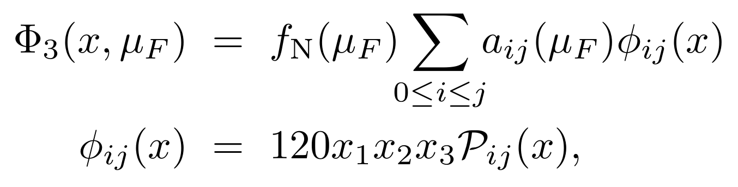
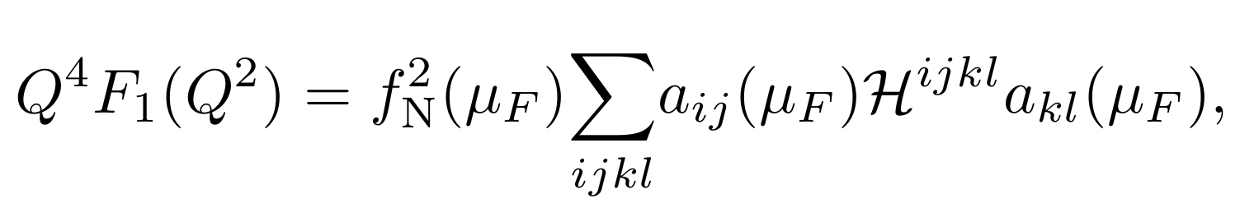
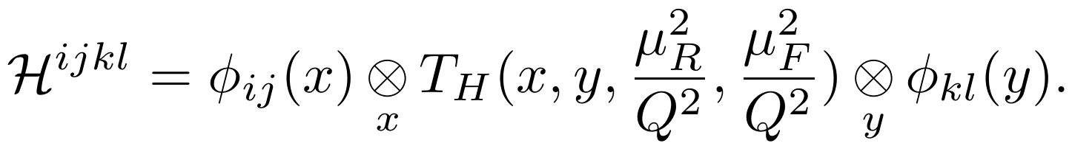
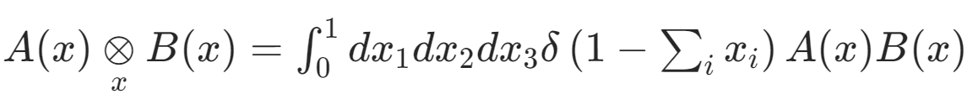
Convolution:
Distribution Amplitudes(DA)
Expressed in terms of GPLs.

Slide 17
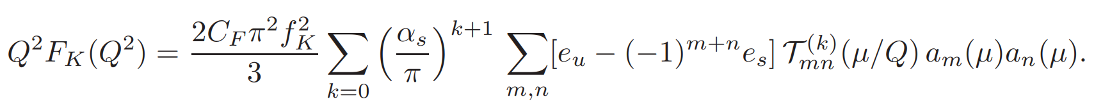
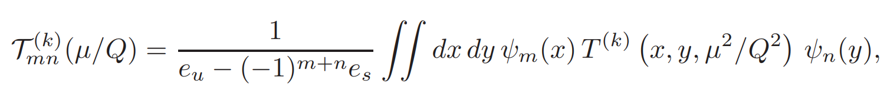
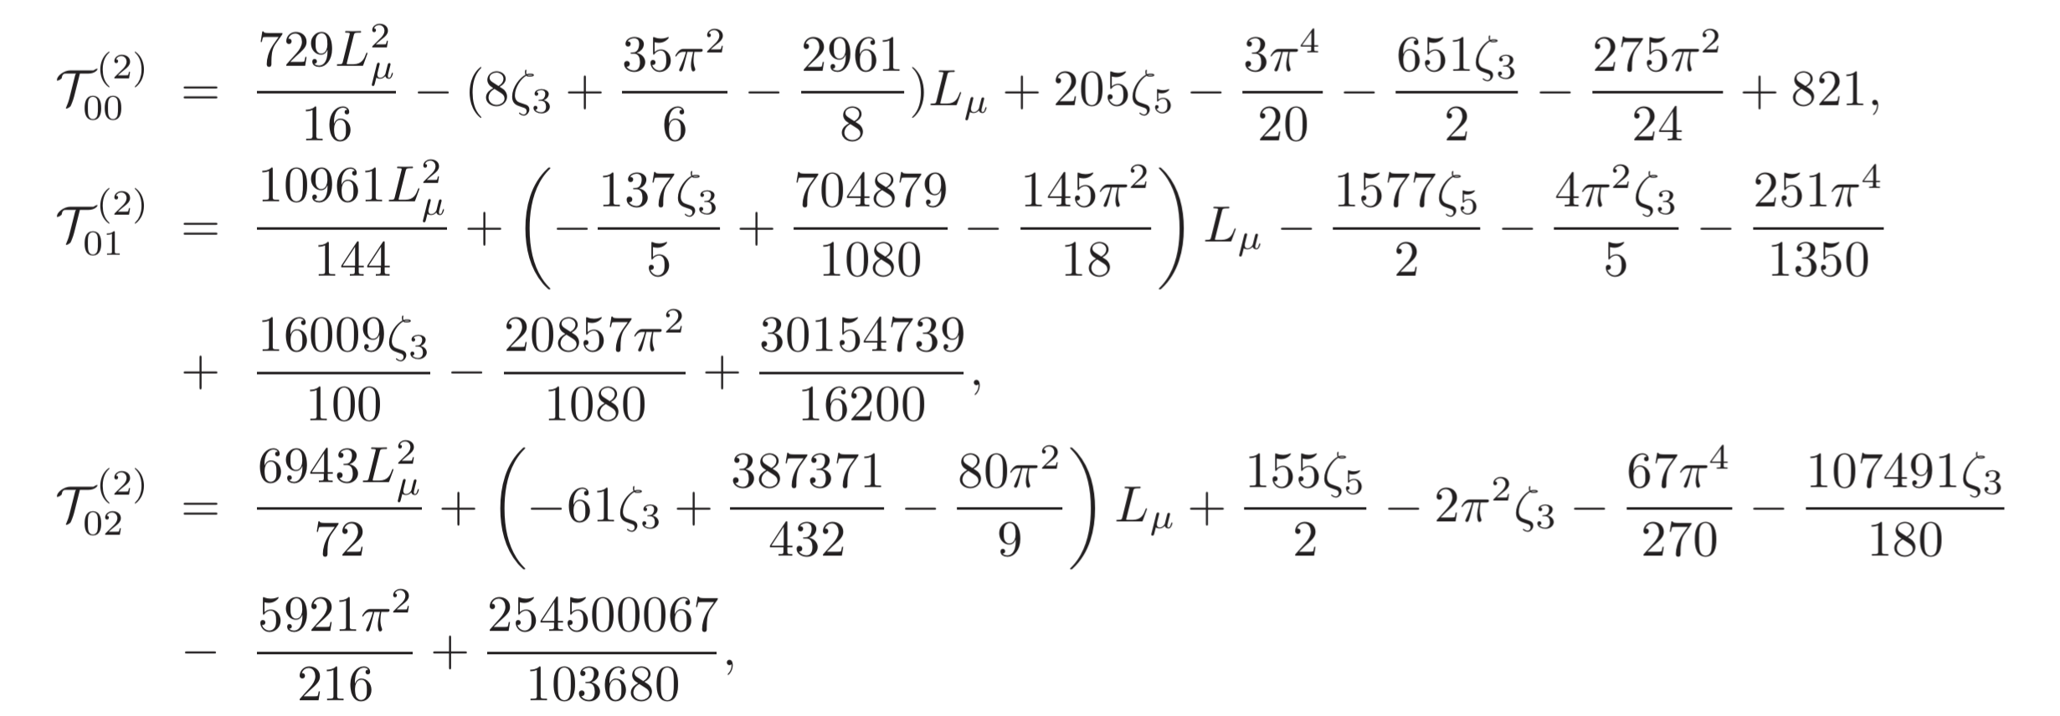
Kaon FFs
The short distance coefficients:

Slide 18
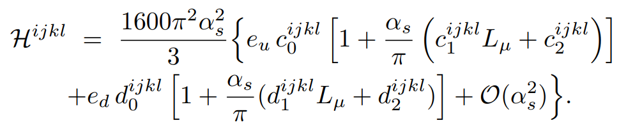
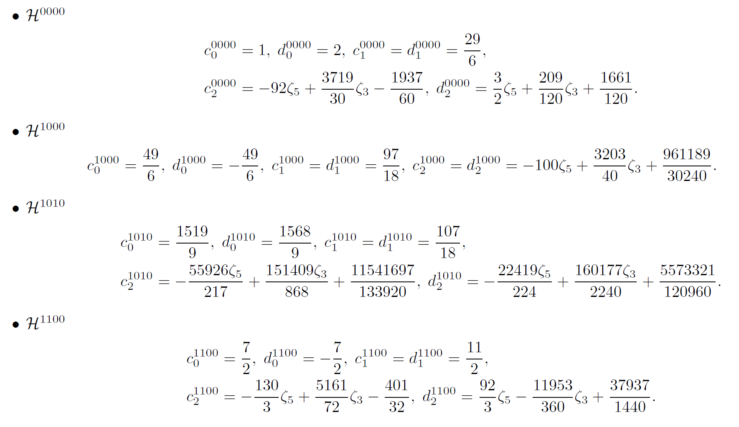
Short-distance coefficients
Only Zeta function and rational number appear.
Validated numerically by Cubature

Slide 19
Phenomenological Exploration

Slide 20
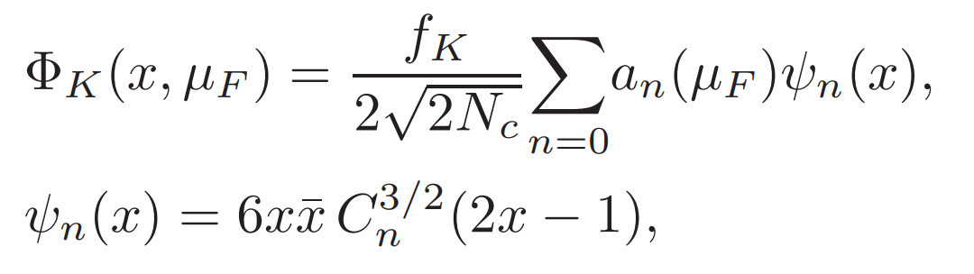
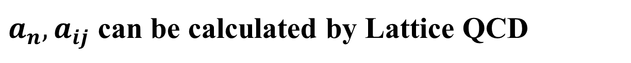
Leading-twist LCDA
Kaon
Twist-2
Nucleon
Twist-3
$a_{n},a_{ij}$ can be calculated by Lattice QCD

Slide 21
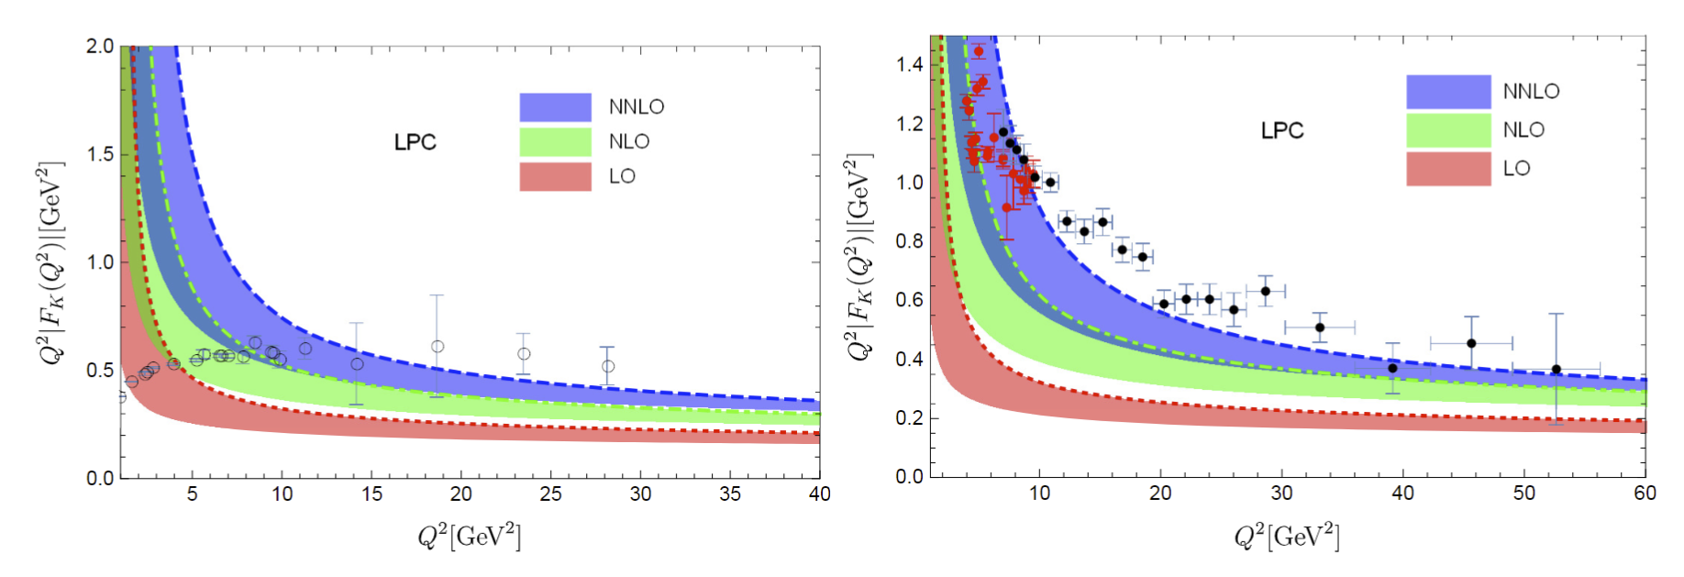
Charge Kaon FFs
Space like FFs, data taken form
Ding et.al. Phys. Rev. Lett. 18, 181902 (2024)
Time like FFs, data taken from BESIII and BarBar

Slide 22
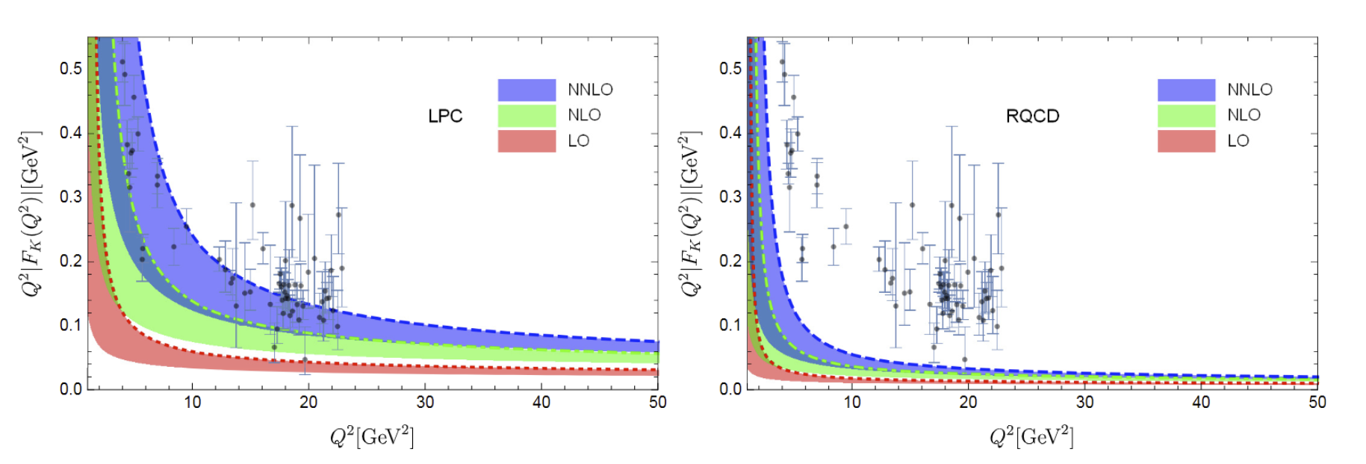
Neutral Kaon FFs
Time like FFs for neutral Kaon,
data take from BESIII[Phys. Rev. Lett. 132,131901 (2024)]

Slide 23
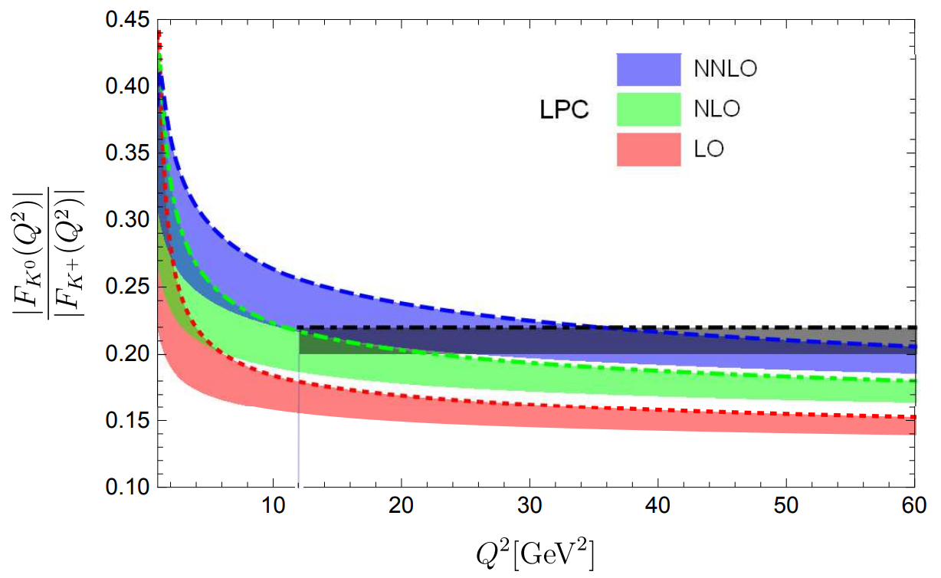
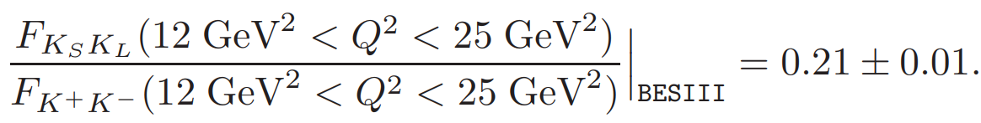
SU(3) Flavor Breaking Effects
Kaon FFs
Data take from BESIII [Phys. Rev. Lett. 132,131901 (2024)]

Slide 24
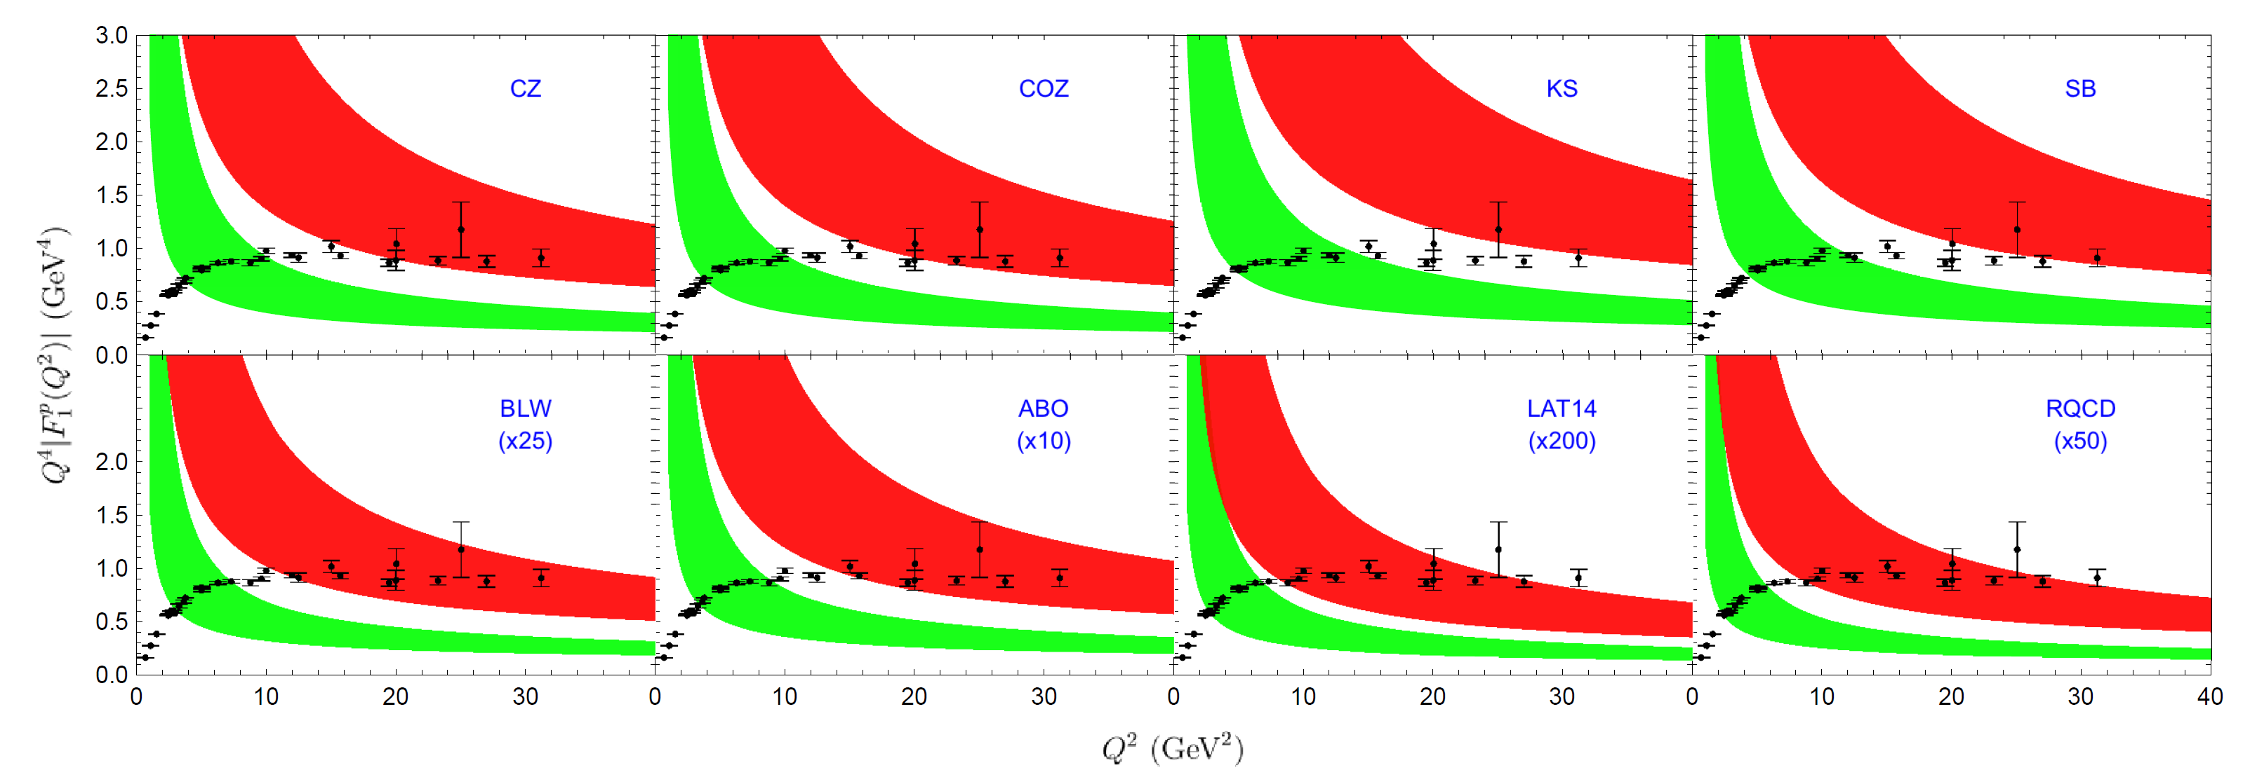
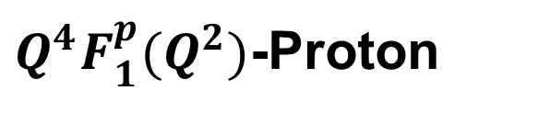
Space like FFs
$Q^{4}F_{1}^{p}(Q^{2})$-Proton

Slide 25
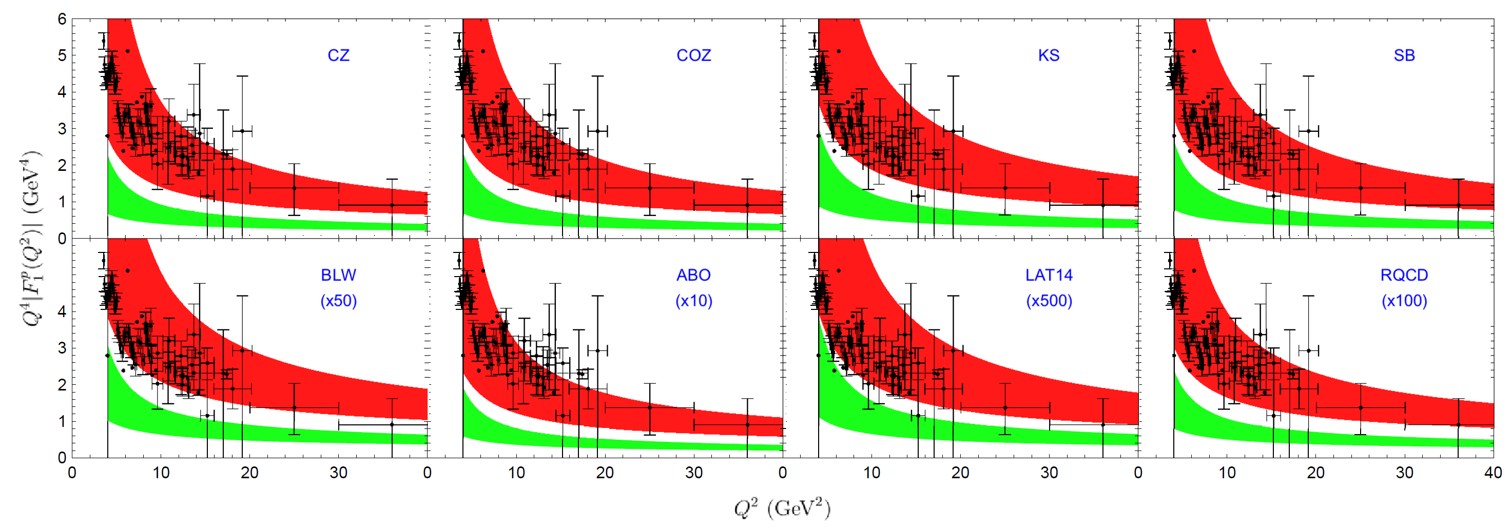
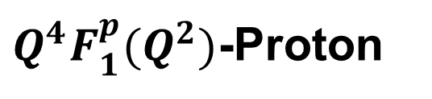
$Q^{4}F_{1}^{p}(Q^{2})$-Proton
Time like FFs

Slide 26
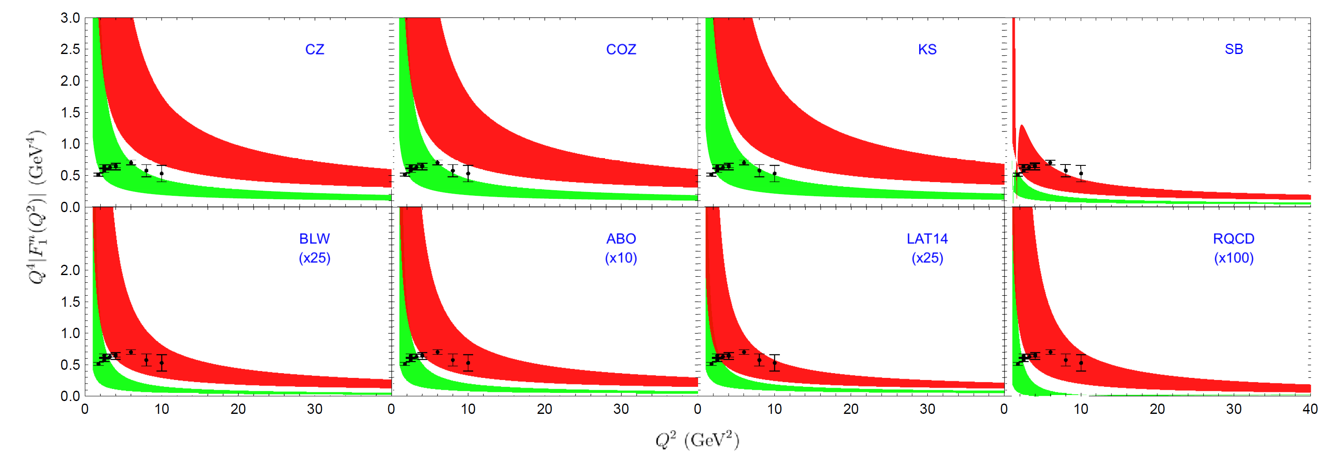
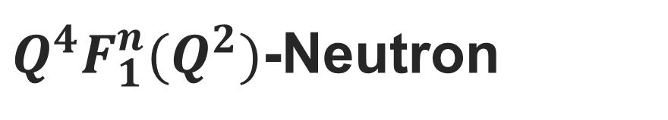
$Q^{4}F_{1}^{n}(Q^{2})$-Neutron
Space like FFs

Slide 27


$Q^{4}F_{1}^{n}(Q^{2})$-Neutron
Time like FFs

Slide 28
Conclusion
The EM form factors for kaon have been calculated up to NNLO QCD corrections.
The EM form factors for baryon have been calculated up to NLO QCD corrections after 50 years.
The matching kernel have been obtained analytically.
The QCD corrections turn out to be positive and significant.
Extend to more exclusive processes…
Combined with PMC [ Rep. Prog. Phys. 78 (2015) 126201] …
陈龙斌

Slide 29
Thanks！
陈龙斌

Slide 30

Relate to Experimental mesurement

