Slide 1
Can sub-GeV dark matter coherently scatter on the electrons in the atom?
Wenyu Wang
Beijing University of Technology
2026.01 @ GuangZhou

Slide 2

超对称场论基础
超对称背景
超对称代数
超场
超对称拉氏量
超对称破缺
超对称粒子物理唯象
最小超对称标准模型
超对称破缺机制
重整化群和质量谱
超对称希格斯粒子唯象
超对称对撞机唯象
超对称暗物质
超出最小超对称标准模型

Slide 3
CONTENT
Detection of WIMP
Sub-GeV Dark matter
Coherently scattering on the electrons in the atom
Conclusion

Slide 4
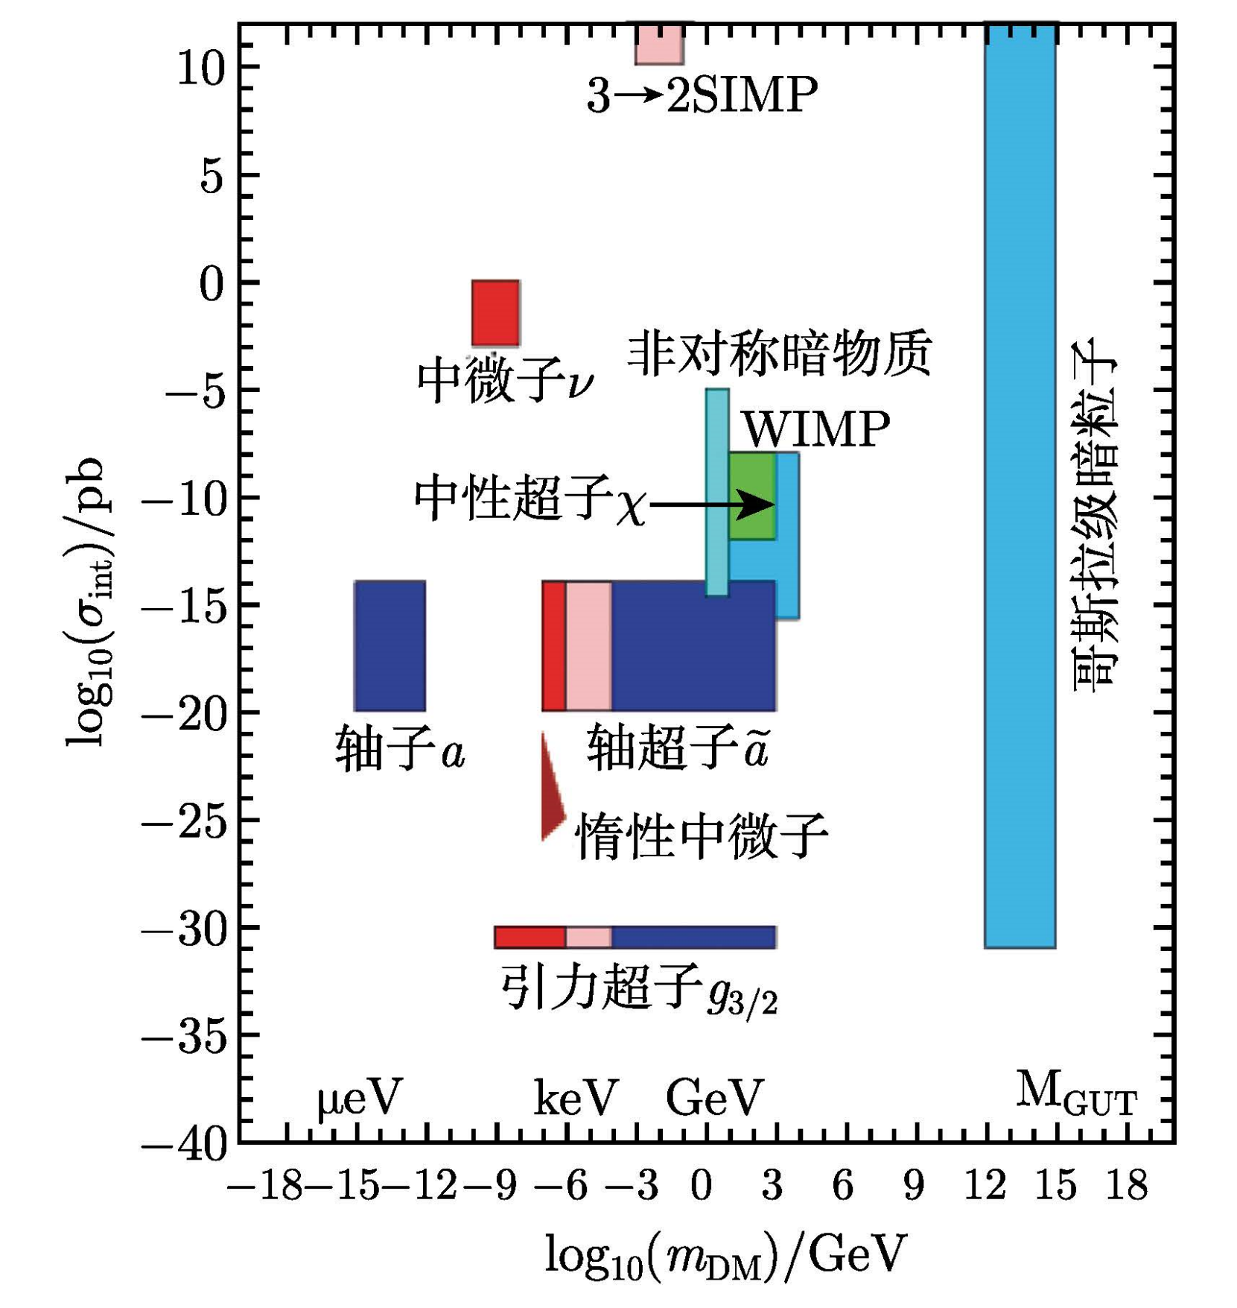

Slide 5
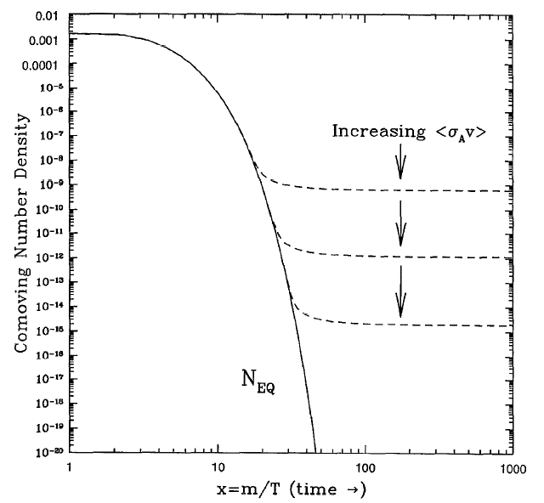
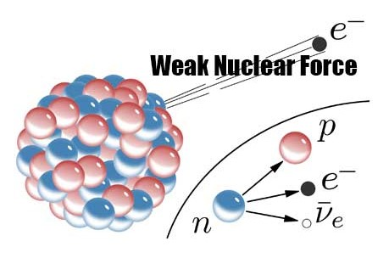
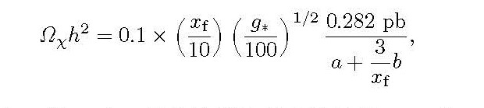

Slide 6
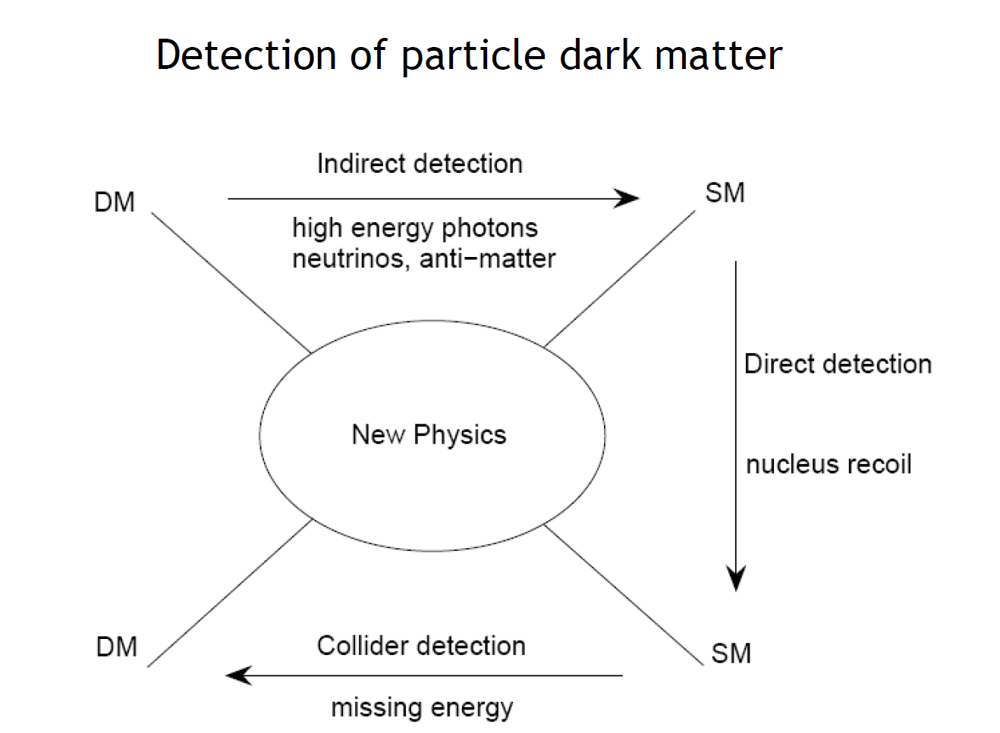

Slide 7
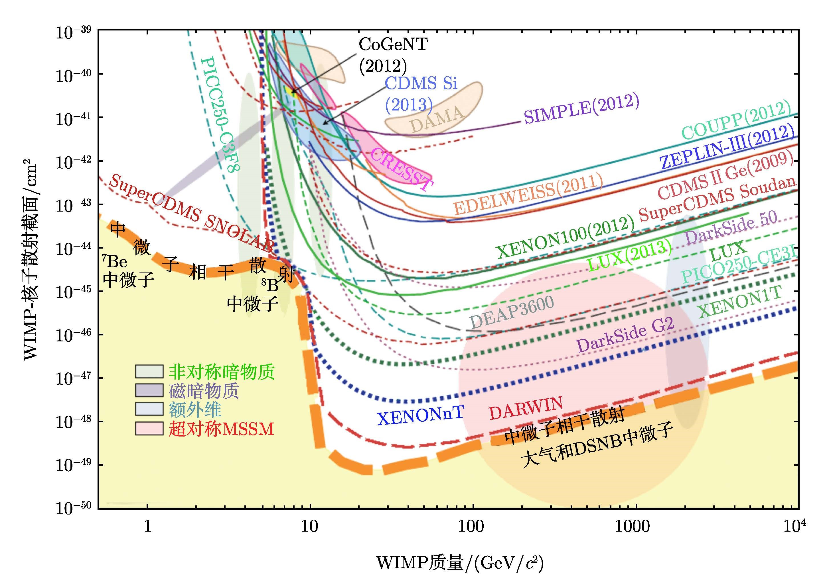
？
！

Slide 8
——某人的报告透明片

Slide 9
关注轻暗物质探测

Slide 10
From PANDAX group Phys. Rev. Lett. 121. 021304

Slide 11
The signal of sub-GeV dark matter in WIMP detections
Other signal
1. Scattering on electrons
2. Migdal effect
3. Bremsstrahlung
Exotic source
1. Cosmic Rays boosted dark matter
2. Atmospheric dark matter
3. Annihilation， decay ……

Slide 12


Recoil of electron

Slide 14


1. The quanta of recoil energy obey binomial distribution
2. The quanta are divided in to ionization and stimulation
3. Ionization quanta are divided in to electron and photon
4. The ionized electron change into photon by gaussian distribution when they drift to S2

Slide 15
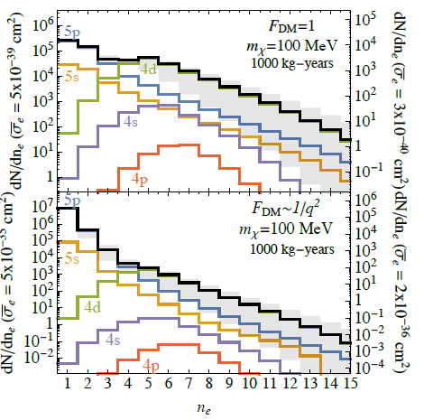
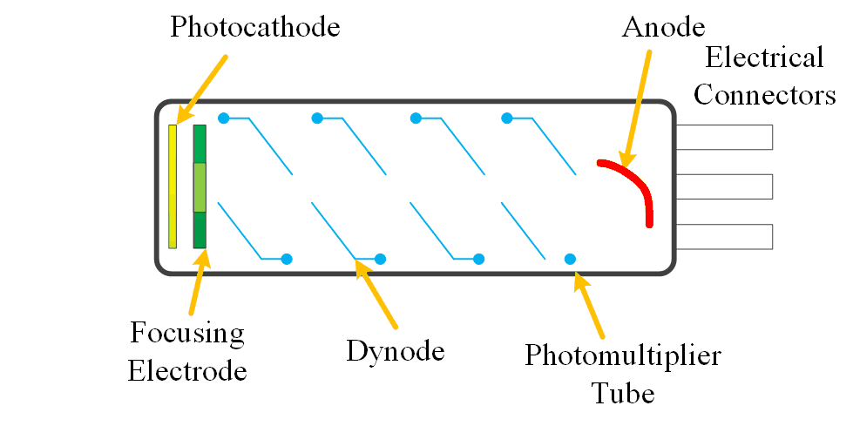
电离电子到光电子
From R. Essig … Phys. Rev. D 96. 043017

Slide 16
Constraints on dark matter mass and cross section from the recoil of electron
From R. Essig … Phys. Rev. D 96. 043017

Slide 17


Migdal效应（核反冲导致的原子反冲）

Slide 18
Migdal效应的限制结果

Slide 19
韧致辐射

Slide 20
From G. Cortona, JHEP 11 (2020) 034

Slide 21
Coherent scattering of electron

Slide 22
Coherent scattering of electron

Slide 23
Coherent scattering of electron
Electron cloud are boosted (coherent scattering) by the dark matter, then dragged back by the static nuclei.

Slide 24
Detect matter structure by XRD
XRD at large angle
XRD at small angle

Slide 25
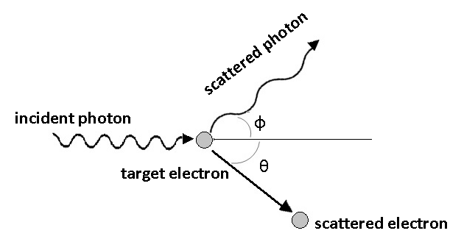
The form factor in small angle scattering
Non-coherent scattering (Campton scattering)
Coherent scattering
Effective charge distribution in an atom

Slide 26
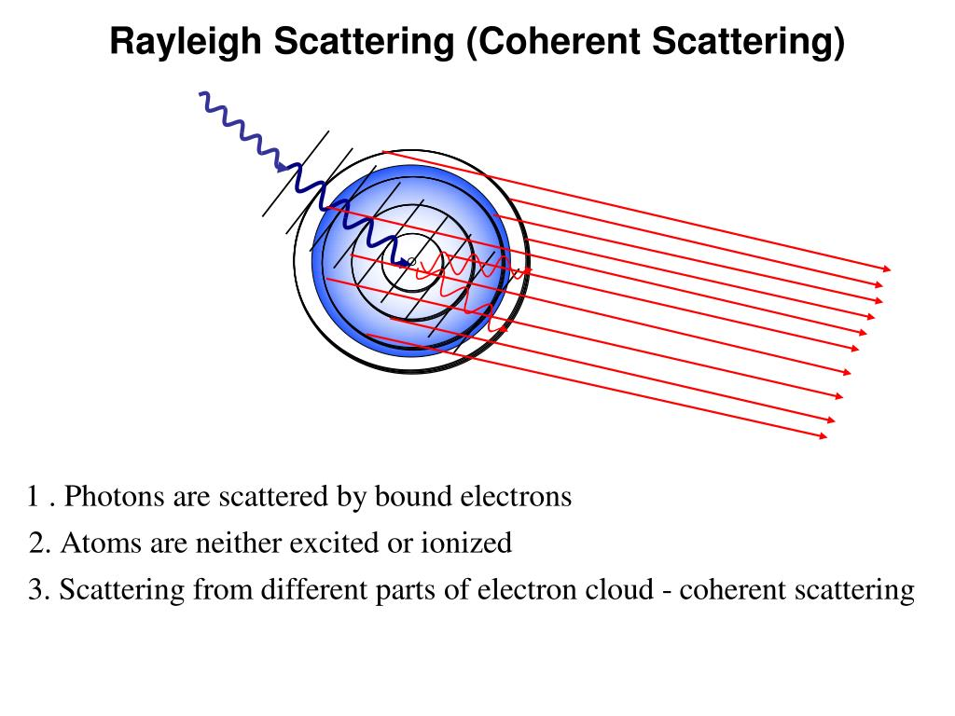

Slide 27
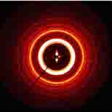
Forward scattering can measure the charge distribution exactly

Slide 28
The coherent scattering implies that all the electrons in the target atom contribute to the scattering, The cross setion has a Z² enhancement. Usually this effect is considered as suppressed by the spatial charge distribution. It become pronounced only when the transfer momemtum are comparable to the inverse of atom size.

Slide 29
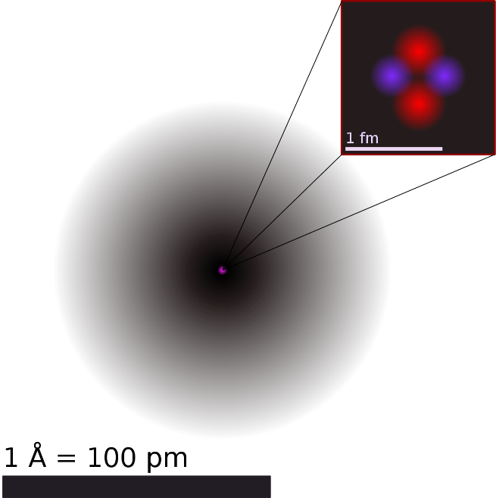
General model
X

Slide 30
Peculiar results of the RHF

Slide 31
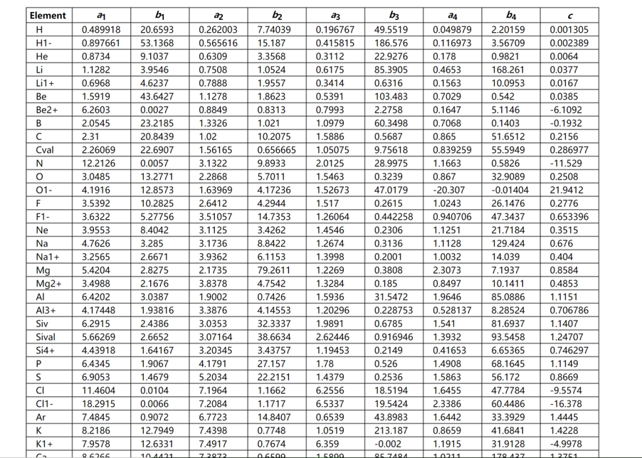
RHF结果

Slide 32
Effective charge distribution
RHF form factor implies the electric charge is always located near the nuclei, which is not conflict with the measured radius of a atom

Slide 33
Coherent scattering
Single particle
Many particle
Interference
Interference are determined by the aggregation of the target particles

Slide 34
RHF form factor implies that effective charge locates in the center of the atom, near the nuclei, which does not conflict with the measured radius.
The electron cloud can be considered as a “compact ball” which causes interference effect
The scattering time scale is about 1000 times fo XRD, thus impulse approximation can be applied when the mediator is heavy enough

Slide 35
Cross section
Kinetics
Dynamics
Event rate

Slide 37
Ionization decreases to zero along with the transfer momentum quickly
The decrease of Migdal effect is not so quickly
Ionization factor from electron cloud recoil is much bigger than the other two effects. This is because of coherent effect. Note that there is a upper limit of the integral

Slide 38
The exclusion line is much lower than the single electron scattering, especially in the sub-GeV region

Slide 40
CONCLUSION
WIMP is very difficult now
Sub-GeV dark matter is sensitive to the recoil of electron
Lots of the electron recoil needs further studies
The ionization happens in the process that the recoiled electron cloud are dragged back, not direct ionization

Slide 41
THANKS！

