Slide 1
Determine the property of wave dark matter from astronomical observations
毕效军
中国科学院高能物理研究所
第十届海峡两岸粒子物理和宇宙学研讨会
2026/1/19-23

Slide 2
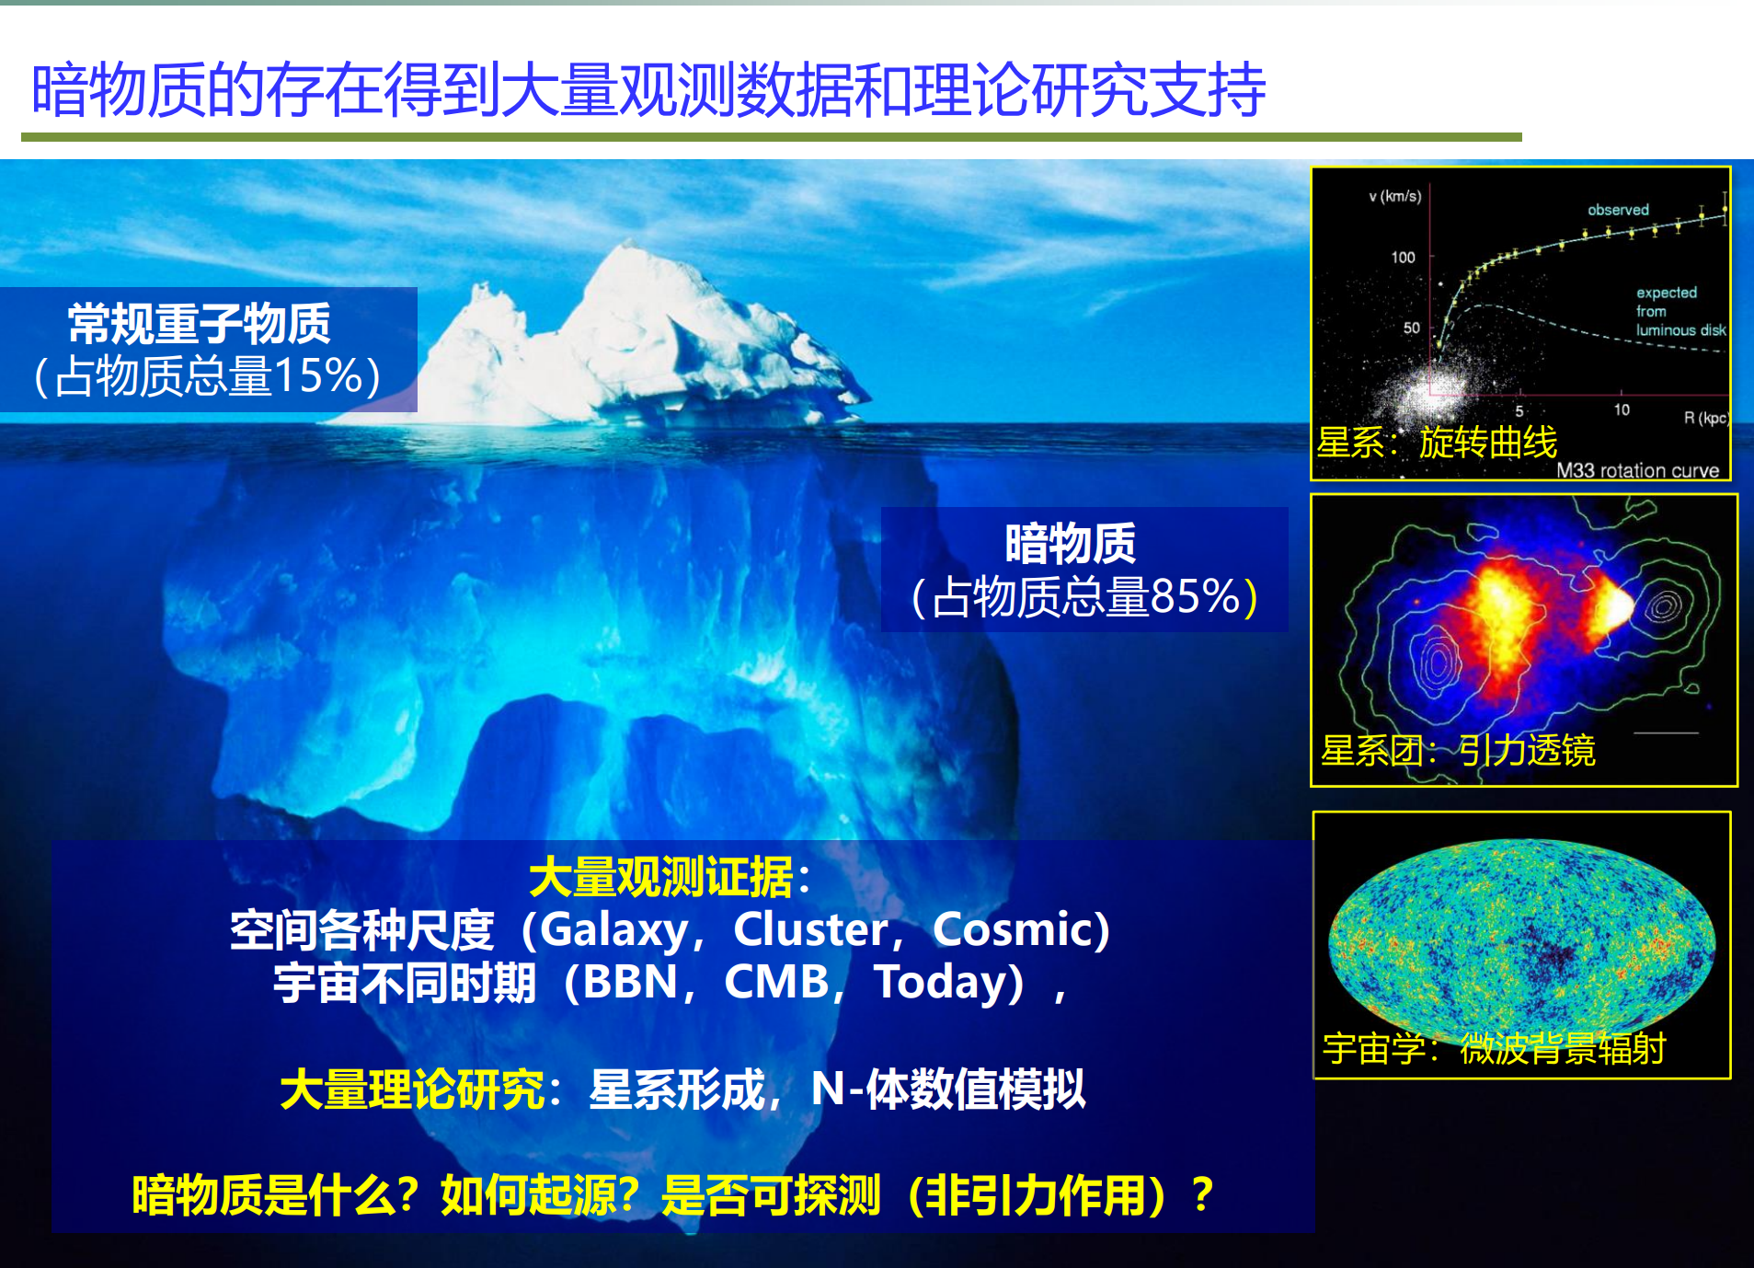
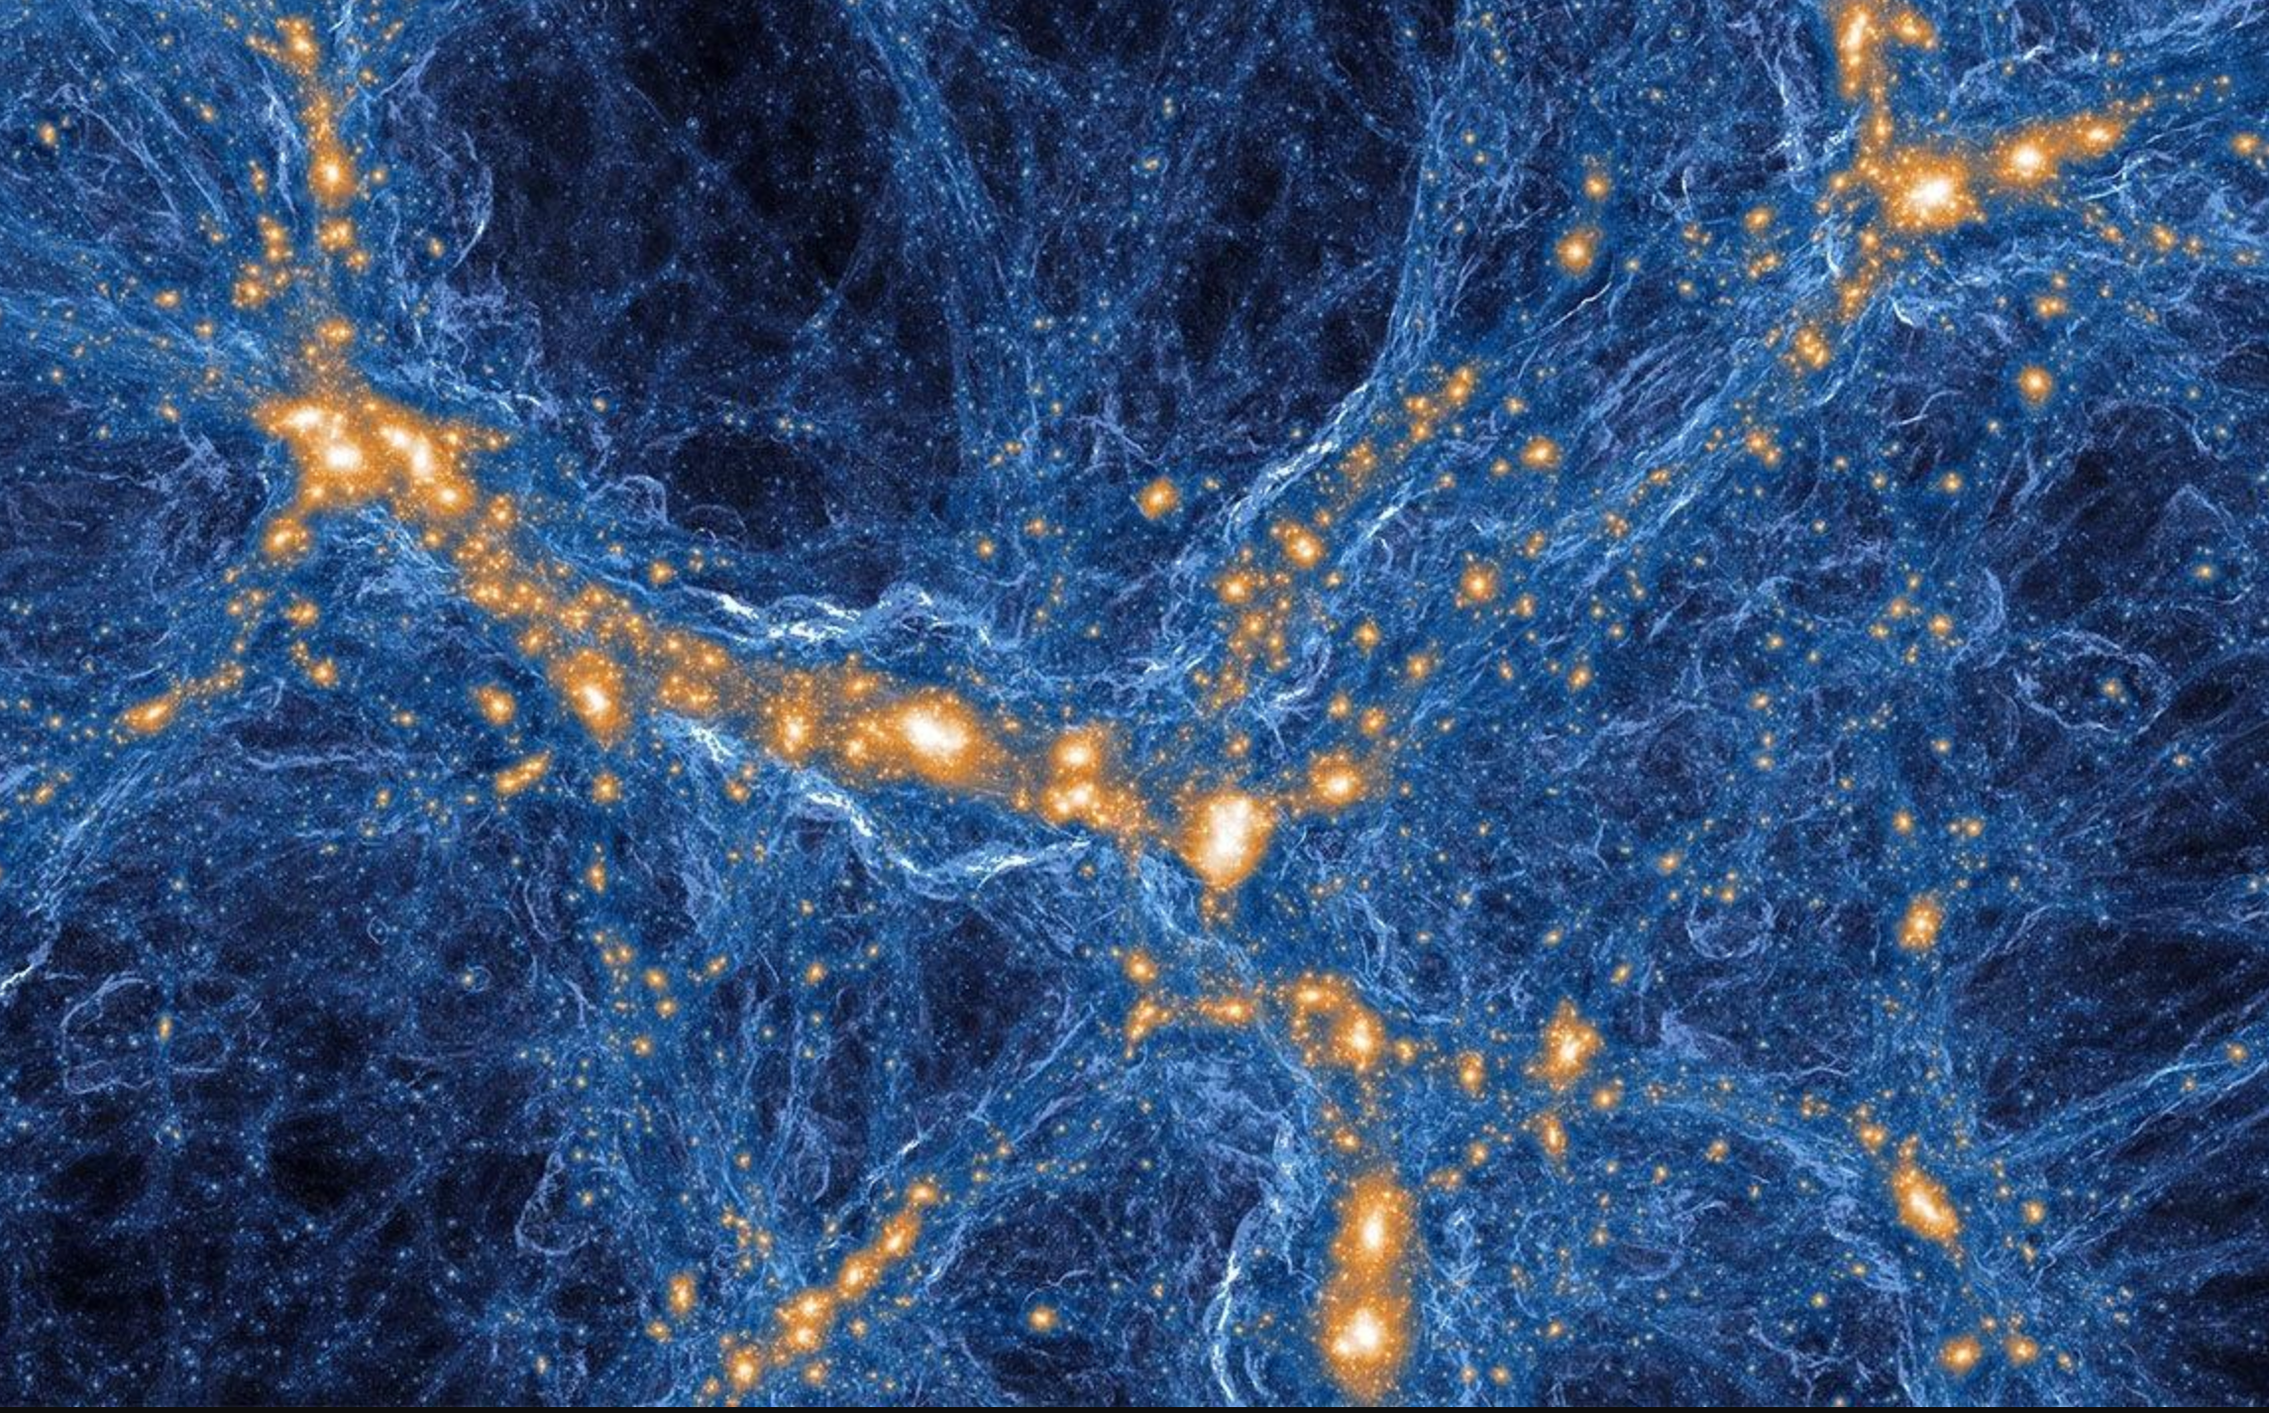
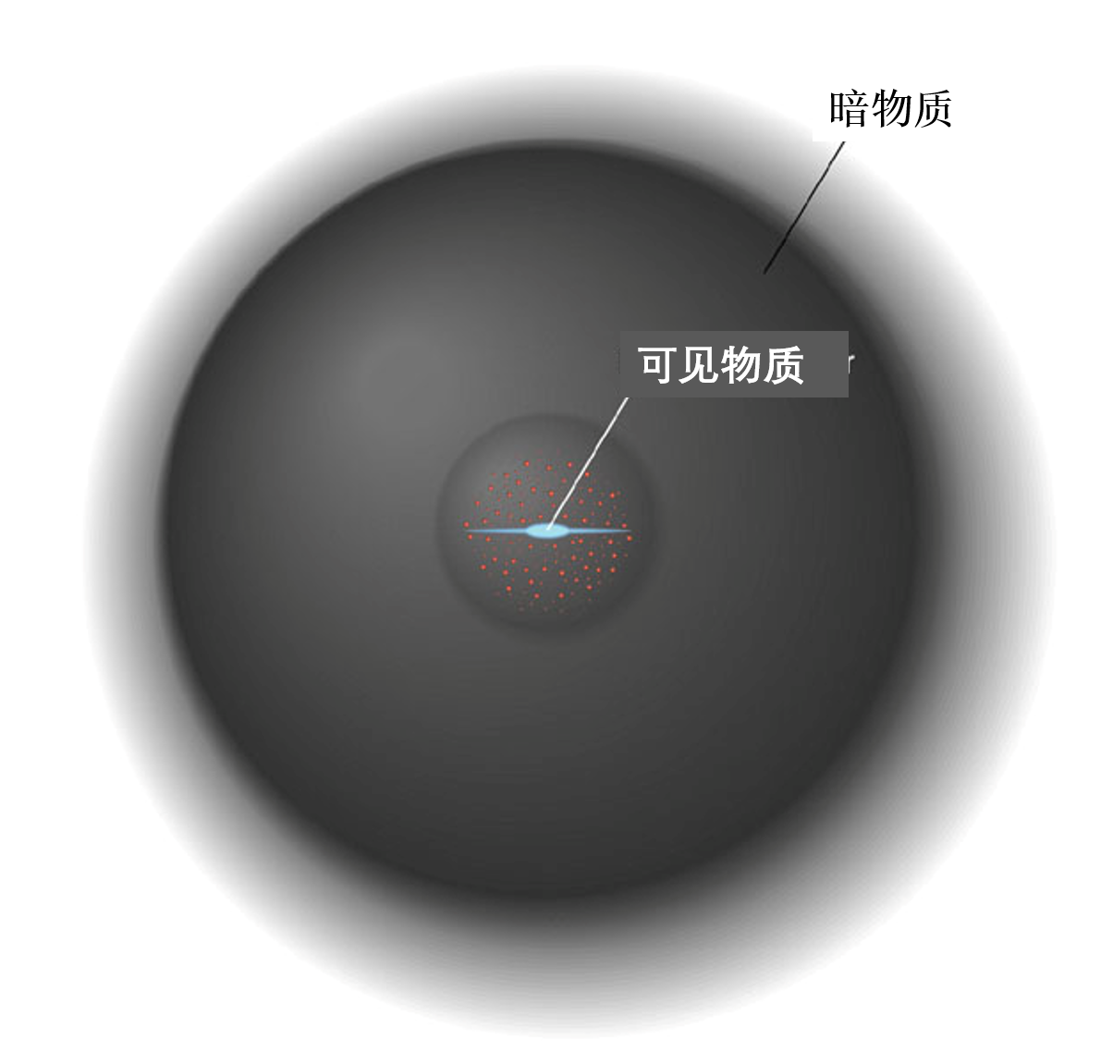

Slide 3
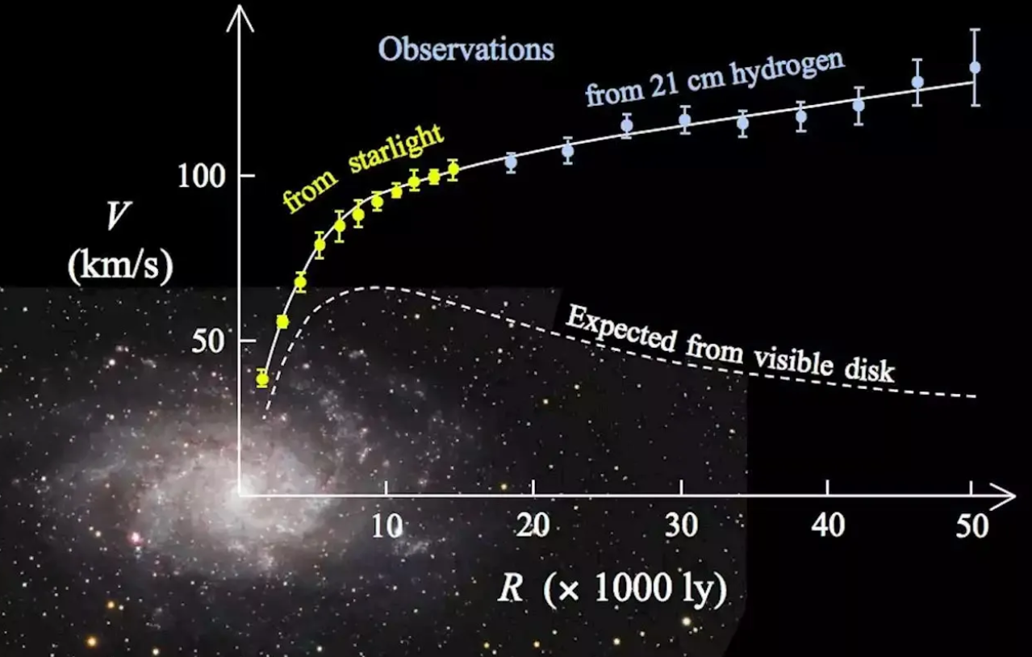
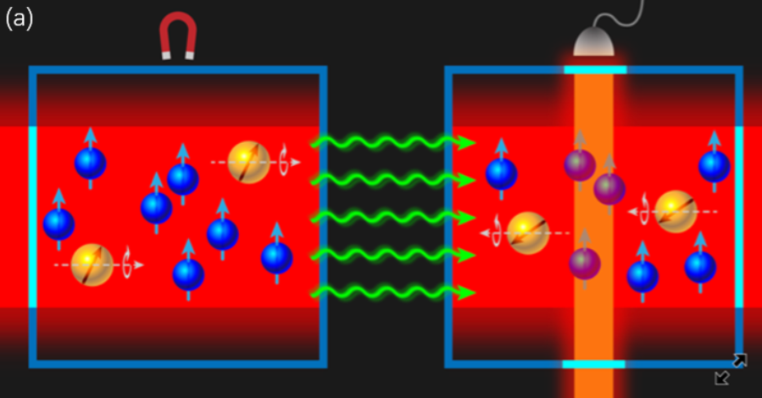
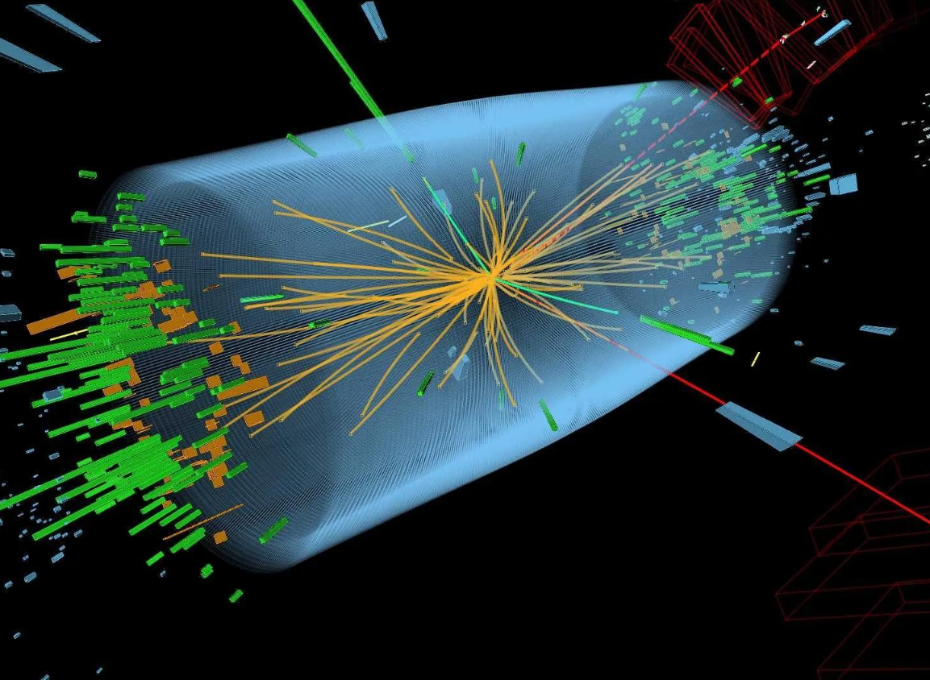
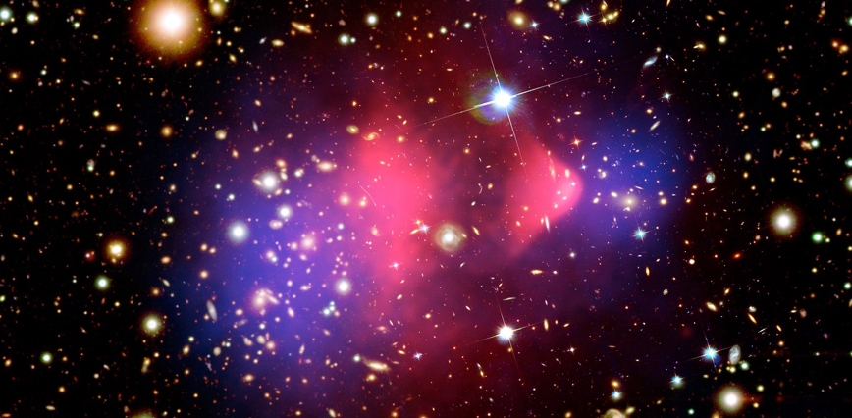
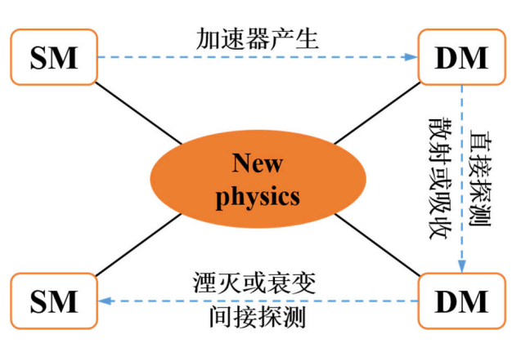
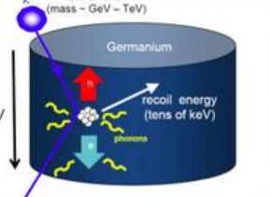
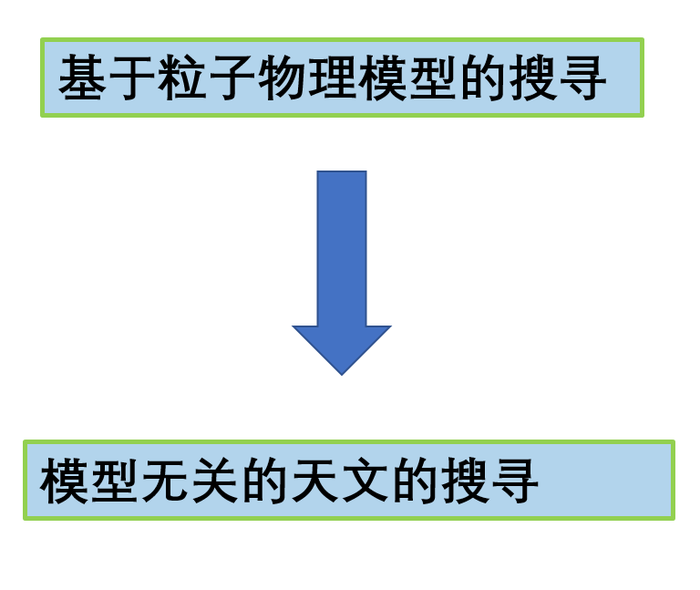
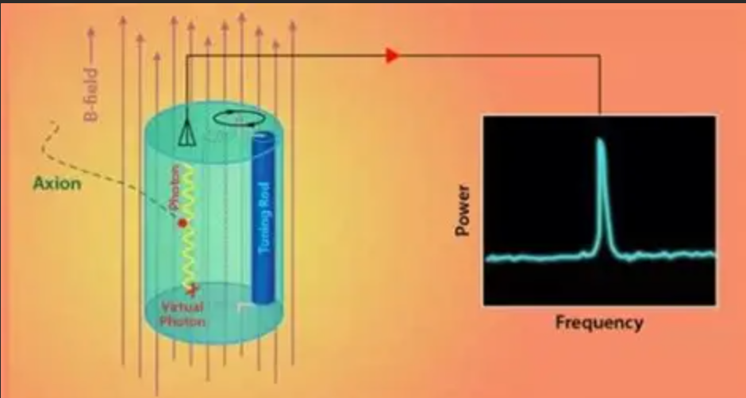
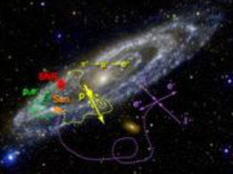
Methods to detect dark matter
Notes:
2008有AMS、Fermi，后来LHC和DD

Slide 4
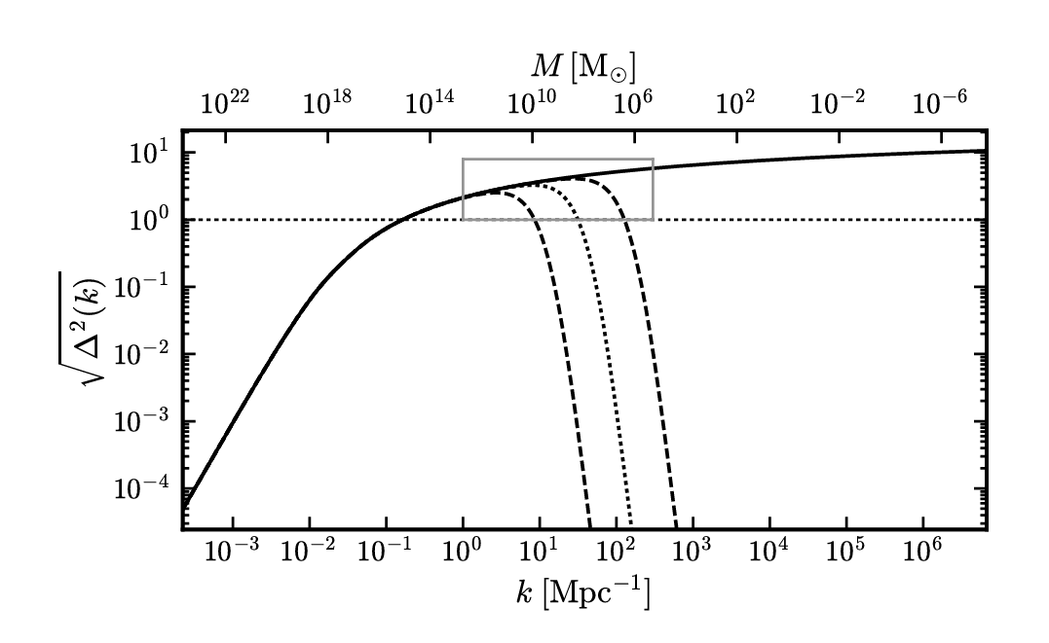
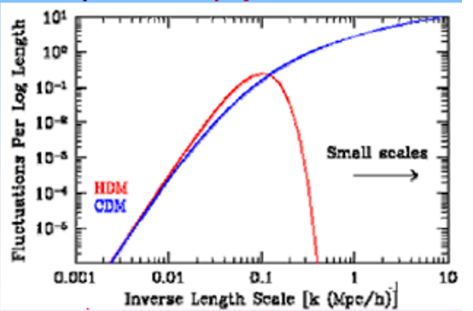
Probing properties of dark matter by astronomical observations
In ΛCDM, dark matter particles are assumed to be generated with ~0 momentum and collisionless, which means there is no interaction between DM besides gravity. DM seeds the structure formation by a nearly scale-invariant fluctuation spectrum.
If DM is different from CDM, it may affect structure at the smallest scale and different from prediction of ΛCDM. Astronomical observations to smaller scales (< 10¹⁰ M_{sun}) may set constraints on the properties of DM particles.
It is very promising because there are very powerful astronomical instruments, DESI, JWST, LSST, CSST, MUST，WFIRST，EUCLID … M ~ 10⁶ M* at ∼ 1 Mpc from the Milky Way and M31 are planed attractive targets.
numerical simulation is necessary;

Slide 5
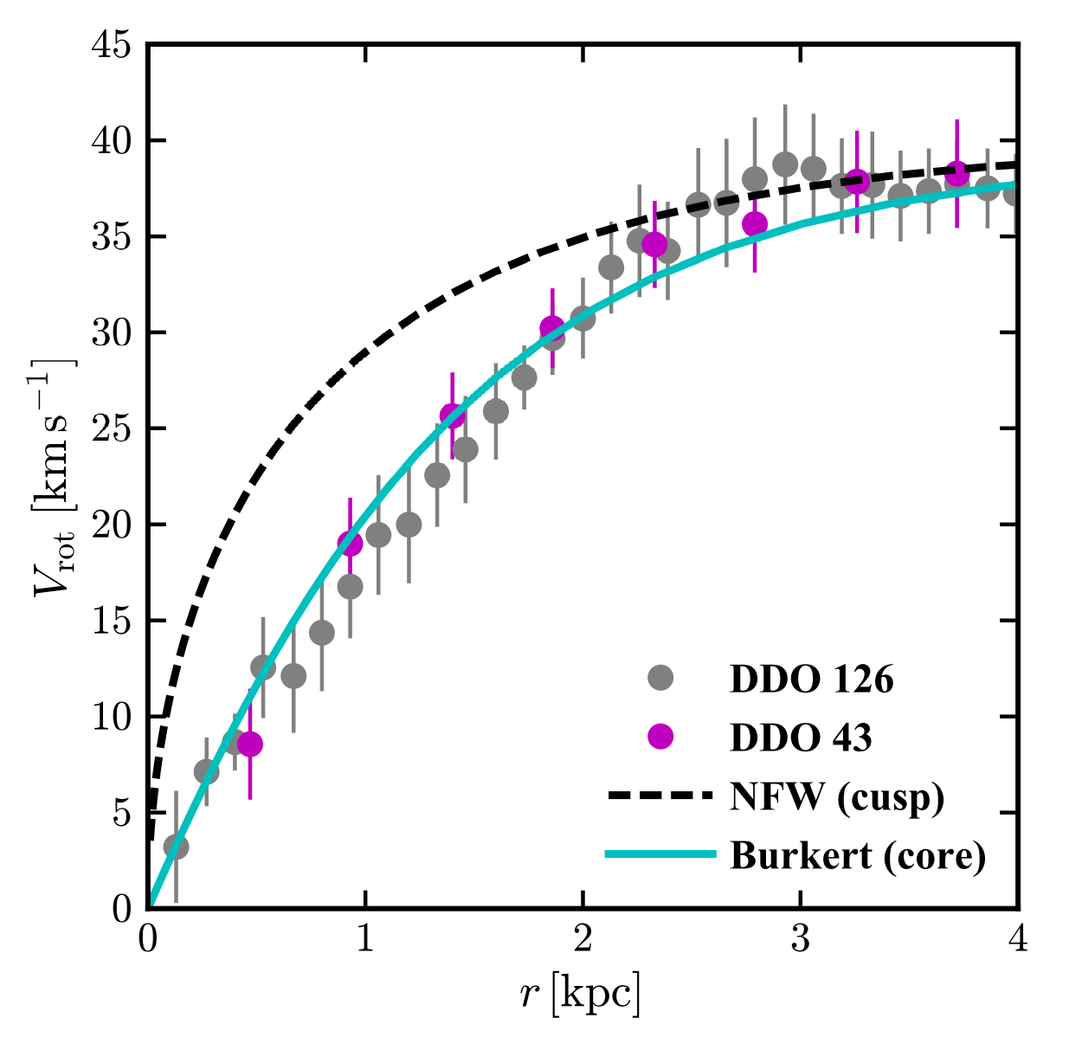
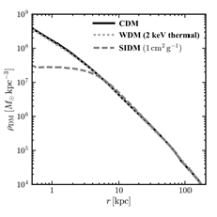
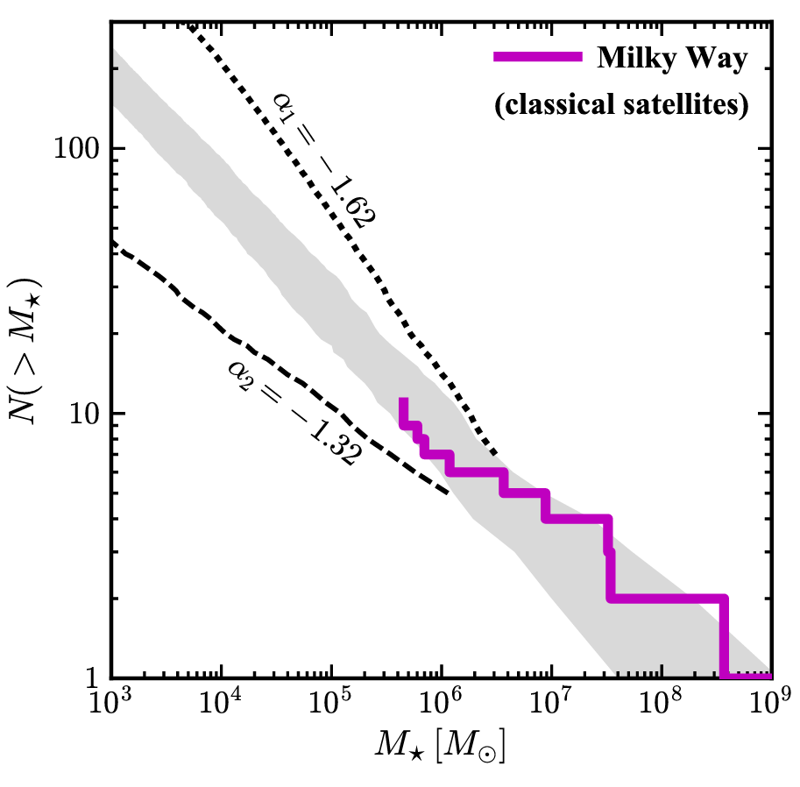
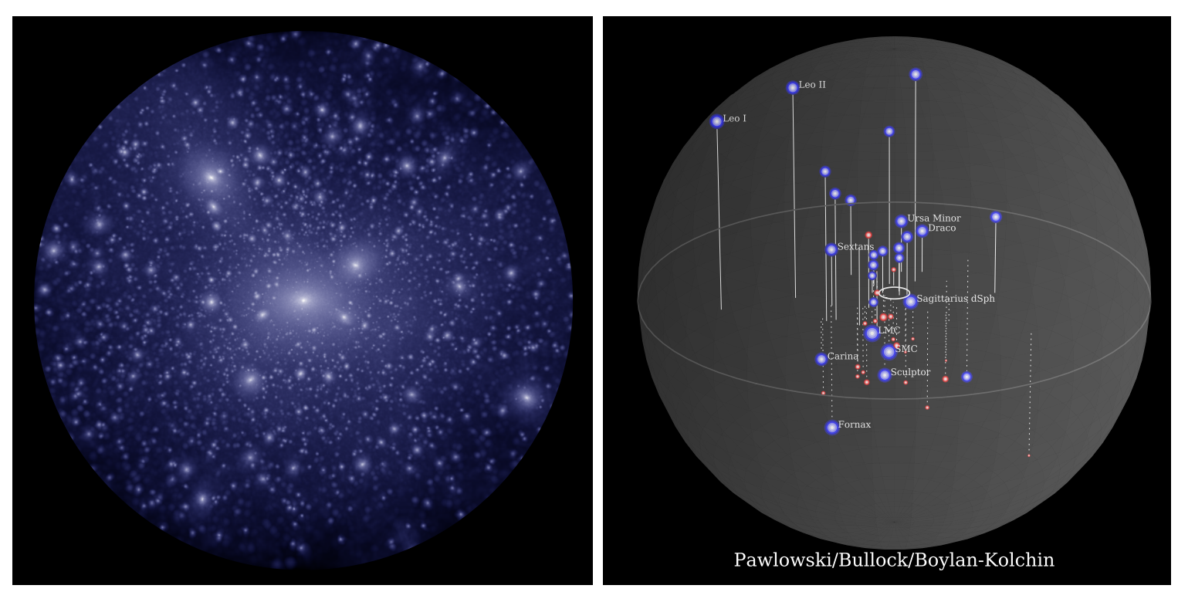
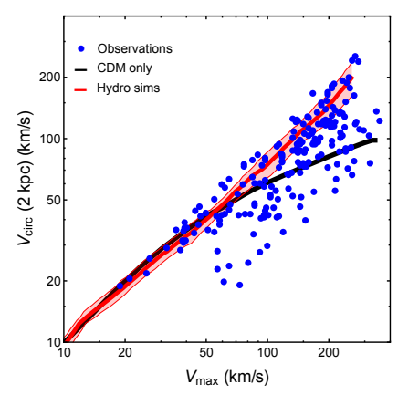
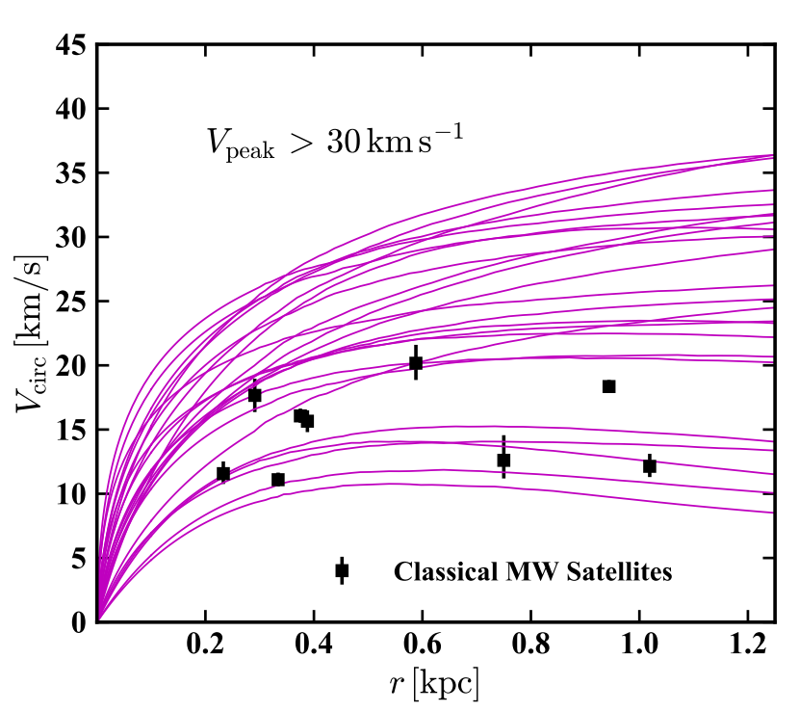
The small scale problems are possible implications on the nature of dark matter particles
1, core-cusp: The dashed line shows the ΛCDM expectation for a typical rotation curve of a Vmax ≈ 40 km s⁻¹ in dwarf galaxies. The data points show the measured rotation curves of two example galaxies of this size requiring a constant DM density core. (LITTLE THINGS survey, Oh et al. 2015)
2, missing satellites. Figure show Simulated and observed dwarf galaxies. Deep survey ‘seems’ solve the problems. (Garrison-Kimmel et al. 2017)
3, diversity problem. The observation of rotation curves shows that the rotation velocity vs maximal velocities have very large dispersion.
4, too-big-to-fail. Simulation gives rotation curves for biggest subhalos, while only smaller dwarf galaxies are observed. No dwarf corresponds to the biggest ones. this is an independent problem to the 1st one.
DM or feedback of baryons?
Notes:
暗物质动能不损失，重子物质会损失动能，集中在核心部位，往往密度大于暗物质，怎么分布受重子物质主导

Slide 6
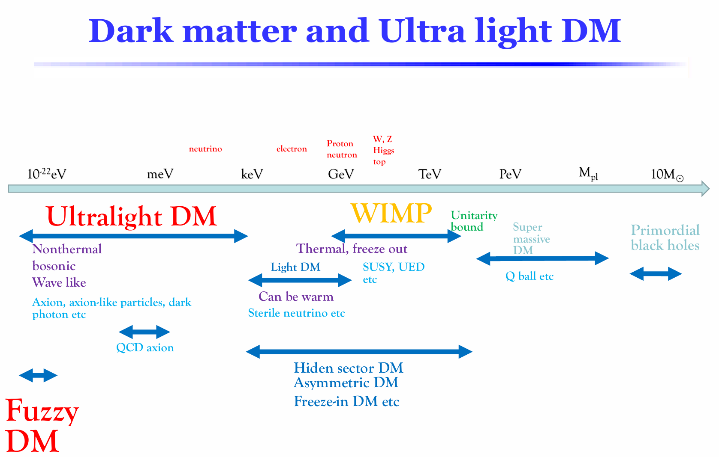

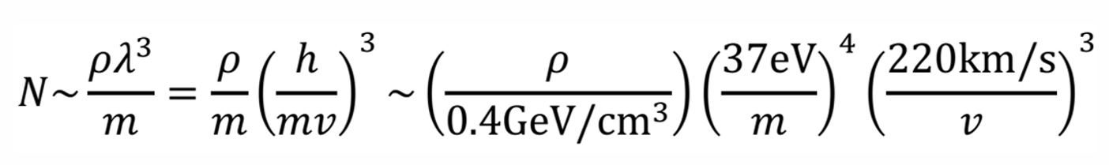
warm WIMP
de Broglie wavelength
nonthermal
Self-interaction
waves, N>>1

Slide 7
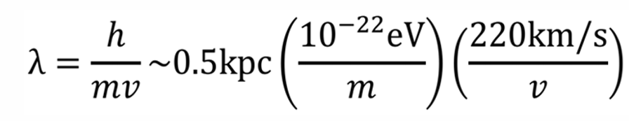
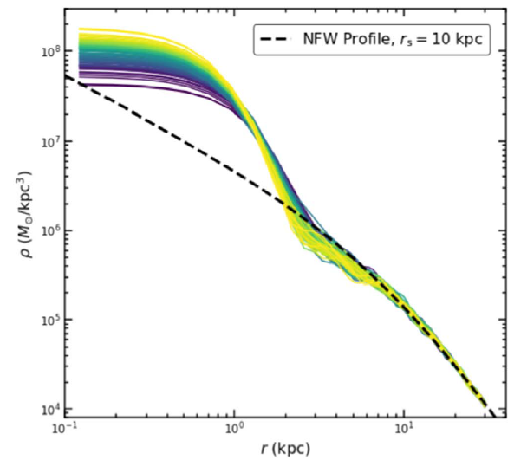
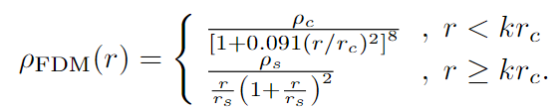
Properties of Fuzzy DM: small scale suppression
FDM does not change the structure at large scales and while at scales comparable to its wave length the structure is suppressed.
The structure suppression within the wave length solves the cusp-core problem.
The FDM halo is characterized by a profile with a soliton core and an NFW envelope. There is a stationary state of FDM with minimal energy, referred to as soliton;
Core-cusp problem

Slide 8
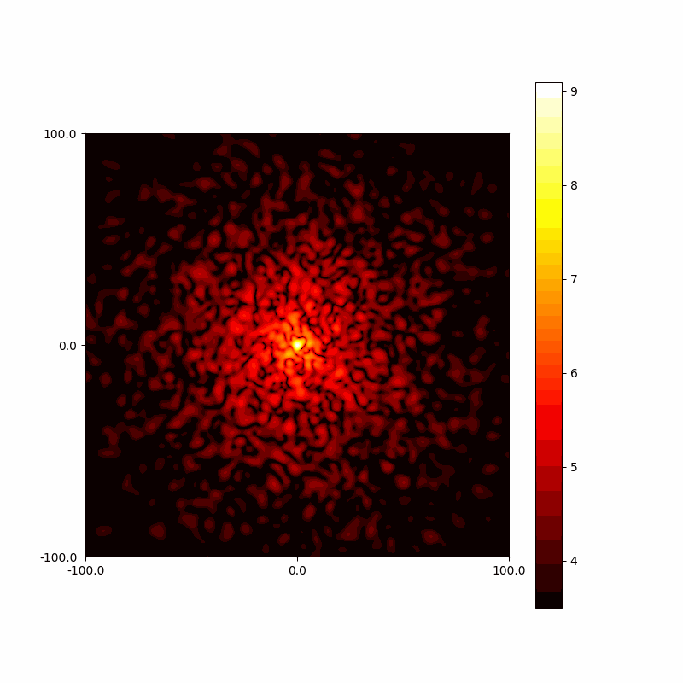
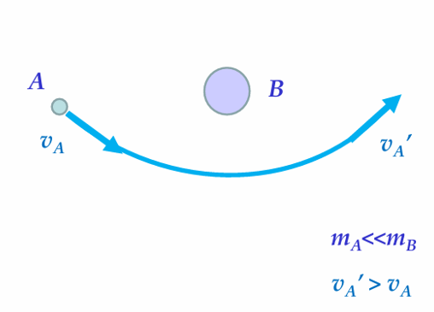
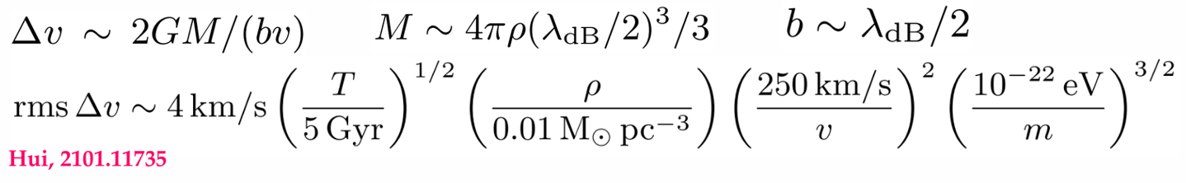
Properties of Fuzzy DM: interference of waves
granules evolution
Interference between the waves results in many interesting effects.
These dynamical evolutions lead to fluctuations of the gravitational field, which inject energy into the stars residing in it, leading their velocities to increase and their spatial distribution to become more diffuse over time.
This effect is referred as the dynamical heating.
Yang, XJB, Yin, Phys.Rev.D 111 (2025) 6, 063013
Gravitational Slingshot

Slide 9
To determine the general properties of DM
Astronomical observations can constrain the general properties of DM in a model-independent way. This is complementary to the model based researches.
Try to study the systems which have minimal degeneracy between DM properties and baryon activities, such the ultra faint (diffuse) dwarf galaxies.
self-interaction beyond gravity? Not collisionless
Properties: wave-like or particle-like. Wave-like has long wave length, interference of waves.
Method: numerical simulation is necessary;

Slide 10
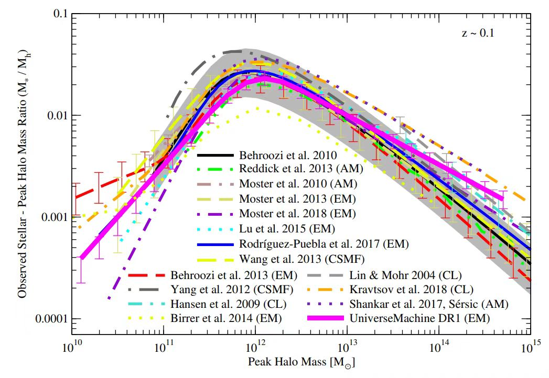
Ultra diffuse(faint) galaxies
Ultra faint, UDG
UDG (ultra-diffuse galaxies)
  Very dark （𝜇 > 24 mag/arcsec²）
  Stars are very diffuse（ 𝑅_{eff}>1.5 kpc）
Usually DM dominated
  Two extreme DM deficit galaxies DF2、DF4
  Many globular clusters
Observations
  Imaging: Dragonfly, SDSS, HST, Gemini…
  Spectroscopy of objects in DF2: W. M. Keck Observatory

Slide 11
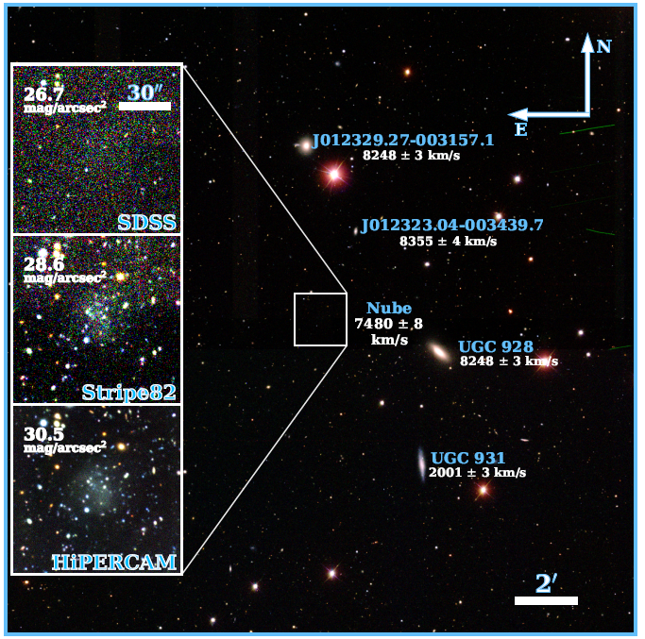




恒星分布异常的一个矮星系——Nube
A&A 681, A15 (2024)
*almost dark galaxy: Nube
距离：
恒星总质量：
有效半径：
动力学质量：
年龄：
位置孤立：没有受到潮汐力的迹象，和最有可能的host halo UGC929 距离是435kpc

Slide 12
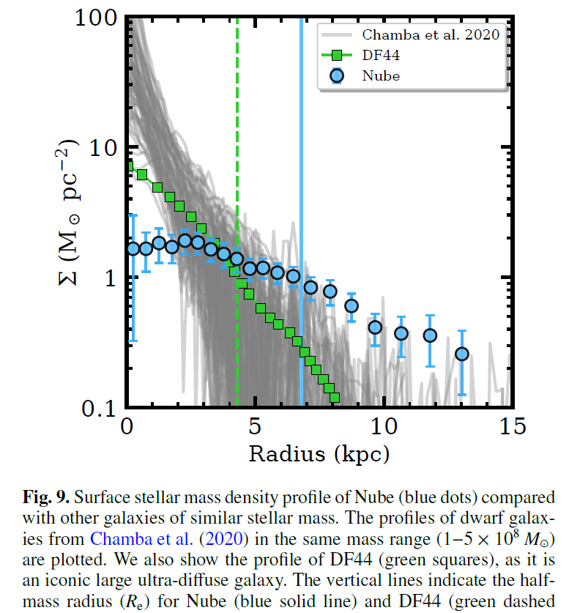
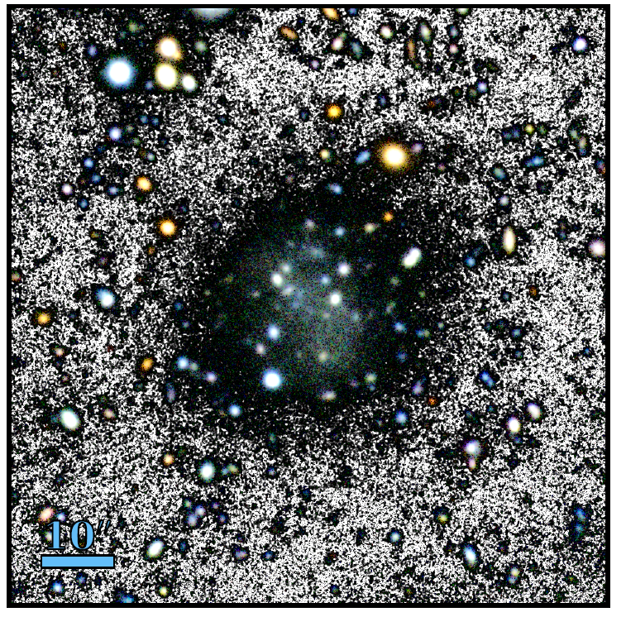
*anomalous star distribution：low central brightness，large R_e，exceeding UDGs(R_e~1.5-5kpc)
Generated by dynamical heating of FDM

Slide 13
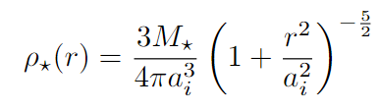








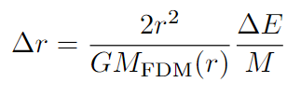
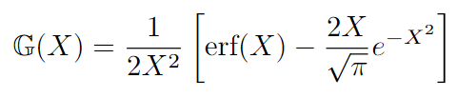



Analytical treatment of heating
initial star distribution：Plummer
Ben Bar-Or et al 2019 ApJ 871 28
Total mass：
Initial half-light radius: a_i as 1kpc （a_i at 0.5-1.5kpc has similar results）
*star distribution is heated by FDM and described by diffusion
A random walk in the energy space leads to larger energy dispersion

Slide 14
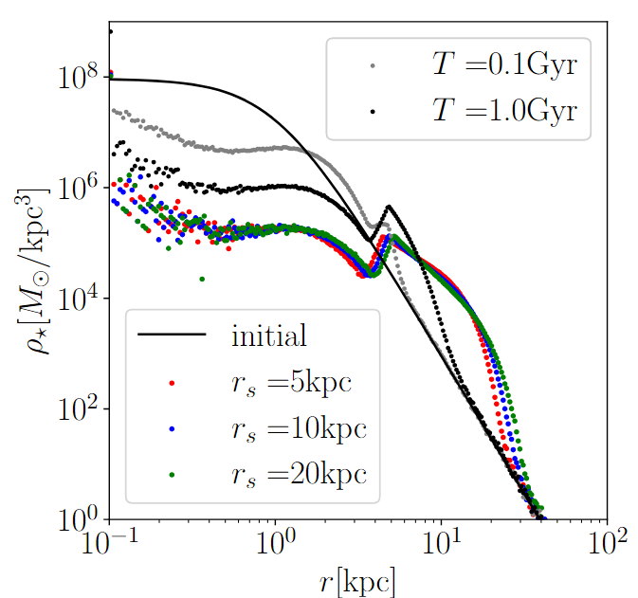
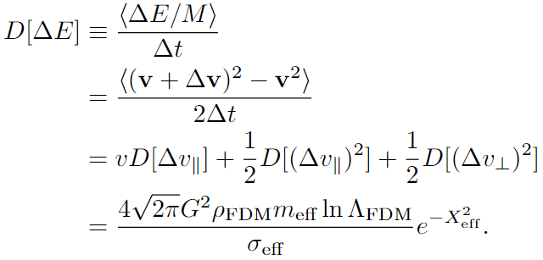
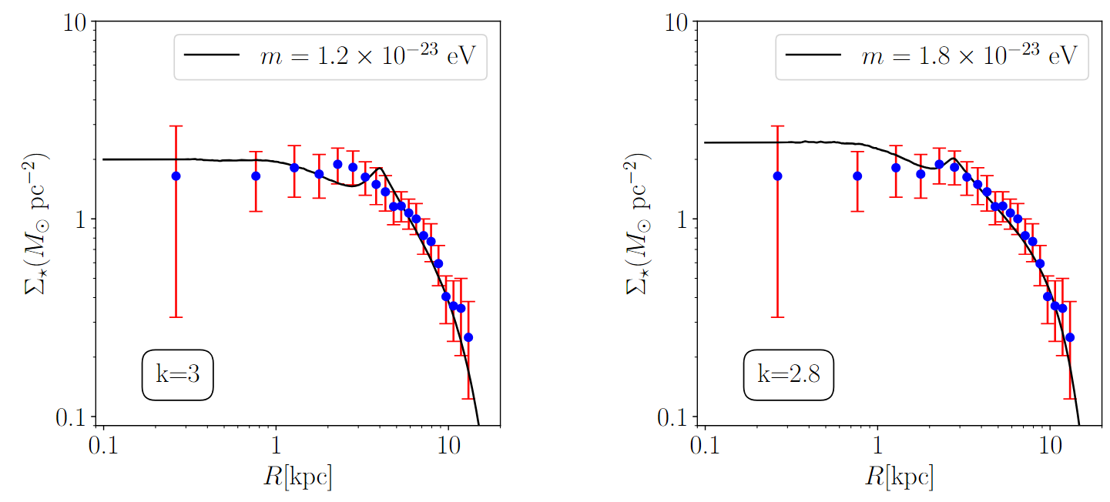
Yang,XJB,Yin,JCAP 07 (2024) 054

Slide 15



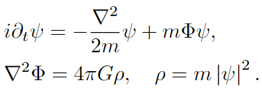
Numerical simulation
FDM基本性质
运动方程
度规：
non-relativistic limit:
Schrodinger-Poisson (SP) equation:
de Broglie波长

Slide 16
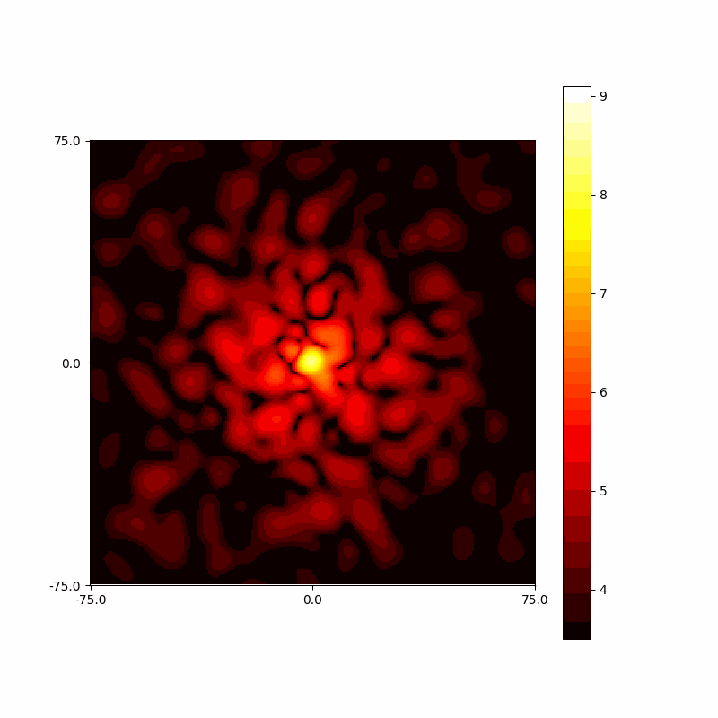
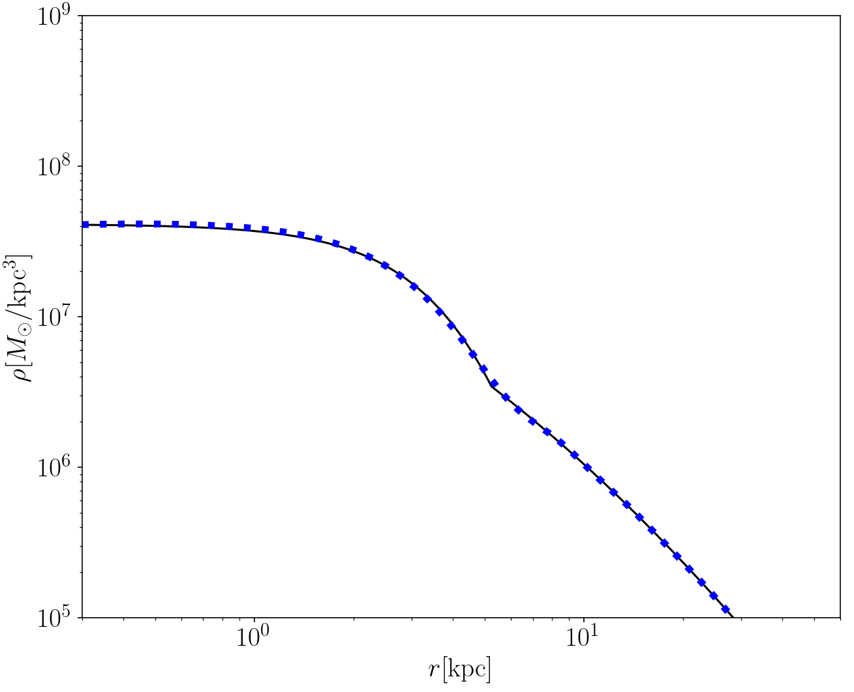
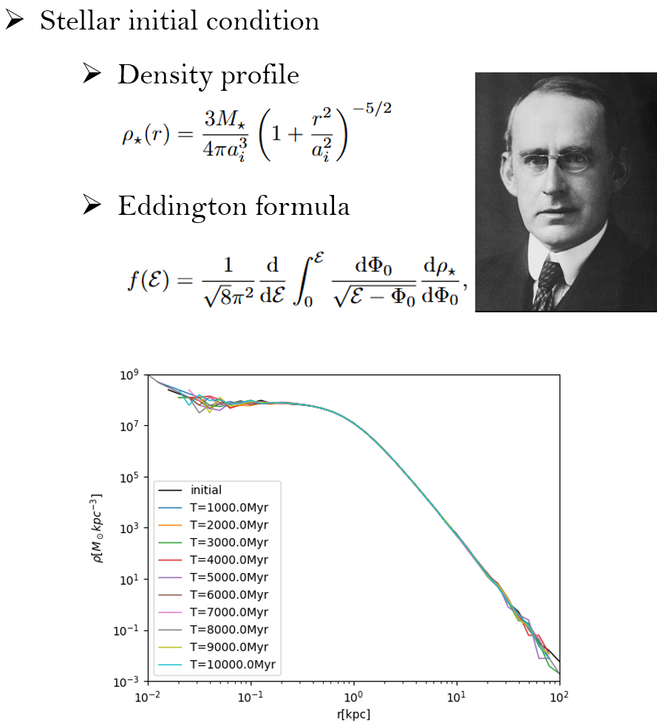
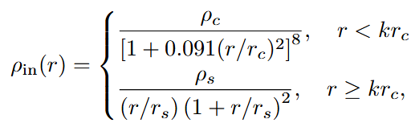
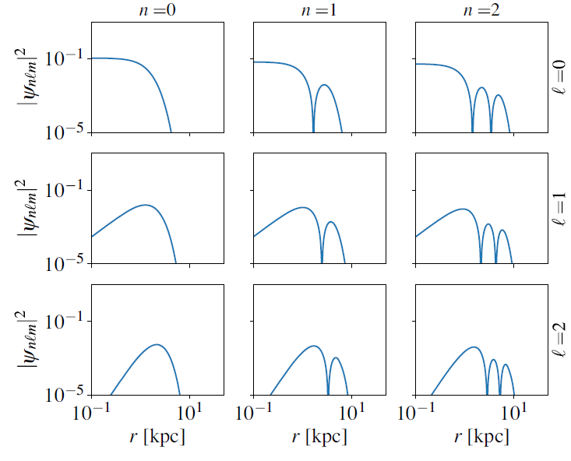

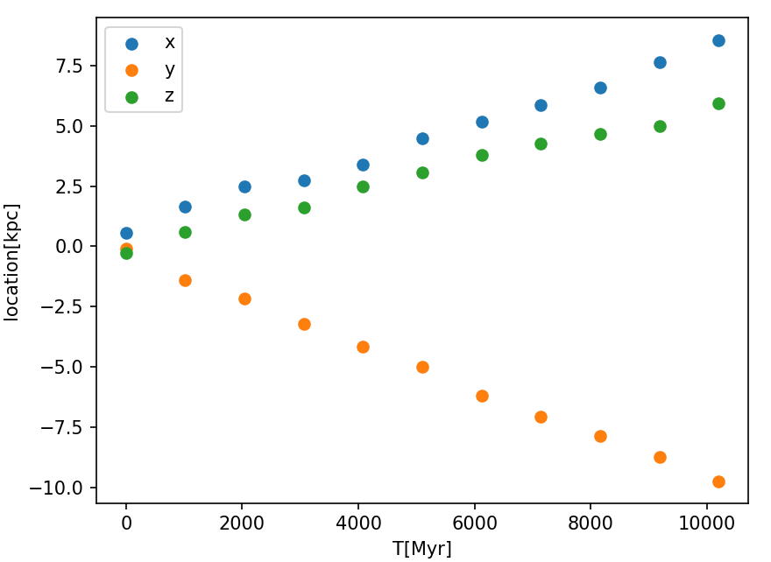


Dynamical heating effect of FDM
Initial wave function
Soliton+NFW profile
T.D. Yavetz, X Li, and L Hui, Phys.Rev.D 105 (2022) 2, 023512
Notes:
To simulate this effect, we first need to determine the initial conditions of the system. There are two components in our simulation, fuzzy dark matter and stars. Fuzzy dark matter is described by the wave function. Therefore, we need a initial wave function such that its density profile is a soliton-NFW profile. We achive this by using the eigenstate decomposition method. We express the initial wave function psi zero as a linear combination of a series of eigenstates. These eigenstates are solutions of the time-independent Schrodinger equation with different quantum numbers n,l,m. We need to adjust these coefficients so that the resulting density follows a soliton–NFW profile. The procedure described above was proposed in twenty twenty two. However, when we let this constructed initial wave function to evolve according to the Schrodinger equation, we found it has a initial velocity. This is manifested as the center of mass of the system undergoing uniform linear motion over time, as shown in these two figures.

Slide 17
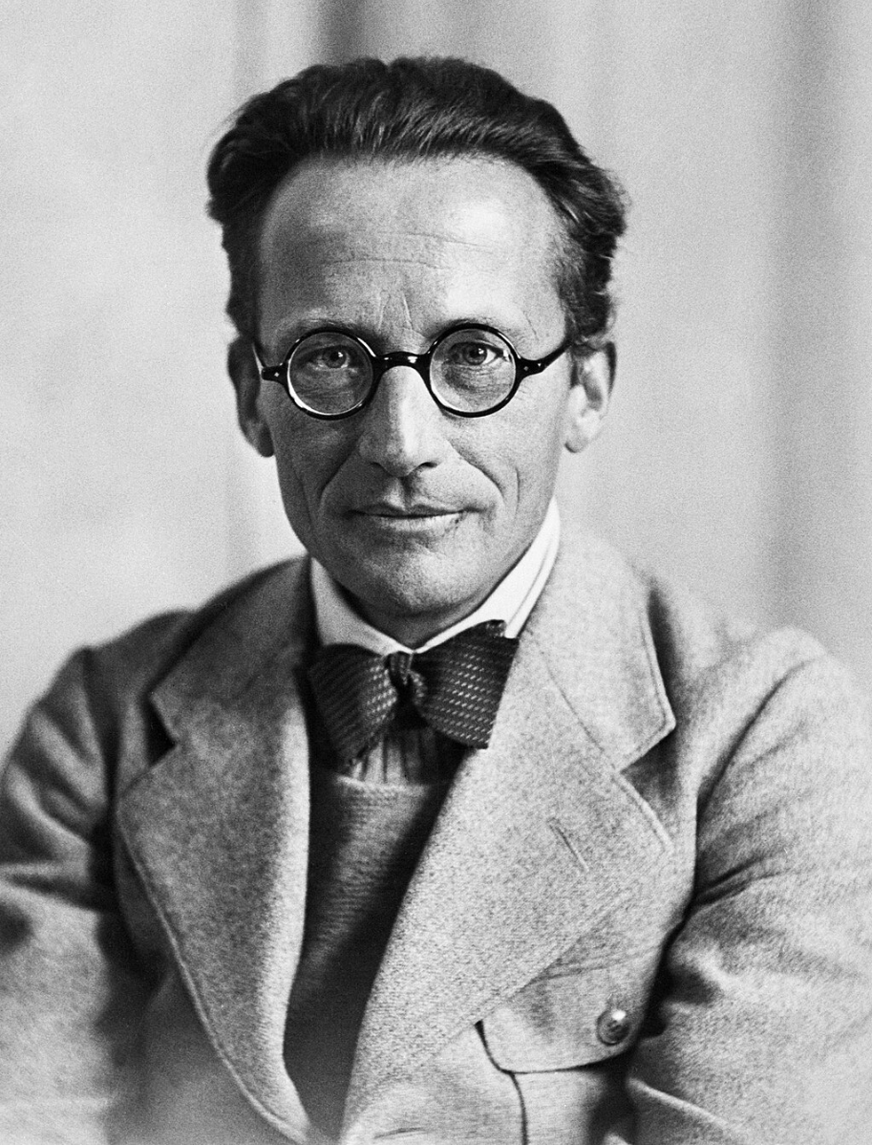

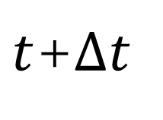






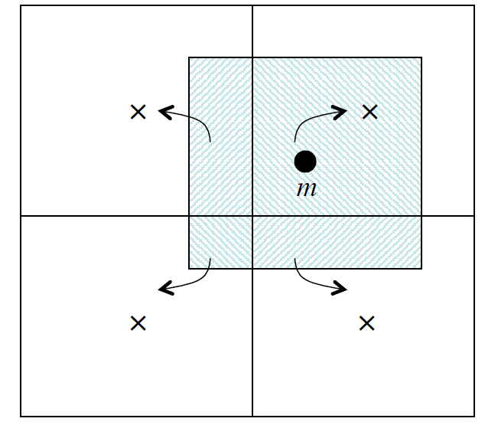

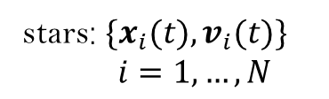
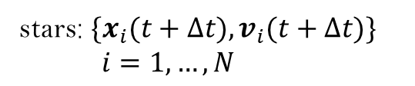

Dynamical heating effect of FDM
Schrödinger equation
Newton’s second law
Particle Mesh
Notes:
In our simulated system, both fuzzy dark matter and stars contribute to the gravitational potential. However, since the mass of the fuzzy dark matter is much greater than the total stellar mass, the gravitational potential contributed by the stars can be safely neglected. At each step of the evolution, the FDM evolves according to the Schrödinger equation, and the stars evolve according to Newton's second law.

Slide 18

模拟结果
arXiv:2412.01307

Slide 19




arXiv:2412.01307

Slide 20



Dynamical heating effect of FDM
Y.M. Yang, Z.C. Zhang, X.J. Bi, and P.F. Yin, 2025 ApJL 981 L26
Notes:
This is our simulation result. It can be seen that the density distribution of fuzzy dark matter evolves over time, or you can see this animation. And the position of the soliton undergoes random walk in the halo. As for the stellar distribution, we can see that it becomes increasingly diffuse over time. The two figures below show a comparison between the stellar surface density distribution evolved to the present day and observational data. It can be seen that fuzzy dark matter with a particle mass around ten to the minus twenty-three eV can well explain the observations.

Slide 21

Dynamical heating effect of FDM
A natural consequence in this picture
The longer the stars experience heating, the more diffuse their distribution becomes, and the larger their velocity dispersion grows.
The dynamical heating effect of FDM is most promising in isolated galaxies, and will be affected by environments
Qualitatively consistent with other observations
Y. M. Yang, X. J. Bi, and P. F. Yin, JCAP 07, 054
B. T. Chiang, J. P. Ostriker, and H. Y. Schive, MNRAS 518, 4045-4063 (2023)
D.J.Prole et al., MNRAS 488, 2143-2157 (2019)
J. Roman and I.Trujillo, MNRAS 468, 4039-4047 (2017)
C.R.Higgs et al., MNRAS 503, 176-199 (2021); R.Pucha et al 2019 ApJ 880 104
Notes:
A natural consequence in this dynamical heating picture is that the longer the stars experience heating, the more diffuse their distribution becomes, and the larger their velocity dispersion grows. Moreover it will be explained in the next section that the dynamical heating effect of FDM is most pronuced in isolated galaxies, and will be suppressed by the tidal effect. Combining these two features, we can see that this picture is qualitatively consistent with some other observations. For example, in the Milky Way, there are two stellar discs, a thick one and a thin one, compared with the thin disc, the thick one is dominated by older stellar populations and exhibits higher velocity dispersion. A research in twenty twenty three concluded that this can be explained by the dynamical heating effect of fuzzy dark matter with a particle mass of zero point five to zero point seven times ten to the minus twenty two eV. Secondly, isolated dwarf galaxies always seem to be young, blue, HI-rich and star-forming. Conseqeuently, there are not so much time for their stellar distributions to be heated to as so diffuse as Nube. Thirdly, there is a trend that, compared to younger dwarf galaxies, older dwarf galaxies tend to lie closer to high-density regions. Therefore, the dynamical heating effect in these old dwarf galaxies are suppressed by tidal effect. Lastly, within a dwarf galaxy, older stars tend to have a more diffuse distribution compared to younger stars. This is consistent with that the longer the stars experience heating, the more diffuse their distribution becomes.

Slide 22








Tidal suppression of the heating effect
Notes:
There are many previous studies set stringent constraints of the particle mass of fuzzy dark matter by examing its dynamical heating effect in Milky Way dwarf galaxies, such as Eridanus two, Segue one, Segue two and Fornax. However, due to technical limitations, none of these works considered the tidal effects induced by the Milky Way potential. Yet the tidal effect is crucial when studying the heating effect of fuzzy dark matter, because the excited states in the outer regions of the subhalo can be stripped by tidal forces, this will suppress interference in the subhalo and significantly reduces the resulting heating.

Slide 23



Tidal suppression of the heating effect
Fornax in the Milky Way
Yang, XJB, Yin, 2507.01686, APJL. 990 (2025) 2, L67
Orbit
FDM & stellar density
Line-of-sight velocity dispersion
m=10⁻²²eV
Notes:
Using this framework, we simulate the galaxy Fornax under the combined influence of the Milky Way and the Large Magellanic Cloud. We carried out three sets of simulations, corresponding to the evolution of Fornax in isolation and under the influence of strong and weak Milky Way gravitational potentials, referred to as the no tidal, strong tidal, and weak tidal cases, respectively. This figure shows the distance of Fornax to the Milky Way and LMC in different cases.

Slide 24



Argument about
Segue 1
A paper pointed out that very small dwarfs like Segue 1 can not be affected by the tidal effect.

Slide 25



Gravity between stars has important effect
Galactic dynamics is important for very dense star clusters. For dense systems, gravity induces system relaxation which leads to core collapose.
FDM stripping of outer stars accelerate the core collapose.
For more extended systems FDM heating may become dominate and disrupt the system.
We give a phase diagram that shows the fate of the system evolution: collapse v.s. disruption.

Slide 26



Collapse versus disruption
fate

Slide 27



A phase diagram man the parameter space

Slide 28
Summary
Astronomical observations can probe DM properties in a model-independent way.
Ultralight wave dark matter has a unique property of interference, different from particle DMs, which helps to solve many observations that seem difficult to be explained by CDM or by baryonic processes.
Rigorous simulations show that we must be very carefule to set limits on the ultralight DM.

Slide 29





*FDM velocity dispersion is given by solving the Jeans equation
*star velocity given by 1D dispersion ，1D velocity dispersion is given by

Slide 30

*the results
m=(1-2)*10⁻²³ eV,
1, constraints are not conclusive.
2，old (10 Gyrs), most UDGs are young
3, isolated, no tidal effects
4, one exception from JWST, there may be interactions with other galaxies.

Slide 32



arXiv:2412.08372

Slide 33

arXiv:2412.08372

Slide 34




波函数和恒星运动的演化
波函数演化
Edwards et al JCAP10(2018)027
SP方程无量纲化

Slide 35


恒星运动演化
对时间步长要求太高
四阶Runge-Kutta

