Slide 1






Neutrino Research on FASER Experiment
Shunliang Zhang, Tsinghua University
FASER Collaboration
2025-10-26 vSTEP 2025 @ Beijing

Slide 2
Contents
Introduction to FASER Detector @ LHC
Estimated/Current Neutrino Results @ FASER
Upgrading with FASER AHCAL @ 2026

Slide 3
Introduction to FASER @ LHC

Slide 4
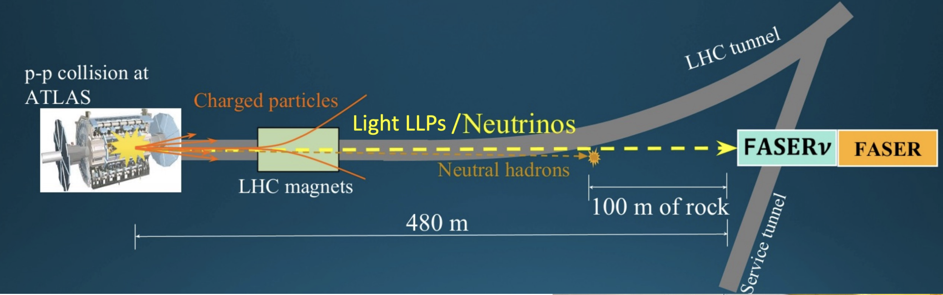
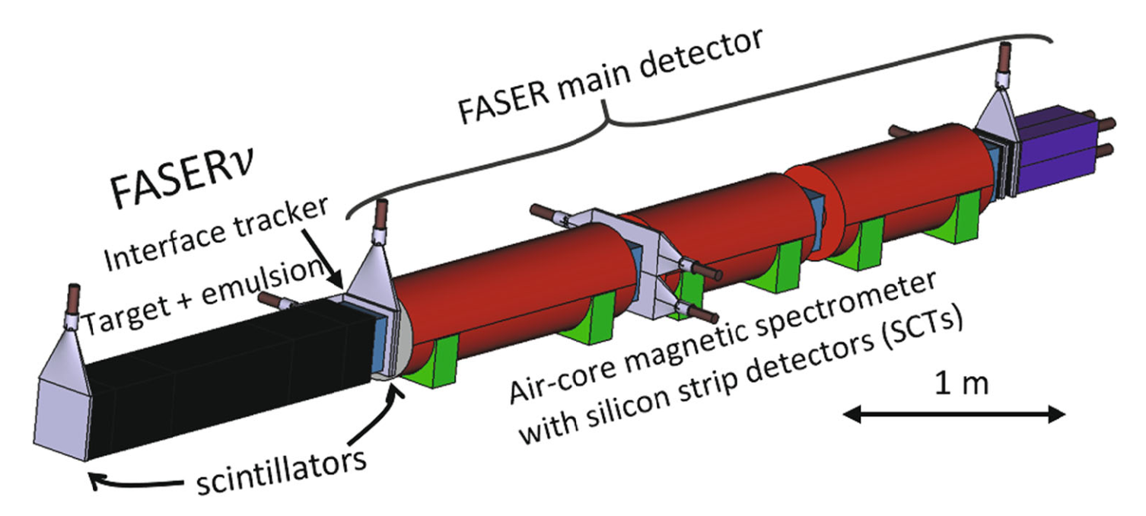
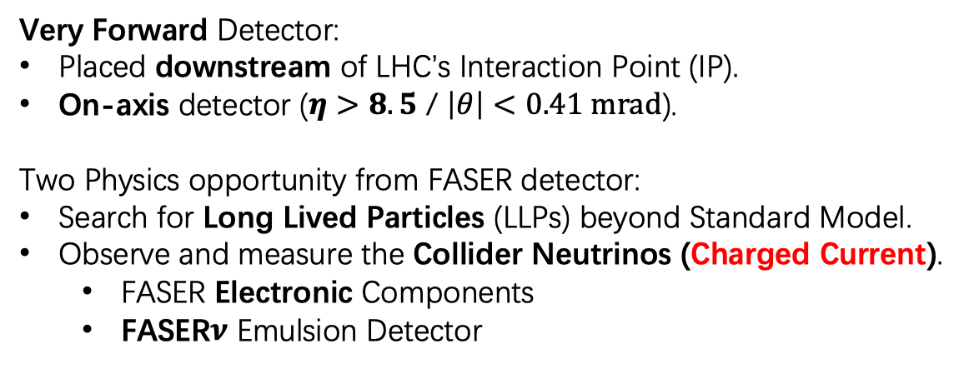
Very Forward Physics @ LHC
FASER:
ForwArd Search ExpeRiment
Very Forward Detector:
Placed downstream of LHC’s Interaction Point (IP).
On-axis detector ($η>8.5$ / $\left|θ\right|<0.41 mrad$).
Two Physics opportunity from FASER detector:
Search for Long Lived Particles (LLPs) beyond Standard Model.
Observe and measure the Collider Neutrinos (Charged Current).
FASER Electronic Components
FASER$ν$ Emulsion Detector
Zoom in
Two independent subsystem for detecting neutrinos!
Beam Line from ATLAS

Slide 5
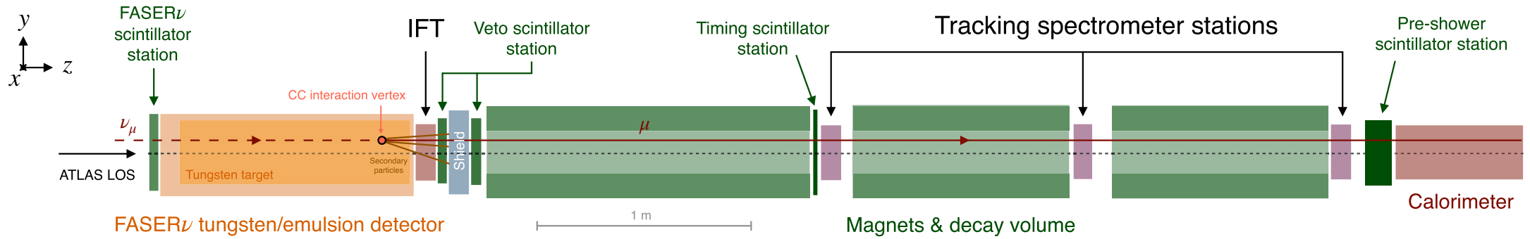
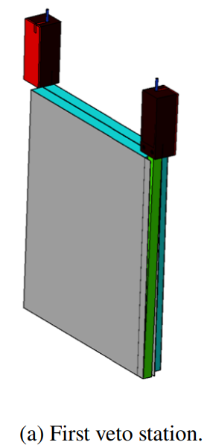
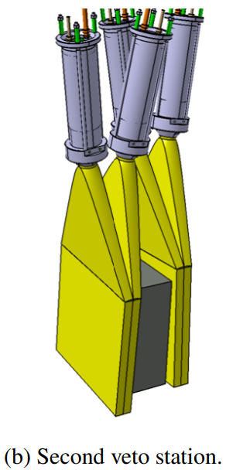
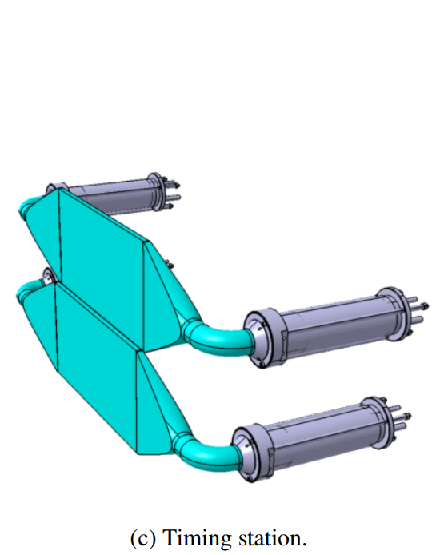
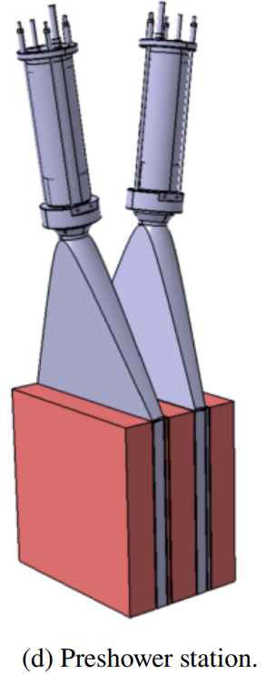
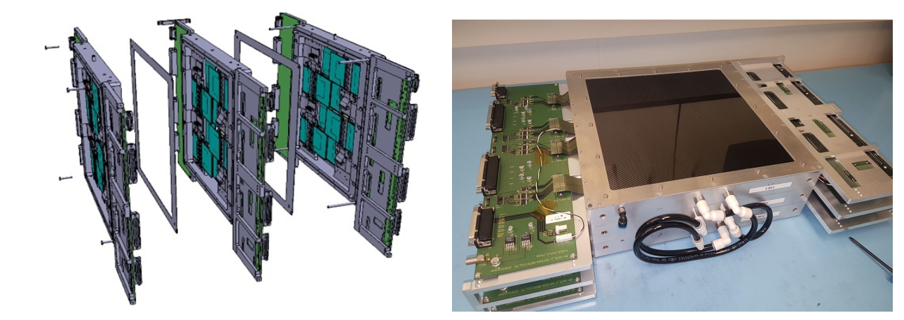
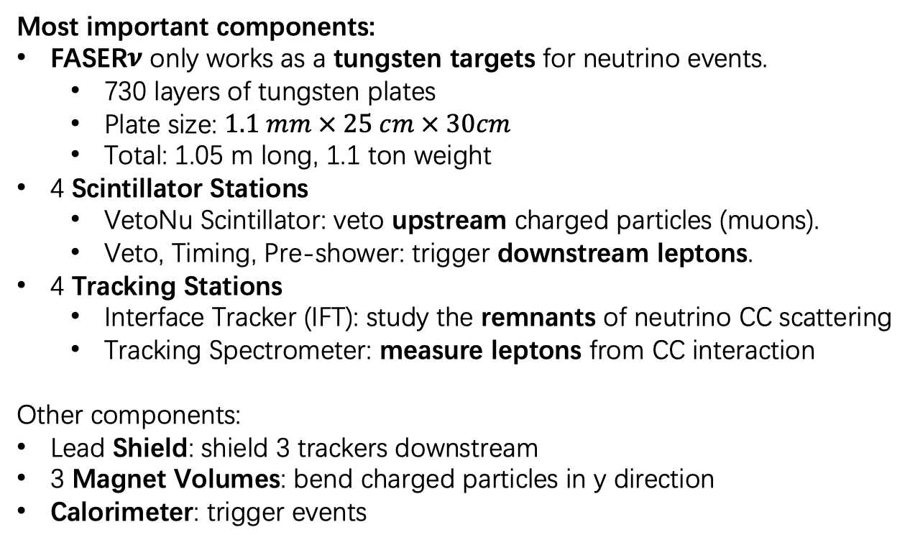
FASER Electronic Components
VetoNu Scintillator Station
Most important components:
FASER$ν$ only works as a tungsten targets for neutrino events.
﻿730 layers of tungsten plates
Plate size: $1.1 mm × 25 cm × 30cm$
Total: 1.05 m long, 1.1 ton weight
4 Scintillator Stations
VetoNu Scintillator: veto upstream charged particles (muons).
Veto, Timing, Pre-shower: trigger downstream leptons.
4 Tracking Stations
Interface Tracker (IFT): study the remnants of neutrino CC scattering
Tracking Spectrometer: measure leptons from CC interaction
Other components:
Lead Shield: shield 3 trackers downstream
3 Magnet Volumes: bend charged particles in y direction
Calorimeter: trigger events

Slide 6
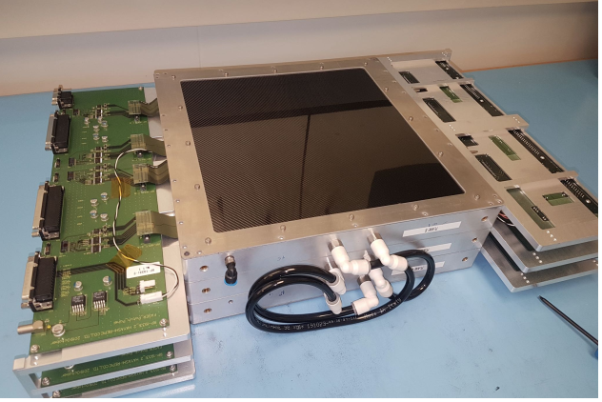
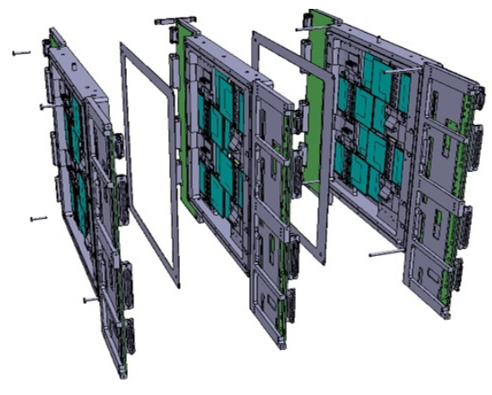
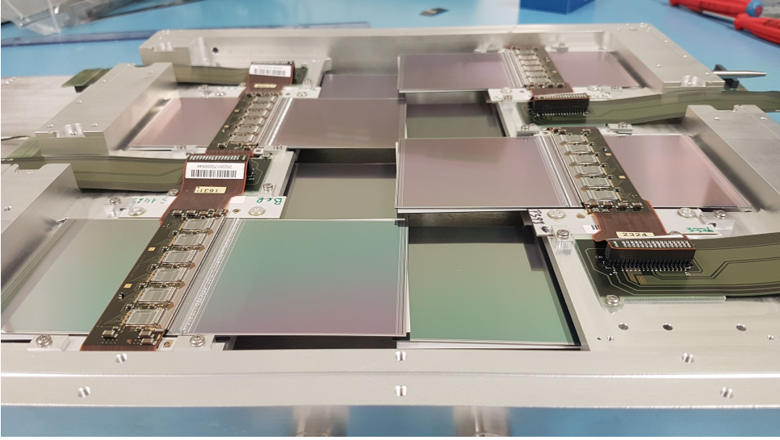
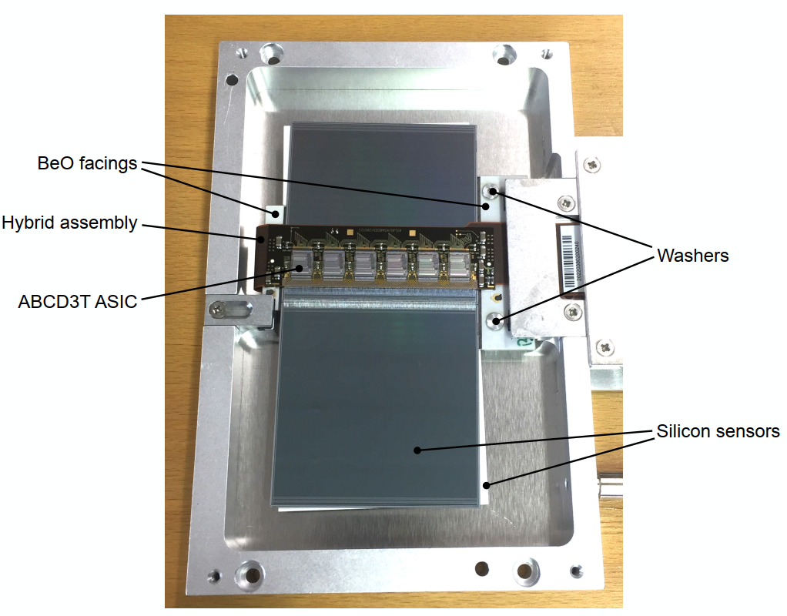
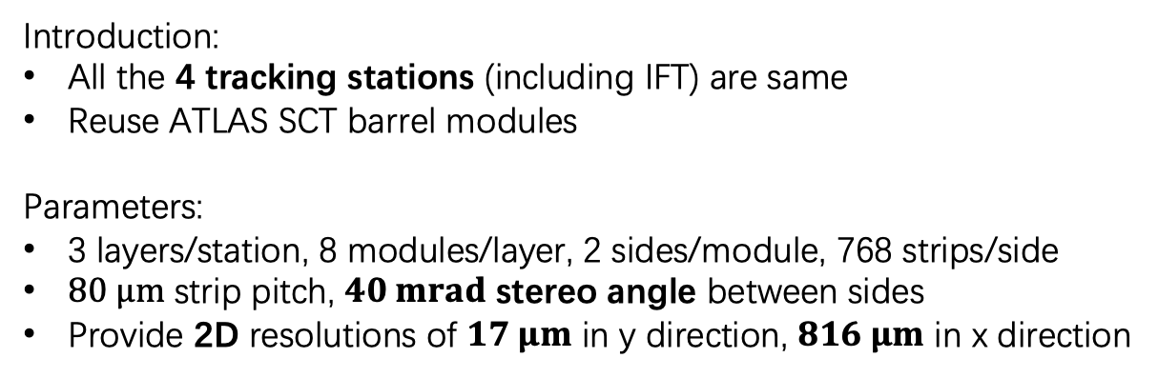
FASER Electronic Components (Tracking Stations)
8 modules / layer
Full assembled station
3 layers / station
Introduction:
All the 4 tracking stations (including IFT) are same
Reuse ATLAS SCT barrel modules
Parameters:
3 layers/station, 8 modules/layer, 2 sides/module, 768 strips/side
$80 μm$ strip pitch, $40 mrad$ stereo angle between sides
Provide 2D resolutions of $17 μm$ in y direction, $816 μm$ in x direction
x
y
2 sides/module, 768 strips / side

Slide 7
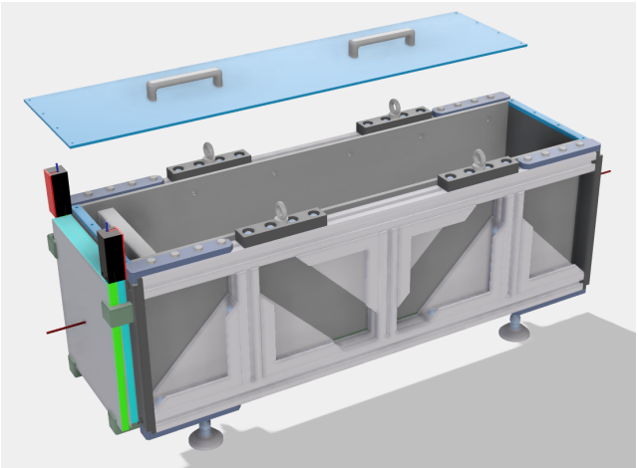
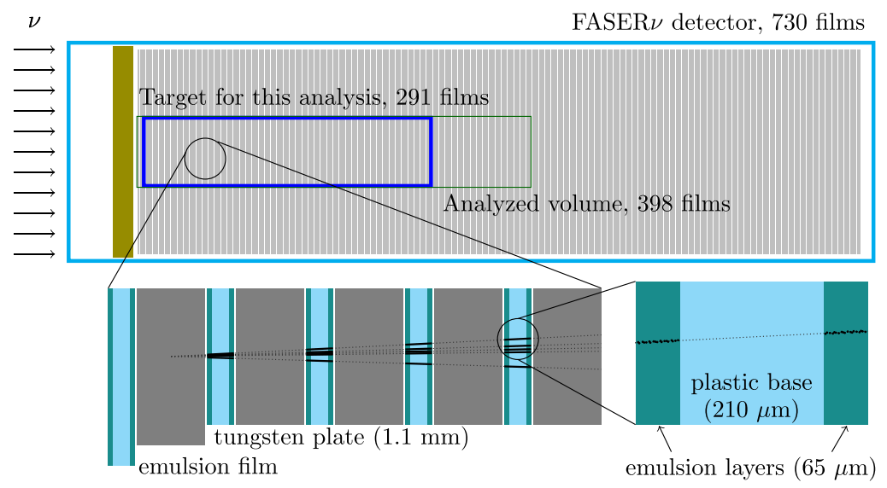
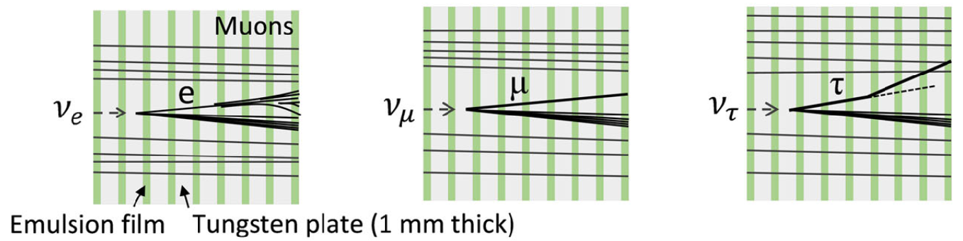
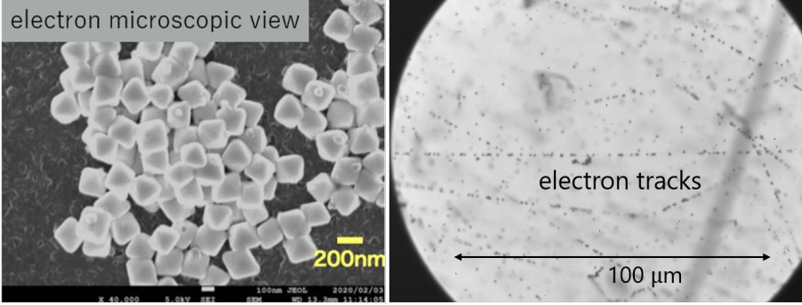
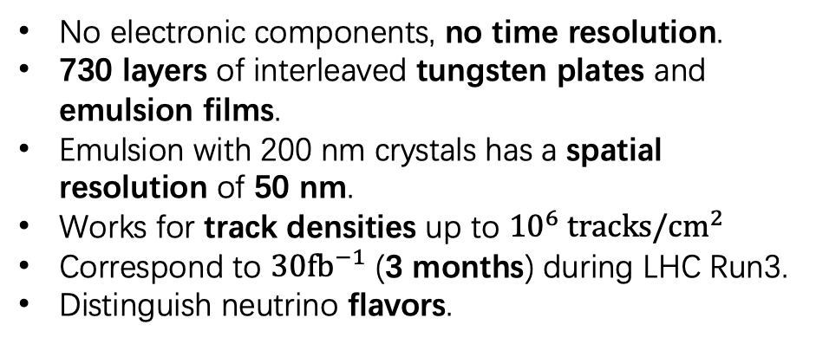
FASER$ν$ Emulsion Detector
No electronic components, no time resolution.
﻿730 layers of interleaved tungsten plates and emulsion films.
﻿Emulsion with 200 nm crystals has a spatial resolution of 50 nm.
﻿Works for track densities up to ${10}^{6} tracks/cm^{2}$
Correspond to $30fb^{−1}$ (3 months) during LHC Run3.
Distinguish neutrino flavors.
Neutrino Flavor Patterns

Slide 8
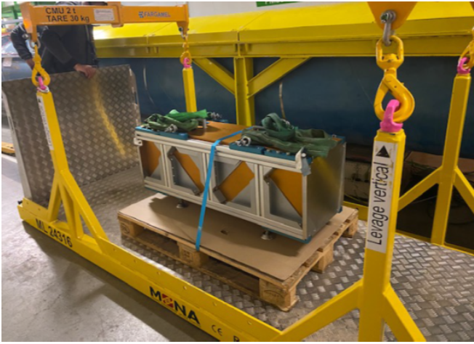
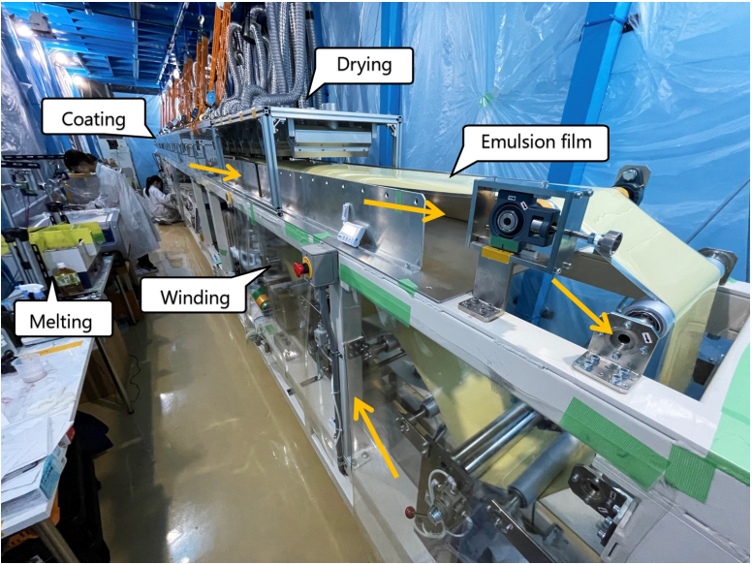
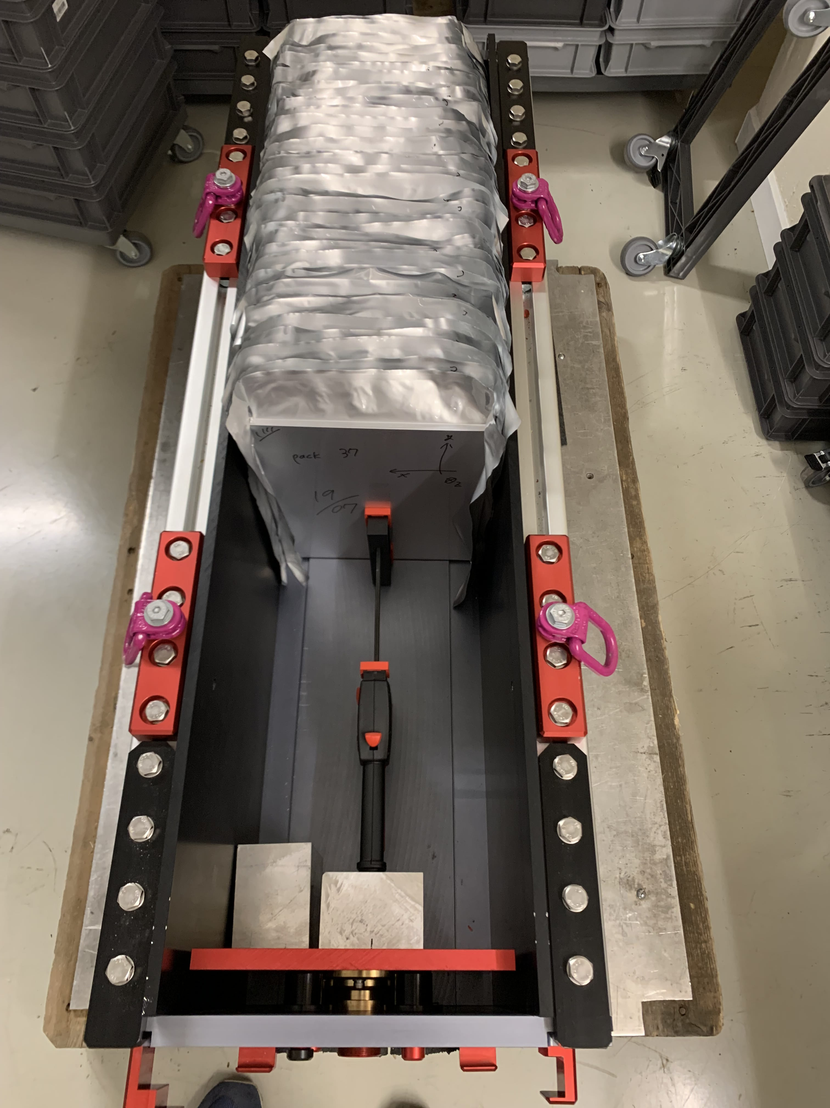
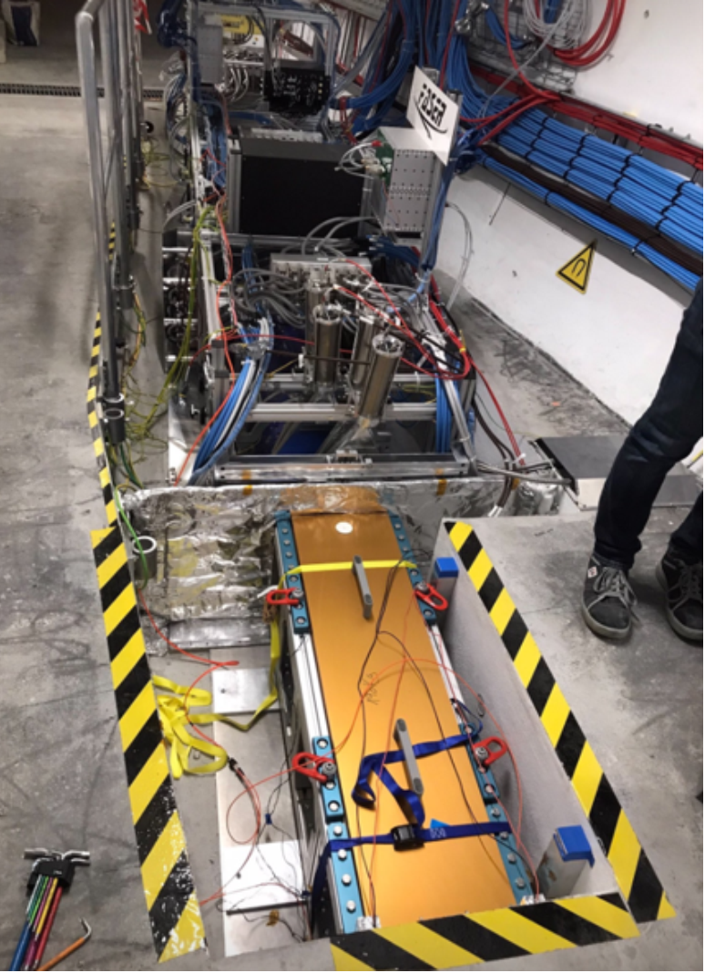
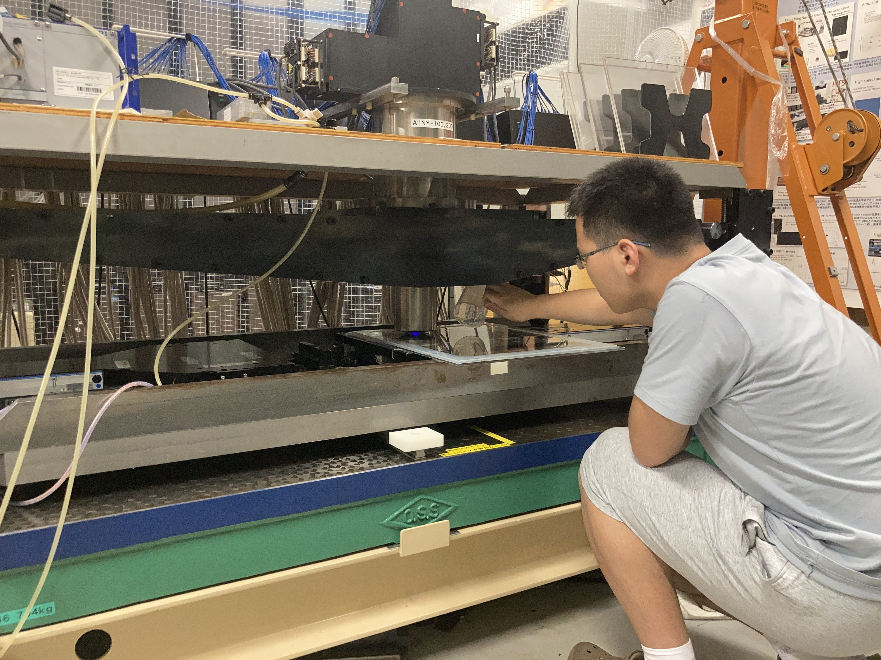
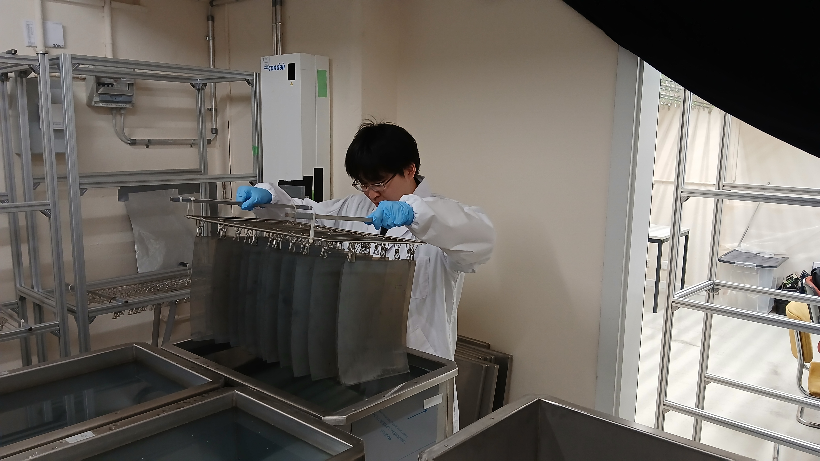
Emulsion Data Taking (repeat every 3 months)
Nagoya University
CERN
Transportation to TI12
Emulsion Production
Packing 10 films/pack
Installation in TI12
Scanning
Chemical Developing

Slide 9
Estimation for the Neutrino Results @ LHC Run 3

Slide 10
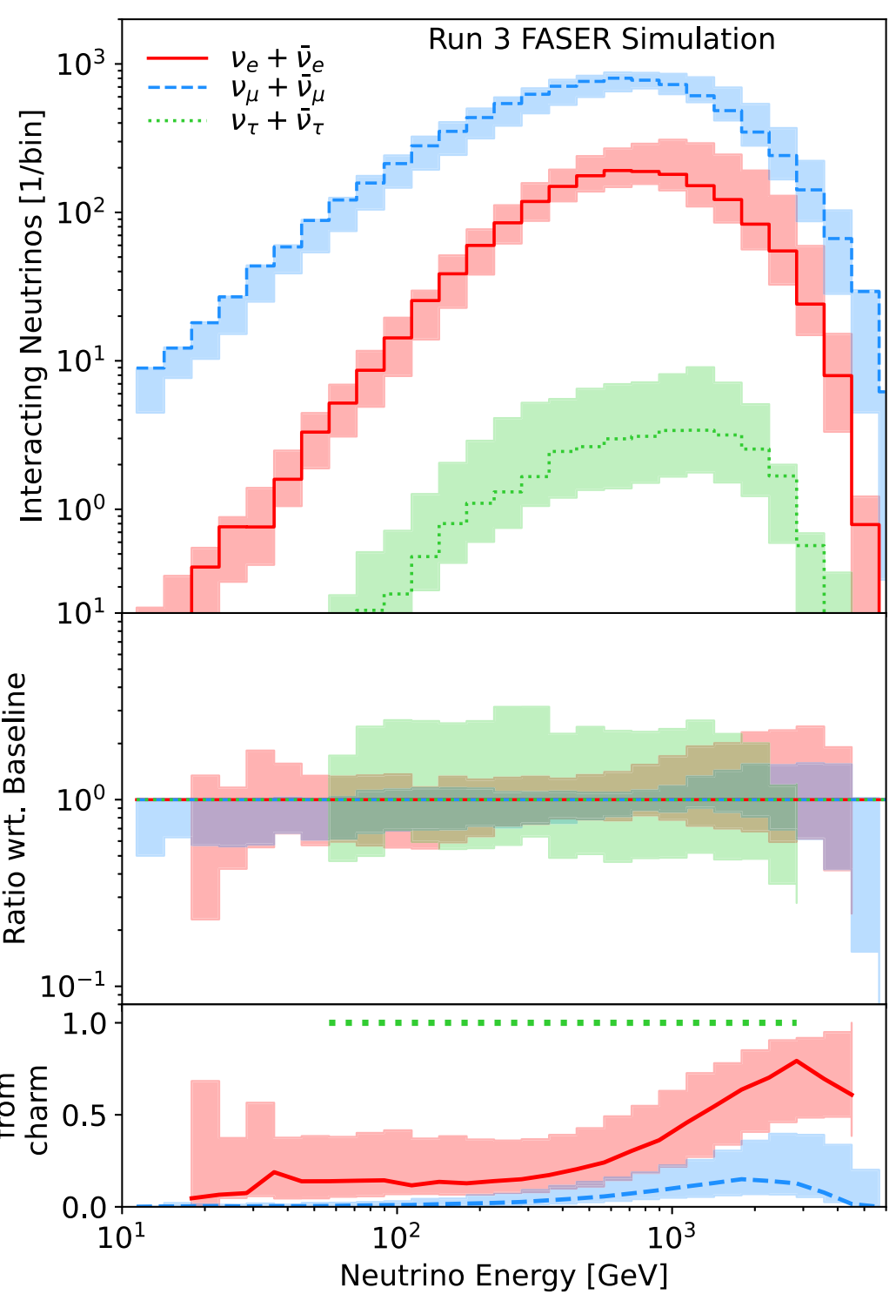
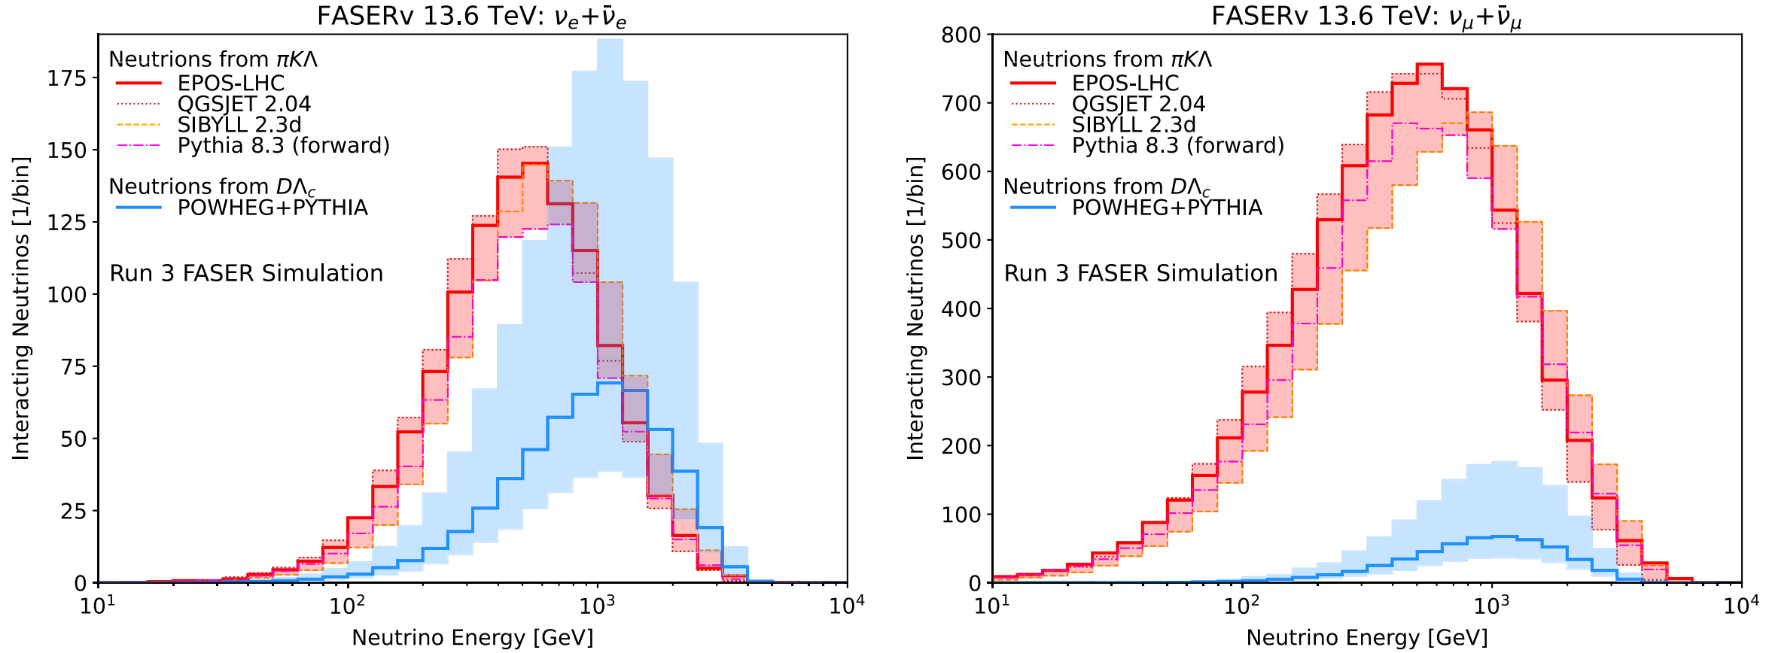
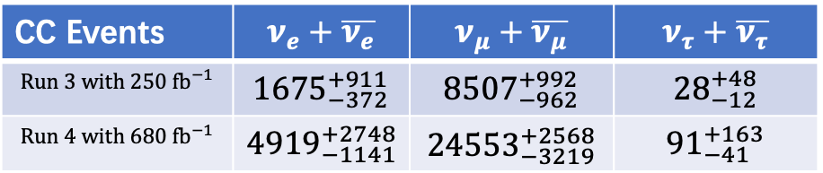
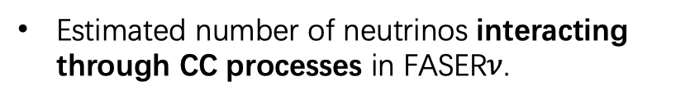
Estimated Neutrinos Events in FASER$ν$ @ LHC Run3 ($250 fb^{−1}$)
﻿10.1103/PhysRevD.110.012009
Neutrino CC events in FASER$ν$, originating distribution
﻿The component of neutrinos originating from light (charm) hadron decays is shown in red (blue).
Neutrino CC events in FASER$ν$, flavor distribution
CC Events | $$ν_{e}+\overline{ν_{e}}$$ | $$ν_{μ}+\overline{ν_{μ}}$$ | $$ν_{τ}+\overline{ν_{τ}}$$
$$Run 3 with 250 fb^{−1}$$ | $${1675}_{−372}^{+911}$$ | $${8507}_{−962}^{+992}$$ | $${28}_{−12}^{+48}$$
$$Run 4 with 680 fb^{−1}$$ | $${4919}_{−1141}^{+2748}$$ | $${24553}_{−3219}^{+2568}$$ | $${91}_{−41}^{+163}$$
﻿Estimated number of neutrinos interacting through CC processes in FASER$ν$.

Slide 11
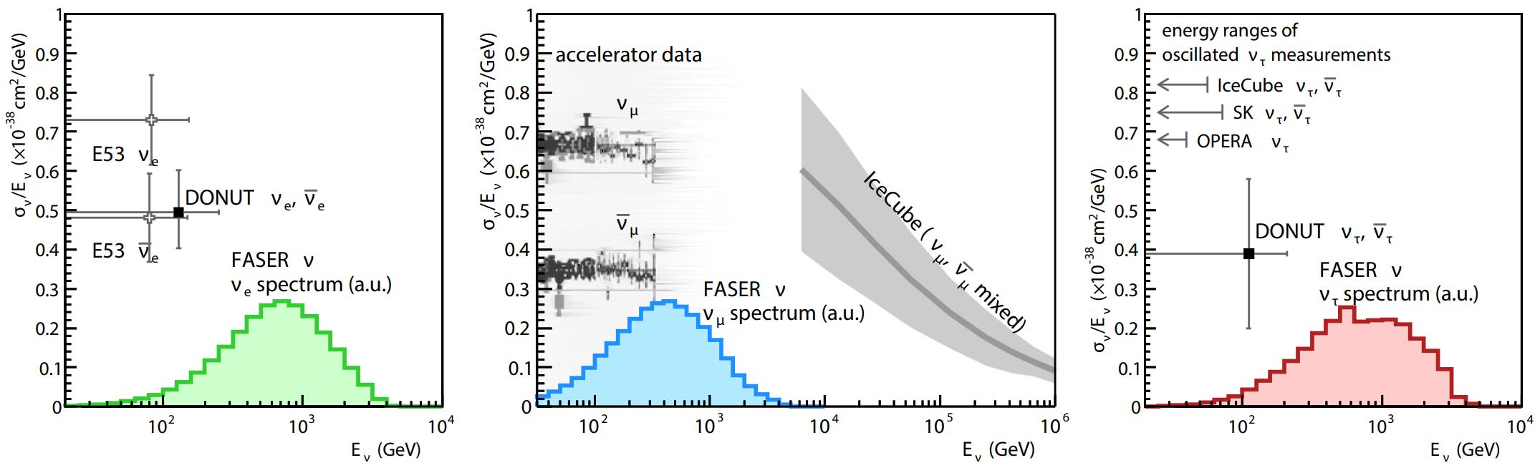
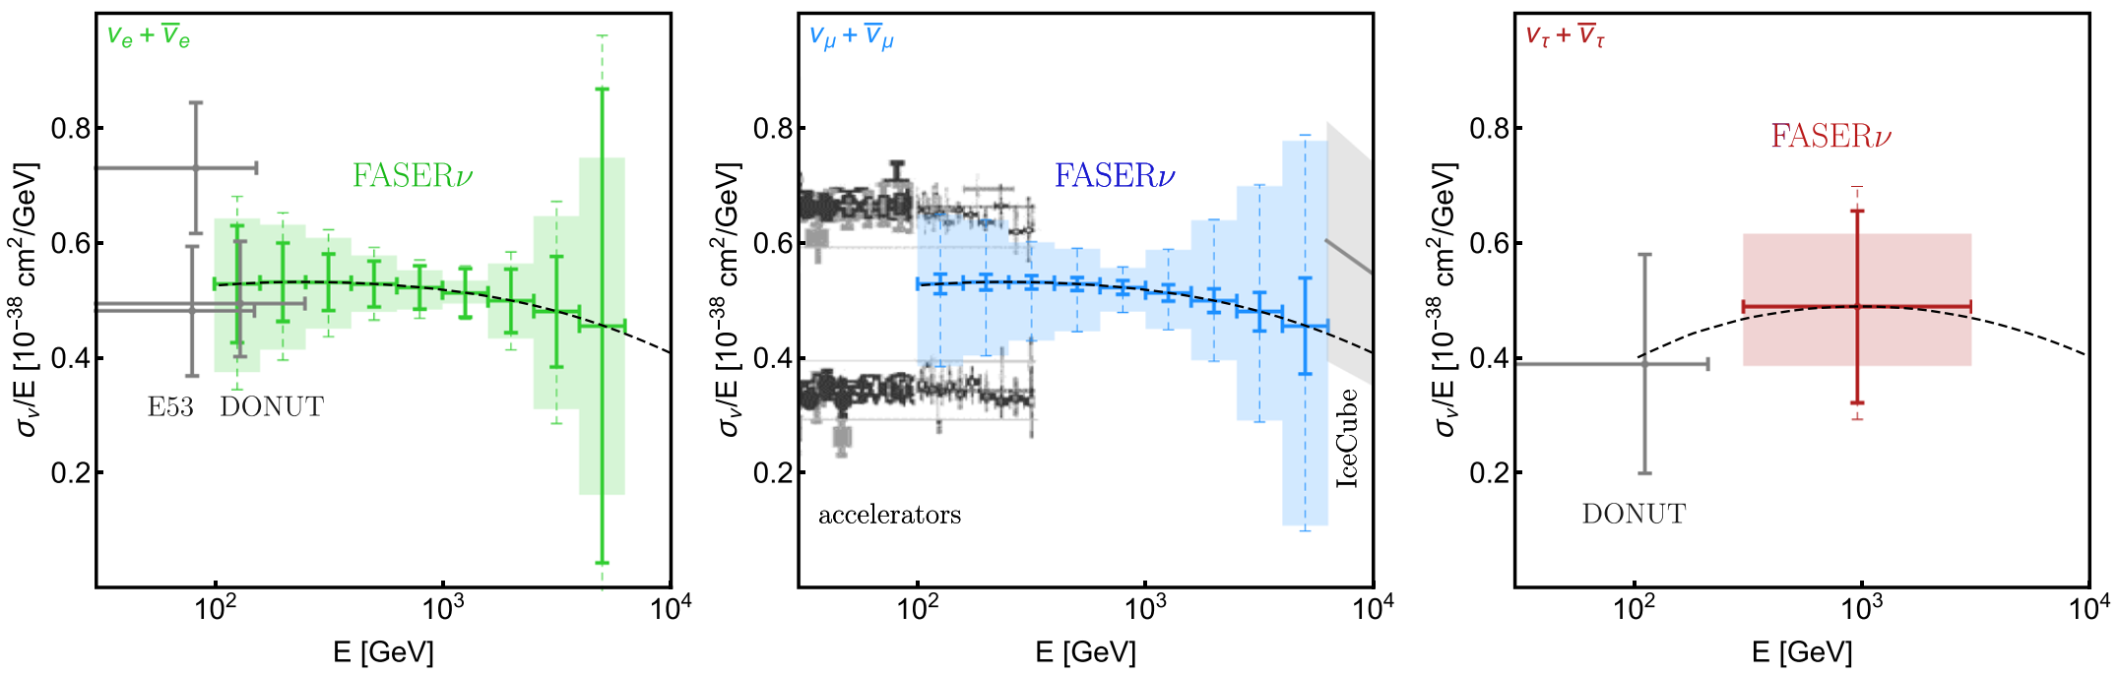
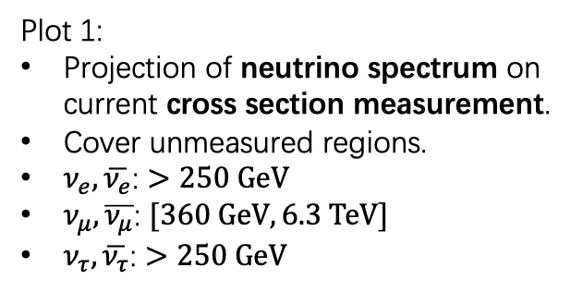
Potential in Neutrino Cross Section Measurement
﻿Eur. Phys. J. C (2020) 80 :61
Plot 1:
Projection of neutrino spectrum on current cross section measurement.
Cover unmeasured regions.
$ν_{e}, \overline{ν_{e}}$: $>250 GeV$
$ν_{μ}, \overline{ν_{μ}}$: $[360 GeV, 6.3 TeV]$
$ν_{τ}, \overline{ν_{τ}}$: $>250 GeV$
Plot 2:
Estimated measurement error bar.
Solid error bars: estimated statistical uncertainty.
Shaded regions: estimated systematical uncertainty from different MC generator.
Dashed error bars: combination.

Slide 12

Neutrino Results @ Pilot & FASER$ν$ & FASER

Slide 13
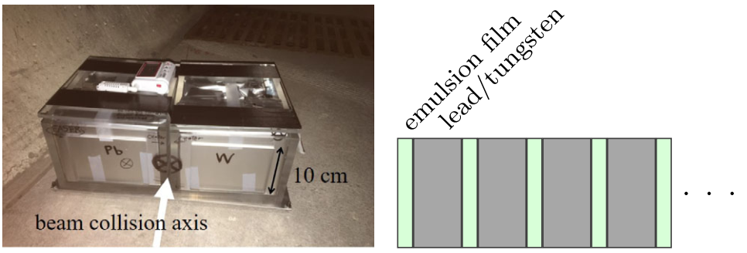
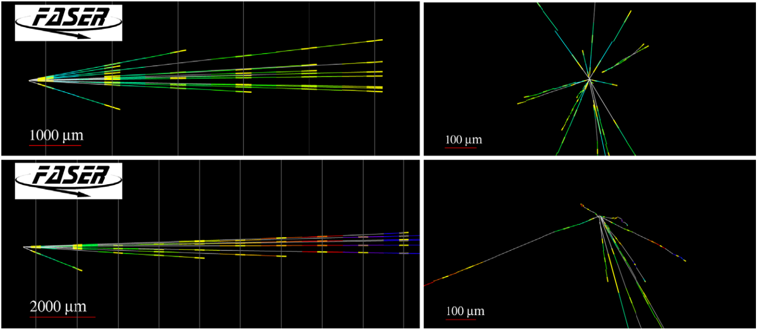
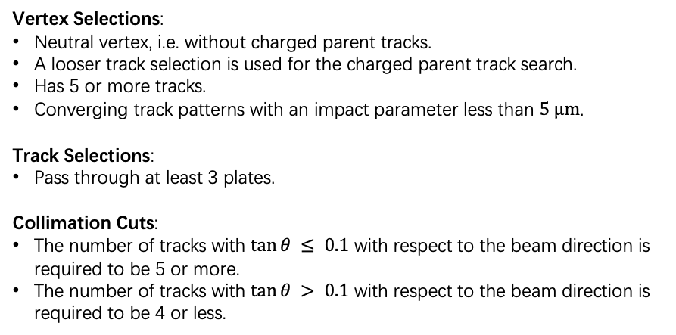
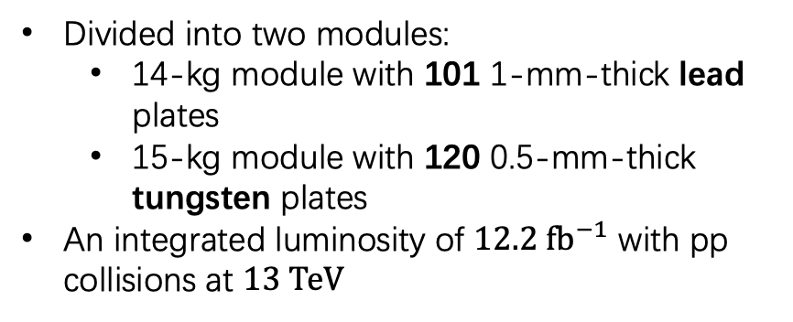
Neutrino Candidates @ Pilot Detector in 2018
﻿10.1103/PhysRevD.104.L091101
Divided into two modules:
﻿14-kg module with 101 1-mm-thick lead plates
15-kg module with 120 0.5-mm-thick tungsten plates
﻿An integrated luminosity of $12.2 fb^{−1}$ ﻿with pp collisions at $13 TeV$
Pilot emulsion detector in TI18
Event Selection: Find Neutral Vertex
Vertex Selections:
Neutral vertex, i.e. without charged parent tracks.
﻿A looser track selection is used for the charged parent track search.
Has 5 or more tracks.
Converging track patterns with an impact parameter less than $5 μm$.
Track Selections:
Pass through at least 3 plates.
Collimation Cuts:
The number of tracks with $tan⁡θ ≤ 0.1$ with respect to the beam direction is required to be 5 or more.
﻿The number of tracks with $tan⁡θ > 0.1$ with respect to the beam direction is required to be 4 or less.
y
y
z
x
Selection based on ﻿reconstructed charged particle tracks, forming a neutral vertex in FASERν
18 neutral ﻿vertices passed the selection

Slide 14
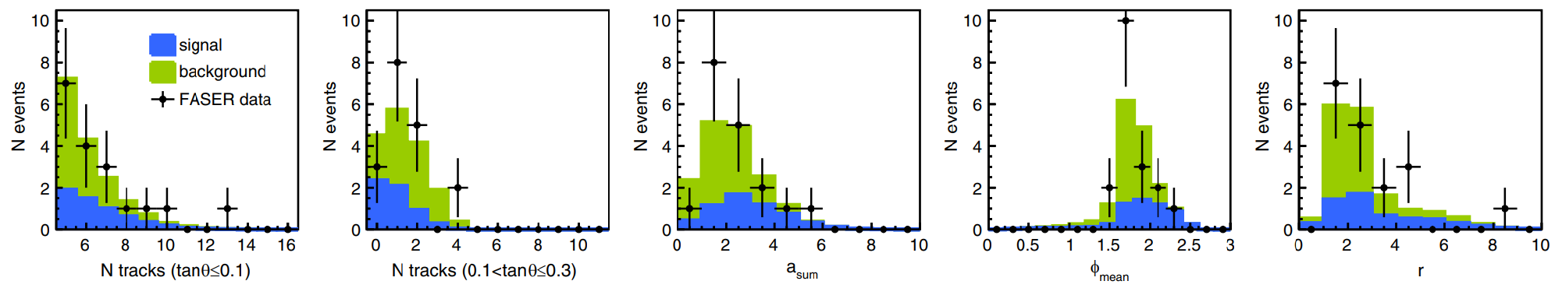
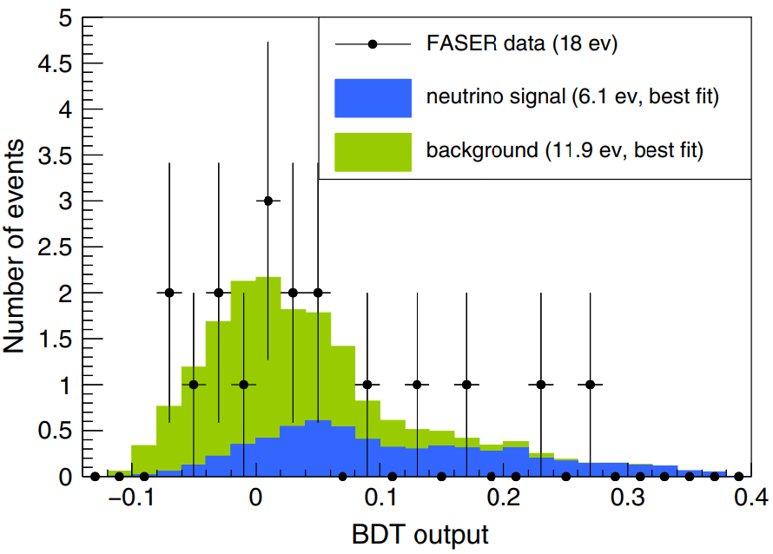
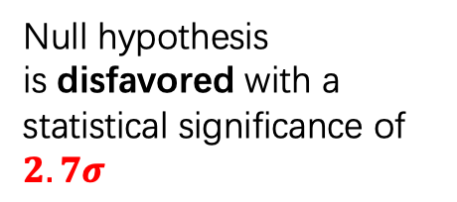
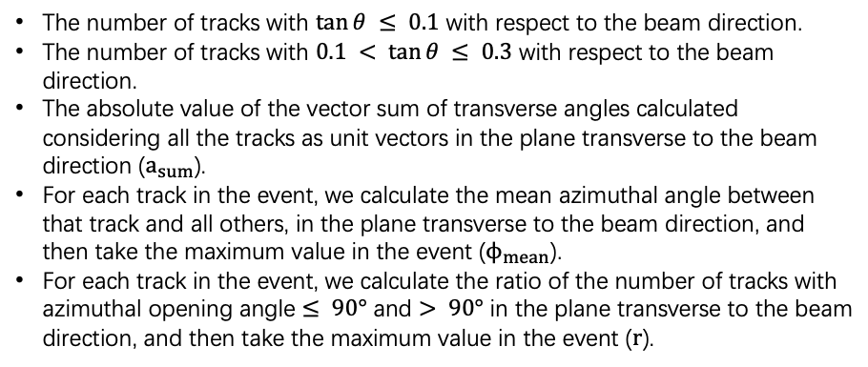
Neutrino Candidates @ Pilot Detector in 2018
Background Estimation
﻿10.1103/PhysRevD.104.L091101
Considered neutral hadron interaction in the FASER$ν$, evaluated with MC simulation
﻿A multivariate discriminant based on a boosted decision tree (BDT) algorithm has been developed to distinguish neutrino signal from neutral hadron background.
Input Variables
﻿The BDT outputs of the 18 observed neutral vertices, and the expected signal and background distributions (stacked) fitted to the data.
The number of tracks with $tan⁡θ ≤ 0.1$ with respect to the beam direction.
﻿The number of tracks with $0.1 < tan⁡θ ≤ 0.3$ with respect to the beam direction.
﻿The absolute value of the vector sum of transverse angles calculated considering all the tracks as unit vectors in the plane transverse to the beam direction ($a_{sum}$).
﻿For each track in the event, we calculate the mean azimuthal angle between that track and all others, in the plane transverse to the beam direction, and then take the maximum value in the event ($ϕ_{mean}$).
﻿For each track in the event, we calculate the ratio of the number of tracks with azimuthal opening angle $≤ 90°$ and $> 90°$ in the plane transverse to the beam direction, and then take the maximum value in the event ($r$).
﻿Null hypothesis is ﻿disfavored with a statistical significance of $2.7σ$

Slide 15
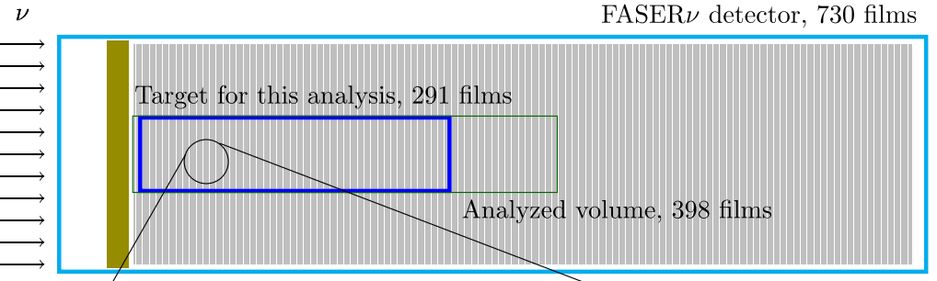
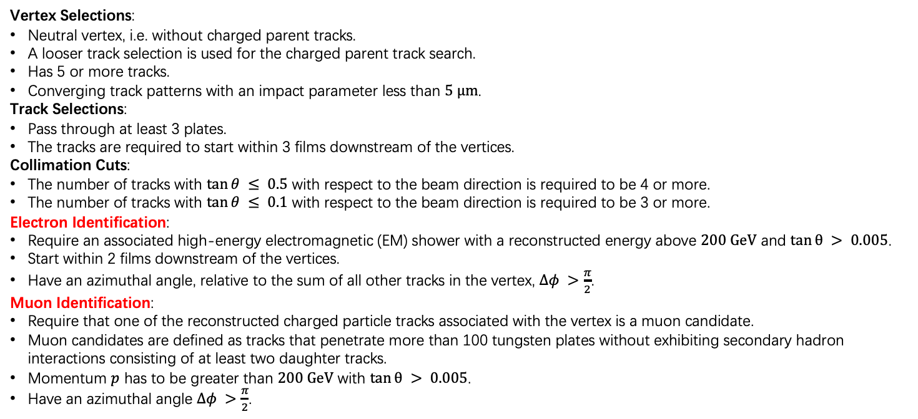
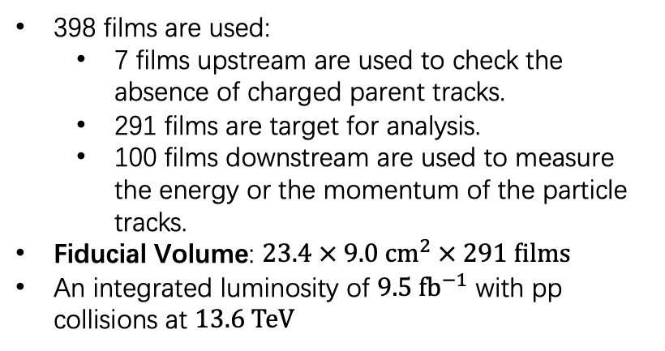
$ν_{e}/\overline{ν_{e}}$ and $ν_{μ}/\overline{ν_{μ}}$ Cross Section @ FASER$ν$ in 2022
﻿10.1103/PhysRevLett.133.021802
398 films are used:
7 films upstream are ﻿used to check the absence of charged parent tracks﻿.
291 films are target for analysis.
100 films downstream ﻿are used to measure the energy or the momentum of the particle tracks.
Fiducial Volume: ﻿$23.4 × 9.0 cm^{2} × 291 films$
An integrated luminosity of $9.5 fb^{−1}$ ﻿with pp collisions at $13.6 TeV$
Vertex Selections:
Neutral vertex, i.e. without charged parent tracks.
﻿A looser track selection is used for the charged parent track search.
Has 5 or more tracks.
﻿Converging track patterns with an impact parameter less than $5 μm$.
Track Selections:
Pass through at least 3 plates.
﻿The tracks are required to start within 3 films downstream of the vertices.
Collimation Cuts:
The number of tracks with $tan⁡θ ≤ 0.5$ with respect to the beam direction is required to be 4 or more.
The number of tracks with $tan⁡θ ≤ 0.1$ with respect to the beam direction is required to be 3 or more.
Electron Identification:
﻿Require an associated high-energy electromagnetic (EM) shower with a reconstructed energy above $200 GeV$ and $tan⁡θ > 0.005$.
﻿Start within 2 films downstream of the vertices.
﻿Have an azimuthal angle, relative to the sum of all other tracks in the vertex, $Δφ >\frac{π}{2}$.
Muon Identification:
﻿Require that one of the reconstructed charged particle tracks associated with the vertex is a muon candidate.
﻿Muon candidates are defined as tracks that penetrate more than 100 tungsten plates without exhibiting secondary hadron interactions consisting of at least two daughter tracks.
﻿Momentum $p$ has to be greater than $200 GeV$ with $tan⁡θ > 0.005$.
﻿Have an azimuthal angle $Δφ >\frac{π}{2}$.
Finding Neutral Vertex
Event Selection
Flavor Inentification

Slide 16
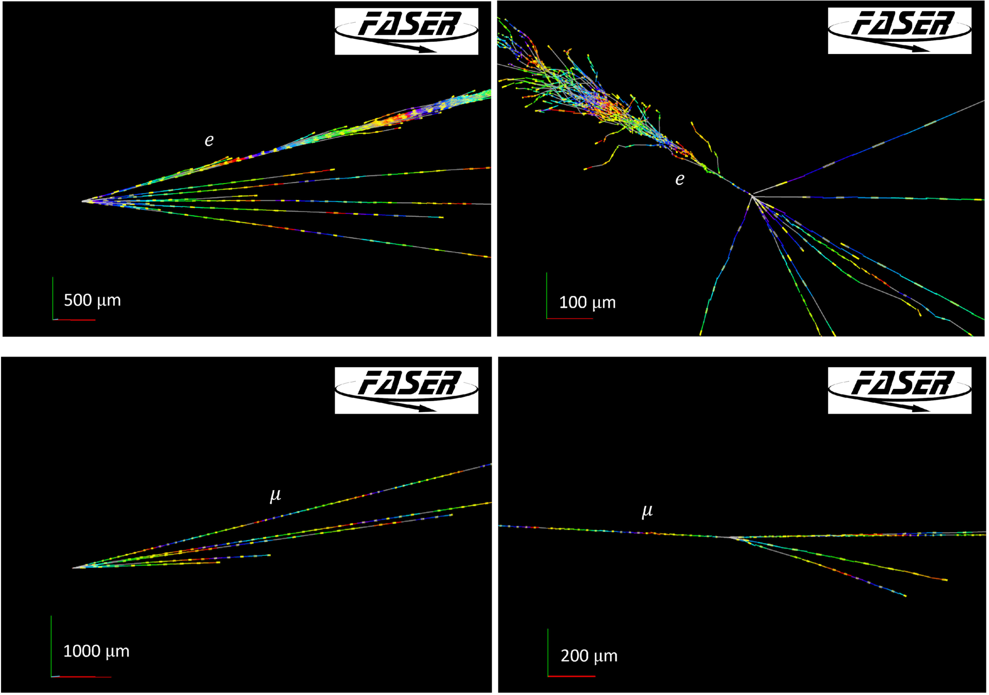
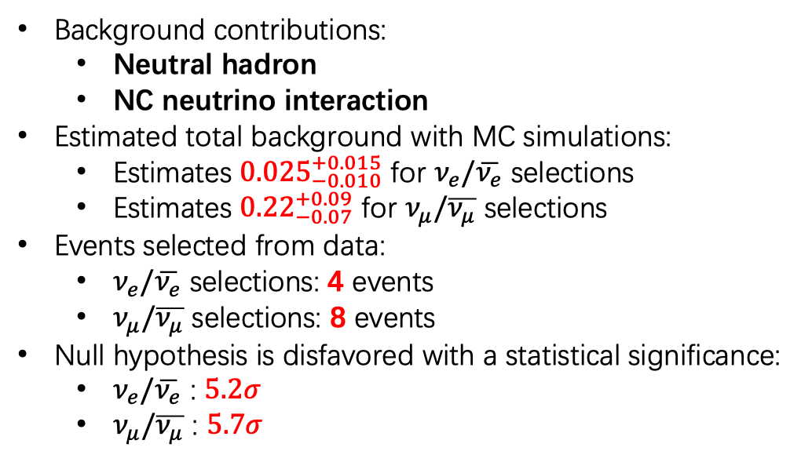


$ν_{e}/\overline{ν_{e}}$ and $ν_{μ}/\overline{ν_{μ}}$ Cross Section @ FASER$ν$ in 2022
﻿10.1103/PhysRevLett.133.021802
A $ν_{e}$ CC candidate event
Background Estimation
Background contributions:
Neutral hadron
NC neutrino interaction
Estimated total background with MC simulations:
Estimates ${0.025}_{−0.010}^{+0.015}$ for $ν_{e}/\overline{ν_{e}}$ selections
Estimates ${0.22}_{−0.07}^{+0.09}$ for $ν_{μ}/\overline{ν_{μ}}$ selections
Events selected from data:
$ν_{e}/\overline{ν_{e}}$ selections: 4 events
$ν_{μ}/\overline{ν_{μ}}$ selections: 8 events
Null hypothesis is disfavored with a statistical significance:
$ν_{e}/\overline{ν_{e}}$ : $5.2σ$
$ν_{μ}/\overline{ν_{μ}}$ : $5.7σ$
A $ν_{μ}$ CC candidate event

Slide 17
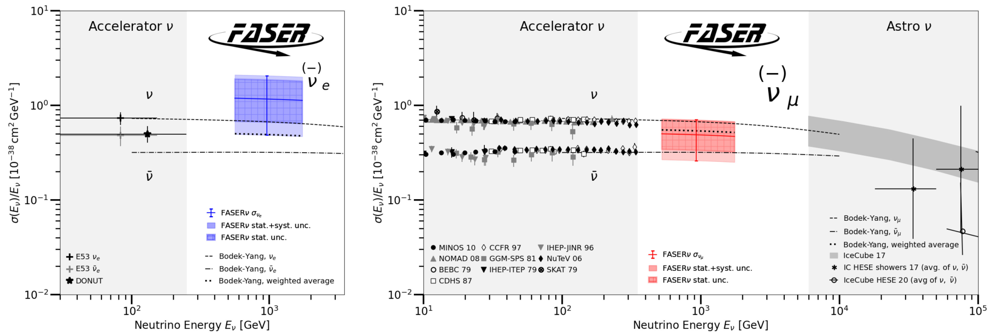
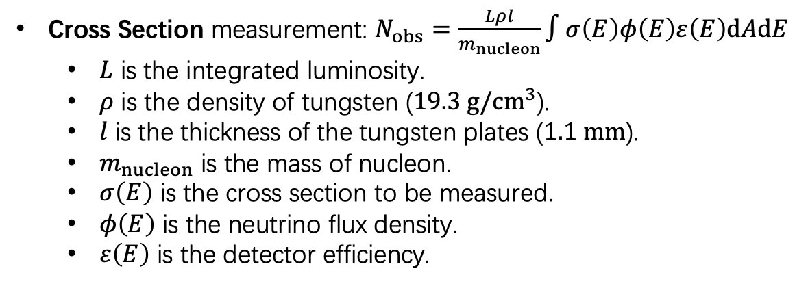

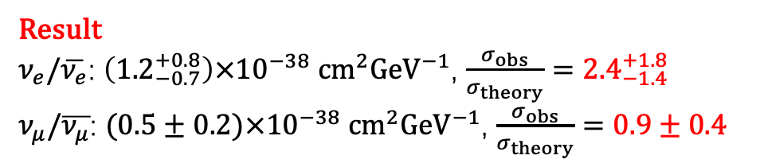
$ν_{e}/\overline{ν_{e}}$ and $ν_{μ}/\overline{ν_{μ}}$ Cross Section @ FASER$ν$ in 2022
Cross Section measurement: $N_{obs}=\frac{Lρl}{m_{nucleon}}∫σ\left(E\right)φ\left(E\right)ε\left(E\right)dAdE$
$﻿L$ is the integrated luminosity.
﻿$ρ$ is the density of tungsten ($19.3 g/cm^{3}$).
$l$ is the thickness of the tungsten plates ($1.1 mm$).
$m_{nucleon}$ is the mass of nucleon.
$σ\left(E\right)$ is the cross section to be measured.
$φ\left(E\right)$ is the ﻿neutrino flux density.
$ε\left(E\right)$ is the detector efficiency.
﻿10.1103/PhysRevLett.133.021802
Result
$ν_{e}/\overline{ν_{e}}$: $\left({1.2}_{−0.7}^{+0.8}\right)×{10}^{−38} cm^{2}GeV^{−1}$, $\frac{σ_{obs}}{σ_{theory}}={2.4}_{−1.4}^{+1.8}$
$ν_{μ}/\overline{ν_{μ}}$: $(0.5±0.2)×{10}^{−38} cm^{2}GeV^{−1}$, $\frac{σ_{obs}}{σ_{theory}}=0.9±0.4$
Assuming ﻿the ratio of the incoming neutrino to antineutrino fluxes to be 1.04 for $ν_{e}$ and 0.61 for $ν_{μ}$.

Slide 18
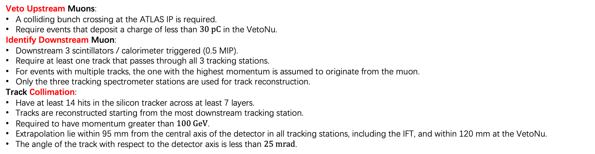
$ν_{μ}$ and $\overline{ν_{μ}}$ Differential Cross Section and Flux @ FASER in 2022 and 2023
First Direct Observation of Collider Neutrinos!
﻿10.1103/PhysRevLett.131.031801
﻿10.1103/PhysRevLett.134.211801
VetoNu Scintillator Station
An integrated luminosity of $(65.6±1.4) fb^{−1}$ ﻿with pp collisions at $13.6 TeV$.
Typical signal: A collimated muon downstream without upstream one in the time window.
Veto Upstream Muons:
﻿A colliding bunch crossing at the ATLAS IP is required.
﻿Require events that deposit a charge of less than $30 pC$ in the VetoNu.
Identify Downstream Muon:
Downstream 3 scintillators / calorimeter triggered (0.5 MIP).
﻿Require at least one track that passes through all 3 tracking stations.
﻿For events with multiple tracks, the one with the highest momentum is assumed to originate from the muon.
﻿Only the three tracking spectrometer stations are used for track reconstruction.
Track Collimation:
﻿Have at least 14 hits in the silicon tracker across at least 7 layers.
﻿Tracks are reconstructed starting from the most downstream tracking station.
﻿Required to have momentum greater than $100 GeV$.
Extrapolation lie within 95 mm from the central axis of the detector in all tracking stations, including the IFT, and within 120 mm at the VetoNu.
﻿The angle of the track with respect to the detector axis is less than $25 mrad$.
Event Selection

Slide 19




$ν_{μ}$ and $\overline{ν_{μ}}$ Differential Cross Section and Flux @ FASER in 2022 and 2023
﻿10.1103/PhysRevLett.134.211801
Background Estimation
Inefficiency of VetoNu: measured through either layer response events, $\sim {10}^{−6}$.
Geometric Background: ﻿muons evade the VetoNu geometrically, ﻿extrapolate from sideband data, $\sim 0.5$.
Neutral Hadron: estimated from simulation, $\sim {10}^{−3}$.
Non-signal Neutrino Events: $ν_{e}CC,ν_{τ}CC, ν_{μ}CC nonfid, νNC$, estimated from simulation, $\sim 25$.
The factor 0.8 ﻿describes that muons typically take 80% of the incident neutrino energy.
﻿Results in a more diagonal response matrix, and therefore smaller uncertainties on the unfolded number of neutrino interactions.
This binning roughly averaged events in 6 bins.
﻿The charge identification accuracy is significantly reduced above $1 TeV$, ﻿thus combine muons and antimuons with momentum larger than $1 TeV$ into a single bin.
Binning according to $\frac{q}{p_{μ}/0.8}$ in each selected event.
$$\left[−\frac{1}{100},−\frac{1}{300},−\frac{1}{600},−\frac{1}{1000},\frac{1}{1000},\frac{1}{300},\frac{1}{100}\right] GeV^{−1}$$

Slide 20



$ν_{μ}$ and $\overline{ν_{μ}}$ Differential Cross Section and Flux @ FASER in 2022 and 2023
﻿10.1103/PhysRevLett.134.211801
Binned number of neutrino interaction (unfolded) $n_{ν}^{k}$ are calculated by binned number of observed muons $n_{μ}^{i}$:
$$n_{μ}^{i}=\sum_{k}{M_{ik}ε_{k}n_{ν}^{k}}+n_{bkg}^{i}$$
$M_{ik}$ ﻿denotes the response matrix, which relates the number of selected events in $\frac{q}{p_{μ}/0.8}$ bin $i$ to the number of neutrinos interacted in $−\frac{L}{E_{ν}}$ bin $k$. ($L$ is the lepton number of the neutrino)
﻿$ε_{k}$ denotes the efficiency of neutrino events to be reconstructed within the fiducial volume.
﻿ $n_{bkg}^{i}$ are the estimated backgrounds.
Response matrix and efficiency are ﻿obtained from simulation and systematic uncertainties are implemented with nuisance parameters.
$\frac{q}{p_{μ}/0.8}$ / $−\frac{L}{E_{ν}}$ | $$\left[−\frac{1}{100},−\frac{1}{300}\right]$$ | $$\left[−\frac{1}{300},−\frac{1}{600}\right]$$ | $$\left[−\frac{1}{600},−\frac{1}{1000}\right]$$ | $$\left[−\frac{1}{1000},\frac{1}{1000}\right]$$ | $$\left[\frac{1}{1000},\frac{1}{300}\right]$$ | $$\left[\frac{1}{300},\frac{1}{100}\right]$$ | $$Total$$
$$n_{μ}^{i}$$ | $$50$$ | $$97$$ | $$71$$ | $$69$$ | $$48$$ | $$27$$ | $$362$$
$$ε_{k} (\%)$$ | $$13.5±1.2$$ | $$23.7±1.7$$ | $$30.8±2.6$$ | $$36.8±3.0$$ | $$40.1±3.1$$ | $$23.5±2.4$$ | $$28.3±1.9$$

Slide 21




$ν_{μ}$ and $\overline{ν_{μ}}$ Differential Cross Section and Flux @ FASER in 2022 and 2023
Response Matrix
Efficiency
Observed: $338.1±19.0\left(stat\right)±8.8(sys)$
Unfolded: $1242.7±137.1$
(subtracted the number of expected background events)

Slide 22




$ν_{μ}$ and $\overline{ν_{μ}}$ Differential Cross Section and Flux @ FASER in 2022 and 2023
﻿10.1103/PhysRevLett.134.211801
Differential Cross Section:
$$σ_{k}=\frac{n_{ν}^{k}}{ρ_{A}Lφ_{sim}^{k}}$$
Differential Flux Density:
$$φ_{k}=\frac{n_{ν}^{k}}{ρ_{A}Lσ_{sim}^{k}}$$

Slide 23
Upgrading @ FASER AHCAL in 2026

Slide 24






CEPC AHCAL Protype
CEPC AHCAL
FASER AHCAL
FASER AHCAL
Same protype, but new usage!
Current idle, can be used in FASER Experiment
A calorimeter protype originally designed for CEPC.
40 sensitive layers interleaved by iron plates.
$18×18$ Channels / Layer
Spatial resolution $\sim 5 cm$.
40 Layers
“SiPM-onTile” Unit
Sensitive Layers

Slide 25











An Off-axis Detector for $ν_{e}$ CC from Charm
$π$ and $K$ source distribution
Red is charm
Beam
FASER$ν$ ($η>8.5$)
AHCAL ($6.5<η<7.6$)
Red is charm
More charm originated neutrinos!
Source from $π$ and $K$ are compared in FASER.
Simulation for source hadron of $ν_{e}/\overline{ν_{e}}$ and $ν_{μ}/\overline{ν_{μ}}$ at AHCAL.
Help constrain gluon PDF until $x\sim {10}^{−6}$.
Use LHC Run3 @ 2026, $\sim 65 fb^{−1}$ data.
Blue is charm
FASER Neutrino Source ($65.6 fb^{−1}$)
AHCAL Neutrino Source ($680 fb^{−1}$)
$65 fb^{−1}$ @ AHCAL | $ν_{e}$ Charged Current |  | $ν_{μ}$CC | $ν_{τ}$ CC | Neutral Current
 | Light Hadron | Charm Hadron
# of interaction | $$31.1$$ | $$76.3$$ | $$600.4$$ | $$6.03$$ | $$230.2$$
+ trigger | $$21.9$$ | $$53.7$$ | $$422.6$$ | $$4.15$$ | $$144.9$$
+ selection (CNN) | $$7.4$$ | $$28.6$$ | $$5.6$$ | $$0.5$$ | $$3.6$$

Slide 26

Summary & Conclusion
Introduced FASER detector @ LHC.
Two independent components for neutrino research.
Electronic component
FASER$ν$
Estimated neutrino results from FASER @ LHC Run3.
Current neutrino results from 3 independent detector components.
Pilot detector @ 2018: collider neutrino candidates with significance of $2.7σ$.
FASER$ν$ @ 2022: find collider $ν_{e}/\overline{ν_{e}}$ and $ν_{μ}/\overline{ν_{μ}}$, and measured cross section.
FASER @ 2022 and 2023: measured differential cross section and flux density of $ν_{μ}$ and $\overline{ν_{μ}}$.
Introduced off-axis AHCAL detector @ 2026.
Thanks!

Slide 27
Backup

Slide 28



FASER Position
Beam Direction

Slide 29

VetoNu Efficiency Measurement
Smaller than ${10}^{−7}$ per layer.
﻿Assuming that the two scintillator layers are independent, ${10}^{−6}$ background are expected.

Slide 30



HTS (﻿Hyper Track Selector) System

Slide 31





LHC and AHCAL Timeline
LHC Timeline
LHC
HL-LHC
Sim
Commissioning
Data
$$\text{6}\text{5} fb^{−1}$$
Upgrade
$$\text{6}80 fb^{−1}$$
Proposed
Install
AHCAL Timeline
Install
2024.11 Hidetoshi Otono and Zhen Hu proposed to install AHCAL in FASER.
2024.11 – 2025.03 Simulation: MC simulation for expected result with Run3.
2025.04 – 2025.09 Commissioning: Functionality and Stability test at USTC.
2025.10 – 2025.12 Commissioning: Integration into FASER DAQ and veto system installation.
2025.12 – 2026.01 Installation: Install AHCAL into TI12.
2026.03 – 2026.05 Data Taking: Use $65 fb^{−1}$ during LHC Run3 @ 2026.
2026.06 – 2027 Analysis: use CNN method to distinguish $ν_{e}/\overline{ν_{e}}$.

Slide 32



AHCAL Cosmic Ray Commissioning
Cosmic Ray
Control PCs
TLU
40 Sensitive Layers
DAQ
Power Supply
Notes:
强调使用宇宙线。

Slide 33



AHCAL Cosmic Ray Data
Hits in each Spiroc2E
Continuous Trigger ID from TLU
5Hz in Cosmic Ray

Slide 34
























Distinguish Neutrino Flavors: 3D CNN
$ν_{e}$CC
True Energy deposits [MeV]
EM shower
$$ν_{e}$$
$$e$$
FASER MC preliminary
$$W$$
$$N$$
Hadron shower
$ν_{μ}$CC
z [mm]
Trainning Sample:
$6.5×{10}^{6}$ events
$ν_{e}CC$ Selection
True Energy deposits [MeV]
$$ν_{μ}$$
$$μ$$
FASER MC preliminary
$$W$$
$$μ$$
$$N$$
Hadron shower
z [mm]
Require $PID>1.95$ [*]
Result:
$ν_{e}CC light:21.9→7.4 (34.0\%)$
$ν_{e}CC charm:53.7→28.6 (53.3\%)$
$ν_{μ}CC:422.6→5.6 (1.3\%)$
$NC:144.9→3.56 (2.5\%)$
NC
True Energy deposits [MeV]
[*] $ν_{e}CC PID score=\ln\left(\frac{p_{ν_{e}CC}}{0.4p_{ν_{e}CC}+0.6p_{NC}}\right)$
$$ν$$
$$ν$$
FASER MC preliminary
$$Z$$
$$N$$
Hadron shower
z [mm]

Slide 35

AHCAL Absorber Materials
All the parts, including absorber plate and frame, made of carbon steel Q235 (Chinese Standard).
Not sure about which sub-grade (A, B, C, D).
A link may be helpful to introduce the material: https://www.theworldmaterial.com/q235-steel/

