Slide 1
Rare Meson->nu anti-nu Deacays Invisible Decays and Light Dark Matter
Xiao-Gang He
Tsung-Dao Lee Institute
Shanghai Jiao Tong University
arXive: 2403.12485 (JHEP 07 (2024)168)
XG He, XD Ma, M. Schmidt, G. Valencia, and R. Volkas
arXive:2505.02031( PRD 112(2025) 055025)
XG He, XD Ma, J. Tandean, G. Valencia
vSTEP 2025
10/24-27/2025

Slide 2
1. A window for a light flavorful dark matter 2. B to K invisible and K to π invisible and DM 3. DM relic density and indirect searches 4. Direct DM searches and Migdal effects 5. Conclusion

Slide 3
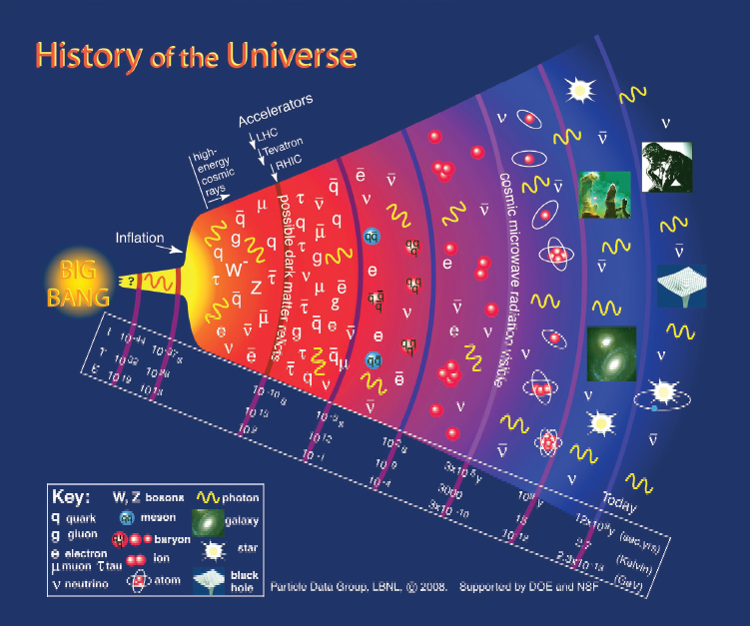
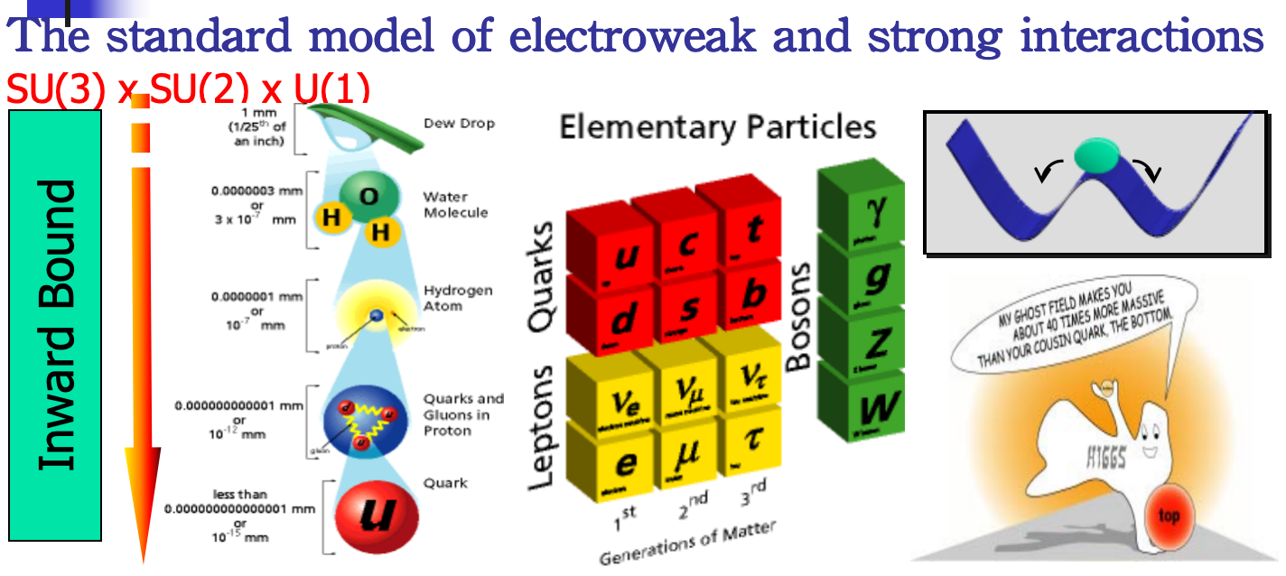
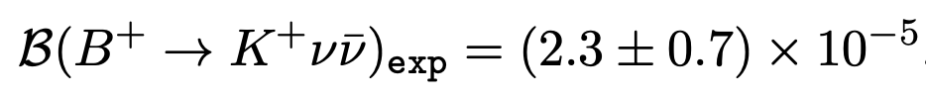
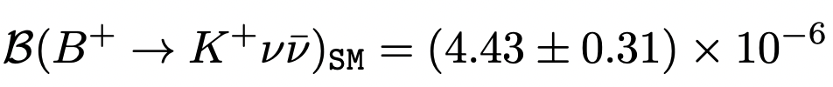

1. A window for a Light Flavorful Dark Matter
Recent BELLE-II and NA62 results
Gravitational effects from cosmology and astrophysics need the existence of Dark Matter! This is new physics beyond the standard model. WIMP is among the best candidates for DM. How it interacts with the SM sector, not known! Just gravity, may be other interactions or it may be specific particle-phlic or particle-phobic.
On the other hand, there are some puzzles or anomalies in particle physics, such as the recently reported excess of B⁺ to K⁺ ѵѵ and room in K⁺ to π⁺ ѵѵ for new physics beyond SM.
DM couplings to SM are flavor dependent
There is the window of a light dark matter for invisible decays!!!
The SM predictions
There is an excess for B to K vv
There is the
window for something new !

Slide 4
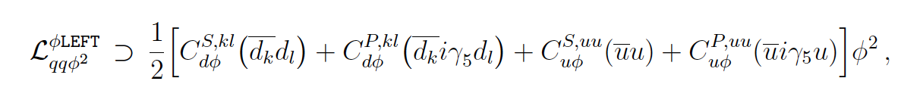
A light flavorful dark matter solution -- DM couplings are flavor dependent
The B⁺ -> K⁺ invisible is due to B⁺ -> K⁺ Φ Φ (Φ dark matter). At the quark level due to: b -> s Φ Φ.
The allowed for K⁺ to π⁺ Φ Φ is due to, at the quark level: s -> d Φ Φ
If true, one should also check if the right relic density for DM can be realized.
At the quark level due to: Φ Φ -> dd, uu!
In a model independnet way, the following minimal interactions terms are needed
There are stringent constraints from indirect DM searches, effects on CMB,
and also direct DM search via Migdal effect.
We find that light DM with a mass m_{Φ} between 110 MeV - 136 MeV is allowed and solves all problems
Light Flavorful Dark Matter Models !

Slide 5




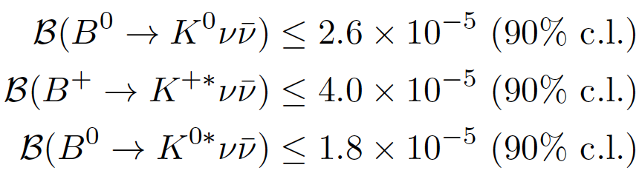
2. B to K invisible and K to π invisible and MD
Combining previous bound,
Room for new physics:
Also need to satisfy constraints
The invisible is due to Φ Φ pair in b to s Φ Φ decay induced B to K invisible

Slide 6
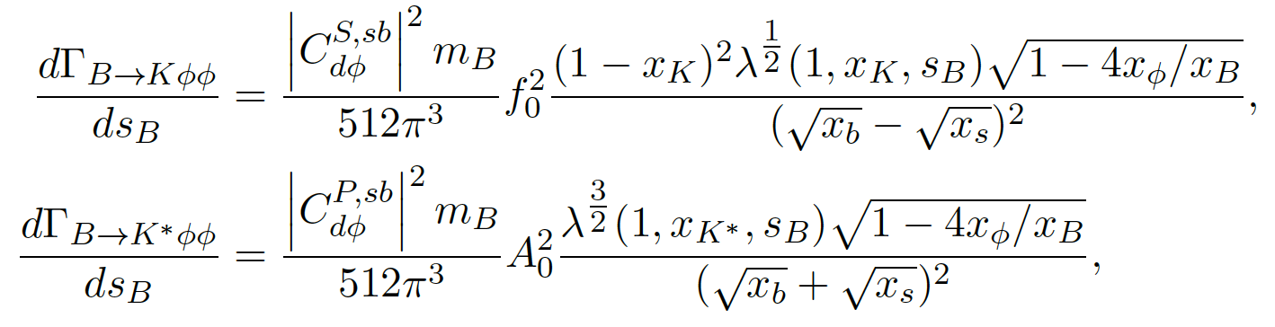


f₀ and A₀ use numerical fitting from “Dispersive analysis of B → K(∗) and
Bs→ ϕ form factors,” JHEP 12 (2023) 153, arrive:2305.06301 [hep-ph].

Slide 7
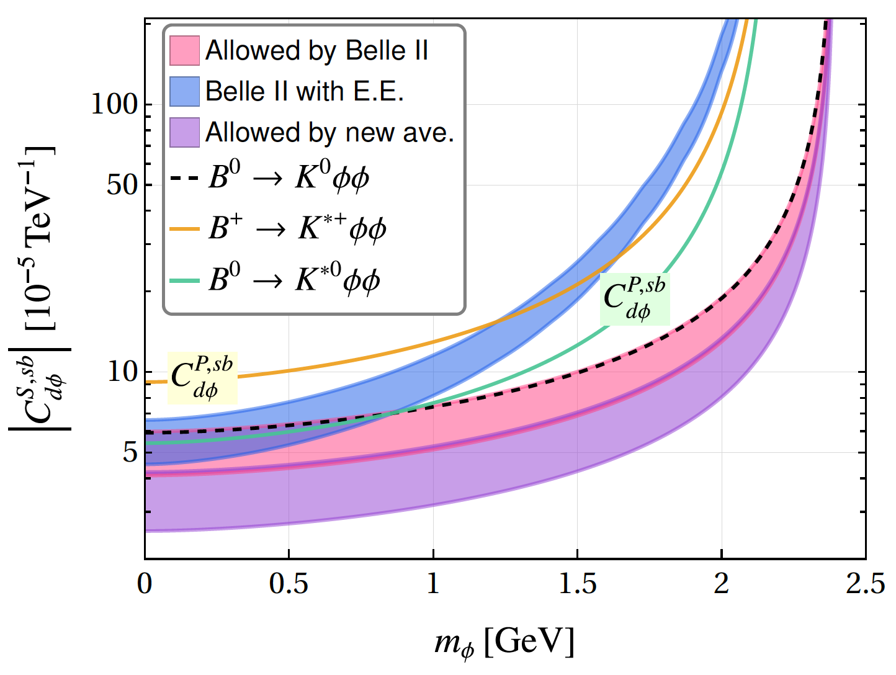
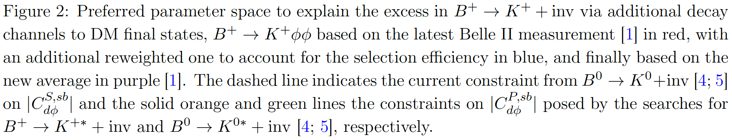
A light flavorful DM can solve the Belle-II excess.
Without conflicting bounds from other decay modes!
Can do more?

Slide 8
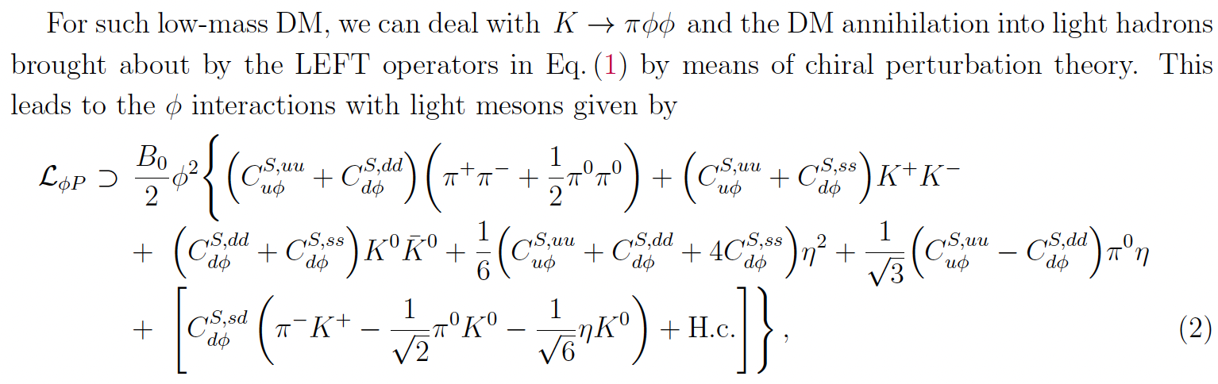
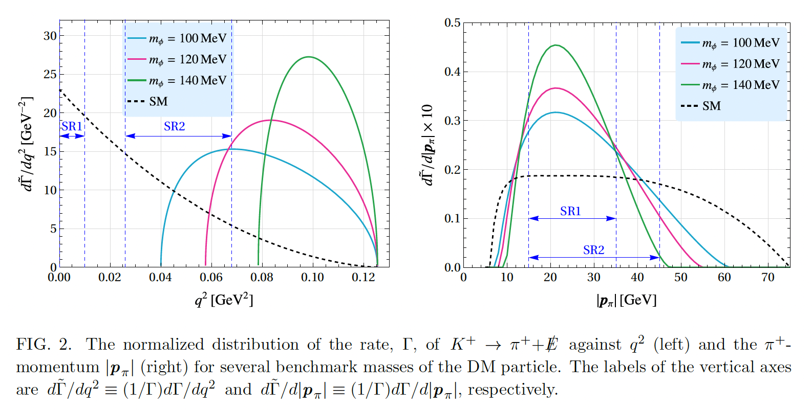
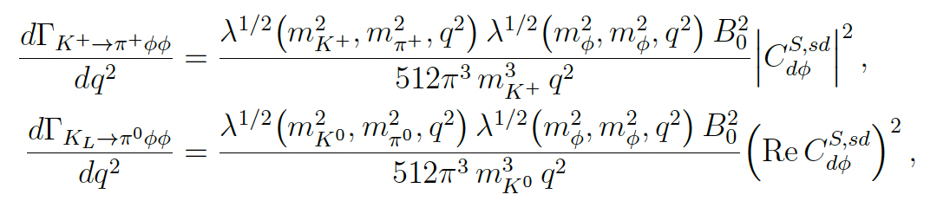
NA62 experiment has measured the rarest SM decay K to π vv process
There is a gap between central values
Allow, s to d Φ Φ decay, induced K to π invisible. Theoretical calculations
Chiral realization

Slide 9
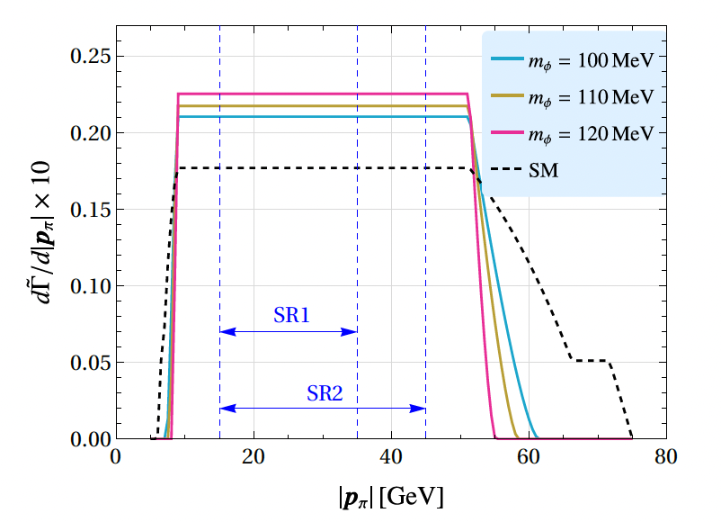
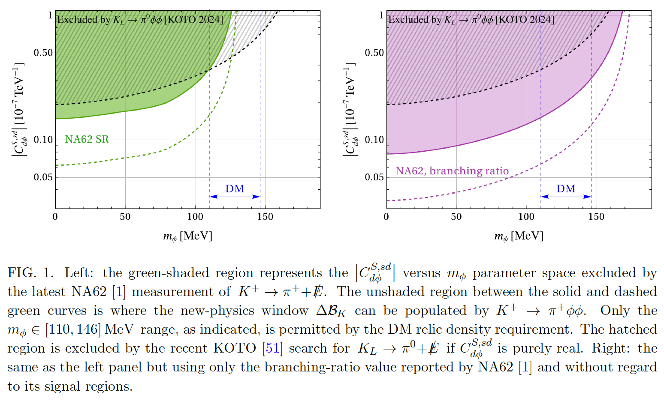
There is room for light DM to contribute to K⁺ to π⁺ Φ Φ
A light flavorful DM allowed!
Refined spectrum measurement for K⁺ to π⁺ vv will test the scenario proposed here
Koto experiment to provide more information.

Slide 10
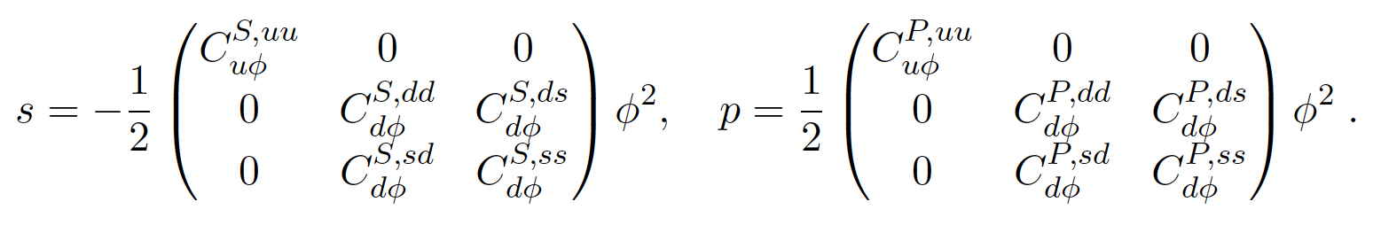
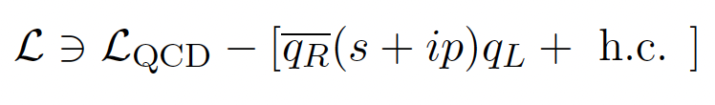
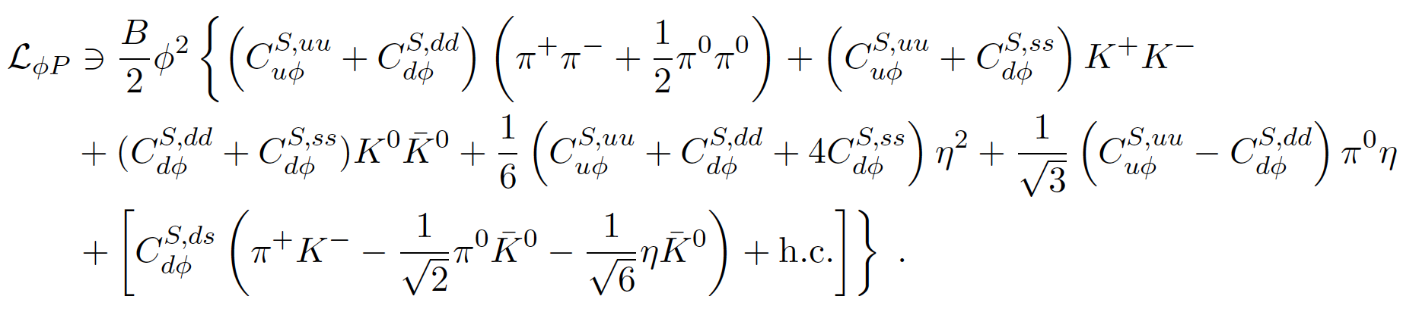
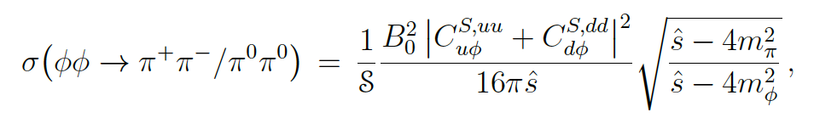
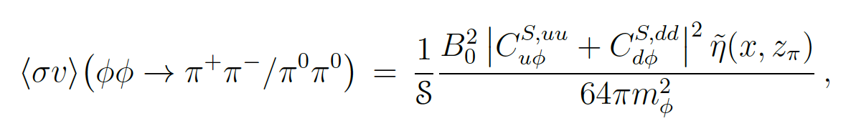

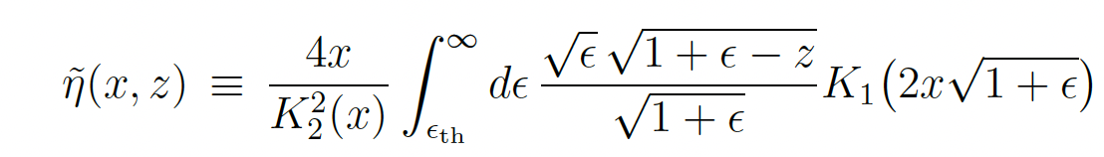


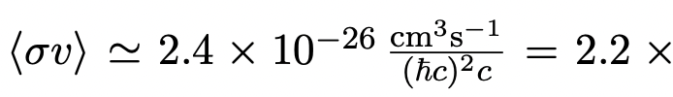

3. DM relic density and indirect seaches
DM relic density: Φ Φ -> uu, dd -> π⁺π⁺, π⁰π⁰ for m_{φ} <177 MeV for hadronic annihilation
also possible to photonic and leptonic finall states, there are some problems!
Chiral realization
DM relic density: Thermal averaged annihilation interaction rate
To produce the DM relic density, Ω h² = 0.12

Slide 11
Various Indirect DM effect constraints
mφ < 177 MeV the DM annihilates mostly into pion pairs, Φ Φ -> π⁺π⁺, π⁰π⁰ .
The neutral pions emit photons (π^{0-> γγ)} and the charged ones produce them radiatively or via the inverse Compton scattering of their secondary electrons/positrons off the background photons.
These processes can take place within the DM halo of the Milky Way galaxy.The DM couplings are subject to constraints from astrophysical X-ray and gamma-ray observations (from telescopes such as INTEGRAL, XMM-Newton, Fermi-LAT, etc).
When DM annihilation occurs during the epoch of CMB, Φ Φ -> π⁺π⁺, π⁰π⁰ formation in the early Universe, the energy injected into the cosmic fluid from the annihilation products can alter the CMB anisotropy spectrum.
Therefore, measurements of CMB temperature and polarization anisotropies also imply restrictions on the annihilation processes.
Among indirect effects, CBM anisotropy spectrum gives a better constraint!

Slide 12
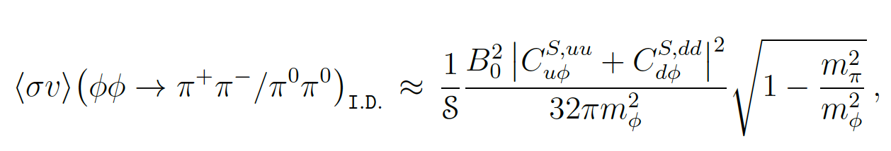
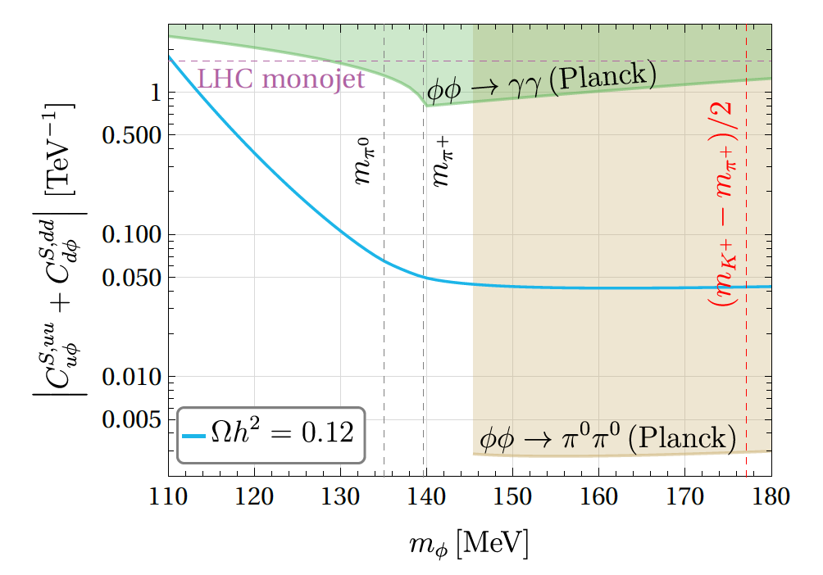
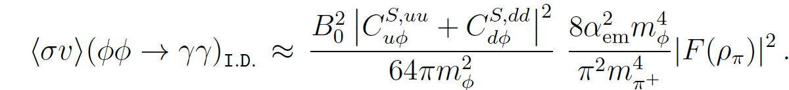
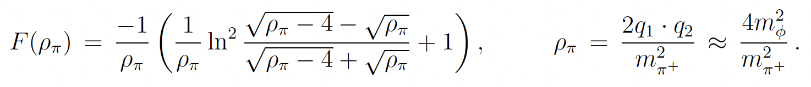
Indirect processes from effective interaction in the model
“I.D.” indicates that the quantity has been derived for DM indirect searches
LHC monojet production DM limit is also shown in the figurehe model
Very strongly constrain parameter space and also allowed DM mass range, but DM window allowed!!!

Slide 13

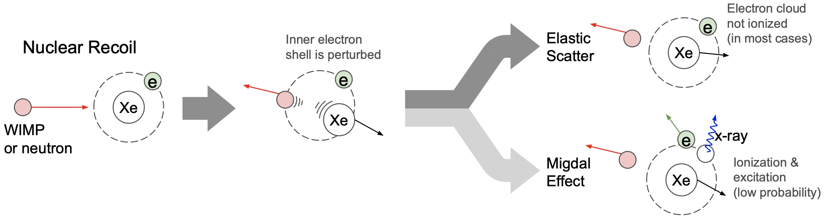

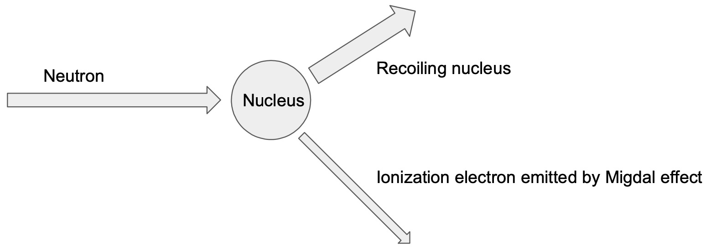
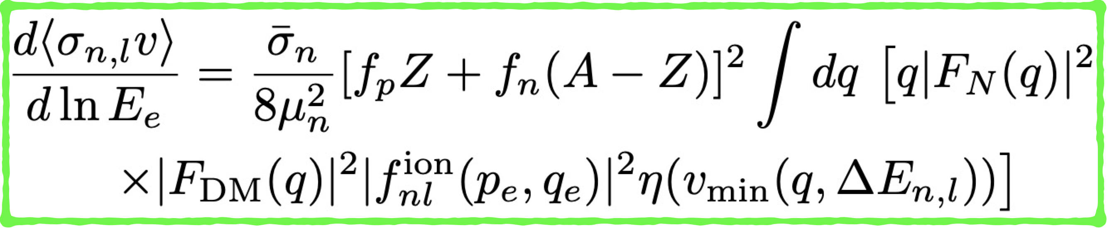
The Migdal effects and light DM constraints
4. Direct DM searches and Migdal effects
Threshold of electron too recoil for Xenon experiment: ~ 100 eV
Two tracks from the same vertex
short
Light DM recoil energy on nuclei too small, not sensitive.
But sensitive to electron reciol energy from Migdal effect
DM
No quenching!
long

Slide 14
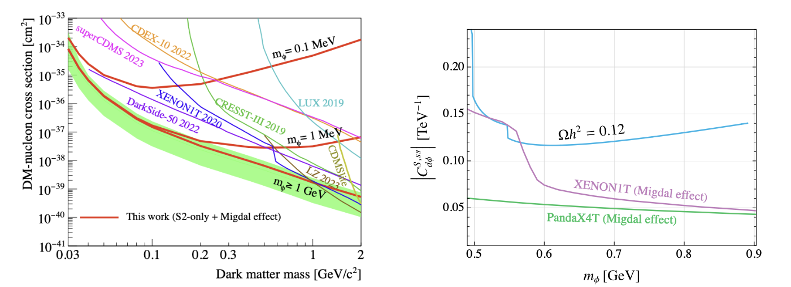
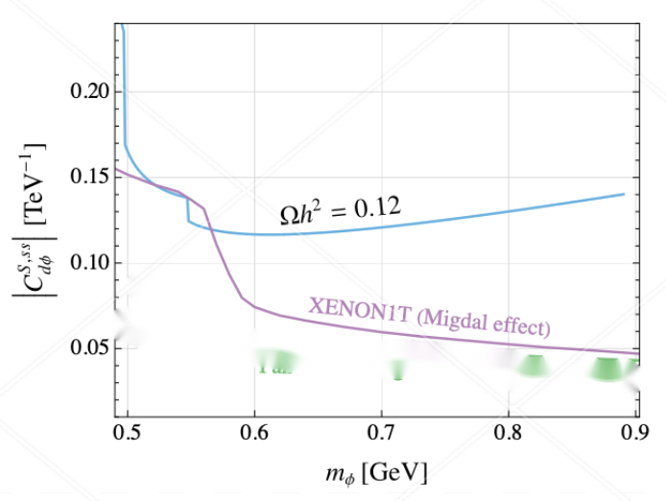

Left figure, m_{Φ} is mediator mass, not the dark mass.
Problem: If only a non-zero , ruled out by PandaX4T data
similarly for only C^{S,uu} and C^{S,dd} ruled out by data. Also even if only uu, dd together and allow cancellations, also ruled out.
But include uu, dd and ss all togheter, possible to have suviving regions!!

Slide 15
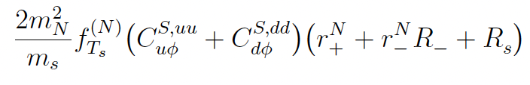

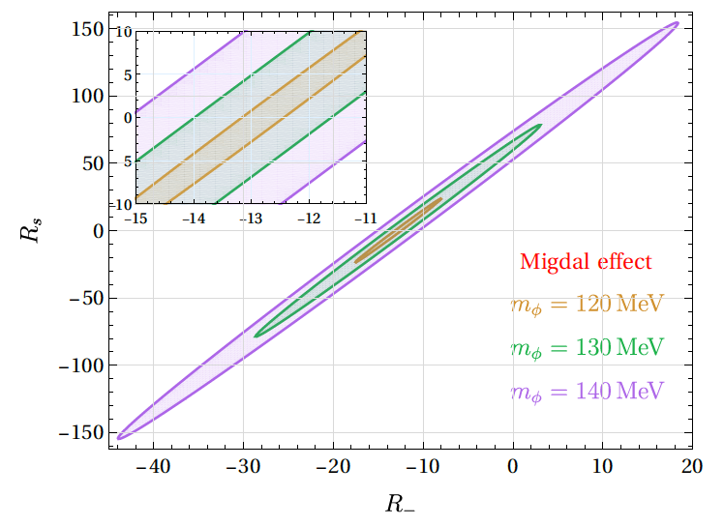

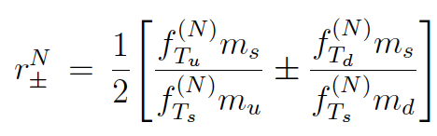
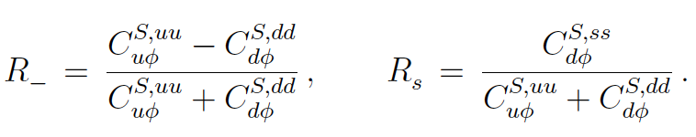
There are allowed parameter space Migdal effect constraints can be envaded. A light DM window of mass below 177 MeV exist!
Including Migdal effects from uu, dd, ss inside nuclei, there are parameter space to have DM mass below 177 MeV

Slide 16
5. Conclusion
It is viable to construct flavorful dark matter model in the window from recent NA62 result from K to π invisible satisfying:
DM relic density, indirect and direct detections for DM in the range 110 - 130 MeV
Further test of such models: Using another Nuclear target, such as CDEX data (⁶⁸Ge...) carry out a similar ananlysis!!
Reniormalzable model? Heavy vector quark fermion (arXiv: 2403.12458 (JHEP07(2024)168), or Two Higgs doblet models (arXiv: 2502.09603) possible.
Dark Matter to be fermion or vector types, under investigations.

Slide 17
Thank you for Listening

