Slide 1
Cosmological Signatures of Neutrino Seesaw mechanism
Chengcheng Han
Sun Yat-sen University
With Hongjian He, Linghao Song, Jingtao You, arXiv: 2412.21045(PRDL)，2412.16033(PRD)
The 2025 Beijing Particle Physics and Cosmology Symposium
2025.9.27

Slide 2
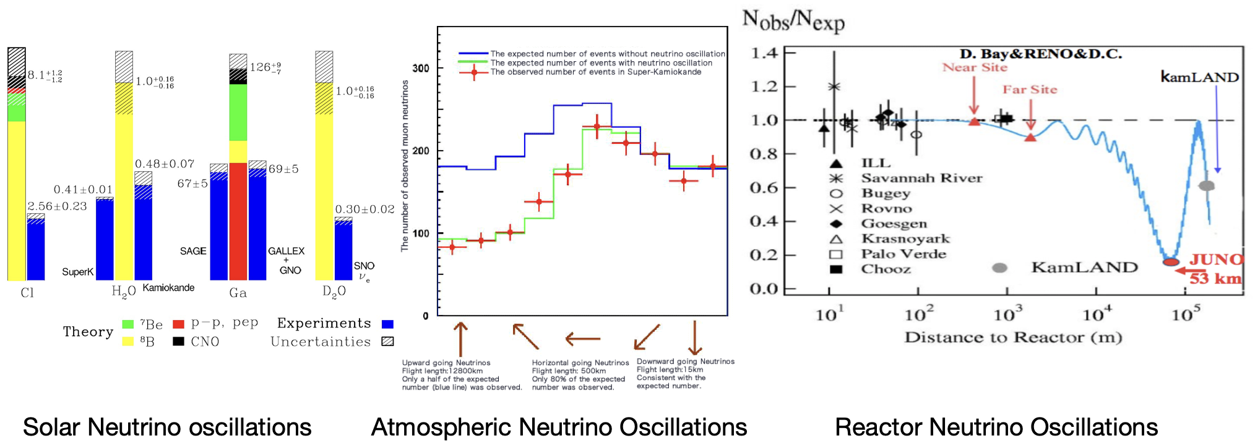
Neutrino masses
Neutrino oscillation indicates massive neutrinos

Slide 3
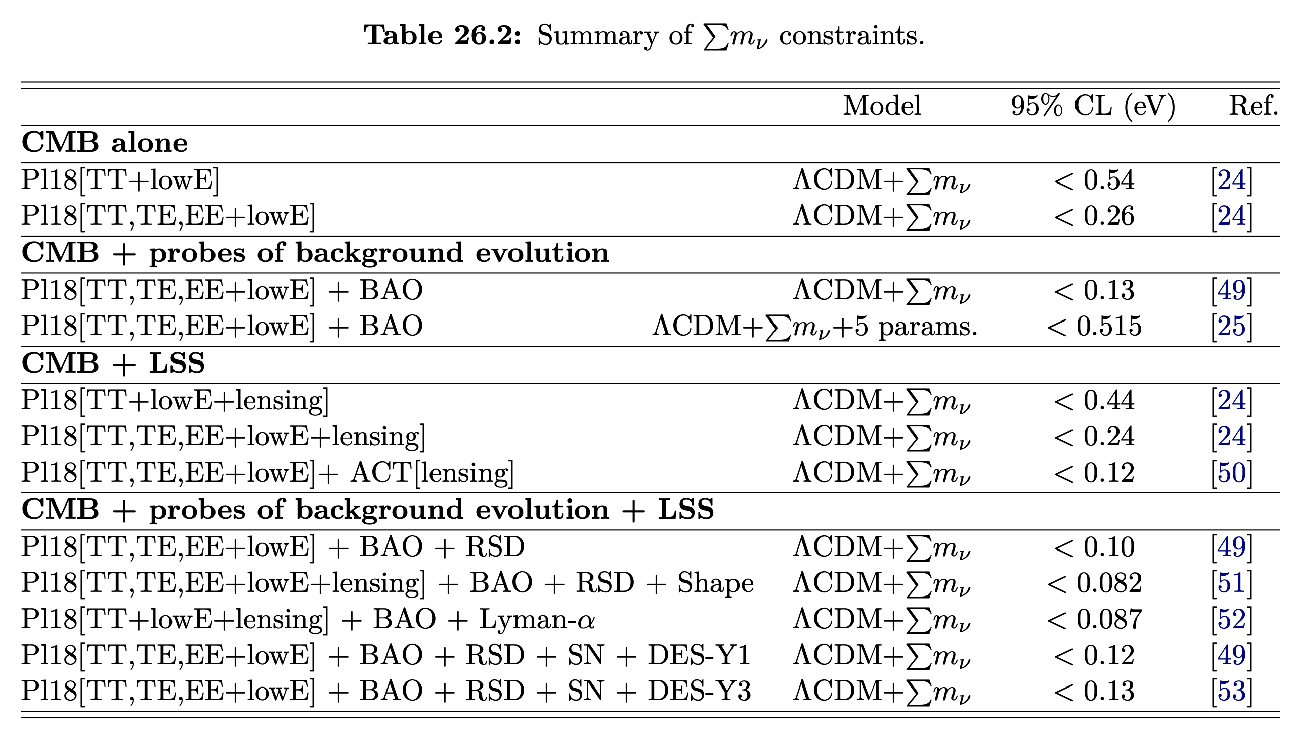
Cosmological limit
PDG
The heavy neutrino mass should be around 0.05 eV(IO)-0.06eV(NO)

Slide 4
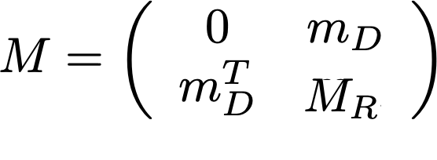
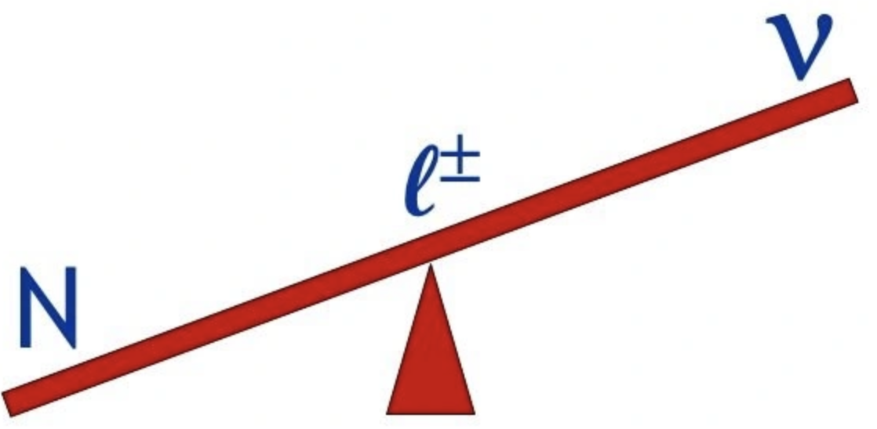
Seesaw mechanism
Origin of neutrino masses: seesaw mechanism
P. Minkowski ；T. Yanagida； S. L. Glashow；
M. Gell-Mann, P. Ramond and R. Slansky
Natural prediction of small neutrino masses
Explain the baryon asymmetry of the universe: leptogenesis
Baryogenesis Without Grand Unification, Fukugita and Yanagida, 1986’

Slide 5
Seesaw mechanism
If the Yukawa coupling is O(1)(as predicted by the GUT), the seesaw scale M_{R} should be around 10¹³⁻¹⁴ GeV, which is much beyond the reach of particle experiments.
How to test such high scale seesaw?

Slide 6
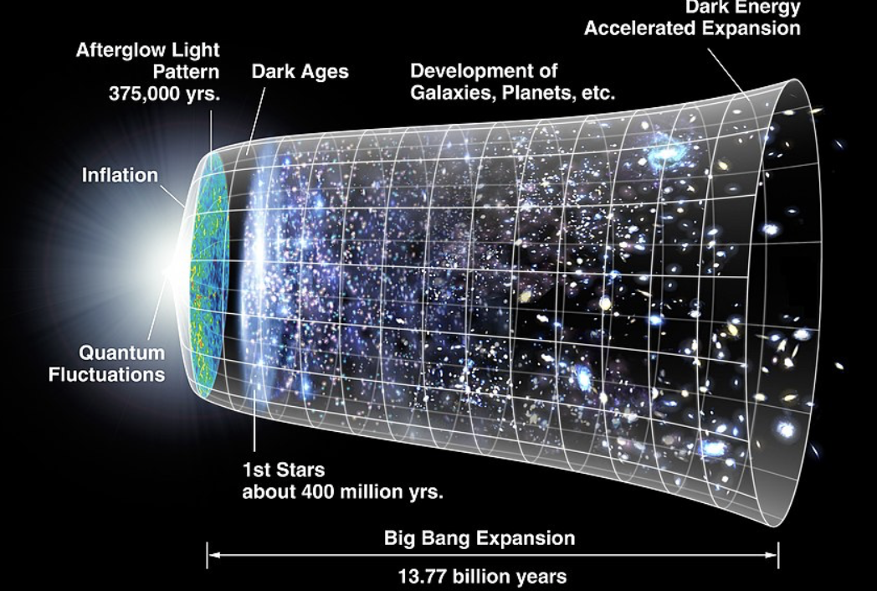
Inflation
Rapid expansion of the universe in the early time
Flatness problem
Horizon problem
Seeding the primordial anisotropies in CMB

Slide 7
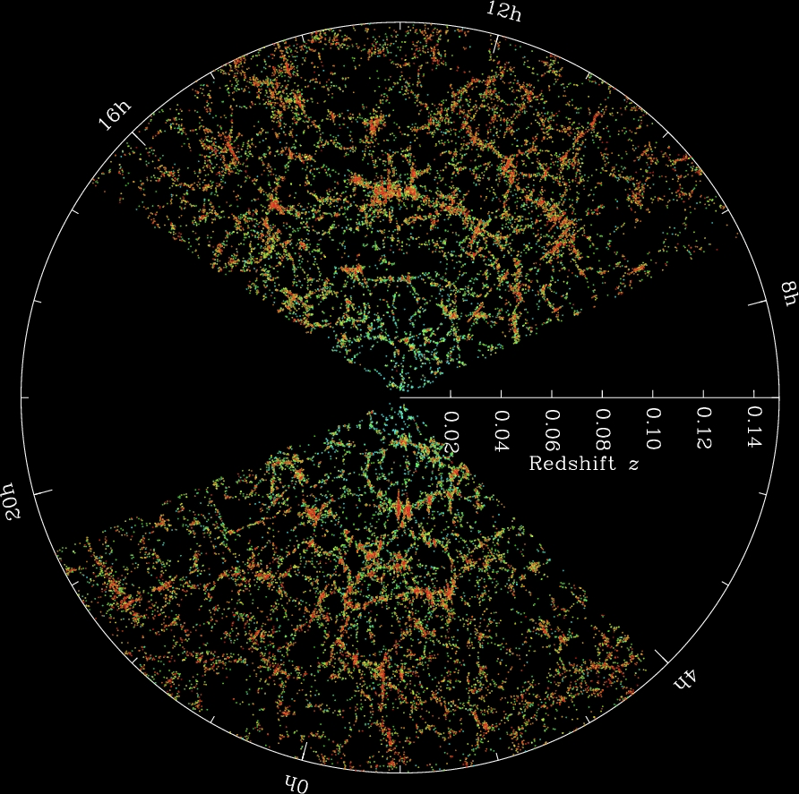
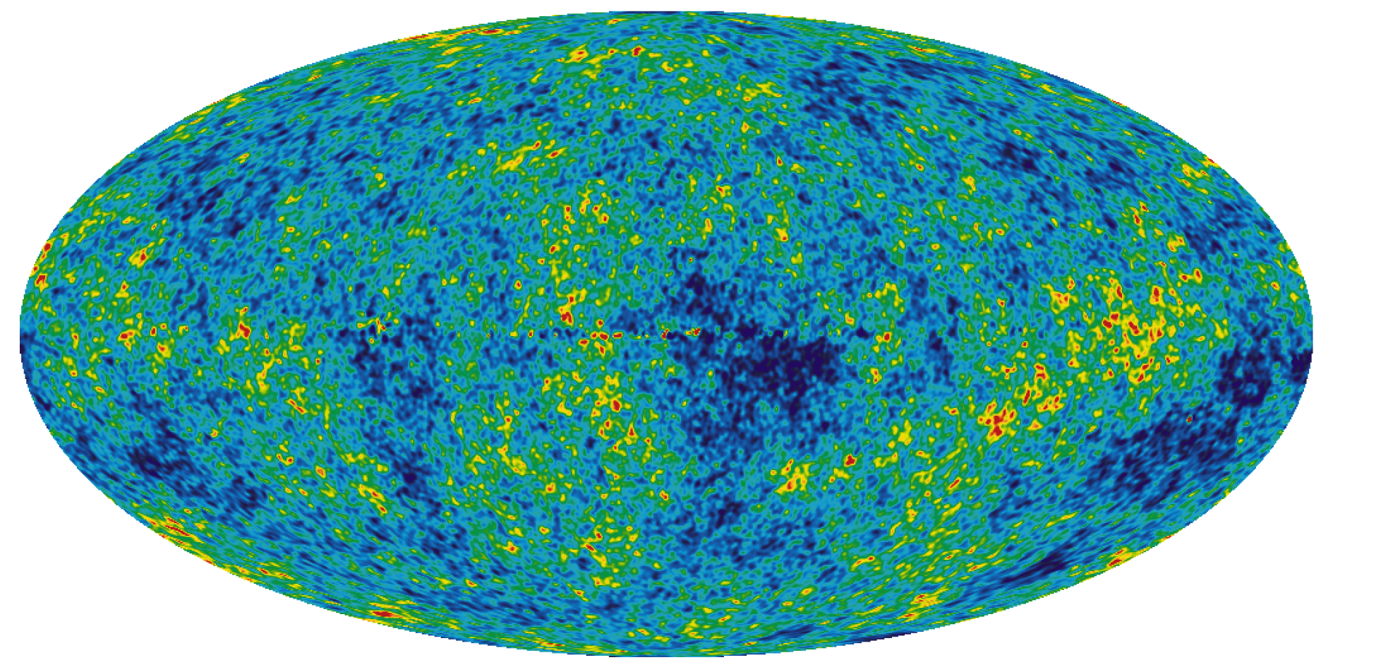

Inflation
Stretching quantum fluctuations to large scale
Such small fluctuations finally develops the large structure of our universe

Slide 8
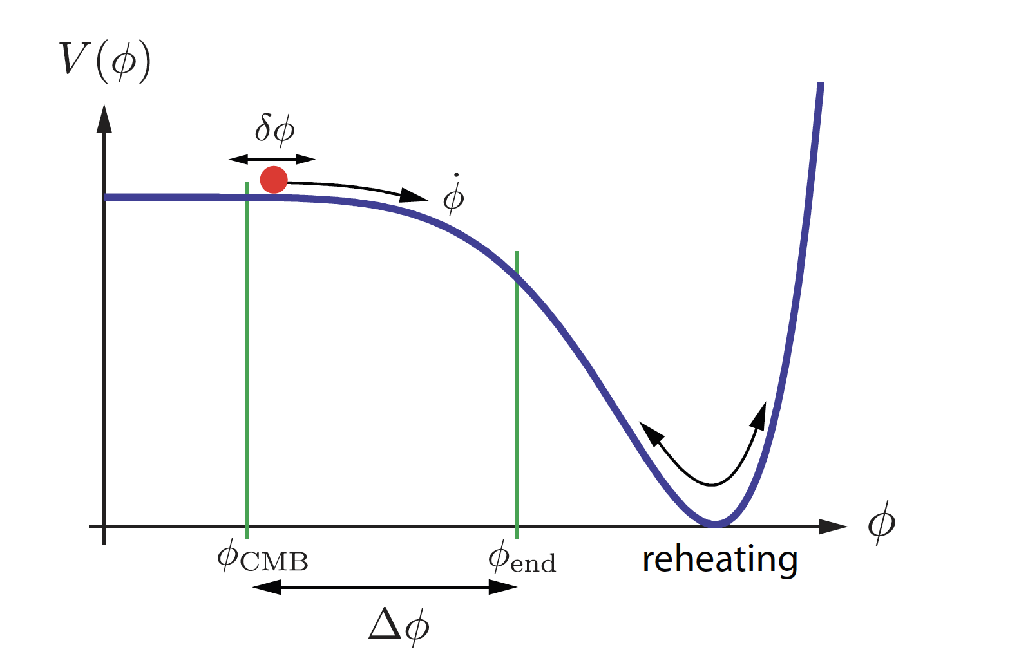
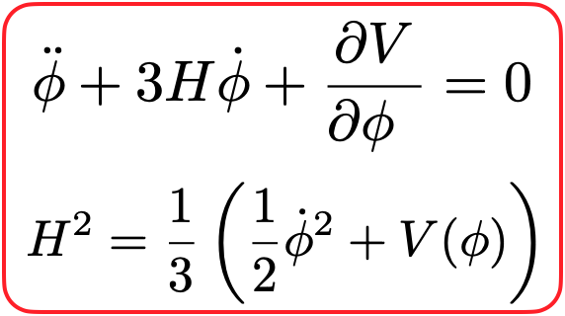
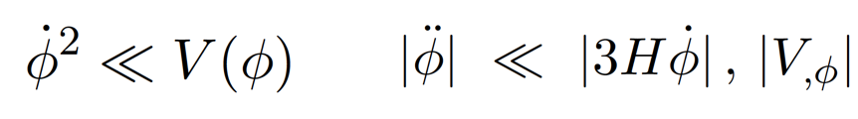
Slow-roll Inflation
Inflation is driven by a scalar field (inflaton)
Slow roll condition
Hubble parameter is nearly constant(de Sitter universe)
After inflation, inflaton oscillates at the bottom of the potential and finally decays into SM particles, then reheats the universe(still no clear how it occurs)

Slide 9
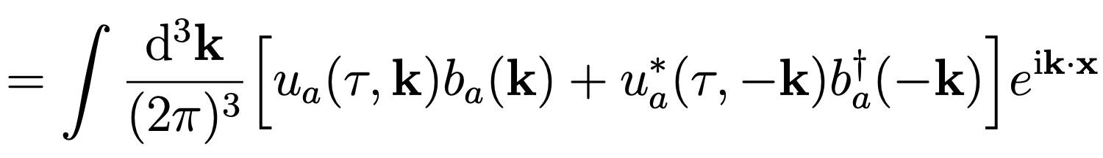
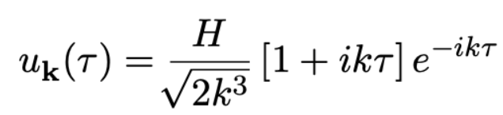
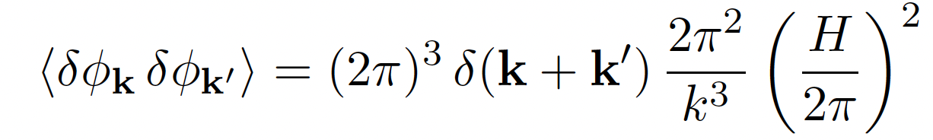
Slow-roll Inflation
In a de Sitter universe, scalar fields get quantum fluctuation
Quantum fluctuation of inflaton induces CMB anisotropies(from curvature perturbations)
In the single field inflation, the fluctuations should be nearly gaussian and adiabatic, close to scale invariant

Slide 10
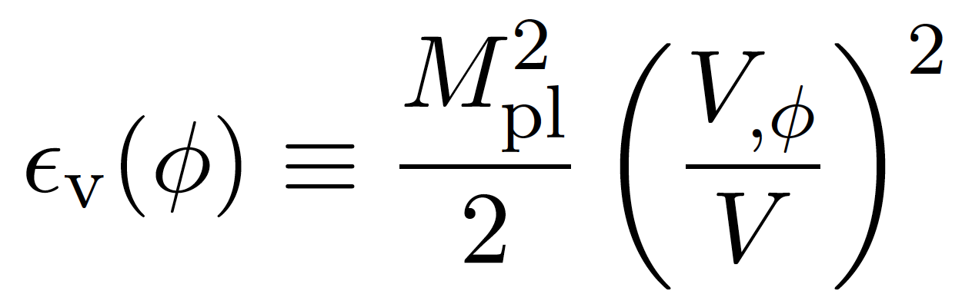
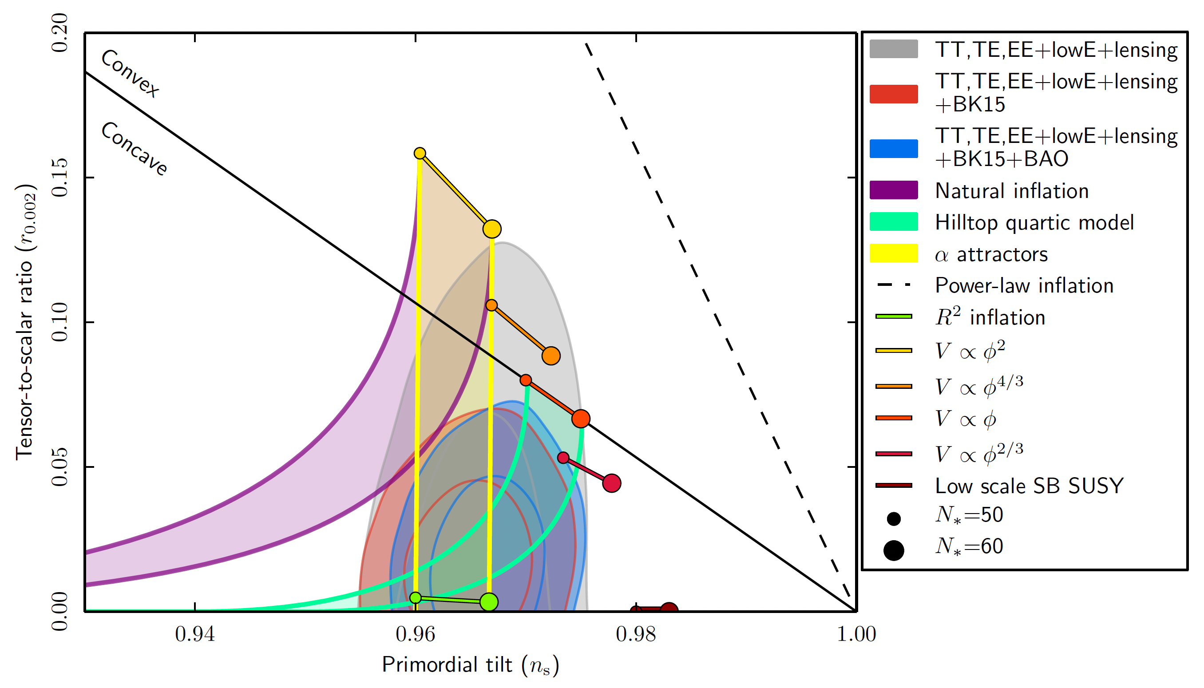
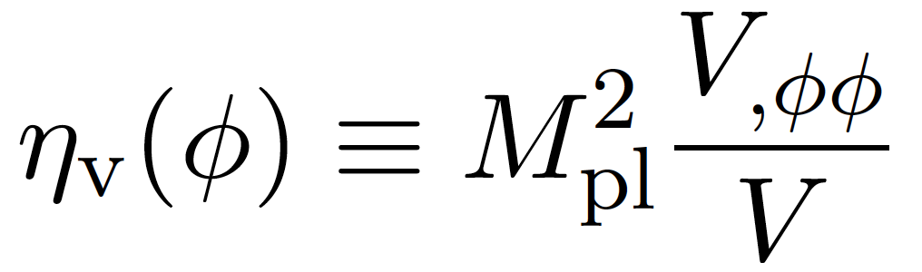
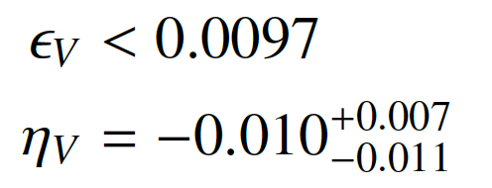
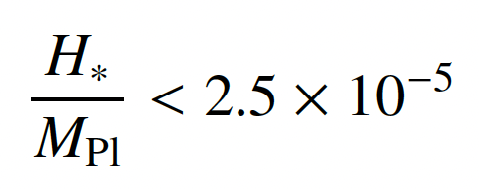
Inflation
Inflaton potential should be flat enough(shift-symmetry?)
Hubble scale could be as high as 6*10¹³ GeV(close to seesaw scale), providing access to the high scale physics

Slide 11
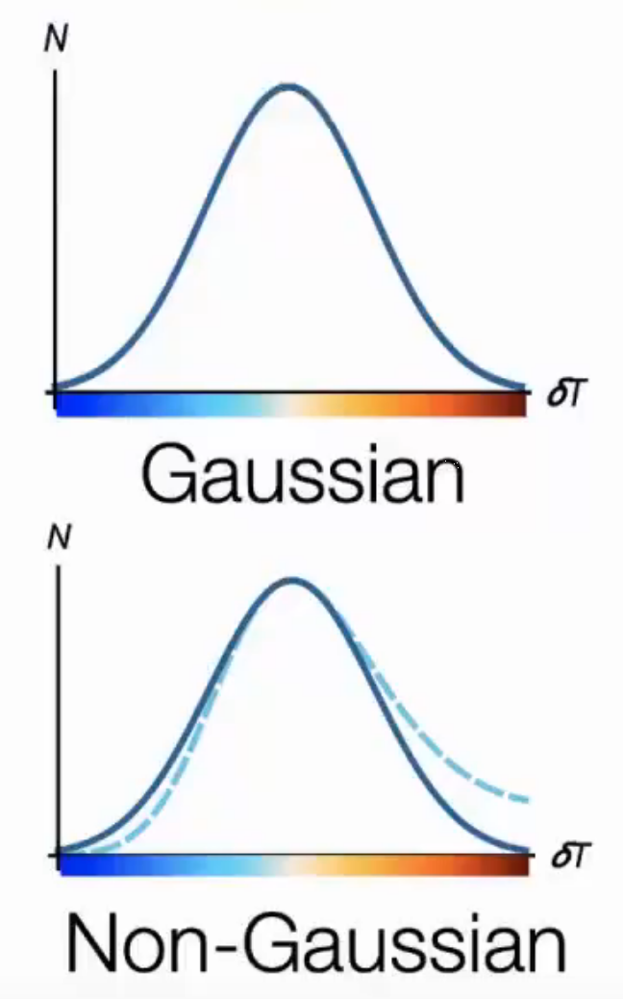
Non-Gaussianity
Non-Gaussianity is sensitive to new physics
New physics could induce large non-Gaussianity : multi-field inflation models, modulated reheating, curvaton scenario…
Current limit from Planck on local type f_{NL}~ O(10), future CMB observations, CMB S4, large scale structure observations DESI O(1), 21 cm tomography O(0.01-0.1)
Non-Gaussianity could provide information to the new particle mass, spin, interactions: cosmological collider signals
Nima Arkani-Hamed, Juan Maldacena, arXiv:1503.08043
Xingang Chen, Yi Wang, JCAP 04 (2010) 027

Slide 12
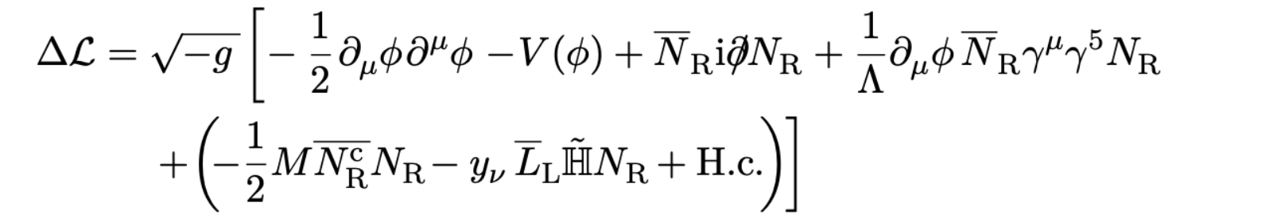
A minimal model
Minimal model incorporates inflation and seesaw
V(phi) is the potential for inflation is unknown but denominated by the mass term after inflation
Derivative coupling to keep the flatness of the inflaton potential(shift-symmetry, dim-4 coupling should be suppressed, otherwise the induced phi⁴ potential would destroy the flatness of the potential)
Lambda > 60 Hubble to keep perturbative unitarity
After inflation, inflaton oscillates at the bottom of the potential until decays into heavy neutrinos ( mphi > 2 mN). The heavy neutrinos quickly decay into SM particles and reheat the universe

Slide 13
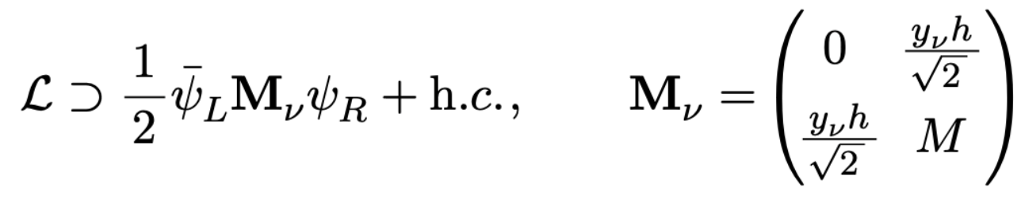
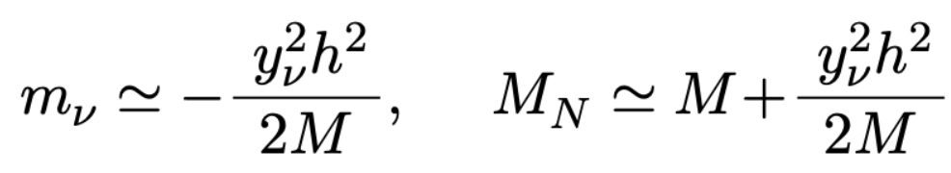
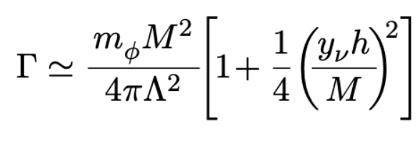
Seesaw mechanism
Consequence of the seesaw mechanism
Light neutrino gets a mass
Heavy neutrino mass are get lifted (h dependent)
Heavy neutrino mass is h dependent, then decay rate of the inflaton is h dependent:
What happens to h in the early universe?

Slide 14
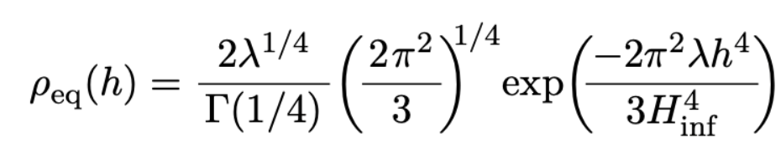
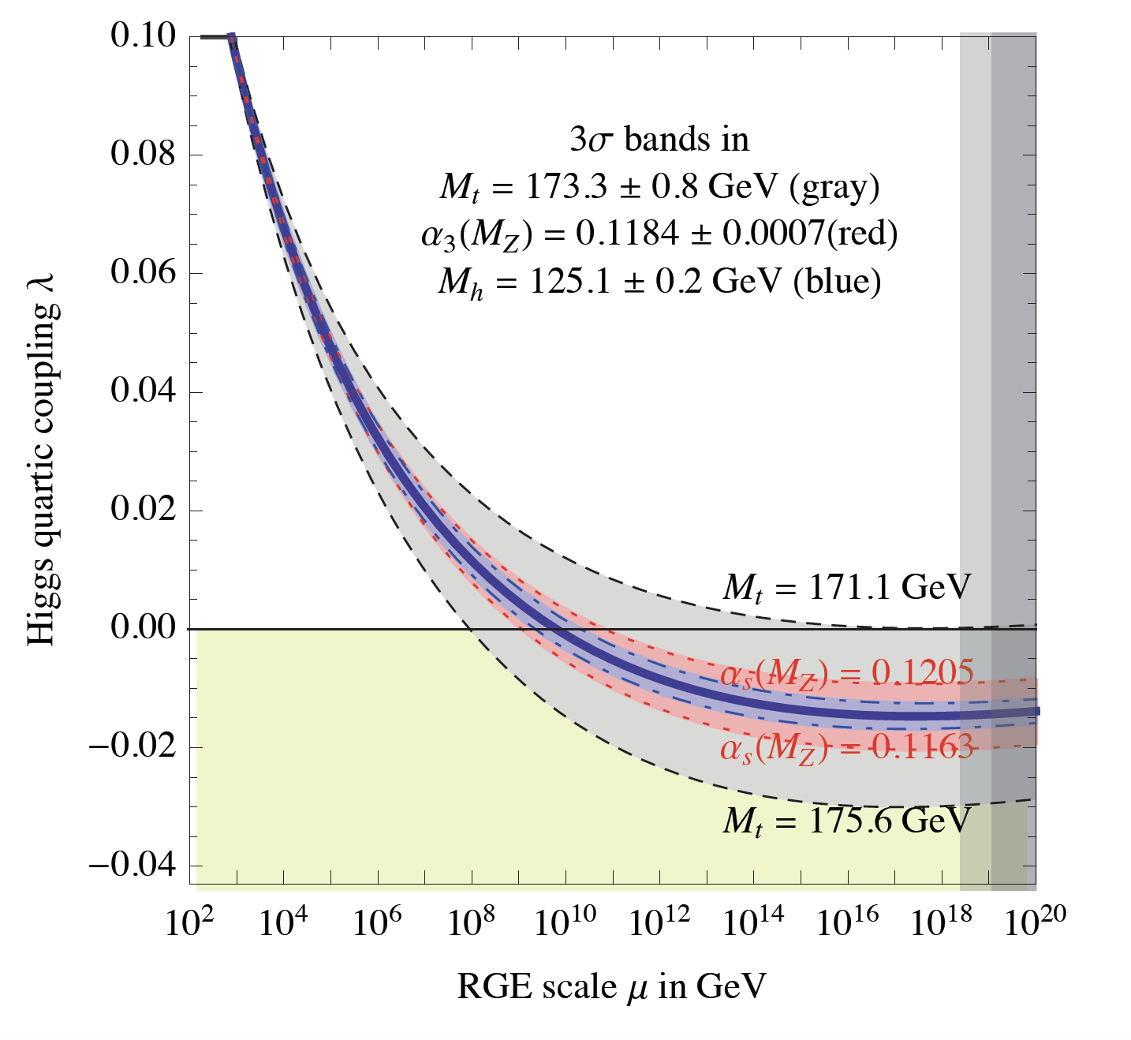
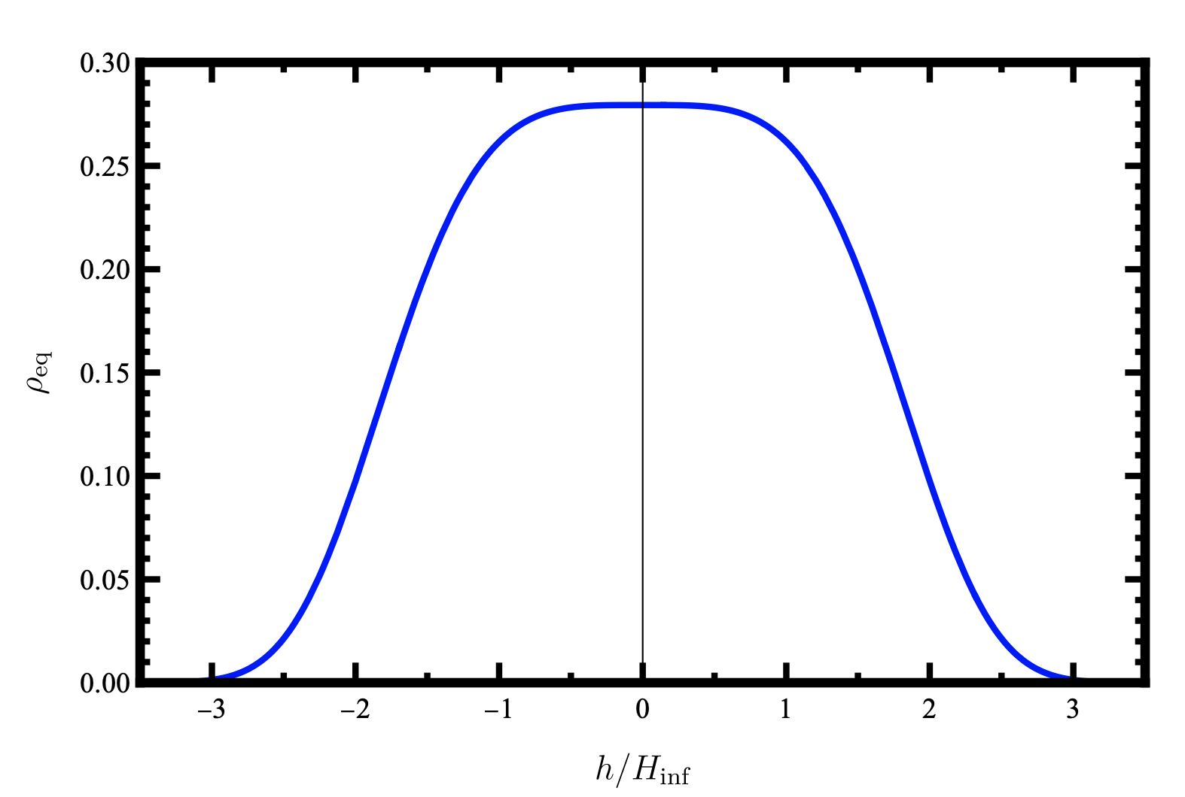
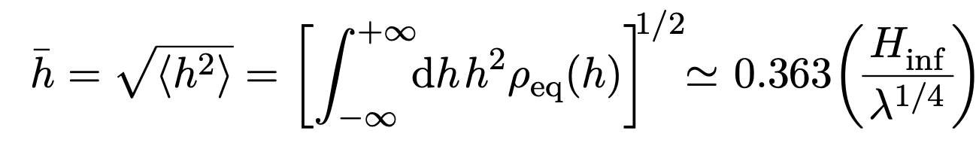
Higgs during inflation
Alexei A. Starobinsky, Jun'ichi Yokoyama,
Phys.Rev.D 50 (1994) 6357-6368
During inflation(de-Sitter universe), Higgs also gets quantum fluctuations
The fluctuations reach a equilibrium state(solution of F-P equation)
D. Buttazzo, et al arXiv:1307.3536

Slide 15
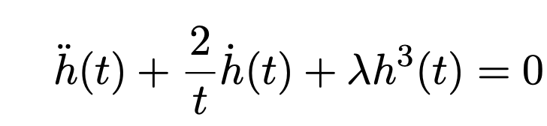
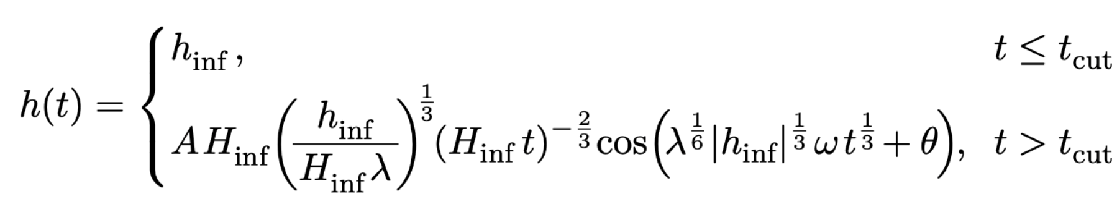
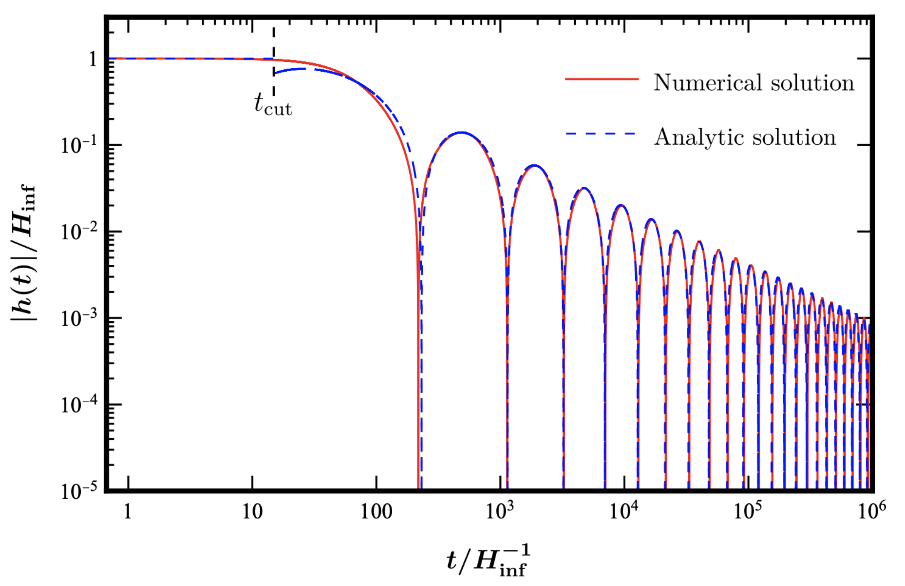
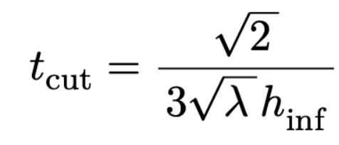
Higgs after inflation
Inflaton oscillates at the bottom potential. If the inflaton potential is dominated by the mass term, the Universe is matter-dominated
Higgs value would oscillate and decrease

Slide 16
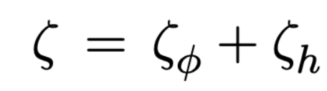
Higgs modulated reheating
Higgs value varies from different patches of the universe, right-handed neutrino mass also varies as well as the decay rate of the inflaton
Gia Dvali, Andrei Gruzinov, Matias Zaldarriaga,
Phys.Rev. D69 (2004) 023505
Different patches of the universe reheat differently (modulated reheating)
The curvature perturbation is generated by Higgs field
Delta N formalism (zeta=delta N~ N- <N>)

Slide 17
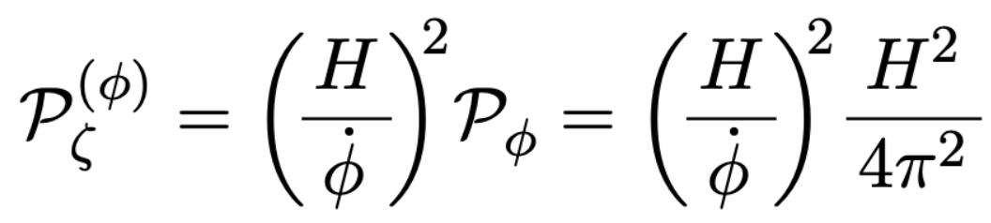
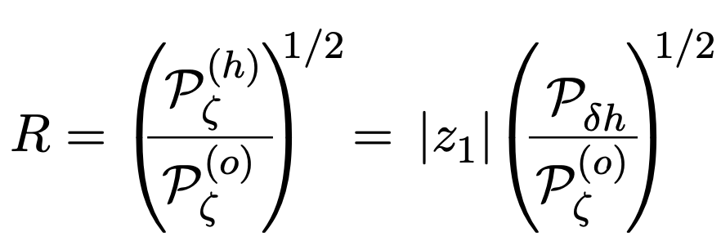
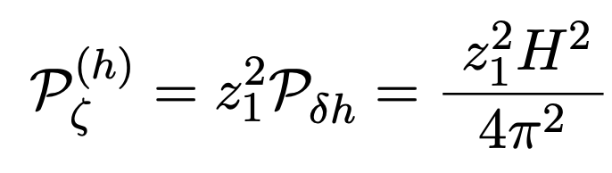
Higgs modulated reheating
Curvature perturbation contains two parts
Taylor expansion of the curvature perturbation
R should be less than 1

Slide 18
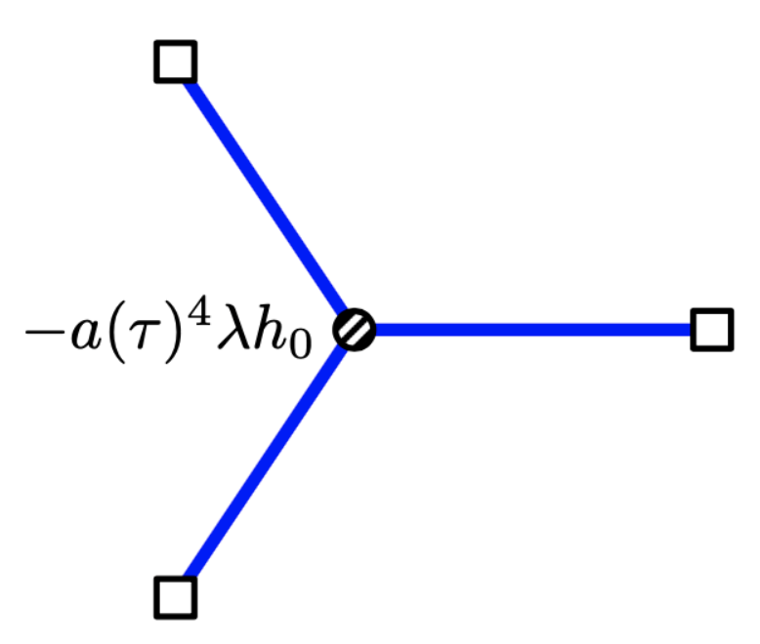
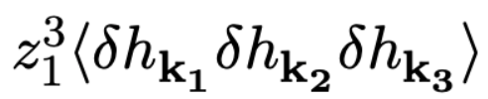
Bispectrum
Considering the three point correlation function
First term is from Higgs self-coupling
Calculated by in-in formalism/Schwinger-Keldysh formalism
Steven Weinberg, Phys.Rev.D 72 (2005) 043514, Phys.Rev.D 74 (2006) 023508
Xingang Chen, Yi Wang, Zhong-Zhi Xianyu, JCAP 1712 (2017) 006

Slide 19
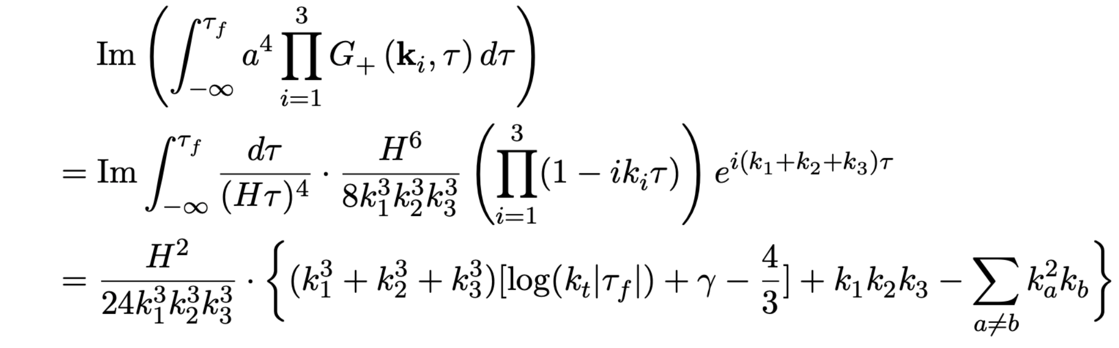
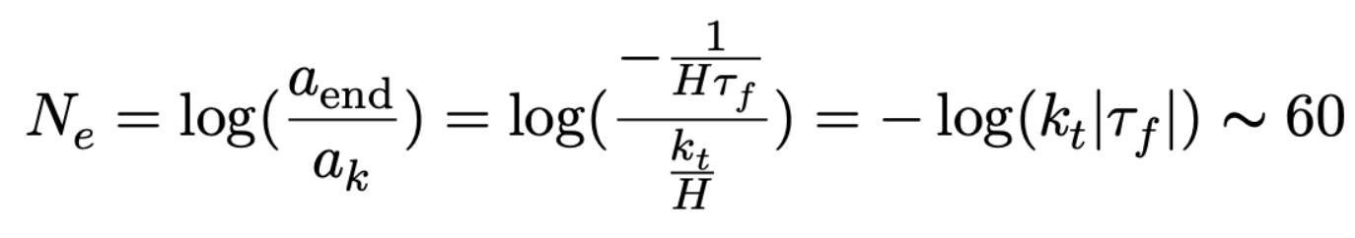
Bispectrum

Slide 20
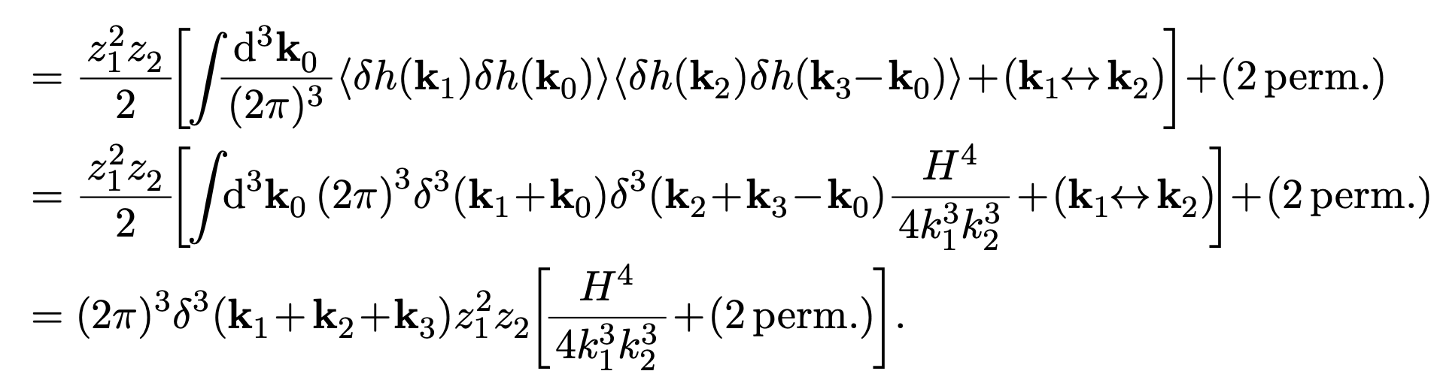
Bispectrum
Second term is from non-linear evolution of the Higgs

Slide 21
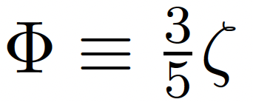
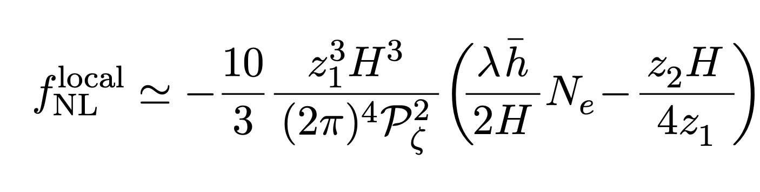
Local type non-gaussianity
The local type non-gaussianity which is defined by Bardeen Potential
In the limit k₁~k₂ >> k₃, we find

Slide 22
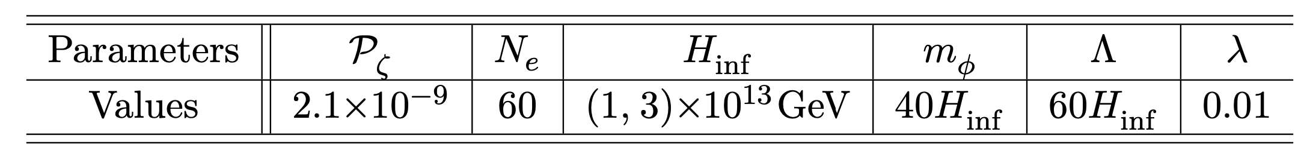
Local type non-gaussianity
Colored curves indicating future searches
Parameter space with Yukawa O(1) could be probed by future observations
The contribution from self-interaction and non-linear term are both important
Interplaying with neutrino experiments(JUNO, DUNE for neutrino ordering)

Slide 23
Summary
We propose a minimal model incorporating inflation and seesaw
Seesaw generated non-Gaussianity could be probed in near future CMB or large-scale structure observations
Cosmological collider signals from fermion loop (in progress)

Slide 24
Thanks!

Slide 25
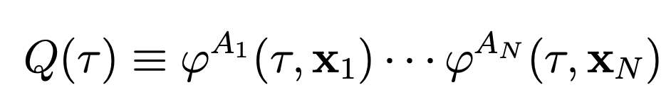
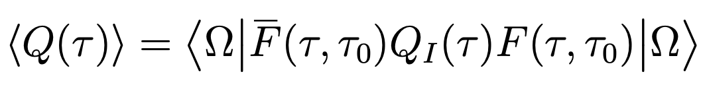
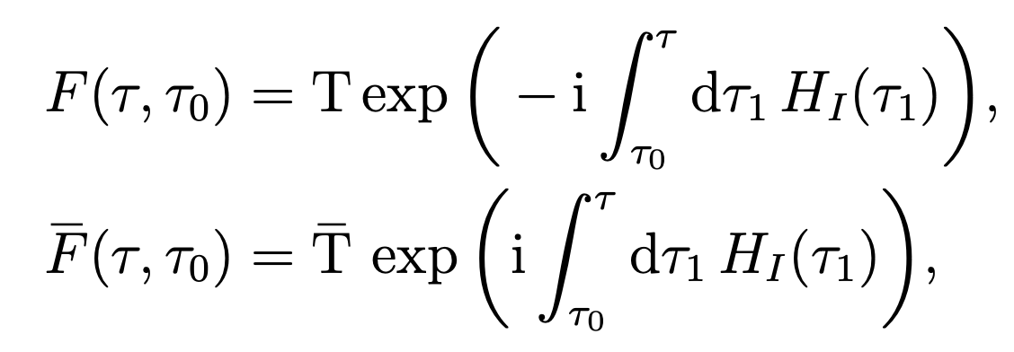
S-K formalism

Slide 26
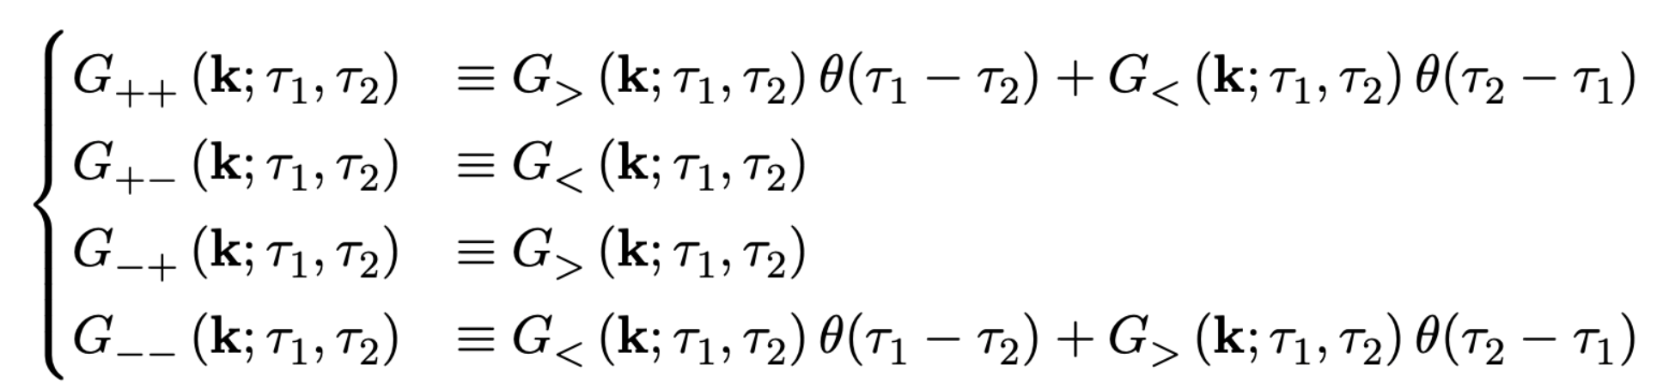
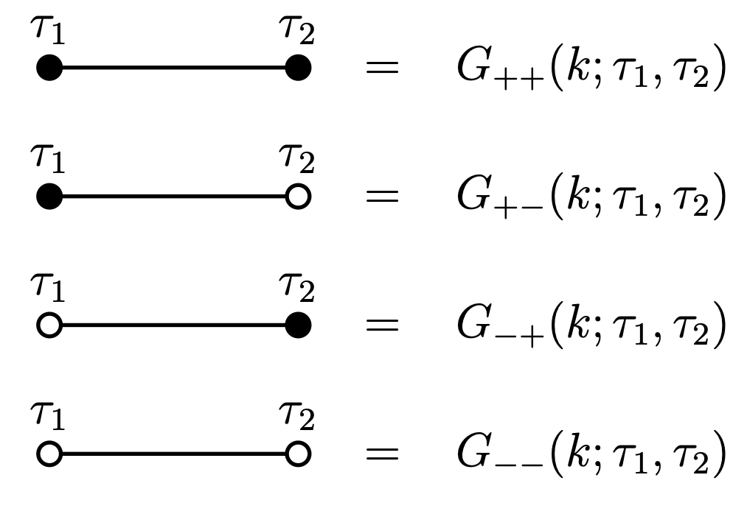
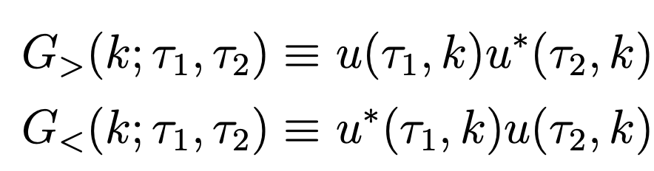
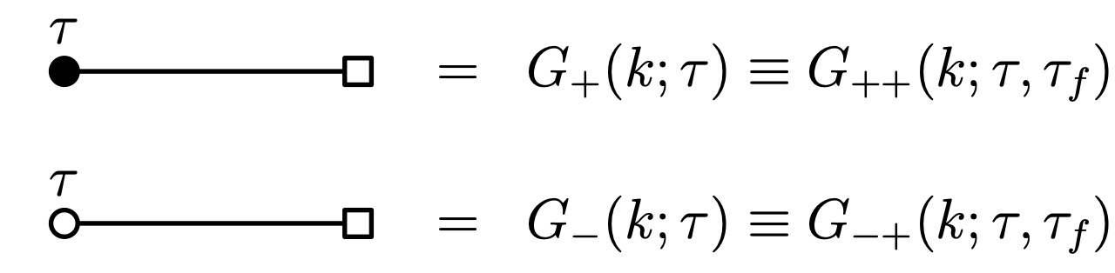


S-K formalism

Slide 27





S-K formalism
Bulk-to-Boundary propagator

Slide 28




Higgs during inflation
During inflation(de-Sitter universe), Higgs also gets quantum fluctuations
暴胀期间，希格斯场可以分为长波和短波两部分
Alexei A. Starobinsky, Jun'ichi Yokoyama,
Phys.Rev.D 50 (1994) 6357-6368
长波部分可以用郎之万方程描述
带自相互作用的随机游走模型

Slide 29

Higgs during inflation
If inflation lasts long enough, these fluctuations reach a equilibrium state
Different part of universe Higgs field takes different value
D. Buttazzo, et al arXiv:1307.3536

Slide 30


Leptogenesis
Baryogenesis Without Grand Unification, Fukugita and Yanagida, 1986’
G.F. Giudice, et al,
Nucl.Phys.B 685 (2004) 89-149
Mass of the right-handed neutrino should heavier than 10⁹ GeV

