Slide 1

Radiative Corrections for Precision Neutrino Physics
Shun Zhou
(IHEP & UCAS, Beijing)
Beijing Particle Physics and Cosmology Symposium (BPCS), Sept. 25-29, 2025

Slide 2
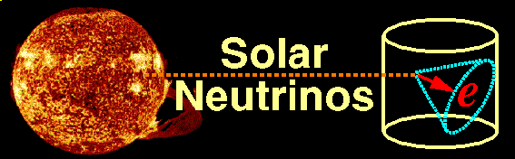
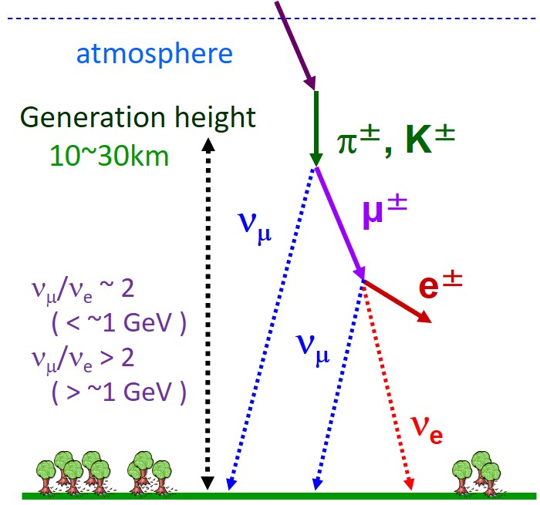
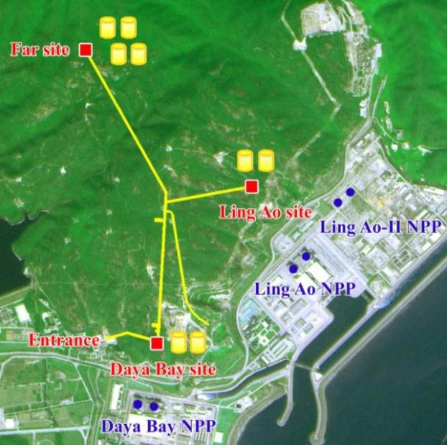
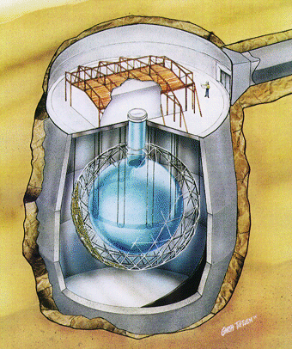
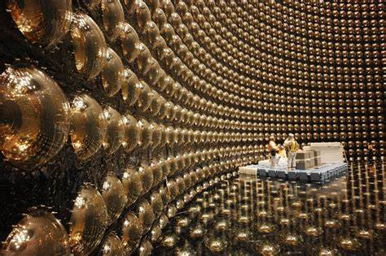
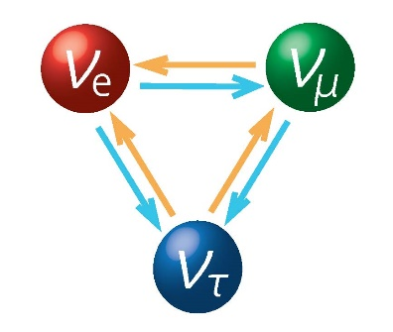


Discovery of neutrino oscillations
Daya Bay
SNO
Evidence for New Physics
Neutrinos are actually massive !!
Large lepton flavor mixing exists
Nobel Prize in 2015
Super-K

Slide 3
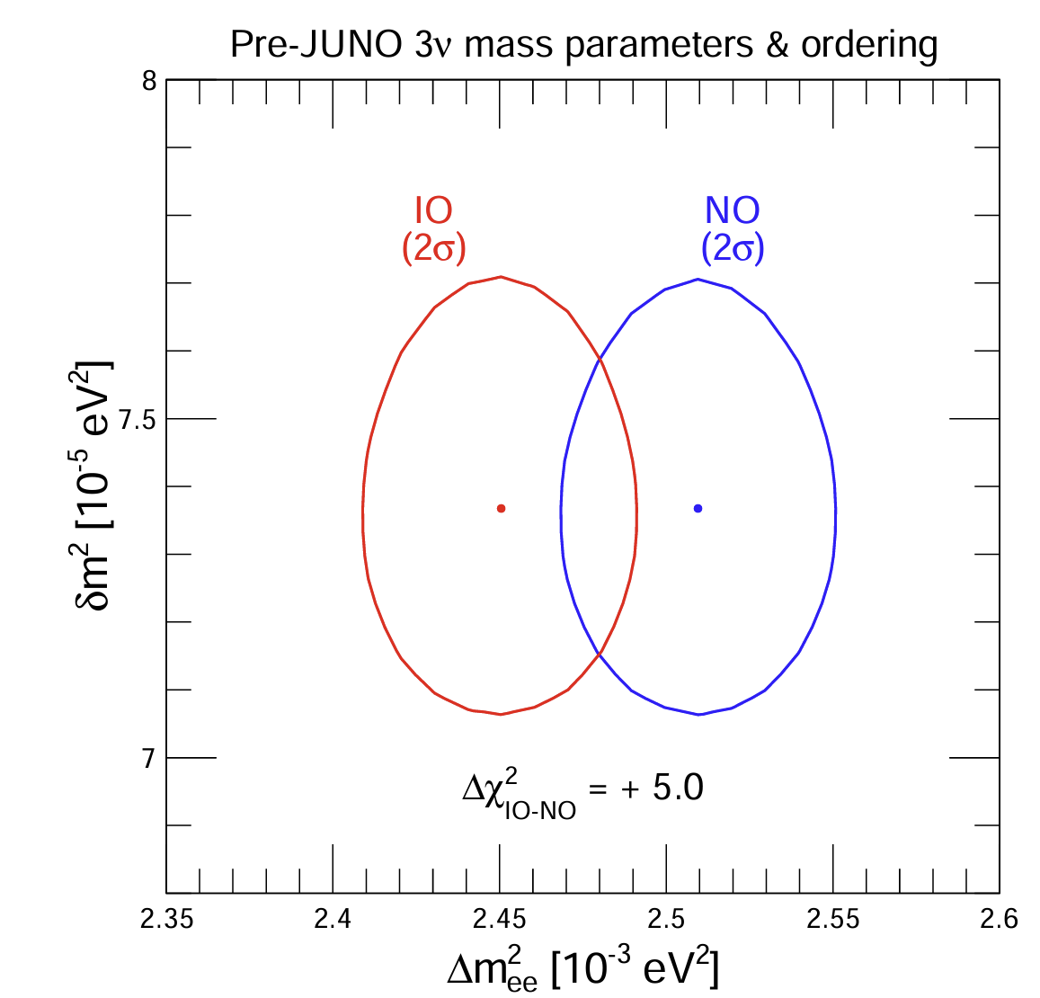
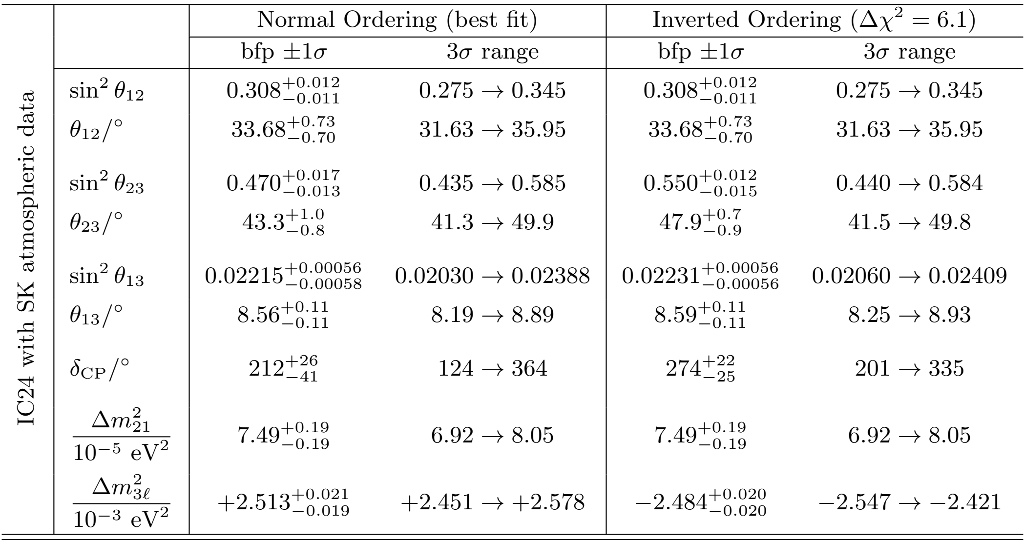
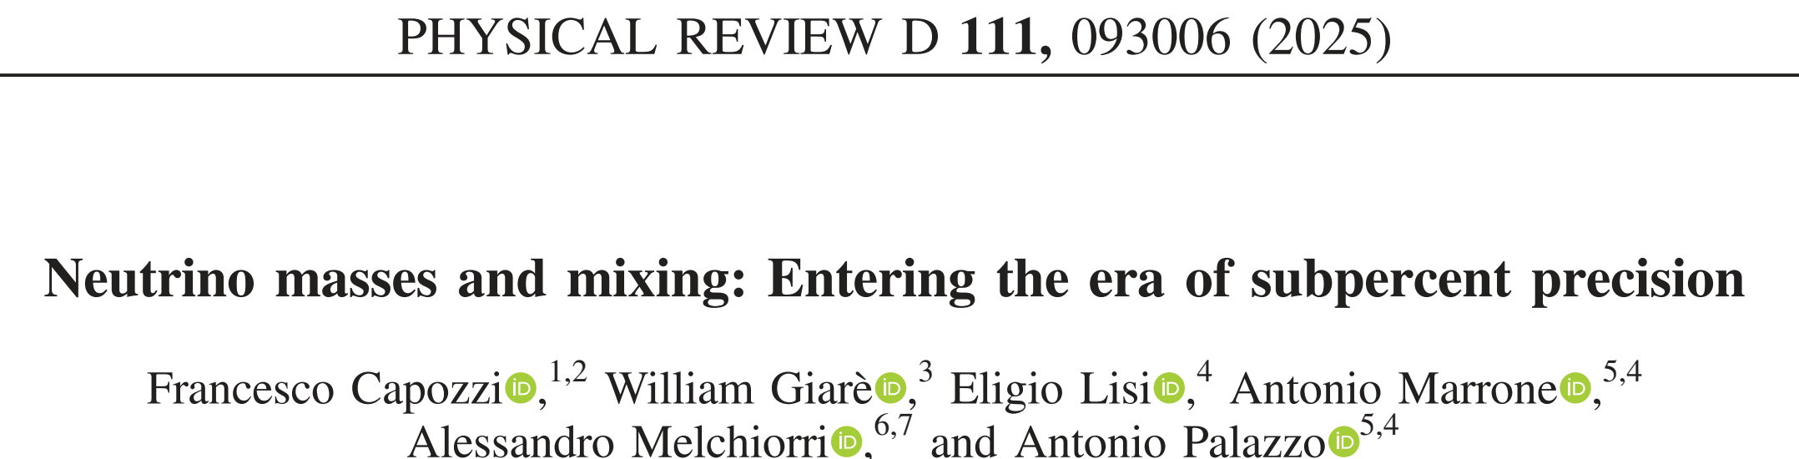
Current status of neutrino oscillations
Latest global-fit analysis of neutrino oscillation data
Esteban et al., 2410.05380
NuFIT 6.0 (2024)
More challenging questions:
2503.07752
Absolute neutrino masses
Majorana nature of neutrinos
Origin of neutrino masses

Slide 4
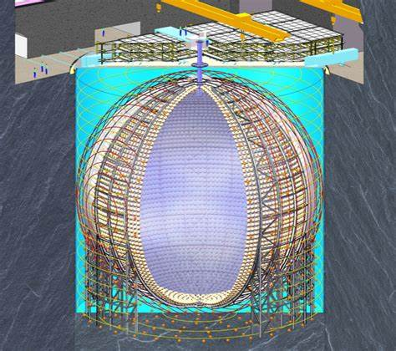
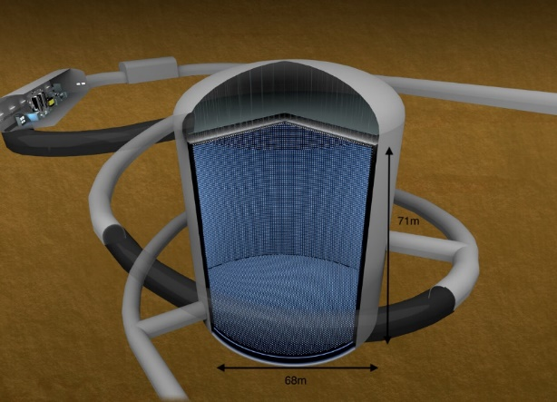
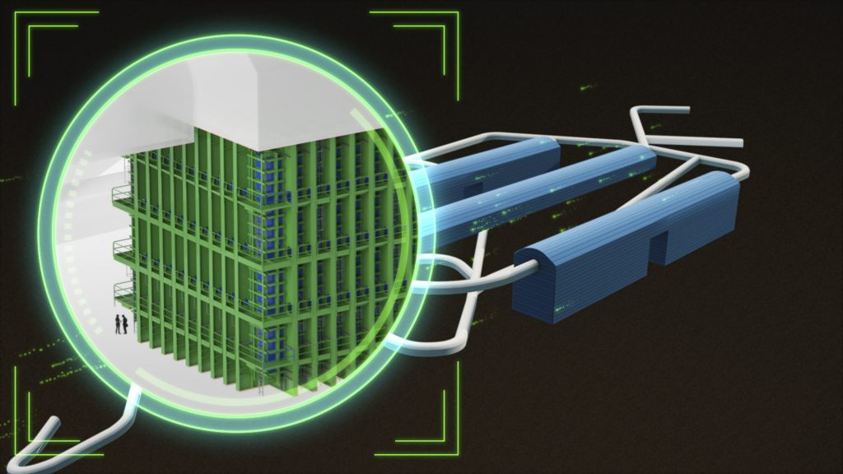

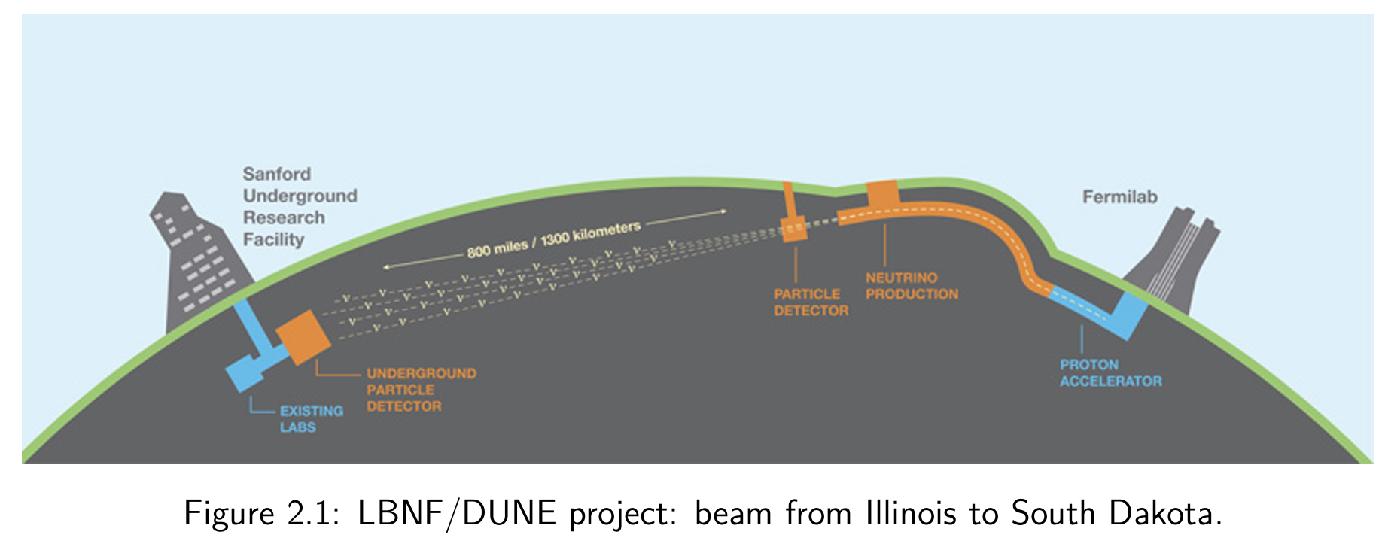
Future neutrino oscillation experiments
Precision era: 1. neutrino mass ordering; 2. mixing angles & mass-squared diff.s; 3. CP-violating phase
JUNO: 2025
20 kt liquid scintillator
Hyper-Kamiokande: 2027
260 kt water Cerenkov
DUNE: 2030
34 kt liquid Argon
JUNO collaboration, CPC 46 (2022) 123001
DUNE collaboration, 2002.03005

Slide 5
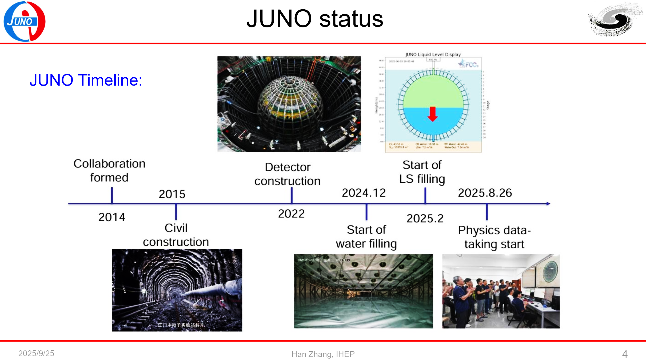
Real physics results soon!

Slide 6
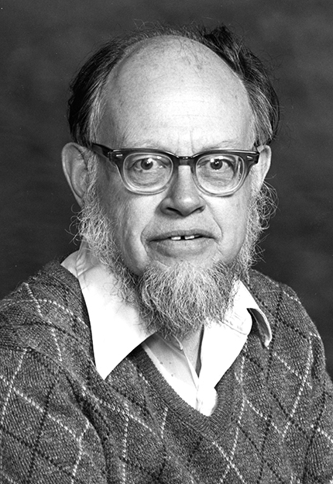
A. The Wolfenstein potential
Effective Hamiltonian for CC interactions
Effective Hamiltonian for NC interactions
CC-potential
NC-potential

Slide 7
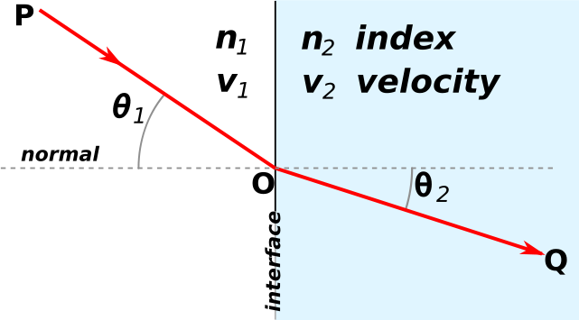
One-loop corrections
ordinary matter
Refraction of light in media
extremely small
It changes dramatically flavor content of supernova neutrinos for a matter density of 𝝆=𝟏𝟎⁶ 𝐠/𝐜𝐦^{𝟑}
Why not do a complete one-loop calculation?
The UV divergences cancel out in the potential difference

Slide 8
One-loop corrections
Extract one-loop corrections to couplings from the renormalized amplitudes
Tree & one-loop diagrams for the CC potential
Finite corrections to CC couplings
Tree & one-loop diagrams for the NC potential
Finite corrections to NC couplings
J. Huang, S.Z., 2307.04685

Slide 9
On-shell scheme & input parameters
One example for the f-f-Z vertex
Dim. regularization & on-shell scheme
Physical parameters: the EM fine-structure constant and particle masses
Aoki et al., 82; Bohm, Spiesberger, Hollik, 86; Hollik, 90; Denner, 93

Slide 10
One-loop corrections
Corrections to the NC couplings
J. Huang, S.Z., 2307.04685
Estimate of one-loop correction
Corrections to the CC couplings
In conclusion, the one-loop correction to CC potential is 5.8%, while that for NC potential is 8.2%

Slide 11
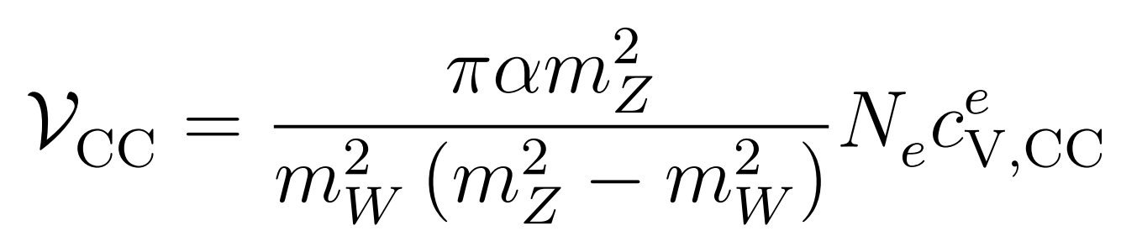
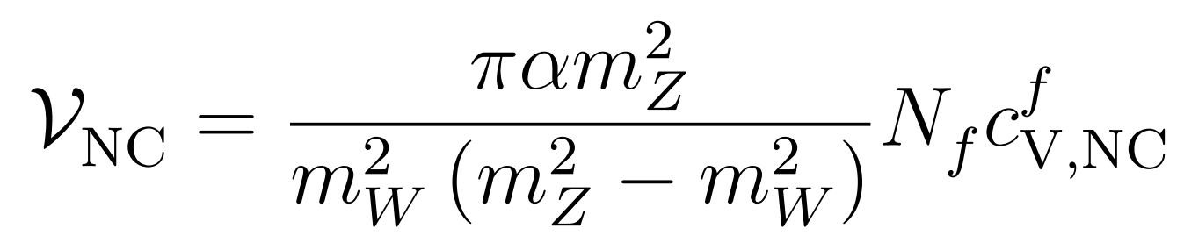
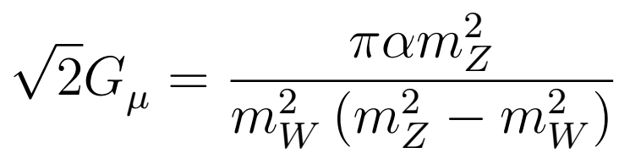
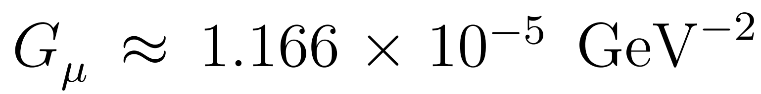
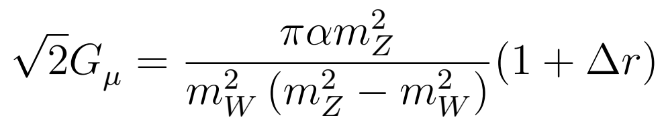

B. Impact on DUNE
Tree-level potentials in term of on-shell parameters
Huang, Sampsa, Ohlsson, S.Z., 2504.15998
Tree-level relation between the Fermi constant and on-shell parameters
determined from the muon lifetime
Tree-level relation will be modified by radiative corrections
Denner, Dittmaier, 1912.06823
Tree-level matter potential with the Fermi constant already includes part of one-loop corrections
2.0%

Slide 12
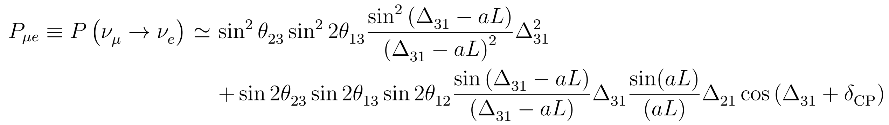
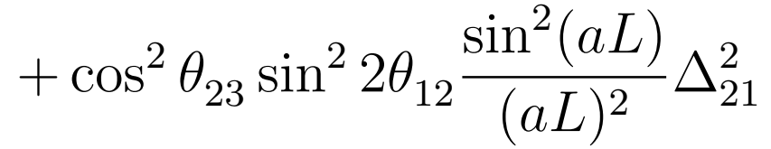
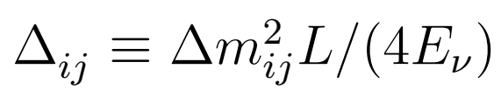



Oscillation probabilities
Neutrino oscillation probabilities in matter
Akhmedov et al., hep-ph/0402175
Sensitivity to neutrino mass ordering
normal mass ordering: $∆_{31}>0$
inverted mass ordering: $∆_{31}<0$
DUNE is able to determine neutrino mass ordering within one-year data taking at more than 5σ

Slide 13
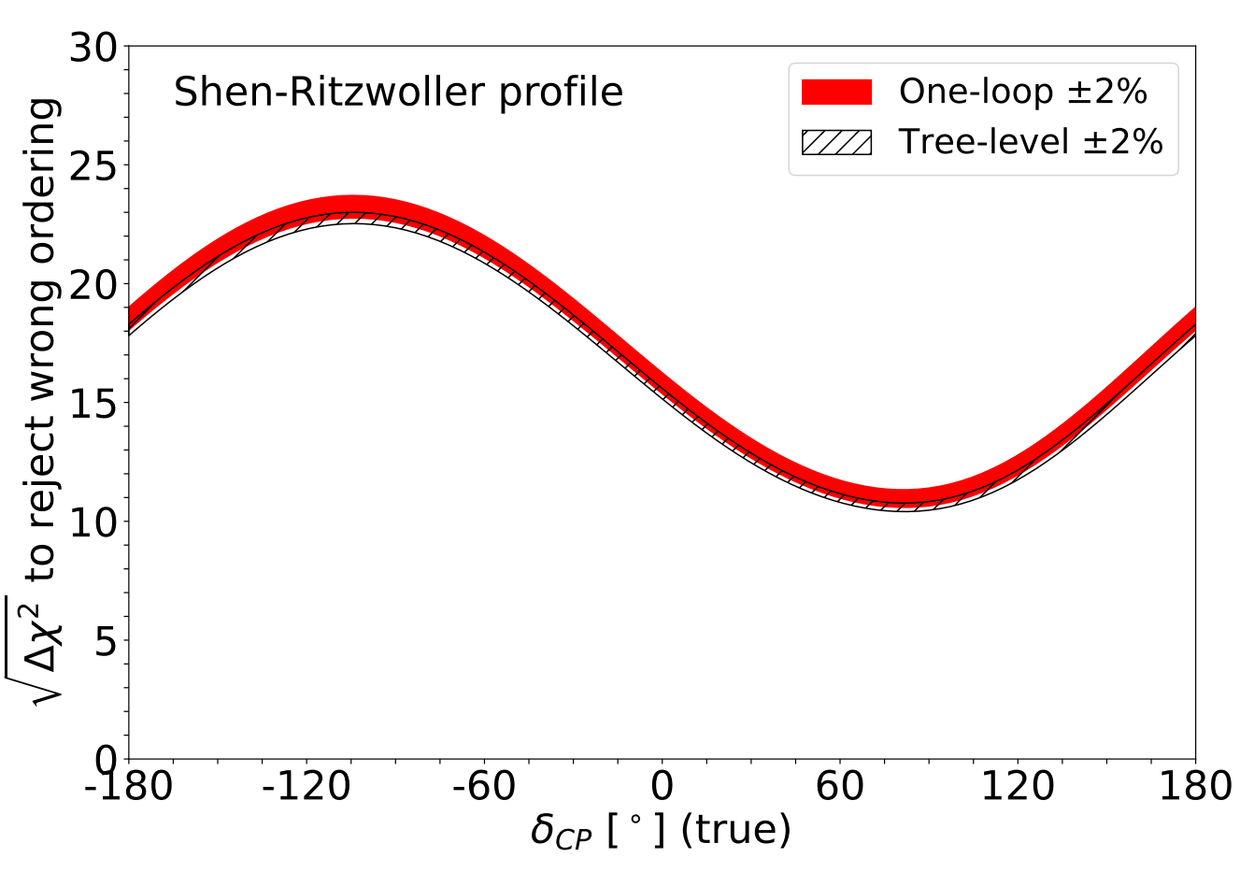
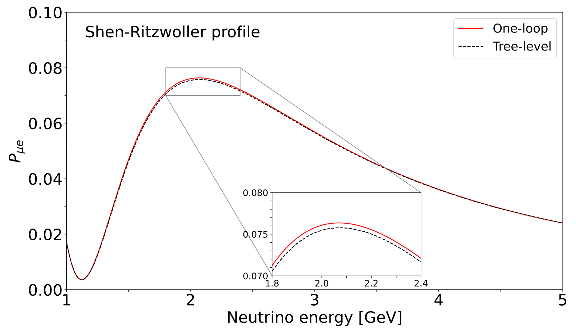
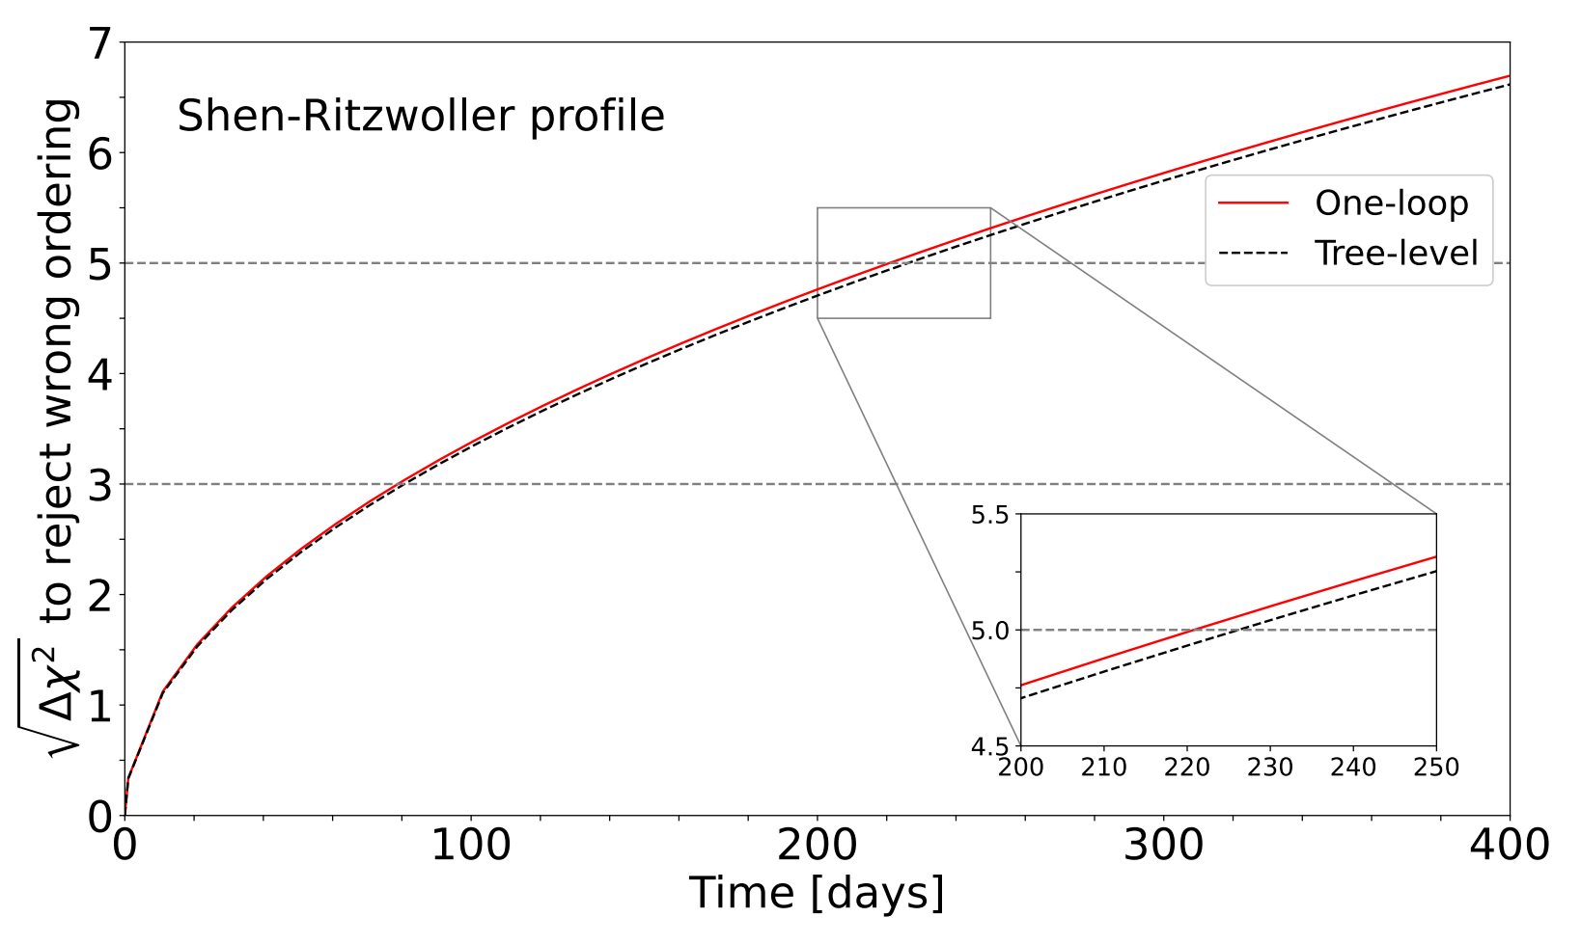
Numerical results
Huang et al., 2504.15998
Roe, arXiv:1707.02322
Matter density vs. distance for the neutrino beam from Fermilab to Lead, South Dakota
Based on geological surveys, matter density uncertainties are reduced to 1-2%
The one-loop correction and matter density uncertainty on the same level
One-loop correction increases the sensitivity to mass ordering by 0.4σ at DUNE, or the time to reach 5σ earlier by 5 days

Slide 14
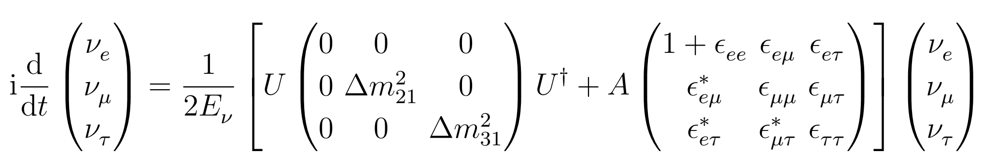
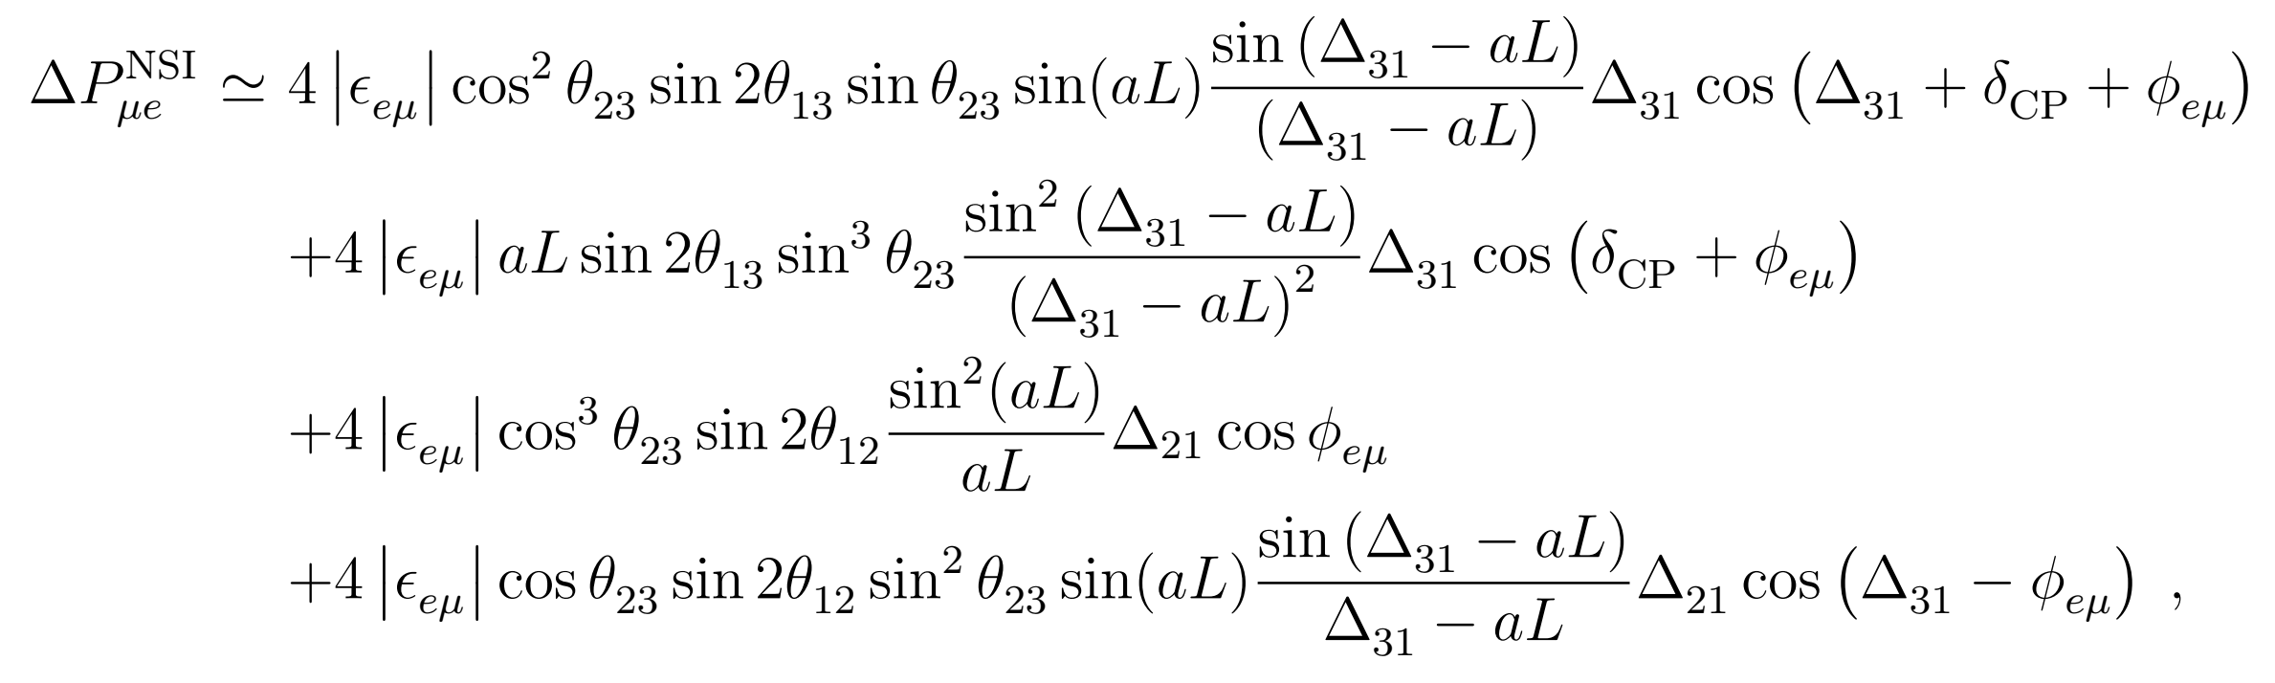
Non-standard Interactions
In the presence of non-standard interactions (NSI)
Ohlsson, 1209.2710
Extra contributions to oscillation probabilities (e.g., just one nonzero NSI parameter）

Slide 15
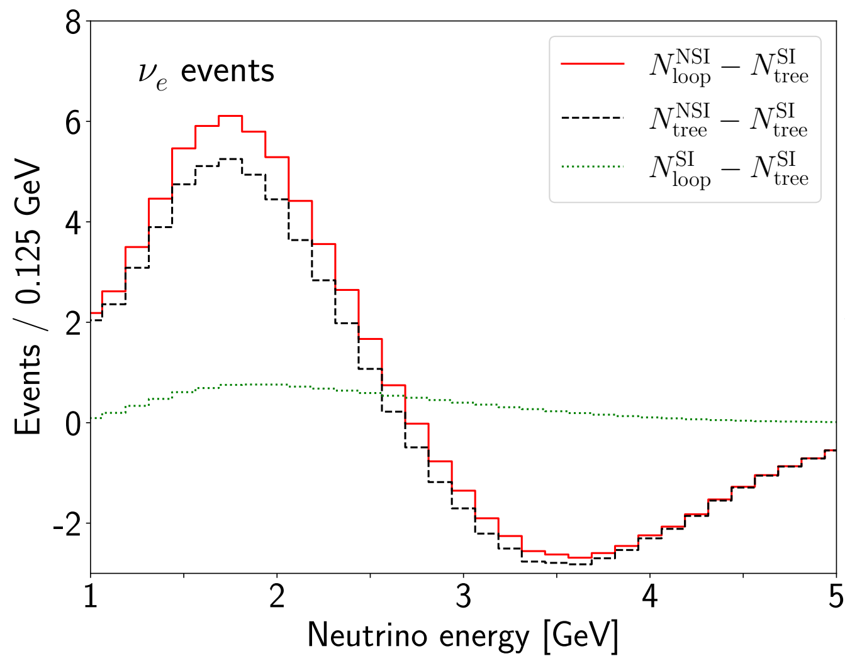
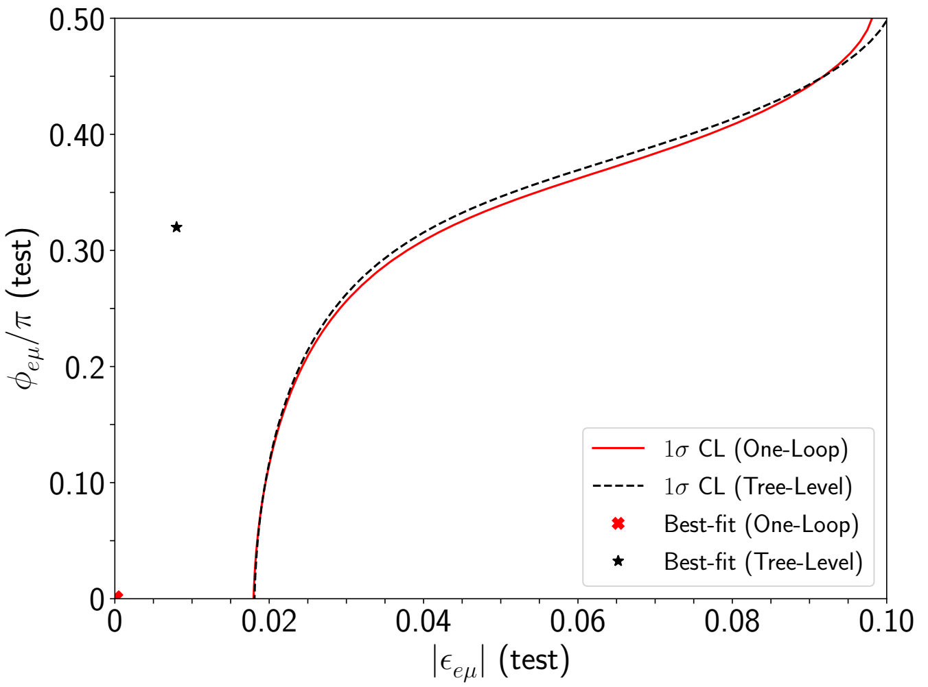
Non-standard Interactions
Neutrino events at DUNE: SI=Standard Interaction
Huang, Sampsa, Ohlsson, S.Z., 2510.xxxxx
Warning! Do NOT mistake radiative corrections in the SM as the discovery of new physics!

Slide 16
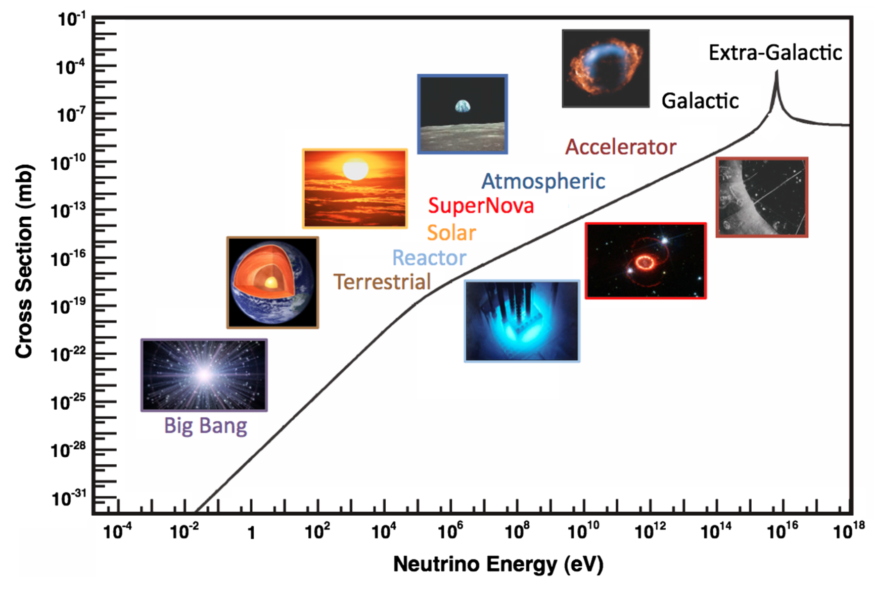
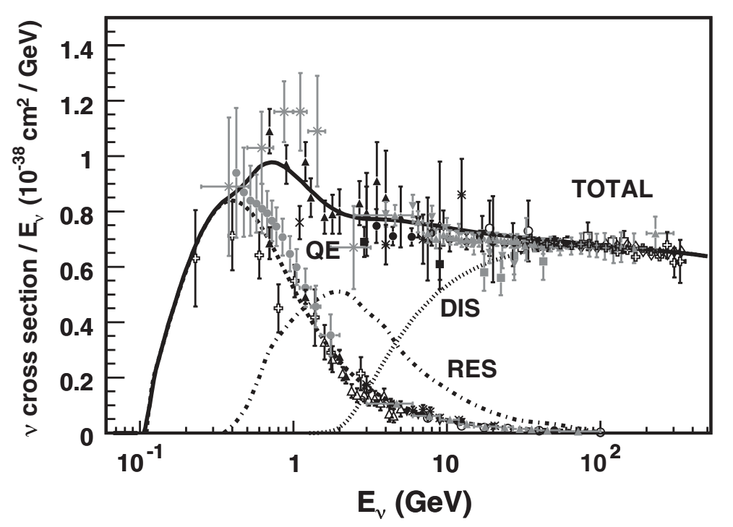
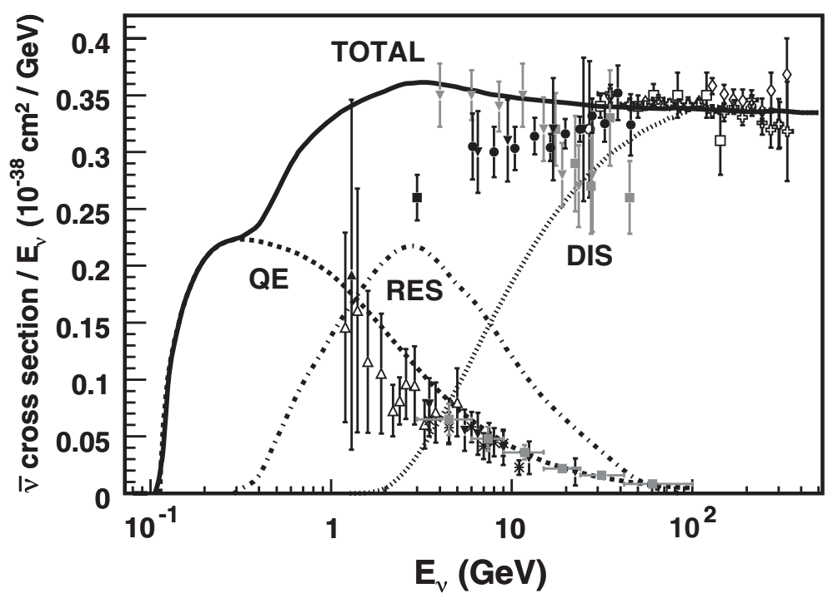

C. Neutrino interactions in the SM
CC $ν$-nucleon
Formaggio, Zeller, RMP, 2012
CC $\overline{ν}$-nucleon
Various sources of neutrinos and antineutrinos in the Universe
Cross sections can be calculated in the standard model (SM)
But complications come from low-energy strong interactions

Slide 17
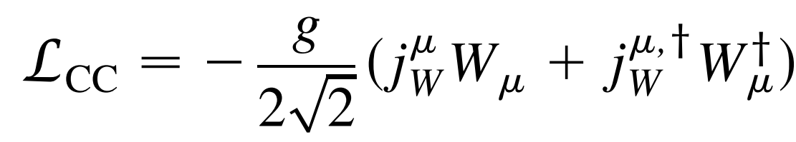
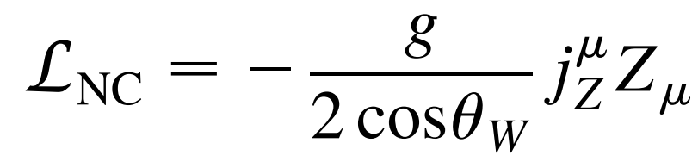
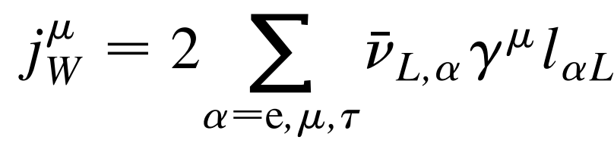
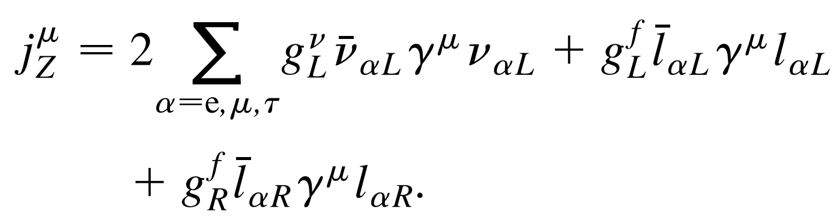
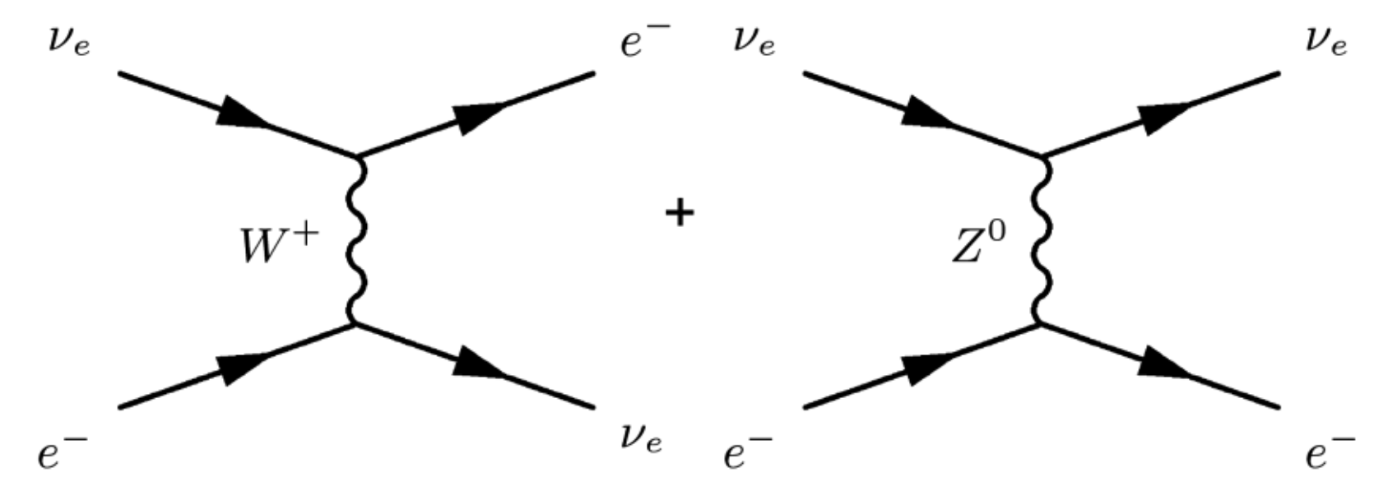
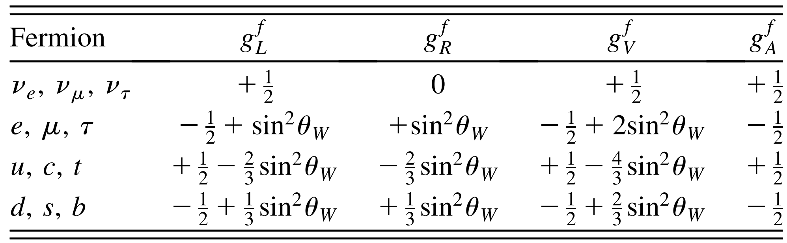
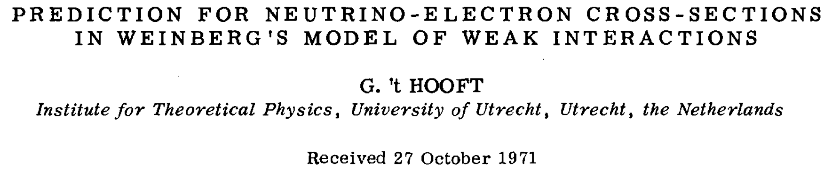
Neutrino interactions in the SM
Charged-current weak interactions
Neutral-current weak interactions
Feynman diagrams for the $ν_{e}$-$e^{−}$ scattering
couplings for the NC interaction
The cross-section for neutrino-electron scattering in the SM was first calculated by ’t Hooft in 1971
Discovery of NC via $ν_{μ}$-$e^{−}$ scattering in 1973

Slide 18
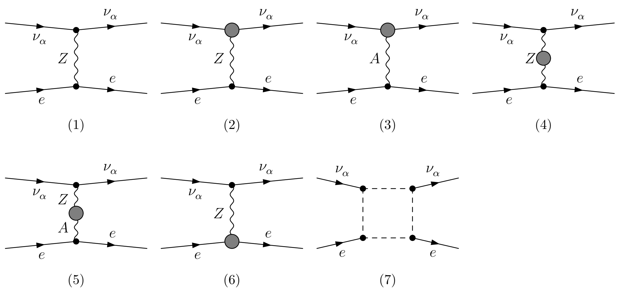
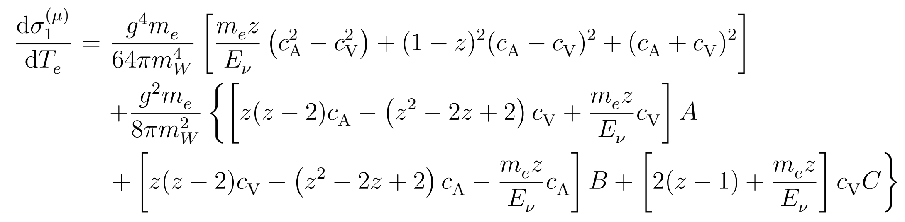


Cross sections at one-loop
Feynman diagrams for $ν_{α}$-$e^{−}$ scattering
Sarantakos et al., NPB, 83
J. Huang, S.Z., 2412.17047
Z self-energy
Z-A mixing
box-diag.
total amplitude:
differential cross section:
recoil energy

Slide 19
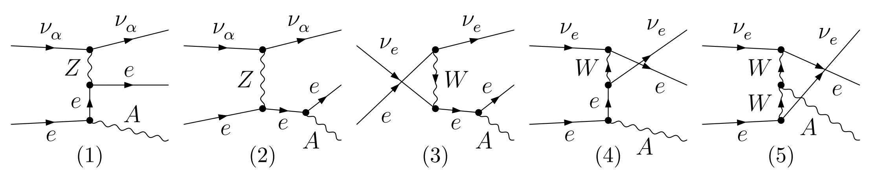
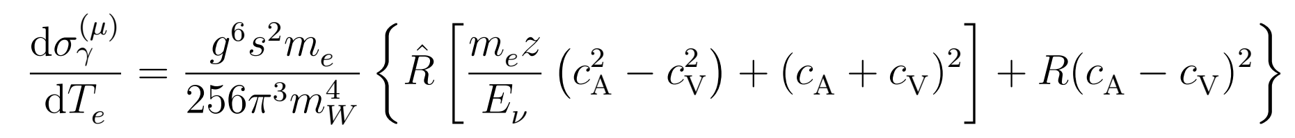
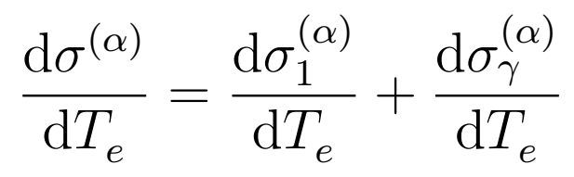
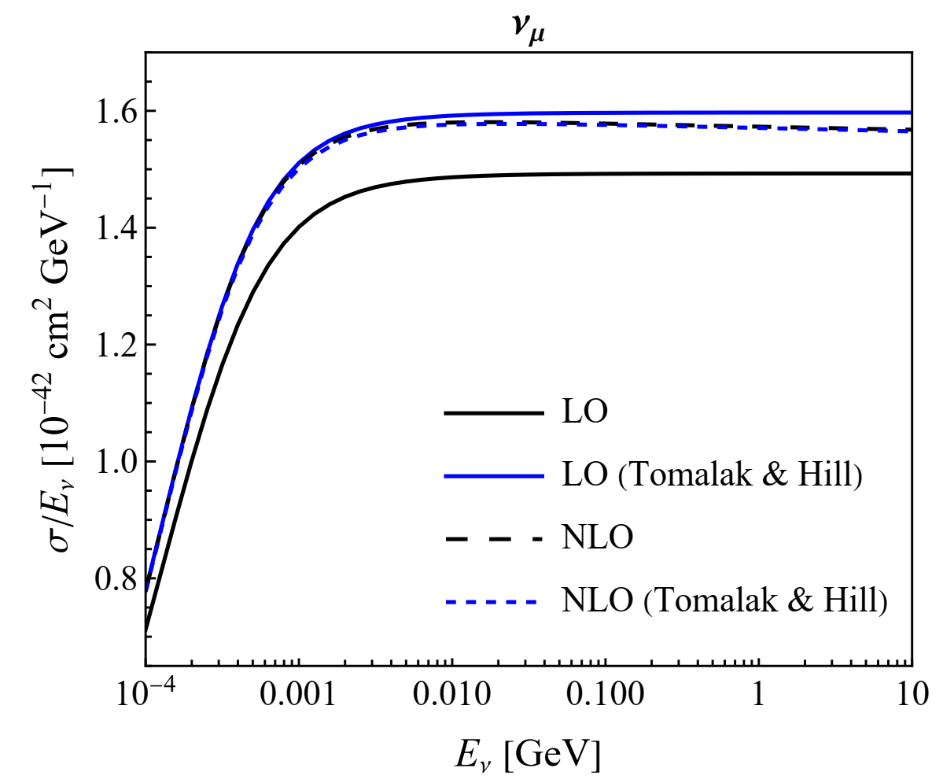
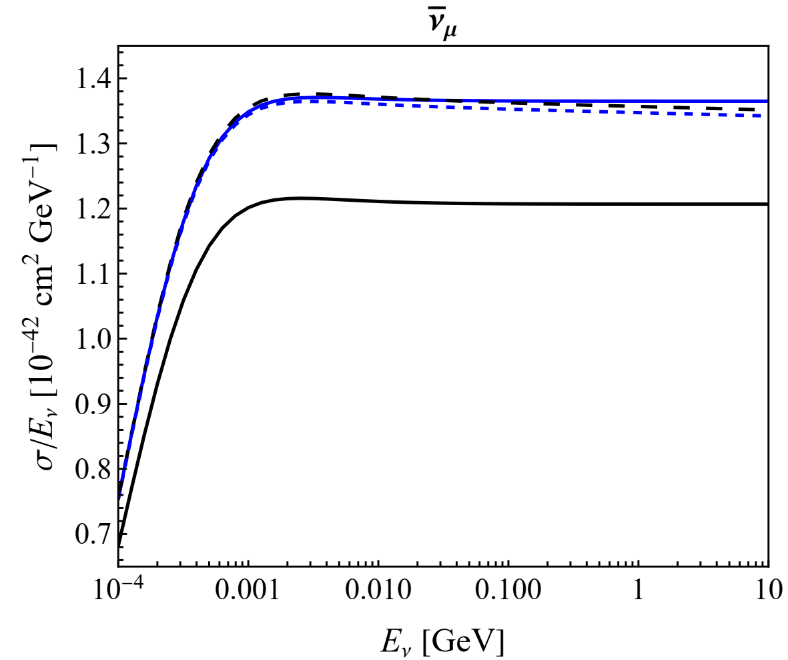
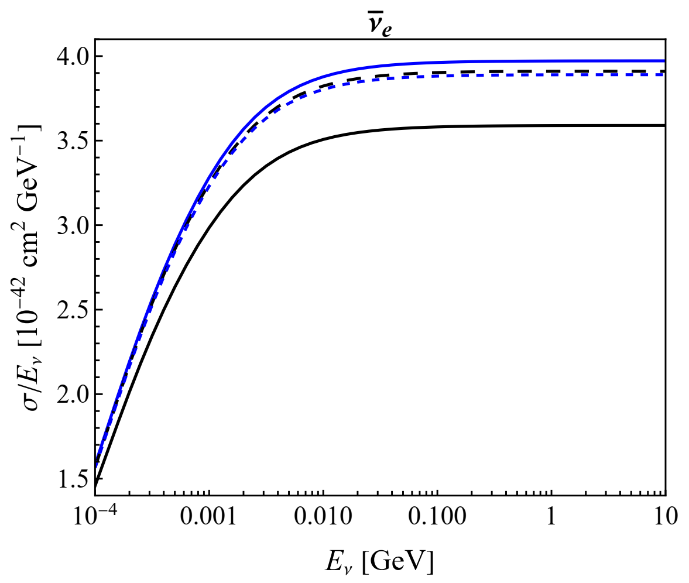
Cross sections at one-loop
Infrared divergences removed by including soft-photon contributions
J. Huang, S.Z., 2412.17047
Tomalak, Hill, 1907.03379
Tree-level results differ, but one-loop ones are consistent

Slide 20
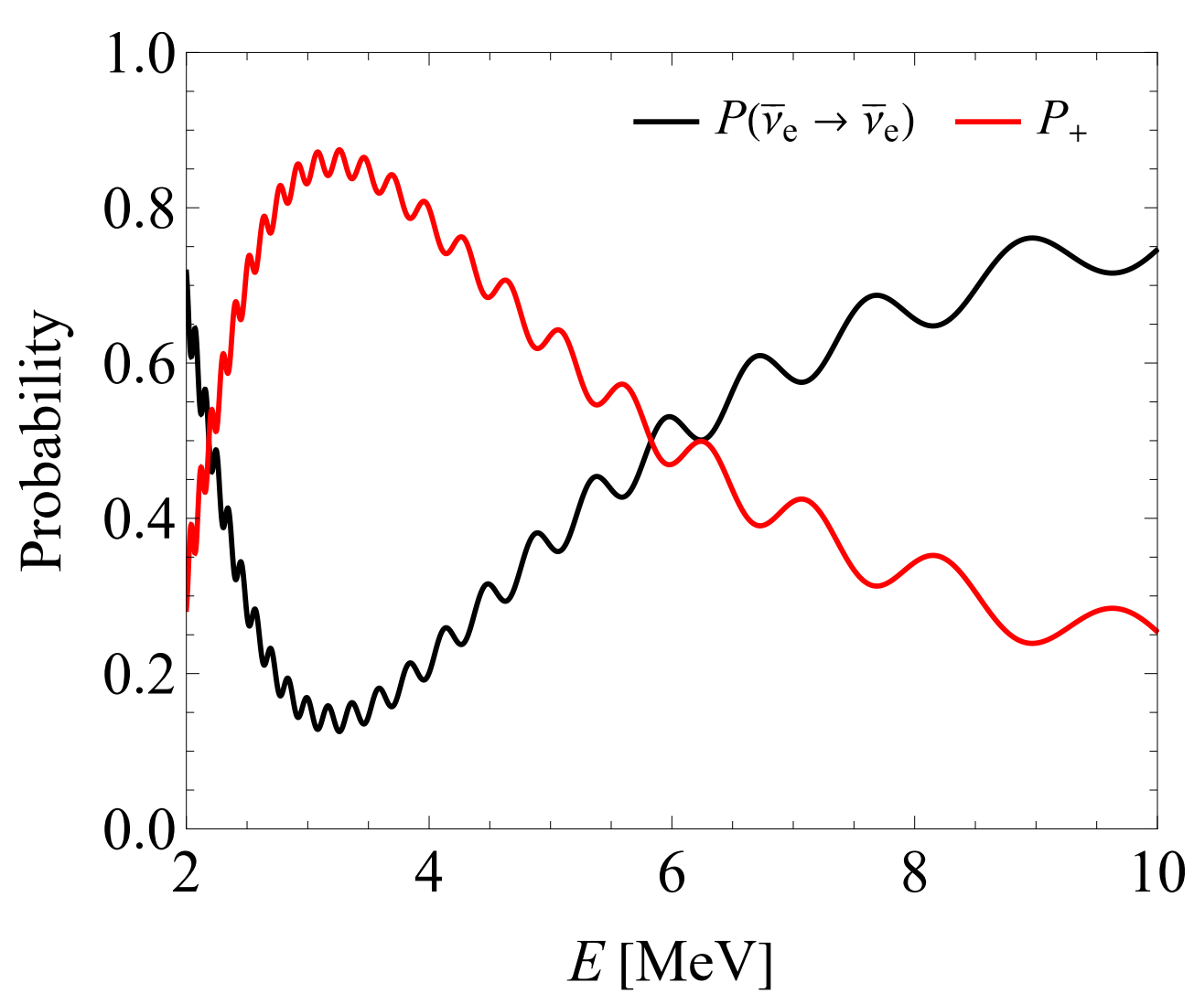


Appearance channel at JUNO
Possible detection of ${\overline{ν}}_{μ}$ and ${\overline{ν}}_{τ}$ from reactor neutrino oscillations at JUNO
Wang, Xing, S.Z., 2509.00422
Due to the oscillation maximum, there will be a large fraction of non-electron antineutrinos
Event rates for elastic neutrino-electron scattering

Slide 21



Appearance channel at JUNO
Different cross sections for ${\overline{ν}}_{μ}$ and ${\overline{ν}}_{τ}$, but arising at one-loop level: only one percent
The event rate does depend on the leptonic CP-violating phase
However, too small to be observed at JUNO

Slide 22




Summary
J-PARC neutrino beam
Fermilab neutrino beams
neutrino spectra @ FASERν
Near-site neutrino detectors
Precision measurements in neutrino physics limited by complex neutrino-matter interactions
Radiative corrections become relevant , but more theoretical works are needed

