Slide 1
GWs from Sound Waves: effects of inverse hydrodynamics and cosmic expansion
Xiao Wang
September 29th, 2025, BPCS2025@Beijing
Based on our current work
In collaboration with Chi Tian, Csaba Balazs
Notes:
Good morning, everyone! First of all, thanks for the organizer’s invitation and the opportunity to present our work here.
I am Xiao Wang, a postdoc fe at Mona
Today, I am going to talk about the GWs from sound waves. Especially the effect of inverse hydrodynamics and cosmic expansion.
I will first introduce some background and motivations.
Then discuss the effect of inverse hydrodynamics in detail.
After that I will present our current progress on the study of the effect of cosmic expansion on the GWs.
Finally, I will give a short summay.

Slide 2
Outline
Introduction
Inverse Hydrodynamics
Cosmic Expansion
Summary

Slide 3
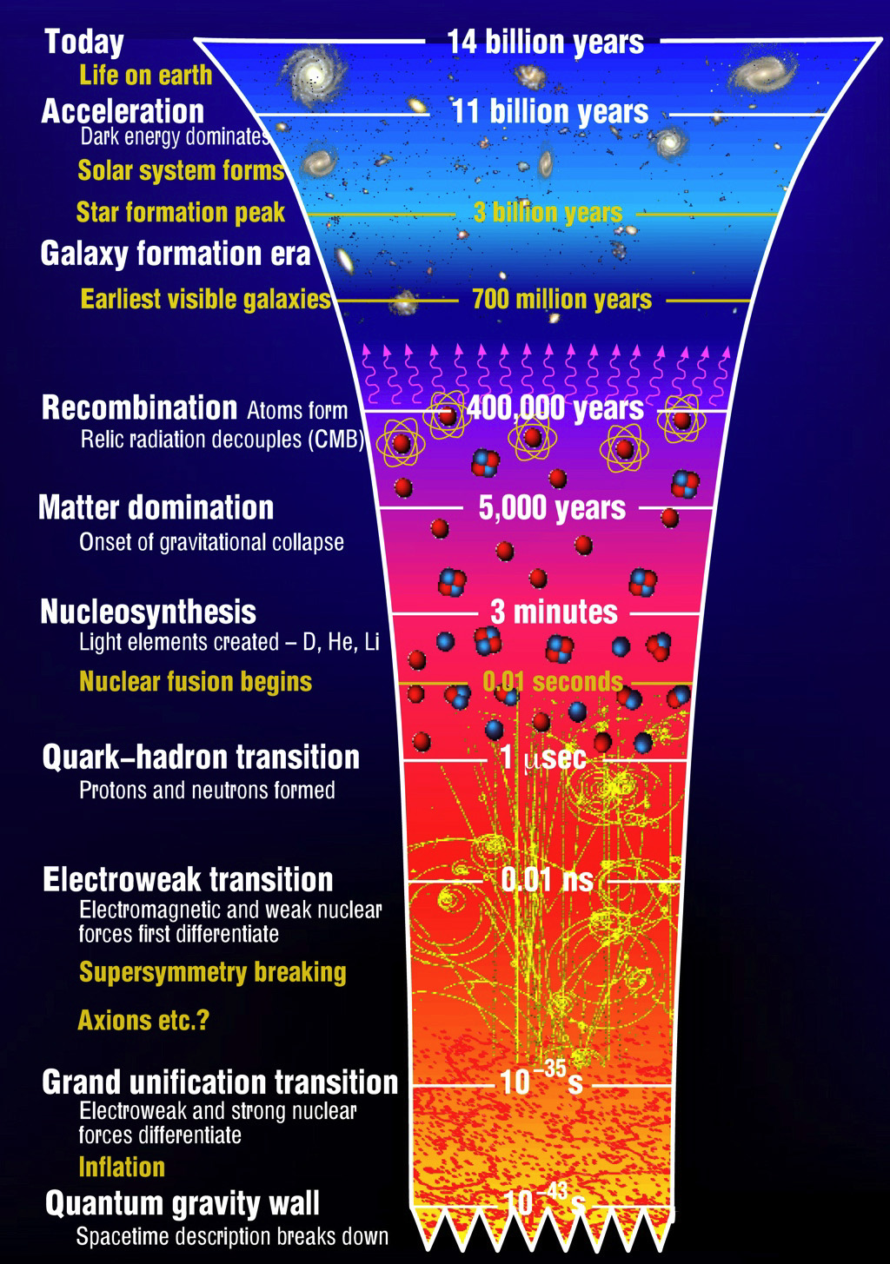
Introduction
The detection of GWs by LIGO and Virgo opens a new era for astrophysics and cosmology.
It also offers a novel probe for the physics beyond the Standard Model of particle physics.
GWs
GWs
？
BSM
BSM
FOPT,
Domain wall,
Cosmic string, etc.
？
？
Early universe is a Black box
Credit: ctc
Notes:
The detection of GWs by LIGO and Virgo opens a new era for astrophysics and cosmology.
It also give us a new method to explore the physics beyond the SM of particle physics.
Since these new physics would generate some interest physical process, like FOPT.
They will generate unique GW signals, if these signals are detected in the future, that could allow us to explore the properties of these new physics.
Here, we focus on the GW from FOPTs, especially those PTs at electroweak scale.
Since the peak of GW generated by the EWPT is around mHz, that means it could be the potential target of the fut….

Slide 4
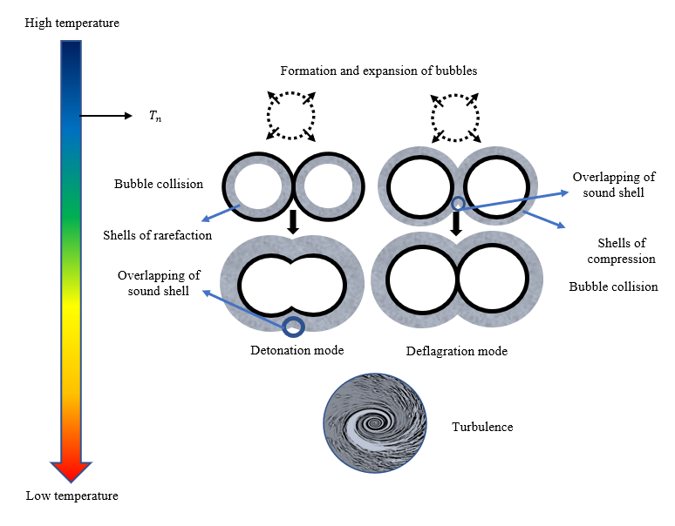
Introduction
Three major GWs sources of during FOPTs:
Bubble collisions
Sound wave
Turbulence
New sources of GWs during phase transition:
  Particles produced by bubble collisions
  (Inomata et al. arXiv: 2412.17912)
  Particle splitting/losing momentum process across the bubble wall
  (Wenyuan Ai. arXiv:2508.02794, Qiu et al, arXiv:2508.04314)
  Feebly Interacting Particles
  (Jinno et al. arXiv: 2211.06405)
  …
JCAP 0809, 022 (2008); PRL112, 041301 (2014); PRD92, no. 12,123009 (2015); PRD96, no. 10,103520 (2017); Phys. Rev. D 66, 024030 (2002), Phys. Rev. D 76 (2007) 083002, JCAP 0912, 024 (2009) etc.
X.Wang, F.P.Huang, X.Zhang, JCAP 05 (2020) 045
Notes:
Unsually, FOPT proceed with bubble expansition, bubble collision,. Evetnually these bubble convert the whole Uni to new stable phase.
And we thus get three
In recent years, people find some new source
And they are…
But for most case the sound wave is still the dominant source.
Figure out various effects on the GWs would help extract a more precise information of new physics from the data…..
In the next, I will discuss the effect of inverse hydrodynamics.

Slide 5
Inverse Hydrodynamics

Slide 6
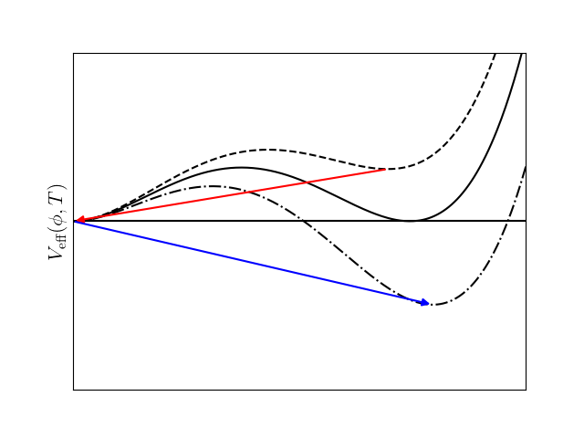
Inverse Hydrodynamics
Inverse Hydrodynamics was first studied in the context of the inverse phase transitions:
Inverse phase transitions (superheated PTs)
  Reheating stage, reheated dark sector…
Initially, inverse hydrodynamics is strongly tied with iPT
Direct phase transitions (supercooled PTs)
  Inverse hydrodynamics exist in dPTs for a SUSY model
Inverse phase transitions
(Buen-Abad et al. PRD ’23; Dent et al. JHEP ’25)
Direct phase transitions
(Barni et al. arXiv:2503.01951)
Notes:
First of all, Inverse Hydrodynamics was first studied in the context of the inverse phase transitions:
Inverse hydrodynamics could be a sign of some specific parameter space, hence we could expect the effect of inverse hydrodynamics would leave some unique feature on GWs from sound wave, that could help to explore such parameter space

Slide 7
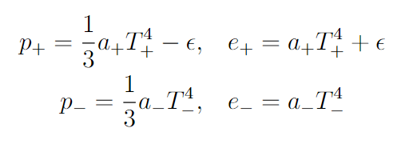


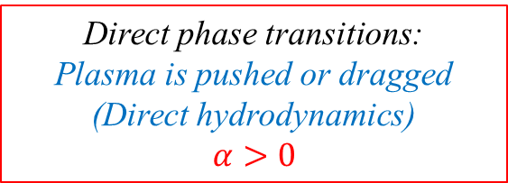
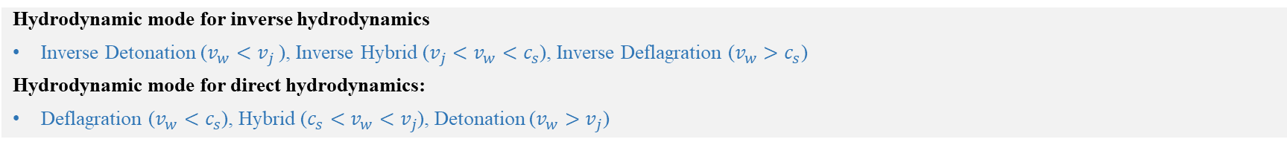




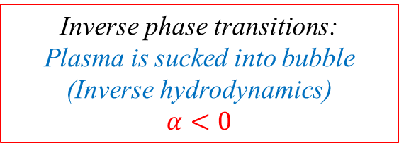
Inverse Hydrodynamics
Broken phase
$$v_{w}$$
Symmetric phase
$$v_{w}$$
$$v_{pl}$$
$$v_{pl}$$
Symmetric phase
Broken phase
Direct phase transitions:
Plasma is pushed or dragged
(Direct hydrodynamics)
$$α>0$$
Inverse phase transitions:
Plasma is sucked into bubble
(Inverse hydrodynamics)
$α<0$
(Barni et al. JCAP ’24)
Hydrodynamic mode for inverse hydrodynamics
Inverse Detonation ($v_{w}<v_{j}$ ), Inverse Hybrid ($v_{j}<v_{w}<c_{s}$), Inverse Deflagration ($v_{w}>c_{s}$)
Hydrodynamic mode for direct hydrodynamics:
Deflagration ($v_{w}<c_{s}$), Hybrid ($c_{s}<v_{w}<v_{j}$), Detonation ($v_{w}>v_{j}$)
Notes:
Now let’s explore the inverse hydrodynamics in the context of inverse phase transition and see the differences of this inverse phydrodynamics compared to the convet

Slide 8
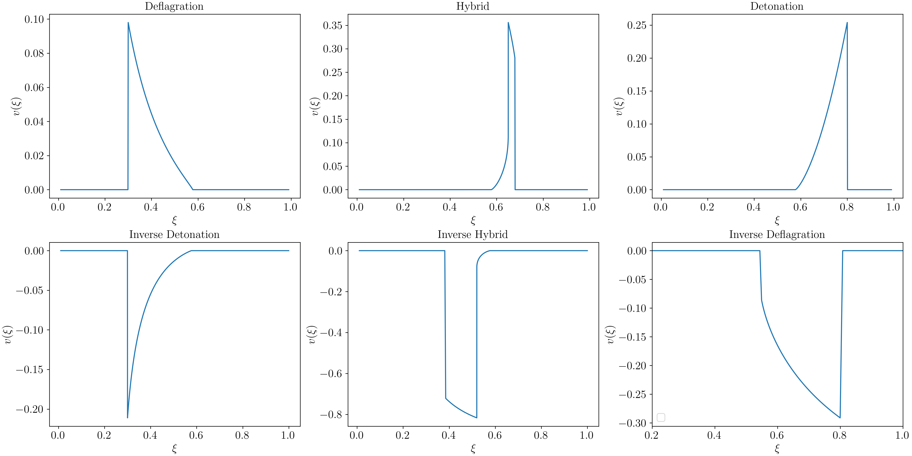
Inverse Hydrodynamic Solutions
Velocity profiles for inverse and direct hydrodynamics

Slide 9
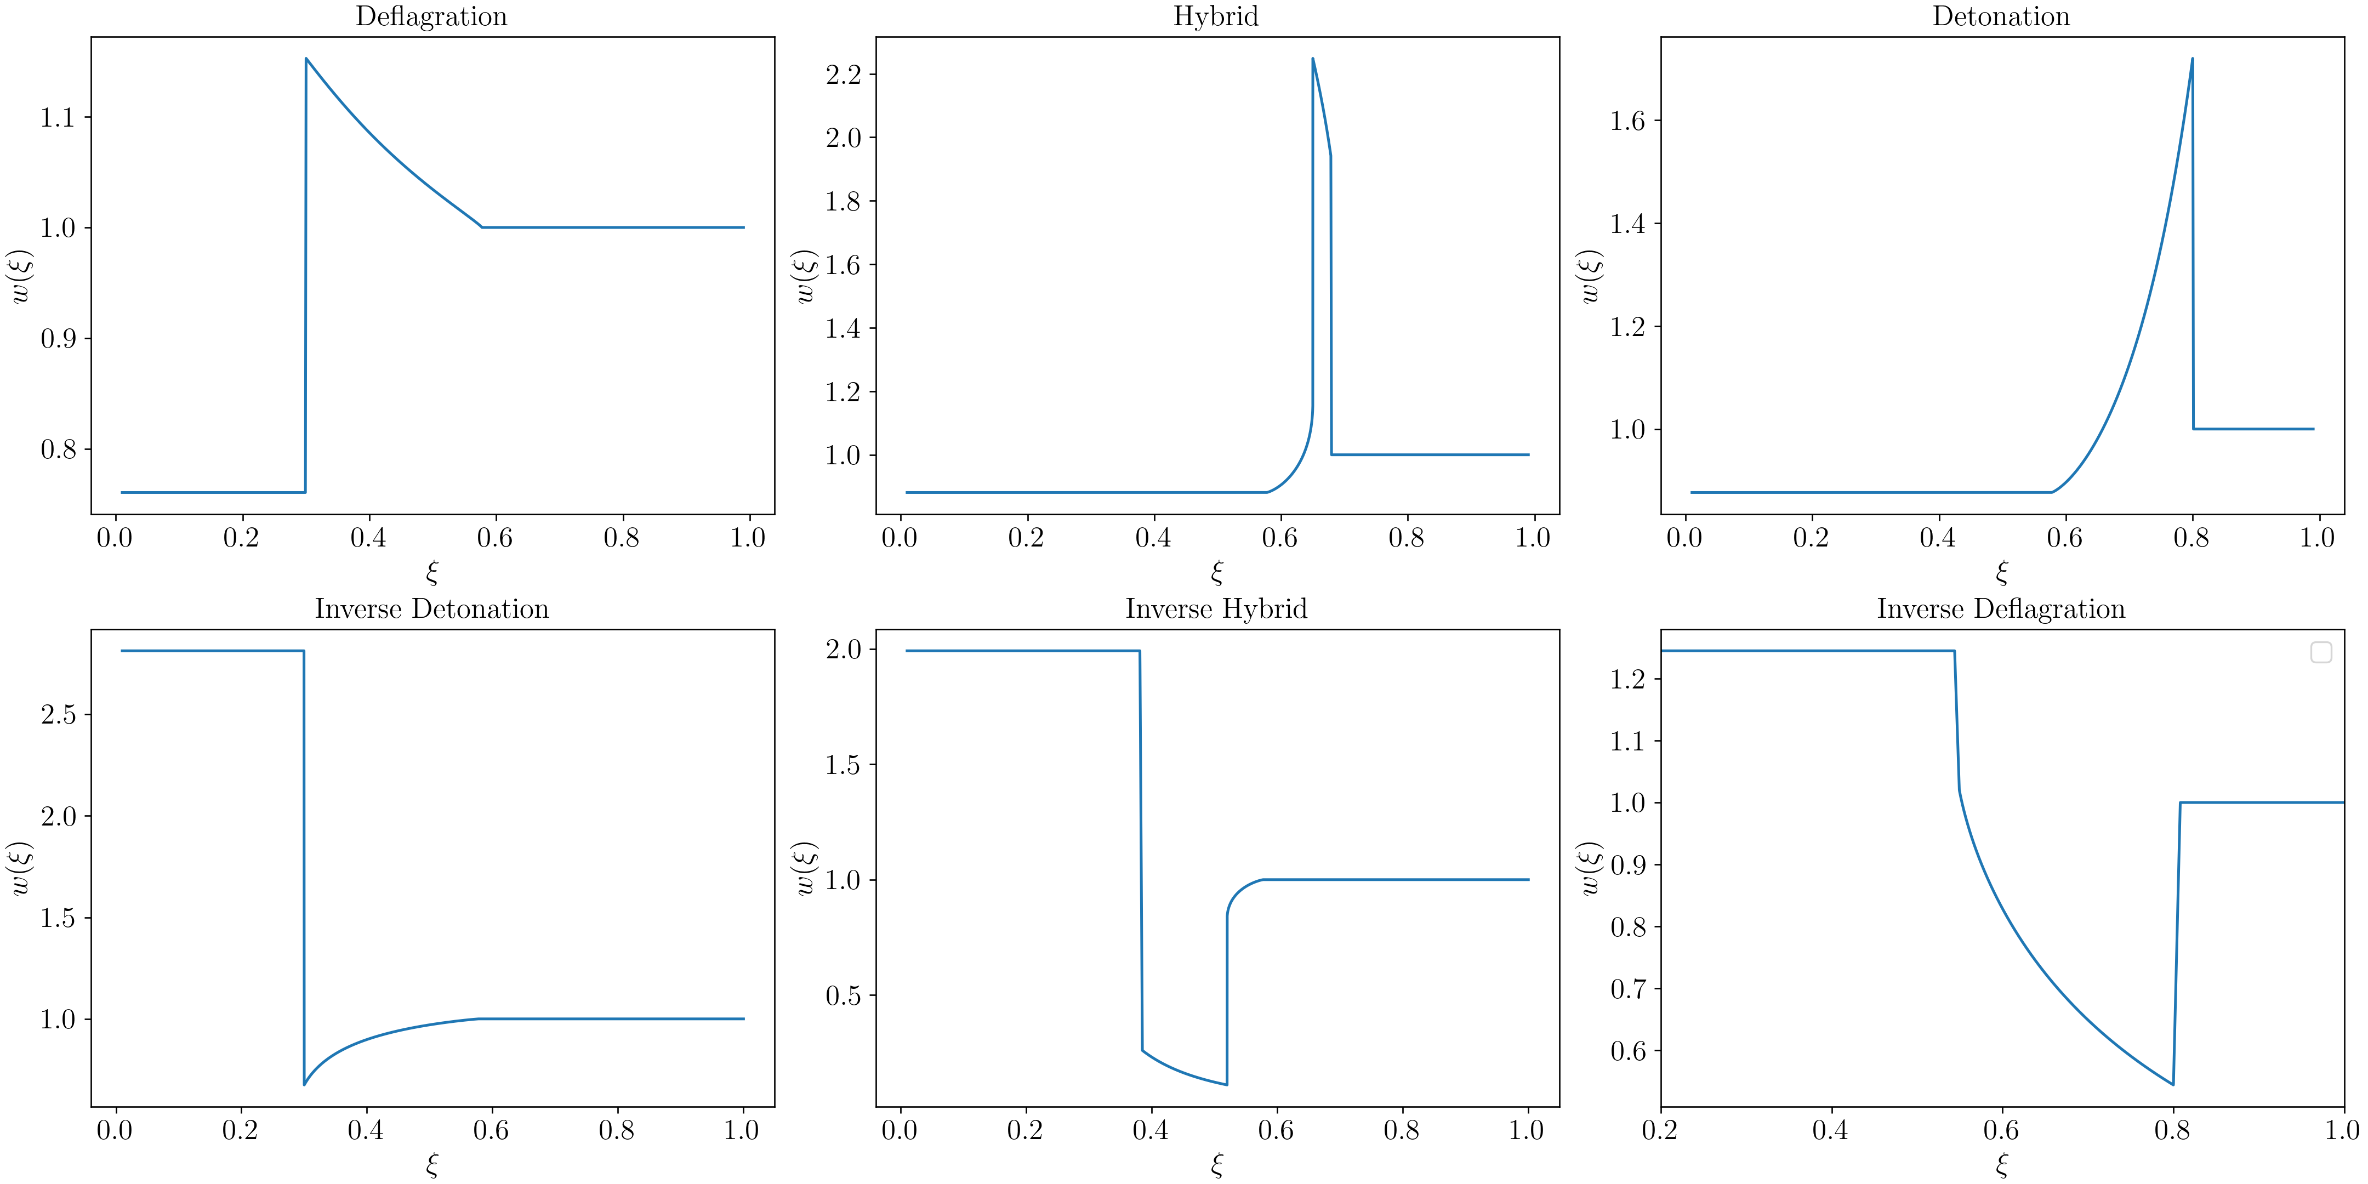
Inverse Hydrodynamic Solutions
Enthalpy profiles for inverse and direct hydrodynamics

Slide 10


Modellings of GW Production
Sound Shell Model (SSM) (Hindmarsh et al. JCAP’19 + Roper Pol et al. PRD ’23)
A simi-analytic method (Introduced lots of approximations)
  Fluid velocities are non-relativistic.
  The fluid velocity field is Gaussian, irrotational and statistically homogeneous.
  The velocity field is represented as a linear superposition of self-similar fluid profiles.
  The velocity correlator remains stationary and bubbles are entirely annihilated once half of their volume has transitioned into the stable phase.
GW spectrum of SSM
Notes:
Fluid velocities are non-relativistic.
The fluid velocity field is Gaussian, irrotational and statistically homogeneous.
The velocity field is represented as a linear superposition of self-similar fluid profiles.
The velocity correlator remains stationary.
and bubbles are entirely annihilated once half of their volume has transitioned into the stable phase.

Slide 11


Modellings of GW Production
Higgsless simulation (Jinno et al. ’23 + Caprini et al. ’25)
A numerical method
  Neglecting the scalar field, numerically solving fluid equation to get $T^{μν}$
GW spectrum of Higgsless simulation
Minkowski
Bubble nucleation history
Solving fluid equations
Weinberg’s formula
GW spectrum

Slide 12
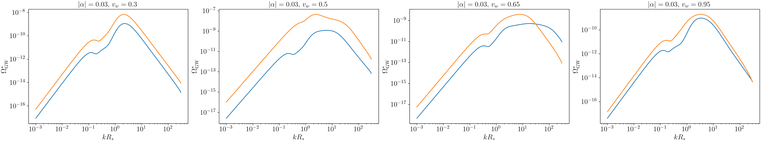
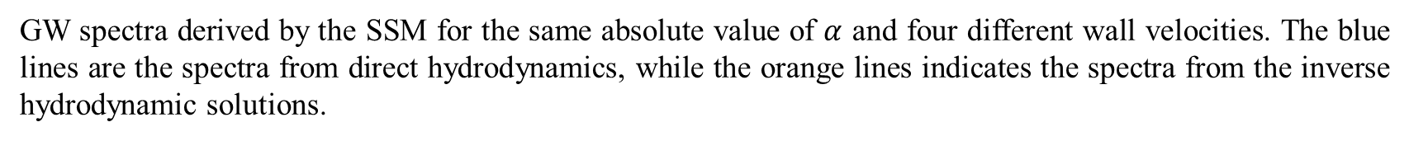
Modellings of GW Production
GW Spectrum from SSM (preliminary results)
GW spectra derived by the SSM for the same absolute value of $α$ and four different wall velocities. The blue lines are the spectra from direct hydrodynamics, while the orange lines indicates the spectra from the inverse hydrodynamic solutions.

Slide 13
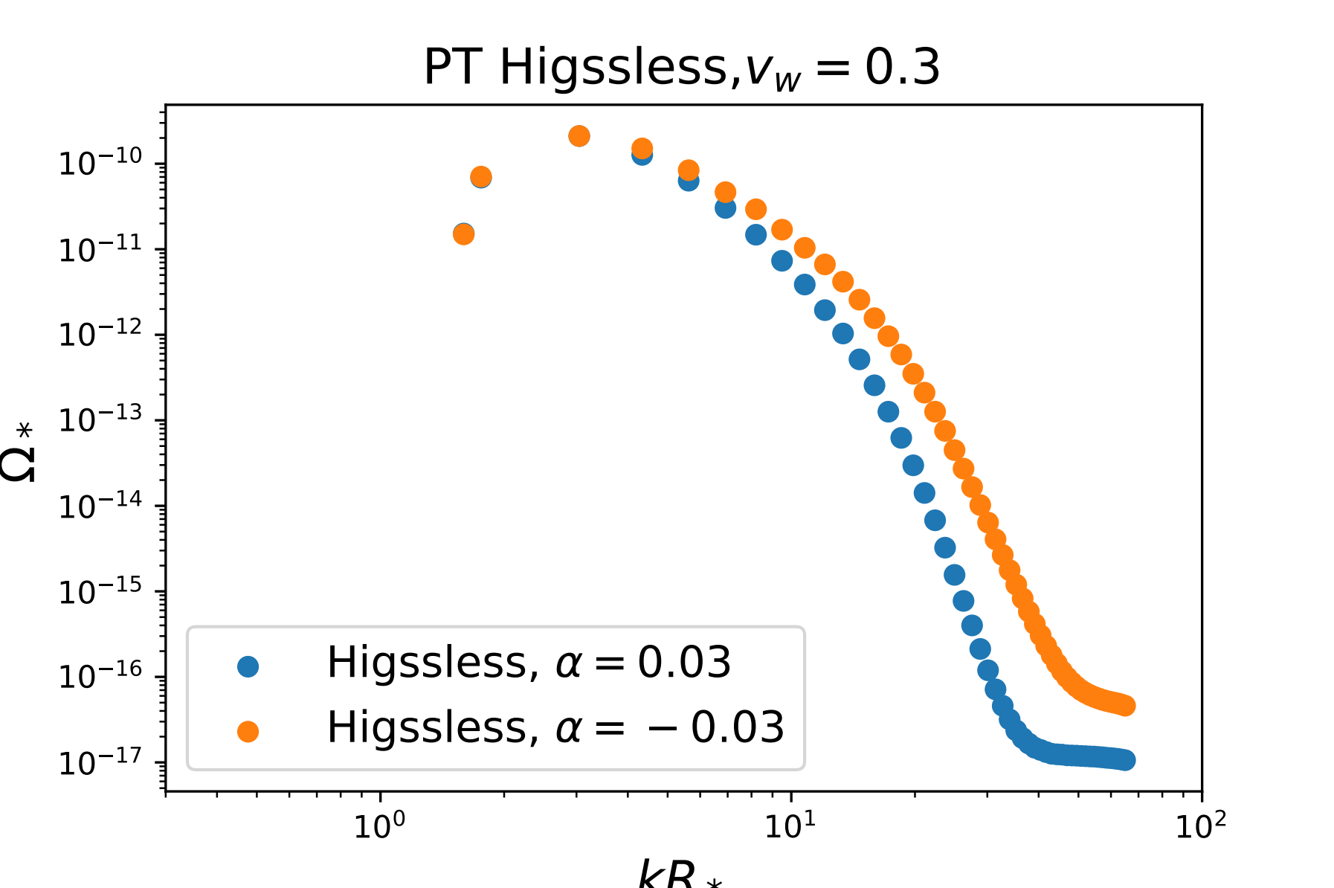
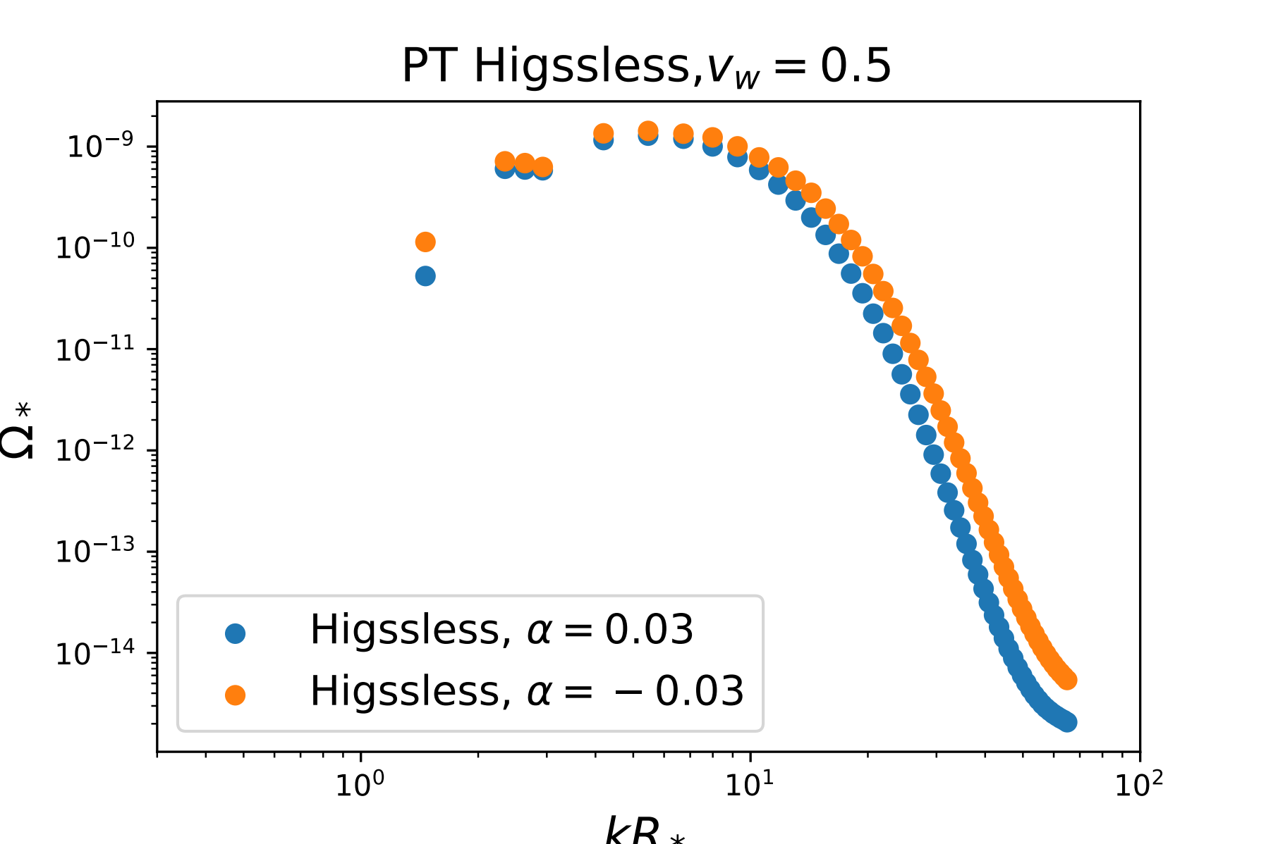
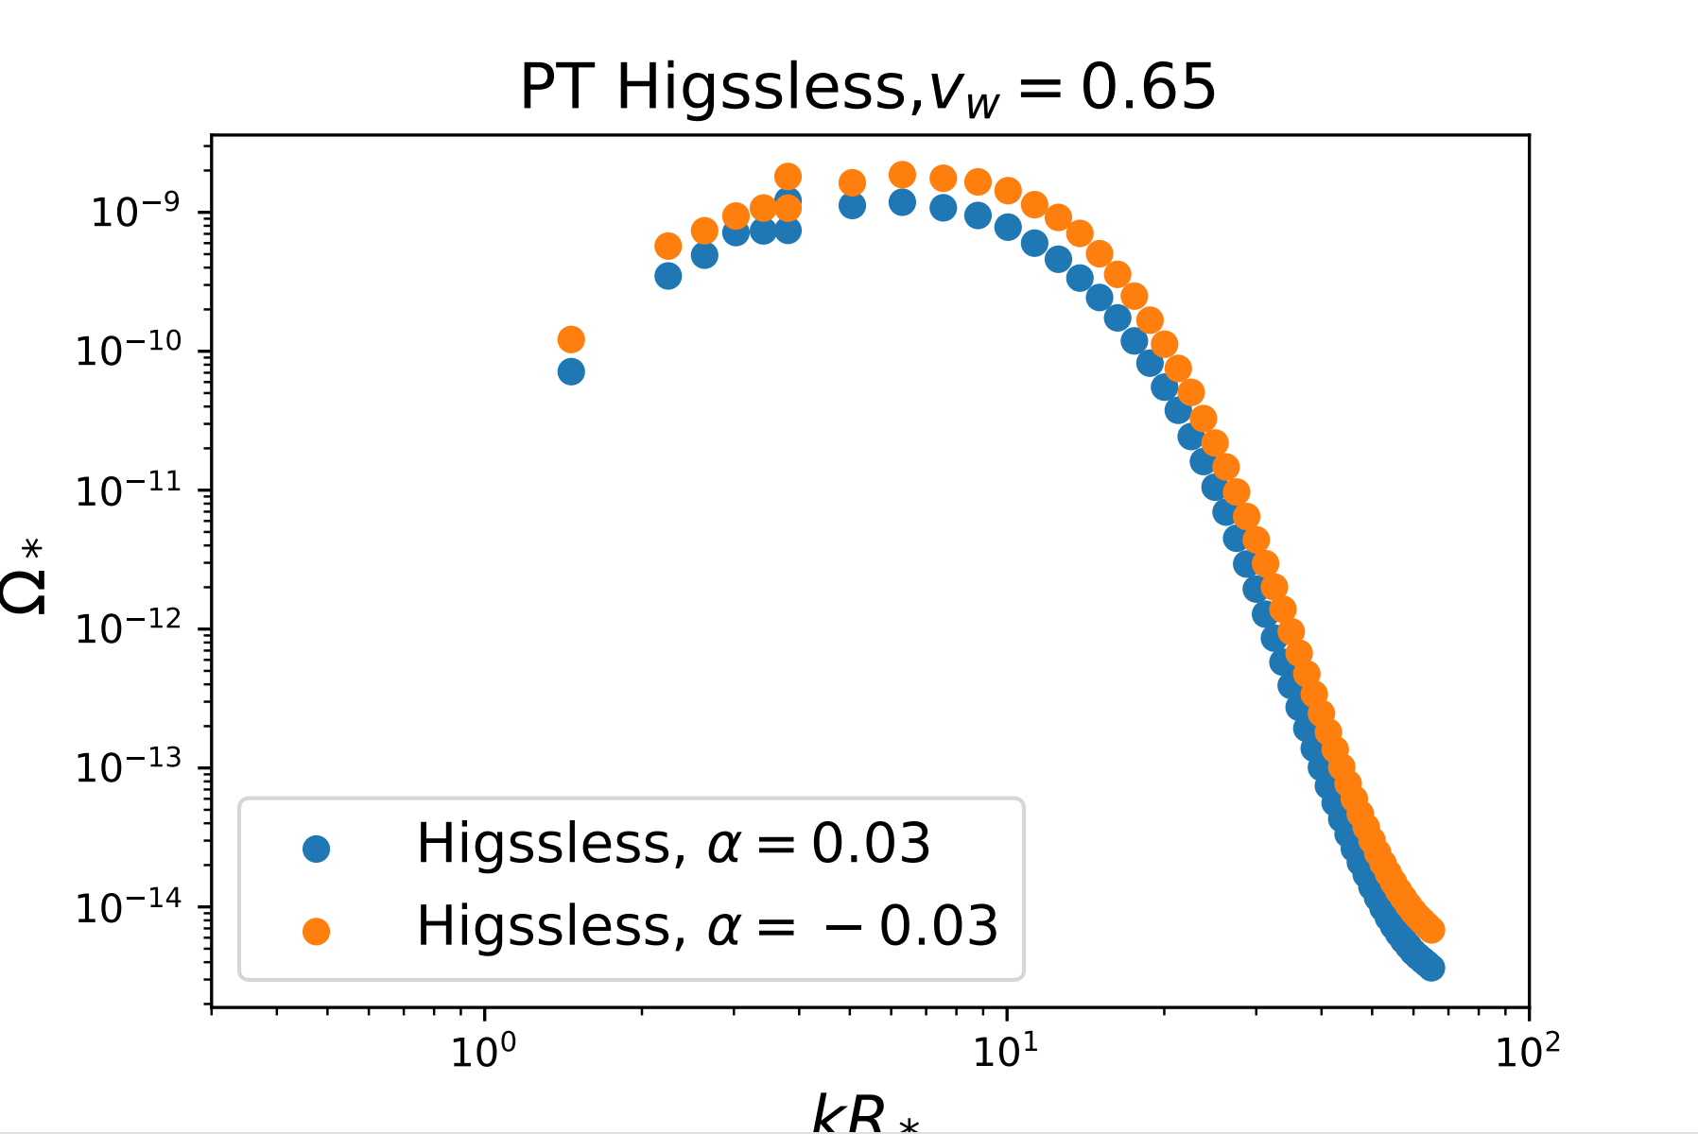
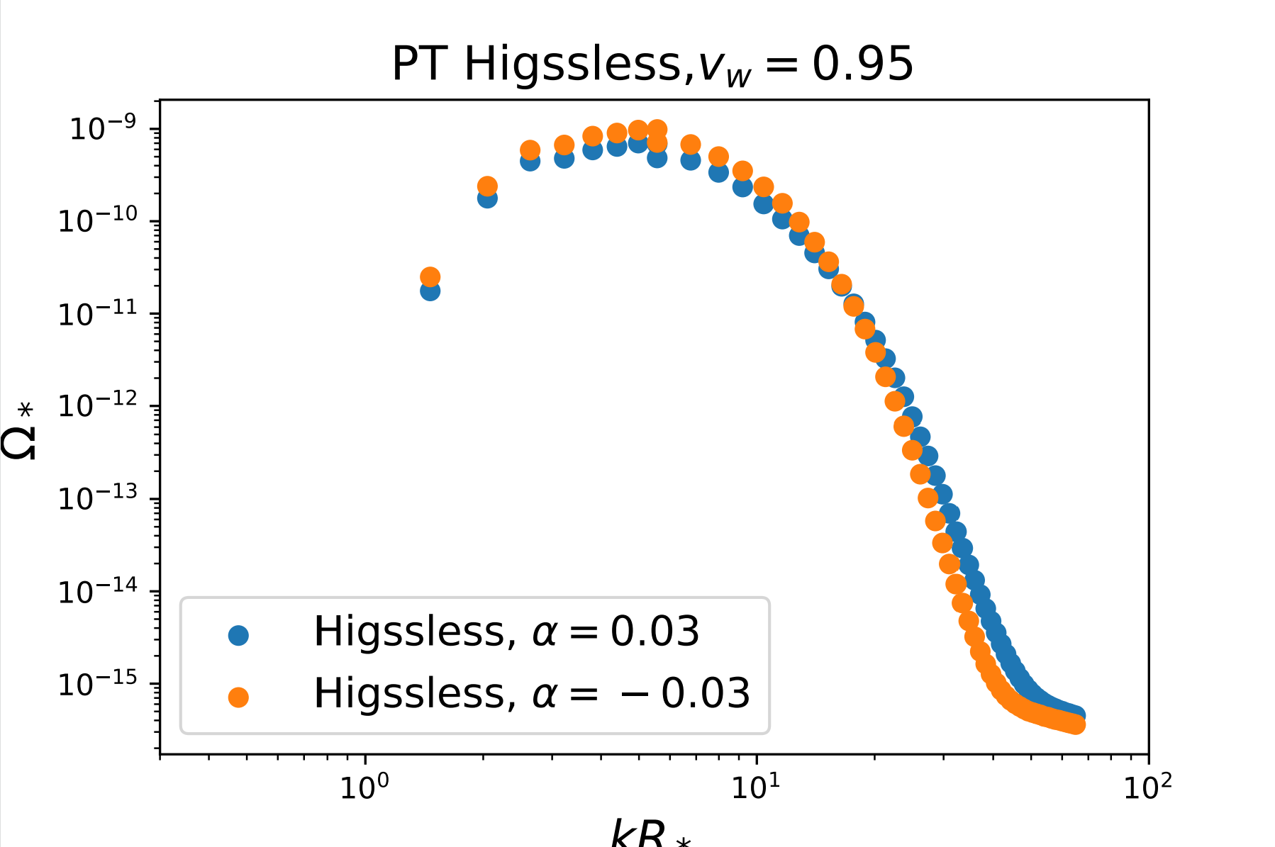
Modellings of GW Production
GW spectra from Higgsless simulation (preliminary results)

Slide 14
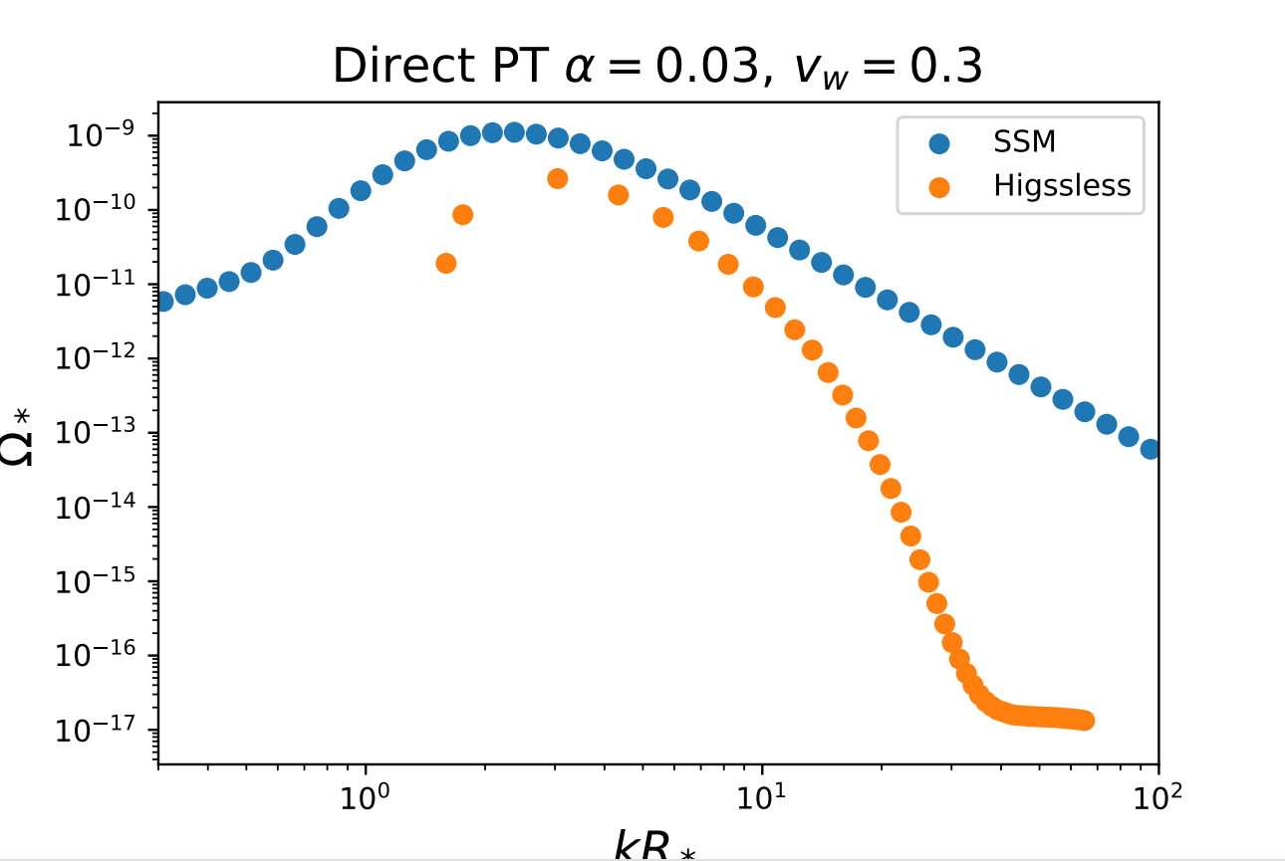
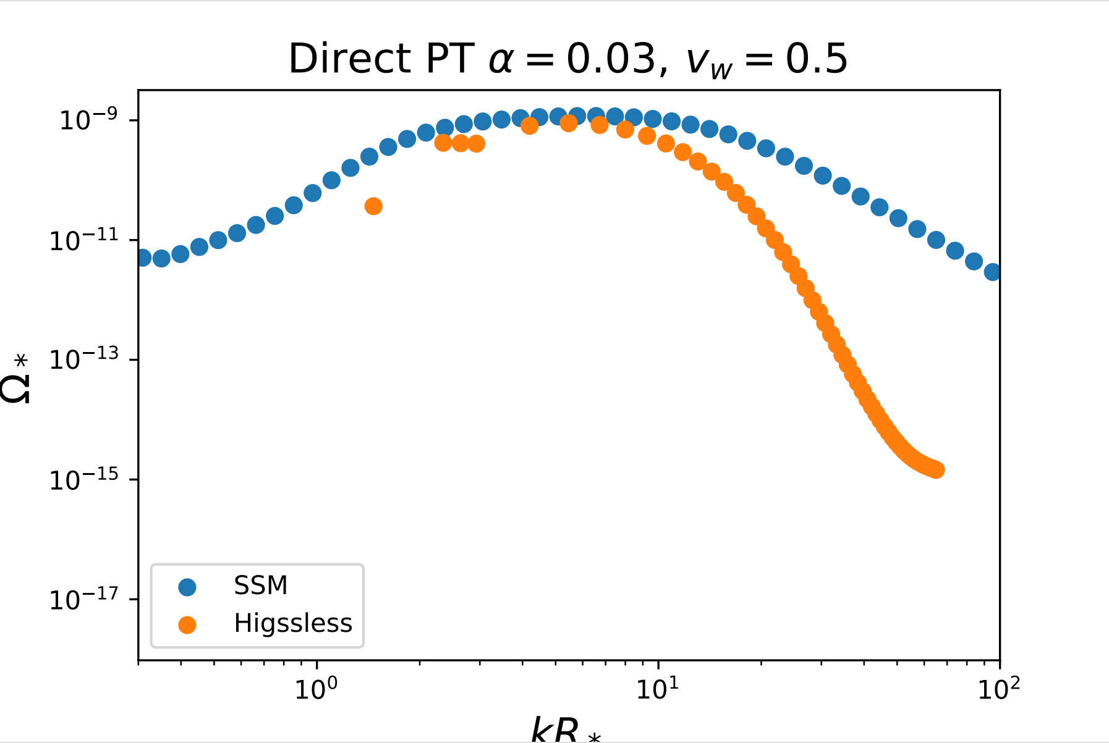
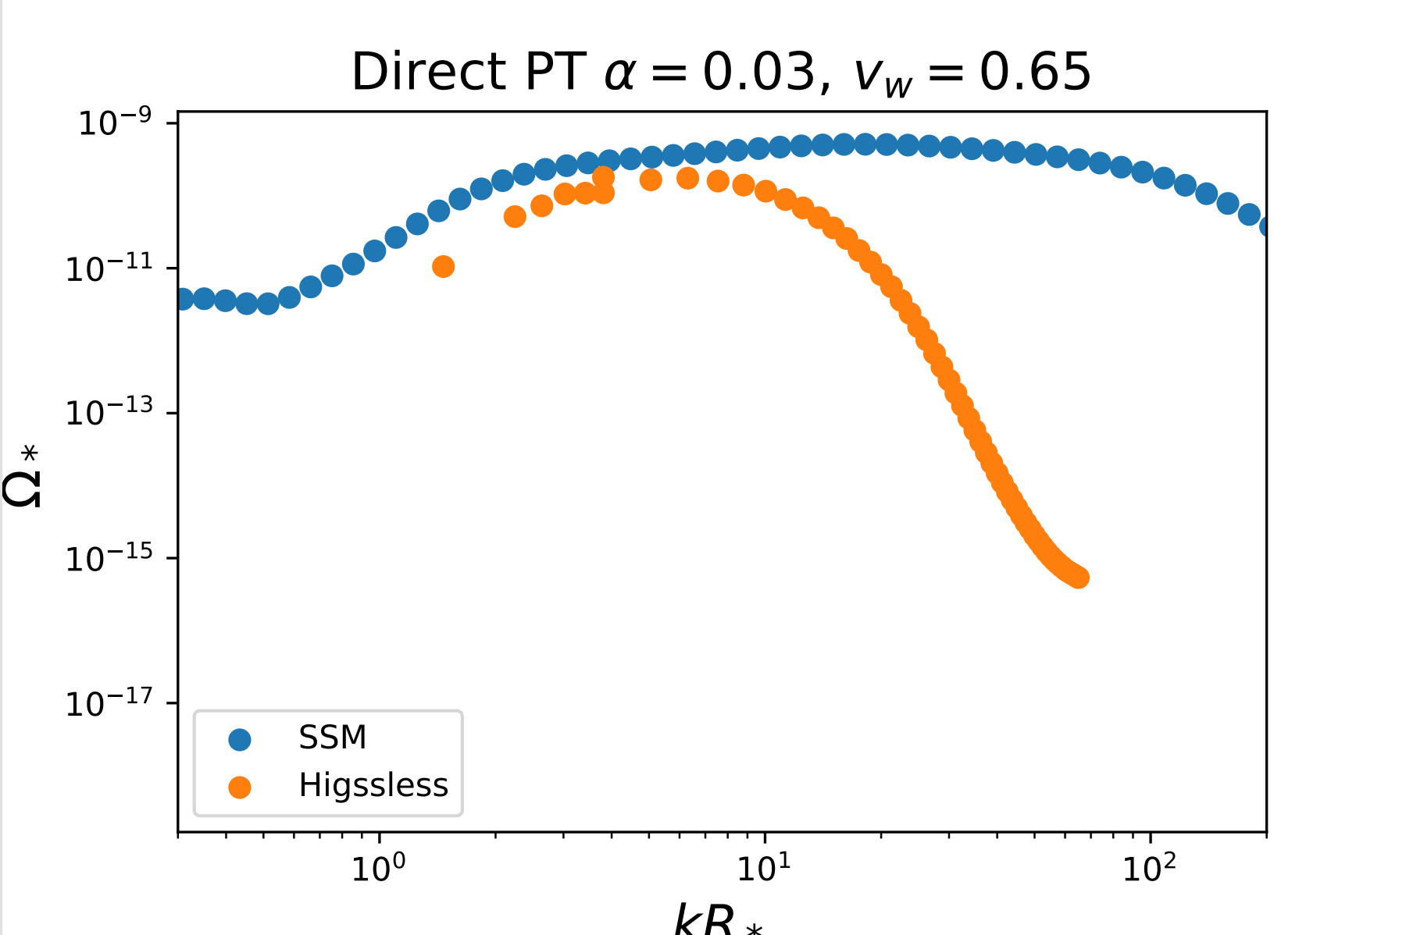
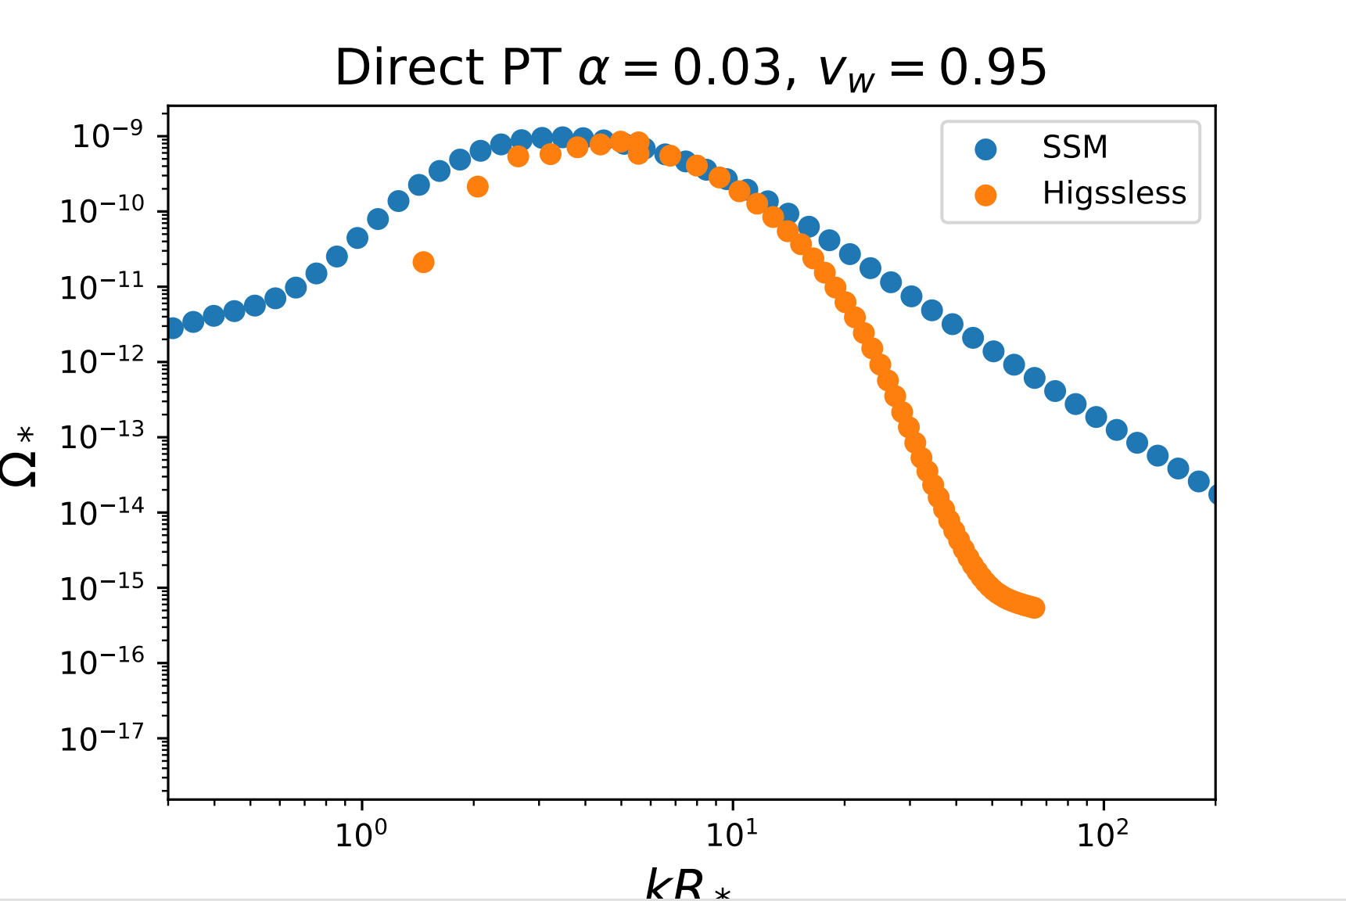
Modellings of GW Production
Comparison for results derived by different modellings (Direct) (preliminary results)

Slide 15
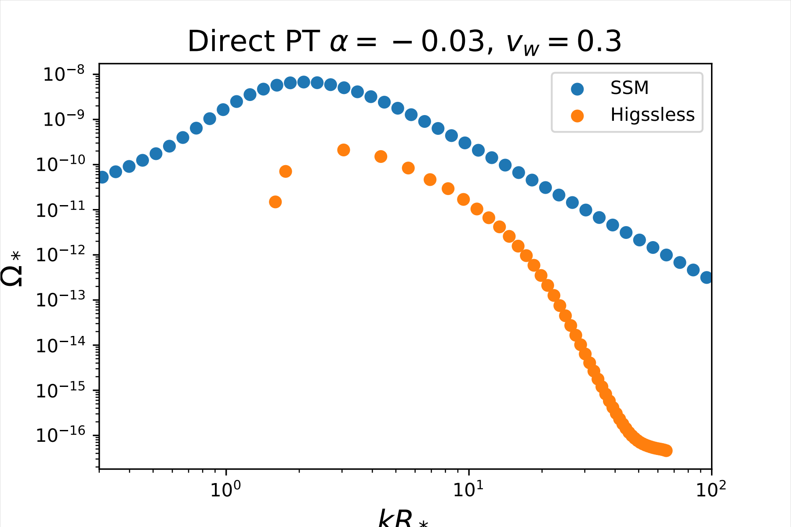
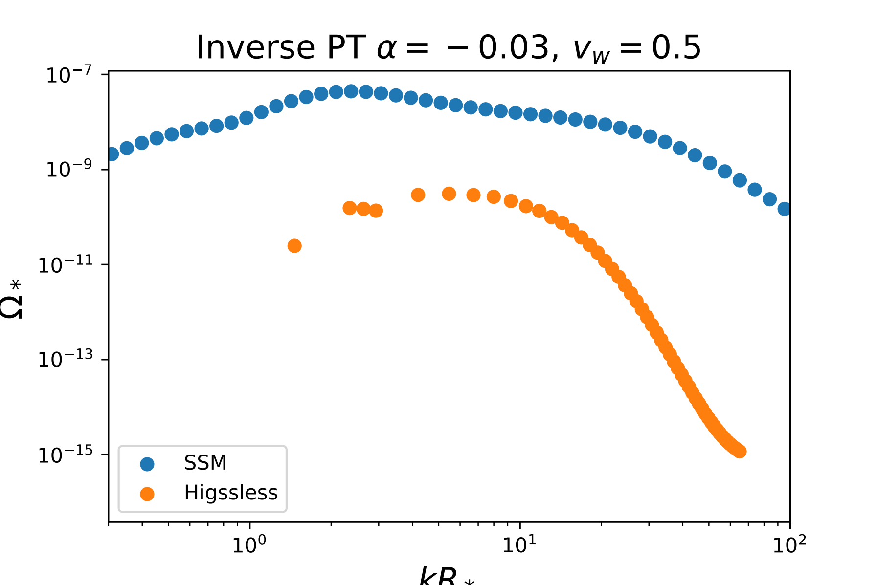
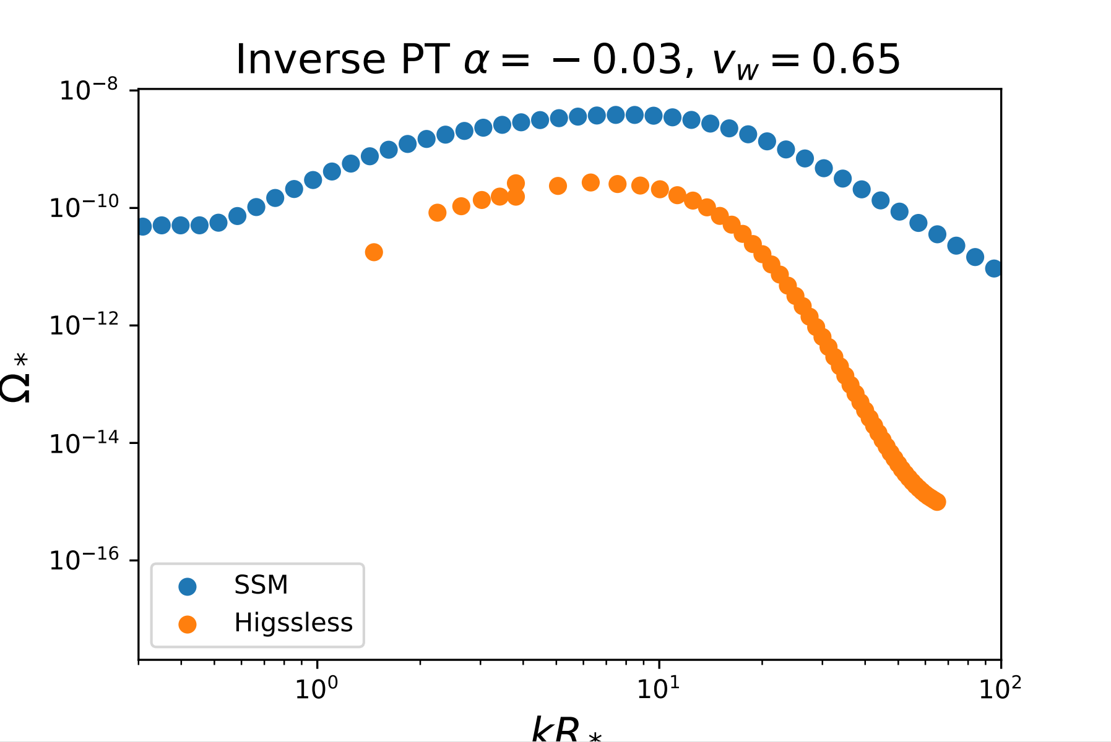
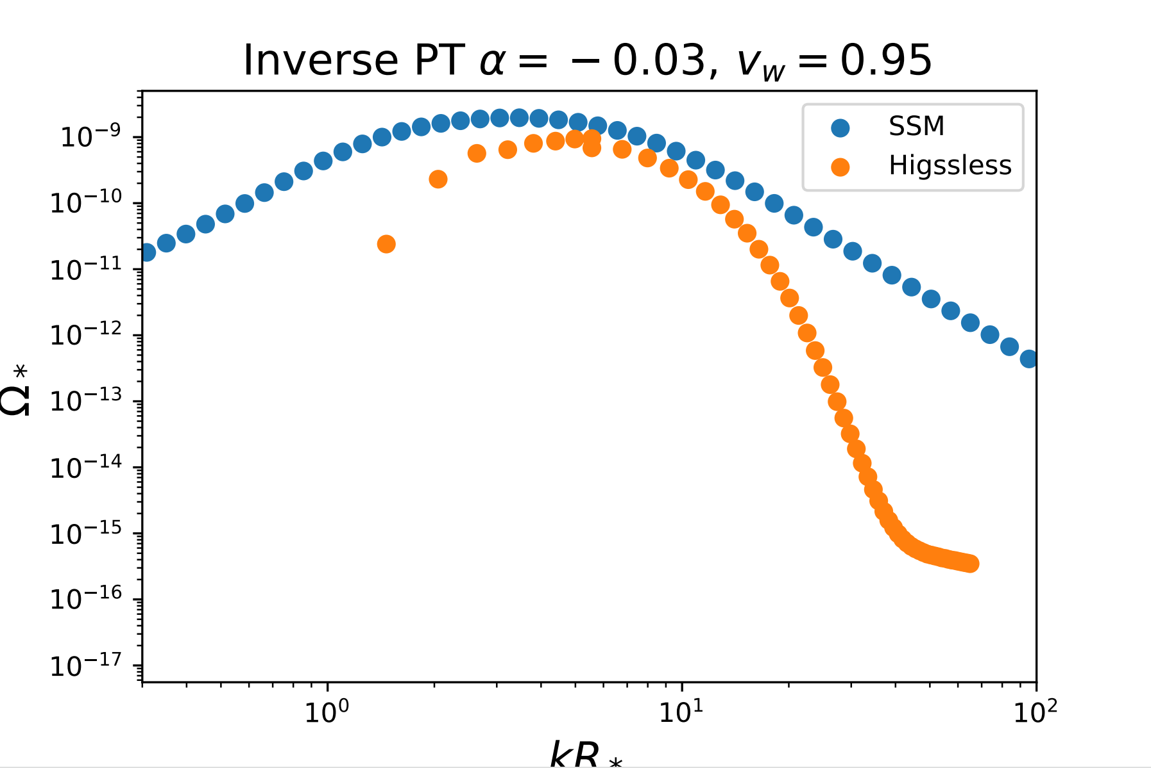
Modellings of GW Production
Comparison for results derived by different models (Inverse) preliminary results

Slide 16
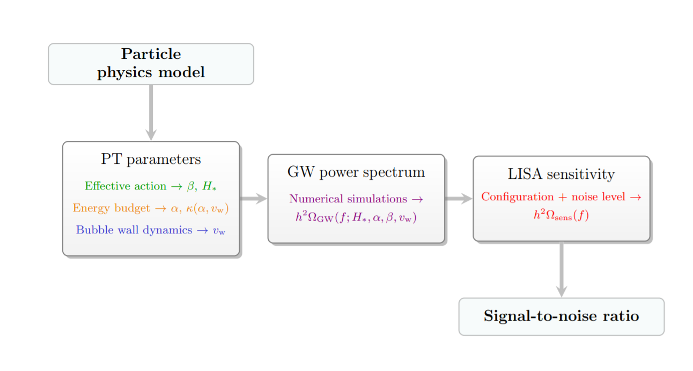
Uncertainties of GW Predictions
Chiara Caprini et al, JCAP03(2020)024

Slide 17
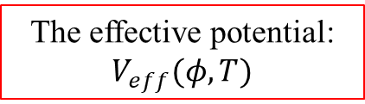
Uncertainties of GW Predictions
Theoretical uncertainties originate from
Phase transition parameters:
  Strength parameter
  Inverse duration
  Reference temperature
  Wall velocity
Modelling of GWs productions
  SSM (validity of approximations…)
  Higgsless (resolutions, simulation volume, integration time…)
strongly related to
The effective potential: $V_{eff}(φ, T)$

Slide 18
Cosmic Expansion

Slide 19
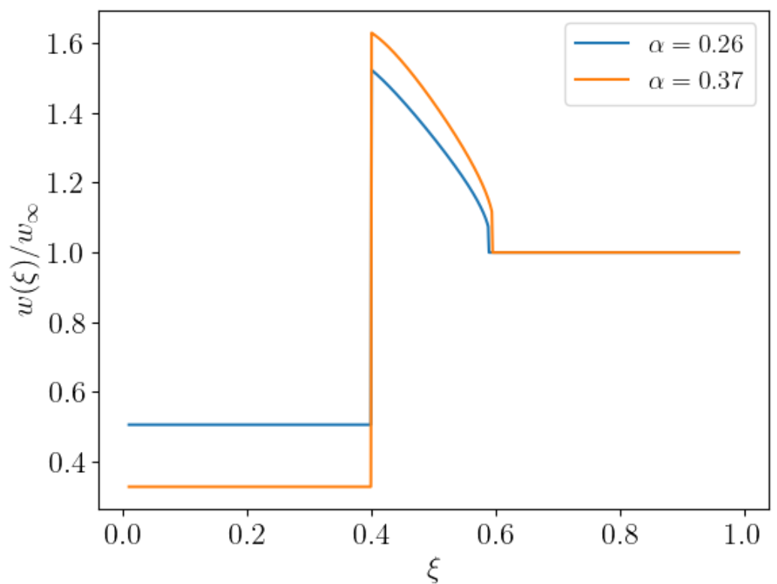
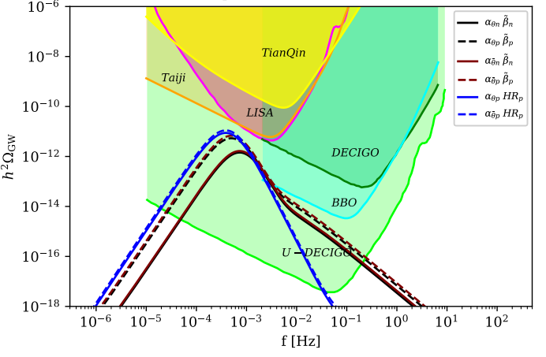
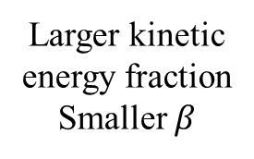
Energy injection VS Dilution
One important fact:
Phase transitions is a dynamical process and all phase transitions parameters are T-dependent.
$$α(T)$$ | $$β(T)$$ | $$v_{w}(T)$$
Increase with the decreasing of T | Decrease with the decreasing of T | Increase with the decreeing of T
Larger kinetic energy fraction
Smaller $β$
Based on X.W. et al. PRD ’21
Notes:
Therefore, the choice of the reference temperature would strongly impact the GW spectrum.

Slide 20

Energy injection VS Dilution
Evolution of PT
Cosmic expansion
vs
Energy continuously injected into plasma
Dilution
$$Υ=1−\frac{1}{\sqrt{1+2Hτ_{sw}}}$$
Guo et al. JCAP ’21
Amplification of GW ?
Suppression of GW
Which effect would be dominant?

Slide 21
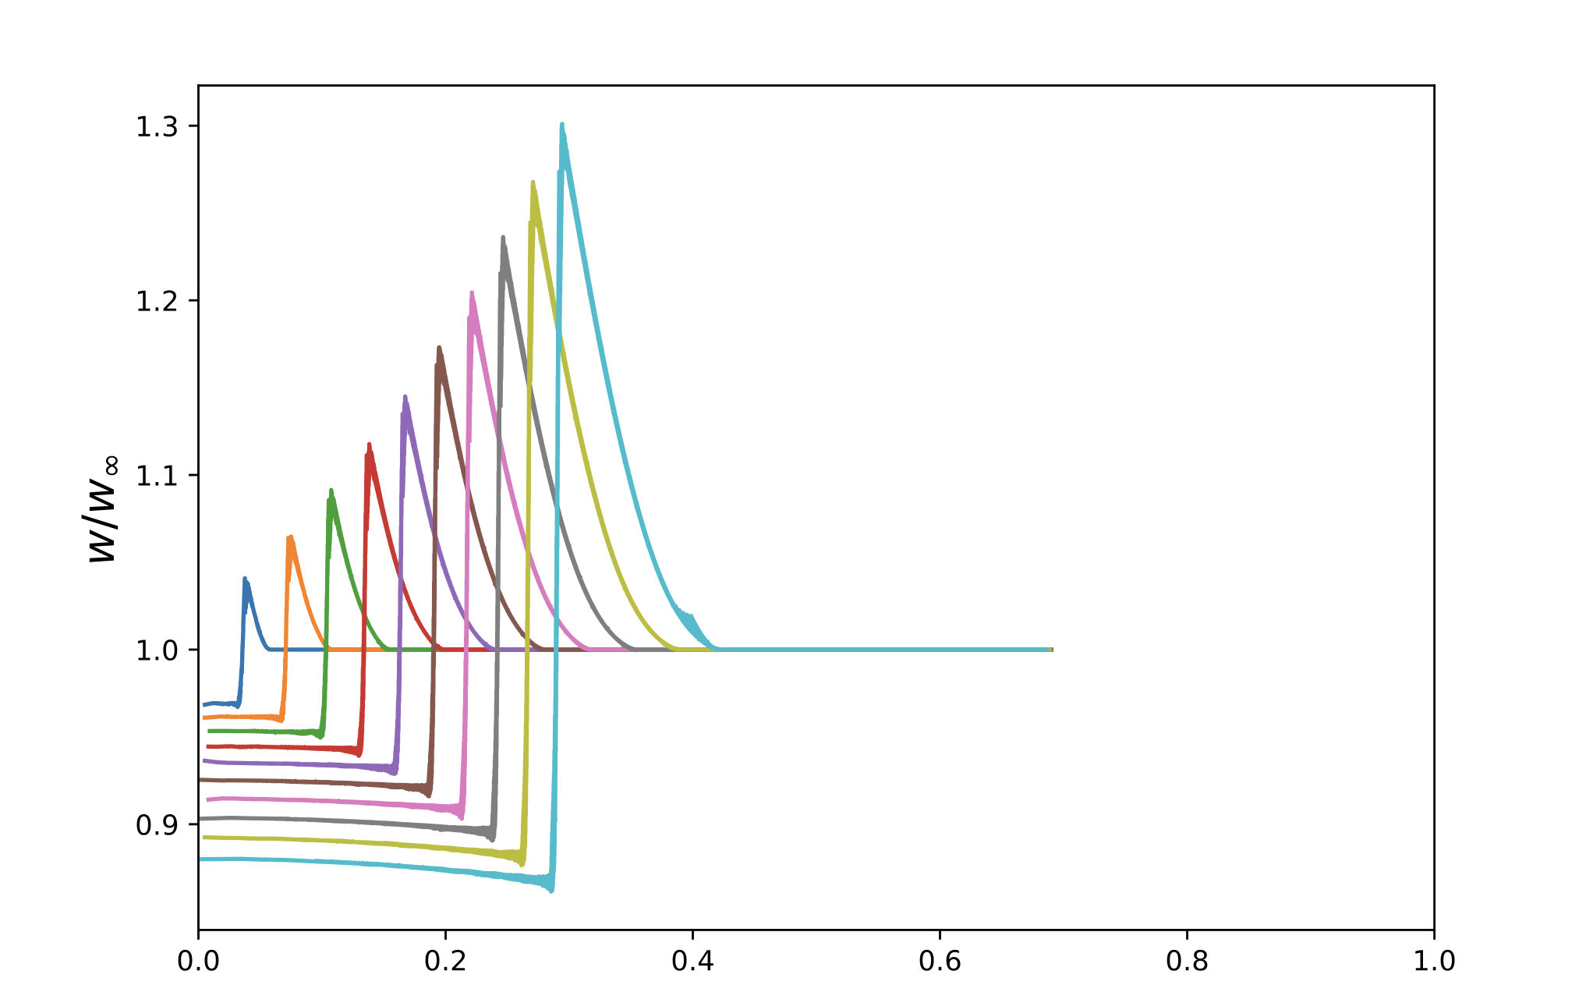
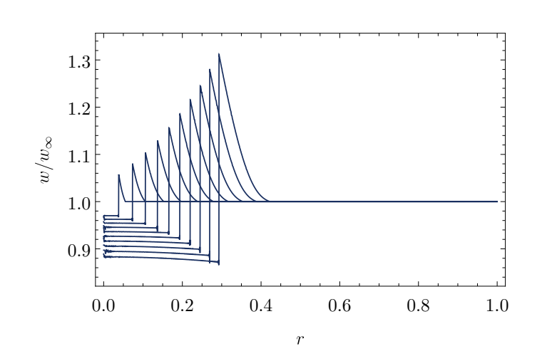

Cosmic Expansion
Simple case: the universe consists of radiation and vacuum energy, which is characterized by the bag model (assumption used for the studies of PTs)
$$p=\frac{1}{3}aT^{4}−ε, e=aT^{4}+ε$$
3D single bubble simulation
1D simulation
Consistent
Jinno et al. JCAP. ’25

Slide 22
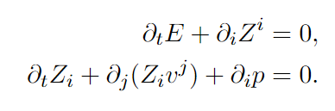
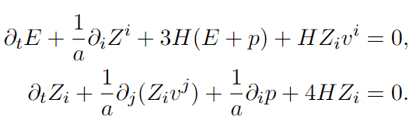
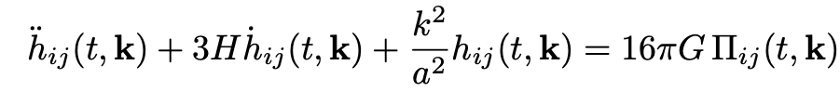
Calculation of GW
The flowchart of the Higgsless simulation for different spacetime:
Minkowski
Bubble nucleation history
Solving fluid equations
Weinberg’s formula
GW spectrum
Friedmann Equation
FLRW
Solving fluid equations
Eisenstein’s equations
GW spectrum
Bubble nucleation history

Slide 23
Summary
Inverse Hydrodynamics & GW Signals
  Offers access to unique BSM parameter spaces
  Distinct from those explored via direct hydrodynamic modeling
Modeling Uncertainties
  Different GW production models introduce theoretical ambiguities
  For each models, the intrinsic assumptions and numerical issues affect predictions
Cosmic expansion
  Ongoing debate: dilution vs. energy injection
  Net impact on GW spectra remains controversial
Thank you!

