Slide 1


Emulating gravitational wave spectra from sound waves during FOPTs
田驰 (Chi Tian)
Anhui University
The 2025 Beijing Particle Physics and Cosmology Symposium (BPCS)
2025年9月 Beijing
Collaborator: 王潇 (Xiao Wang), Csaba Balázs
arXiv: 2501.10244 (Tian, et. al. JCAP 2025)
https://github.com/ctian282/DeepSSM
Notes:
Hi

Slide 2
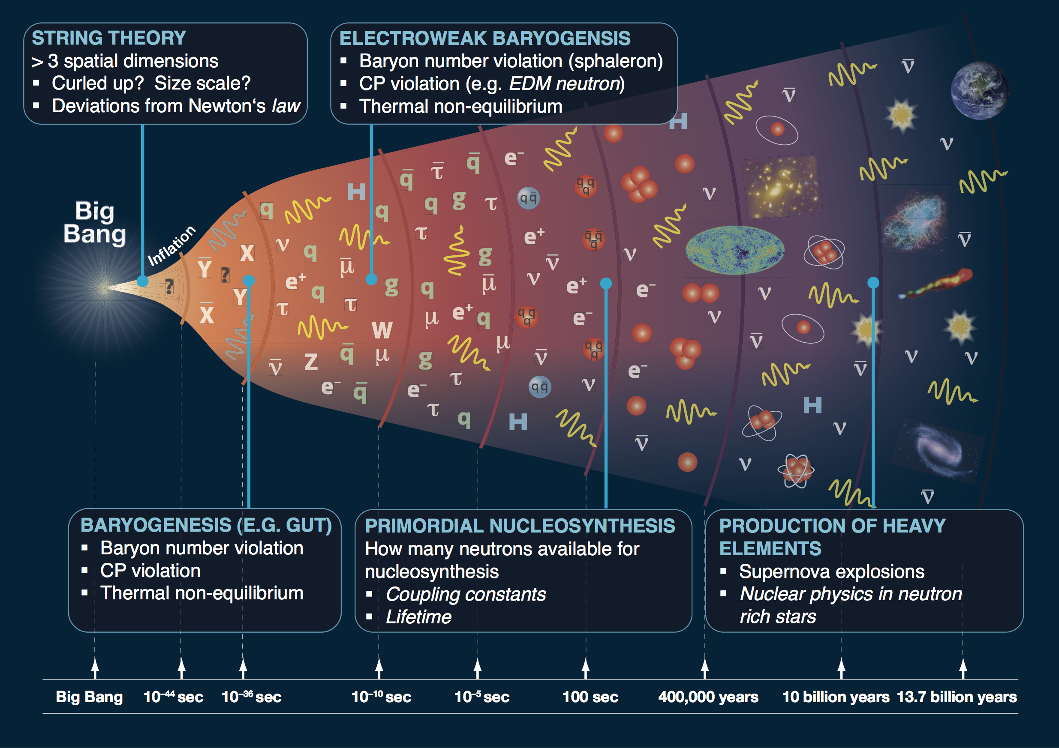
Credit: 1205.2451

Slide 3
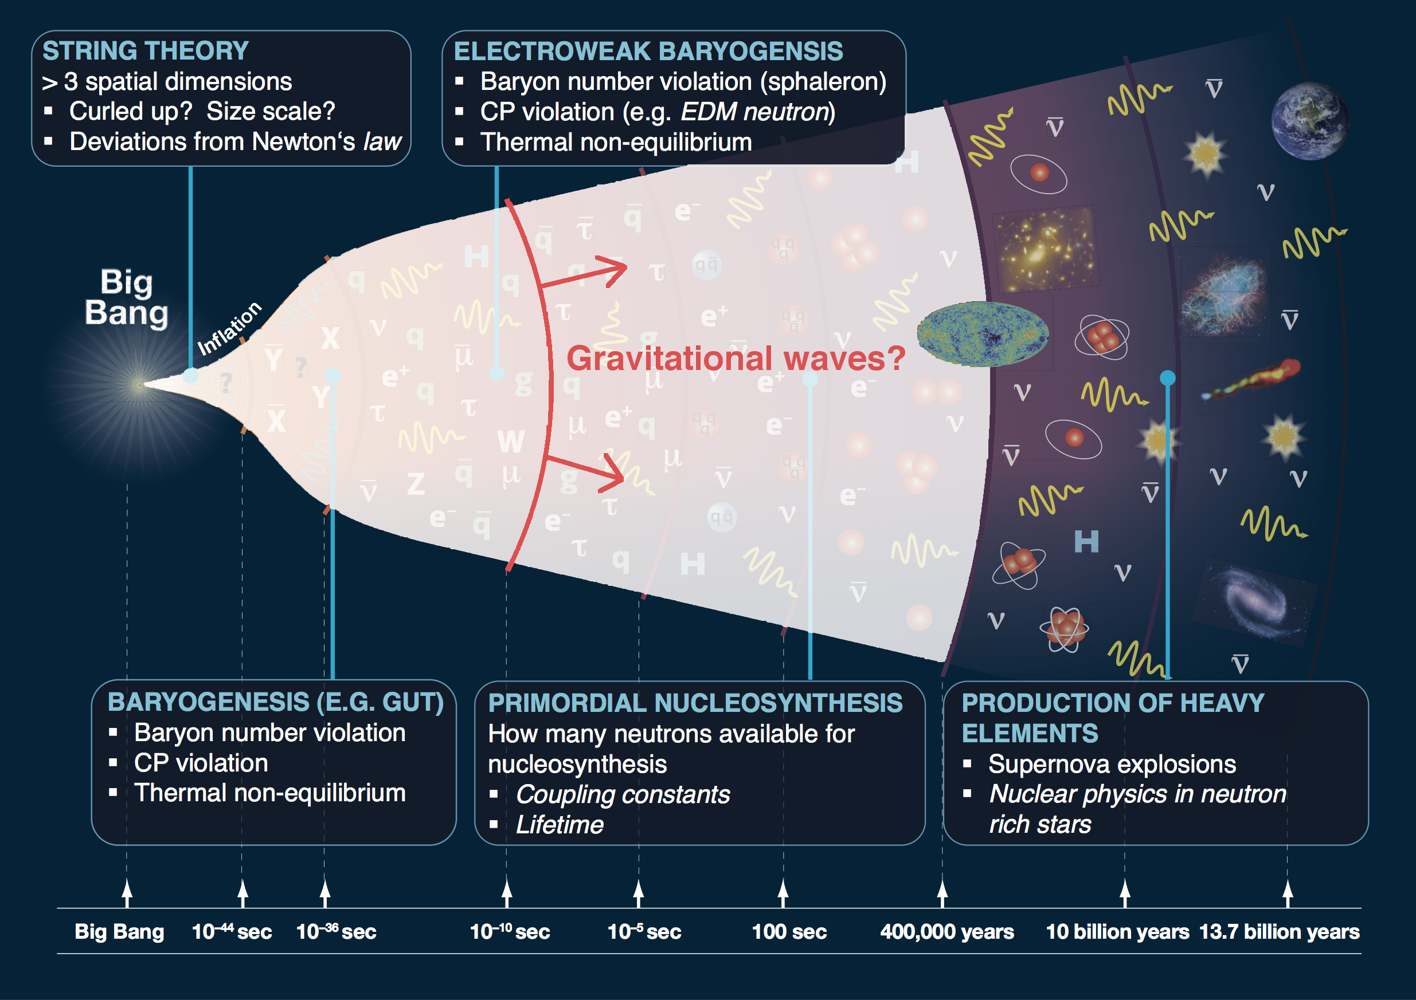
Credit: 1205.2451

Slide 4
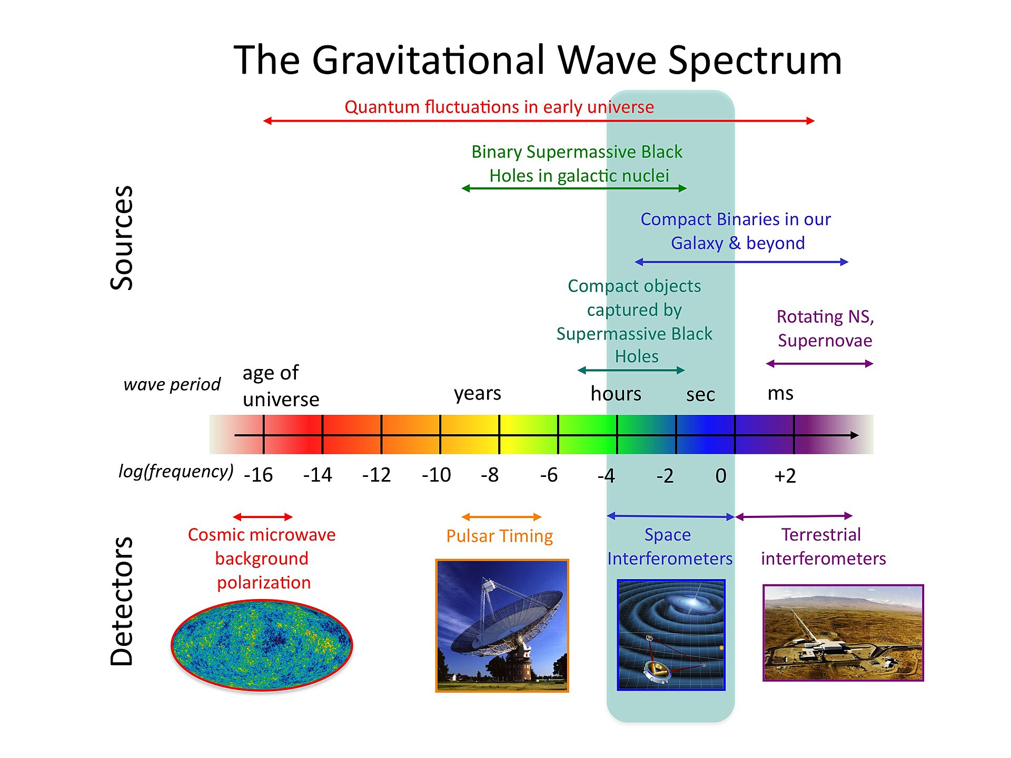
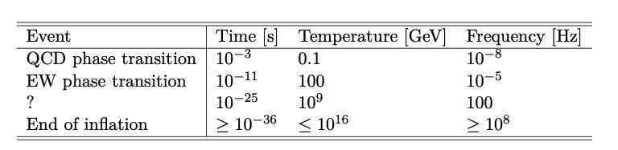
Credit: 1205.2451
Credit: NASA

Slide 5
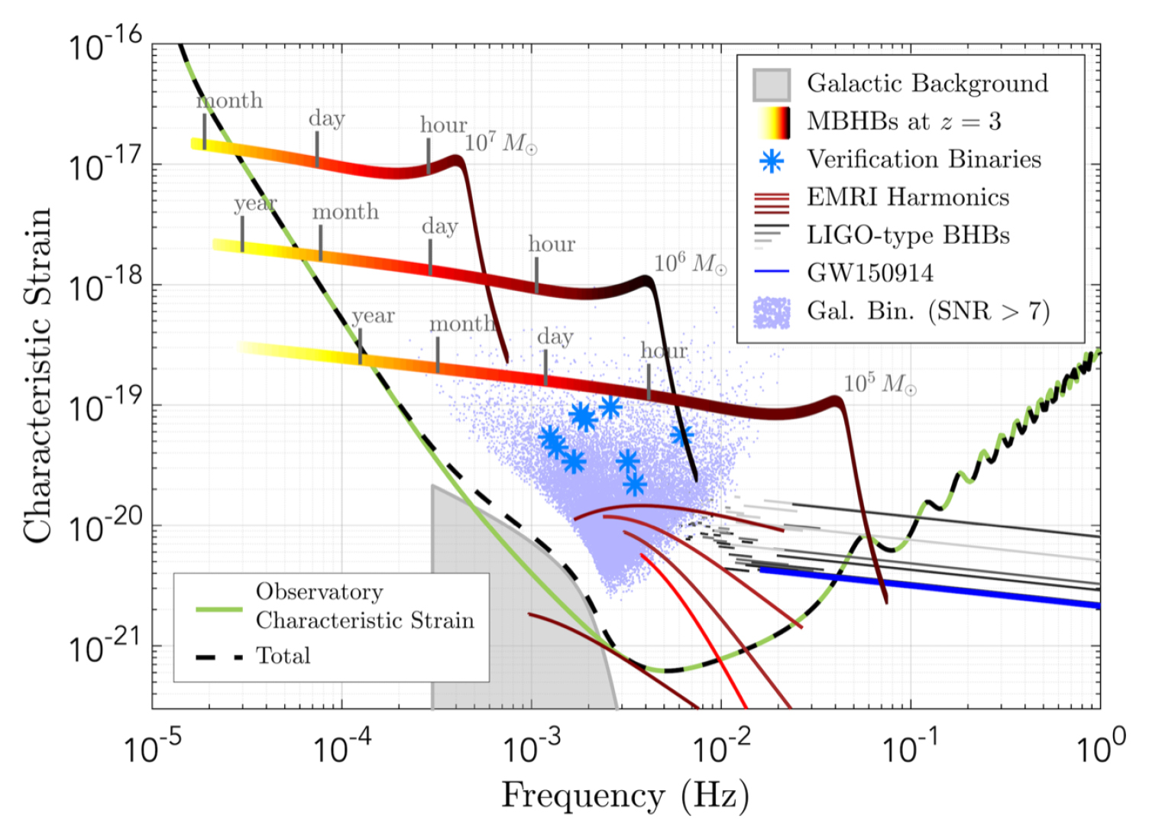
Credit: 1205.2451

Slide 6
Credit: 1205.2451
Cosmological origins

Slide 7
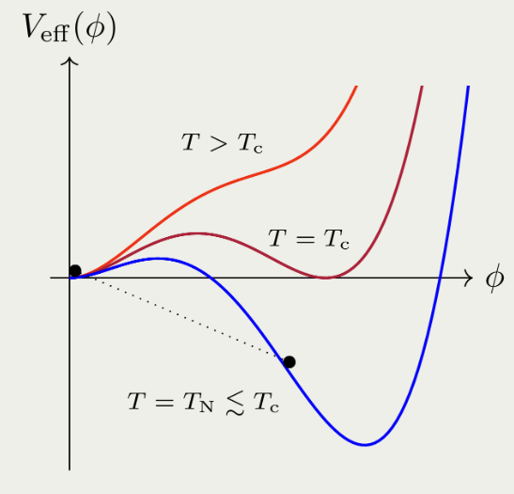
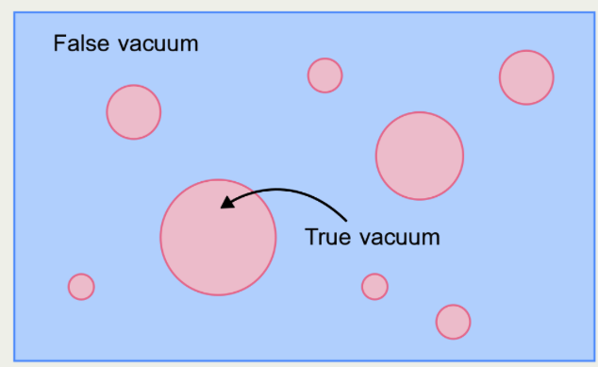
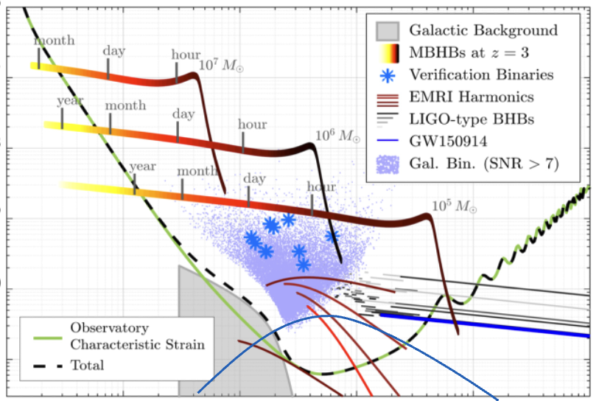
Credit: 1205.2451
Credit: 1205.2451
Cosmological FOPTs as SGWB origins
Bubble nucleation
Dynamics of PTs

Slide 8

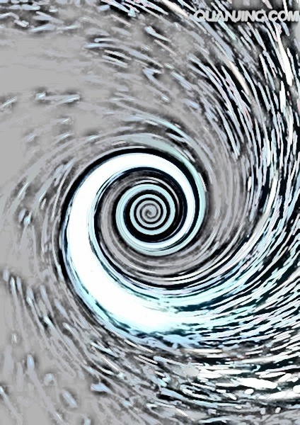
Credit: 1205.2451
Various GW generation mechanisms
GWs sources of FOPT:
Bubble collisions
Sound wave
Turbulence
JCAP 0809, 022 (2008); PRL112, 041301 (2014); PRD92, no. 12,123009 (2015); PRD96, no. 10,103520 (2017); Phys. Rev. D 66, 024030 (2002), Phys. Rev. D 76 (2007) 083002, JCAP 0912, 024 (2009)
The amplitude and shape of GW spectrum are strongly related to PT dynamics.
Formation and expansion of bubbles
Decreasing temperature
Bubble collision
Overlapping of sound shell
Shells of rarefaction
Shells of compression
Overlapping of sound shell
Bubble collision
Detonation mode
Deflagration mode
Turbulence
Wang, et. al. PRD 2022

Slide 9
Credit: 1205.2451
Numerical vs. semi-analytical methods
Full Hydrodynamical simulation:
Require a simulation volume large enough.
The grid spacing must be small enough
Pros:
Less priori assumptions
More robust predictions
Cons:
Phenomenological friction term
numerically expensive / time consuming
Higgsless (Hybrid) Hydrodynamical simulation:
No Higgs (fluid only)
The grid spacing can be larger
Pros :
Higher efficiency
Higher flexibility (with realistic EoS)
Cons :
More assumptions
Complicate to implement
(Semi) analytical approach: (Sound shell model.)
Modeling of the relevant sources
Some basic assumptions
Pros:
Better physics insight
Less cost
Cons:
Robustness of assumptions and modeling
Hindmarsh, et. al. PRL 2013;
Hindmarsh, et. al. PRD 2015 …
Jinno, et. al. JCAP 2021; Jinno, et. al. JCAP 2023;
Tian, et. al. EPJC 2025; Wang, CT, et. al. 2409.06599
Hindmarsh, et. al. PRL 2019;
Hindmarsh, et. al. JCAP 2019

Slide 10
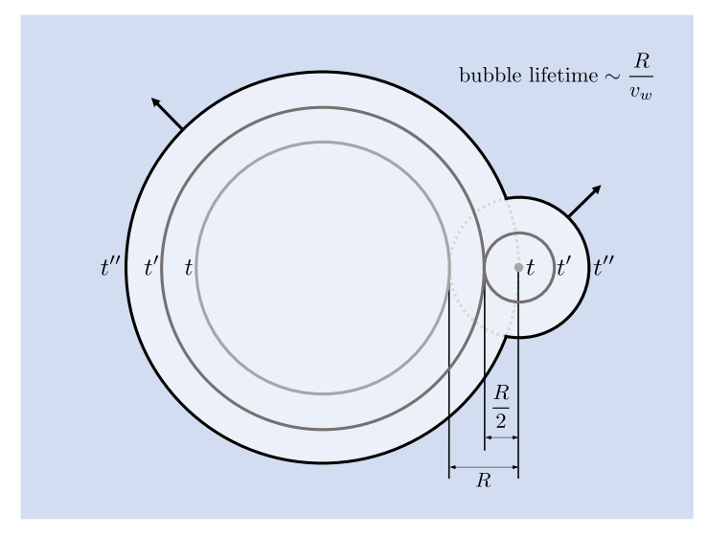
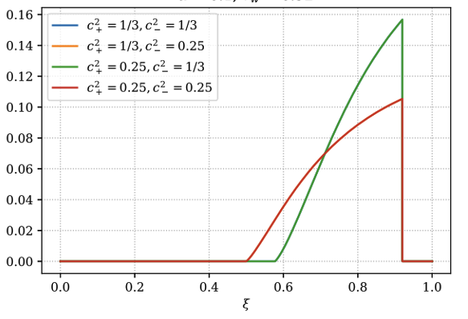

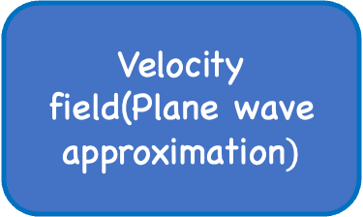
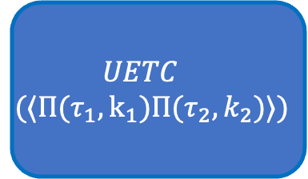

Credit: 1205.2451
The sound shell model in a nutshell
Velocity field(Plane wave approximation$)$
$$UETC$$
$$(⟨Π(τ_{1},k_{1})Π(τ_{2},k_{2})⟩)$$
$$ρ_{GW}$$
$$\left\langle ΠΠ\right\rangle ∼⟨vv⟩⟨vv⟩$$
Self-similar solutions
Bubble life-time distribution

Slide 11

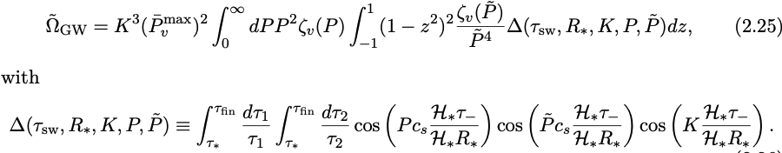
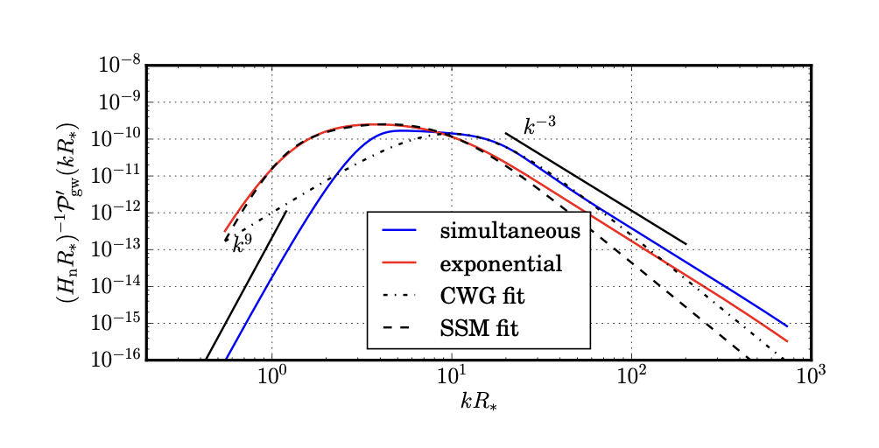
Credit: 1205.2451
The sound shell model in a nutshell
redshift
approximated as delta function

Slide 12
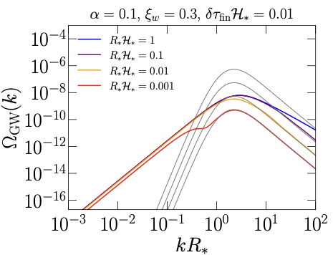

Credit: 1205.2451
The sound shell model in a nutshell
redshift
approximated as delta function
Enhanced sound shell model (Pol et. al. PRD 2024)
$$k^{3}$$

Slide 13
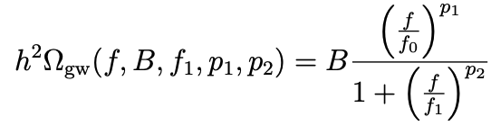
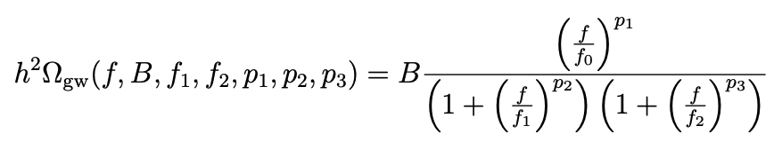
Credit: 1205.2451
Extracting GW shapes from data
Slow
Data (noise + data)
Empirical template
Physical models (SSM)
See also Guo, et. al. JCAP 2025
Very slow
Bayesian inference
A broken or double broken power-law template is still necessary!

Slide 14
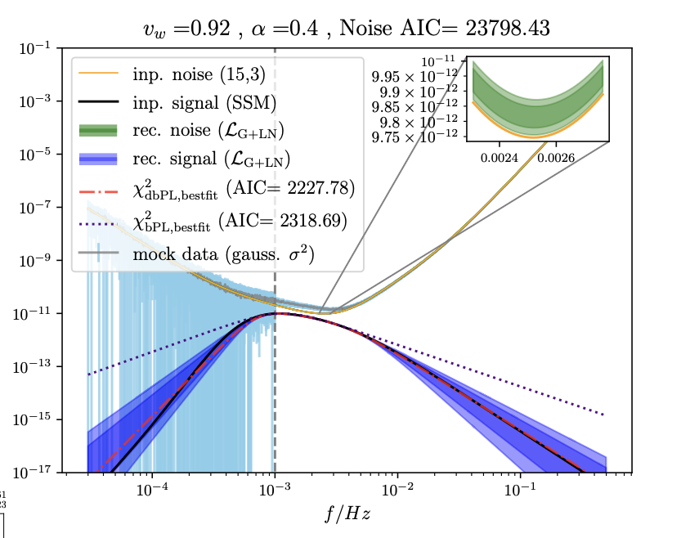
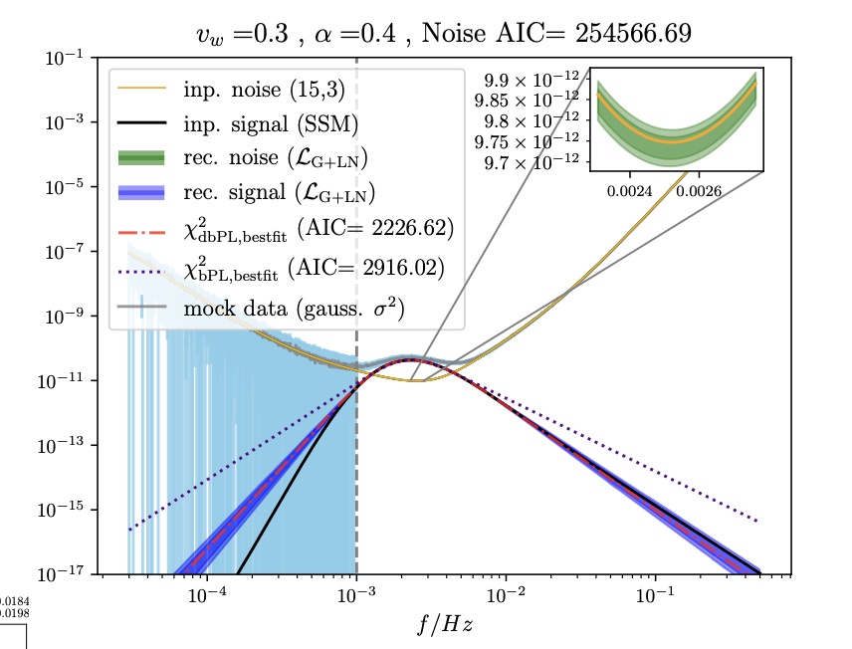
Credit: 1205.2451
Extracting GW shapes from data
Giese et. al. JCAP 2024
A broken or double broken power-law template is still necessary!

Slide 15
Credit: 1205.2451
Extracting GW shapes from data
Giese et. al. JCAP 2024
Data (noise + data)
Empirical template
Physical models
A broken or double broken power-law template is still necessary!

Slide 16
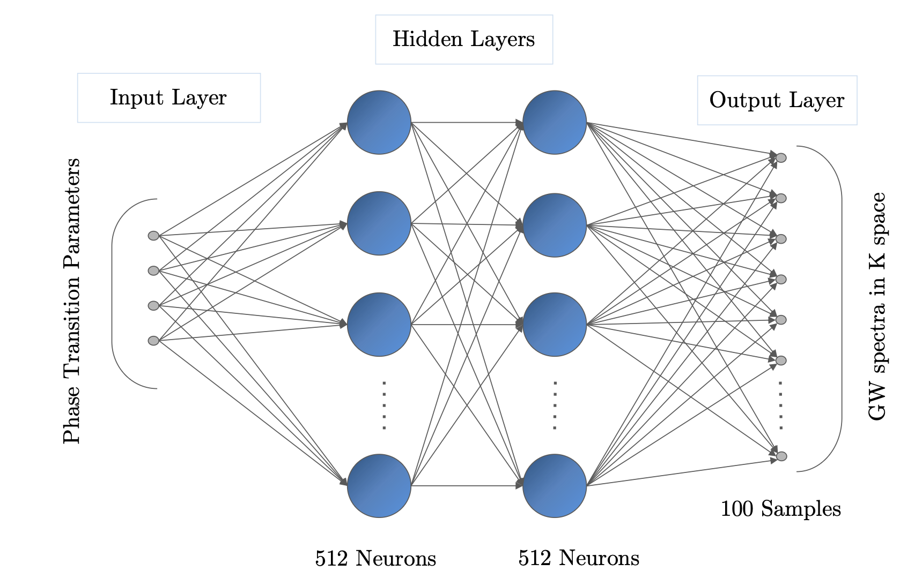
Credit: 1205.2451
Emulating the sound-shell model
Physical model (SSM)
Data (noise + data)
Slow
Learn
Faster
Emulator

Slide 17
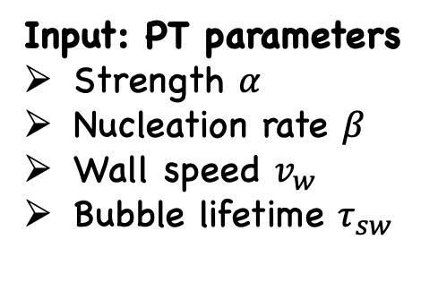
Credit: 1205.2451
Emulating the sound-shell model with DeepSSM
Input: PT parameters
Strength $α$
Nucleation rate $β$
Wall speed $v_{w}$
Bubble lifetime $τ_{sw}$
Output: Spectrum of gravitational waves

Slide 18
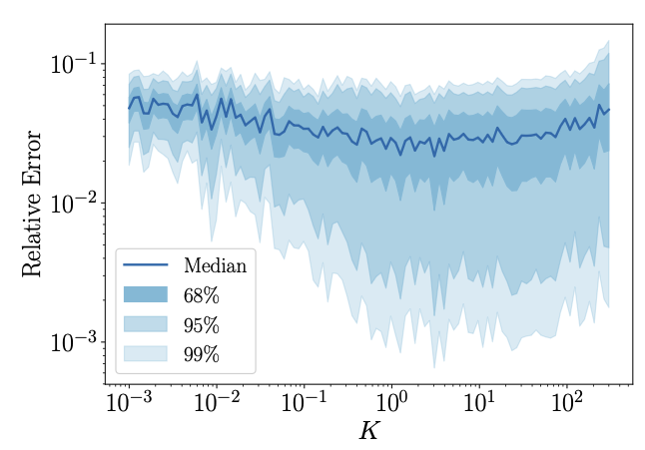
Credit: 1205.2451
Emulating the sound-shell model
Train the NN based emulator on 400,000 spectra by SSM
Immediate GW spectrum output (<100 ms) can be achieved with percent level of accuracy.

Slide 19

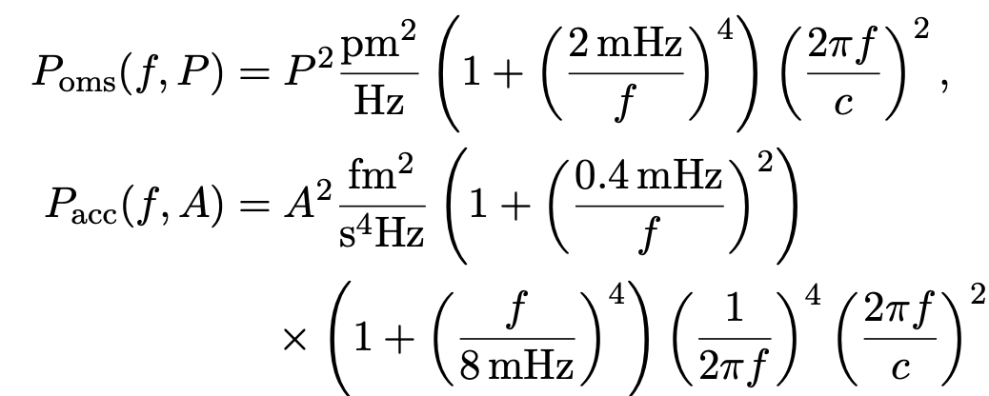
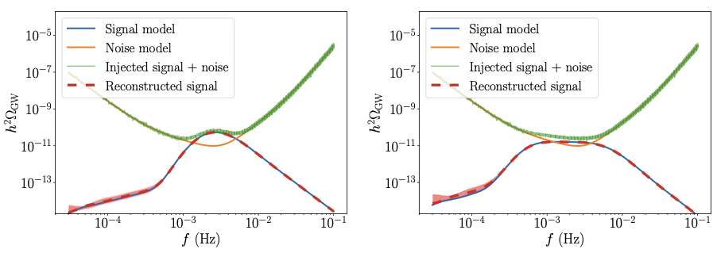
Credit: 1205.2451
Reconstructions of PT parameters directly from enhanced-SSM
7 parameters included LISA noise parameter are reconstructed by MCMC
A gradient based sampling scheme is employed (Hamiltonian Monte Carlo).
$$α=0.3, v_{w}=0.15$$
$$α=0.3, v_{w}=0.6$$

Slide 20
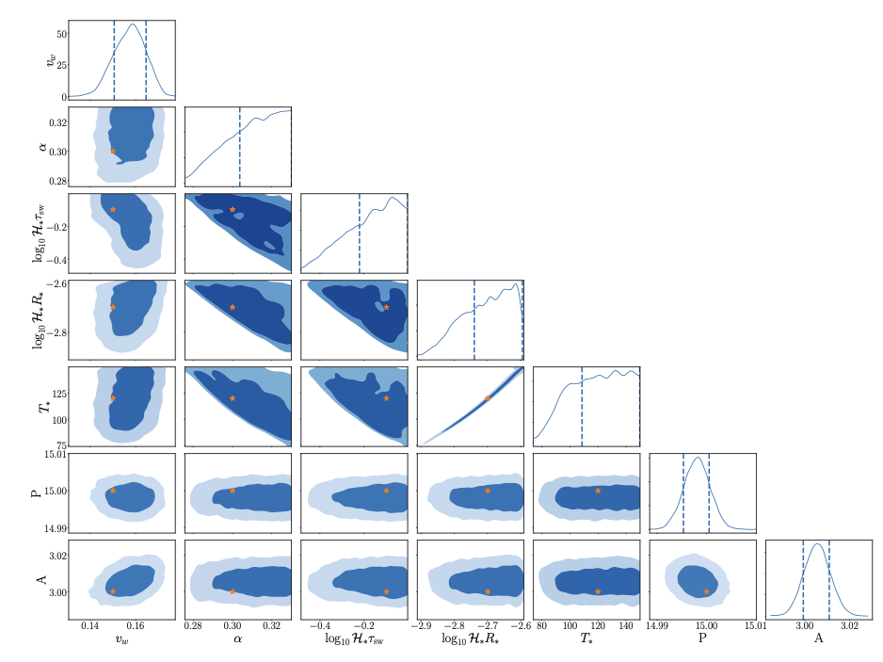
Credit: 1205.2451
Reconstruction of PT parameters directly from enhanced SSM

Slide 21
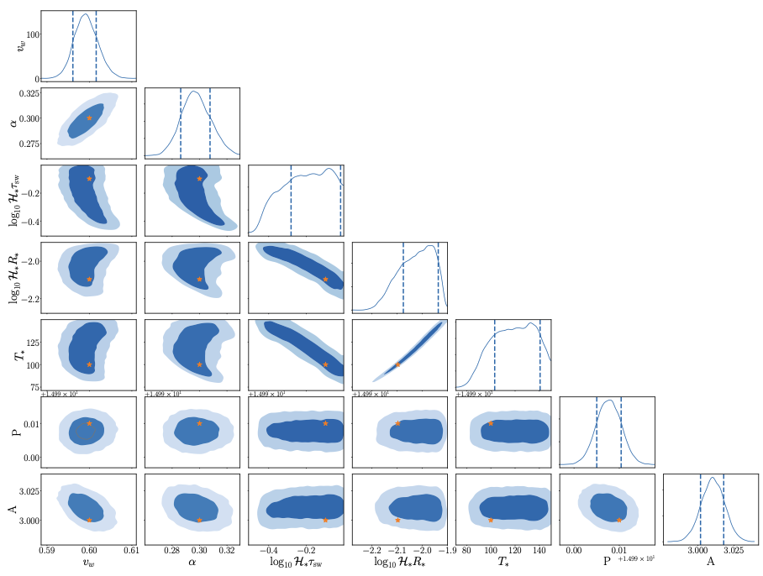
Credit: 1205.2451
Reconstruction of PT parameters directly from enhanced SSM

Slide 22
Outlooks
Based on an enhanced sound-shell model, a neuron-network based emulator is proposed ;
This emulator can be employed to directly Bayesian infer PT parameters; Example based on LISA mock data is provided;
More applications await to be explored.

Slide 23
Thank You

