Slide 1

Ringdown Signals: Data Gaps, Joint Observations, and Theoretical Outlook
The 2025 Gravitational Wave
Physics Conference
Junxi Shi
ICTP-AP
2025.10.19
Thousand Island Lake, Hangzhou City
Notes:
Good afternoon every one. I am junxi shi, from UCAS. My title is --- .

Slide 2

Content
Background of Ringdown Signals
Quantitative Analysis of Data Gaps
The Effects of Joint Observations
Recent Ringdown Works
Notes:
1!!!!!!!!!!
The pre includes four parts.
At the beginning, I will give a breif introduction of Ringdown. It’s a significant source in the GW detection mission.
Data gaps is an inevitable problem in the GW detection mission. This obstacle has the chance to deeply impact the ringdown observation.
So, we give a Quantitative Analysis of the problem.
We find Joint Observation have positive effect to gap problem, we have done some analyssi, but it remains further studies.
At last, I will give a breif outlook of current works of our group or something we are interested in.

Slide 3
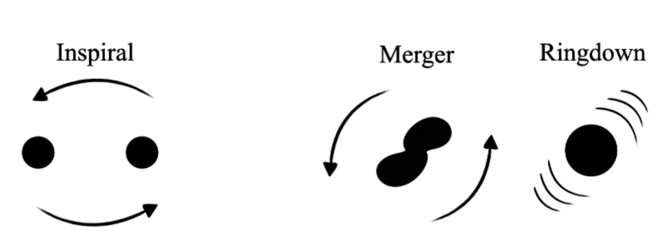
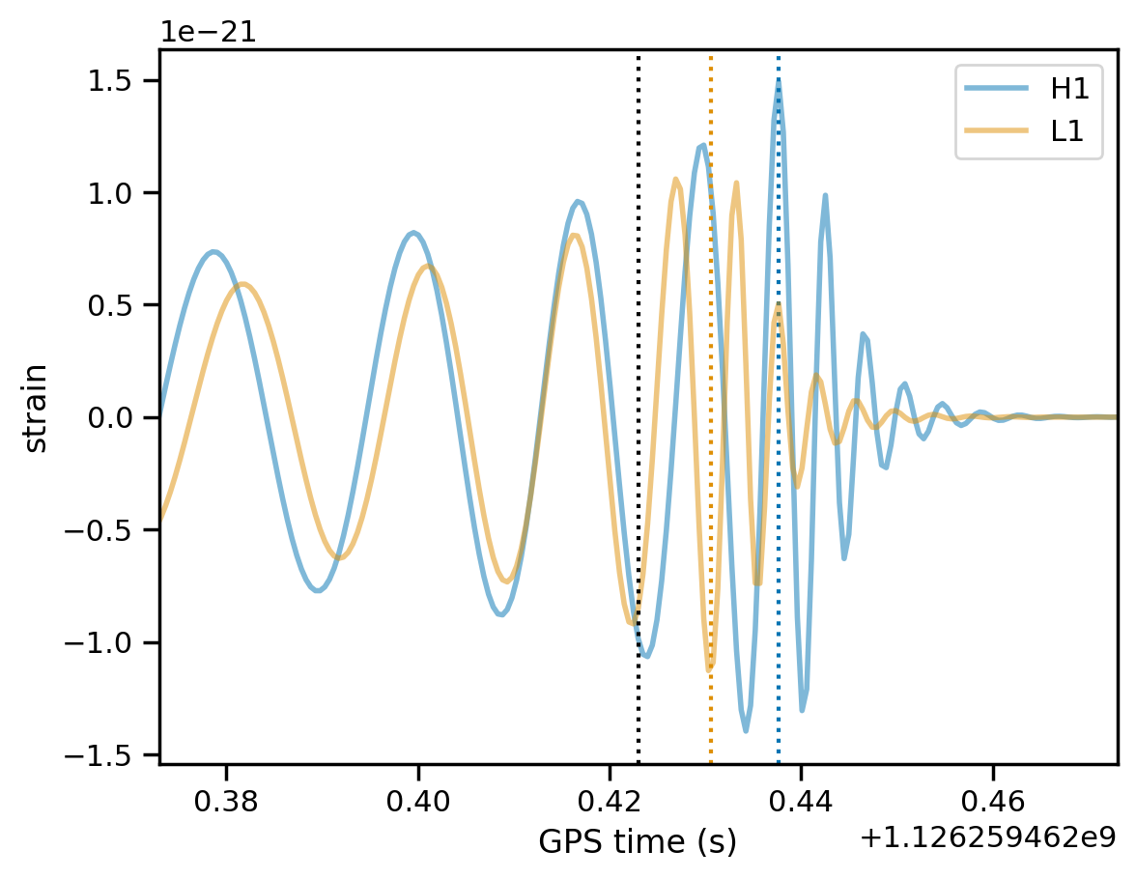

Ringdown Signals
Significance of Ringdown：
Parameter Estimation
Testing General Relativity (GR)
Nonlinearities of Ringdown
  Second Order Quasinormal Modes (QNMs)
  Nonlinear Late-Time Tails
Direct Waves
Echo Signals
Quantum Gravity
Notes:
1
Binary Black hole includes three phases --- Inspiral, merger, and ringdown. The rd starting time has not well definit. But, the orange and blue part of the figure almost covers the ringdown signal.
RD is significant, because it’s strongly related with black hole perturbation thoery and contributes near half signal to noise ratio of a full Binary BH data.
With ringdown we can do the ...
The direct wave is also an interesting phenomeano, I will introduce later.

Slide 4
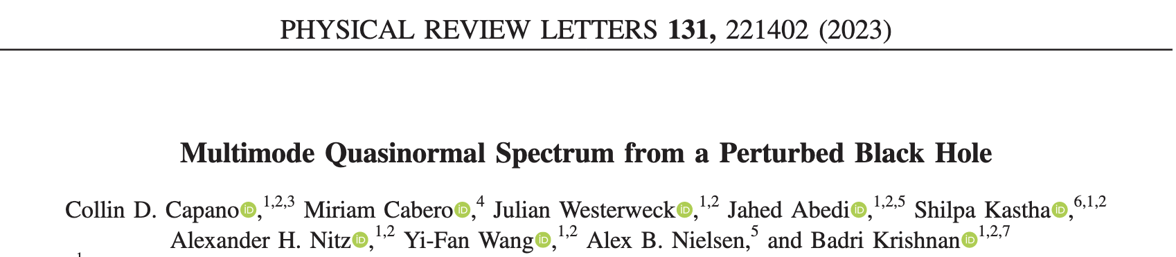
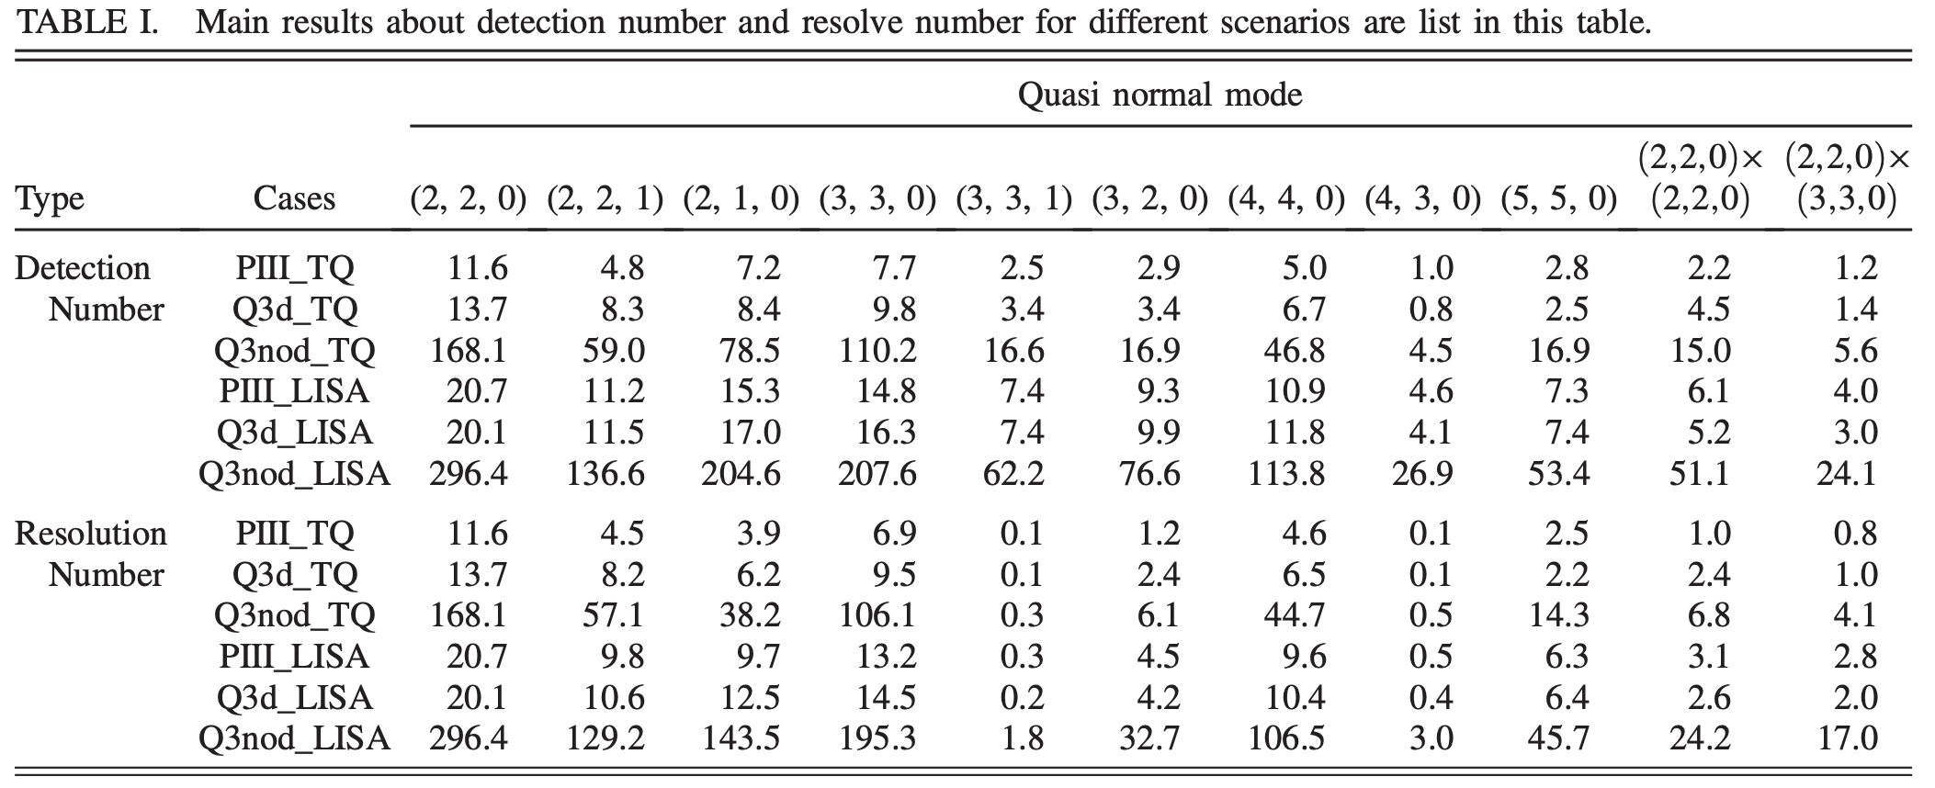
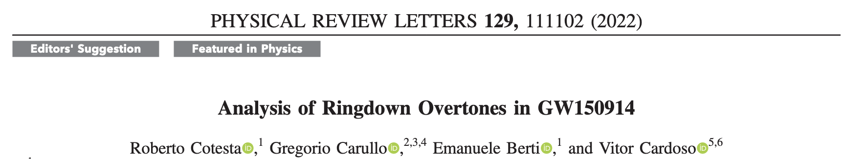
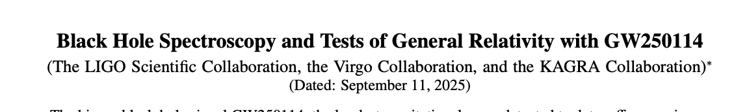
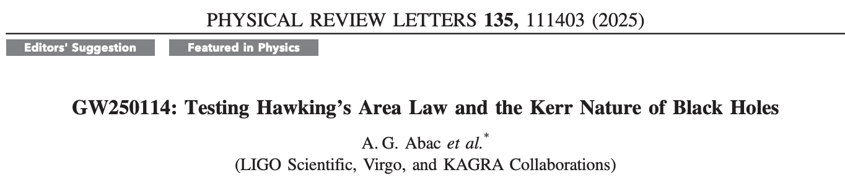
Observations of Ringdown
LVK
Space-Based Detectors
PHYSICAL REVIEW D 110, 124007 (2024)
The number of detections will increase
The number of resolvable modes will increase
The identification of second order QNMs becomes possible
Notes:
With so many benefits, RD signal come from lvk have been deeply studied.
such as multimode identification, analysis of overtones, testing GR and so on.
But ,the signal is really weak. Some phenomenon like second order quasinormal modes, late time tails are hard to be identified.
After space based detectors successfully operate, the situation will be changed. just read ---

Slide 5
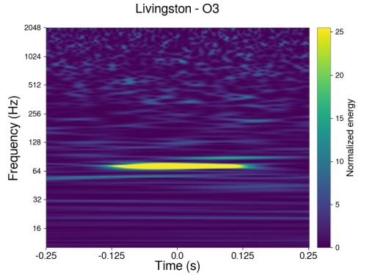
Data Gaps
Scheduled Gap
Unscheduled Gap
Data
Transmission
地球
Perodical data transmission of
space-based GW detectors
Data glitches
Notes:
But, space based detectors are still facing many chanllenges. One of them is data gap.
Data gap is inevitable in SBGWD. And can be classified as the scheduled gap or unscheduled gap.
An example of schuduled gap is regular data transmission. Because of the cartwheel orbit, Heliocentric orbital detector needs regular antenna repointing. The process will dramatically impact the data quality, inducing the data gaps.
Glitches are a possible type of unscheduled gap, this problem is also included in LIGO operation.
Only after the detector is launched will we know where the glitches come from

Slide 6
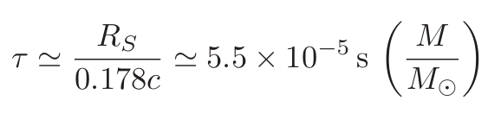
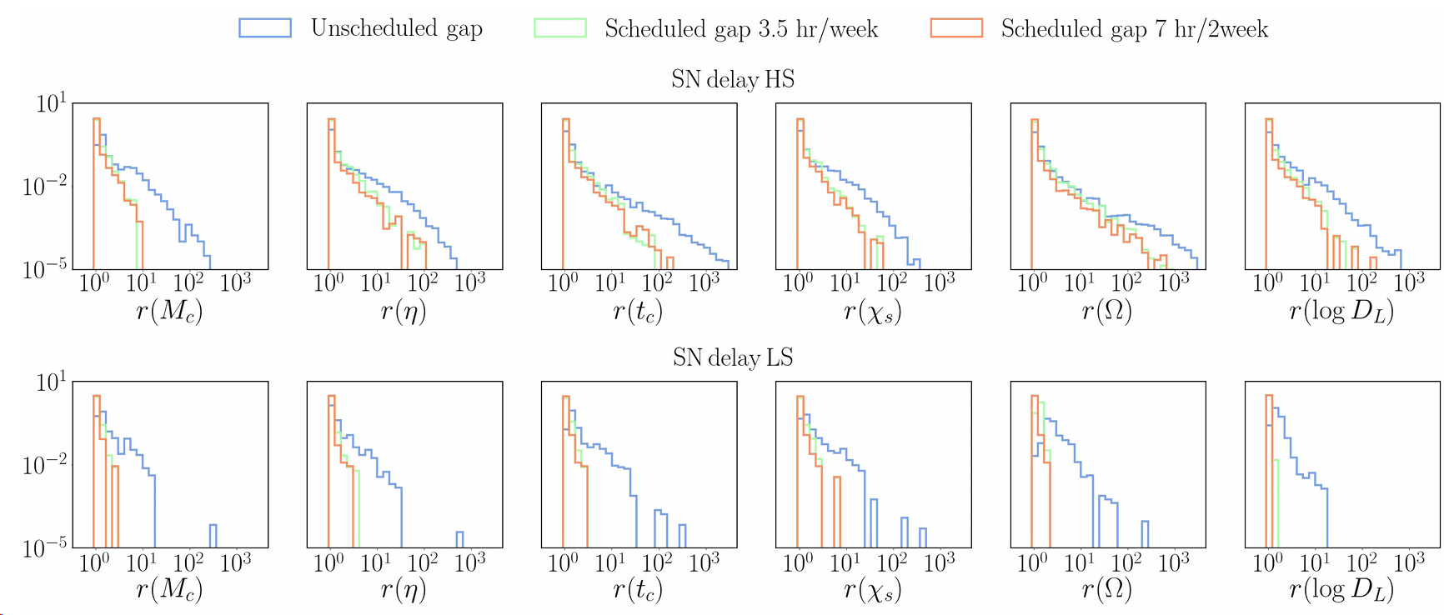
Data Gaps
Effects of data gaps:
  Spectral leakage
  Reducing parameter-estimation (PE) accuracy
Unscheduled gaps can have a larger impact
Specialized processing can mitigate the effects
In the space band, ringdown lasts from a few seconds up to roughly half a day
Data gaps are typically minutes to several hours; some anomalies can be longer
Since ringdown durations are comparable to gap lengths, ringdown measurements can be strongly affected
PHYS. REV. D 104, 044035 (2021)
The effects for paremeter estimation of different gap types
Notes:
The data gaps will directly bring two problems, spectral leakage and impact on PE.
Previous researchers have studied the effects of gaps on binary black hole inspiral signals.
And they have pointed out that unscheduled gap can bring larger impact.
Of course with some specialized data processing methods we will mitigate the influence. And our group raised the method of joint observation to provide a solution.
As the damping time of the ringdown signal shows. Read ....
Above is our motivation to analysis the effects of gaps on ringdown detection.

Slide 7
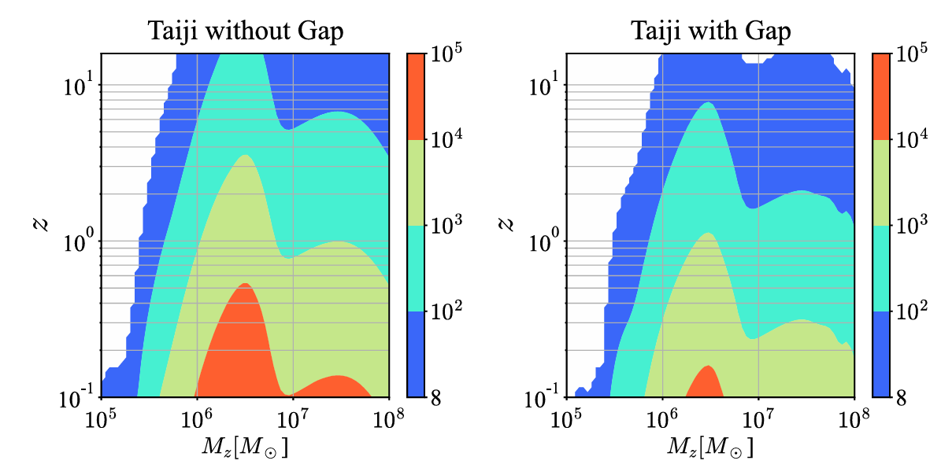
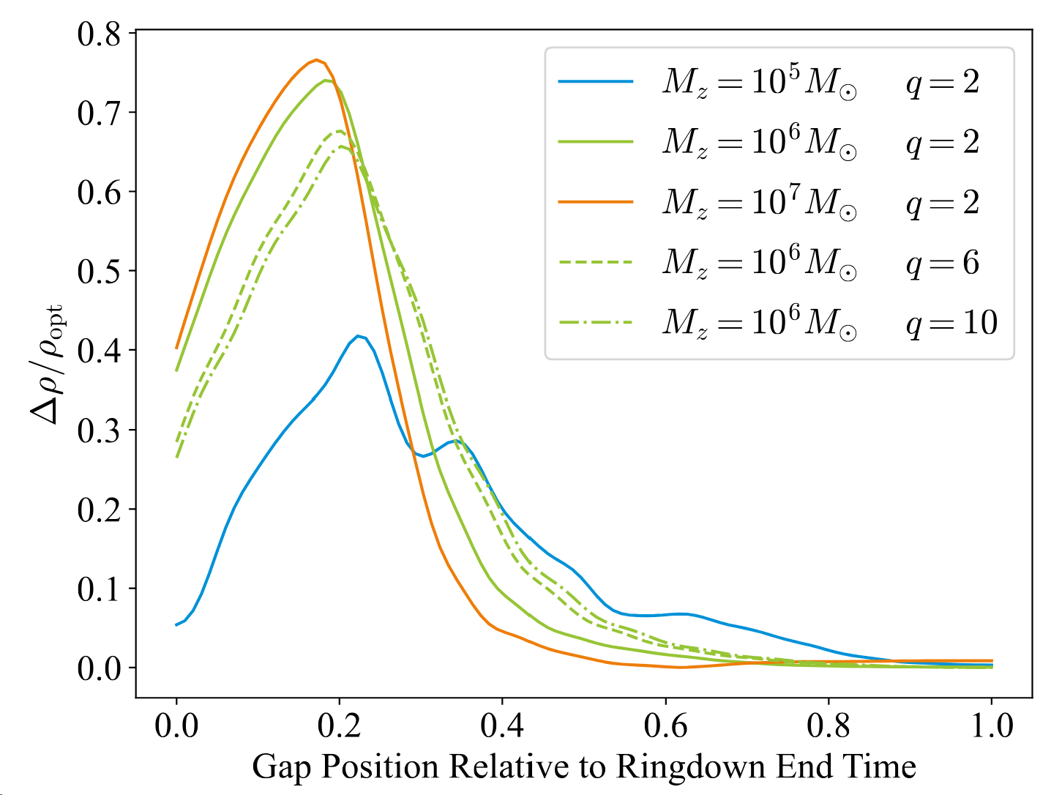
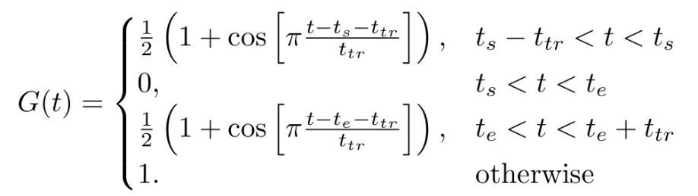
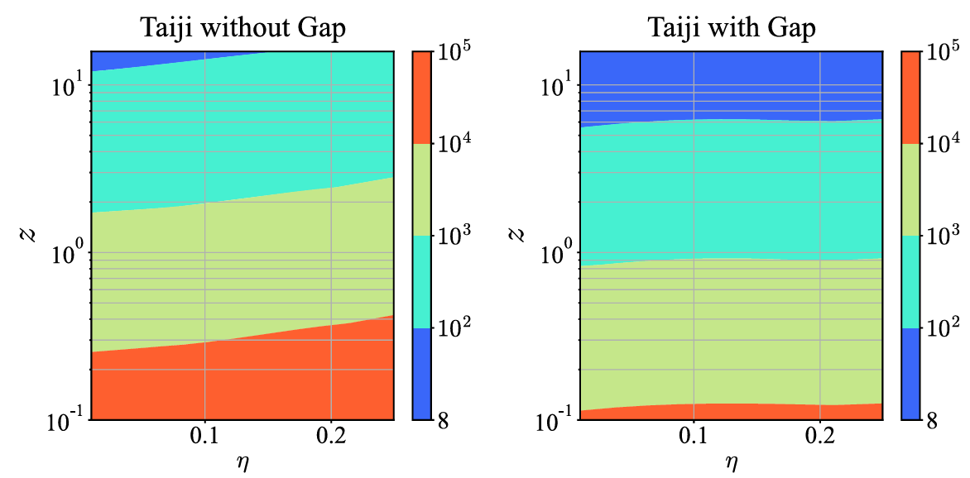

Gap Effects on Ringdown
Data Gaps Model
$$h_{G}(t) = G(t)h(t)$$
With unscheduled gaps yielding a 75% duty cycle, we evaluate the worst-case impact on ringdown detection.
…… Out of the 4 years of science measurement, the duty cycle of usable science data at full (nominal) performance shall be greater than 75%.
------ LISA Science Requirement Document
Relative change in SNR
at a fixed 75% duty cycle for ringdown signals
Effects of gaps for detection range
Notes:
We utilise this gap model to evaluate the effects.
read the first paragraphy.
This choice is aligned with LSRD. We estimate the effects in the worst case.
At the very beginning, we need capture the signiture of the effect.
This figure shows ---. The x axis indicates ---. We can see if a gap located in the initial period of ringdown the impacts on SNR are significant.
And the influence also varys with remnant mass and spin.
Similar signitures can be showed more clearly on redshift contour plot. We can see the effects are varying with different mass or spin.

Slide 8
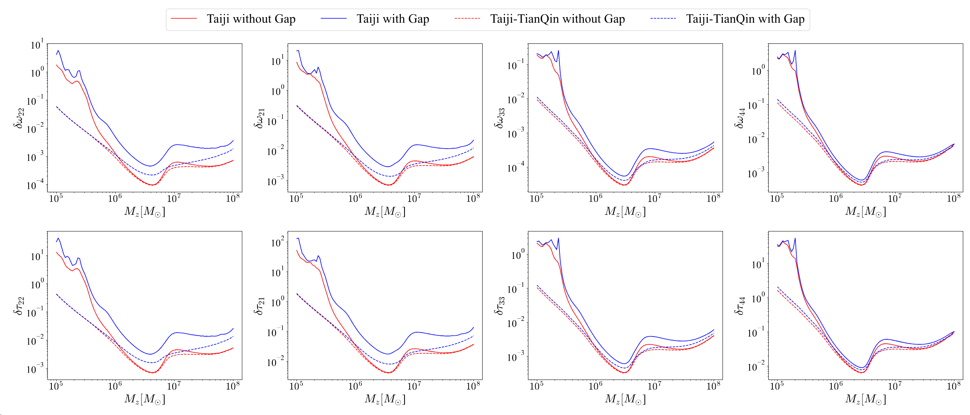
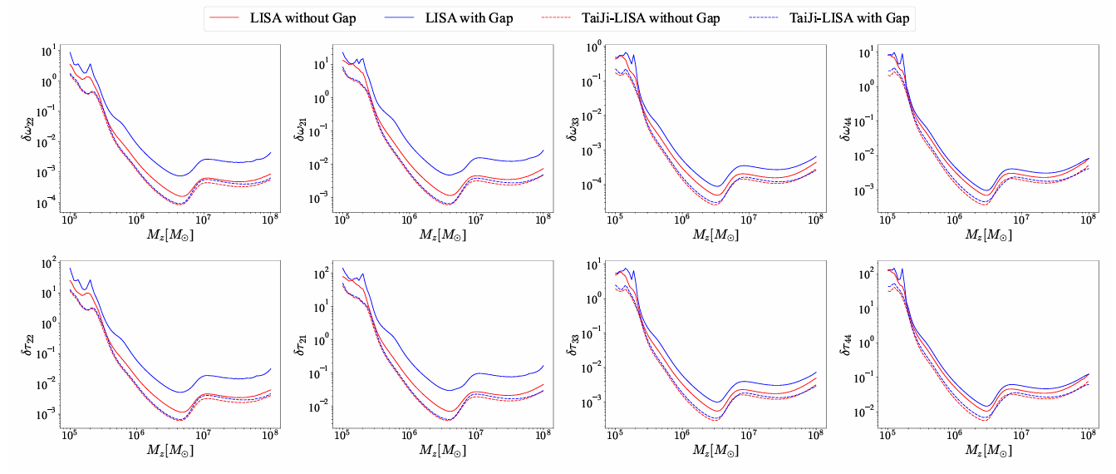

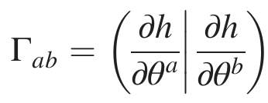
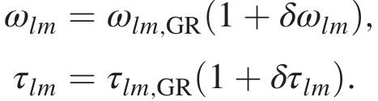
Effects of Joint Observation
Analysis of Joint Observations
Detectors have independent data gaps, so joint observations can mitigate their impact
Assess mitigation for the Taiji–LISA and Taiji–TianQin networks
Consider the case: one detector heavily gapped, the other mildly affected
PE Accuracy for $ω_{lm}$ and $τ_{lm}$
Notes:
Because Detectors have independent gaps, the gap won’t overlap anytime. so joint observations can mitigate their impact.
Here we assess ---.
---
We use PE accuracy of QNMs frequency to indicate the effects.
color indicate xxx, type of line indicate xxx.
we can see the accuracy are increased due to joint observation.
Taiji TQ network indicate xxx
Taiji LISA xxx
The most exciting thing is the two dashed lines have only minor difference.
This situation is telling us that, even one detector is severly affected, as long as the other operates normally, the final result will still be close to the situation without gaps.
So, the joint observation is important in gap problem.

Slide 9
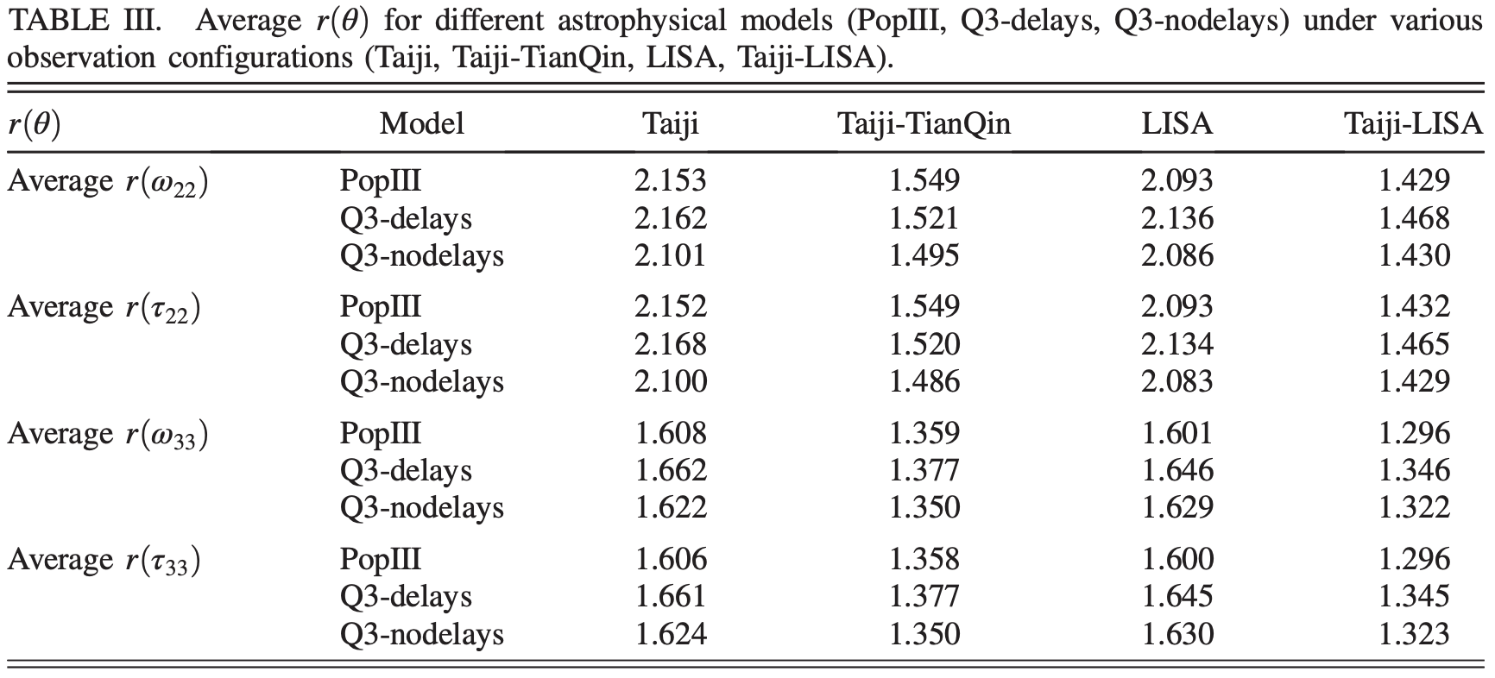
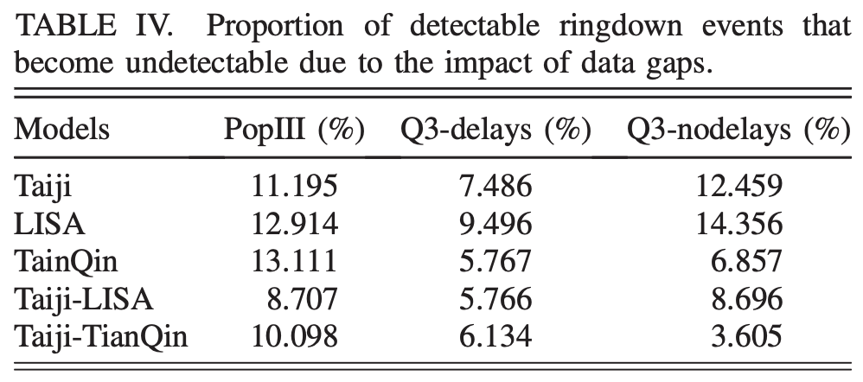

Average Results by Population
With concrete astrophysical models, expectation-value estimates of the impact of data gaps on detection are more practically meaningful
We compare gap induced effects on ringdown detection across three astrophysical populations in two joint observation network configurations
The ratio is utilised to indicate the effects
$$r\left(θ\right)=δθ_{gap}/δθ_{opt}$$
Notes:
More general average results need astrophysical population models. This is more practically meaningful.
read ---
read ---
The first table shows ----.
We can see that joint observation networks notably decrease the ratio. And because low frequency band is more sensitive to ringdown, taiji LISA network behaves better.
The second table shows ---.

Slide 10
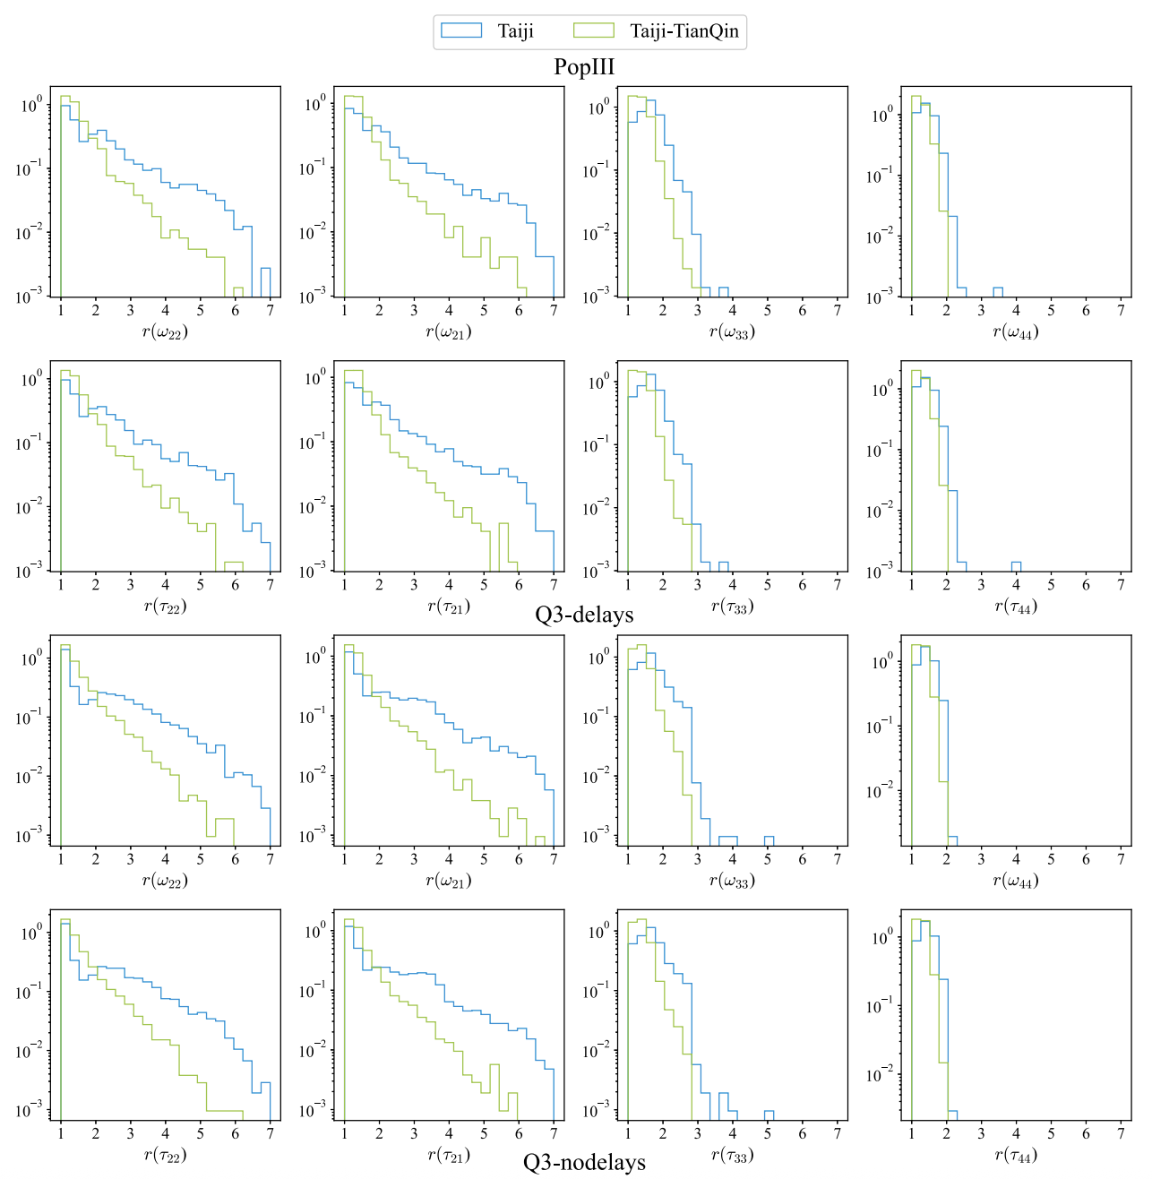
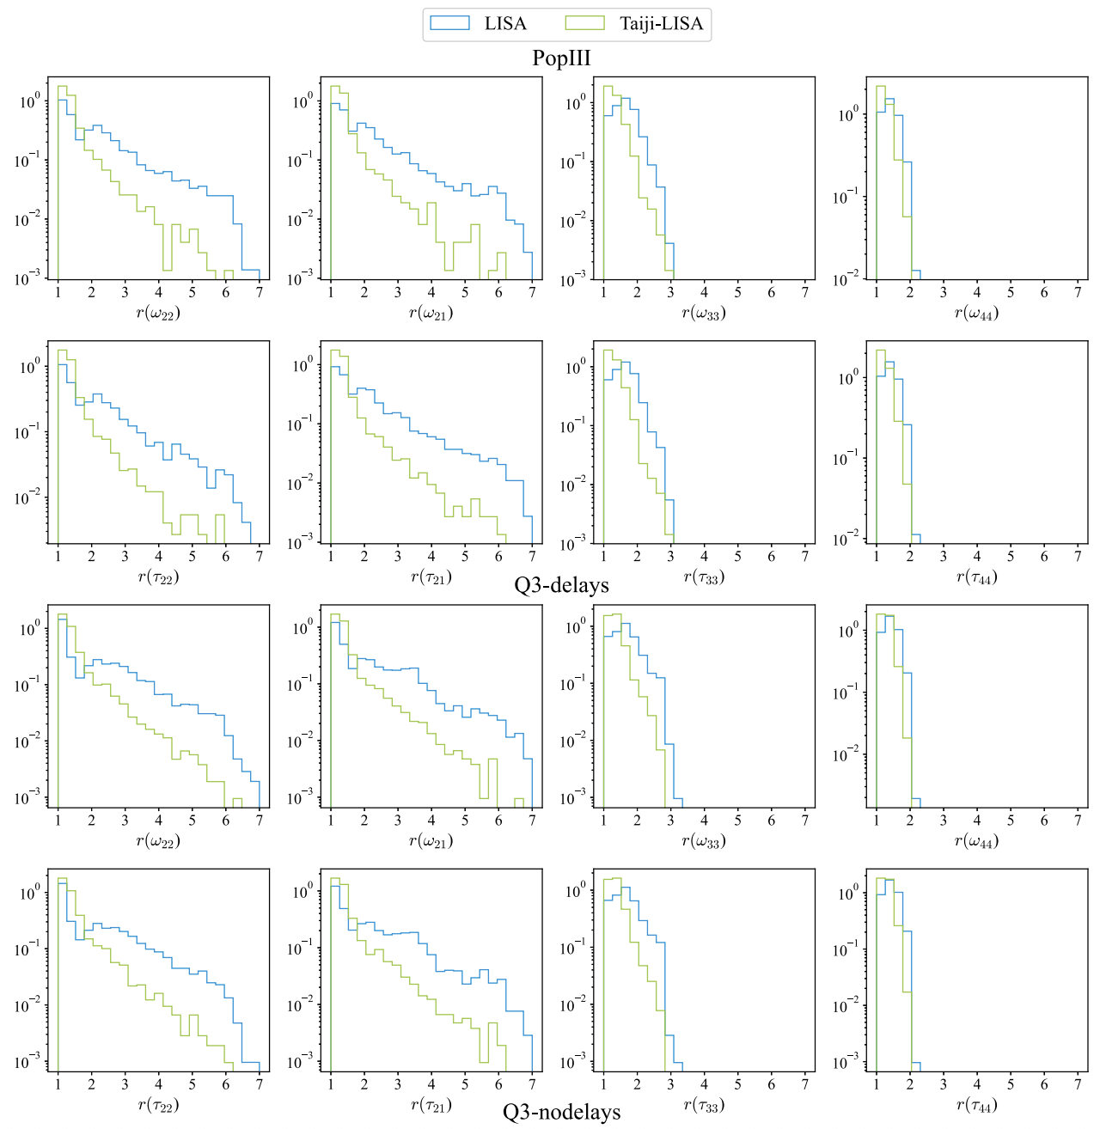
Detailed Results by Population
Notes:
Here we present detailed histogram. The x axis is still the ratio. With joint observation the contour shifts to left. It shows the effect of joint observation.

Slide 11
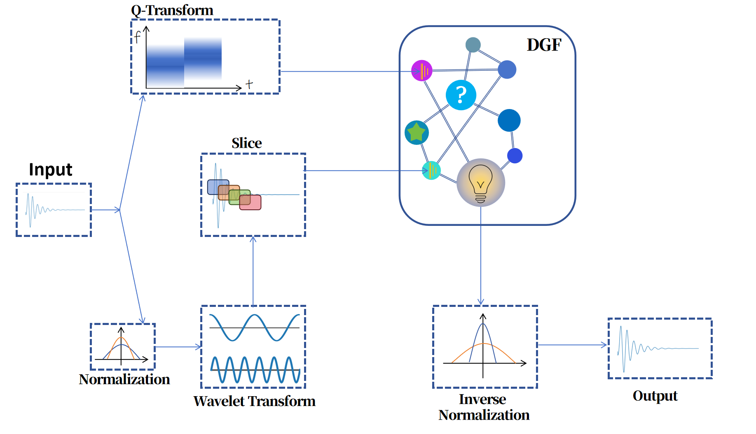
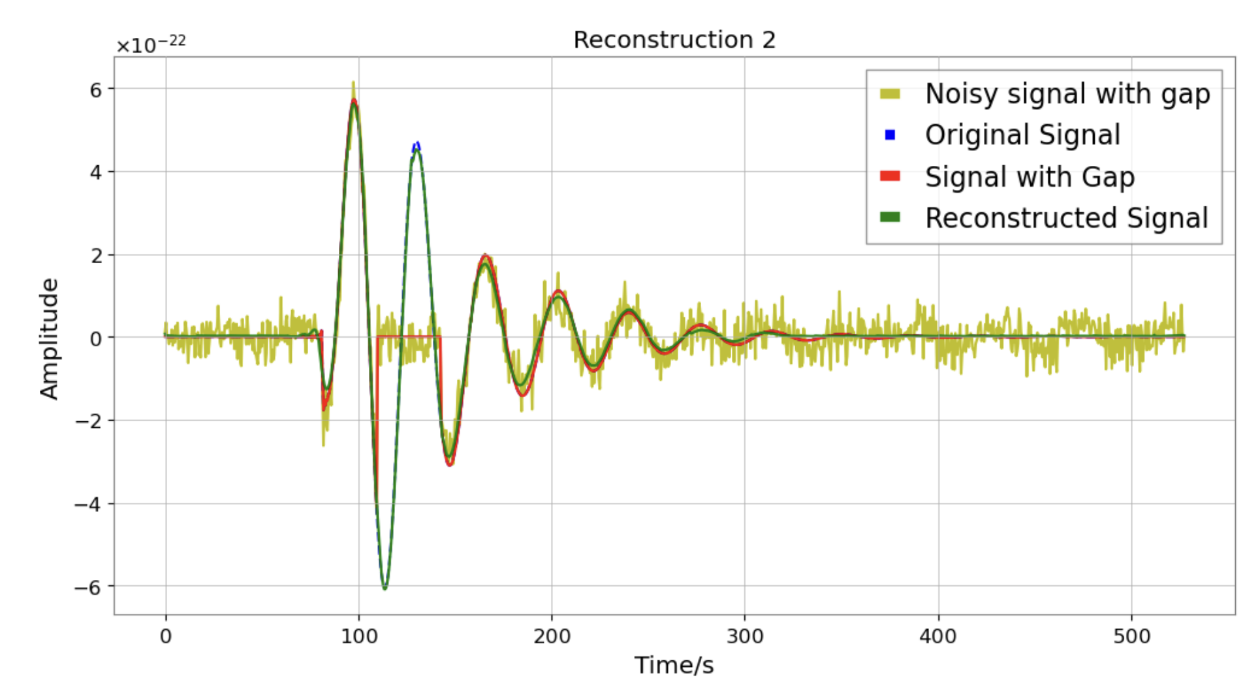
Recent Works Outlook
Deep Learning for Gapped Signal Reconstruction
DenoiseGapFiller
Output
Jingqi Lai, The next talk
Notes:
A proper way to deal with gap problem is to reconstruct the gapped signals.
Some previous researchers have utilised imprinting method to reconstruct gapped data.
Our group also achieves ML to .
Give a breif description
My group member ---

Slide 12
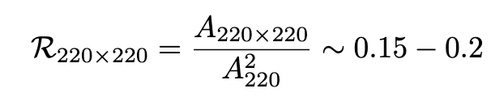
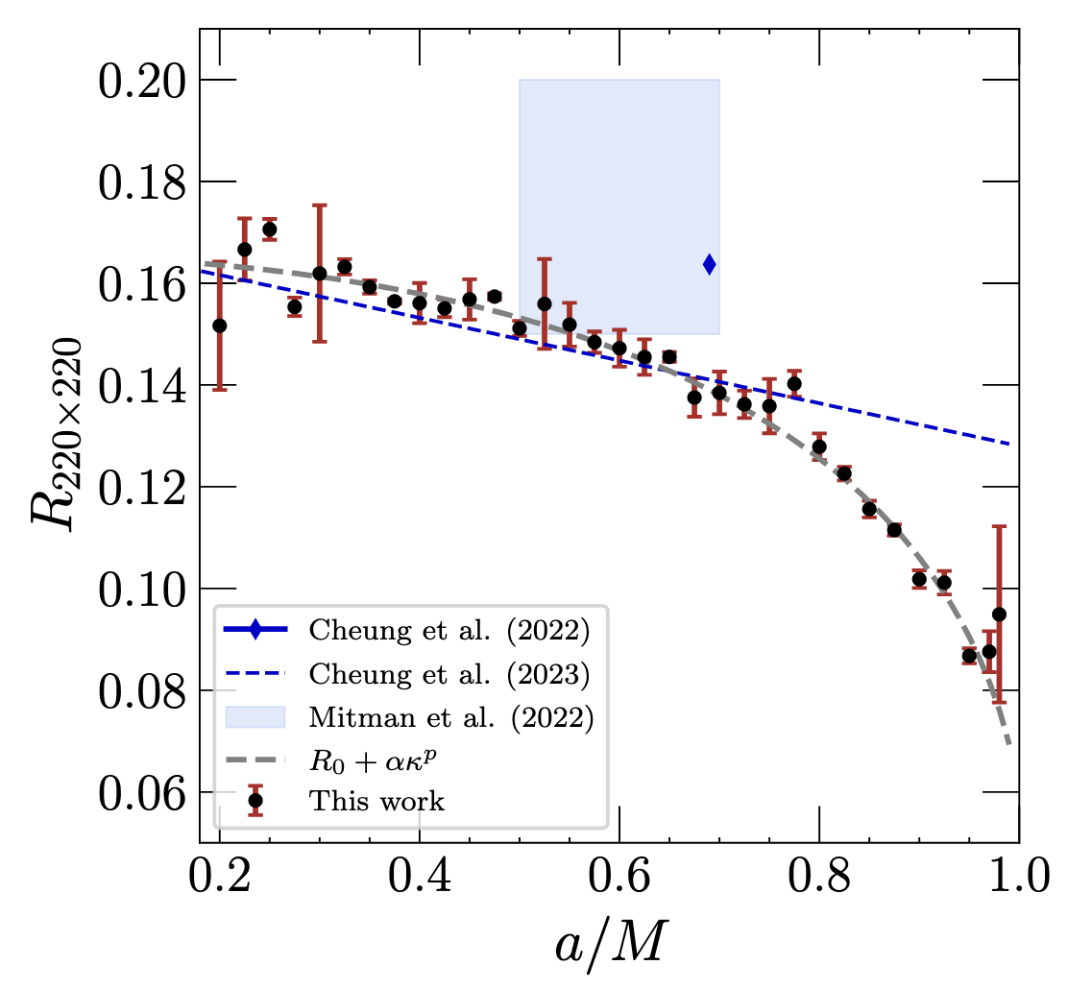
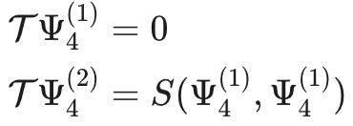
Recent Works Outlook
Nonlinear Quasinormal Modes
Amplitude Ratios
Testing GR in Nonlinear Region
Post-Peak Waveform Modeling
PHYSICAL REVIEW D 109, L101503 (2024)
Notes:
Secondary, I want to talk about nonlinear quasinormal modes.
It’s natural to turn our sight from linear to nonlinear.
Considering the vaccum situation, the second order teukolsky function reads. The linear order Psi4 consists of the source term.
Amplitude Ratio is an important task in this research area. Somebody says it’s indenpent with initial data, some says no. It is didn’t clearly solved.
With Nonlinear QNMs, we can test GR in Nonlinear region, and try to do full post peak waveform modeling.

Slide 13
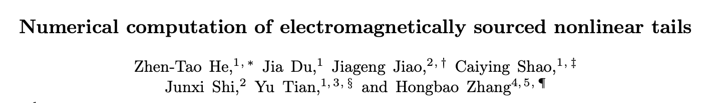
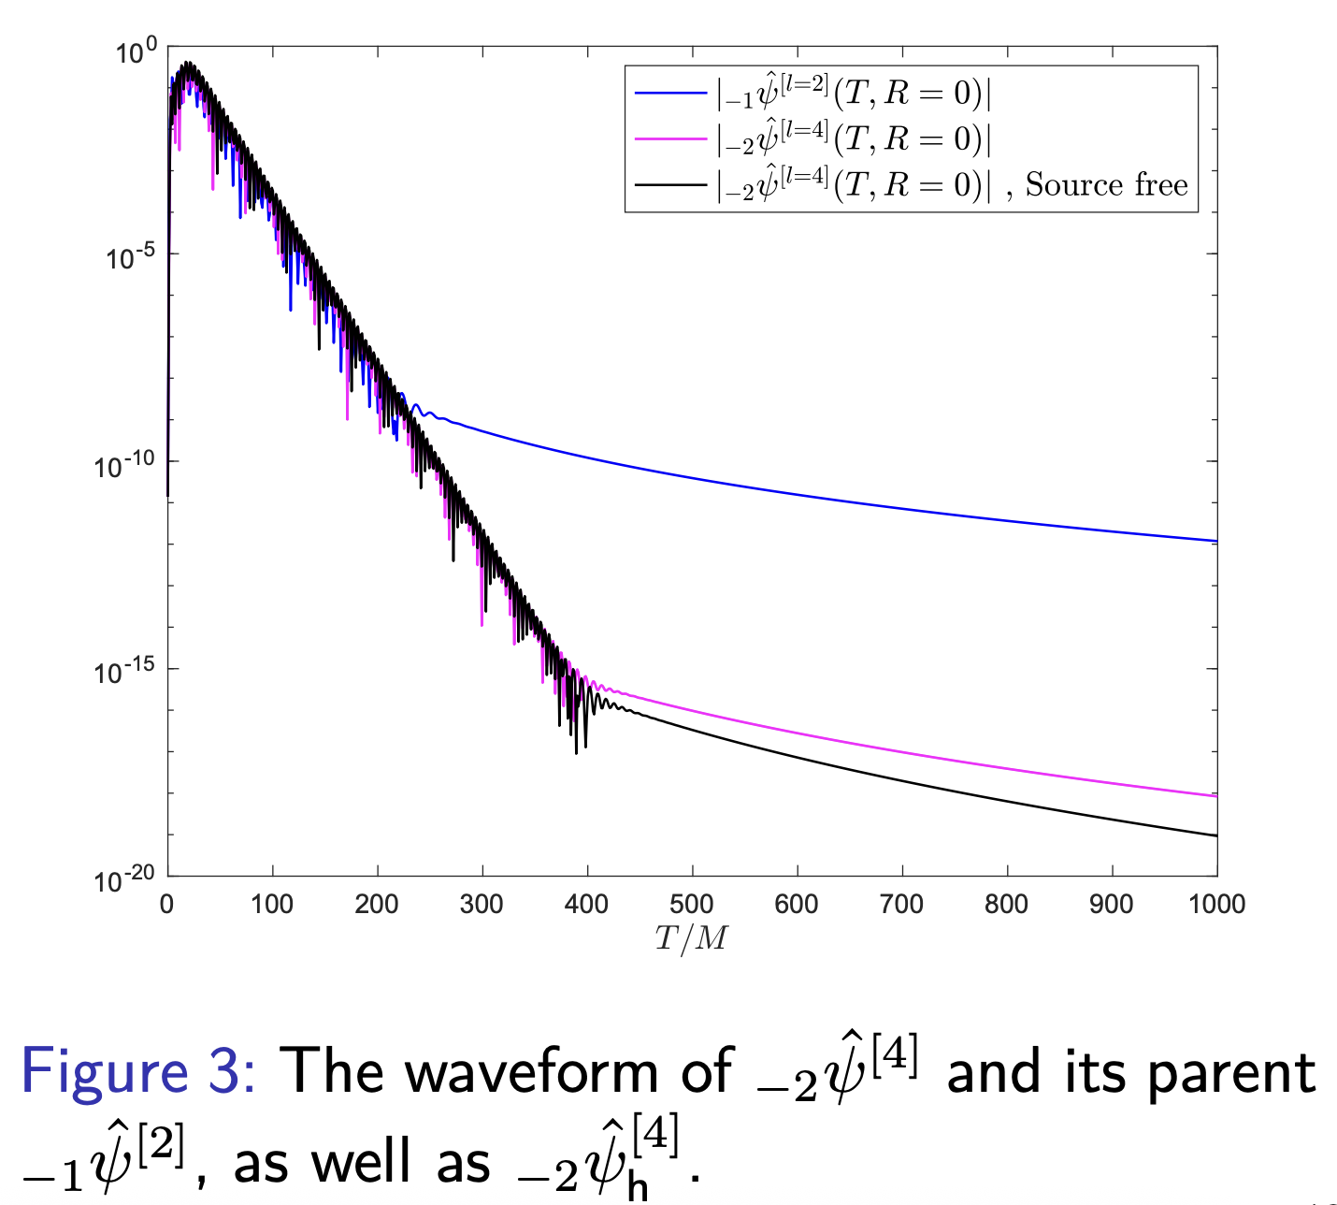
Recent Works Outlook
arXiv:2508.20499v2
Notes:
Nonlinear tails are also a new research direction.
It decays slower than linear tails, so it’s possible to be detected.
It also sensitive to enviroment, making it a suitable probe to enviroment effect.
A talk of my elder group member yesterday shows that the Electromagnetically sourced nonlinear tails significantly decrease the decay rate.

Slide 14
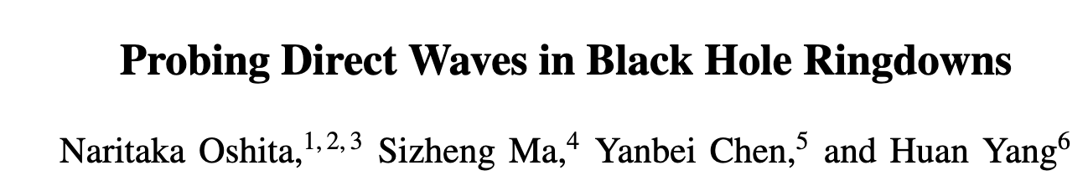
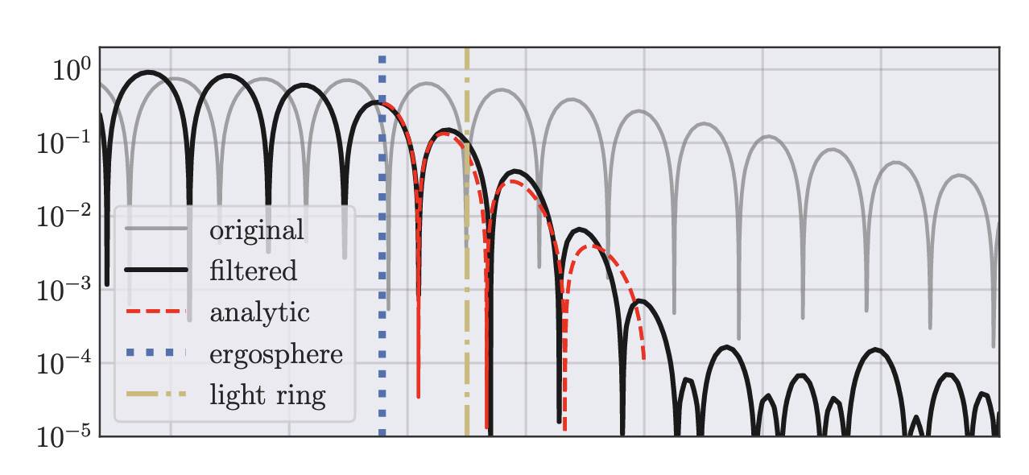
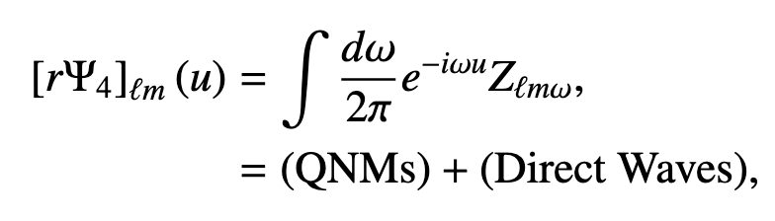
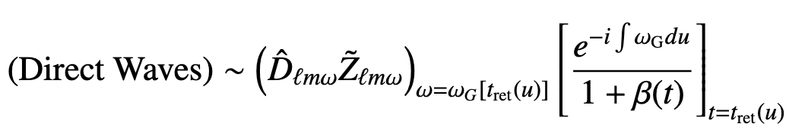
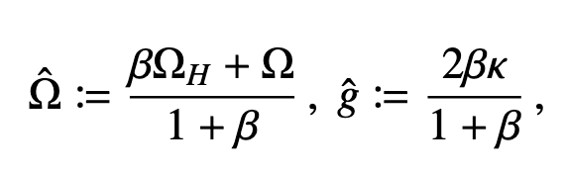
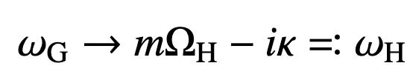

Recent Works Outlook
arXiv:2509.09165v1, arXiv:2510.01001v1
Notes:
The last interesting work I want to share is Direct Wave.
Researchers find expect QNMs, a contribution named direct wave is also present in ringdown phase.
The wave has also the shape of damping sinusoid waveform. But the frequency is time dependent.
At the very late time, the frequency tends to a horizon mode, which real part is identical with horizon frequency, and imaginary part is identical with surface grarity.
After the QNMs are discarded totally, the residual is direct wave. This can be a new probe to black hole horizon.

Slide 15
Thanks

