Slide 1
One-loop corrections to infrared GWs is forbidden by symmetries
Cheng-Jun Fang
Institute of theoretical physics
Based on 2501.11337, 2507.00077 and 2509.00420

Slide 2
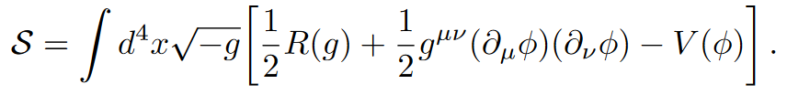
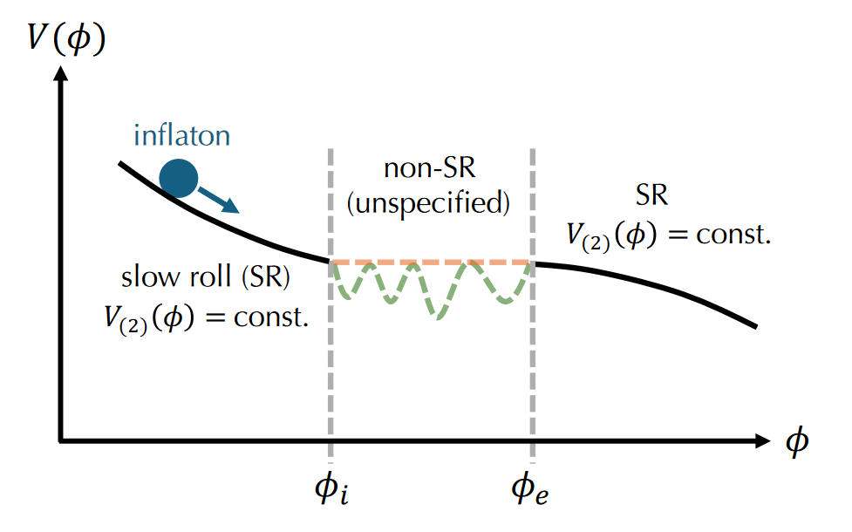


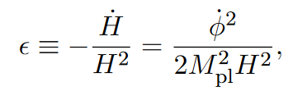
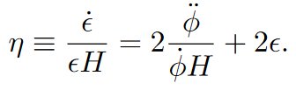
Non-attractor inflation
Inomata 2502.08707

Slide 3
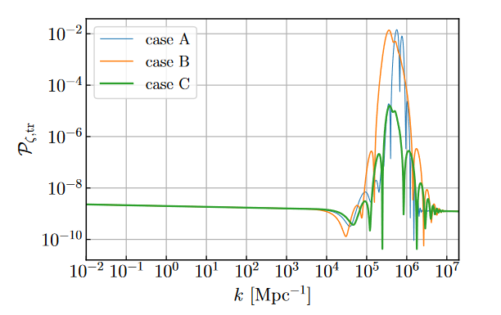



Linear perturbations
Resonance models:
Comoving curvature:
Inomata et.al 2211.02586

Slide 4
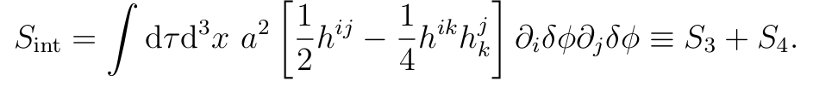

One-loop GWs
Scalar-tensor Interactions in spatially flat gauge:
Schwinger-Keldysh formalism:
One-loop diagrams:
Ota et.al 2211.12766

Slide 5



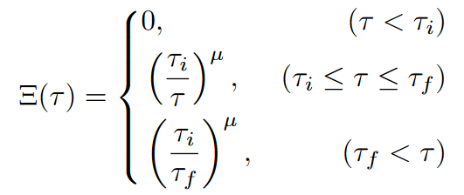

Enhancement ansatz
The interaction picture operator:
Enhancement of the scalar mode function:
Ota et.al 2211.12766

Slide 6
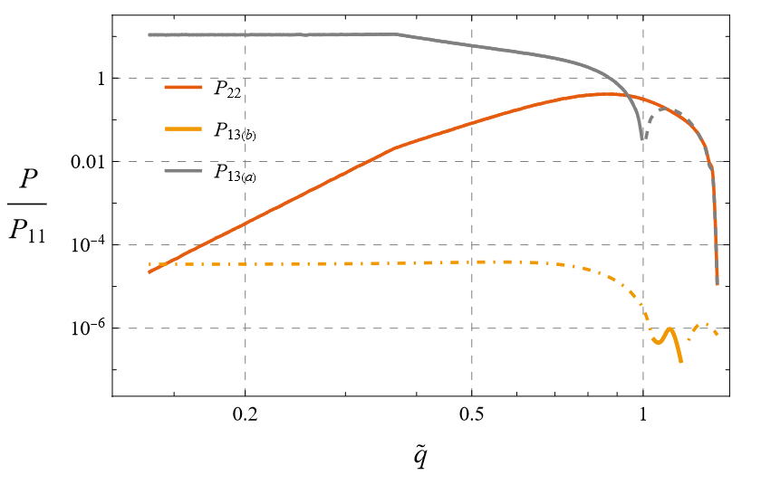

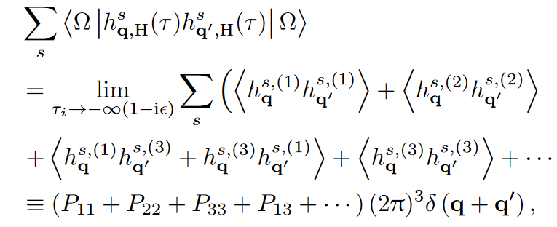
The power spectrum
Expansion w.r.t. order of perturabtions:

Slide 7
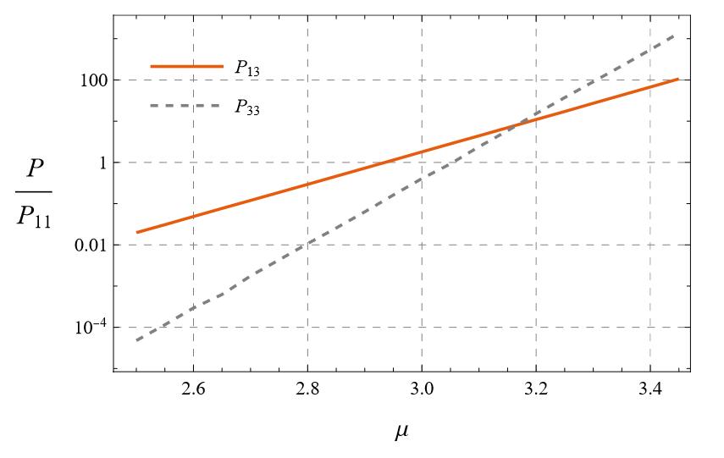
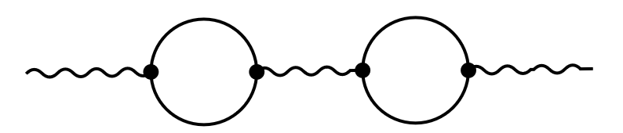
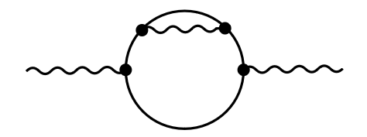
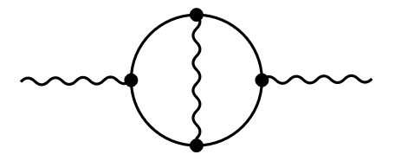
Breaking of the perturbation theory
The spectrum of third order tensor perturbations:

Slide 8
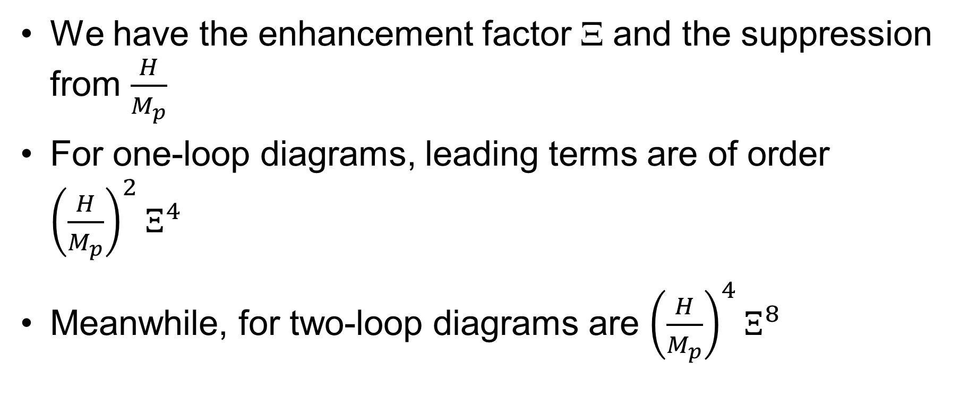
Counting the orders
We have the enhancement factor Ξ and the suppression from $\frac{H}{M_{p}}$
For one-loop diagrams, leading terms are of order ${\left(\frac{H}{M_{p}}\right)}^{2}Ξ^{4}$
Meanwhile, for two-loop diagrams are ${\left(\frac{H}{M_{p}}\right)}^{4}Ξ^{8}$

Slide 9

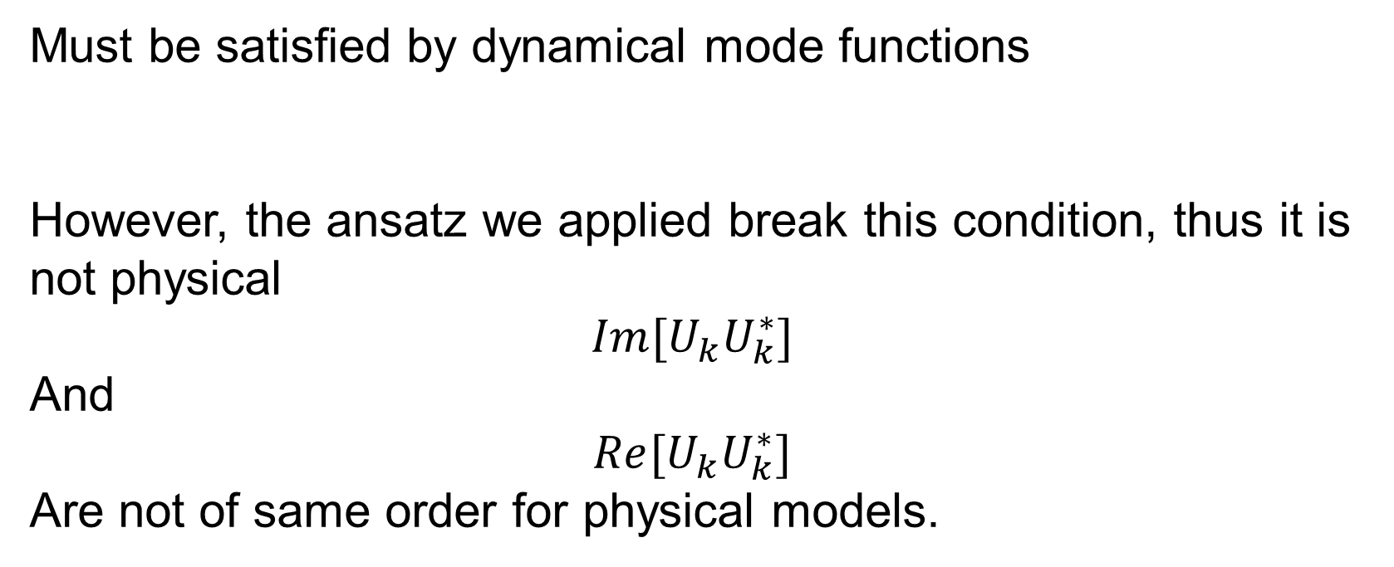
Wronskian condition
Must be satisfied by dynamical mode functions
However, the ansatz we applied break this condition, thus it is not physical
$$Im[U_{k}U_{k}^{∗}]$$
And
$$Re[U_{k}U_{k}^{∗}]$$
Are not of same order for physical models.

Slide 10
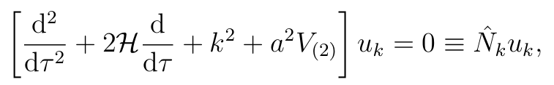

Consistency relation
From the Eoms of the mode function and the BD vacuum
We can prove an integral expression
offering us information of the Eoms

Slide 11
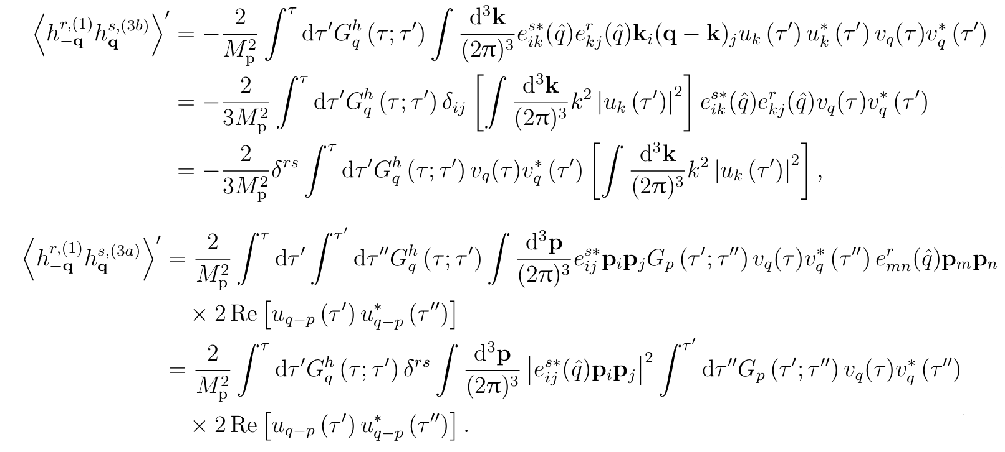
Cancellation between diagrams

Slide 12
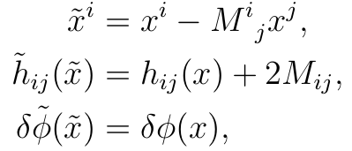
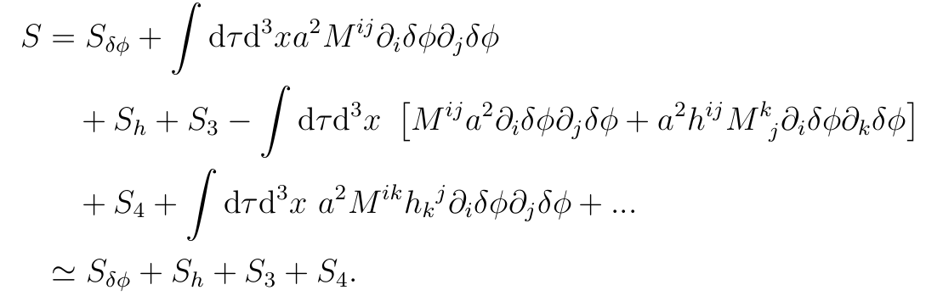
Symmetry of the action
Additional terms cancel each other

Slide 13


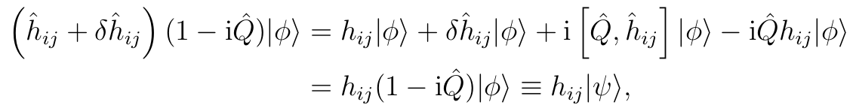
Ward identities
The operator form
Consider the transformation of a field configuration eigen state

Slide 14
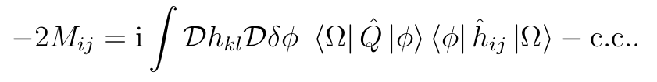
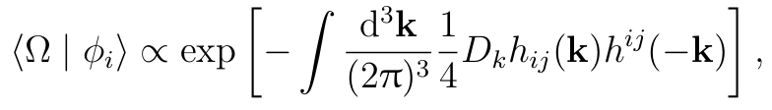
Wave functions
Taking expectation value of the identity
Considering early time eigen states

Slide 15
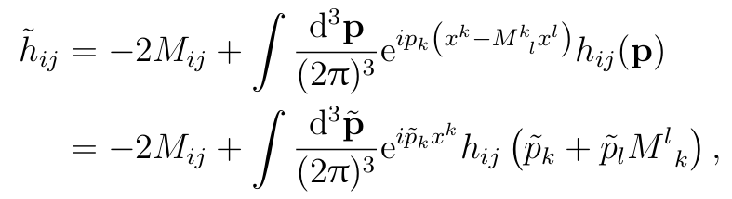
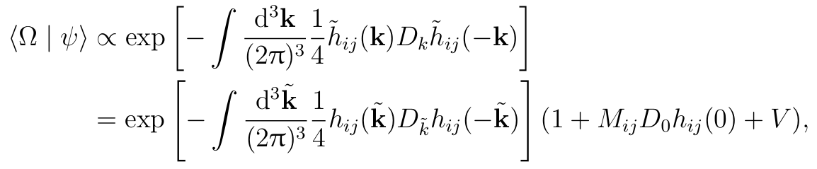
Wave functions
The transformation property of the wave functions

Slide 16


Correlation between different times
The matrix element
The identity thus becomes

Slide 17
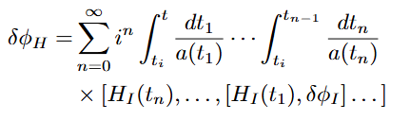


Two kinds of lines
Lines with arrow: Green’s function

Slide 18

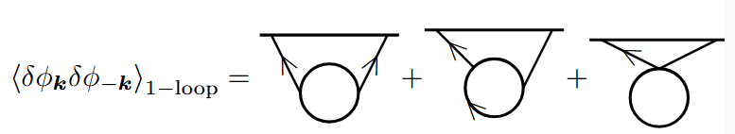
Two kinds of lines
Lines without arrow: Wick contractions

Slide 19
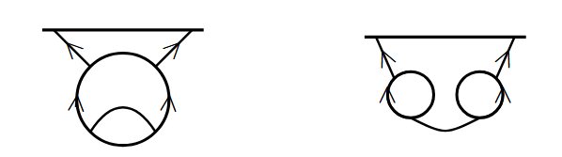
IR limit
The extension of 1-PI:
Those that can become non-connected after cutting a na-line.(reducible)
Those that cannot.(irreducible)

Slide 20

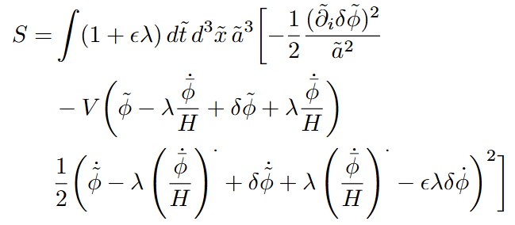
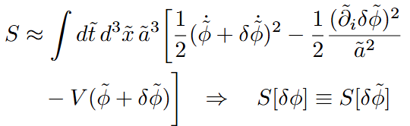
Symmetry

Slide 21
Thank you!

