Slide 1
Formation of Merging Compact Binaries
Dong Lai 赖东
T.D. Lee Institute 李政道研究所
Peng Huanwu Gravitational Wave Physics Conference, 千岛湖，10/14/2025

Slide 2
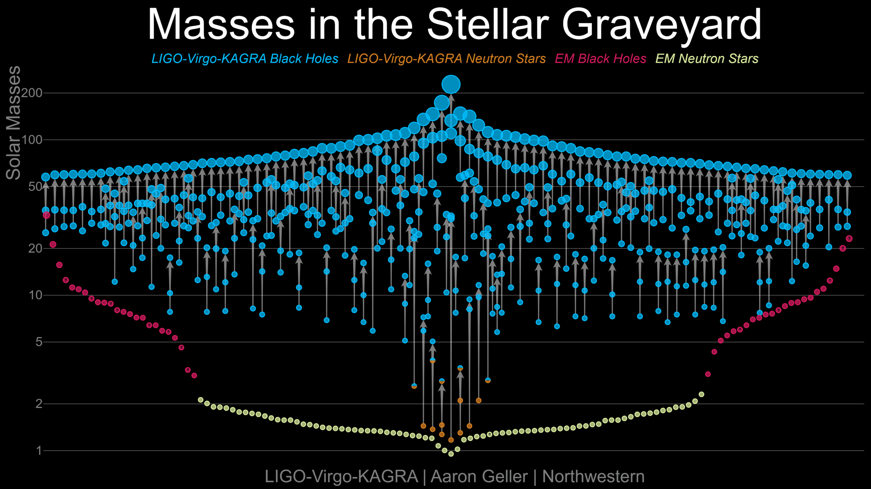
GWTC-4 (8/2025): 218 merger events, with 5 NS/BH mergers, 2 NS/NS mergers

Slide 3
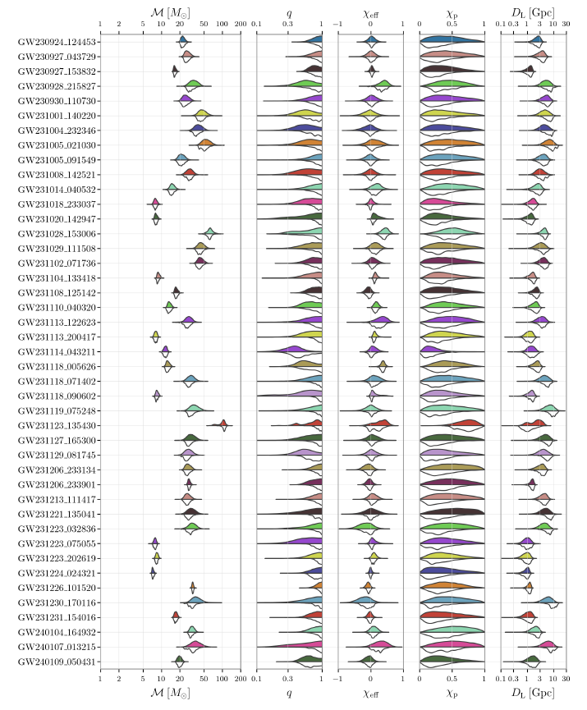

Gravitational waveform gives

Slide 4
What to do with these GW detections?

Slide 5
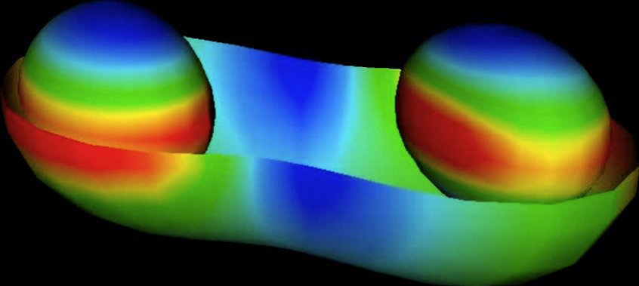
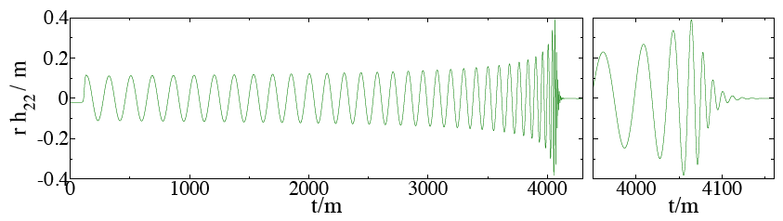
What to do with these GW detections?
1. Test gravity theory in nonlinear regime:
Cornell-Caltech collaboration

Slide 6
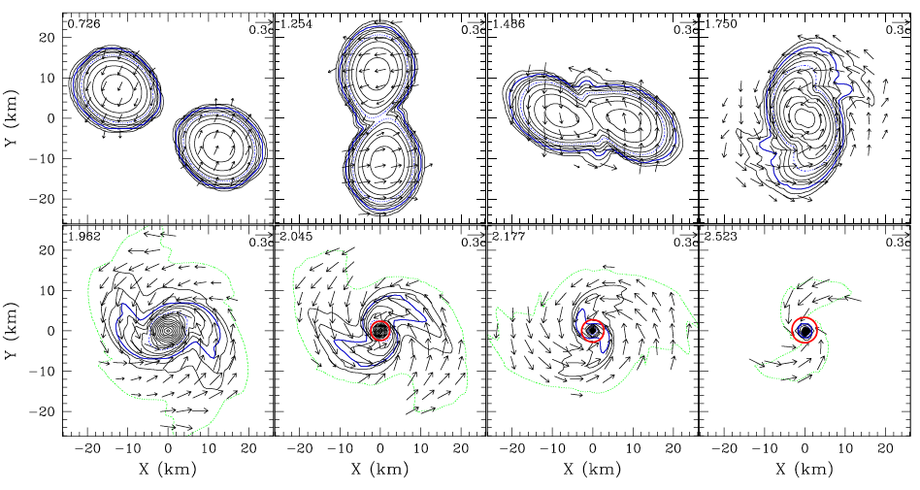
What to do with these GW detections?
Test gravity theory in nonlinear regime
Study dense nuclear matter
Shibata et al.

Slide 7
What to do with these GW detections?
Test gravity theory in nonlinear regime
Study dense nuclear matter
Inspiral phase:
Tidal/spin deformation (quasi-static tide) well-understood (since 1990s): many papers…
Resonant tide (excitation of g-mode etc) ? e.g. Lai 1994; Xu & Lai 2017; Yu et al 2024…
Merger waveform:
Remnant NS (hyper-massive or supermassive) or BH ?
Quark star mergers (QS-QS, QS-BH)?

Slide 8
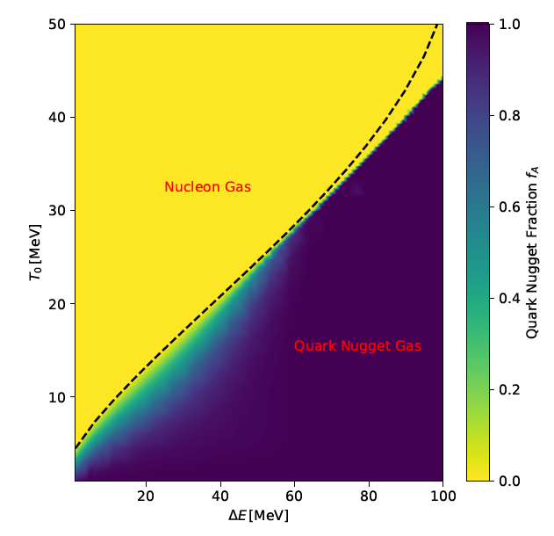
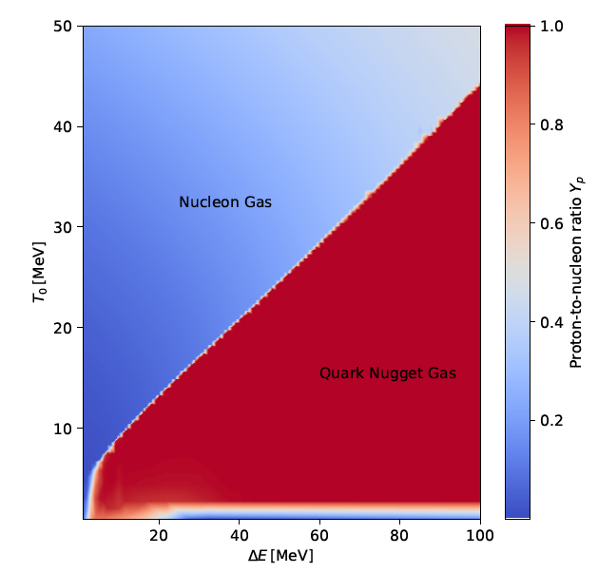
Quark star mergers (QS-QS, QS-BH)?
(Strange) Quark stars may be stable (Witten 1984...):
Neither confirmed nor ruled out
QS merger: Decompressed quark matter… into what?
nucleon gas (n-p-e)
or quark nugget gas ➔ no/weak r-process, no kilonova
Miao, Zhu & Lai 2025, PRL

Slide 9
What to do with these GW detections?
Test gravity theory in nonlinear regime
Study dense nuclear matter
Nucleosynthesis & EM counterparts

Slide 10
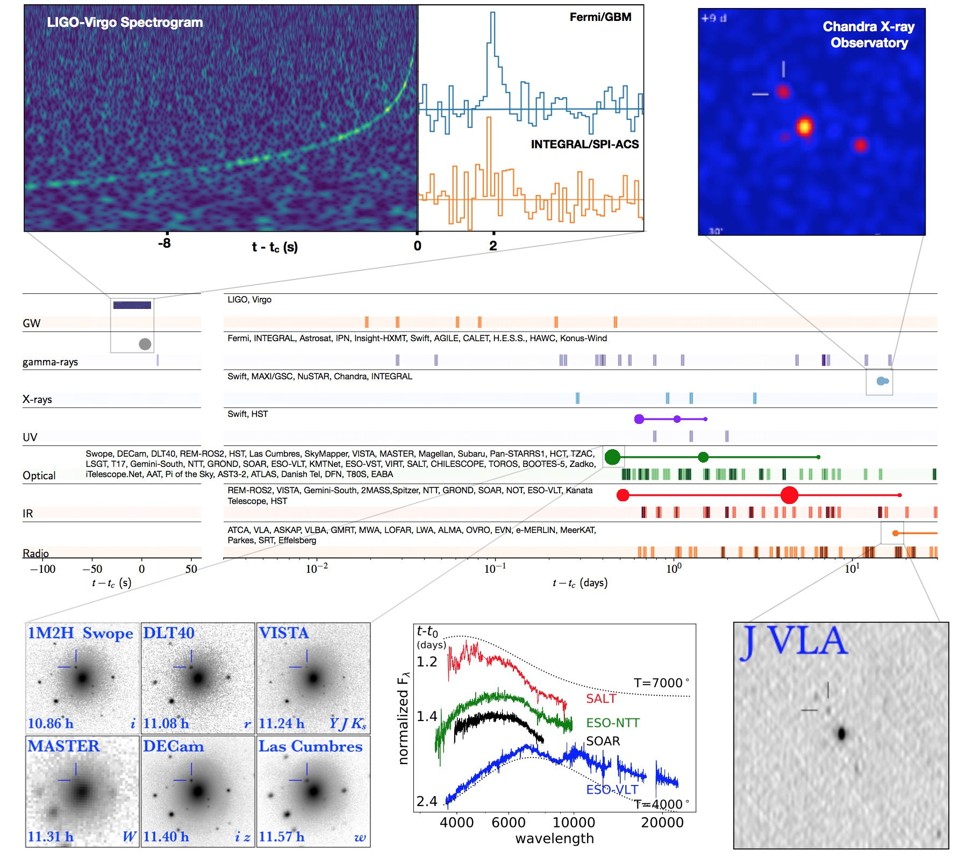
LIGO’s first NS Binaries: GW170817 / AT2017gfo

Slide 11
What to do with these GW detections?
Test gravity theory in nonlinear regime
Study dense nuclear matter
Nucleosynthesis & EM counterparts
Astrophysics of BH binary formation

Slide 12
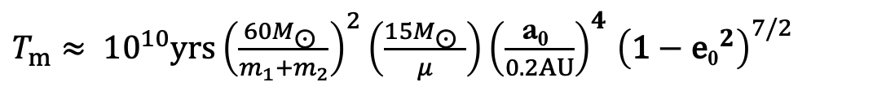
Formation of Merging BH Binaries
$T_{m}≈ {10}^{10}{yrs\left(\frac{60M\text{⊙} }{m_{1}+m_{2}}\right)}^{2}\left(\frac{15M\text{⊙} }{μ}\right){\left(\frac{\text{a}\text{0} }{0.2AU}\right)}^{4}$ ${\left(\text{1}−{\text{e}\text{0}}^{2}\right)}^{7/2}$
Final AU problem…

Slide 13
Formation Channels of Merging BH Binaries

Slide 14
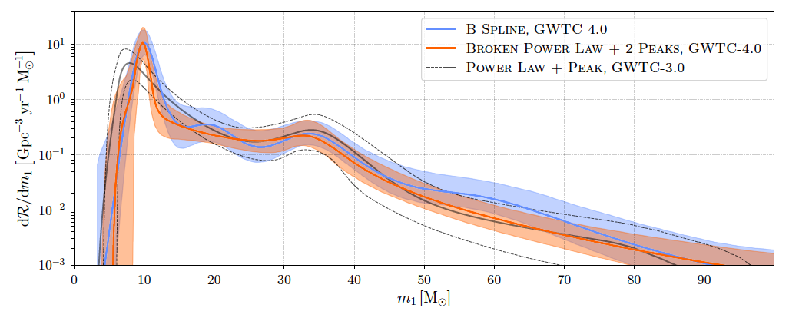
How to distinguish different channels?
Rates (uncertain)?
Masses
LIGO:
arXiv:2508.18083
Most massive BH-BH merger:
GW231123:

Slide 15
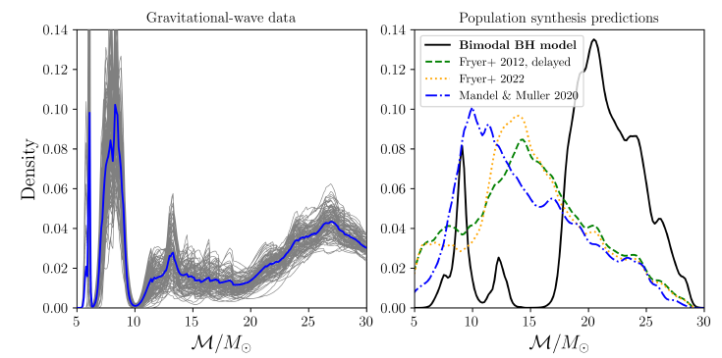
How to distinguish different channels?
Rates (uncertain)?
Masses
Willcox et al.
2508.20787
Chirp mass:

Slide 16
How to distinguish different channels?
Rates (uncertain)?
Masses
Residual eccentricity when enter LIGO band (10-20 Hz)
Circular orbit waveform:

Slide 17
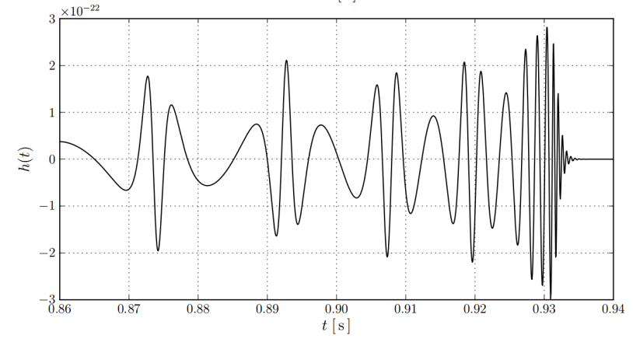
How to distinguish different channels?
Rates (uncertain)?
Masses
Residual eccentricity when enter LIGO band (10-20 Hz)
Eccentric orbit waveform:
GW200105 (BH-NS): e₂₀=0.048-0.15 (Morras+2025)

Slide 18
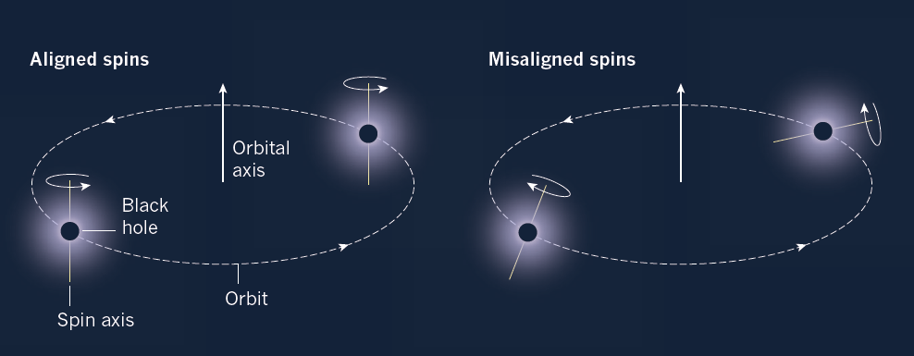
How to distinguish different channels?
Rates (uncertain)?
Masses
Residual eccentricity when enter LIGO band (10-20 Hz)
Spin-orbit misalignment

Slide 19
How to distinguish different channels?
Rates (uncertain)?
Masses
Residual eccentricity when enter LIGO band (10-20 Hz)
Spin-orbit misalignment
EM counterpart

Slide 20
Formation Channels of Merging BH Binaries
-- Isolated Binary Evolution
-- Dynamical Formation:
several flavors: star clusters, triples (multiples), AGN disks

Slide 21
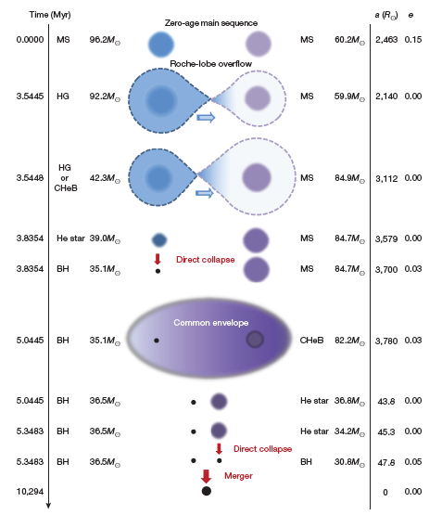
Isolated Binary Evolution Channel: Standard
many papers, uncertain
physical ingredients
(e.g. common envelope;
Gaia BH1,2,3 ??)
Produce
circular orbit at 10 Hz
mostly aligned spin-orbit
Belczynski +16

Slide 22
Dynamical Formation Channels
several flavors…

Slide 23
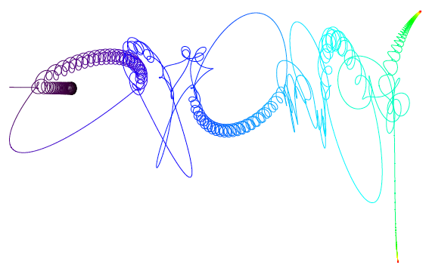
Dynamical Formation Channels
several flavors…
1. Dense clusters: binary-single scatterings ➔ tight binary
Samsing+14
Enough BHs in clusters? Kicks? GCs or Nuclear Star Clusters?
Produce mostly circular orbit when enter LIGO band (10 Hz) ??
Expect random spin-orbit orientations
Portegies Zwart & McMillan 2000; Rodriguez et al.2015; Chatterjee et al.2017; Samsing et al. 2018; …

Slide 24
Dynamical Formation Channels
several flavors…
1. Dense clusters: binary-single scatterings ➔ tight binary
2. Tertiary-Induced Mergers:
Mergers induced by (gentle) perturbations from tertiary companion
(via Lidov-Kozai or other secular resonance effects)
stellar triples in galactic field, binary around SMBH

Slide 25
Lidov-Kozai Effect
Can perturbation from the Moon make Earth’s satellites fall?
Notes:
3 Quadrupole potential of the companion perturbs planet orbit. Even if you’ve never heard of Kozai, you would say obviously one thing that happens is that the orbital axis will precess around the the binary axis. But it turns out something else happens if the relative inclination is high enough. E max when I min. Etc.

Slide 26
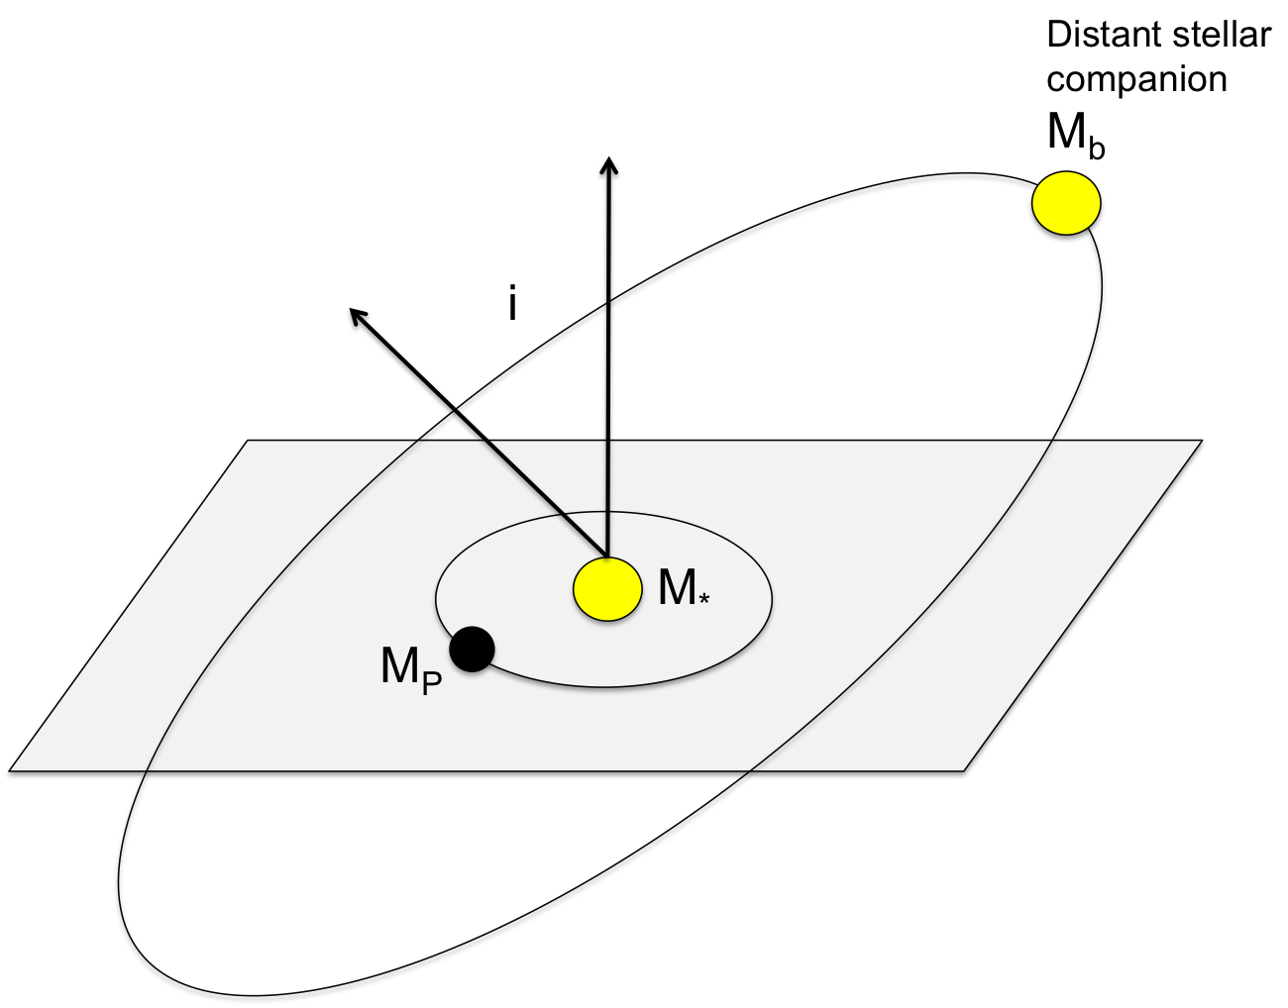
Lidov-Kozai Effect
Eccentricity and inclination oscillations induced if i > 40 degrees.
If i large (85-90 degrees), get extremely large eccentricities (e > 0.99)
Notes:
3 Quadrupole potential of the companion perturbs planet orbit. Even if you’ve never heard of Kozai, you would say obviously one thing that happens is that the orbital axis will precess around the the binary axis. But it turns out something else happens if the relative inclination is high enough. E max when I min. Etc.

Slide 27
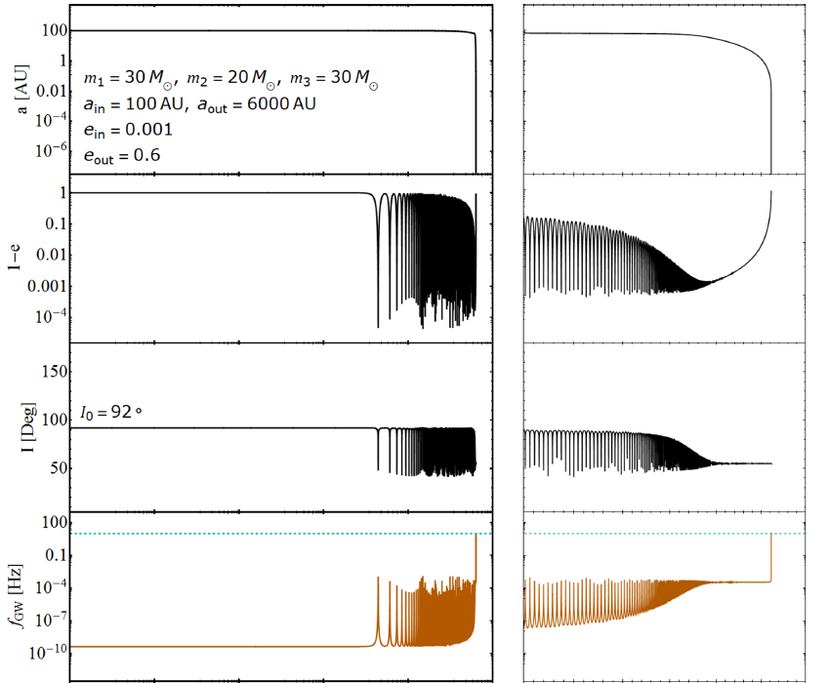
LK oscillation + Gravitation Radiation

Slide 28
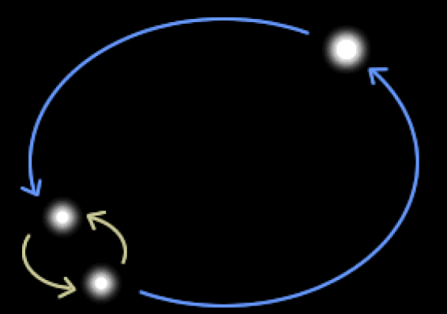


Tertiary-Induced Binary Mergers
merger window, mass ratio, GR effects, spin-orbit misalignments
Bin Liu
(Cornell→Niels Bohr Inst
→ Zhejiang U.)
Yubo Su
(Cornell, Ph.D.22
→ Princeton→CITA)
Liu & DL 2017-2023
Su et al.2021a,b; Su+2024
Previous/related works (in various contexts):
e.g. Blaes et al. 2002; Miller & Hamilton 2002; Wen 2003;
Thompson 2011; Antonini et al. 2012,2014,2017,
Silsbee & Tremaine 2017; Petrovich & Antonini 2017....
Note: Related/general effects of galatic tidal potential
Hamilton & Rafikov 2019-2021 (a la Heisler-Tremaine)

Slide 29
Summary of Tertiary-Induced Mergers
Some general “predictions”:
1. Residual eccentricity at 10 Hz: a few % have e ~0.1-0.2
2. Broad spin-orbit angles, peak around 90 degrees
3. In galactic field (induced by another star):
unequal-mass mergers are more likely (other factors being equal)
maybe constrained by LIGO data
4. In nuclear star cluster (induced by SMBH):
SMBH spin enhances the LK merger fraction;
Galactic tidal potential (e.g. Petrovich & Antonini 2017; Hamilton & Rafikov)
Synergy between galactic tide and stellar flybys (Winter-Granic+2024)

Slide 30
Summary of Tertiary-Induced Mergers
Some general “predictions”:
1. Residual eccentricity at 10 Hz: a few % have e ~0.1-0.2
2. Broad spin-orbit angles, peak around 90 degrees
3. In galactic field (induced by another star):
unequal-mass mergers are more likely (other factors being equal)
maybe constrained by LIGO data
4. In nuclear star cluster (induced by SMBH):
SMBH spin enhances the LK merger fraction;
Galactic tidal potential (e.g. Petrovich & Antonini 2017; Hamilton & Rafikov)
Synergy between galactic tide and stellar flybys (Winter-Granic+2024)

Slide 31







How does BH spin axis evolve ?
$$L_{out}$$
$$m_{3}$$
$$S_{2}$$
$$L$$
$$m_{2}$$
$$S_{1}$$
$$m_{1}$$

Slide 32


How does BH spin axis evolve ?
$$L_{out}$$
$$m_{3}$$
$$S_{2}$$
$$L$$
Spin-orbit coupling
(de Sitter precession):
$$m_{2}$$
$$S_{1}$$
$$m_{1}$$

Slide 33
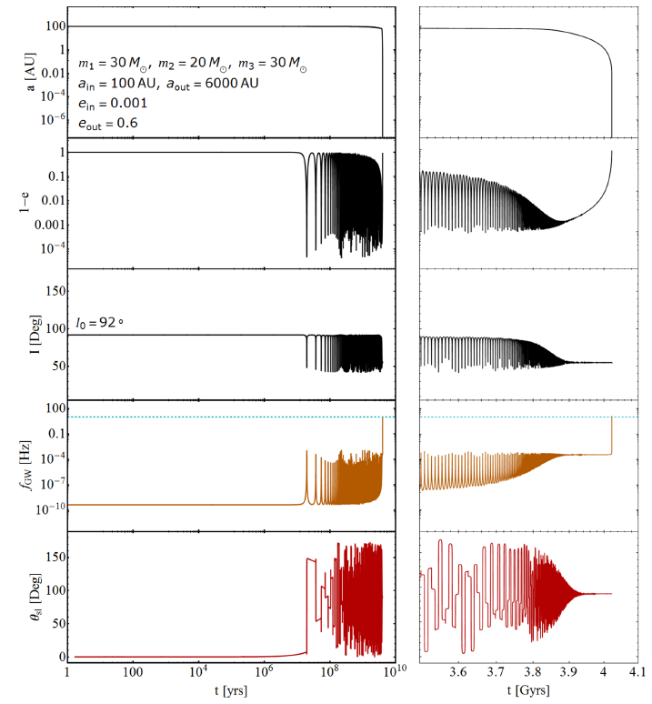

Slide 34
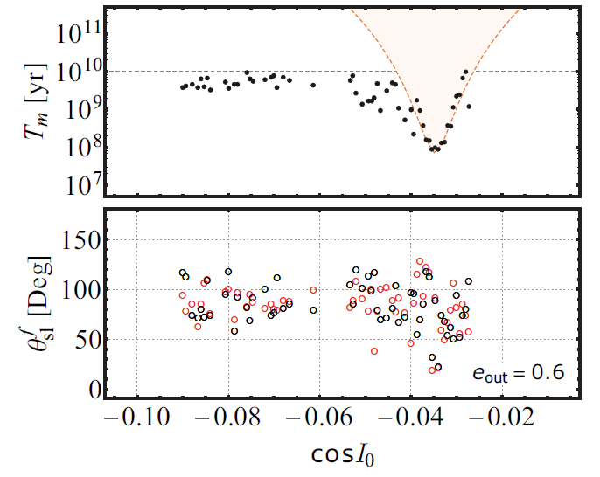
90⁰ “attractor”

Slide 35

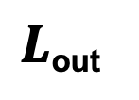
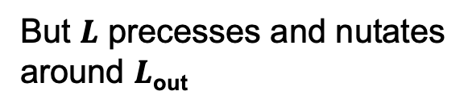

BH spin dynamics during LK oscillations
(de Sitter Precession)
Ω_{L}
Ω_{SL}
$L$_{out}
$$L$$
$$S_{1}$$
But $L$ precesses and nutates
around $L$_{out}
θ_{sl}
I
Outer binary axis
Inner binary axis
Spin axis

Slide 36



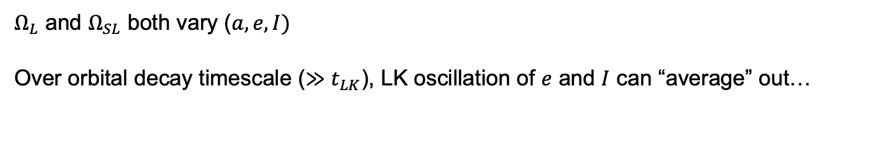
In the frame co-rotating with $L$
$Ω_{L}$ and $Ω_{SL}$ both vary ($a, e, I)$
Over orbital decay timescale ($≫t_{LK}$), LK oscillation of $e$ and $I$ can “average” out…
➔
➔
Su, Lai & Liu 2021; Su 2025

Slide 37
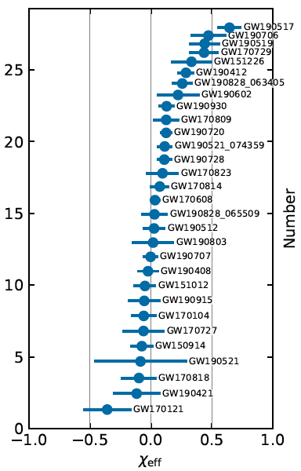
Observed
90⁰ “attractor”
Liu & Lai 2018

Slide 38
Summary of Tertiary-Induced Mergers
Some some general “predictions”:
1. Residual eccentricity at 10 Hz: a few % have e ~0.1-0.2
2. Broad spin-orbit angles, peak around 90 degrees
3. In galactic field (induced by another star):
unequal-mass mergers are more likely (other factors being equal)
maybe constrained by LIGO data
4. In nuclear star cluster (induced by SMBH):
SMBH spin enhances the LK merger fraction;
Galactic tidal potential (e.g. Petrovich & Antonini 2017; Hamilton & Rafikov)
Synergy between galactic tide and stellar flybys (Winter-Granic+2024)

Slide 39
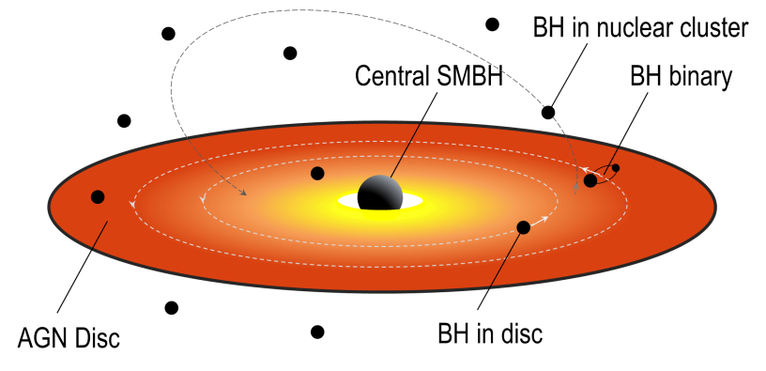
Dynamical Formation Channel:
3. Binary BH Mergers in AGN (Active Galactic Nuclei) disks

Slide 40
Empirical evidence for massive stars (-> stellar mass BHs)
in AGN disks
Galactic Center:
0.04-0.5 pc: OB/WR stars in disk
Broad emission lines of AGN
==> metal rich (independent of redshift)

Slide 41
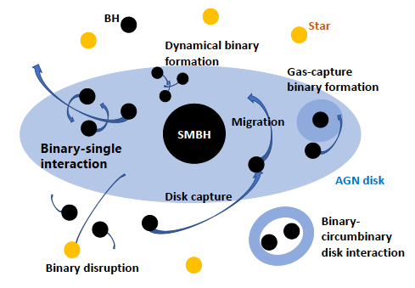
Dynamical Formation Channel:
3. Binary BH Mergers in AGN (Active Galactic Nuclei) disks
Tagawa+20
Several merger scenarios…
Previous works: Bellovary+16, Bartos+16, Stone+17, McKernan+18, Secunda+18, Yang+19, Tagawa+20…

Slide 42
AGN channel merger scenarios:
(leading to different “predictions”)
-- Gas-free (essentially) mergers
AGN disk helps to bring BHs to a plane…
-- Gas-assisted mergers

Slide 43



Gas-free single-single “collision”
via GW bremsstrahlung
Li, Lai & Rodet 2022
Also: Rom, Sari & Lai 2024
Jiaru Li, Cornell Ph.D.23
➔ Northwestern
$$a_{1}$$
m₁
M
m₂
$$a_{2}$$
Two BHs (m₁, m₂) on closely-packed, nearly circular, nearly-coplanar orbits around a SMBH (M)
(e.g. brought together by migration in AGN disks
When
orbits are dynamically unstable.
What happens to the two BHs?

Slide 44
Two planets in unstable orbits around a star:
Three outcomes:
Ejection of lower-mass planet
Planet-planet collision
Injection into the the near vicinity of star
$$a_{1}$$
m₁
M
m₂
$$a_{2}$$
Two BHs in unstable orbits around a SMBH:
Since
Ejection and injection are not possible
(takes many orbits > Hubble time)
Since
The two BHs undergo “chaotic” motion, experience
recurring closer encounters (separation < R_{H})

Slide 45
For VERY close encounter:
GW emission
Capture radius for forming “permanent” binary
due to GW bremsstrahlung

Slide 46
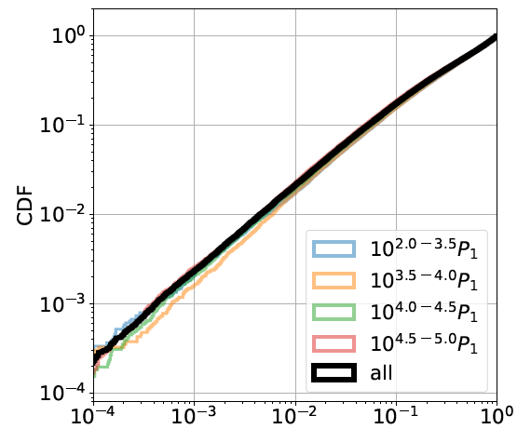
How likely/often does this happen?
(“loss cone” problem…)
Probability of very close encounters

Slide 47
Two BHs get captured into a (very eccentric) binary
via GW bremsstrahlung
Once captured, it will take a few orbital period to merge
it enters LIGO band with
This mechanism always produces eccentric mergers
Li, Lai & Rodet 2022
Rom, Sari & Lai 2024

Slide 48
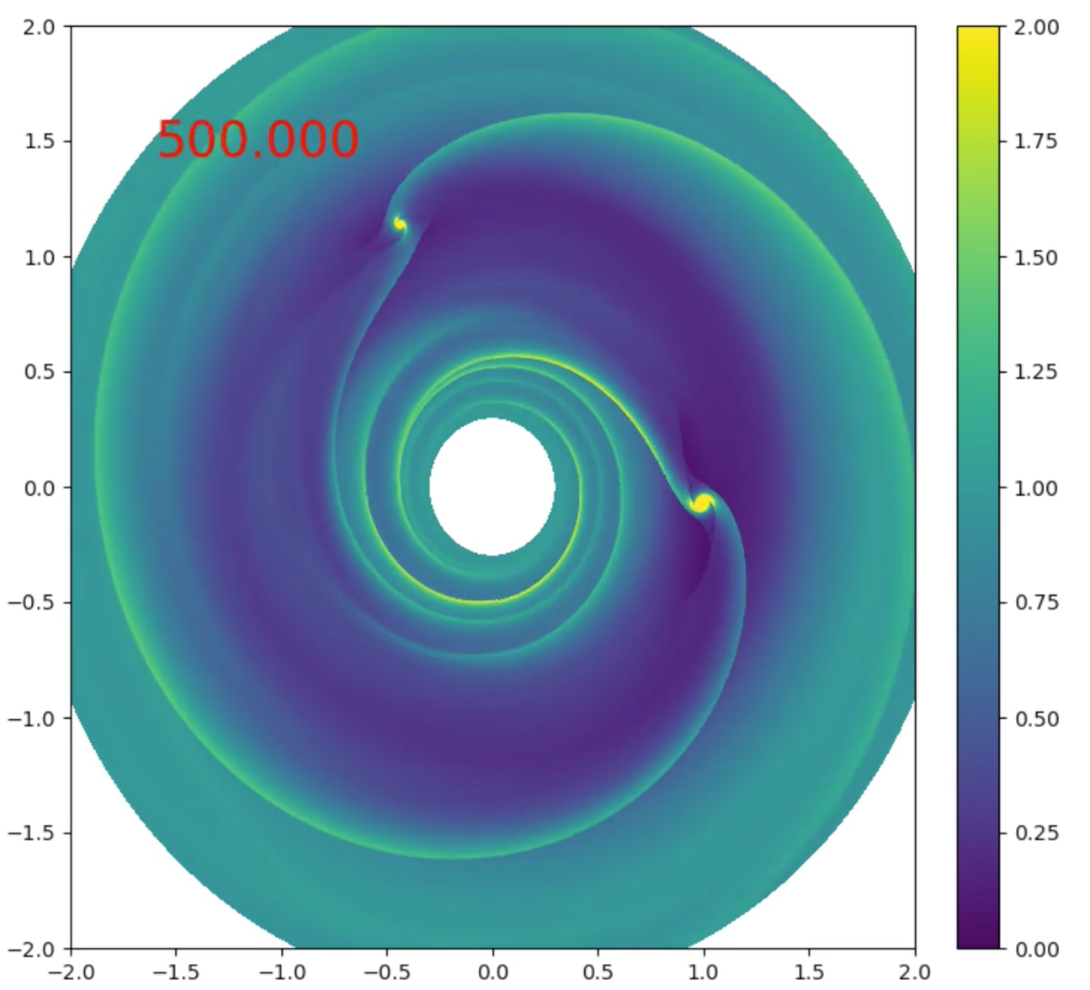
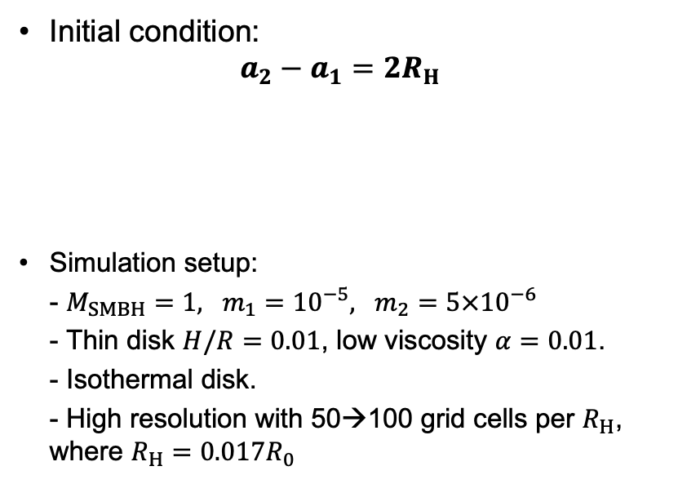




Gas Effects: Formation of BH binaries
hydrodynamics simulations
Jiaru Li … Hui Li’s LANL group… 2023,2024
$$m_{2}$$
Initial condition: $a_{2}−a_{1}=2R_{H}$
Simulation setup:
- $M_{SMBH}=1, m_{1}={10}^{−5}, m_{2}=5×{10}^{−6}$
- Thin disk $H/R=0.01$, low viscosity $α=0.01$.
- Isothermal disk.
- High resolution with 50→100 grid cells per $R_{H}$, where $R_{H}=0.017R_{0}$
$$a_{2}$$
$$m_{1}$$
Y [R₀]
$$a_{1}$$
M
X [R₀]
See also Rowan et al. 2023,24;
Whitehead et al 2024
Notes:
Now we look at the effect of gas during CEs. We setup the BHs in a way that is similar to what we have previously.
But we add a gas disk, which is couple to the BHs via gravity and the evolution with hydrodynamics simulations.

Slide 49
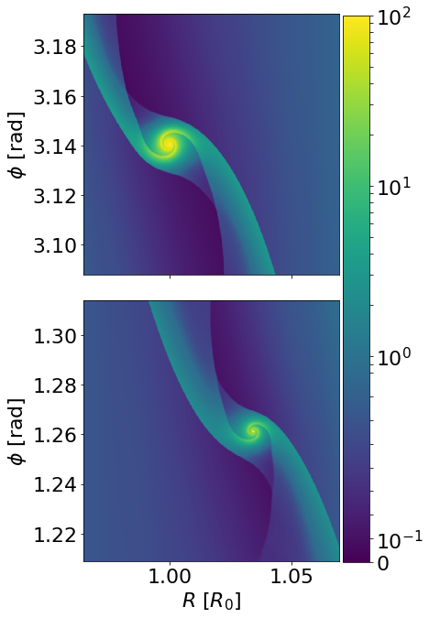
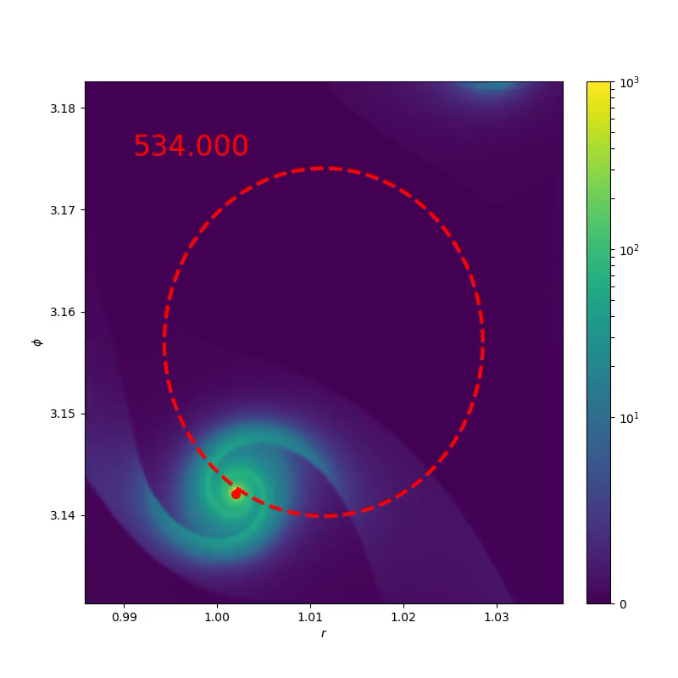
Circum-single disk (CSD)
Formation of a binary
Circum-single disk (CSD)
Notes:
Now we release the two BHs from the initial circular orbits, allows their trajectories to be perturbed by the gas and deflected by the other BH.
The inner one has a higher angular speed, so it will approach the outer one from behind, and have a close encounter.
The plot on the left shows the density around each BH before when they are ready to be released.
You see each of them has co-moving CSD around it. You can imagine that during close encounter, the CSDs will collide.
The right panel shows what happens during the close encounters in BHs center-of-mass frame:
As the BHs passes each other, their CSD gas collide at supersonic speed.
The gas evolution becomes highly non-linear and the CSDs are destroyed. A long-live BH binary is formed during this process .
When I re-run the sane close encounter without gas, the BHs will leave each other immediately after their first closest approach. This capture only happens when sufficient amount of gas is around.

Slide 50
Outcomes: depends on gas density,
initial and orbital phase
Notes:
Let me just take one step back a explain our results slowly.
In most of our hydrodynamics simulations, the two BHs experience their first close encounter at around t=534.
If the distance between the two BHs remains smaller than $R_{\rm H}$ from the beginning of the close encounter to the end of the simulation, then we say a bound BHs binary is formed.
By this definition, some of the close encounters in our simulations form tightly bound binaries, although not all of them do.
When we run the simulations with different disk surface density and different encountering trajectories, the outcomes are different.
Some of them forms binary, some of them just do a quick scattering, sending both BHs to an eccentric orbits around the SMBH.
The scatted BHs will just wait for their next close encounters, or wait for their orbital eccentricity to be damped by the disk.

Slide 51
Gas-assisted binary formation: Toy model calculation
Gas drag on each BH:

Slide 52
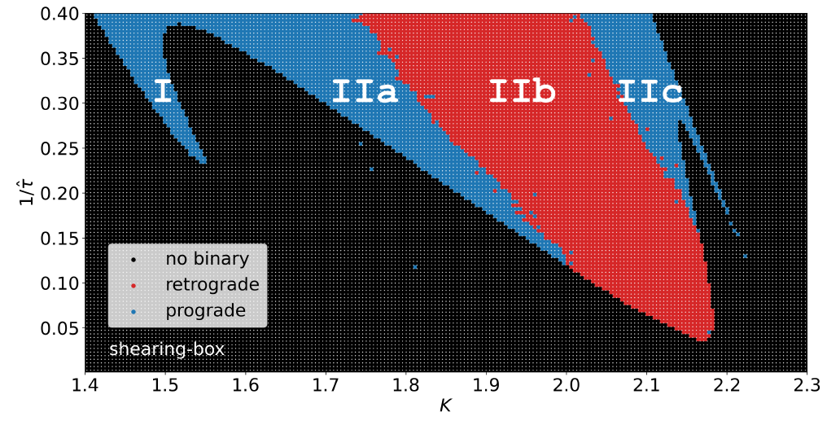

Gas-assisted binary formation: Toy model calculation
Gas drag on each BH:
Initial condition:
Qian, Jiaru Li & DL 2024
See also
Tjarda Boekholt et al. 2023
Mark Dodici & Tremaine 2024
Kecheng (Stephon) Qian
(Cornell ’24 -> UC Berkeley)

Slide 53
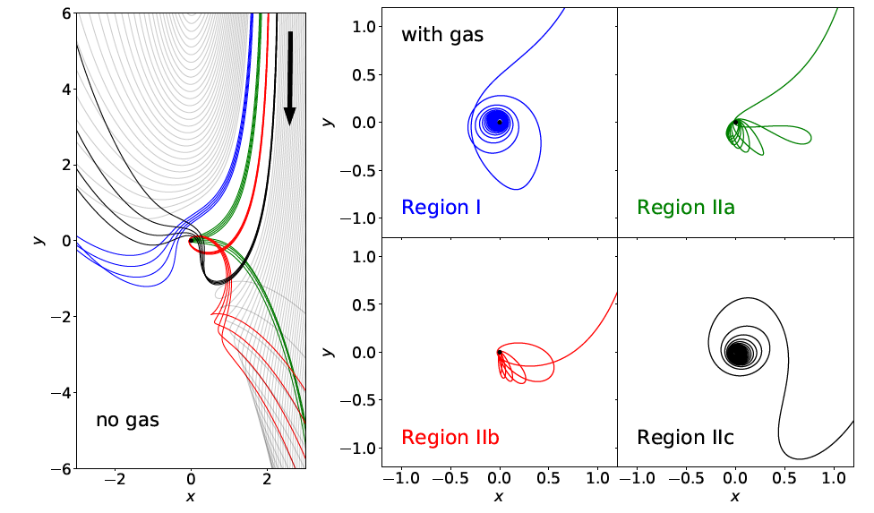


m₂
$$a_{2}$$
$$a_{1}$$
m₁
M
See Petit & Helon 1986
“Satellite Encounters”

Slide 54
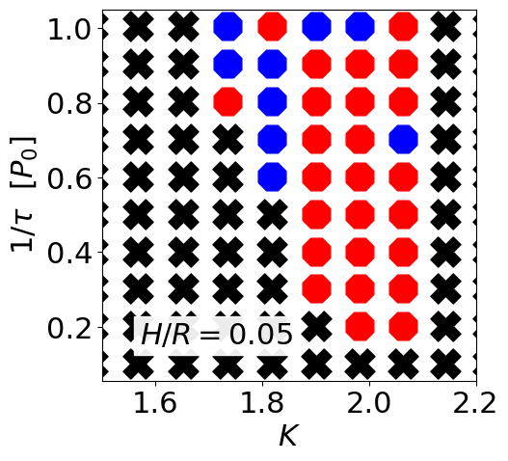
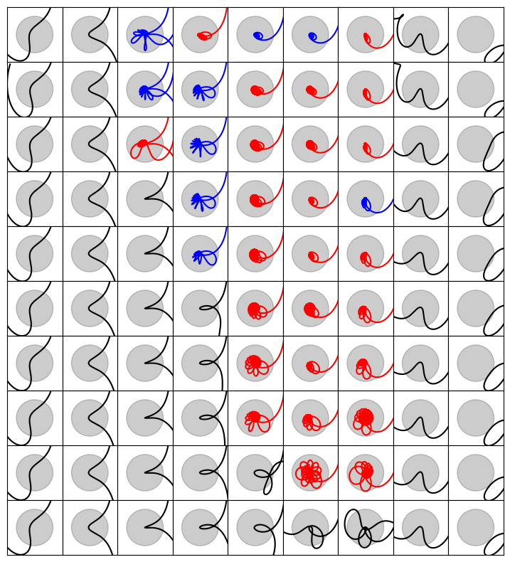
2D Hydro simulation survey:
Jiaru Li et al, 2025 (in prep)
Relative trajectories of the BHs ⇒
Capture happens only for
Why? →

Slide 55
Digression:
Two-body encounter

Slide 56


$$a$$
m
M
Test mass
$$a+x$$

Slide 57
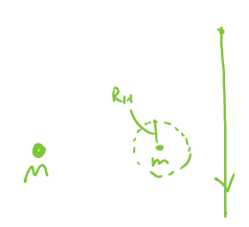
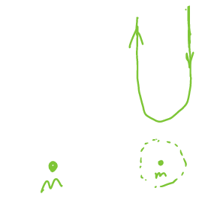
Two-body encounter in the presence of M
M

Slide 58
2D Hydro simulation survey:
Jiaru Li et al, 2025 (in prep)
Relative trajectories of the BHs ⇒
Capture happens only for

Slide 59
Gas effects: Embedded Binary in AGN Disk
SMBH
Baruteau et al. 2011
Y.Li,… H.Li… 2021
Dempsey, H.Li… 2023
R.Li & DL 2022,23,24

Slide 60
Important for understanding the formation of SMBH binaries
see Lai & Munoz 2023 Annual Review A&A
Circumbinary Disk
Spiral Density Waves
Gap/Cavity
Accretion Stream
Circum-single Disk (“Mini Disk”)

Slide 61
Gas effects: Embedded Binary in AGN Disk
SMBH
Baruteau et al. 2011
Y.Li,… H.Li… 2021
Dempsey, H.Li… 2023
R.Li & DL 2022,23,24

Slide 62
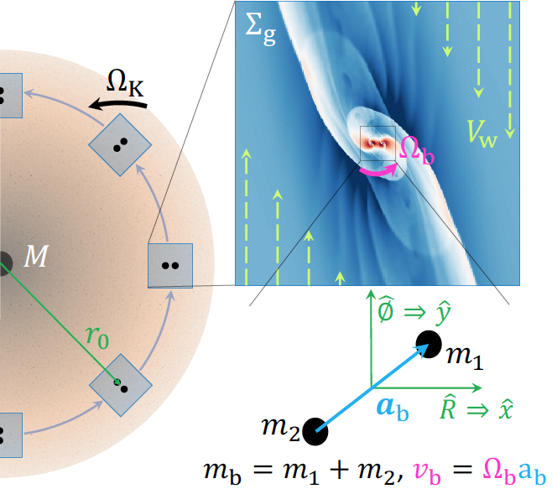
Local simulations of binary in disk
R.Li & Lai 2022,2023,2024
Dr. Rixin Li
(Cornell -> Berkeley)
Local shearing box
(not ”local wind tunnel box”
used by Kaaz et al. 2021)
ATHENA
Mesh refinement
Resolution: a_{b} ~250 cells
zero softening in gravity

Slide 63
Length scales of the problem:
Velocity scales of the problem:
➔ Dimensionless ratios:

Slide 64
Example of flow structure
Pairs of bow shocks, spiral shocks
BH = absorbing sphere:
➔
Force on each BH: from gravity + accretion + pressure
➔ Torque on binary, energy transfer rate ➔

Slide 65
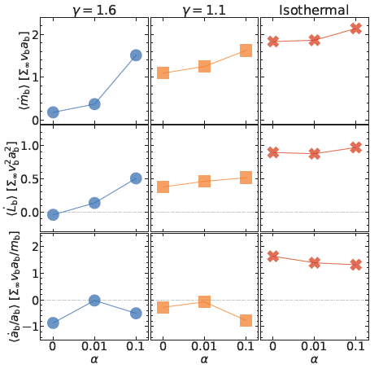
Rixin Li & DL 2024
prograde

Slide 66
Embedded binaries in gas disks
Prograde binaries:
Orbital decay or expansion? Depends on gas thermodynamics, viscosity, size of accretor…
Retrograde binaries:
Always orbital decay
In general, orbital evolution of the binary is much faster than migration
of the center of mass of binary in AGN disk.

Slide 67
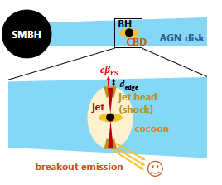
Binary BH Mergers and EM Counterparts?
ZTF19abanrhr: Graham et al 2020
Optical flare L~10⁴⁵ erg/s, duration ~ 1month, in AGN J124942
Associated with GW190521 (heavy BH merger)? (within 18 days)
6 similar ZTF flares reported: Graham et al. 2022
GRB (Fermi) (10⁴⁹erg/s, ~1s) associated with GW150914 ?? (Connaughton+16)
GRB associated with LVT151012 ?? (Bagily+16)
Tagawa+2023

Slide 68
Summary
Formation of Merging BH Binaries
Standard isolated binary evolution channel:
uncertain physics (common envelope…)
➔ circular mergers (e_{m}=0), mostly aligned spin-orbit angle
Dynamical formation channels:
“clean” physics, but “environmental” uncertainties
1. Dense star clusters
➔ mostly circular mergers ? expect random spin-orbit misalignments ?
2. Tertiary-induced mergers
Perturbations from outer companion → Lidov-Kozai
Spin-orbit misalignment
➔ a few % mergers have residual e>0.1 when entering LIGO band
Preference of 90⁰ spin-orbit misalignment, especially for circular mergers
3. BH Mergers in AGN disks
GW capture → very eccentric mergers
gas assisted mergers? More works to be done…
Rates? All potentially can play a role
LISA/Taiji & AION/Deci-Hz useful for probing dynamical formation

