Slide 1

“Bright”siren without electromagnetic counterpart by LISA-Taiji-TianQin network
Yejing Zhan (詹业靖)
Supervisor: Fa-yin Wang (王发印)
Collaborators: David Izquierdo-Villalba, Xiao Guo , Qing Yang, Daniele Spinoso
Nanjing university
School of Astronomy & Space Science

Slide 2

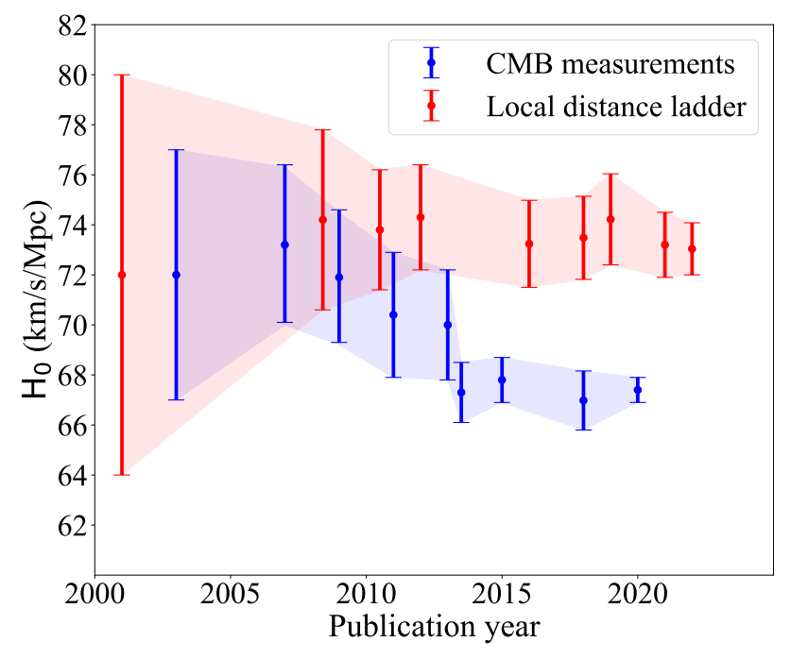



Hubble Tension
Hu, J. P., & Wang, F. Y. (2023). Universe
Current: Error accumulation
$$∼3σ$$
Early: Model depended
New method to constrain $H_{0}$?

Slide 3
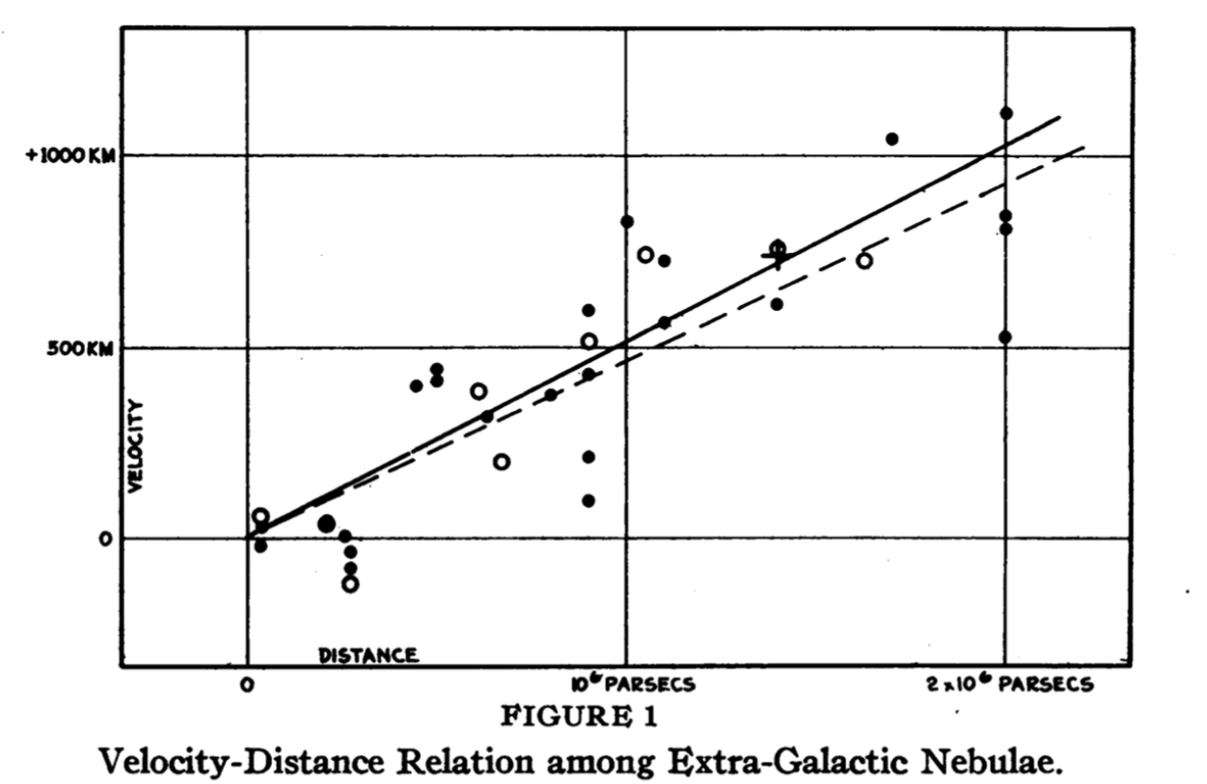
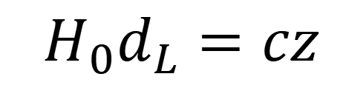
Methodology: GW to $H_{0}$ measurement
$$H_{0}d_{L}=cz$$

Slide 4
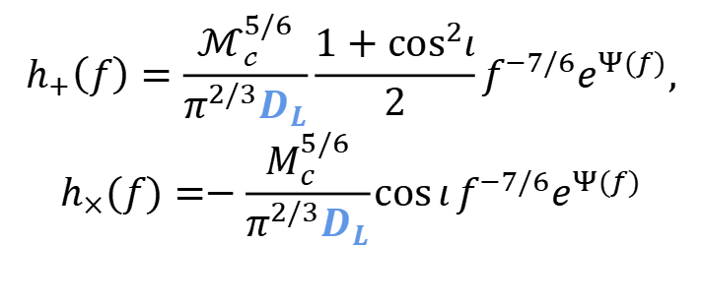
Methodology: GW to $H_{0}$ measurement
GW with match-filtering
$$h_{+}\left(f\right)=\frac{ℳ_{𝒸}^{5/6}}{π^{2/3}D_{L}}\frac{1+\cos^{2}ι}{2}f^{−7/6}e^{Ψ(f)},$$
$$h_{×}(f)=−\frac{M_{c}^{5/6}}{π^{2/3}D_{L}}\cos{ι}f^{−7/6}e^{Ψ(f)}$$
$$H_{0}d_{L}=cz$$

Slide 5
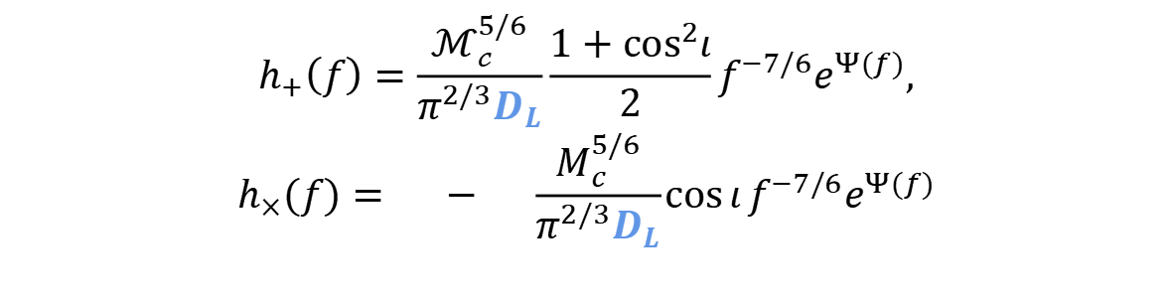
Methodology: GW to $H_{0}$ measurement
GW with match-filtering
With electromagnetic counterpart (EMc)
$$h_{+}\left(f\right)=\frac{ℳ_{𝒸}^{5/6}}{π^{2/3}D_{L}}\frac{1+\cos^{2}ι}{2}f^{−7/6}e^{Ψ(f)},$$
$$h_{×}(f)=−\frac{M_{c}^{5/6}}{π^{2/3}D_{L}}\cos{ι}f^{−7/6}e^{Ψ(f)}$$
(Bright siren)
by localizing the host galaxy to obtain the redshift
$$H_{0}d_{L}=cz$$
Without EMc
(Dark siren)
Statistically map the GW event to the galaxy catalog (indirectly obtain the redshift)
… …
How?

Slide 6
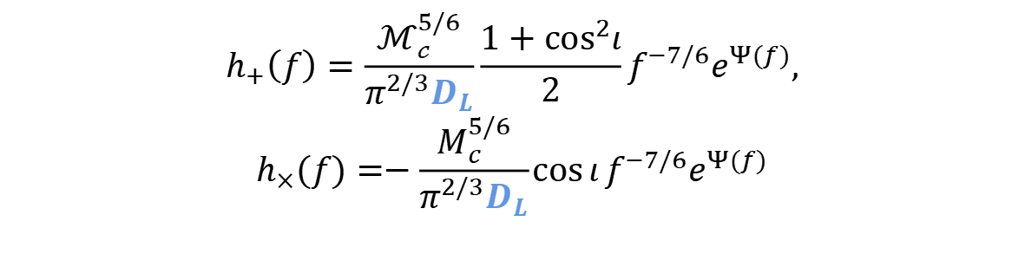
Methodology: GW to $H_{0}$ measurement
GW with match-filtering
With electromagnetic counterpart (EMc)
$$h_{+}\left(f\right)=\frac{ℳ_{𝒸}^{5/6}}{π^{2/3}D_{L}}\frac{1+\cos^{2}ι}{2}f^{−7/6}e^{Ψ(f)},$$
$$h_{×}(f)=−\frac{M_{c}^{5/6}}{π^{2/3}D_{L}}\cos{ι}f^{−7/6}e^{Ψ(f)}$$
(Bright siren)
by localizing the host galaxy to obtain the redshift
$$H_{0}d_{L}=cz$$
Without EMc
(Dark siren)
Statistically map the GW event to the galaxy catalog (indirectly obtain the redshift)
… …
How?

Slide 7
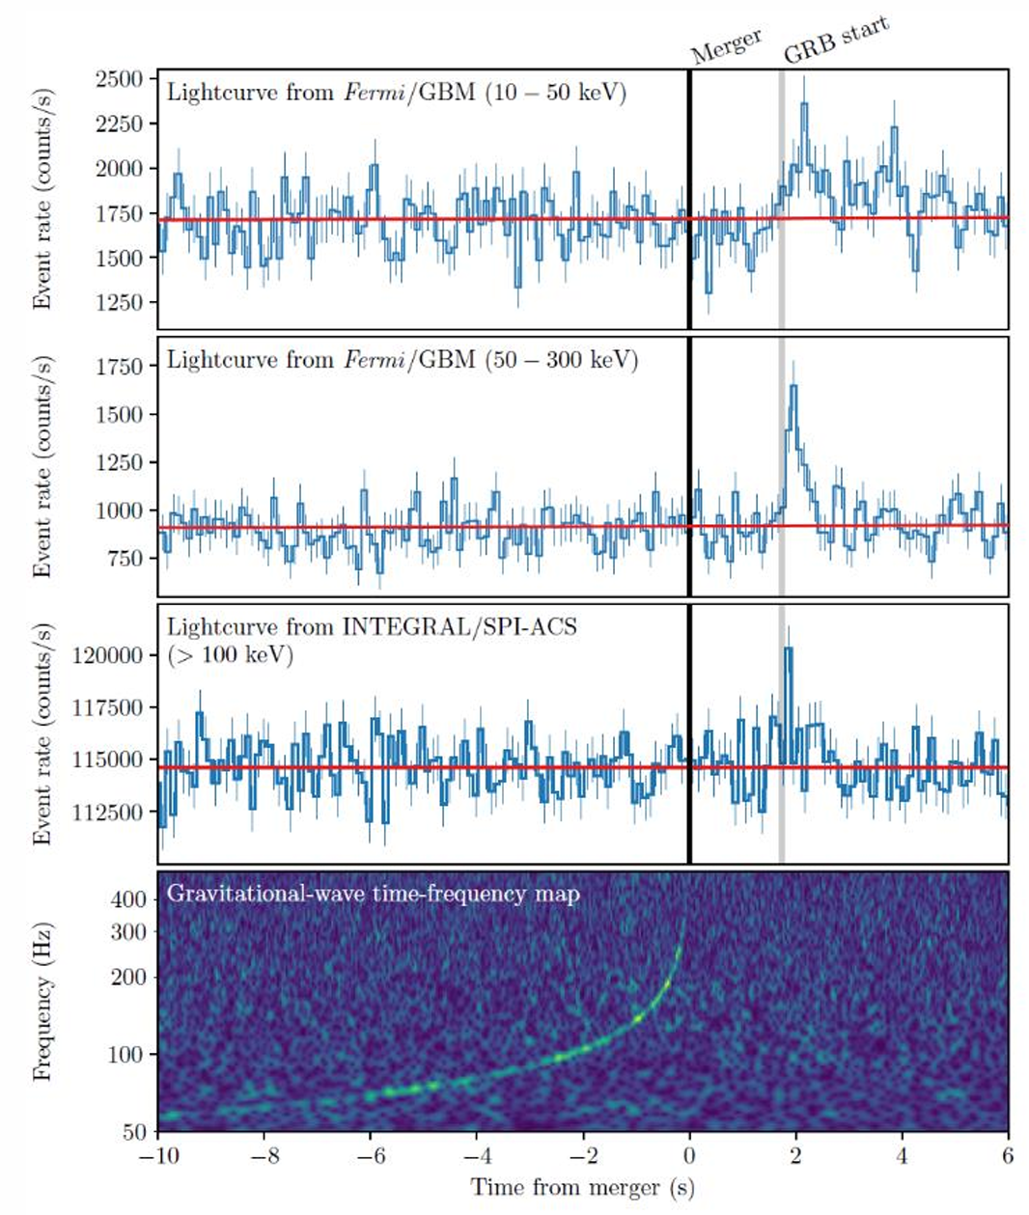
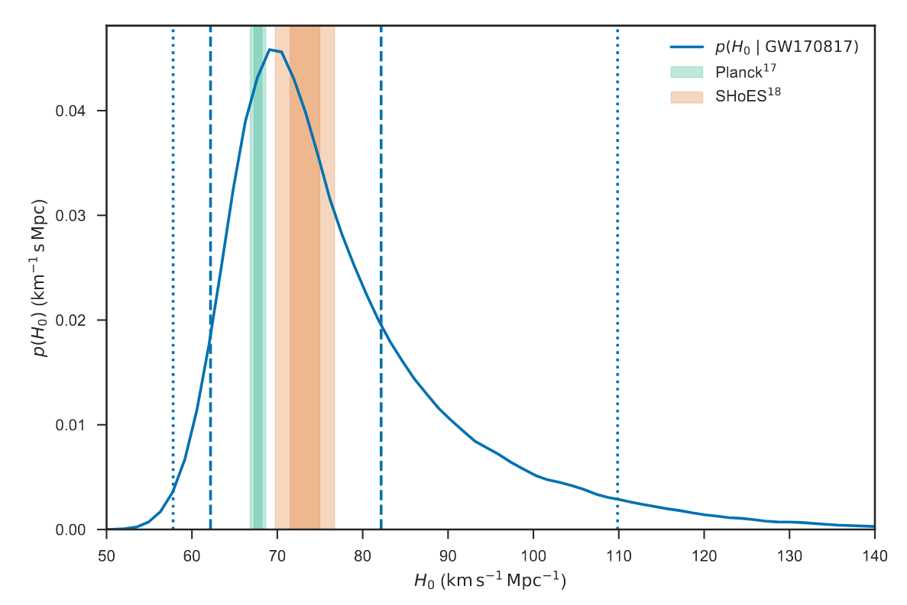
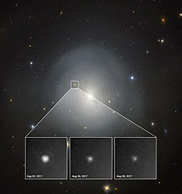


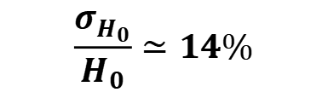

Bright siren: BNS GW170817
Redshift: $z$
Constrain on $H_{0}$
Host galaxy
identify
NGC 4993
LIGO Scientific Collaboration. et al (2017) Nature
Match
Luminosity distance
$$\frac{σ_{H_{0}}}{H_{0}}≃14\%$$
filter
$$d_{L}$$
LIGO Scientific Collaboration. (2019) The Astrophysical Journal Letters

Slide 8
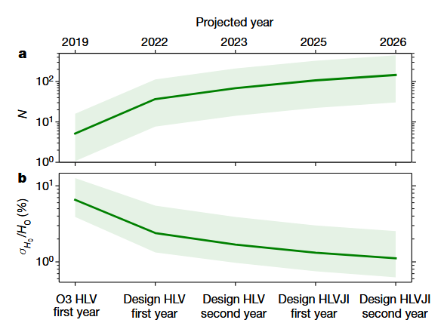
Low detection rate for BNS
Predict
Predicted number of bright sirens is much higher than the reality
Real
Can we bypass the Emc to localize the host galaxy directly?
Chen, H. Y., et al.(2018). Nature

Slide 9


Localization:
The uncertainty volume
$$ΔV=d_{L}^{2}Δd_{L}ΔΩ_{s}$$
If $n_{galaxy}×ΔV<1$, one identify the host galaxy uniquely.
Examples: For $n_{galaxy}=0.02 {Mpc}^{−3}$
LIGO-Virgo-Kagra $\frac{Δd_{L}}{d_{L}}∼30\%$ (based on GW170817$), ΔΩ_{s}∼100−1000 {\text{deg}}^{2}$
$n_{galaxy}×ΔV<1$ at $d ≲10 Mpc$
LISA $\frac{Δd_{L}}{d_{L}}∼10\%, ΔΩ_{s}∼10 {\text{deg}}^{2}$
$n_{galaxy}×ΔV<1$ at $d ≲50 Mpc$
Notes:
但是对于这种双中子星并合事件作为亮汽笛有缺点，可能由于其电磁对应体比如说gamma暴，千新星比较难探测，或者是本身并和率不高的原因，导致预测的亮汽笛源的数目要远低于实际的数目。
目前为止有确定电磁对应体的引力波事件只有刚刚提到的那一例
所以我们需要找寻更多的可能的亮汽笛

Slide 10
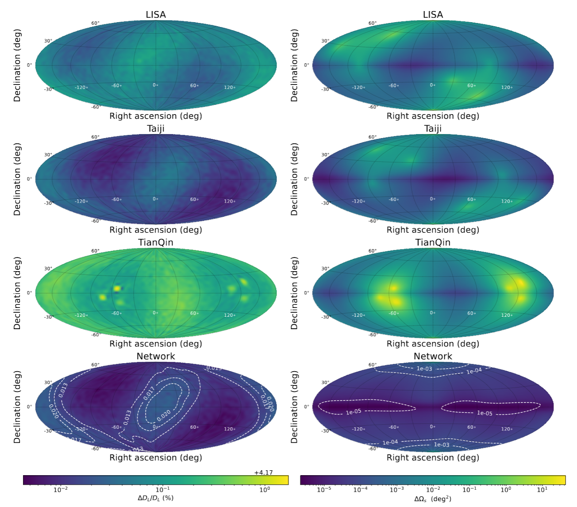
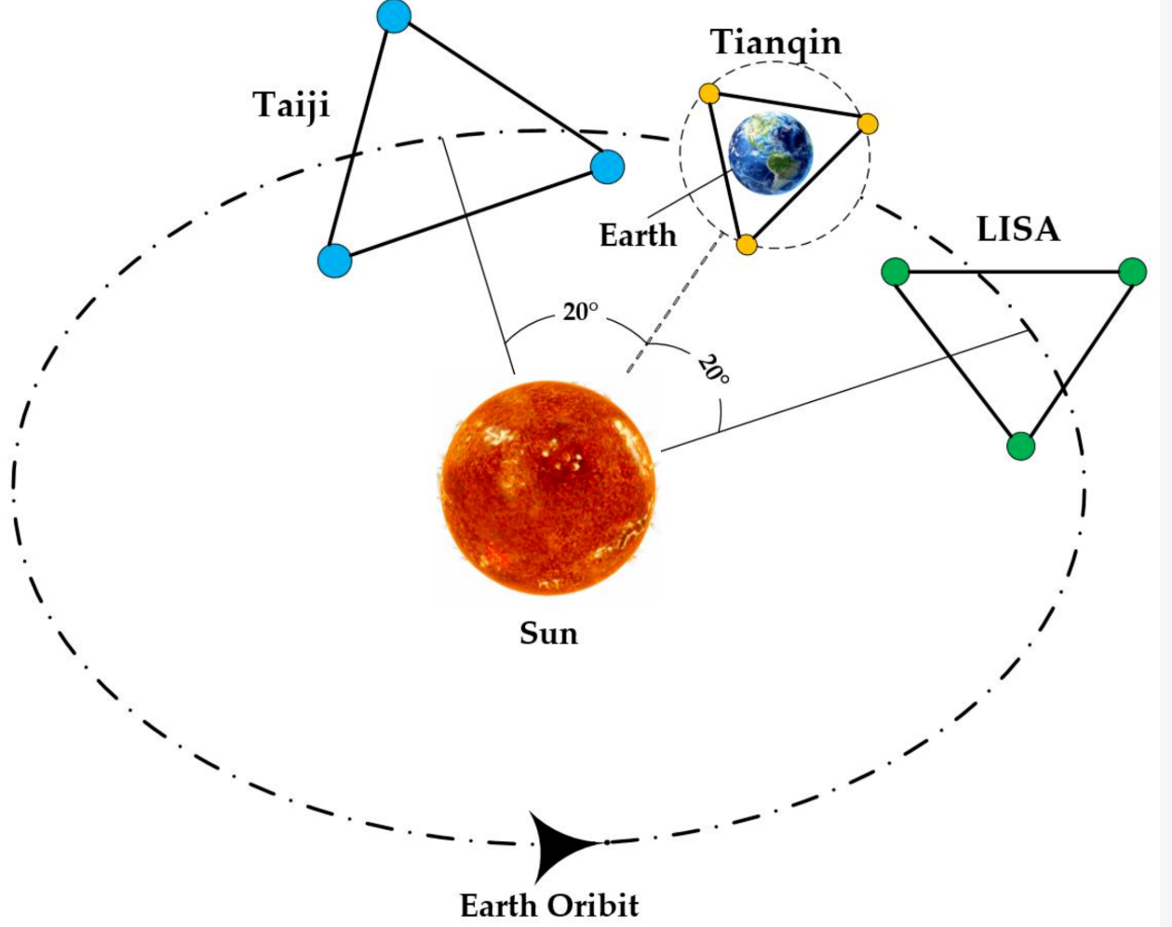

Network
LISA-Taiji-Tianqin network
$$\frac{Δd_{L}}{d_{L}}∼5\%, ΔΩ_{s}≲10^{−3} {\text{deg}}^{2}$$
Notes:
但是对于这种双中子星并合事件作为亮汽笛有缺点，可能由于其电磁对应体比如说gamma暴，千新星比较难探测，或者是本身并和率不高的原因，导致预测的亮汽笛源的数目要远低于实际的数目。
目前为止有确定电磁对应体的引力波事件只有刚刚提到的那一例
所以我们需要找寻更多的可能的亮汽笛

Slide 11
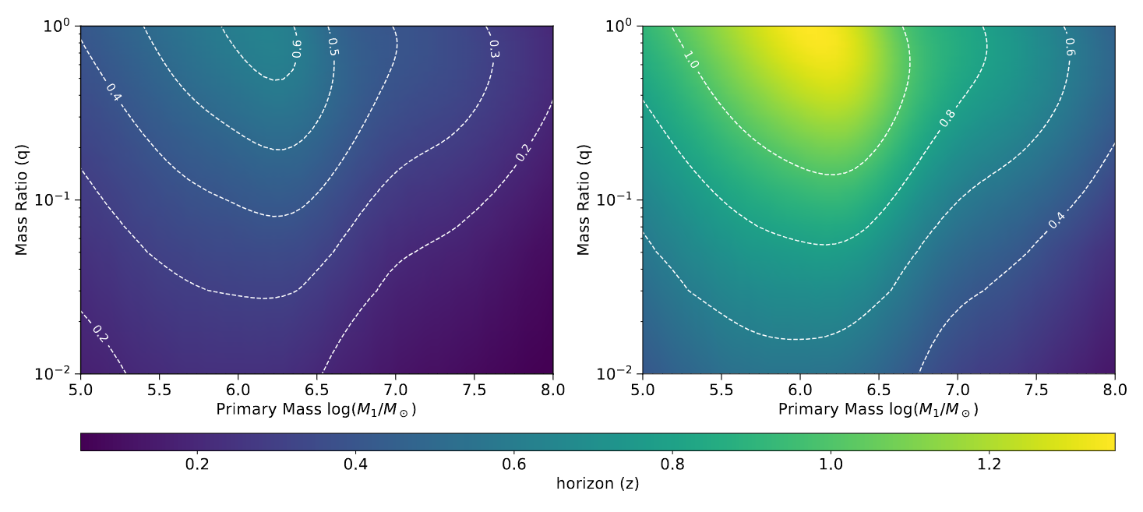
Identification horizon:
Target: supermassive black hole binary merger
Most inaccurate case
Most accurate case
(detect at sky pole)
(detect at sky equator)
The network has the ability to identify the SMBHB’s host galaxy at $z∼1.3$

Slide 12
Population models
Semi-analytic model （SAM model）
LightSeed-Nodelay model: “Light-seeding” from population III stars with a mass $300 M_{⊙}$
HeavySeed-Delay model: “Heavy-seeding” with a mass of ${10}^{5} M_{⊙}$ from the collapse of the gas, consider delay between halo merger and black hole merger
HeavySeed-Nodelay model: the same as HeavySeed-Delay model but without delay
N-body simulation model (refined model)
Izquierdo-Villalba D. et al, (2024)
IV24 model: a variant of the L-Galaxies model, calibrated by Millennium and Millennium-II simulation
Qing Y. et al, (2025)
QY25 model: utilize L-Galaxies model, selecting events within the light-cone
Notes:
但是对于这种双中子星并合事件作为亮汽笛有缺点，可能由于其电磁对应体比如说gamma暴，千新星比较难探测，或者是本身并和率不高的原因，导致预测的亮汽笛源的数目要远低于实际的数目。
目前为止有确定电磁对应体的引力波事件只有刚刚提到的那一例
所以我们需要找寻更多的可能的亮汽笛

Slide 13
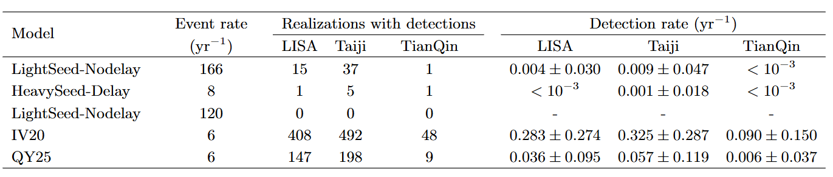

1000-realization simulation: single detectors
$H_{0}$ constraint
Event rate
Taiji yields the best detectability, LISA ranks second, due to the armlength
Detection rates are too low to ensure promising detection
Notes:
所以我们需要找寻更多的可能的亮汽笛

Slide 14
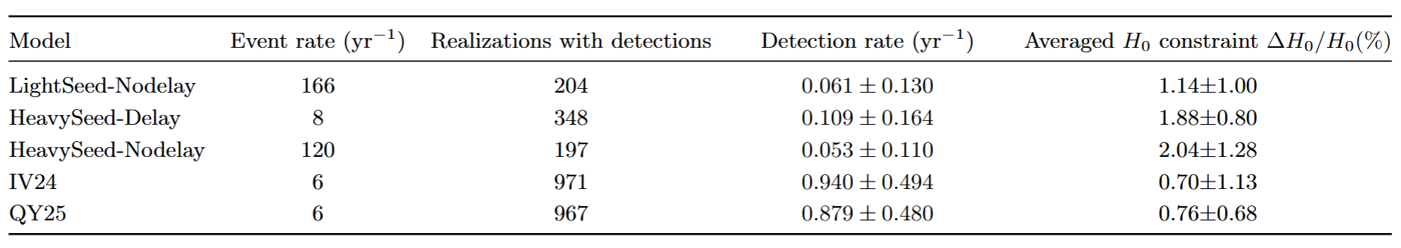
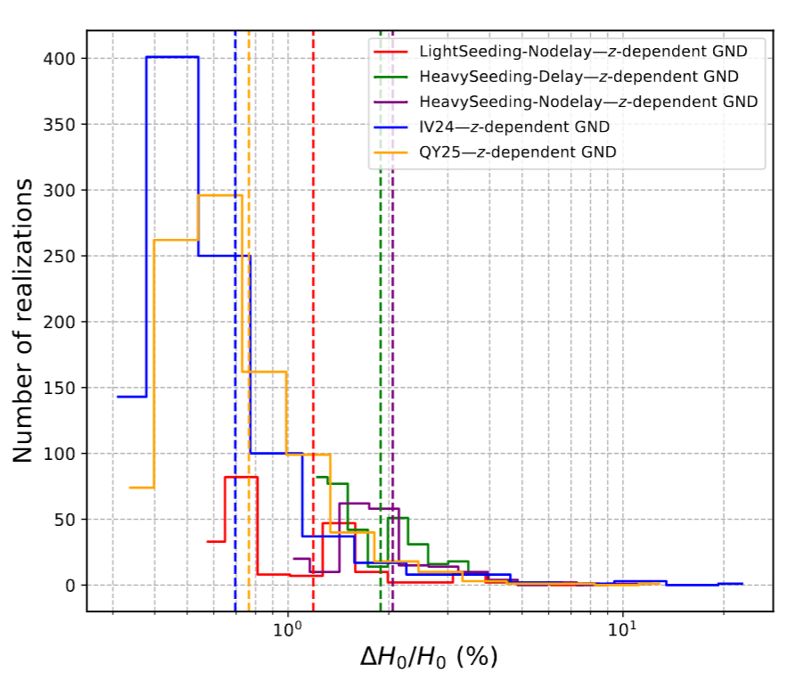
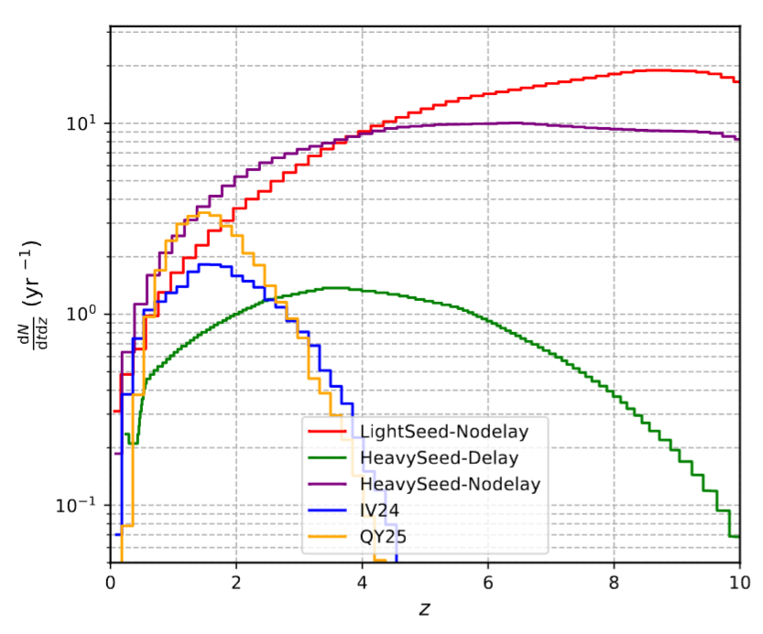
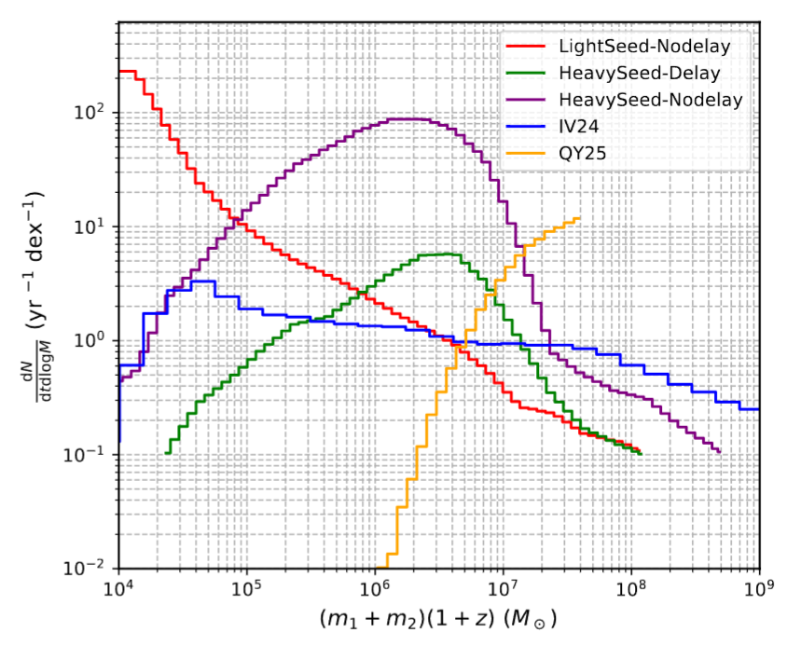
1000-realization simulation: network
$H_{0}$ constraint
Event rate

Slide 15
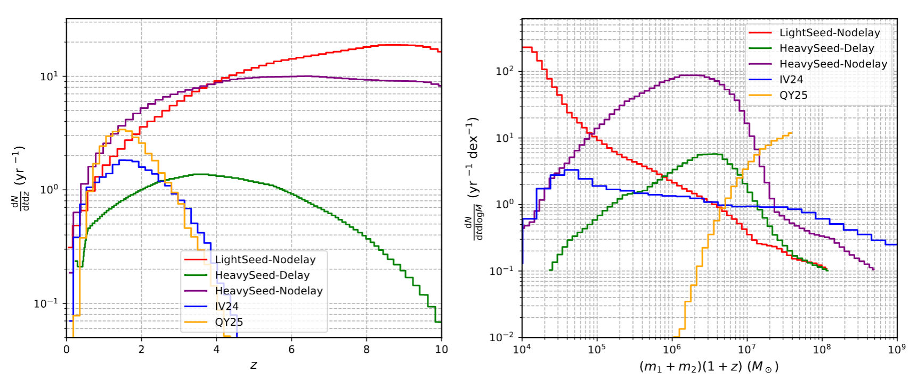
1000-realization simulation: network
No detections for SAM models
Due to in inappropriate redshift-, mass-, mass-ratio-distribution

Slide 16
1000-realization simulation: network
Promising detections for refined models in several-year network lifetime
Promising constraint on $H_{0}$ with fractional uncertainty $<1\%$

Slide 17
Outline
The identification horizon of network reaches a maximum of $z∼1.3$ for equal-mass SMBHB (${10}^{6} M_{⊙})$
Detection rates are too low to ensure promising detection for single detectors
Network yields promising detections for refined models, constraining $H_{0}$ to $<1\%$

Slide 18
Thanks

