Slide 1

A treatment to gravitational perturbations and Lorentz-violating effects with Lagrangian analysis
ZHANG Chao (张超),
School of Science, China University of Petroleum-Beijing (CUP)
phyzc@cup.edu.cn & chaoz123@qq.com
Oct\2025 @ Chun’an, China

Slide 2
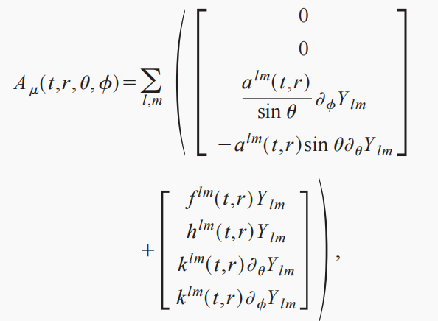
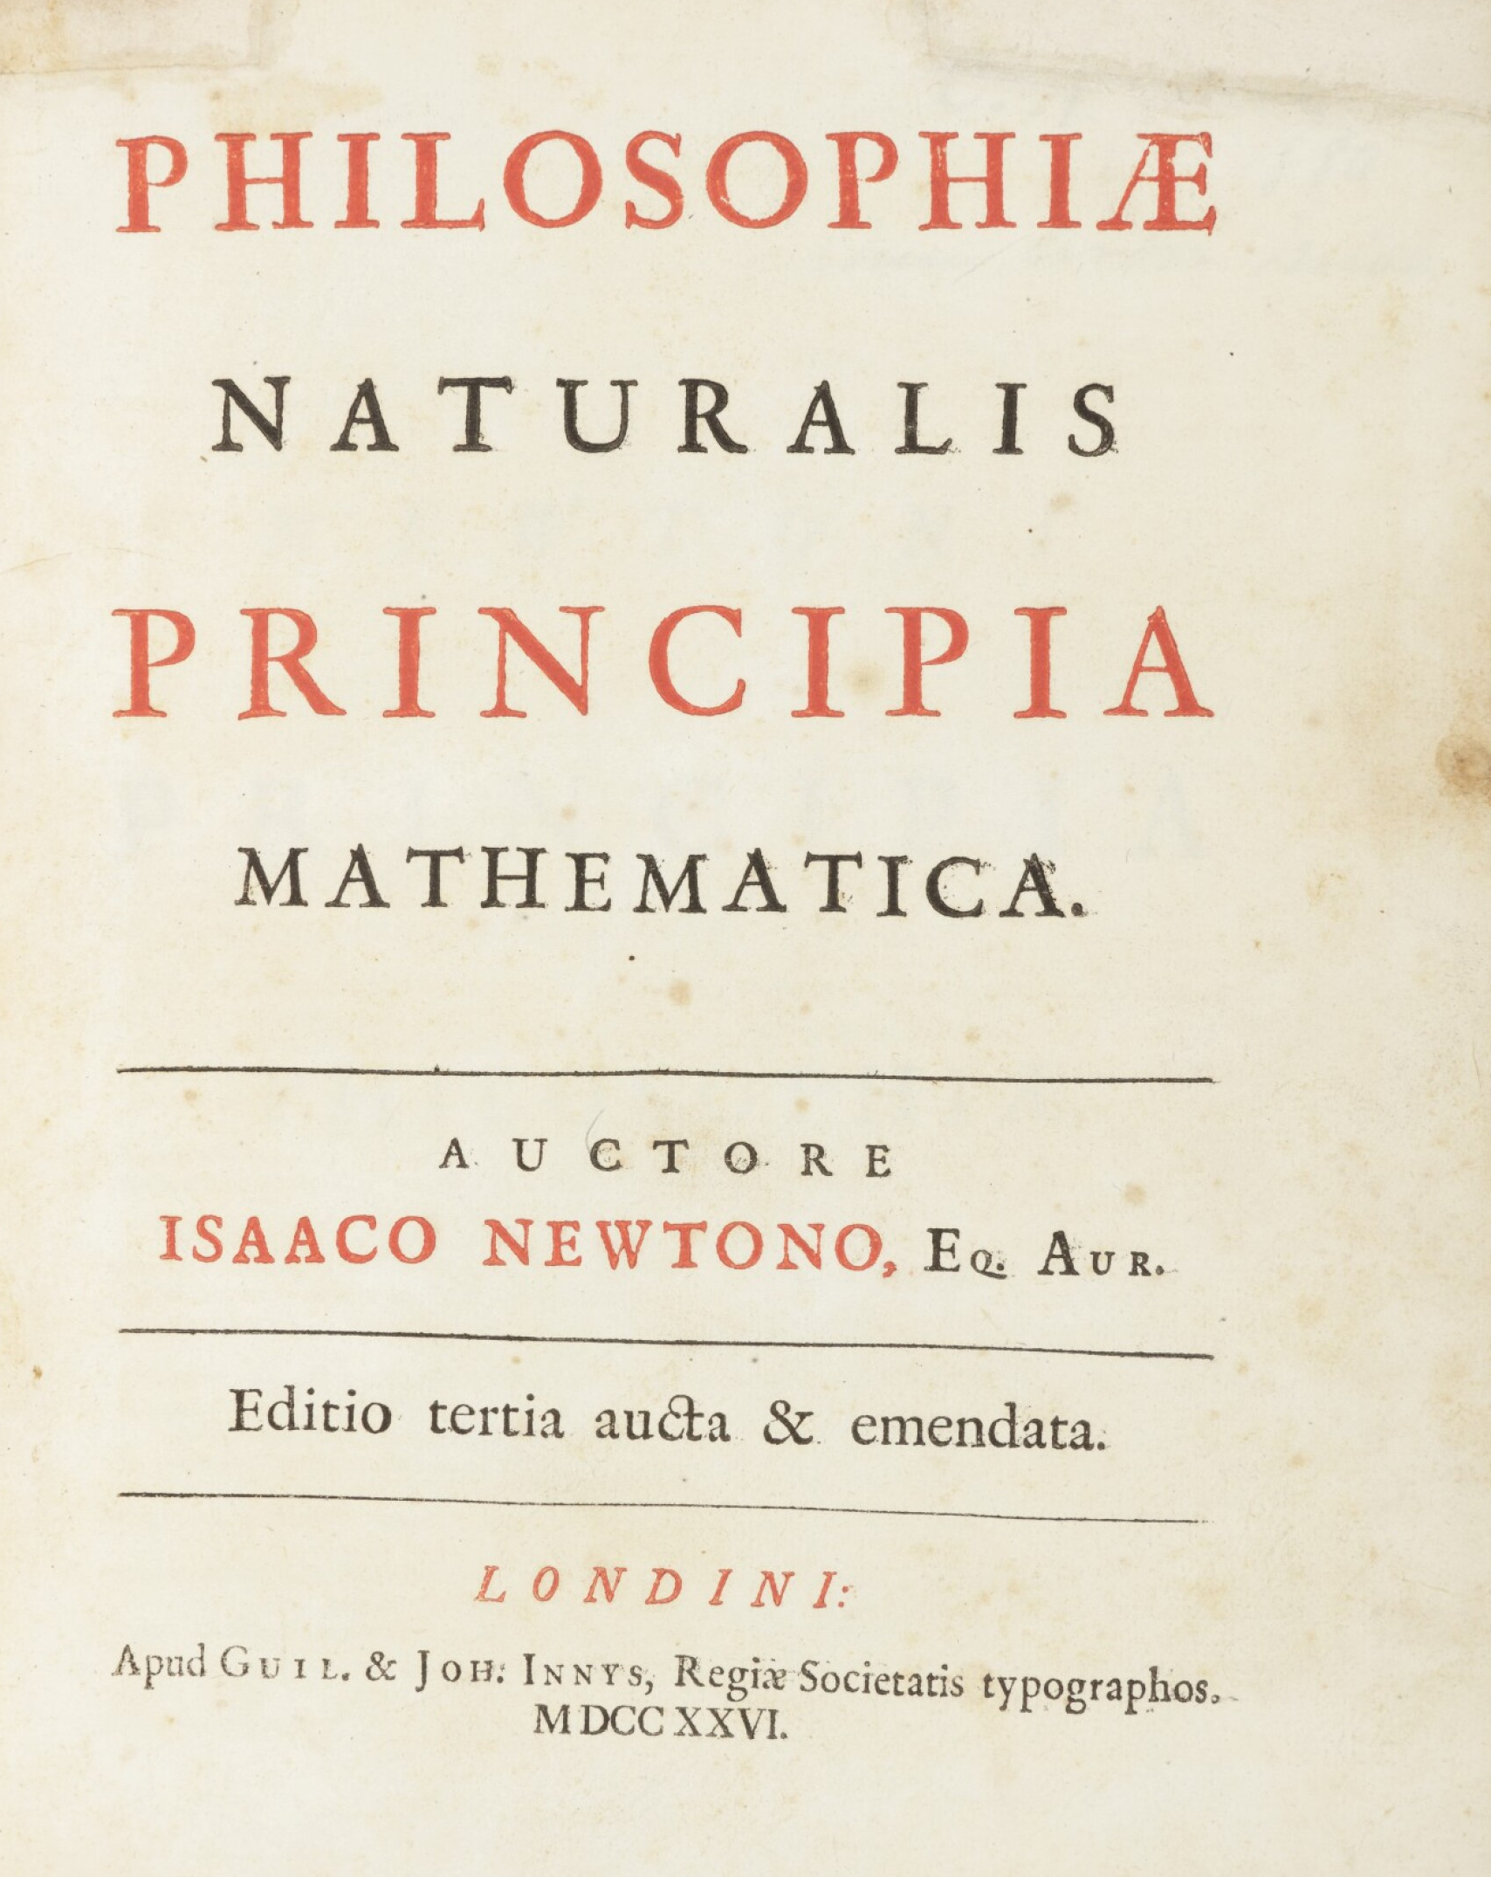

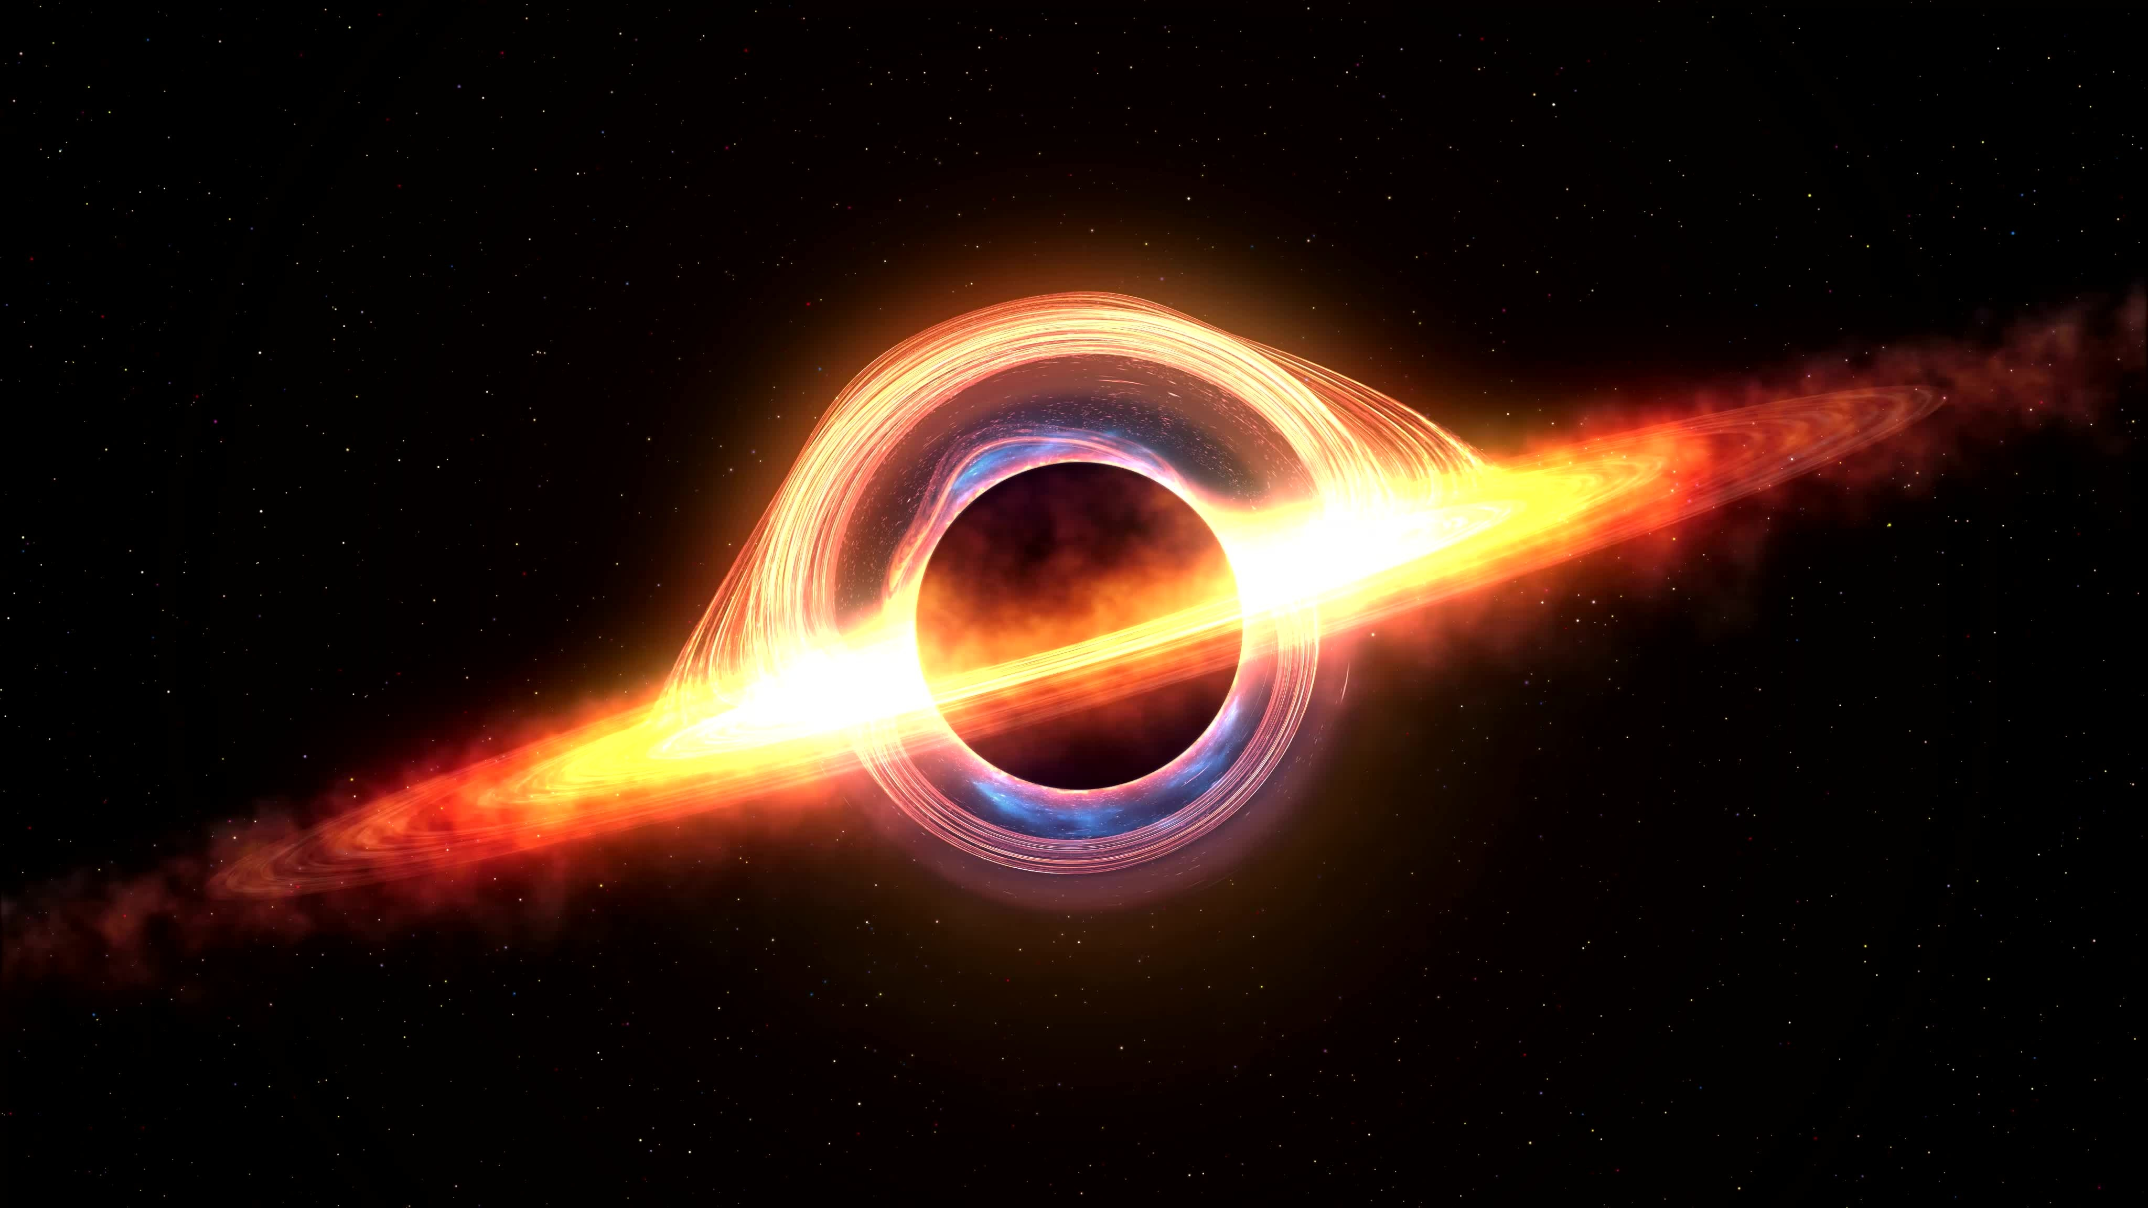
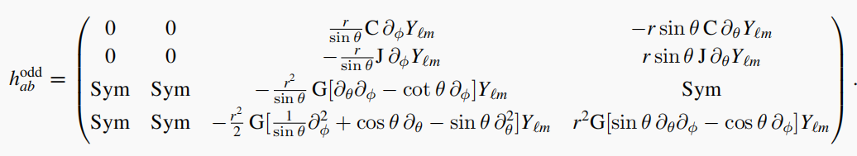
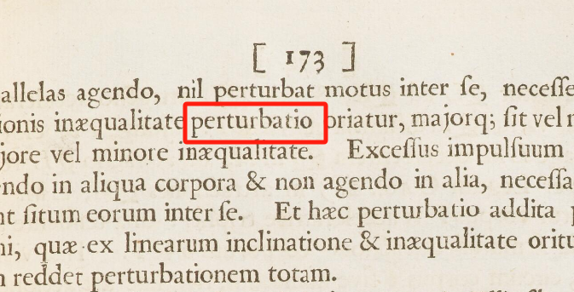
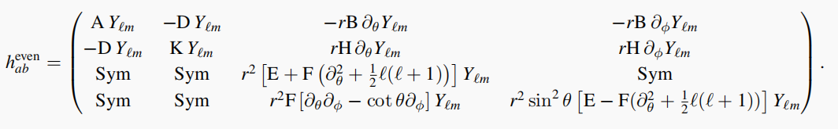
1. Gravitational perturbations
Scalar
Background BH
Electromagnetic
Gravitational
Ref.:
https://cudl.lib.cam.ac.uk/view/PR-ADV-B-00039-00001/371
Ramin G. Daghigh et al., PHYSICAL REVIEW D 103, 084031 (2021).
Vitor Cardoso and J. S. Lemos, PHYSICAL REVIEW D 64 084017 (2001).
Jonathan E Thompson et al 2017 Class. Quantum Grav. 34 174001.

Slide 3



1. Gravitational perturbations
A parametrization framework:
1st-order perturbation
Odd-parity gravitational perturbation
background
C, J, G(t,r)
$$Y_{lm}(θ,φ)$$
Even-parity gravitational perturbation
A, B, D,
H, K, E,
F(t,r)
Consider a spherically symmetric background
Ref.:
Jonathan E Thompson et al 2017 Class. Quantum Grav. 34 174001.

Slide 4
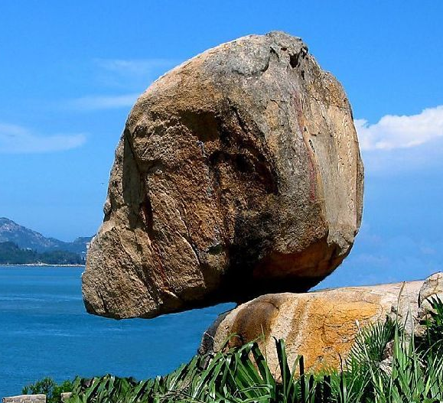

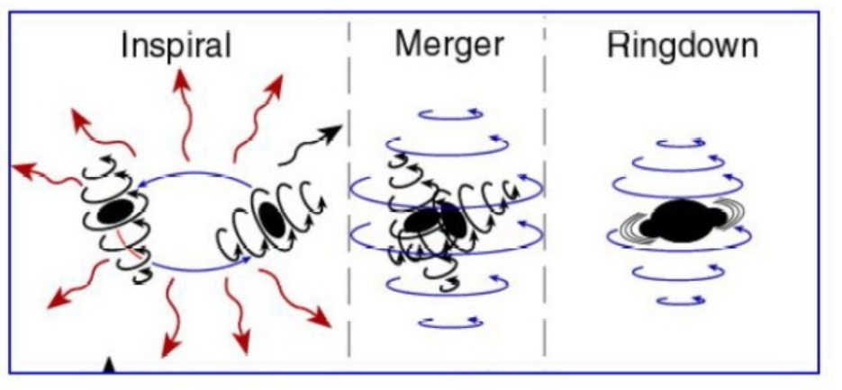
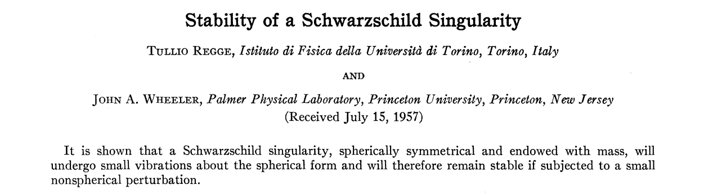
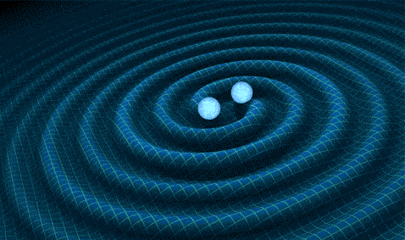
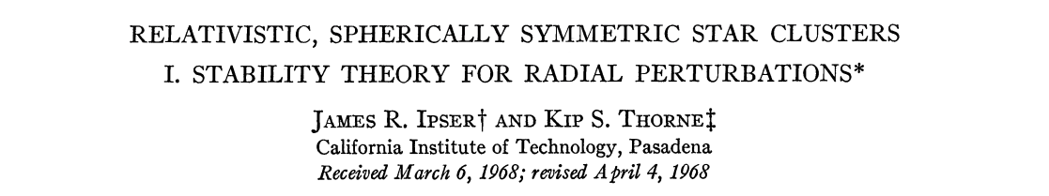
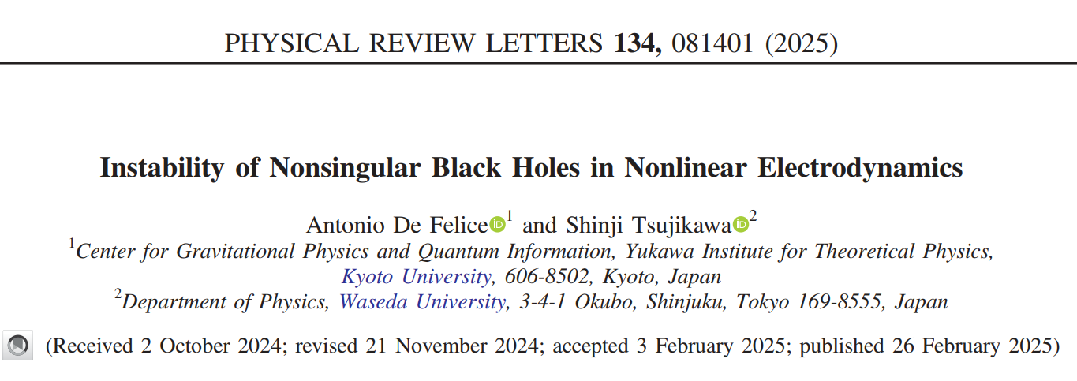
1. Gravitational perturbations
Stability analysis
Physical observable
J. Wheeler1957
K. Thorne1968
Gravitational waves
Quasi-normal mode (QNM)
A. De Felice 2025

Slide 5


1. Gravitational perturbations
A traditional routine:
Lagrangian
Field equations
Ingredients are ready
Insert perturbation terms
1st-order part
Gauge choice
Coupled PDEs
Assemble
PDEs we are able to handle
Ref.:
Jonathan E Thompson et al 2017 Class. Quantum Grav. 34 174001.

Slide 6
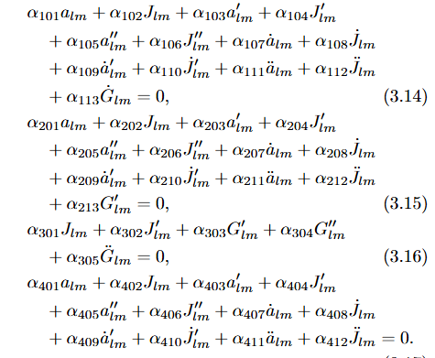
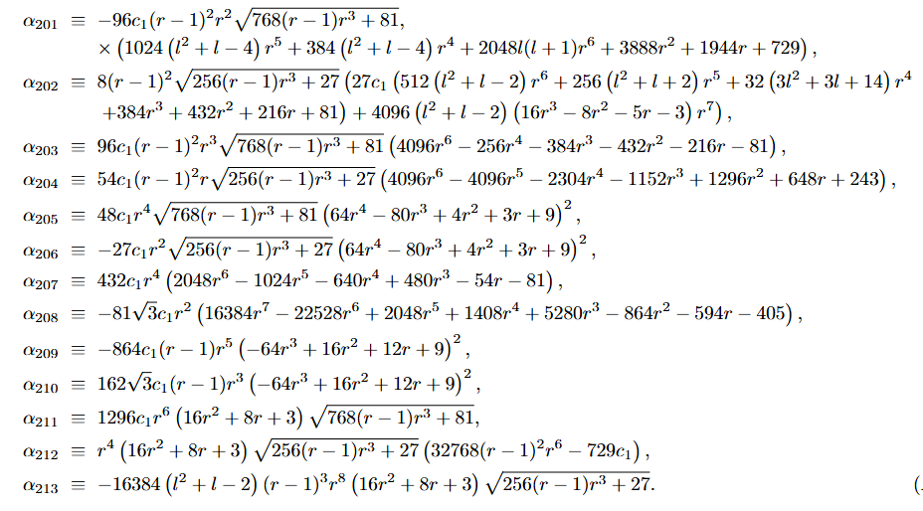

1. Gravitational perturbations
Example:
New approach?
Ref.:
Chao Zhang, Anzhong Wang and Tao Zhu, Eur. Phys. J. C (2023) 83:841. arXiv:2209.04735v3

Slide 7

2. Lagrangian analysis
Original Lagrangian
A new routine:
Lagrangian
Gravitational perturbations
Expand and pick up the 2nd-order part
Gauge choice
Simplification
Remove redundant d.o.f
Reduced Lagrangian
Reduced Lagrangian
PDEs we are able to handle
Ref.:
Chao Zhang and Ryotaro Kase, PRD 110, 044047 (2024). arXiv:2404.11910v3
Chao Zhang, Anzhong Wang and Tao Zhu, JCAP05(2023)059. arXiv:2303.08399v2
Shinji Tsujikawa, Chao Zhang, Xiang Zhao and Anzhong Wang, PRD, 064024 (2021). arXiv:2107.08061v2
Chao Zhang, Anzhong Wang and Tao Zhu, Eur. Phys. J. C (2023) 83:841. arXiv:2209.04735v3

Slide 8
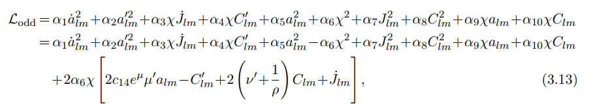
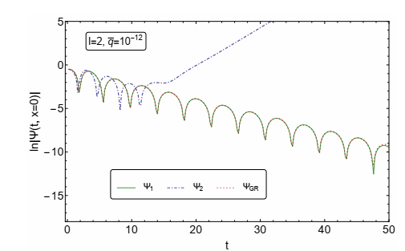
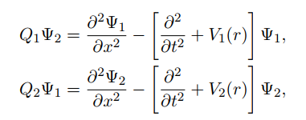
2. Lagrangian analysis
It benefits the GW calculations:
Reduced Lagrangian
New approach
Temporal evolution of GWs
Ref.:
Chao Zhang, Anzhong Wang and Tao Zhu, JCAP05(2023)059. arXiv:2303.08399v2

Slide 9
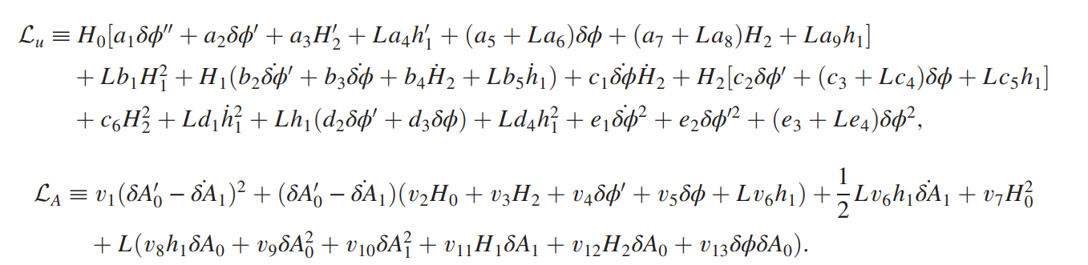

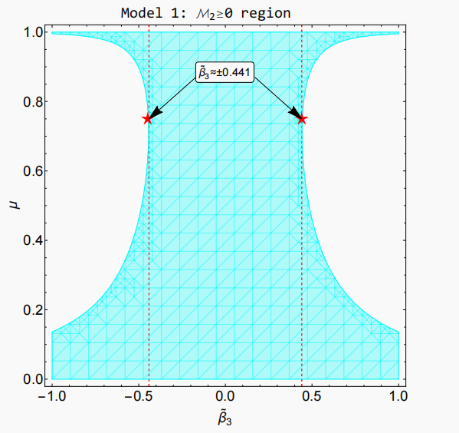
3. Application to stability analysis
It provides stability analysis:
Reduced Lagrangian
Novel constraints
New approach
Read off
Stable conditions
survive
Ref:
Chao Zhang and Ryotaro Kase, PRD 110, 044047 (2024). arXiv:2404.11910v3

Slide 10
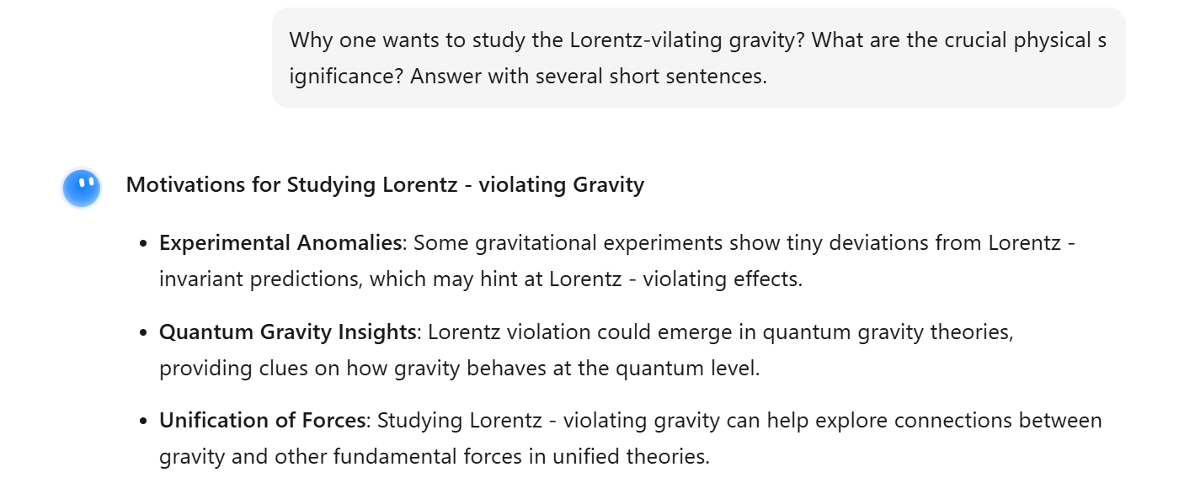

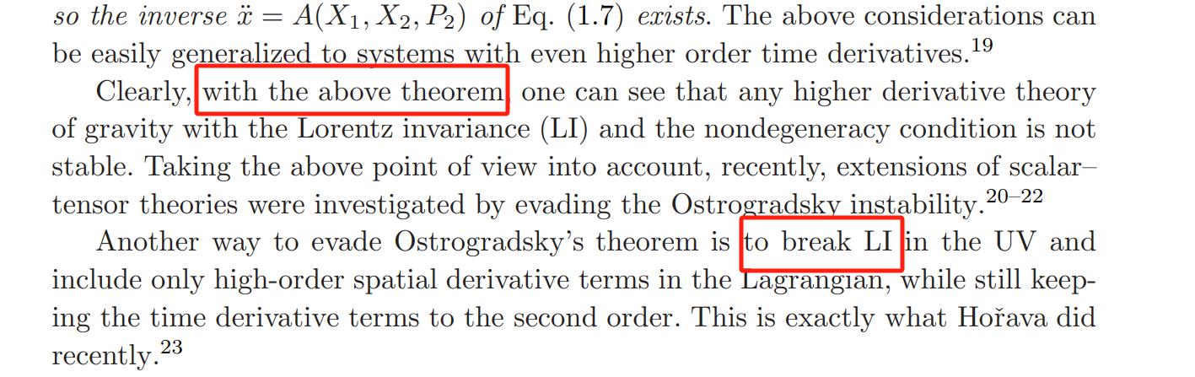
4. Application to Lorentz-violating gravity
Motivation?
Ref:
Anzhong Wang, International Journal of Modern Physics D Vol. 26 (2017) 1730014.

Slide 11
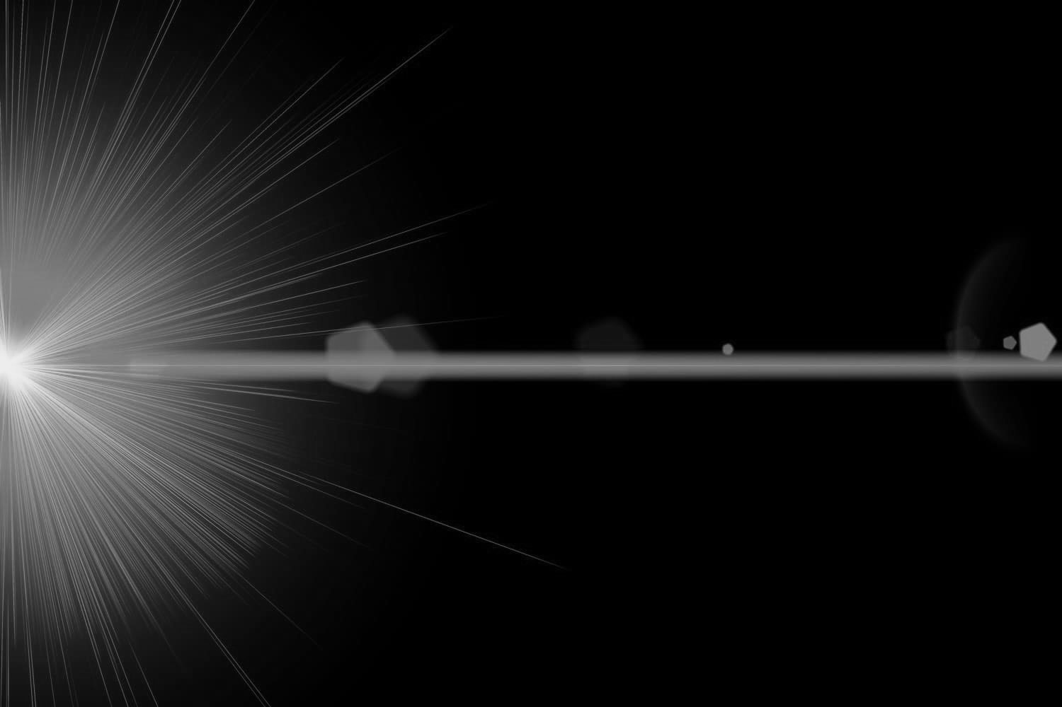
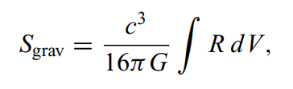
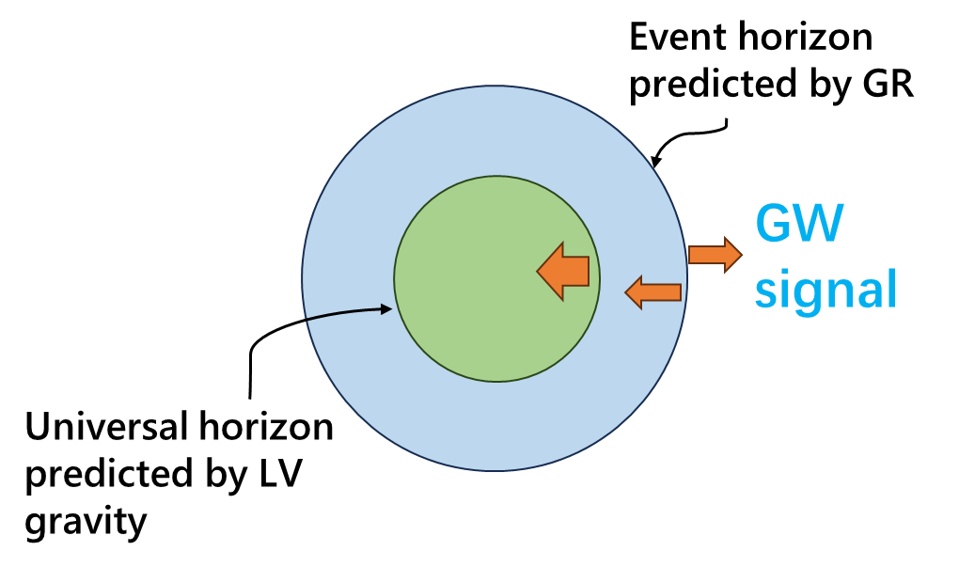
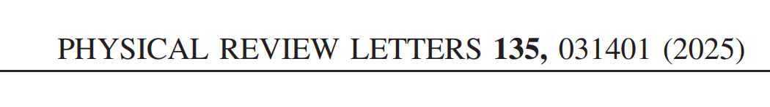

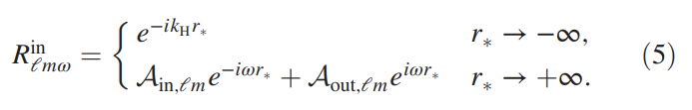



4. Application to Lorentz-violating gravity
11
Example: Æ-theory – a surviving model & its LV effects
General relativity: Gravitons with the speed of light $c$
LV gravity: $v_{additional modes}≥c$
GR:
Based on a toy model:
BH
Ref:
Chao Zhang et al., PHYSICAL REVIEW D 102, 064043 (2020). arXiv:2004.06155v4
Chao Zhang, Anzhong Wang and Tao Zhu, Eur. Phys. J. C (2023) 83:841. arXiv:2209.04735v3
Naritaka Oshita, Emanuele Berti and Vitor Cardoso, PHYSICAL REVIEW LETTERS 135, 031401 (2025).

Slide 12
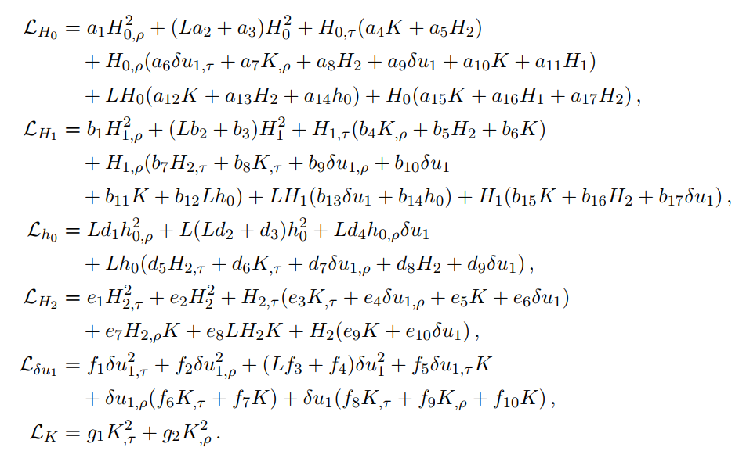
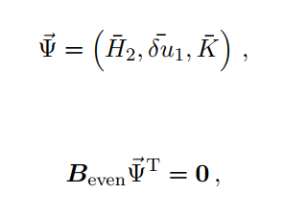
4. Application to Lorentz-violating gravity
Handle this formidable case
(under an asymptotical approximation)
New approach
d.o.f=3
Reduced Lagrangian:
The resultant constraints are consistent with those appearing in the literature.
Ref:
Antonio De Felice et al., JCAP08(2024)056. arXiv:2407.00287
Shinji Tsujikawa, Chao Zhang, Xiang Zhao and Anzhong Wang, PRD 104, 064024 (2021). arXiv:2107.08061v2

Slide 13
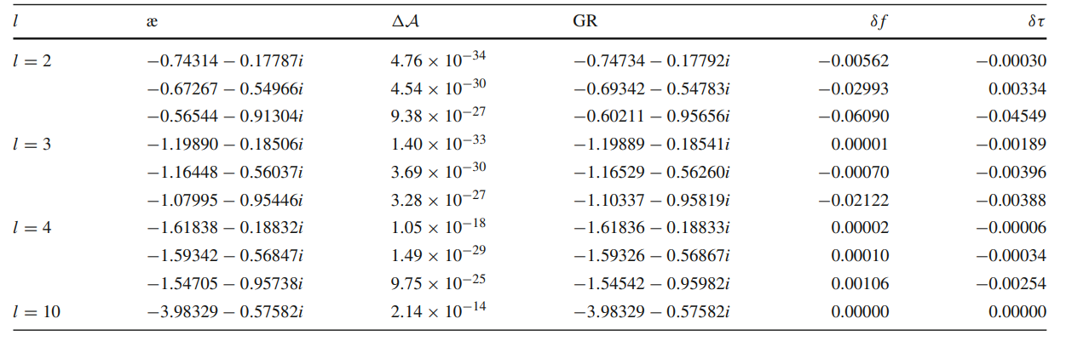
4. Application to Lorentz-violating gravity
Be aware about the observational significance
Within the detectability of the 3rd-gen. detectors.
Reflects the influence of universal horizon
Some results from the QNM calculations under the LV gravity
(with special background geometry)
Ref:
Chao Zhang, Anzhong Wang and Tao Zhu, Eur. Phys. J. C (2023) 83:841. arXiv:2209.04735v3
C.-F. Shi et al., Phys. Rev. D 100, 044036 (2019).

Slide 14

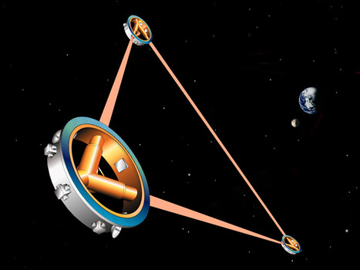
5. Summary & outlook
Lagrangian analysis method gives us an unprecedented opportunity in tackling the LV gravity.
The universal horizon has a strong potential to affect the boundary condition and GWs.
Current results have revealed a part of the observational significance of our work.

Slide 15

谢谢
Thank you

