Slide 1
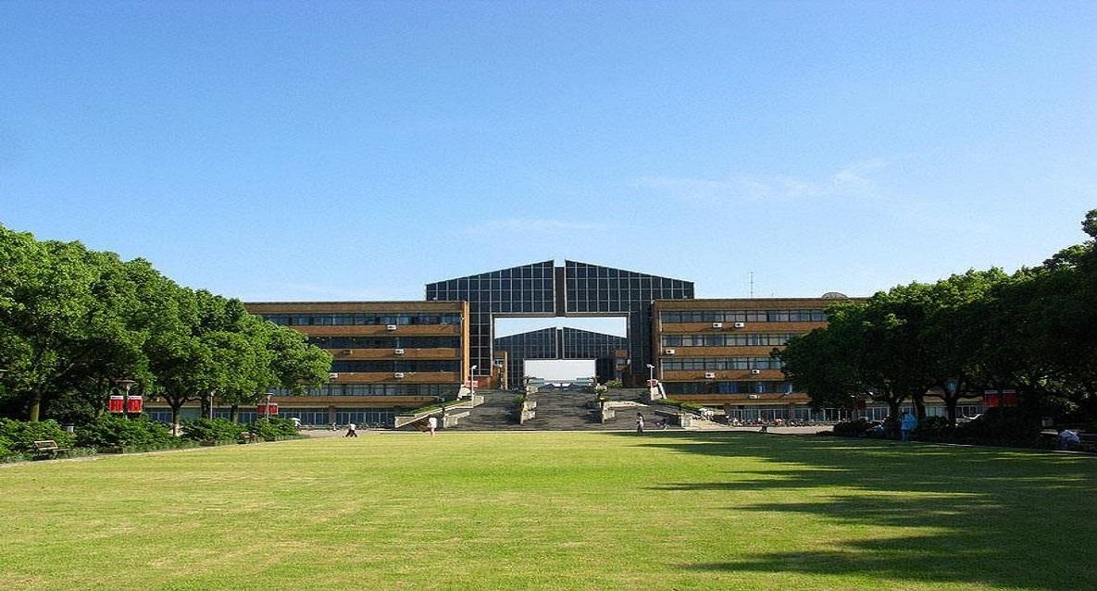
Probing Fundamental Physics with Extreme mass ratio inspirals (EMRI)
Yungui Gong
龚云贵
Ningbo University
2025 GW Physics Conference， Chun’an, 2025.10.16

Slide 2
Motivation: Physics with Extreme mass ratio inspirals (EMRIs)
Dark matter around Black holes
Neutron Star Internal Structure (Nuclear Physics)
Hairy Black holes (Modified Gravity)
Conclusion
Outline
Jiang, Dai, Gong, Liang & Zhang, JCAP 12 (22) 023; C. Zhang & Y. Gong, PRD 105 (2022) 124046; H. Guo, Y. Liu, C. Zhang, Y. Gong, W.-L. Qian, PRD 106 (2022) 024047; C. Zhang, Y. Gong, D. Liang & B. Wang, JCAP 06 (2023) 054; C. Zhang, H. Guo, Y. Gong & B. Wang, JCAP 06 (2023) 020; C. Zhang and Y. Gong, PRD 110 (2024) 104052; N. Dai, Y. Gong, T. Jiang & D. Liang, PRD 106 (2022) 064033; N. Dai, Y. Gong, Y. Zhao, T. Jiang, PRD 110 (2024) 084080; Q. Gao, N. Dai, Y. Gong, C. Zhang, C. Zhang & Y. Zhao, ApJ 978 (2025) 8; Y. Zhao, N. Dai, Y. Gong, MNRAS 543 (2025) 2326; C. Zhang etal 2505.19732.

Slide 3
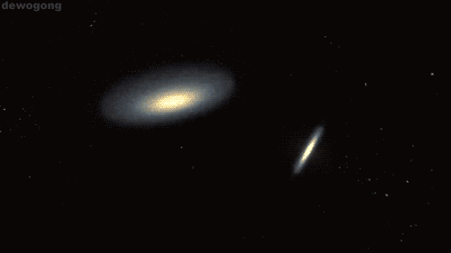
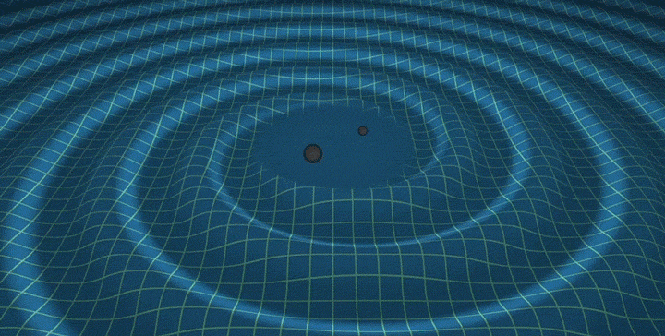


Gravitational Waves
Opens a new window to uncover the Universe
Probe the Universe by listening its sound
Test of gravity in strong field and nonlinear regimes (BHs)
The dawn of multi-messenger astronomy

Slide 4
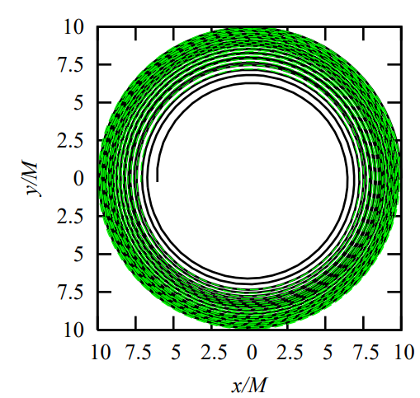
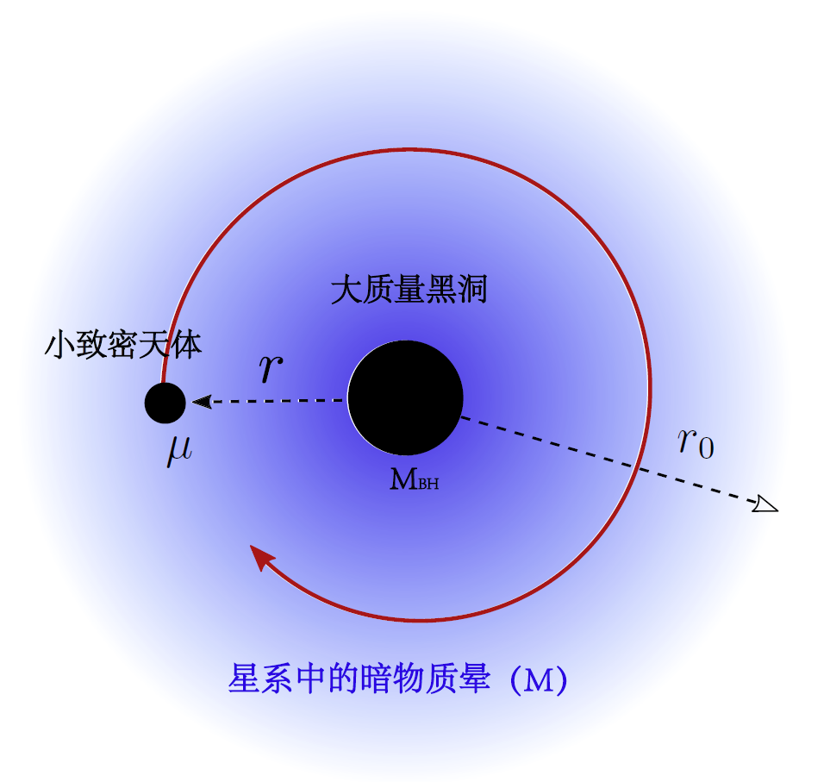
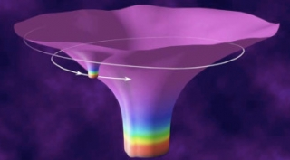
Physics with EMRIs
EMRIs
Test GR in nonlinear and strong field regimes
Probe spacetime geometry, astrophysical environments, BH population, Accretion, Bosonic clouds
Test no-hair theorem or detect extra charge
Impossible for numerical relativity
Thousands of cycles
Accurately scan the geometry and environments around BHs

Slide 5
Dark Matter (DM) around Black holes (BHs)
Hernquist-type dark matter (DM)，total mass M
Black hole (BH) spacetime: non-vacuum solution
Galaxy size
Compactness
Anisotropic matter distribution
Constant force by DM halos
Reduce to Hernquist-type
V. Cardoso etal., PRD 105, L061501 (2022)

Slide 6
BHs surrounded by DM
Spacetime with BHs surrounded by DM
(No DM)
Taylor expansion in terms of compactness
Constant force
V. Cardoso etal., PRD 105, L061501 (2022)

Slide 7
The effect of DM
Geodesics
Static and spherically symmetric spacetime
Conserved Energy and angular momentum
No precession
Retrograde precession
外部
内部
K. Destounis etal., 2210.09357

Slide 8
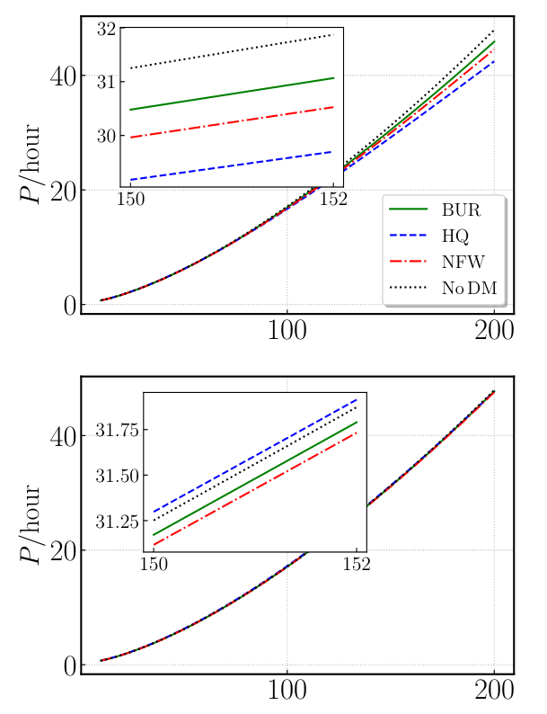
The effect of DM on orbits
Orbital period and precession
The presence of DM may slow down the increase of orbital period
Constant force
The presence of of DM halo decreases the gravitational force of central black hole (screening?), but its own mass adds gravity.
Y. Zhao, N. Dai, Y. Gong, 2410.06882

Slide 9
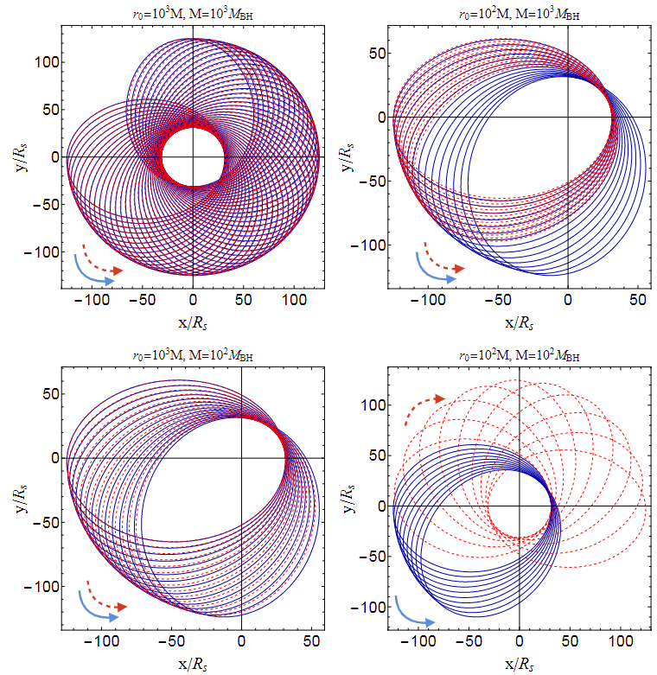
The effect of DM on orbits
Orbital Motion
Orbital angular momentum
prograde precession
Red：With DM environment
Blue：No Dm
Retrograde precession
If the density of DM environment is large enough, then retrograde precession appears
N. Dai, Y. Gong, Y. Zhao, T. Jiang, PRD 110 (24) 084080; Y. Zhao, N. Dai, Y. Gong, 2410.06882

Slide 10
Spacetime of BHs around by DM halos
General profiles
Model 1:
Z. Shen, A. Wang, Y. Gong, S. Yin, PLB 855 (2024) 138797

Slide 11
DM Halos
Profiles of DM halos
Burke model: dwarf galaxies
Navarro-Frenk-White (NFW) model: galaxies with high DM content
Hernquist model: bulges and elliptical galaxies
Taylor-Silk model: lightest neutralino
A. Burkert, ApJL 447, L25 (1995); J. F. Navarro, C. S. Frenk, and S. D. M. White, MNRAS 275, 720 (1995); L. Hernquist, ApJ 356, 359 (1990); J. E. Taylor and J. Silk, MNRAS 339, 505 (2003).

Slide 12
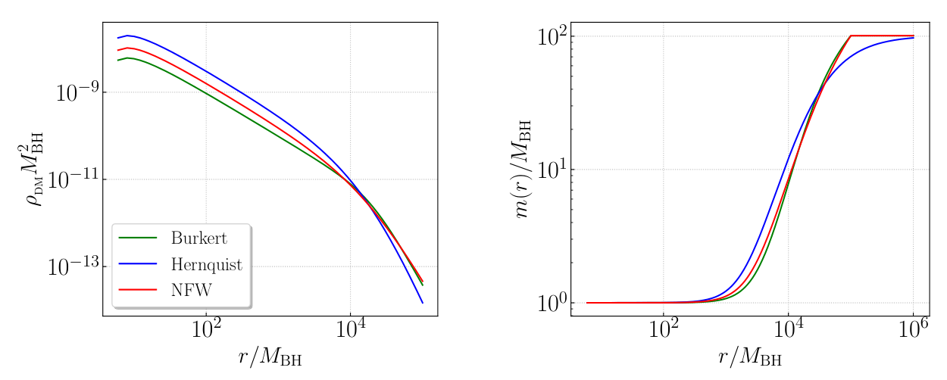
Profiles of DM halos
Mass of density profiles
Y. Zhao, N. Dai, Y. Gong, 2410.06882

Slide 13
Approximate analytical formulas
Newtonian like potential
Constant force
Y. Zhao, N. Dai, Y. Gong, 2410.06882

Slide 14
Approximate analytical formulas
Effective potential
Y. Zhao, N. Dai, Y. Gong, 2410.06882

Slide 15

Orbital Motion
Dynamical Friction
The effect is bigger at larger orbital distance
Wake
Notes:
Dynamical friction is the gravitational drag induced by the constituents of a dense medium in which a massive object moves. The object, a cluster or a satellite galaxy for instance, attracts constituents of the medium, like stars, gas or dark matter, toward its position. However, because of its motion, the medium accumulates behind the cluster (i.e. at the position it occupied moments earlier). Such accumulation constitutes an overdensity in the medium of which gravitational force on the cluster drags it against its motion and thus slows it down (Chandrasekhar, 1943).

Slide 16
Orbital motion
Bondi-Hoyle Accretion
Energy and Angular Momentum Conservation

Slide 17






Gravitational radiation reaction
Gravitational radiation reaction
Closer to the central BH, fluxes become larger

Slide 18
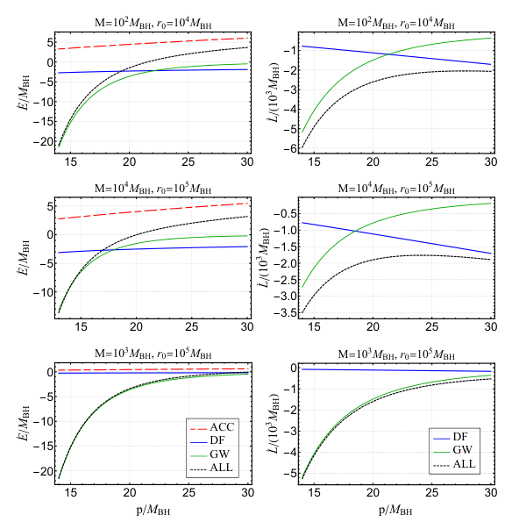
The energy and angular momentum fluxes
Energy fluxes of accretion are positive
Close to the central BH, energy fluxes of GW reaction dominate
Energy fluxes of dynamical friction dominate
Angular momentum fluxes of GW reaction dominate over DF
Angular momentum fluxes of DF dominate over GW reaction
The effects of DF and accretion are mainly related to the DM density
N. Dai, Y. Gong, Y. Zhao, T. Jiang, PRD 110 (24) 084080

Slide 19
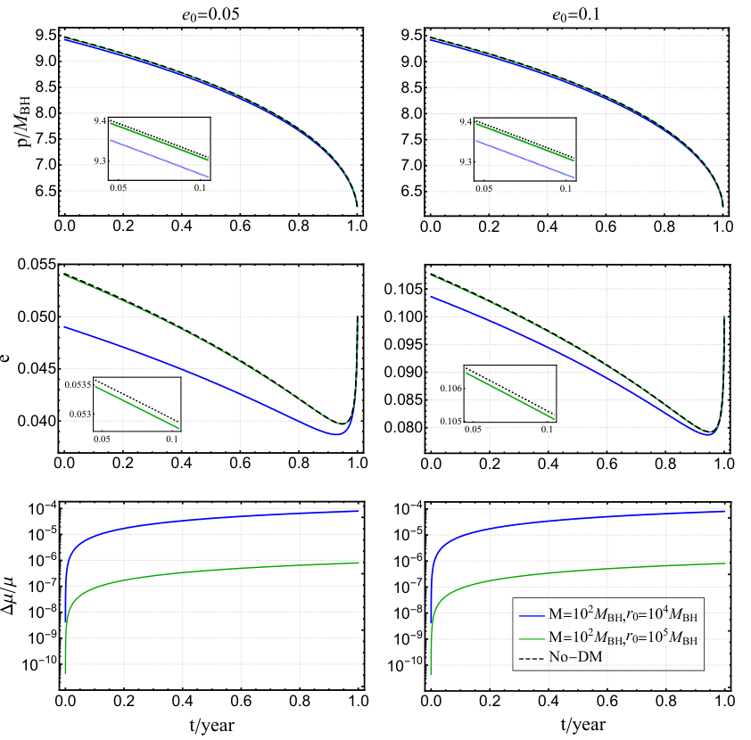
The net effect of DM halos
The presence of DM halos slows down the orbital motion
The presence of DM halos slows down the decrease rate of the eccentricity
Around , the orbital eccentricity of EMRIs increases sharply, which is a significant feature of eccentric EMRIs
In the one-year evolution, the mass of the small BH increases very little and the mass increases less with smaller
N. Dai, Y. Gong, Y. Zhao, T. Jiang, PRD 110 (24) 084080

Slide 20
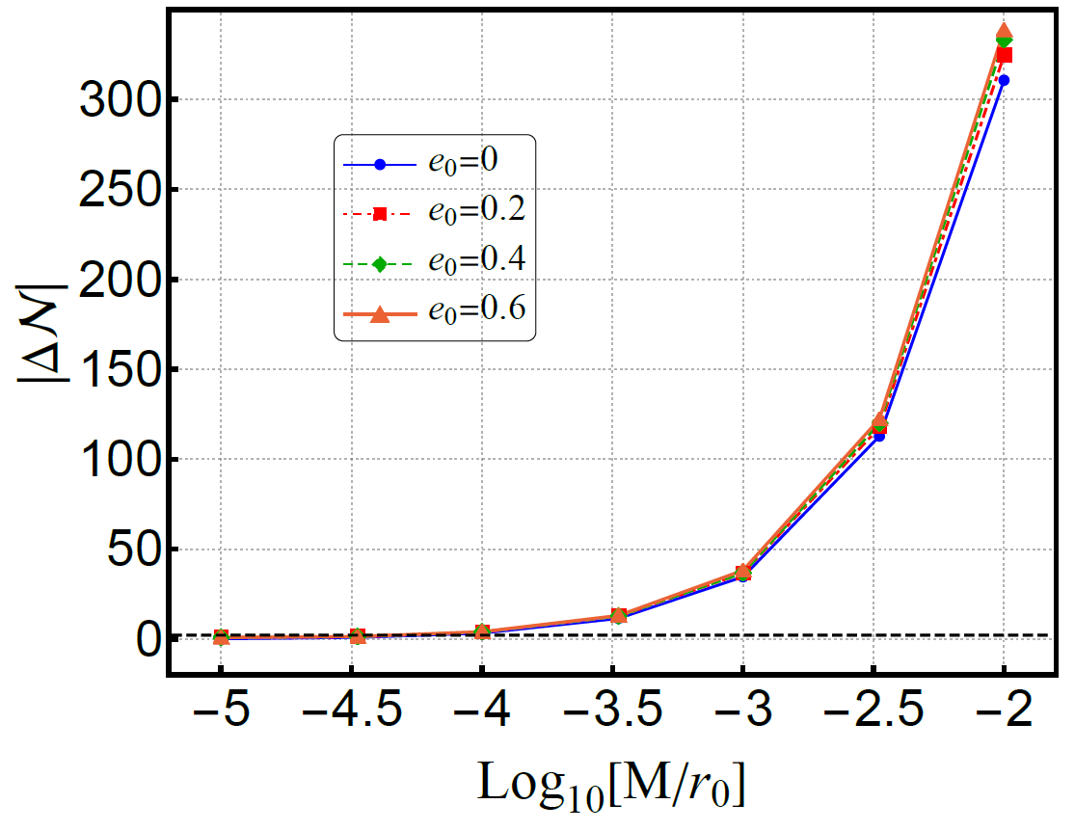
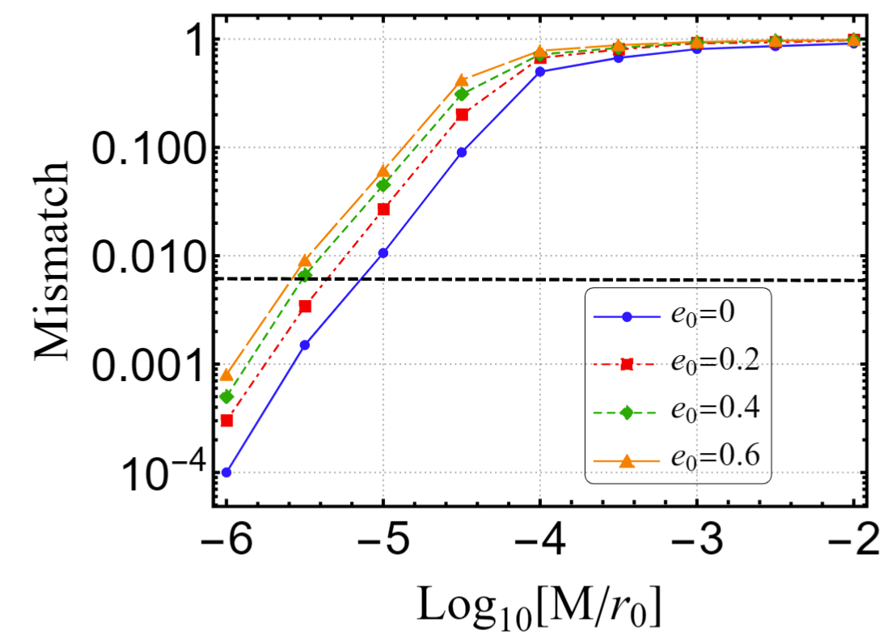
The constraints on DM with EMRIs
The constraints on the compactness
The difference between the orbital cycles with and without DM halos over one-year evolution before the merger for different compactness of halos
The results of the mismatch between GW waveforms with and without DM halos for different compactness
N. Dai, Y. Gong, Y. Zhao, T. Jiang, PRD 110 (24) 084080

Slide 21
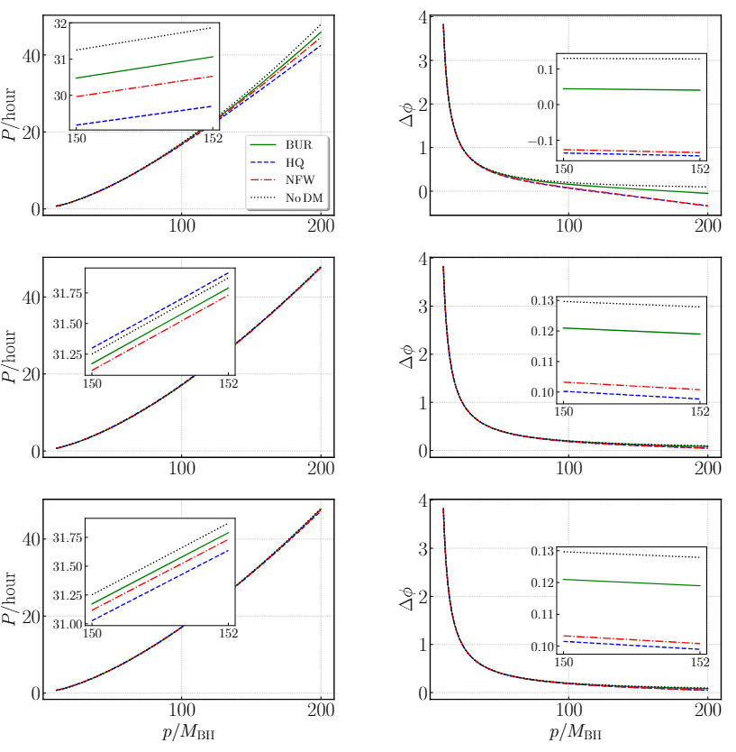
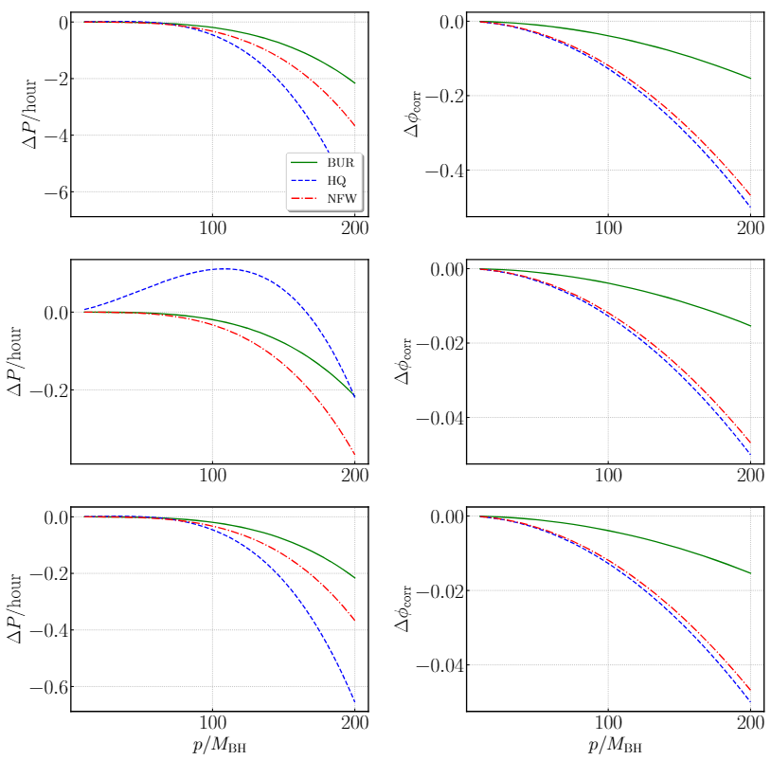
Orbital Period and Precession (no decay)
Y. Zhao, N. Dai, Y. Gong, MNRAS 543 (2025) 2326

Slide 22
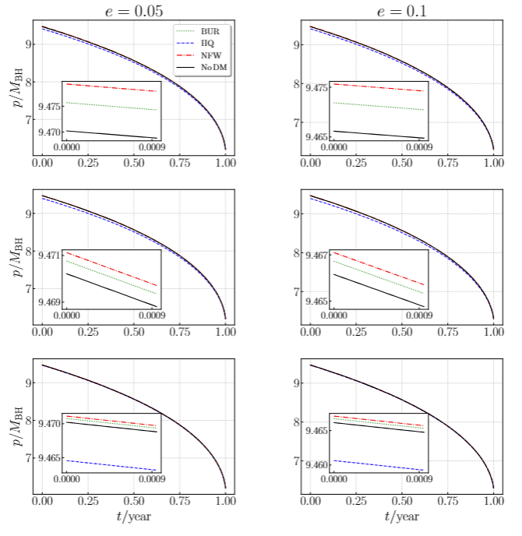
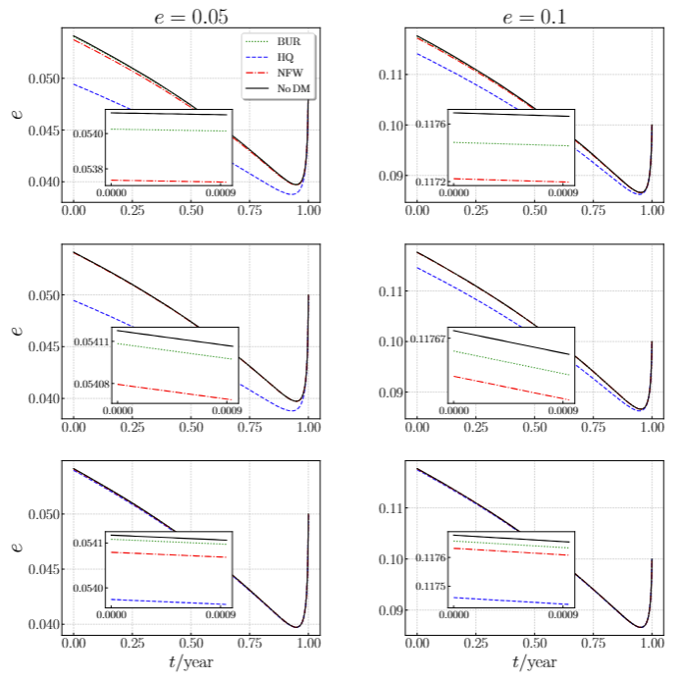
The distinction between different DM halos
Orbital evolution

Slide 23
Orbital evolution with different DM halos
The evolution of EMRIs within Hernquist-type DM halos significantly affects the semi-latus rectum and eccentricity, while the Burkert density distribution has the least influence.
EMRIs embedded in Hernquist-type DM halos evolve more slowly compared to those without DM halos,whereas EMRIs in Burkert-type and NFW-type halos evolve more rapidly.
The presence of DM halos reduces the rate of eccentricity decrease for EMRIs across all three types of DM halos.
With the same compactness, larger values of lead to greater differences in the evolution of the semi-latus rectum and eccentricity across the three DM halo models.
Higher compactness and density distribution of DM halos lead to larger variations in the evolution of both the semi-latus rectum and eccentricity.

Slide 24
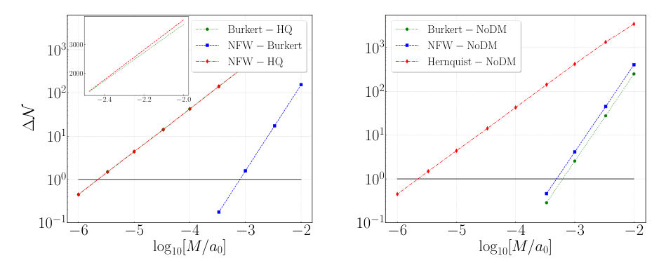
The distinction between different DM halos
Number of cycles
Y. Zhao, N. Dai, Y. Gong, MNRAS 543 (2025) 2326

Slide 25
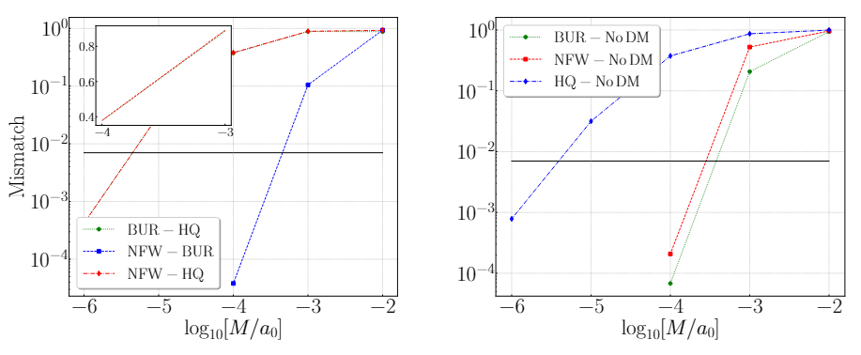
The distinction between different DM halos
Mismatch (LISA)
Y. Zhao, N. Dai, Y. Gong, MNRAS 543 (2025) 2326

Slide 26
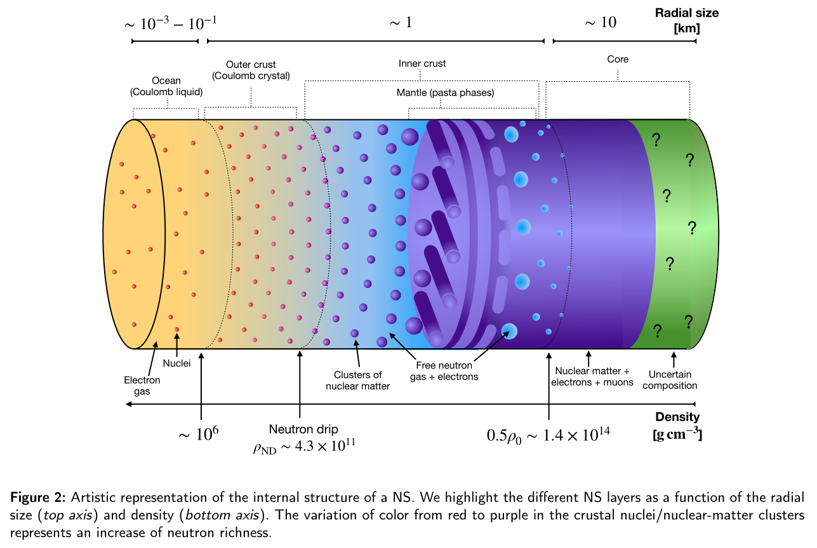
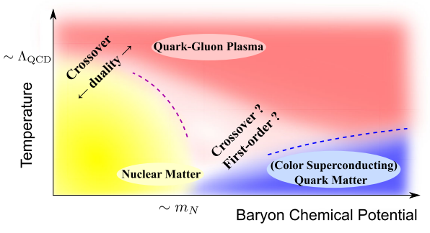
Primordial BHs (PBHs) captured by Neutron Stars
Neutron Stars (NSs): 1.4 Solar mass, 12 km
Gaseous Environment
Iron
Nuclear Saturation density: start of core
S. Ascenzi, V. Graber & N. Rea, 2401.14930, Astropart.Phys. 158 (2024) 102935

Slide 27
EMRIs with NS and PBH
Massive NSs
The constraints on NSs: mass, radius, Moment of Inertia, Tidal deformability
PBHs inside NSs (Accretion, Dynamical Friction)
Y. Fujimoto, K. Fukushima, K. Hotokezaka & K. Kyutoku, PRL 130 (2023) 091404; P. Demorest, T. Pennucci, S. Ransom, M. Roberts & J. Hessels, Nature. 467, 1081 (2010);
E. Fonseca et al., ApJL 915, L12 (2021); J. Antoniadis et al., Science. 340, 6131 (2013).
PSR J1614-2230:
PSR J0740+6620:
PSR J0348+0432:
Concept of probing NS internal structure
C. Kouvaris & P. Tinyakov, PRD 90, 043512 (2014); W.E. East & L. Lehner, PRD.100, 124026 (2019); Y. G´enolini, P. Serpico & P. Tinyakov, PRD 102, 083004 (2020); C.J. Horowitz & S. Reddy, PRL 122, 071102 (2019); Z.-C. Zou & Y.-F. Huang, ApJL 928, L13 (2022); T.W. Baumgarte, S.L. Shapiro, 2402.01838.

Slide 28
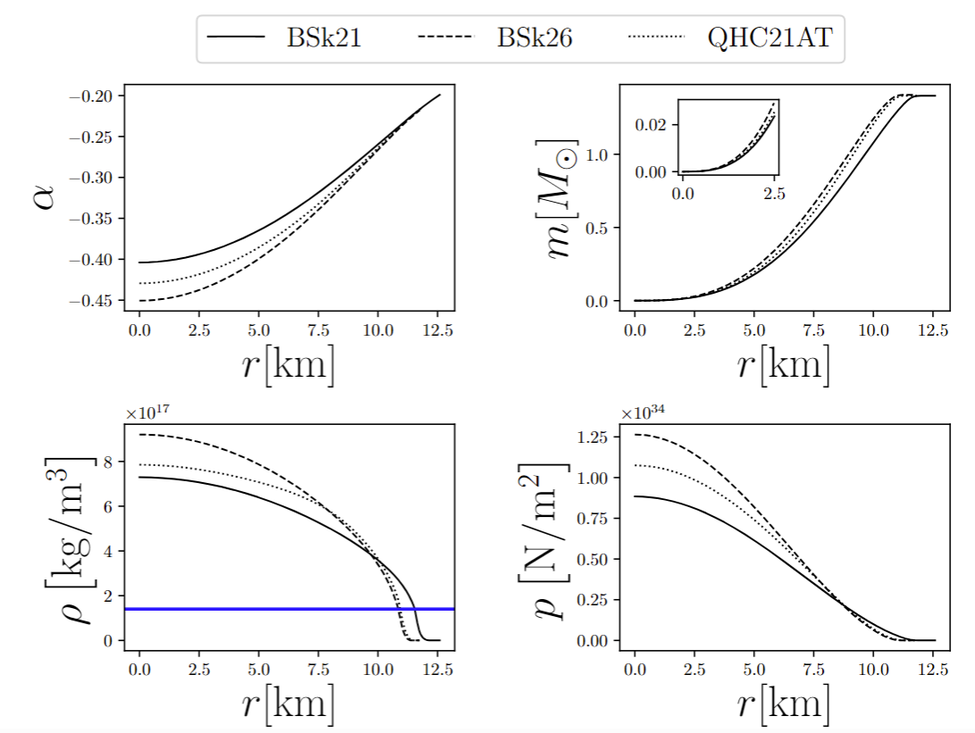
NS internal geometry of
Static and Spherically symmetric spacetime
Einstein equations
Tolman-Oppenheimer-Volkoff equation
Mass function
The density and pressure near the NS surface are much smaller than those inside the NS, so the mass contributions from the surface shell to the total mass are negligible and the mass keeps to be a constant as r decreases

Slide 29
The orbits inside NS
Background geometry
Orbits inside NSs
Dynamical Friction
Bondi–Hoyle–Lyttleton Accretion
Gravitational radiation
The transitions from the inner crust to the core are at
km for the EoS models BSk21, BSk26, and QHC21AT,respectively
The variation of orbital energy
Q. Gao, N. Dai, Y. Gong, C. Zhang, C. Zhang & Y. Zhao, ApJ 978 (2025) 8

Slide 30
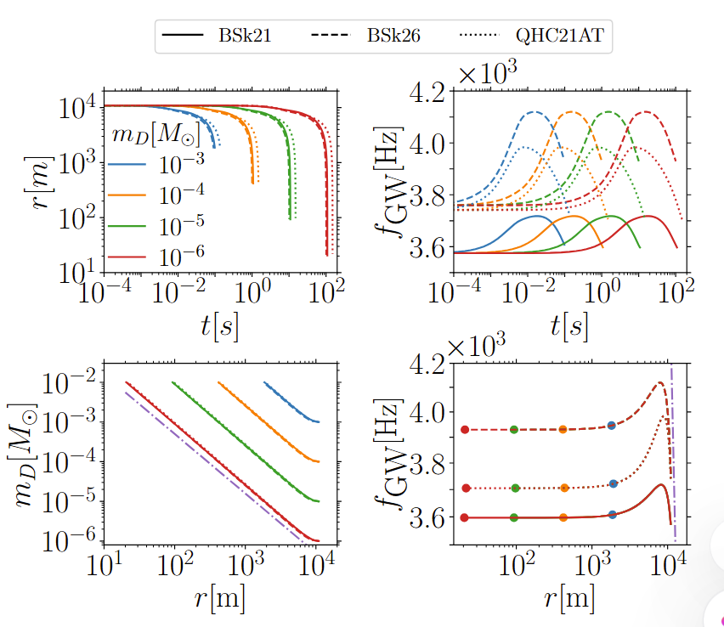
The motion inside NSs
The orbital energy
Q. Gao, N. Dai, Y. Gong, C. Zhang, C. Zhang & Y. Zhao, ApJ 978 (2025) 8

Slide 31
GWs from PBHs inside NS
Orbital Evolution
Outside the NS core, the mass function is almost a constant, so initially the GW frequency increases as r decreases.
As the PBH inspirals deeper inside the NS core, the mass decreases as , so the GW frequency decreases slowly to a constant as r decreases.
The frequency reaches the maximum at km for the three EoS models
Near the surface
Since PBHs follow a geodesic path during each revolution under the adiabatic approximation, the orbital frequency is solely determined by the geodesic motion in the interior metric of NSs once PBHs in the EMRIs can be taken as point particles, so the orbital frequency is independent of the mass of PBHs and the same f-r trajectory follows.
The unique characteristics of GW frequency serve as the smoking gun of GW signals emitted by PBHs inspiralling inside NSs, GW signals can be used to probe the internal NS structure and nuclear matter in the crust and core of NSs.

Slide 32
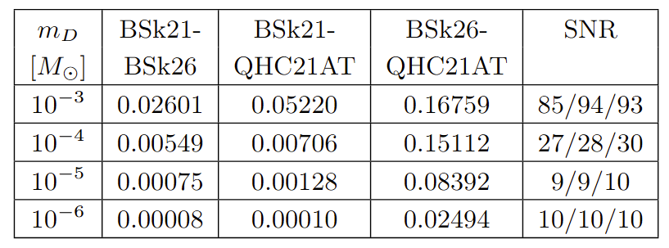
Probing NS internal structure and EoS
Faithfulness between GWs with ET
Einstein Telescope can distinguish the EoS of NSs by detecting GWs from PBHs inspiralling inside NSs within the Galaxy
The unique characteristics of GW frequency can be used to probe the NS internal structure, NS population and physics under extreme conditions.
Q. Gao, N. Dai, Y. Gong, C. Zhang, C. Zhang & Y. Zhao, ApJ 978 (2025) 8

Slide 33
Hairy Black Holes
Scalarization (modified gravity with extra fundamental fields)
The more massive a black hole is, the more weakly charged it is
scalar charge, not Noether charge
B. Kleihaus, J. Kunz & E. Radu, PRL 106, 151104 (2011); C. A. R. Herdeiro & E. Radu, PRL 112, 221101 (2014). T. P. Sotiriou & S.-Y. Zhou, PRL 112, 251102 (2014); H. O. Silva etal, PRL 120, 131104 (2018); D. D. Doneva & S. S. Yazadjiev, PRL 120, 131103 (2018); G. Antoniou, A. Bakopoulos &P. Kanti, PRL 120, 131102 (2018);

Slide 34
Vector charge
Vector field coupled to gravity

Slide 35

Scalar and Vector charges
Dipolar radiation
Post-Newtonian expansion (spin of central Kerr BH: a)
Weak field region
C. Zhang and Y. Gong, PRD 110 (2024) 104052

Slide 36
Energy fluxes by scalar and vector charges
Numerical results (circular orbits)
N. Warburton and L. Barack, Self force on a scalar charge in Kerr spacetime: Circular equatorial orbits, Phys. Rev. D 81, 084039 (2010)
C. Zhang and Y. Gong, PRD 110 (2024) 104052

Slide 37
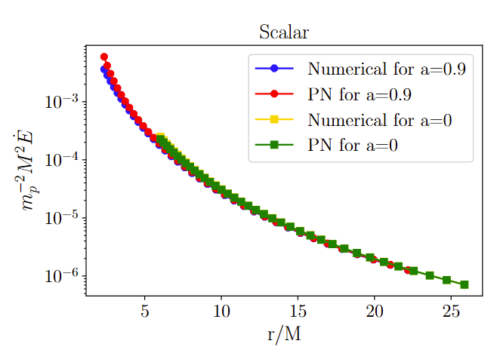
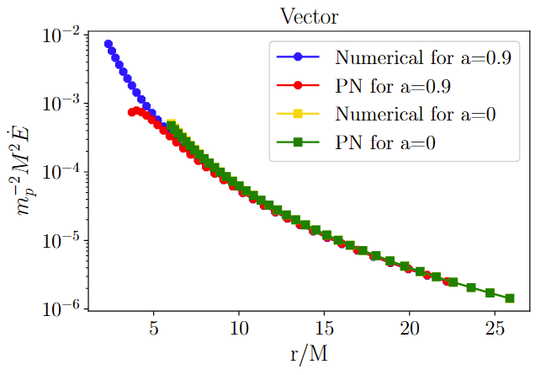
Energy fluxes by scalar and vector charges
Numerical results (circular orbits)
C. Zhang and Y. Gong, PRD 110 (2024) 104052

Slide 38
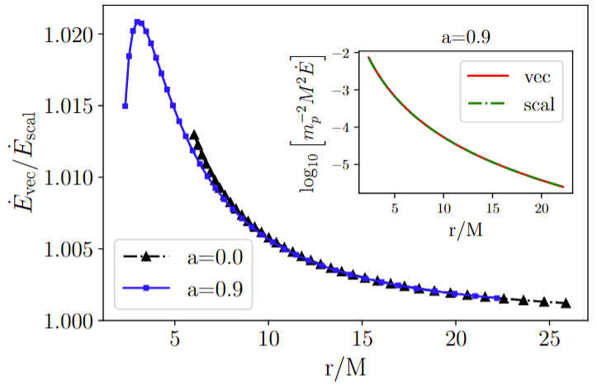
Energy fluxes by scalar and vector charges
Numerical results (circular orbits)
C. Zhang and Y. Gong, PRD 110 (2024) 104052

Slide 39
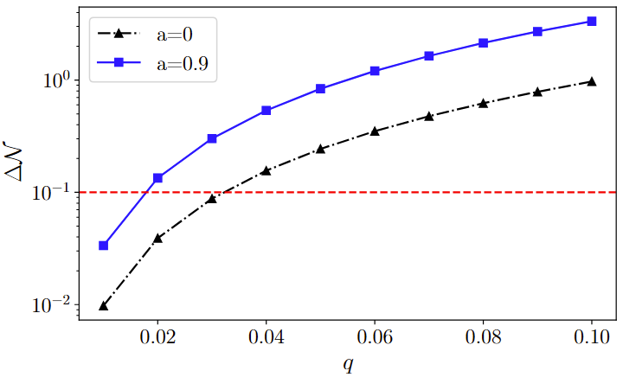
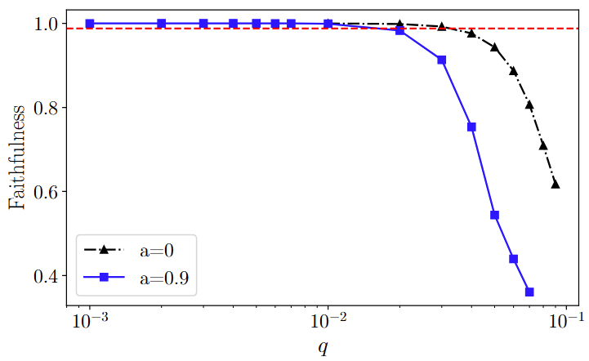
The distinction between vector and scalar charges
Number of cycles and Faithfulness (LISA one year)
C. Zhang and Y. Gong, PRD 110 (2024) 104052

Slide 40
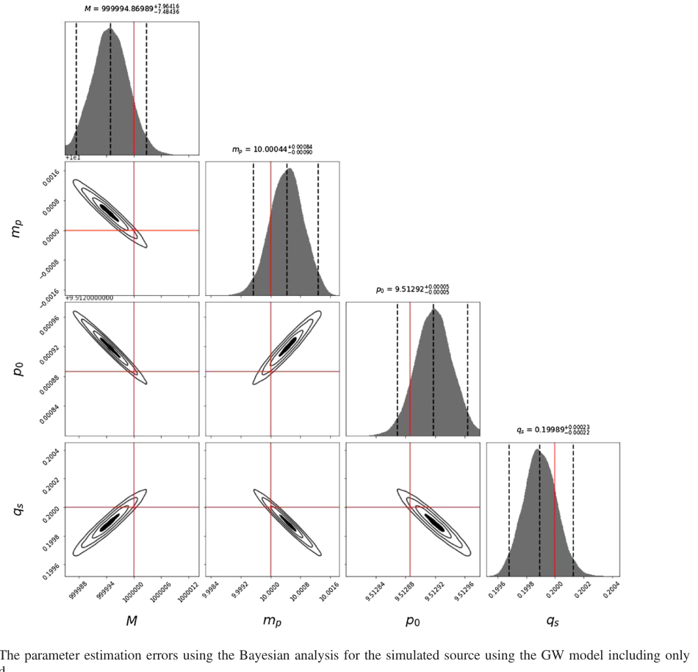
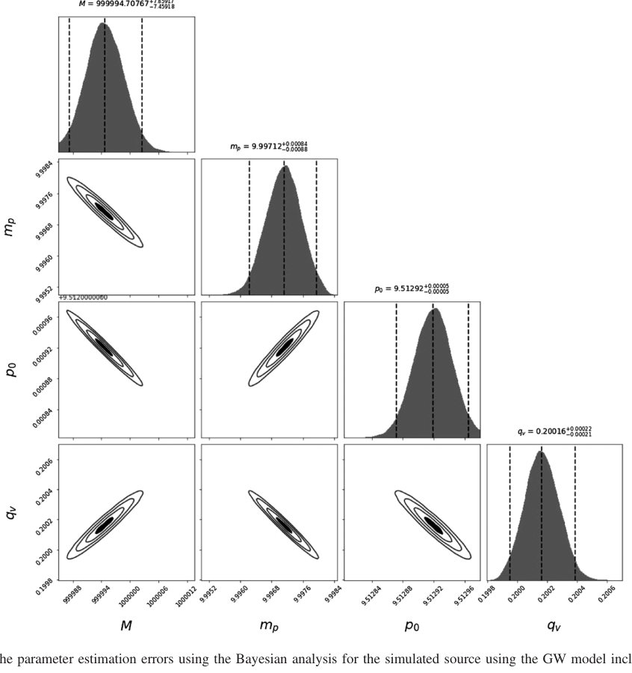
The distinction between vector and scalar charges

Slide 41
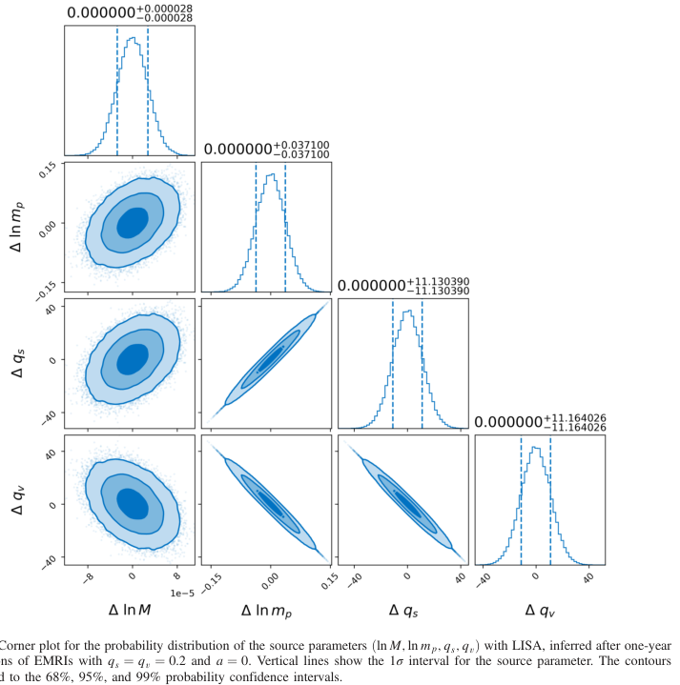
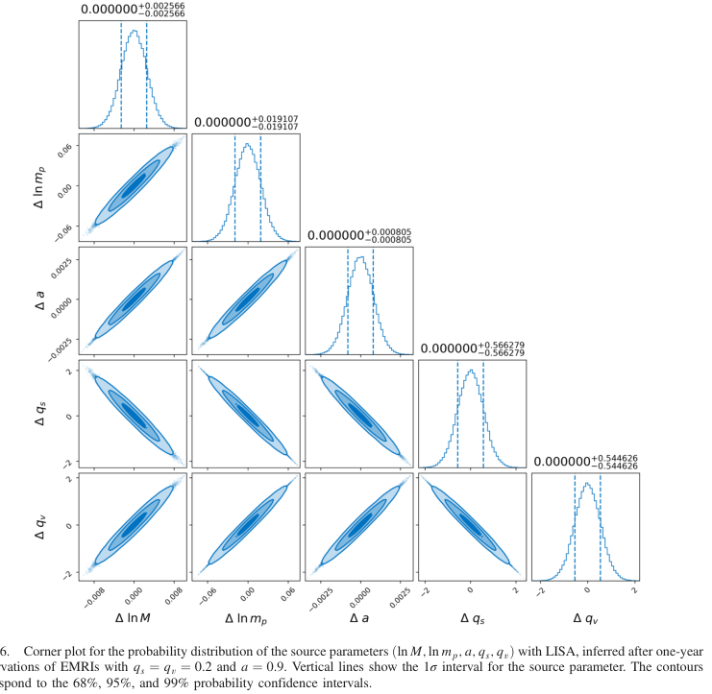
The distinction between vector and scalar charges
FIM (LISA one year)
C. Zhang and Y. Gong, PRD 110 (2024) 104052

Slide 42
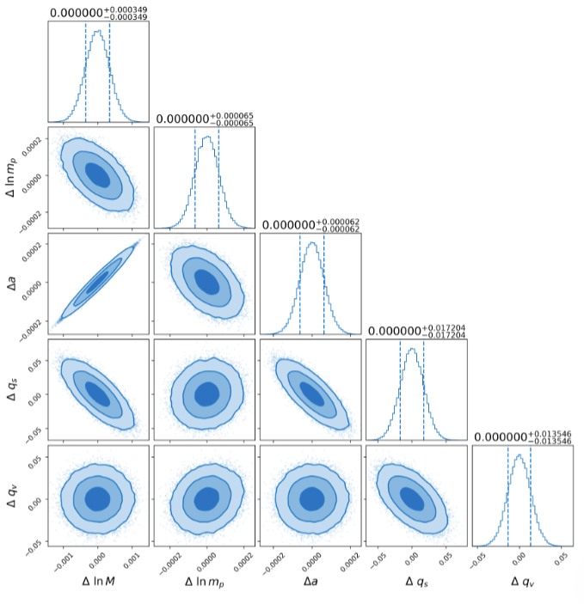
The distinction between vector and scalar charges
Including extra polarizations can break the correlations between the scalar field and vector field.
SNR=150
C. Zhang and Y. Gong, PRD 110 (2024) 104052

Slide 43
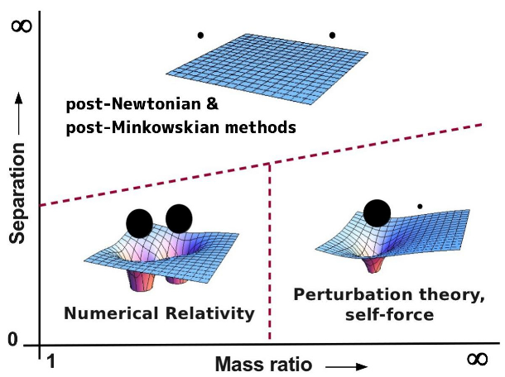
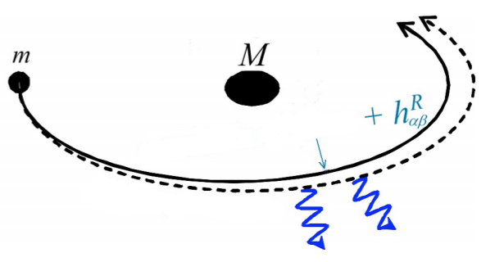
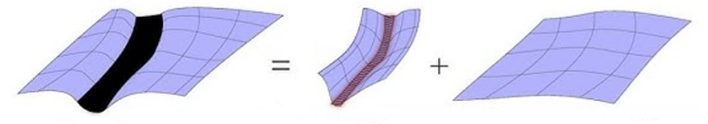
Discussions: Self-force method
The necessary of Self-force method
Effective source
测地线
Geodesics
测地线
Barack & Pound, Rep. Prog. Phys. 82 (2019) 016904
总度规
Total metric
自场
有效度规
Self field
Effective metric

Slide 44
Conclusion
EMRIs carry rich physics information
EMRIs can be used to probe the DM environment around astrophysical BHs, provide the information and constraints on the property of DM like the compactness of DM halos
PBHs inspiral inside NSs (The unique characteristics of GW frequency) can probe the NS internal structure, NS population and physics under extreme conditions
EMRIs can be used to probe fundamental physics and BH hairs (the scalar or vector charges carried by the secondary black hole)

Slide 45
Thank you

