Slide 1


Extreme Mass-Ratio Inspirals: Population and Environments
Huan Yang
Astronomy Department, Tsinghua University
Collaborators: Beatrice Bonga, Scott Hughes, Ya-Ping Li, Zhenwei Lyu, Zhen Pan, Houyi Sun, Jun Zhang
2025引力波物理研讨会, 浙江淳安县, 2025年10月17日

Slide 2
Formation of Binary Black Holes for LIGO
LIGO has observed hundreds of BBH mergers. One of the central questions is that where do they come from.
Many proposals exist: e.g. field binaries, formation in dense clusters, formation in AGNs, etc.
How to probe the formation channels? The main approach is to use distributions of various parameters and compare with the predictions of formation models.

Slide 3
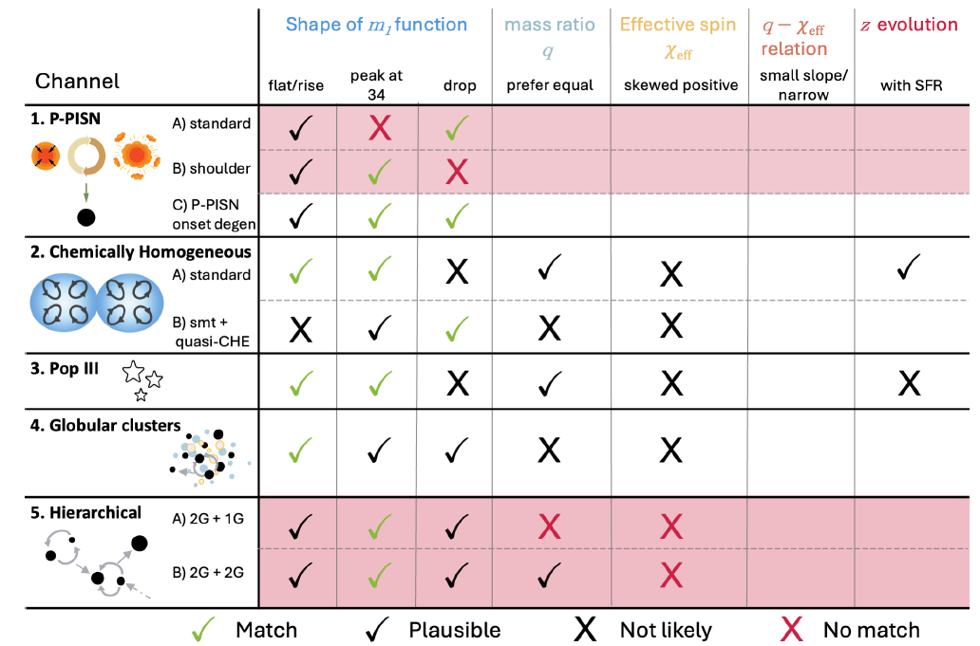
Formation of Binary Black Holes for LIGO
For example, one recent population study from Roy, Son, Farr [2025]:

Slide 4
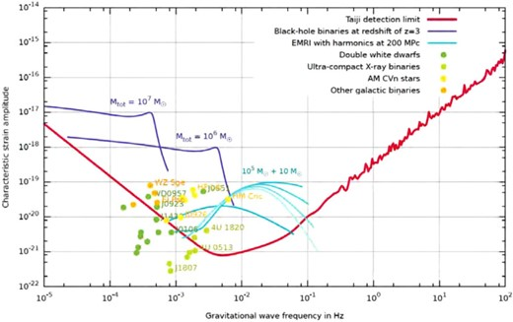
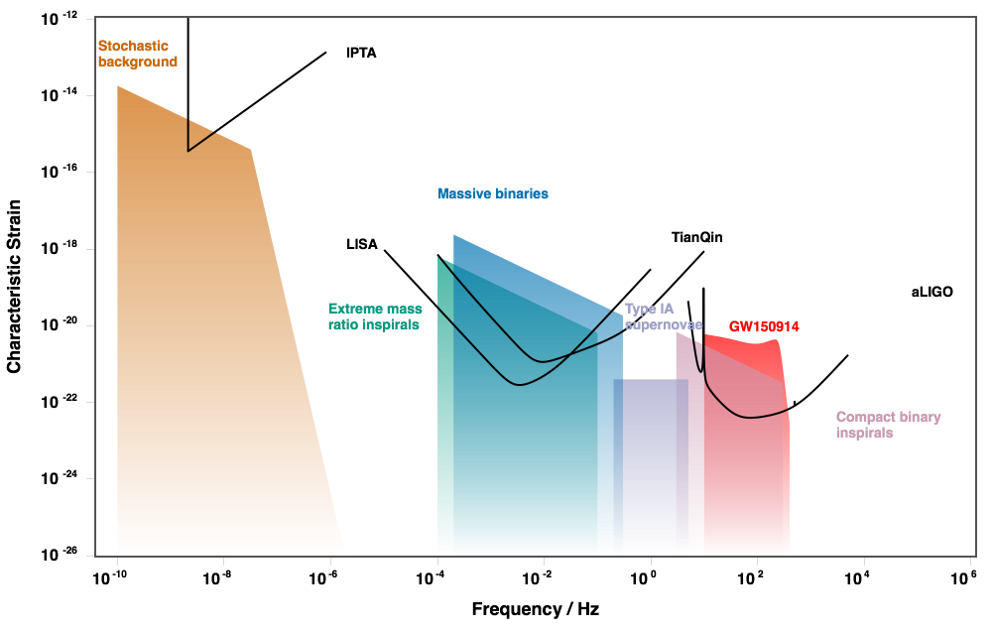
Space-based Gravitational Wave Detection (LISA/Taiji/Tianqin)
Taiji
Z. Luo, Z. Guo, G. Jin, Y. Wu, W. Hu, Results in Physics, 2020
Figure adapted from gwplotter.com

Slide 5
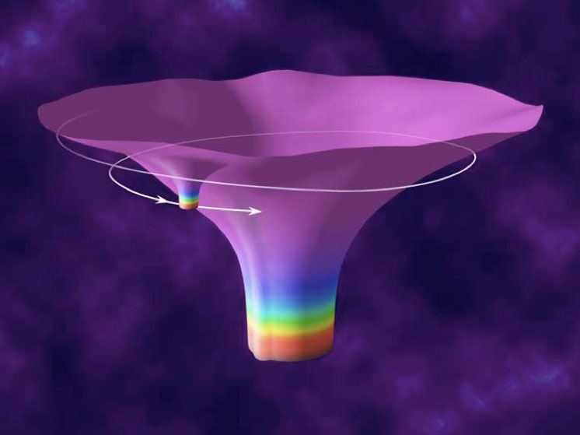
Extreme Mass Ratio Inspirals (EMRIs)
Extreme mass-ratio inspirals: stellar-mass object (black holes, neutron stars, compact stars) orbiting around the massive black hole (10⁵-10⁷ solar mass).

Slide 6
Extreme Mass Ratio Inspirals (EMRIs)
Extreme mass-ratio inspirals: stellar-mass object (black holes, neutron stars, compact stars) orbiting around the massive black hole (10⁵-10⁷ solar mass).
A typical EMRI is in-band for 10⁴-10⁵ cycles.
EMRI$→$ideal tool for measuring small perturbations: opportunities for studying astrophysics and fundamental physics
Measurement uncertainty of eccentricity, spin, mass ~ 10⁻⁴ - 10⁻⁶

Slide 7
Formation of EMRI systems
Formation channels considered here:
“Dry formation”, which is mainly driven by multi-body scattering in the nuclear star cluster.
“Wet formation”, which is assisted by the accretion flow around the massive black hole;

Slide 8
Wet Formation Channel
The wet formation channel relies on the interaction between the accretion disk and the nuclear cluster around the supermassive black holes. The rate calculation requires consistent modelling for disk+cluster.
Roughly 1% of local galaxies and 10% of high-redshift galaxies have AGNs. However, AGNs will dramatically accelerate EMRI formations.
The sBHs trapped in accretion disk may form sBHBs – a promising source for ground-based gravitational wave detection.

Slide 9
Comparison between Dry/Wet Formations
Wet EMRIs may be at least as frequent as dry EMRIs.
Wet EMRIs have e ~0, many dry EMRIs have much larger e in the detection band
Wet EMRIs may have EM counterparts from the AGN.
Z. Pan, HY, PRD 2021
Z. Pan, Z. Lyu, HY, PRD 2021

Slide 10
Overview
Probing EMRI formation channels with indirect measurements
Eccentricity: dry EMRI vs. wet EMRI (mean-motion resonance and turbulent AGN)
Mass function: dry EMRI vs. wet EMRI (capture, accretion, merger)
EMRIs environmental effects and direct impact on waveform
Tidal resonance to probe stellar neighbors
Dynamic friction to probe Dark Matter/Axion clouds

Slide 11
Overview
Probing EMRI formation channels with indirect measurements
Eccentricity: dry EMRI vs. wet EMRI (mean-motion resonance and turbulent AGN)
Mass function: dry EMRI vs. wet EMRI (capture, accretion, merger)
EMRIs environmental effects and direct impact on waveform
Tidal resonance to probe stellar neighbors
Dynamic friction to probe Dark Matter/Axion clouds

Slide 12
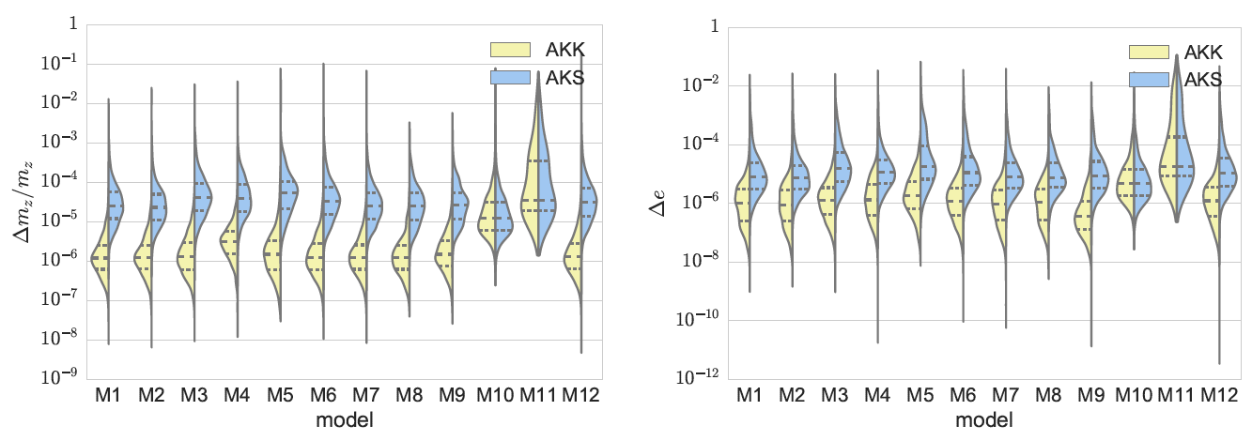
Eccentricity: measurement precision
The measurement precision for eccentricity depends on the specific EMRI orbit and the MBH mass & spin, but roughly at ~ O(10⁻⁵) [Babak et al. 2017]
Eccentricity may serve as one of the key observables to probe formation mechanisms.

Slide 13
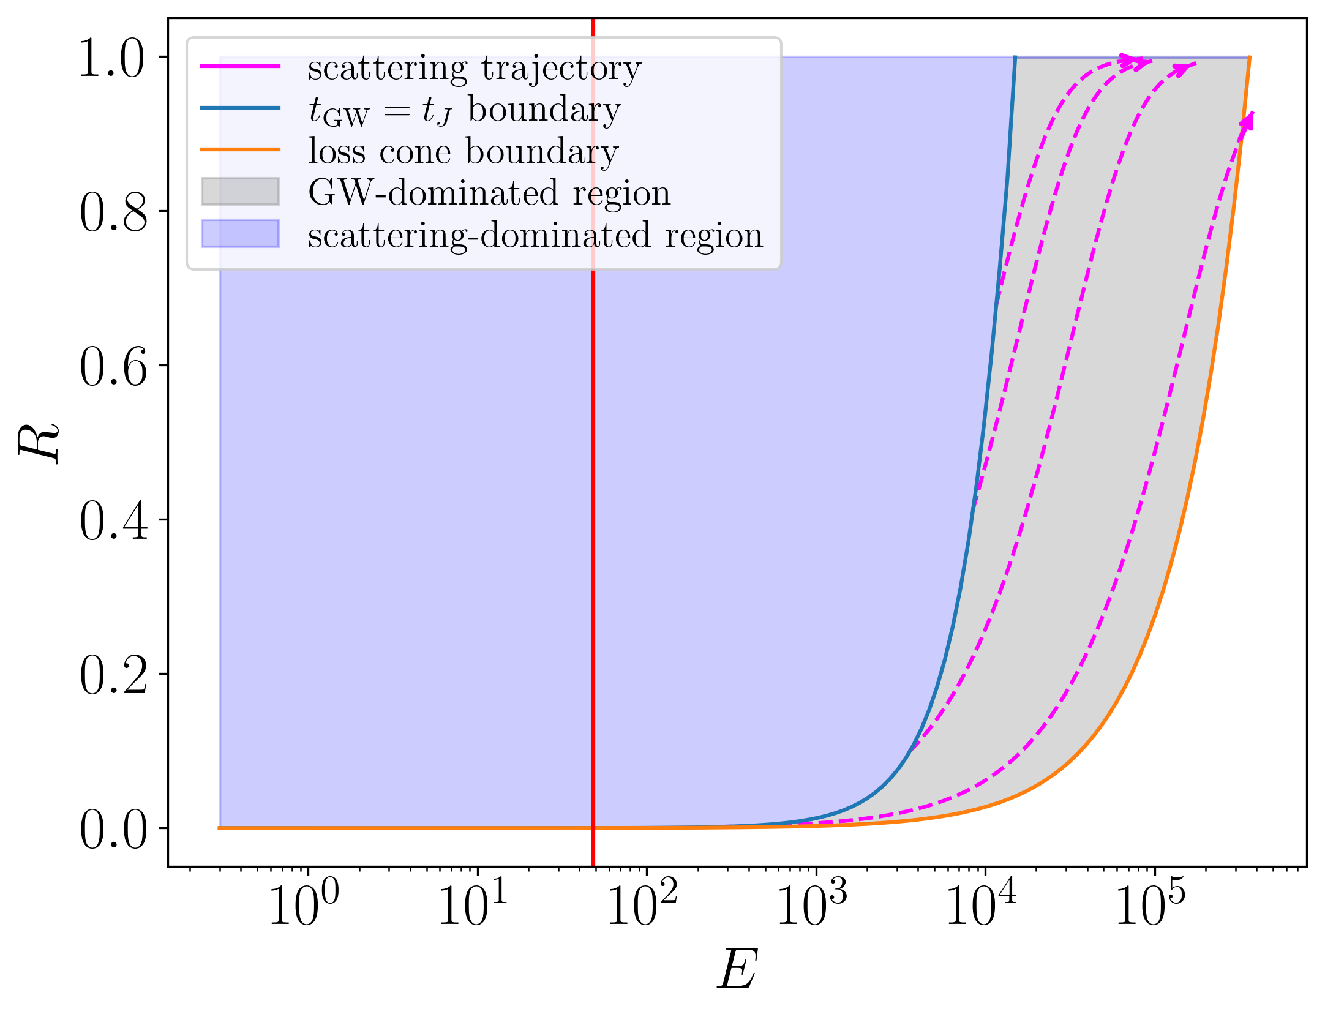
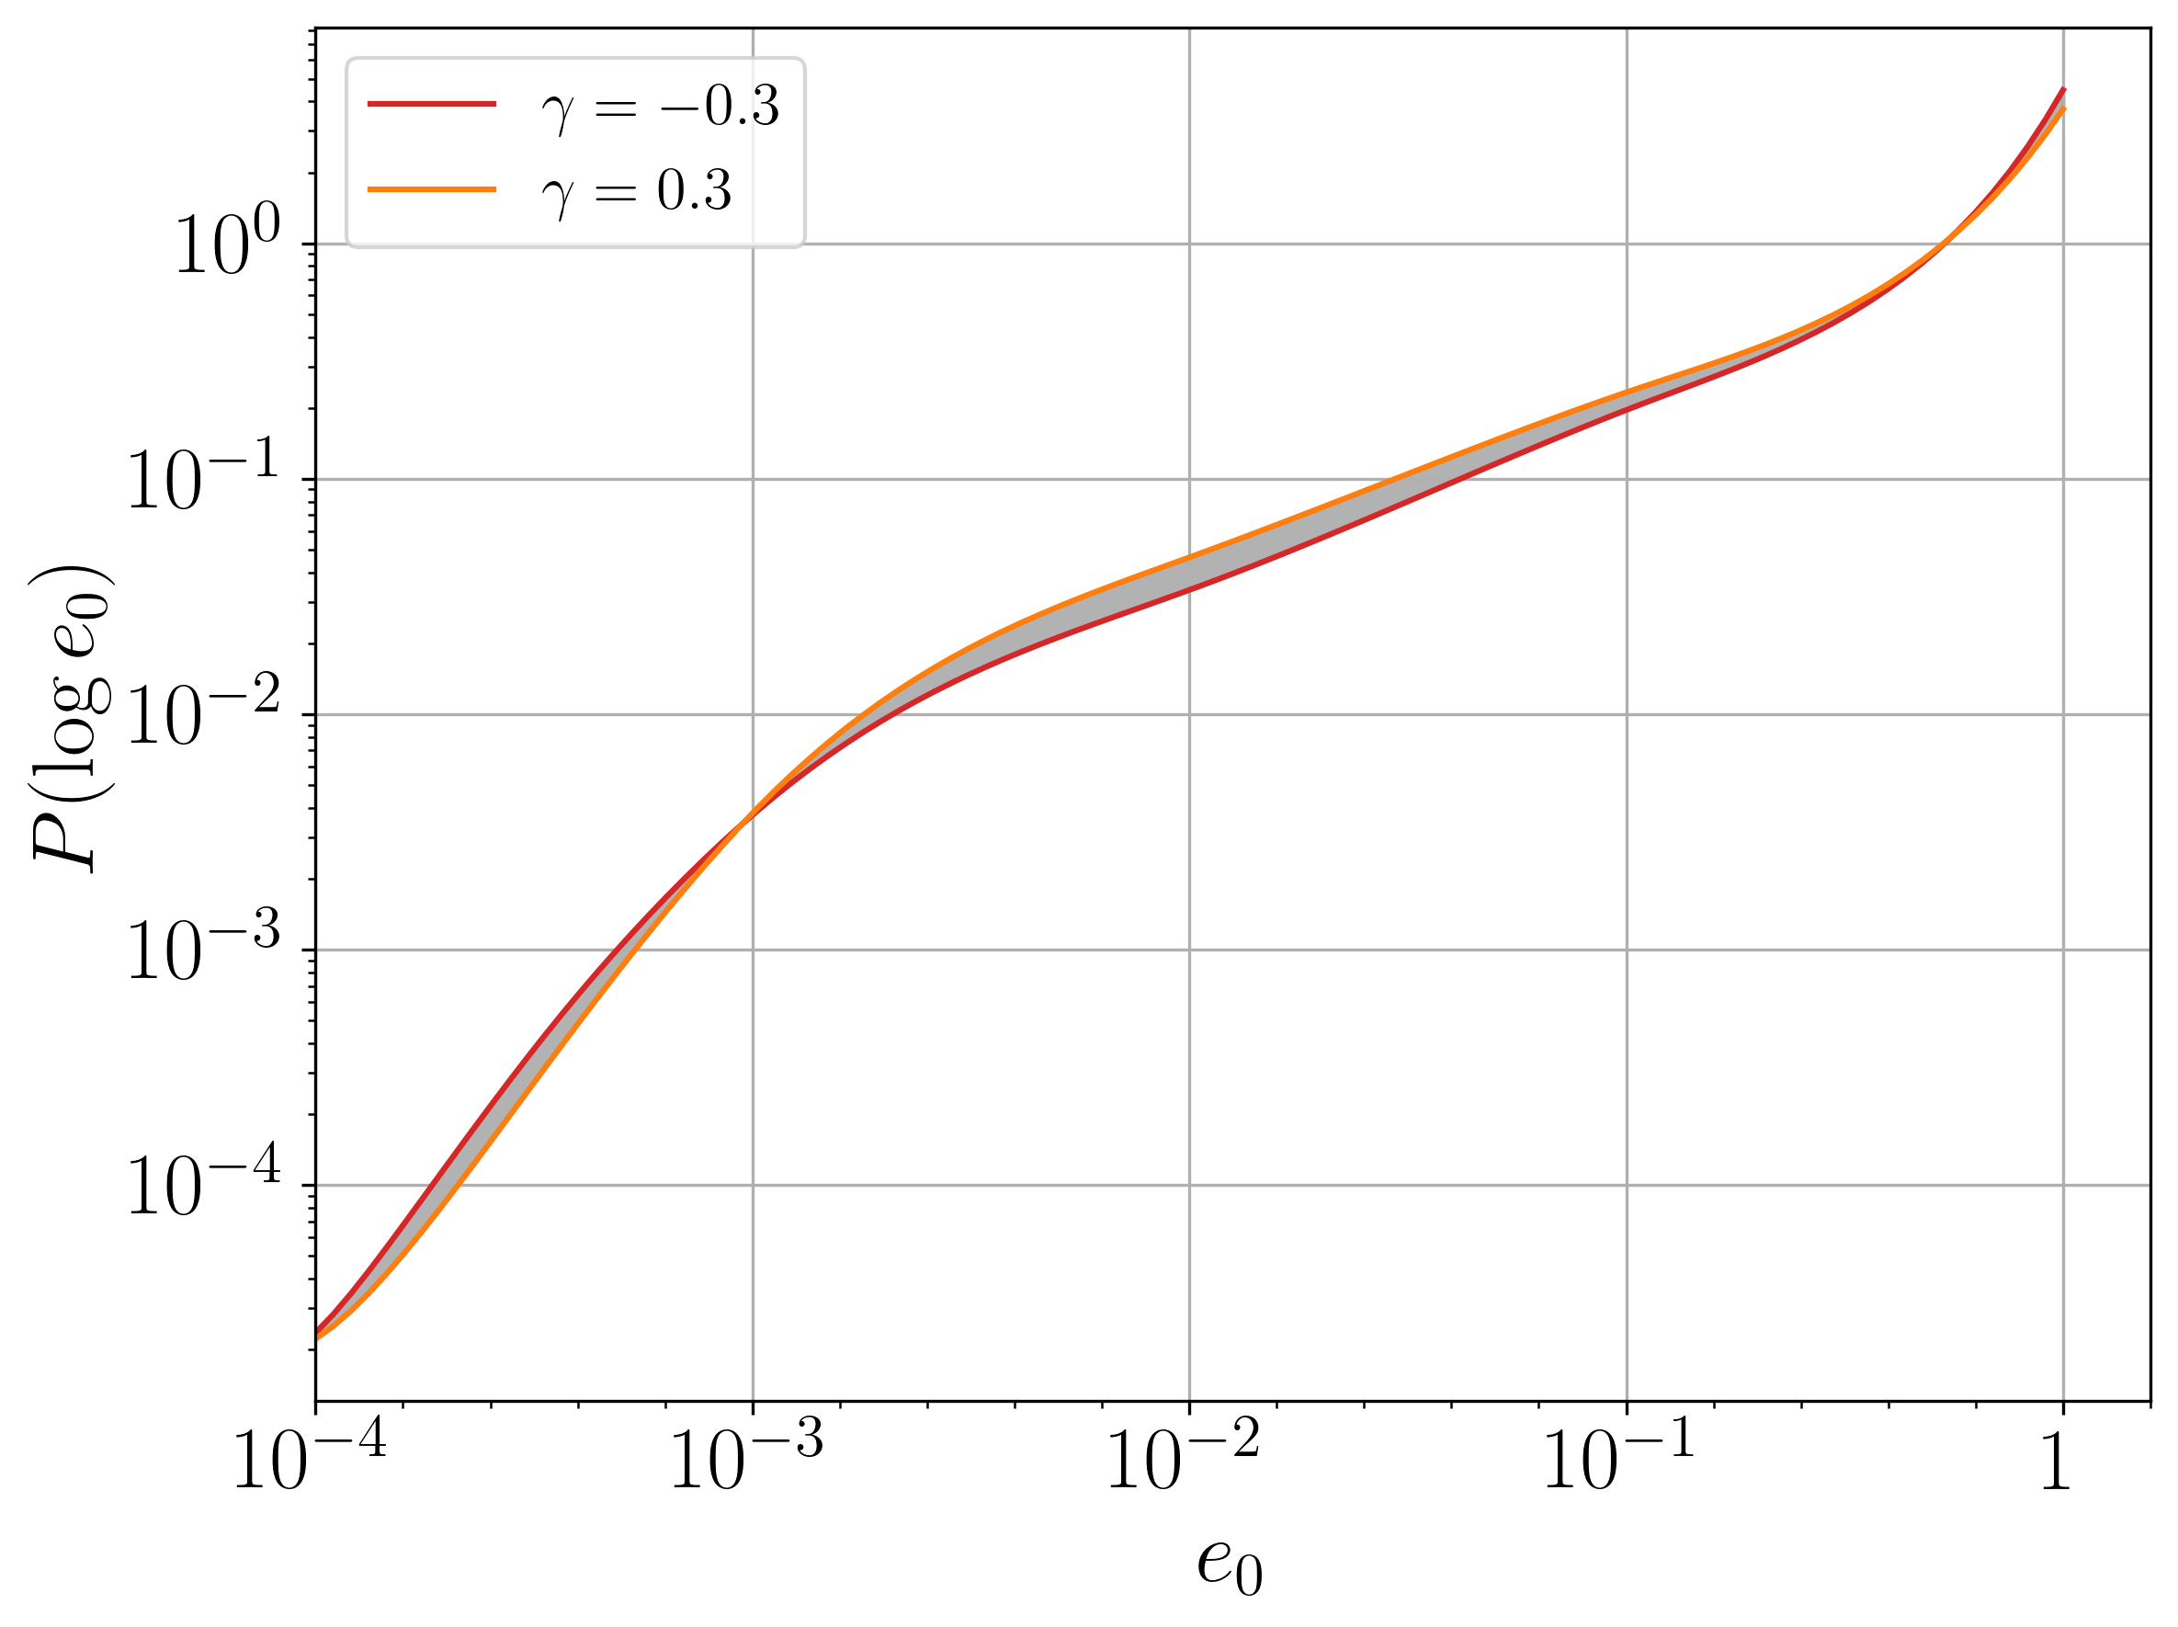
Eccentricity: dry EMRIs
Dry EMRIs are formed by gravitational multi-body scatterings in the Nuclear Star Cluster.
Need to model the cluster: Fokker-Planck method.
Eccentricities are mostly > 0.01 (95%).
Power-law index of MBH mass function
More circular Orbit
Smaller semi-major axis

Slide 14
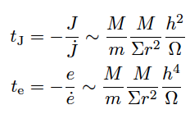
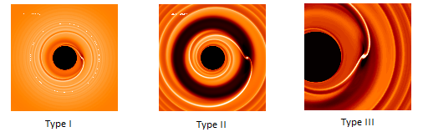
Eccentricity damping in accretion disks
The migration force/torque (density wave & corotation torques) is extensively studied in planetary systems. Likely similar things happen in AGN disks.
The eccentricity damping is very efficient for thin disks:
One would expect effective zero eccentricity in this picture.

Slide 15
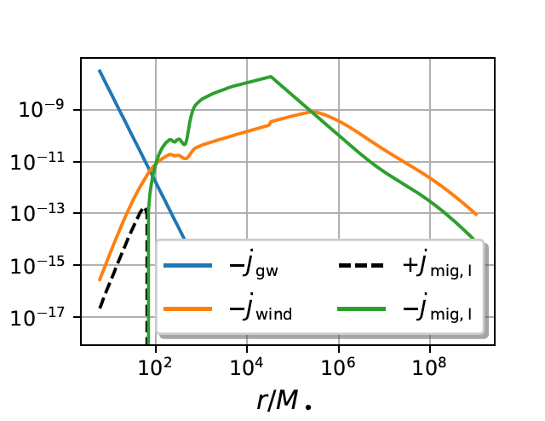
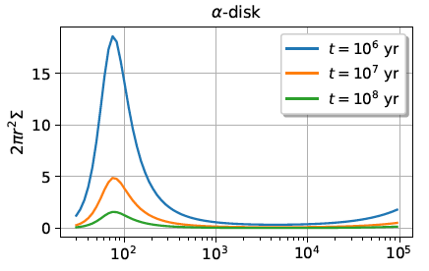

Wet EMRI e excitation: multiple sBHs
The sBHs migrate in AGN disks have different migration rate have different radius. The rate is longest around O(10²)M.
It is more likely to find multiple sBHs around that radius.

Slide 16
Wet EMRI e excitation: multi-body effects
We place two sBHs onto the accretion disks at a range of radius and let them evolve under the disk interaction and gravitational interaction with the massive BH and each other.
We perform the simulations (using REBOUND) 100 times and analyze the evolutions. The main eccentricity evolution is affected by disk and GW damping, mean-motion resonance (pumping), and transient resonance (pumping).

Slide 17


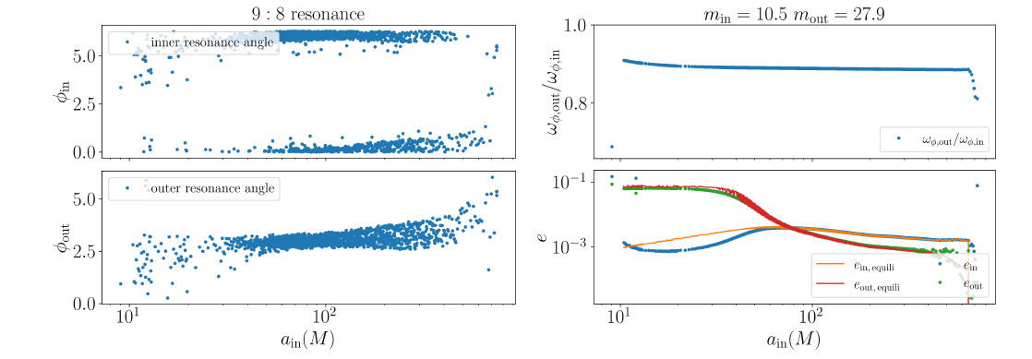
Wet EMRI e excitation: mean-motion resonance
The two sBHs may be locked into inner and outer mean-motion resonances which satisfy (p,q)_{in/out}
Mean-motion resonance+migration may lead to eccentricity excitation.

Slide 18
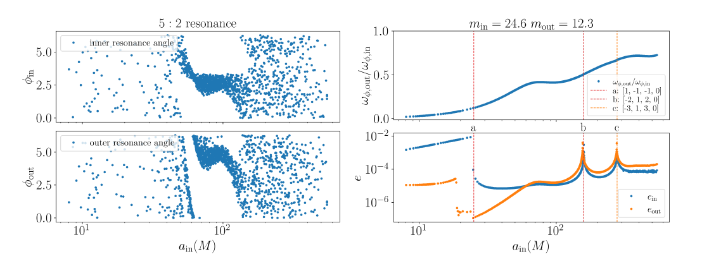
Wet EMRI e excitation: transient resonance
The mean-motion resonances may break for a fraction of systems. In the free-evolution stage, the eccentricity decreases in time due to GW & disk damping forces.
The conservative quantities (including eccentricity) are kicked during a transient crossing a mean-motion resonance.

Slide 19
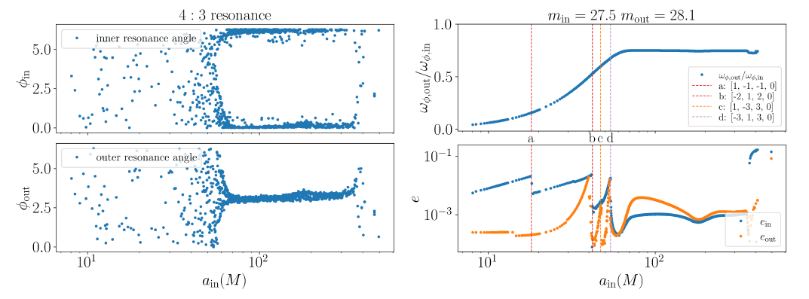
Wet EMRI e excitation: transient resonance
The mean-motion resonances may break for a fraction of systems. In the free-evolution stage, the eccentricity decreases in time due to GW & disk damping forces.
The conservative quantities (including eccentricity) are kicked during a transient crossing a mean-motion resonance.

Slide 20
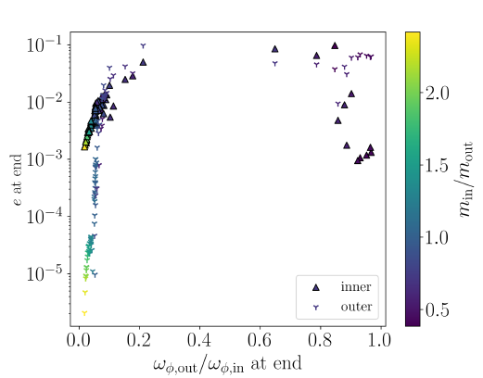
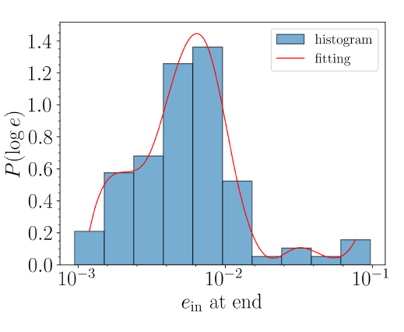
Wet EMRI e excitation: population
The fate of 100 systems depends on the mass ratios and initial conditions (no MMR, MMR for the full duration, MMR break in the middle).
The eccentricity of e_{in} at ~ 10 M is mostly less than 0.01, which is robust for various disk profiles tried.

Slide 21
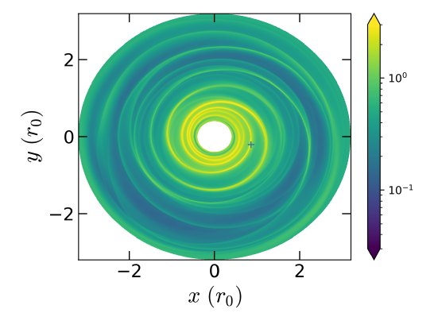
Wet EMRI e excitation: turbulence
AGN disks are turbulent driven by magneto-rotational instabilities.
Turbulent eddies give rise to density fluctuations and stochastic gravitational forces on the EMRI object.
We prepare a hydrodynamical disks with tunable turbulent density fluctuations generated with prescribed spectrum, based on MHD simulations.

Slide 22
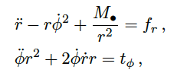
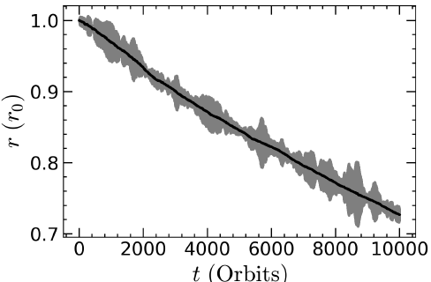
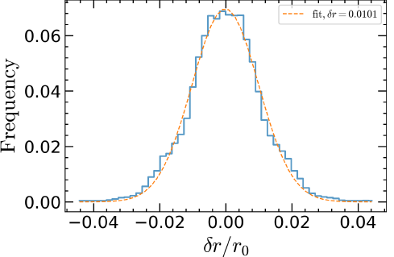

EMRI motion under turbulent force
EMRI motion is perturbed by the stochastic force from the disk:
In addition to the migration, there is stochastic radial oscillations
It is important to understand how does the turbulence-induced e ~ $δr/r$ depend on disk properties.

Slide 23
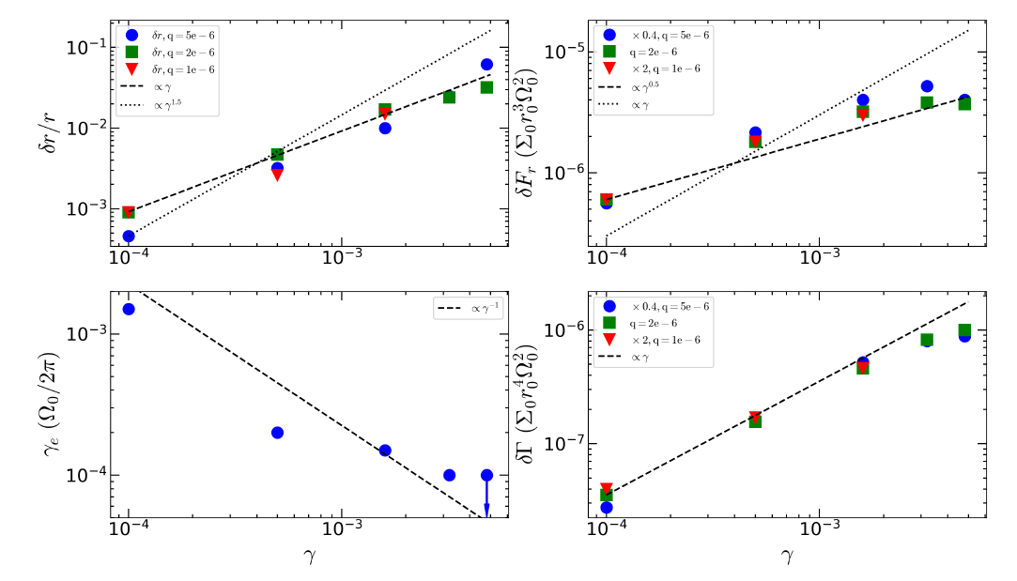
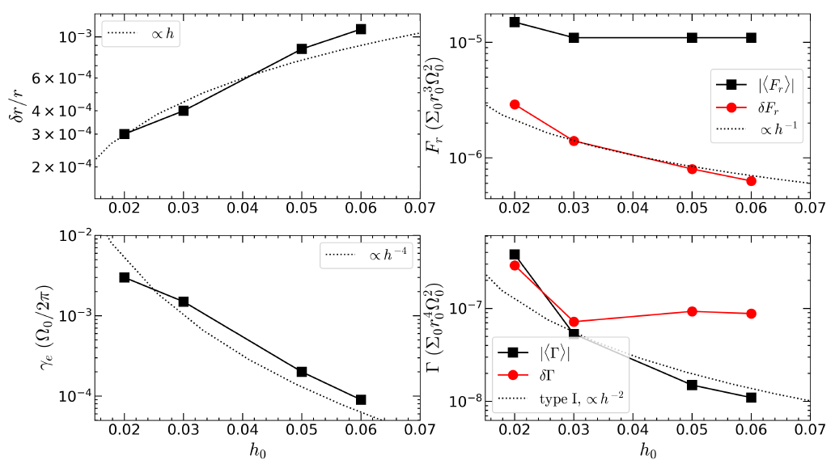
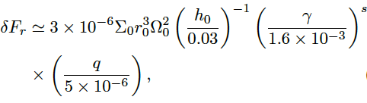



The scaling laws
Eccentricity may depend on mass ratio q, turbulence strength $α$ (or $γ$), disk aspect ratio h, surface density $Σ$, radius r, same for the timescale reaching equilibrium with turbulent forces $γ_{e}$, and radial forces/azimuthal torques.
Scaling laws are obtained by fitting simulations performed with different parameter (along with analytical considerations).

Slide 24
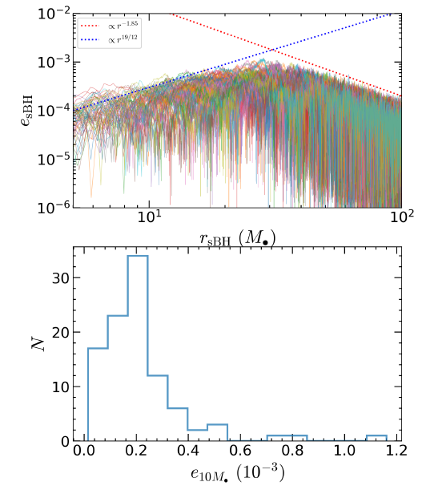
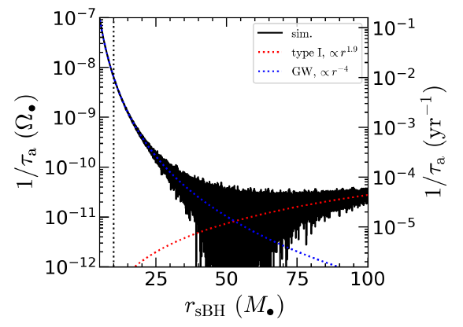

EMRI evolution and eccentricity
Stochastic forces and torques following the scaling laws are used in N-body code REBOUND, to drive evolution of EMRIs from larger distances. 100 realizations are performed.
e peaks at $γ_{e}\sim γ_{eGW}$, and then decay afterwards (GW damping)

Slide 25
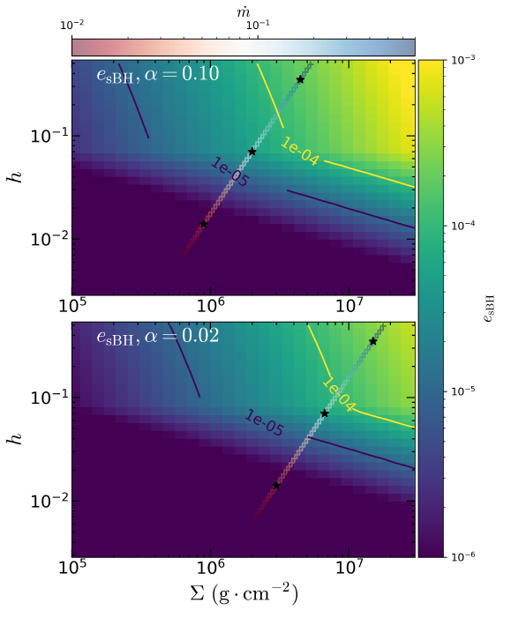
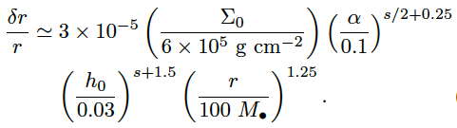
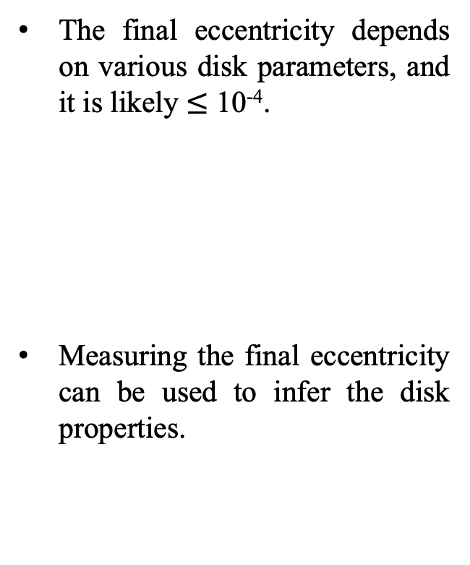
EMRI evolution and eccentricity
The final eccentricity depends on various disk parameters, and it is likely $≤$ 10⁻⁴.
Measuring the final eccentricity can be used to infer the disk properties.
equilibrium eccentricity

Slide 26
Overview
Probing EMRI formation channels with indirect measurements
Eccentricity: dry EMRI vs. wet EMRI (mean-motion resonance and turbulent AGN)
Mass function: dry EMRI vs. wet EMRI (capture, accretion, merger)
EMRIs environmental effects and direct impact on waveform
Tidal resonance to probe stellar neighbors
Dynamic friction to probe Dark Matter/Axion clouds

Slide 27



Mass function of LIGO BBHs
For LIGO BHs, the relation between binary mass function and the intrinsic mass can be expressed as (with the pairing function)
The primary BH mass function with a BBH is
The pairing function can be parametrized [Roy et al. 2025]

Slide 28
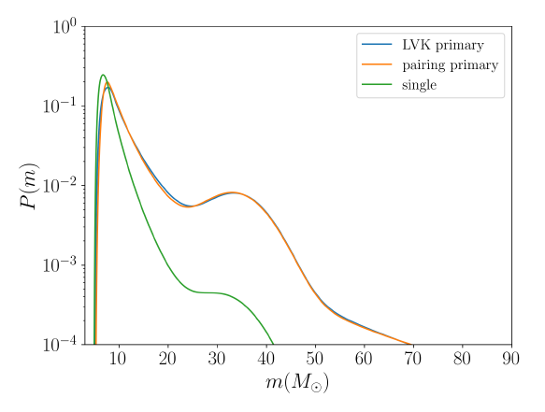
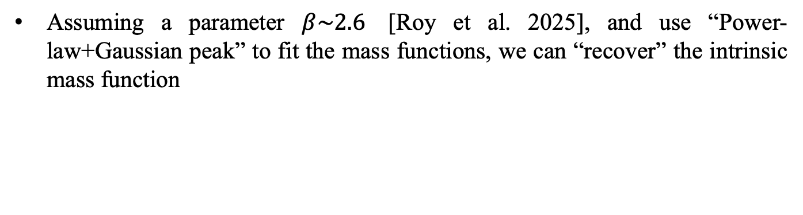
Mass function of LIGO BBHs
Assuming a parameter $β\sim 2.6$ [Roy et al. 2025], and use “Power-law+Gaussian peak” to fit the mass functions, we can “recover” the intrinsic mass function

Slide 29
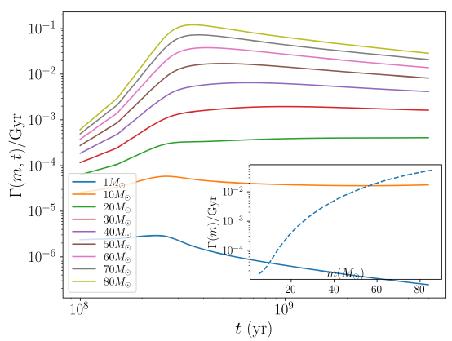
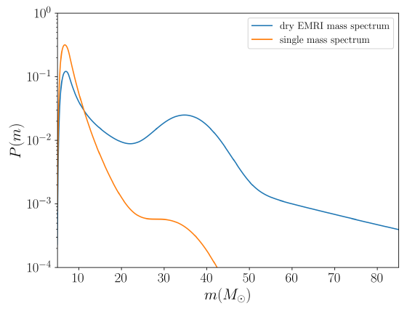

(sBH) Mass function of dry EMRIs
We use the “intrinsic” single BH mass function as the initial mass function of sBHs in the Nuclear Star Cluster. The goal is to compute the measured sBH mass function in dry EMRIs.
In a Fokker-Planck calculation, the diffusion and (gravitational) scattering coefficient are mass dependent. Taking into account the initial mass function in NSC, the mass function of dry EMRIs become
Larger peak at ~35$M_{⨀}$

Slide 30
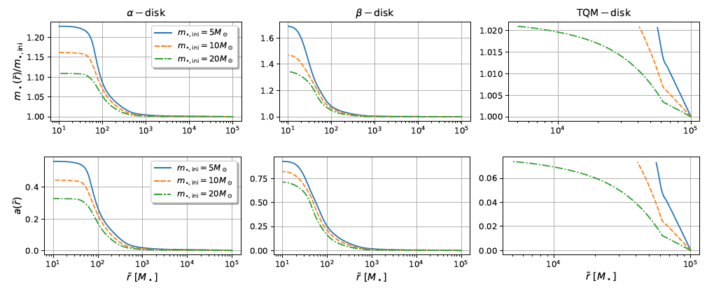
(sBH) Mass function of wet EMRIs
The mass function of wet EMRIs are affected by three additional mechanisms.
The diffusion of sBHs in the angular direction and capture rate (by the disk) is mass-dependent.
The accretion of sBHs along the way of migration.
The formation of sBH binary and merger.

Slide 31
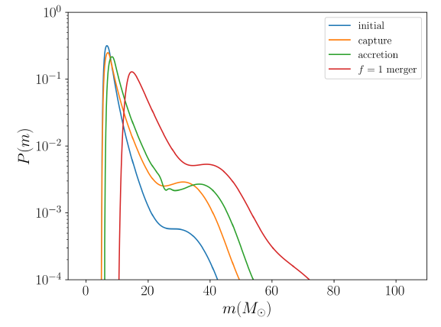


(sBH) Mass function of wet EMRIs
10$M_{⨀}$+ 10$M_{⨀}$
10$M_{⨀}$+ 35$M_{⨀}$

Slide 32
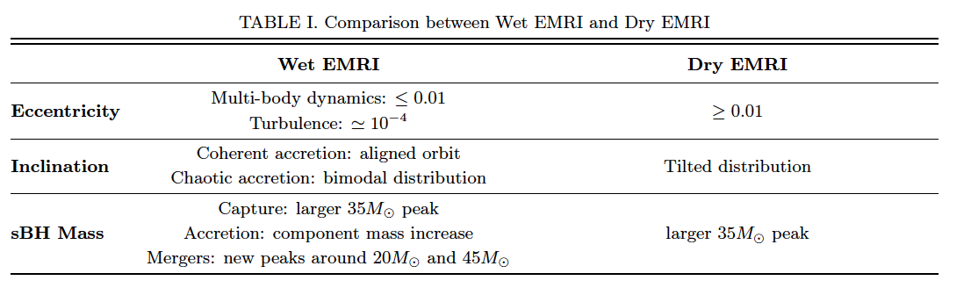
Summary for Indirect Measurements
H. Sun, Y. Li, Z. Pan, HY, PRD 2025

Slide 33
Overview
Probing EMRI formation channels with indirect measurements
Eccentricity: dry EMRI vs. wet EMRI (mean-motion resonance and turbulent AGN)
Mass function: dry EMRI vs. wet EMRI (capture, accretion, merger)
EMRIs environmental effects and direct impact on waveform
Tidal resonance to probe stellar neighbors
Dynamic friction to probe Dark Matter/Axion clouds

Slide 34
Perturbing EMRIs with environmental effects
“Extra dissipation”, which is contributed by the radiation of extra degree(s) of freedom and/or dynamical friction with the extra matter/field:
“Extra gravitational field”, background spacetime is modified from Kerr
“Resonance”, environmental forces (both conservative and dissipative) also cause finite changes for conserved quantities
Dark matter
Accretion disk
Stellar neighbor

Slide 35
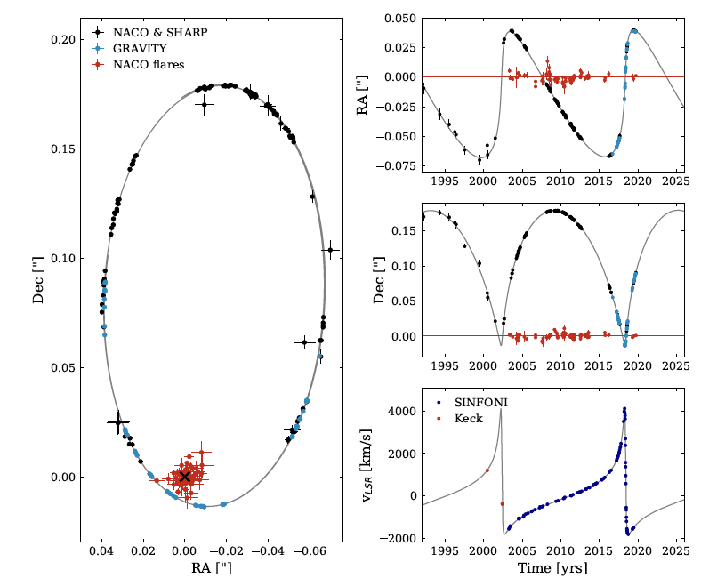
Close stars to Sgr A*
The observation of the S2 star in our galactic center has led to the identification of compact object (~4 million solar mass) in galactic center – a strong evidence for SMBH [Nobel Prize 2020, Ghez & Genzel]!
Measuring the GR precession by the GRAVITY Collaboration, 2020

Slide 36
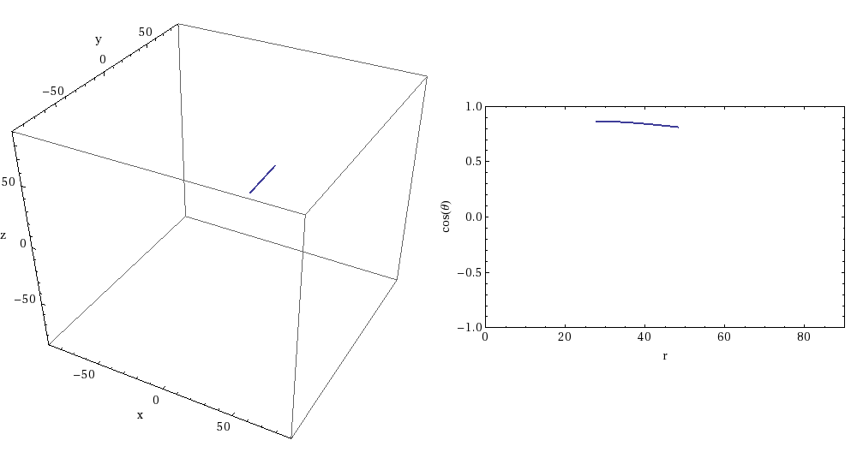
Directly probing the companion
The presence of a stellar-mass companion generally adds an oscillatory force on the EMRI object – no long term effect at the leading order.
Except at resonances the “extra” conservative forces can change the conserved quantities (i.e., modified Kerr metric). Sometimes there are chaotic behavior.
HY and M. Casals, PRD 2017
B. Bonga, HY and S. Hughes, PRL 2019

Slide 37
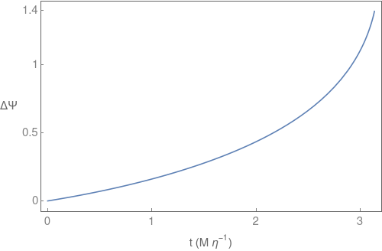
Tidal Resonance
The “jump” of conserved quantities across a resonance will cause long-term shift of the gravitational wave phase. This can be used to detect the companion.
O(100) gravitational radii !

Slide 38
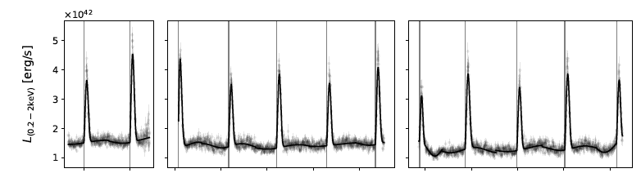
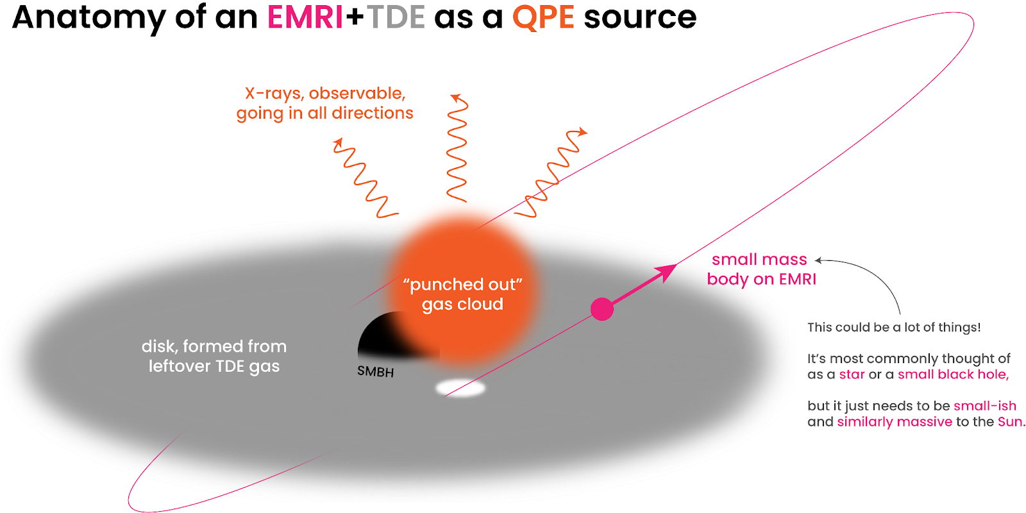
QPE and stellar-mass objects close to SMBH
One of the leading models for QPEs is the “TDE disk+EMRI” scenario [Linial & Metzger 2023]. The timing of X-ray flares can be used to infer the orbital radius of these EMRIs: O(100) gravitational radii ! [Cong Zhou et al. 2024 ab]
They may come from disk migration in previous AGN episode, and they produce tidal resonance!

Slide 39
Overview
Probing EMRI formation channels with indirect measurements
Eccentricity: dry EMRI vs. wet EMRI (mean-motion resonance and turbulent AGN)
Mass function: dry EMRI vs. wet EMRI (capture, accretion, merger)
EMRIs environmental effects and direct impact on waveform
Tidal resonance to probe stellar neighbors
Dynamic friction to probe Dark Matter/Axion clouds

Slide 40
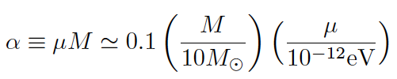
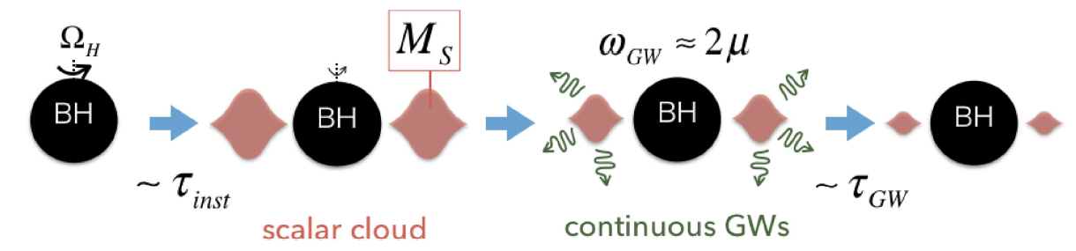
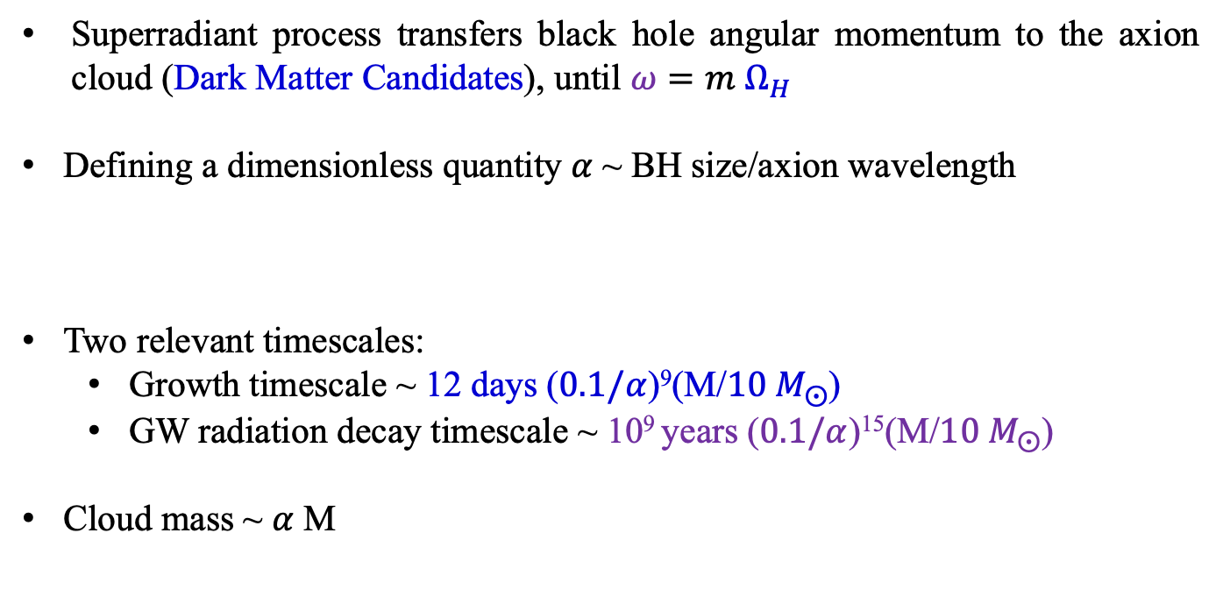
Axion Clouds
Superradiant process transfers black hole angular momentum to the axion cloud (Dark Matter Candidates), until $ω=m Ω_{H}$
Defining a dimensionless quantity $α$~ BH size/axion wavelength
Two relevant timescales:
Growth timescale ~ 12 days ($0.1/α$)⁹(M/${10 M}_{⨀}$)
GW radiation decay timescale ~ 10⁹ years ($0.1/α$)¹⁵(M/${10 M}_{⨀}$)
Cloud mass ~ $α$M

Slide 41
EMRIs within a cloud
There are two major dissipation channels: scalar radiation and gravitational wave radiation.
Scalar radiation is physically equivalent to the dynamic friction of the scalar field on the point mass.
The modulation of gravitational radiation needs to be computed using the modified Teukolsky equation [Dongjun Li, et al. 2023]

Slide 42
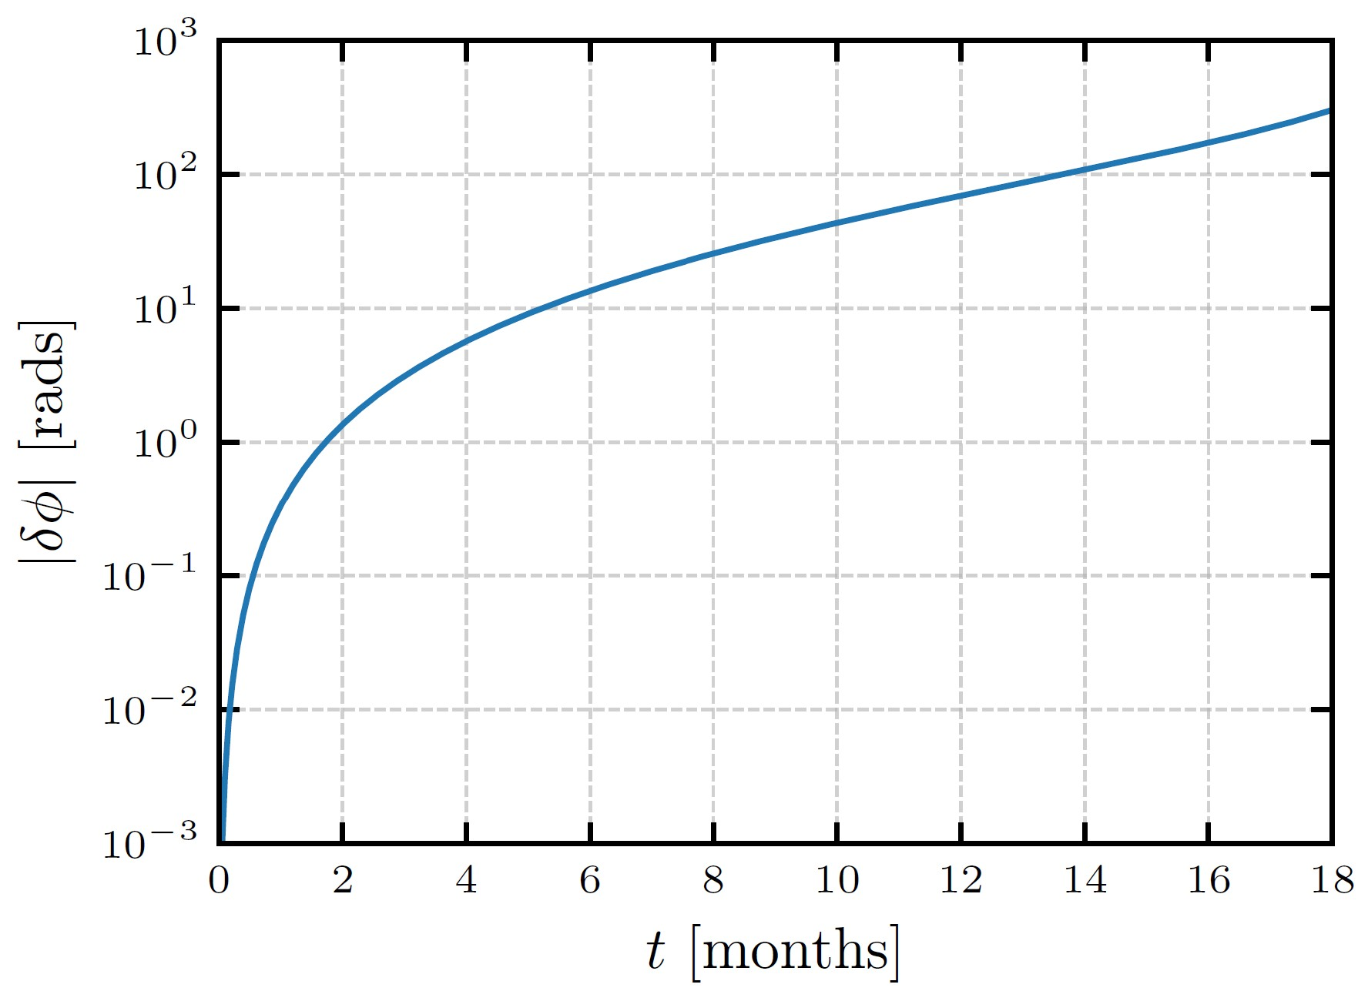
Scalar sector
(Li, Weller, Bourg, LaHaye, Yunes, & HY, arXiv 2507.02045)

Slide 43
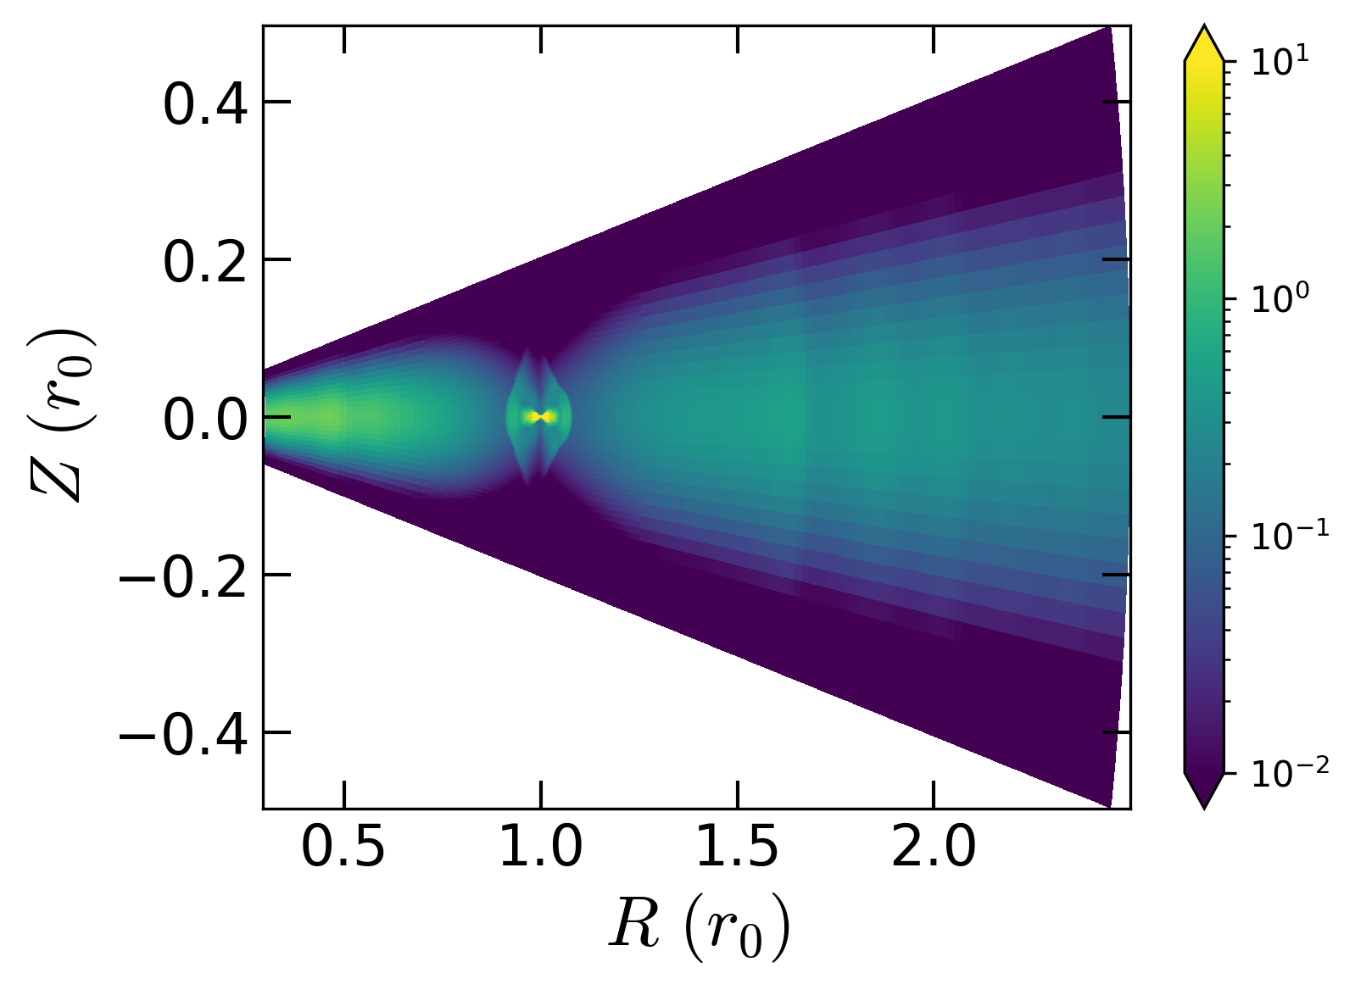
Conclusion
Wet and dry EMRIs are likely primary formation channels of EMRIs.
Wet and dry EMRIs have distinct predictions. They can be used for population study with a set of events.
Probing formation channels through distribution of EMRI observables: eccentricity, inclination, sBH mass,..
Environmental impact on waveforms: extra dissipation channel, extra gravitational field, resonances.

