Slide 1
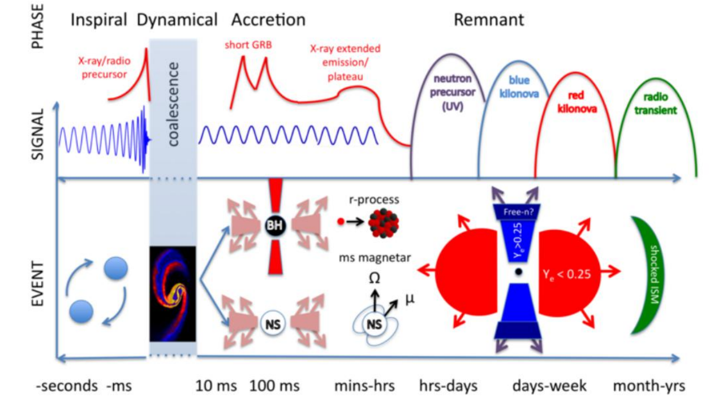
Gravitational-wave standard sirens and implication for cosmology
Wen Zhao
Department of Astronomy,
University of Science and Technology of China (USTC)

Slide 2
OUTLINE
New era of GW astronomy
GW standard sirens and cosmology
Hunting for EM counterparts with WFST
Conclusions

Slide 3
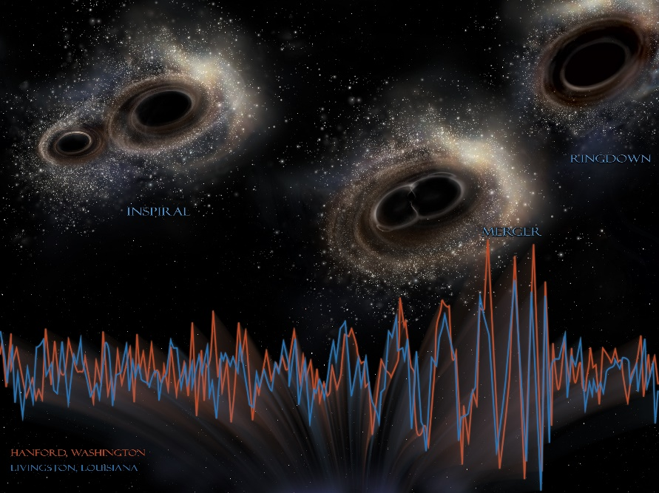
New era of GW astronomy
GW150914: the first GW generated by BBH merger has been detected，which opens the new era of GW astronomy.
GW170817: the first electromagnetic counterpart of GW event has been detected, including sGRB, x-ray and radio from afterglow and kilonova emission.

Slide 4
The electromagnetic counterpart of the merging of binary neutron stars
For binary neutron star merging events, the most important electromagnetic counterparts include: short gamma-ray bursts, multi-band afterglows, kilonovae, X-ray plateau, etc

Slide 5
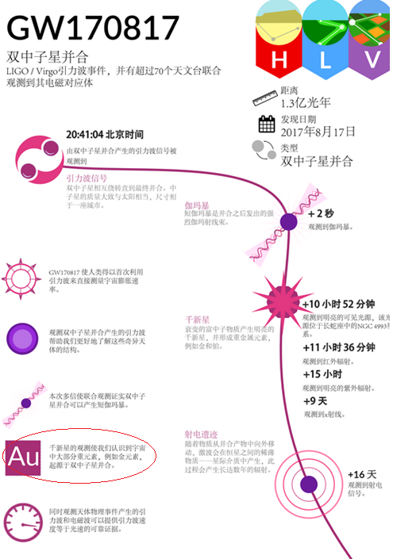
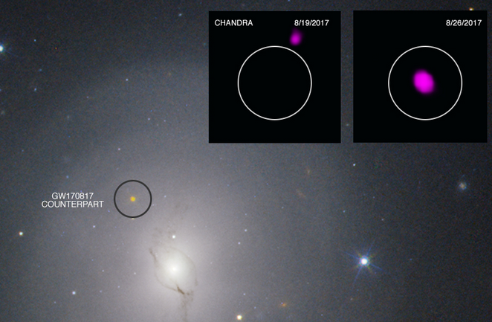
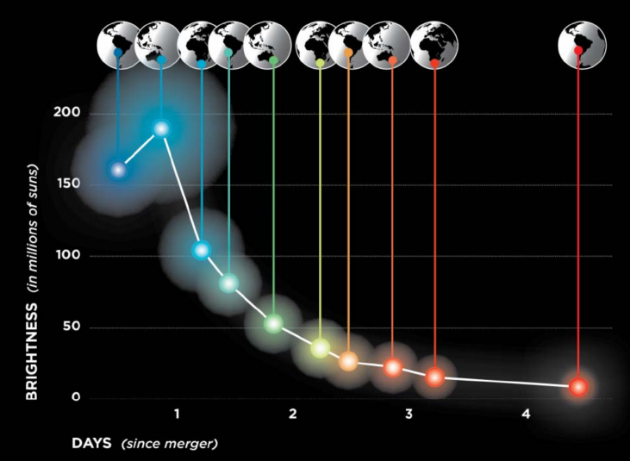

Slide 6
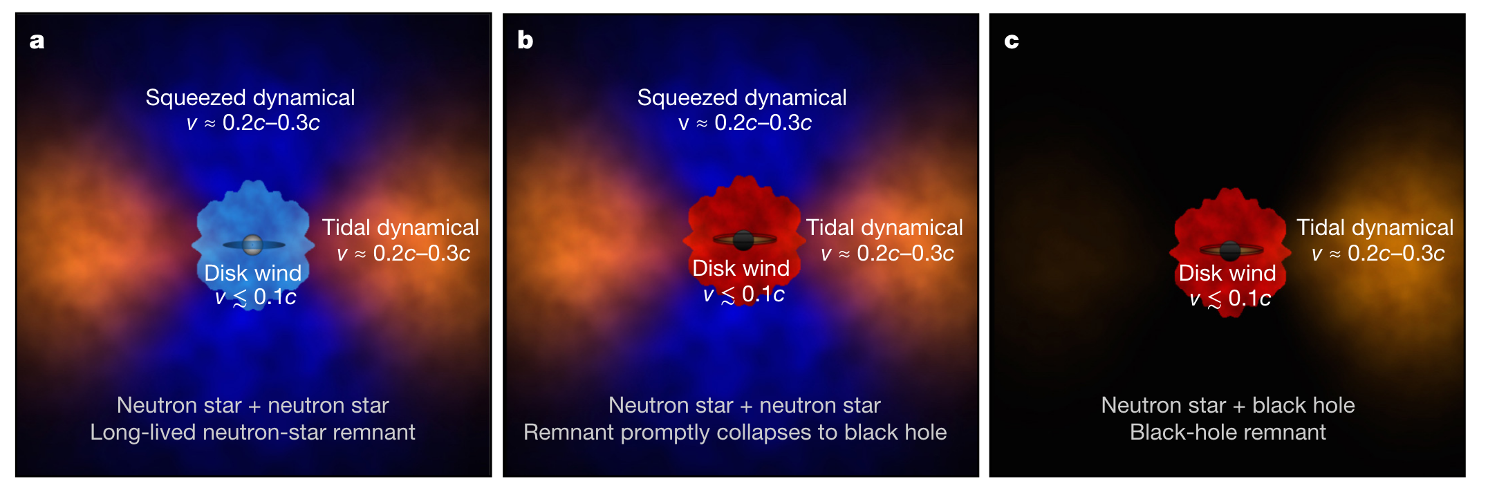
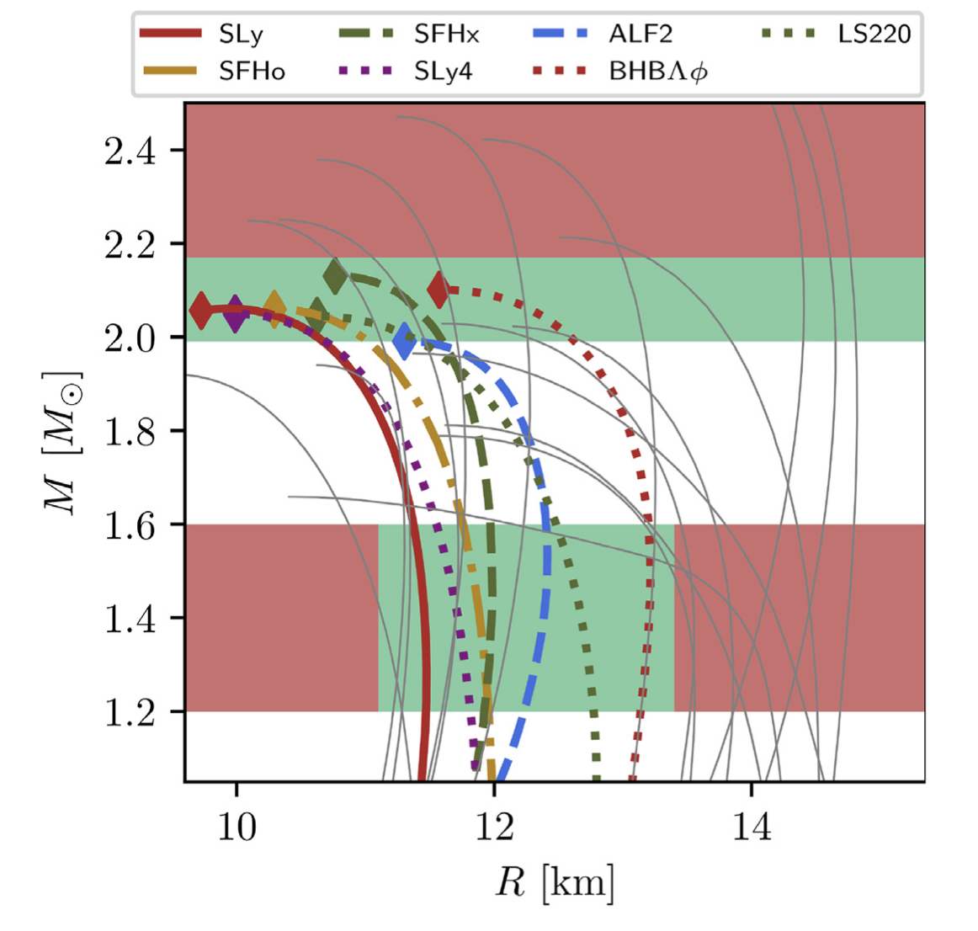
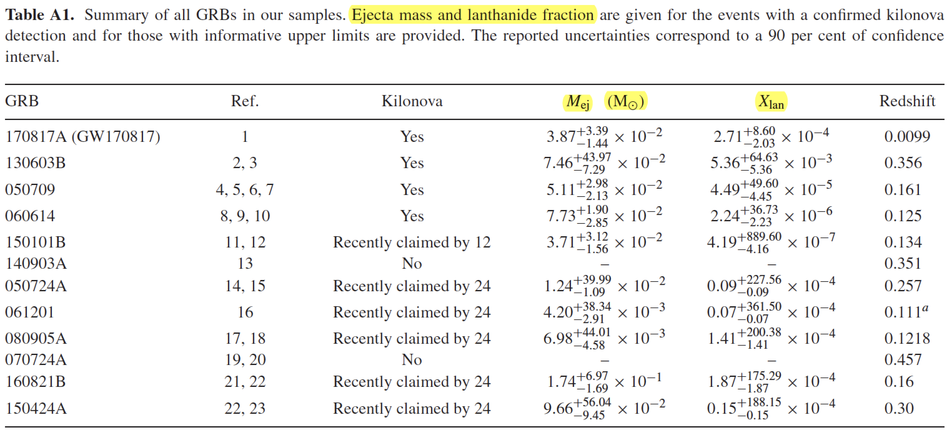
Scientific achievements
1. Origin of heavy element
2. Physics of compact star
The observation of kilonova can be used to constrain the EOS of Neutron star.
Kasen et al.2017 Nature
Coughlin et al. 2019 MNRAS
According AT2017gfo, the compact binary merger may be the main way for its origin.
Ascenzi et al. 2019 MNRAS

Slide 7
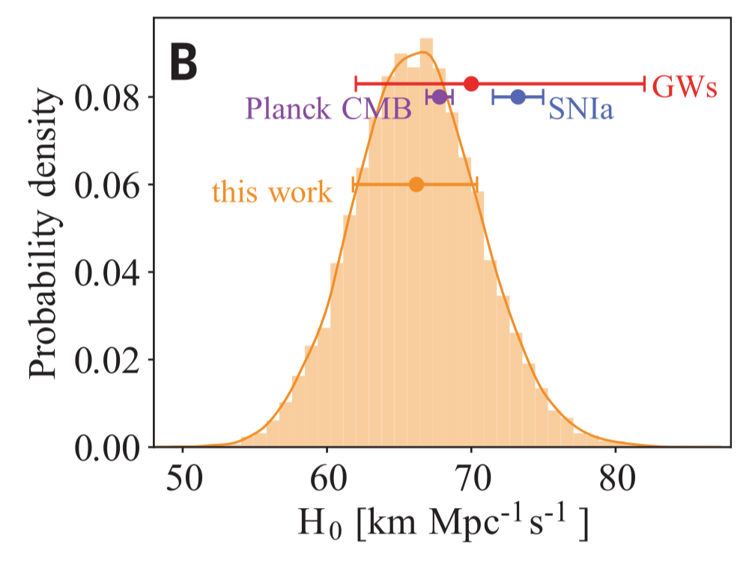
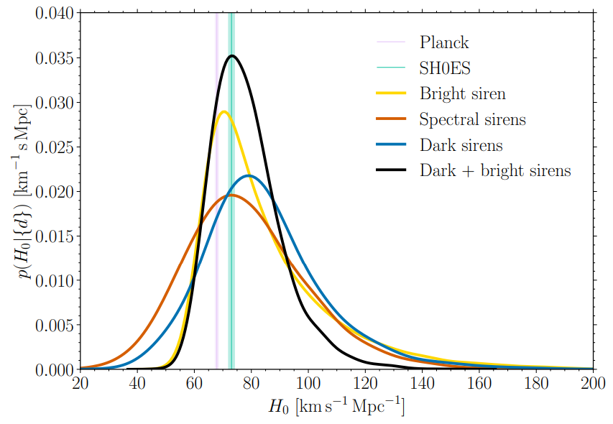
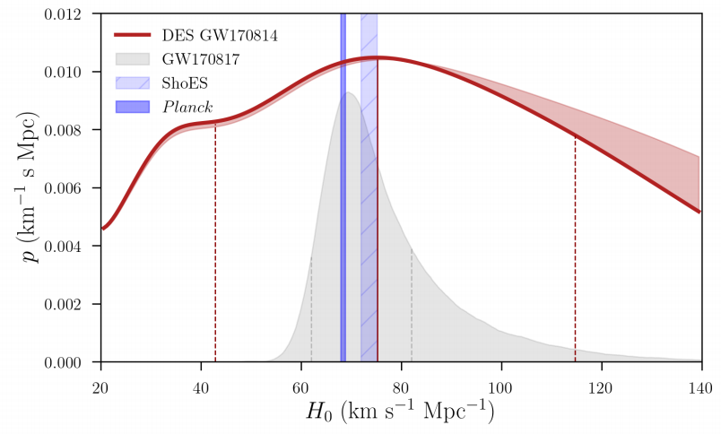
Scientific achievements ------ measurements of Hubble constant
3.1 Bright sirens
3.2 Dark sirens
LVC Collaboration. 2017 Nature
Fishbach et al., 2019 ApJL
Dietrich et al. 2021 Science
LVK Collaboration, arXiv:2509.04348

Slide 8

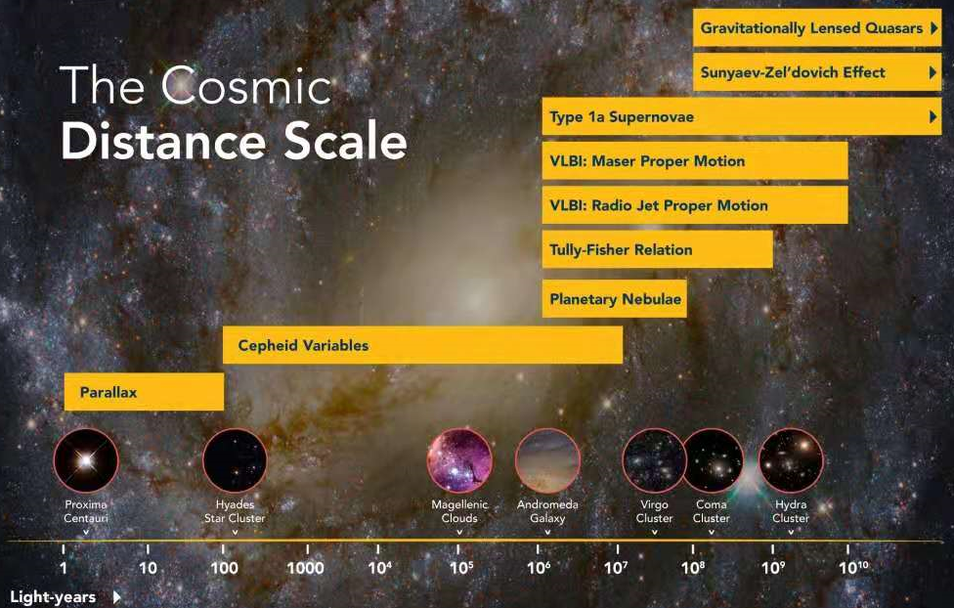
GW sources as ‘standard sirens’
In 1986, Schutz found that the luminosity distance of the binary neutron stars (or black hole) can be independently determined by observing the GW generated by this system . If we can also measure the redshift (how?), the dL-z relation can be used to study the evolution of universe. This is the so-called: standard sirens. (Schutz,Nature,1986)
Characters：
1. non-EM method
2. independent of
“cosmic distance
ladder”

Slide 9
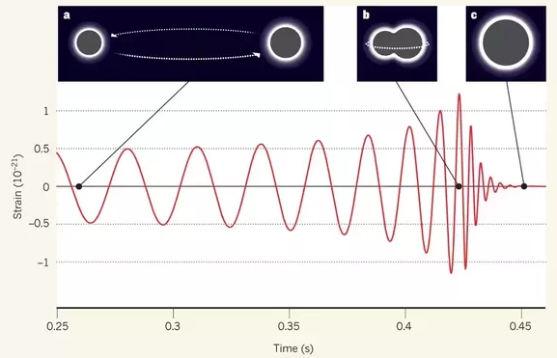
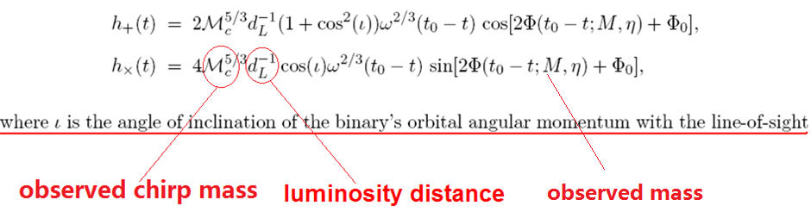
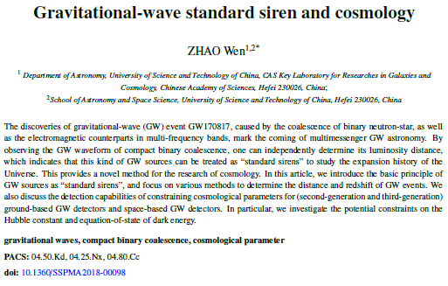
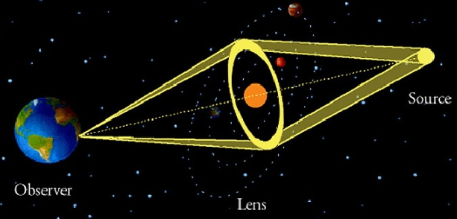
GW sources as ‘standard sirens’
How to determine the ‘distance’？
By amplitude and phase of GW (Schutz, 1986)
By lensed GW events (Liao et al. 2017)
赵文， 中国科学 47, 079805 (2018)

Slide 10
GW sources as ‘standard sirens’
How to determine the ‘redshift’？
By observation of EM counterparts
By fixing the host galaxies
By tidal effect on GW phases
By redshift distribution of compact binaries
By mass distribution of compact objects
赵文， 中国科学 47, 079805 (2018)

Slide 11
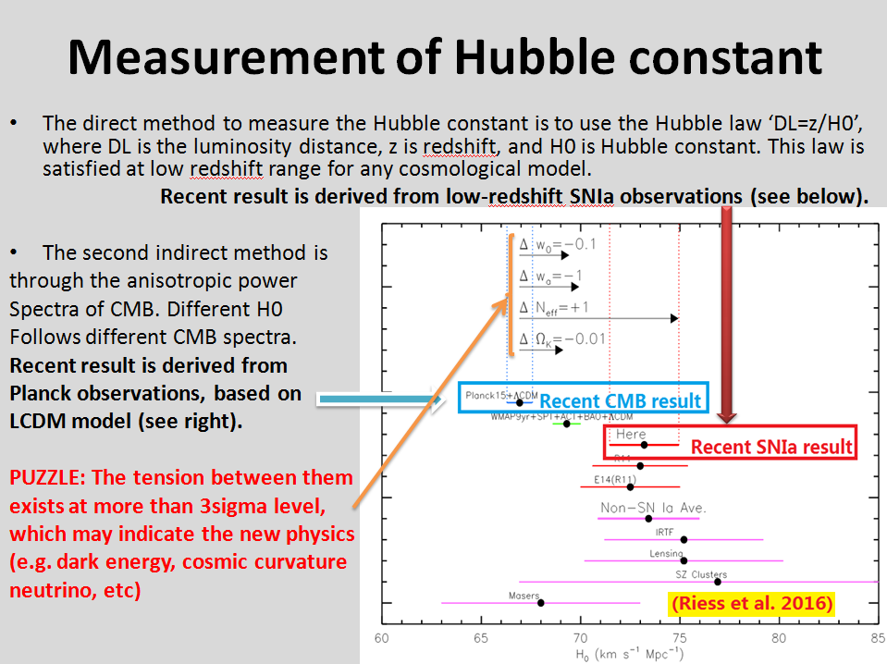


Slide 12
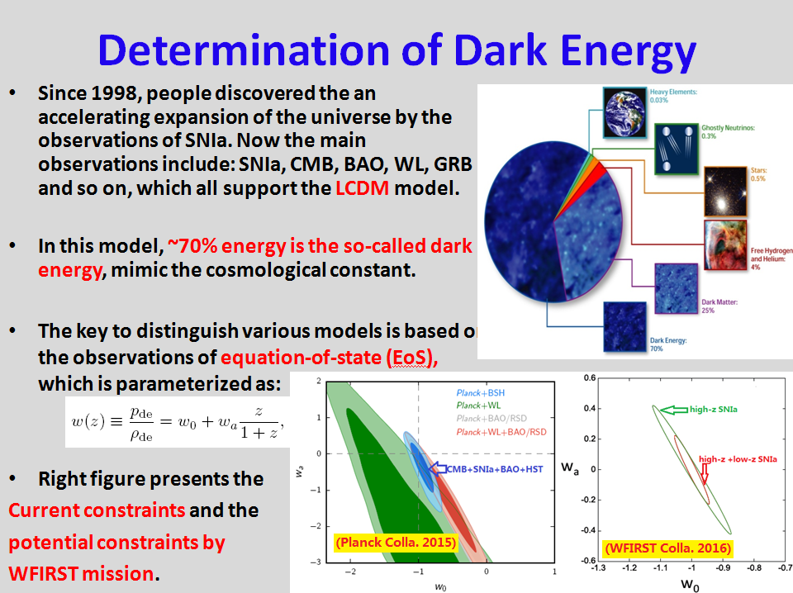

Slide 13
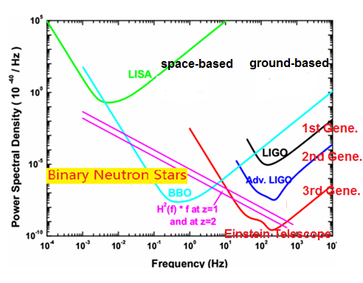
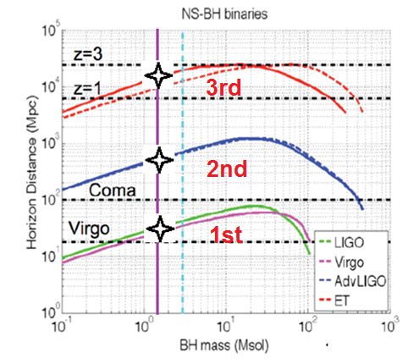
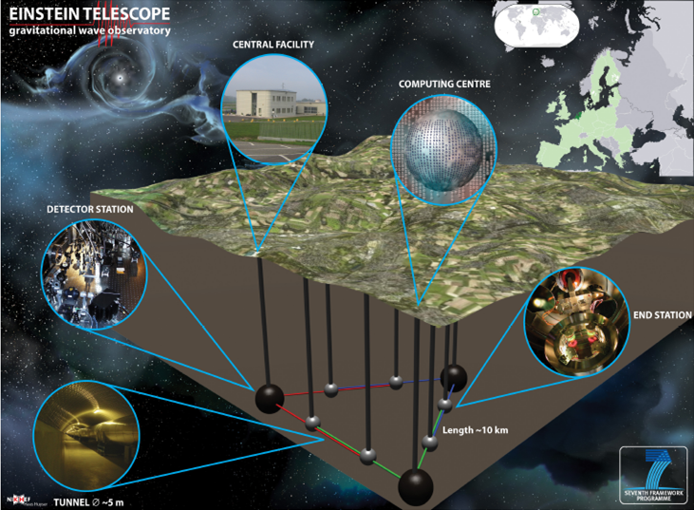
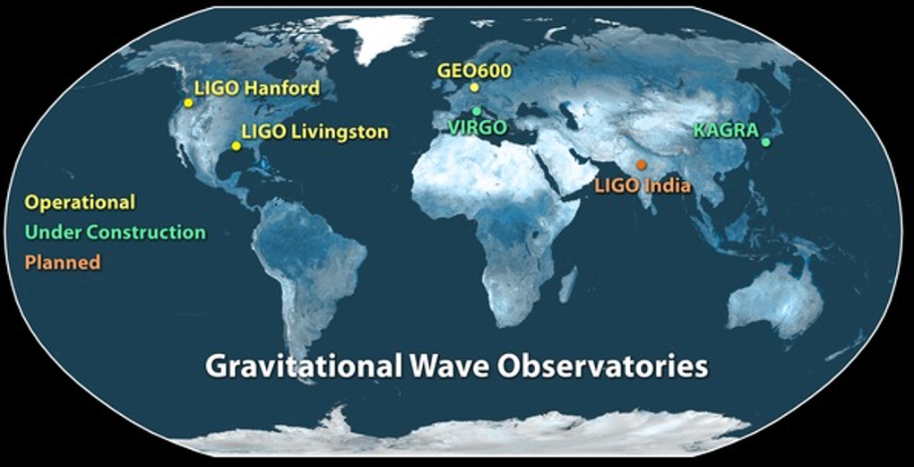
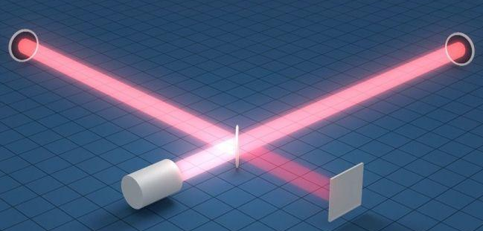
GW detectors

Slide 14
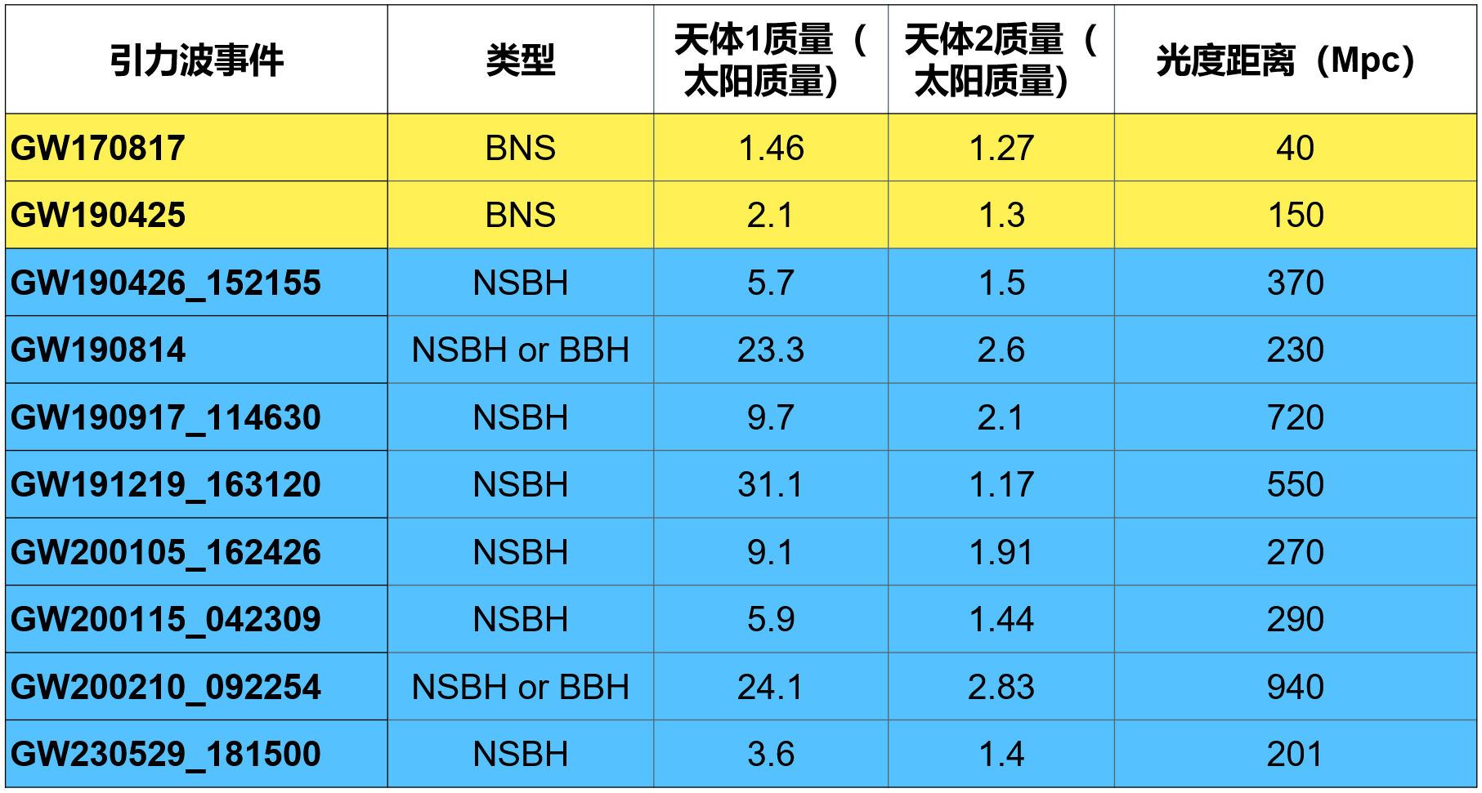
Event rates of BNS and NSBH mergers
From current LVK observations, we have the event rates
* BNSs (7.6-250)/Gpc³/year, consisting with the sGRB rate,
* NSBHs (9.1-84)/Gpc³/year.
BNSs rate is (2.4-80)/year for z<0.1, and (4.3*10³-1.4*10⁵)/year for z<2.
NSBHs rate is (2.9-27)/year for z<0.1, and (5*10³-4.8*10⁴)/year for z<2.

Slide 15
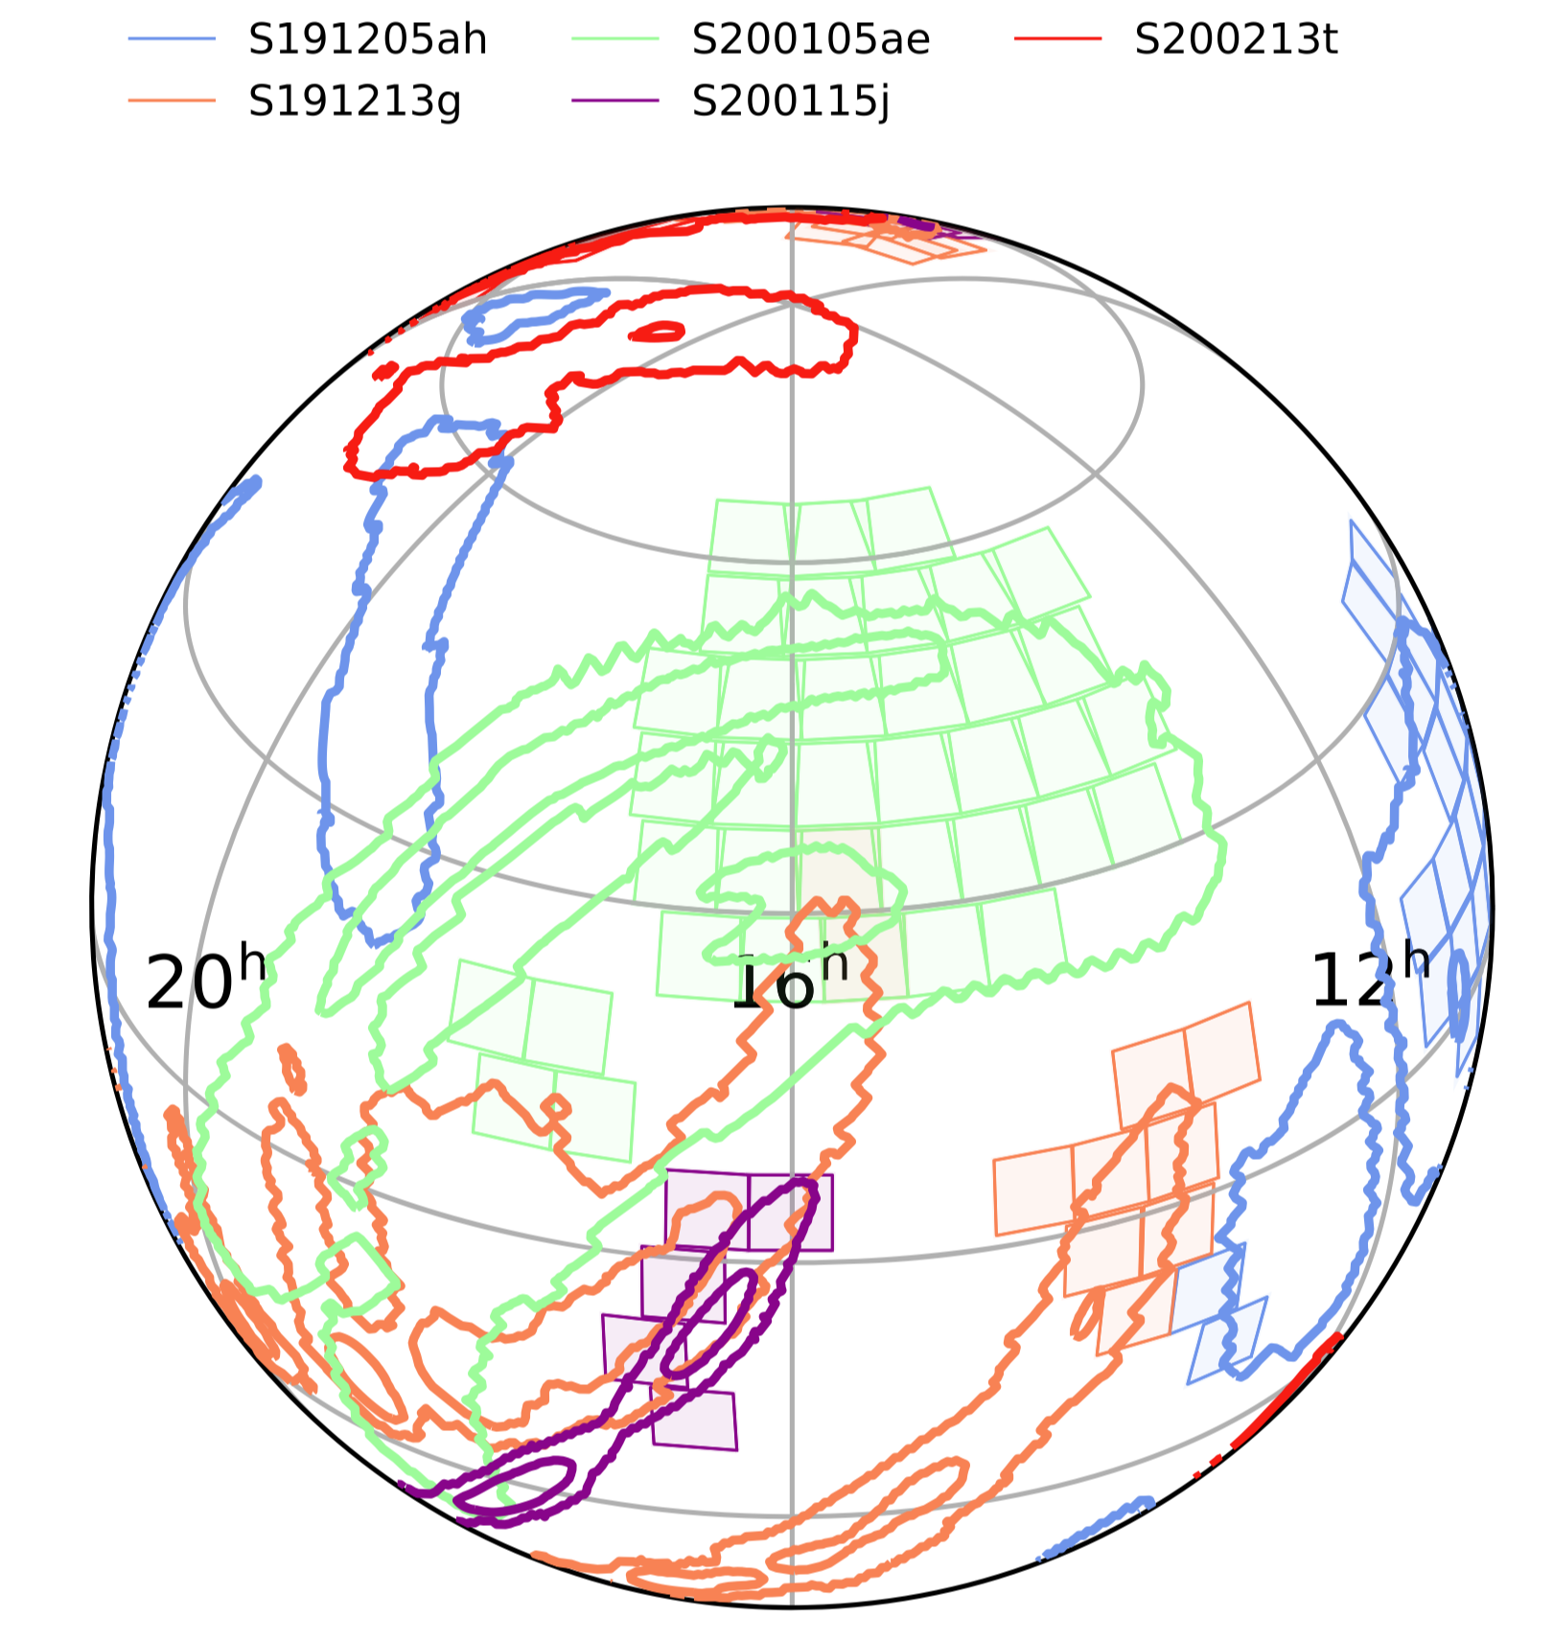
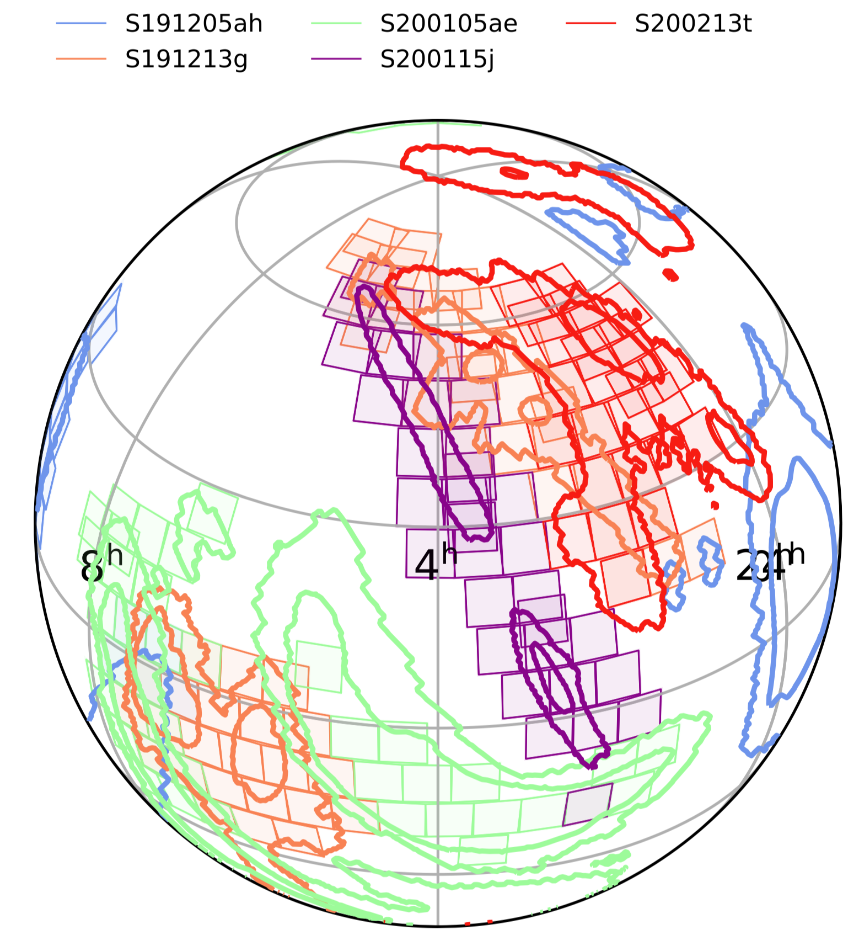
Localization capabilities of GW detector networks
In 2G Era: Status
In 3G Era: Future
In 3G era, due to Doppler effect caused by the Earth’s rotation, a single detector is equivalent to a detector network.
Kasliwal et al.2020 ApJ
WZ* & L.Wen, PRD 97, 064031 (2018)

Slide 16
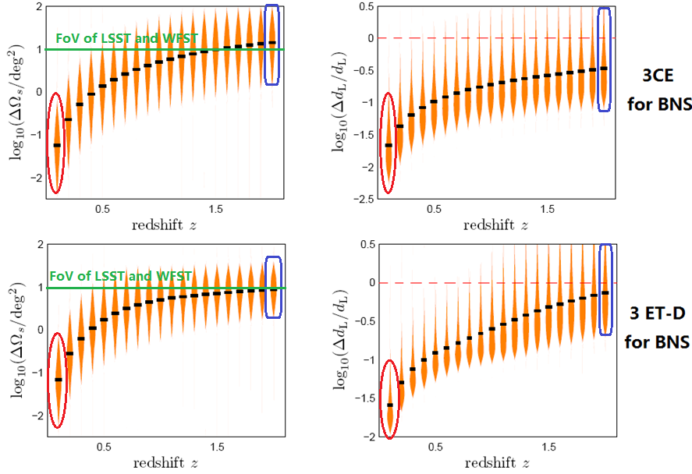

Localization capabilities of 3-detector network
WZ* & L.Wen, PRD 97, 064031 (2018)

Slide 17
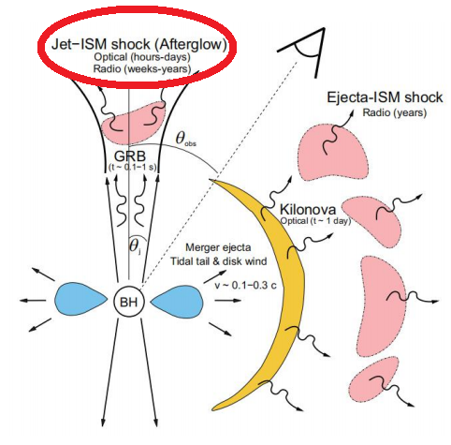
Electromagnetic counterparts and their detections
For the high-z events, the expected EM counterparts are the short-GRBs and their afterglows.
However, GRBs are believed to be beamed: the gamma radiation is emitted in a narrow cone more or less perpendicular to the plane of the inspiral. Therefore, only a small fraction of BNS mergers are expected to have observed GRBs and afterglows.
In most previous works, we always roughly assume that ~ 1000 events in z<2 will be detected by both GW and GRB detections in 3G era. (This assumption will be justified by simulation in our recent work)

Slide 18
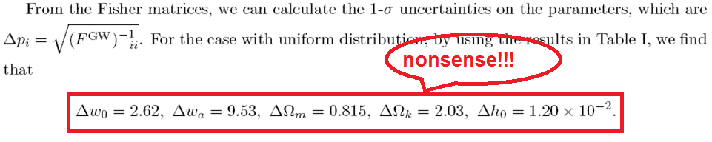

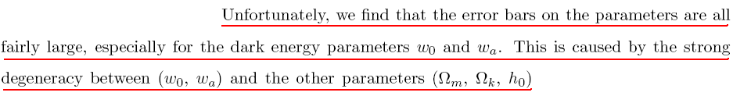
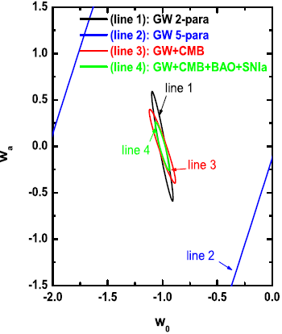



WZ* et al., PRD 83, 023005 (2011)

Slide 19
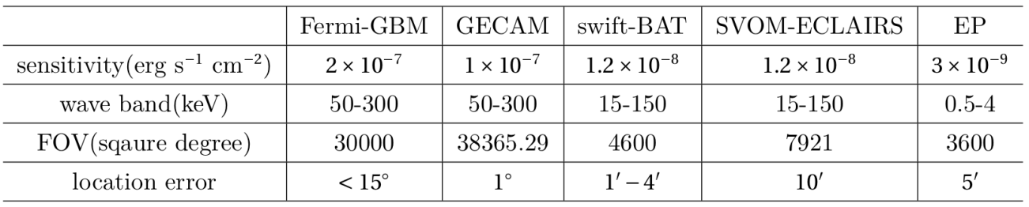
Joint observations of GW and “sGRB+afterglow” detecion
J.Yu, WZ*, et al., ApJ, 916, 54 (2021)
We studied the detection rate of distributions of BNSs which can be detected by GW detectors (2G, 2.5G, 3G) + GRB detectors (EP, GECAM, Swift-BAT, SVOM-ECLAIRS, Fermin-GBM) + the optical telescopes for their afterglow (LSST, WFST etc.).

Slide 20
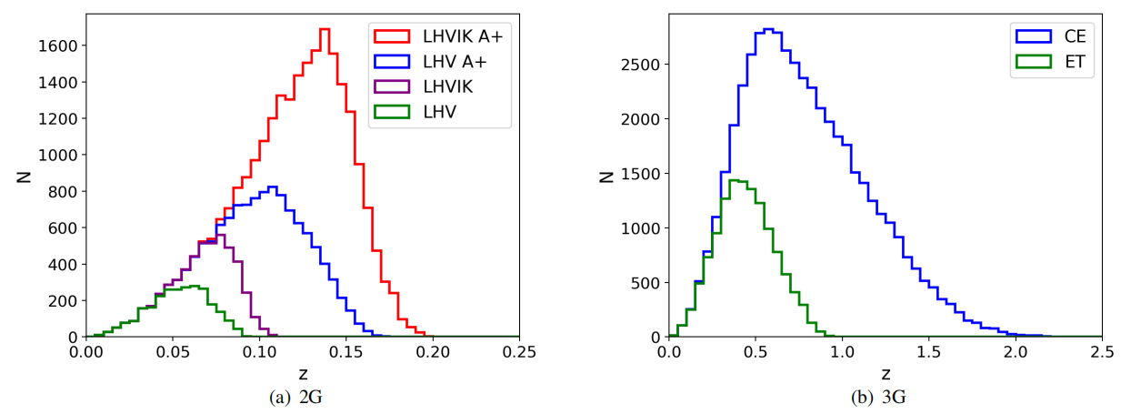
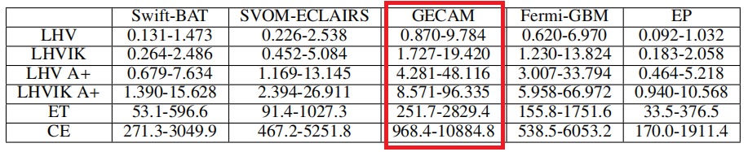
Event rate and redshift distribution

Slide 21
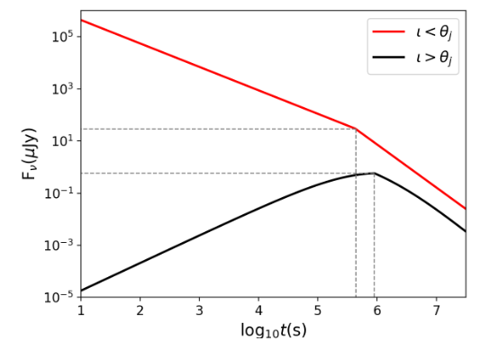
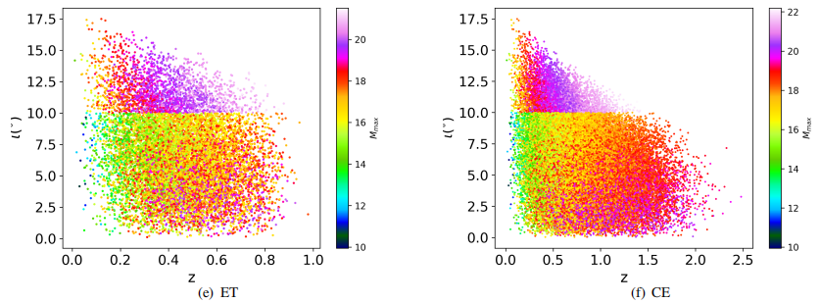
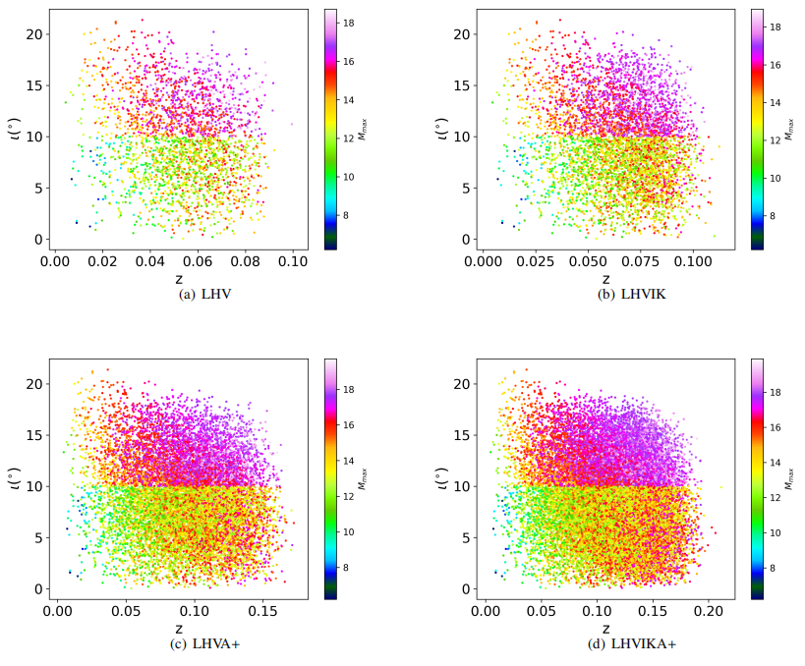
Distribution of “inclination angles” and “the magnitudes of afterglows”

Slide 22
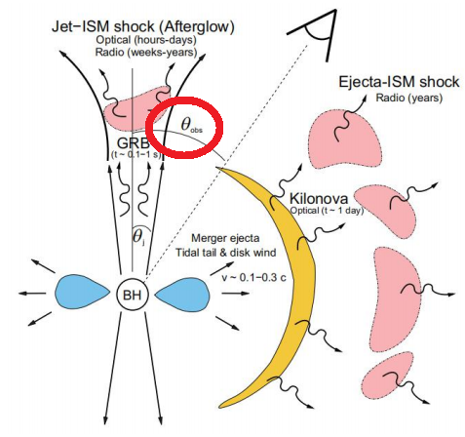
Key Problems
The inclination angle (iota) should be fixed by EM observations Zhao et al., JCAP (2019), Gupta et al., ApJ (2019).

Slide 23
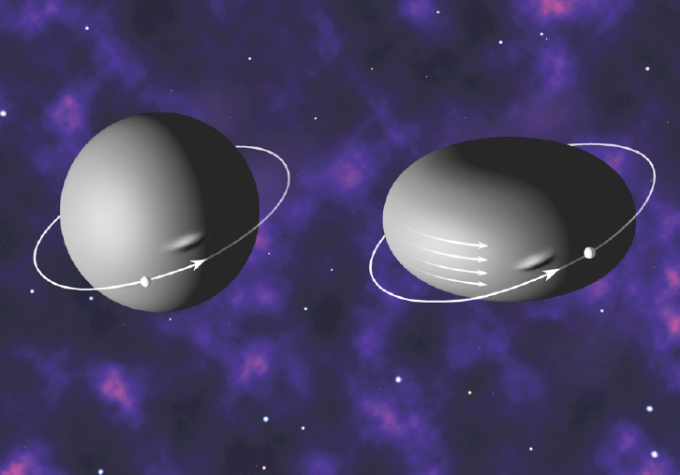
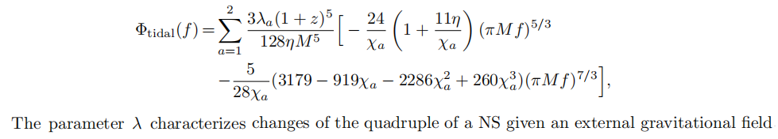
GW standard sirens with tidal effect of NS
B.Wang, Z.Y.Zhu, A.Li & WZ* ApJS 250, 6 (2020)
In the final stage of the inspiral BNS or NSBH, the tidal deformation which contains imprints of the internal structure of NS can affect the orbital motion as well as the waveform of the emitted GWs.
The extra phase term depends on 'lambda' and physical mass 'M/(1+z)'. If 'lambda' is knows (depends on NS's EOS), the physical mass will be measured, which induces the redshift 'z'.
Our ideal is that: (1) Using low-z BNS to fix NS's EOS; (2) Applying it to high BNSs, which can be used as standard sirens.

Slide 24
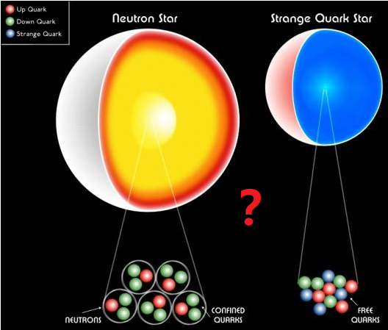
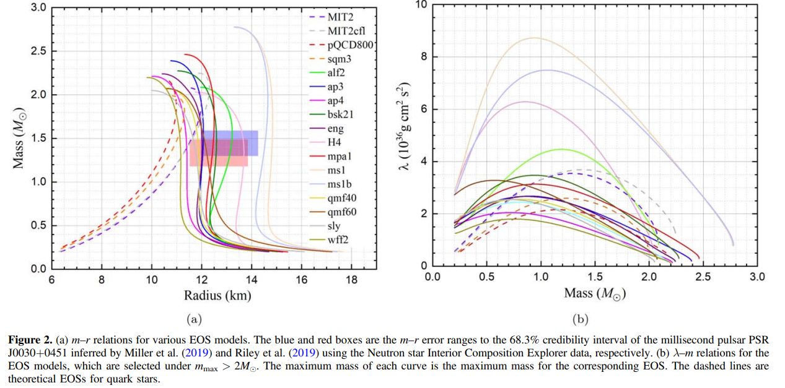
17 different EOSs of NSs or quark stars

Slide 25
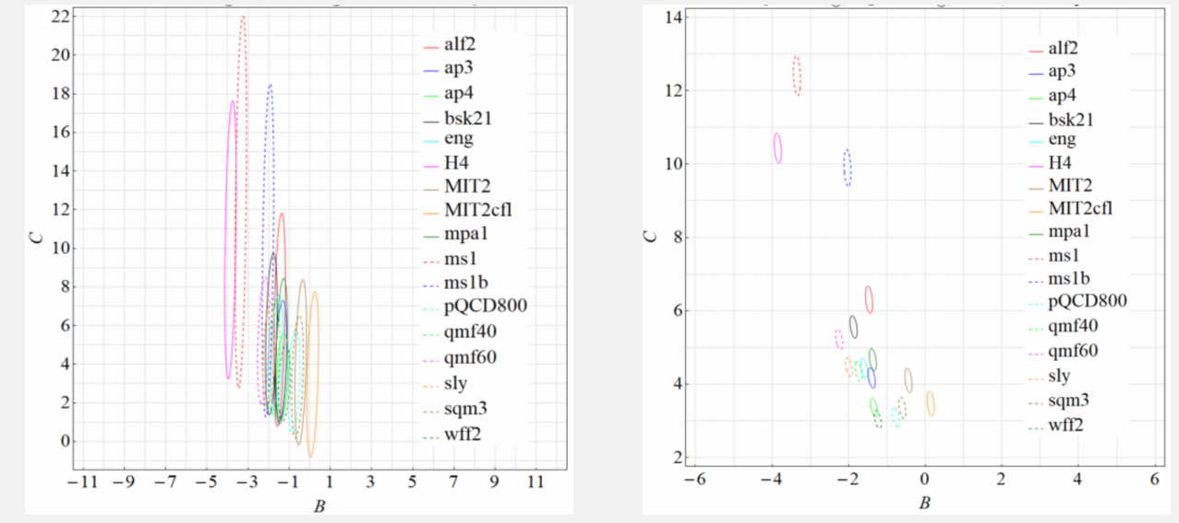
Considering LHVIK network with pesimmistic event rate, we get the constraints of EOS constraints: Left (without EM counterparts); Right (with EM counterparts). Note that, for low-z events, kilonovas are expected to be detected in the future observations.
Fixing NS's EOS by z<0.1 events

Slide 26
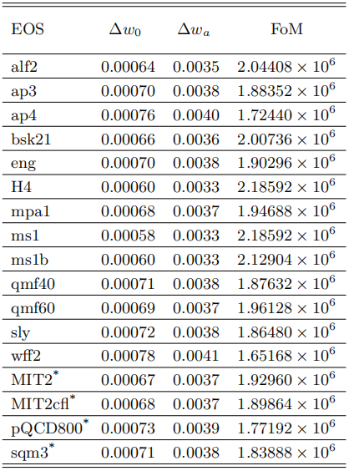
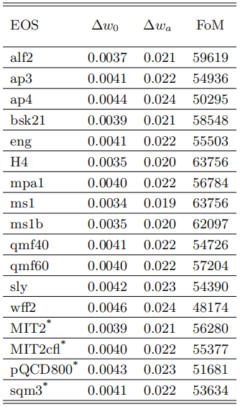
Considering 3G detector networks of ET+CE+CE, we get the constraints of dark energy's EOS. Left (pessimistic case for event rate); Right (optimastic case for event rate).
Constraining EOS of dark energy
Conclusion
BNSs and NSBH with tidal effect, combining with the low-z (z<0.1 or z<0.05) EM counterparts observations, may guide the future of GW cosmology!

Slide 27
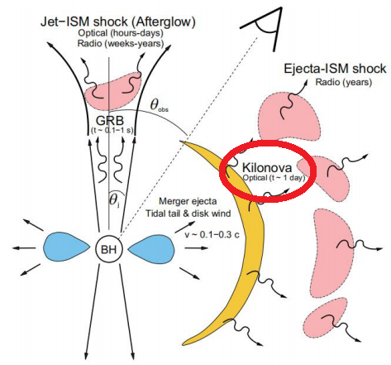
Electromagnetic counterparts and their detections
The emission of kilonovas are nearly isotropic, so for the low-z (i.e. z<0.1 or even lower) GW events, most events are expected to be discovered with kilonovas by LSST, WFST and so on, which can be treated as standard sirens to measuring Hubble constant.
GW170817: z=0.01, dL=(43.8^{+2.9}_{-6.9})Mpc. According to Hubble law, the derived h=(0.70^{+0.12}_{-0.08}). (LVC collaboration 2017). The Hubble tension problem is expected to be sovled by GW observation in the near future.

Slide 28
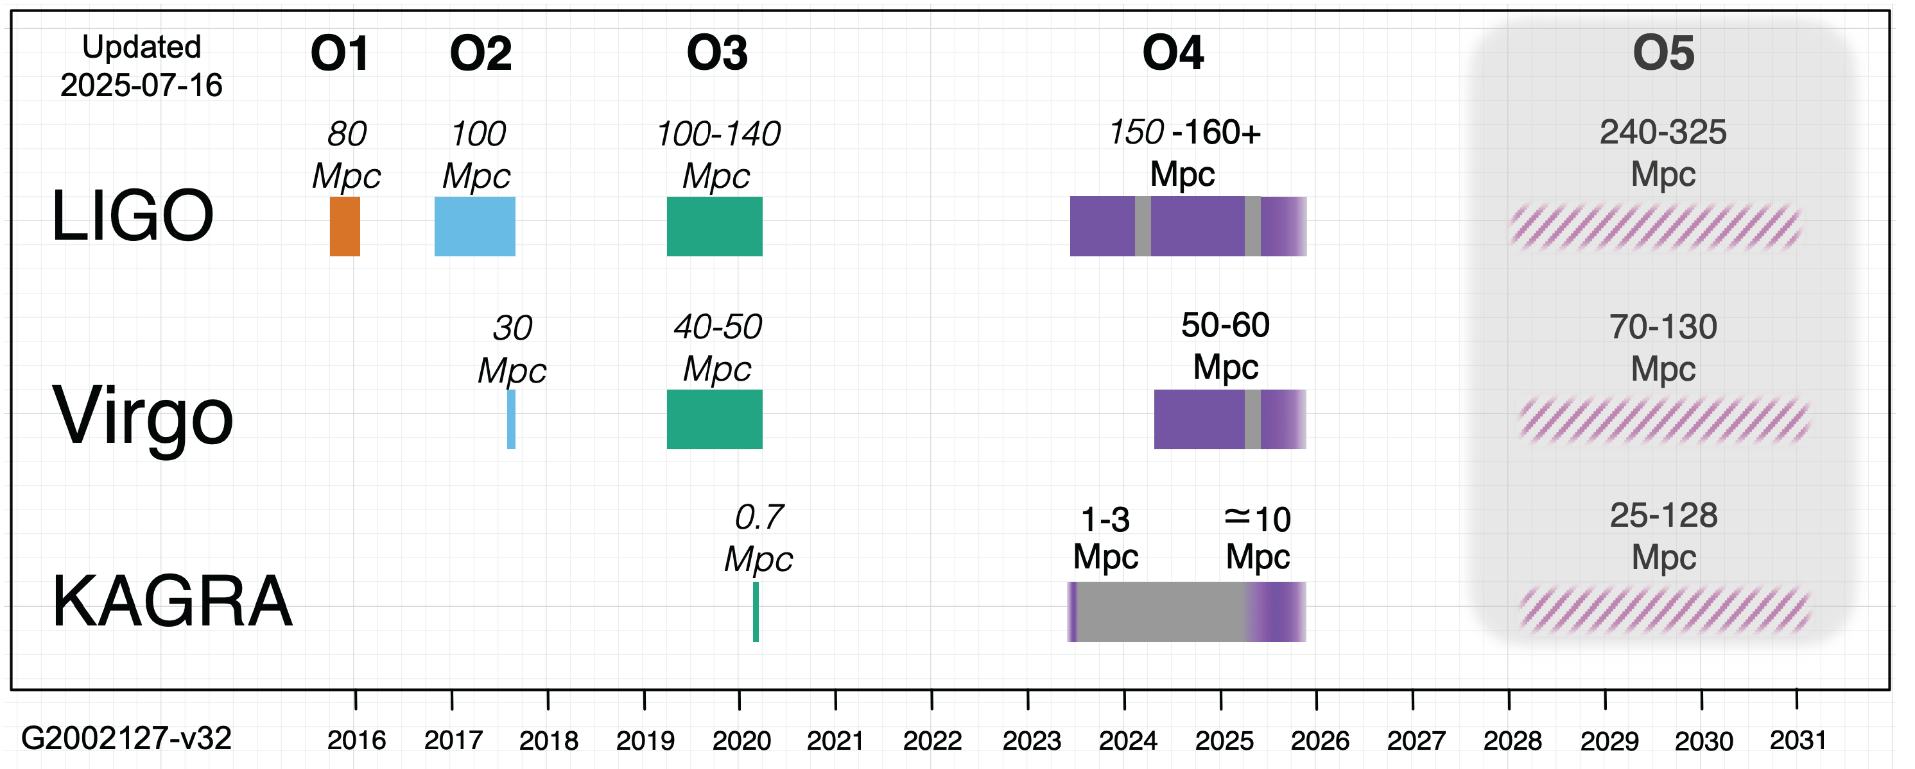
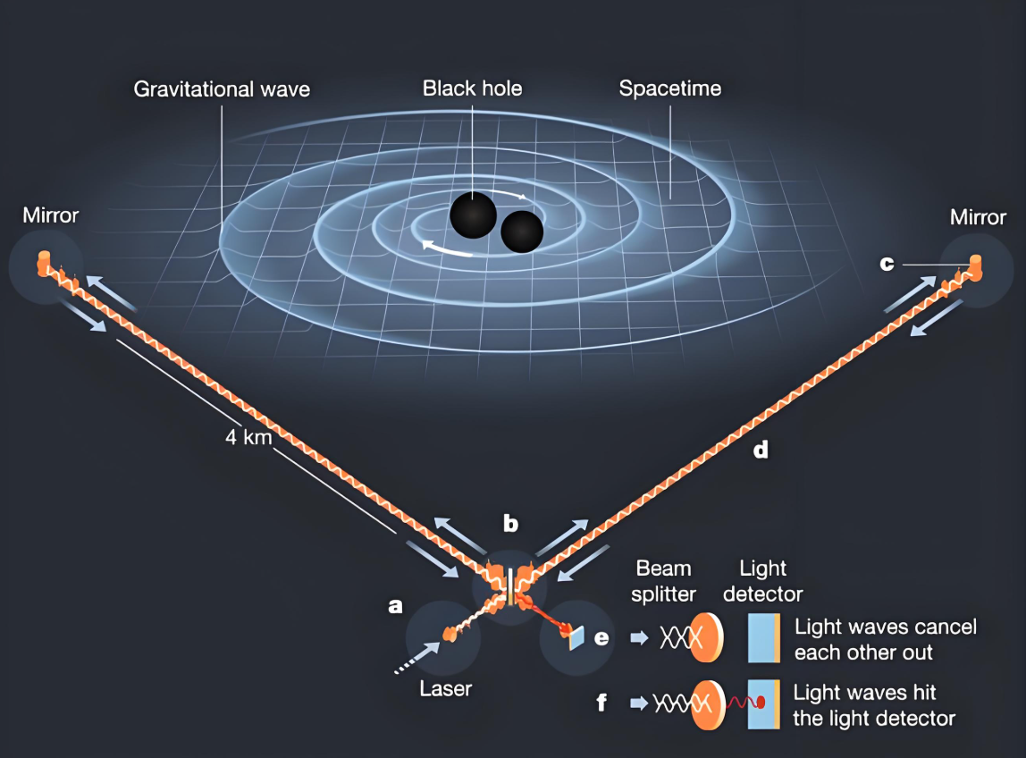
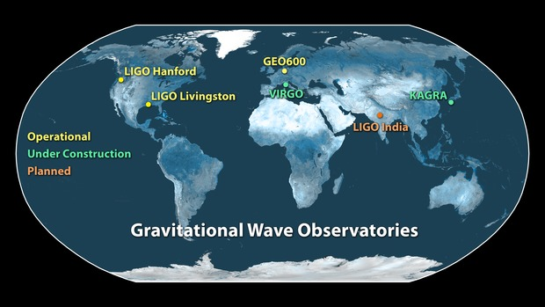

Slide 29
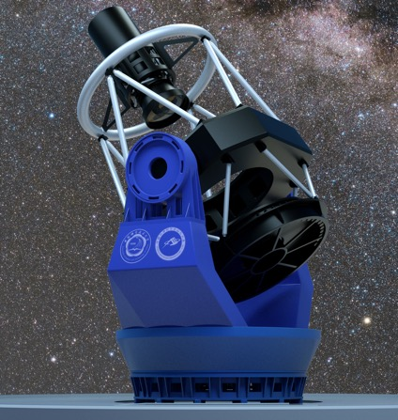


WFST Overview
Introduction and Background
On the top of Saishiteng mountain near the town of Lenghu, Qinghai province.
The site locates at N38.74 deg, E93.34 deg with an altitude of 4200m, seeing of 0.75’’
Wide Field Survey Telescope
2.5-meter primary mirror
A prime focus camera with a field of view of 6 square degrees
Filled with a 9 × 9K×9K mosaic CCD detector.
Five bands: ugriz
r ~ 22.5 mag in 30s integration, 6000 square deg/night
Key scientific goals: time-domain astronomy
WFST is complementary with ZTF, DECAM, PanSTARRS, etc in position (7h for PanSTARRS, 10h for ZTF). They have the equal opportunities for first discovery.
Notes:
WFST是中国科学技术大学与南京紫金山天文台合办的2.5米大视场巡天望远镜，具有7平方度的视场，位于青海省冷湖台址。深度上，30s的曝光时间r波段可达22.5mag

Slide 30


Targets
According to the current restrictions on the EoS of NS, when M_{BH}>3M_{sun}, the kilonovae is basically unobservable (C.D.Capano et al., arXiv:1908.10352).

Slide 31

How to detect?
1. Random search base on a certain survey:
2. ToO observations base on GW alert:
Introduction and Background
AT2017gfo
Villar et al.2017 ApJL
Kasliwal et al.2020 ApJ
Given the luminosity of kilonova and its event rate, the detection efficiency is low:
~0.2/0.8/20 yr⁻¹ for ZTF/WFST/LSST (Zhu et al.2021 ApJL)
3~6 kilonovae for LSST per year (Cowperthwaite et al.2019 ApJL)
Follow-up observation may be a better choice!
In O3 stage, ZTF follow-up observed 13 BNS&NSBH events, but detected zero kilonova:
ZTF detection depth
Insufficient sky coverage
Uncertainty of kilonova from NSBH
……
In O3 stage, ZTF follow-up observed 13 BNS&NSBH events, but detected zero kilonova:
ZTF detection depth
Insufficient sky coverage
Uncertainty of kilonova from NSBH
……
WFST is expected to strength the detection depth of counterpart in Northern sky
Notes:
双中子星或黑洞中子星在并合中将产生抛射物质，这些物质通过快中子俘获过程形成不稳定重元素。千新星就是由这些重元素衰变供能的光学辐射。对于双中子星并合的千新星，辐射一般认为是近乎各向同性的，在光学波段的电磁对应体我们的主要目标为千新星。目前有两种搜寻千新星的方式：第一种基于巡天随机搜索，许多工作对这种方式展开了研究，数目在每年几个左右，但考虑到具体的认证难度，效率会进一步降低。另一种是预警后随观测，这种模式下在O3阶段ZTF对13例双中子星和黑洞中子星事件进行了观测，但没有探测到千新星，原因如下：。所以我们期望在北天WFST能在探测深度上加强对千新星的搜寻，我们的工作也基于后随观测展开。

Slide 32
Pipeline for GWE detection

Slide 33

Simulations for WFST
Research Progress
on:
The way for simulating kilonova detection:
Generate simulated image, do judgement according to SNR:
Noise from host galaxy and atmosphere
The effect from image subtraction
The elements of image:
Kilonova template:
AT2017gfo-like lightcurve by mosfit
Host galaxy:
Use the galaxy in synthetic galaxy catalog cosmoDC2
Z.Liu, WZ*, et al., ApJ 947, 59 (2023)
Notes:
模拟探测的方法主要有两种：第一种是比较千新星视星等与望远镜极限星等，第二种可以通过模拟图像研究能否探测，这种方式可以考虑宿主星系与图像相减带来的影响。
我们选择了第二种方式进行预研究。图像中包括宿主星系和kilonova，千新星使用类170817千新星由mosfit产生，宿主星系使用合成星表cosmoDC2的星系。在生成图像之前有两个问题需要处理：哪些星系更容易成为宿主星系以及宿主中心与并合位置的距离问题。

Slide 34



Simulation Results
Research Progress
For peak of kilonova for each band:
According the sensitivity of LVK in O4 stage, with 30s~90s exposures, WFST can detect the most kilonovae which locate in WFST’s field.
Exposure time set: 30, 40, 200s respectively for WFST, LSST and ZTF, which is inversely proportional to telescopes’ FoV.
Even considering the FoV difference, WFST can detect kilonovae more distant than ZTF.
Notes:
考虑千新星的峰值时刻，对每一个红移范围内的星系样本进行模拟后，对BNS发生率加权平均后可以得到探测率曲线，其中加入星系带来的影响可从曲线的下降快慢看出：根据某红移处星系各波段的流量分布，波长约长，流量分布越广就对应探测率曲线下降更慢，具体的探测深度结果由表格展示，结合LVK在O4的灵敏度，WFST使用30s-90s的曝光即可探测到大部分视场中的千新星

Slide 35


Optimize exposure time
Base on these result:
For each observable time segment after merger, we can choose the exposure time according the distance information and the average magnitude of the kilonova.
Using the package like gwemopt, we can generate a search strategy for certain GW event by setting bands and exposures.
distance
distance
detectability
detectability
An example for GW190426
Notes:
基于这些结果，可以用于优化后随观测中曝光时间的选取。根据引力波预警给出的距离分布，结合探测率曲线，保证一定的探测率下，我们可以选出一个合适的曝光时间进行探测。对于每个触发后可观测时段，通过计算每个时段的千新星平均视星等，我们就可以为每个时段每个波段分配曝光时间。
具体的观测顺序我们利用一些开源包，根据概率分布和曝光时间设计观测策略，右下角的动画是一个例子。

Slide 36




ToO estimation
Total time with different localizations and distances
The number of pointing: area & FoV
Exposure time: based on the method in this work
For WFST with two bands: $\sim 1000\deg^{2}$ and $<300Mpc.$
Given observable sky, Milky Way, weather efficiency, moon, sun..., WFST is expected to find ~ 1 kilonovae each year in O4.
Notes:
最后，我们估计了WFST在不同定位精度和不同距离下的ToO时间花费情况。根据视场和天区大小可以简单估算出需要的指向数目，再结合之前的曝光时间选取，可以得到左侧图中的结果：可以看出在1000平方度，300Mpc内的事件，WFST使用6-8小时就可以完成双波段的覆盖，对应两晚的时间。右侧展示了O4模拟的定位与距离情况，可以发现大部分事件都处于这个范围之内，考虑观测倾角，银河前景，天气等因素，WFST预计每年在O4观测2-3例千新星。

Slide 37


S230518h: First GW event during O4! LVK predicted HasRemnant <1%.
GW230529: Too bad sky coverage (~ 24100 $\deg^{2}$ )
S230627c: Too bad follow-up observation!
S240422d: Classification of being non-Astrophysical (93%)

Slide 38




S250206dm事件的WFST后随观测
观测执行情况和天区覆盖：
2025.2.7-12，除10号下雪未观测外，其他夜晚观测正常执行，其中 8号多云，其余天气较好
覆盖情况
7-9号：~64%，~333平方度
11-12号：~56%，~120平方度
Notes:
同样的，针对该事件，WFST望远镜也在光学波段开展了后随观测。由于该事件在南天，因此WFST望远镜只能观测到一小部分天区。观测事件长达一周，得到差分源总数约76万，重复源约10万。最后发现没有疑似的电磁对应体。

Slide 39

Z.Liu, WZ* et al., submitted（2025）

Slide 40

观测计划安排

Slide 41


Slide 42

Z.Liu, WZ* et al., submitted（2025）

Slide 43


Slide 44


Slide 45
Conclusions
We are in the new era of multi-messenger GW astronomy.
As an application of GW events and EM counterparts, standard sirens can be used to constrain Hubble constant in 2G era, and to detect dark energy in 3G era.
In the near future, WFST is hopeful to detect several GW EM counterparts of BNS and/or NSBH mergers in O4 and O5 (Need good luck!).

Slide 46
Thank you for your attention!

Slide 47

面对时域天文的天地一体化协同观测网络
研究目标：
基于WFST、EP、SVOM、GECAM等设施的天地一体化多波段协同观测，完成多次引力波电磁对应体的高能、光学搜寻与多波段后随观测研究。
人员：赵文*、陶炼、
薛永泉、孙宁晨等
单位：中国科学技术大学、
高能物理研究所、
国家空间科学中心、
中国科学院大学、
国家天文台

Slide 48
ZTF surveys in O3

Slide 49

ZTF detection in O3

Slide 50
Simulations for WFST
on:
The way for simulating kilonova detection:
Generate simulated image, do judgement according to SNR:
Noise from host galaxy and atmosphere
The effect from image subtraction
The elements of image:
Kilonova template:
AT2017gfo-like lightcurve by mosfit
Host galaxy:
Use the galaxy in synthetic galaxy catalog cosmoDC2
Research Progress
on:
Two questions before combining kilonova lightcurve with galaxy to generate images:
Which galaxies can produce BNS and have more weight?
The offset between galaxy center and kilonova?
Z.Liu, WZ*, et al., ApJ 947, 59 (2023)
Notes:
模拟探测的方法主要有两种：第一种是比较千新星视星等与望远镜极限星等，第二种可以通过模拟图像研究能否探测，这种方式可以考虑宿主星系与图像相减带来的影响。
我们选择了第二种方式进行预研究。图像中包括宿主星系和kilonova，千新星使用类170817千新星由mosfit产生，宿主星系使用合成星表cosmoDC2的星系。在生成图像之前有两个问题需要处理：哪些星系更容易成为宿主星系以及宿主中心与并合位置的距离问题。

Slide 51





Simulations for WFST
1. Which galaxies can produce BNS and have more weight?
2. The offset between galaxy center and kilonova?
Research Progress
Two methods：
Trace BNS by observed sGRBs which have offset measurements
Use the result from population synthesis
Base on the sample reported in Fong et al.2013:
Artale et al.2019
We can calculate the weight for each galaxy as a host of kilonova by:
Some filters for galaxy catalog cosmoDC2:
$z<0.2$
$\log_{10}\left(n_{GW}\right)>4$
Notes:
对于权重问题，我们采取2019年这篇工作，它使用星族合成方法得到了并合事件率与星系恒星质量之间的拟合关系，利用此关系，可计算每个星系的权重大小。除此之外，通过对红移和权重做一定筛选，扔掉不重要的星系，进一步降低计算时间。
关于并合处与星系中心的距离，我们使用sGRB示踪双中子星并合的位置，基于13年报告的22个sGRB样本，我们又增加了表格中其他5个样本，得到了间距的分布拟合关系，用于生成间距样本。

