Slide 1
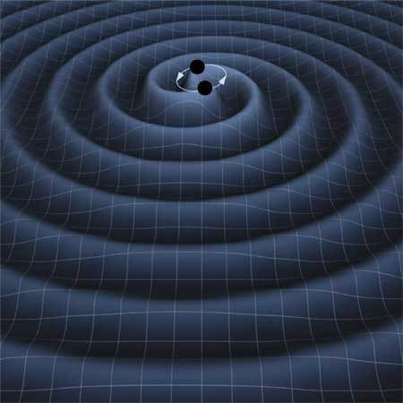
Machine Learning Techniques for
Gravitational Wave data analysis
Zhoujian Cao
Beijing Normal University
2025-10-16
@ 千岛湖

Slide 2
Content
Chance and challenge of GW astronomy
Role of ML for GW astronomy
Waveform modelling
Data analysis
Summary

Slide 3
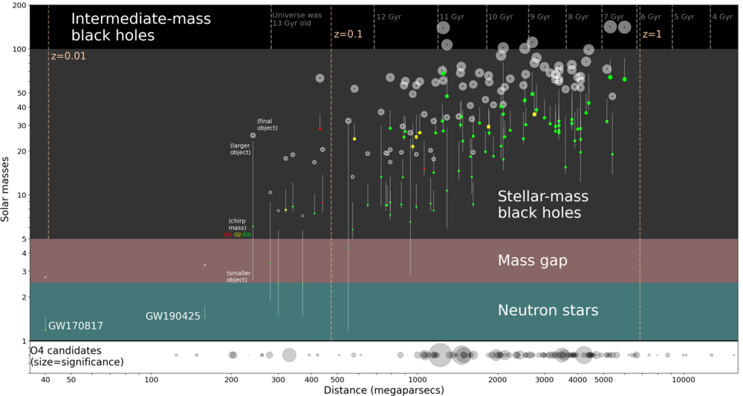
Achievements of ongoing GW detection

Slide 4
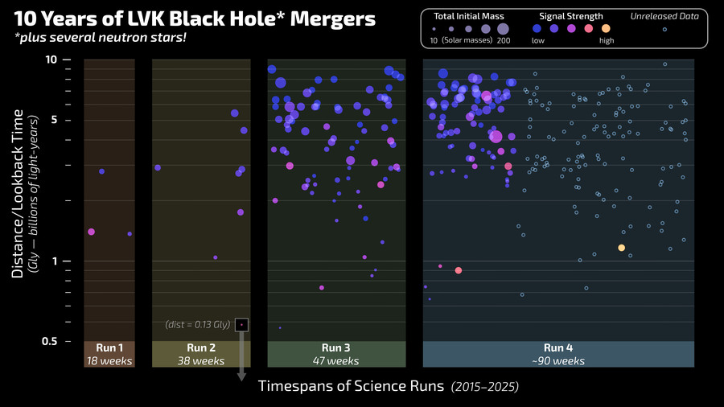
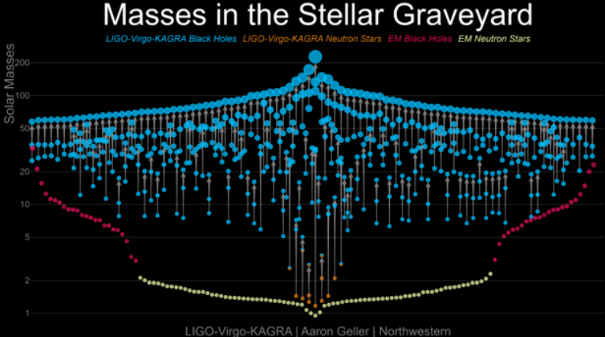
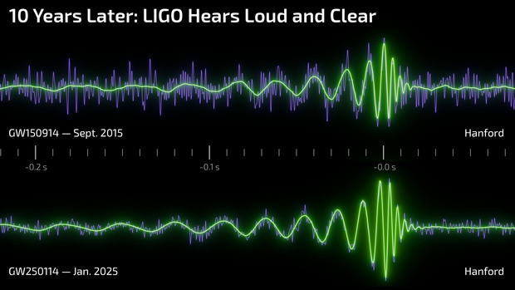
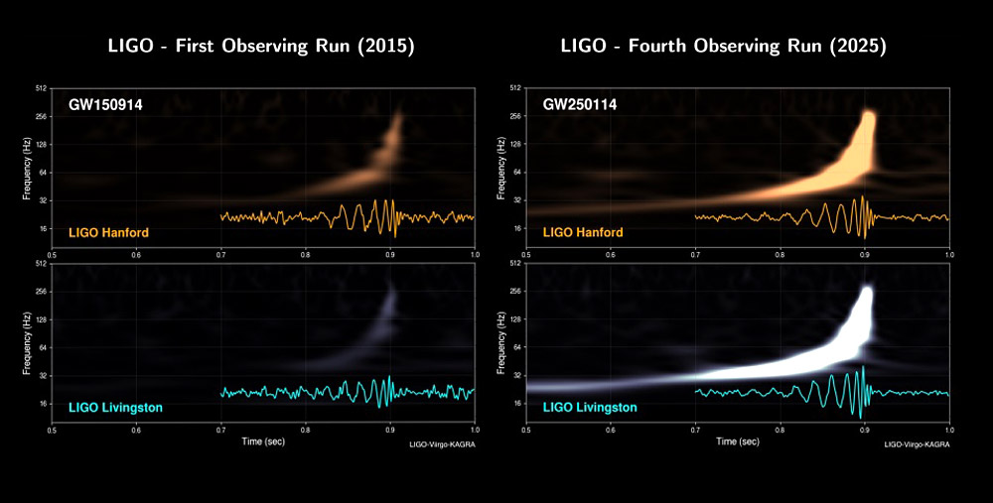

Slide 5
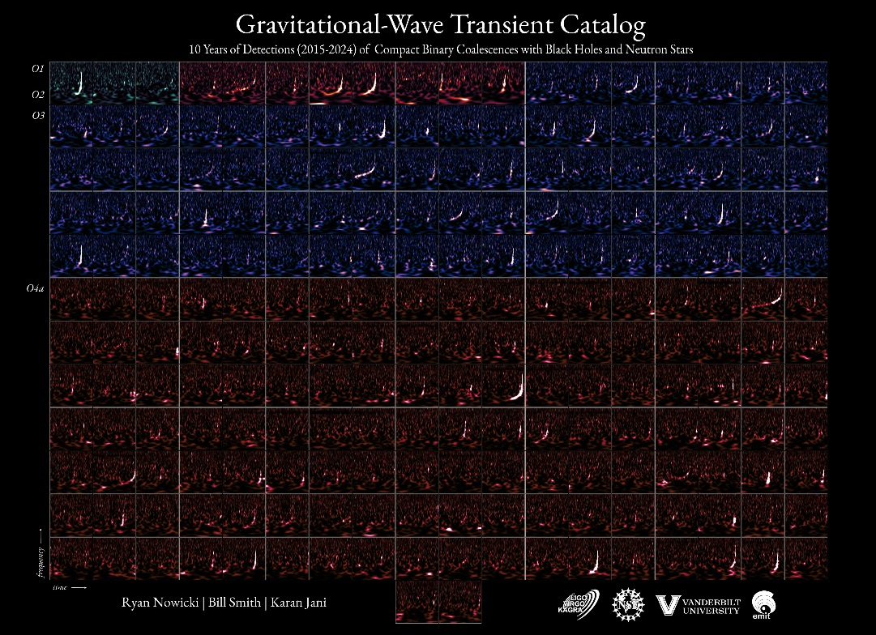
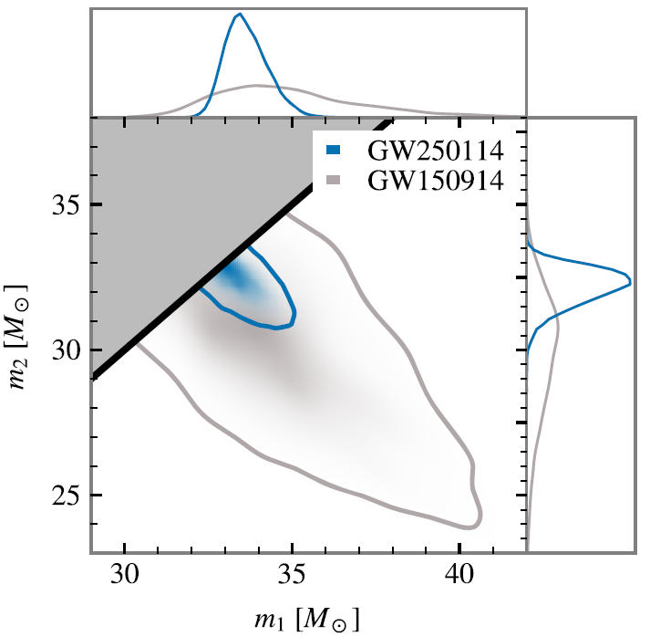
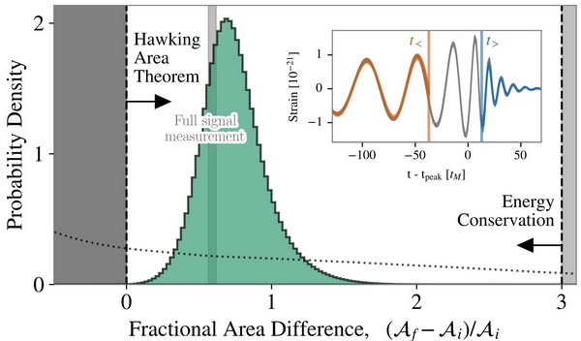

Slide 6
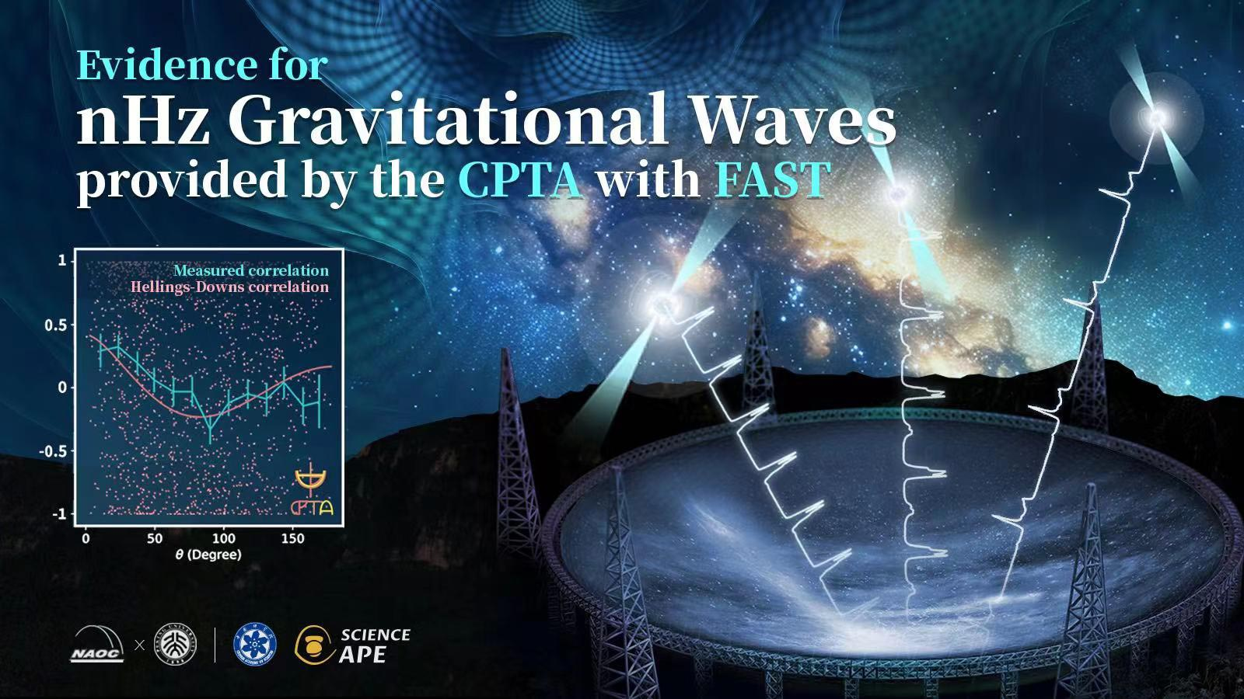
Achievements of ongoing GW detection
Evidence of SGWBs has been detected

Slide 7
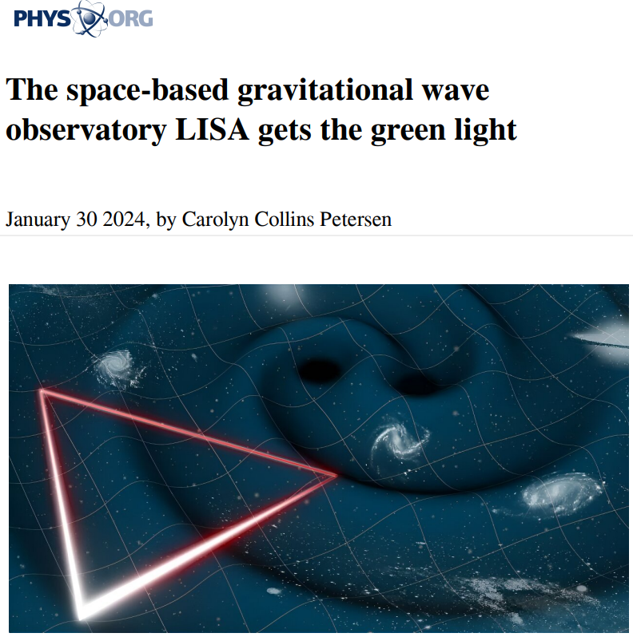
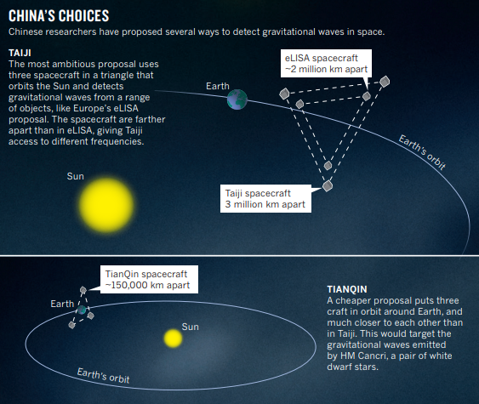

Slide 8
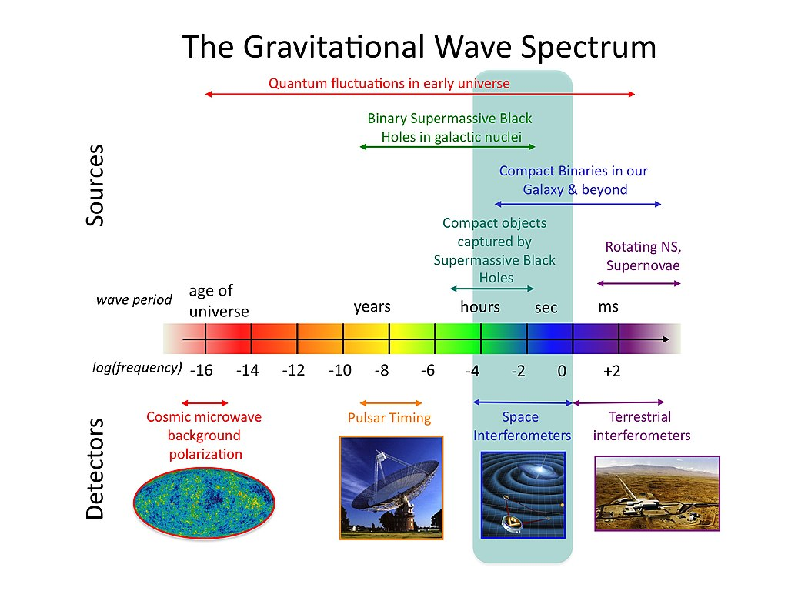

Slide 9
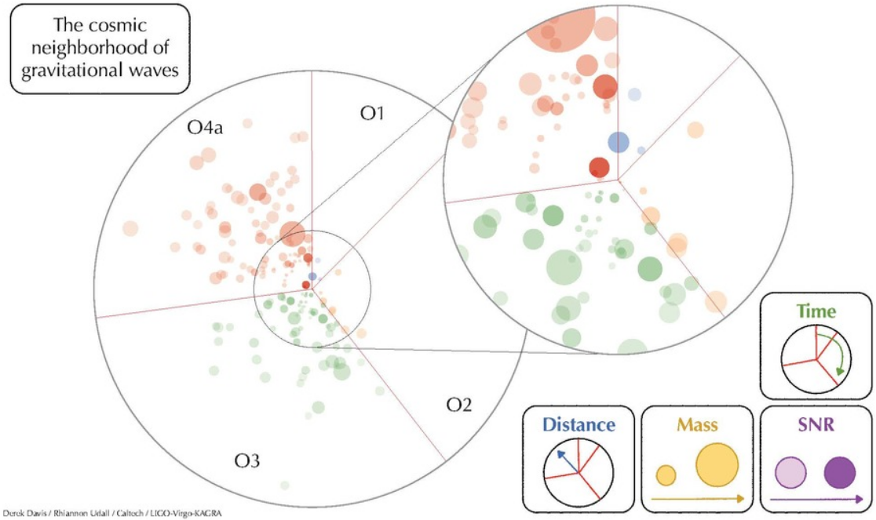
Chance of GW astronomy
100s events → much more events
→ statistics for astronomy

Slide 10
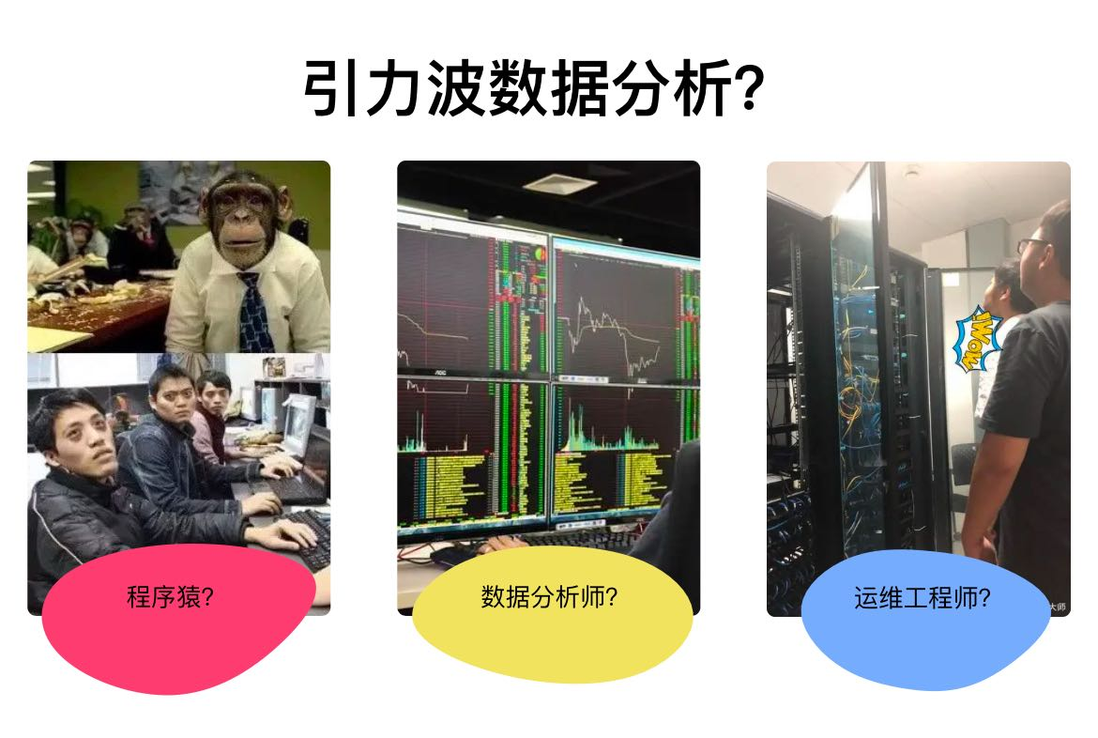
Chance of GW astronomy
100s events → much more events
→ statistics for astronomy
Brand new object → open a new astronomy
Signal beyond GR? signal for Quantum Gravity?

Slide 11
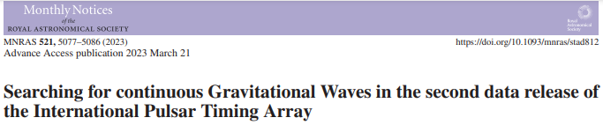
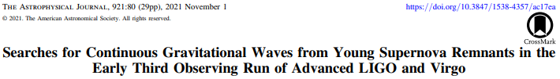

What’s more?
Continuous wave?

Slide 12
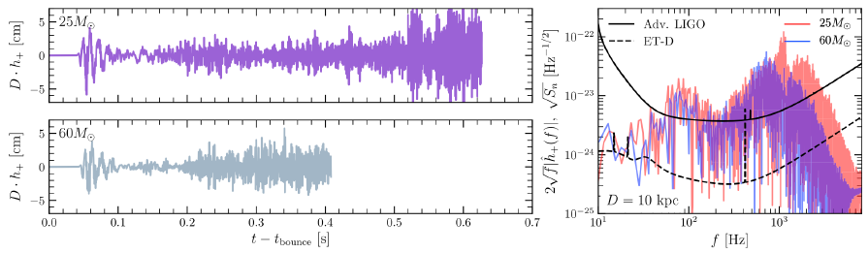
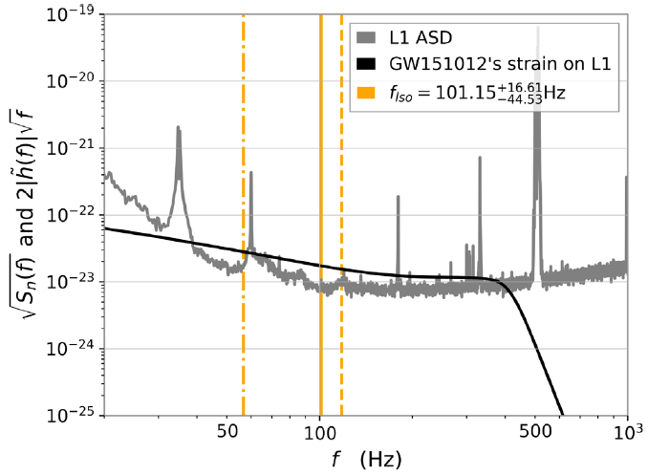
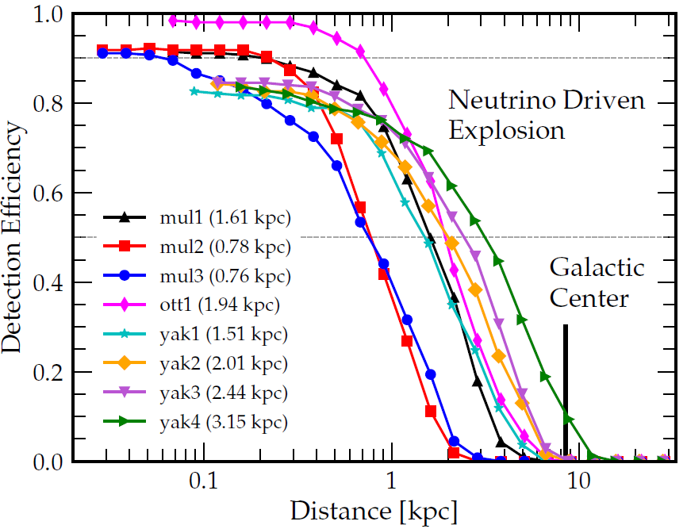
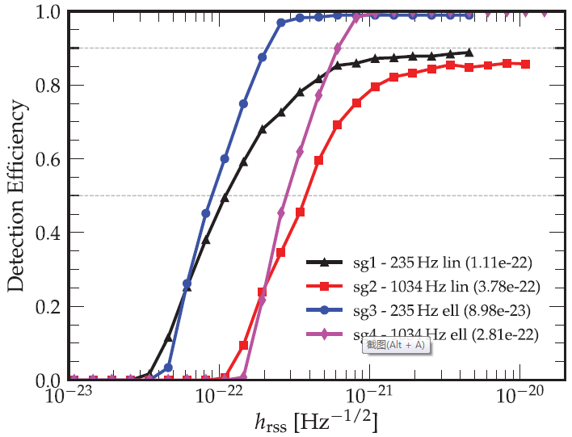
What’s more?
Supernovae?
VS
BBH detection

Slide 13
Challenge of GW astronomy
100s events → much more events
→ statistics for astronomy
Brand new object → open a new astronomy
Signal beyond GR? signal for Quantum Gravity?
Faster and more efficient!
Unlimited by template!

Slide 14
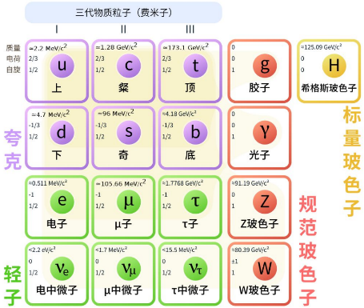
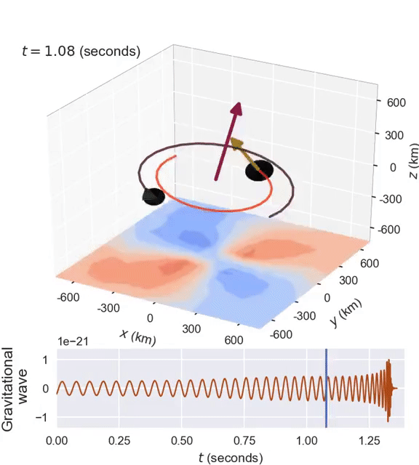
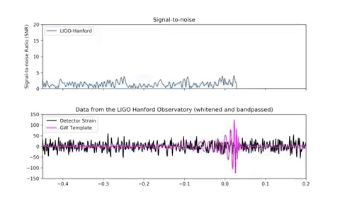
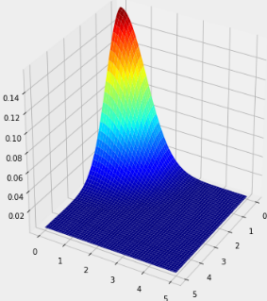
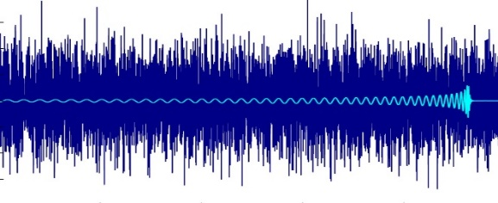
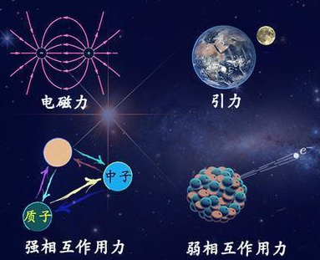
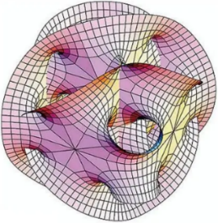
从传统算法到人工智能算法 !
模板匹配
智能贝叶斯参数估计
低信噪比（-40dB）
非稳非高斯噪声
多模态数据
亚原子核级别振幅
非模板信号搜索
引力波信号识别与分类
基本理论检验与颠覆
智能降噪与分离
波形定性半定量分析
人工智能算法：
基于自注意力的大规模降噪模型
基于变分自编码器的信号分离模型
基于深度生成方法的物理参数反演模型
训练数据：
LIGO/VIRGO真实观测数据（10TB）
联合多信道激光干涉模拟数据
极端物理条件下引力场模拟：
引力理论：标准广义相对论；标量/张量引力理论；超对称引力理论；膜宇宙引力理论；额外维引力理论
量子场论：标准量子场理论；中微子带质量的理论；暗物质与暗能量理论

Slide 15
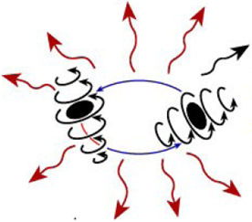
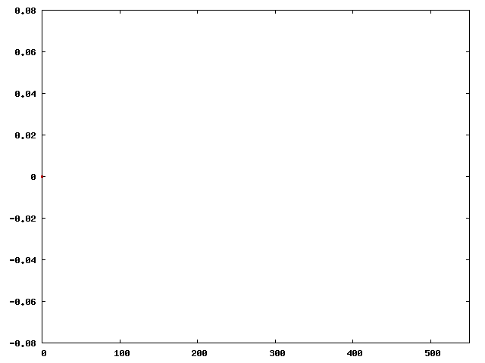
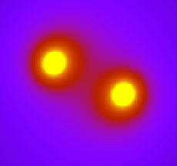
时间演化释放引力波，由爱因斯坦方程完全确定
+
初始条件，参数：
质量、自旋、轨道离心率
解析分析
引力波数据分析可用模板

Slide 16
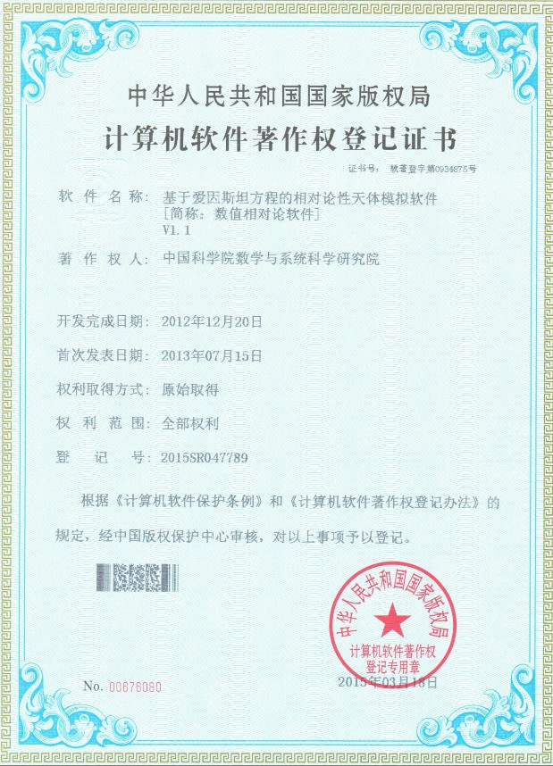
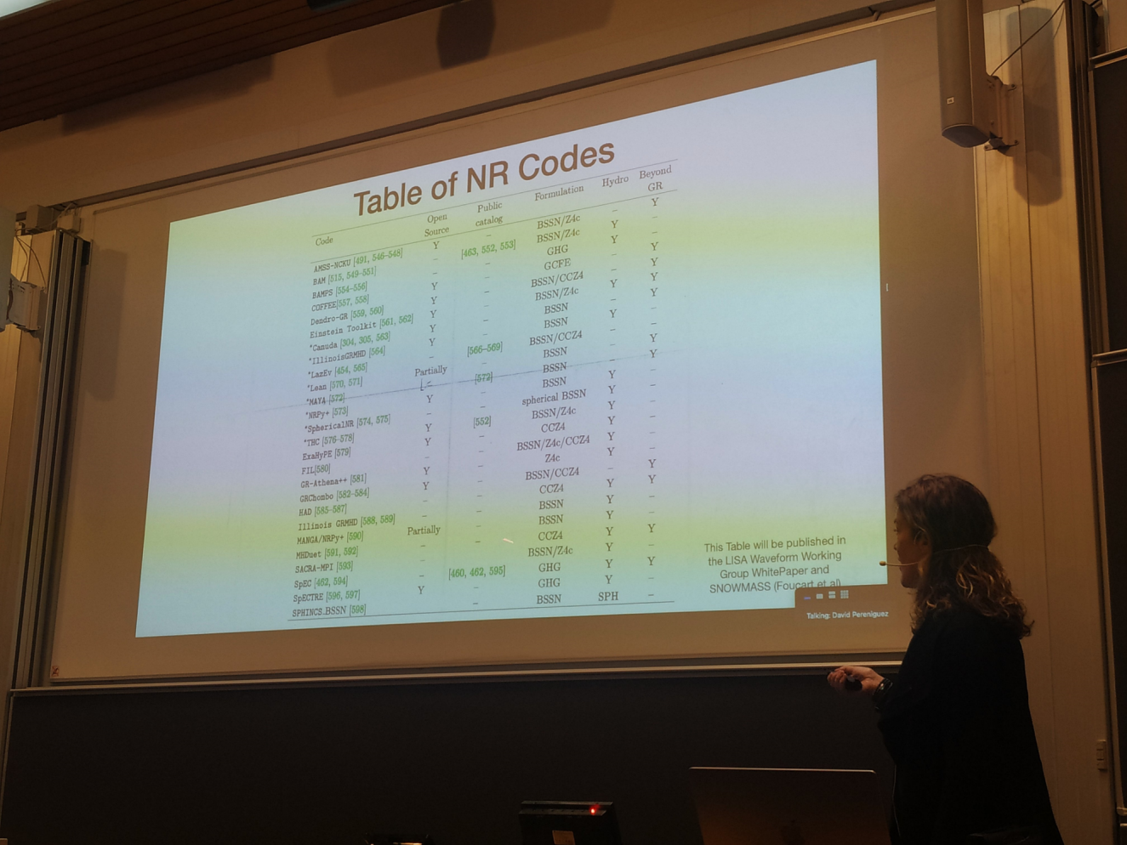
数值相对论软件AMSS-NCKU
LISA波形模板工作组报告

Slide 17
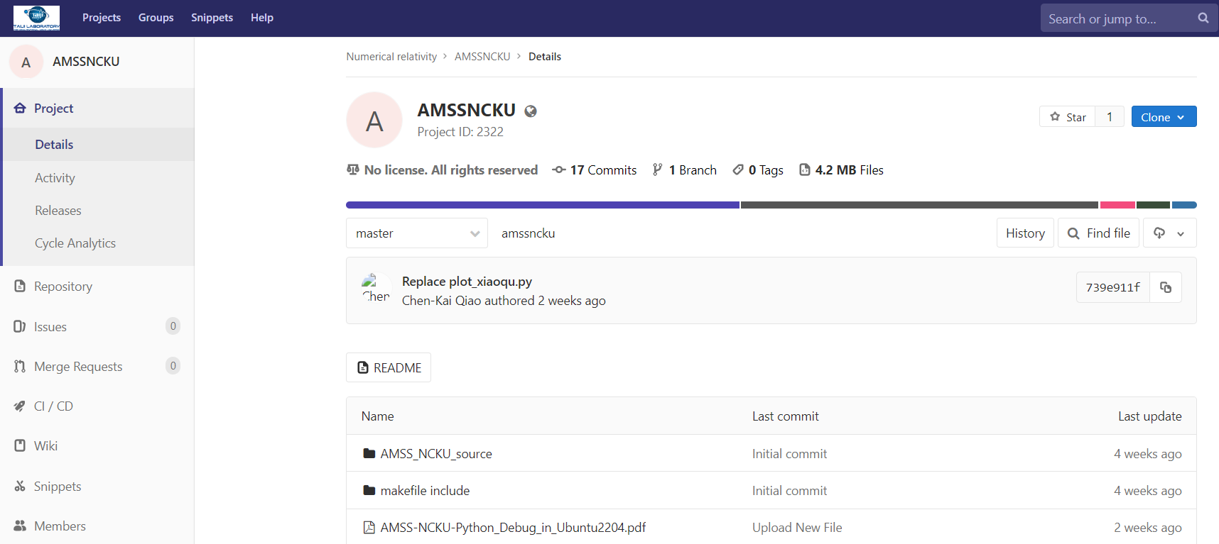
数值相对论软件AMSS-NCKU
Notes:
http://210.77.30.40/NR/amssncku

Slide 18
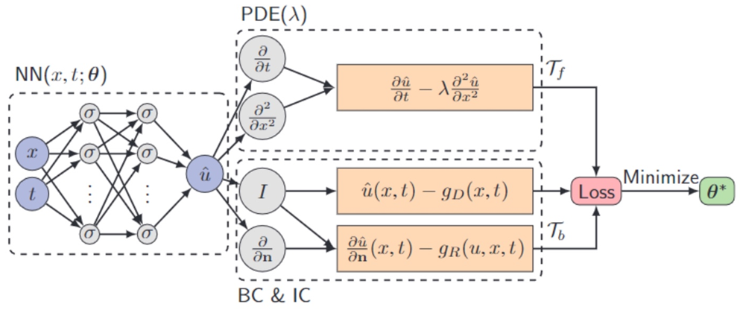
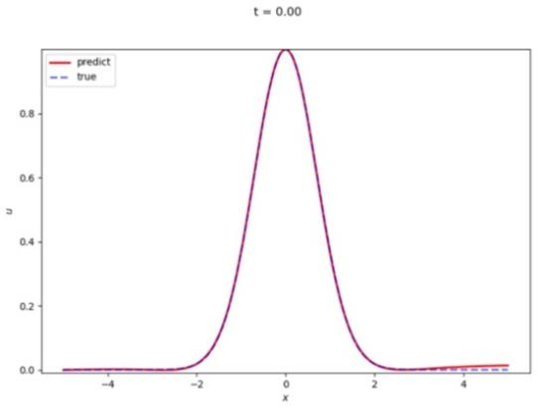
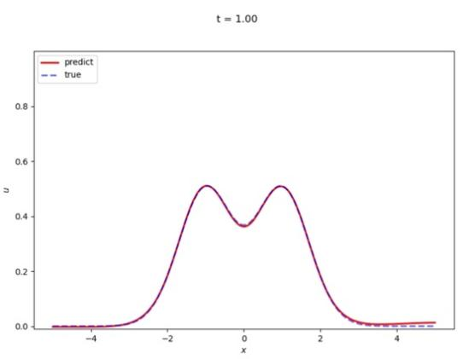
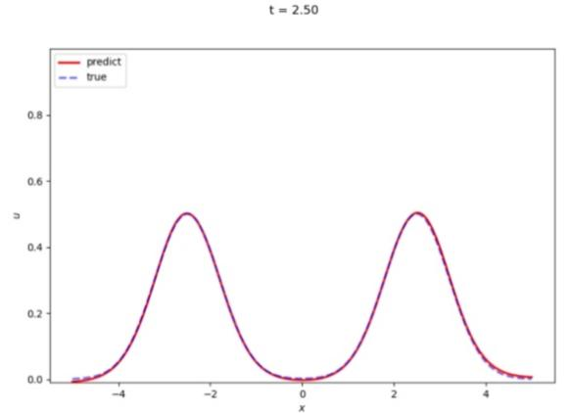
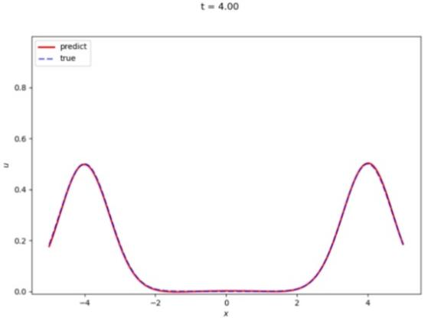

AI for NR
On going ……

Slide 19
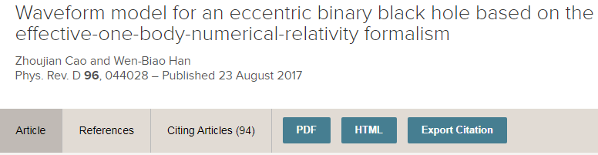
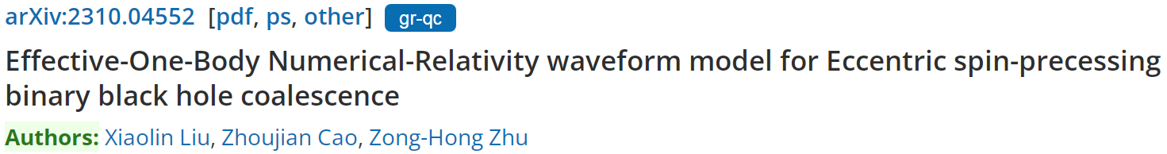

Slide 20
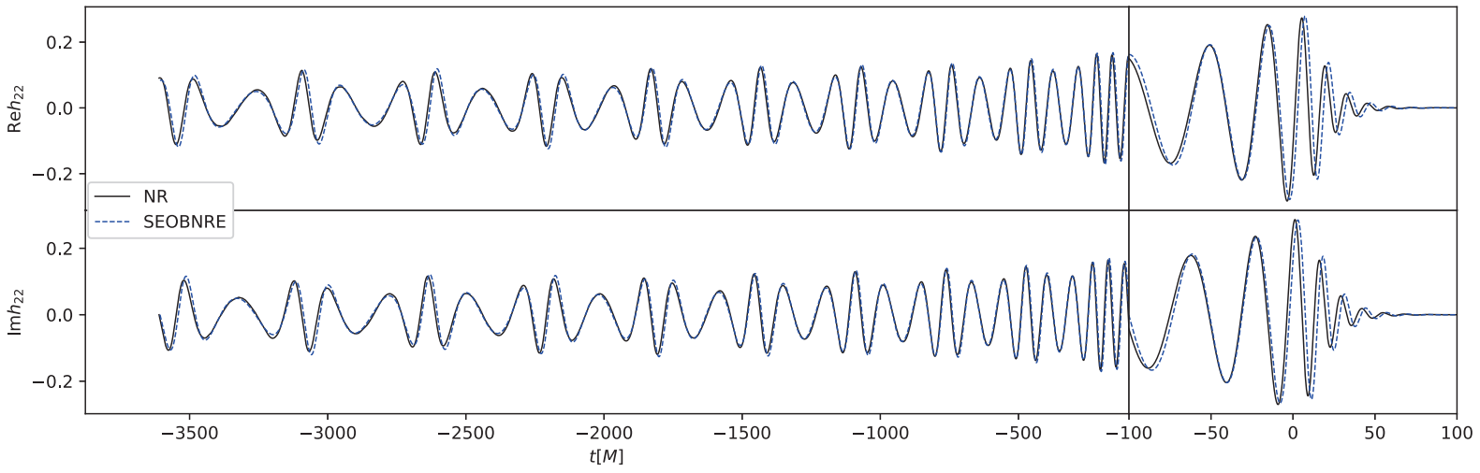
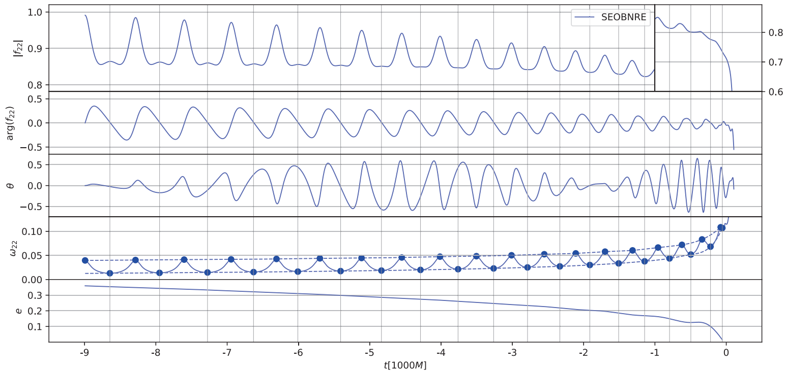
轨道平面进动角
轨道离心率

Slide 21
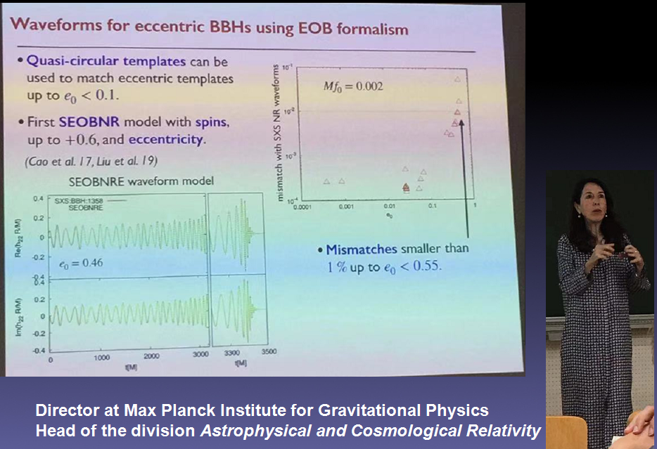
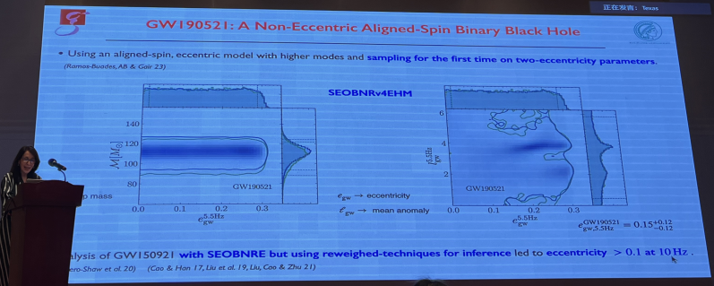
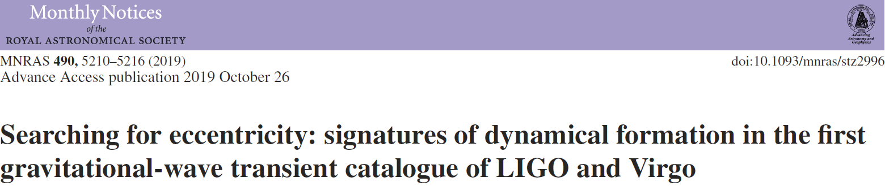
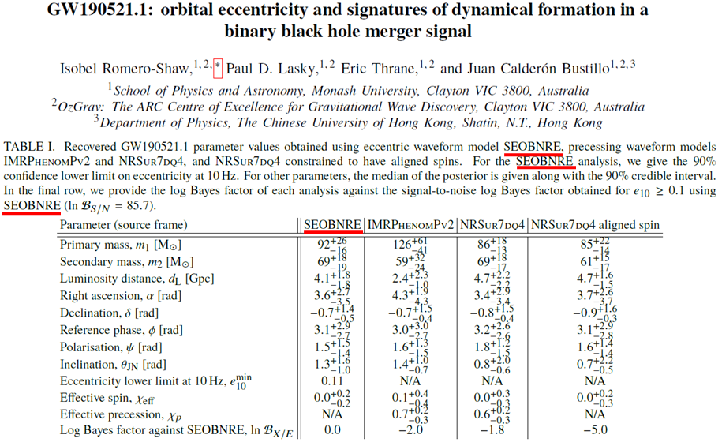
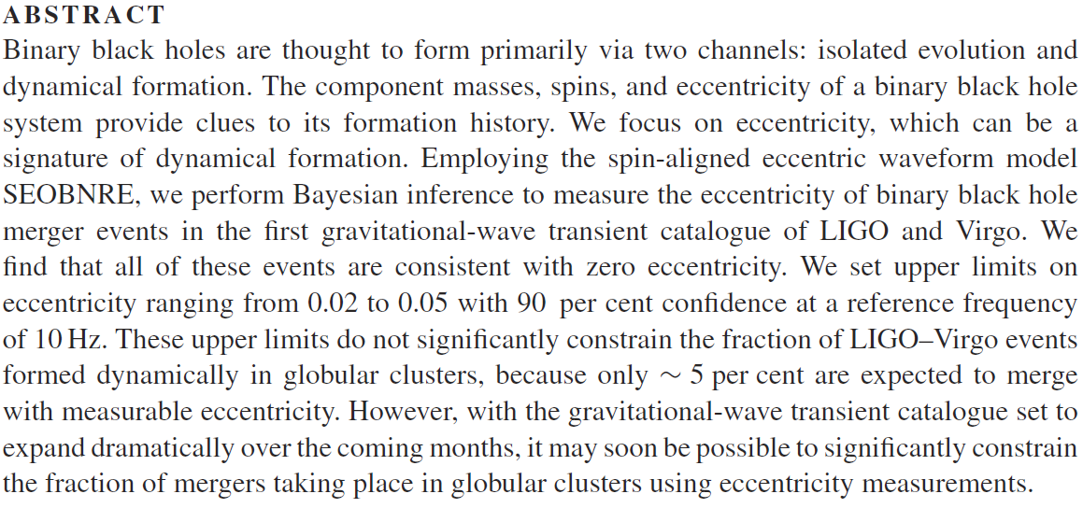
受到德国马普引力所所长Buonanno教授的好评
被国际同行广泛使用，并被LIGO数据分析人员成功应用于引力波实测数据
Notes:
世界上首个能同时描述自旋和椭圆轨道的引力波模板，受到德国马普引力所所长Buonanno教授的好评。被LIGO数据分析人员成功应用于引力波实测数据，测量出LIGO的O1/O2双黑洞并合系统的轨道离心率，辅助学者确定GW190521“奇怪”黑洞的形成机制

Slide 22
1、SEOBNRE
2、SEOBNRv4EHM(德国马普引力所团队)
3、TEOBResumS (法国团队)

Slide 23
Waveform modelling
--AI 加速波形生成

Slide 24
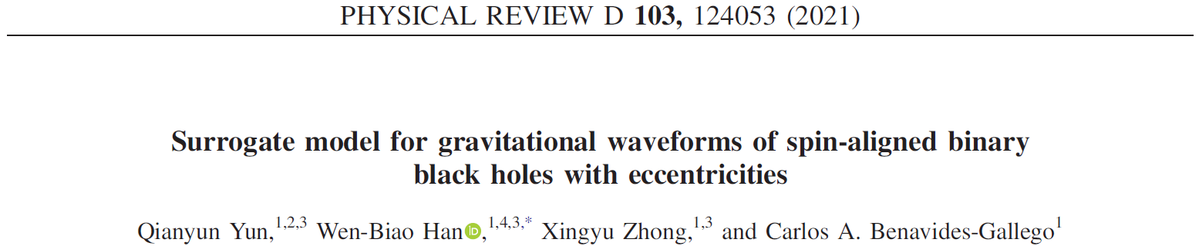





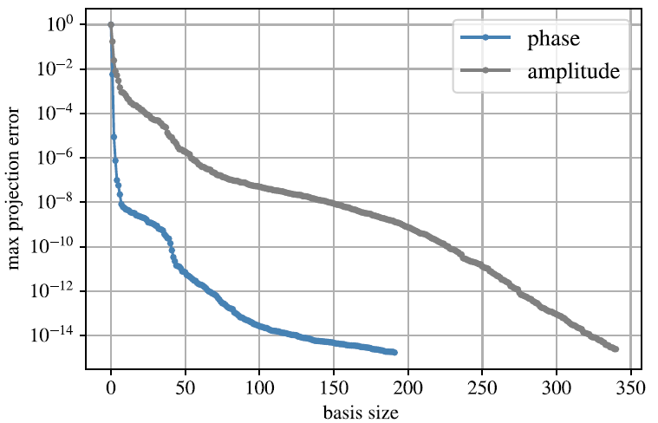


SVD
Use greedy algorithm to reduce the number of basis
Notes:
贪心算法（greedy algorithm，又称贪婪算法）

Slide 25



Slide 26



Residual connection:
Training and Inference Steps:
Rescale waveform parameters to [-1, 1]
Train three separate models: amplitude, phase, waveform length
Use cubic spline interpolation to restore original length and output waveform
Notes:
生成式预训练变换器（Generative Pre-trained Transformer，GPT）,卷积神经网络（Convolutional Neural Network, CNN）,多层感知机（MLP，Multilayer Perceptron）

Slide 27



Slide 28


Eccentricity evolution admits unphysical feature
The accuracy is good

Slide 29



Fourier Analysis Network, FAN
Notes:
傅里叶分析网络(Fourier Analysis Network, FAN)

Slide 30


Better than

Slide 31


Waveform generation time is about mini-second

Slide 32


Recover the eccentricity evolution well

Slide 33
Data analysis
--signal recognization

Slide 34


MFCNN

Slide 35


Recognize the 11 events in O1+O2
Notes:
Behavior is similar to matched filetering

Slide 36


Recognize the extra three events reported in 1-OGC
Recognize the tested hardware injection

Slide 37

Recognize the 15 SBBH mergers in LISA mock data,
PLB 841, 137904 (2023)

Slide 38



Set1: spinless, smaller mass range
Set2: spin align
Set3: general spin
Set4: real noise from detector

Slide 39


background
foreground

Slide 40




Slide 41



Slide 42





Slide 43

Recognize the 11 events in O1+O2
Better for burst signal, but less efficient for long while weak signal, say GW170817

Slide 44


Thousands neurals
Millions neurals

Slide 45




EMRI
SMBBH
BWD

Slide 46
Data analysis
--denoising

Slide 47



Slide 48



Slide 49


Slide 50




Without the addition of BNS confusion noise
with the inclusion of BNS confusion noise

Slide 51



Transformer network + SPIIR idea

Slide 52

SNR of GW170817 = 32.4

Slide 53
Data analysis
--parameter estimation

Slide 54


Parameter estimation problem

Slide 55





DINGO
Notes:
条件式变换自编码机 Nature Physics 18, 112 (2022)

Slide 56


Normalizing flow
Train
Test and use
y = noise n + signal x
(random x)
Prior distribution z
Prior distribution z
random x
random x
Posterior distribution

Slide 57


Posterior distribution comparison to MCMC for GW150914, Normalization flow can complete the work in miniseconds

Slide 58
Data analysis
--treating overlapping signals

Slide 59

there are large biases in the PE when the frequency evolutions of the two signals overlap to a large extent
For the whole parameter space, the existence of large biases is common, but biases are more likely to occur when the masses of the two signals, especially the chirp masses, are close
Subjecting one by one is dangerous！

Slide 60


Notes:
贝叶斯分析用来提取信号强度，deep learning 用来提取信号形状。

Slide 61




Slide 62


The earlier arrived signal is called A. The difference means B-A

Slide 63
Summary
Powerful: promising to solve every tough problems in GW data analysis
How to make it independent and trustable?

