Slide 1

Modeling and prediction of the foreground noise in space-based gravitational wave detections
Pin Gao (高品) gaopin@ucas.ac.cn
International Center for Theoretical Physics (Asia-Pacific)
University of Chinese Academy of Sciences

Slide 2
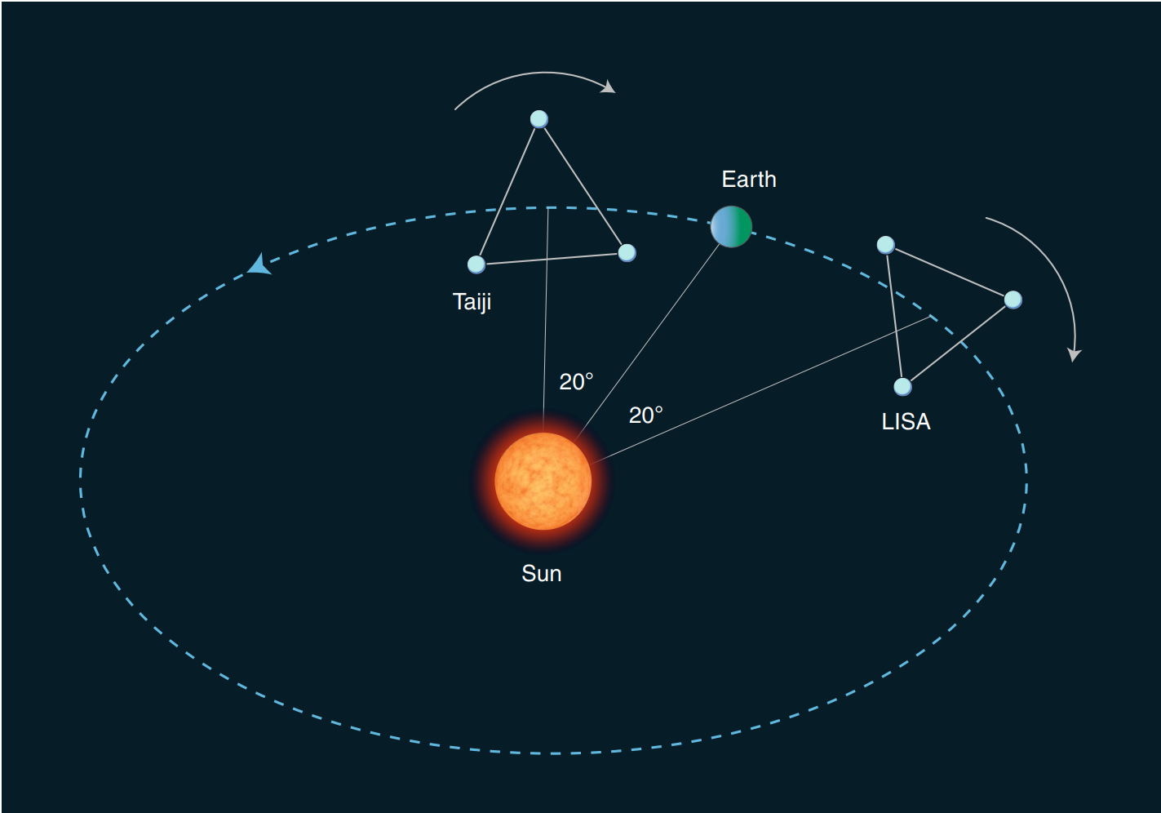
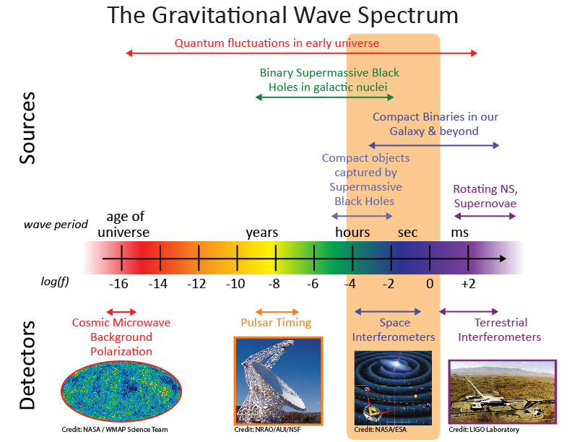
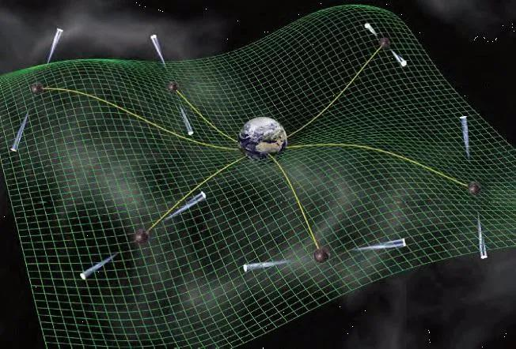
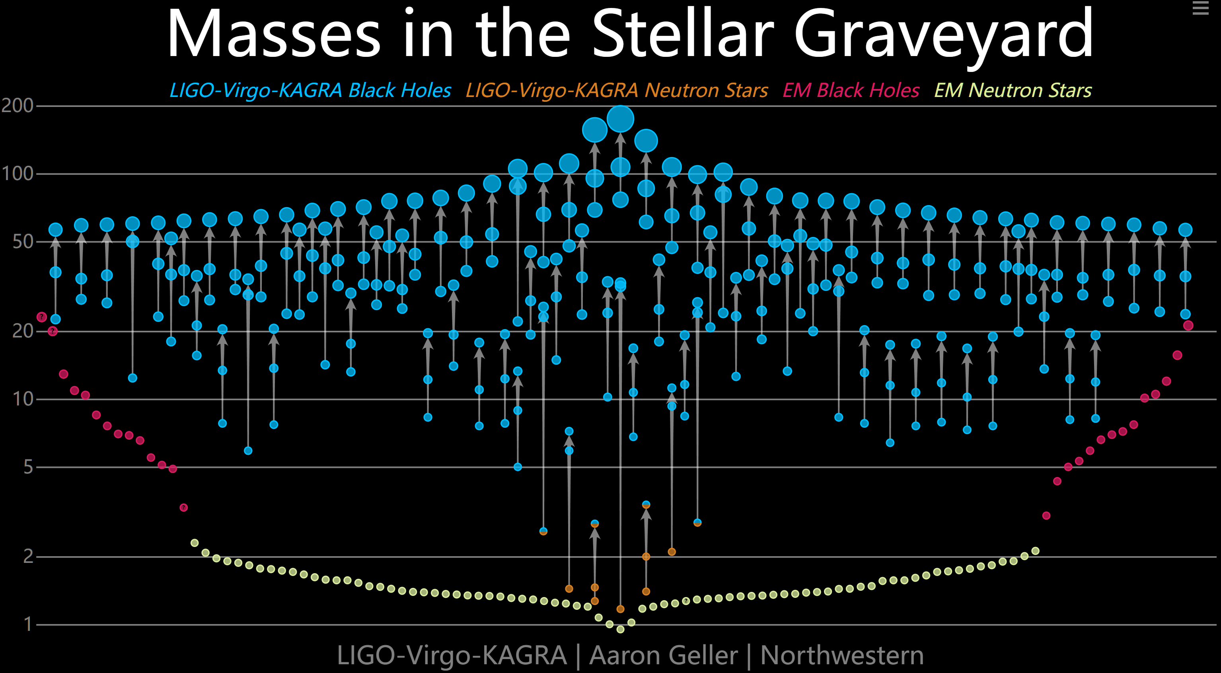
Gravitational wave spectrum https://lisa.nasa.gov/
2025/10/18

Slide 3
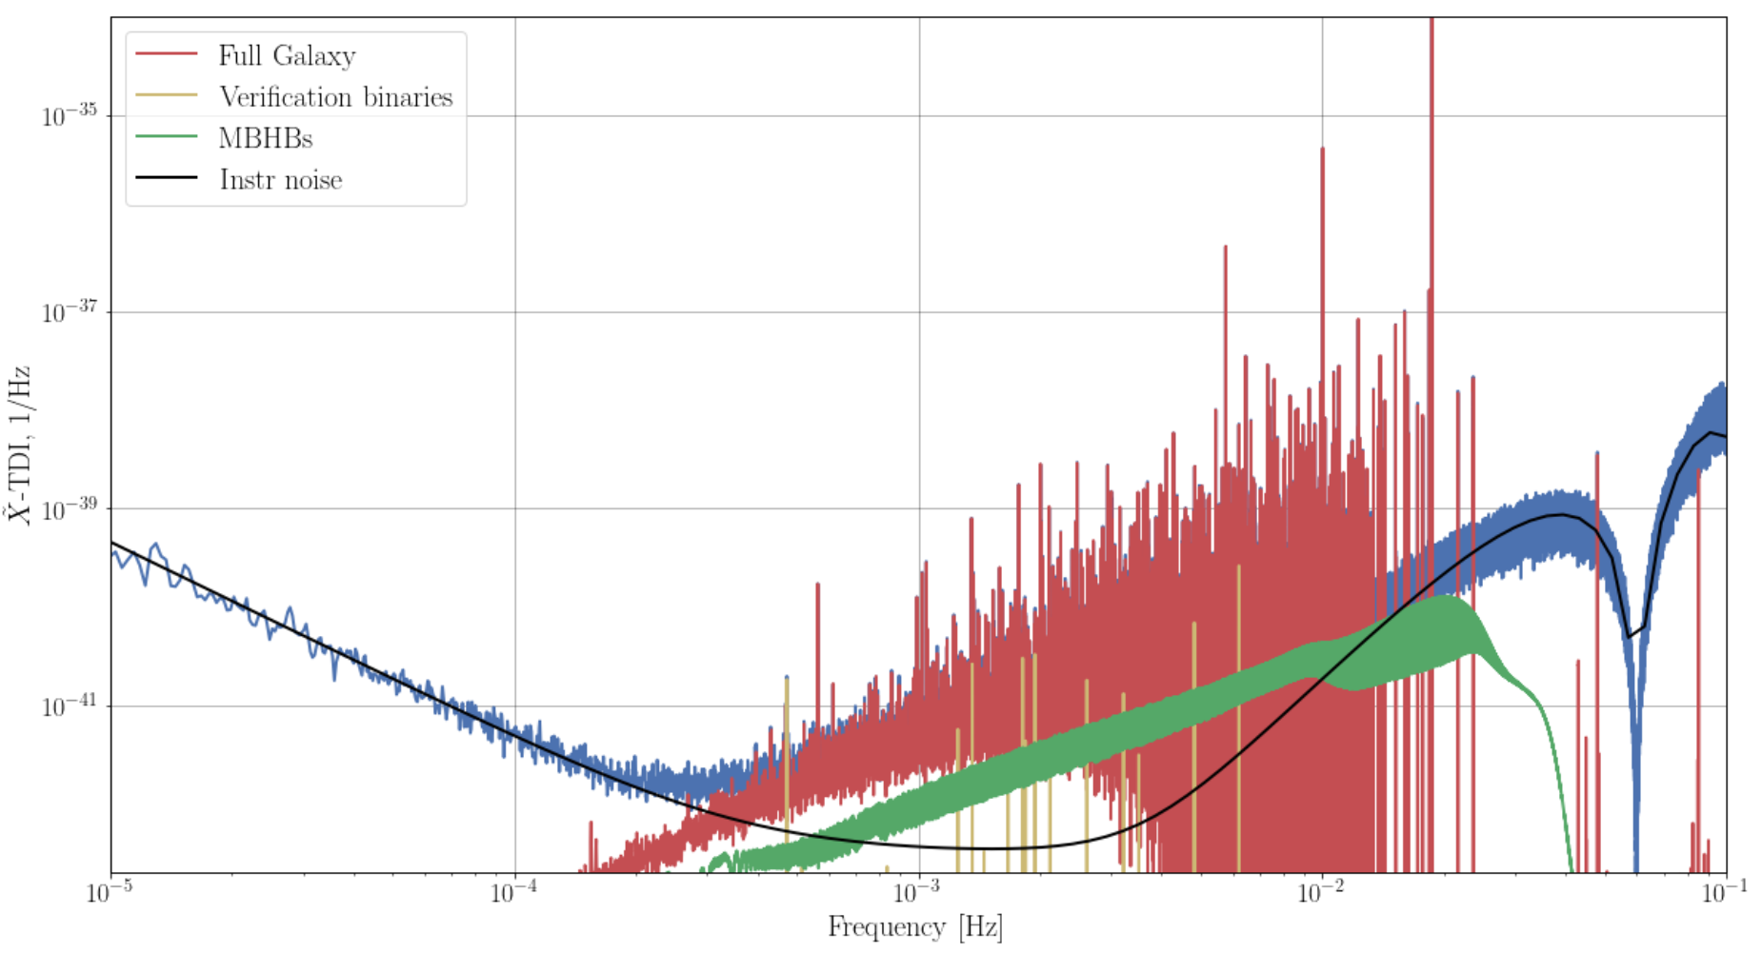
https://lisa-ldc.lal.in2p3.fr/

Slide 4
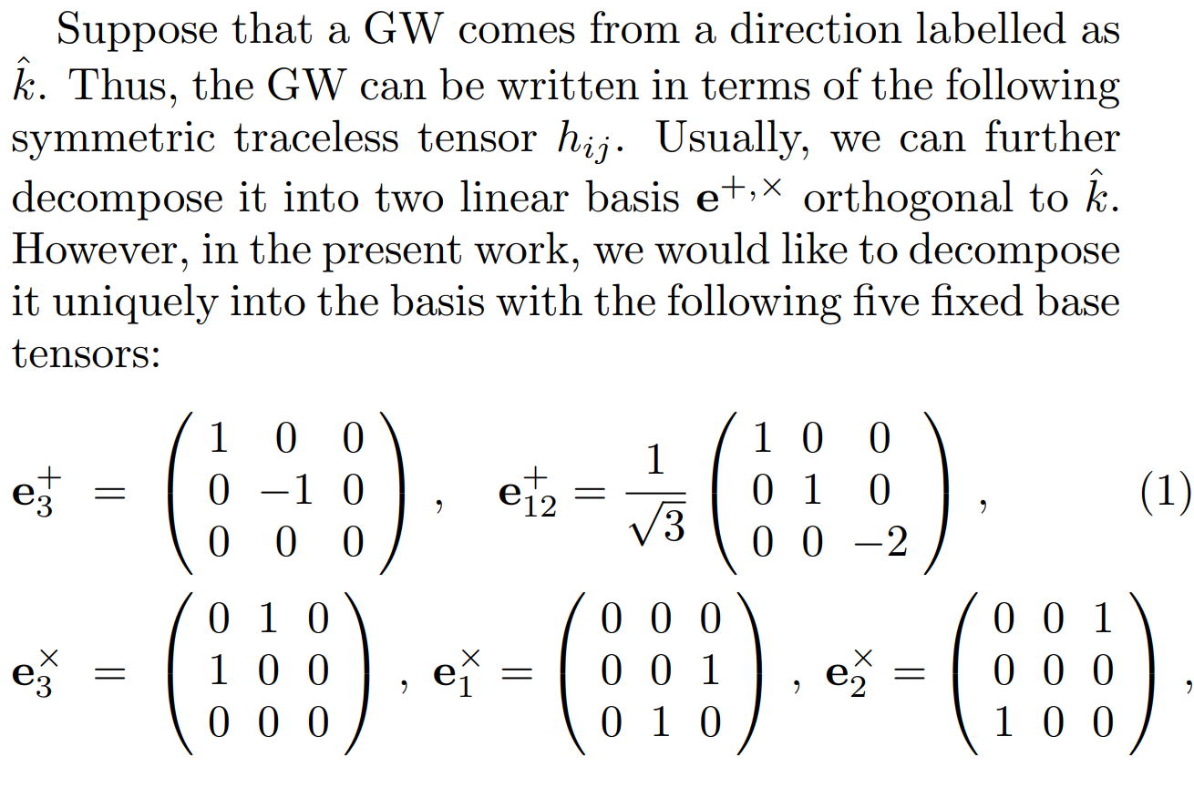
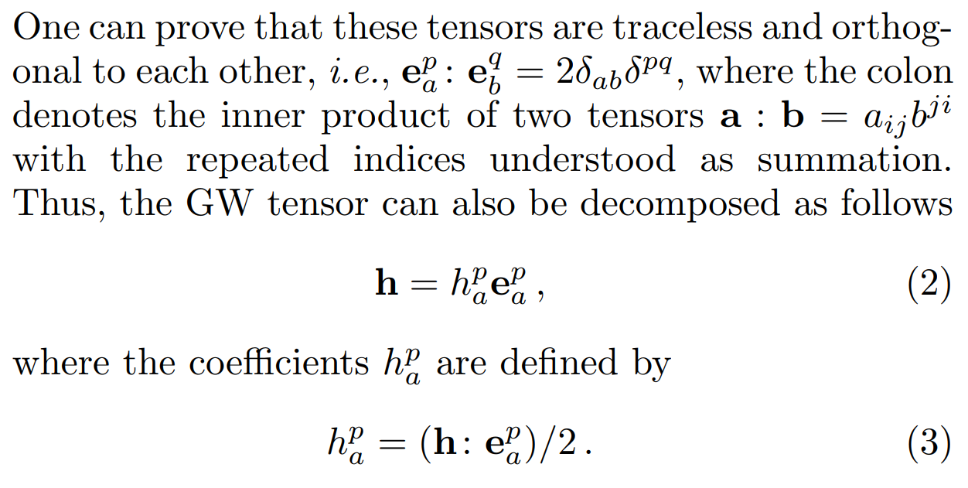
Gravitational wave modeling and combination
Modeling of a GW onto six basis

Slide 5
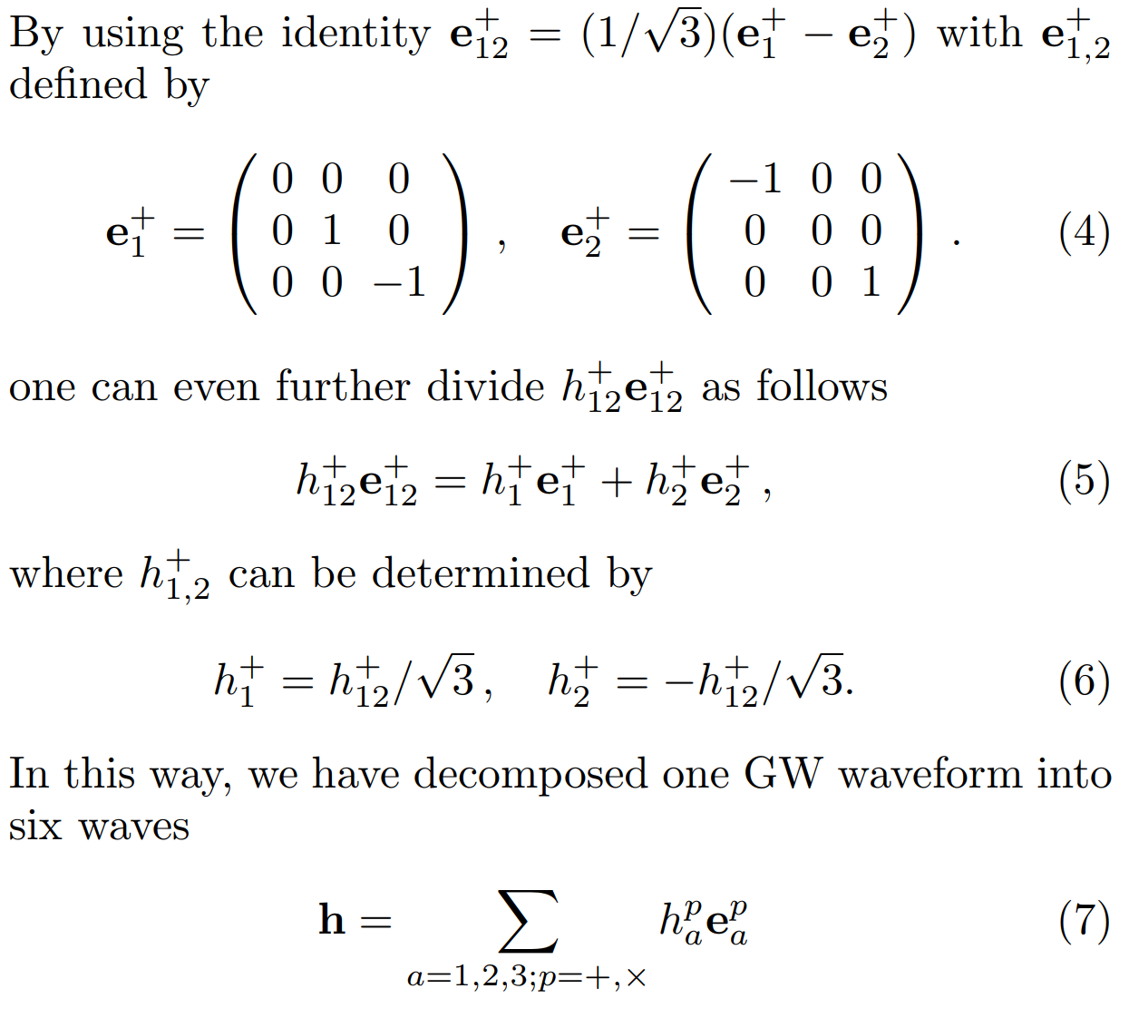
Gravitational wave modeling and combination

Slide 6
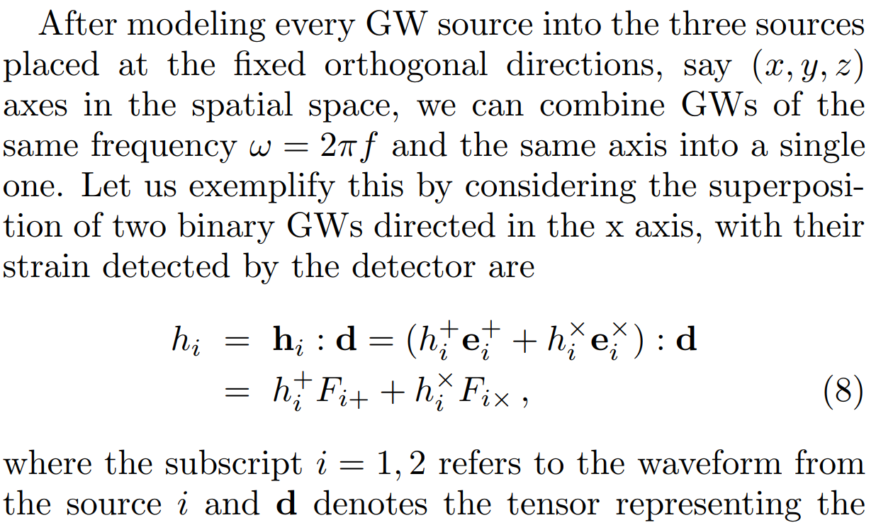
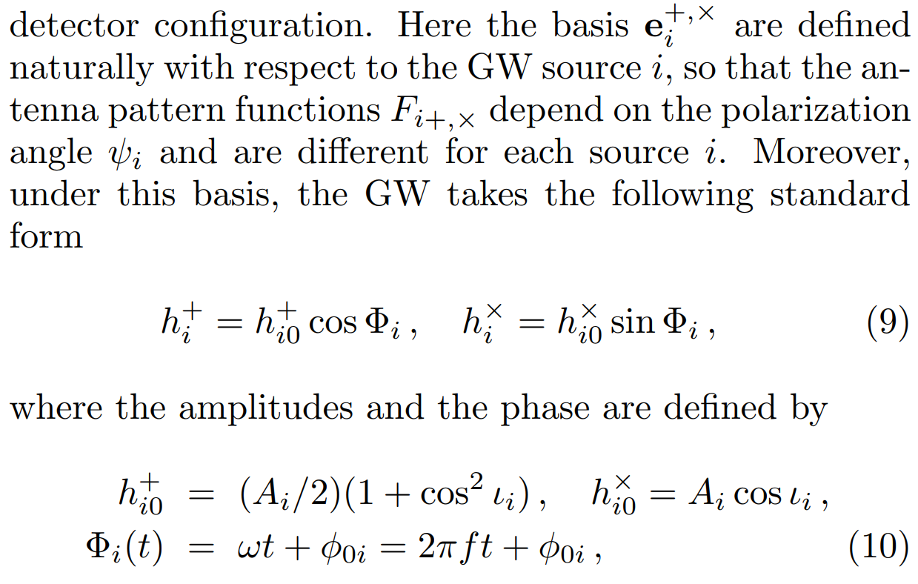
Gravitational wave modeling and combination
Combination of GWs

Slide 7
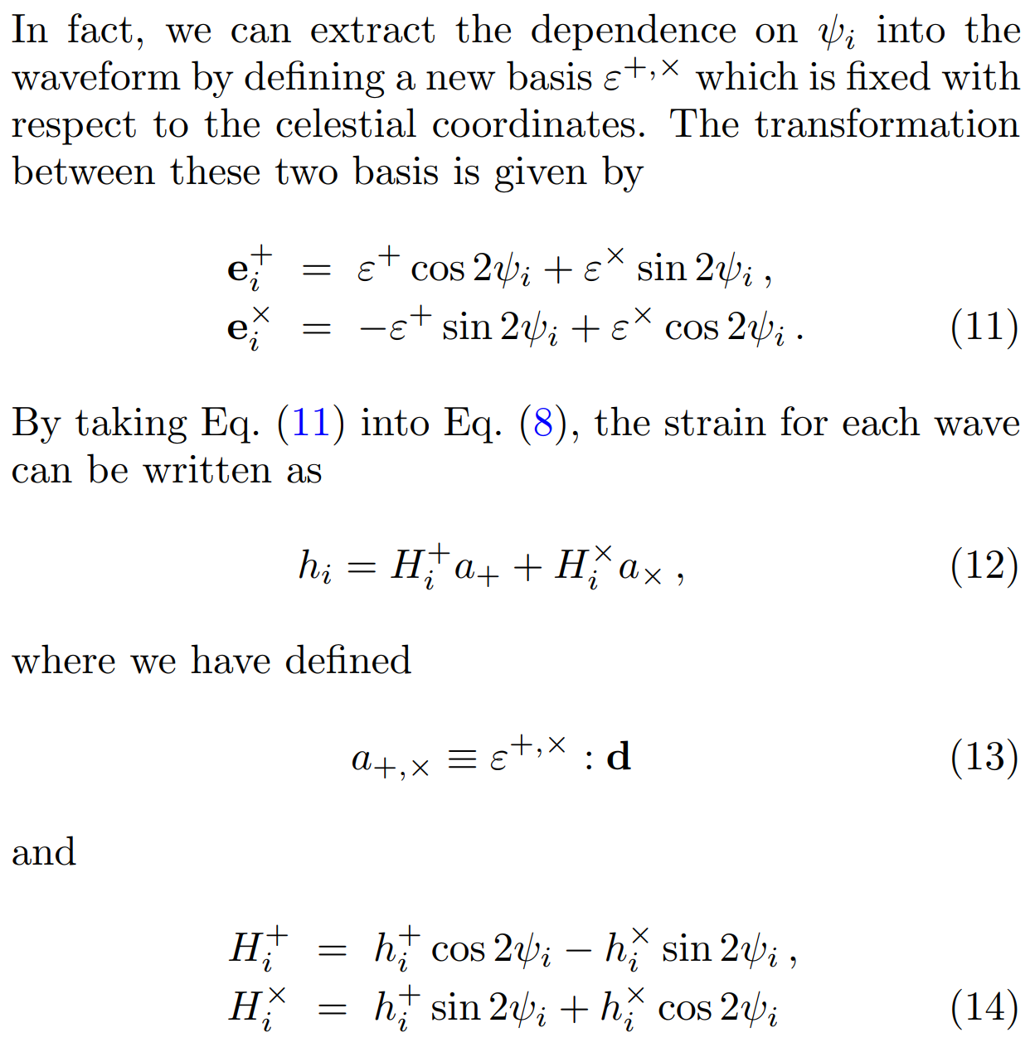
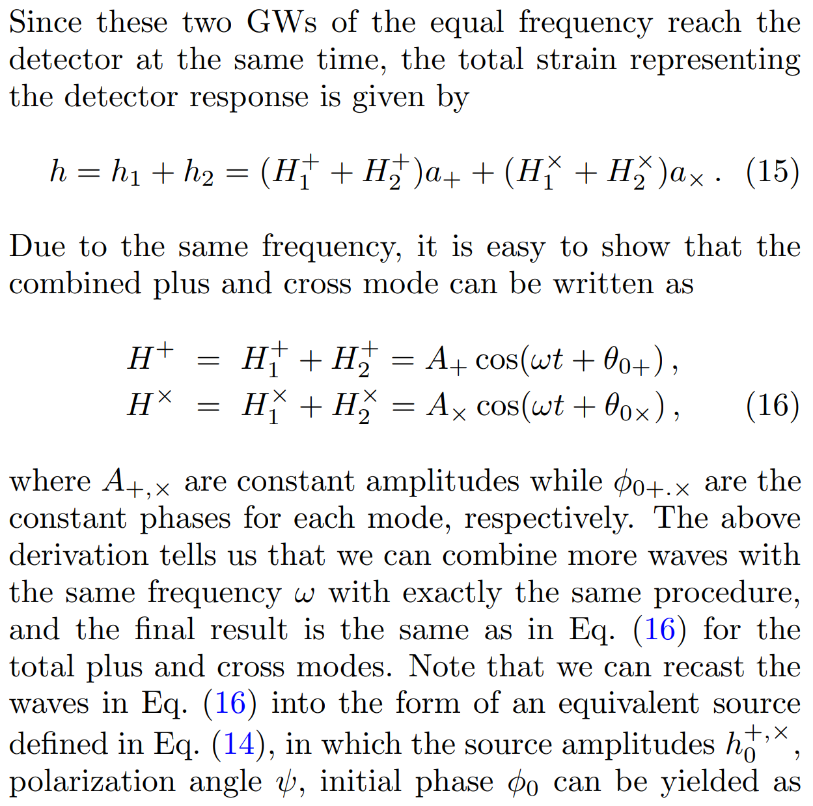
Gravitational wave modeling and combination

Slide 8
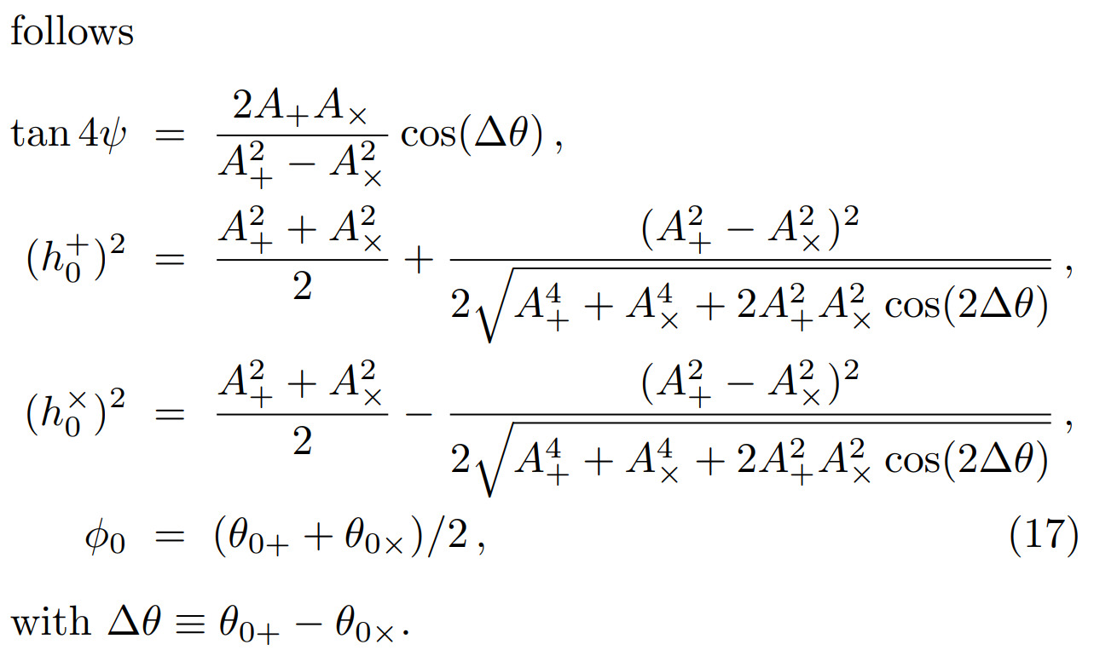
Gravitational wave modeling and combination

Slide 9
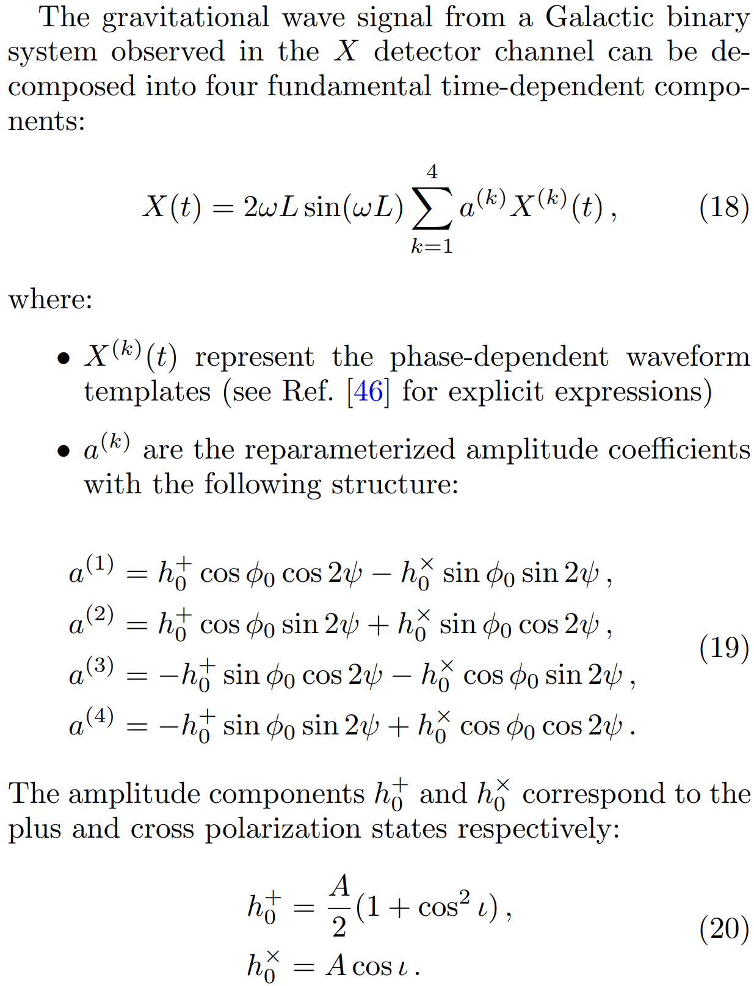
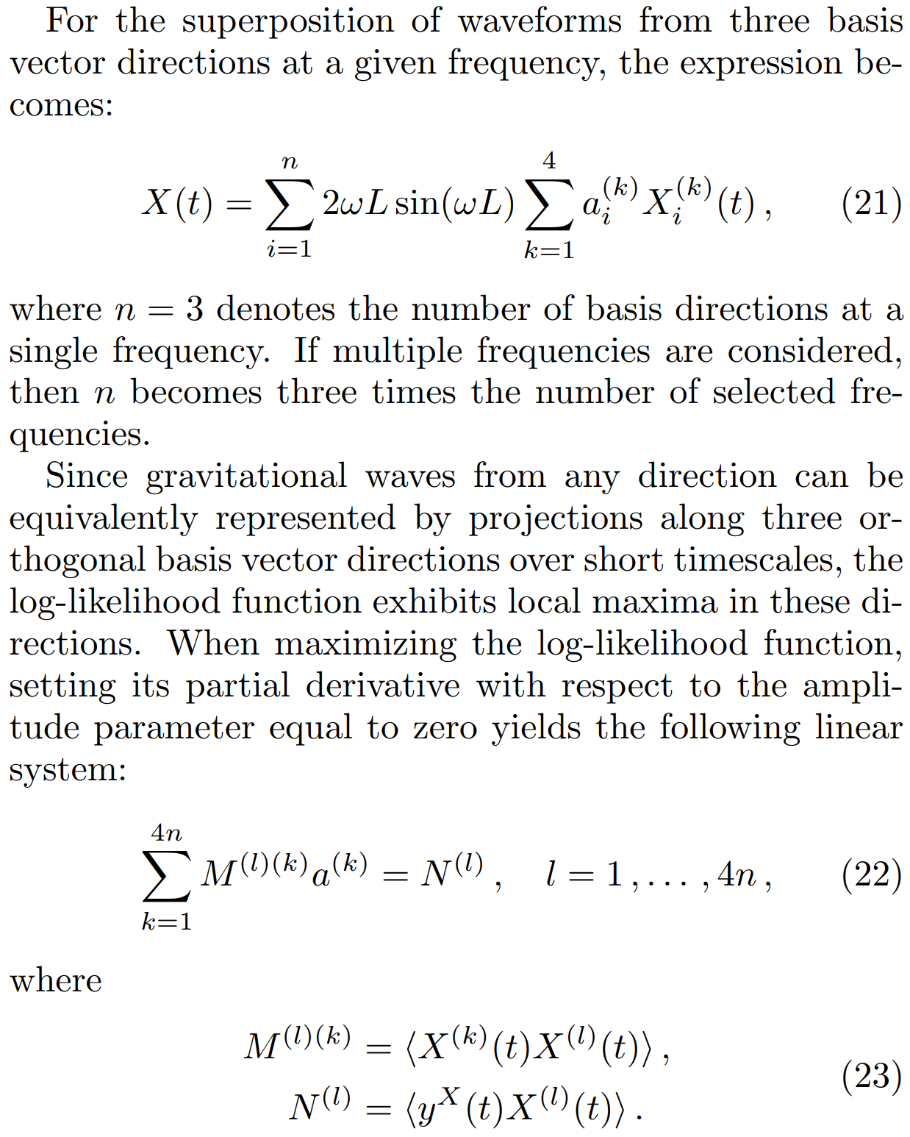
Basis vector selection and parameter calculation
Parameter calculation from the detection data

Slide 10
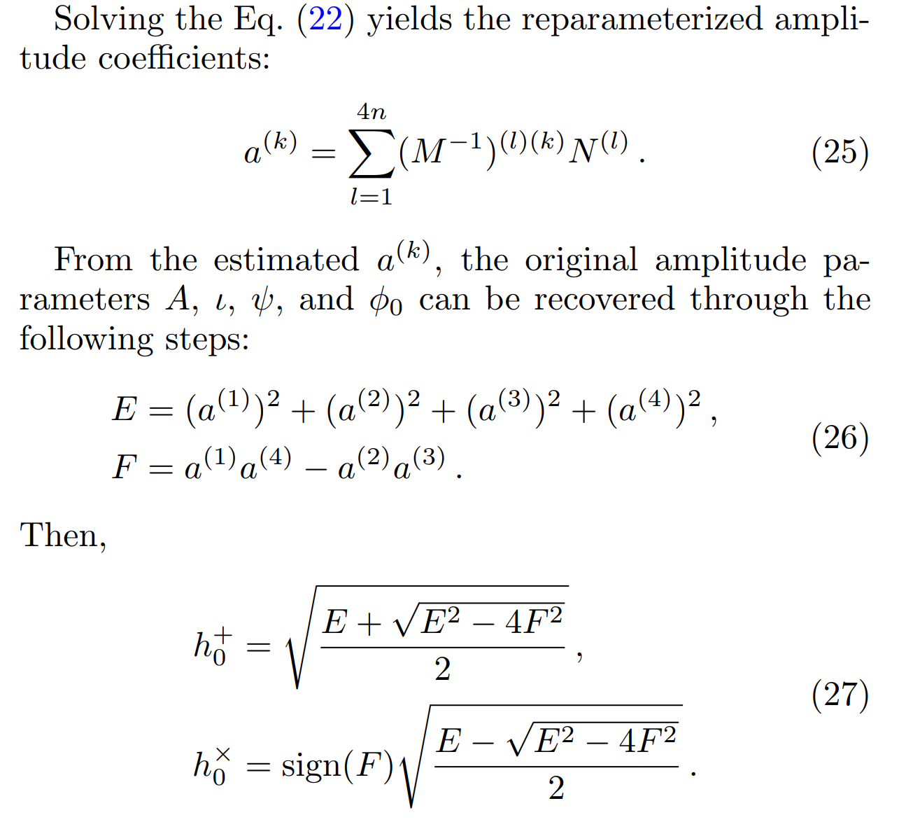
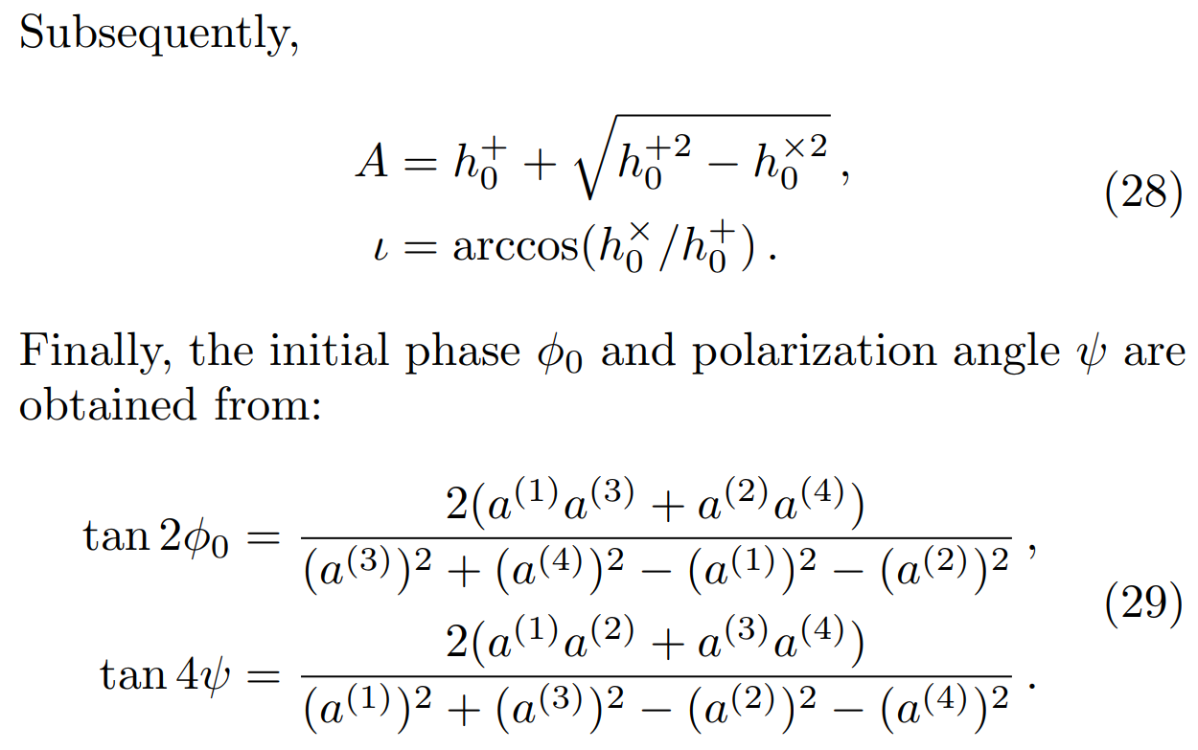
Basis vector selection and parameter calculation

Slide 11
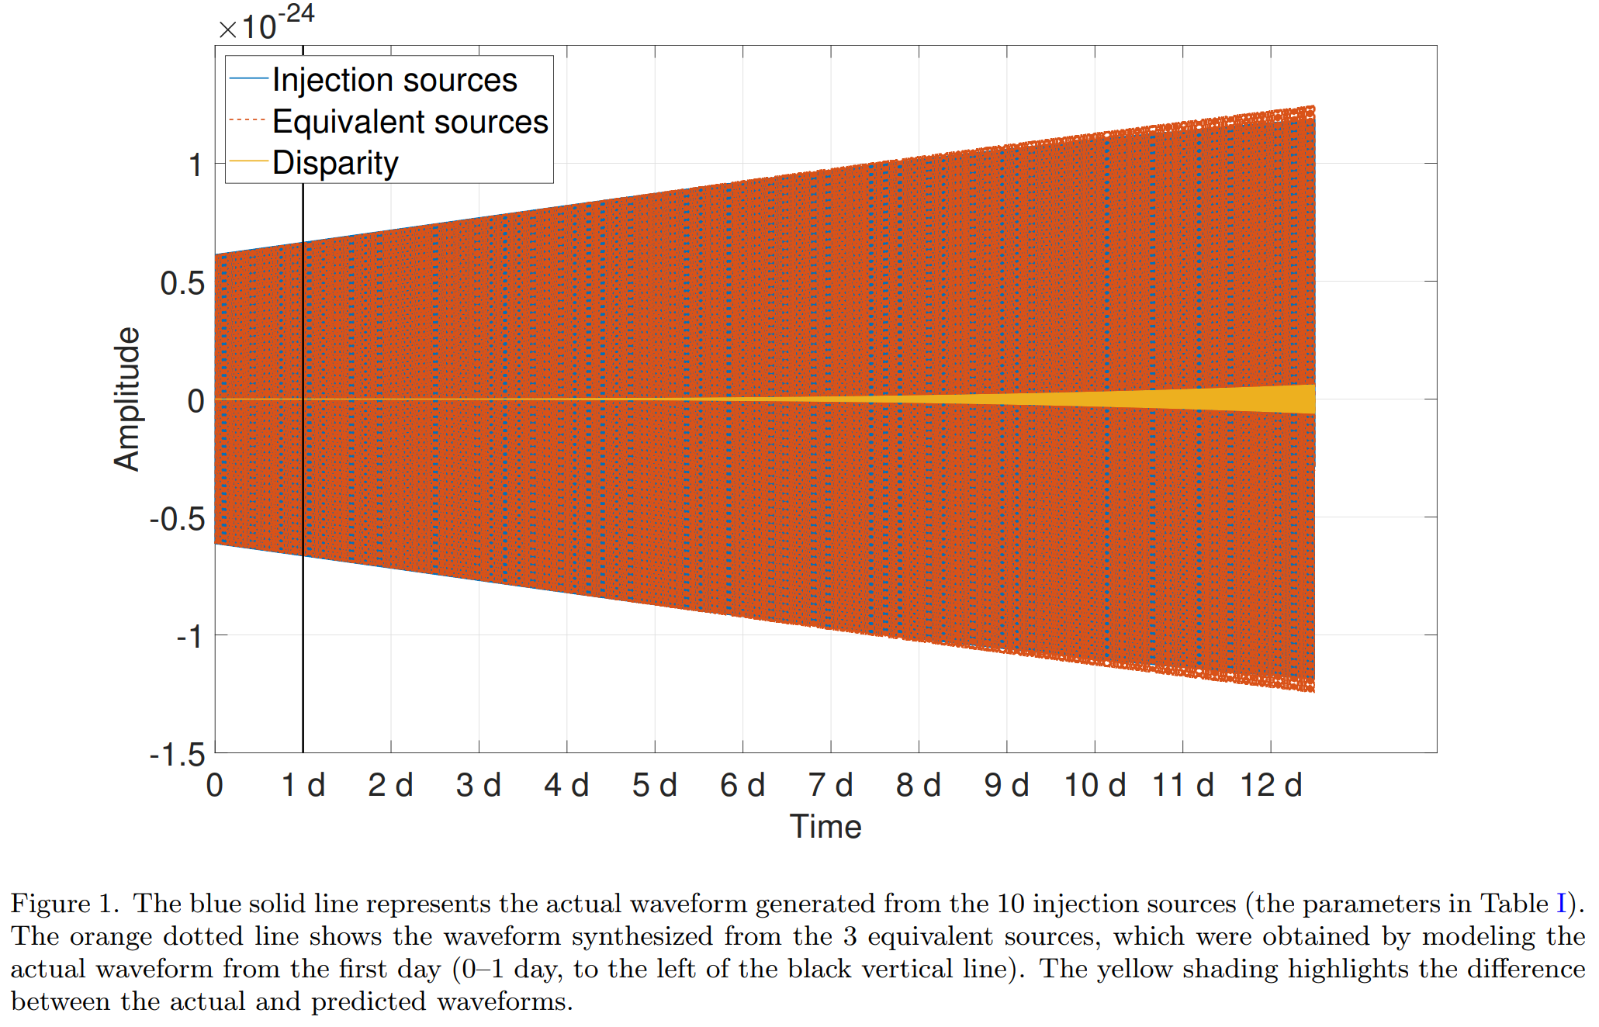
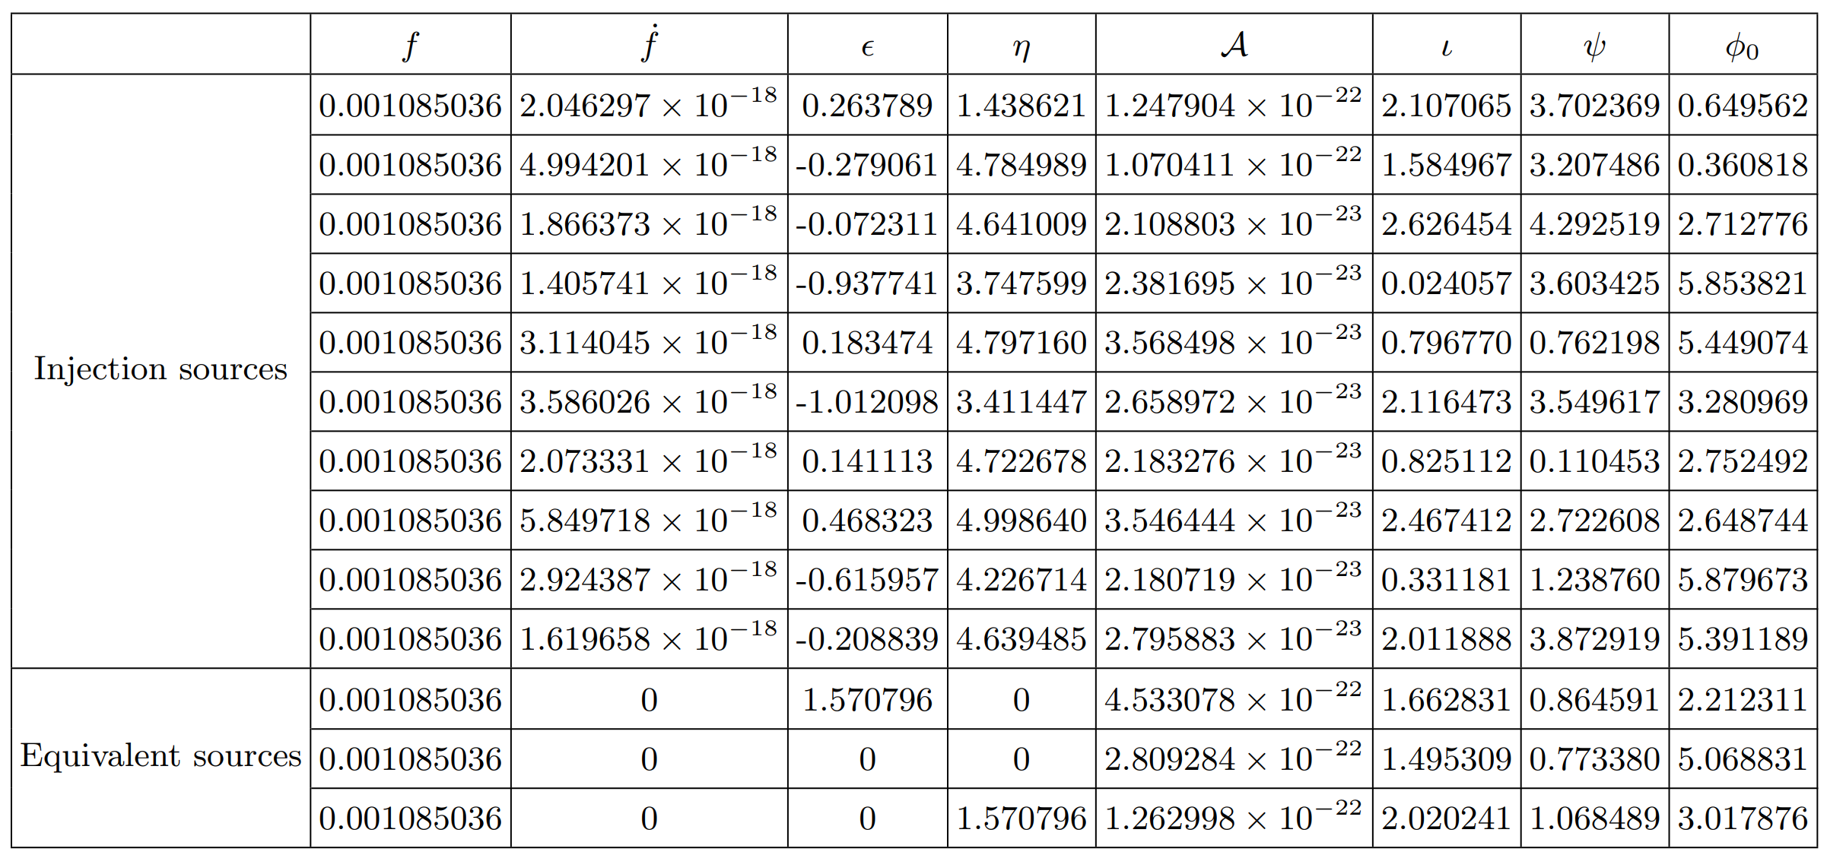
Modeling and prediction of foreground noise
Single frequency modeling-prediction
The North Ecliptic Pole (ϵ = π/2, η = 0)
The Vernal Equinox direction (ϵ = 0, η = 0)
The Summer Solstice direction (ϵ = 0, η = π/2)

Slide 12
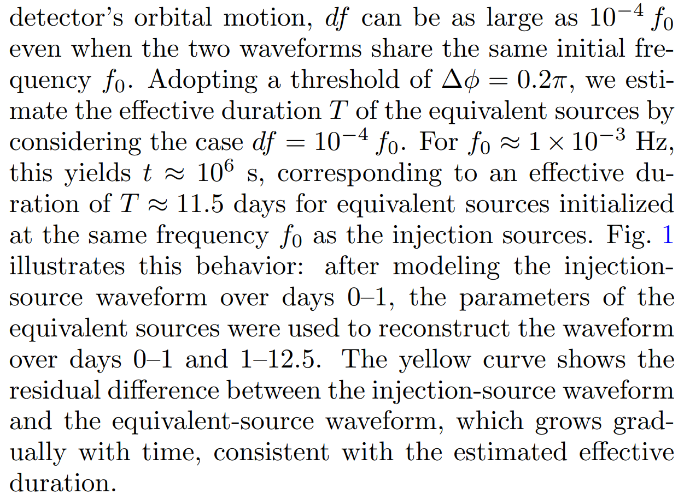
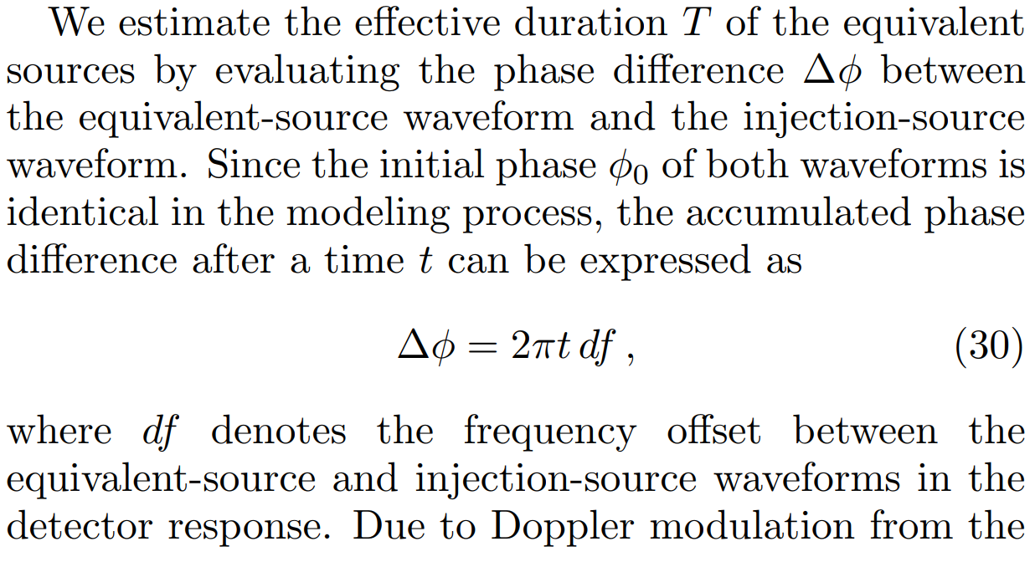
Effective duration

Slide 13
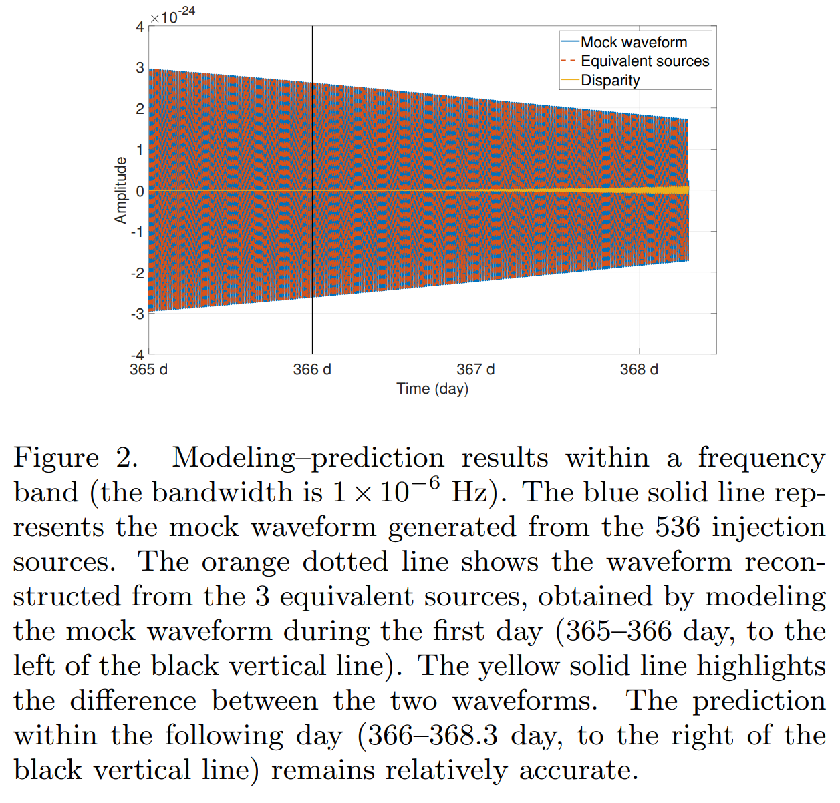
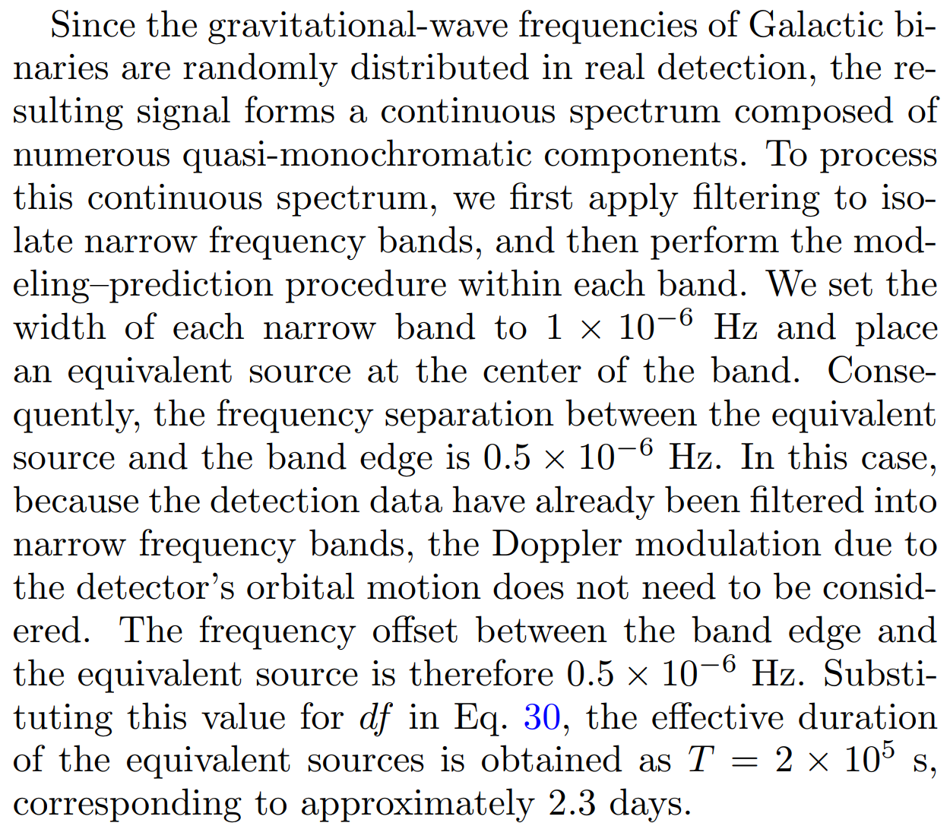
Modeling and prediction of foreground noise
Frequency band modeling-prediction

Slide 14
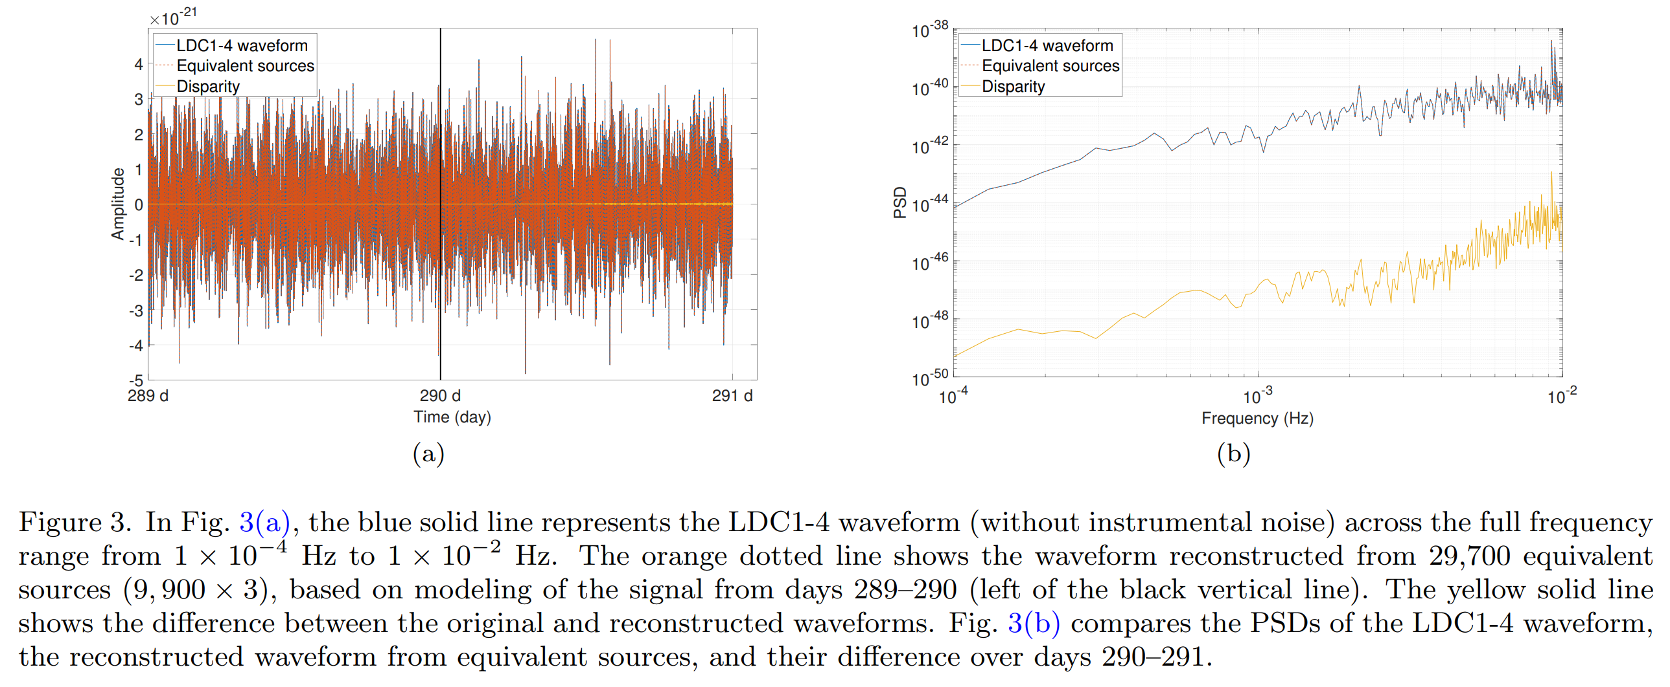
Modeling and prediction of foreground noise
Full frequency modeling–prediction

Slide 15
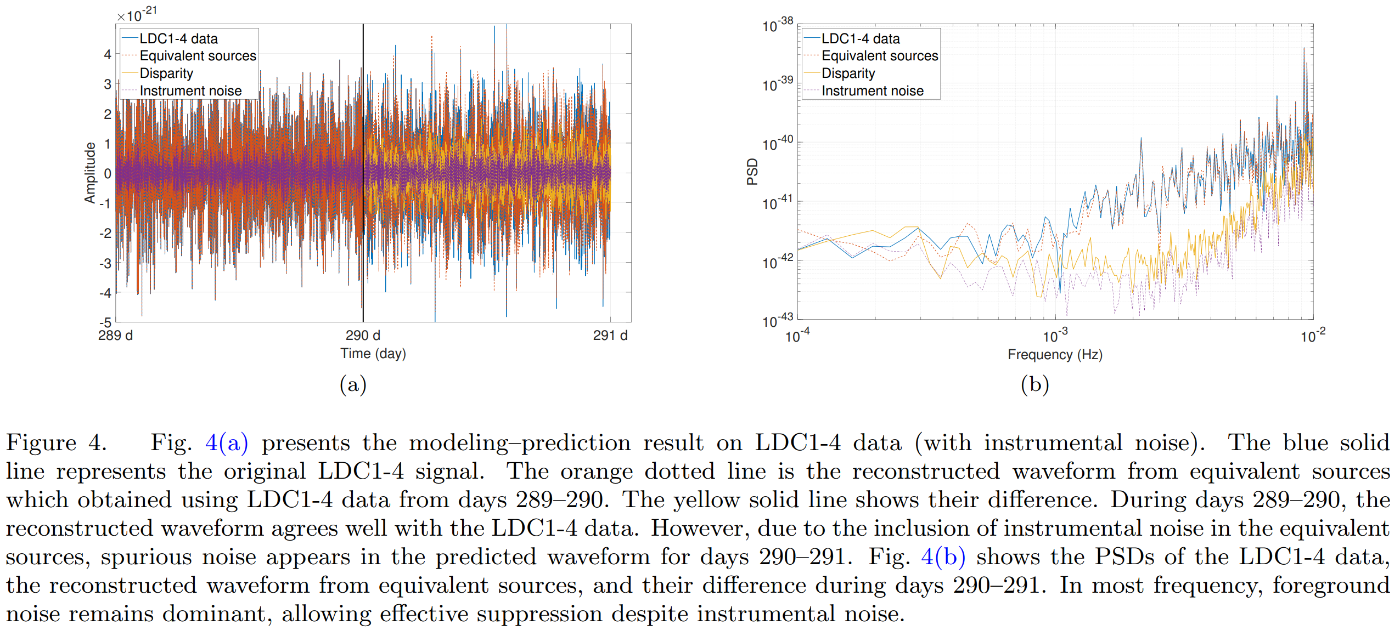
Modeling and prediction of foreground noise
The effect of instrumental noise

Slide 16
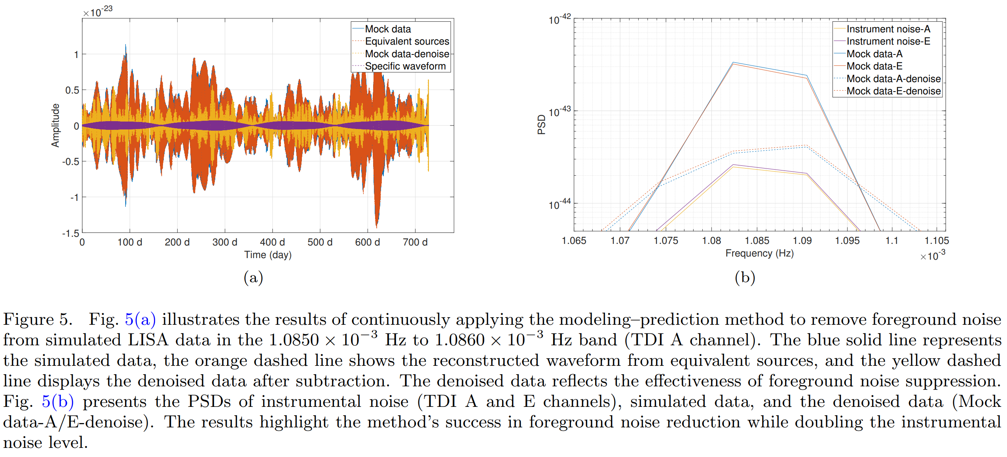
Foreground noise reduction improves the SNR
The SNR of GB
536 injection sources SNR from 7.49 to 20.12

Slide 17
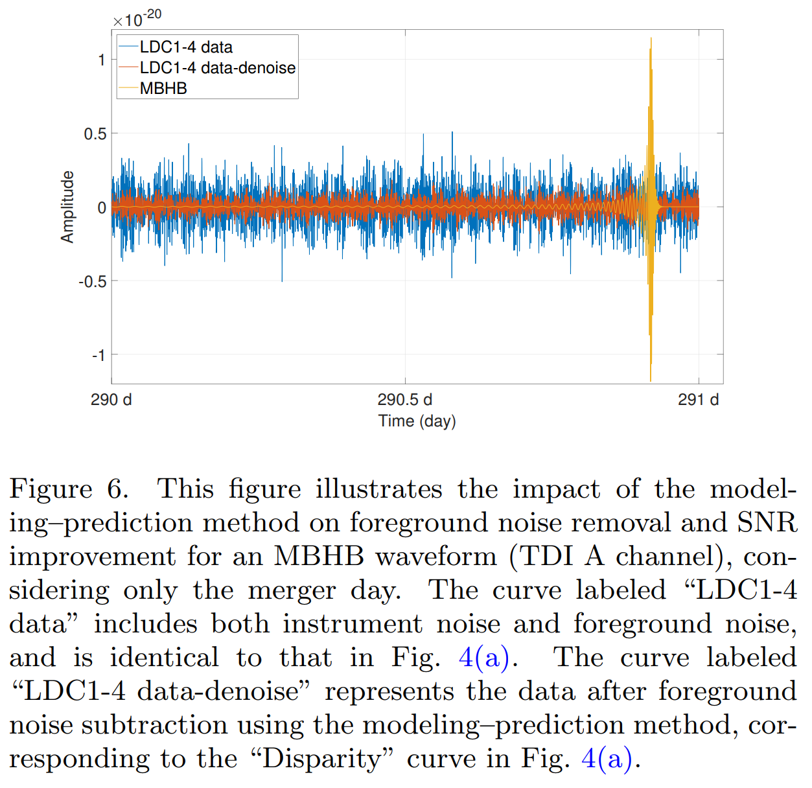
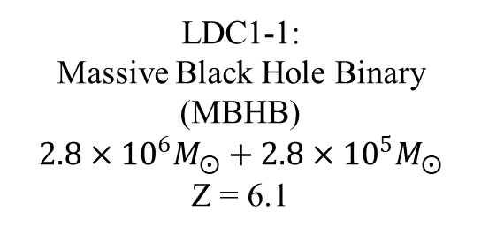
Foreground noise reduction improves the SNR
The SNR of MBHB
LDC1-1:
Massive Black Hole Binary (MBHB)
$2.8×{10}^{6}M_{⨀}+2.8×{10}^{5}M_{⨀}$
Z = 6.1
THANKS!
day 290–291 SNR from 194.2 to 672.0

