Slide 1


Quantum simulation of the phase transition of the massive Thirring model
Ji-Chong Yang
yangjichong@lnnu.edu.cn
Based on: arXiv:2412.00803
2025.10.12 @ 中国格点量子色动力学研讨会

Slide 2
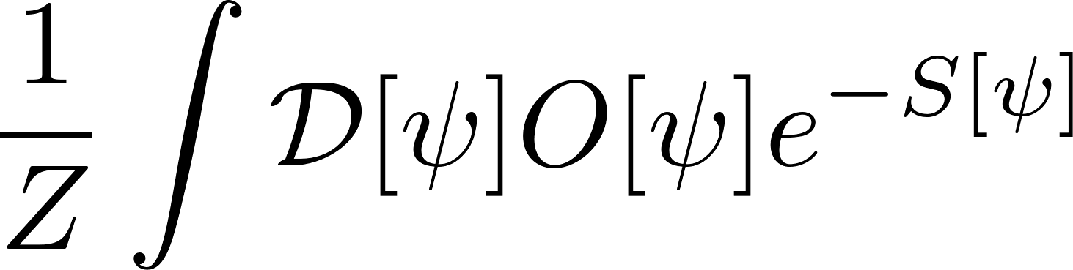
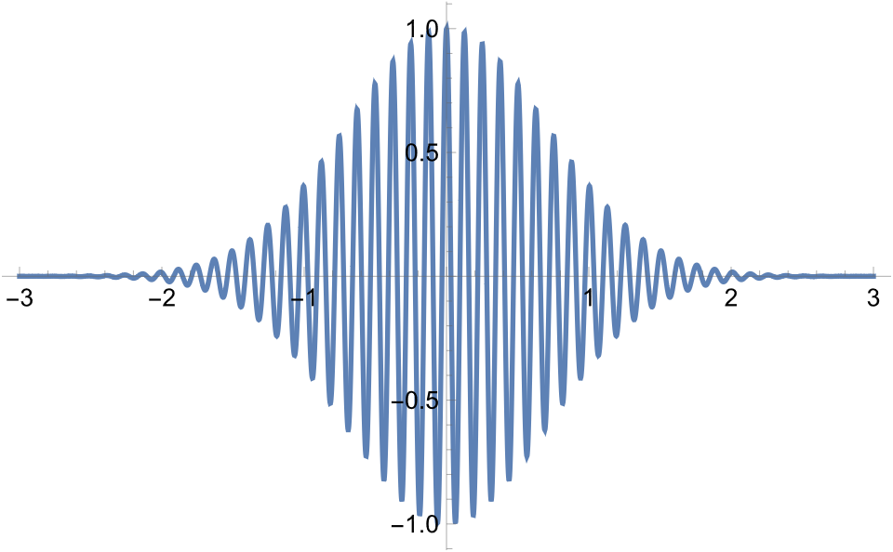
Motivation
Sign problem in Monte-Carlo simulations:
The problem of numerical integration

Slide 3
Motivation
Sign problem in Monte-Carlo simulations (lattice QCD):
Finite density (critical endpoint)
Rotation frame (even has sign problem with pure gauge action)
Accelerating frame (or expanding universe)
External electric field
…
Taylar expansion, Wick-rotation, complex Langevin, Canonical approach(fugacity expansion)…

Slide 4

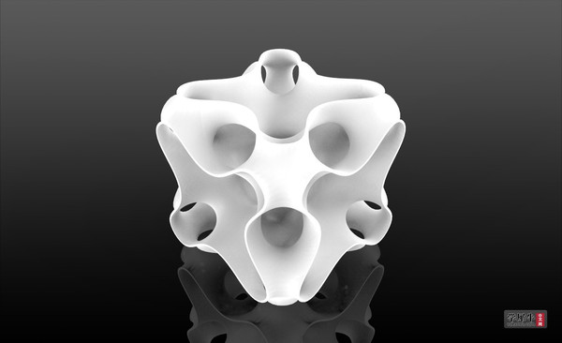
Motivation
Translate the problem into a physics problem

Slide 5


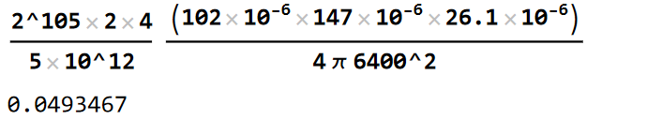
Motivation
Large data
The total amplitude data (where complex numbers are treated as two single-precision floating-point numbers) storable by the Zuchongzhi 3 quantum computer would require so many 3.5-inch 5TB mechanical hard drives that, if laid out across the Earth's surface, they would form a layer 50 meters thick.

Slide 6

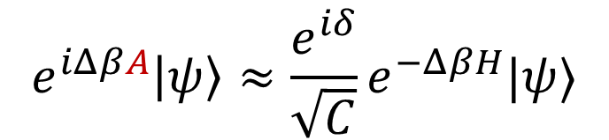
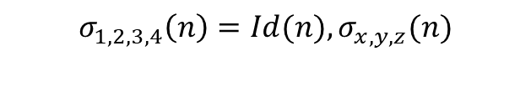
QMETTS (QITE) for finite temperature problem
Finite temperature in quantum simulation:
quantum imaginary time evolution (QITE) [1901.07653]
quantum minimally entangled typical thermal states (QMETTS) [2112.03944]
pure state vs mixed state
A: some Hermitian matrix:
$$e^{iΔβA}\left|ψ\right\rangle ≈{\frac{e^{iδ}}{\sqrt{C}}e}^{−ΔβH}|ψ⟩$$
$$C=\left\langle ψ\left|e^{−2ΔβH}\right|ψ\right\rangle ≈e^{−2Δβ⟨H⟩}$$
$$A=∑x_{i}σ_{i} σ_{i=(\sum{4^{n}j_{n}})}=⊗∏σ_{j_{n}}(n)$$
$$σ_{1,2,3,4}\left(n\right)=Id(n),σ_{x,y,z}(n)$$

Slide 7
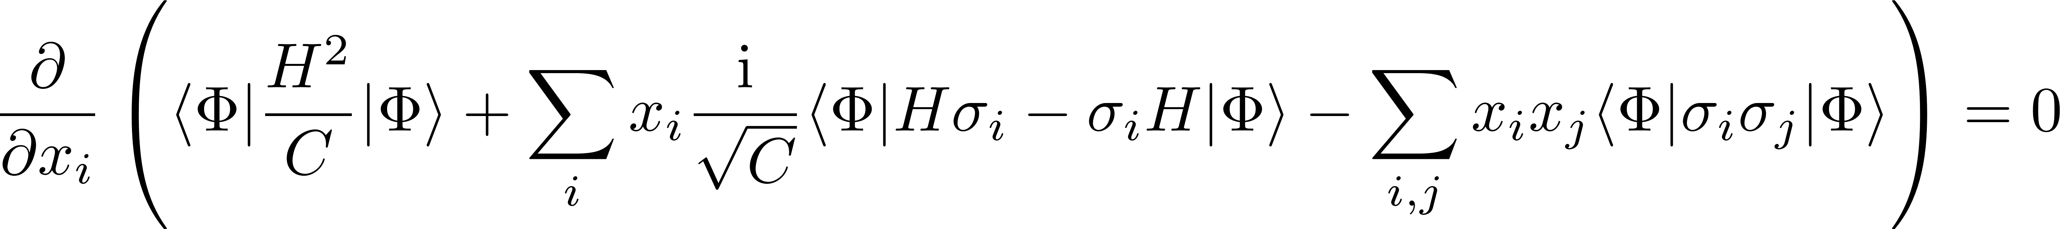
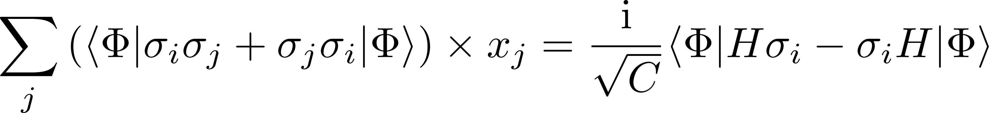

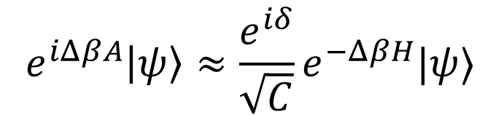

Calculate the coefficients
$$e^{iΔβA}\left|ψ\right\rangle ≈{\frac{e^{iδ}}{\sqrt{C}}e}^{−ΔβH}|ψ⟩$$
Minimize:
$$A=∑x_{i}σ_{i}$$
Solving a linear system

Slide 8
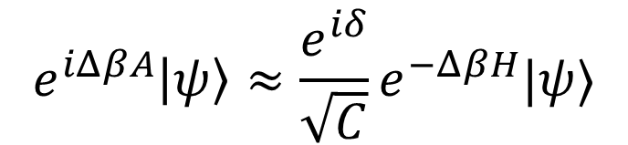



QMETTS:
$$e^{iΔβA}\left|ψ\right\rangle ≈{\frac{e^{iδ}}{\sqrt{C}}e}^{−ΔβH}|ψ⟩$$
If this can be calculated:
${|Φ\left(β\right)⟩≡e}^{−ΔβH}\left|φ\right\rangle ≈e^{iδ}\sqrt{C(β_{k},Δβ)}e^{iΔβA(β_{k})}|φ⟩$
$$β_{k}≡kΔβ$$
$${Tr\left[{Oe}^{−βH}\right]=∑⟨φ_{i}|Oe}^{−βH}\left|φ_{i}\right\rangle ≈∑⟨φ_{i}|e^{−\frac{β}{2}H}{Oe}^{−\frac{β}{2}H}|φ_{i}⟩≈∑\left\langle Φ_{i}\left(\frac{β}{2}\right)\left|O\right|Φ_{i}\left(\frac{β}{2}\right)\right\rangle$$
$$\left\langle O\right\rangle =\frac{Tr\left[{Oe}^{−βH}\right]}{Tr\left[e^{−βH}\right]}$$
Sum over a Hilbert space
$${Tr[e^{−βH}]=∑⟨φ_{i}|e}^{−βH}\left|φ_{i}\right\rangle =∑\left\langle Φ_{i}\left(\frac{β}{2}\right) | Φ_{i}\left(\frac{β}{2}\right)\right\rangle$$

Slide 9




QMETTS:
For $|φ_{i} (β)⟩$ and Hamiltonian: H, Observable: O, start from $β=0$
Start with one of the vectors to do the trace
$${Tr\left[{Oe}^{−βH}\right]=∑⟨φ_{i}|Oe}^{−βH}\left|φ_{i}\right\rangle$$
$$|φ_{i} (0)⟩$$
$$\left|φ_{i}(β=0)\right\rangle =\left|φ_{i}\right\rangle$$

Slide 10
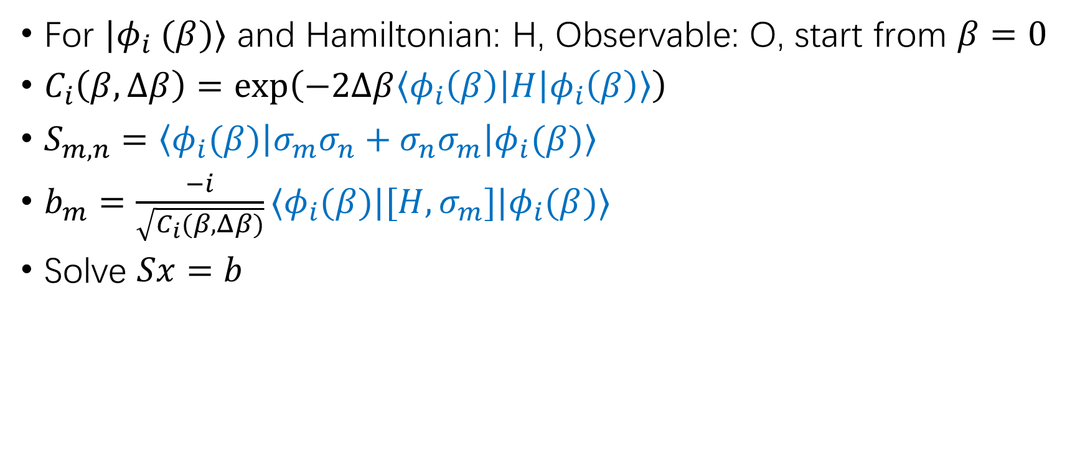

QMETTS:
For $|φ_{i} (β)⟩$ and Hamiltonian: H, Observable: O, start from $β=0$
$C_{i}\left(β,Δβ\right)=\exp\left(−2Δβ\left\langle φ_{i}\left(β\right)\left|H\right|φ_{i}\left(β\right)\right\rangle \right)$
$S_{m,n}=\left\langle φ_{i}(β)\left|σ_{m}σ_{n}+σ_{n}σ_{m}\right|φ_{i}(β)\right\rangle$
$b_{m}=\frac{−i}{\sqrt{C_{i}(β,Δβ)}}⟨φ_{i}(β)|[H,σ_{m}]|φ_{i}(β)⟩$
Solve $Sx=b$
$$|φ_{i} (0)⟩$$
$$C_{i}\left(0,Δβ\right)$$
$$x_{i}$$

Slide 11

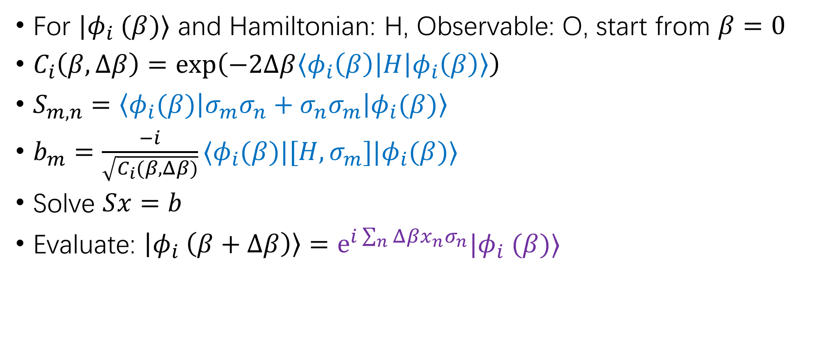



QMETTS:
For $|φ_{i} (β)⟩$ and Hamiltonian: H, Observable: O, start from $β=0$
$C_{i}\left(β,Δβ\right)=\exp\left(−2Δβ\left\langle φ_{i}\left(β\right)\left|H\right|φ_{i}\left(β\right)\right\rangle \right)$
$S_{m,n}=\left\langle φ_{i}(β)\left|σ_{m}σ_{n}+σ_{n}σ_{m}\right|φ_{i}(β)\right\rangle$
$b_{m}=\frac{−i}{\sqrt{C_{i}(β,Δβ)}}⟨φ_{i}(β)|[H,σ_{m}]|φ_{i}(β)⟩$
Solve $Sx=b$
Evaluate: $\left|φ_{i} \left(β+Δβ\right)\right\rangle =e^{i\sum_{n}{{Δβx}_{n}σ_{n}}}|φ_{i} (β)⟩$
$$|φ_{i} (0)⟩$$
$$e^{i\sum_{n}{{Δβx}_{n}σ_{n}}}$$
$$|φ_{i} (Δβ)⟩$$
$$C_{i}\left(0,Δβ\right)$$
$$x_{i}$$

Slide 12


QMETTS:
For $|φ_{i} (β)⟩$ and Hamiltonian: H, Observable: O, start from $β=0$
$C_{i}\left(β,Δβ\right)=\exp\left(−2Δβ\left\langle φ_{i}\left(β\right)\left|H\right|φ_{i}\left(β\right)\right\rangle \right)$
$S_{m,n}=\left\langle φ_{i}(β)\left|σ_{m}σ_{n}+σ_{n}σ_{m}\right|φ_{i}(β)\right\rangle$
$b_{m}=\frac{−i}{\sqrt{C_{i}(β,Δβ)}}⟨φ_{i}(β)|[H,σ_{m}]|φ_{i}(β)⟩$
Solve $Sx=b$
Evaluate: $\left|φ_{i} \left(β+Δβ\right)\right\rangle =e^{i\sum_{n}{{Δβx}_{n}σ_{n}}}|φ_{i} (β)⟩$
$$|φ_{i} (0)⟩$$
$$e^{i\sum_{n}{{Δβx}_{n}σ_{n}}}$$
$$|φ_{i} (Δβ)⟩$$
$$e^{i\sum_{n}{{Δβx}_{n}σ_{n}}}$$
$$C_{i}\left(0,Δβ\right)$$
$$x_{i}$$
$$C_{i}\left(Δβ,Δβ\right)$$
$$x_{i}$$

Slide 13



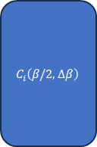


QMETTS:
For $|φ_{i} (β)⟩$ and Hamiltonian: H, Observable: O, start from $β=0$
$C_{i}\left(β,Δβ\right)=\exp\left(−2Δβ\left\langle φ_{i}\left(β\right)\left|H\right|φ_{i}\left(β\right)\right\rangle \right)$
$S_{m,n}=\left\langle φ_{i}(β)\left|σ_{m}σ_{n}+σ_{n}σ_{m}\right|φ_{i}(β)\right\rangle$
$b_{m}=\frac{−i}{\sqrt{C_{i}(β,Δβ)}}⟨φ_{i}(β)|[H,σ_{m}]|φ_{i}(β)⟩$
Solve $Sx=b$
Evaluate: $\left|φ_{i} \left(β+Δβ\right)\right\rangle =e^{i\sum_{n}{{Δβx}_{n}σ_{n}}}|φ_{i} (β)⟩$
$$|φ_{i} (0)⟩$$
$$e^{i\sum_{n}{{Δβx}_{n}σ_{n}}}$$
$$|φ_{i} (Δβ)⟩$$
$$e^{i\sum_{n}{{Δβx}_{n}σ_{n}}}$$
$$|φ_{i} (2Δβ)⟩$$
…
$$|φ_{i} (β/2)⟩$$
$$C_{i}\left(0,Δβ\right)$$
$$x_{i}$$
$$C_{i}\left(Δβ,Δβ\right)$$
$$x_{i}$$
$$C_{i}\left(2Δβ,Δβ\right)$$
$$x_{i}$$
$$C_{i}\left(β/2,Δβ\right)$$

Slide 14



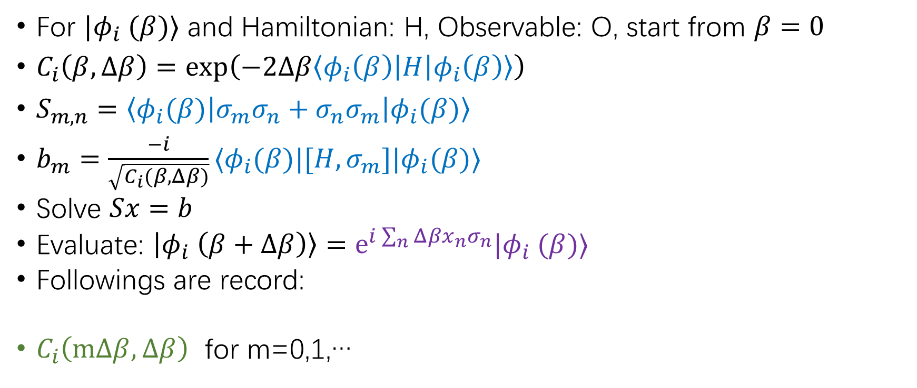




QMETTS:
For $|φ_{i} (β)⟩$ and Hamiltonian: H, Observable: O, start from $β=0$
$C_{i}\left(β,Δβ\right)=\exp\left(−2Δβ\left\langle φ_{i}\left(β\right)\left|H\right|φ_{i}\left(β\right)\right\rangle \right)$
$S_{m,n}=\left\langle φ_{i}(β)\left|σ_{m}σ_{n}+σ_{n}σ_{m}\right|φ_{i}(β)\right\rangle$
$b_{m}=\frac{−i}{\sqrt{C_{i}(β,Δβ)}}⟨φ_{i}(β)|[H,σ_{m}]|φ_{i}(β)⟩$
Solve $Sx=b$
Evaluate: $\left|φ_{i} \left(β+Δβ\right)\right\rangle =e^{i\sum_{n}{{Δβx}_{n}σ_{n}}}|φ_{i} (β)⟩$
Followings are record:
$C_{i}\left(mΔβ,Δβ\right)$ for m=0,1,…
$$|φ_{i} (0)⟩$$
$$e^{i\sum_{n}{{Δβx}_{n}σ_{n}}}$$
$$|φ_{i} (Δβ)⟩$$
$$e^{i\sum_{n}{{Δβx}_{n}σ_{n}}}$$
$$|φ_{i} (2Δβ)⟩$$
…
$$|φ_{i} (β/2)⟩$$
$$C_{i}\left(0,Δβ\right)$$
$$x_{i}$$
$$C_{i}\left(Δβ,Δβ\right)$$
$$x_{i}$$
$$C_{i}\left(2Δβ,Δβ\right)$$
$$x_{i}$$
$$C_{i}\left(β/2,Δβ\right)$$
$$⟨φ_{i}(\frac{β}{2})\left|O\right|φ_{i}(\frac{β}{2})⟩$$

Slide 15
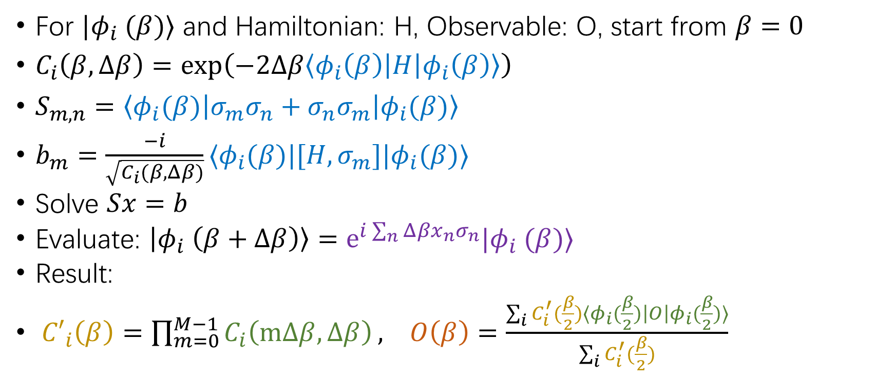
QMETTS:
For $|φ_{i} (β)⟩$ and Hamiltonian: H, Observable: O, start from $β=0$
$C_{i}\left(β,Δβ\right)=\exp\left(−2Δβ\left\langle φ_{i}\left(β\right)\left|H\right|φ_{i}\left(β\right)\right\rangle \right)$
$S_{m,n}=\left\langle φ_{i}(β)\left|σ_{m}σ_{n}+σ_{n}σ_{m}\right|φ_{i}(β)\right\rangle$
$b_{m}=\frac{−i}{\sqrt{C_{i}(β,Δβ)}}⟨φ_{i}(β)|[H,σ_{m}]|φ_{i}(β)⟩$
Solve $Sx=b$
Evaluate: $\left|φ_{i} \left(β+Δβ\right)\right\rangle =e^{i\sum_{n}{{Δβx}_{n}σ_{n}}}|φ_{i} (β)⟩$
Result:
${C′}_{i}\left(β\right)=\prod_{m=0}^{M−1}{C_{i}\left(mΔβ,Δβ\right)}, O\left(β\right)=\frac{\sum_{i}{C_{i}^{′}(\frac{β}{2})⟨φ_{i}(\frac{β}{2})\left|O\right|φ_{i}(\frac{β}{2})⟩}}{\sum_{i}{C_{i}^{′}(\frac{β}{2})}}$

Slide 16
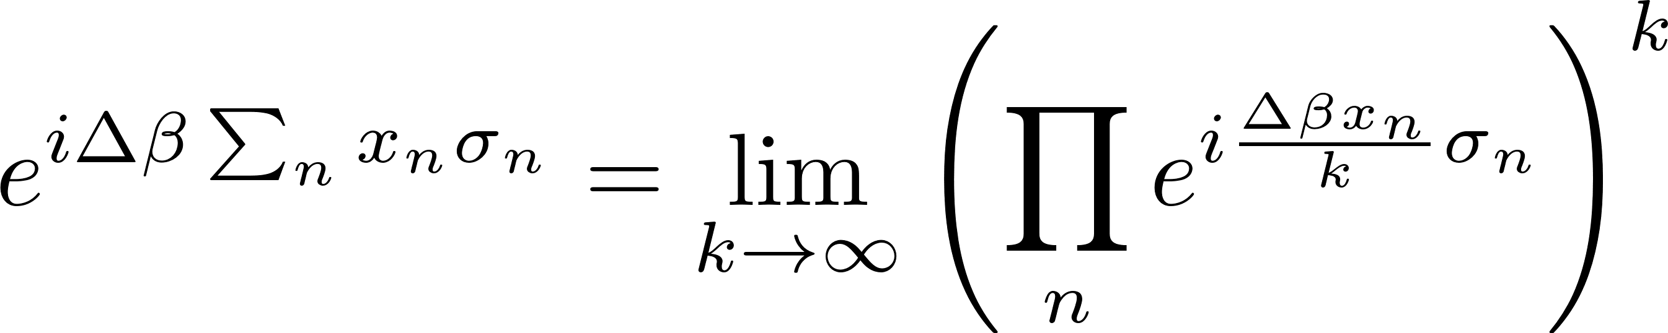


Circuit for evaluation
$$e^{i\sum_{n}{{Δβx}_{n}σ_{n}}}|φ_{i} (β)⟩$$
Trotter expansion:
$$A=∑x_{i}σ_{i} σ_{i=(\sum{4^{n}j_{n}})}=⊗∏σ_{j_{n}}(n)$$
H
H
$exp⁡(it⊗∏σ_{z}\left(n\right))$=
$exp⁡(itσ_{x}⊗σ_{z})$=
+
Rz
+
+
+
+
Rz(t)
+
+
+

Slide 17
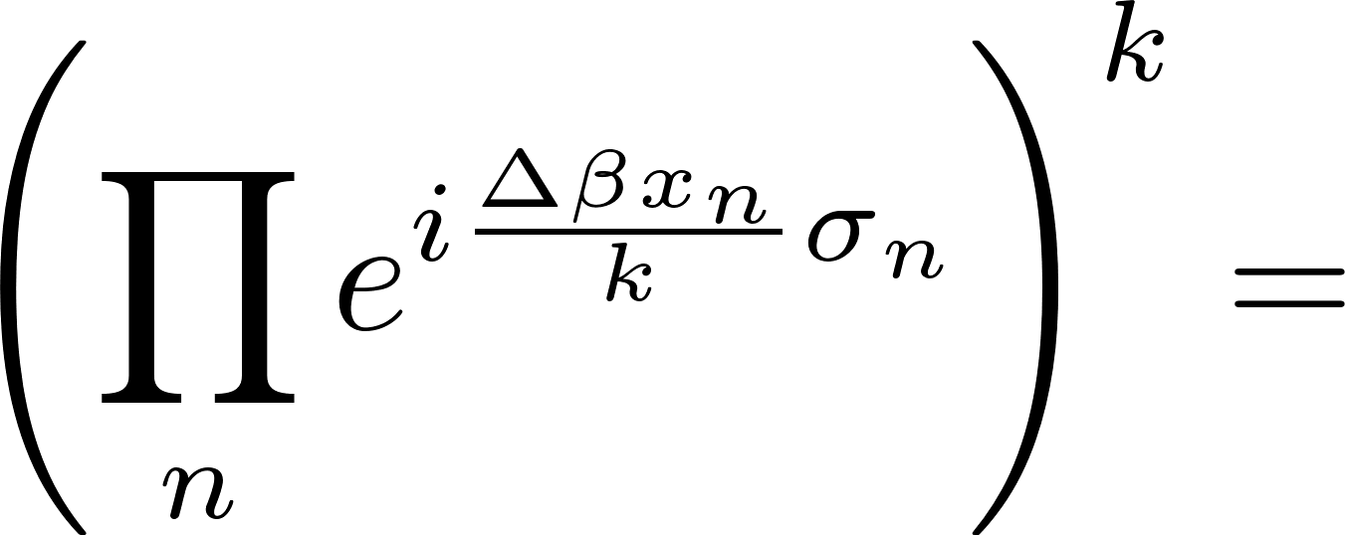
Circuit for evaluation
a Hamiltonian in the form of sum of Pauli strings can be directly translated into circuits in Qiskit
n such circuits
…
+
+
+
Rz
+
+
+
+
+
+
Rz
+
+
+
+
+
+
Rz
+
+
+
repeat k times

Slide 18


Truncation
The most expansive part:
$S_{m,n}=\left\langle φ_{i}(β)\left|σ_{m}σ_{n}+σ_{n}σ_{m}\right|φ_{i}(β)\right\rangle$
$H=h_{1}+h_{2}+…$
$e^{−ΔβH}≈∏$ $e^{−Δβh_{j}}$
$2^{q}×2^{q}$ matrix
‘Super-local’ or ‘two-local’

Slide 19

Truncation
: HHL, VQLS, Quantum Krylov
Always 16x16 matrix
h:
$$S_{m,n}=\left\langle φ_{i}(β)\left|σ_{m}σ_{n}\right|φ_{i}(β)\right\rangle$$
$$β$$
[1901.07653]
[10.1038/s41534-021-00409-y]

Slide 20
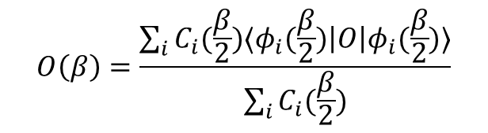
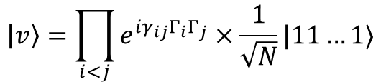




Stochastic estimation of trace
Trace:
$$O\left(β\right)=\frac{\sum_{i}{C_{i}(\frac{β}{2})⟨φ_{i}(\frac{β}{2})\left|O\right|φ_{i}(\frac{β}{2})⟩}}{\sum_{i}{C_{i}(\frac{β}{2})}}$$
$$Tr[Oe^{−βH}]$$
$$Tr[e^{−βH}]$$
Entire Hilbert space
$$Tr\left[M\right]≈∑⟨v|M|v⟩$$
v: random Gaussian complex vectors, or random Z4 complex vectors
$$\left|v\right\rangle =\prod_{i<j}{e^{iγ_{ij}Γ_{i}Γ_{j}}}×\frac{1}{\sqrt{N}}|11…1⟩$$
$$γ_{ij} :uniform \left[0,2π\right) random number$$
[2401.04176]
$$Γ_{i}=\frac{1−σ_{z}(i)}{2}$$

Slide 21
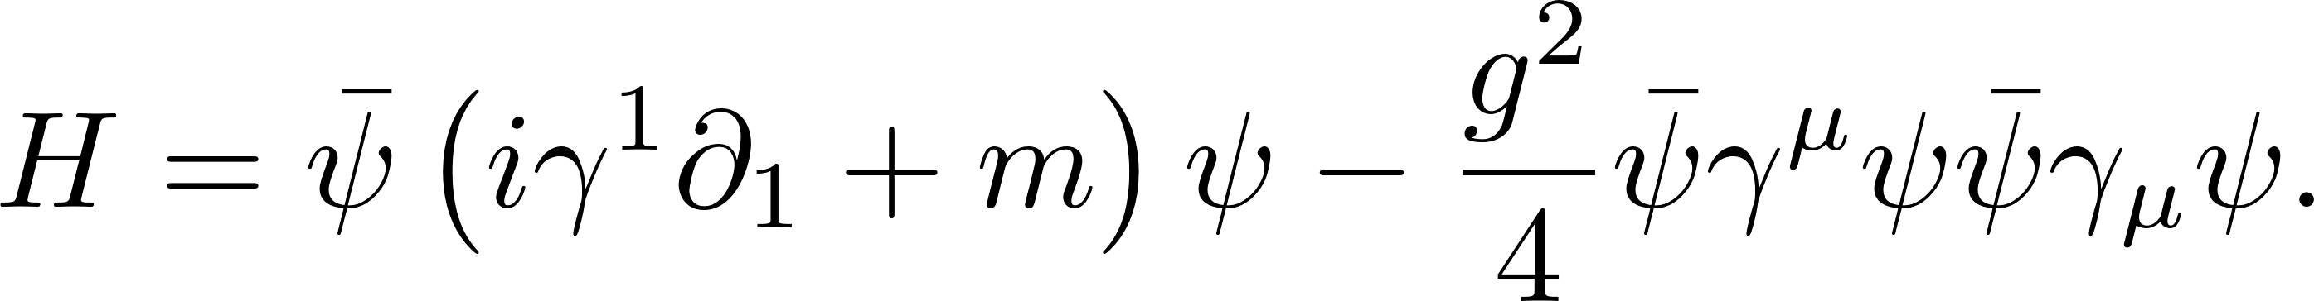
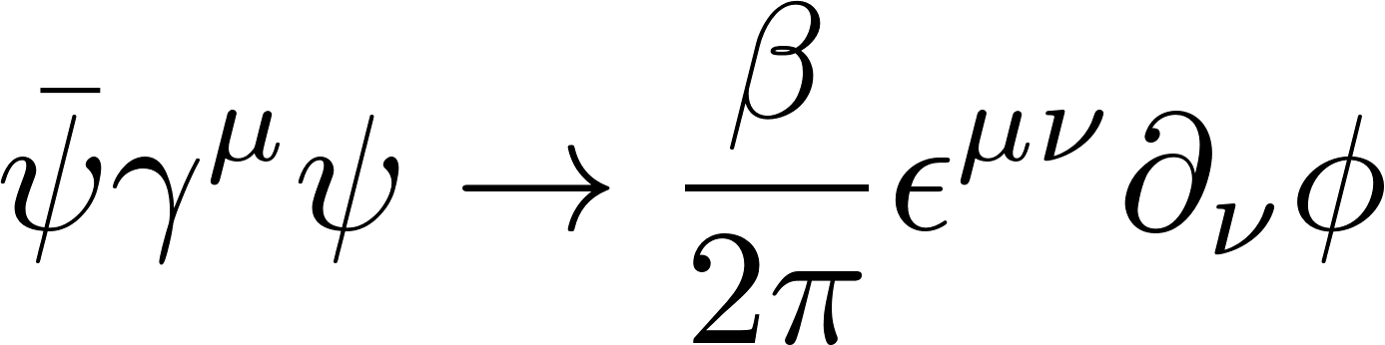
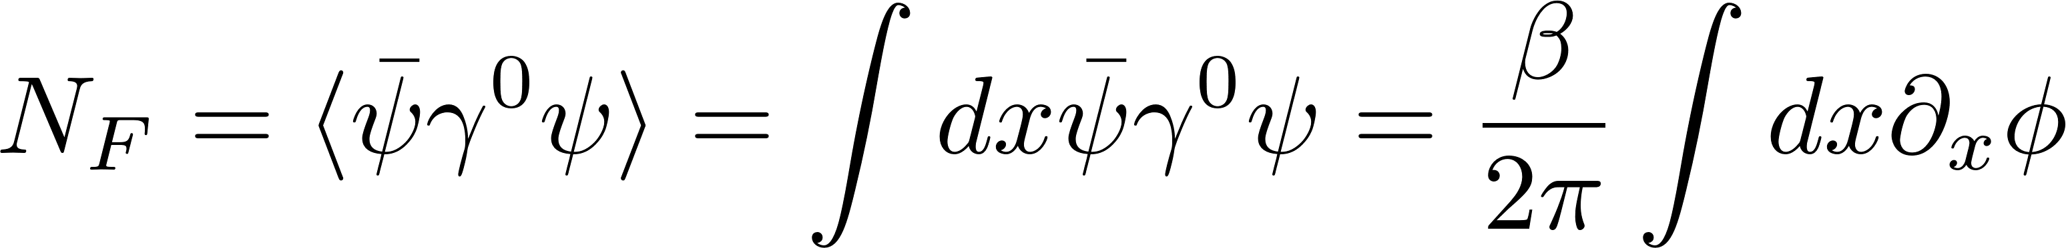
Massive Thirring model
Hamiltonian in D=1+1
a scalar field in sine-Gordon model
Fermion number
Topological charge
interesting at low temperature, with topological phase transition

Slide 22
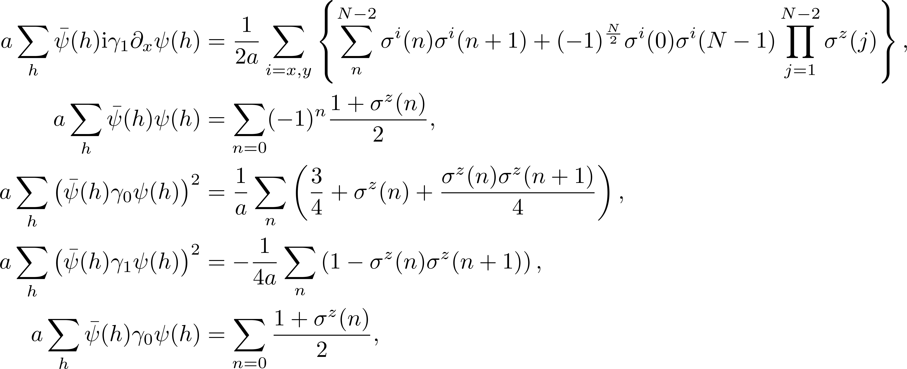
Staggered fermion and Jordan-Wigner representation
Standard approach

Slide 23
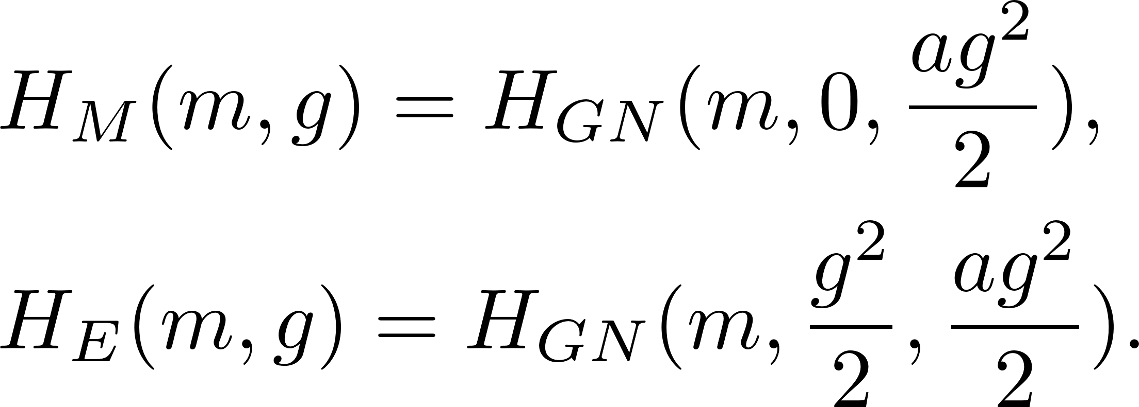
Massive Thirring model and Gross-Neveu model
GN model with contact interaction and chemical potential
In Jordan-Wigner representation,
finite chemical potential -> finite density problem in lattice QCD

Slide 24
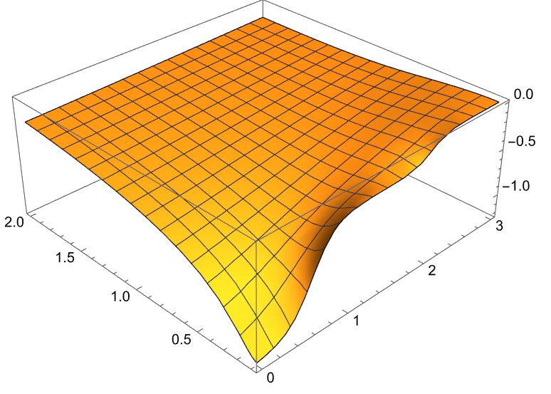
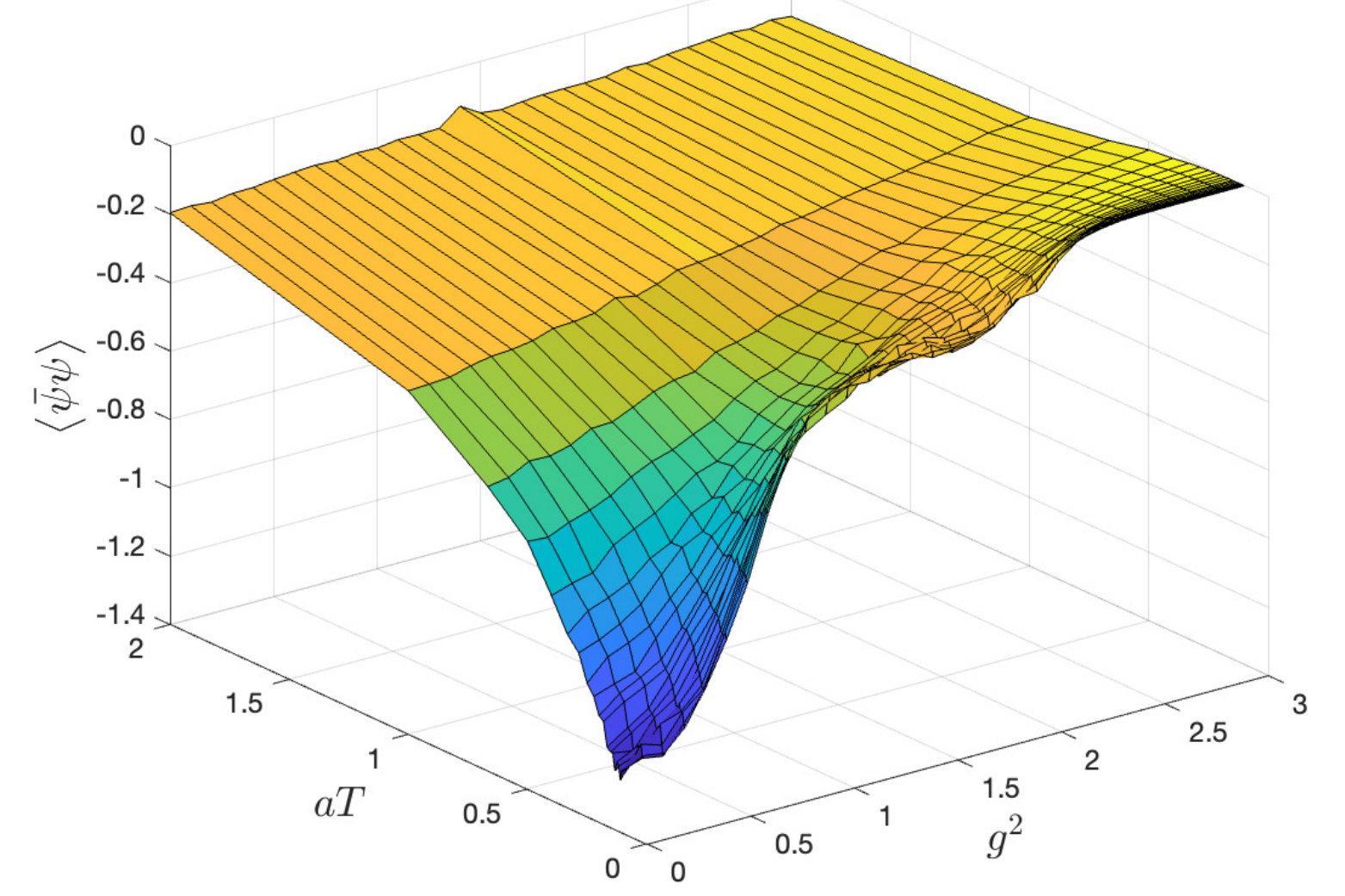
Numerical result: 4-qubits
HE chiral condensation:
exact diagonalization (left) vs QMETTS (right, using Qiskit)

Slide 25
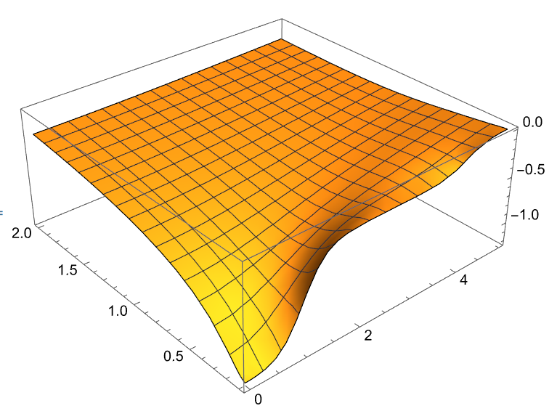
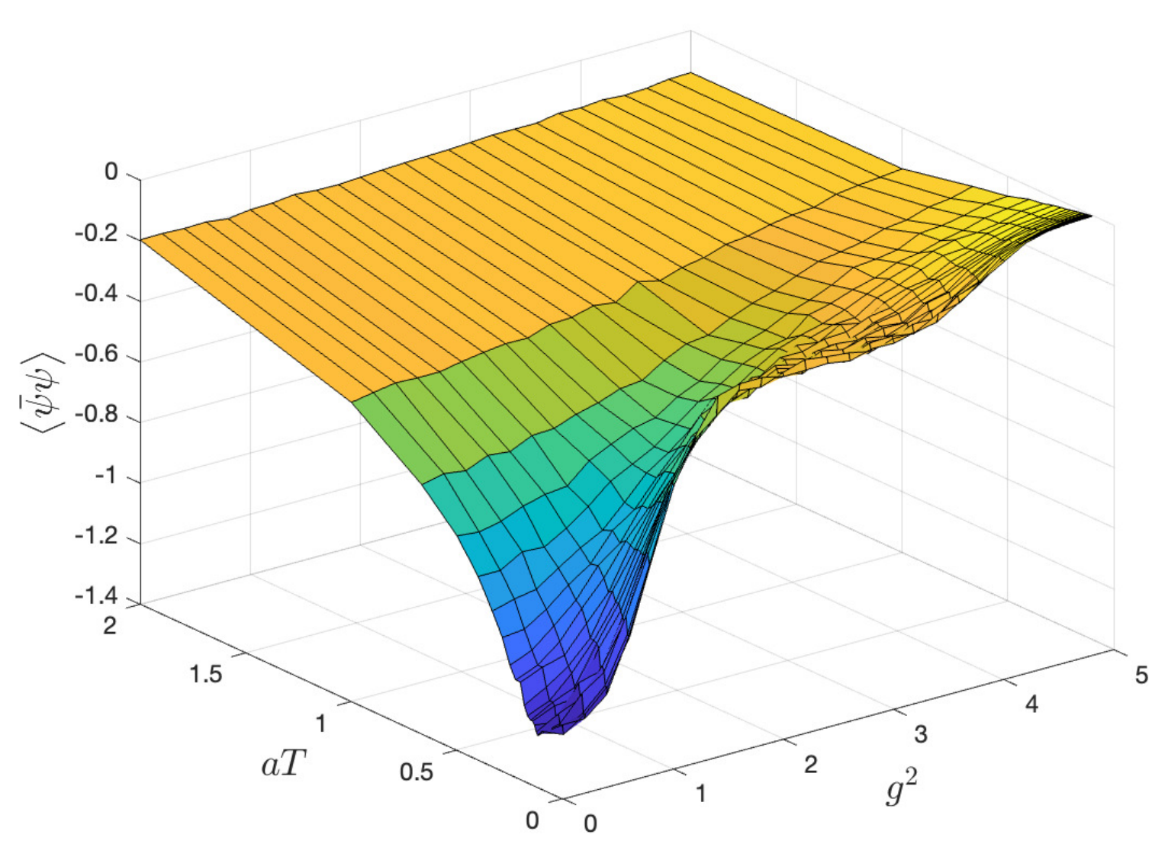
Numerical result:
HM chiral condensation:

Slide 26
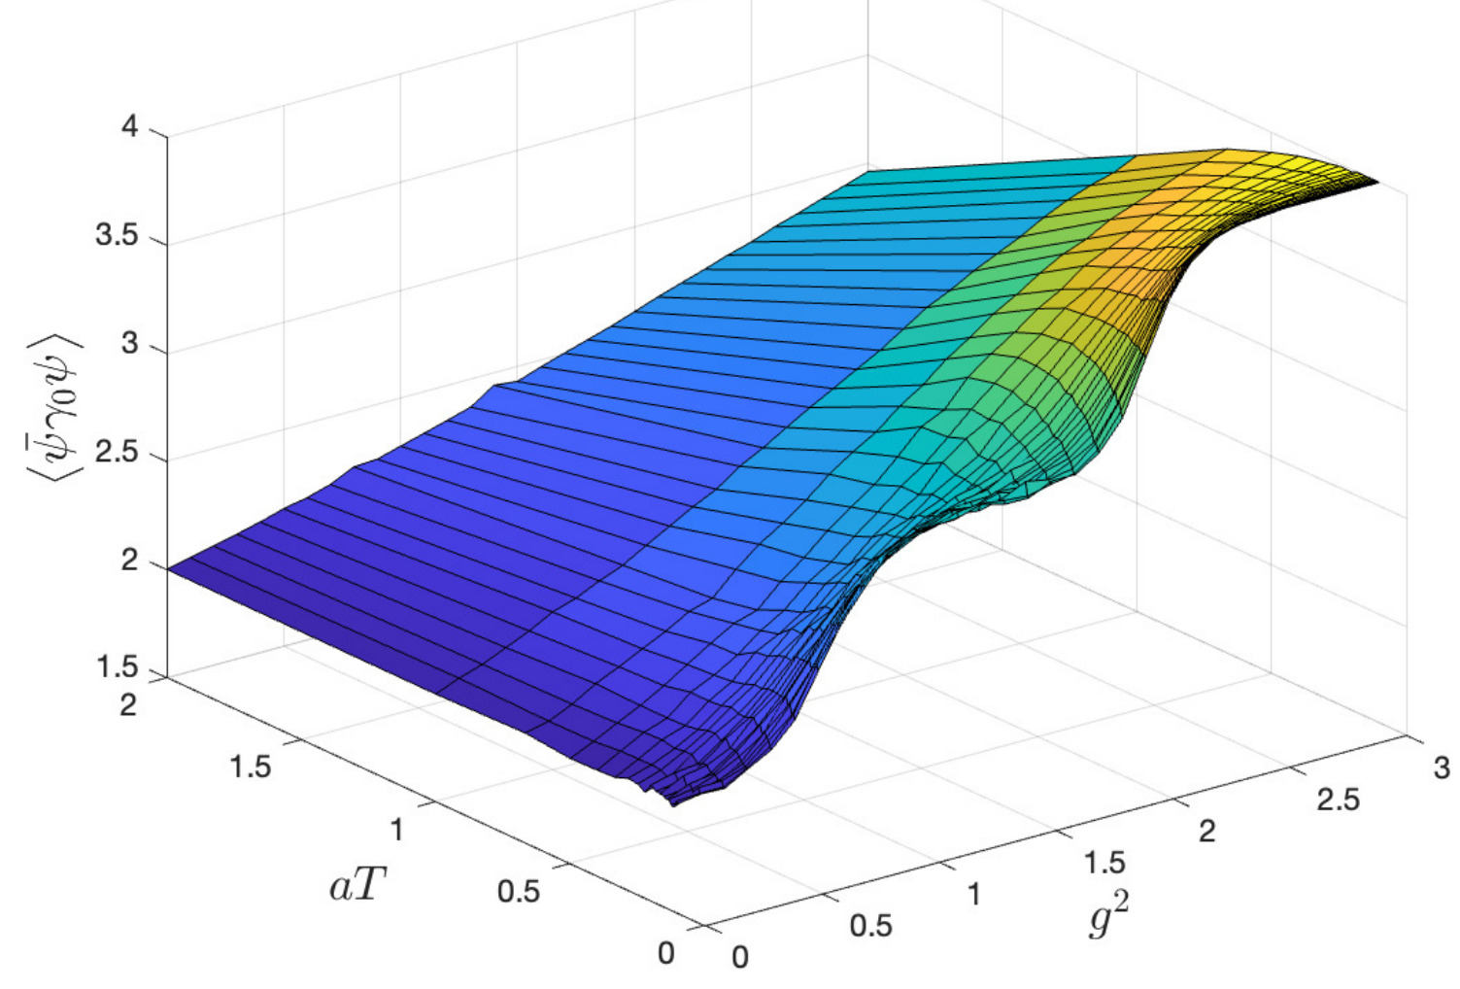
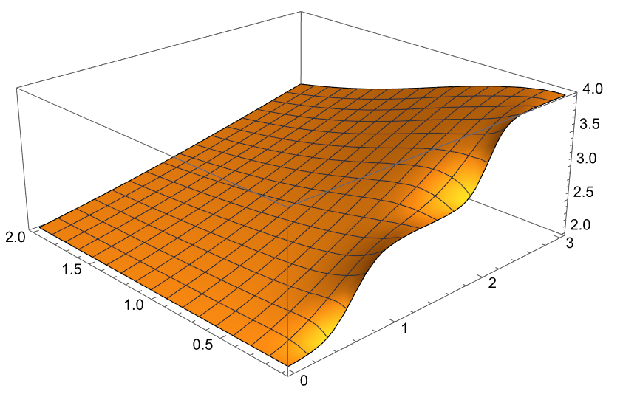
Numerical result:
HE fermion number

Slide 27
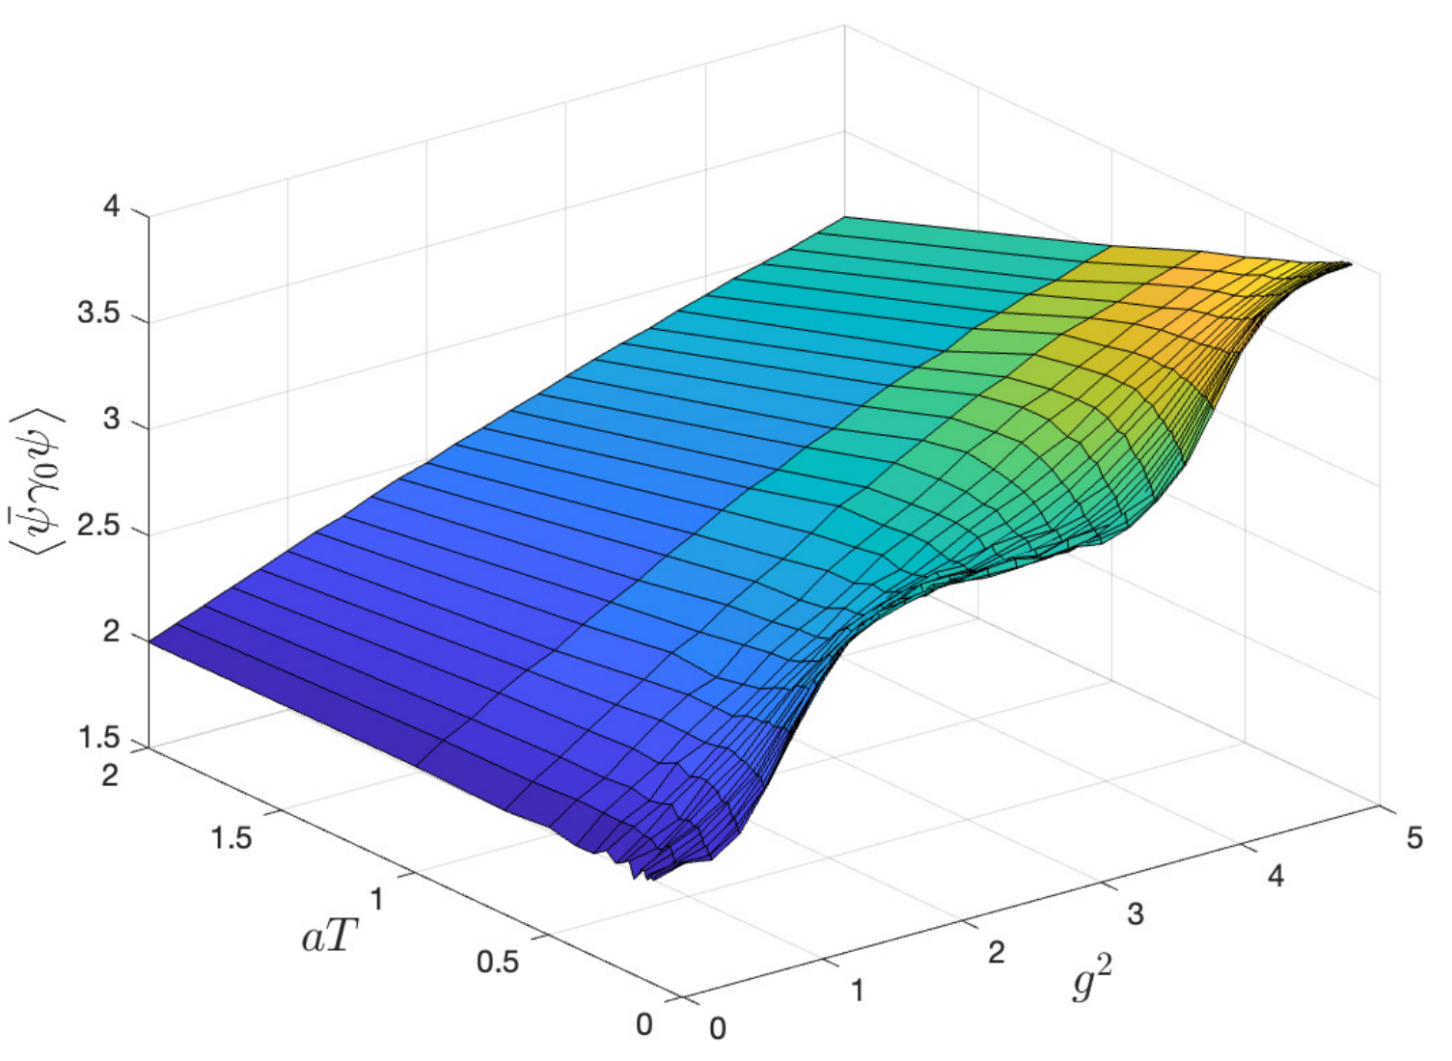
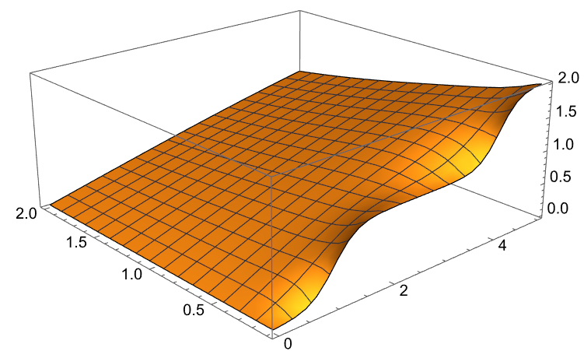
Numerical result:
HM fermion number:

Slide 28
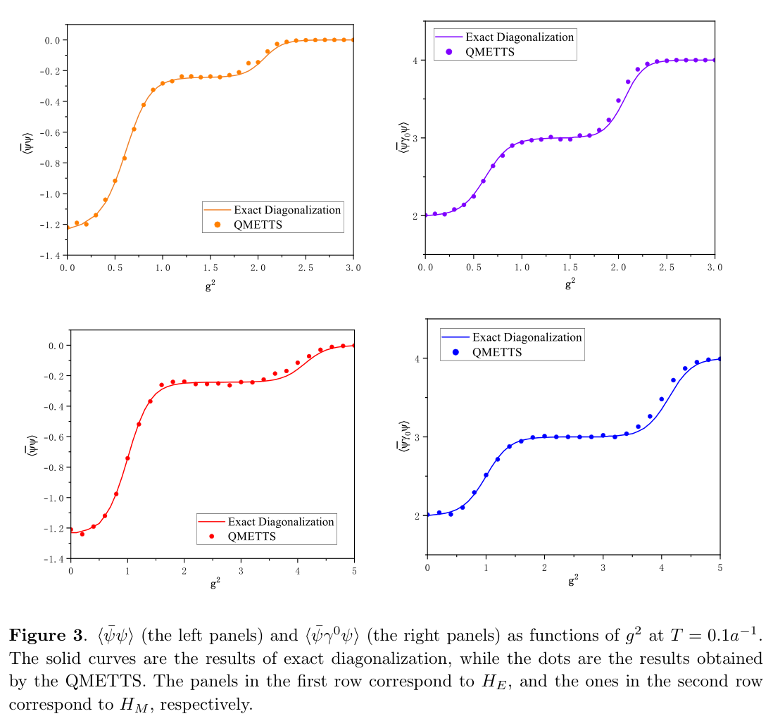
Numerical result:
Low temperature

Slide 29
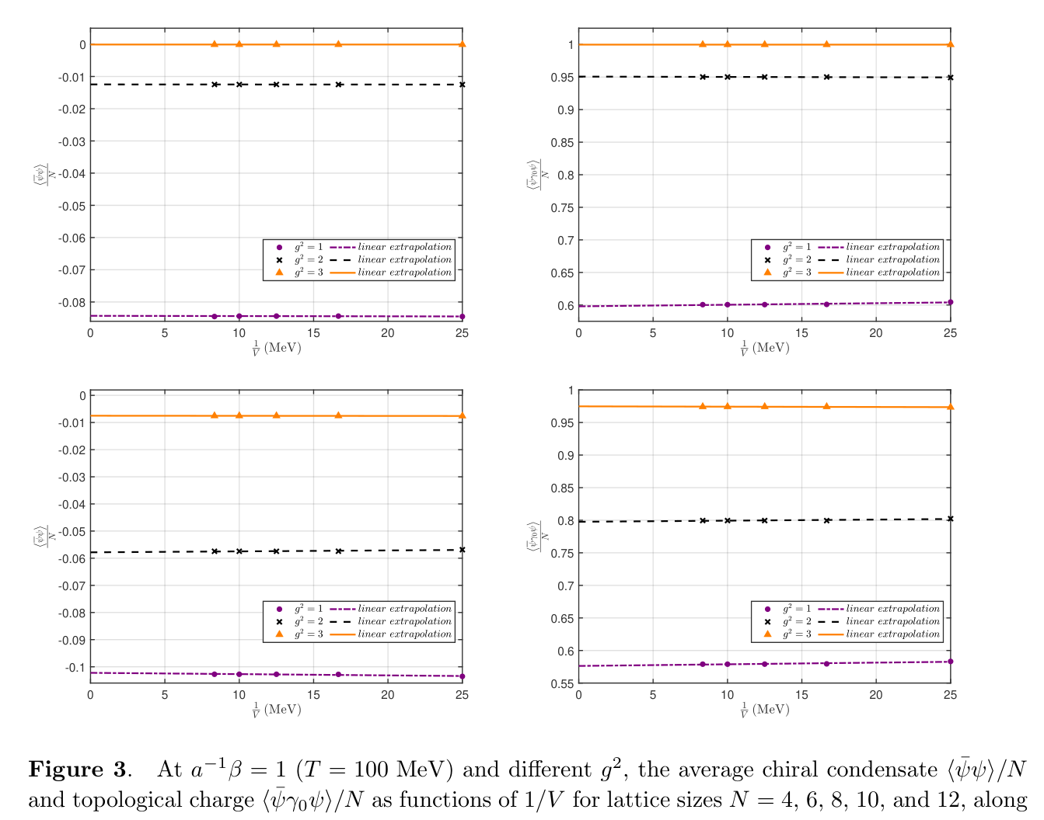
Finite volume effect
Beta=1

Slide 30
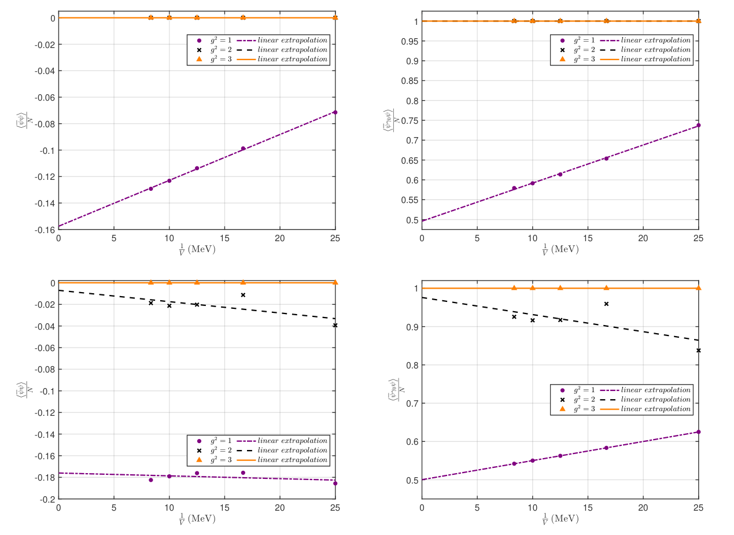
Finite volume effect
Beta=10

Slide 31
Summary
QITEs can be used to reproduce the result of the phase transitions of the massive Thirring model
We are exploring other situations with sign problems such as accelerating frame
Thank you very much!

Slide 32
Backups

Slide 33
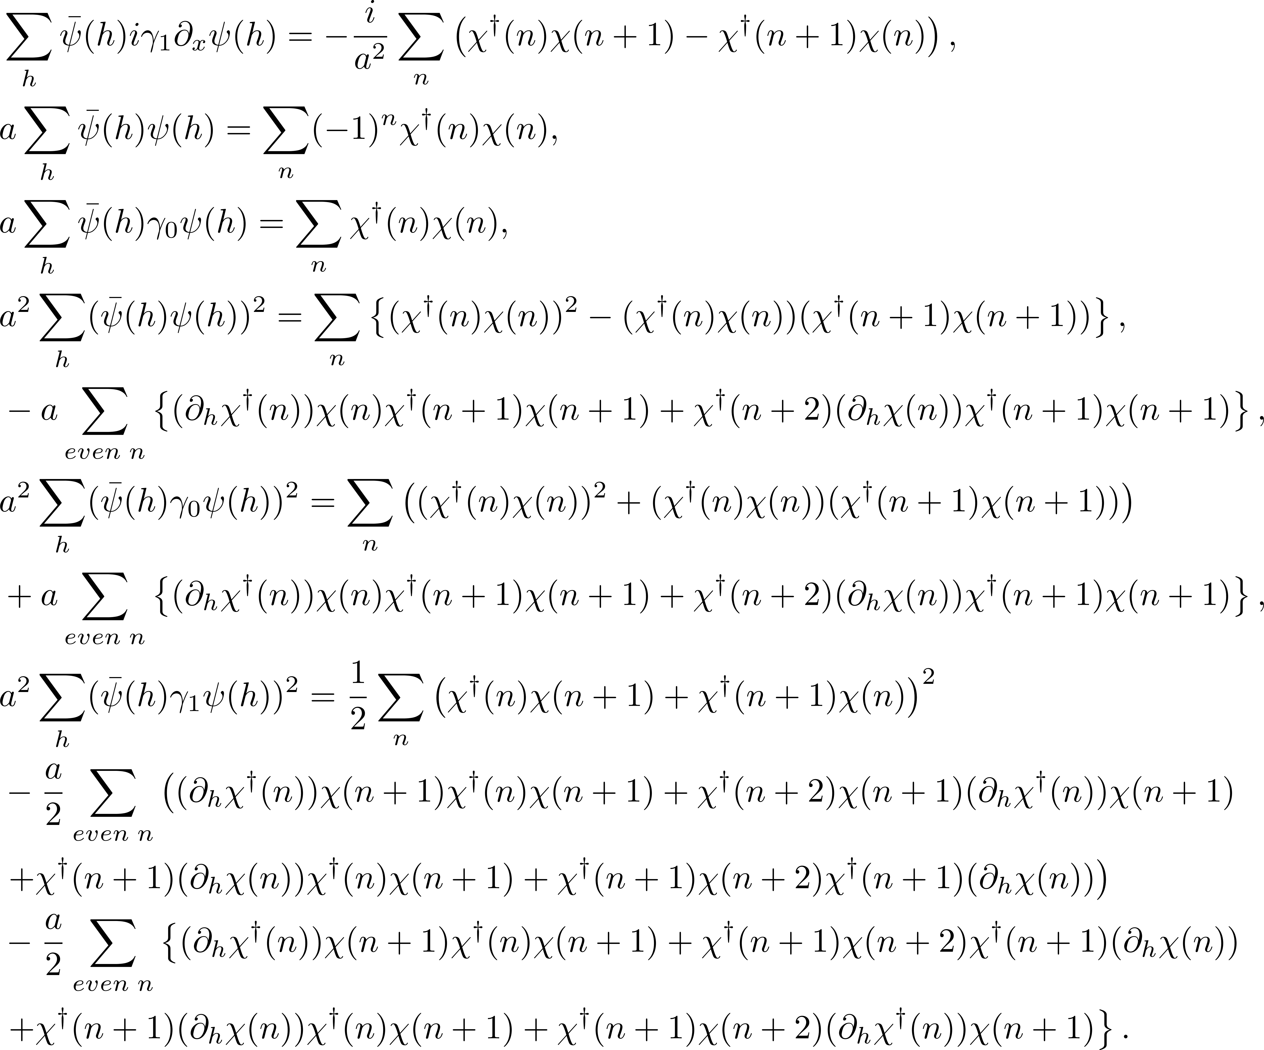
Omitted O(a) terms
To preserve translational invarience

Slide 34
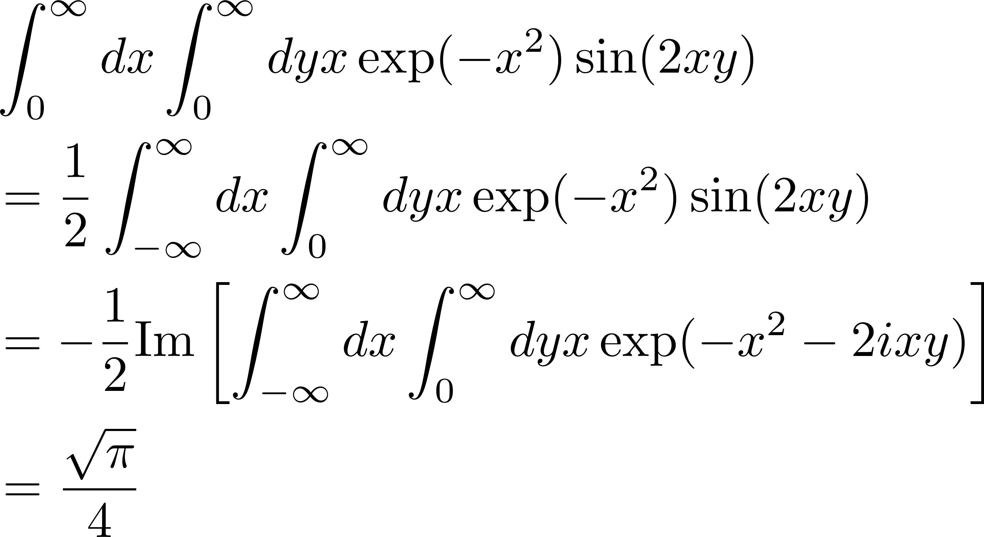
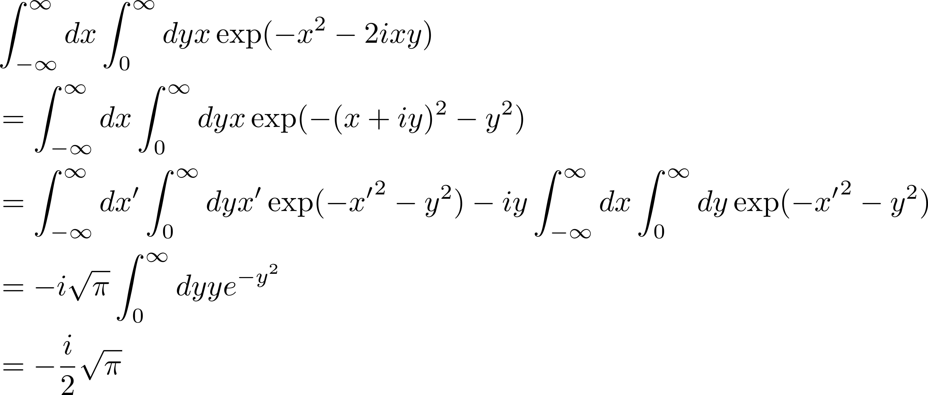
Wick rotation, an example
The integration of y is highly oscillated, so integrate over x first, using Gaussian integration

Slide 35
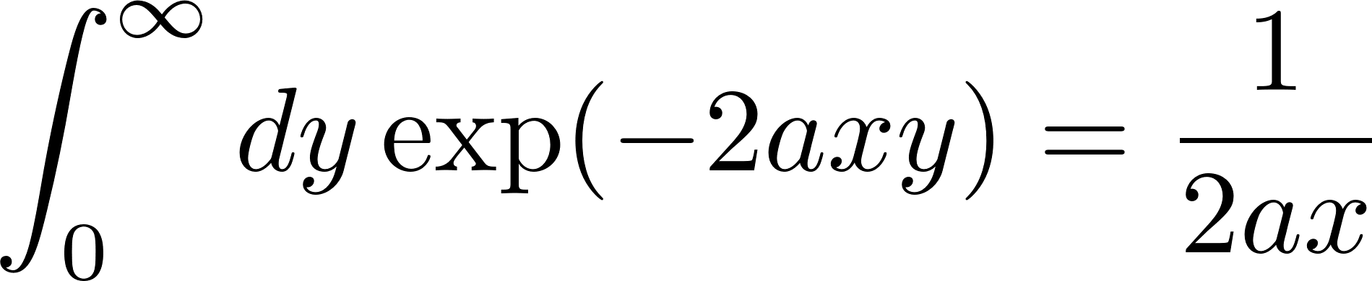
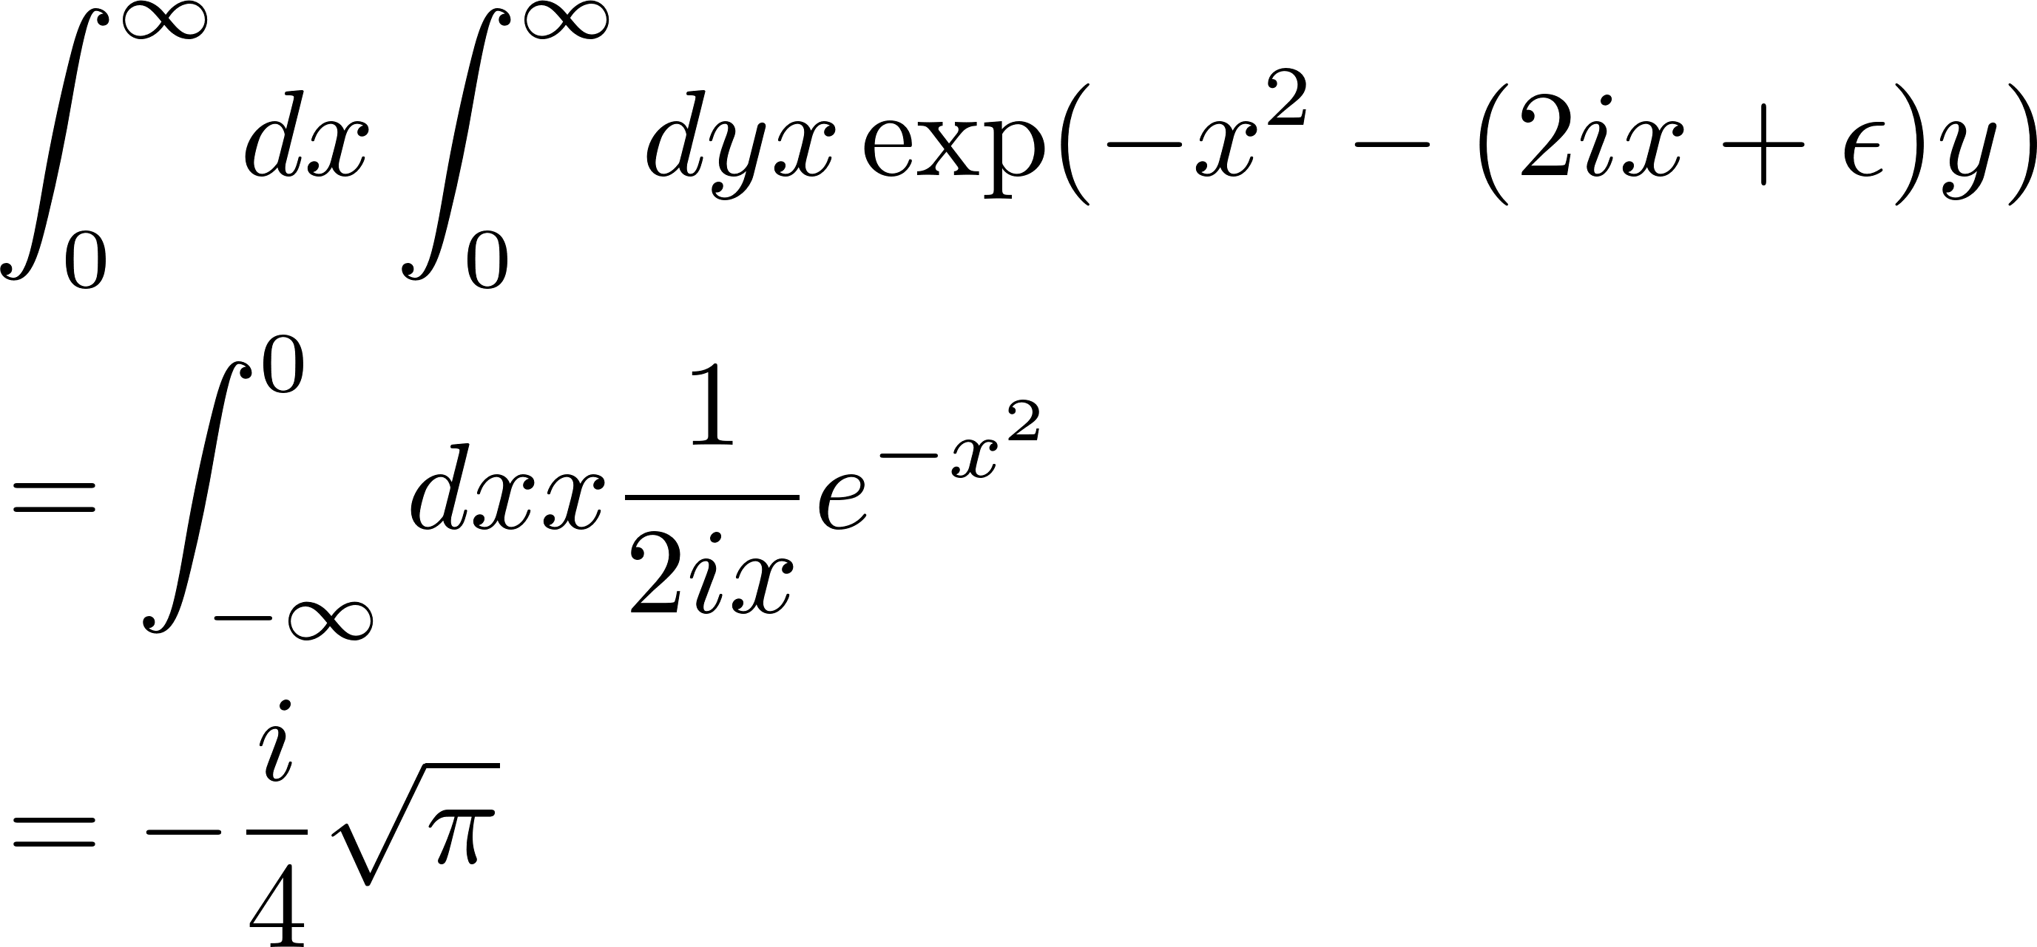

Wick rotation, an example
Rotate y to real axis to integrate
using
Then
Assumption: analytic function

Slide 36
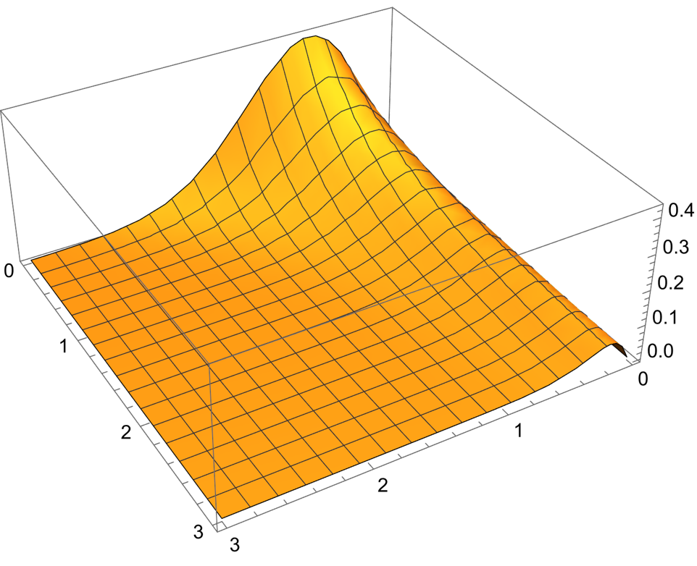
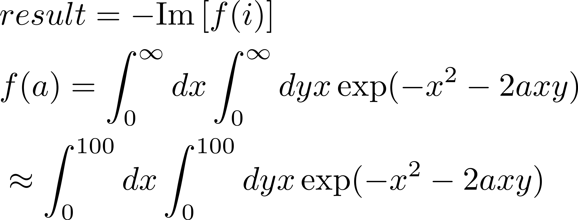
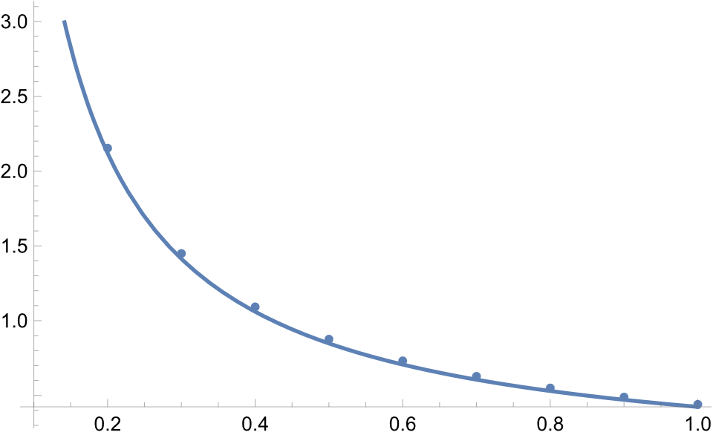
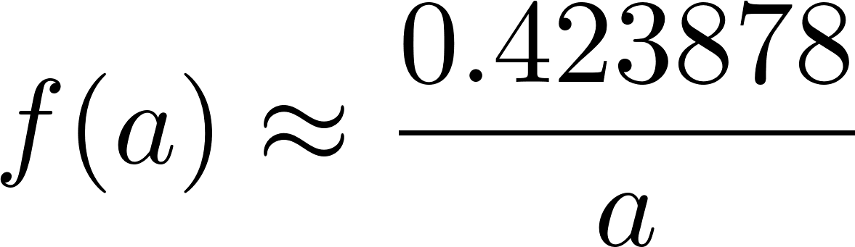
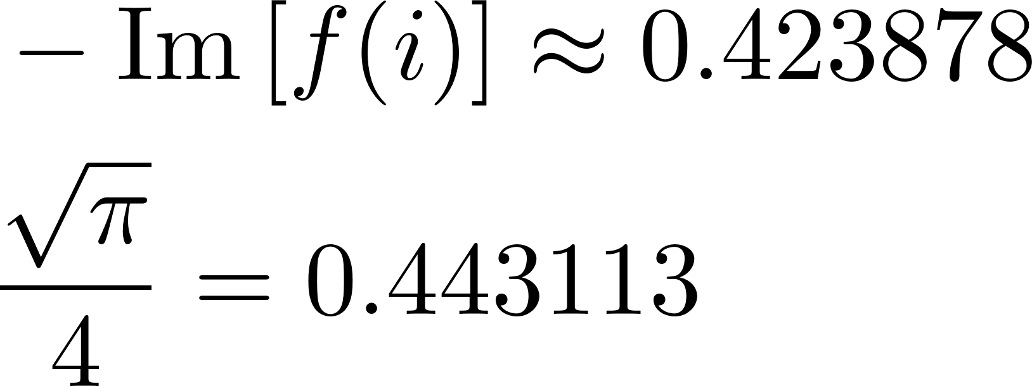
Wick rotation, an example
An example of integrand with a=1
It is not just a change of integrate variable
Now it can be numerically integrated

Slide 37
There is an omitted term?
Note that Hamiltonian participate in this form: [H, …]
The numbers in the absolute commutate with all Pauli matrices, does not contribute to x.

Slide 38
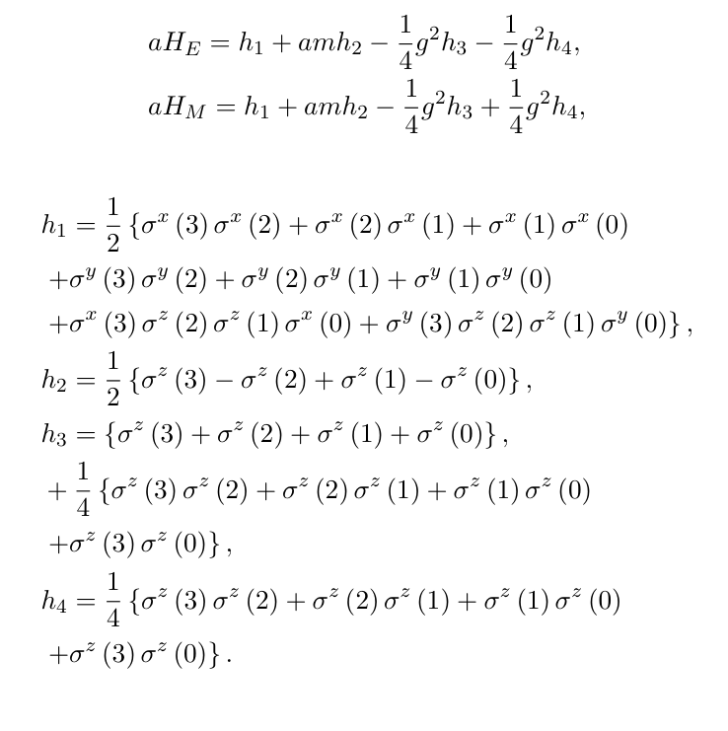
Hamiltonian

Slide 39
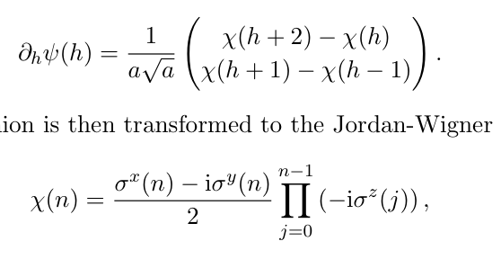

Staggered fermion in 1+1 D

