Slide 1
High Energy Nuclear Physics at HIAF
-- from H-NS to EicC
Yutie Liang
Institute of Modern Physics, CAS
2025-10-11
CLQCD 2025 Huizhou

Slide 2
Outline
Introduction
Highlights of EicC
Highlights of H-NS
From H-NS to EicC
Summary

Slide 3

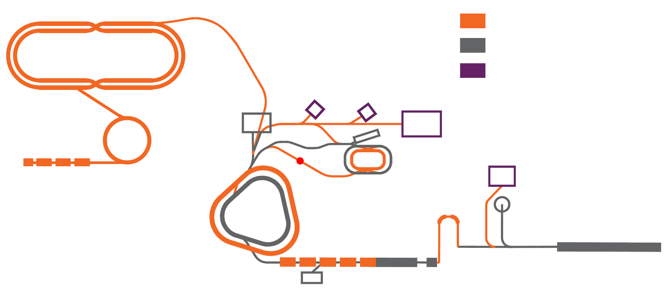
HIAF高能核物理规划
中国先进核物理研究装置（CNUF）China advanced NUclear physics research Facility
EicC
超高脉冲流强多运行模式重离子加速器 (HIAF-U)
新建装置
电子离子对撞机
在建装置
pRing
提升2.0-3.0 GeV能区精度
填补3.2-7.7 GeV能区空白
新建终端
eRing
H-NS
兆瓦级高功率束流驱动同位素在线分离系统 (ISOL)
核物质相结构/超核/强子物理
e-Injector
AR
兆瓦级功率极丰中子
超重元素稳定岛
MRing
离子离子并束
海夸克区双极化高亮度电子离子对撞装置 (EicC)
高能量密度物理
SRing
HIAF
BRing-N
BRing-S
CiADS
ISOL
放射性束
海夸克区唯一装置
重味强子态
iLinac

Slide 4
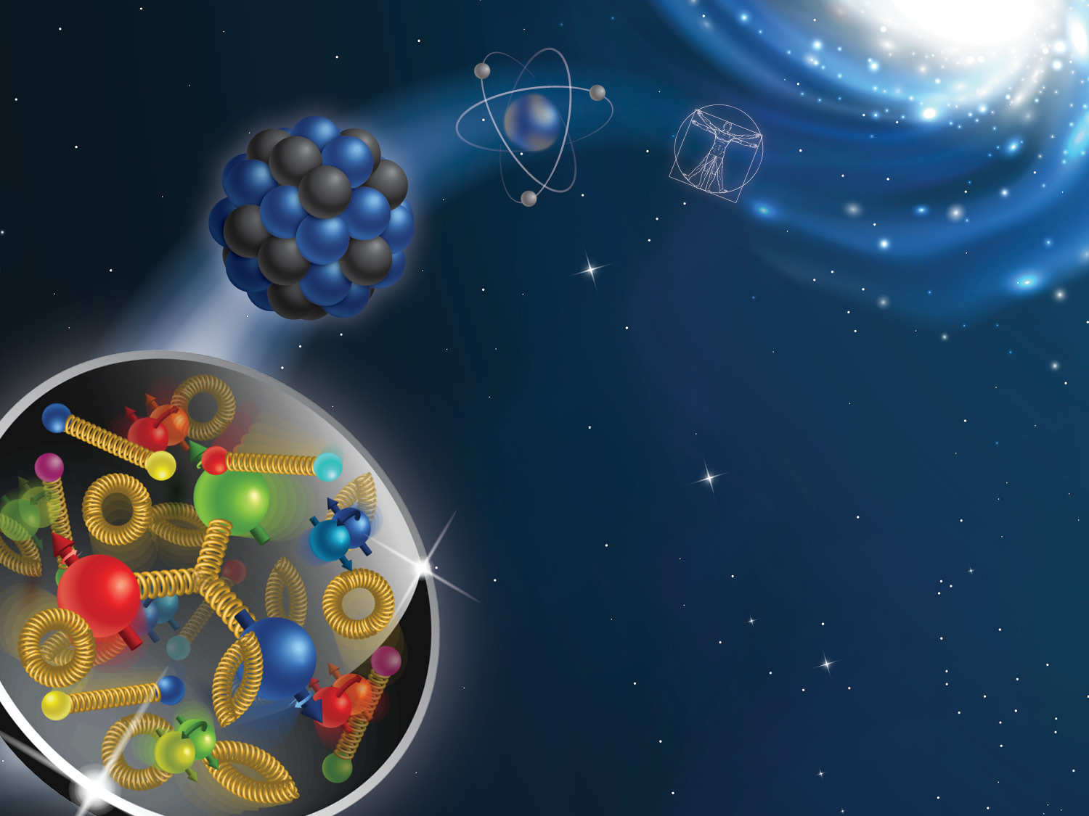
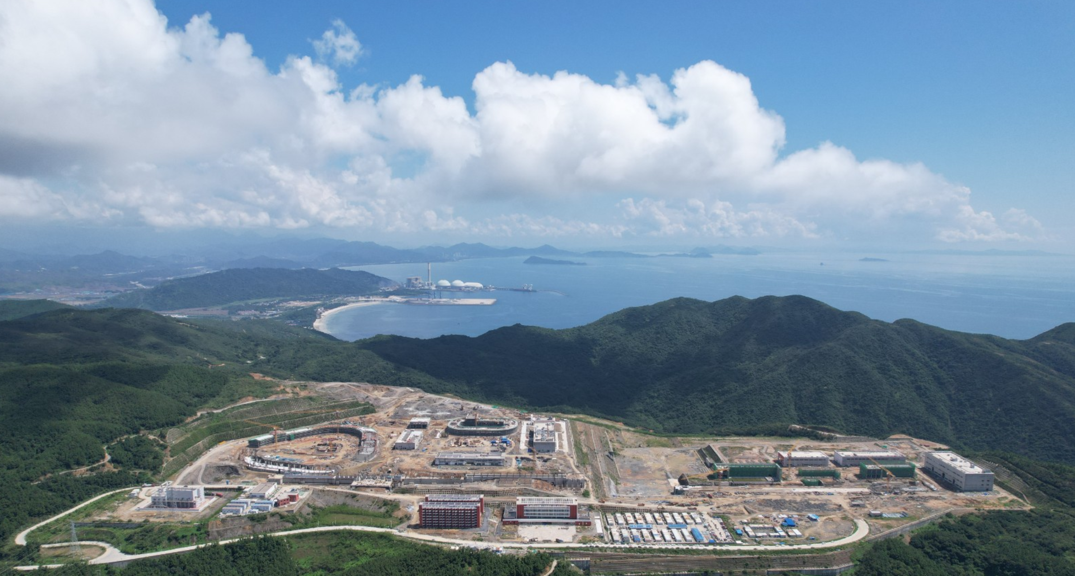
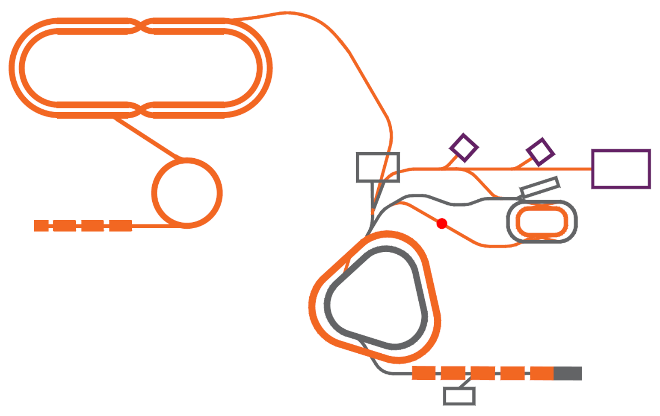
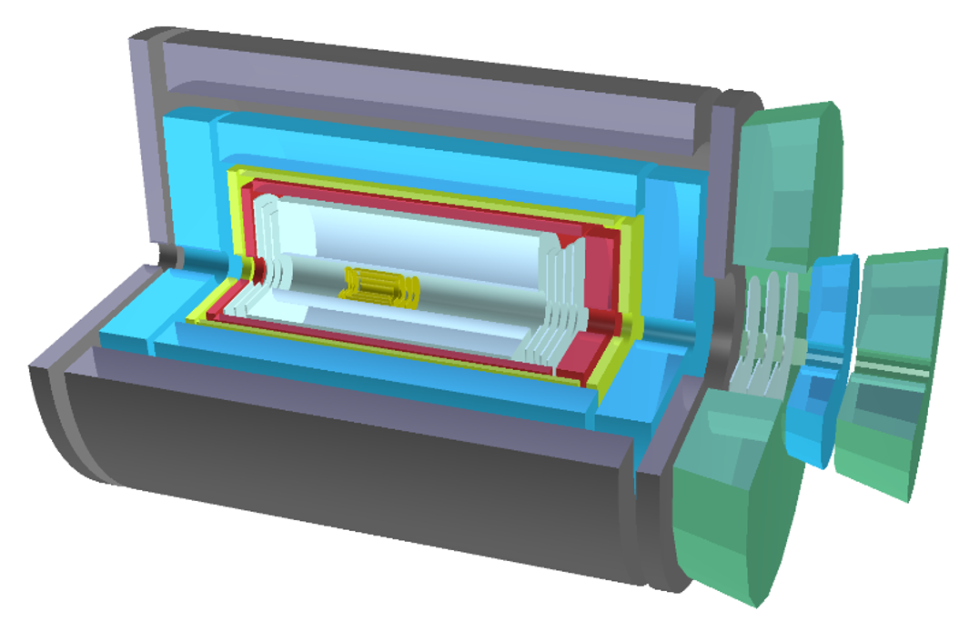


广东，惠州
Development in China-HIAF&EicC
EicC
EicC
2012:Discussion in community
2020.2,2021.6:white paper(CN,EN)
2021-2024:CDR
（213 authors from 69 institutes）
HIAF
As part of the long-term planning project for major scientific and technological infrastructure in particle physics and nuclear physics, the project has undergone two international expert reviews and one domestic expert review.
$\sqrt{s}$: 16.7 GeV
Proton & ion
Electron
EicC’s advantages (to EIC-US)：
The energy is in the sea quark region, closer to nuclear physics
Nearer to the threshold for the production of heavy quarkonium
HIAF：
Completed by the end of 2025, it will provide the world's highest-intensity pulsed heavy ion beams, creating unique conditions for the construction of the EicC
http://www.j.sinap.ac.cn/hjs/CN/Y2020/V43/I2/20001
https://journal.hep.com.cn/fop/EN/10.1007/s11467-021-1062-0

Slide 5
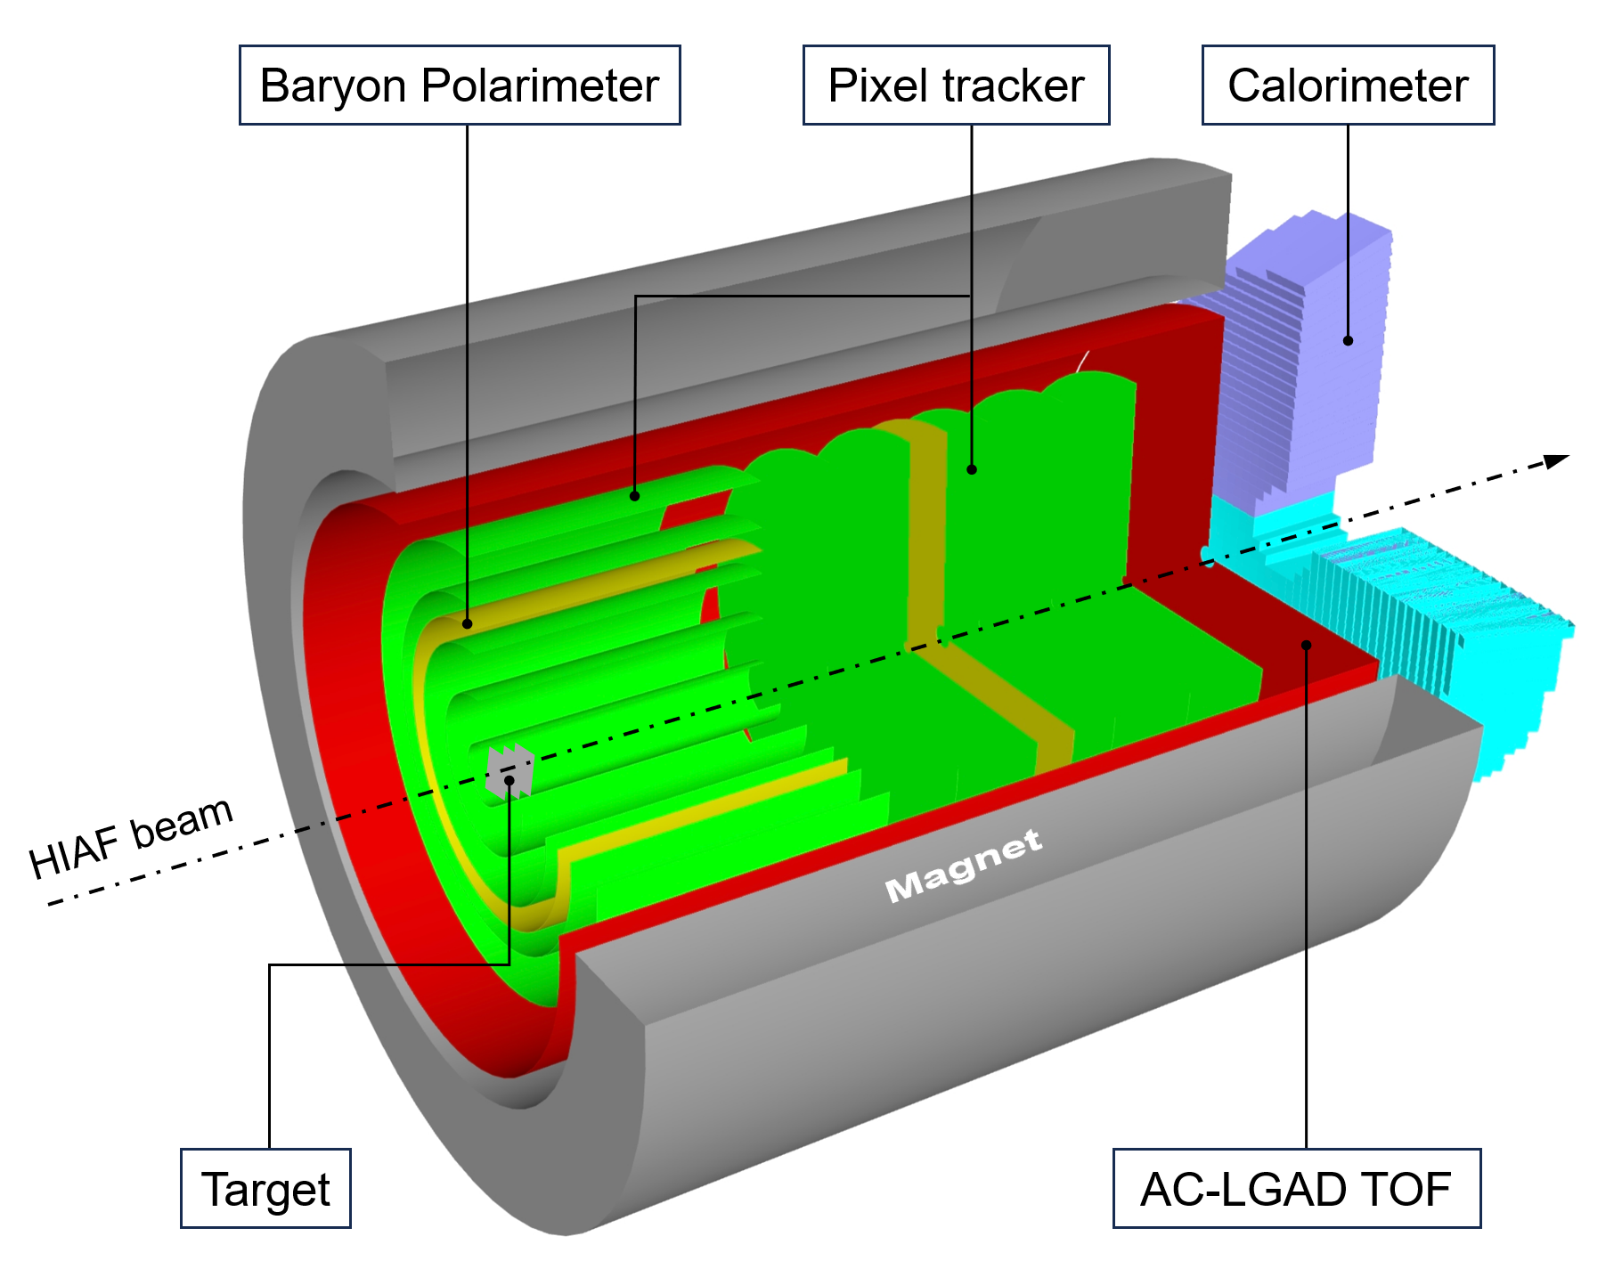
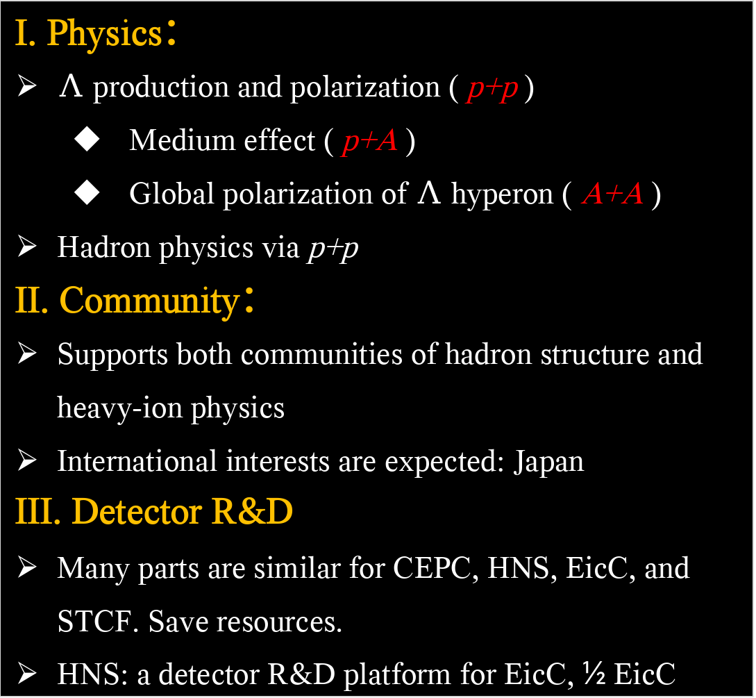
Hyperon-Nucleon Spectrometer (H-NS)
I. Physics：
$Λ$ production and polarization ( p+p )
Medium effect ( p+A )
Global polarization of $Λ$ hyperon ( A+A )
Hadron physics via p+p
II. Community：
Supports both communities of hadron structure and heavy-ion physics
International interests are expected: Japan
III. Detector R&D
Many parts are similar for CEPC, HNS, EicC, and STCF. Save resources.
HNS: a detector R&D platform for EicC, ½ EicC
目前参加单位：北京航空航天大学、复旦大学、国科大、华中师范大学、华南师范大学、近代物理研究所、清华大学、山东大学、香港中文大学（深圳）、中科大、原子能院
子系统研发：Silicon tracker, AC-LGAD, Target, Baryon polarimeter, Calorimeter, Electronics, DAQ, Magnet, Beamline, Mechanics + Engineering

Slide 6
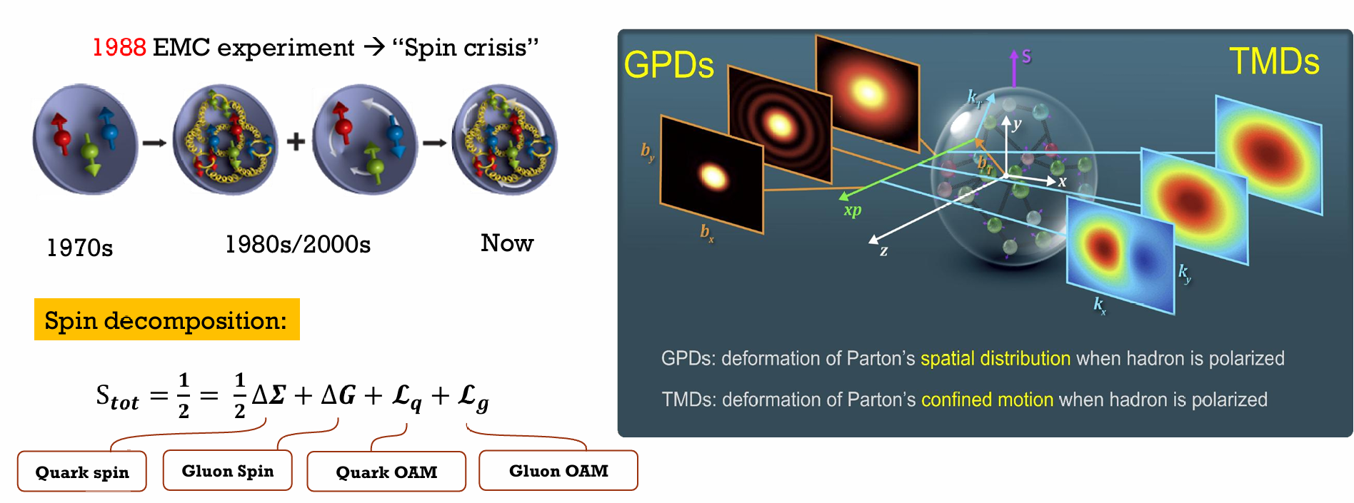
About nucleon spin structure
We have a framework for the understanding of the spin structure of the nucleon
EIC/EicC is the future

Slide 7
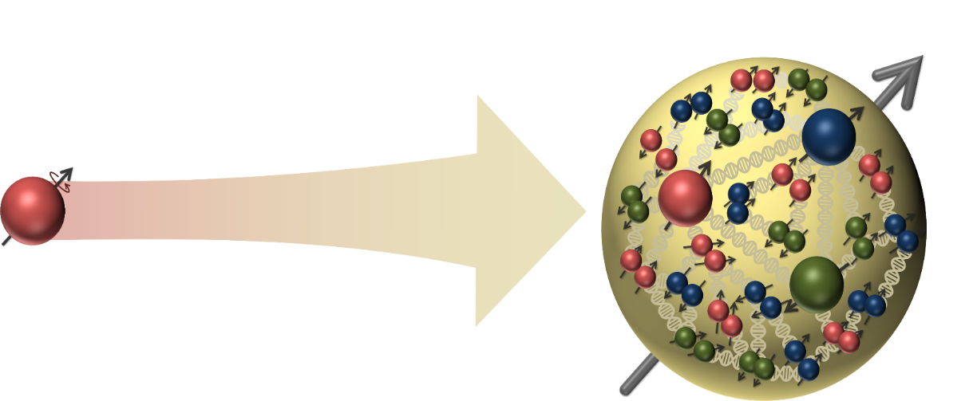

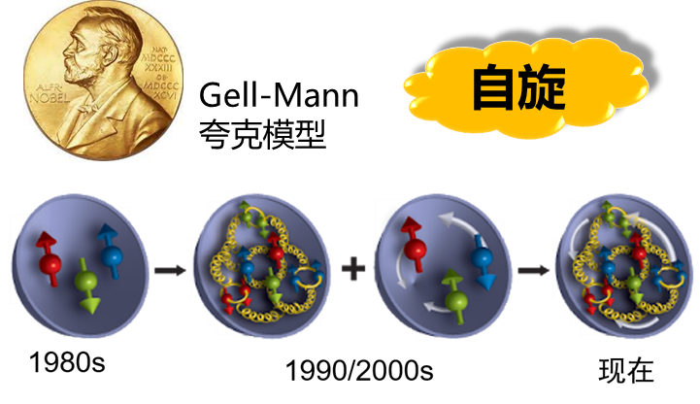
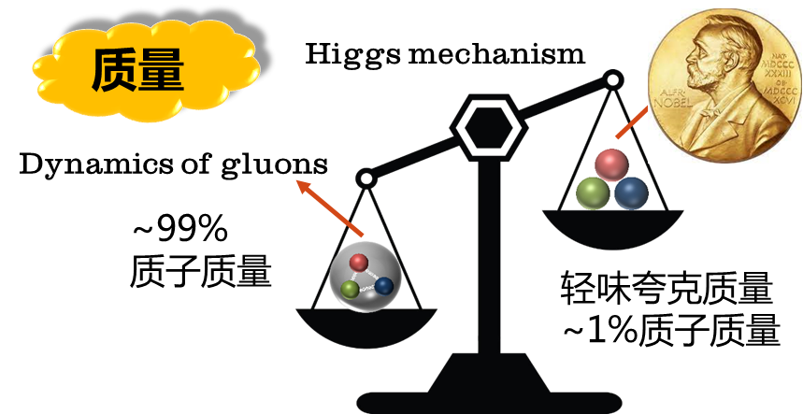
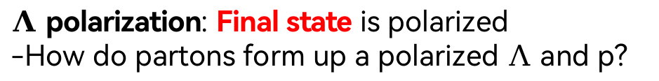
A new domain: from nucleon to hyperon
What is the origin of Λ/p polarization
What is the link between Λ/p spin structure and polarization
Electron ion collider in China (EicC)
Hyperon-Nucleon Spectrometer (H-NS)
EIC: Initial state is polarized
-How do partons form up a polarized nucleon?
$Λ$ polarization: Final state is polarized
-How do partons form up a polarized $Λ$ and p?
Final state
Initial state
Polarized by device
$Λ$ polarization: self-analyzing; p polarization: new concept detector
Baryon spin structure: origin of nucleon spin VS origin of $Λ$/p polarization

Slide 8
Highlights of EicC

Slide 9
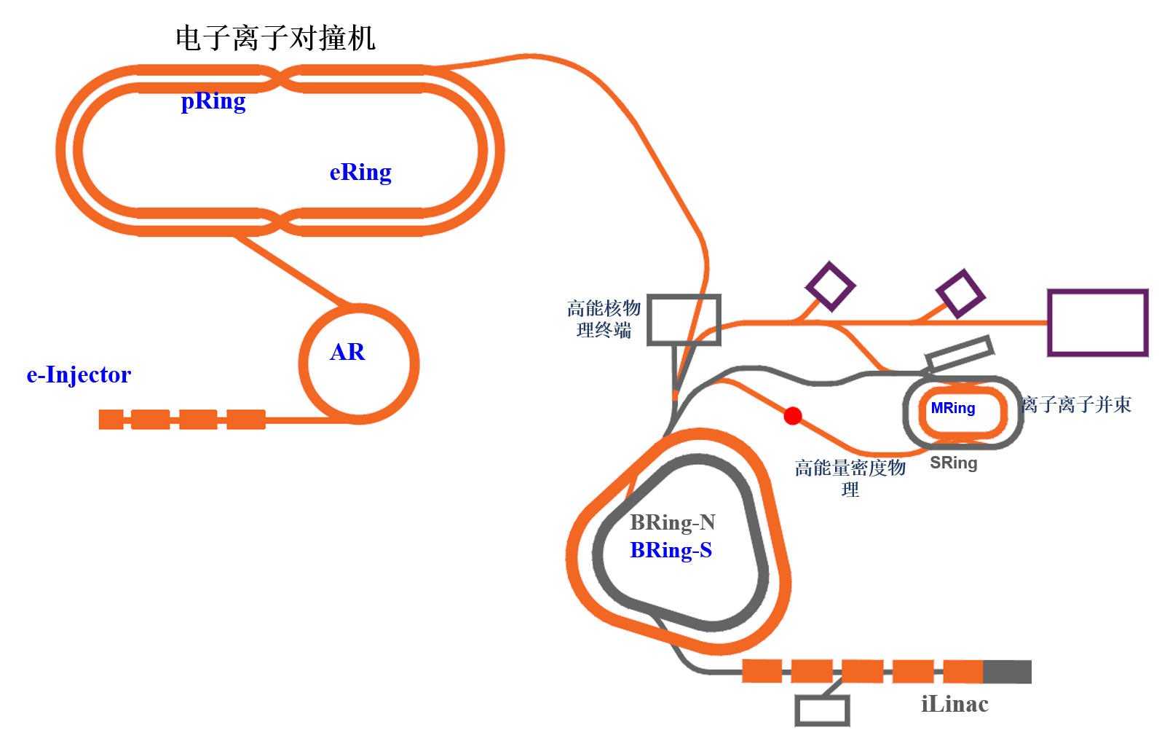

EicC accelerator complex overview
20 GeV p + 3.5 GeV e
$\sqrt{S}:$16.7GeV
High Lumi.：
2-4 x10³³ cm⁻²s⁻¹
Polarized beams
新建装置
在建装置
新建终端

Slide 10
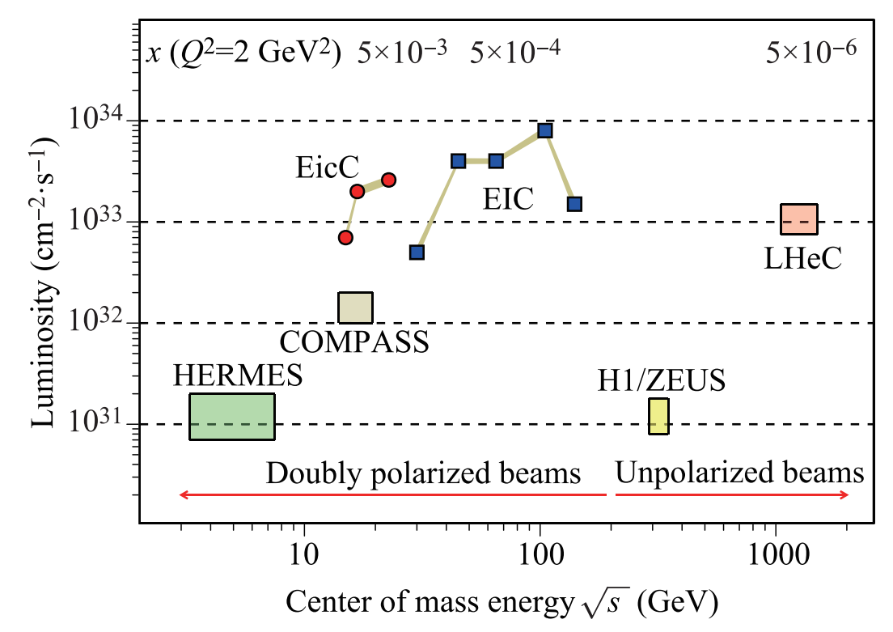
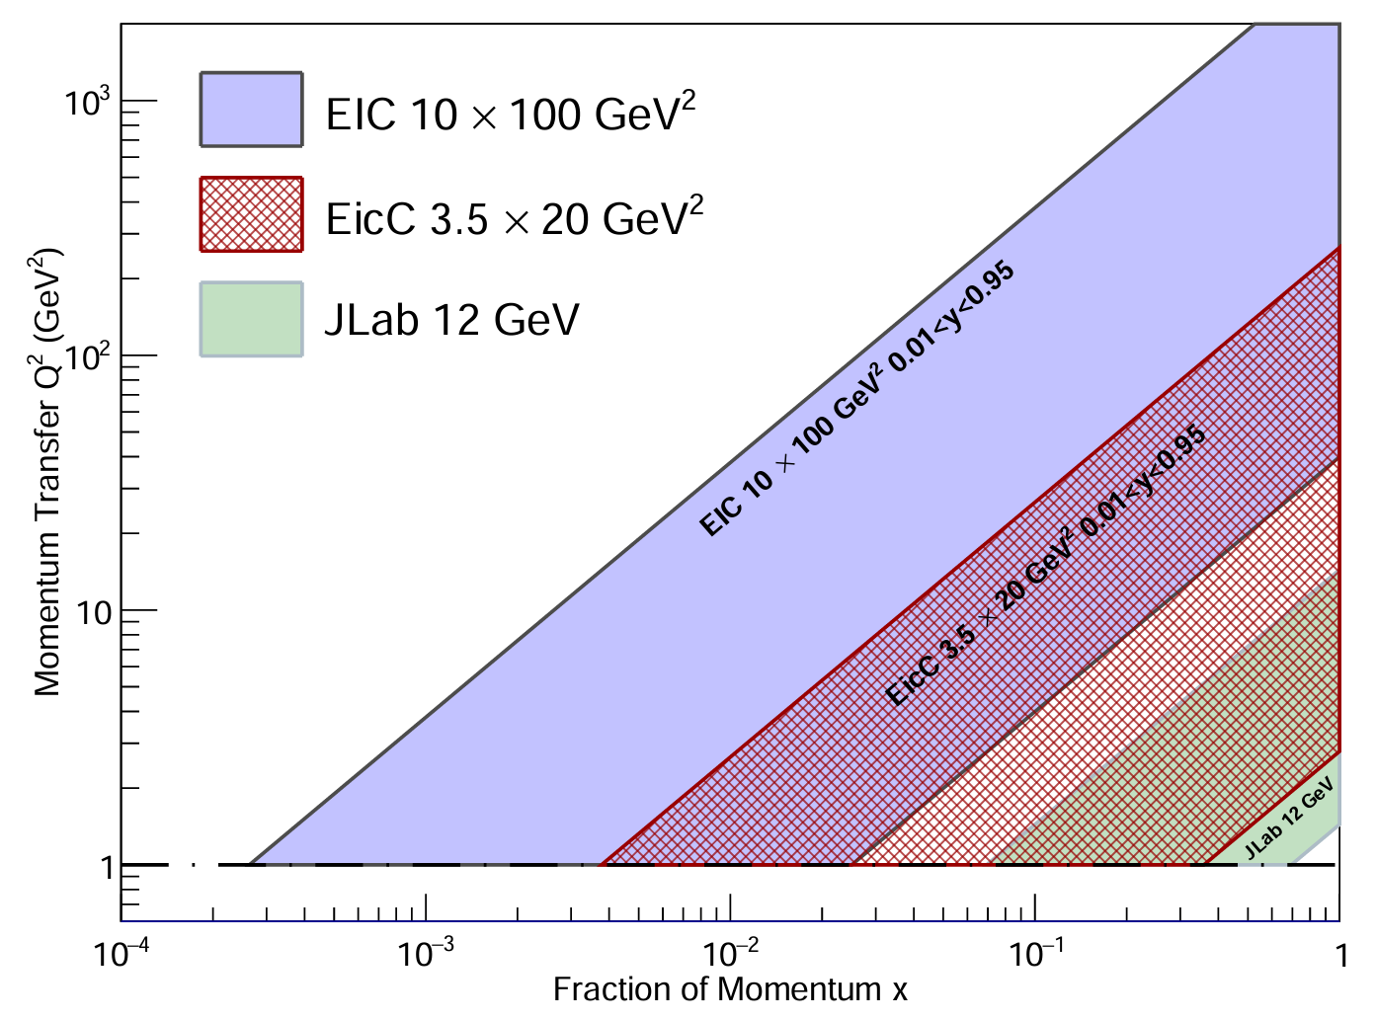
Machine Kinematics
EicC, √s : 15 ~ 20 GeV
The energy is in the sea quark region, closer to nuclear physics
Nearer to the threshold for the production of heavy quarkonium
Facilities | Main goals
JLab 12 GeV | Valence quark
EicC | Valence and Sea
US and Europe EIC | gluon

Slide 11
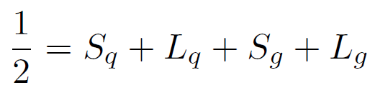
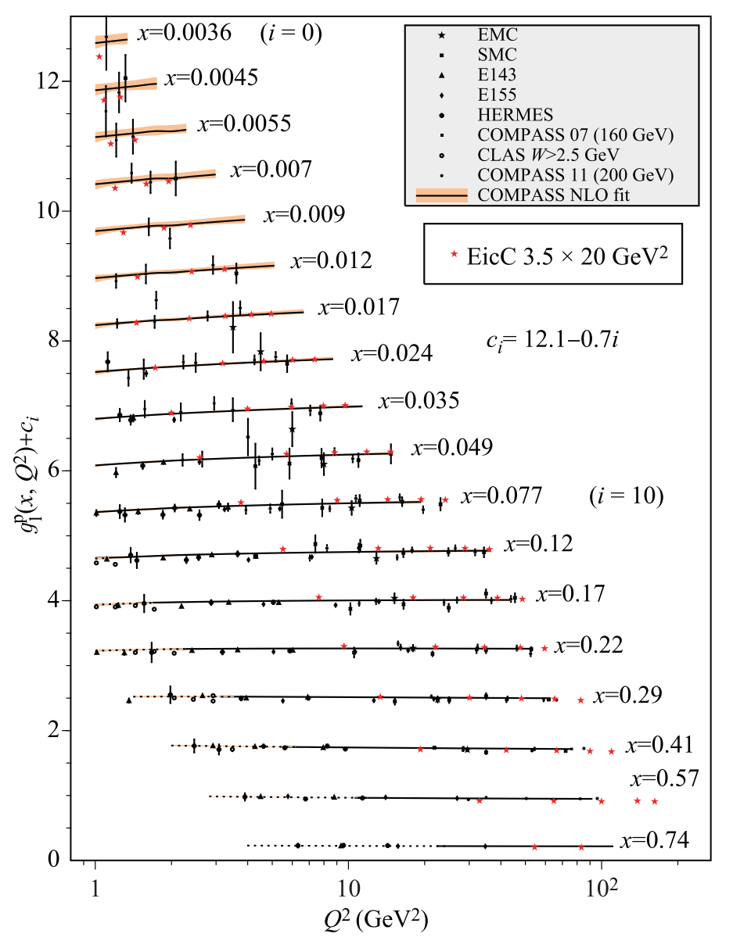
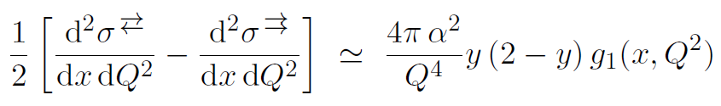
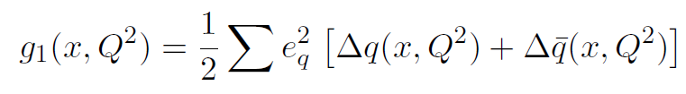
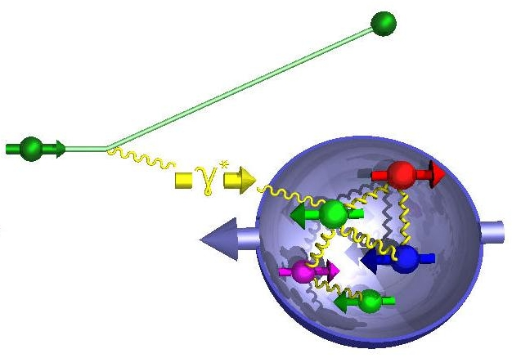
The Longitudinal Spin of the Nucleon
e’
π,K
e

Slide 12
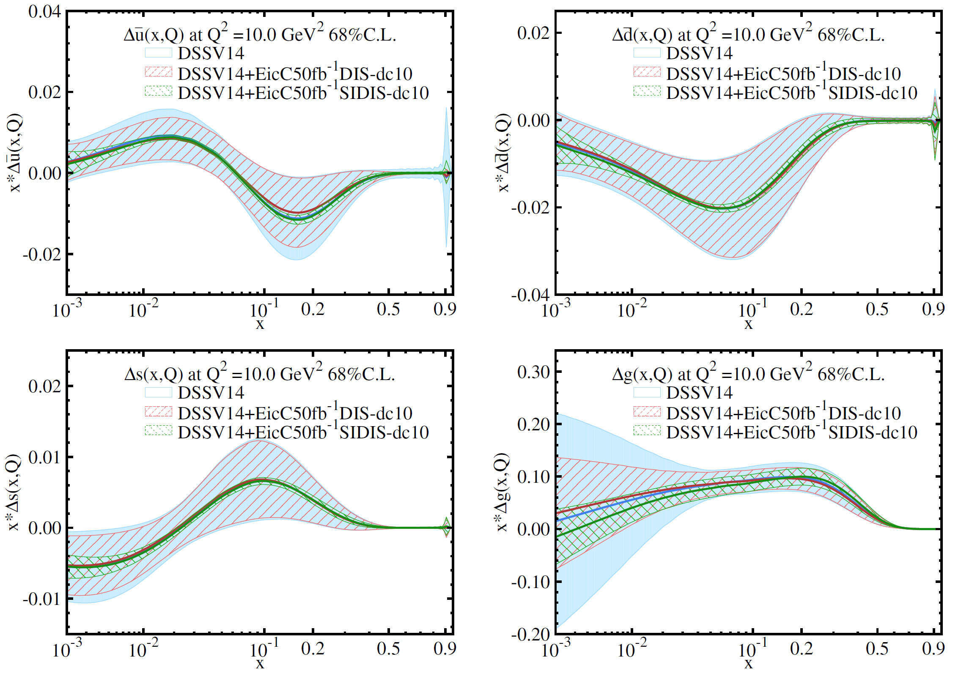
Physics Projections -- helicity distributions
EicC SIDIS data:
Pion(+/-), Kaon(+/-)
ep: 3.5 GeV X 20 GeV
eHe-3: 3.5 GeV X 40 GeV
Pol.: e(80%), p(70%),
He-3(70%)
Lumi: ep 50 fb⁻¹
eHe-3 50 fb⁻¹
SIDIS is much more powerful
EicC significantly improve the precision in sea quark region
Fragmentation function used: DSS

Slide 13
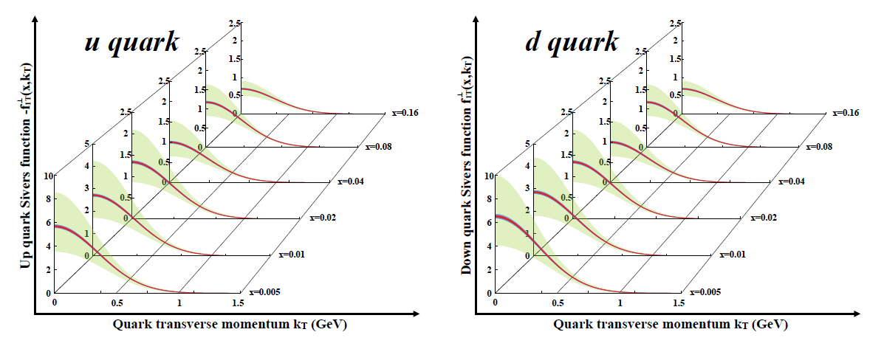
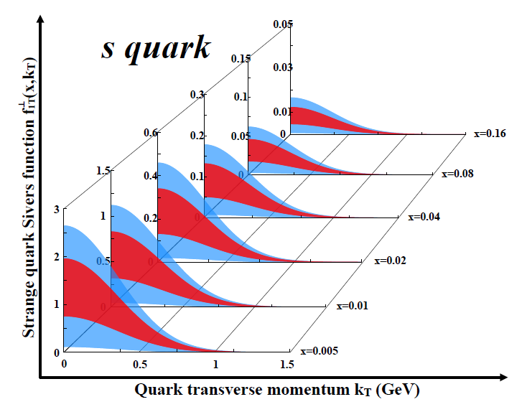
3D Structure of Nucleons – TMDs
u/d Sivers EicC vs world data
LO analysis
EicC SIDIS data:
Pion(+/-), Kaon(+/-)
ep: 3.5 GeV X 20 GeV
eHe-3: 3.5 GeV X 40 GeV
Pol.: e(80%), p(70%), He-3(70%)
Lumi: ep 50 fb⁻¹, eHe-3 50 fb⁻¹
Green: Current accuracy
Red: stat. error only
Blue: sys. error included
EicC, precise measurements.

Slide 14
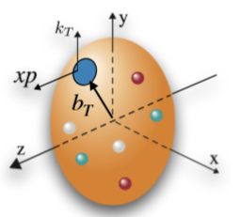
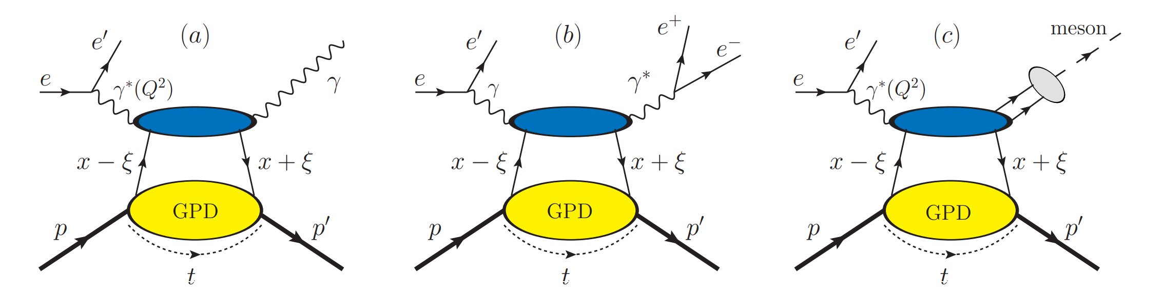
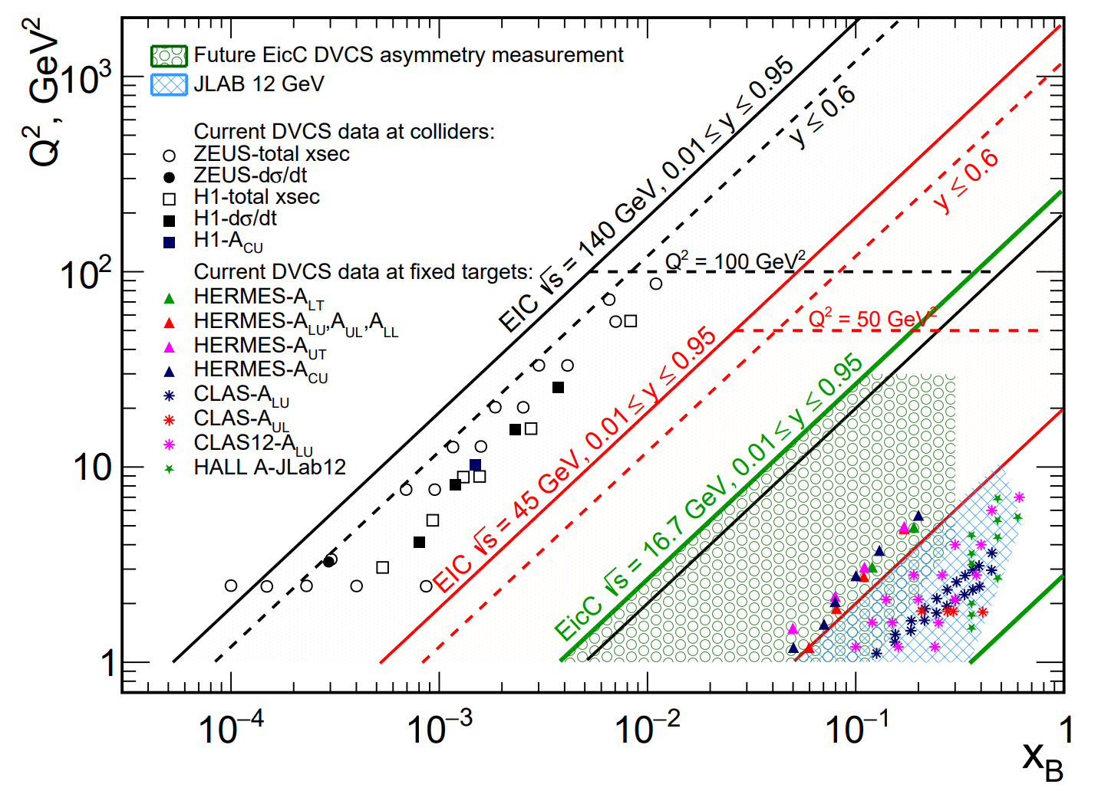
3D Structure of Nucleons – GPDs
Constrain DVCS CFF using LQCD calculations -- 黄源源
DVCS
TCS
DVMP
GPDs encode information about the spatial distribution of partons inside a hadron, correlated with their distribution in longitudinal momentum.
GPD related to quark angular momentum.
Progress at CFF and cross section level by FemtoNet

Slide 15
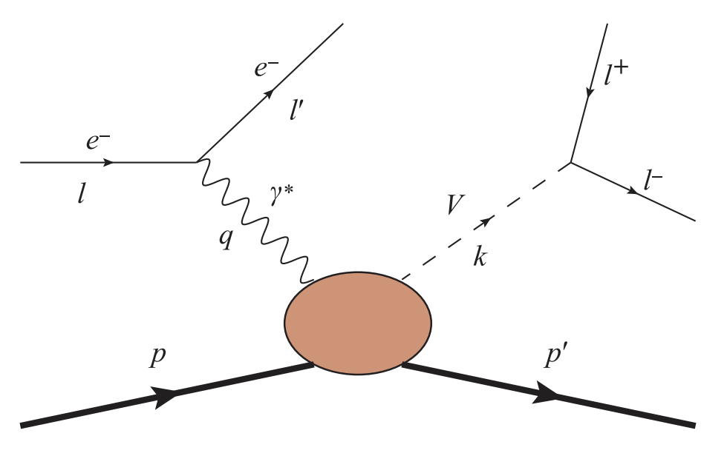
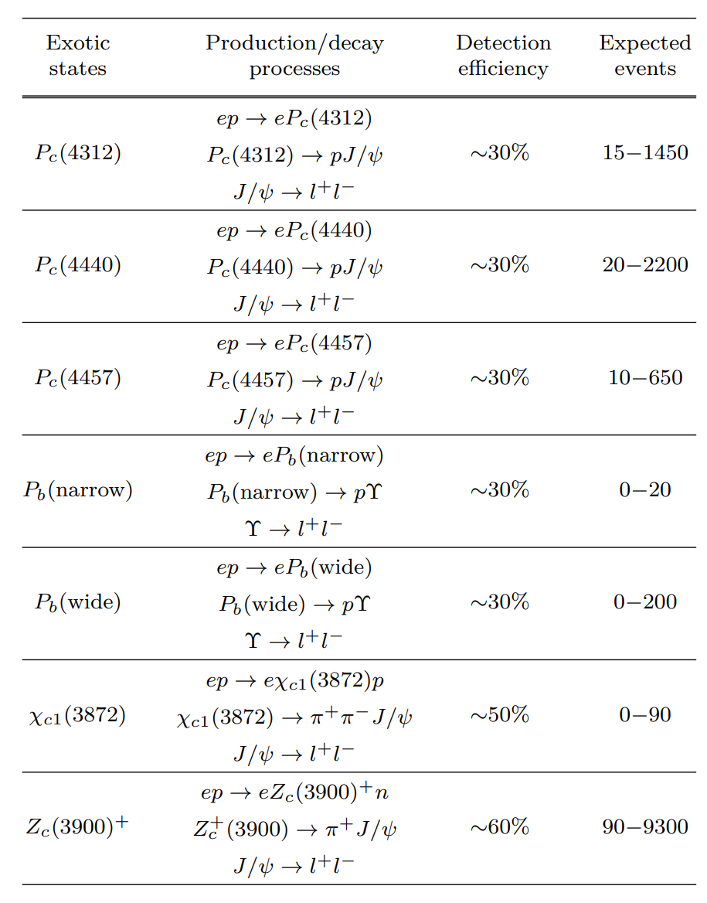
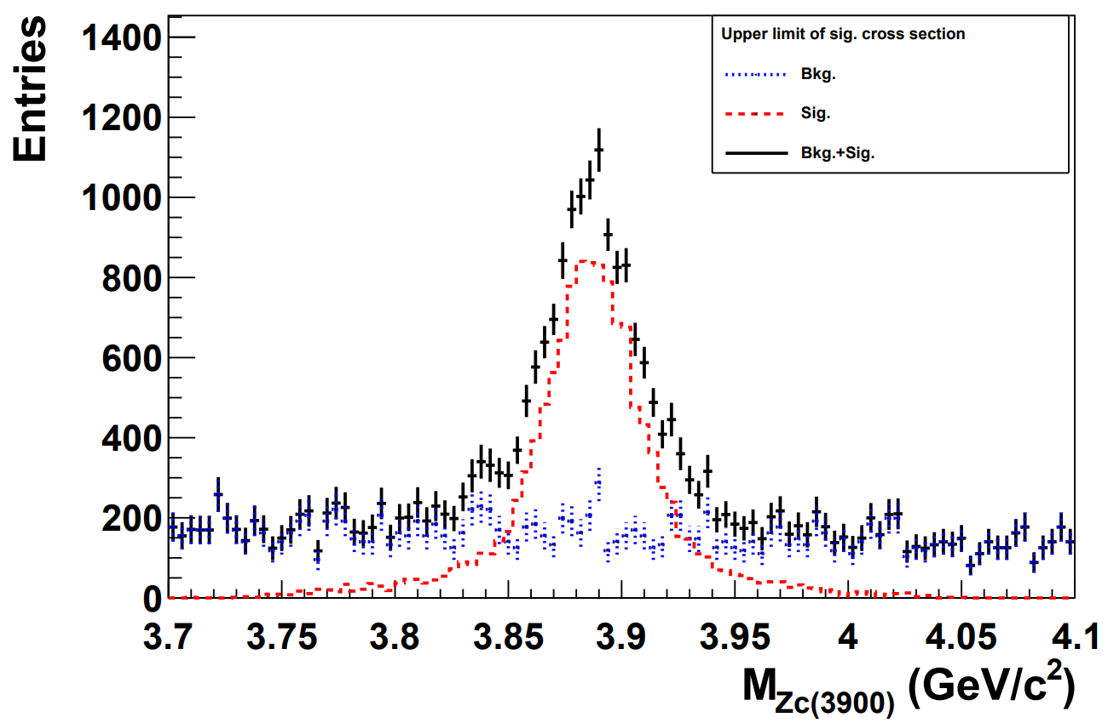
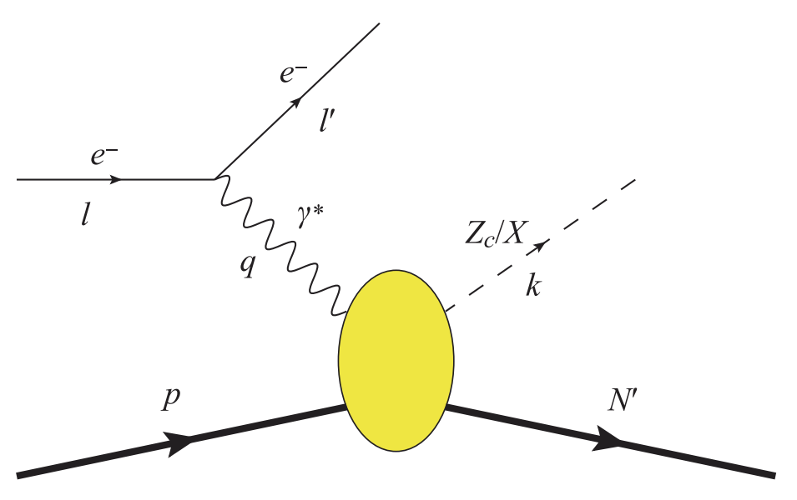
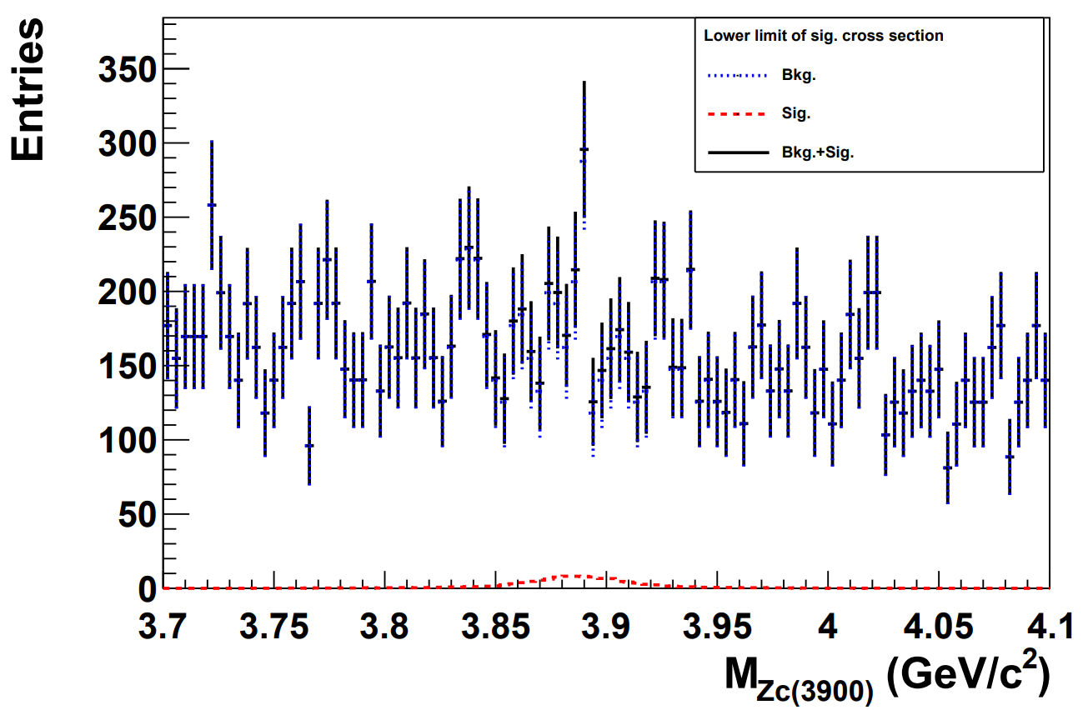
Exotic hadrons
[1]
[1] C. Adolph, et. Al., COMPASS, Phys. Lett. B 742, 330 (2015)

Slide 16
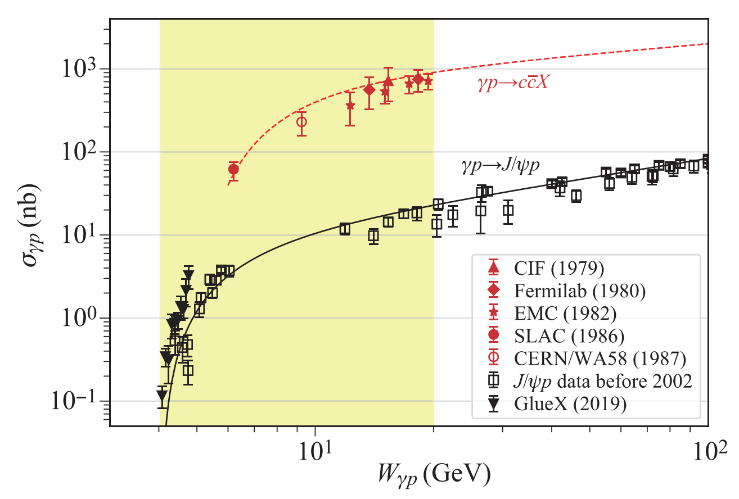
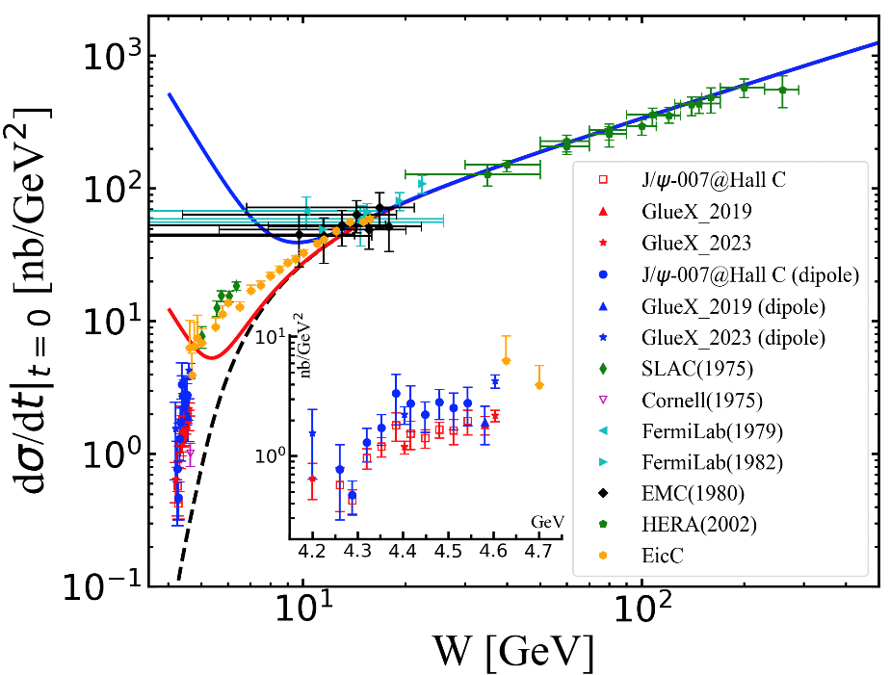
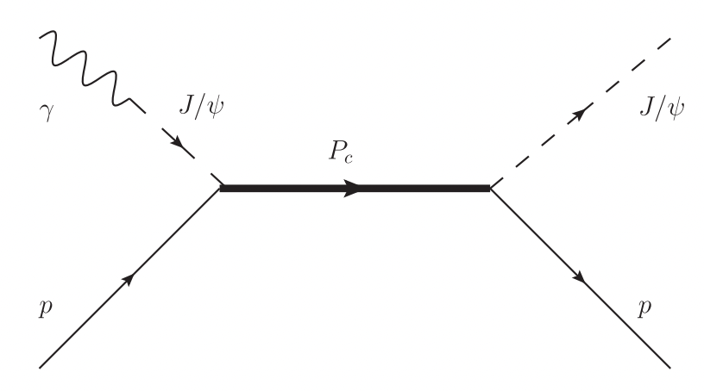
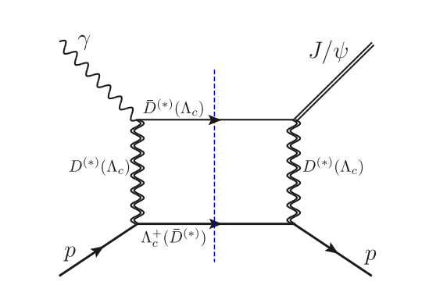
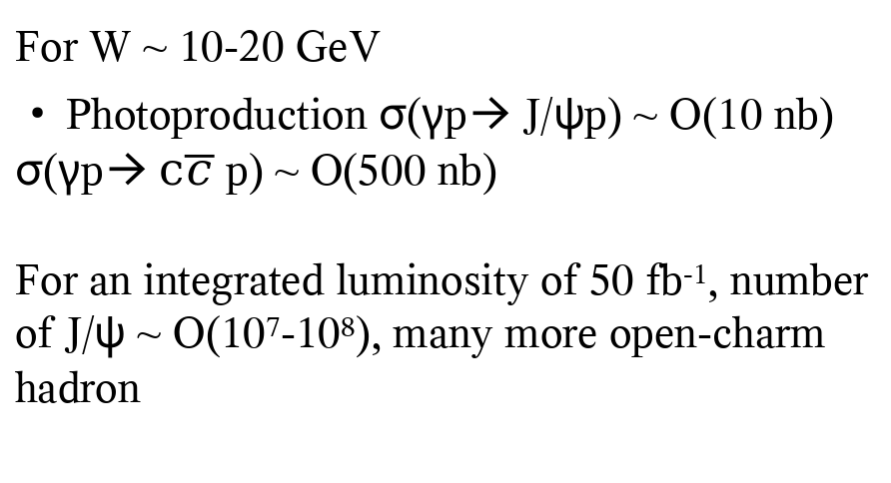
J/psi production at EicC
For W ~ 10-20 GeV
Photoproduction σ(γp→ J/ψp) ~ O(10 nb)
σ(γp→ $c\overline{c}$ p) ~ O(500 nb)
For an integrated luminosity of 50 fb⁻¹, number of J/ψ ~ O(10⁷-10⁸), many more open-charm hadron
Multi-quark states
Kinematic effect (CUSP)
16

Slide 17
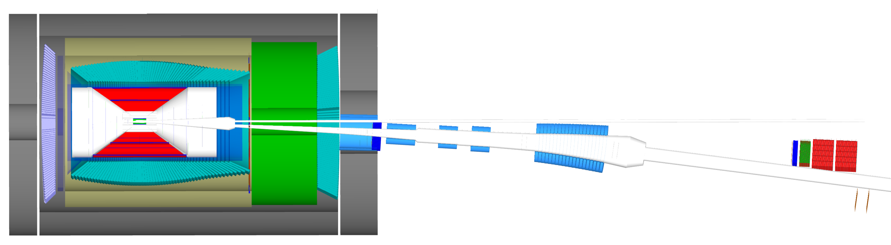
EicC Detector (central + ion far-forward)
Pixel + MPGD
Coil
RICH
ZDC
ECal
DIRC
ToF
EDT
RP
OMD

Slide 18
Highlights of H-NS

Slide 19
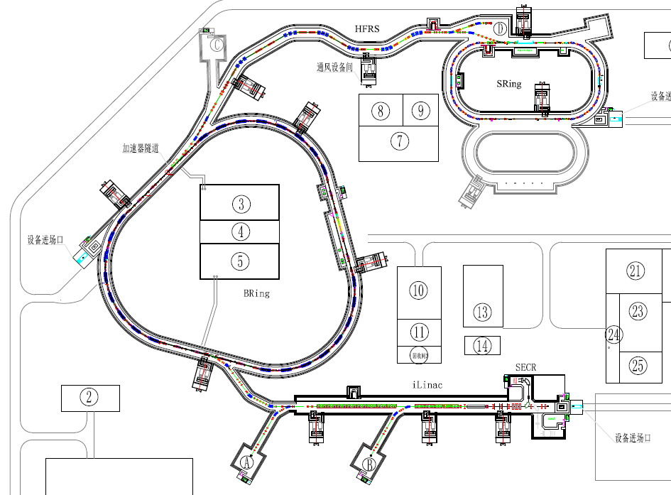
Hyperon Nucleon Spectrometer (H-NS)
p up to 9.3 GeV; ion up to 4.25 GeV/u
p + p
p + A
A + A
High Energy Nuclear Physics Terminal
MIC6 MAPS

Slide 20
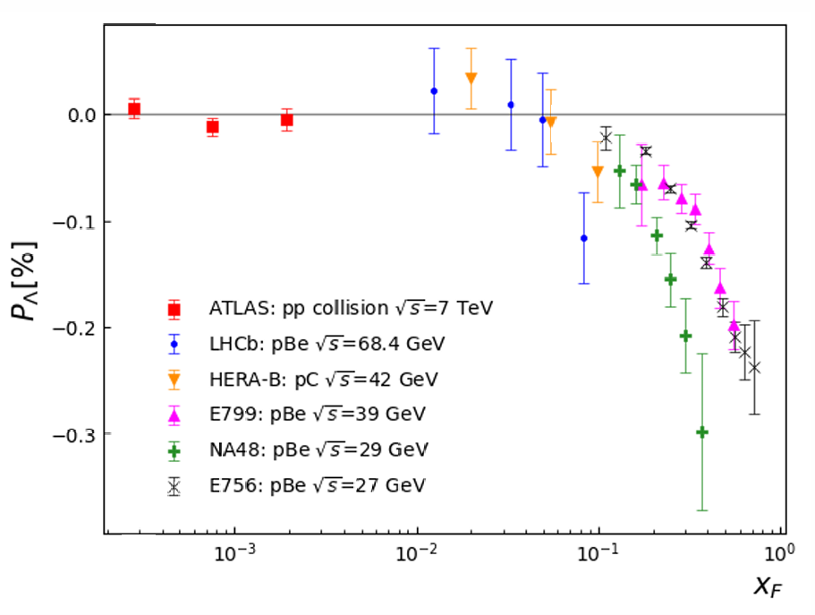
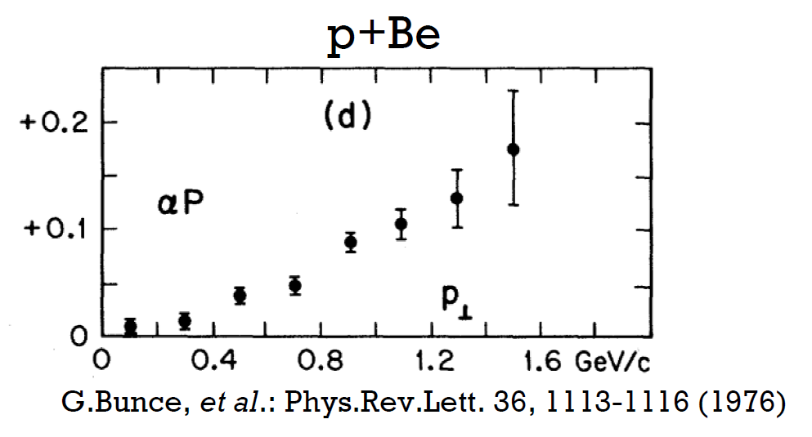
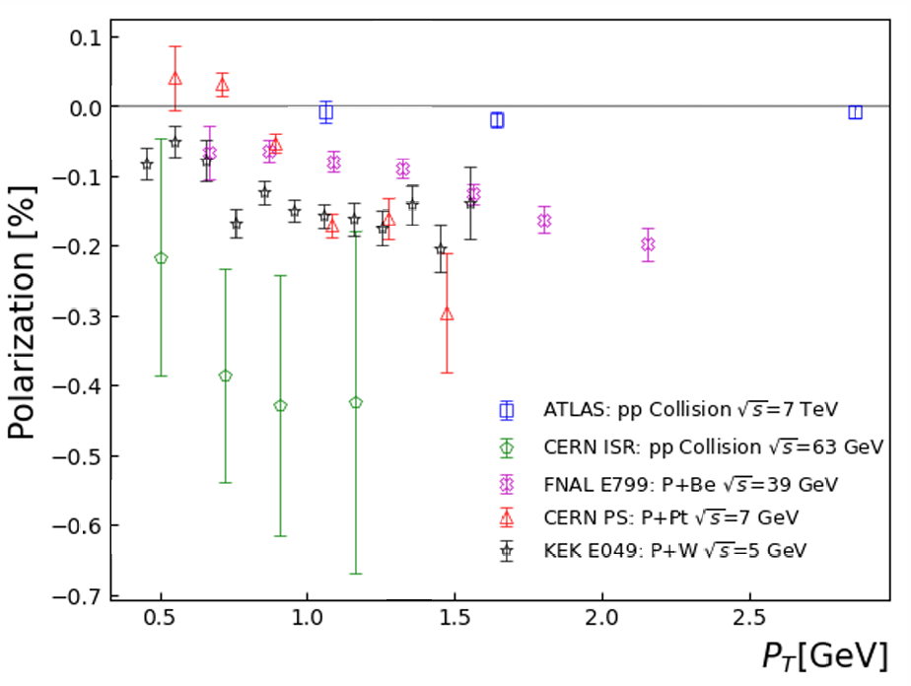
First observation of Λ polarization in the 1970’s
First observation:
In 1976 at Fermi-Lab, Hyperons were produced polarized in p + Be collisions: 300 GeV protons on Beryllium target

Slide 21
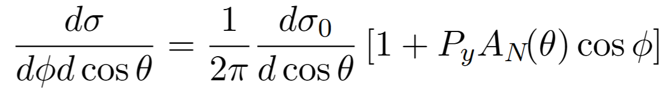
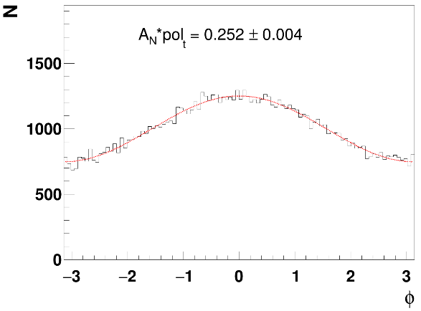
Principle of proton polarimeter
Relation between the spin-dependent cross-section of p + p/C scattering and the asymmetries
y
Transversely polarized protons
Carbon foil
x
Ф
C
More protons to the left:
Left-right asymmetry
Widely used as polarimetric reaction to measure proton beam polarization (PSI, TRIMUF, LAMPF, COSY, SATURNE, ZGS, KEK-PS, AGS, RHIC …)

Slide 22
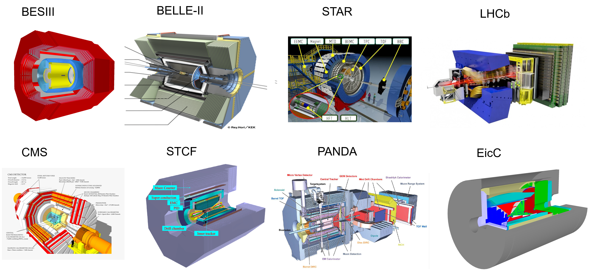
No polarimeter function in previous general-purpose spectrometer

Slide 23
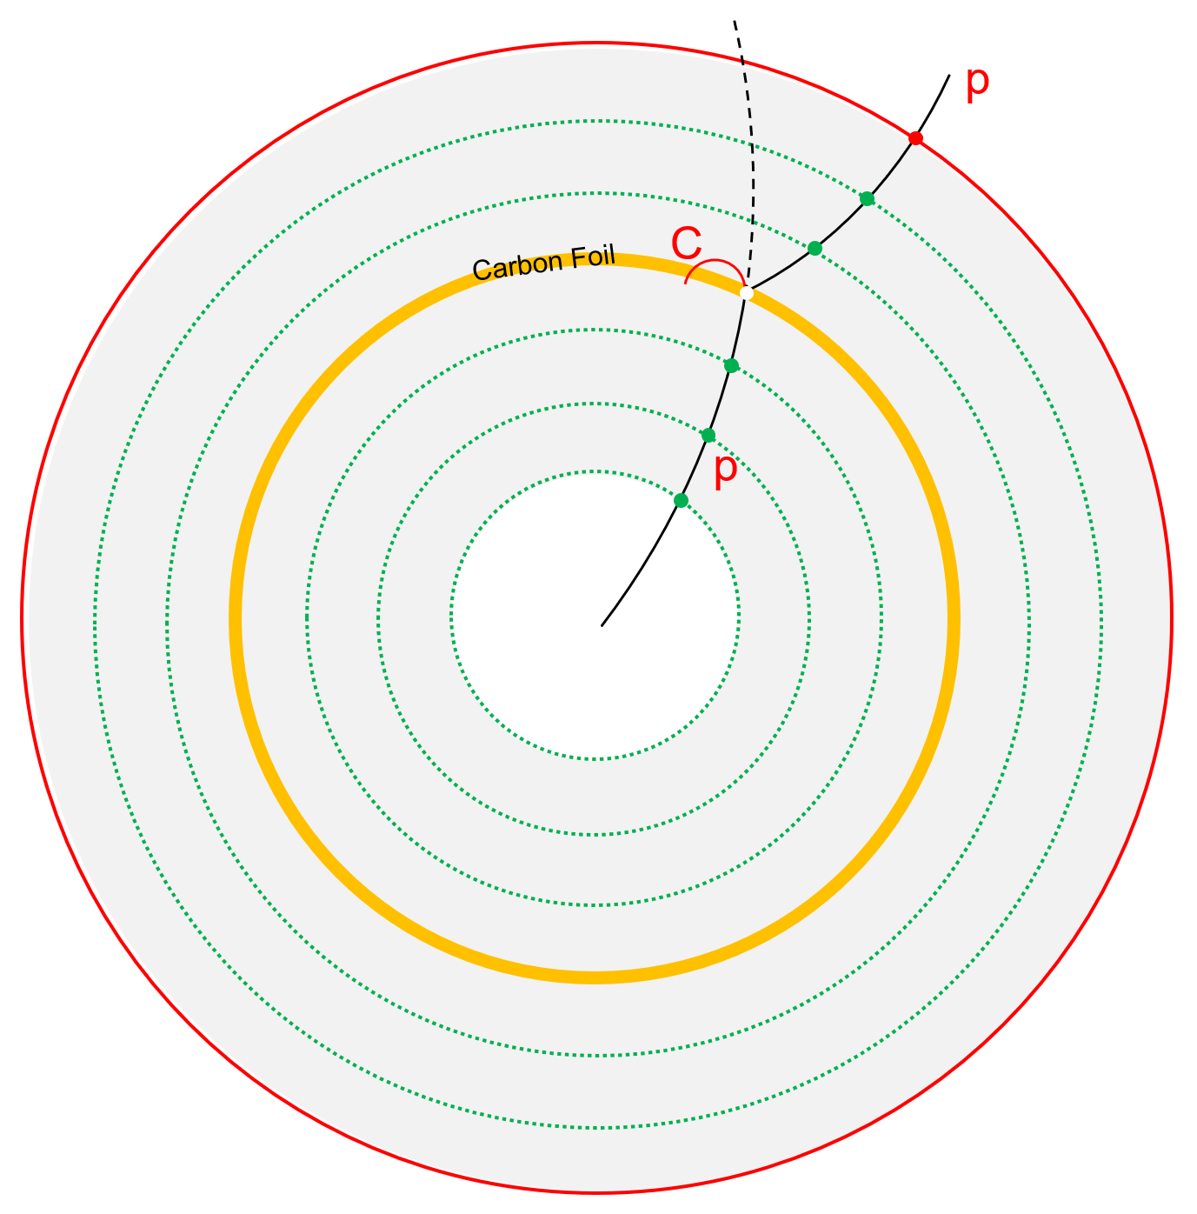
An extra carbon layer serve as baryon polarimeter
Carbon layer
~1 mm thickness
Material budget: <1% X/X₀
Probability: pC (1E-3)
Tiny influence to the conventional performance
Position : in-between the tracking devices
Appliable in all reactions: ee/ep/pp/pA/AA
Appliable in high energy machines
Phys. Rev. D 112, L031502

Slide 24
Uncertainty projection of the polarization measurement
pp → p/Λ + X
σ_{stat.} < 0.01 for Λ 400 bins σ_{stat.} < 0.02 for p 400 bins
H-NS
Reaction: p+p
Event rate:1MHz
Time: 3 months
pp →Λ+X N ~ 10¹¹
pp → p+X N ~ 10¹³
pp → pKΛ N ~ 10¹⁰
pC scattering ~ 10¹³ * 4*10⁻⁴ = 4*10⁹
σ_{stat.} < 0.01
σ_{stat.} < 0.02

Slide 25
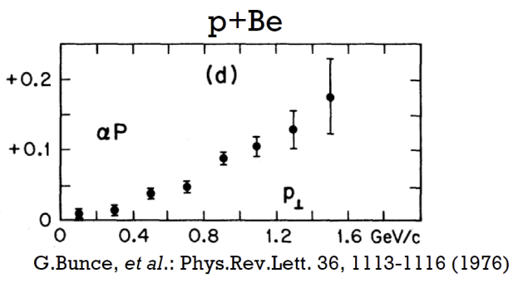
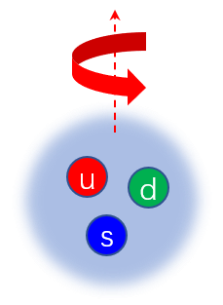
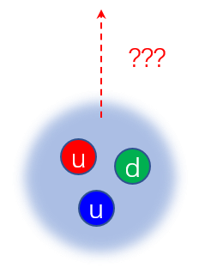
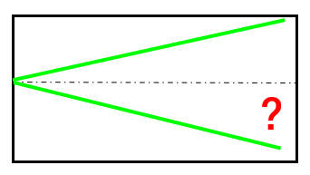
Baryon spin structure -- inclusive production of p/Λ
pp → p/Λ + X
Λ polarization
p polarization

Slide 26


Physics potentials at H-NS -- Hadron structure
Λ*, Σ*, Ξ*, Ω*, resonance need ECal.
https://doi.org/10.1007/s00601-022-01756-y

Slide 27






Physics potentials at H-NS -- Heavy ion physics
HICs@HIAF (T<100 MeV, ρ≤3 ρ₀)
H-NS
Reaction: A+A
Event rate:?
Time:
AA →Λ+X
AA → p+X
QCD Phase Structure
A new probe with proton polarization?
Global polarization of proton?
UU@HIAF
$2.2≤\sqrt{s_{NN}} ≤2.9$GeV
3.0-7.7 GeV
BES-II、FAIR、
NICA、HIAF-U

Slide 28








3-Step to H-NS
HNS0: 探测器+电子学+DAQ 核心技术验证
部分探测器，可扩展性
1-10MHz，全尺寸探测器
能重建出$Λ$
TOF未显示
丰富的物理：
高精度、多维度超子极化测量
轻强子物理、奇特强子态…
核介质效应
超核物理，核物质相结构
全尺寸磁铁，部分立体角覆盖探测器；物理取数
1亿￥
全尺寸磁铁，全尺寸径迹与飞行时间探测器，量能器研发平台
3亿￥
MIC6芯片验证
300万￥
2026
2026-2030
2030-

Slide 29
From H-NS to EicC

Slide 30

From H-NS to EicC--Physics
Electron ion collider in China (EicC)
Hyperon-Nucleon Spectrometer (H-NS)
EIC: Initial state is polarized
-How do partons form up a polarized nucleon?
$Λ$ polarization: Final state is polarized
-How do partons form up a polarized $Λ$ and p?
Final state
Initial state
Polarized by device
$Λ$ polarization: self-analyzing; p polarization: new concept detector
Baryon spin structure: origin of nucleon spin VS origin of $Λ$ polarization

Slide 31
From H-NS to EicC--Accelerator
H-NS: ion accelerator
EicC: ion accelerator
+ e accelerator

Slide 32

From H-NS to EicC--Detector
Accelerator:
1/2 of EicC (ion beam)
Detector:
1/2 of EicC (ion endcap)
Physics:
1/2 of EicC(spin structure of baryon)

Slide 33
Timeline
18 | 19 | 20 | 21 | 22 | 23 | 24 | 25 | 26 | 27 | 28 | 29 | 30 | 31 | 32 | 33 | 34 | 35 | 36 | 37 | 38 | 39 | 40
十三五 |  |  | 十四五 |  |  |  |  | 十五五 |  |  |  |  | 十六五 |  |  |  |  | 十七五
HIAF
Accelerator
HIAF-U
EicC
CEE@CSR
Detector
H-NS DEMO
H-NS construction
H-NS run
EicC
完成谱仪小样机

Slide 34
Summary
Long range plan of high energy nuclear physics at HIAF: from H-NS to EicC
Focus on the spin structure of baryon (H-NS & EicC)
H-NS as ½ of EicC in many aspects, and way ahead of EicC
H-NS supports both communities of hadron physics and heavy ion physics.
Thank You

Slide 36

Physics potentials at H-NS
pp → pKΛ
p p → p K Λ→ p K p π σ_{stat.} < 0.005
Slides from Haibo Li
H-NS
Reaction: p+p
Event rate:1MHz
Time: 3 months
pp →Λ+X N ~ 10¹¹
pp → p+X N ~ 10¹³
pp → pKΛ N ~ 10¹⁰

Slide 37

A simple channel to start
pp → pKΛ
Λ polarization
Λ
p
K⁺
p
p polarization
?

Slide 38


A possible probe to baryon spin structure
pp → pKΛ
Λ
K⁺
Λ polarization
p polarization
p
Senario 1:
s quark causes the Λ polarization, assuming a Pt_{Λ} dependence.

Slide 39
Uncertainty projection of the polarization measurement
pp → pKΛ
σ_{stat.} < 0.01 for Λ 100 bins σ_{stat.} < 0.05 for p 100 bins
H-NS
Reaction: p+p
Event rate:1MHz
Time: 3 months
pp →Λ+X N ~ 10¹¹
pp → p+X N ~ 10¹³
pp → pKΛ N ~ 10¹⁰
σ_{stat.} < 0.01
σ_{stat.} < 0.05

Slide 40

A simple channel to start
pp → pKΛ
Λ
K⁺
p

Slide 41


Proton polarimeter in general-purpose detector ?
General-use detector requirements:
e± μ± π± K± p± γ
Good tracking efficiency
Good momentum resolution
Good energy resolution
Secondary interaction
tracking || target || tracking
target || tracking
High luminosity machine?

Slide 42




GPD -- EicC Projections
DVCS and BH processes together with their interference simulated by MILOU
Final state gamma and electron detected by the central detector
Small angle proton in final state detected by the far-forward dtector

Slide 43






DVCS with far-forward detectors
e
Proton in DVCS
mrad : ratio
16-60: 9.9%
5-16: 45.3%
2-5：44.7%
γ
EDT
p
FDT
EDT/FDT is essential for studies as GPD measurements. One of main process is the DVCS (ep→ epγ), in which the final state electron and photon are detectable in the central detector.
φ(rad)
θ(rad)

Slide 44










DVCS with far-forward detectors
High Lumi.
Low Lumi.
Assuming ¼ of data taking time running at low luminosity mode.
Tiny asymmetry
in –t < 0.01 GeV2
predicted by GK model
50 fb⁻¹ data→ ~1% stat. error on asymmetry
Notes:
Relative uncertainties of asymmetries with transversely polarized proton beam are shown in this plot.
Tiny asymmetries in –t < 0.01 GeV2 are predicted by GK model so the relative uncertainties seems to be big.
But the absolute stat. error is around ~1% with one year running of the machine.

Slide 45



DVCS with far-forward detectors
Assuming ¼ of data taking time running at low luminosity mode.
50 fb⁻¹ data→ ~1% stat. error on asymmetry
Notes:
Relative uncertainties of asymmetries with transversely polarized proton beam are shown in this plot.
Tiny asymmetries in –t < 0.01 GeV2 are predicted by GK model so the relative uncertainties seems to be big.
But the absolute stat. error is around ~1% with one year running of the machine.

