Slide 1

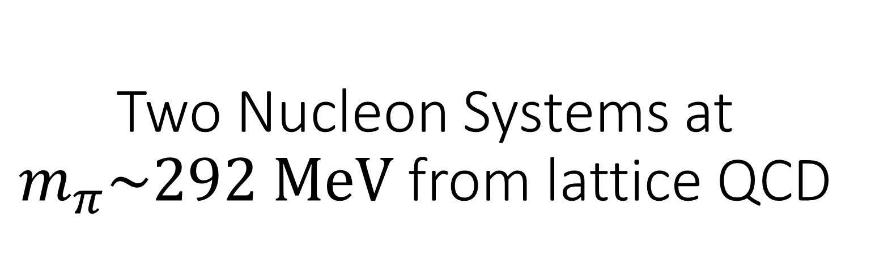
Two Nucleon Systems at $m_{π}\sim 292 MeV$ from lattice QCD
Speaker: Kuan Zhang
Kang Yu, Yiqi Geng, Liuming Liu, Peng Sun, Jia-Jun Wu
Fifth Chinese Lattice QCD conference 2025.10.10

Slide 2
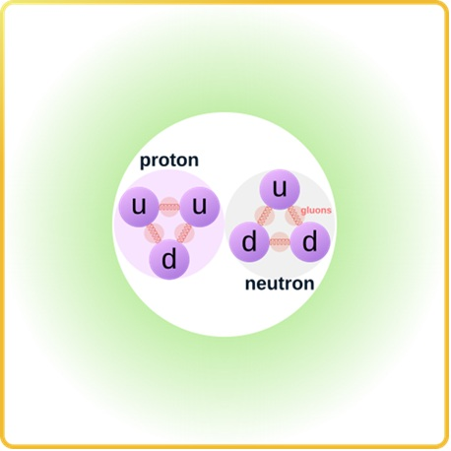
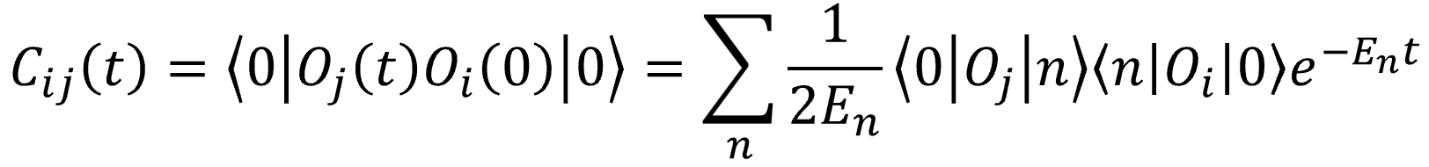
Motivation
Calculating the properties of multi-nucleon systems directly from quantum chromodynamics (QCD)
Spectrum decomposition with the same quantum numbers
The existence of a composite particle is indicated by the presence in scattering S-matrix of a pole singularity

Slide 3
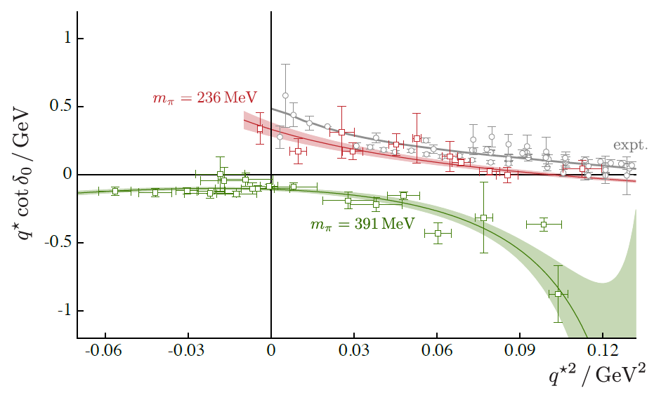
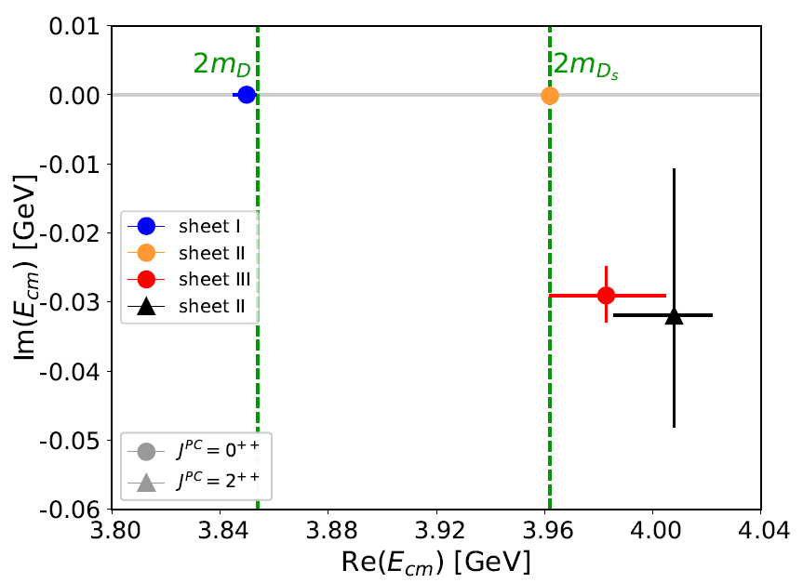

Generalized Lϋscher formula
Information about scattering amplitudes can be obtained from the discrete spectrum in a finite volume $\det\left[T^{−1}+δG\left(E,P;L\right)\right]=0$
M. Luscher, Commun. Math. Phys. 104 (1986) 177
Briceno et al. Phys. Rev. Lett. 118, 022002 (2017)
S. Prelovsek et al. JHEP 06, 035 (2021)

Slide 4
Outline
1、Finite volume spectrum: ³S₁ and ¹S₀ channels
2、Scattering Analysis: 2.1 K-matrix parameterization 2.2 Solve Luscher formula 2.3 Pole singularity
3、Summary

Slide 5
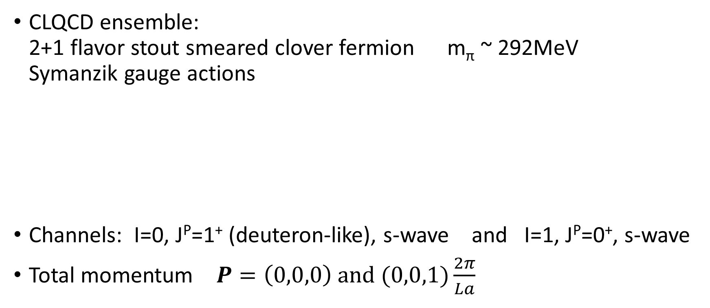
Lattice setup
CLQCD ensemble: 2+1 flavor stout smeared clover fermion m_{π} ~ 292MeV Symanzik gauge actions
Channels: I=0, J^{P}=1⁺ (deuteron-like), s-wave and I=1, J^{P}=0⁺, s-wave
Total momentum $P=\left(0,0,0\right) and (0,0,1)\frac{2π}{La}$
Z.-C. Hu et al. (CLQCD), Phys. Rev. D 109, 054507 (2024)
Tag | L | T | a (fm) | m_{π} x La | m_{N} (MeV) | N_{cfg}
C24P29 | 24 | 72 | 0.10530(18) | 3.75 | 1026(4) | 838
C32P29 | 32 | 64 | 0.10530(18) | 5.01 | 1005(3) | 981
C48P29 | 48 | 96 | 0.10530(18) | 7.52 | 1007.1(1.1) | 731

Slide 6
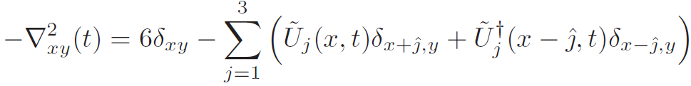
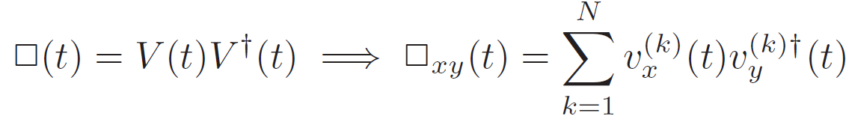

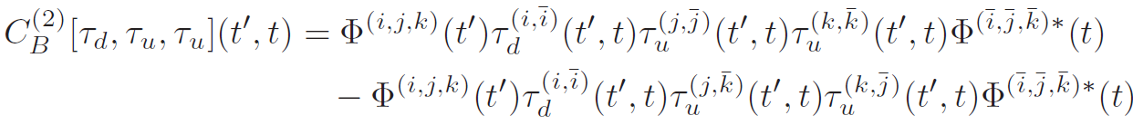


Distillation method:
Lattice Laplacian & Low mode projection operator
Factorization
Variation method:
Generalized eigenvalue problem (GEVP) $C\left(t\right)v_{α}=λ_{α}\left(t\right)C\left(t_{0}\right)v_{α}$
Principal correlators $λ_{α}\left(t\right)=e^{−m_{α}\left(t−t_{0}\right)}(1+O(e^{−|δm|\left(t−t_{0}\right)}))$
Elementals
Perambulators
M. Peardon et al. [Hadron Spectrum], Phys. Rev. D 80, 054506 (2009)
J. J. Dudek, R. G. Edwards, N. Mathur, and D. G. Richards, Phys. Rev. D 77, 034501 (2008)

Slide 7
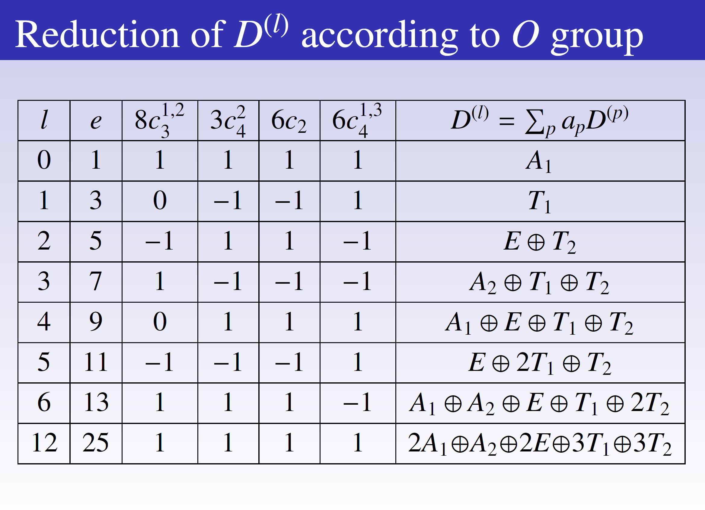

Hadron operator
Isospin symmetry: SU(2) group $p=\left|\left.1/2,1/2\right\rangle \right. n=\left|\left.1/2,−1/2\right\rangle \right. \left|\left.0,0\right\rangle \right.=\frac{1}{\sqrt{2}}(pn−np)$
Angular momentum & Lattice irreducible representation
channel | d | irrep
³S₁ | 0,0,0 | T1+
³S₁ | 0,0,1 | E2
¹S₀ | 0,0,0 | A1+
¹S₀ | 0,0,1 | A1
OpTion package
Haobo Yan et al. JHEP (2025), arXiv:2507.16070

Slide 8
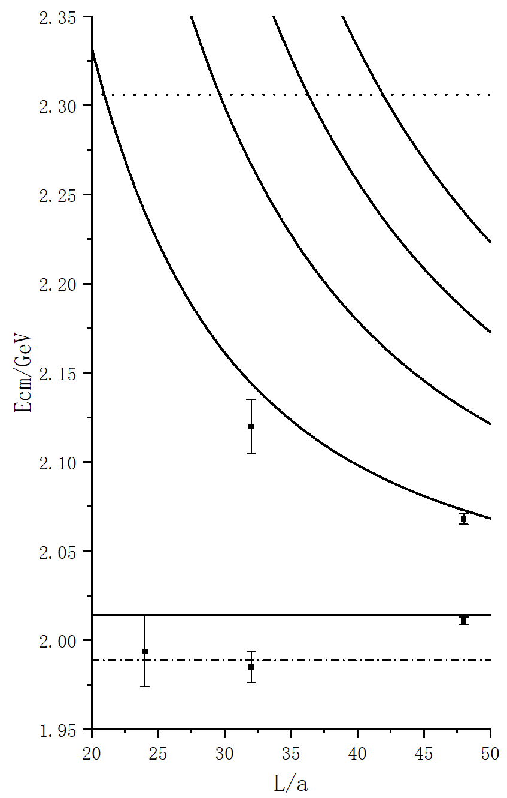
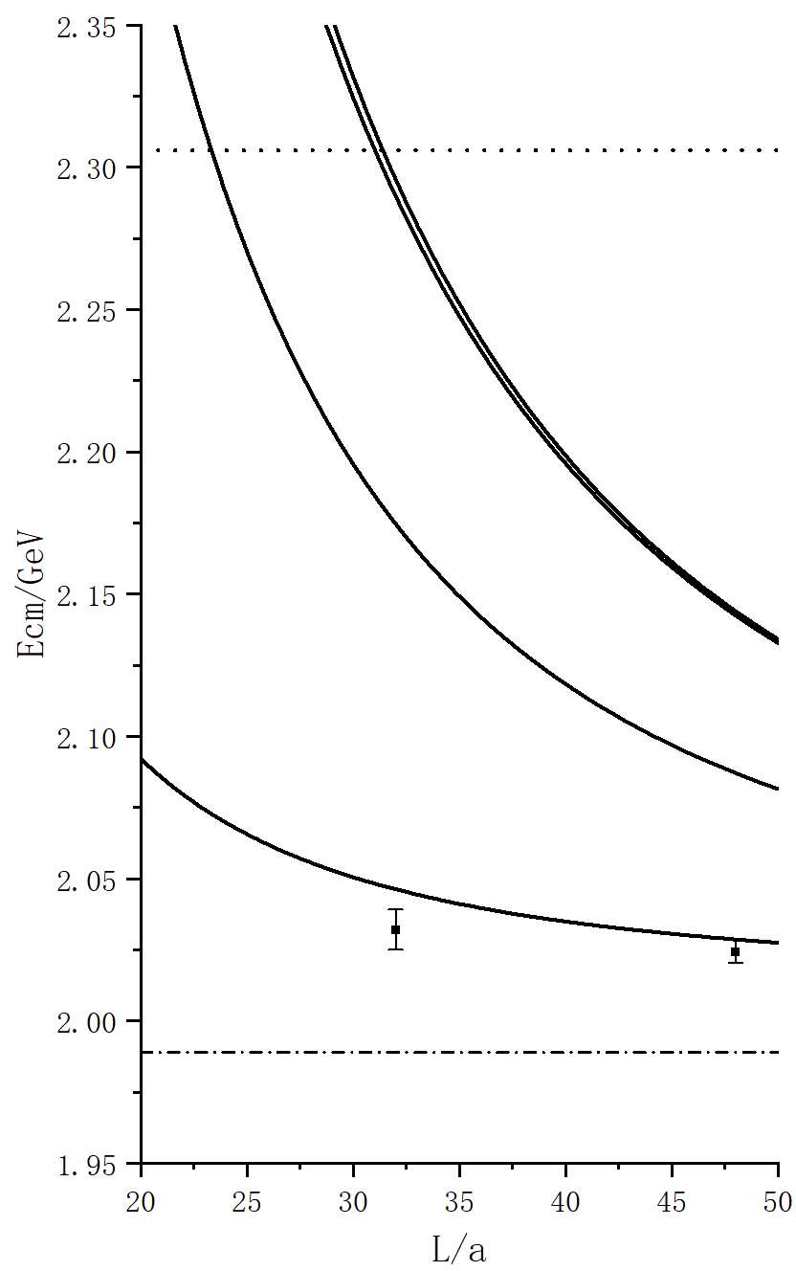
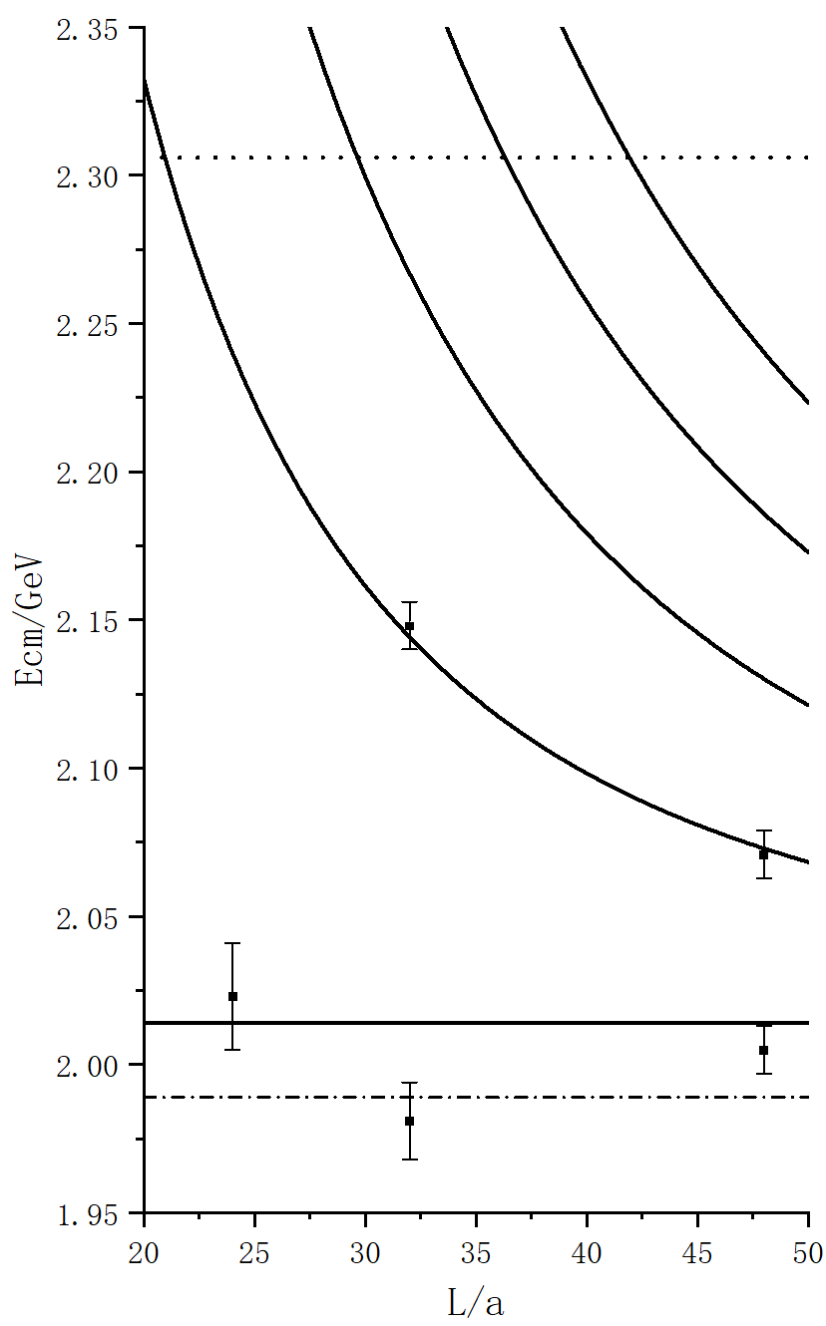
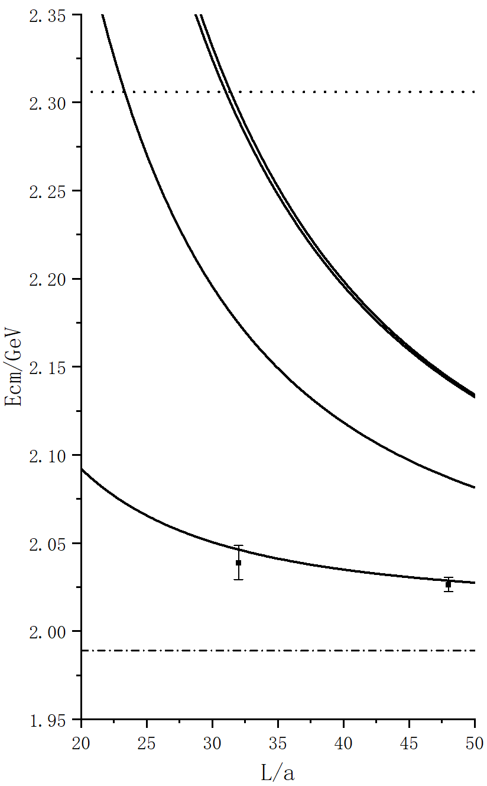
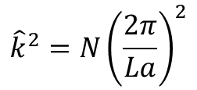
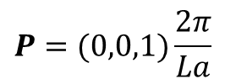

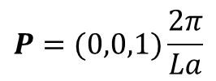




Finite volume spectrum
$$E=\sqrt{m_{1}^{2}+k_{1}^{2}}+\sqrt{m_{2}^{2}+k_{2}^{2}}$$
$${\hat{k}}^{2}=N{\left(\frac{2π}{La}\right)}^{2}$$
$$E_{cm}=\sqrt{E^{2}−P^{2}}$$
$$P=(0,0,0)$$
$$P=(0,0,1)\frac{2π}{La}$$
$$P=(0,0,0)$$
$$P=(0,0,1)\frac{2π}{La}$$
NN$π$
³S₁
¹S₀
lhc

Slide 9
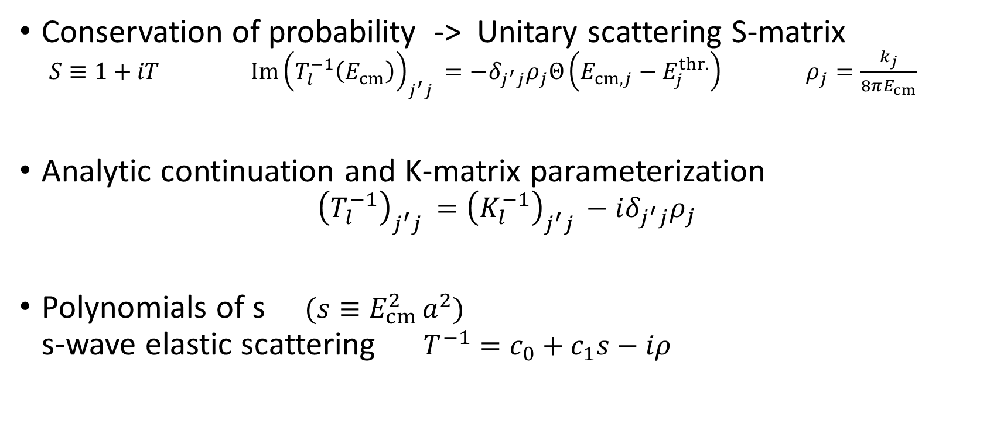
K-matrix parameterization
Conservation of probability -> Unitary scattering S-matrix $S≡1+iT {Im\left(T_{l}^{−1}\left(E_{cm}\right)\right)}_{j^{′}j }=−δ_{j^{′}j}ρ_{j}Θ\left(E_{cm,j}−E_{j}^{thr.}\right) ρ_{j}=\frac{k_{j}}{8πE_{cm}}$
Analytic continuation and K-matrix parameterization ${\left(T_{l}^{−1}\right)}_{j^{′}j }={\left(K_{l}^{−1}\right)}_{j^{′}j }−iδ_{j^{′}j}ρ_{j}$
Polynomials of s $(s≡E_{cm }^{2}a^{2})$ s-wave elastic scattering $T^{−1}=c_{0}+c_{1}s−iρ$

Slide 10
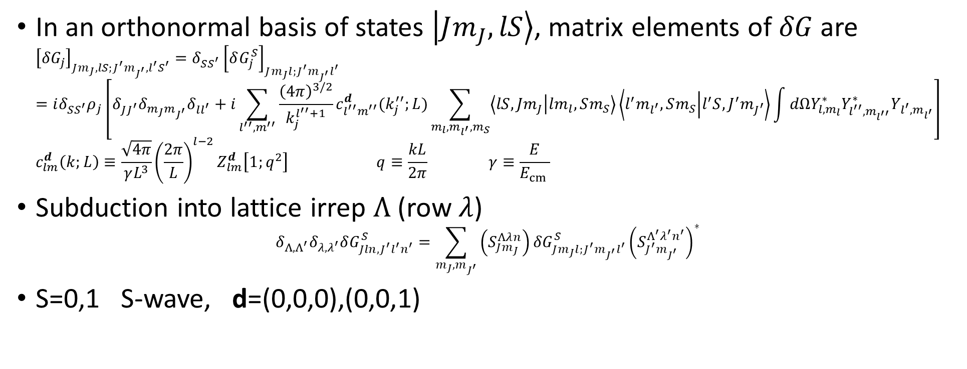
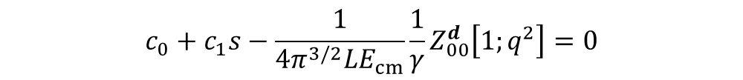
Solve Lϋscher formula
$$\det\left[T^{−1}+δG\left(E,P;L\right)\right]=0$$
In an orthonormal basis of states $\left|\left.Jm_{J},lS\right\rangle \right.$, matrix elements of $δG$are ${\left[{δG}_{j}\right]}_{Jm_{J},lS;J^{′}m_{J^{′}},l^{′}S^{′}}=δ_{SS^{′}}{\left[δG_{j}^{S}\right]}_{Jm_{J}l;J^{′}m_{J^{′}}l^{′}}$ $=iδ_{SS^{′}}ρ_{j}\left[δ_{JJ^{′}}δ_{m_{J}m_{J^{′}}}δ_{ll^{′}}+i\sum_{l^{′′},m^{′′}}{\frac{{\left(4π\right)}^{3/2}}{k_{j}^{l^{′′}+1}}}c_{l^{′′}m^{′′}}^{d}(k_{j}^{′′};L)\sum_{m_{l},m_{l^{′}},m_{S}}{\left\langle lS,Jm_{J} | lm_{l},Sm_{S}\right\rangle \left\langle l^{′}m_{l^{′}},Sm_{S} | l^{′}S,J^{′}m_{J^{′}}\right\rangle }\int{dΩY_{l,m_{l}}^{∗}Y_{l^{′′}{,m}_{l^{′′}}}^{∗}Y_{l^{′},m_{l^{′}}}}\right]$ $c_{lm}^{d}\left(k;L\right)≡\frac{\sqrt{4π}}{γL^{3}}{\left(\frac{2π}{L}\right)}^{l−2}Z_{lm}^{d }\left[1;q^{2}\right] q≡\frac{kL}{2π} γ≡\frac{E}{E_{cm }}$
Subduction into lattice irrep $Λ$ (row $λ$) $δ_{Λ,Λ^{′}}δ_{λ,λ^{′}}δG_{Jln,J^{′}l^{′}n^{′}}^{S}=\sum_{m_{J},m_{J^{′}}}{\left(S_{Jm_{J}}^{Λλn}\right)}{δG}_{Jm_{J}l;J^{′}m_{J^{′}}l^{′}}^{S}{\left(S_{J^{′}m_{J^{′}}}^{Λ^{′}λ^{′}n^{′}}\right)}^{∗}$
S=0,1 S-wave, d=(0,0,0),(0,0,1)
R. A. Briceno, Phys. Rev. D 89, 074507 (2014)
C. Morningstar et al. Nucl. Phys. B 924, 477 (2017)
$$c_{0}+c_{1}s−\frac{1}{4π^{3/2}LE_{cm}}\frac{1}{γ}Z_{00}^{d }\left[1;q^{2}\right]=0$$

Slide 11
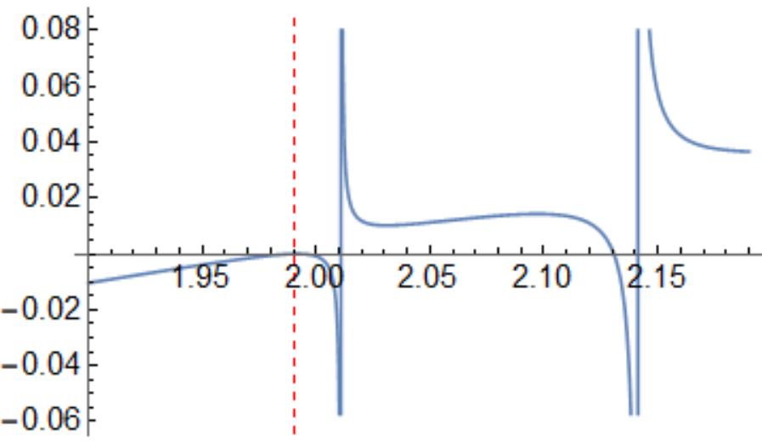
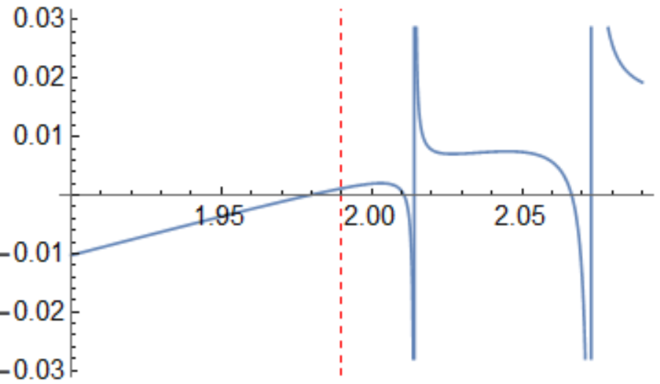
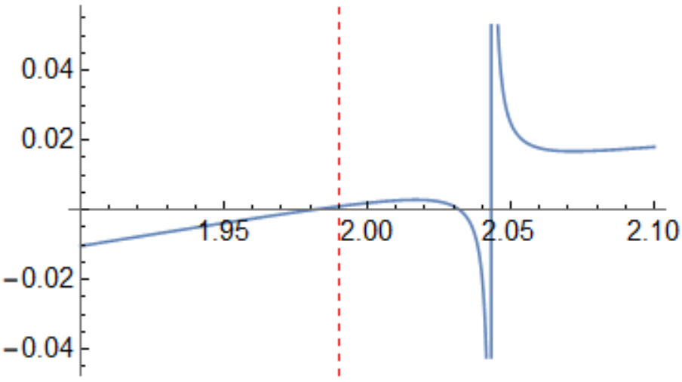
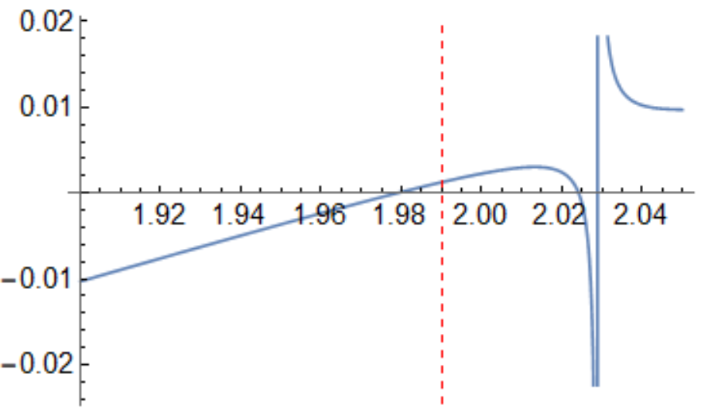

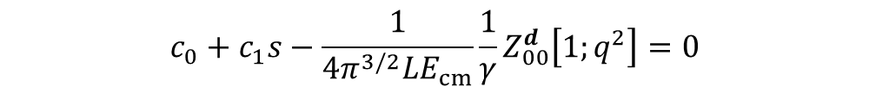
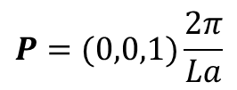


Solve Lϋscher formula
$$c_{0}+c_{1}s−\frac{1}{4π^{3/2}LE_{cm}}\frac{1}{γ}Z_{00}^{d }\left[1;q^{2}\right]=0$$
$$c_{0}=−0.176698$$
$$c_{1}=\text{0.155040}$$
³S₁
$$P=(0,0,0)$$
$$P=(0,0,1)\frac{2π}{La}$$
C32P29
C48P29

Slide 12



Fitting details
Minimize $χ^{2}/dof$
Dispersion relation on lattice, shift energy method
S. Piemonte et al. Phys. Rev. D 100, 074505 (2019)

Slide 13
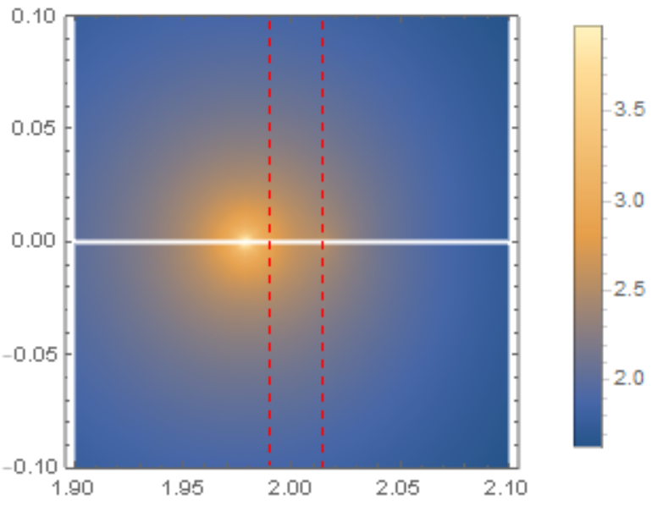
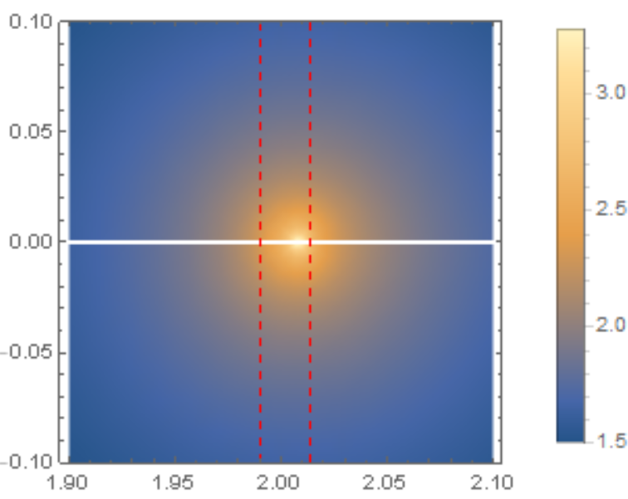
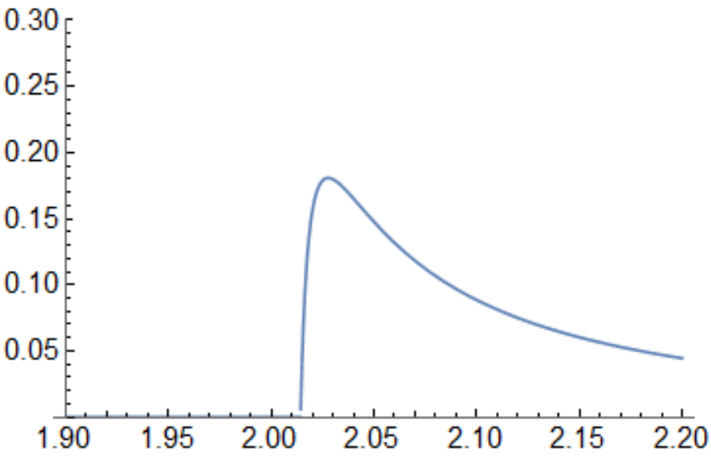
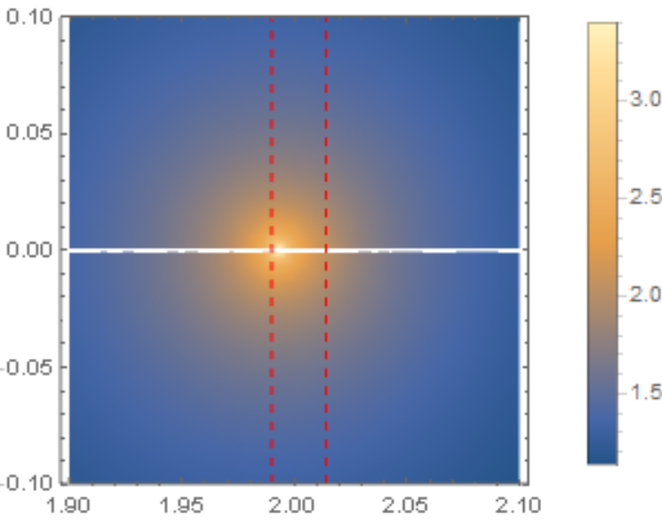
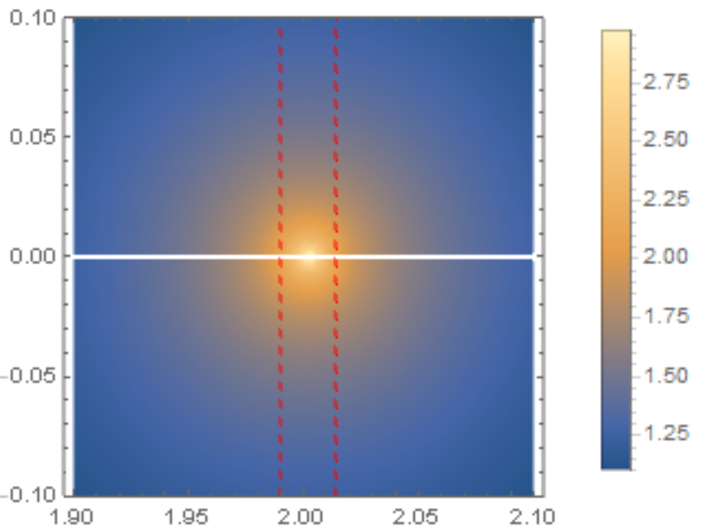
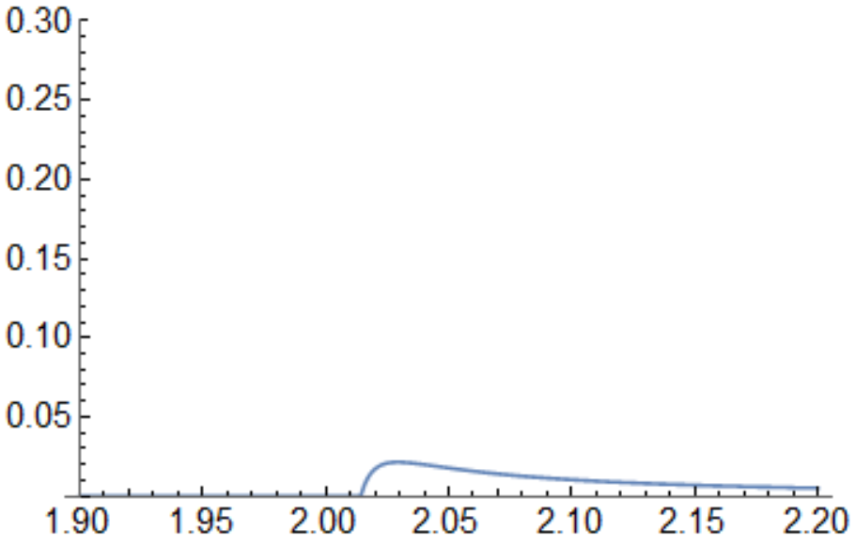









Pole singularity
$$ρ=\frac{k}{8πE_{cm}}$$
$$T^{−1}=c_{0}+c_{1}s−iρ$$
lgT, Imk>0
lgT, Imk<0
$$ρ^{2}{\left|T\right|}^{2}$$
³S₁
lhc
thr
$$c_{0}=−0.176698$$
$$c_{1}=\text{0.155040}$$
$$χ^{2}/dof=\text{0.}\text{44}$$
pole
¹S₀
$$c_{0}=−0.526277$$
$$c_{1}=\text{0.462596}$$
$$χ^{2}/dof=\text{0.}\text{33}$$

Slide 14
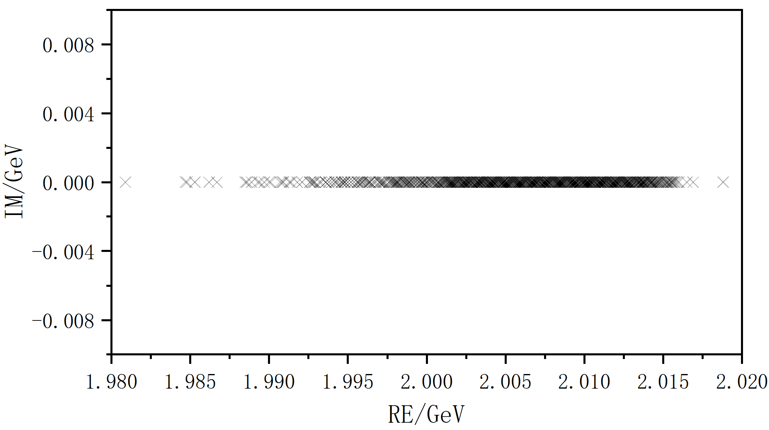
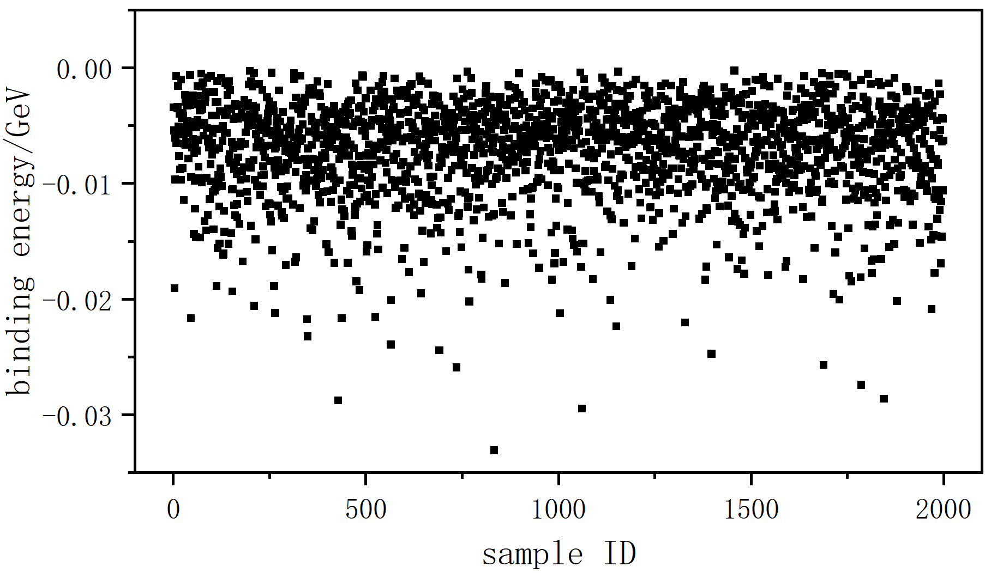
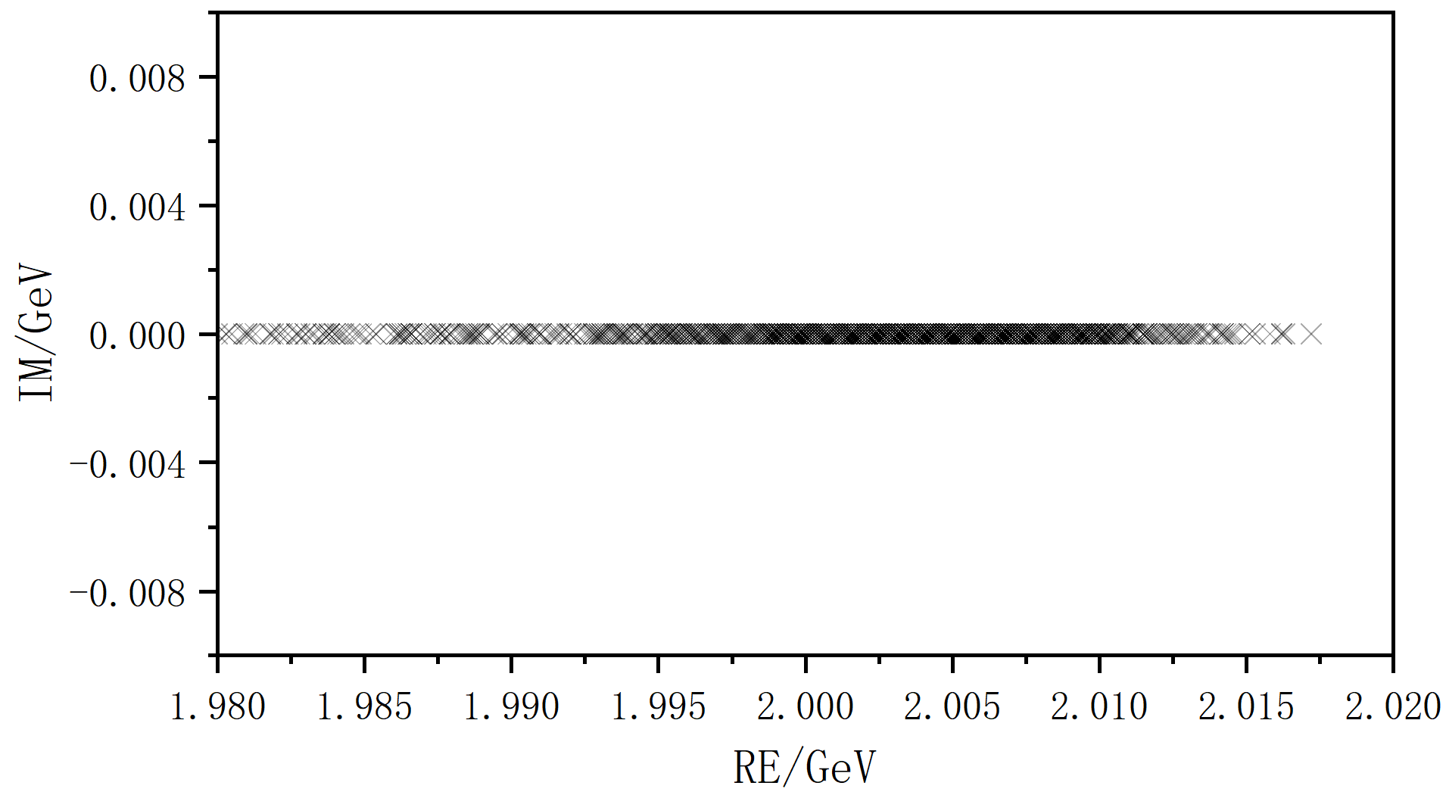
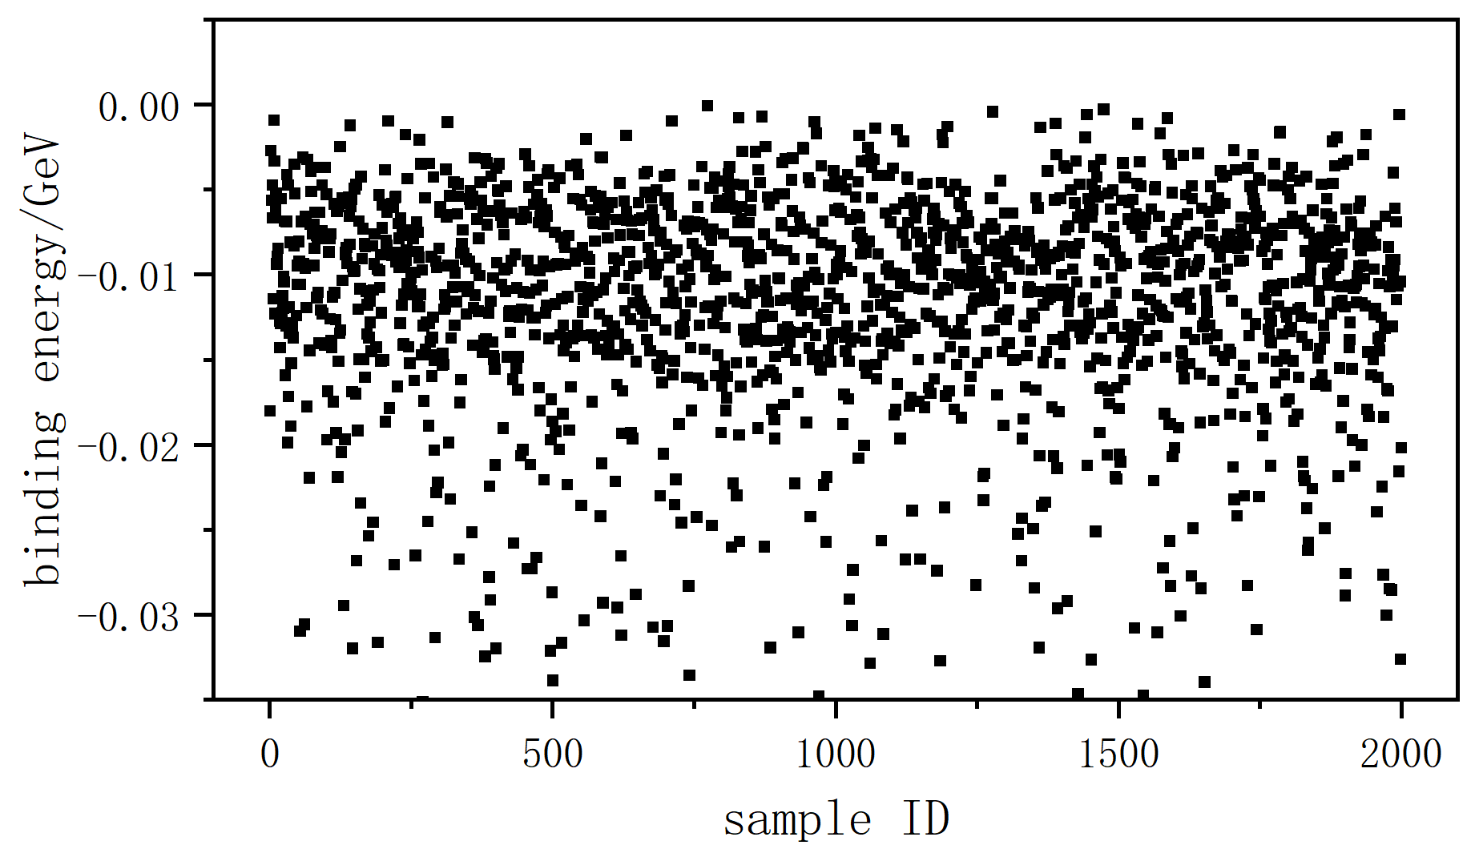




Bootstrap
$${2008}_{−5}^{+4} MeV$$
$$6_{−3}^{+5} MeV$$
³S₁
$${2004}_{−7}^{+5} MeV$$
$${11}_{−5}^{+7} MeV$$
¹S₀

Slide 15
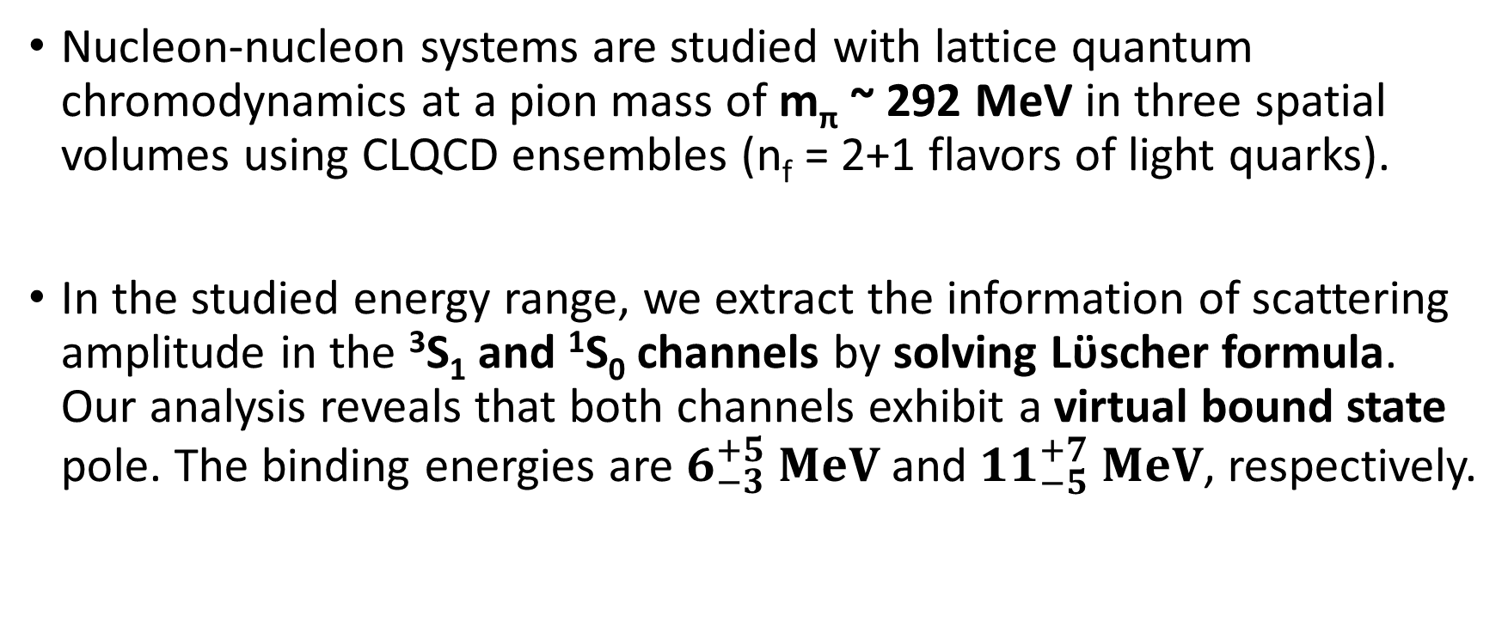
Summary
Nucleon-nucleon systems are studied with lattice quantum chromodynamics at a pion mass of m_{π} ~ 292 MeV in three spatial volumes using CLQCD ensembles (n_{f} = 2+1 flavors of light quarks).
In the studied energy range, we extract the information of scattering amplitude in the ³S₁ and ¹S₀ channels by solving Lϋscher formula. Our analysis reveals that both channels exhibit a virtual bound state pole. The binding energies are $6_{−3}^{+5} MeV$ and ${11}_{−5}^{+7} MeV$, respectively.

Slide 16
backup

Slide 17
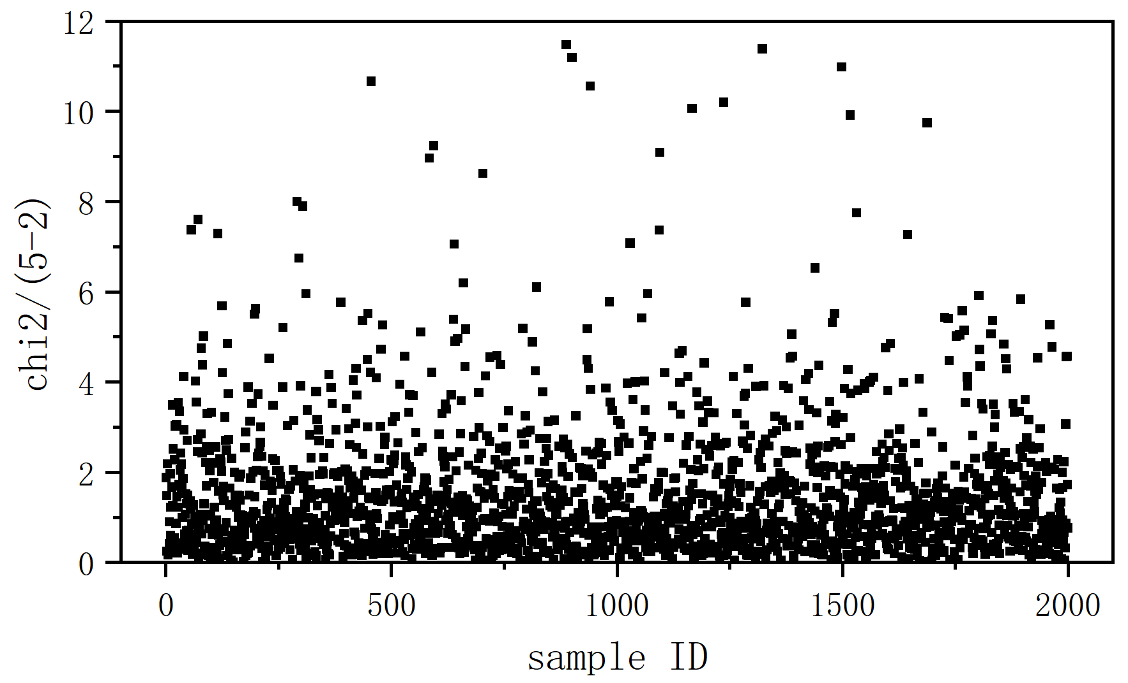
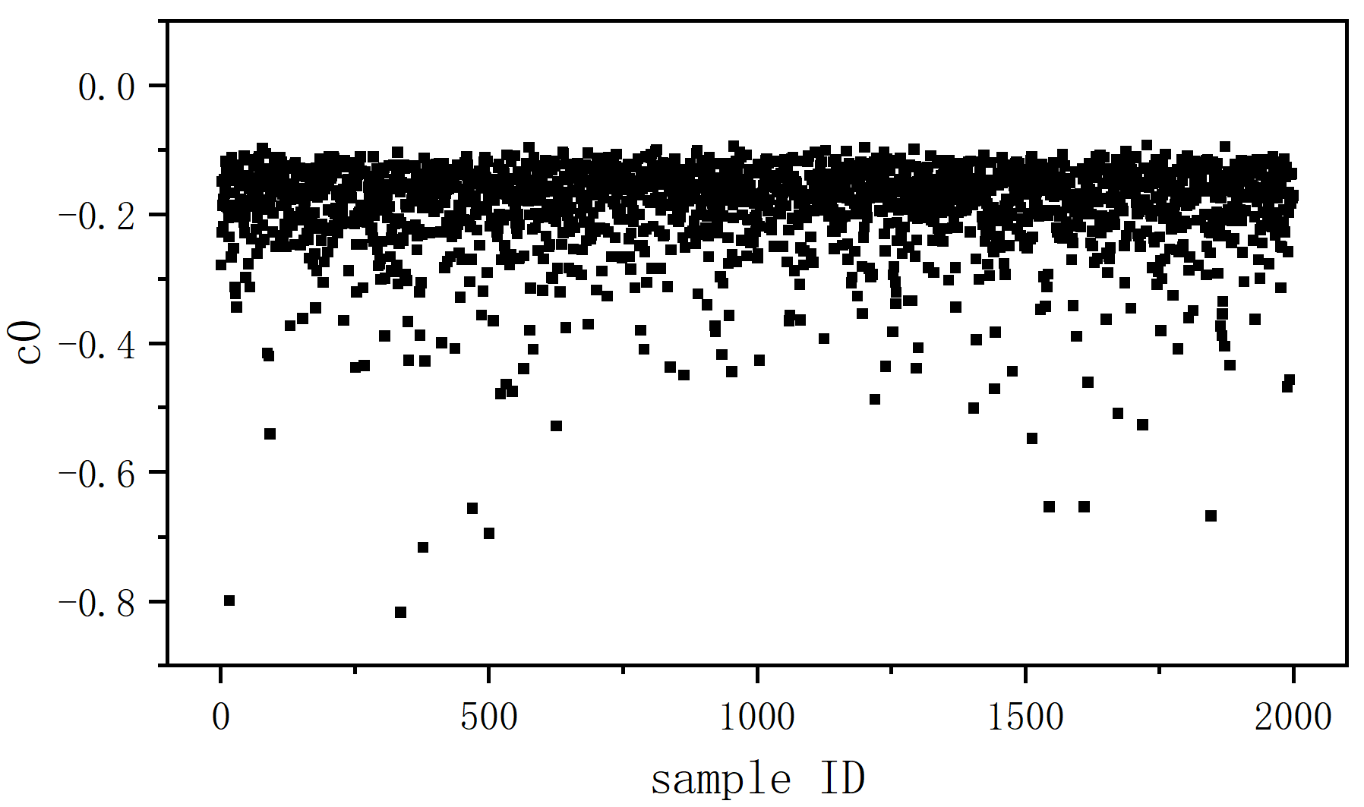
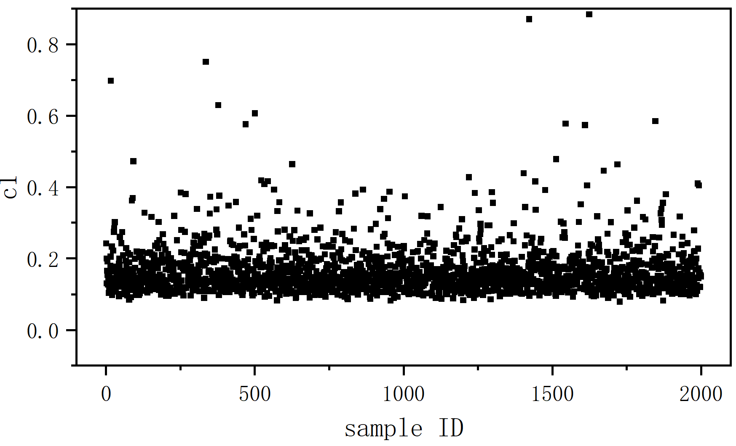
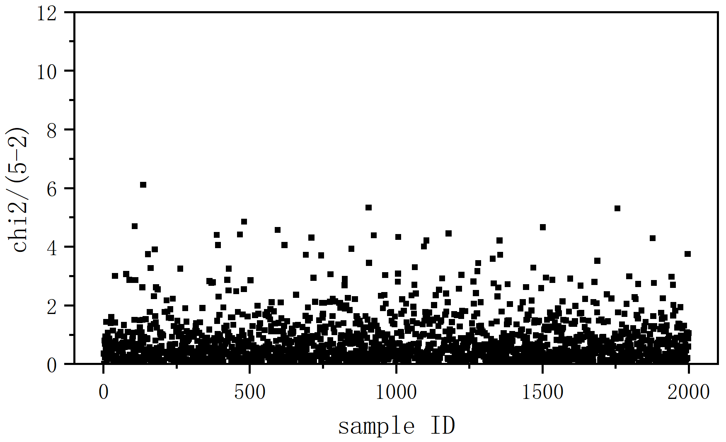
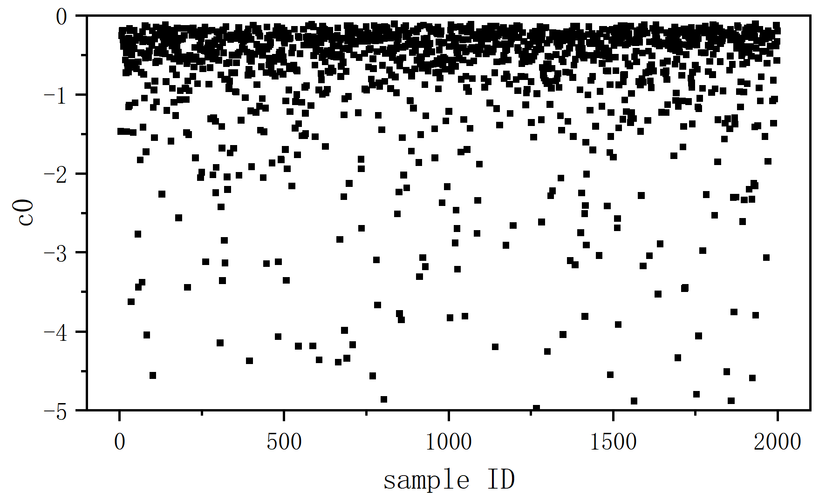
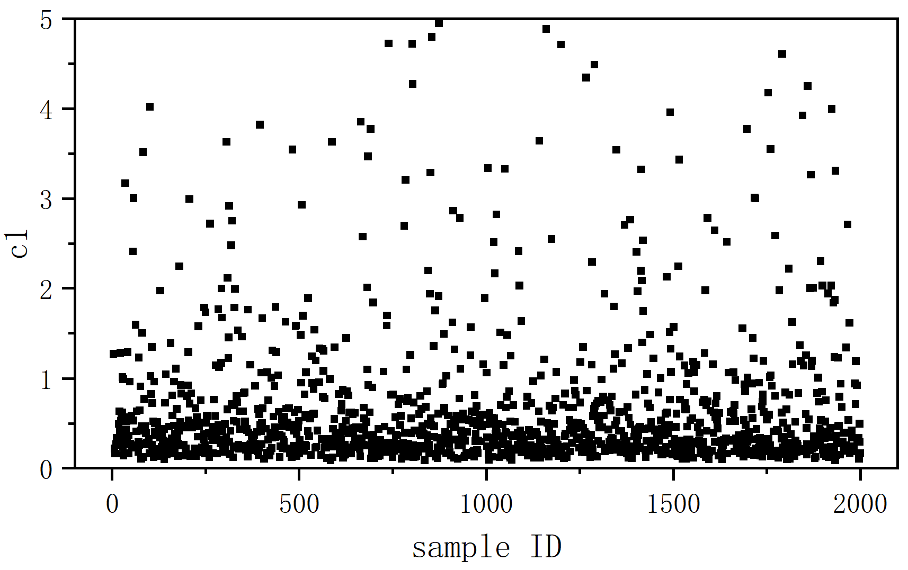





Bootstrap
$$K^{−1}=c_{0}+c_{1}s$$
$$c_{0}={−0.17}_{−0.07}^{+0.04}$$
$$c_{1}={0.15}_{−0.03}^{+0.06}$$
³S₁
$$c_{0}={−0.6}_{−30.5}^{+0.3}$$
$$c_{1}={0.5}_{−0.3}^{+26.5}$$
¹S₀

