Slide 1





Approaches to the Inverse Fourier Transformation with Limited and Discrete Data
第五届中国格点量子色动力学研讨会
2025.10.11 惠州
Speaker: Yu-Fei Ling
Joint work with Jun Hua, Jian Liang, Ao-Sheng Xiong, and Qi-An Zhang
South China Normal University, Guangzhou, China

Slide 2
Outline
Motivation
Ill-posedness
Inversion methods
  Tikhonov regularization
  Backus-Gilbert
  Bayesian approach
  Artificial neurons network (ANN)
  Results
Conclusions&Outlook

Slide 3

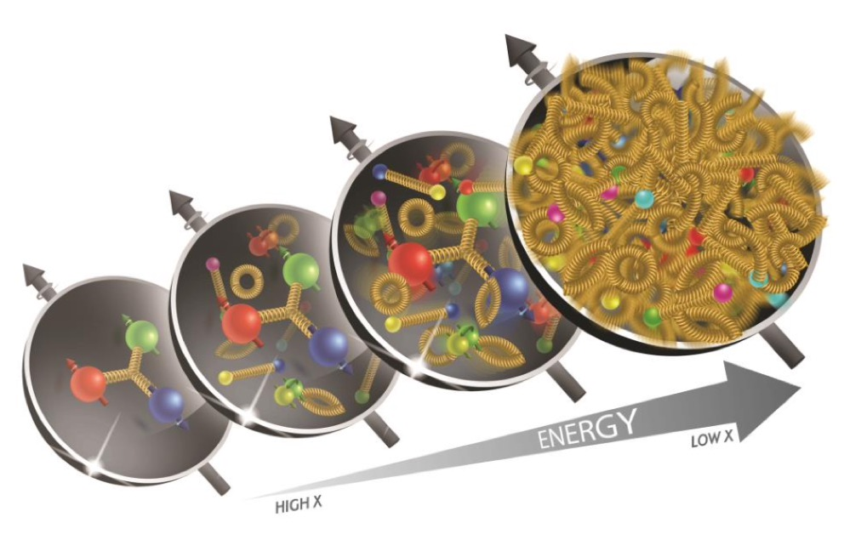
Motivation
The partonic structure of hadron—the fundamental goal
Lattice QCD is formulated in Euclidean space-time.
light-cone PDFs/DAs are formulated in Mikowski space-time.
Direct calculation of light-cone PDFs/DAs from first principles remained a major challenge for a long time.
Mismatch

Slide 4
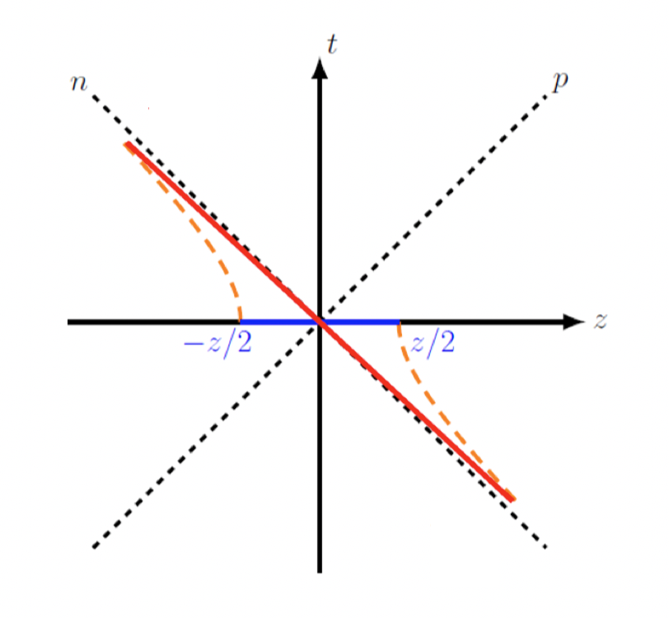



Motivation
LaMET—transformative progress
A direct pathway to access light-cone observables
We can define an equal-time, spatial separated quasi-DA which can be calculated by lattice QCD.
Quasi-DA and LCDA are related by a rigorous factorization formula. (Matching)
Boosting${ P}_{z}$
$$\frac{ξ^{−}}{\sqrt{2}}$$
EFT
$$−\frac{ξ^{−}}{\sqrt{2}}$$

Slide 5

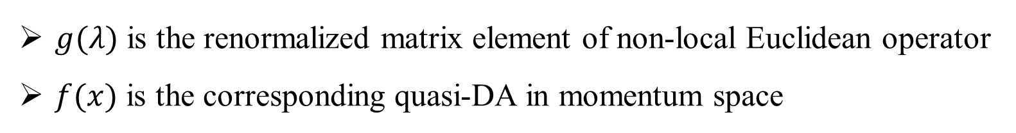
Motivation
Key numerical step in LaMET: obtain the momentum-fraction quasi-DA from non-local matrix elements computed in Euclidean lattice
$g\left(λ\right)$ and $f(x)$ are related by a Fourier transform
We have
Our target
$g(λ)$ is the renormalized matrix element of non-local Euclidean operator
$f(x)$ is the corresponding quasi-DA in momentum space

Slide 6
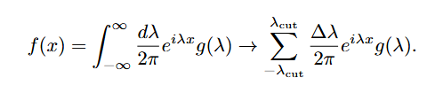
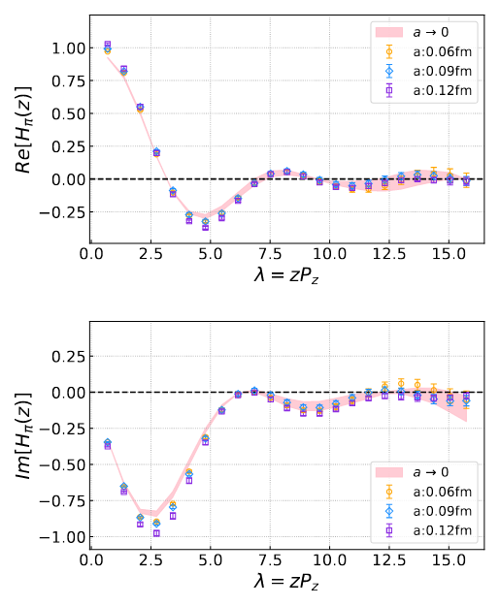
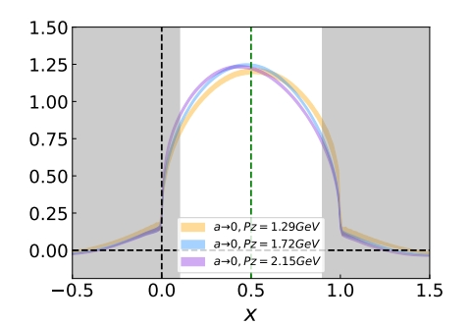
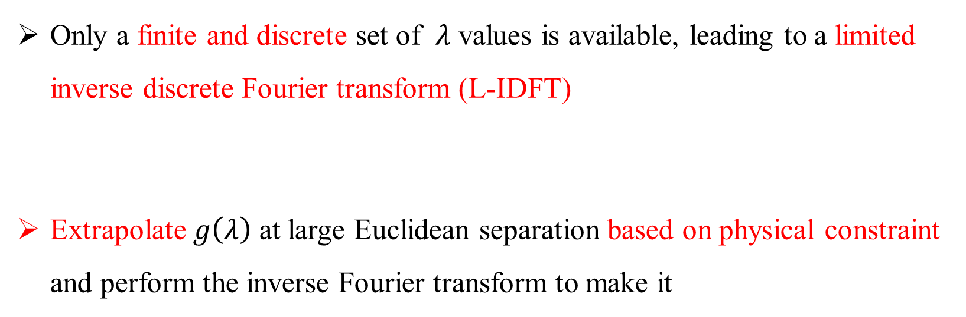
Motivation
Physics-driven $λ$-extrapolation is good and effective
Only a finite and discrete set of $λ$ values is available, leading to a limited inverse discrete Fourier transform (L-IDFT)
Extrapolate $g\left(λ\right)$ at large Euclidean separation based on physical constraint and perform the inverse Fourier transform to make it
(LPC)Jun Hua et.al. PRL129. 132001(2022)

Slide 7
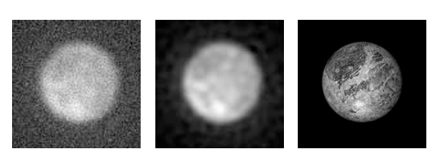
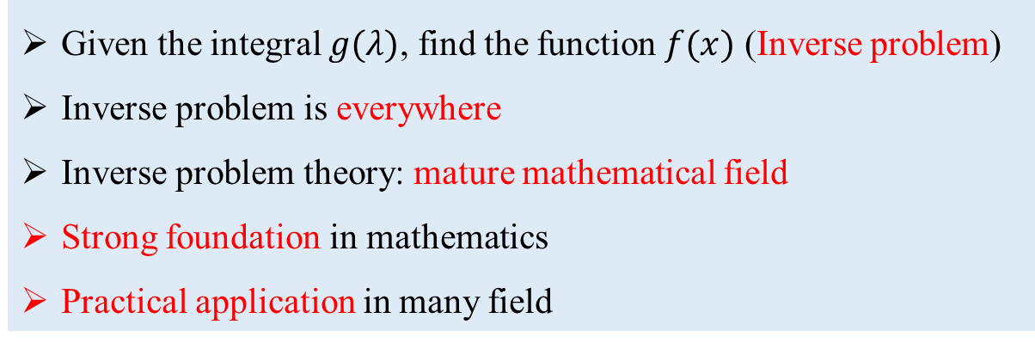
Motivation
New perspective: inverse problem approach
Given the integral $g(λ)$, find the function $f(x)$ (Inverse problem)
Inverse problem is everywhere
Inverse problem theory: mature mathematical field
Strong foundation in mathematics
Practical application in many field
Classic books on the inverse problem theory:
Recovering image using inverse problem method
Solutions of Ill-Posed Problems (1977)
Computational Methods for Inverse Problems (2002)
Inverse Problem Theory and Methods for Model Parameter Estimation (2005)
Statistical and Computational Inverse Problems (2005)
(T. Albert. Inverse Problem Theory and Methods for Model Parameter Estimation (2005), SIAM.)

Slide 8
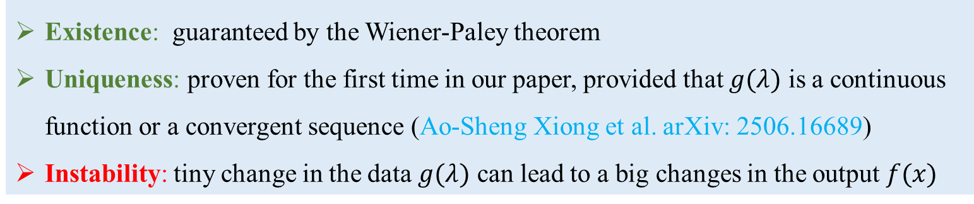
Ill-posedness
Ill-posedness is the key to the inverse problem
Well-posedness: satisfy the existence, uniqueness and stability
Ill-posedness: fail to satisfy any one of the above condition
The ill-posedness of limited Fourier inversion problem
Existence: guaranteed by the Wiener-Paley theorem
Uniqueness: proven for the first time in our paper, provided that $g(λ)$ is a continuous function or a convergent sequence (Ao-Sheng Xiong et al. arXiv: 2506.16689)
Instability: tiny change in the data $g(λ)$ can lead to a big changes in the output $f(x)$

Slide 9
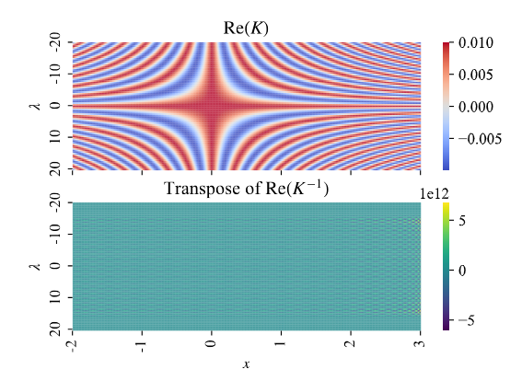
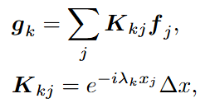
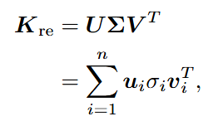
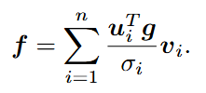

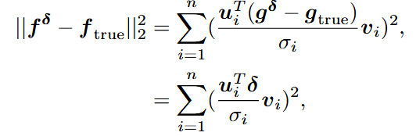
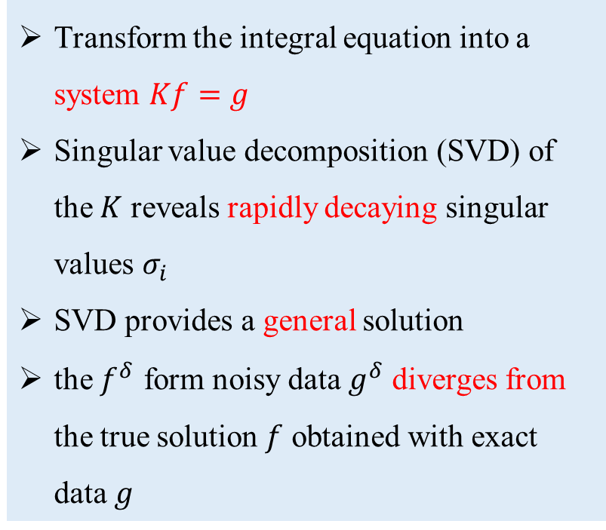
Ill-posedness
Quantify the instability using SVD formulation
Transform the integral equation into a system $Kf=g$
Singular value decomposition (SVD) of the $K$ reveals rapidly decaying singular values $σ_{i}$
SVD provides a general solution
the $f^{δ}$ form noisy data $g^{δ}$ diverges from the true solution $f$ obtained with exact data $g$

Slide 10

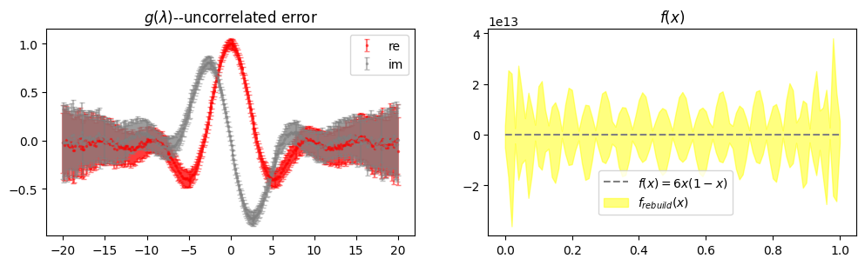
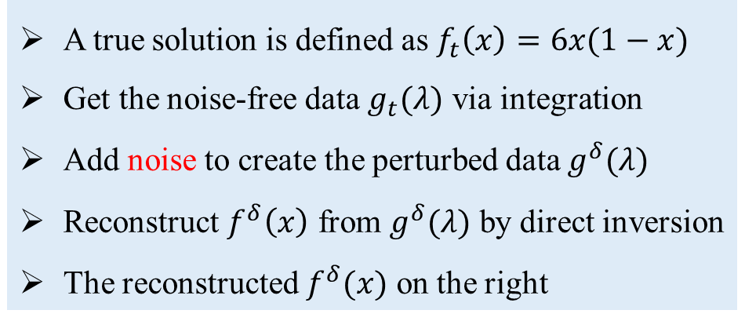
Ill-posedness
The instability of direct inversion
A true solution is defined as $f_{t}\left(x\right)=6x(1−x)$
Get the noise-free data $g_{t}(λ)$ via integration
Add noise to create the perturbed data $g^{δ}(λ)$
Reconstruct $f^{δ}\left(x\right)$ from $g^{δ}(λ)$ by direct inversion
The reconstructed $f^{δ}(x)$ on the right
The inverse problem of limited discrete Fourier inversion is ill-posed: existence and uniqueness but instability

Slide 11
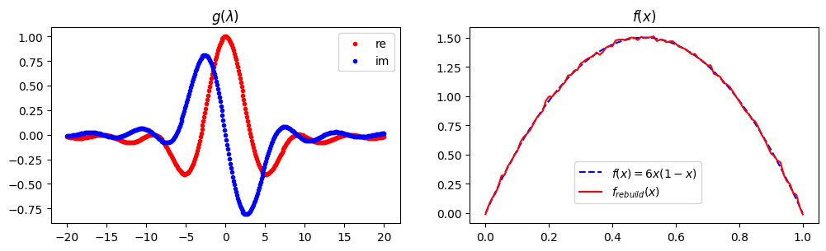
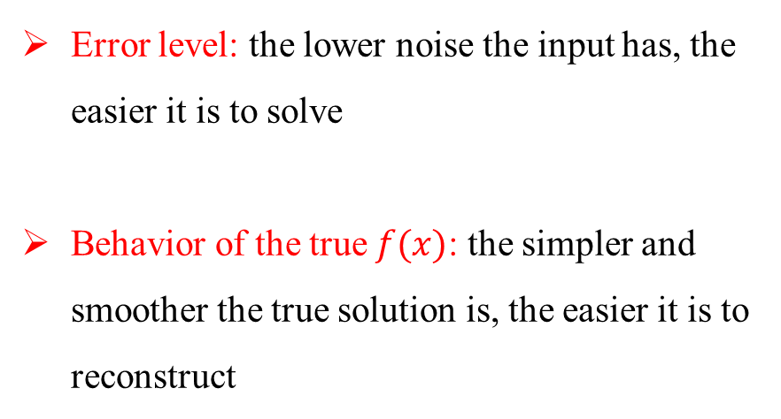
Ill-posedness
Factors influencing the difficulty of ill-posed problems:
Error level: the lower noise the input has, the easier it is to solve
Behavior of the true $f(x)$: the simpler and smoother the true solution is, the easier it is to reconstruct
The limited discrete Fourier inversion problem is tractable
Error level: reconstruction quality improves with lower error in the quasi-DA
Solution Nature: the DA has a simple form

Slide 12
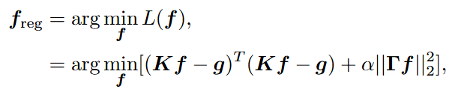
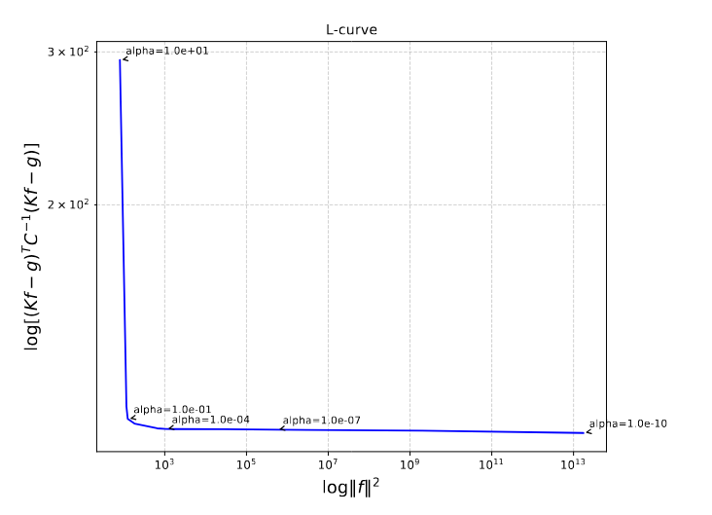


Inversion methods—Tikhonov regularization
Tikhonov regularization is a standard technique for addressing ill-posed inverse problems
Aim to find the minimizer $f_{α}^{δ}$ of the Tikhonov functional:
data fitness
regulator
Using variational principles, the solution is given by:
L-curve
Overcome instability by slowing down the rapid decay of singular values
The regularization parameter $α$ can be rigorously determined using L-curve criterion

Slide 13
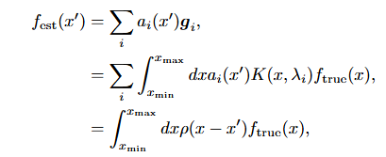




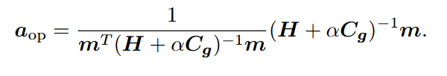
Inversion methods—Backus-Gilbert
The Backus-Gilbert (BG) method and Tikhonov approach are conceptually similar
Assumes the solution $f_{est}(x′)$ can be expressed as a linear combination of the data $g(λ_{i})$
A trade off between the width $l$ of resolution function $ρ\left(x−x′\right)$ and the solution stability, leading to minimizing the objective functional $L[a]$
width 𝑙
regulator
normalized constraint
normalized constraint
Using variational principles, the optimal vector $a$ is given by:

Slide 14
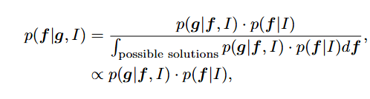
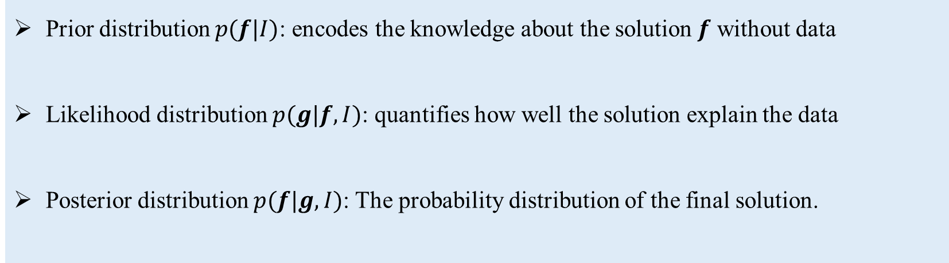
Inversion methods—Bayesian approach
In the Bayesian framework, the unknown solution is modeled as a random variable characterized by a probability distribution
The Bayesian approach is based on Bayes’ theorem:
Prior distribution $p(f|I)$: encodes the knowledge about the solution $f$ without data
Likelihood distribution $p(g|f,I)$: quantifies how well the solution explain the data
Posterior distribution $p(f|g,I)$: The probability distribution of the final solution.

Slide 15
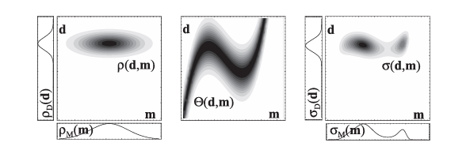
Inversion methods—Bayesian approach
Instability corresponds to a probability distribution with large uncertainty
Prior distribution $p(f|I)$ serves as a regulator to overcome instability
(T. Albert. Inverse Problem Theory and Methods for Model Parameter Estimation (2005), SIAM.)
Likelihood
(large uncertainty)
Prior
Posterior
The solution to the problem is determined from the posterior distribution using Maximum a posteriori (MAP) estimation or posterior mean estimation

Slide 16
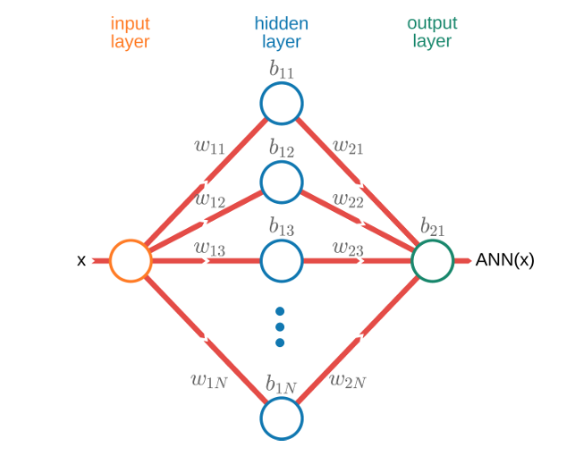
Inversion methods—ANN
ANN provides ​a​ powerful non-linear representation capacity which enables ​it​ to approximate highly complex mappings.
(Min-Huan Chu et.al. arXiv: 2506.16689)
Minimizing the following loss function corresponds to finding a configuration of the network parameters that provides the optimal solution to the problem.

Slide 17

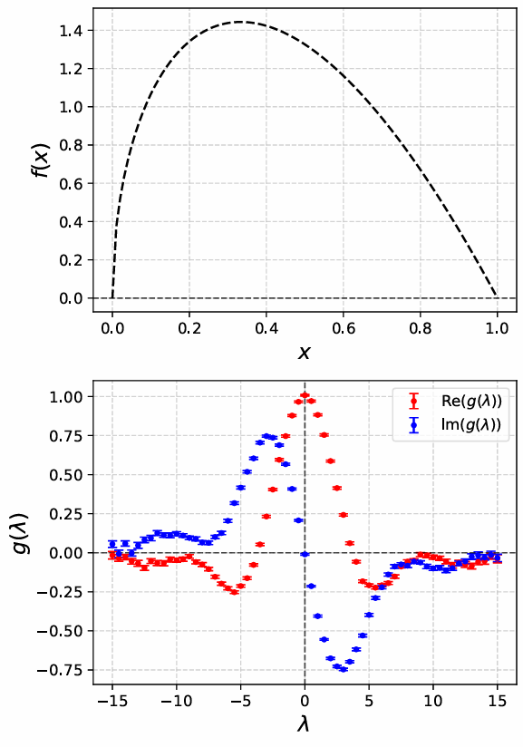
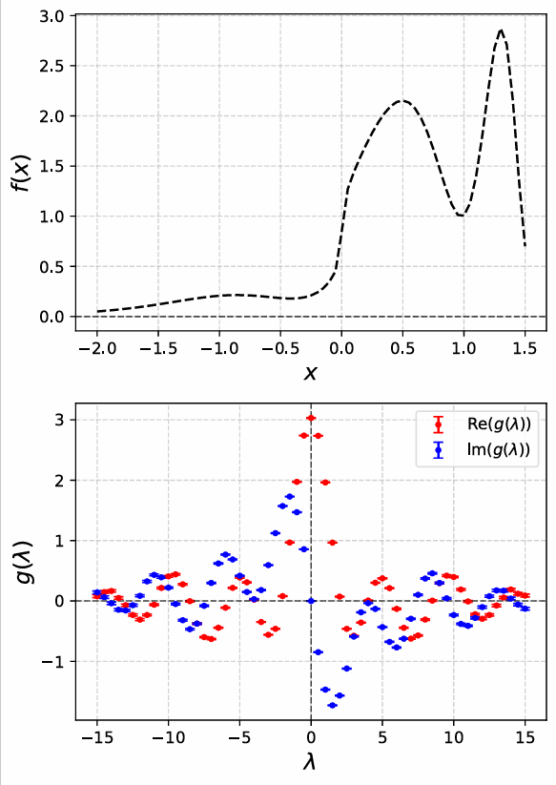
Inversion methods—Results
Toy models I&II：Include correlated errors and uncorrelated errors

Slide 18
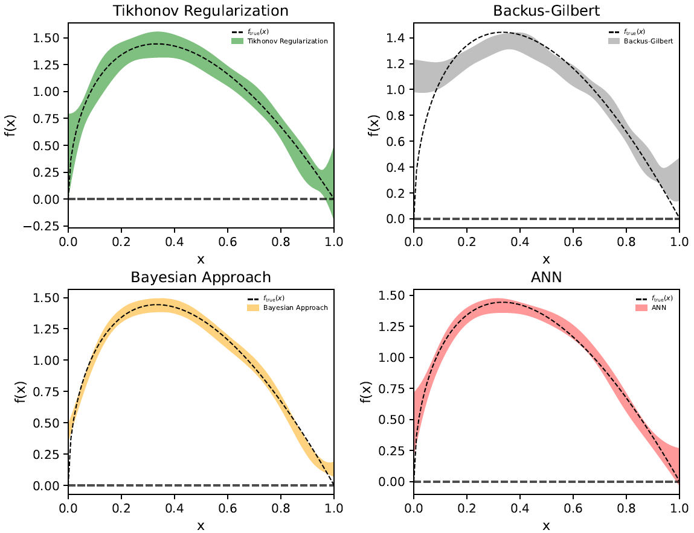
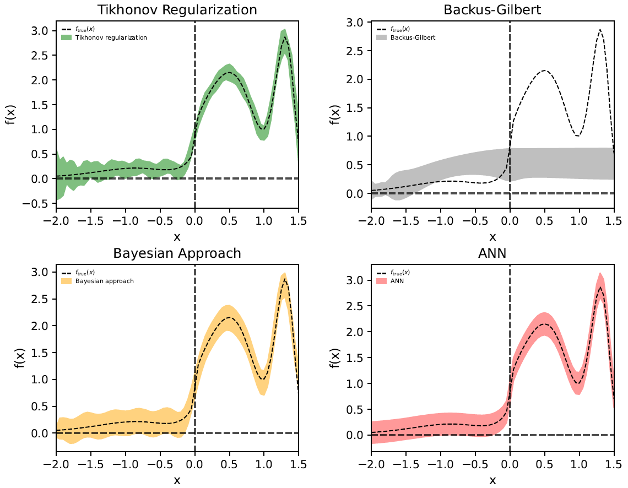
Inversion methods—Results
[1]Aster, R. C., Borchers, B., & Thurber, C. H. (2019). Parameter Estimation and Inverse Problems (3rdEdition), Elsevier, 135–149.
Reconstruction results of Toy models I&II obtained by four inversion methods
Tikhonov, Bayesian, ANN gets good result
BG performs poorly: mathematical foundation is weak[1], effective for simple models but breaking down with complex ones
Single layer
5 neurons
Multi-layers
300~400 neurons

Slide 19
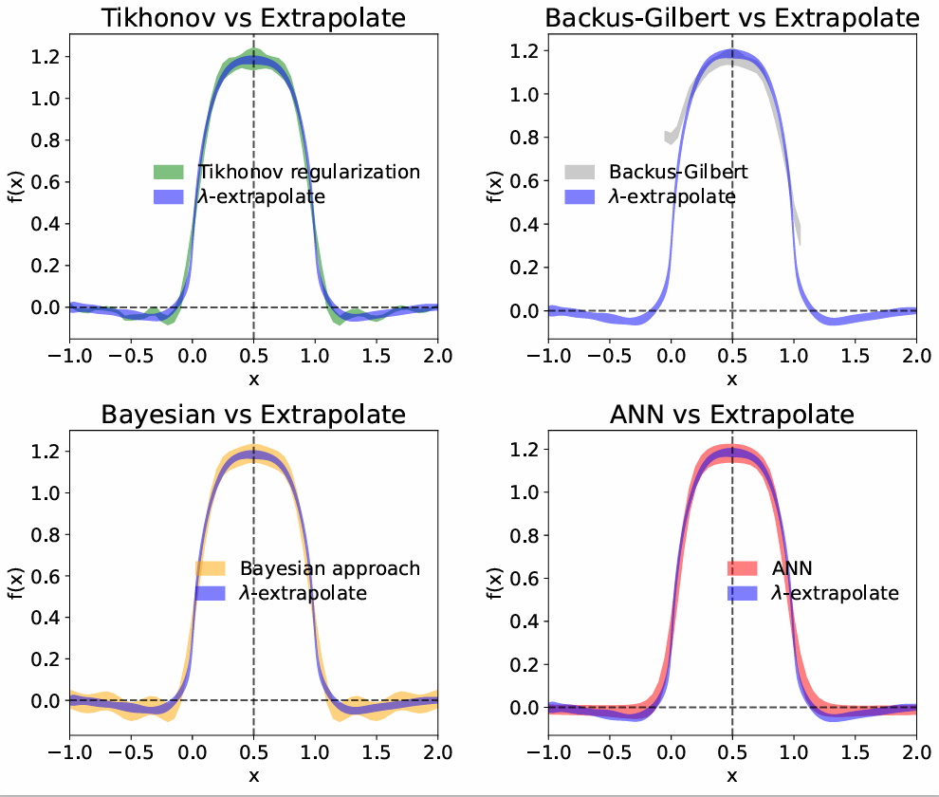
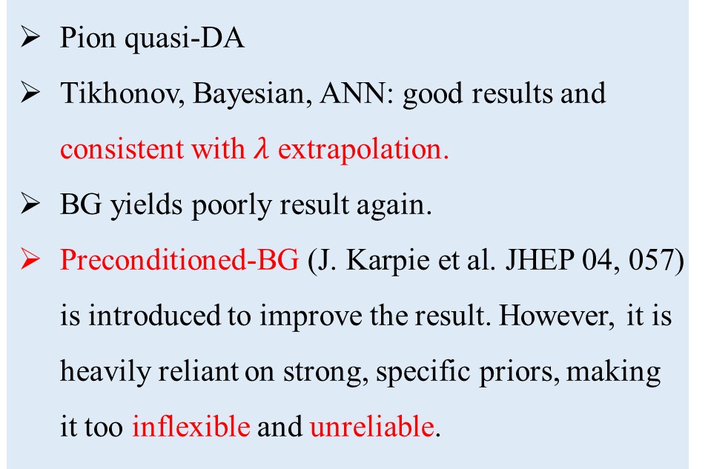
Inversion methods—Results
Reconstruction results obtained by the four methods using real lattice QCD data as input
Pion quasi-DA
Tikhonov, Bayesian, ANN: good results and consistent with $λ$ extrapolation.
BG yields poorly result again.
Preconditioned-BG (J. Karpie et al. JHEP 04, 057) is introduced to improve the result. However, it is heavily reliant on strong, specific priors, making it too inflexible and unreliable.

Slide 20
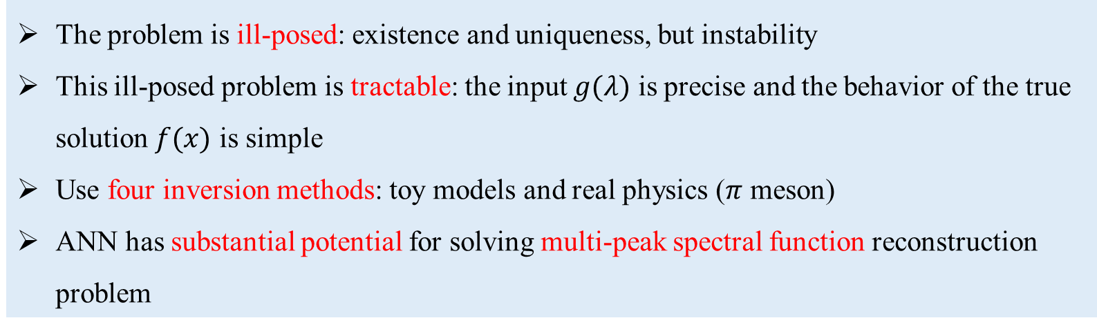
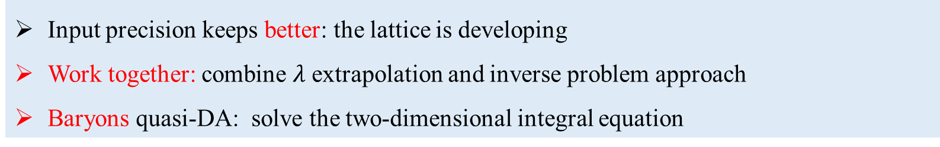
Conclusions&Outlook
New perspective: inverse problem approach to solve the limited discrete Fourier transform
Conclusions:
The problem is ill-posed: existence and uniqueness, but instability
This ill-posed problem is tractable: the input $g(λ)$ is precise and the behavior of the true solution $f(x)$ is simple
Use four inversion methods: toy models and real physics ($π$ meson)
ANN has substantial potential for solving multi-peak spectral function reconstruction problem
Outlook:
Input precision keeps better: the lattice is developing
Work together: combine $λ$ extrapolation and inverse problem approach
Baryons quasi-DA: solve the two-dimensional integral equation

Slide 21
Thanks for watching

