Slide 1


Quark masses and low energy constants on HISQ ensembles
Speaker: Tong-Wei Lin
time：2025.10.11

Slide 2


01
HISQ ensembles
02
Dimensionless joint fit
CONTENTS
03
Renormalization
04
Conclusion

Slide 3

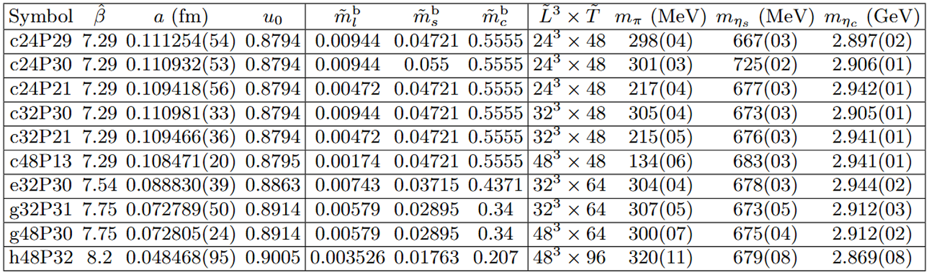
01
HISQ ensembles
To conserve computational resources while achieving higher-precision lattice construction, we have generated the 2+1+1 flavors Highly Improved Staggered Quark ensembles：

Slide 4
01
HISQ ensembles
With the intent to compute diverse physical observables on these ensembles, we must accordingly determine the relevant parameters：
1.Bare quark mass
2.Nonperturbative renormalization
3.Physical quark mass from joint fit
4.Decay constants
…

Slide 5
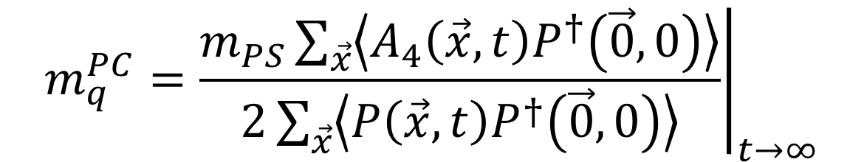
02
Dimensionless joint fit
Through the PCAC relation $Z_{A}∂_{μ}A_{μ}=2m_{q}^{R}Z_{P}P$,we define the PCAC quark mass:
$$m_{q}^{PC}={\left.\frac{m_{PS}\sum_{\vec{x}}{\left\langle A_{4}\left(\vec{x},t\right)P^{†}\left(\vec{0},0\right)\right\rangle }}{2\sum_{\vec{x}}{\left\langle P\left(\vec{x},t\right)P^{†}\left(\vec{0},0\right)\right\rangle }}\right|}_{t→∞}$$
then the renormalized quark mass is defined as $m_{q}^{R}=Z_{A}/Z_{P}m_{q}^{PC}$.
We construct two kinds of the two-point functions：
$$C_{2,wp}^{ΓΓ^{′}}\left(t;m_{q}\right)=\sum_{\vec{x}}{\left\langle Tr\left[S_{C}^{†}\left(\vec{x},y_{0}+t;y_{0};m_{q}\right)γ_{5}Γ×S_{C}\left(\vec{x},y_{0}+t;y_{0};m_{q}\right)Γ^{′}γ_{5}\right]\right\rangle }/L^{3}$$
$$C_{2,ww}^{ΓΓ^{′}}\left(t;m_{q}\right)=\sum_{\vec{x},\vec{z}}{\left\langle Tr\left[S_{C}^{†}\left(\vec{x},y_{0}+t;y_{0};m_{q}\right)γ_{5}Γ×S_{C}\left(\vec{z},y_{0}+t;y_{0};m_{q}\right)Γ^{′}γ_{5}\right]\right\rangle }/L^{3}$$

Slide 6
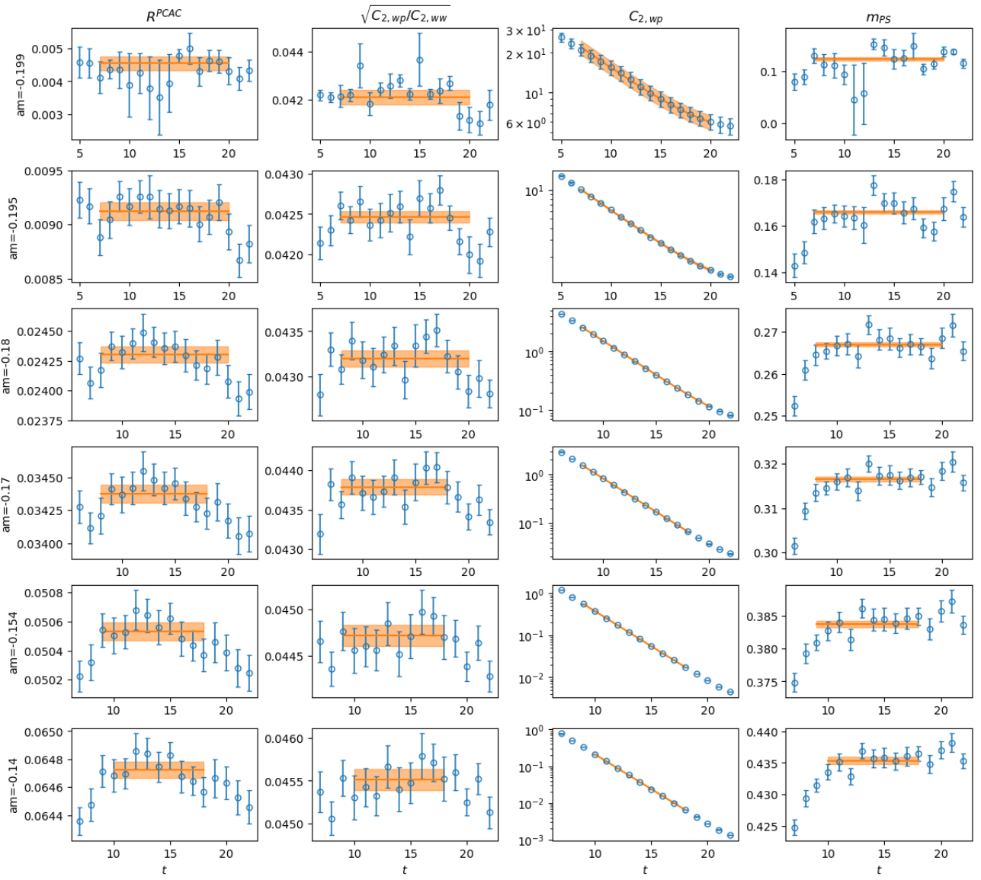
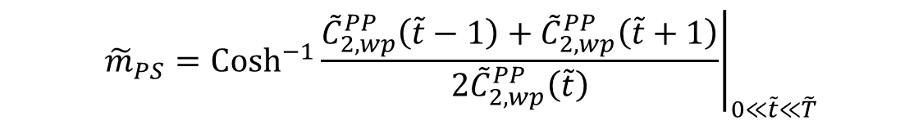
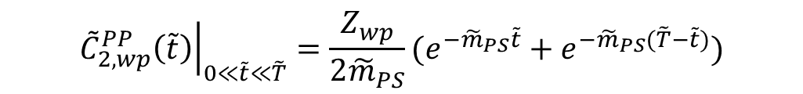

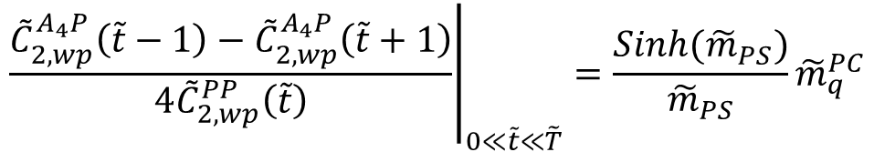
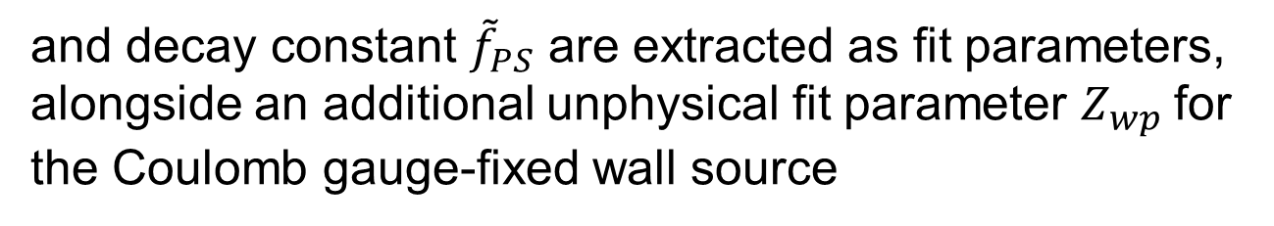
02
Dimensionless joint fit
Through a joint fit
$${\left.\frac{{\tilde{C}}_{2,wp}^{A_{4}P}\left(\tilde{t}−1\right)−{\tilde{C}}_{2,wp}^{A_{4}P}\left(\tilde{t}+1\right)}{4{\tilde{C}}_{2,wp}^{PP}\left(\tilde{t}\right)}\right|}_{0≪\tilde{t}≪\tilde{T}}=\frac{Sinh({\tilde{m}}_{PS})}{{\tilde{m}}_{PS}}{\tilde{m}}_{q}^{PC}$$
$${\left.\sqrt{\frac{{\tilde{C}}_{2,wp}^{PP}\left(\tilde{t}\right)}{{\tilde{C}}_{2,w}^{PP}\left(\tilde{t}\right)}}\right|}_{0≪\tilde{t}≪\tilde{T}}=\frac{{\tilde{m}}_{PS}^{2}}{2{\tilde{m}}_{q}^{PC}\sqrt{Z_{wp}}}{\tilde{f}}_{PS}$$
$${\left.{\tilde{C}}_{2,wp}^{PP}\left(\tilde{t}\right)\right|}_{0≪\tilde{t}≪\tilde{T}}=\frac{Z_{wp}}{2{\tilde{m}}_{PS}}(e^{−{\tilde{m}}_{PS}\tilde{t}}+e^{−{\tilde{m}}_{PS}(\tilde{T}−\tilde{t})})$$
the PCAC quark mass $m_{q}^{PC}$ , pseudo-scalar mass
$${\tilde{m}}_{PS}={\left.{Cosh}^{−1}\frac{{\tilde{C}}_{2,wp}^{PP}\left(\tilde{t}−1\right)+{\tilde{C}}_{2,wp}^{PP}\left(\tilde{t}+1\right)}{2{\tilde{C}}_{2,wp}^{PP}\left(\tilde{t}\right)}\right|}_{0≪\tilde{t}≪\tilde{T}}$$
and decay constant ${\tilde{f}}_{PS}$ are extracted as fit parameters, alongside an additional unphysical fit parameter $Z_{wp}$for the Coulomb gauge-fixed wall source

Slide 7
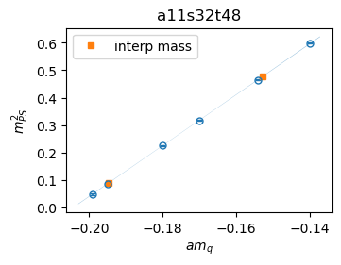
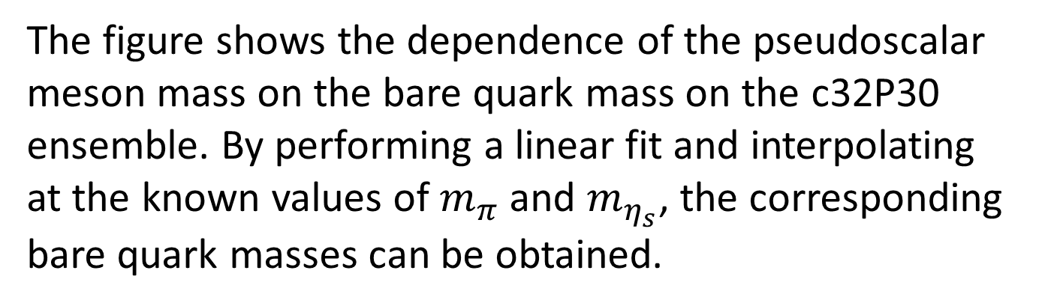
02
Dimensionless joint fit
c32P30
The figure shows the dependence of the pseudoscalar meson mass on the bare quark mass on the c32P30 ensemble. By performing a linear fit and interpolating at the known values of $m_{π}$ and $m_{η_{s}}$, the corresponding bare quark masses can be obtained.

Slide 8
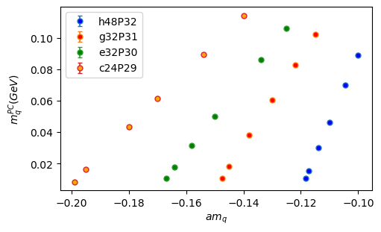
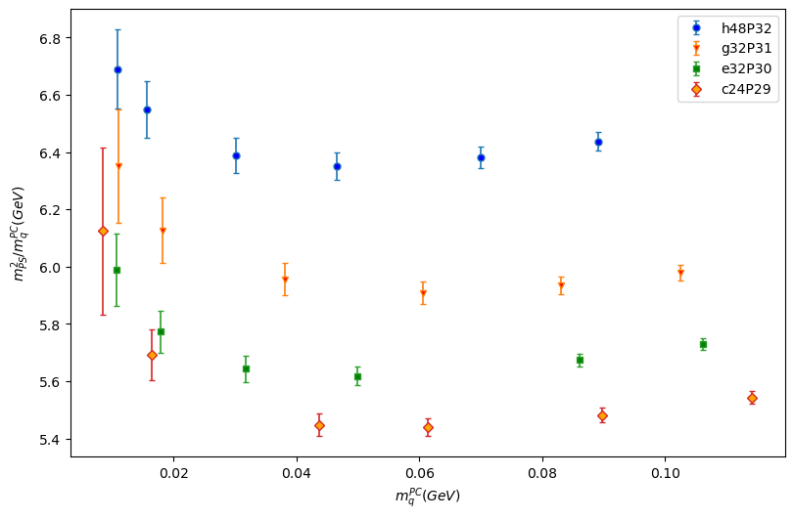
02
Dimensionless joint fit

Slide 9
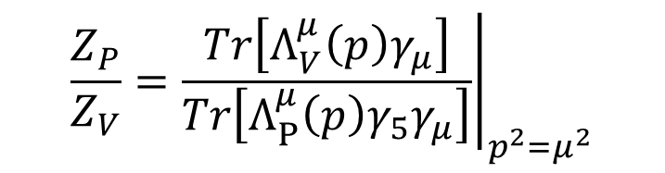
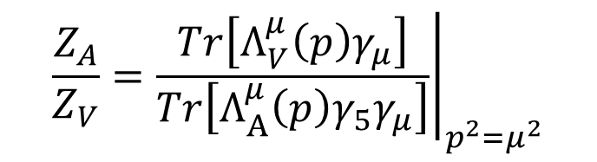
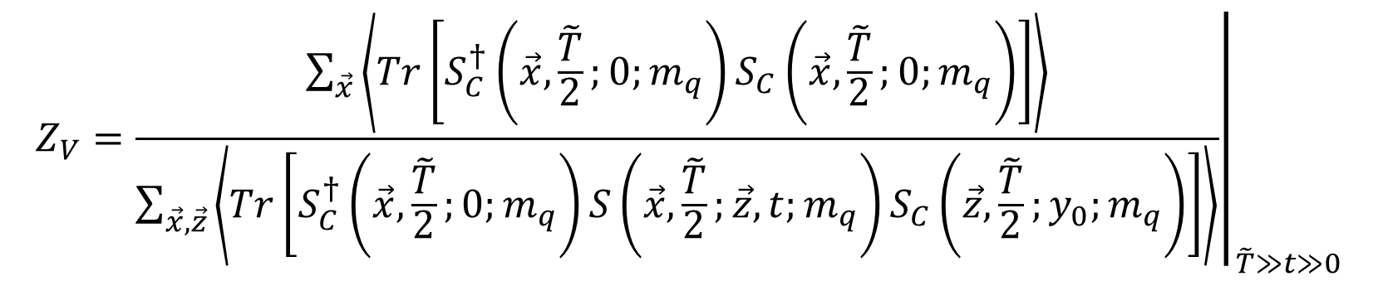
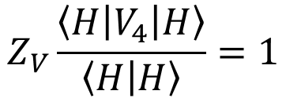
03
Renormalization
The renormalization constant ZV can be determined from the vector current conservation condition
$$Z_{V}\frac{\left\langle H | V_{4} | H\right\rangle }{\left\langle H | H\right\rangle }=1$$
$$Z_{V}={\left.\frac{\sum_{\vec{x}}{\left\langle Tr\left[S_{C}^{†}\left(\vec{x},\frac{\tilde{T}}{2};0;m_{q}\right)S_{C}\left(\vec{x},\frac{\tilde{T}}{2};0;m_{q}\right)\right]\right\rangle }}{\sum_{\vec{x},\vec{z}}{\left\langle Tr\left[S_{C}^{†}\left(\vec{x},\frac{\tilde{T}}{2};0;m_{q}\right)S\left(\vec{x},\frac{\tilde{T}}{2};\vec{z},t;m_{q}\right)S_{C}\left(\vec{z},\frac{\tilde{T}}{2};y_{0};m_{q}\right)\right]\right\rangle }}\right|}_{\tilde{T}≫t≫0}$$
We also need nonperturbative renormalization constants $Z_{A}=Z_{V}\frac{Z_{A}}{Z_{V}}$, $Z_{P}=Z_{P}\frac{Z_{P}}{Z_{V}}$
$$\frac{Z_{A}}{Z_{V}}={\left.\frac{Tr\left[Λ_{V}^{μ}\left(p\right)γ_{μ}\right]}{Tr\left[Λ_{A}^{μ}\left(p\right){γ_{5}γ}_{μ}\right]}\right|}_{p^{2}=μ^{2}}$$
$$\frac{Z_{P}}{Z_{V}}={\left.\frac{Tr\left[Λ_{V}^{μ}\left(p\right)γ_{μ}\right]}{Tr\left[Λ_{P}^{μ}\left(p\right){γ_{5}γ}_{μ}\right]}\right|}_{p^{2}=μ^{2}}$$

Slide 10
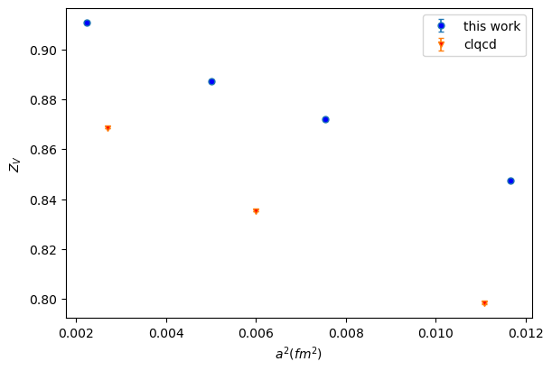
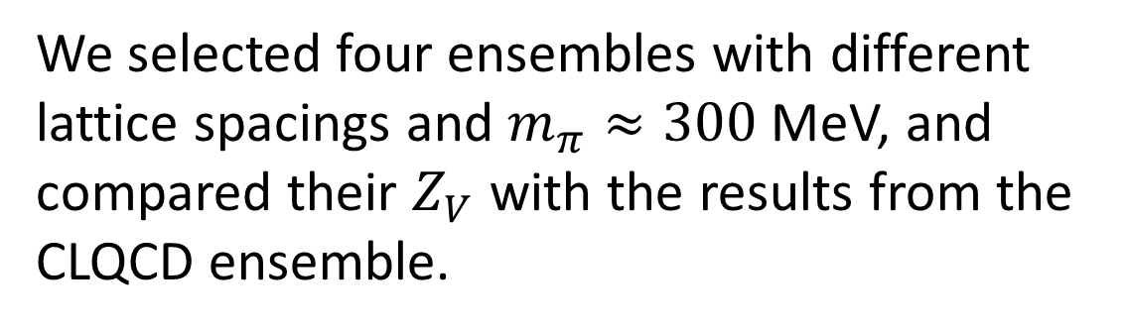
03
Renormalization
We selected four ensembles with different lattice spacings and $m_{π}≈300$MeV, and compared their $Z_{V}$ with the results from the CLQCD ensemble.
PHYSICAL REVIEW D 109, 054507 (2024)

Slide 11
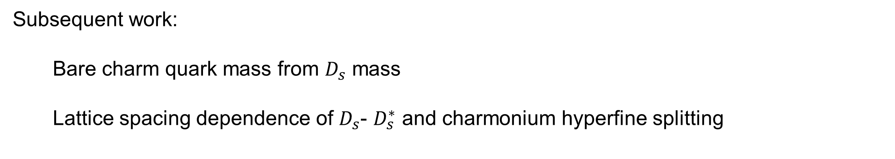
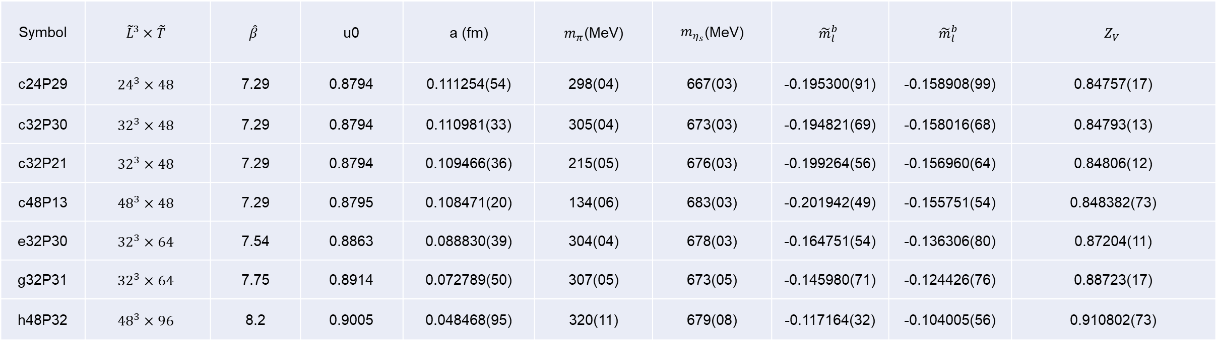
04
Conclusion
Symbol | $${\tilde{L}}^{3}×\tilde{T}$$ | $$\hat{β}$$ | u0 | a (fm) | $m_{π}$(MeV) | $m_{η_{s}}$(MeV) | $${\tilde{m}}_{l}^{b}$$ | $${\tilde{m}}_{l}^{b}$$ | $$Z_{V}$$
c24P29 | $${24}^{3}×48$$ | 7.29 | 0.8794 | 0.111254(54) | 298(04) | 667(03) | -0.195300(91) | -0.158908(99) | 0.84757(17)
c32P30 | $${32}^{3}×48$$ | 7.29 | 0.8794 | 0.110981(33) | 305(04) | 673(03) | -0.194821(69) | -0.158016(68) | 0.84793(13)
c32P21 | $${32}^{3}×48$$ | 7.29 | 0.8794 | 0.109466(36) | 215(05) | 676(03) | -0.199264(56) | -0.156960(64) | 0.84806(12)
c48P13 | $${48}^{3}×48$$ | 7.29 | 0.8795 | 0.108471(20) | 134(06) | 683(03) | -0.201942(49) | -0.155751(54) | 0.848382(73)
e32P30 | $${32}^{3}×64$$ | 7.54 | 0.8863 | 0.088830(39) | 304(04) | 678(03) | -0.164751(54) | -0.136306(80) | 0.87204(11)
g32P31 | $${32}^{3}×64$$ | 7.75 | 0.8914 | 0.072789(50) | 307(05) | 673(05) | -0.145980(71) | -0.124426(76) | 0.88723(17)
h48P32 | $${48}^{3}×96$$ | 8.2 | 0.9005 | 0.048468(95) | 320(11) | 679(08) | -0.117164(32) | -0.104005(56) | 0.910802(73)
Subsequent work:
Bare charm quark mass from $D_{s}$ mass
Lattice spacing dependence of $D_{s}$- $D_{s}^{∗}$ and charmonium hyperfine splitting

Slide 12
Thank you for watching

