Slide 1

Radiative decay and charge radius of heavy-light meson systems
Wenzheng Hou
South China Normal University
Cooperate with Jian Liang ,Jun Hua ,Longcheng Gui

Slide 2
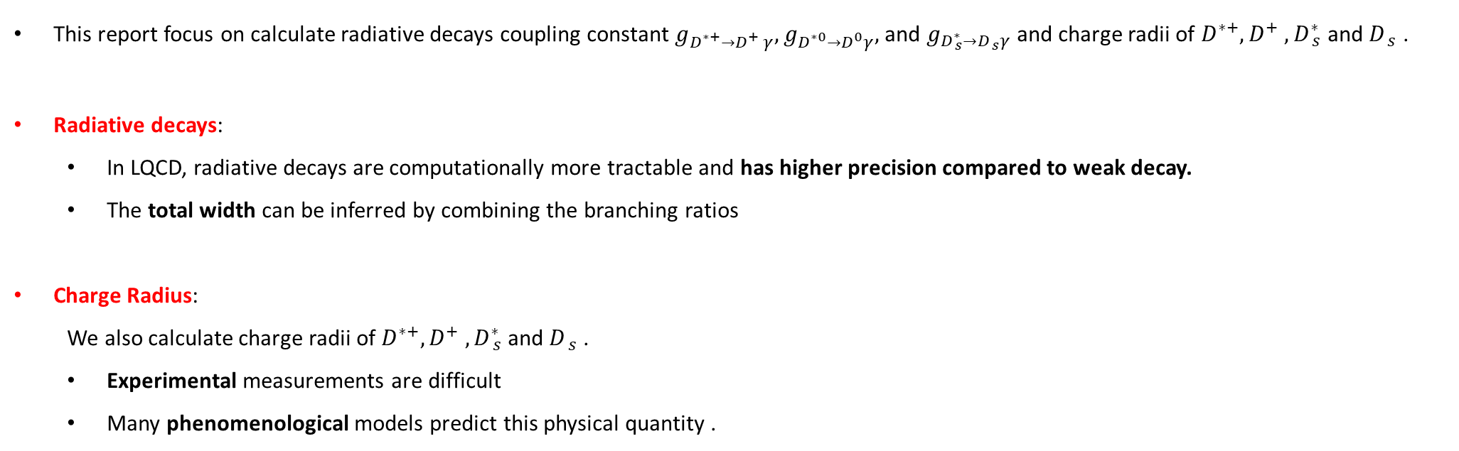
Motivation
This report focus on calculate radiative decays coupling constant $g_{D_{ }^{∗+}→{D_{ }^{+}}_{ }^{ }γ},g_{D_{ }^{∗0}→D_{ }^{0}γ},$and $g_{D_{ s}^{∗}→D_{ s}^{ }γ}$and charge radii of $D_{ }^{∗+}, D_{ }^{+} ,D_{ s}^{∗}$and $D_{ s}^{ }$.
Radiative decays:
In LQCD, radiative decays are computationally more tractable and has higher precision compared to weak decay.
The total width can be inferred by combining the branching ratios
Charge Radius:
We also calculate charge radii of $D_{ }^{∗+}, D_{ }^{+} ,D_{ s}^{∗}$and $D_{ s}^{ }$.
Experimental measurements are difficult
Many phenomenological models predict this physical quantity .
2

Slide 3

Radiative decay of $D_{ }^{∗+}→{D_{ }^{+}}_{ }^{ }γ,D_{ }^{∗0}→D_{ }^{0}γ$ and $D_{ s}^{∗}→D_{ s}^{ }γ$
Electromagnetic radius of $D_{ }^{∗+}, D_{ }^{+} ,D_{ s}^{∗}$and $D_{ s}^{ }$mesons

Slide 4
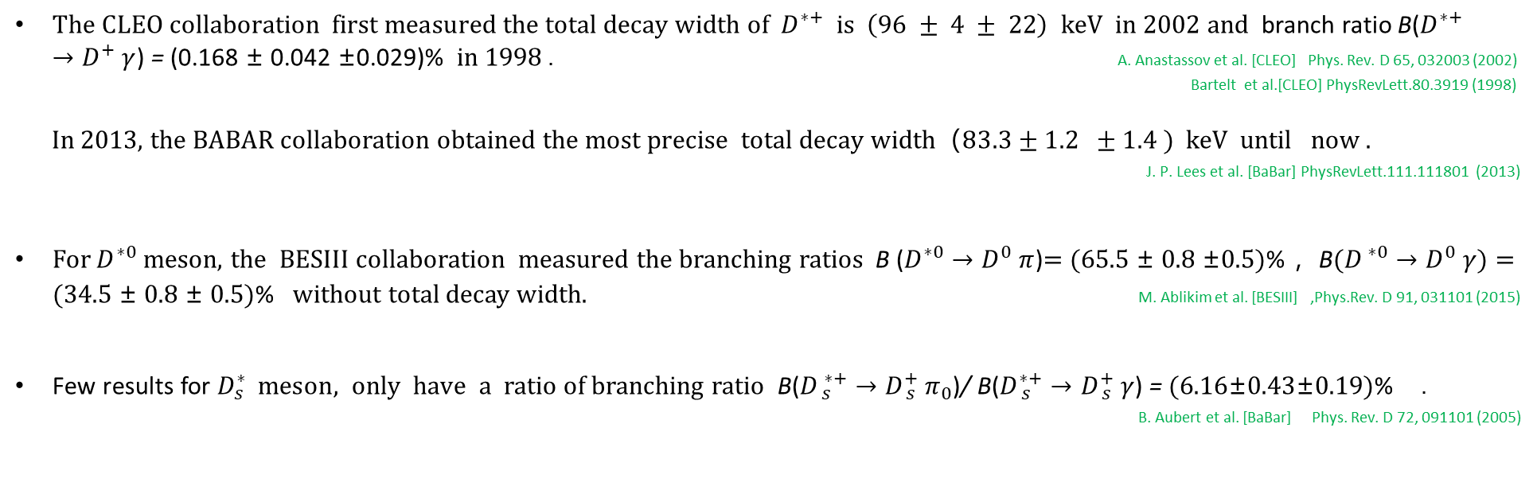
Background-exp
$The CLEO collaboration first measured the total decay width of{ D}_{ }^{∗+} is \left(96 ± 4 ± 22\right) keV in 2002 and$branch ratio B($D_{ }^{∗+}→{D_{ }^{+}}_{ }^{ }γ$) = (0.168 ± 0.042 ±0.029)% in 1998 . A. Anastassov et al. [CLEO] Phys. Rev. D 65, 032003 (2002)
Bartelt et al.[CLEO] PhysRevLett.80.3919 (1998)
In 2013, the BABAR collaboration obtained $\text{the} \text{most} \text{precise} total decay width（83.3±1.2 ±1.4 ) keV$ until now .
J. P. Lees et al. [BaBar] PhysRevLett.111.111801 (2013)
For $D^{∗0}$ meson, the BESIII collaboration measured the branching ratios B ($D_{ }^{∗0}→{D_{ }^{0}}_{ }^{ }π$)= (65.5 ± 0.8 ±0.5)% ，B$(D_{ }^{ ∗0}→{D_{ }^{0}}_{ }^{ }γ)$ = (34.5 ± 0.8 ± 0.5)% without total decay width. M. Ablikim et al. [BESIII] ,Phys.Rev. D 91, 031101 (2015)
Few results for ${D_{s}^{∗}}_{ }^{ } meson, only have a$ratio of branching ratio B($D_{ s}^{ ∗+}→{D_{ s}^{+}}_{ }^{ }π_{0}$)/ B($D_{ s}^{∗+}→{D_{ s}^{+}}_{ }^{ }γ$) = (6.16±0.43±0.19)% . B. Aubert et al. [BaBar] Phys. Rev. D 72, 091101 (2005)
3

Slide 5
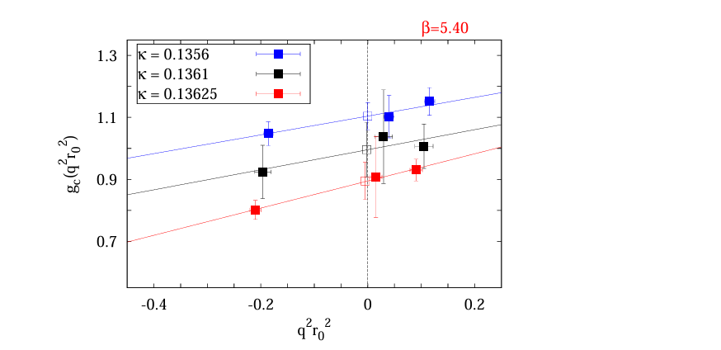
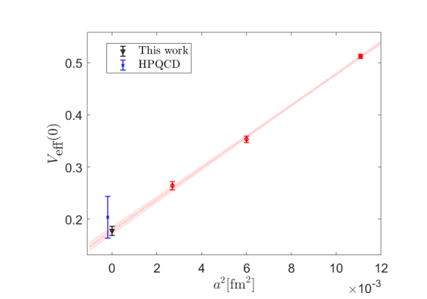
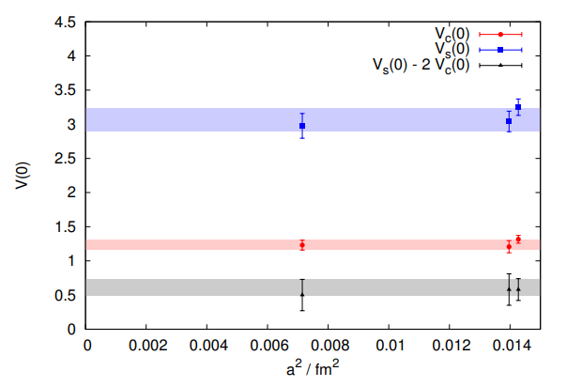
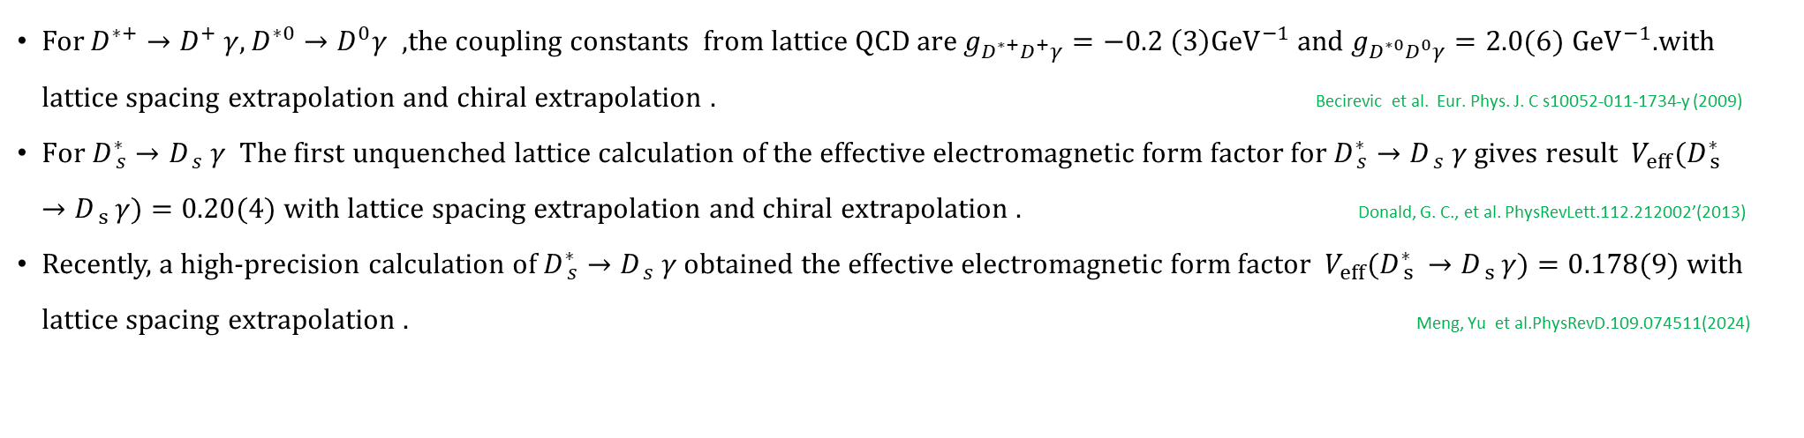
Background-Lat
For $D_{ }^{∗+}→{D_{ }^{+}}_{ }^{ }γ,D_{ }^{∗0}→D_{ }^{0}γ$ ,the coupling constants from lattice QCD are $g_{D^{∗+}D^{+}γ}=−0.2 \left(3\right){GeV}^{−1}$ and $g_{D^{∗0}D^{0}γ}=2.0(6)$ ${GeV}^{−1}$.with lattice spacing extrapolation and chiral extrapolation . Becirevic et al. Eur. Phys. J. C s10052-011-1734-y (2009)
$\text{For} D_{ s}^{∗}→{D_{ s}^{ }}_{ }^{ }γ The first unquenched lattice calculation of the effective electromagnetic form factor for D_{ s}^{∗}→{D_{ s}^{ }}_{ }^{ }γ gives result V_{eff}(D_{ s }^{∗}→D_{ s }^{ }γ)=\text{0.20(4)}$ with lattice spacing extrapolation and chiral extrapolation . Donald, G. C., et al. PhysRevLett.112.212002’(2013)
Recently, a high-precision calculation of $D_{ s}^{∗}→{D_{ s}^{ }}_{ }^{ }γ$obtained $the effective electromagnetic form factor{ V}_{eff}(D_{ s }^{∗}→D_{ s }^{ }γ)=0.178($9) with lattice spacing extrapolation . Meng, Yu et al.PhysRevD.109.074511(2024)
4

Slide 6
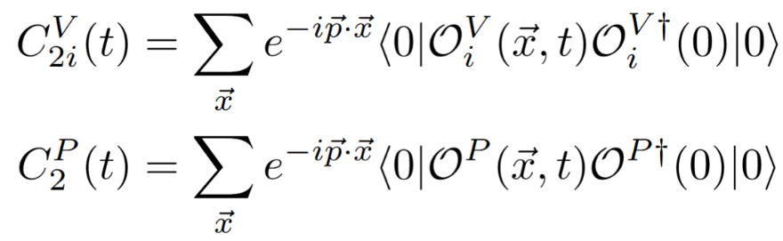
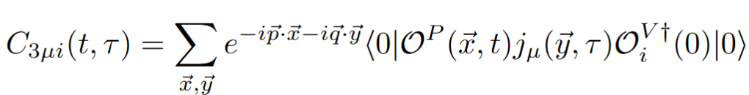
Formula
The radiative transition matrix elements of process $V →Pγ$can be extracted from Euclidean correlation functions. The two-point functions with momentum $\vec{p}$ for vector mesons with Lorentz index $i$and pseudoscalar mesons are
where = $O_{i}^{V}=\overline{l}γ_{i}c$ and $O_{ }^{P}=\overline{l}γ_{5}c$with $l$ denoting the light quarks (u,d,s) and c denoting charm quark. The electromagnetic current operator $j_{u}=e_{l}\overline{l}γ_{u}l+e_{c}\overline{c}γ_{u}c$ is inserted at time $τ$in the three-point functions can be written as
5

Slide 7
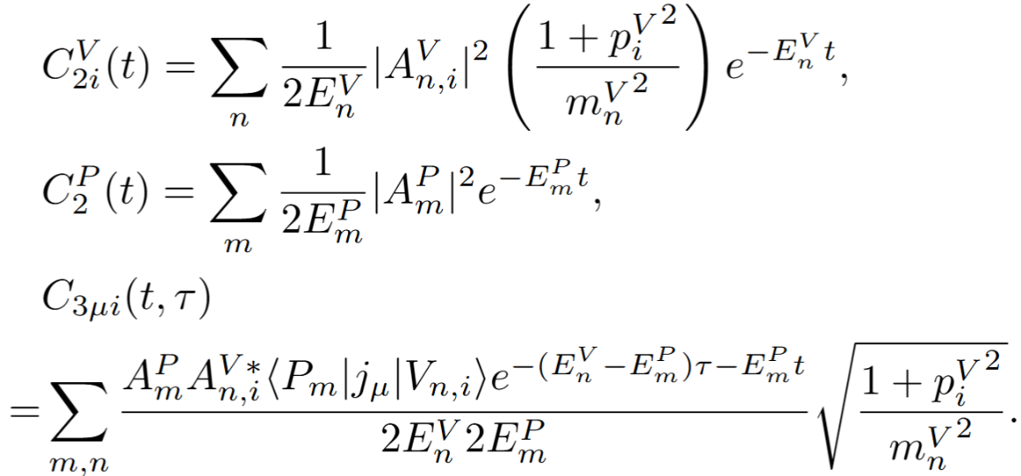
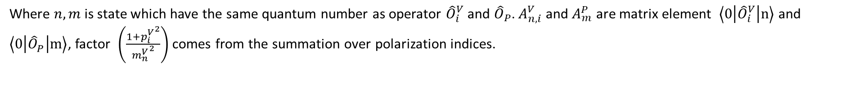
Formula
Then we insert complete set in correlation function and time and space translation $O_{ }(\vec{x},t)={e^{\hat{H}t}e^{−i\hat{p}\vec{x}}O}_{ }(0,0)e^{−\hat{H}t}$ $e^{i\hat{p}\vec{x}}$ , get
Where $n,m$ is state which have the same quantum number as operator ${\hat{O}}_{i}^{V}$ and ${\hat{O}}_{P}$. $A_{n,i}^{V}$ and $A_{m}^{P}$ are matrix element $\left\langle 0\left|{\hat{O}}_{i}^{V}\right|n\right\rangle$ and $\left\langle 0\left|{\hat{O}}_{P}^{ }\right|m\right\rangle$, factor $\left(\frac{1+{p_{i}^{V}}^{2}}{{m_{n}^{V}}^{2}}\right)$ comes from the summation over polarization indices.
6

Slide 8
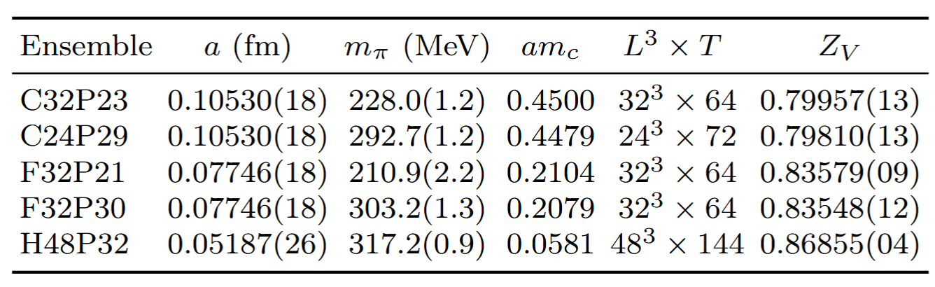
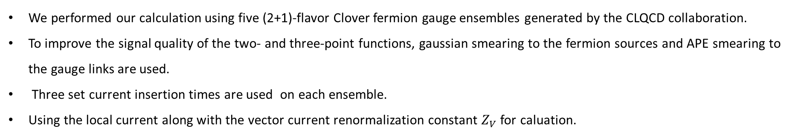
Numerical setup
Z.-C. Hu et al. (CLQCD), Phys. Rev. D 109, 054507(2024]. Meng, Yu et al.PhysRevD.109.074511(2024)
We performed our calculation using five (2+1)-flavor Clover fermion gauge ensembles generated by the CLQCD collaboration.
To improve the signal quality of the two- and three-point functions, gaussian smearing to the fermion sources and APE smearing to the gauge links are used.
Three set current insertion times are used on each ensemble.
Using the local current along with the vector current renormalization constant $Z_{V}$ for caluation.
7

Slide 9
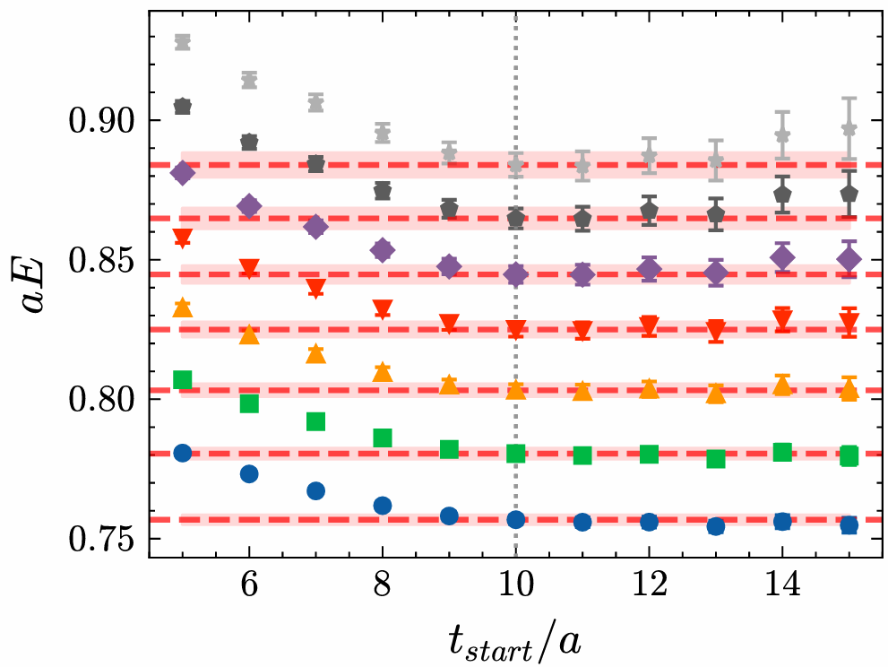
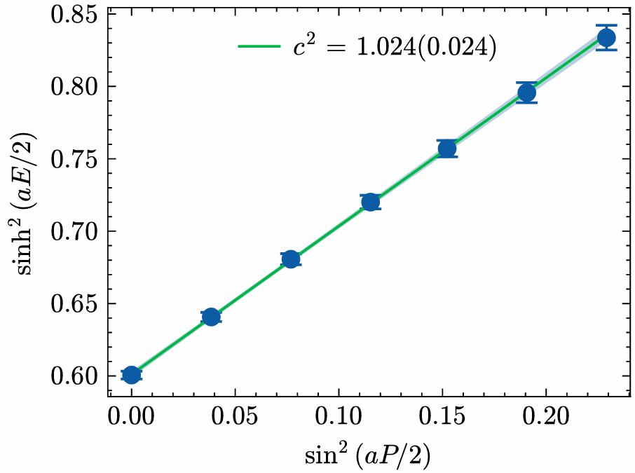
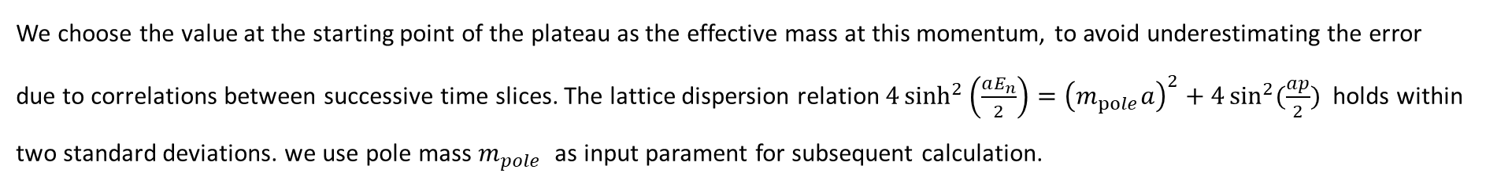
Results
Results for $D^{ }$meson on ensemble F32P21
We choose the value at the starting point of the plateau as the effective mass at this momentum, to avoid underestimating the error due to correlations between successive time slices. The lattice dispersion relation $4\sinh^{2}\left(\frac{aE_{n}}{2}\right)={\left(m_{pole}a\right)}^{2}+4\sin^{2}{(\frac{ap}{2}})$ holds within two standard deviations. we use pole mass $m_{pole}$ as input parament for subsequent calculation.
8

Slide 10
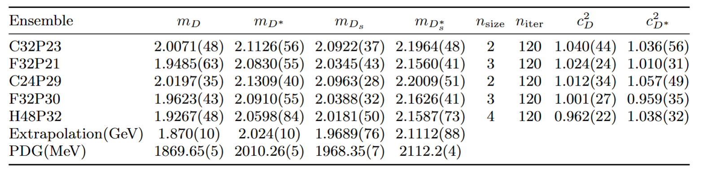
Results
Fitting results on different ensembles
$m\left(a^{2},m_{π}^{2}\right)=m\left(0,m_{π,phy}^{2}\right)+{Aa}^{2}+B(m_{π}^{2}−m_{π,phy}^{2})$
The table lists the meson masses and smearing parameters for each ensemble. Here, $n_{\text{size}}$ denotes the smearing radius in lattice units, while $n_{iter}$ is the number of smearing iterations. The last two columns show the $c^{2}$ from fitting for D and $D^{∗}$ mesons.
9

Slide 11
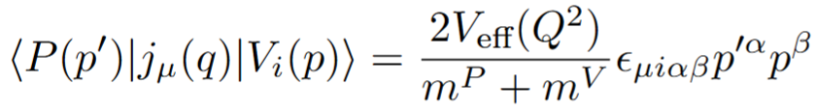
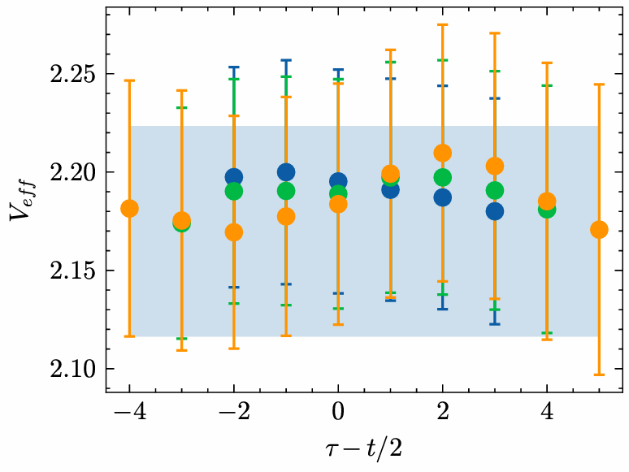
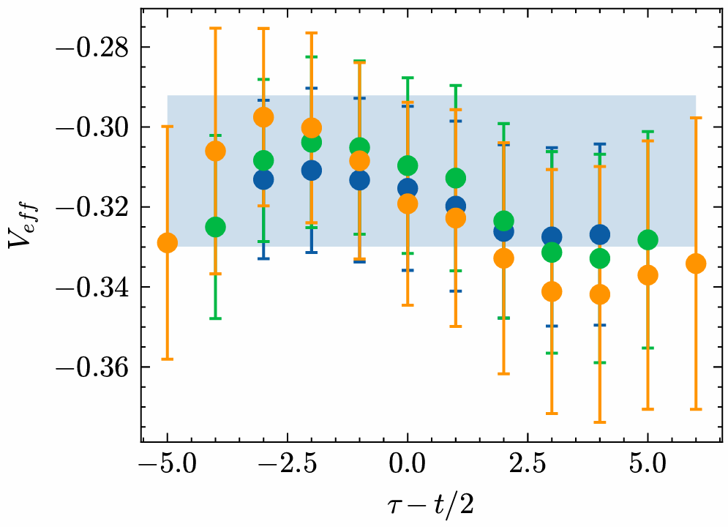
Results
We use joint fitting method to extract the matrix elements $\left\langle {P(p_{ }^{′})}^{ }\left|j_{u}(q)\right|V_{i}(p_{ })\right\rangle$, they are multiplied by the corresponding kinematic factors to obtain the effective form factor $V_{eff}\left(Q^{2}\right)$ and coupling $g=\frac{2}{m_{p}+m_{V}}$ $V_{eff}\left(0\right)$ .
Results for $D^{∗0}$and $D^{∗+}$ at $Q^{2}=0.33$GeV on ensemble F32P21
The blue band is fitting value. it is consistent with our data.
10

Slide 12
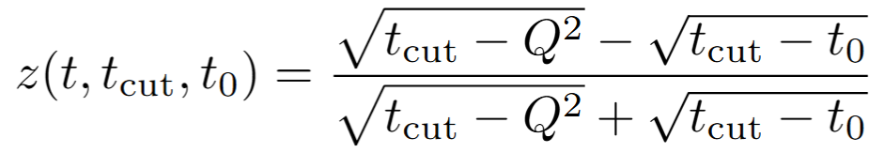
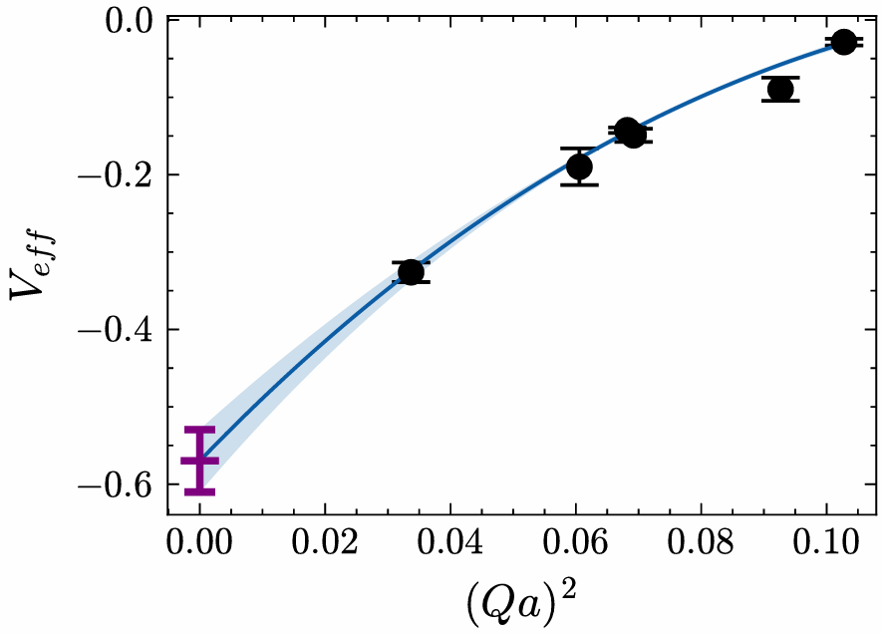
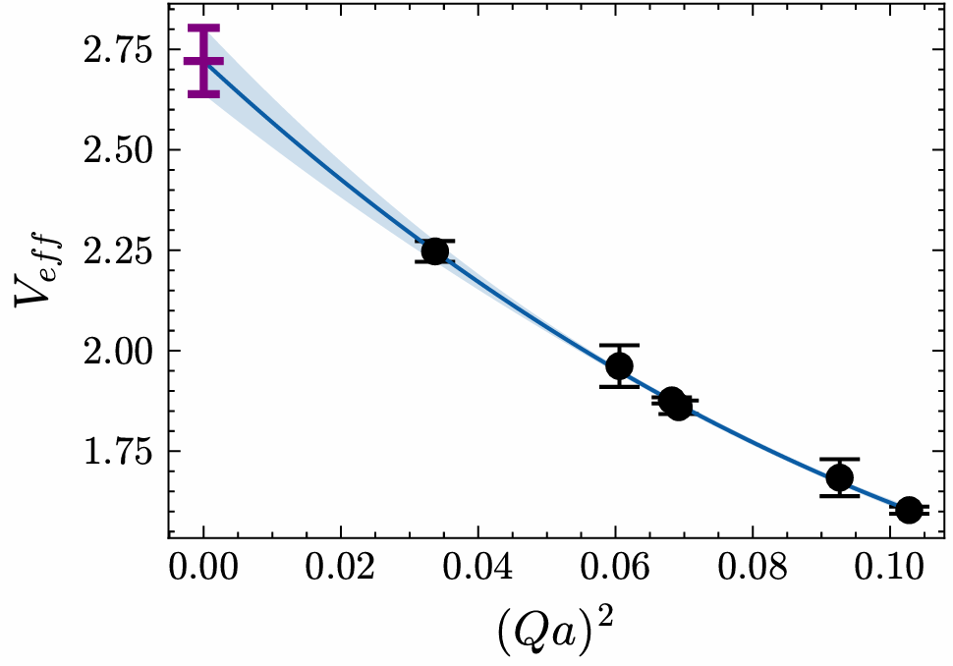
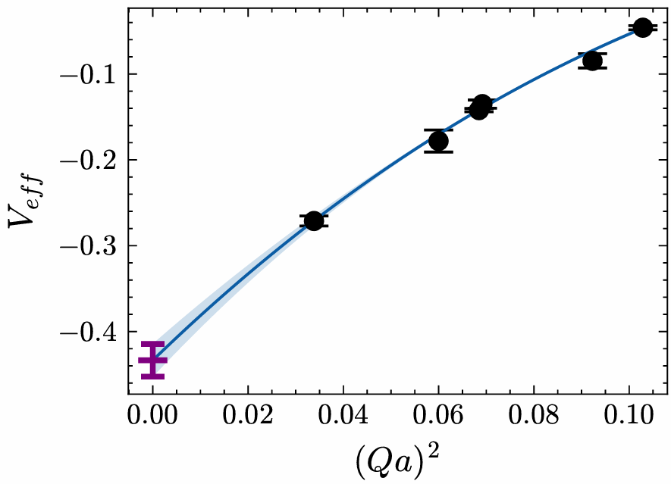
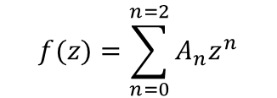
Results
Then extrapolated to Q²=0 using the model-independent z-expansion method.
$$f(z)=\sum_{n=0}^{n=2}{A_{n}z^{n}}$$
Where $t_{cut}={\left(m_{D}+m_{π}\right)}^{2},t_{0}=t_{cut}(1−\sqrt{1+\frac{Q_{max}^{2}}{t_{cut}}})$
Results for $D^{∗+}$,$D^{∗0}$ and $D_{s}^{∗}$at ensemble F32P21
11

Slide 13
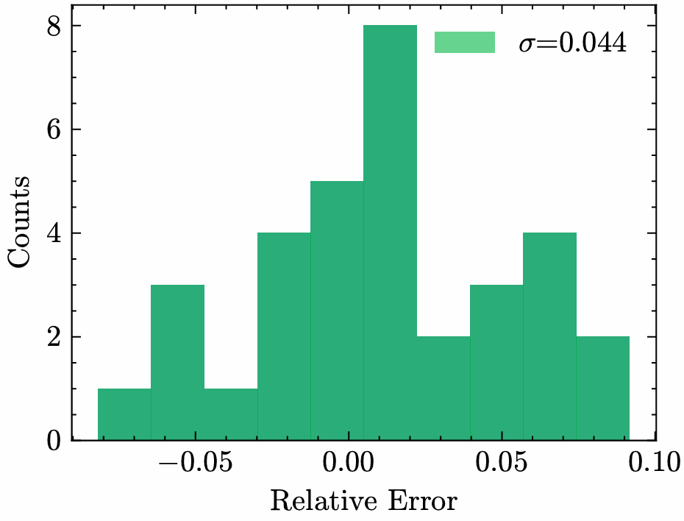
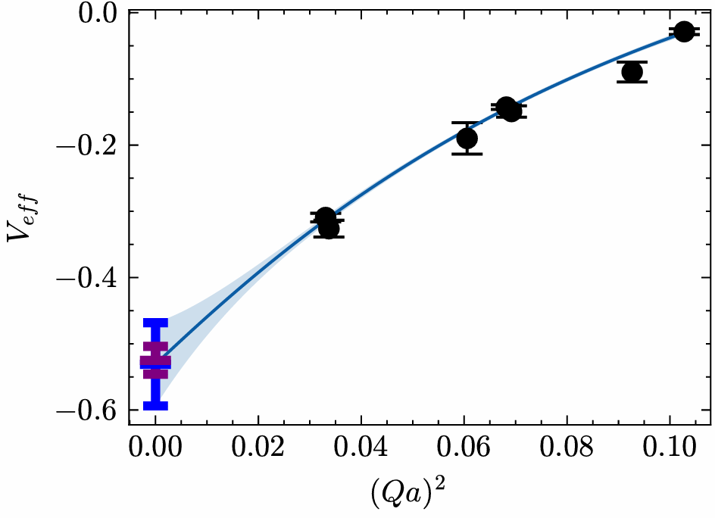
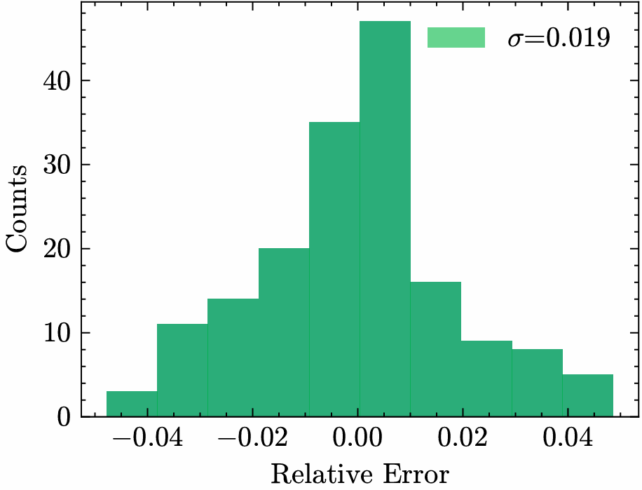
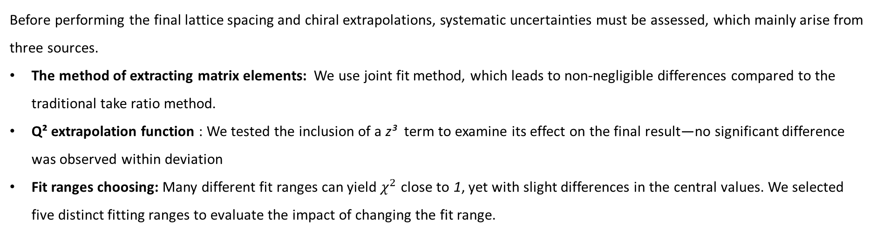
Results
Before performing the final lattice spacing and chiral extrapolations, systematic uncertainties must be assessed, which mainly arise from three sources.
The method of extracting matrix elements: We use joint fit method, which leads to non-negligible differences compared to the traditional take ratio method.
Q² extrapolation function : We tested the inclusion of a z³ term to examine its effect on the final result—no significant difference was observed within deviation
Fit ranges choosing: Many different fit ranges can yield $χ^{2}$ close to 1, yet with slight differences in the central values. We selected five distinct fitting ranges to evaluate the impact of changing the fit range.
12

Slide 14
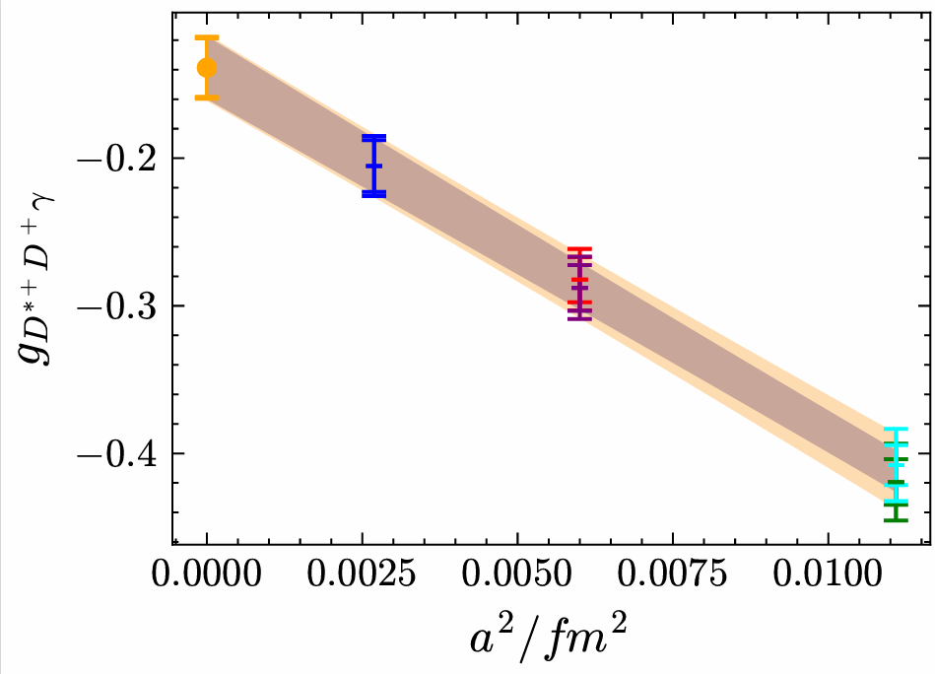
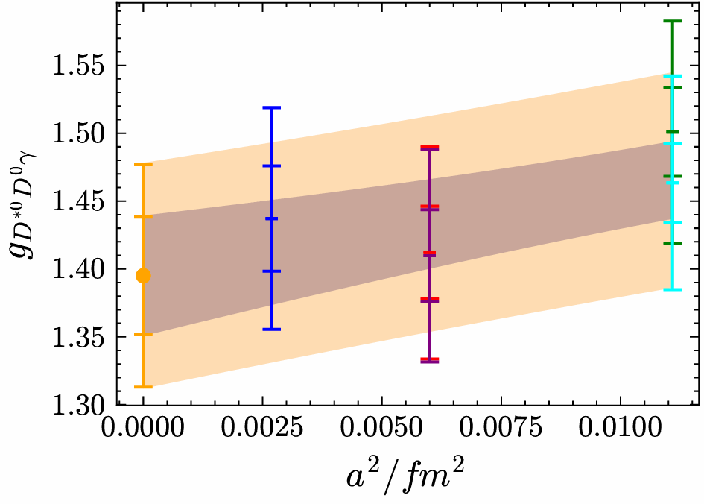
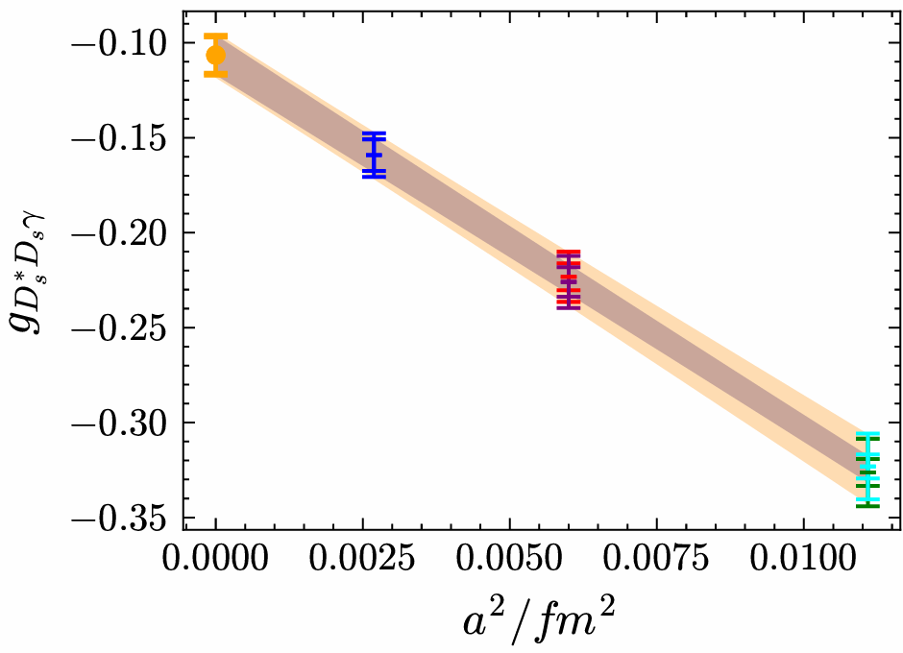
Results
The final physical result was obtained after performing calculations on a total of five ensembles with different pion masses and lattice spacings, followed by corresponding extrapolations.
$V_{eff}\left(a^{2},m_{π}^{2}\right)=V_{eff}\left(0,m_{π,phy}^{2}\right)+{Aa}^{2}+B(m_{π}^{2}−m_{π,phy}^{2})$
To compare with previous lattice results, we convert our results into the form of the coupling constant g.
13

Slide 15
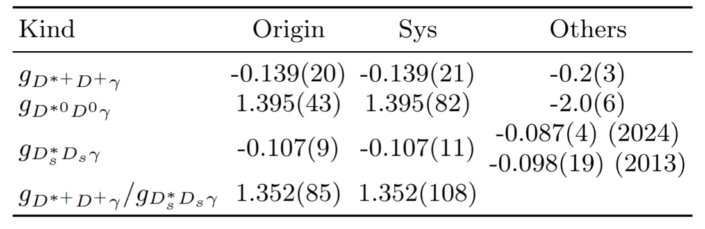
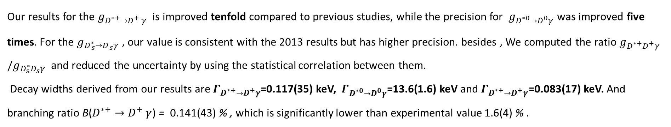
Results
Finally get results
Our results for the $g_{D_{ }^{∗+}→{D_{ }^{+}}_{ }^{ }γ}$ is improved tenfold compared to previous studies, while the precision for $g_{D_{ }^{∗0}→D_{ }^{0}γ}$ was improved five times. For the $g_{D_{ s}^{∗}→D_{ s}^{ }γ}$, our value is consistent with the 2013 results but has higher precision. besides , We computed the ratio $g_{D^{∗+}D^{+}γ}/g_{D_{s}^{∗}D_{s}^{ }γ}$ and reduced the uncertainty by using the statistical correlation between them.
Decay widths derived from our results are $Γ_{D^{∗+}→D^{+}γ}$=0.117(35) keV, $Γ_{D^{∗0}→D^{0}γ}$=13.6(1.6) keV and $Γ_{D^{∗+}→D^{+}γ}$=0.083(17) keV. And branching ratio B($D_{ }^{∗+}→{D_{ }^{+}}_{ }^{ }γ$) = 0.141(43) % , which is significantly lower than experimental value 1.6(4) % .
14

Slide 16

Radiative decay of $D_{ }^{∗+}→{D_{ }^{+}}_{ }^{ }γ,D_{ }^{∗0}→D_{ }^{0}γ$ and $D_{ s}^{∗}→D_{ s}^{ }γ$
Electromagnetic radius of${ D}_{ }^{∗+}, D_{ }^{+} ,D_{ s}^{∗}$and $D_{ s}^{ }$mesons

Slide 17
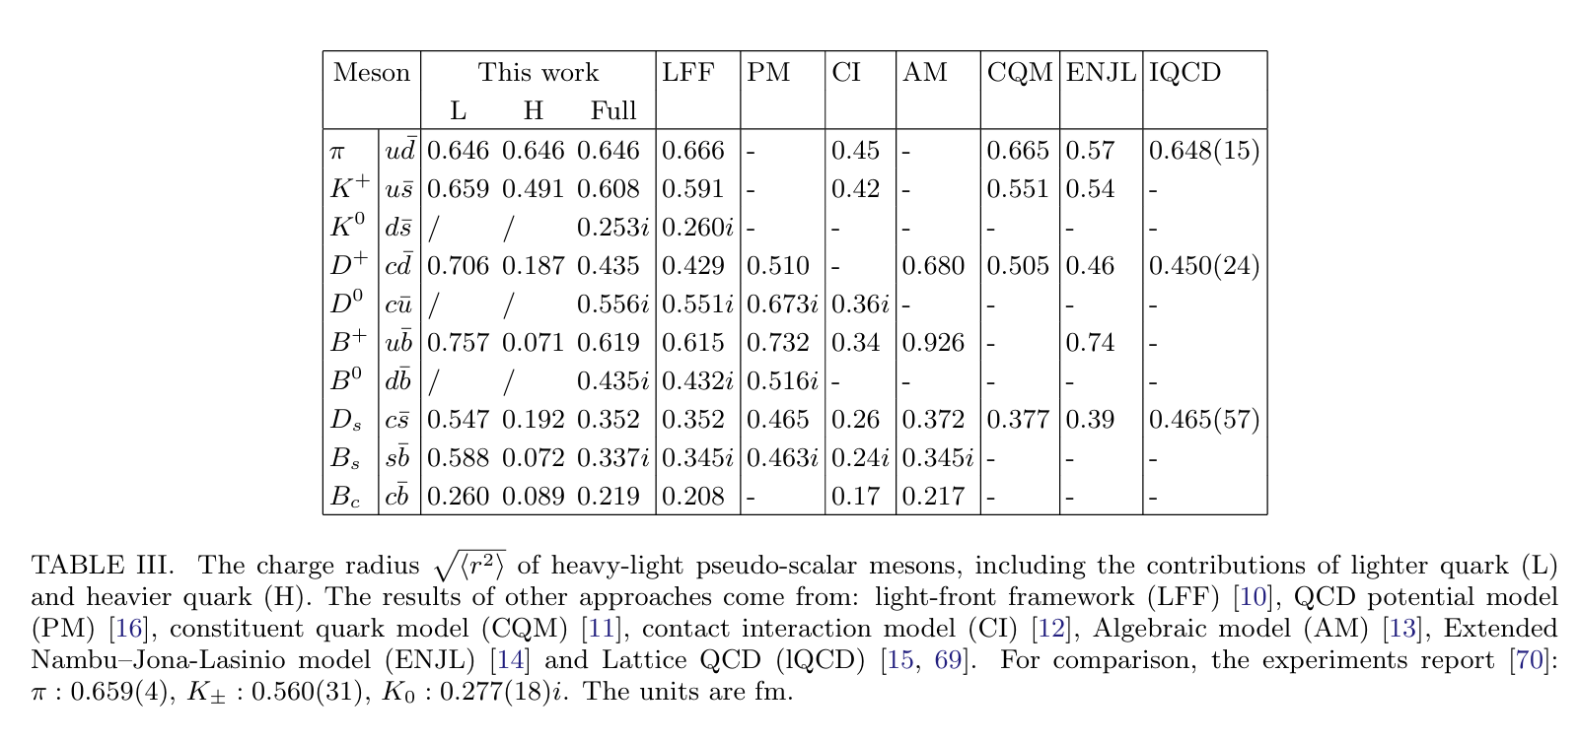
Background-Th, Ph
The study of charm-light mesons charge radius is challenging experimentally due to their large masses and short lifetimes. Various approaches, including phenomenological models and non-perturbative methods have been used to predict their charge radius.
Xu, Yin-Zhen , JHEP07(2024)118
12

Slide 18
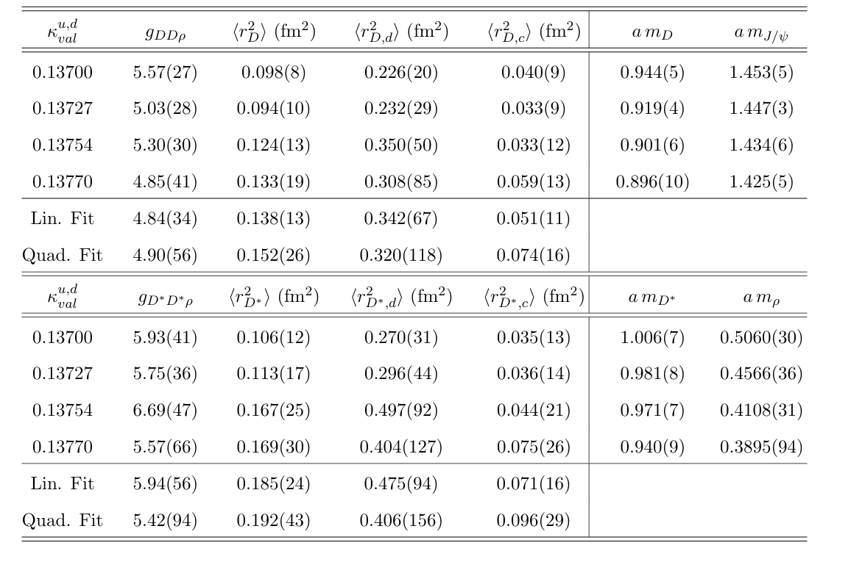
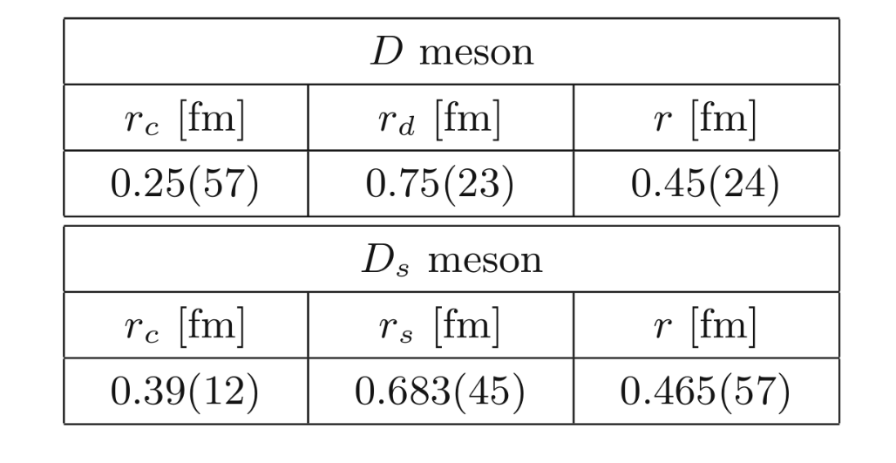
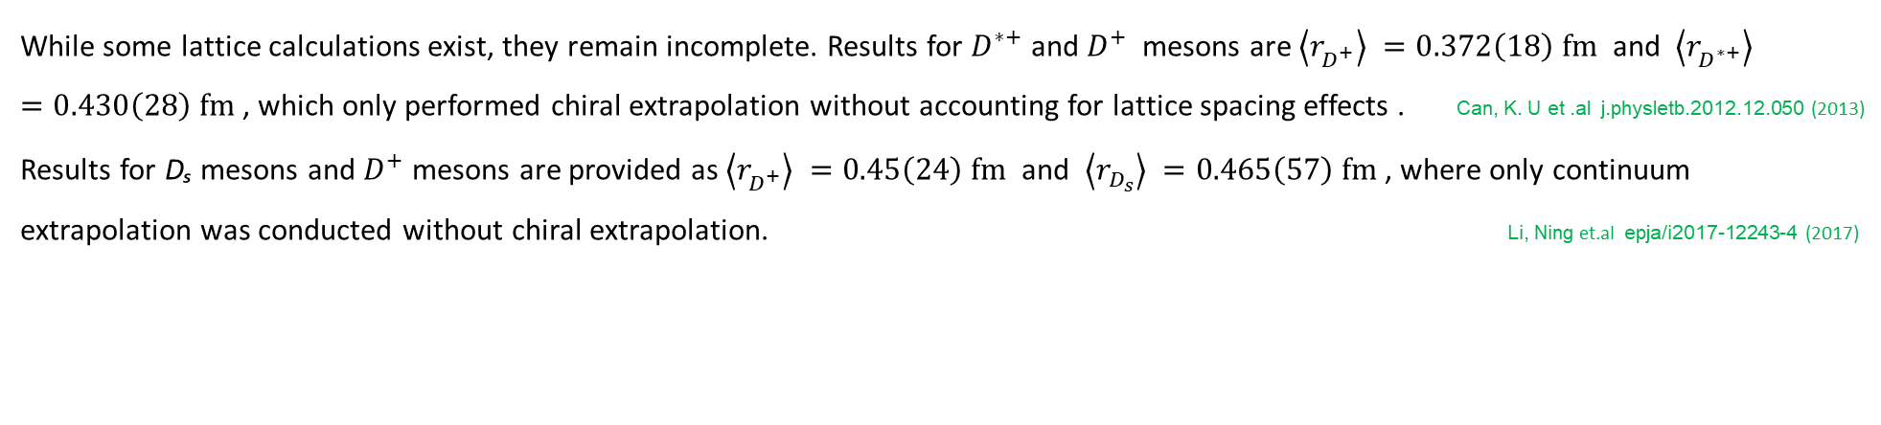
Background-lat
While some lattice calculations exist, they remain incomplete. Results for $D^{∗+}$ and ${D^{+}}^{ }$ mesons are $\left\langle r_{D^{+}}^{ }\right\rangle =0.372\left(18\right) fm^{ }$ and $\left\langle r_{D^{∗+}}^{ }\right\rangle =0.430\left(28\right) fm^{ }$, which only performed chiral extrapolation without accounting for lattice spacing effects . Can, K. U et .al j.physletb.2012.12.050 (2013)
Results for Dₛ mesons and $D^{+}$ mesons are provided as $\left\langle r_{D^{+}}^{ }\right\rangle =0.45\left(24\right) fm^{ }$ and $\left\langle r_{D_{s}^{ }}^{ }\right\rangle =0.465\left(57\right) fm^{ }$, where only continuum extrapolation was conducted without chiral extrapolation. Li, Ning et.al epja/i2017-12243-4 (2017)
13

Slide 19
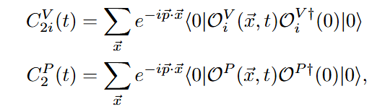
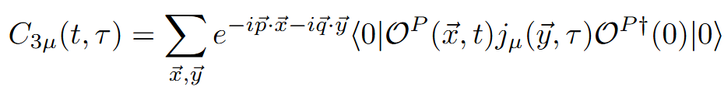
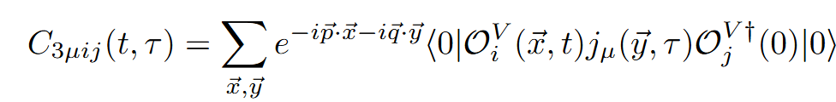
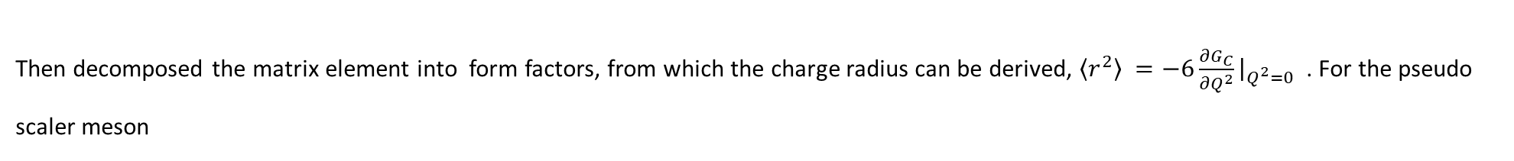
Formula
The core procedure still is extracting matrix elements from three-point and two-point functions
Then decomposed the matrix element into form factors, from which the charge radius can be derived, $\left\langle r^{2}\right\rangle =−6{{\frac{∂G_{C}}{∂Q^{2}}{\left.​\right|}_{Q^{2}=0}}_{ }}_{ }$. For the pseudo scaler meson
$$\left\langle P\left(p^{′}\right)\left|j_{u}\left(q\right)\right|P\left( p\right)\right\rangle ={\left(p+p^{′}\right)}_{u}{G_{C}}_{ }(Q^{2})$$
14
4

Slide 20
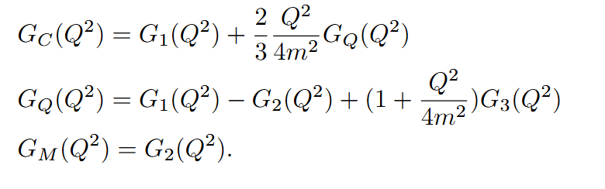
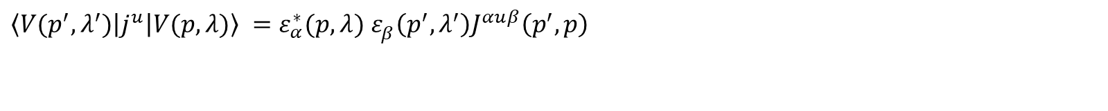
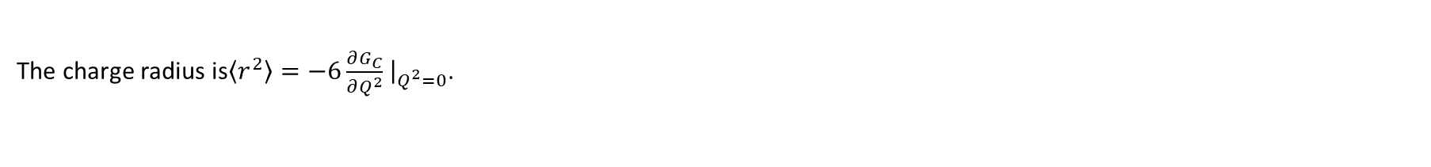
Formula
For the vector meson
$\left\langle V(p^{′},λ^{′})\left|j^{u}\right|V(p,λ)\right\rangle =ε_{α}^{∗}(p,λ)$ $ε_{β}^{ }\left(p^{′},λ^{′}\right)J^{αuβ}\left(p^{′},p\right)$
Arrange these form factor $G_{1}$, $G_{2}$ and $G_{3}$ in terms of electric, magnetic and quadrupole form factors as follows
The charge radius is$\left\langle r^{2}\right\rangle =−6\frac{∂G_{C}}{∂Q^{2}}$ ${\left.​\right|}_{Q^{2}=0}$.
15

Slide 21
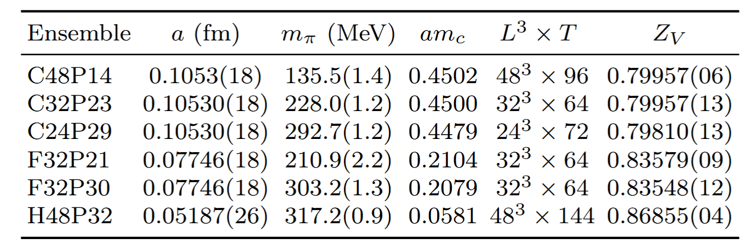
Numerical setup
Z.-C. Hu et al. (CLQCD), Phys. Rev. D 109, 054507(2024]. Meng, Yu et al.PhysRevD.109.074511(2024)
In the calculation of the form factors, we have added a set of ensemble C48P14 ,which pion mass is close to physical point.
7

Slide 22
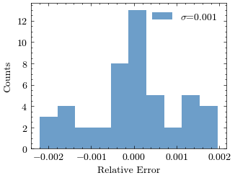
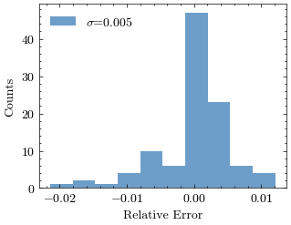
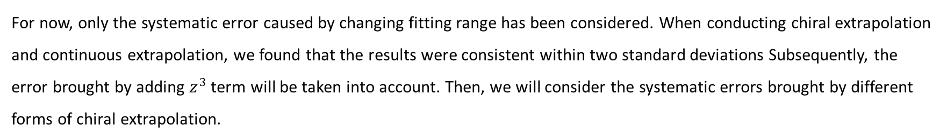
Preliminary results
For now, only the systematic error caused by changing fitting range has been considered. When conducting chiral extrapolation and continuous extrapolation, we found that the results were consistent within two standard deviations Subsequently, the error brought by adding $z^{3}$ term will be taken into account. Then, we will consider the systematic errors brought by different forms of chiral extrapolation.
Pseudoscalar
Vector
18

Slide 23


Preliminary results
We use same method extract matrix element at different $Q^{2}$ ,then use z-expansion fit our results .
We also estimated the systematic error from fit range and obtained preliminary results. For the pseudo scalar meson $D^{+}$ and $D_{s}$
z-expansion with $z^{2}$ term .
16

Slide 24






Preliminary results
Extrapolation with this form for $D^{+}$ and $D_{s}^{ }$
$V_{eff}\left(a^{2},m_{π}^{2}\right)=V_{eff}\left(0,m_{π,phy}^{2}\right)+{Aa}^{2}+B(m_{π}^{2}−m_{π,phy}^{2})$
After adding $m_{π}^{2}ln⁡(\frac{m_{π}^{2}}{Λ^{2}})$ term
$$D^{+}$$
$$D_{s}^{ }$$
$$D^{+}$$
$$D_{s}^{ }$$
17

Slide 25



Preliminary results
For vector mesons, we calculated $G_{3},G_{2}$ and $G_{1}$ respectively, combined them into $G_{Q}$, and then multiplied $G_{Q}$ by the factor $\frac{Q^{2}}{6m^{2}}$ and added it to $G_{1}$ to obtain $G_{C}$
$G_{3}$
$G_{2}$
$G_{1}$
18

Slide 26



Preliminary results
$$G_{C}$$
$\frac{Q^{2}}{6m^{2}}G_{Q}$
Results for $\frac{Q^{2}}{6m^{2}}G_{Q}$ and $G_{C}$.
19

Slide 27







Preliminary results
Extrapolation with this form for $D^{∗+}$ and
$V_{eff}\left(a^{2},m_{π}^{2}\right)=V_{eff}\left(0,m_{π,phy}^{2}\right)+{Aa}^{2}+B(m_{π}^{2}−m_{π,phy}^{2})$
After adding $m_{π}^{2}ln⁡(\frac{m_{π}^{2}}{Λ^{2}})$ term
$$D^{∗+}$$
$$D_{s}^{∗}$$
$$D^{∗+}$$
$$D_{s}^{∗}$$
17

Slide 28

Preliminary results
Taking the result in function form $V_{eff}\left(a^{2},m_{π}^{2}\right)=V_{eff}\left(0,m_{π,phy}^{2}\right)+{Aa}^{2}+B(m_{π}^{2}−m_{π,phy}^{2})$ as a reference .We get the Preliminary results $<r_{D^{+}}^{ }> =0.350\left(10\right) fm^{ }$ , $<r_{D_{s}}^{ }> =0.294\left(8\right) fm^{ },<r_{D^{∗+}}^{ }> =0.360\left(21\right) fm^{ } \text{and} <r_{D_{s}^{∗}}^{ }> =0.316\left(22\right) fm^{ }$.
For comparison,, $<r_{D^{+}}^{ }> =0.372\left(18\right) fm^{ }$ and $<r_{D^{∗+}}^{ }> =0.430\left(28\right) fm^{ }$(2012) , which included chiral extrapolation over 300–700 MeV.$<r_{D^{+}}^{ }> =0.45\left(24\right) fm^{ }$ and $<r_{D_{s}^{+}}^{ }> =0.465\left(57\right) fm^{ }$(2017) used lattice spacing extrapolation.
19

Slide 29

Summary and outlook
Summary
Our results for the $g_{D_{ }^{∗+}→{D_{ }^{+}}_{ }^{ }γ}$ is improved ten times compared to previous studies, while the precision for $g_{D_{ }^{∗0}→D_{ }^{0}γ}$ was improved five times. For the $g_{D_{ s}^{∗}→D_{ s}^{ }γ}$, our value is consistent with the 2013 results but has higher precision
We get preliminary results of charge radii of $D_{ }^{∗+}, D_{ }^{+} ,D_{ s}^{∗}$and $D_{ s}^{ }$with high precision ,besides we also estimate deviation brought by different chiral extrapolation form.
Outlook
Our data also allow for the calculation of the coupling $g_{D^{∗}Dπ}$, which can be used in the study of $T_{CC}\left(3875\right)$Moreover, across five configurations in the 300–210 MeV range, the requirement $m_{D^{∗}}−m_{D}<{m_{π}}_{ }$is satisfied.
We can also perform calculations related to $D_{s0}^{∗}{\left(2317\right)}^{+}$ , and after completing the theoretical preparations, we will consider computing coupling of $D_{s0}^{∗}{\left(2317\right)}^{+}→D_{s}^{∗+}γ$ and $D_{s0}^{∗}{\left(2317\right)}^{+}→D_{s}^{+}π^{0}$.
19

Slide 30
Thanks

