Slide 1




Emerging axion detection in magnetoelectric materials
July, 29@Nanjing_axion
孙斯纯 （Sichun Sun）
北京理工大学/Beijing Institute of Technology
Based on: 2505.08477,1911.04511, 2003.10527, 2206.13543, 2305.00877，2309.15069 ，2309.08407 , 2405.00490, 2406.13480
With Yu Gao (IHEP), Jinxing Zhang(BNU), Fei Gao (BIT), Jungsong Cang(IHEP), Junxi Duan(BIT), Chang-Yin Ji(BIT), Yugui Yao(BIT), Yiming Liu(BIT), Chu-Tian Gao(BIT), Jinneng Luo(BIT), Mingqiu Li (GUCAS &BIT), Yun-Long Zhang(NAOC), Qi-Shu Yan(GUCAS), Zhijie Zhao (GUCAS &DESY), Graham White (Southampton).

Slide 2
Outline
Blackholes and axions.
Detecting Axion by Measuring Magnetization
Detecting Axion by Magnetoelectric Coupling
Materials and Methods

Slide 3
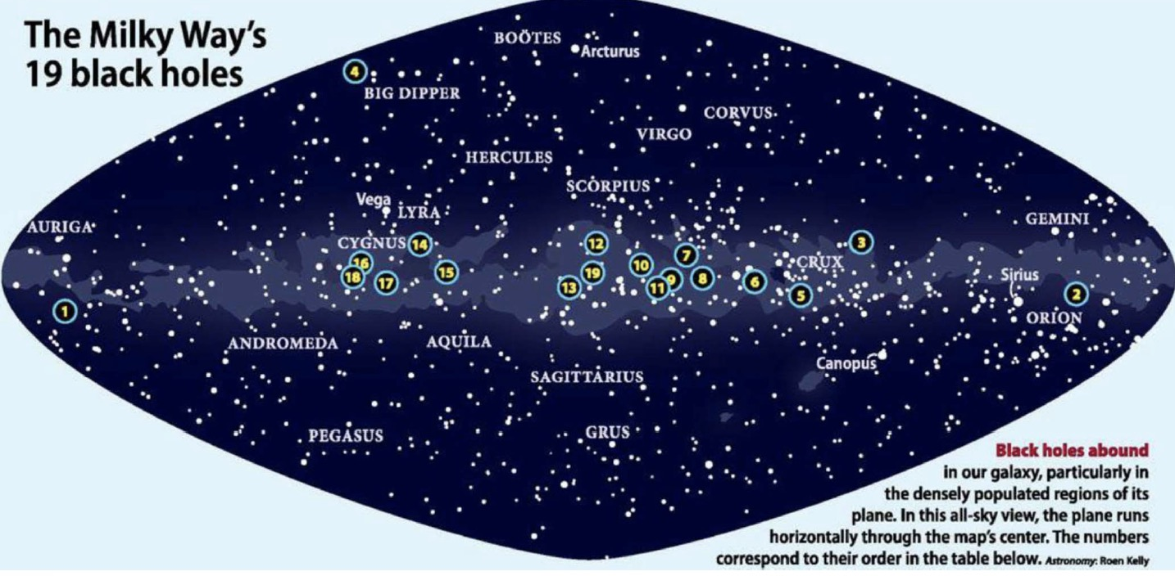

Slide 4
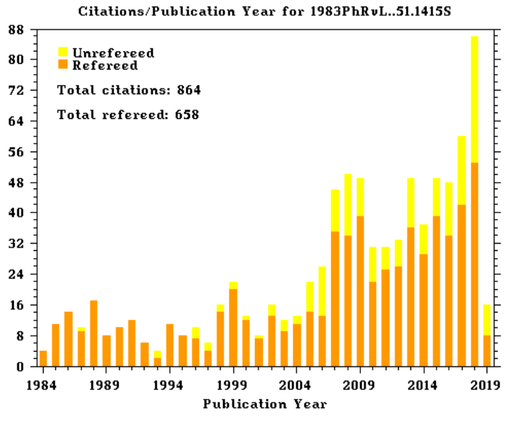
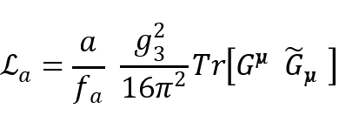





Axion: scientific importance
One very interesting dark matter candidate!
Solving strong CP problem (Fundamental symmetry)
One important particle in many beyond the
Standard Model extension
Large parameter space, tens of orders of magnitude:
  m a ~ 10⁻⁵ eV, f a ~ 10¹³ GeV
Various detections with interdisciplinary fields and modern technology
In condensed matter systems, axions appear as quasi-particles in certain materials,
Peccei-Quinn机制的
引用率走势（ADS）
Citations on the axion paper
R. Peccei
F. Wilczek
H.Quinn
S.Weinberg

Slide 5
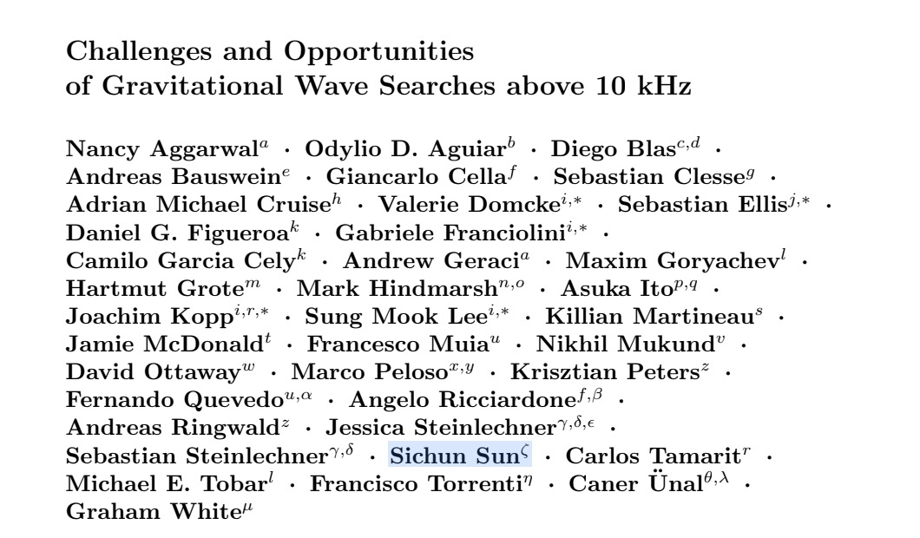
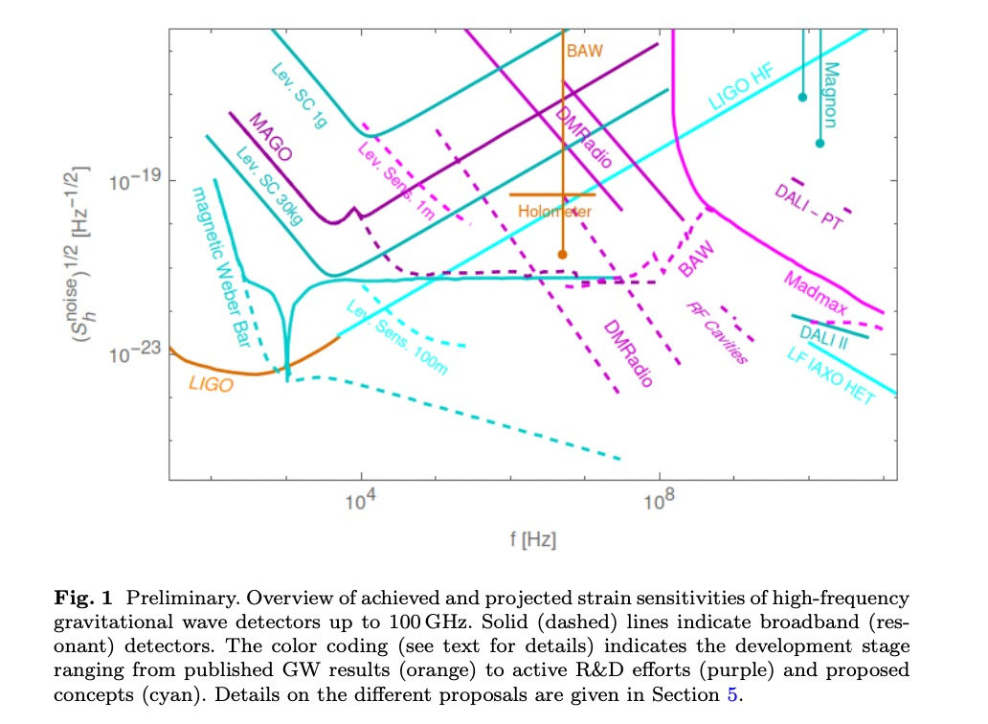
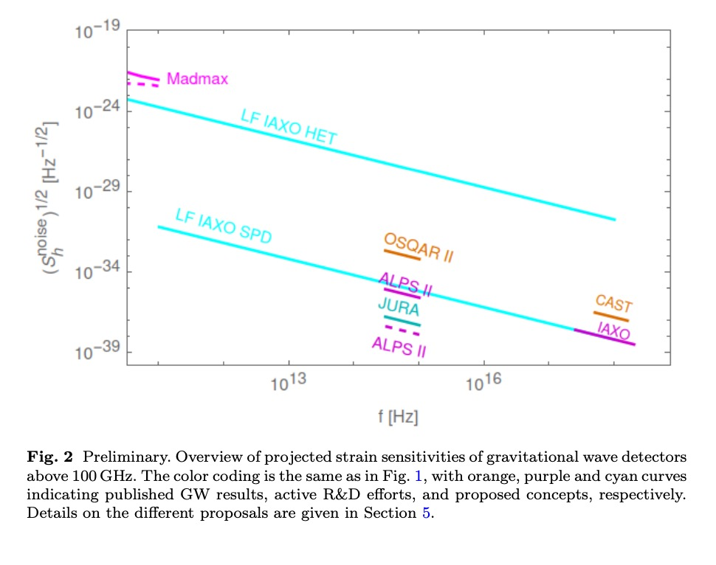
Challenges and opportunities of gravitational-wave searches at above 10kHz, updating 2025, LRR

Slide 6
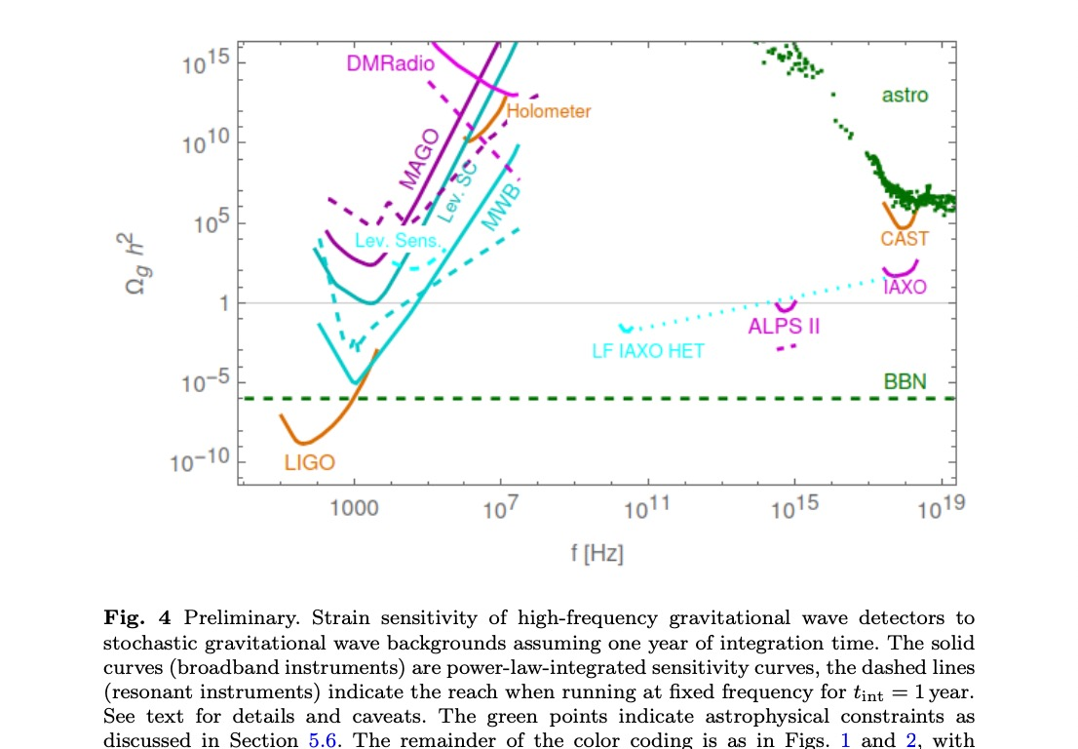
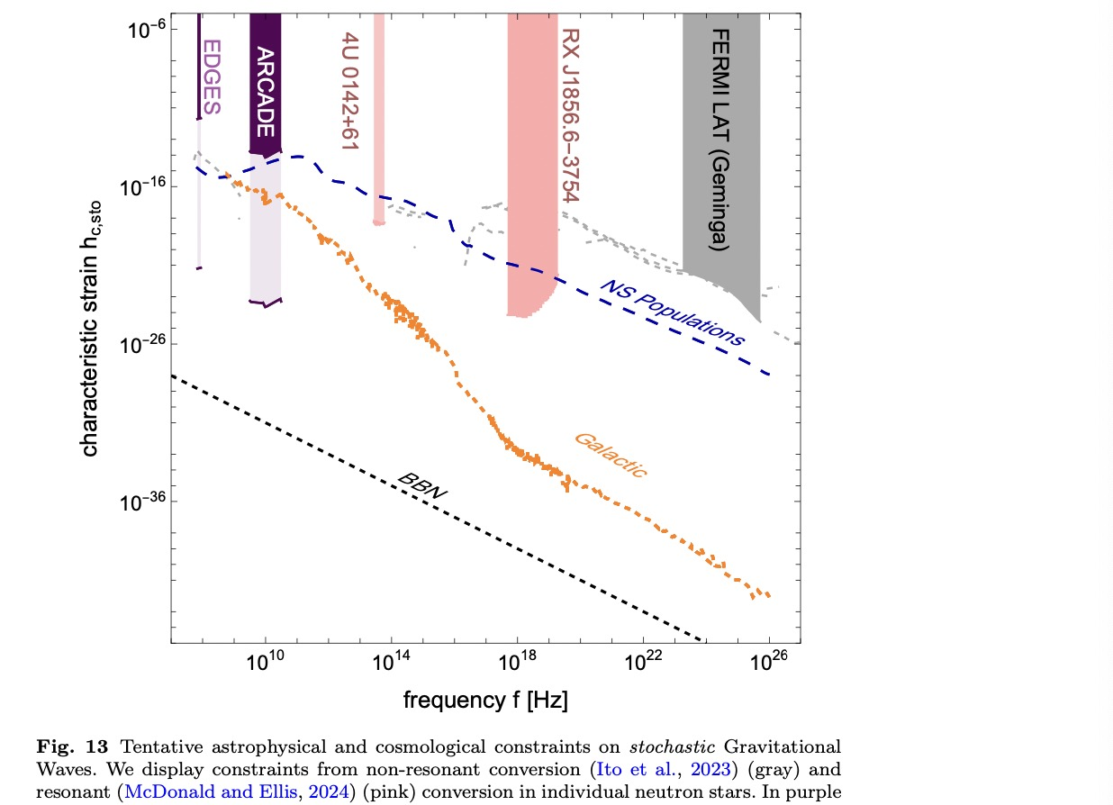

Slide 7
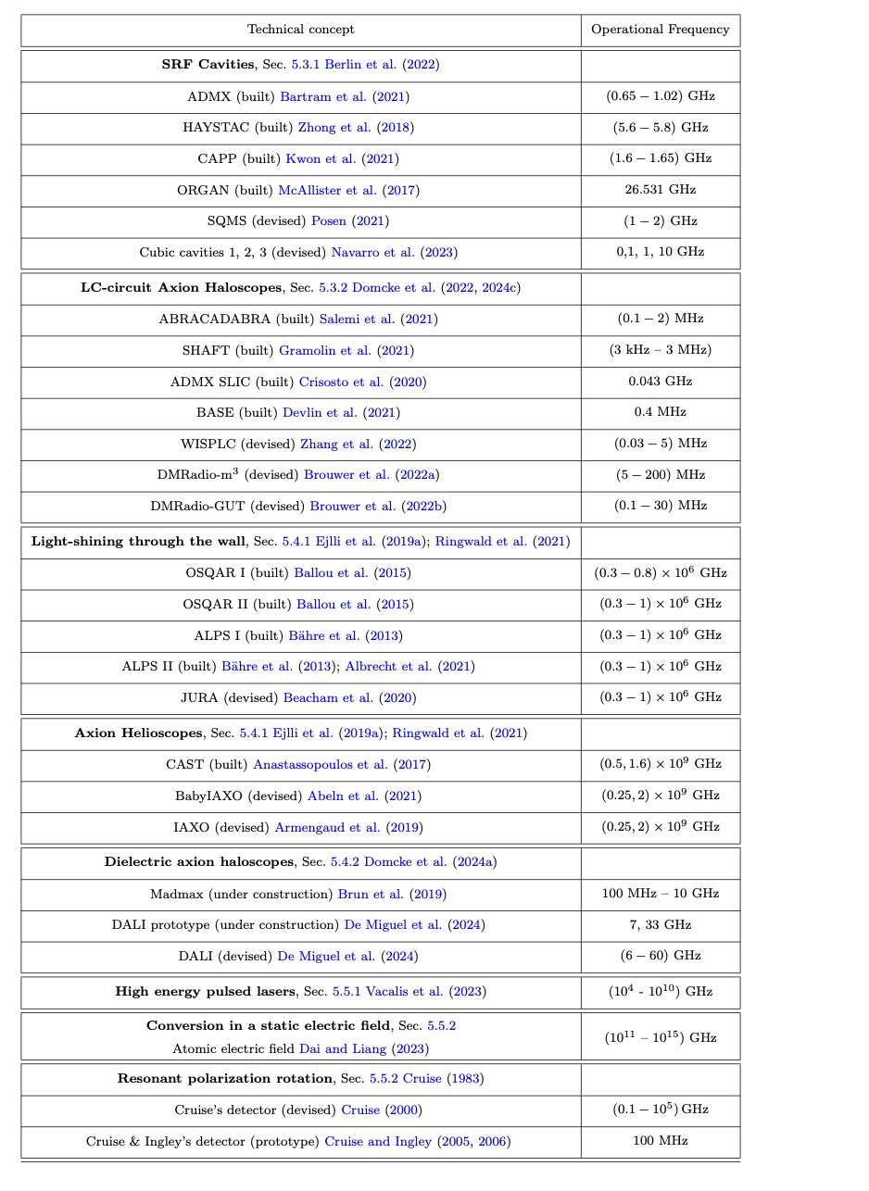
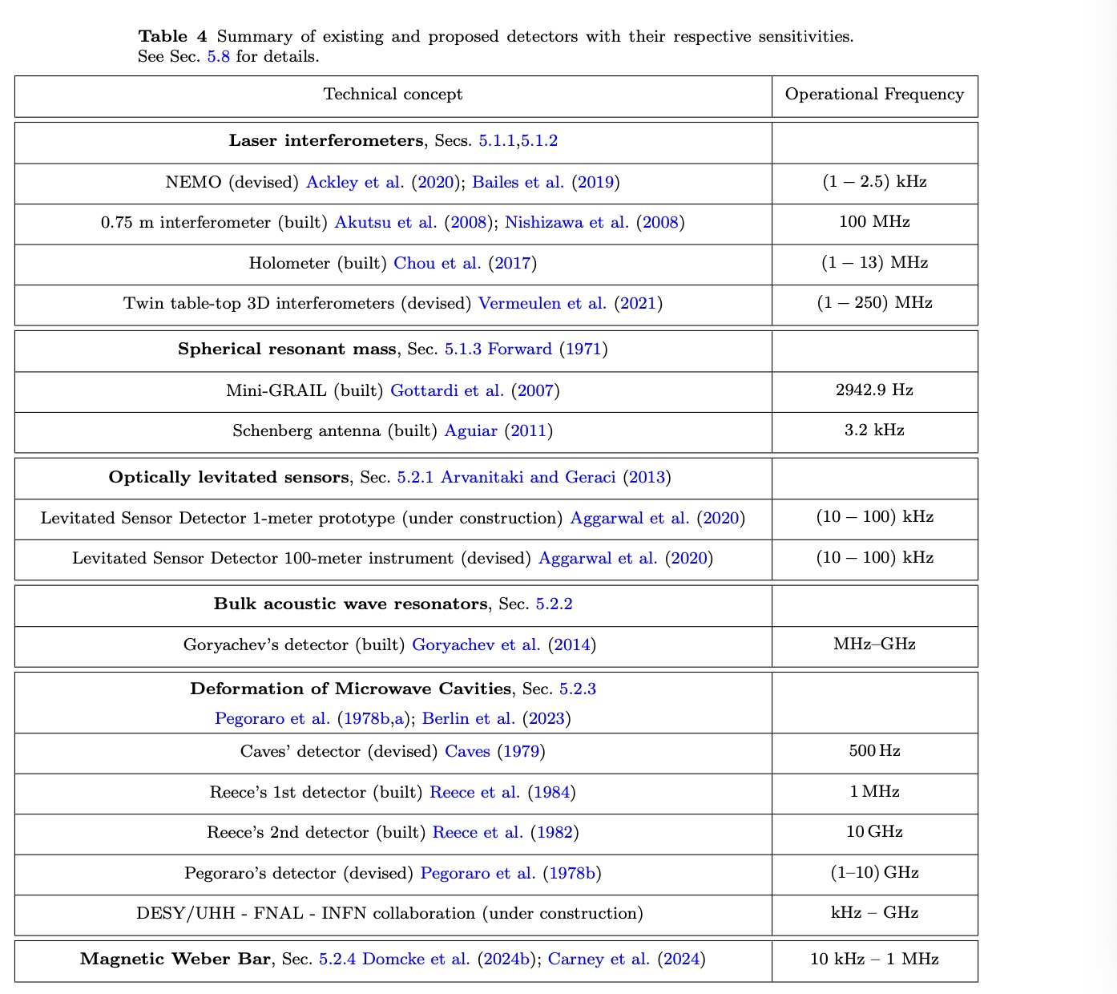

Slide 8
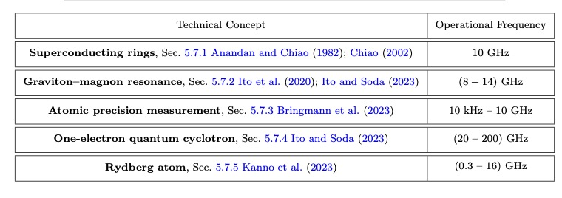

Slide 9
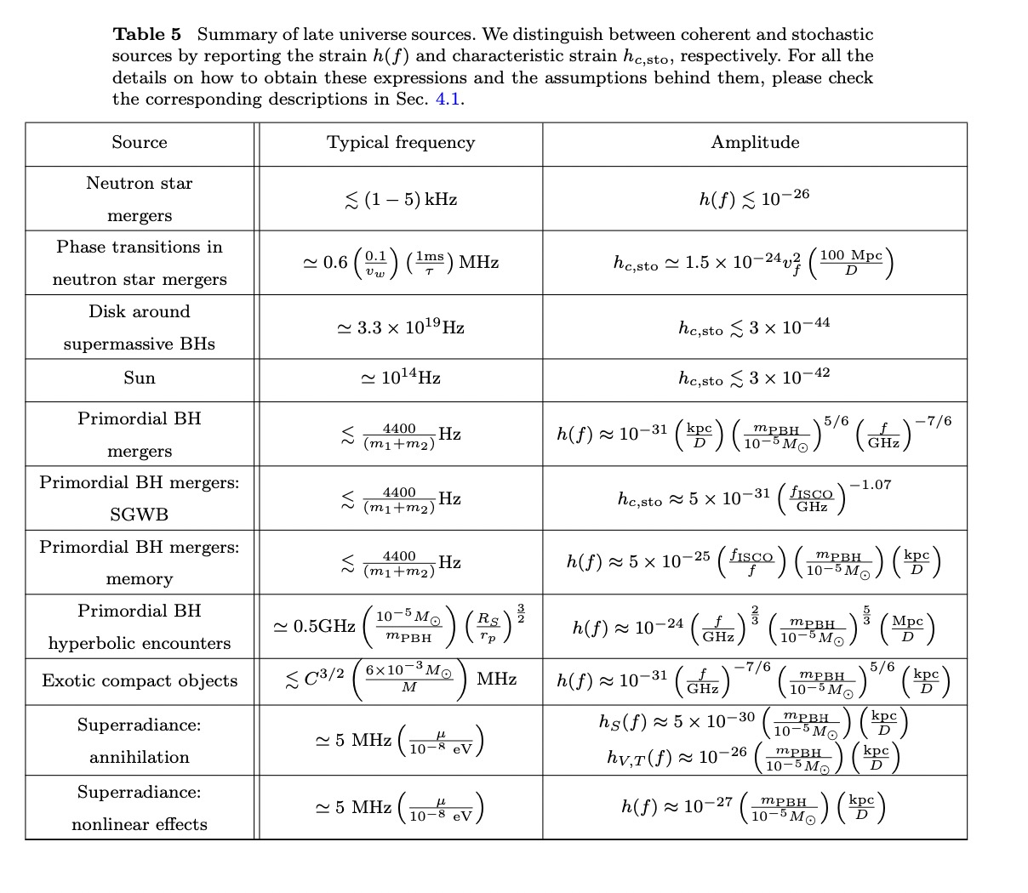
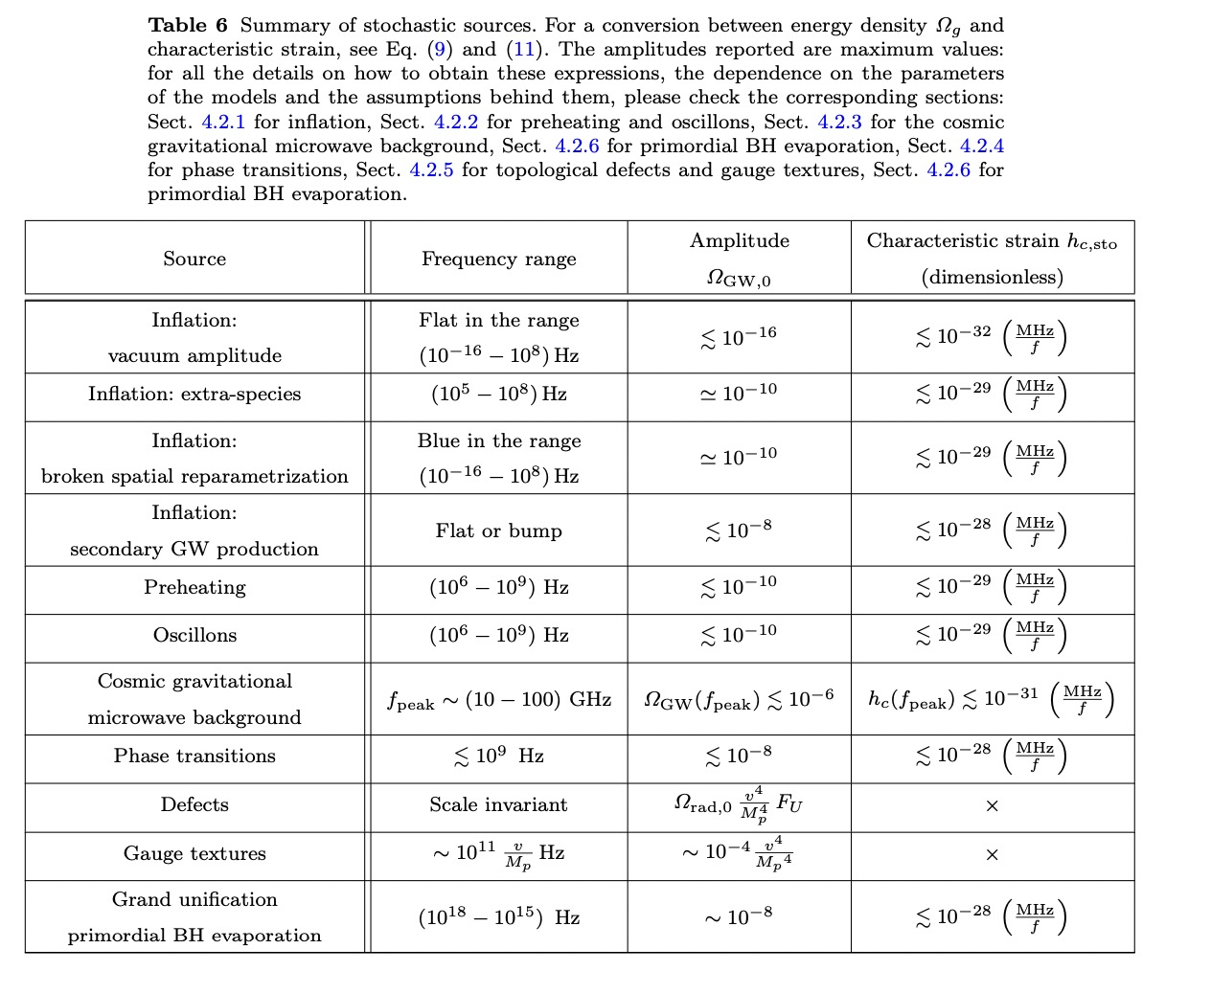

Slide 10
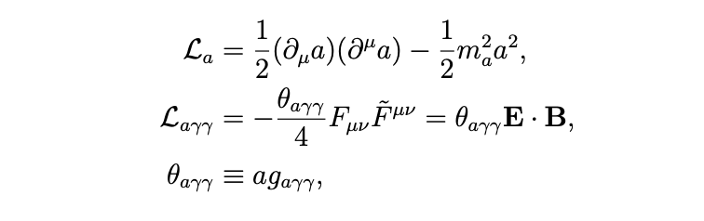

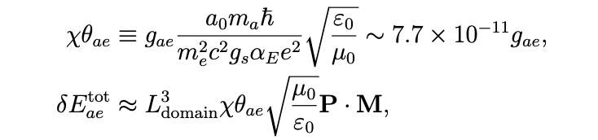
Two different assumtions:
Axions are either coupled to photons or electrons
in the materials:

Slide 11
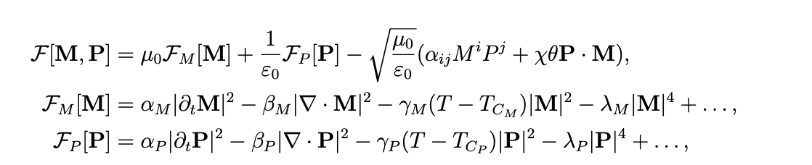
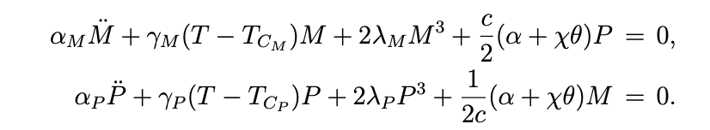
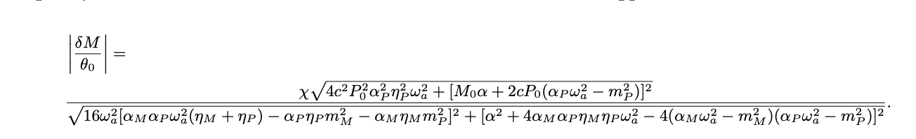

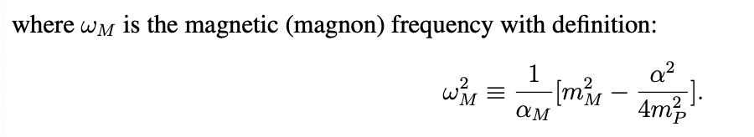
According to the Ginzburg-Landau theory

Slide 12
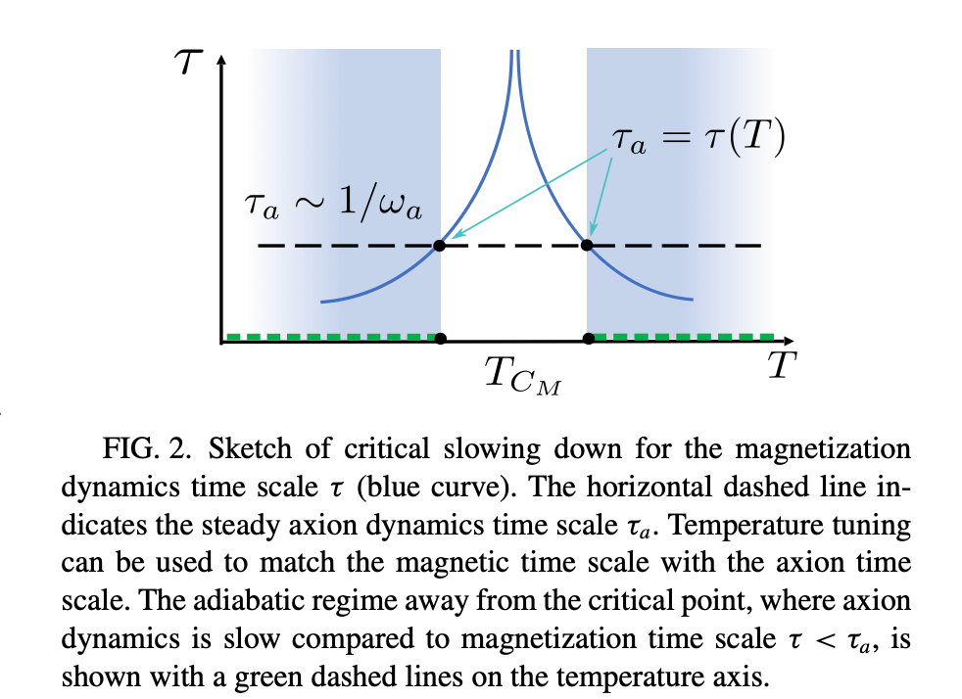
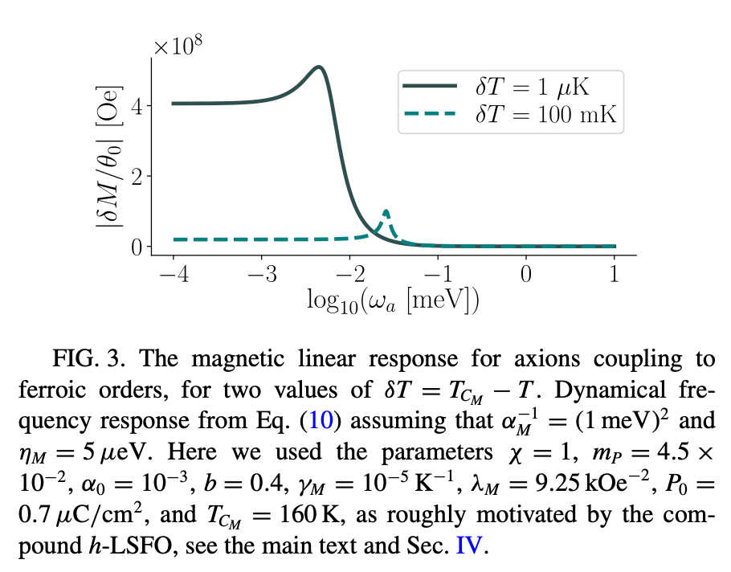

Slide 13
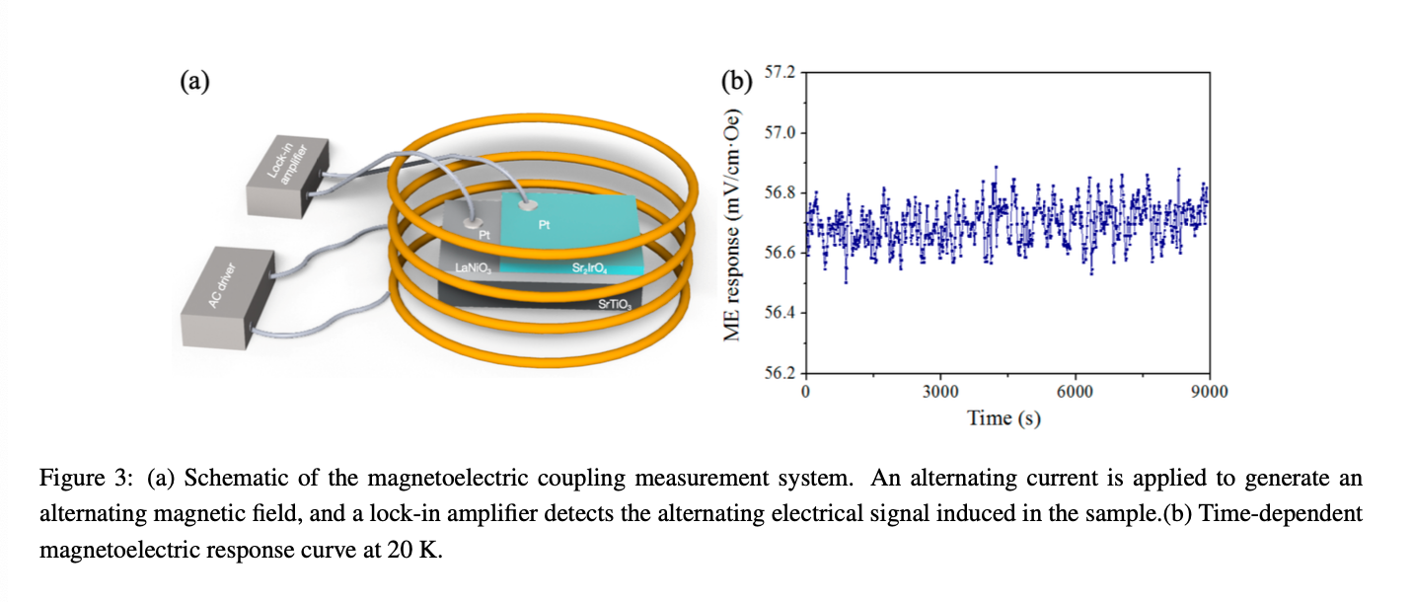

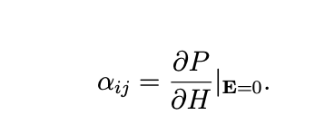
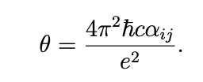
Detecting Axion by Magnetoelectric Coupling
reflection high-energy electron diffraction (RHEED)
Measuring the axion number directly:

Slide 14
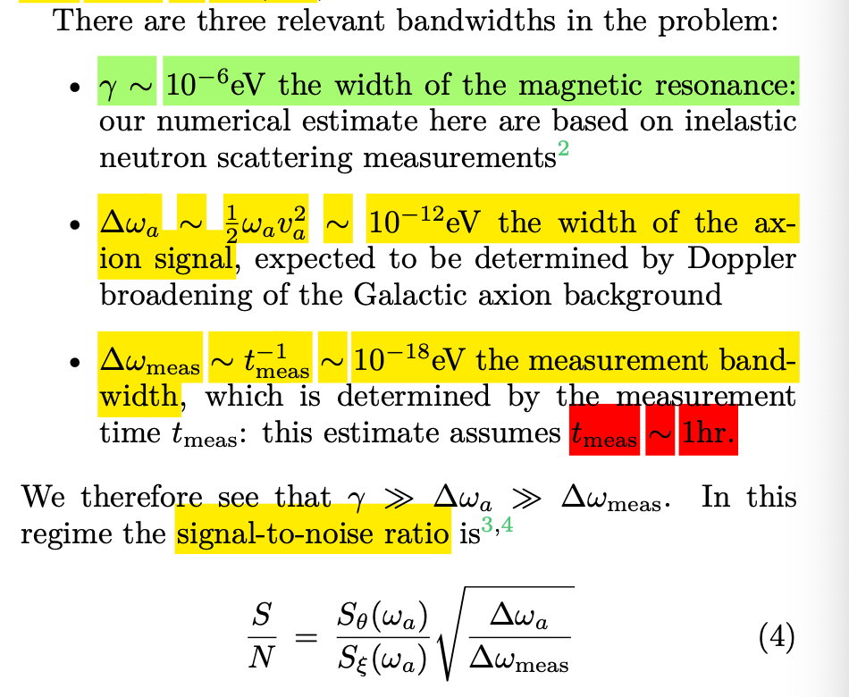
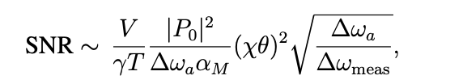

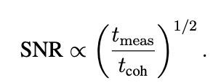
Future projection:
With the limits:
Several scales:

Slide 15
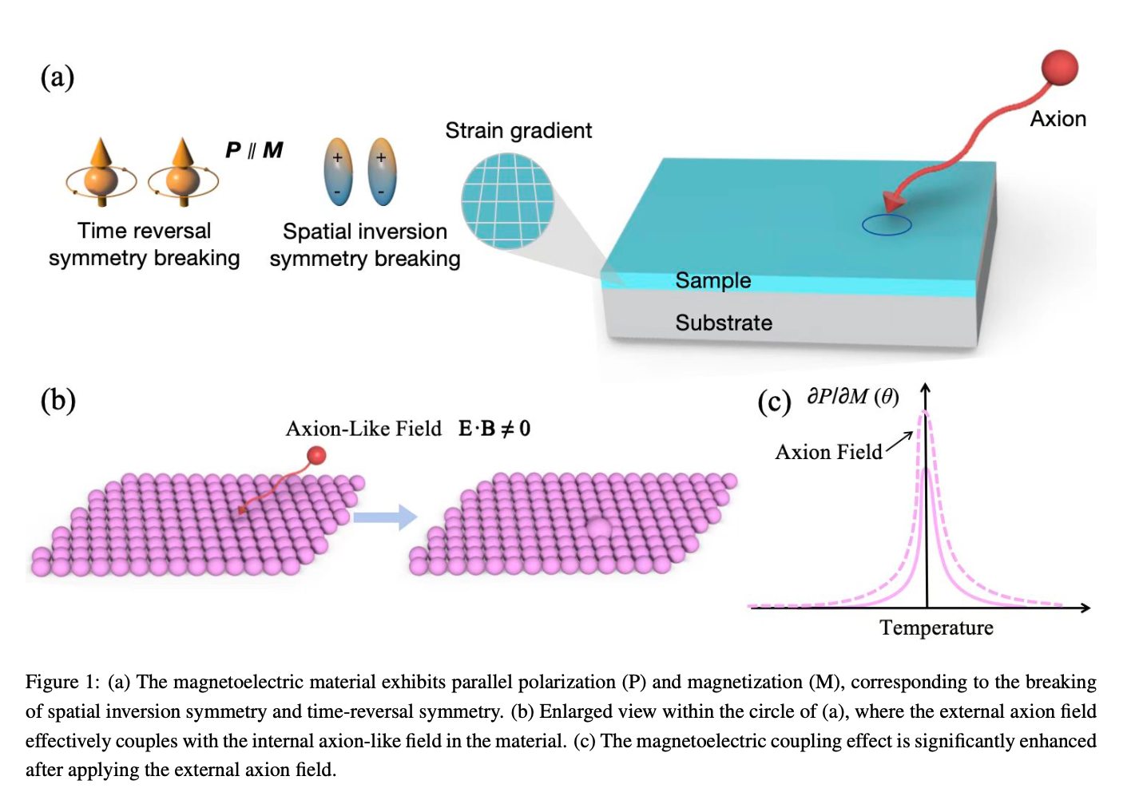

Slide 16
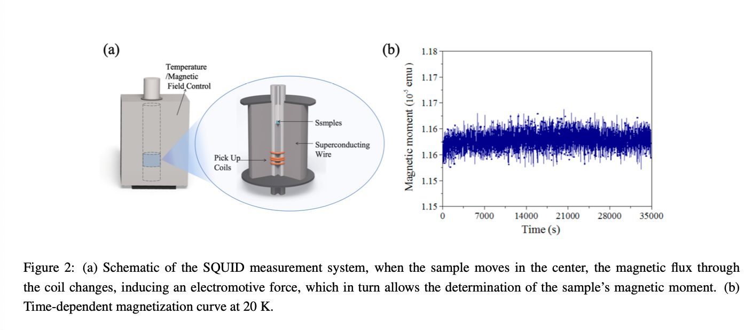

Slide 17
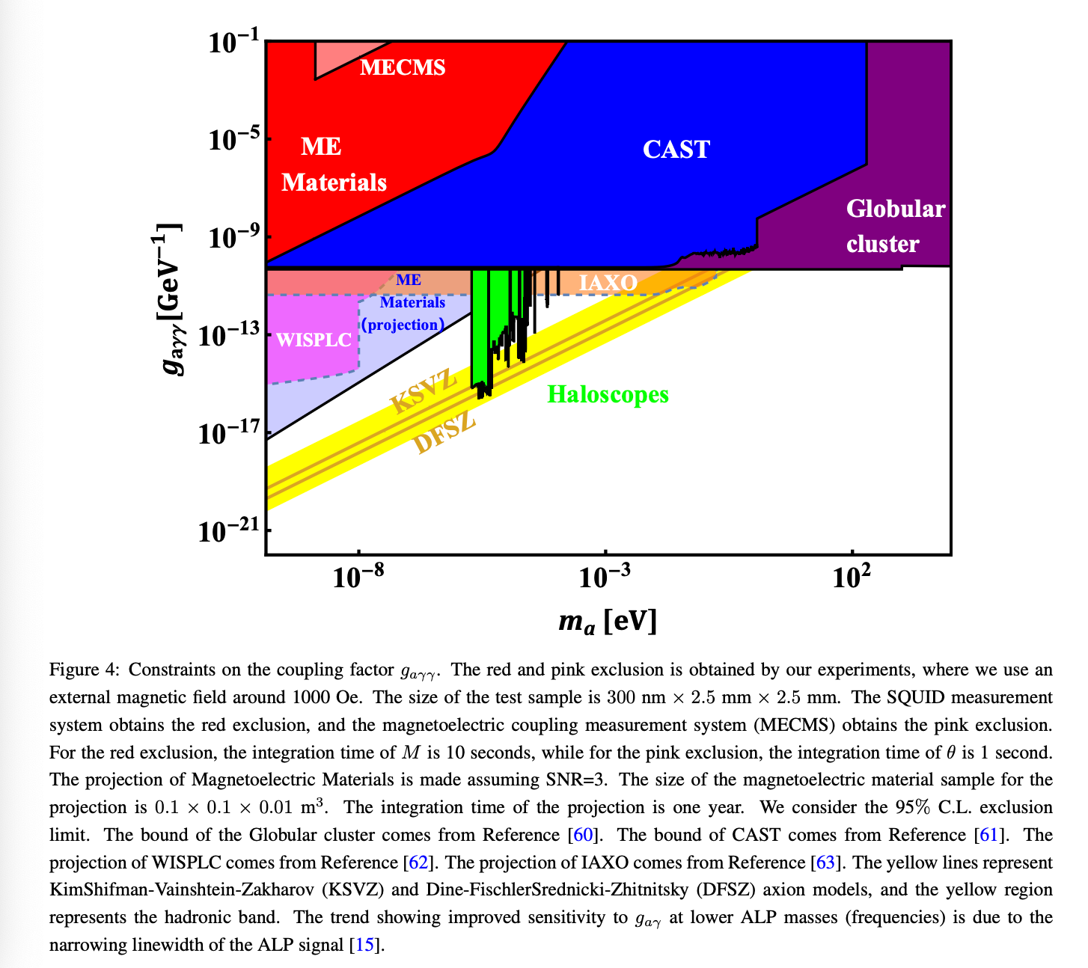

Slide 18
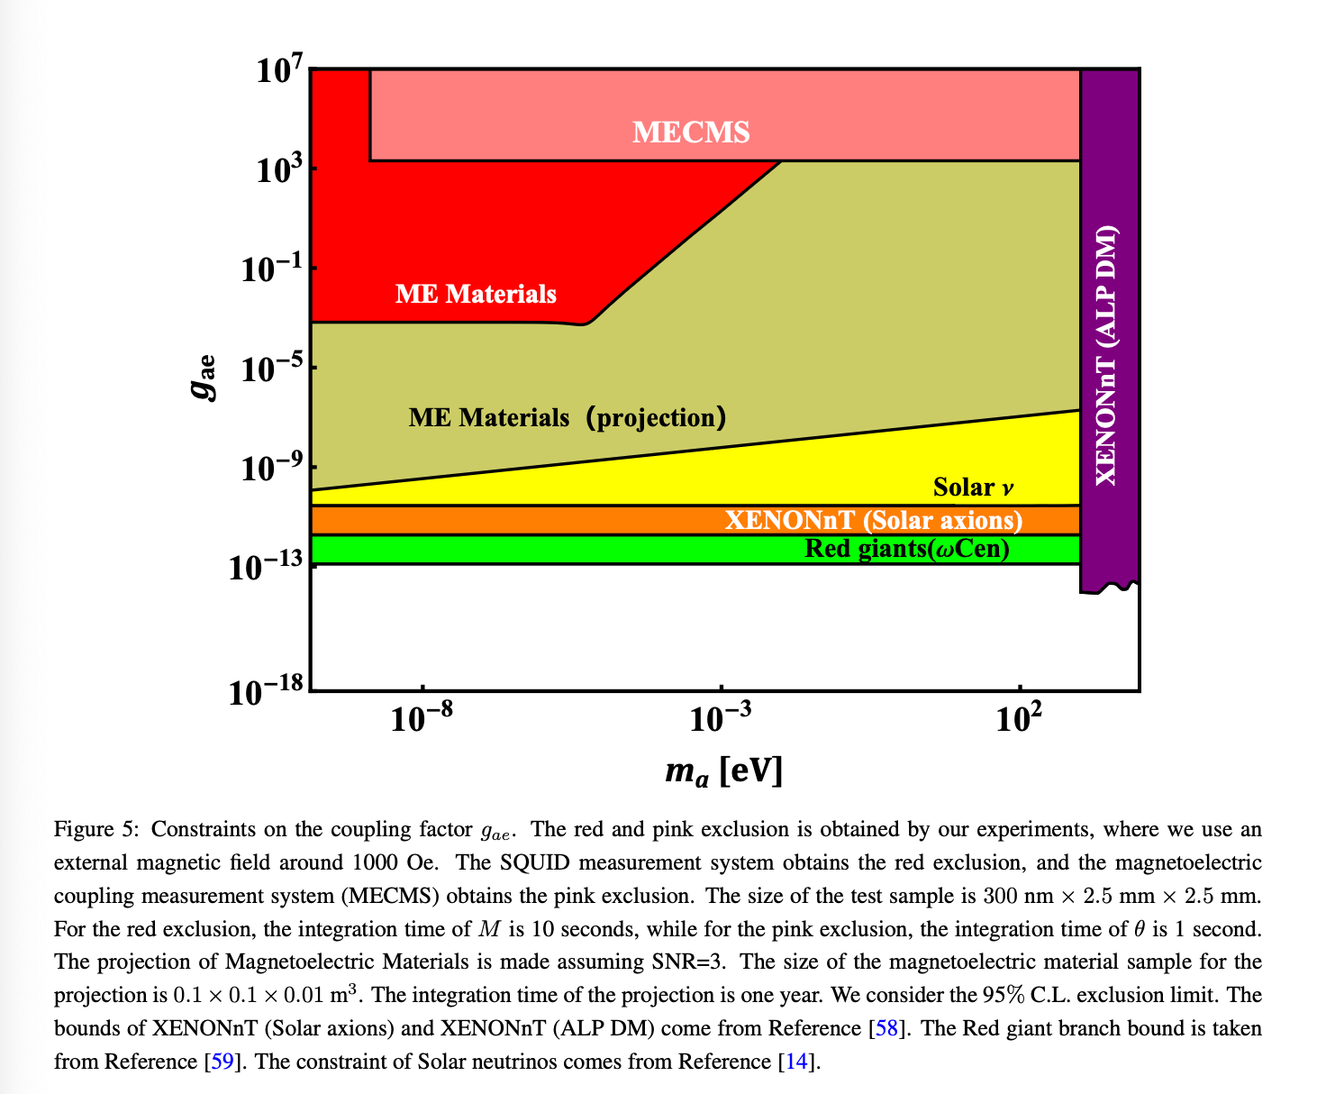

Slide 19
Thanks.

