Slide 1
Recent spectroscopy results from $B→DDX$ decays at LHCb
钱文斌
中国科学院大学
2024/10/22
强子论坛第105期
2024/10/22
国科大 钱文斌
1

Slide 2
Outline of the talk
Introduction
A general amplitude analysis tool: TF-PWA
New results from $B^{+}→D^{±}D^{∗∓}K^{+}$ decays
New results from $B→D^{(∗)}D_{s}^{+}π^{+}π^{−}$ decays
Prospects and conclusion
2024/10/22
国科大 钱文斌

Slide 3
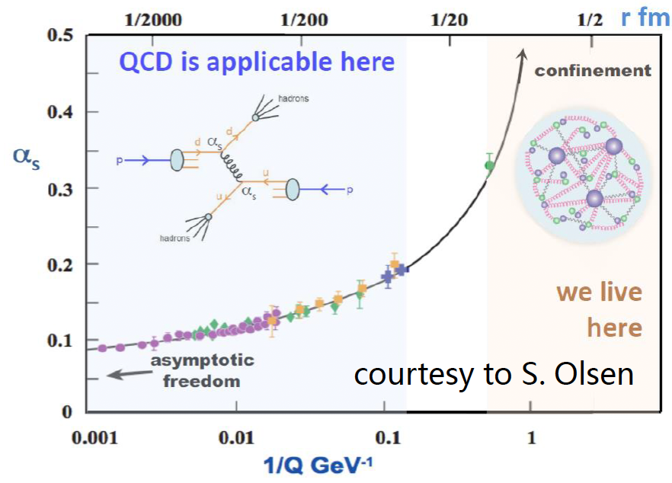
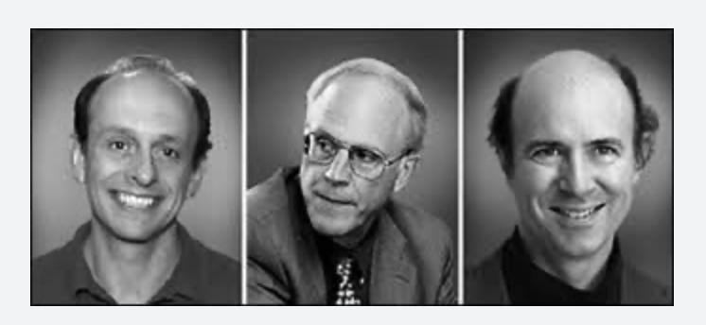
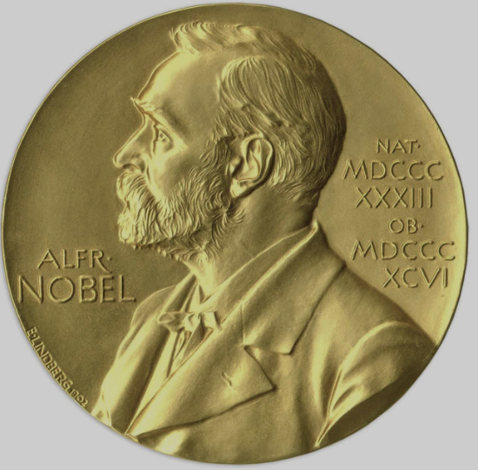
Non-perturbative QCD: central of HEP
QCD at low energy
p
New physics hunting in hadron decays
New physics searching in lepton sector
New physics hunting at TeV scale
Neutrino studies
All related to QCD
2024/10/22
国科大 钱文斌
3

Slide 4
Hadron physics: colorful and tasty
QCD at low energy
Spectroscopy studies
Structure of hadrons
Hadron interaction with matter
Production and decay of hadrons
Fragmentation process into hadron
Everything related to matter
p
2024/10/22
国科大 钱文斌
4

Slide 5
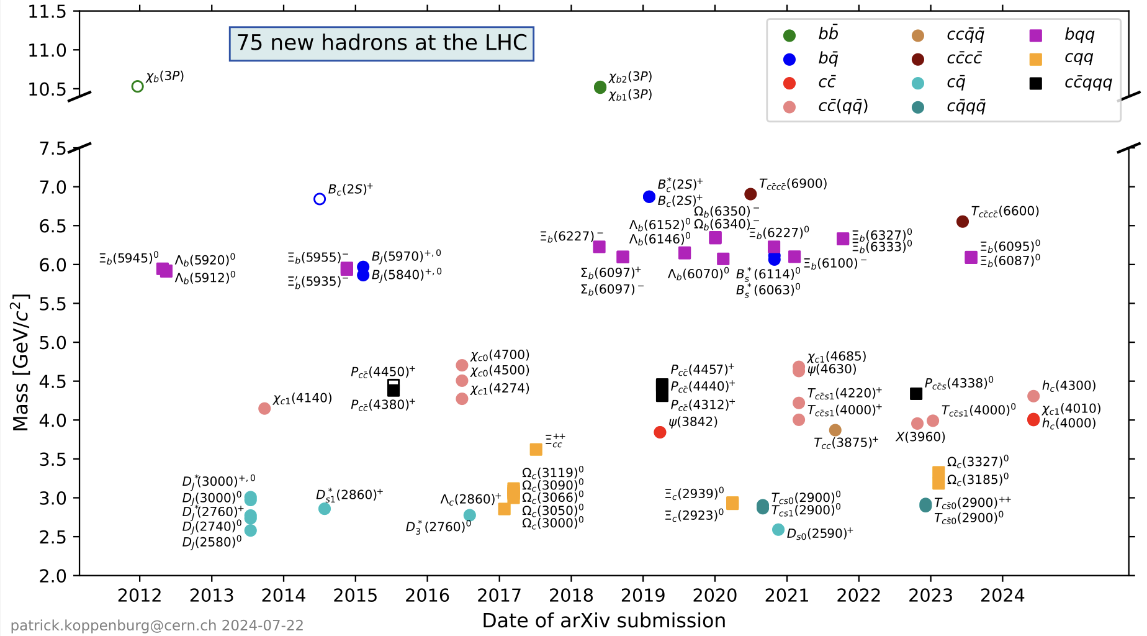
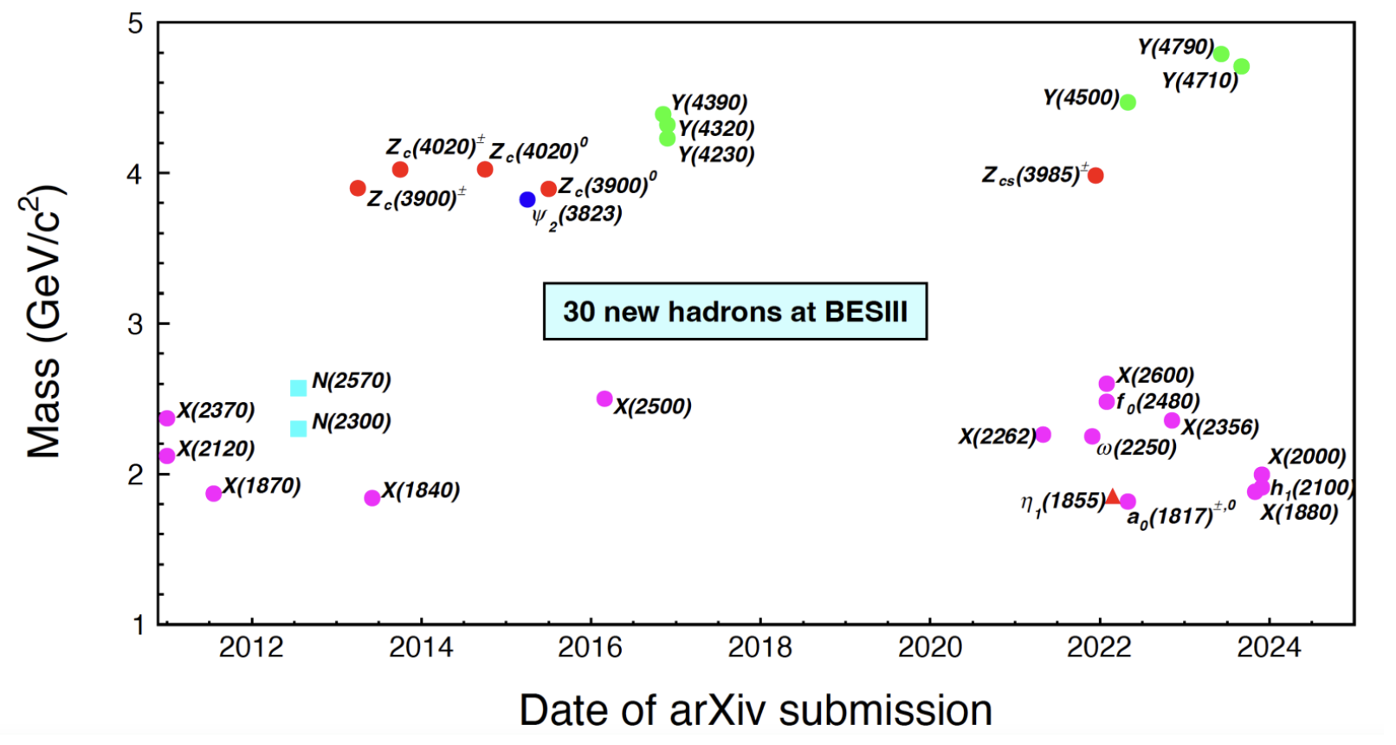
Particle zoo 2.0
Many new hadrons discovered since the discovery of $χ_{c1}(3872)$ in 2003: renaissance and revolution?
75 new hadrons
30 new hadrons
LHC (mainly LHCb)
BESIII
+ 17 new hadrons from Belle (>35 from its start)
> 20 new hadrons since 2022 (only selected ones are shown)
Many can not be explained by conventional quark model
More than 140 new hadrons
2024/10/22
国科大 钱文斌
5

Slide 6
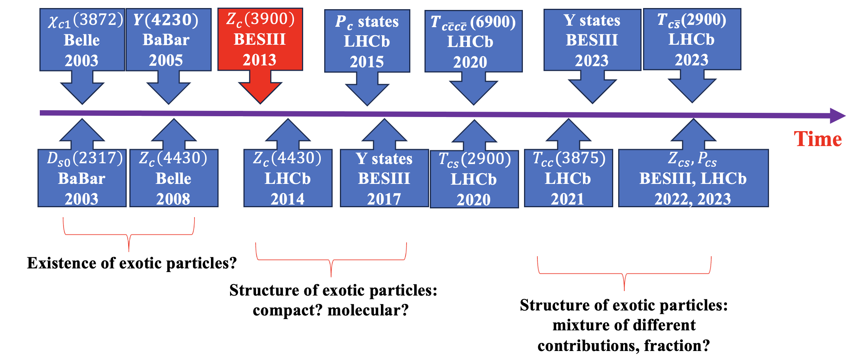
A history of understanding
$c\overline{c}(X)$+ $c\overline{s} (X)$
More states
Better understanding
Unified model for all hadrons?
$$c\overline{c}g$$
$$c\overline{c}$$
+
$$c\overline{c}qq$$
+
+
$$c\overline{c}$$
$$qq$$
+ …
Particle X =
$$cq$$
$$\overline{c}q$$
2024/10/22
国科大 钱文斌
6

Slide 7
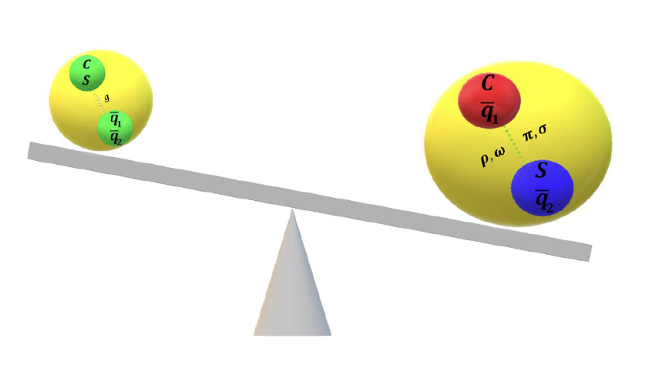
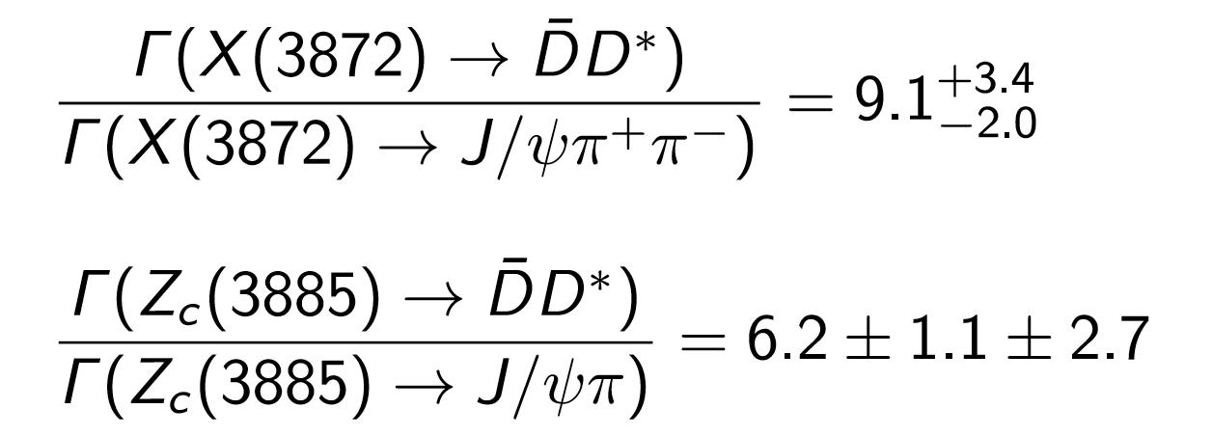
Experimental inputs
$$c\overline{c}g$$
$$c\overline{c}$$
+
$$c\overline{c}qq$$
+
+
$$c\overline{c}$$
$$qq$$
+ …
Particle X =
$$cq$$
$$\overline{c}q$$
Charm + charm + X
charmonium + X
Experimental tasks:
Discover more and understand them through production and decays
However, studies with $B→DDX$decays rather limited
2024/10/22
国科大 钱文斌
7

Slide 8
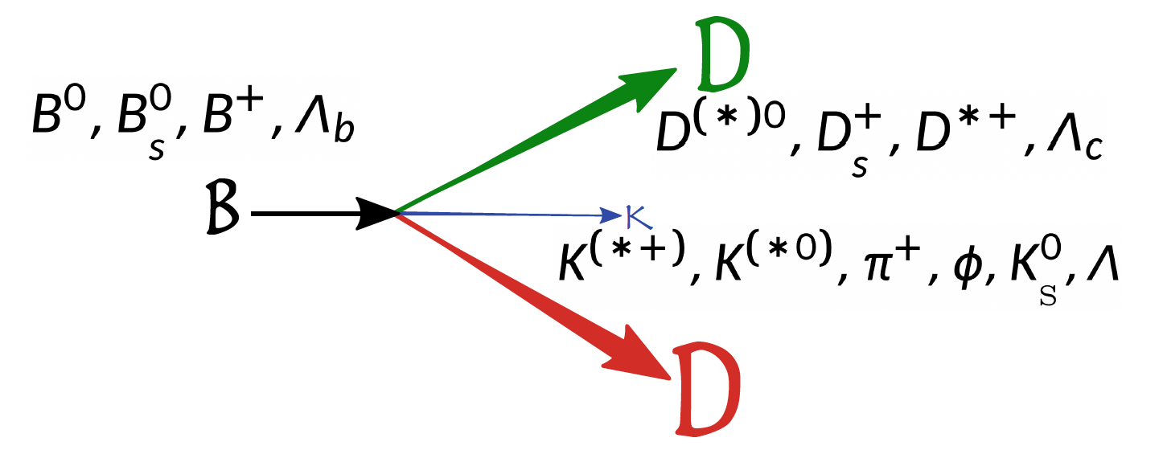
Related physics
From Dan Johnson
Charmonium(-like) spectra from $D^{(∗)}D^{(∗)}, D^{(∗)}Λ_{c}, Λ_{c}Λ_{c}$ etc
$D_{s}, D^{+}, D^{0}, Λ_{c}$ excited states from $D^{(∗)}{K(π)}^{(∗)}, {K(π)}^{(∗)}Λ_{c}$ etc
Exotic structures from $D^{(∗)}{K(π)}^{(∗)}, {K(π)}^{(∗)}Λ_{c}$ etc
Also important to understand charm loop in $b→sμμ$
2024/10/22
国科大 钱文斌
8

Slide 9
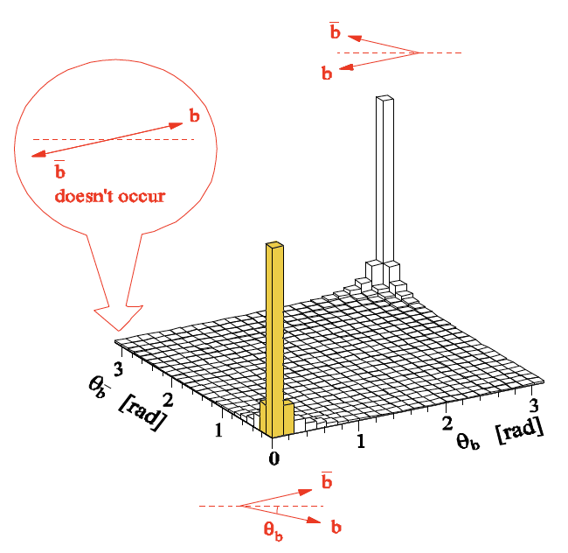
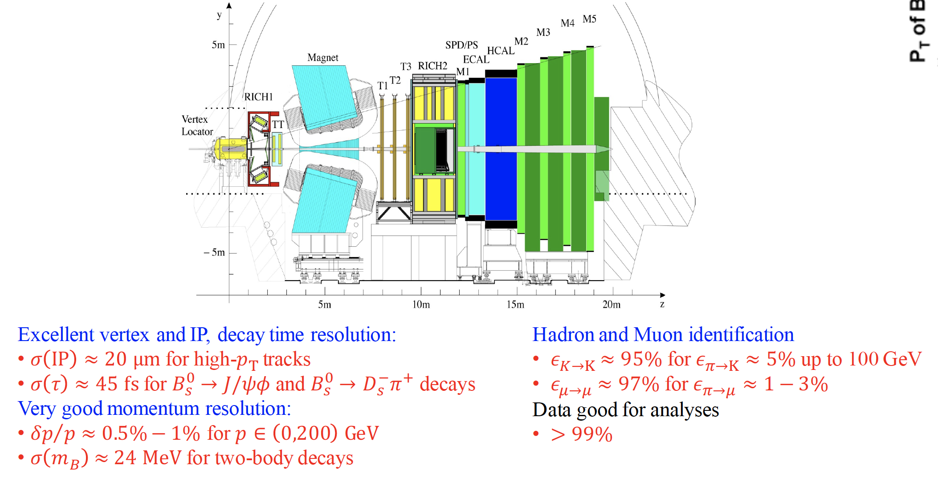
The LHCb experiment
Run 1+2 detector
Designed for CP violation and heavy flavor studies
2024/10/22
国科大 钱文斌
9

Slide 10
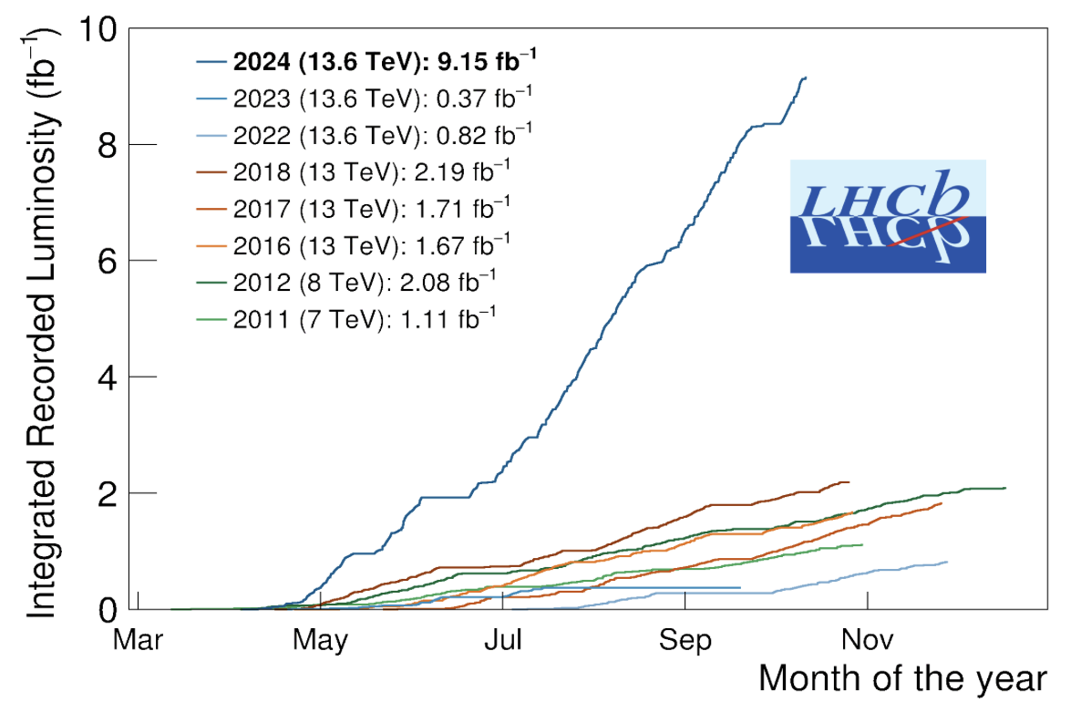
The LHCb status
Run 1:
2011 (7 TeV): 1 fb⁻¹
2012 (8 TeV): 2 fb⁻¹
Run 2:
2015-2018 (13 TeV): 6 fb⁻¹
Run 3:
2022- 2026? (13 TeV):>10 fb⁻¹
Brand new LHCb detector for Run 3
Similar performance, while efficiency for hadron final states increased by a factor of 2
2024/10/22
国科大 钱文斌
10

Slide 11
Extract resonant information
Most exotic states and their properties established in multi-body decays
Amplitude analyses crucial
Amplitude analyses very complicated: main limitations to start an analysis
Enormous data from BESIII, LHCb and other flavor physics experiments: massive CPU time needed to perform analyses
A general PWA framework using modern acceleration technology (such as GPU, AD,…) eagerly needed
We have developed a new framework using TensorFlow
B : $p_{B}^{μ}$
A: $p_{A}^{μ}$
?
$$∼P(p_{B}^{μ},p_{C}^{μ},p_{D}^{μ};θ)$$
C : $p_{C}^{μ}$
…
D : $p_{D}^{μ}$
2024/10/22
国科大 钱文斌
11

Slide 12
TF-PWA
A general and user-friendly partial wave analysis framework
Hao Cai¹, Chen Chen⁵, Shuangshi Fang⁴, Haojie Jing², Yi Jiang², Pei-Rong Li³, Beijiang Liu⁴, Yin-Rui Liu², Xiao-Rui Lyu²,
Runqiu Ma⁴, Rong-Gang Ping⁴, Wenbin Qian², Rongsheng Shi³, Mengzhen Wang⁵, Shi Wang⁴, Zi-Yi Wang²,
Jiajun Wu², Shuming Wu², Liming Zhang⁵,Yang-Heng Zheng²
¹WHU, ²UCAS, ³LZU, ⁴IHEP, ⁵THU
Joint efforts + experience on previous analyses + very good students
Cross-checks performed with several independent fitters developed previously for dedicated analyses: e.g. Z(4430)⁺ and pentaquark search, $B^{0}→\overline{D^{0}}π^{+}π^{−}$ analysis etc.
2024/10/22
国科大 钱文斌
12

Slide 13
Features
Fast
General
Easy to use
GPU based
Vectorized calculation
Automatic differentiation
https://gitlab.com/jiangyi15/tf-pwa
Custom model available
Open access and well supported
Simple configuration file
Automatics process
All necessary functions implemented
2024/10/22
国科大 钱文斌
13

Slide 14
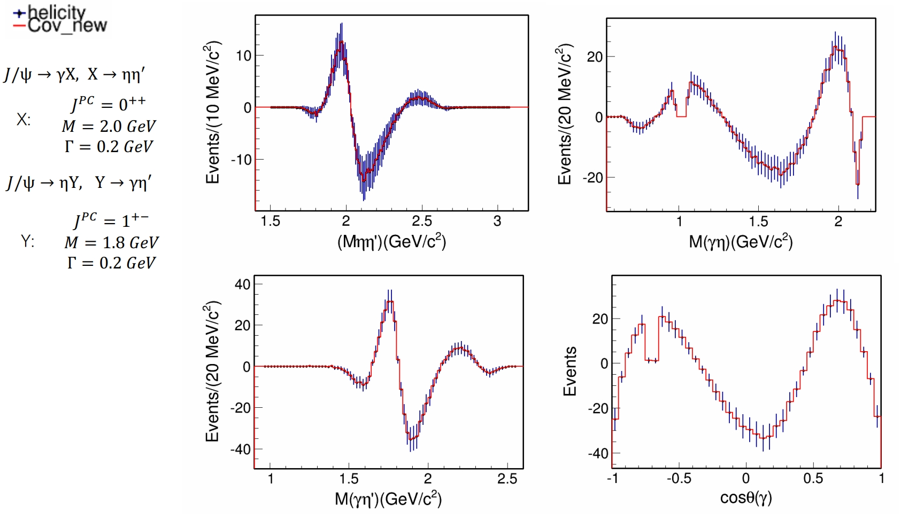
New functions
Default option: helicity formulism based amplitude model
Now also “traditional” covariant tensor formulism
+ Irreducible tensor formulism
$$J/ψ→γηη^{′}$$
Opening possibilities for alignment between theoretical and experimental studies
2024/10/22
国科大 钱文斌
14

Slide 15
New results from $B→DDX$ decays
2024/10/22
国科大 钱文斌

Slide 16
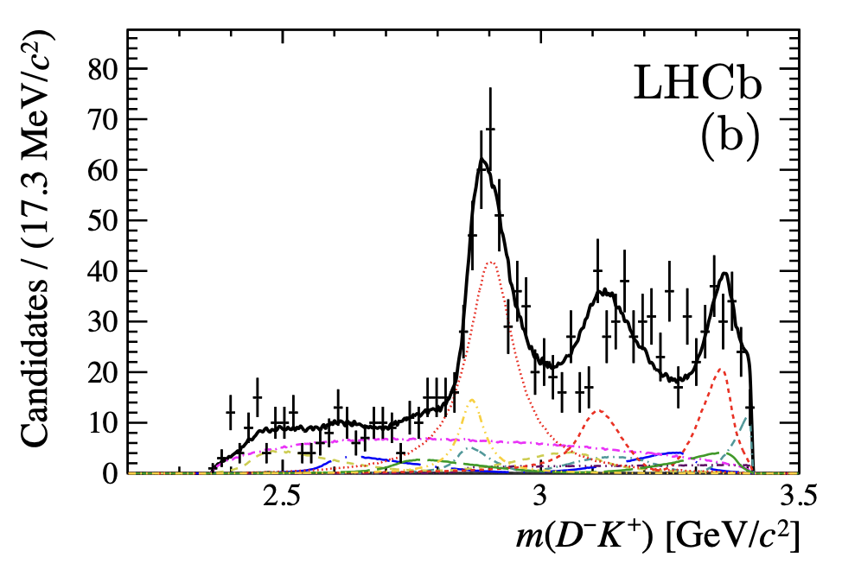
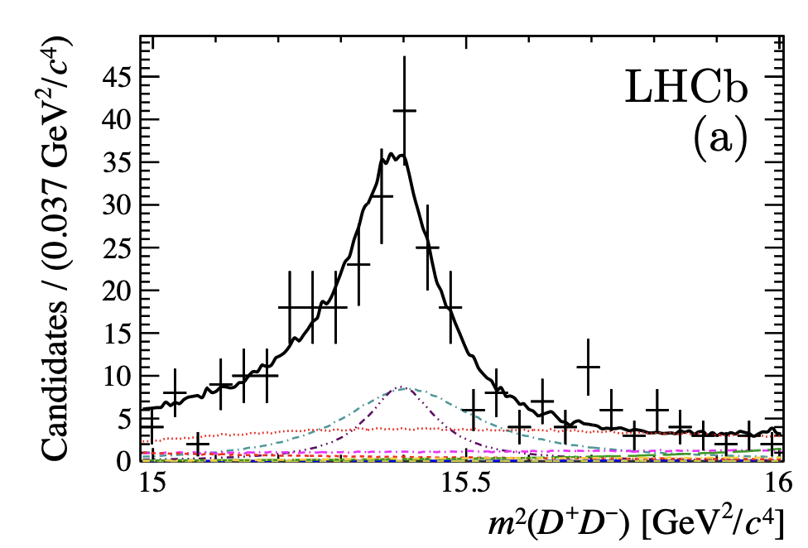
A bit of history
Amplitude analysis of $B^{+}→D^{+}D^{−}K^{+}$
$X(5568)$： four different flavors; however, not confirmed by other experiments
$X_{0,1}(2900)$ or $T_{cs0}^{∗}\left(2870\right)$ and $T_{cs1}^{∗}(2900)$: four different flavors; need confirmation from other decays
A spin 0 state $χ_{c0}(3930)$ also observed while no evidence for $χ_{c0}(3860)$ found by Belle
2024/10/22
国科大 钱文斌
16

Slide 17
Doubly charged tetraquark and its Isospin partner
Around 4K signal events
$$B^{0}→\overline{D^{0}}D_{s}^{+}π^{−}$$
$$B^{+}→D^{−}D_{s}^{+}π^{+}$$
$$T_{c\overline{s}}^{a}{\left(2900\right)}^{0}$$
$$T_{c\overline{s}}^{a}{\left(2900\right)}^{++}$$
$$FF:\left(4.8±1.1±1.4\right)\%$$
$$FF:\left(1.96±0.87±0.88\right)\%$$
$T_{cs}^{a}\left(2900\right) \text{have} \text{quark} \text{content} c\overline{s}\overline{u}d \text{and} c\overline{s}u\overline{d}$
Two states consist with each other: isospin triplet
No other states are needed currently
2024/10/22
国科大 钱文斌
17

Slide 18
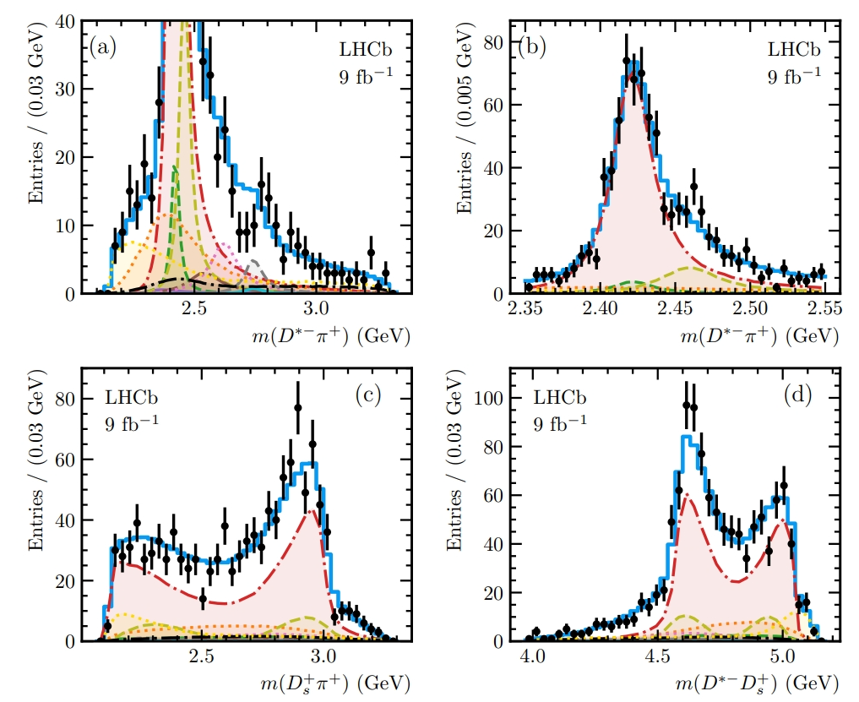
Exotic searches in $B^{+}→D^{∗−}D_{s}^{+}π^{+}$
Motivated by doubly charged tetraquark state seen in $B^{+}→D^{−}D_{s}^{+}π^{+}$
Main contributions from $D^{∗}$ states including $D_{1}(2420)$, $D_{1}(2430)$, $D_{2}(2460)$, $D_{0}(2550)$, $D_{1}^{∗}\left(2600\right)$ and $D_{2}(2740)$ etc.
No strong evidence of $T_{c\overline{s}0}^{a}{\left(2900\right)}^{++}$, upper limits set on fit fractions to be smaller than 2.5% @ 90% CL
Around 1K signal events
2024/10/22
国科大 钱文斌
18

Slide 19
Amplitude analysis of $B^{+}→D^{±}D^{∗∓}K^{+}$ decays
2024/10/22
国科大 钱文斌

Slide 20
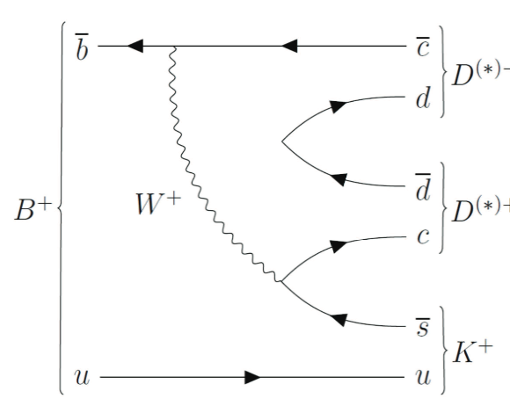
Feynman diagrams
$$D^{−}$$
$$D^{+}$$
$$D^{∗+}$$
$$D^{∗−}$$
Not charge conjugation of each other
$$B^{+}→D^{−}D^{∗+}K^{+}$$
$$B^{+}→D^{+}D^{∗−}K^{+}$$
2024/10/22
国科大 钱文斌
20

Slide 21
C parity
$$B^{+}→D^{∗+}D^{−}K^{+}$$
$$D^{∗+}D^{−}$$
$$B^{+}→XK^{+}, X→$$
$$B^{+}→D^{∗−}D^{+}K^{+}$$
$$D^{∗−}D^{+}$$
$B^{+}→XK^{+}$: weak decay, violate C and P
$X→D^{∗}D$: strong decay, obey C and P symmetry
$$A\left({X→D}^{∗+}D^{−}\right)=A(X→D^{∗−}D^{+})$$
C = 1: $|D^{∗+}D^{−}> +|D^{∗−}D^{+}>$
C = $−$1: $|D^{∗+}D^{−}>−|D^{∗−}D^{+}>$
$$A\left({X→D}^{∗+}D^{−}\right)=−A(X→D^{∗−}D^{+})$$
The first time, amplitude analysis can tell the C-parity of resonant particles, decaying not in the C eigenstates
2024/10/22
国科大 钱文斌
21

Slide 22
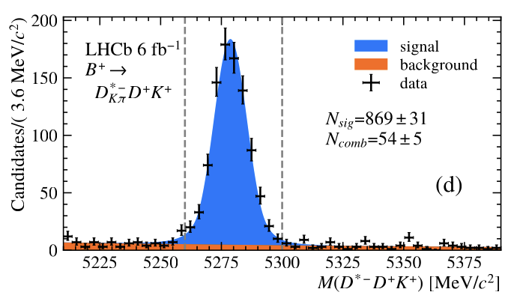
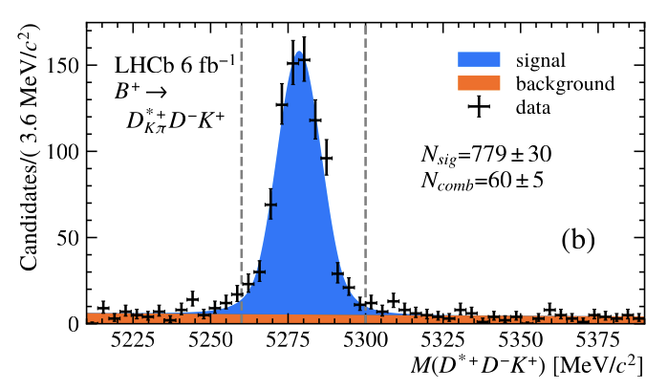
Signal yields
$D^{0}$ decays reconstructed in both $K^{−}π^{+}$ and $K^{−}π^{+}π^{−}π^{+}$ final states
In total, we have $1772±44 B^{+}→D^{∗−}D^{+}K^{+}$ and $1636±43 B^{+}→D^{∗+}D^{−}K^{+}$ signals
Mainly combinatorial background, peaking background negligible
2024/10/22
国科大 钱文斌
22

Slide 23
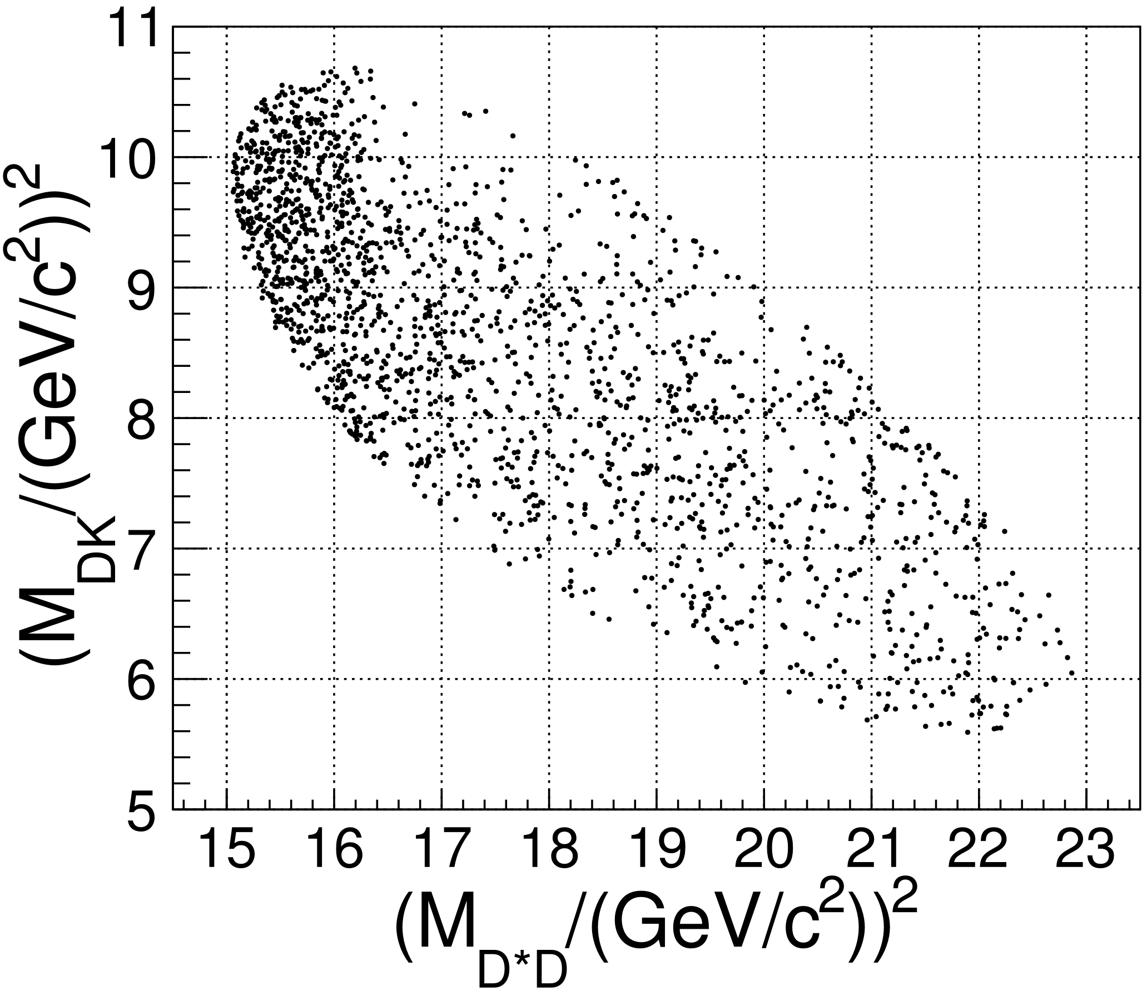
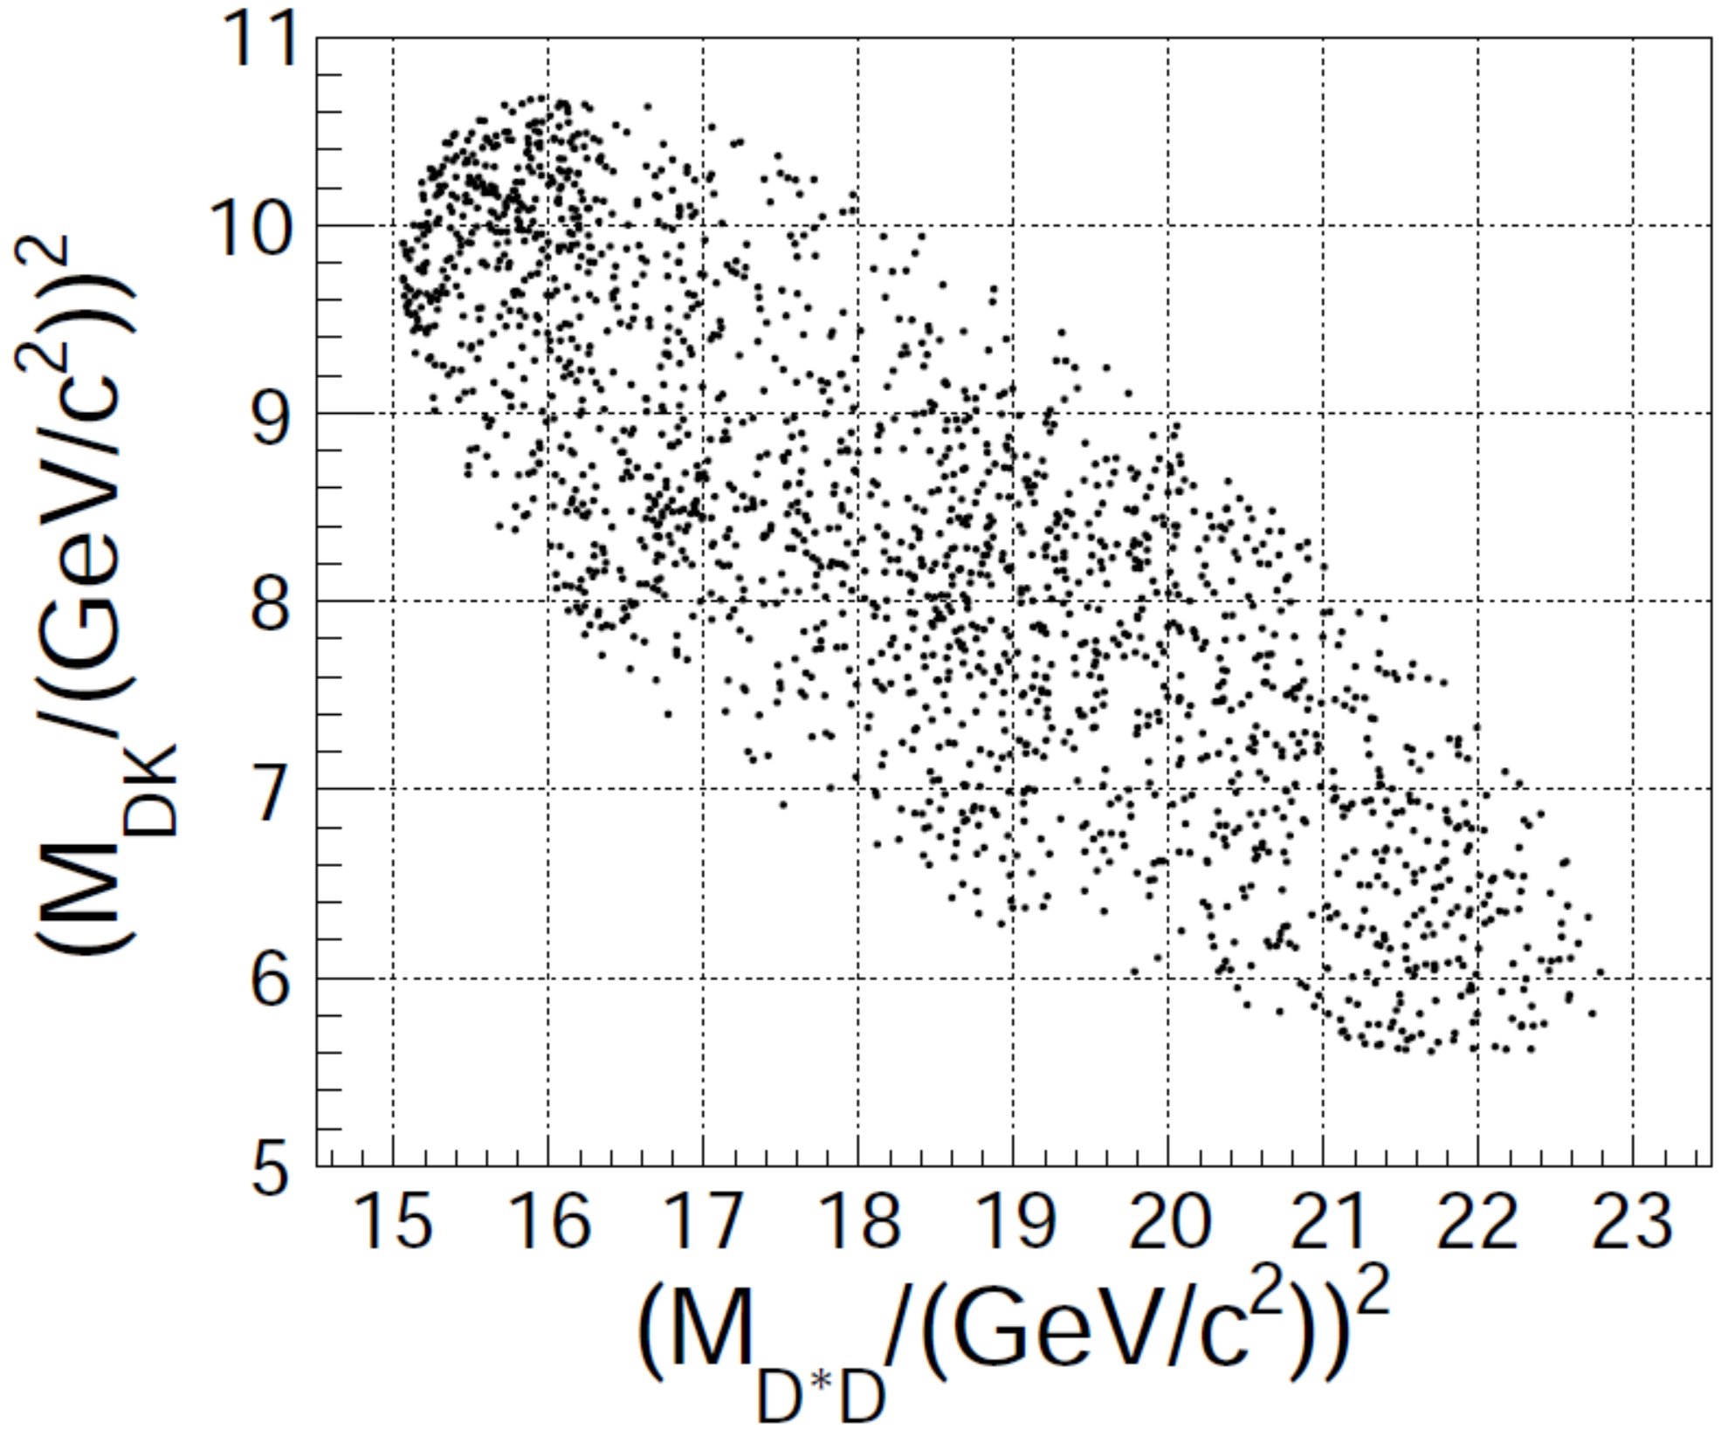
Dalitz plot
$$B^{+}→D^{∗−}D^{+}K^{+}$$
$$B^{+}→D^{∗+}D^{−}K^{+}$$
Clear difference due to interference of different C parities
Contributions from $T_{cs}^{∗}$ seen in one channel
2024/10/22
国科大 钱文斌
23

Slide 24
Spectrum of $M(D^{∗}D)$
$$B^{+}→D^{∗−}D^{+}K^{+}$$
$$B^{+}→D^{∗+}D^{−}K^{+}$$
$C=+1:$ NR + $η_{c}(3945)$
$C=+1:$ NR + EFF+$χ_{c1}(4010)$
$$J^{P}=0^{−}$$
$$J^{P}=1^{+}$$
$C=−1:$ NR
$C=−1:$ $h_{c}\left(4000\right)+h_{c}(4300)$
$$J^{P}=2^{++} :χ_{c2}(3930)$$
$$J^{P}=1^{−−} :NR+ψ \left(4040\right)$$
Resonances well separated from each other except 1⁺⁺; more theoretically motivated model for future analysis
2024/10/22
国科大 钱文斌
24

Slide 25
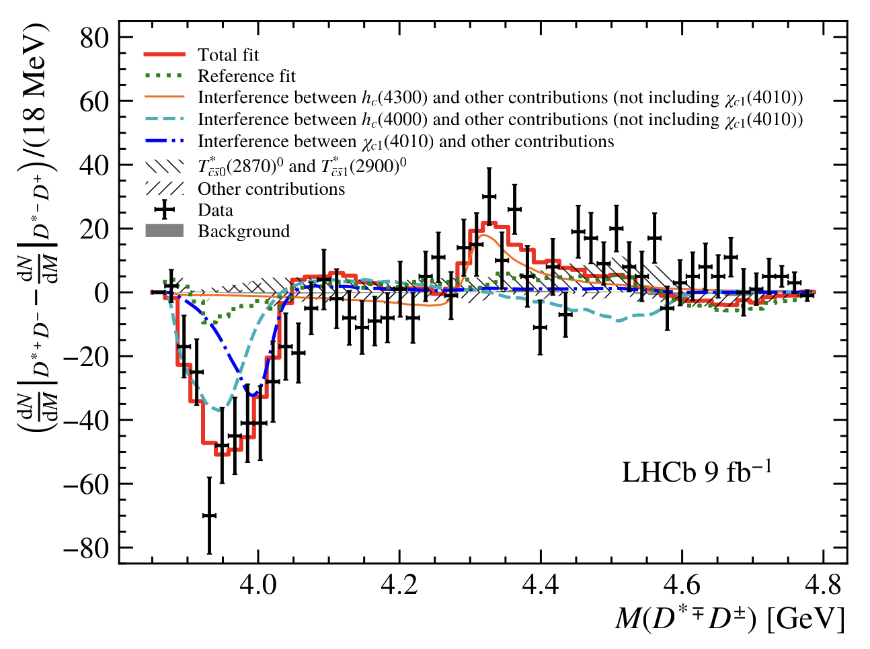
Three new states
Decay 1:
$${\left|A_{1}+A_{2}\right|}^{2}={\left|A_{1}\right|}^{2}+{\left|A_{2}\right|}^{2}+2Re(A_{1}A_{2}^{∗})$$
$$h_{c}(4300)$$
Decay 2:
$${\left|A_{1}+CA_{2}\right|}^{2}={\left|A_{1}\right|}^{2}+{\left|A_{2}\right|}^{2}+2CRe(A_{1}A_{2}^{∗})$$
$$χ_{c1}(4010)$$
Difference:
$C:$ relative $C$ parity of $A2$ to $A1$
$$h_{c}(4000)$$
$$2(C−1)Re(A_{1}A_{2}^{∗})$$
$$∫Re\left(A_{1}A_{2}^{∗}\right)=0$$
Different $J^{P}$:
$C=+1:$ NR + EFF+$χ_{c1}(4010)$
Only interference with same J^{P} but different C party remains
$$J^{P}=1^{+}$$
$C=−1:$ $h_{c}\left(4000\right)+h_{c}(4300)$
2024/10/22
国科大 钱文斌
25

Slide 26
$$h_{c}(4000)$$
$h_{c}\left(4000\right):1^{+−}$
$$T_{c\overline{c}}{\left(4020\right)}^{0}:C=−1$$
$h_{c}\left(2P\right):1^{+−}$
$m_{0}=4000_{−14−22}^{+17+29}$ MeV
$m_{0}=402{5.5}_{−4.7}^{+2.0}±3.1$ MeV
$m_{0}=3956$ MeV
$Γ_{0}={184}_{−45−61}^{+71+97}$ MeV
$Γ_{0}=23±6.0±1.0$ MeV
$Γ_{0}=87$ MeV
Significance: 9.1$σ$
$$e^{+}e^{−}→{\left(D^{∗}\overline{D^{∗}}\right)}^{0}π^{0}$$
QM Predictions
Also prediction by wang et al.
Width much larger than $T_{c\overline{c}}{\left(4020\right)}^{0}$, potential candidate for $h_{c}(2P)$
1⁺ resonance modeled by
2024/10/22
国科大 钱文斌
26

Slide 27
$$h_{c}(4300)$$
$h_{c}\left(4300\right):1^{+−}$
$$χ_{c1}\left(4274\right):1^{++}$$
$h_{c}\left(3P\right):1^{+−}$
$m_{0}=430{7.3}_{−6.6−4.1}^{+6.4+3.3}$ MeV
$m_{0}=4294±4_{−3}^{+6}$ MeV
$m_{0}=4318$ MeV
$Γ_{0}={58}_{−16−25}^{+28+28}$ MeV
$Γ_{0}=53±5±5$ MeV
$Γ_{0}=75$ MeV
Significance: 6.4$σ$
QM Predictions
$χ_{c1}\left(3P\right):1^{++}$
Another state $χ_{c1}(4274)$ at similar mass, however with different C parity; new state potentially $h_{c}(3P)$
$m_{0}=4317$ MeV
$Γ_{0}=39$ MeV
2024/10/22
国科大 钱文斌
27

Slide 28
$$χ_{c1}(4010)$$
$χ_{c1}\left(4010\right):1^{++}$
$$χ_{c1}\left(3872\right):1^{++}$$
$χ_{c1}\left(2P\right):1^{++}$
$m_{0}=4012.5_{−3.9−3.7}^{+3.6+4.1}$ MeV
$m_{0}=3871.64±0.06$ MeV
$m_{0}=3953$ MeV
$Γ_{0}={62.7}_{−6.4−6.6}^{+7.0+6.4}$ MeV
$Γ_{0}=1.19±0.21$ MeV
$Γ_{0}=165$ MeV
Significance: 16$σ$
QM Predictions
Lattice prediction
Puzzles with $χ_{c}(2P)$
$χ_{c0}\left(2P\right):$ current assigned to $χ_{c0}(3860)$, however, not confirmed by other experiments; relationship with $X\left(3915\right)$ and $χ_{c0}(3930)$ not clear
$χ_{c1}\left(2P\right):$ mass (width) much smaller than QM predictions; relationship with $χ_{c1}(4010)$ not clear
Prediction by wang et al. and Deng et al.
2024/10/22
国科大 钱文斌
28

Slide 29
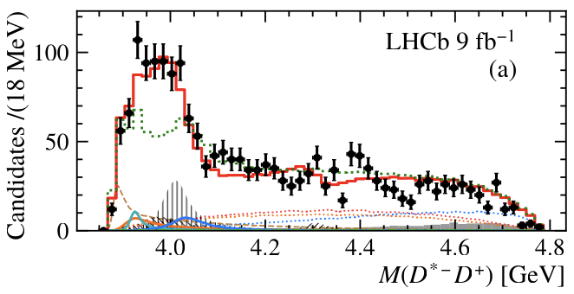
$$η_{c}(3945)$$
$η_{c}\left(3945\right):0^{−+}$
$$X(3940):?^{??}$$
$η_{c}(3S):0^{−+}$
$m_{0}=3945_{−17−28}^{+28+37}$ MeV
$m_{0}=3942±9$ MeV
$m_{0}=4064$ MeV
$Γ_{0}={130}_{−49−70}^{+92+101}$ MeV
$Γ_{0}=37_{−17}^{+27}$ MeV
$Γ_{0}=80$ MeV
Significance: 10$σ$
$$e^{+}e^{−}→{\left(D^{(∗)}\overline{D^{(∗)}}\right)}^{0}J/ψ$$
QM Predictions
Mass and width consistent with $X(3940)$, while J^{PC} now determined
$$η_{c}\left(3945\right)$$
2024/10/22
国科大 钱文斌
29

Slide 30
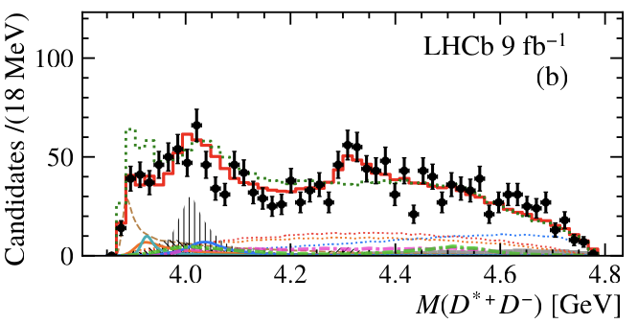
EFF
A near threshold 1⁺⁺ contribution needed
Can be described either by exponential or tail of $χ_{c1}(3872)$
$1^{+−}$ contribution not needed
If assuming to be $χ_{c1}(3872)$ (only tail contributes), violation of Isospin or more complicated nature? (I = 1 states?)
EFF
EFF
$$Br\left(B^{+}→χ_{c1}\left(3872\right)K^{+}, χ_{c1}\left(3872\right)→D^{∗±}D^{∓}\right)$$
$$={(1.48}_{−0.36}^{+0.42})×{10}^{−4}$$
$$Br\left(B^{+}→χ_{c1}\left(3872\right)K^{+}, χ_{c1}\left(3872\right)→D^{∗0}{\overline{D}}^{0},{\overline{D}}^{∗0}D^{0}\right)$$
$$=(0.80±0.23)×{10}^{−4}$$
2024/10/22
国科大 钱文斌
30

Slide 31
A state around 4.4 GeV?
Not well modeled in $B^{+}→D^{∗−}D^{+}K^{+}$, but not in $B^{+}→D^{∗+}D^{−}K^{+}$ around 4.4 GeV
Adding a new neutral 1⁺⁺ state (3.7$σ$) giving:
not well modeled
$m_{0}=4462±13$ MeV
$Γ_{0}=67±18$ MeV
$Z_{c}\left(4430\right):1^{+−}$ （C needs confirmation）
$m_{0}=4476_{−18}^{+15}$ MeV
$Γ_{0}=181±31$ MeV
If fixed to $Z_{c}\left(4430\right)$, giving 3.9$σ$
2024/10/22
国科大 钱文斌
31

Slide 32
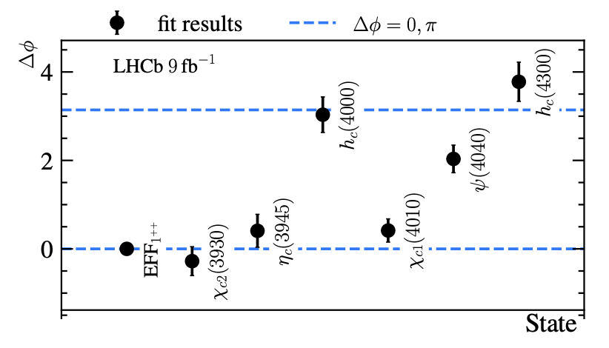
Confirmation of C relationship
2.7$σ$
Fixed 0
$$A_{λ_{R},λ_{D^{∗+}},0}^{R→D^{∗+}D^{−}}=C_{R}A_{λ_{R},λ_{D^{∗−}},0}^{R→D^{∗−}D^{+}} ⇒A_{λ_{R},λ_{D^{∗+}},0}^{R→D^{∗+}D^{−}}=e^{iΔφ}A_{λ_{R},λ_{D^{∗−}},0}^{R→D^{∗−}D^{+}}$$
$$C_{R}=1⇒Δφ=0, C_{R}=−1⇒Δφ=π$$
2024/10/22
国科大 钱文斌
32

Slide 33
Alternative solution?
EFF: $1^{++}$
$h_{c}(4300)$: $1^{+−}$
$η_{c}(3945)$: $0^{−+}$
$χ_{c1}(4010)$: $1^{++}$
$h_{c}(4000)$: $1^{+−}$
$$Z_{c}\left(3900\right):1^{+−}$$
$χ_{c1}\left(4274\right)$:$1^{++}$
$X(3940)$: $0^{−−}$
$X(4020)$: $1^{+−}$
$χ_{c1}(4000)$: $1^{++}$
If replacing EFF $1^{++}$ with the tail of $Z_{c}(3900)$: C parity changed
Due to $χ_{c2}(3930)$ and $ψ(4040)$, NLL worse by ~50
Large NR contributions with exotic J^{PC} = $1^{−+}$
$η_{c}\left(3945\right)$ also becomes $X\left(3940\right)$ with exotic J^{PC} = $0^{−−}$
2024/10/22
国科大 钱文斌
33

Slide 34
$$T_{cs}→DK$$
Negative in search $T_{c\overline{s}0}{\left(2900\right)}^{++}$
$FF\left(B^{+}→T_{c\overline{s}0}{\left(2900\right)}^{++}D^{∗−},T_{c\overline{s}0}{\left(2900\right)}^{++}→D^{+}K^{+}\right)<3.3\% @ 95\%$ C.L.
Confirming $T_{\overline{c}\overline{s}0}^{∗}{\left(2870\right)}^{0}$ and $T_{\overline{c}\overline{s}1}^{∗}{\left(2900\right)}^{0}$ in a new decay channel $B^{+}→D^{∗+}T_{\overline{c}\overline{s}}^{∗}$
$$T_{\overline{c}\overline{s}0}^{∗}{\left(2870\right)}^{0}$$
$$T_{\overline{c}\overline{s}1}^{∗}{\left(2900\right)}^{0}$$
$$m_{0}$$
$$2914±19$$
$$2866±7$$
$$m_{0}$$
$$2887±10$$
$$2904±5$$
$$Γ_{0}$$
128$±32$
57$±13$
$$Γ_{0}$$
92$±23$
110$±12$
This work
Mass and width agree within 2$σ$
Previous work
2024/10/22
国科大 钱文斌
34

Slide 35
$$T_{cs}→DK$$
Negative in search $T_{c\overline{s}0}{\left(2900\right)}^{++}$
$FF\left(B^{+}→T_{c\overline{s}0}{\left(2900\right)}^{++}D^{∗−},T_{c\overline{s}0}{\left(2900\right)}^{++}→D^{+}K^{+}\right)<3.3\% @ 95\%$ C.L.
Confirming $T_{\overline{c}\overline{s}0}^{∗}{\left(2870\right)}^{0}$ and $T_{\overline{c}\overline{s}1}^{∗}{\left(2900\right)}^{0}$ in a new decay channel $B^{+}→D^{∗+}T_{\overline{c}\overline{s}}^{∗}$
This work
Previous work
Large difference on branching fraction ratio, further hints on structures?
2024/10/22
国科大 钱文斌
35

Slide 36
$$T_{cs}→DK_{S}^{0}$$
Yanxi Zhang
Amplitude analysis of $B^{+}→D^{−}D^{0}K_{S}^{0}$ finding $T_{\overline{c}\overline{s}0}^{∗}{\left(2870\right)}^{0}$, but not $T_{\overline{c}\overline{s}1}^{∗}{\left(2900\right)}^{0}$ to $D^{0}K_{S}^{0}$
$$\frac{T_{cs0}^{∗}{\left(2870\right)}^{0}→D^{0}K_{S}^{0}}{T_{cs0}^{∗}{\left(2870\right)}^{0}→D^{+}K^{−}}=3.3±1.9$$
$$\frac{T_{cs1}^{∗}{\left(2870\right)}^{0}→D^{0}K_{S}^{0}}{T_{cs1}^{∗}{\left(2870\right)}^{0}→D^{+}K^{−}}=0.15±0.17$$
Similar as $B→D^{∗}T_{cs}$, more spin 0 contributions than spin 1
While 1 from Isospin symmetry?
2024/10/22
国科大 钱文斌
36

Slide 37
$$T_{cs}→D^{∗}K$$
0⁺ can not decay into $D^{∗}K$
$1^{−}$ not found in $D^{∗−}K^{+}$ decays
$FF\left(B^{+}→T_{\overline{c}\overline{s}1}^{∗}{\left(2900\right)}^{0}D^{+},T_{\overline{c}\overline{s}1}^{∗}{\left(2900\right)}^{0}→D^{∗−}K^{+}\right)<1.5\% @ 95\%$ C.L.
$$\frac{Br(T_{\overline{c}\overline{s}1}^{∗}{\left(2900\right)}^{0}→D^{∗−}K^{+})}{Br(T_{\overline{c}\overline{s}1}^{∗}{\left(2900\right)}^{0}→D^{−}K^{+})}<0.21 @ 95\%$$
2024/10/22
国科大 钱文斌
37

Slide 38
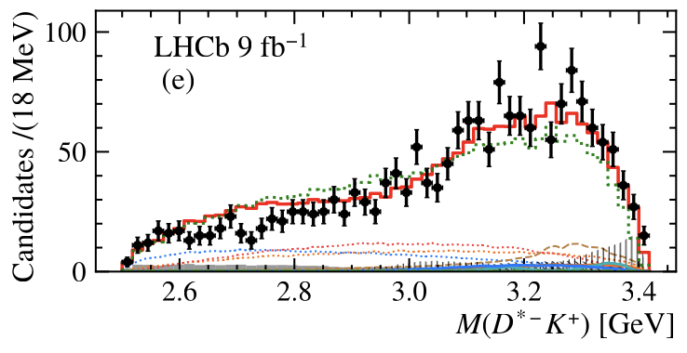
A state around 2.7 GeV?
not well modeled
Possibly a broad state, however, when added, fit not stable due to interference with NR in $M(D^{∗}D)$
Fixing mass to 2750 MeV and width to 100 MeV, improving NLL by 30 (very large)
Spin-parity prefer 1⁺
2024/10/22
国科大 钱文斌
38

Slide 39
Amplitude analysis of $B→D^{(∗)}D_{s}^{+ }π^{+}π^{−}$ decays
2024/10/22
国科大 钱文斌

Slide 40
Puzzles on $D_{s}(2317)$ and $D_{s}(2460)$
Under HQSS, $\vec{j}= \vec{s_{Q}}+(\vec{L}$ + $\vec{s_{q}}$ ) = $\vec{s_{Q}}$ + $\vec{s_{l}}$, $Q=c,b , q=u,d,s$
$\vec{L}$
$\vec{s_{q}}$
$\vec{L}$
$\vec{s_{q}}$
$$\vec{s_{Q}}$$
$$\vec{s_{Q}}$$
$$\vec{s_{l}}$$
$$1/2$$
$$1/2$$
$$3/2$$
2024/10/22
国科大 钱文斌
40

Slide 41
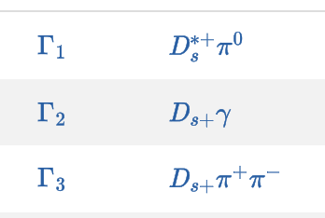
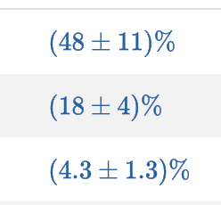
Properties of $D_{s}(2317)$ and $D_{s}(2460)$
$$D_{s}{\left(2317\right)}^{+}$$
$$D_{s1}{(2460)}^{+}$$
Mass below DK threshold
Width very narrow (<3.8 MeV @ 95% CL)
Dominant decay channel: $D_{s}^{+}π^{0}$, Isospin breaking?
Neutral and doubly charged partner not found previously
Mass above DK threshold
Width very narrow (<3.5 MeV @ 95% CL)
Dominant decay channel: $D_{s}^{+}π^{0}$, Isospin breaking?
2024/10/22
国科大 钱文斌
41

Slide 42
Search for neutral and doubly charged $D_{s}(2317)$
BaBar, 2006, searched in $e^{+}e^{−}→c\overline{c}+X$ @10.6 GeV, not found
Belle, 2015, searched in $B→DD_{s}^{+}π$, not found
LHCb, 2023, searched in $B→DD_{s}^{+}π$, found neutral and doubly charged $T_{c\overline{s}}(2900)$
$2900−2317=583$ MeV similar as $M\left(ψ\left(2S\right)\right)−M(ψ(1S))$: radial excitation of $D_{s}{\left(2317\right)}^{+}$
Many other theoretical discussions
We look into $B→D^{(∗)}D_{s}^{+}π^{+}π^{−}$, where $D_{s}{\left(2460\right)}^{+}→D_{s}^{+}π^{+}π^{−}$
2024/10/22
国科大 钱文斌
42

Slide 43
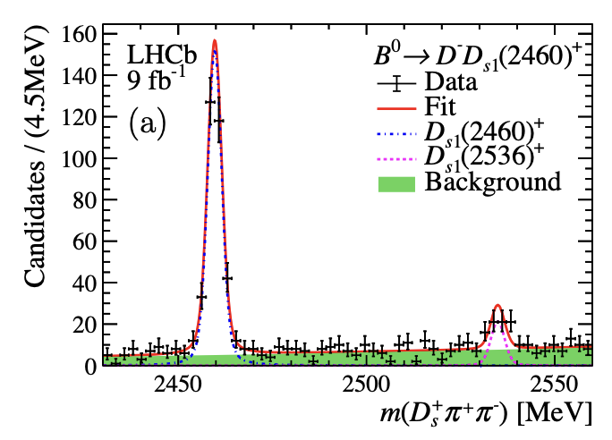
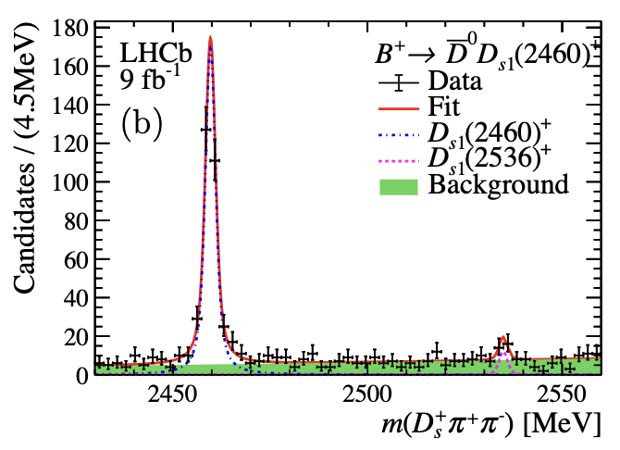
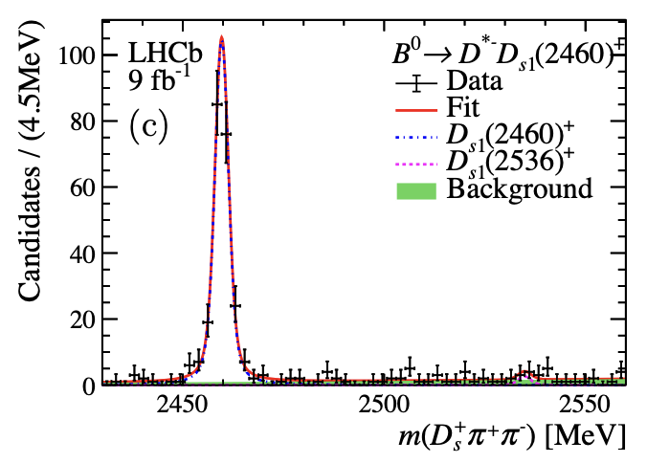
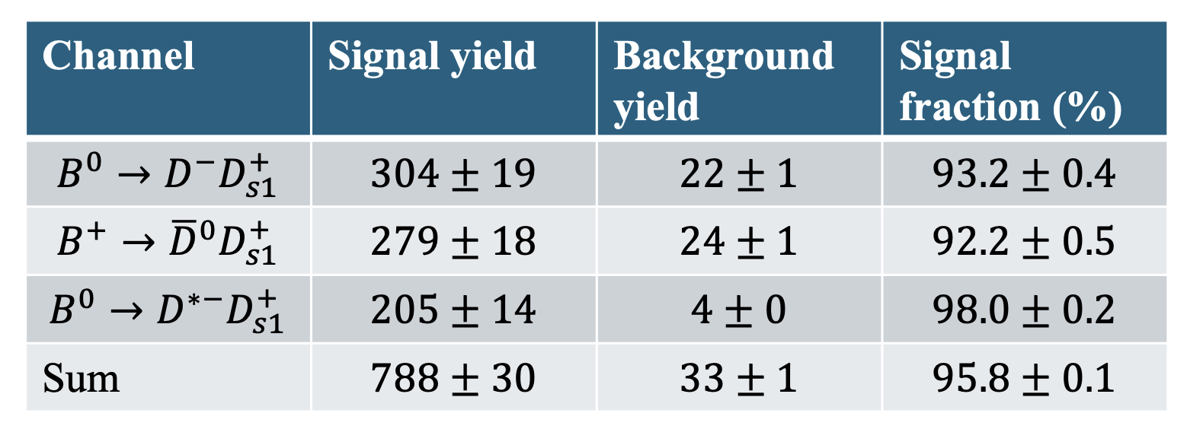
Signal yields
2024/10/22
国科大 钱文斌
43

Slide 44
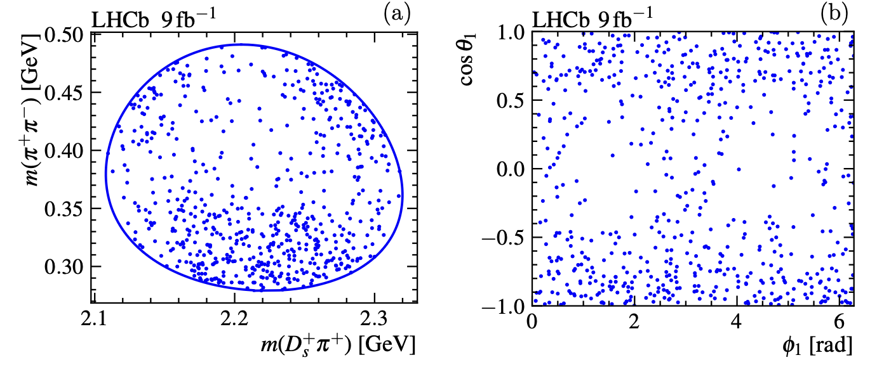
Dalitz plot
Clear gathering of events in three different regions, possible contributions from $T_{c\overline{s}}\left(2317\right)?$
2024/10/22
国科大 钱文斌
44

Slide 45
Projections of Dalitz plot
Double peak structures in $m(π^{+}π^{−})$, quite interesting
Some studies by Guo et al. which shows double peak structures from $D_{s}{\left(2460\right)}^{+}→D_{s}^{+}π^{+}π^{−}$ decays assuming molecular structure of $D_{s1}^{+}(2460)$
Amplitude analysis needed
2024/10/22
国科大 钱文斌
45

Slide 46
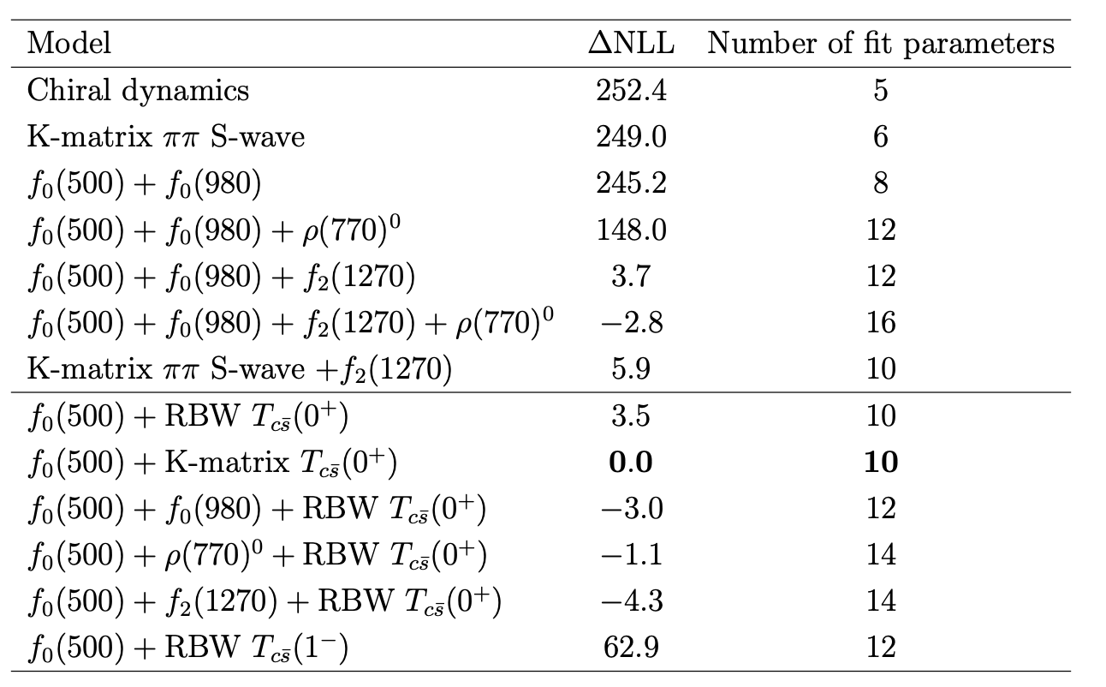
Possible amplitude models
Model without $T_{c\overline{s}}$
Model with $T_{c\overline{s}}$
2024/10/22
国科大 钱文斌
46

Slide 47
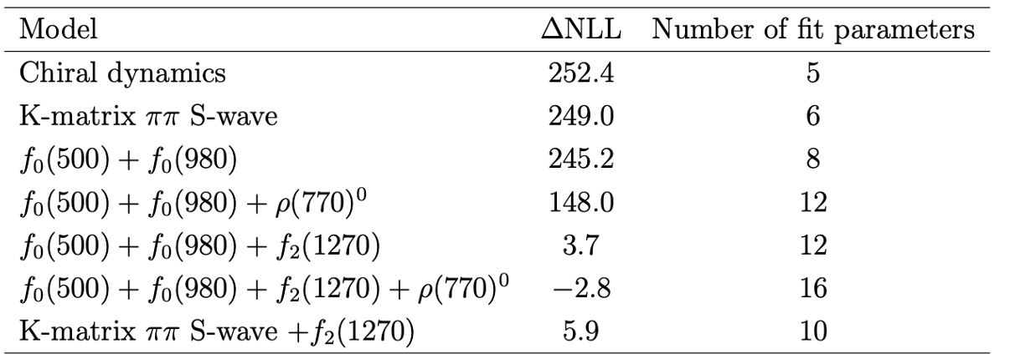
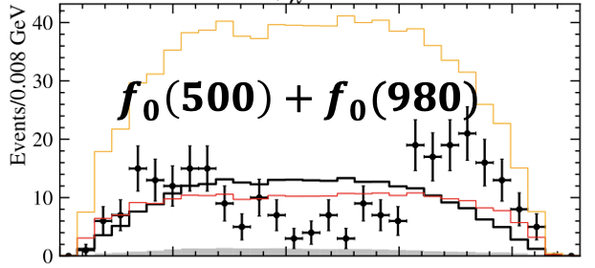
Discussions on $π^{+}π^{−}$ only model
$m\left(π^{+}π^{−}\right)∈\left[279.2, 491.2\right]$ MeV
$m\left(π^{+}π^{−}\right)>390$ MeV
Chiral model from Guo et al. failed to describe data (worse NLL by ~252)
Models with $ππ$ S-wave also failed (K-Matrix: 5 pole, 5 channels)
$ππ$ S-wave + $ρ(770)$ helps, but still not good
Only when $ππ$ S-wave + $f_{2}(1270)$ gives good fit (both Isobar and K-Matrix)
$ρ(770)$ contributions not important
2024/10/22
国科大 钱文斌
47

Slide 48
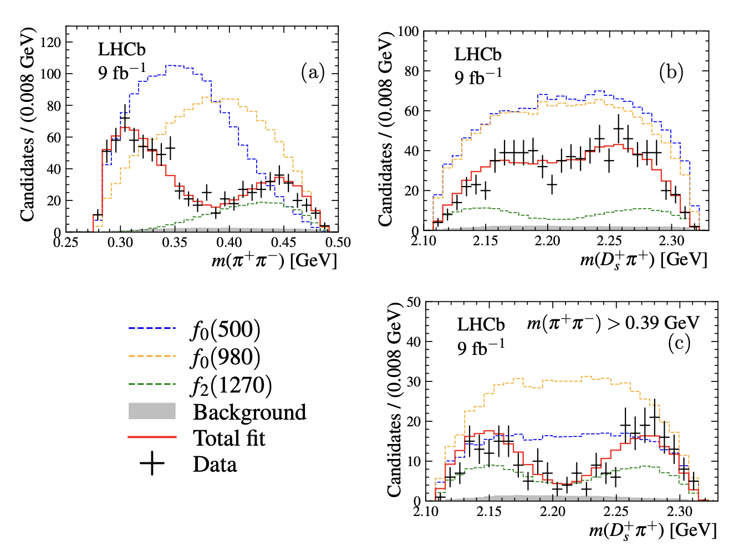
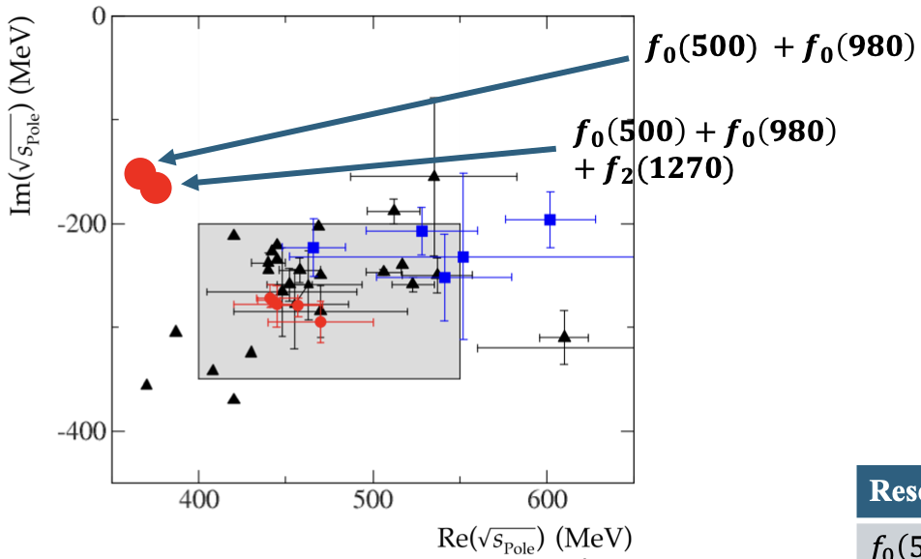
Fit results with $ππ$ only models
$m\left(π^{+}π^{−}\right)∈\left[279.2, 491.2\right]$ MeV
Both $f_{0}(980)$ and $f_{2}(1270)$ far away from threshold (492 MeV)
Very puzzling $f_{0}(500)$ parameters
$ππ$ S-wave line shapes quite different from other processes
2024/10/22
国科大 钱文斌
48

Slide 49
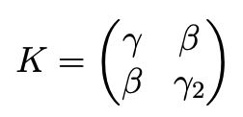
Discussions on models with $T_{c\overline{s}}$
$m\left(π^{+}π^{−}\right)∈\left[279.2, 491.2\right]$ MeV
$T_{c\overline{s} }$K-Matrix
Elastic $DK$
$$DK↔D_{s}π$$
Elastic $D_{s}π$
Both RBW and K-Matrix $T_{c\overline{s}}$ + $f_{0}(500)$ gives good description to data
Contributions from $f_{0}\left(980\right), f_{2}(1270)$ and $ρ(770)$ not significant
$FF\left(D_{s1}{\left(2460\right)}^{+}→D_{s}^{+}ρ\left(770\right)\right)<2.8\% @ 90$ CL
$γ_{2}$ very small, set to 0 by default
Line shape:
Scattering length:
2024/10/22
国科大 钱文斌
49

Slide 50
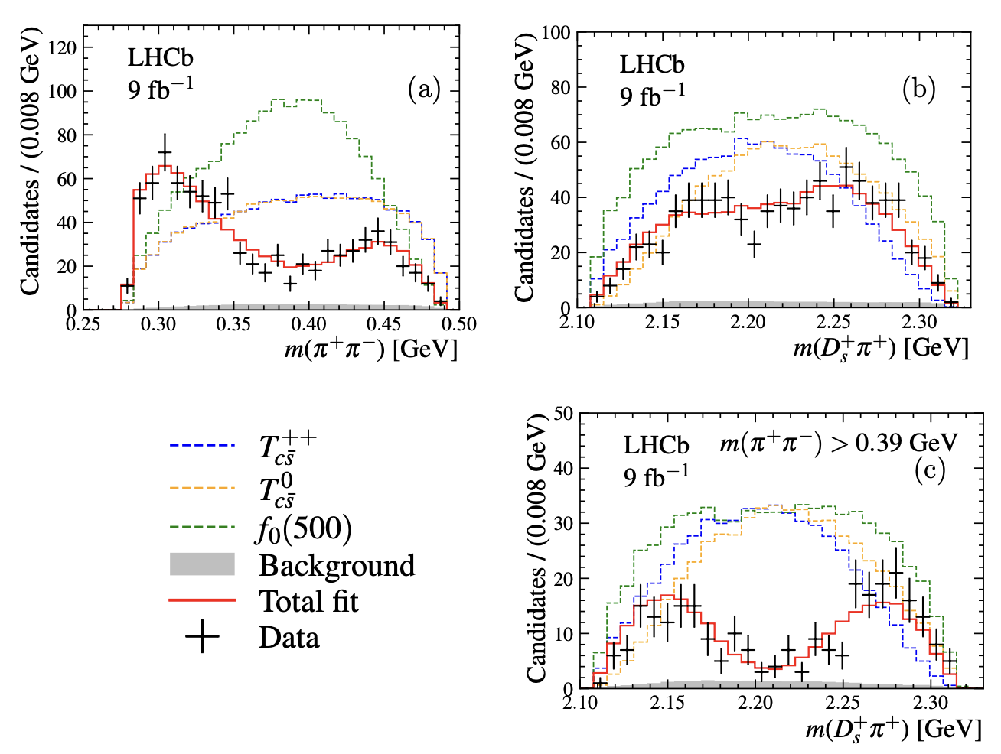
Fit results for models with $T_{c\overline{s}}$
$m\left(π^{+}π^{−}\right)∈\left[279.2, 491.2\right]$ MeV
$f_{0}\left(500\right)$ mass and width agree with other measurements
Scattering length in K-Matrix determined to be
Significance of $T_{c\overline{s}}>10σ$
Coupling, masses and widths of $T_{c\overline{s}}^{0}$ and $T_{c\overline{s}}^{++}$ fixed to be the same; if free, consistent with each other
2024/10/22
国科大 钱文斌
50

Slide 51
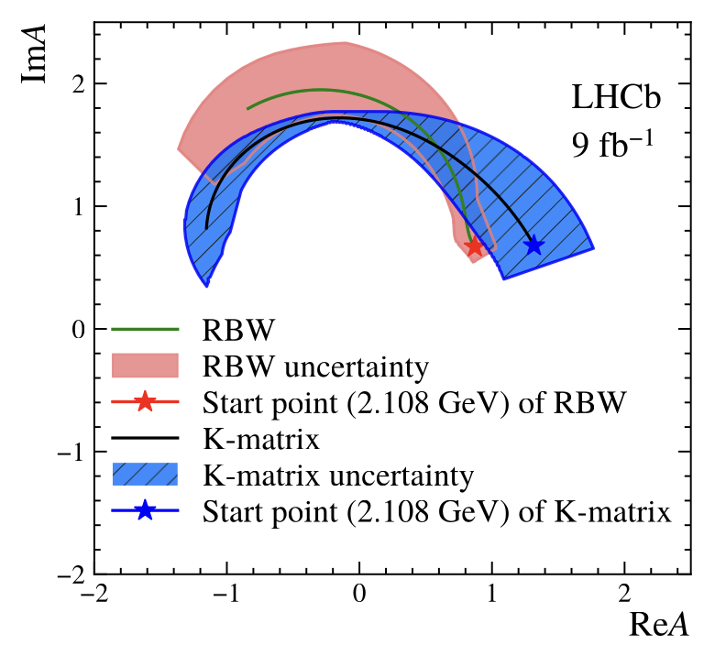
Comparison between RBW and K-Matrix
Reasonably good agreement between two line shapes
Though pole width differ by around 100 MeV
Masses from both models consistent with $D_{s}{\left(2317\right)}^{+}$, however widths significantly larger
2024/10/22
国科大 钱文斌
51

Slide 52
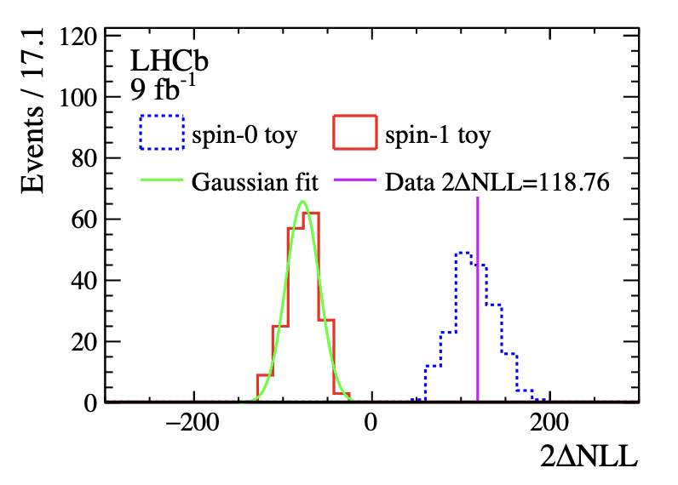
Spin test
Spin test based on RBW model
Spin 0 clearly favored compared to spin 1 ($>10σ$)
Though spin 1 has much smaller interference
2024/10/22
国科大 钱文斌
52

Slide 53
Discussion
Both models with and without $T_{c\overline{s}}$ states can describe data
However, models without $T_{c\overline{s}}$ states have some deficiencies and implausible
Model with $T_{c\overline{s}}$ states:
Relationship with $D_{s}{\left(2317\right)}^{+}?$
Indication of exotic structures in $D_{s}{\left(2460\right)}^{+}$?
Mass consistent with $D_{s}{\left(2317\right)}^{+}$
Width significantly larger than $D_{s}{\left(2317\right)}^{+}$
Spin 0⁺
2024/10/22
国科大 钱文斌
53

Slide 54
Conclusion
Understanding QCD at low energy important for almost all aspects of high energy physics
Hadron structures provide a unique environment
Less studied $B→DDX$ system offers complementary information to other studies
Fresh results from $B^{+}→D^{∗±}D^{∓}K^{+}$ and $B→D^{(∗)}D_{s}^{+}π^{+}π^{−}$ studies may shed new lights on long standing puzzles
Thank you for your attention!
2024/10/22
国科大 钱文斌
54

Slide 55
21 years ago
First heavy exotic candidate containing $c\overline{c}$, $χ_{c1}(3872)$, opening a new field of research
In the same year, an open charmed exotic candidate, $D_{s0}^{∗}(2317)$, was also discovered
2562 citations
1002 citations
2024/10/22
国科大 钱文斌
55

