Slide 1
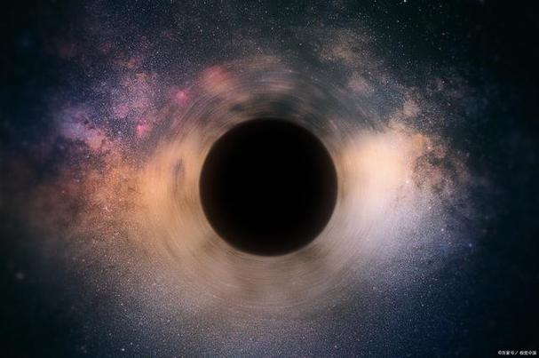
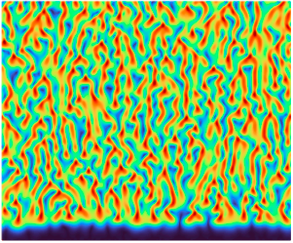
Pattern formation from Gauge/Gravity duality
Hua Bi Zeng（曾化碧）
Center for Theoretical Physics，Hainan University
With Chuan Yin Xia（夏传印），e-Print: 2404.04274 [hep-th]
@Gauge/Gravity Duality 2024, Sanya

Slide 2
Gauge/Gravity duality has been applied to many fields of physics,
here we show an attempt to apply the duality to a pattern formation
system similar to the complex Ginzburg-Landau equation (CGLE).

Slide 3
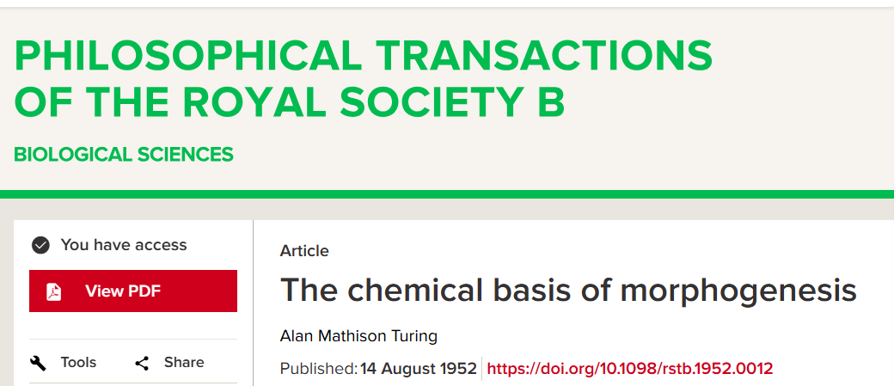
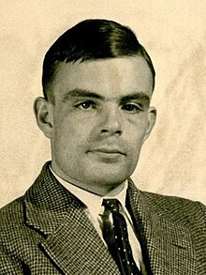
Reaction-Diffusion Model for pattern formation
Alan Turing
from wikipedia：The Turing pattern is a concept introduced by English mathematician Alan Turing in a 1952 paper titled "The Chemical Basis of Morphogenesis" which describes how patterns in nature, such as stripes and spots, can arise naturally and autonomously from a homogeneous, uniform state. The pattern arises due to Turing instability which in turn arises due to the interplay between differential diffusion (i.e., different values of diffusion coefficients) of chemical species and chemical reaction. The instability mechanism is unforeseen because a pure diffusion process would be anticipated to have a stabilizing influence on the system.

Slide 4
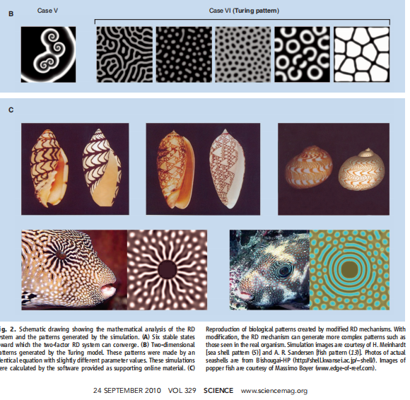
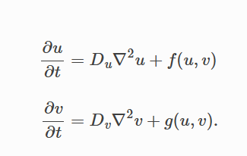
Gray-Scott model、Gierer-Meinhardt model ...
Diffusion terms

Slide 5
Complex Ginzburg-Landau equation as a Reaction-Diffusion model
The complex Ginzburg–Landau equation (CGLE), probably the most celebrated nonlinear equation in physics,describes generically the dynamics of oscillating, spatially extended systems close to the onset of oscillations.
The Ginzburg–Landau equation, named after Vitaly Ginzburg and Lev Landau, describes the nonlinear evolution of small disturbances near a finite wavelength bifurcation from a stable to an unstable state of a system. At the onset of finite wavelength bifurcation, the system becomes unstable for a critical wavenumber k_c which is non-zero. In the neighbourhood of this bifurcation, the evolution of disturbances is characterised by the particular Fourier mode for k_c with slowly varying amplitude A (more precisely the real part of A). The Ginzburg–Landau equation is the governing equation for
A. The unstable modes can either be non-oscillatory (stationary) or oscillatory.
Cross, M. C., & Hohenberg, P. C. (1993). Pattern formation outside of equilibrium. Reviews of modern physics, 65(3), 851.
Cross, M., & Greenside, H. (2009). Pattern formation and dynamics in nonequilibrium systems. Cambridge University Press.

Slide 6
For non-oscillatory bifurcation,
A satisfies the real Ginzburg–Landau equation
which was first derived by Alan C. Newell and John A. Whitehead and by Lee Segel in 1969.
Newell, A. C., & Whitehead, J. A. (1969). Finite bandwidth, finite amplitude convection. Journal of Fluid Mechanics, 38(2), 279-303.
Segel, L. A. (1969). Distant side-walls cause slow amplitude modulation of cellular convection. Journal of Fluid Mechanics, 38(1), 203-224.

Slide 7
For oscillatory bifurcation, A satisfies the complex Ginzburg–Landau equation
which was first derived by Keith Stewartson and John Trevor Stuart in 1971. Here α and β are real constants.
Stewartson, K., & Stuart, J. T. (1971). A non-linear instability theory for a wave system in plane Poiseuille flow. Journal of Fluid Mechanics, 48(3), 529-545.
Hocking, L. M., & Stewartson, K. (1972). On the nonlinear response of a marginally unstable plane parallel flow to a two-dimensional disturbance. Proceedings of the Royal Society of London. A. Mathematical and Physical Sciences, 326(1566), 289-313.

Slide 8
The complex Ginzburg-landau equation (CGLE) has been used to describe the travelling wave behaviour in reaction-difusion (RD) systems.
Kuramoto showed all RD equations with a reaction dynamics close to the onset of oscillations, can be mapped to a universal model with a great predictive power, the complex Ginzburg–Landau equation (CGLE).
Kuramoto, Y. Chemical Oscillations, Waves and Turbulence, 1st ed., Springer-Verlag, Berlin, 1984.

Slide 9
Few comments about CGLE
1. CGLE describes a variety of physical phenomena at a qualitative or even quantitative level, from nonlinear waves to
second-order phase transitions, from superconductivity,superfluidity, Bose-Einstein condensation to liquid crystal strings in field theory.
2. Formally, it is a semi-parabolic nonlinear partial differential equation that can describea single-component reaction-diffusion system, also actual chemical systems.
3. A is a complex field to describe spatio-temporal phenomena in continuous media, in a chemical system A is the concentration.
4. The real parameters α and β can both determine the properties of the pattern,in principle can be decided from experiments. See: F. Hynne and P. Graae Sørensen, Experimental determination of ginzburg-landau parameters for reaction-diffusion systems, Phys. Rev. E 48, 4106 (1993)

Slide 10
Patterns of 1D complex Ginzburg-Landau equation.
Plane wave solution (trivial solution) and instability analysis:
See review : Aranson, I. and Kramer, L. (2001) The World of the Complex Ginzburg-Landau Equation. Reviews of Modern Physics, 74, 99-143. (Preprint cond-mat/0106115) https://doi.org/10.1103/RevModPhys.74.99) Cited by 2251 times.

Slide 11
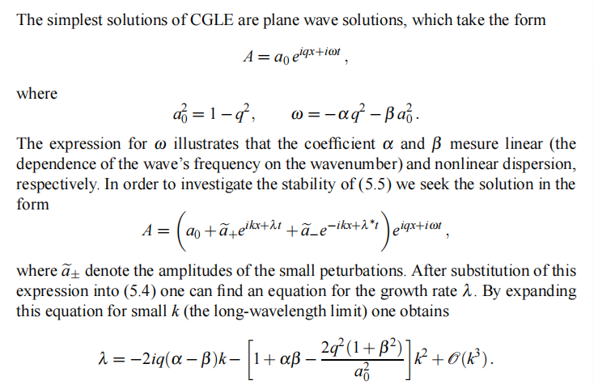

Slide 12
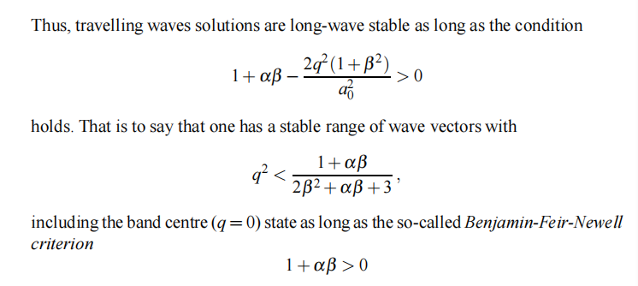
T. B. Benjamin, Instability of Periodic Wavetrains in Nonlinear Dispersive Systems, Proceedings of the Royal
Society of London Series A 299, 59 (1967).
T. B. Benjamin and J. E. Feir, The disintegration of wave trains on deep water. Part 1. Theory, Journal of FluidMechanics 27, 417 (1967).

Slide 13
Phase diagram of 1D CGLE:
Aside from plane waves, a host of other exotic solutions have been observed in the CGLE. In particular, several different forms of spatiotemporal chaotic or disordered states have been found. Shraiman et al. (1992) distinguished between two forms of chaotic behaviour found beyond the regime of stable plane waves. These are defect-mediated turbulence and phase turbulence, an example of each is given below. This picture was extended by Chaté (1994) who identified spatiotemporal intermittency in the regime where plane waves are stable.
Spatiotemporal chaos in the one-dimensional complex Ginzburg-Landau equation
B.I. Shraiman, A. Pumir, W. van Saarloos, P.C. Hohenberg, H. Chate and M. Holen, Physica D 57:241-248, 1992
Spatiotemporal intermittency regimes of the one-dimensional complex Ginzburg-Landau equationH. Chaté, Nonlinearity 7:185-204, 1994

Slide 14
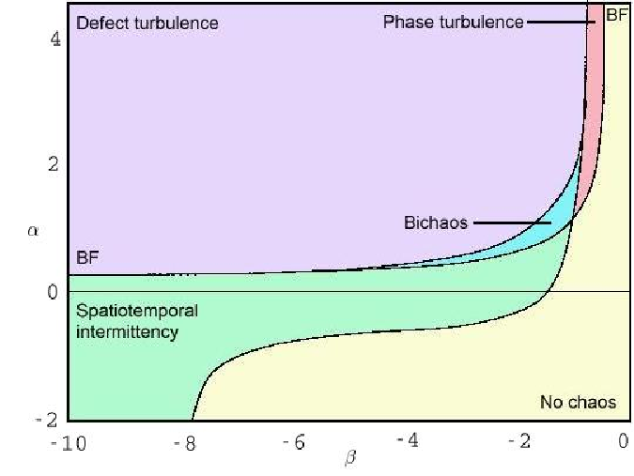
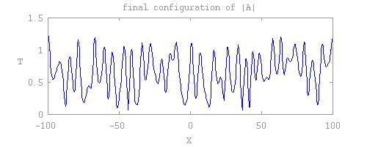
Defect-mediated turbulence
.
Turbulence in this region is characterised by 'defects' (i.e., points in space-time where A=0). At these points, the phase is not defined and can vary by multiples of 2pi over L when going through them (L is the container size).

Slide 15
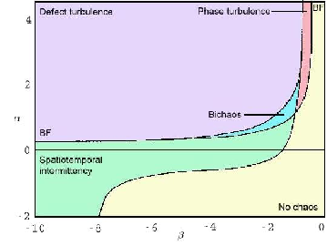
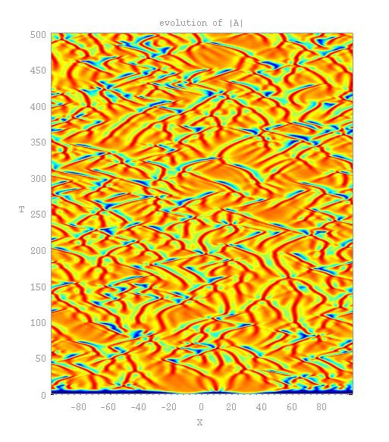
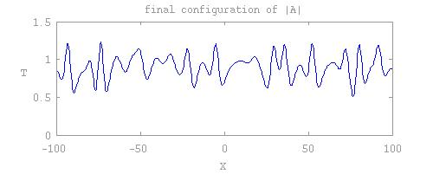
Phase turbulence
In this form of chaotic behaviour, |A| never reaches zero and the total phase is conserved. This behaviour occurs just above the BF line in the phase diagram where the amplitude |A| can be seen to be strongly slaved to the marginal phase mode. This allows a description of the dynamics to be formulated based on a systematic expansion in gradients of the phase.

Slide 16
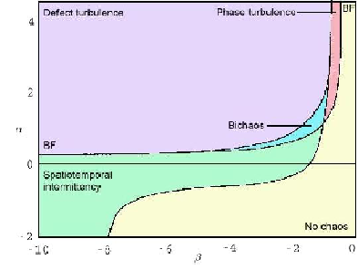
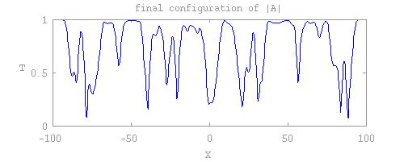
Spatio-temporal intermittency
In the region of the phase diagram below the Benjamin-Feir instability line, plane waves attract most initial conditions. However, using a suitably large and localised initial condition, spatio-temporally intermittent states, such as the one above, have been found. These are characterised by localised structures which evolve in a complicated fashion and delimit regions of uniform amplitude.

Slide 17
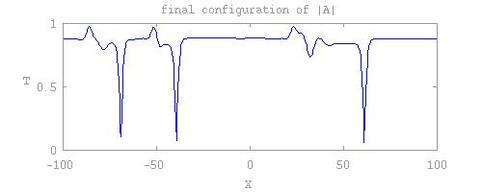
Coherent structures
Aside from plane waves, many other nonlinear solutions exist. The best known are Bekki-Nozaki holes (Bekki and Nozaki, 1985), which are illustrated above (the holes are the sharp dips in amplitude). These structures asymptotically connect plane waves of different amplitude and wavenumber. Holes are part of a family of solutions called coherent structures which are comprised of fixed spatial profiles that can vary through propagation and oscillation.

Slide 18
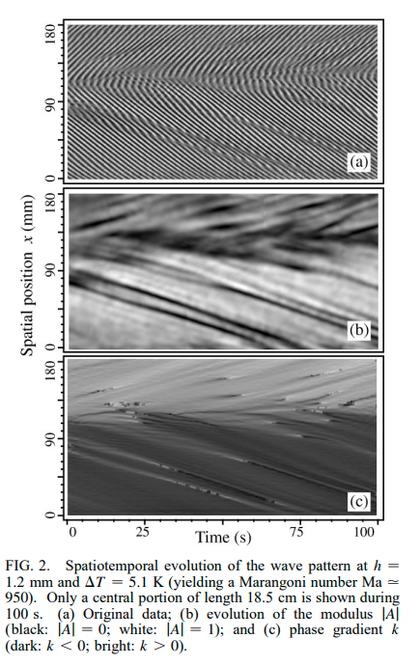
Patterns of CGLE realized in real systems: one example

Slide 19
Move to Holography:
Build a Reaction-Diffusion model from black hole physics
Reaction-Diffusion effect in the bulk will induce pattern formation on the boundary

Slide 20
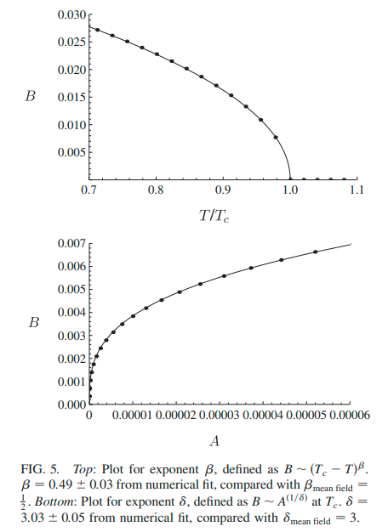
A Holographic model whose behavior near T_c is a G-L theory
Neutral scalar living in a 3+1 dimensional charged black hole show a temperature induced second phase transition

Slide 21
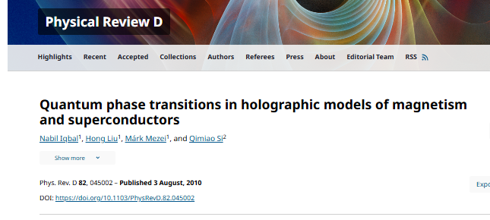
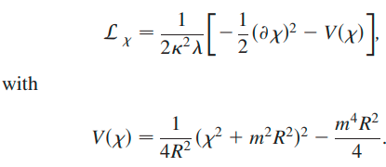
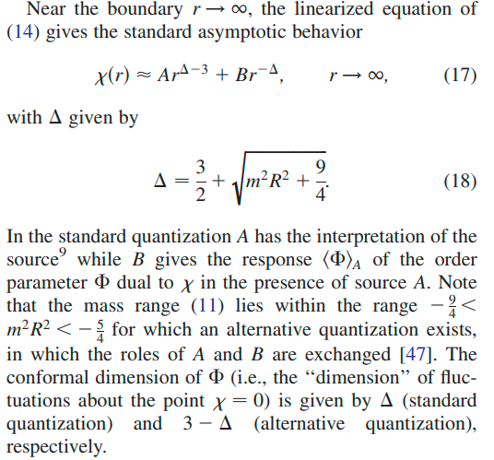
Scalar field:
Charged black hole background:

Slide 22
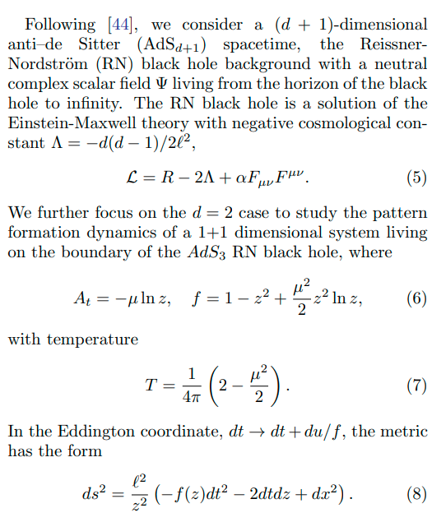
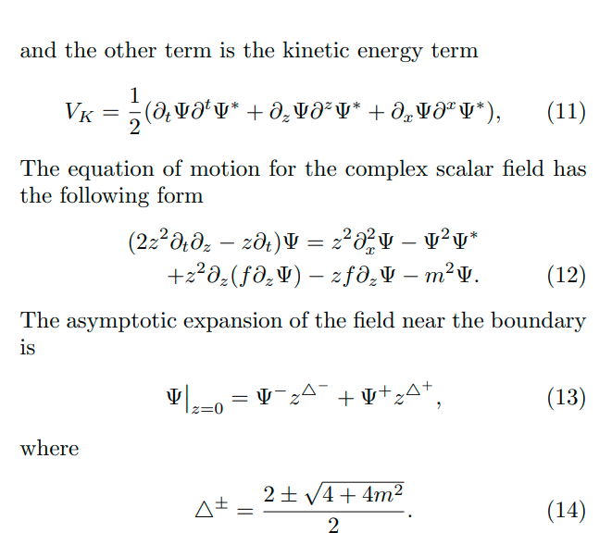
2+1 dimensional Charged black hole:

Slide 23
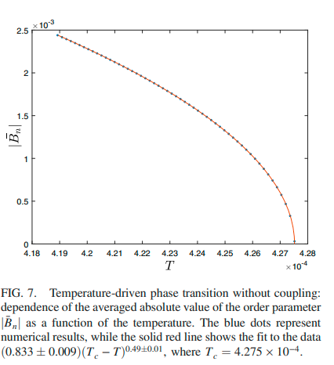
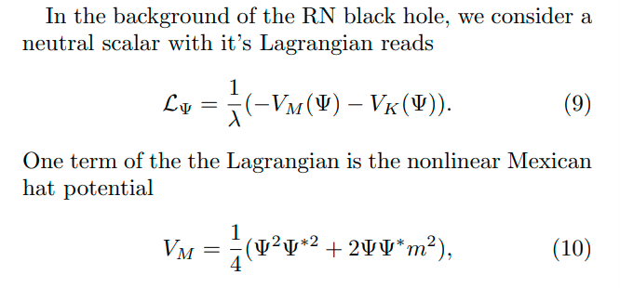
Neutral scalar:
C.-Y. Xia, H.-B. Zeng, C.-M. Chen, and A. del Campo, Structural phase transition and its critical dynamics from holography, Phys. Rev. D 108, 026017 (2023)

Slide 24
Reaction-Diffusion in the bulk:
Equation of motion:
similar to CGLE:

Slide 25
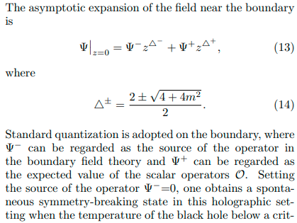
Numerical scheme:

Slide 26
Plane wave solution and instability analysis
solved by the Newton_x0002_Raphson iteration method
Holography:
CGLE:
Ansatz:
Ansatz:
Different from CGLE

Slide 27
Stability analysis of plane wave solution:
The zero q plane wave solution will
be destroyed by the growing perturbations if there are
Re(λ(k)) > 0, corresponding to the linear unstable region in the phase diagram

Slide 28
Phase diagram:
For CGLE: the BFN line

Slide 29
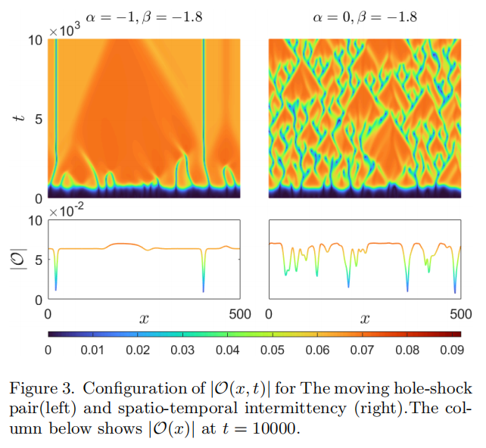
Other patterns: similar to CGLE

Slide 30
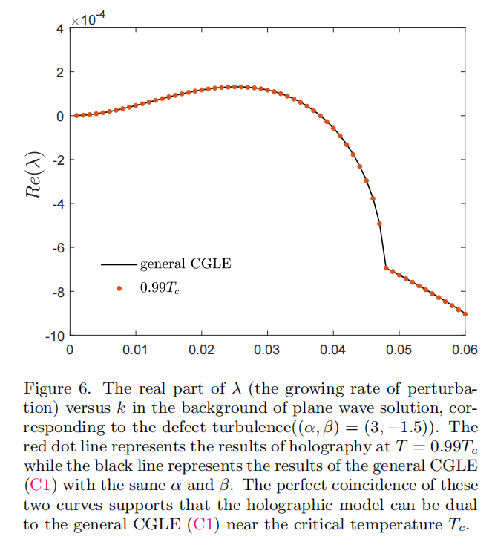
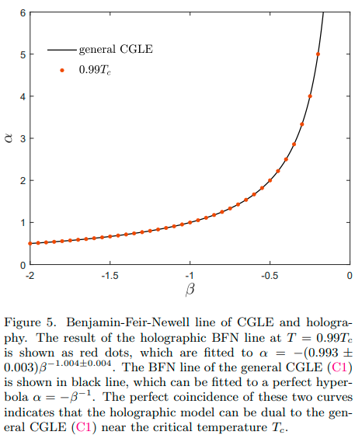
General CGLE and holographic model near T_c
Defect turbulence region

Slide 31
Summary and outlooks
Reaction-Diffusion effect in the bulk will induce pattern formation on the boundary
Holographic model near T_c is dual to CGLE
Lower temperature effective theory（Different from CGLE）?
Higher dimension cases

Slide 32
Spiral wave in AdS_4:

Slide 33
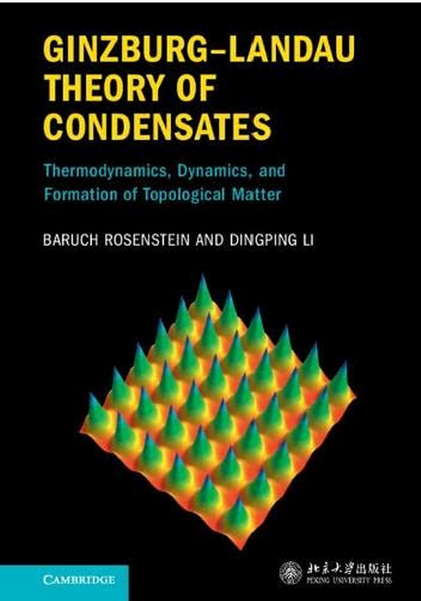
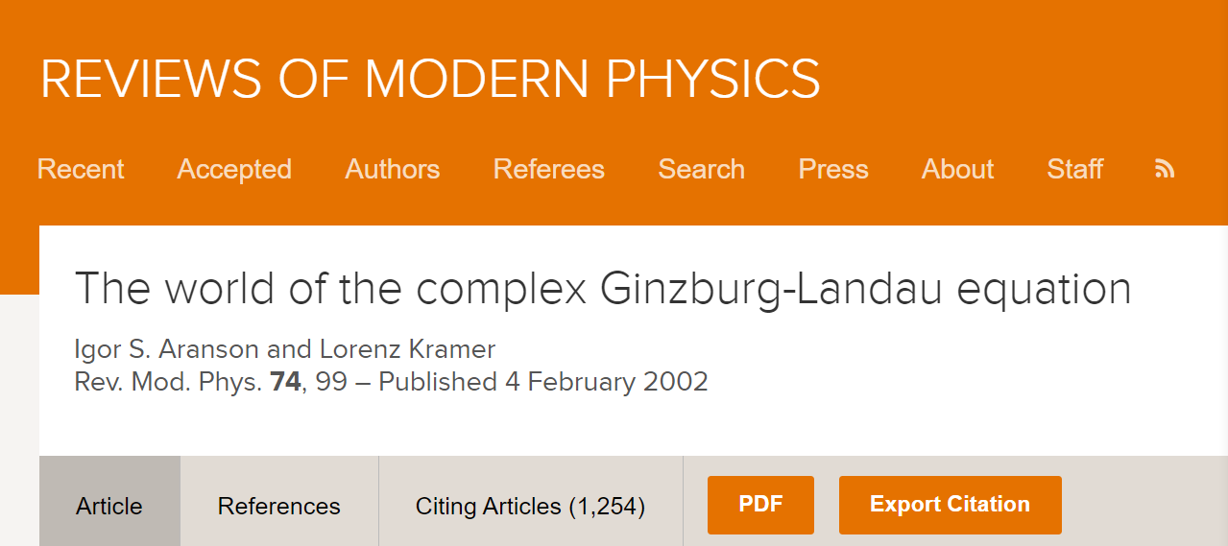
Many aspects deserved to be studied in future: holography may
provide new insights about the pattern formation dynamics
holographic U(1) theory dynamics

Slide 34
Thanks very much!

