Slide 1
Black hole interiors and holographic topological properties
Ling-Long Gao (高凌龙)
Gauge/Gravity Duality 2024, Sanya, Hainan, China

Slide 2
Based on
Internal structure of hairy rotating black holes in three dimensions
Published in: JHEP 01 (2024) 063 e-Print: 2310.15781 [hep-th]
Black hole interiors in holographic topological semimetals
Published in: JHEP 03 (2023) 034 e-Print: 2301.01468 [hep-th]

Slide 3
Black hole interior
Singularity ↔ 2-point function
[H. Liu]
inevitability of singularity and event horizon [Penrose, 1970s]
CV:
ER bridge ↔ Complexity
[Susskind]
description of singularity [Kasner, 1921; Belinski, Khalatnikov, Lifshitz, 1970]
CA:
WDW action ↔ Complexity
it’s still challenging to extract the internal information, via AdS/CFT or...
Proper time ↔
1-point function
the dynamic evolution of interior
is fundamentally important !
[Maldacena]
1/15

Slide 4
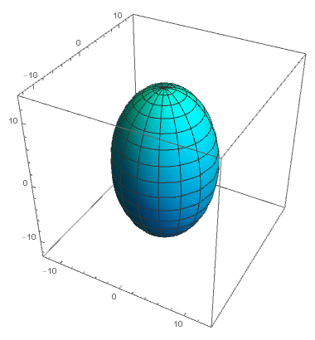
BKL singularity
Kasner singularity: deterministic dynamic [Kasner, 1921]
BKL singularity: generic description in GR [BKL, 1970]
many quasi-Kasner regions
chaotic dynamics
2/15

Slide 5
Recent studies: static black holes
hairy charged black holes [Cai, Li, Yang, et al.]
helical black holes [Liu, Lyu, 2022]
holographic superconductor [Hartnoll, et al.; Sword, Vegh.]
...
Motivation
What are the interiors of stationary BHs ?
3/15

Slide 6
3D hairy rotating BHs
lower symmetry, richer interiors
no Cauchy horizon
Case 1: real
Case 2: complex
triggers a Kasner inversion
[Gao, Liu, Lyu, 2023]
4/15

Slide 7
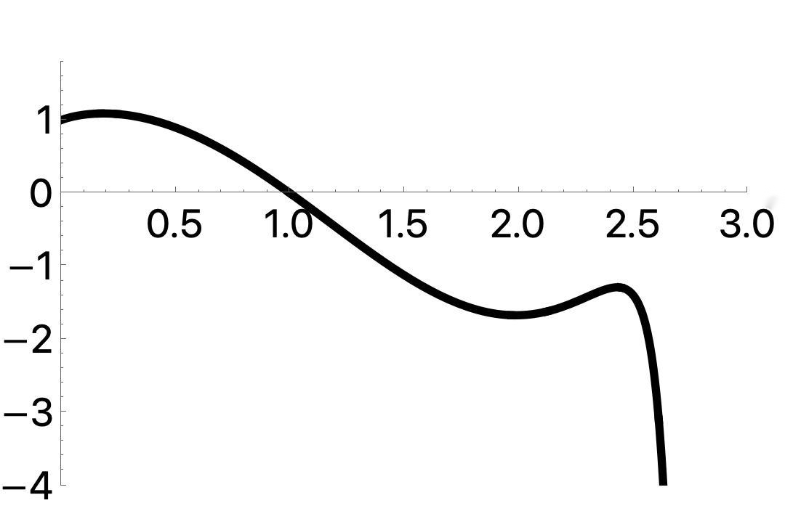
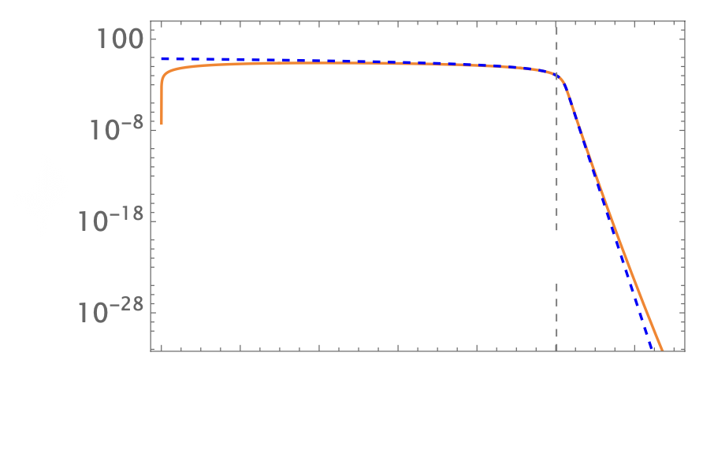
ER bridge collapse
Length of
ER bridge
Would-be
Cauchy horizon
event horizon
would-be
Cauchy horizon
singularity
Could be a universal behavior inside BHs with the Cauchy horizon destroyed ? (ER collapse in hairy charged BHs [Hartnoll,2020] )
5/15

Slide 8
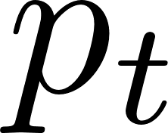
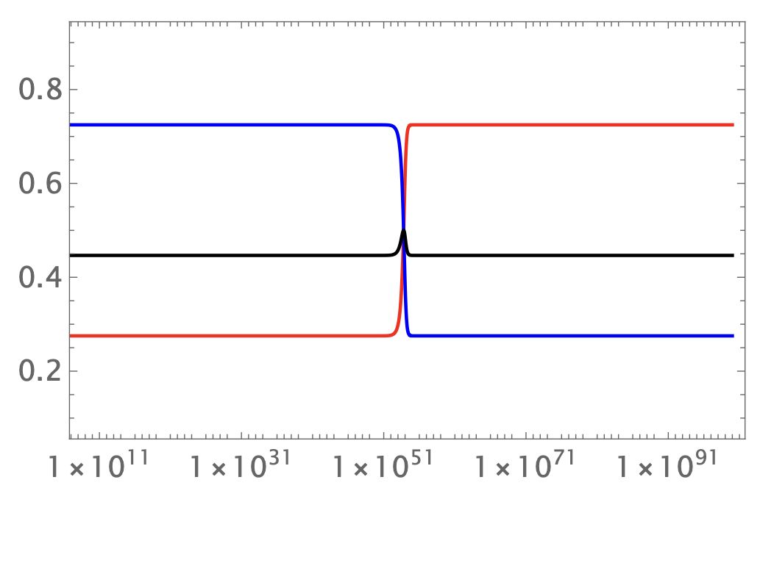
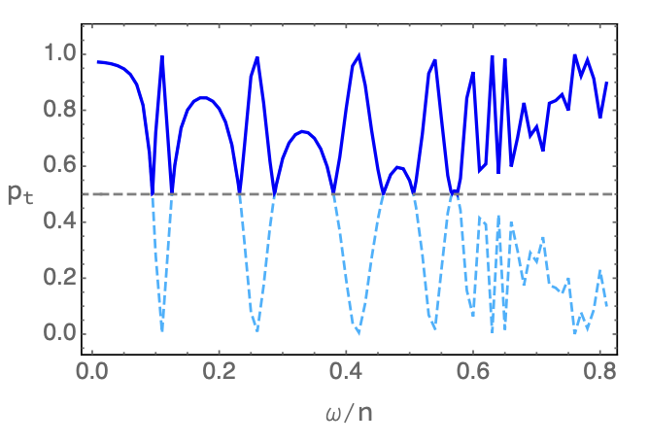
Singularity: One Kasner inversion
only exists for complex scalar field
intermidiate
Kasner
final Kasner
existence: parameter dependent
singularity
6/15

Slide 9
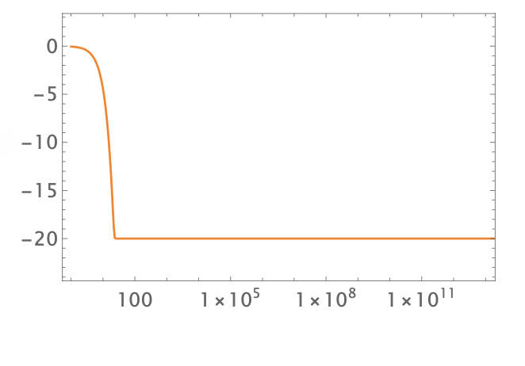
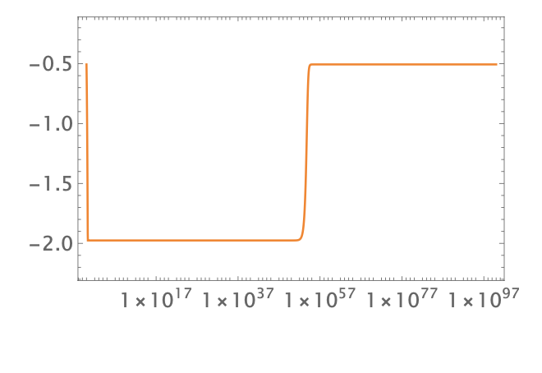
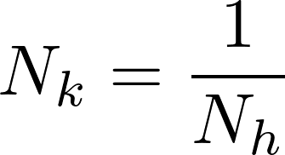
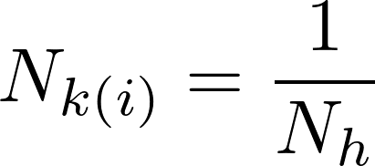
Relation of N
if no inversion
if inversion exists
singularity
A possible connection:
7/15

Slide 10
Summary 1
The interiors of 3D hairy rotating BHs
ER collapse
Kasner inversion
Relation of
Next step: what happens to interiors during phase transitions at boundary ? (another model)
8/15

Slide 11
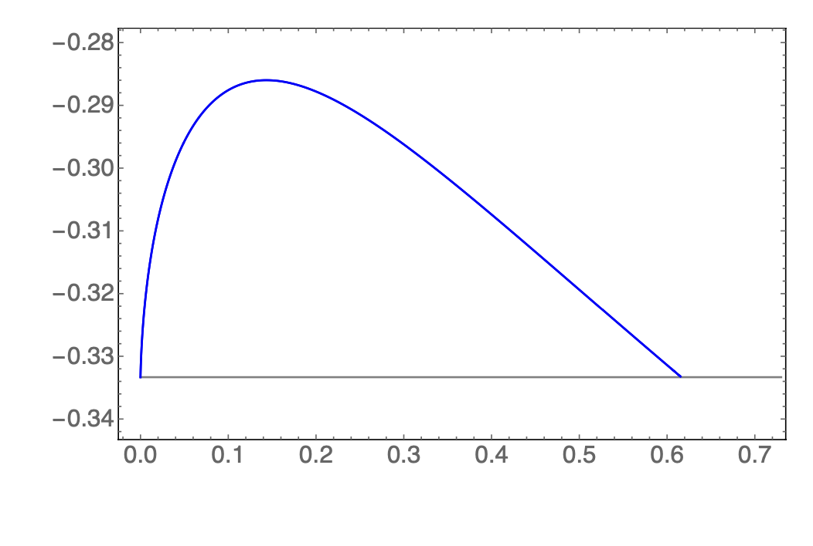
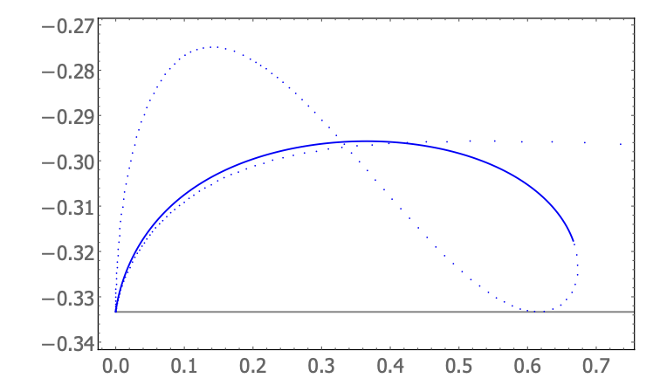
Singularity during Landau phase transition
continuous
phase transition
first-order
phase transition
Kasner exponents are analogous to thermodynamic quantities: S...
[Liu, Lyu, Raju. 2021]
9/15

Slide 12
Topological phase transition
Weyl semimetal, nodal line semimetal (WSM, NLSM)...
Beyond Landau paradiam
Motivation
What happens to singularity during topological phase transition at boundary ?
10/15

Slide 13
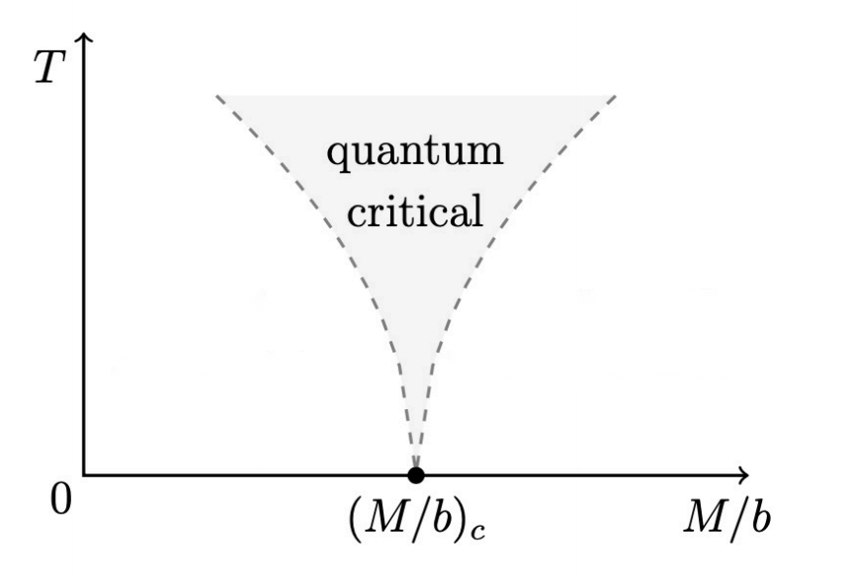
HWSM & HNLSM
We choose the HWSM and HNLSM models in
[Landsteiner, Liu, Sun,
1511.05505, 2012.12602]
Phase transition is clearly observable at low temperature
topological phase
trival phase
11/15

Slide 14
Kasner exponents in HWSM
Kasner exponents are constant in topo-phase
Exactly the Schwarzschild singularity
matter doesn’t matter
topo phase
trival phase
12/15

Slide 15
Kasner exponents in HNLSM
Kasner exponents are constant in topo-phase
non-Schwarzschild
matter backreacts to the IR geometry
topo phase
trival phase
13/15

Slide 16
Conclusion
The interiors of 3D hairy rotating BHs
ER collapse (maybe universal in hairy charged and rotating BHs)
Kasner inversion (only complex scalar)
Relation of
BH interiors of holographic topological semimetals
Topological behaviors of Kasner singularity in topo-phase
14/15

Slide 17
Future work
Are topological behaviors of singularities universal
inside holographic topological matters ?
“Relation of N”in other rotating BHs ?
still holds in 3D rotating BHs with super-expotential V
(many Kasner regions)
The effect of quantum matter on singularity ?
obtained from AdS/CFT
[Kiritsis, et,al., 2023]
15/15

Slide 18
Thank you ！

